Slide 1
2.16 Multiplicative contexts: area and perimeter 1
Representations | Year 4
Multiplication and Division

Slide 2
How to use this presentation
You can find the teacher guide 2.16 Multiplicative contexts:
area and perimeter 1 by following the link below.

Slide 3


2.16 Area and perimeter 1 Step 1:1
Notes:
The caterpillar walks around the edge of the leaf.

Slide 4




2.16 Area and perimeter 1 Step 1:1
Notes:
The distance around the edge of the leaf is its perimeter.

Slide 5





2.16 Area and perimeter 1 Step 1:1

Slide 6
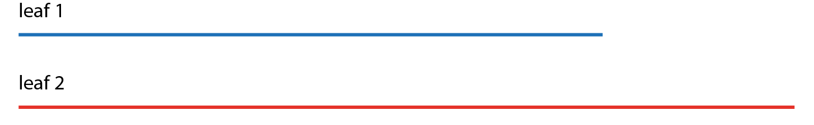
2.16 Area and perimeter 1 Step 1:1
Notes:
Is the distance around the edge of leaf 2 longer, shorter or
the same as the distance around the edge of leaf 1?

Slide 7
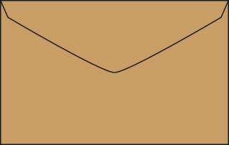
2.16 Area and perimeter 1 Step 1:2
Do the pictures show the perimeters of the envelopes?
✓
✗

Slide 8

2.16 Area and perimeter 1 Step 1:3
Different shapes with the same perimeter

Slide 9



2.16 Area and perimeter 1 Step 1:4
Whose shape has the longest perimeter?
Bhav
Kirti
Notes:
Bhav says that her shape has the longest perimeter.
Kirti says that her shape has the longest perimeter.
Liz says that both shapes could have the same perimeter.
Who is right?

Slide 10
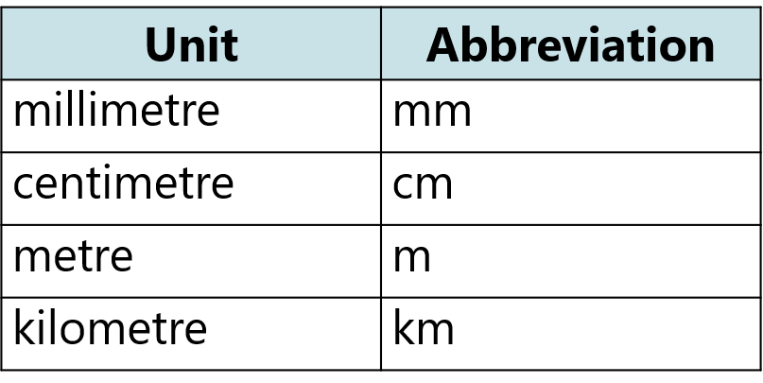
2.16 Area and perimeter 1 Step 2:1

Slide 11

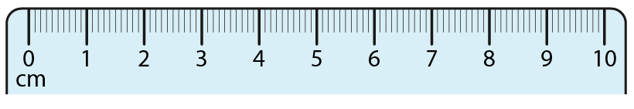
2.16 Area and perimeter 1 Step 2:1
Measuring the perimeter of leaf 1
Notes:
The perimeter of the leaf is 8 cm.

Slide 12

2.16 Area and perimeter 1 Step 2:2
Notes:
What is the perimeter of this rectangle? Count the sticks.

Slide 13
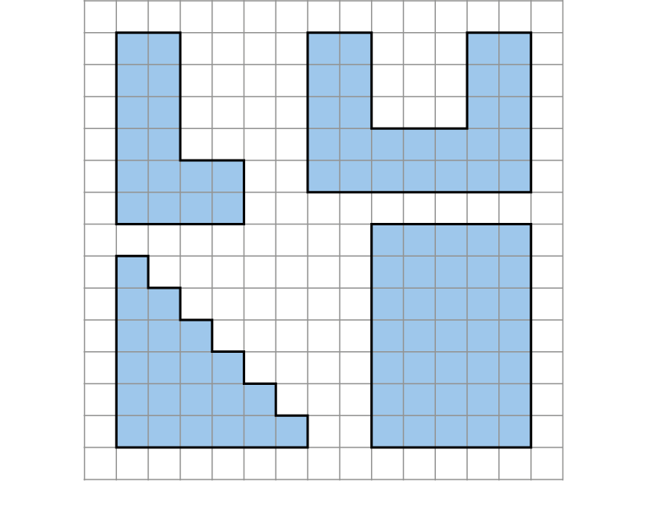
2.16 Area and perimeter 1 Step 2:2
P = 20 cm
P = 30 cm
P = 24 cm
P = 24 cm
Notes:
What is the perimeter of each shape? Count the squares.

Slide 14
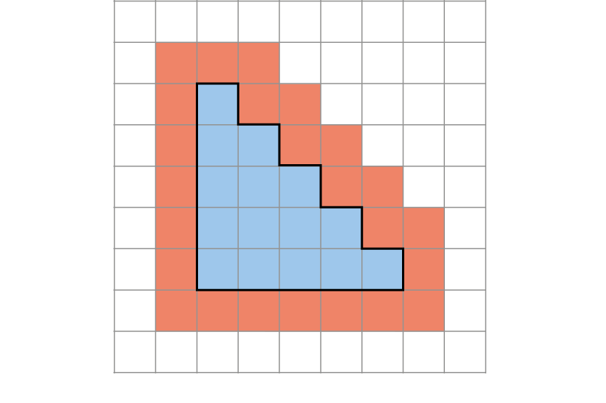
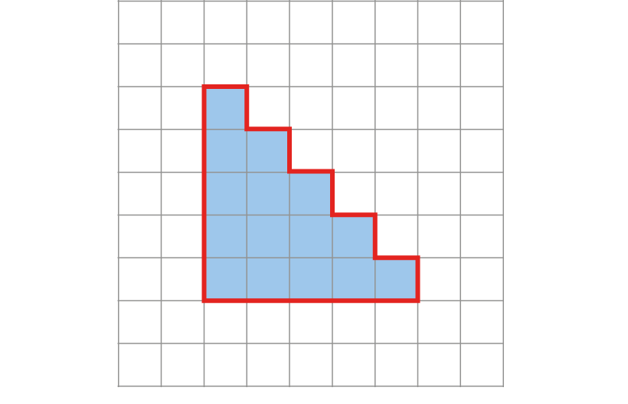
2.16 Area and perimeter 1 Step 2:2
Who is correct?
Sally says the perimeter is 24 units.
Felicity says the perimeter is 20 units.
✓

Slide 15
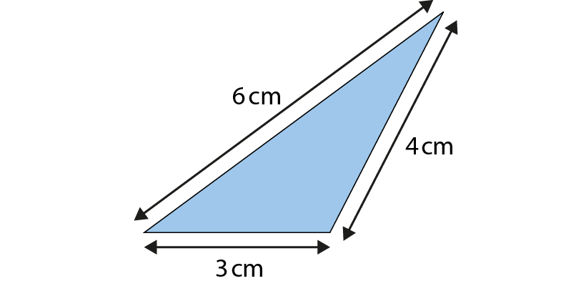
2.16 Area and perimeter 1 Step 2:3
What is the perimeter of this triangle?
P = 13 cm
Notes:
perimeter = 6 cm + 4 cm + 3 cm
= 13 cm
We can write the side lengths in any order.

Slide 16
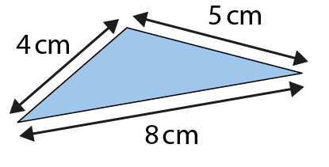
2.16 Area and perimeter 1 Step 2:3
What is the perimeter of this triangle?
P = 17 cm

Slide 17
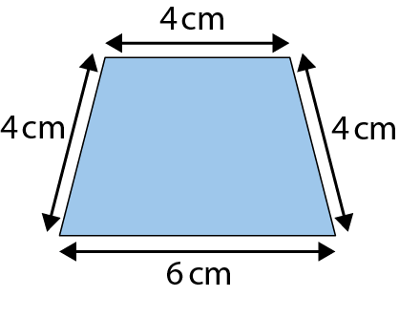
2.16 Area and perimeter 1 Step 2:3
What is the perimeter?
P = 18 cm

Slide 18
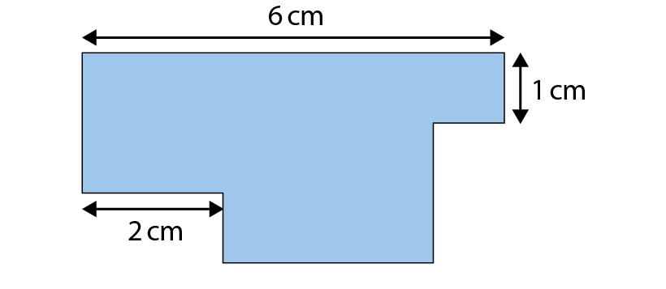
2.16 Area and perimeter 1 Step 2:4
Notes:
Do you have enough information to work out the perimeter of this shape?

Slide 19
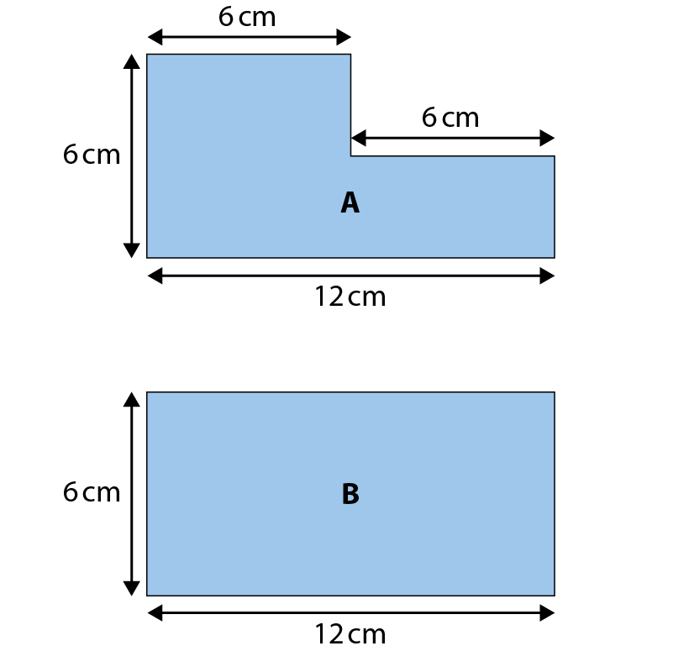
2.16 Area and perimeter 1 Step 2:4
True or false?
The perimeter of shape A is longer than
the perimeter of shape B.
✗
P = 36 cm
P = 36 cm

Slide 20
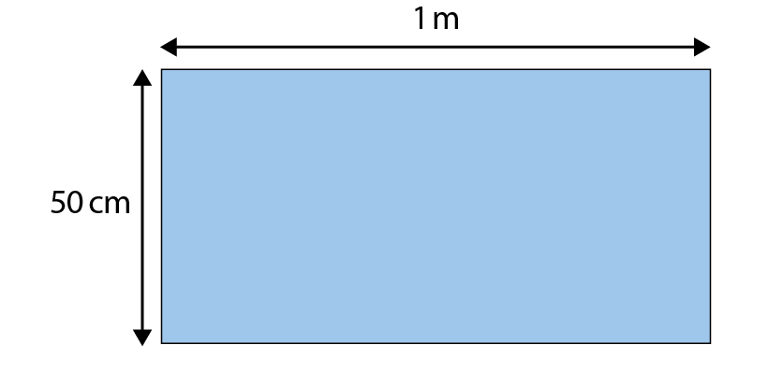
2.16 Area and perimeter 1 Step 2:4
Which answers give the correct perimeter for this shape?
51 cm
3 m
✓
102 cm
300 cm
✓
1 m 50 cm
210 cm

Slide 21
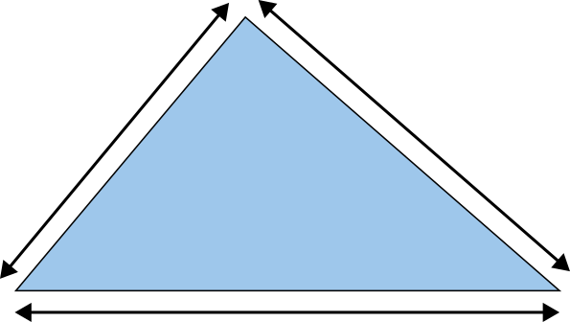
2.16 Area and perimeter 1 Step 2:4
The perimeter of this triangle is 22 cm.
6 cm
7 cm
?
9 cm

Slide 22
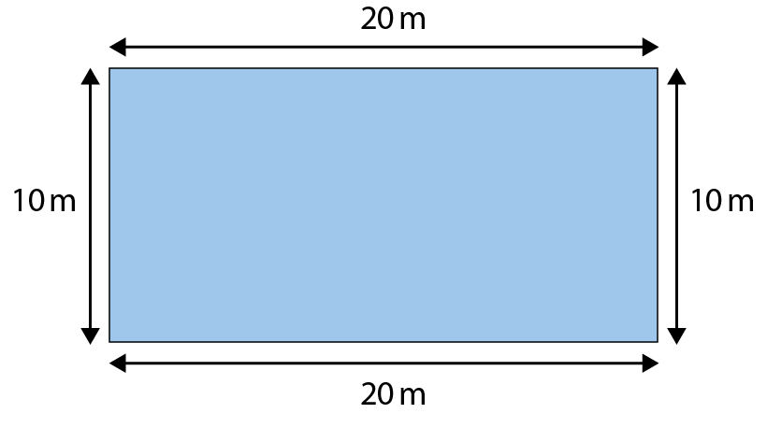
2.16 Area and perimeter 1 Step 3:1
P = 20 m + 10 m + 20 m + 10 m
= 60 m
P = 20 m + 20 m + 10 m + 10 m
= 60 m

Slide 23




2.16 Area and perimeter 1 Step 3:2/3
P = 2 × 20 m + 2 × 10 m
= 40 m + 20 m
= 60 m

Slide 24
2.16 Area and perimeter 1 Step 3:2/3
P = 2 × 20 m + 2 × 10 m
20 + 10 = 30
= 40 m + 20 m
30 × 2 = 60
= 60 m
P = 60 m

Slide 25
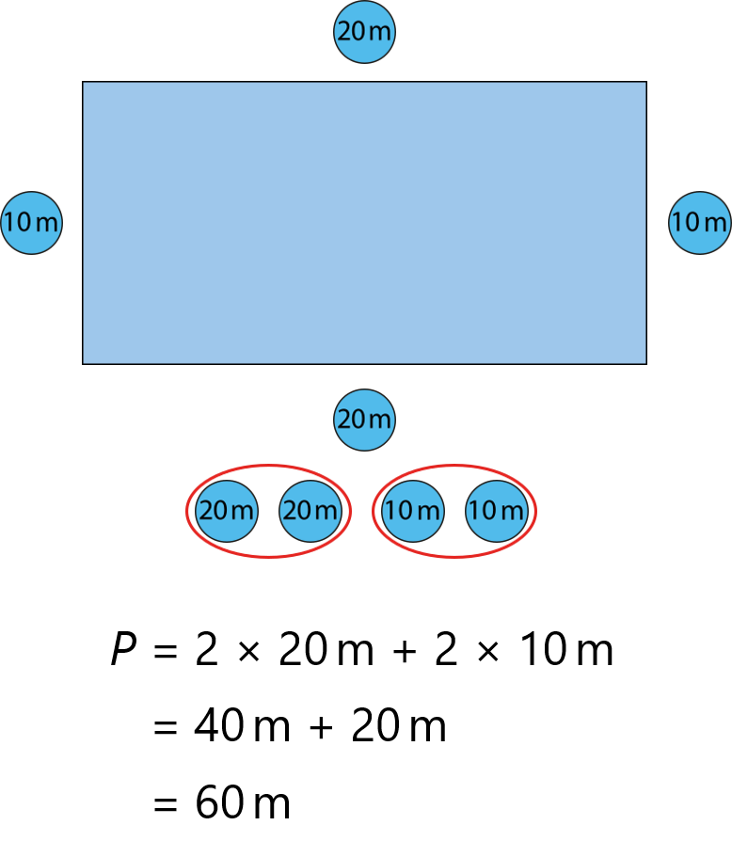
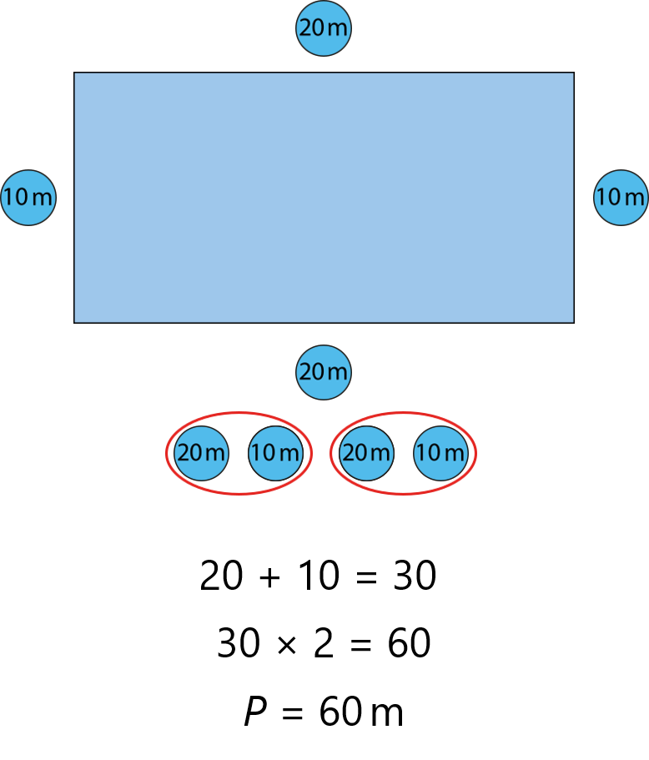
2.16 Area and perimeter 1 Step 3:2/3

Slide 26
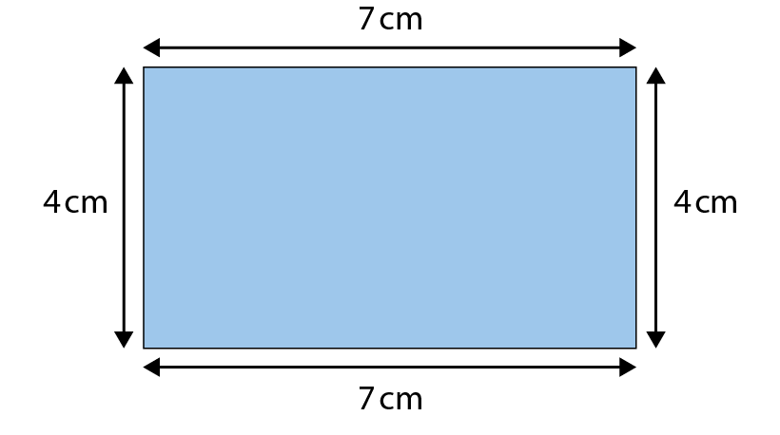
2.16 Area and perimeter 1 Step 3:3
Method 1
Method 2
7 cm + 4 cm = 11 cm
P = 7 cm × 2 + 4 cm × 2
11 cm × 2 = 22 cm
= 14 cm + 8 cm
P = 22 cm
P = 22 cm

Slide 27
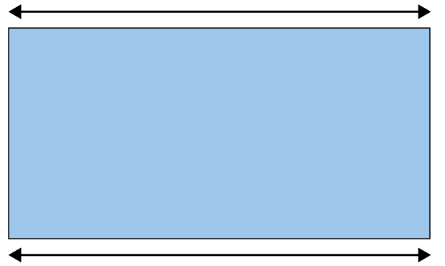
2.16 Area and perimeter 1 Step 3:4
The perimeter of this rectangle is 30 cm.
What is the length of each short side?
10 cm
5 cm
?
5 cm
?
10 cm
30 cm − 2 × 10 cm = 30 cm − 20 cm = 10 cm
10 cm ÷ 2 = 5 cm
short side = 5 cm

Slide 28
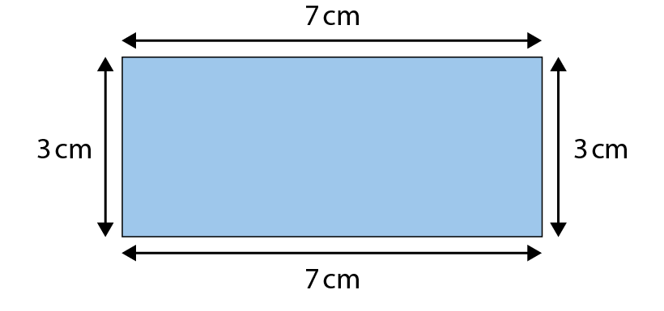
2.16 Area and perimeter 1 Step 3:5
P =
20 cm

Slide 29
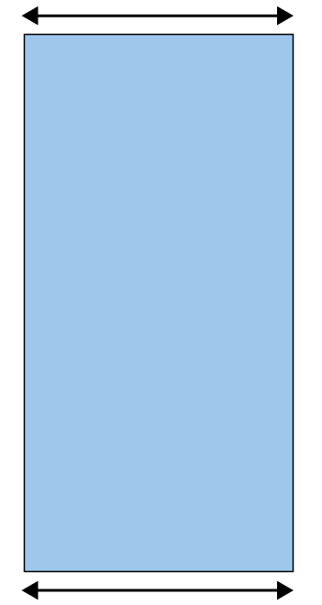
2.16 Area and perimeter 1 Step 3:5
The perimeter of this rectangle is 60 cm.
How long are the long sides?
10 cm
20 cm
?
20 cm
?
10 cm

Slide 30
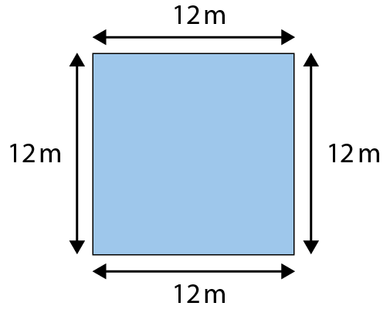
2.16 Area and perimeter 1 Step 3:6
P = 12 m + 12 m + 12 m + 12 m
= 12 m × 4
= 48 m

Slide 31
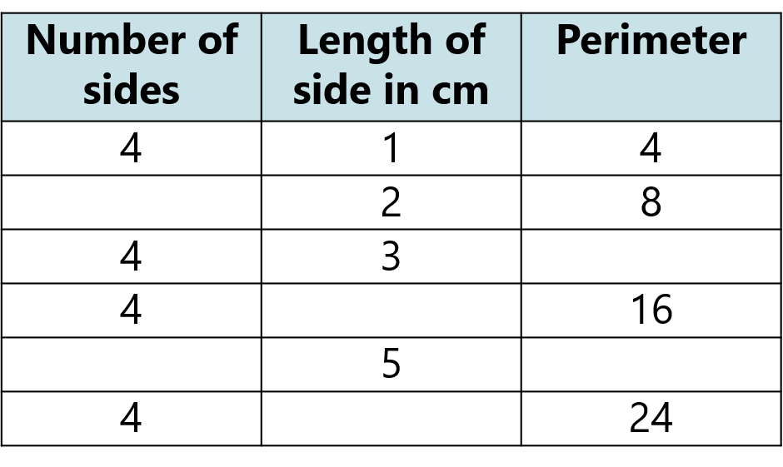

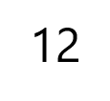
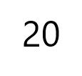

2.16 Area and perimeter 1 Step 3:6

Slide 32
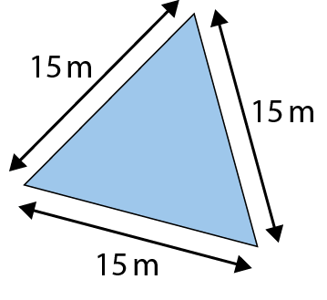
2.16 Area and perimeter 1 Step 3:6
What is the perimeter of this equilateral triangle?
P = 15 m + 15 m + 15 m
= 3 × 15 m
= 45 m

Slide 33
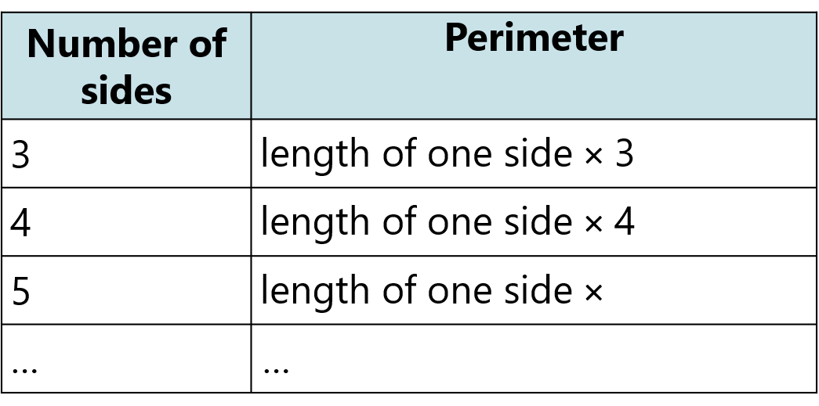


2.16 Area and perimeter 1 Step 3:7
For shapes with equal side lengths…

Slide 34
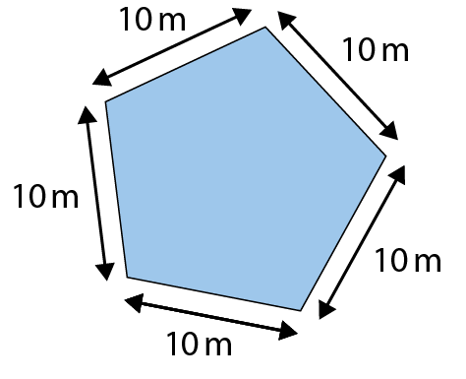
2.16 Area and perimeter 1 Step 3:7
What is the perimeter of this regular pentagon?
P = 10 m + 10 m + 10 m + 10 m + 10 m
= 5 × 10 m
= 50 m

Slide 35
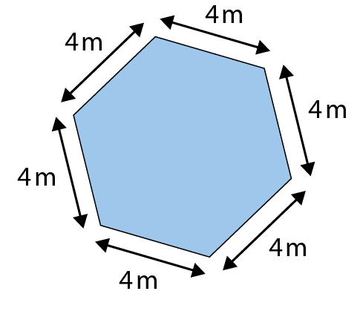
2.16 Area and perimeter 1 Step 3:7
What is the perimeter of this regular hexagon?
P = 4 m + 4 m + 4 m + 4 m + 4 m + 4 m
= 6 × 4 m
= 24 m

Slide 36
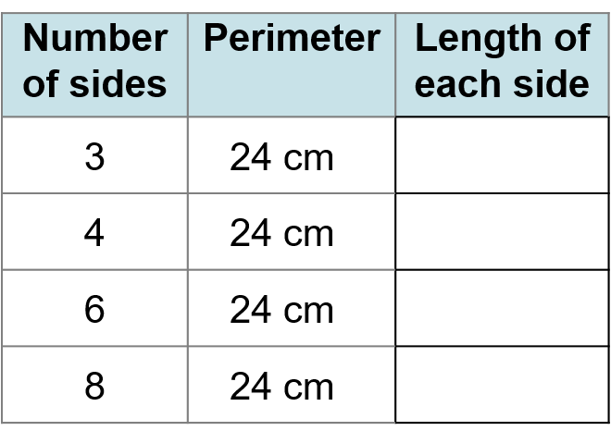
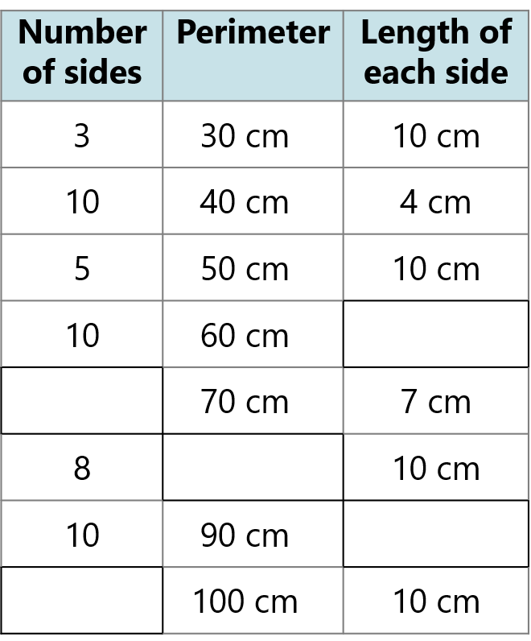







2.16 Area and perimeter 1 Step 3:8

Slide 37
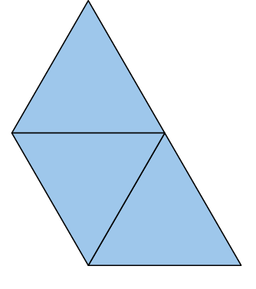
2.16 Area and perimeter 1 Step 3:9
Every side of each triangle is 40 cm.
Joseph writes: P = 40 cm × 9
Becca writes: P = 40 cm × 5
What do you think?
Notes:
There are three triangular paving slabs. Every side of each triangle is 40 cm in length.
Joseph thinks: ‘If I place these paving slabs like this, the perimeter is 40 cm x 9 as
there are three triangles and each has three sides.
Becca thinks: ‘The perimeter is always 40 cm x 5 no matter how you place them.’

Slide 38
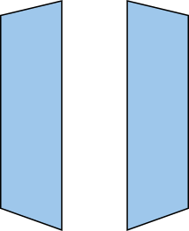
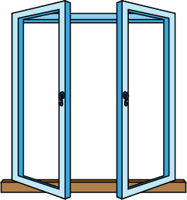
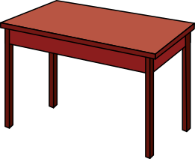

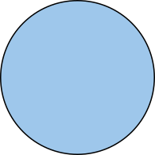

2.16 Area and perimeter 1 Step 4:1

Slide 39
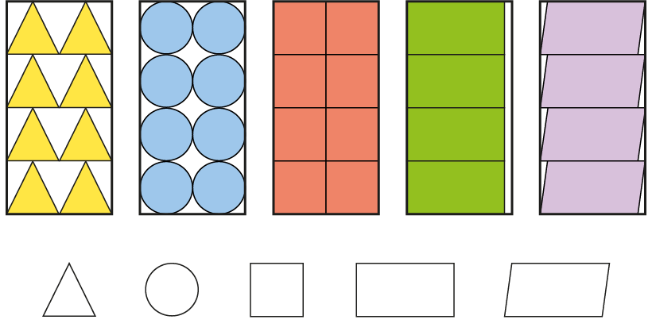











2.16 Area and perimeter 1 Step 4:2

Slide 40
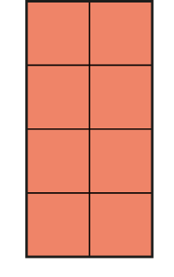
2.16 Area and perimeter 1 Step 4:3
Notes:
What is the area of this table?
This table has an area of eight square units.

Slide 41


2.16 Area and perimeter 1 Step 4:4
Notes:
What is the area of this shape?
This shape has an area of fourteen square units.

Slide 42



2.16 Area and perimeter 1 Step 4:5
Notes:
What is the area of this shape?
This shape has an area of eleven square units.

Slide 43
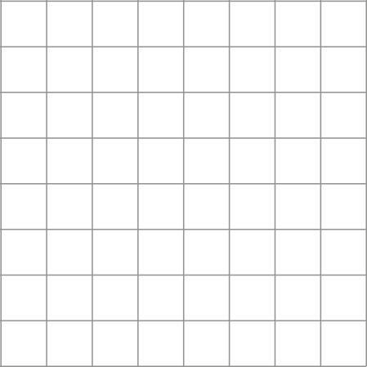
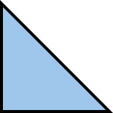


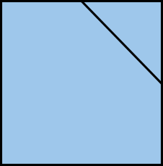
2.16 Area and perimeter 1 Step 4:5
Notes:
What is the area of this shape?
This shape has an area of sixteen square units.

Slide 44
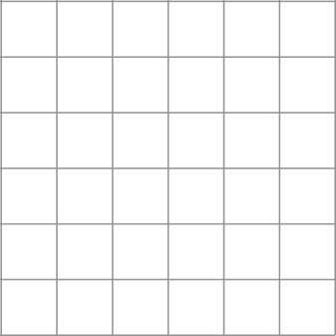



2.16 Area and perimeter 1 Step 4:6
Notes:
Does one shape look bigger?

Slide 45


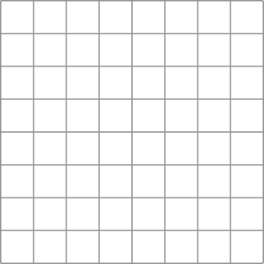
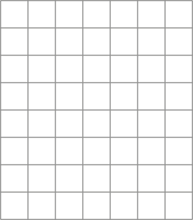

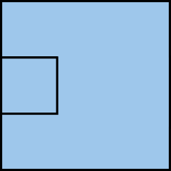
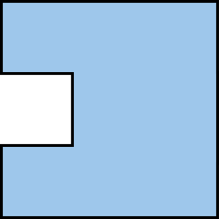





2.16 Area and perimeter 1 Step 4:7

Slide 46
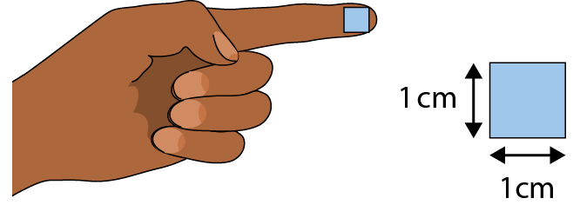
2.16 Area and perimeter 1 Step 5:1

Slide 47
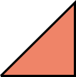
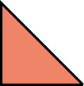

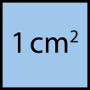


2.16 Area and perimeter 1 Step 5:4

Slide 48






2.16 Area and perimeter 1 Step 5:4

Slide 49



2.16 Area and perimeter 1 Step 6:1
How many squares?
A = 20 cm²
Notes:
There are twenty 1 cm squares, so A = 20 cm².

Slide 50
2.16 Area and perimeter 1 Step 6:2
How many squares?
A = 20 cm²

Slide 51


2.16 Area and perimeter 1 Step 6:4
5 cm × 4 cm = 20 cm²
4 cm × 5 cm = 20 cm²
A = 20 cm²
Notes:
The ‘5 cm’ represents the width.
The ‘4 cm’ represents the length.
The ’20 cm’ represents the area.

Slide 52






2.16 Area and perimeter 1 Step 6:5

Slide 53

2.16 Area and perimeter 1 Step 6:7
The area of this rectangle is 80 cm². How long is the short side?
10 cm
8 cm
?
A = 80 cm²
80 ÷ 10 = 8
short side = 8 cm

Slide 54

2.16 Area and perimeter 1 Step 6:8
What is the area of this shape?
A = 6 cm × 6 cm + 2 cm × 4 cm
= 44 cm²

Slide 55


2.16 Area and perimeter 1 Step 6:8
What is the area of this shape?
A = 8 cm × 6 cm − 2 cm × 2 cm
= 44 cm²

Slide 56

2.16 Area and perimeter 1 Step 6:9
The area of this shape is 176 cm².
Find the missing side-length.
A = 176 cm²
4
12 × 12 + × 8 = 176 cm²

Slide 57

2.16 Area and perimeter 1 Step 6:9
Here is a T-shape made from three identical rectangles.
The area of the shape is 90 cm².
What is the missing side-length?
A = 90 cm²

Slide 58

2.16 Area and perimeter 1 Step 6:9
area of rectangle A > area of rectangle B
True or false?
✗
A = 120 cm²
A = 132 cm²

Slide 59

2.16 Area and perimeter 1 Step 6:9
Each square has a side-length of 6 cm.
What are the area (A) and perimeter (P) of shape A and shape B?
A = 108 cm²
P = 48 cm
A = 108 cm²
P = 48 cm
Notes:
What’s the same?
What’s different?

Slide 60

2.16 Area and perimeter 1 Step 6:9
Notes:
This picture frame has an area of 48 cm².
What could the dimensions of the outer rectangle and
the inner rectangle be?

