Slide 1
Year 5, Unit 7
Factors, multiples and primes

Slide 2
Year 5, Unit 7
These materials heavily reflect the prioritisation approach of the ready-to-progress criteria in the DfE Primary Mathematics Guidance 2020 and on the PPTs that exemplify them on the NCETM website. They also include other relevant National Curriculum content. Related sections of the NCETM Primary Mastery Professional Development Materials provide small-step teaching guidance.
Ready-to-progress criteria addressed by this unit
Teaching of this unit supports the following criteria from the ‘DfE Mathematics Guidance: key stages 1 & 2’ (the 335-page document available as a download)
5MD-2 Page 245
Prior learning
If the following ready-to-progress criteria, contained in the same DfE guidance document as above, were secured in Year 4, children will be ready to start on this unit.
4MD-2 Page 173

Slide 3
Contents
The links below take you to the starting slide of each learning outcome.
1 | Pupils explain what ‘volume’ is using a range of contexts
2 | Pupils describe the units used to measure volume
3 | Pupils explain how to calculate the volume of a cuboid
4 | Pupils explain what a cube number is
5 | Pupils use their knowledge of calculating volume to solve problems in a range of contexts
6 | Pupils explain how to calculate the volume of compound shapes
7 | Pupils explain the use of the commutative and distributive laws when multiplying three or more numbers
Click the arrow button to return to this Contents slide.

Slide 4
Contents
The links below take you to the starting slide of each learning outcome.
8 | Pupils explain the reasons for changing two-factor multiplication calculations to three-factor multiplications
9 | Pupils explain what a factor is and how to use arrays and multiplication/division facts to find them
10 | Pupils explain how to systematically find all factors of a number and how they know when they have found them all
11 | Pupils use a complete list of factors to explain when a number is a square number
12 | Pupils explain how to identify a prime number or a composite number
Click the arrow button to return to this Contents slide.

Slide 5
Contents
The links below take you to the starting slide of each learning outcome.
13 | Pupils explain how to identify a common factor or a prime factor of a number
14 | Pupils explain how to identify a multiple or common multiple of a number
15 | Pupils use knowledge of properties of number to solve problems in a range of contexts
16 | Pupils explain how to use the factor pairs of ‘100’ to solve calculations efficiently
Click the arrow button to return to this Contents slide.

Slide 6
Year 5, Unit 7, Learning Outcome 1
Learning Outcome 1
Pupils explain what ‘volume’ is using a range of contexts
The following slides have been collated to support the teaching of this learning outcome.

Slide 7
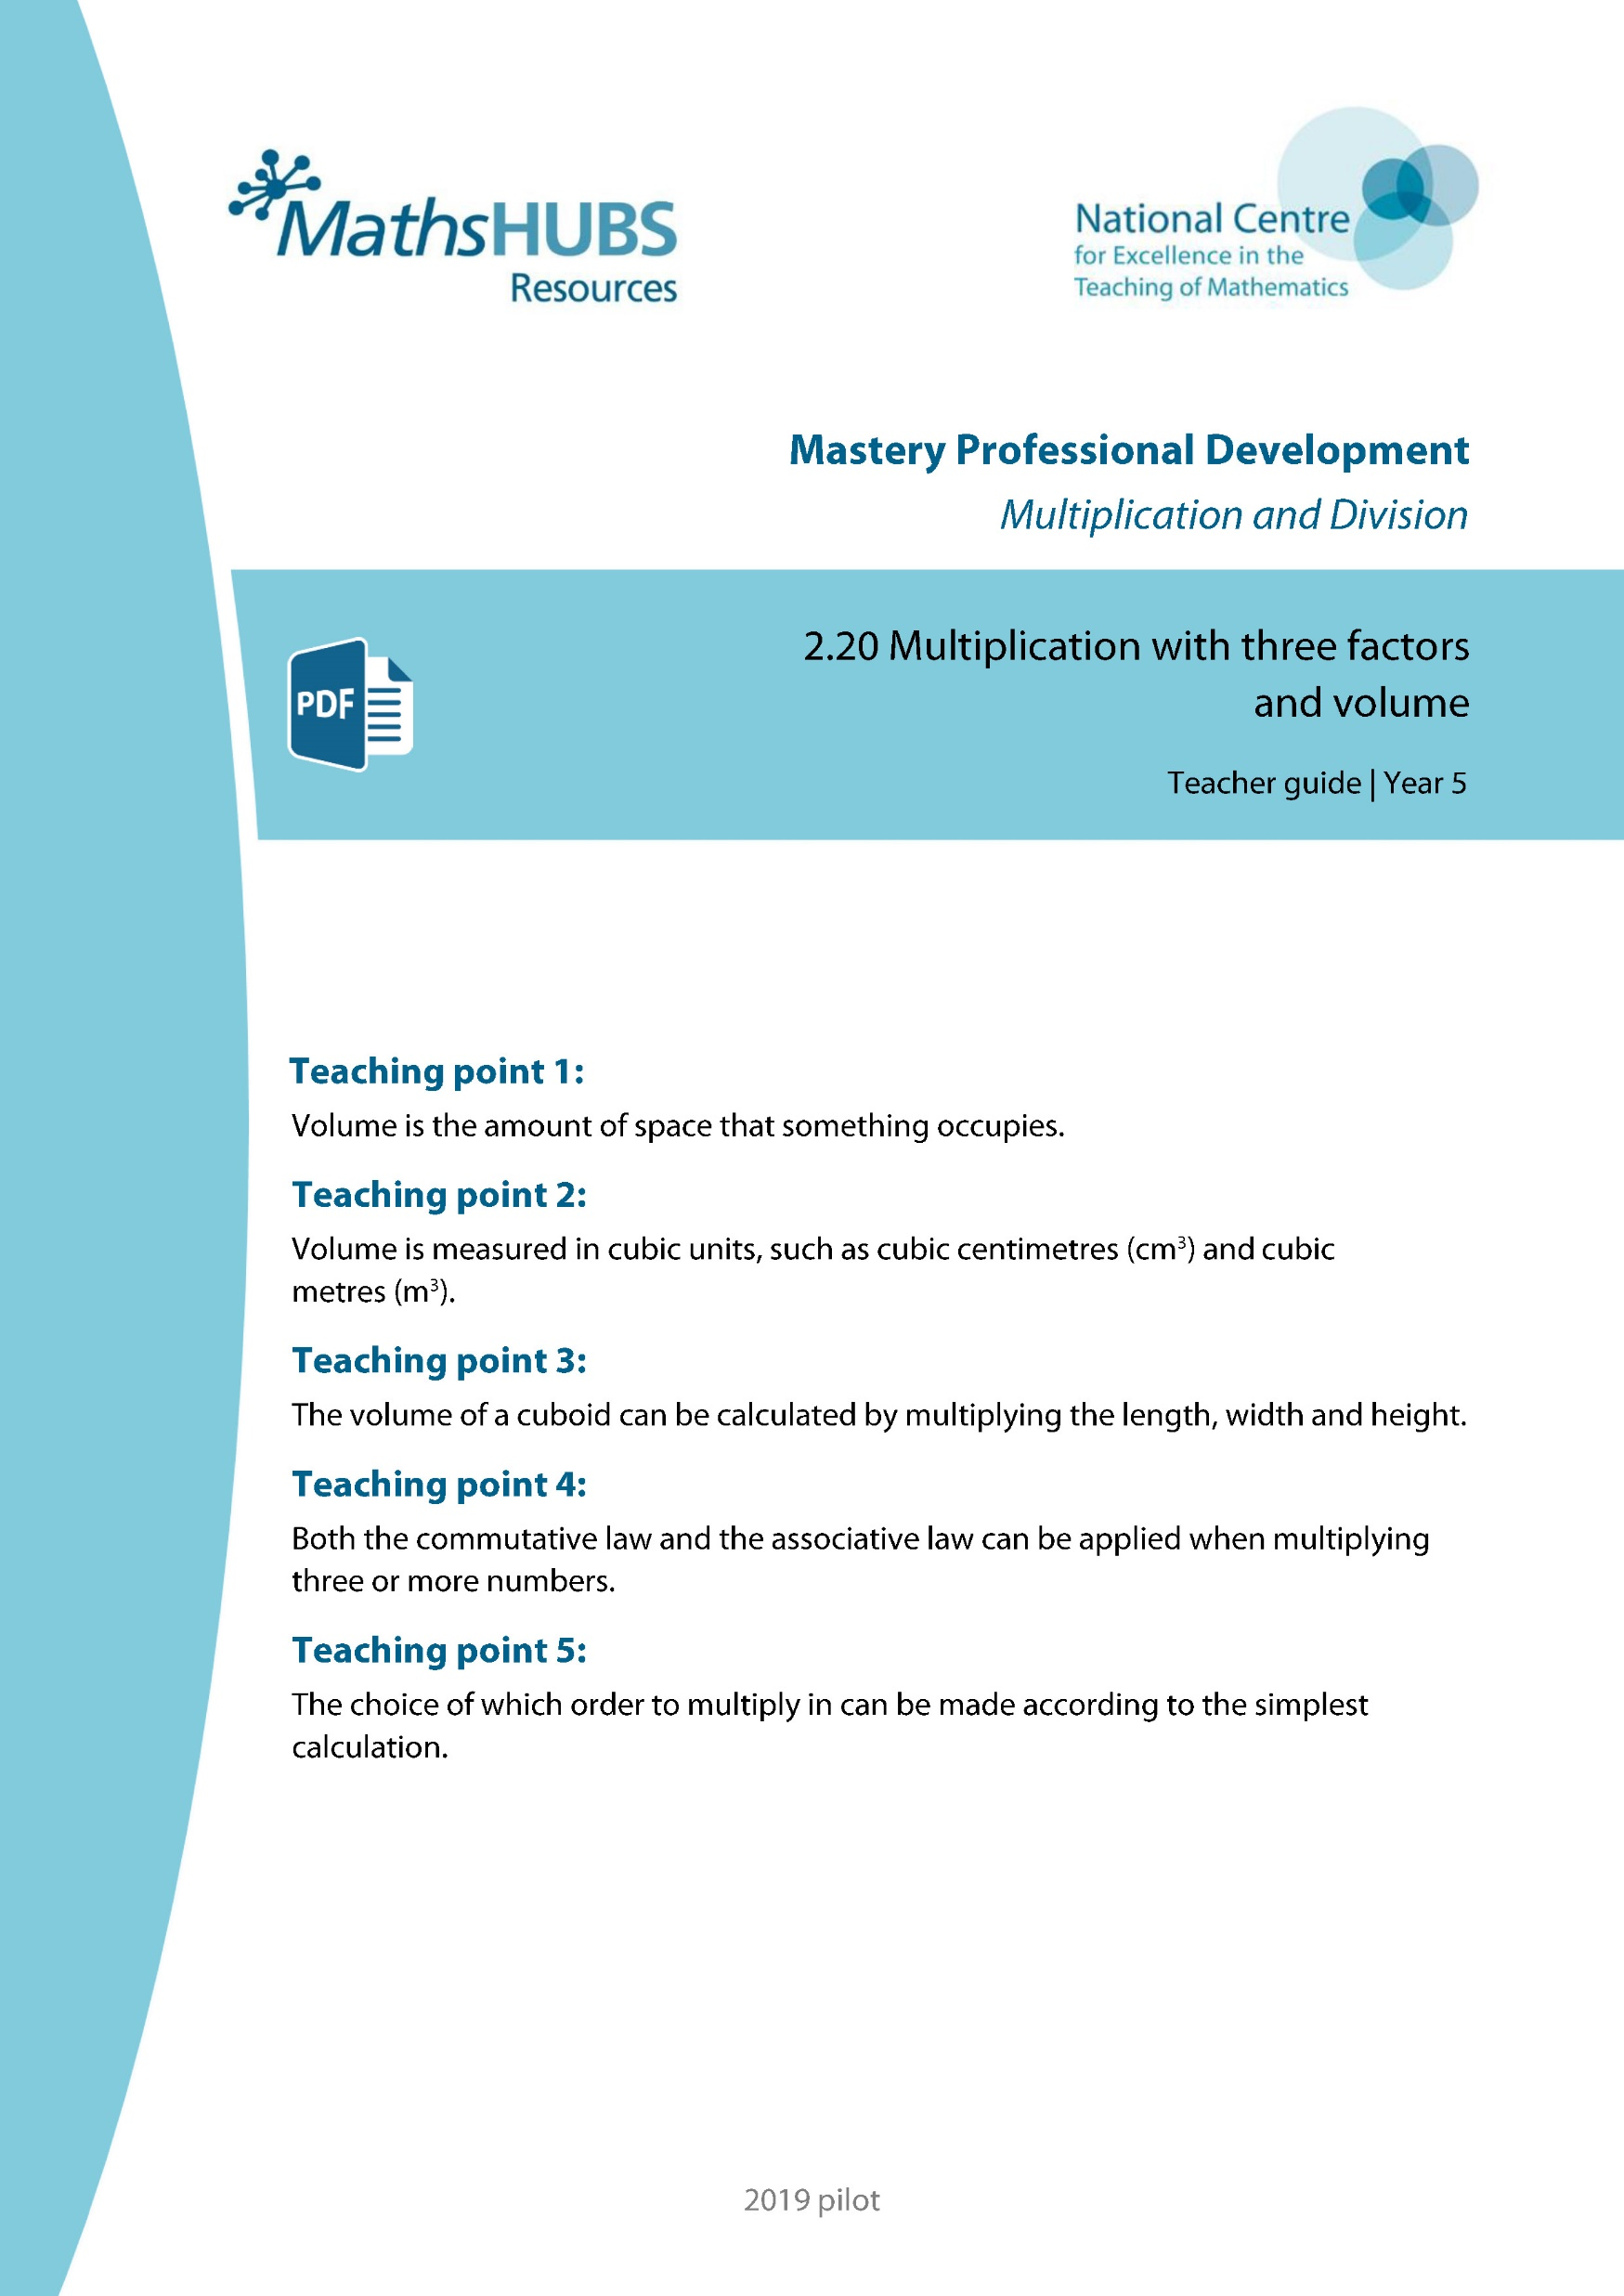
Year 5, Unit 7, Learning Outcome 1
Additional teacher guidance for this outcome should be read first and can be found in this segment of the NCETM Primary Mastery Professional Development Materials:
2.20 Multiplication with three factors and volume
The spine materials are divided into ‘teaching points’ and ‘steps in learning’.
Teaching point | Steps in learning | Pages
1 | 1:1-1:5 | 3-5

Slide 8
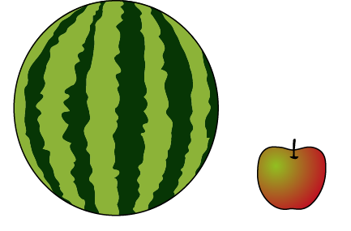
2.20 Multiplying three factors Step 1:1
Notes:
Which takes up more space, the melon or the apple?
The amount of space the ____ takes up is its volume.
The melon has a larger volume than the apple.

Slide 9
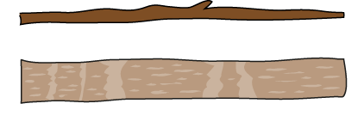
2.20 Multiplying three factors Step 1:2
Notes:
Which stick has a larger volume?

Slide 10

2.20 Multiplying three factors Step 1:2
Notes:
Which book has a larger volume?

Slide 11

2.20 Multiplying three factors Step 1:3
Notes:
Although objects might look different, they can have the same volume.

Slide 12
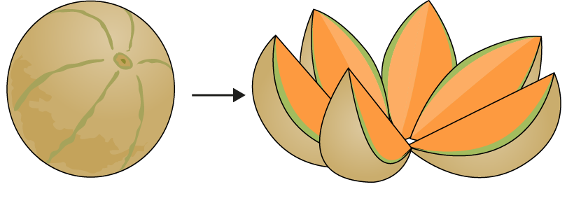
2.20 Multiplying three factors Step 1:3

Slide 13

2.20 Multiplying three factors Step 1:4
Notes:
What’s the same and what’s different?
The shape is the same.
The volume is the same.
The mass is different.

Slide 14
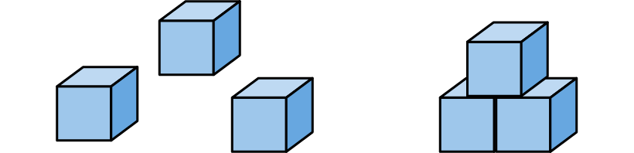
2.20 Multiplying three factors Step 1:5
Notes:
Evie says that the three separate bricks have a larger volume than the stack
of three bricks, because they take up more space when they are separate.
Do you agree or disagree? Explain your answer.

Slide 15
Year 5, Unit 7, Learning Outcome 2
Learning Outcome 2
Pupils describe the units used to measure volume
The following slides have been collated to support the teaching of this learning outcome.

Slide 16
Year 5, Unit 7, Learning Outcome 2
Additional teacher guidance for this outcome should be read first and can be found in this segment of the NCETM Primary Mastery Professional Development Materials:
2.20 Multiplication with three factors and volume
The spine materials are divided into ‘teaching points’ and ‘steps in learning’.
Teaching point | Steps in learning | Pages
2 | 2:1-2:8 | 6-11

Slide 17
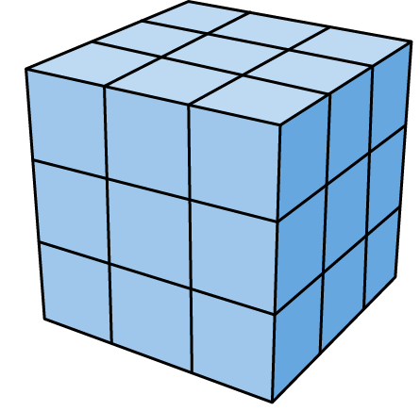
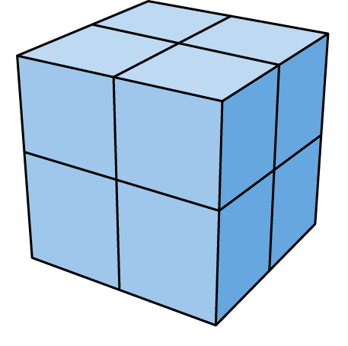
2.20 Multiplying three factors Step 2:1
A: Made using 27 cubes
B: Made using 8 cubes
Notes:
Shape A must be larger because it is made using more cubes. True or false?

Slide 18
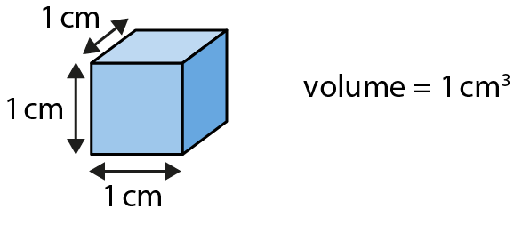
2.20 Multiplying three factors Step 2:2

Slide 19
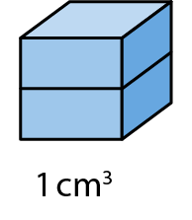
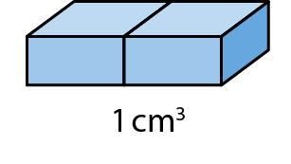
2.20 Multiplying three factors Step 2:3

Slide 20
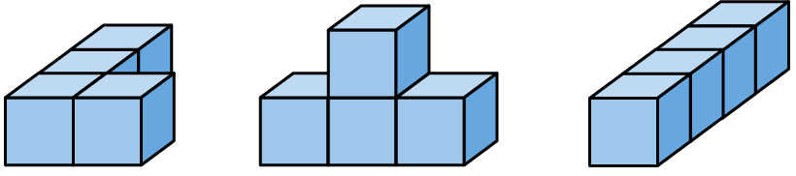
2.20 Multiplying three factors Step 2:4
Notes:
What is the volume of each shape?

Slide 21
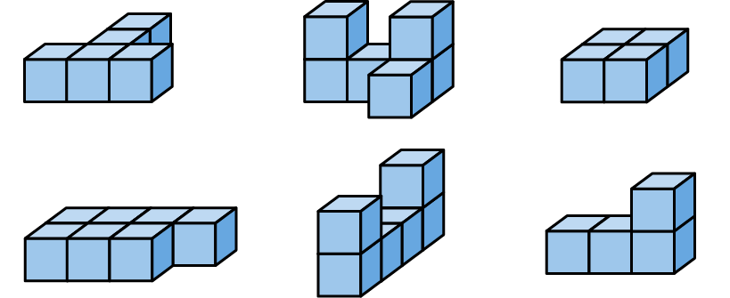
2.20 Multiplying three factors Step 2:5
Notes:
What is the volume of each shape?

Slide 22
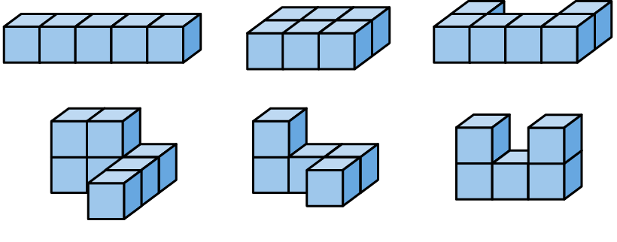
2.20 Multiplying three factors Step 2:5
Notes:
Which of these shapes have a volume of 6 cm³?

Slide 23
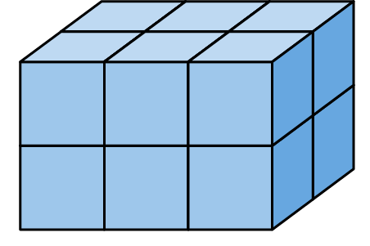
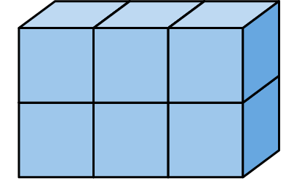
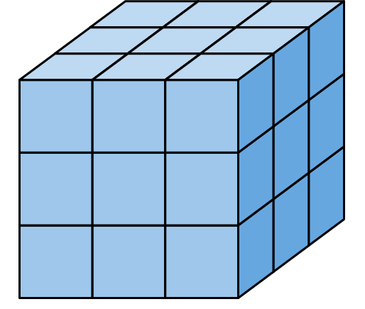
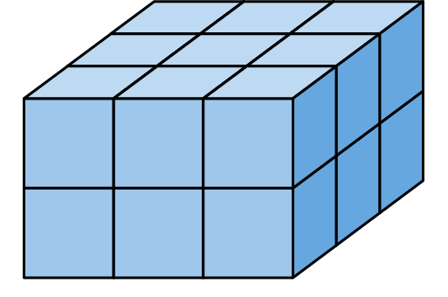
2.20 Multiplying three factors Step 2:6
6 cm³
12 cm³
18 cm³
27 cm³
Notes:
Count the small cubes to find the volume of each shape.
What’s the same?
The width
The size of each small cube
What’s different?
The volume

Slide 24
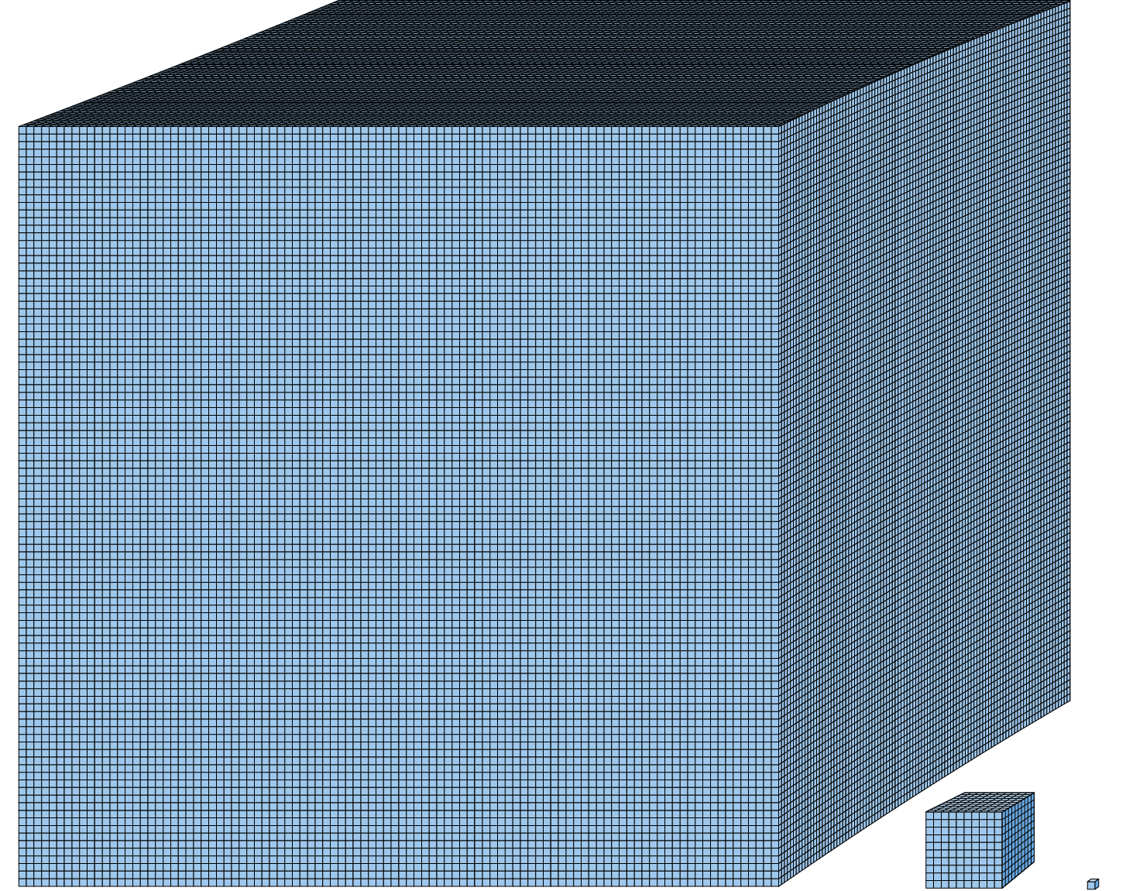
2.20 Multiplying three factors Step 2:8
1,000,000 cm³ (or 1 m³)
1,000 cm³
1 cm³

Slide 25
Year 5, Unit 7, Learning Outcome 3
Learning Outcome 3
Pupils explain how to calculate the volume of a cuboid
The following slides have been collated to support the teaching of this learning outcome.

Slide 26
Year 5, Unit 7, Learning Outcome 3
Additional teacher guidance for this outcome should be read first and can be found in this segment of the NCETM Primary Mastery Professional Development Materials:
2.20 Multiplication with three factors and volume
The spine materials are divided into ‘teaching points’ and ‘steps in learning’.
Teaching point | Steps in learning | Pages
3 | 3:1-3:5 and 3:7 | 12-15 and 16

Slide 27
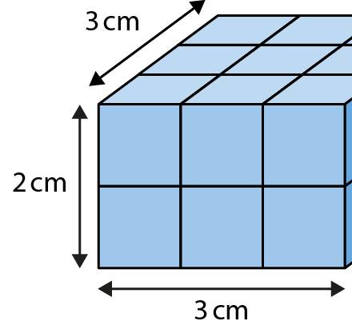
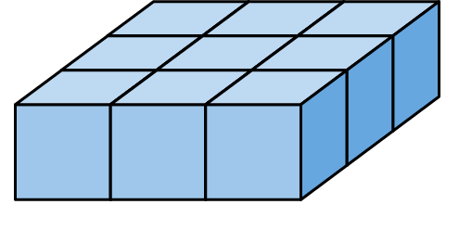
2.20 Multiplying three factors Step 3:2
What is the volume of this cuboid?
18 cm³
9 cm³
3 × 3 = 9
9 × 2 = 18
3 cm × 3 cm × 2 cm = 18 cm³

Slide 28
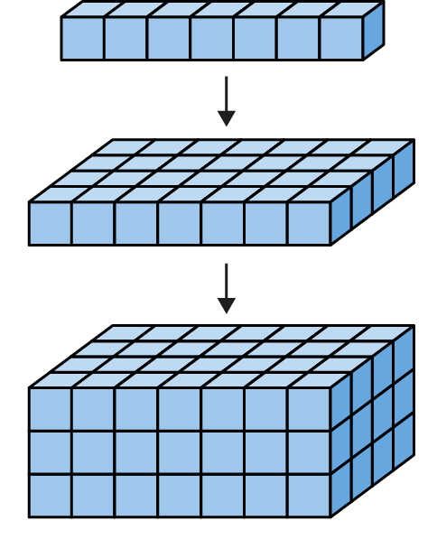
2.20 Multiplying three factors Step 3:2
Notes:
What is the volume of this cuboid?
7 cm × 4 cm × 3 cm = 84 cm³

Slide 29
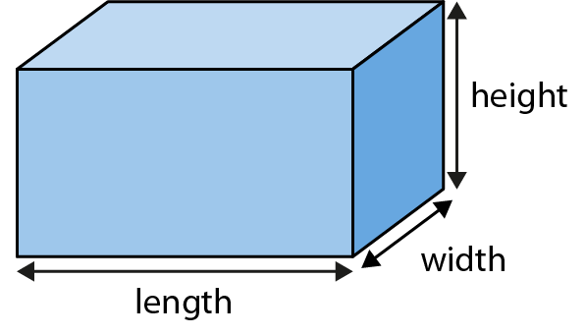
2.20 Multiplying three factors Step 3:3
Notes:
Finding the volume of a cuboid

Slide 30
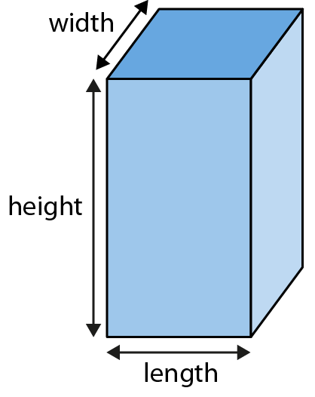
2.20 Multiplying three factors Step 3:4

Slide 31
Year 5, Unit 7, Learning Outcome 4
Learning Outcome 4
Pupils explain what a cube number is
The following slide supports the teaching of this learning outcome.

Slide 32
Year 5, Unit 7, Learning Outcome 4
Additional teacher guidance for this outcome should be read first and can be found in this segment of the NCETM Primary Mastery Professional Development Materials:
2.20 Multiplication with three factors and volume
The spine materials are divided into ‘teaching points’ and ‘steps in learning’.
Teaching point | Steps in learning | Pages
3 | 3:6 | 15-16

Slide 33
Year 5, Unit 7, Learning Outcome 5
Learning Outcome 5
Pupils use their knowledge of calculating volume to solve problems in a range of contexts
The following slide supports the teaching of this learning outcome.

Slide 34
Year 5, Unit 7, Learning Outcome 5
Additional teacher guidance for this outcome should be read first and can be found in this segment of the NCETM Primary Mastery Professional Development Materials:
2.20 Multiplication with three factors and volume
The spine materials are divided into ‘teaching points’ and ‘steps in learning’.
Teaching point | Steps in learning | Pages
3 | 3:8-3:9 | 16-20

Slide 35
Year 5, Unit 7, Learning Outcome 6
Learning Outcome 6
Pupils explain how to calculate the volume of compound shapes
The following slides have been collated to support the teaching of this learning outcome.

Slide 36
Year 5, Unit 7, Learning Outcome 6
Additional teacher guidance for this outcome should be read first and can be found in this segment of the NCETM Primary Mastery Professional Development Materials:
2.20 Multiplication with three factors and volume
The spine materials are divided into ‘teaching points’ and ‘steps in learning’.
Teaching point | Steps in learning | Pages
3 | 3:10-3:11 | 21-24

Slide 37
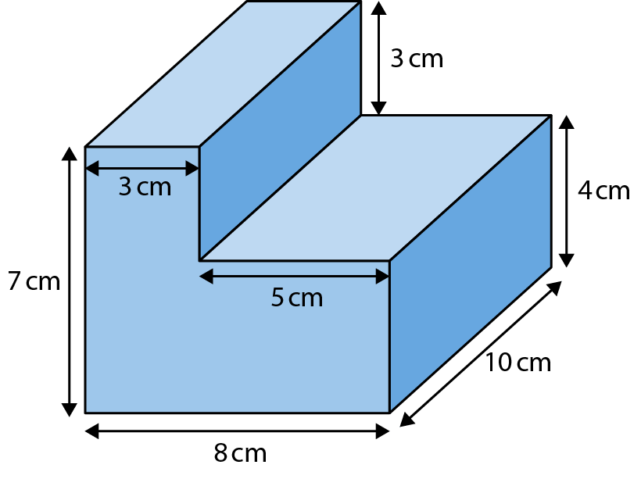
2.20 Multiplying three factors Step 3:10
Notes:
What is the volume of this shape?
Cuboid 1: 7 cm × 3 cm × 10 cm
Cuboid 1: 5 cm × 4 cm × 10 cm
V = 7 cm × 3 cm × 10 cm + 5 cm × 4 cm × 10 cm
V = 410 cm³

Slide 38
2.20 Multiplying three factors Step 3:10
Notes:
Cuboid 1: 3 cm × 3 cm × 10 cm
Cuboid 2: 8 cm × 4 cm × 10 cm
V = 3 cm × 3 cm × 10 cm + 8 cm × 4 cm × 10 cm
V = 410 cm³

Slide 39
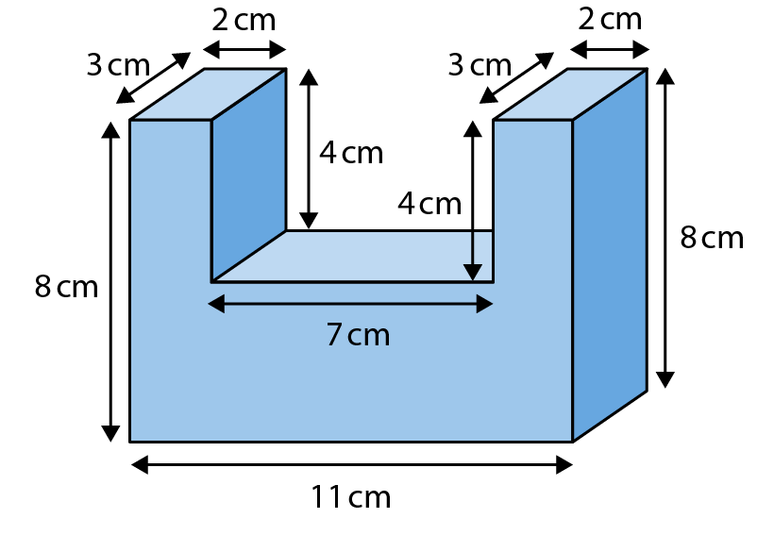
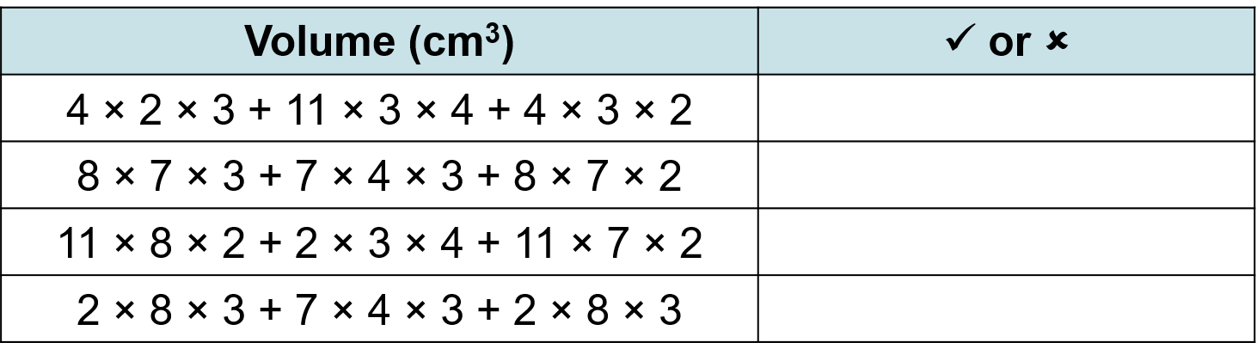
2.20 Multiplying three factors Step 3:10
What is the volume of this shape?

Slide 40
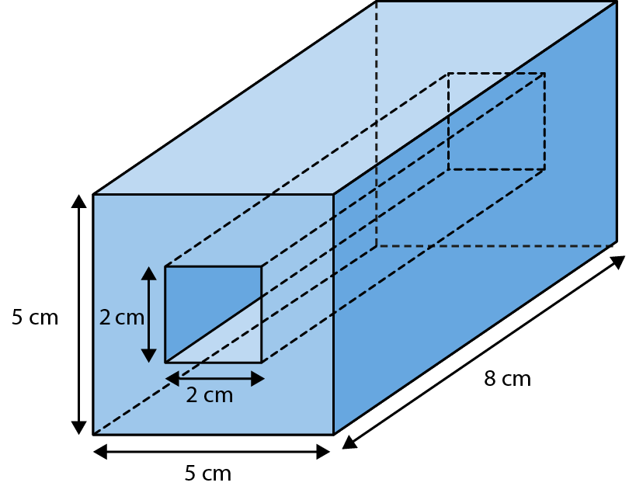
2.20 Multiplying three factors Step 3:11
Notes:
This cuboid has a hole in the middle.
Find the volume of the surrounding shape.

Slide 41
Year 5, Unit 7, Learning Outcome 7
Learning Outcome 7
Pupils explain the use of the commutative and distributive laws when multiplying three or more numbers
The following slides have been collated to support the teaching of this learning outcome.

Slide 42
Year 5, Unit 7, Learning Outcome 7
Additional teacher guidance for this outcome should be read first and can be found in this segment of the NCETM Primary Mastery Professional Development Materials:
2.20 Multiplication with three factors and volume
The spine materials are divided into ‘teaching points’ and ‘steps in learning’.
Teaching point | Steps in learning | Pages
4 | 4:1-4:4 | 25-29

Slide 43
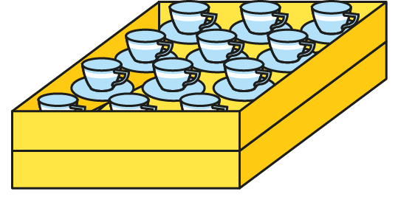
2.20 Multiplying three factors Step 4:1
If we stack up two trays,
how many teacups will there be in total?

Slide 44
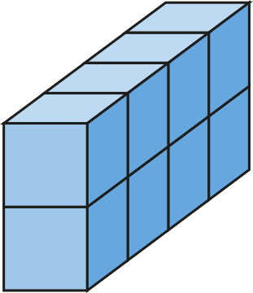
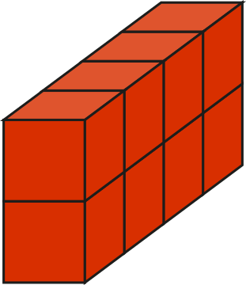
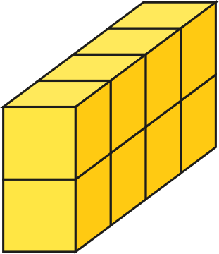
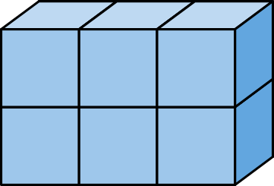
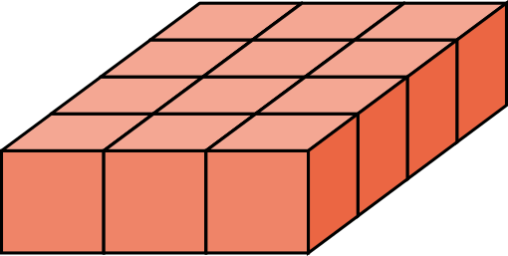
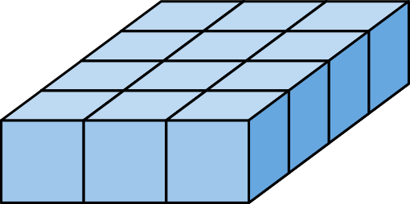
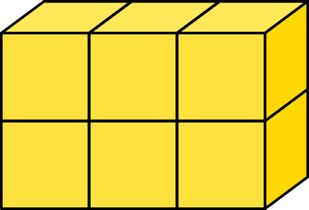
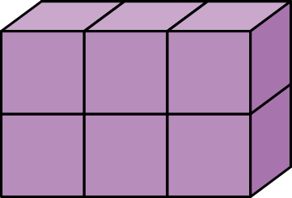
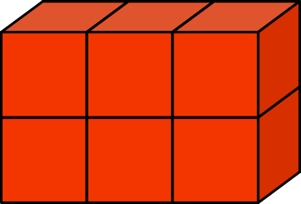
2.20 Multiplying three factors Step 4:2
How many cubes are there?
3 × 4
4 × 2
3 × 2
× 2
× 3
× 4
= 12 × 2
= 6 × 4
= 8 × 3
= 24
= 24
= 24

Slide 45




2.20 Multiplying three factors Step 5:2
18 × 5
= 9 × 2 × 5
5 × 2 × 9 = 10 × 9
= 90
Notes:
An equation can be made easier to solve by expressing
one of the factors as a multiplication of two factors.
We could think of 18 as 9 × 2.
We could choose to multiply 2 × 5 first,
to get 10, and then work out 9 × 10 = 90.

Slide 46
Year 5, Unit 7, Learning Outcome 8
Learning Outcome 8
Pupils explain the reasons for changing two-factor multiplication calculations to three-factor multiplications
The following slide supports the teaching of this learning outcome.

Slide 47
Year 5, Unit 7, Learning Outcome 8
Additional teacher guidance for this outcome should be read first and can be found in this segment of the NCETM Primary Mastery Professional Development Materials:
2.20 Multiplication with three factors and volume
The spine materials are divided into ‘teaching points’ and ‘steps in learning’.
Teaching point | Steps in learning | Pages
5 | 5:1-5:4 | 30-32

Slide 48
Year 5, Unit 7, Learning Outcome 9
Learning Outcome 9
Pupils explain what a factor is and how to use arrays and multiplication/division facts to find them
The following slides have been collated to support the teaching of this learning outcome.

Slide 49
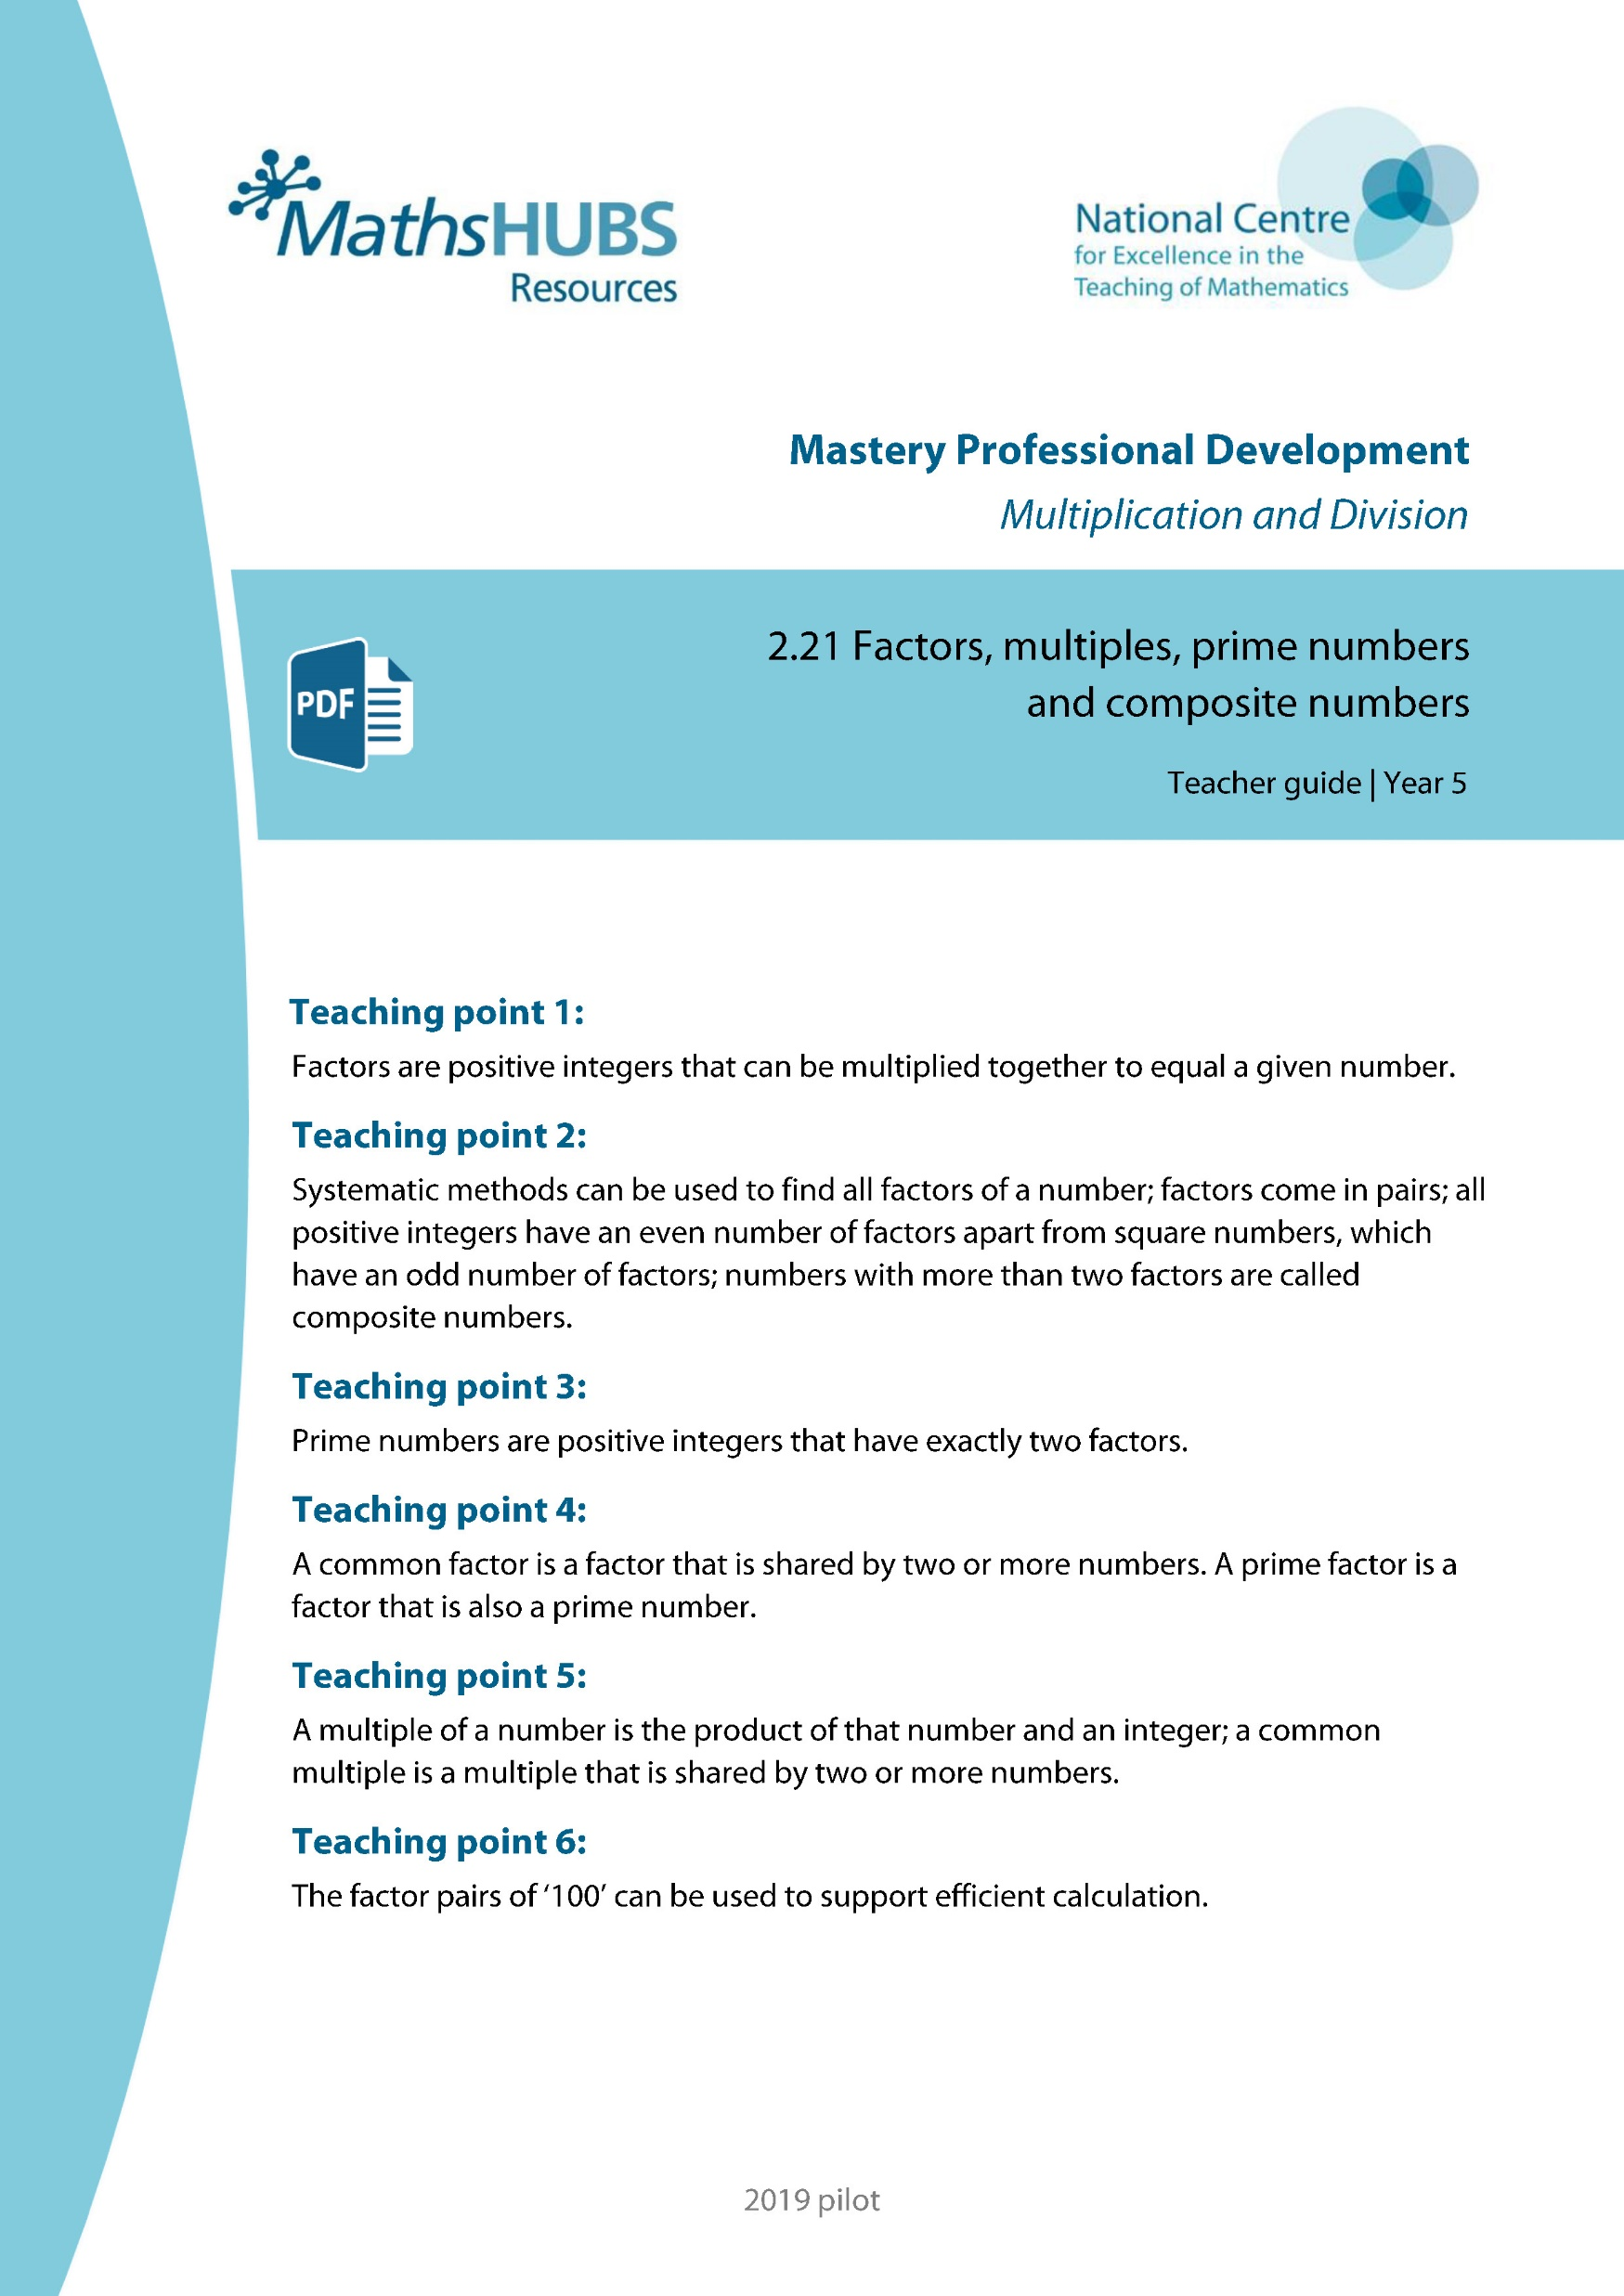
Year 5, Unit 7, Learning Outcome 9
Additional teacher guidance for this outcome should be read first and can be found in this segment of the NCETM Primary Mastery Professional Development Materials:
2.21 Factors, multiples, prime numbers and composite numbers
The spine materials are divided into ‘teaching points’ and ‘steps in learning’.
Teaching point | Steps in learning | Pages
1 | 1:1-1:7 | 3-7

Slide 50


2.21 Properties of factors and multiples Step 1:1
Notes:
How many different ways can you arrange ‘12‘ tiles into a rectangle?

Slide 51
2.21 Properties of factors and multiples Step 1:1
12
1
Notes:
There are ‘12‘ tiles. There is ‘1‘ row and ‘12‘ columns.
So ‘12‘ and ‘1‘ are factors of ‘12‘.

Slide 52
2.21 Properties of factors and multiples Step 1:1
1
12
1
12
Notes:
There are ‘12‘ tiles. There are ‘12‘ rows and ‘1‘ column.
So ‘12‘ and ‘1‘ are factors of ‘12‘.

Slide 53
2.21 Properties of factors and multiples Step 1:1
1
2
6
12
Notes:
There are ‘12‘ tiles. There are ‘6‘ rows and ‘2‘ columns.
So ‘6‘ and ‘2‘ are factors of ‘12‘.

Slide 54
2.21 Properties of factors and multiples Step 1:1
2
6
2
6
Notes:
There are ‘12‘ tiles. There are ‘2‘ rows and ‘6‘ columns.
So ‘6‘ and ‘2‘ are factors of ‘12‘.

Slide 55
2.21 Properties of factors and multiples Step 1:1
3
6
2
4
Notes:
There are ‘12‘ tiles. There are ‘4‘ rows and ‘3‘ columns.
So ‘4‘ and ‘3‘ are factors of ‘12‘.

Slide 56
2.21 Properties of factors and multiples Step 1:1
3
4
3
4
Notes:
There are ‘12‘ tiles. There are ‘3‘ rows and ‘4‘ columns.
So ‘4‘ and ‘3‘ are factors of ‘12‘.

Slide 57
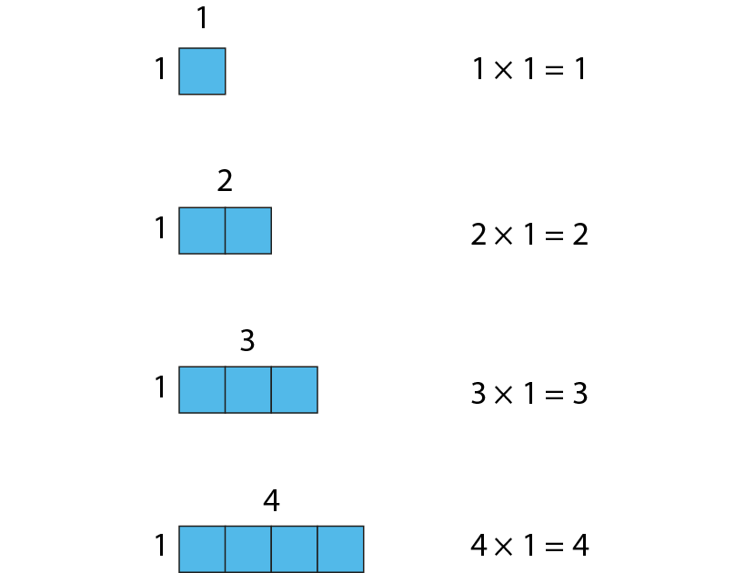
2.21 Properties of factors and multiples Step 1:3
Notes:
When ‘1‘ is a factor, the product is equal to the other factor.

Slide 58


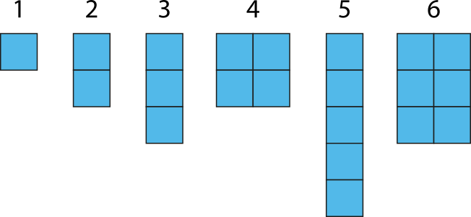
2.21 Properties of factors and multiples Step 1:4
Notes:
Which of these are square numbers?

Slide 59
2.21 Properties of factors and multiples Step 1:5
× | 0 | 1 | 2 | 3 | 4 | 5 | 6 | 7 | 8 | 9 | 10 | 11 | 12
0 | 0 | 0 | 0 | 0 | 0 | 0 | 0 | 0 | 0 | 0 | 0 | 0 | 0
1 | 0 | 1 | 2 | 3 | 4 | 5 | 6 | 7 | 8 | 9 | 10 | 11 | 12
2 | 0 | 2 | 4 | 6 | 8 | 10 | 12 | 14 | 16 | 18 | 20 | 22 | 24
3 | 0 | 3 | 6 | 9 | 12 | 15 | 18 | 21 | 24 | 27 | 30 | 33 | 36
4 | 0 | 4 | 8 | 12 | 16 | 20 | 24 | 28 | 32 | 36 | 40 | 44 | 48
5 | 0 | 5 | 10 | 15 | 20 | 25 | 30 | 35 | 40 | 45 | 50 | 55 | 60
6 | 0 | 6 | 12 | 18 | 24 | 30 | 36 | 42 | 48 | 54 | 60 | 66 | 72
7 | 0 | 7 | 14 | 21 | 28 | 35 | 42 | 49 | 56 | 63 | 70 | 77 | 84
8 | 0 | 8 | 16 | 24 | 32 | 40 | 48 | 56 | 64 | 72 | 80 | 88 | 96
9 | 0 | 9 | 18 | 27 | 36 | 45 | 54 | 63 | 72 | 81 | 90 | 99 | 108
10 | 0 | 10 | 20 | 30 | 40 | 50 | 60 | 70 | 80 | 90 | 100 | 110 | 120
11 | 0 | 11 | 22 | 33 | 44 | 55 | 66 | 77 | 88 | 99 | 110 | 121 | 132
12 | 0 | 12 | 24 | 36 | 48 | 60 | 72 | 84 | 96 | 108 | 120 | 132 | 144
Notes:
‘7‘ is a factor of ‘42‘ because ‘42‘ is in the‘ 7‘ times table.
42 ÷ 7 = 6 so I can make a rectangular array that is 6 × 7
‘6‘ and ‘7‘ are factors of ‘42‘.

Slide 60
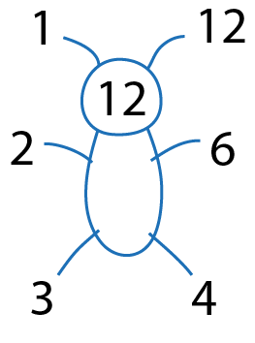
5MD-2 Find factors and multiples
3
6
12
24
1
2
4
Record the multiplication equations shown by the array after each animation.
Why were the 24 cubes not shown in five rows?
Identify all the factors of 24 from the factors within the multiplication equations.
Repeat with other numbers, using cubes to create 3-D arrays at each stage.
1
24
8 x 3 = 24
8
24
4 x 6 = 24
2
12
2 x 12 = 24
4
6
1 x 24 = 24
8
3

Slide 61
Year 5, Unit 7, Learning Outcome 10
Learning Outcome 10
Pupils explain how to systematically find all factors of a number and how they know when they have found them all
The following slides have been collated to support the teaching of this learning outcome.

Slide 62
Year 5, Unit 7, Learning Outcome 10
Additional teacher guidance for this outcome should be read first and can be found in this segment of the NCETM Primary Mastery Professional Development Materials:
2.21 Factors, multiples, prime numbers and composite numbers
The spine materials are divided into ‘teaching points’ and ‘steps in learning’.
Teaching point | Steps in learning | Pages
2 | 2:1-2:4 | 8-12

Slide 63





2.21 Properties of factors and multiples Step 2:1
and
and
Factors of 6 are 1, 2, 3 and 6.

Slide 64
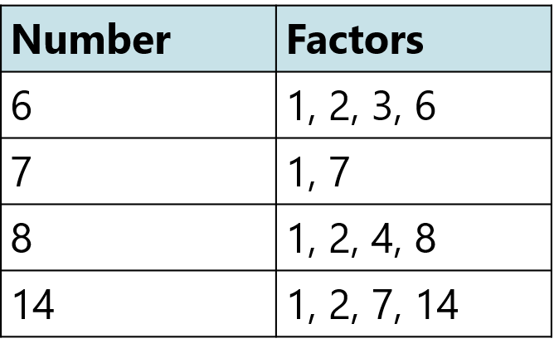
2.21 Properties of factors and multiples Step 2:1
Notes:
What‘s the same?
All numbers have ‘1‘ and themselves as factors.
‘6‘, ‘8‘ and ‘14‘ have ‘2‘ as a factor.
‘7‘ has only two factors.
What‘s different?
Some factors only appear in one list.
‘7‘ has two factors.
‘6‘, ‘8‘ and ‘14‘ have four factors.

Slide 65
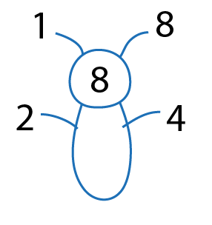
2.21 Properties of factors and multiples Step 2:2

Slide 66
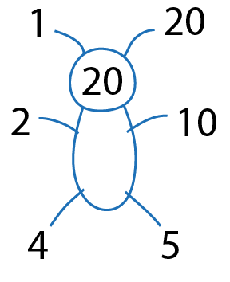
2.21 Properties of factors and multiples Step 2:3

Slide 67
Year 5, Unit 7, Learning Outcome 11
Learning Outcome 11
Pupils use a complete list of factors to explain when a number is a square number
The following slides have been collated to support the teaching of this learning outcome.

Slide 68
Year 5, Unit 7, Learning Outcome 11
Additional teacher guidance for this outcome should be read first and can be found in this segment of the NCETM Primary Mastery Professional Development Materials:
2.21 Factors, multiples, prime numbers and composite numbers
The spine materials are divided into ‘teaching points’ and ‘steps in learning’.
Teaching point | Steps in learning | Pages
2 | 2:5-2:6 | 12

Slide 69
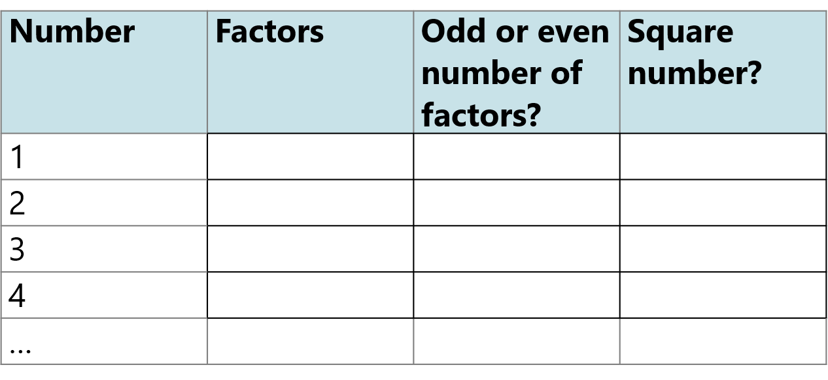

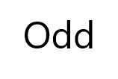

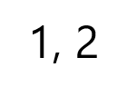
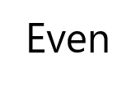

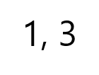
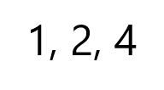
2.21 Properties of factors and multiples Step 2:5
Notes:
Complete the table to identify factors and square numbers.

Slide 70


5MD-2 Find factors and multiples
Create a square array using nine cubes.
What factor does the square array show?
Does nine have an odd or even number of factors? Why?
Will other square numbers have an odd or even number of factors? Why?
Explore the factors of the other square numbers, using cubes if required.
Images © 2017 Alphablocks Ltd. All Rights Reserved.

Slide 71
5MD-2 Find factors and multiples
× | 0 | 1 | 2 | 3 | 4 | 5 | 6 | 7 | 8 | 9 | 10 | 11 | 12
0 | 0 | 0 | 0 | 0 | 0 | 0 | 0 | 0 | 0 | 0 | 0 | 0 | 0
1 | 0 | 1 | 2 | 3 | 4 | 5 | 6 | 7 | 8 | 9 | 10 | 11 | 12
2 | 0 | 2 | 4 | 6 | 8 | 10 | 12 | 14 | 16 | 18 | 20 | 22 | 24
3 | 0 | 3 | 6 | 9 | 12 | 15 | 18 | 21 | 24 | 27 | 30 | 33 | 36
4 | 0 | 4 | 8 | 12 | 16 | 20 | 24 | 28 | 32 | 36 | 40 | 44 | 48
5 | 0 | 5 | 10 | 15 | 20 | 25 | 30 | 35 | 40 | 45 | 50 | 55 | 60
6 | 0 | 6 | 12 | 18 | 24 | 30 | 36 | 42 | 48 | 54 | 60 | 66 | 72
7 | 0 | 7 | 14 | 21 | 28 | 35 | 42 | 49 | 56 | 63 | 70 | 77 | 84
8 | 0 | 8 | 16 | 24 | 32 | 40 | 48 | 56 | 64 | 72 | 80 | 88 | 96
9 | 0 | 9 | 18 | 27 | 36 | 45 | 54 | 63 | 72 | 81 | 90 | 99 | 108
10 | 0 | 10 | 20 | 30 | 40 | 50 | 60 | 70 | 80 | 90 | 100 | 110 | 120
11 | 0 | 11 | 22 | 33 | 44 | 55 | 66 | 77 | 88 | 99 | 110 | 121 | 132
12 | 0 | 12 | 24 | 36 | 48 | 60 | 72 | 84 | 96 | 108 | 120 | 132 | 144
What do you notice about the numbers highlighted in blue?
What is special about these numbers?
Would it be possible to create a square shaped array of each of these numbers? Why/why not?

Slide 72
Year 5, Unit 7, Learning Outcome 12
Learning Outcome 12
Pupils explain how to identify a prime number or a composite number
The following slides have been collated to support the teaching of this learning outcome.

Slide 73
Year 5, Unit 7, Learning Outcome 12
Additional teacher guidance for this outcome should be read first and can be found in this segment of the NCETM Primary Mastery Professional Development Materials:
2.21 Factors, multiples, prime numbers and composite numbers
The spine materials are divided into ‘teaching points’ and ‘steps in learning’.
Teaching point | Steps in learning | Pages
3 | 3:1-3:3 | 13-15

Slide 74



2.21 Properties of factors and multiples Step 3:1
Notes:
Which of these are prime numbers?

Slide 75
5MD-2 Find factors and multiples
What do you notice about the arrays that have been created for the first six counting numbers?
Could any of the arrays have been created in different ways? What do those arrays tell you about the number of factors that number has?
What does each array tell you about the number? Which are prime? Which are not prime? Which are square?
Repeat for other small numbers to investigate further.

Slide 76
Year 5, Unit 7, Learning Outcome 13
Learning Outcome 13
Pupils explain how to identify a common factor or a prime factor of a number
The following slides have been collated to support the teaching of this learning outcome.

Slide 77
Year 5, Unit 7, Learning Outcome 13
Additional teacher guidance for this outcome should be read first and can be found in this segment of the NCETM Primary Mastery Professional Development Materials:
2.21 Factors, multiples, prime numbers and composite numbers
The spine materials are divided into ‘teaching points’ and ‘steps in learning’.
Teaching point | Steps in learning | Pages
4 | 4:1-4:3 | 16-17

Slide 78


2.21 Properties of factors and multiples Step 4:1
Notes:
What are the common factors of ‘12‘ and ‘20‘?
The common factors of ‘12‘ and ‘20‘ are ‘1‘, ‘2‘, and ‘4‘.

Slide 79


2.21 Properties of factors and multiples Step 4:2
Notes:
Factors that are prime numbers are called prime factors.
What are the prime factors of ‘12‘ and ‘20‘?
The prime factors of ‘12‘ are ‘2‘ and ‘3‘.
The prime factors of ‘20‘ are ‘2‘ and ‘5‘.

Slide 80
Year 5, Unit 7, Learning Outcome 14
Learning Outcome 14
Pupils explain how to identify a multiple or common multiple of a number
The following slides have been collated to support the teaching of this learning outcome.

Slide 81
Year 5, Unit 7, Learning Outcome 14
Additional teacher guidance for this outcome should be read first and can be found in this segment of the NCETM Primary Mastery Professional Development Materials:
2.21 Factors, multiples, prime numbers and composite numbers
The spine materials are divided into ‘teaching points’ and ‘steps in learning’.
Teaching point | Steps in learning | Pages
5 | 5:1-5:4 | 18-20

Slide 82

2.21 Properties of factors and multiples Step 5:1
Notes:
‘2‘ is a factor of ‘6‘ because 2 × 3 = 6
‘6‘ is a multiple of ‘2‘ because 2 × 3 = 6
‘2‘ is a factor of ‘6‘ because 6 ÷ 3 = 2
‘6‘ is a multiple of ‘2‘ because 6 ÷ 3 = 2

Slide 83

2.21 Properties of factors and multiples Step 5:3
Notes:
Some multiples have been highlighted in this hundred square.
Which number is a factor of all of these multiples?
Is there more than one number that is a factor of all of these multiples?

Slide 84



2.21 Properties of factors and multiples Step 5:4
Notes:
Use a hundred square to find the common multiples of ‘3‘ and ‘5‘.

Slide 85
5MD-2 Find factors and multiples
What do you notice about the highlighted numbers?
Which number is a factor of all of these multiples?
Is there more than one number that is a factor of all of these multiples?
Nine is a factor of all of these numbers.
Three is a factor of nine which means it is also a factor of all of these numbers.

Slide 86
5MD-2 Find factors and multiples
Use an empty hundred square and shade the multiples of three and five different colours.
Use the shaded hundred square to identify common multiples of 3 and 5.
What do you notice about the common multiples?
What would the next common multiple be? How do you know?

Slide 87
Year 5, Unit 7, Learning Outcome 15
Learning Outcome 15
Pupils use knowledge of properties of number to solve problems in a range of contexts
The following slides have been collated to support the teaching of this learning outcome.

Slide 88
Year 5, Unit 7, Learning Outcome 15
Additional teacher guidance for this outcome should be read first and can be found in this segment of the NCETM Primary Mastery Professional Development Materials:
2.21 Factors, multiples, prime numbers and composite numbers
The spine materials are divided into ‘teaching points’ and ‘steps in learning’.
Teaching point | Steps in learning | Pages
5 | 5:5-5:6 | 21-22

Slide 89

2.21 Properties of factors and multiples Step 5:6
12
9
25
18
42
36
54
64
360
48
63
45
24
630
72
480
27
63
25
12
72
27
18
630
9
24
64
48
54
42
45
480
360
36
Notes:
Sort the numbers into multiples of ‘6‘, multiples of ‘9‘, both or neither.
What do you notice about numbers in the intersection? Are they odd or even?

Slide 90



2.21 Properties of factors and multiples Step 5:6
Notes:
The numbers are sorted so that they are in the sections with the correct labels.
One number is in the wrong place. Which number is it and why?

Slide 91
5MD-2 Find factors and multiples
Identify where each of the digits in the multiplication equation are represented in the array.
From the array and multiplication equations, what statements about factors and multiples can be made?
7 represents the number of counters in each row.
3 represents the number of counters in each column.
21 represents the total number of counters.
7 × 3 = 21
7 and 3 are factors of 21.
21 is a multiple of 7 and 3.

Slide 92
5MD-2 Find factors and multiples
Identify where each of the digits in the multiplication equation are represented in the array.
From the array and multiplication equations, what statements about factors and multiples can be made?
10
10
10
10
10
10
10
10
10
10
10
10
10
10
7 represents the number of counters in each row.
30 represents the total value of the counters in each column.
210 represents the total value of the counters.
10
10
10
10
10
10
10
7 × 30 = 210
70 × 3 = 210
3, 7, 10, 21 and 70 are factors of 210.
210 is a multiple of 3, 7, 10, 21 and 70.
10 x 21 = 210

Slide 93
5MD-2 Find factors and multiples
Identify where each of the digits in the multiplication equation are represented in the array.
From the array and multiplication equations, what statements about factors and multiples can be made?
100
100
100
100
100
100
100
100
100
100
100
100
100
100
7 represents the number of counters in each row.
300 represents the total value of the counters in each column.
2,100 represents the total value of the counters.
100
100
100
100
100
100
100
7 × 300 = 2,100
700 × 3 = 2,100
3, 7, 100, 21 and 700 are factors of 2100.
2,100 is a multiple of 3, 7, 100, 21 and 700.
100 x 21 = 2,100

Slide 94
5MD-2 Find factors and multiples
What do you notice about the three equations?
The first equation shows 21 is a multiple of 3 and 7. What similar statement can be made from the other expressions?
How can the second expression help to determine if 2 is a factor of 210?
21 = 7 × 3
210 = 7 × 3 × 10
2,100 = 7 × 3 × 100
21 is a multiple of 3 and 7, so…
210 and 2,100 are multiples of 3 and 7.
2 is a factor of 10.
Because 10 is a factor of 210, this means 2 is also a factor of 210.

Slide 95
Year 5, Unit 7, Learning Outcome 16
Learning Outcome 16
Pupils explain how to use the factor pairs of ‘100’ to solve calculations efficiently
The following slides have been collated to support the teaching of this learning outcome.

Slide 96
Year 5, Unit 7, Learning Outcome 16
Additional teacher guidance for this outcome should be read first and can be found in this segment of the NCETM Primary Mastery Professional Development Materials:
2.21 Factors, multiples, prime numbers and composite numbers
The spine materials are divided into ‘teaching points’ and ‘steps in learning’.
Teaching point | Steps in learning | Pages
6 | 6:1-6:3 | 23-25

Slide 97

2.21 Properties of factors and multiples Step 6:1
Notes:
List the factor pairs of ‘100‘.

Slide 98

2.21 Properties of factors and multiples Step 6:1
Notes:
What is the temperature shown on this thermometer?
There are ’10’ intervals on the thermometer.
We know that ‘10‘ and ‘10‘ are factor pairs of ‘100‘, so there are ’10’ intervals of ‘10‘.
The temperature is 10˚C.

Slide 99

2.21 Properties of factors and multiples Step 6:1
Notes:
What is the temperature shown on this thermometer?
There are ‘4’ intervals on the thermometer.
We know that ‘4‘ and ‘25‘ are factor pairs of ‘100‘, so there are ‘4’ intervals of ‘25‘.
The temperature is 25˚C.

