Slide 1
Year 3, Unit 10
Parallel and perpendicular sides in polygons

Slide 2
Year 3, Unit 10
These materials heavily reflect the prioritisation approach of the ready-to-progress criteria in the DfE Primary Mathematics Guidance 2020 and on the PPTs that exemplify them on the NCETM website. They also include other relevant National Curriculum content. Related sections of the NCETM Primary Mastery Professional Development Materials provide small-step teaching guidance.
Ready-to-progress criteria addressed by this unit
Teaching of this unit supports the following criteria from the ‘DfE Mathematics Guidance: key stages 1 & 2’ (the 335-page document available as a download)
3G-2 Page 137

Slide 3
Contents
The links below take you to the starting slide of each learning outcome.
1 | Pupils make compound shapes by joining two polygons in different ways (same parts, different whole)
2 | Pupils investigate different ways of composing and decomposing a polygon (same whole, different parts)
3 | Pupils draw polygons on isometric paper
4 | Pupils use geostrips to investigate quadrilaterals with and without parallel and perpendicular sides
5 | Pupils make and draw compound shapes with and without parallel and perpendicular sides
Click the arrow button to return to this Contents slide.

Slide 4
Contents
The links below take you to the starting slide of each learning outcome.
6 | Pupils learn to extend lines and sides to identify parallel and perpendicular lines
7 | Pupils make and draw triangles on circular geoboards
8 | Pupils make and draw quadrilaterals on circular geoboards
9 | Pupils draw shapes with given properties on a range of geometric grids
Click the arrow button to return to this Contents slide.

Slide 5
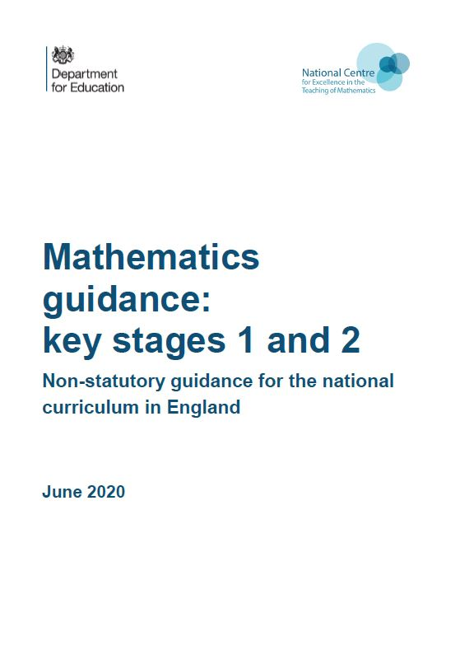
Year 3, Unit 10, Learning Outcomes 1 – 9
Additional teacher guidance for this outcome should be read first and can be found in the DfE Mathematics guidance. Page references relate to the 335-page document available as a download at the bottom of this web page.
Ready to progress criteria | Pages
3G-2 | 137-139

Slide 6
Year 3, Unit 10, Learning Outcome 1
Learning Outcome 1
Pupils make compound shapes by joining two polygons in different ways (same parts, different whole)
The following slides have been collated to support the teaching of this learning outcome.

Slide 7
Year 3, Unit 10, Learning Outcome 1
Take two identical triangle cut-outs.
How can you put them together to make a new shape?
For each compound shape you make, place it on your blank sheet of paper, mark each of the vertices, and then join them with a ruler. This will be a record of the different shapes you have made.
The compound shapes here have been made by joining two sides exactly. What compound shapes can you make by placing a shorter side against a longer side?

Slide 8
Year 3, Unit 10, Learning Outcome 2
Learning Outcome 2
Pupils investigate different ways of composing and decomposing a polygon (same whole, different parts)
The following slides have been collated to support the teaching of this learning outcome.

Slide 9



Year 3, Unit 10, Learning Outcome 2
Have a play with the pattern block pieces.
Once you’ve had a chance to get familiar with them, start to look for shapes that can be made up of other shapes.
Look at the hexagon piece. What different ways can you make the hexagon from other pieces?
Can you work systematically to find all the different ways?

Slide 10
Year 3, Unit 10, Learning Outcome 2
Draw several hexagons on a blank piece of paper by
    laying a hexagon on the paper
    marking each of the six vertices
    joining the six vertices with a ruler
On these hexagons, draw all the different ways you can find to make the hexagon from smaller pieces.

Slide 11
Year 3, Unit 10, Learning Outcome 3
Learning Outcome 3
Pupils draw polygons on isometric paper
The following slides have been collated to support the teaching of this learning outcome.

Slide 12

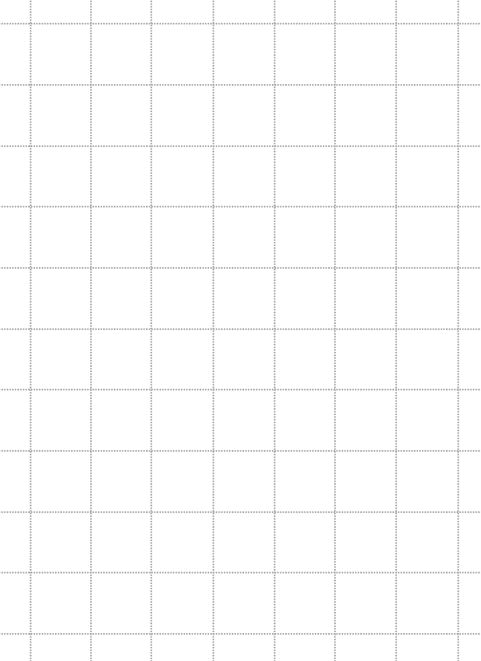
Year 3, Unit 10, Learning Outcome 3
You have two pieces of paper in front of you. Look at them and compare them. Discuss the units that you can see on each piece of paper.
The paper with the triangular units is called ‘isometric paper’.
Try drawing some different shapes on each paper. What kind of shapes do you make on each?

Slide 13
Year 3, Unit 10, Learning Outcome 3
Now take a large piece of isometric paper.
Let’s draw each of these pattern block pieces onto the paper. What do you notice about how many unit triangles big each piece is?
Use the pattern block pieces to make a pattern or arrangement of pieces. Get familiar with the isometric paper by copying your pattern onto it.
  Mark each vertex of each new piece you are drawing.
  Join the vertices with a ruler.

Slide 14
Year 3, Unit 10, Learning Outcome 4
Learning Outcome 4
Pupils use geostrips to investigate quadrilaterals with and without parallel and perpendicular sides.
The following slides have been collated to support the teaching of this learning outcome.

Slide 15
Year 3, Unit 10, Learning Outcome 4
You will need
  a selection of card strips of different lengths
  split pins
  right angle checker (set square or folded paper)

Slide 16
Year 3, Unit 10, Learning Outcome 4
Take two long and two shorter strips, and four split pins. Join them together.
Have a play with the shape you have made. Notice how it changes. Look at the sides, the angles at the vertices, and the space inside (we call this the area).
Look around. Has everyone made the same shape as you?

Slide 17
Year 3, Unit 10, Learning Outcome 4
If you need to, rearrange your two long and two short strips to make a shape like this.
This shape is called a parallelogram. It is called a parallelogram because it has two pairs of parallel sides.
Change the angles of your parallelogram. What happens to the sides as you change the angles?
“Two lines are parallel because they are always the same distance apart. They will never meet no matter how far we extend them.”

Slide 18
Year 3, Unit 10, Learning Outcome 4
Can you move the sides of your parallelogram so that it has a right angle?
What do you notice about the angle at each of the vertices?
Where two lines are at a right angle to one another, we say they are perpendicular.
A parallelogram with four right angles is called a rectangle.
“Two lines are perpendicular because they are at right angles to each other.”

Slide 19
Year 3, Unit 10, Learning Outcome 5
Learning Outcome 5
Pupils make and draw compound shapes with and without parallel and perpendicular sides.
The following slides have been collated to support the teaching of this learning outcome.

Slide 20
3G-2 Draw polygons and recognise parallel and perpendicular sides
Give children two identical shapes, like these two isosceles triangles. Ask the children to put the shapes together to fit certain criteria, e.g.
  Join these two isosceles triangles to make a parallelogram.
  Join these two isosceles triangles together to make a quadrilateral with no parallel sides.
Repeat this activity with other shapes.

Slide 21
Year 3, Unit 10, Learning Outcome 6
Learning Outcome 6
Pupils learn to extend lines and sides to identify parallel and perpendicular lines.
The following slides have been collated to support the teaching of this learning outcome.

Slide 22
3G-2 Draw polygons and recognise parallel and perpendicular sides
Children should be able to identify parallel and perpendicular sides in polygons. The language focus sentences should be used to support understanding.
Ask children to draw parallel lines with a ruler. Do the lines fit the description of parallel lines from the language focus box? Repeat with perpendicular lines. Show children pairs of lines and ask them to say whether the heading of parallel lines/perpendicular lines are true or false.
“These two lines are parallel because they are always the same distance apart. They will never meet no matter how far we extend them.”
“These two lines are perpendicular because they are at right angles to each other.”

Slide 23
3G-2 Draw polygons and recognise parallel and perpendicular sides
Exploring parallel lines
Give children 4 lolly sticks and ask them to arrange the sticks as parallel lines. They could arrange the sticks in two lines, three lines or four lines; they could use two sticks to make a longer line; they could move the sticks further apart; they could offset the sticks but keep them parallel; they could move them so they are not horizontal or vertical. Encourage children to explore what makes lines parallel. Also ask them to arrange the sticks to make lines that are not parallel. Can they explain why they are not parallel?
Children should recognise parallel lines when they look ‘peculiar’. The POG ‘Peculiar, Ordinary, General’ activity can be used to encourage them to think about drawing parallel lines with different length lines and in different orientations. Start by drawing ‘ordinary’ parallel lines and move to drawing ‘peculiar’ parallel lines. Children should focus on what are the ‘essential features’ of parallel lines – the lines are always the same distance apart. Look at all the ‘peculiar’ parallel lines and discuss what is the same or ‘general’ about them all.

Slide 24
3G-2 Draw polygons and recognise parallel and perpendicular sides
Exploring perpendicular lines
Give children four lolly sticks and ask them to arrange the sticks as two perpendicular lines. Can they do this using two sticks, three sticks and four sticks? This activity will encourage them to see perpendicular lines as lines that join at right angles. The lines do not have to be the same length. Use right angle checkers to make sure the lines are perpendicular. Encourage children to change the orientation of the perpendicular lines they have made. Also ask them to arrange the sticks to make lines that are not perpendicular. Can they explain why they are not perpendicular?
Parallel and perpendicular lines in the environment
Explore where parallel and perpendicular lines can be found in the classroom and in the school grounds.

Slide 25
3G-2 Draw polygons and recognise parallel and perpendicular sides
It will be useful to provide children with an assortment of 2D shapes for them to select from, handle, compare and sort. Discuss whether the shapes have any perpendicular or parallel lines. Can the children explain their thinking? Put shapes into a feely bag and see if children can pick out shapes that have perpendicular sides and shapes that have parallel sides.
Images of shapes should also be used and presented in a variety of orientations. Children should identify lines that are perpendicular because they are at right angles to each other. Children should be able to identify pairs of parallel lines on images of shapes. Children should mark parallel lines using standard notation.

Slide 26
Year 3, Unit 10, Learning Outcome 7
Learning Outcome 7
Pupils make and draw triangles on circular geoboards.
The following slides have been collated to support the teaching of this learning outcome.

Slide 27
Year 3, Unit 10, Learning Outcome 7
9-pin circular geoboards
In front of you, you have a sheet of 9-pin circular geoboards, and a sheet of 12-pin circular geoboards.
What different triangles can you draw on each set of geoboards?
Do any of the triangles you have drawn have parallel sides?
Do any of the triangles you have drawn have perpendicular sides?
12-pin circular geoboards

Slide 28
Year 3, Unit 10, Learning Outcome 7

Slide 29
Year 3, Unit 10, Learning Outcome 7

Slide 30
Year 3, Unit 10, Learning Outcome 8
Learning Outcome 8
Pupils make and draw quadrilaterals on circular geoboards.
The following slides have been collated to support the teaching of this learning outcome.

Slide 31
Year 3, Unit 10, Learning Outcome 8
9-pin circular geoboards
In front of you, you have a sheet of 9-pin circular geoboards, and a sheet of 12-pin circular geoboards.
What different quadrilaterals can you draw on each set of geoboards?
Do any of the quadrilaterals you have drawn have parallel sides?
Do any of the quadrilaterals you have drawn have perpendicular sides?
12-pin circular geoboards

Slide 32
Year 3, Unit 10, Learning Outcome 8

Slide 33
Year 3, Unit 10, Learning Outcome 8

Slide 34
Year 3, Unit 10, Learning Outcome 9
Learning Outcome 9
Pupils draw shapes with given properties on a range of geometric grids.
The following slides have been collated to support the teaching of this learning outcome.

Slide 35



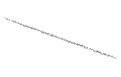



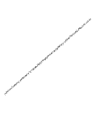



3G-2 Draw polygons and recognise parallel and perpendicular sides
Here are five vertices of a regular hexagon. Mark the sixth vertex and join the points to draw the hexagon.
Can you join three points to make an equilateral triangle? Try starting with a different point.
Two sides of a square have been drawn. Can you complete the drawing of this square?
Complete other incomplete polygons matching specific criteria, e.g. Complete this quadrilateral so that two sides are perpendicular.

Slide 36
Year 3, Unit 10

Slide 37
Year 3, Unit 10

Slide 38
Year 3, Unit 10

Slide 39
Year 3, Unit 10

Slide 40
Year 3, Unit 10

Slide 41
Year 3, Unit 10

