Slide 1
Numberblocks
Support Materials
Series 1 Episode 1
One

Slide 2
Practitioner Notes

Slide 3
Episode Description
In this episode a little block falls out of the sky, meets her numberling, One, and discovers one wonderful world of numerous single things that appear during the song, e.g. one sun, one smile. One also sings about being first in line and being lonely.

Slide 4
Maths in the Episode
Counting to 1.
Saying 'one' when there is one thing to be counted.
Concept of ‘oneness’
One is a single unit. If one is the quantity then what is being counted is arbitrary, and the size of the one thing being counted is also arbitrary, e.g. one sun or one ant – there is one of each even though the sun is bigger than an ant. One is represented as a Numberblock, as a finger, familiar things, as a spoken word, as a movement (one hop), as a numeral. Related words for oneness, e.g. first and alone.

Slide 5
Using Mathematical Language
During this episode there is the opportunity to attach the number name ‘one’ to a single unit.
Use ‘one’ in multiple situations, e.g.:
The answer to ‘how many…?’
One is the amount.
One is the quantity.
First means position one.
Once means one time.
Encourage children to use a stem sentence to talk about a single unit, e.g.
“ I see one apple.”

Slide 6
Talk and Discuss Together

Slide 7
Talk and Discuss Together
Watch the episode of Numberblocks. First ask the children what they noticed and allow them to talk to you and each other. The following slides are designed to stimulate children and adults to talk about the episode and draw out some key aspects of the mathematics.

Slide 8
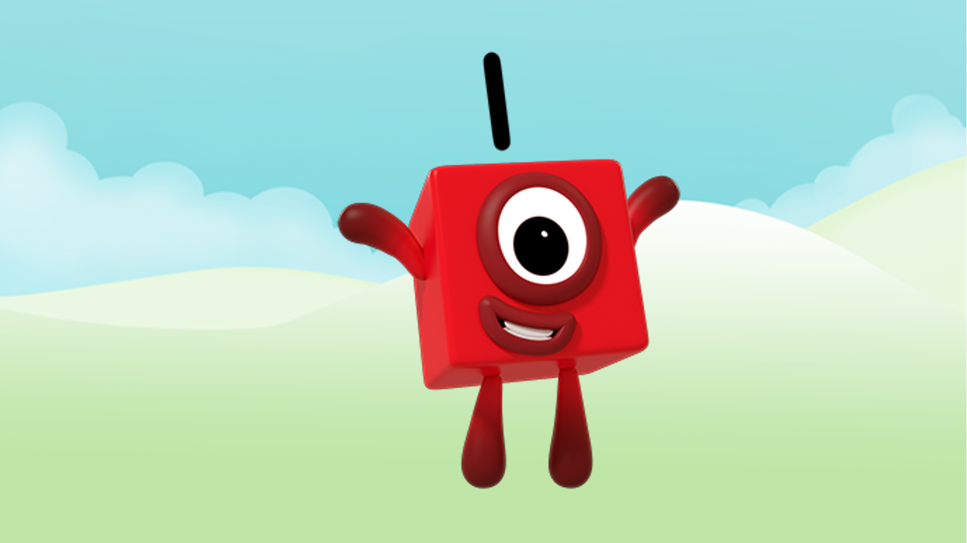
Images © 2017 Alphablocks Ltd. All Rights Reserved.
Notes:
Discuss what the children noticed about the programme. What did they like about it?
Ask: “When have you been on your own?”, “What did it feel like?” “When are you on your own when no-one else is with you?”.

Slide 9
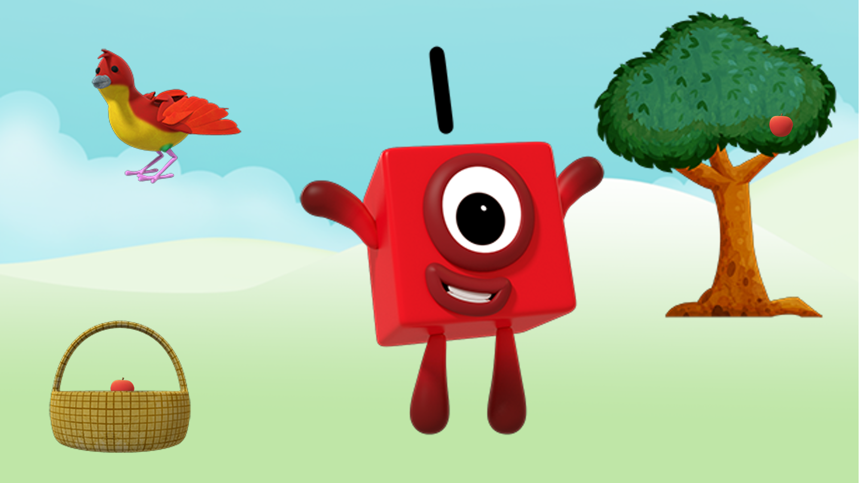
Images © 2017 Alphablocks Ltd. All Rights Reserved.
Notes:
Discuss the single items that children noticed in the programme.

Slide 10


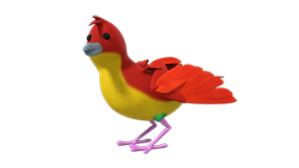
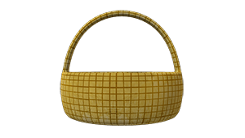
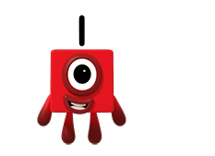
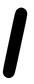
Images © 2017 Alphablocks Ltd. All Rights Reserved.
Notes:
This slide is animated:
Ask the children “What do you notice?”
Ask the children to discuss how each picture on the left has a partner on the right. Accept any answer where children are reasoning, e.g. they may argue that the apple belongs on the tree and the bird wants to sit in the basket. Encourage children to reason for themselves, remembering that there may be more than one correct answer.
Click 1: Arrow appears to link apple to basket
Click 2: Arrow appears to link bird to tree
Click 3: Arrow appears to link Numberblock to numeral
Can they think of any more examples from the programme. (You could find objects or pictures of the things below to match)
Bat – Ball (one ball with one bat)
Cat – Cake (one cat with one cake)
Chimpanzee – Surfboard (one chimpanzee with one surfboard)
Cow – cap (one cow with one cap)

Slide 11
Enabling Environments

Slide 12
Enabling Environments
Playing and Exploring
Pupils look out for things in the indoor and outdoor environment that they find one of. Use objects and photos of things the children find to create a One Wonderful World display.
Active Learning
Notice how the children are able to hand out one each of snacks at snack time.
Sing One Finger One Thumb (Keep Moving). Ask the children to offer suggestions of other body parts to add to the song.
Creating and Thinking Critically
Children find and collect objects to use as a printing ‘stamp’, e.g. potatoes, sponges, hands, feet etc. Using each stamp just once they create a One Wonderful World display.

Slide 13
Learning Together in Y1

Slide 14
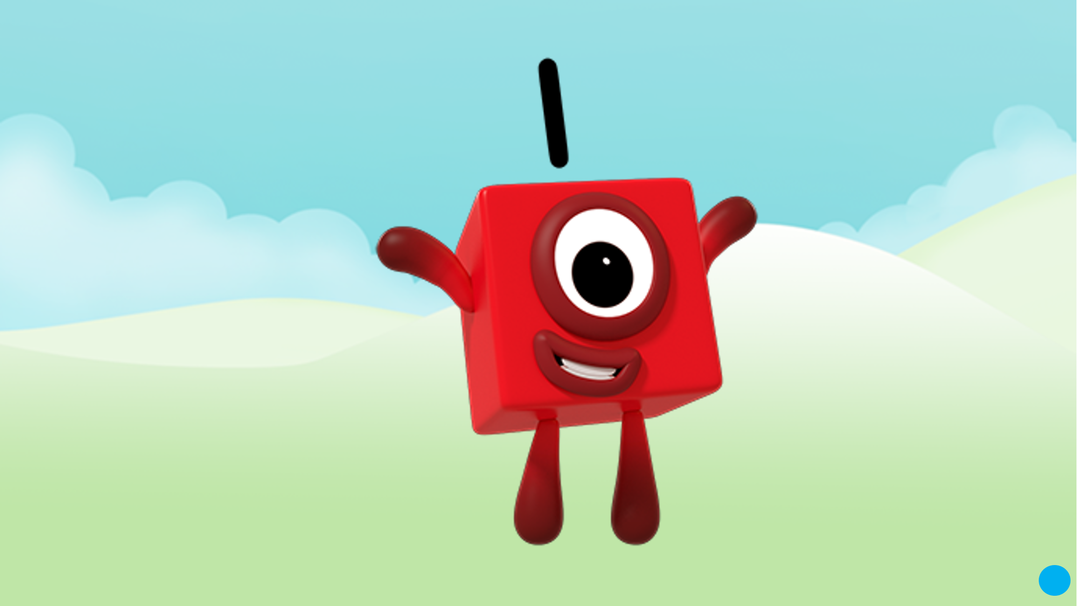
Images © 2017 Alphablocks Ltd. All Rights Reserved.
Notes:
Discuss what the children noticed about the programme. What did they like about it?

Slide 15
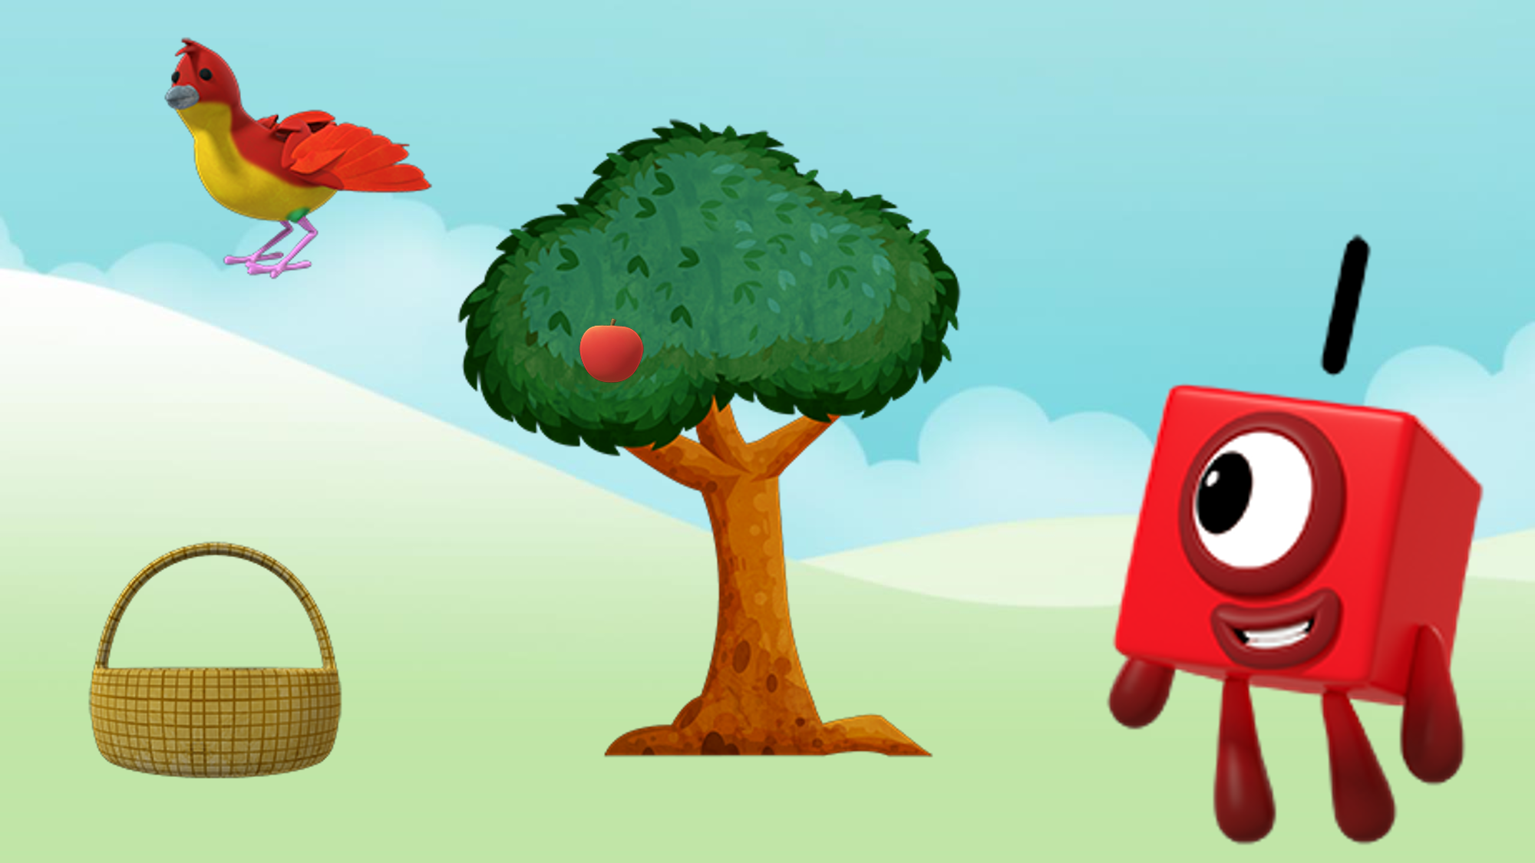
Images © 2017 Alphablocks Ltd. All Rights Reserved.
Notes:
Ask the children “What do you see?”
"I see one bird.”
"I see one basket.”
"I see one tree.”
"I see one apple.”
"I see One."
"I see the number 1."
Ask the children if they noticed in the programme some things that One counted that we can’t ‘see or draw a picture of’?
Prompt: One hop or one step.
What other things can we count that we can’t ‘see’?
Prompt: Bangs, claps, clicks.

Slide 16

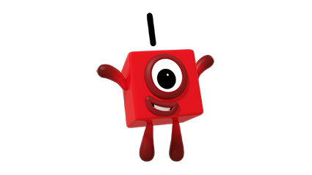
Images © 2017 Alphablocks Ltd. All Rights Reserved.
Notes:
This slide is animated:
Click 1: One jumps up and down. What did One just do? How many times?
Invite a child up. Whisper an instruction in to the ear of the child so the rest of the class can’t hear, e.g. One hop, one jump, one clap.
Child performs the sequence. Ask the class to say what they saw happening.
Ask “How many times did he/she hop?"
Ans: "He/she hopped one time" or "He/she hopped once".
Ask "How many times did he/she jump?"
Ans: "He/she jumped one time" or "He/she jumped once".
Ask "How many times did he/she clap?"
Ans: "He/she clapped one time" or "He/she clapped once".

Slide 17
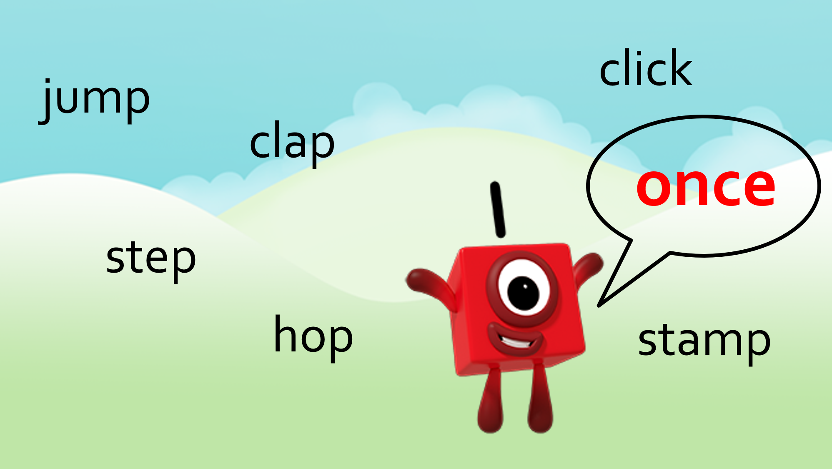
Images © 2017 Alphablocks Ltd. All Rights Reserved.
Notes:
Children work in pairs to give each other instructions to perform actions once in a sequence.

