Slide 1
Year 2, Unit 10
Fractions

Slide 2
Year 2, Unit 10
These materials heavily reflect the prioritisation approach of the ready-to-progress criteria in the DfE Primary Mathematics Guidance 2020 and on the PPTs that exemplify them on the NCETM website. They also include other relevant National Curriculum content. Related sections of the NCETM Primary Mastery Professional Development Materials provide small-step teaching guidance.
Ready-to-progress criteria addressed by this unit
Teaching of this unit does not support any criteria from the ‘DfE Mathematics Guidance: key stages 1 & 2’ (the 335-page document available as a download)
Prior learning
There are no specific ready-to-progress criteria supporting the prior learning for this unit.

Slide 3
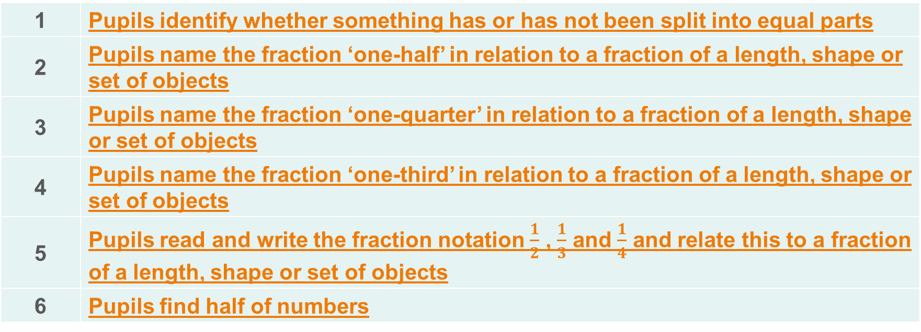
Contents
The links below take you to the starting slide of each learning outcome.
1 | Pupils identify whether something has or has not been split into equal parts
2 | Pupils name the fraction ‘one-half’ in relation to a fraction of a length, shape or set of objects
3 | Pupils name the fraction ‘one-quarter’ in relation to a fraction of a length, shape or set of objects
4 | Pupils name the fraction ‘one-third’ in relation to a fraction of a length, shape or set of objects
5 | Pupils read and write the fraction notation $\frac{1}{2}$ , $\frac{1}{3}$ and $\frac{1}{4}$ and relate this to a fraction of a length, shape or set of objects
6 | Pupils find half of numbers
Click the arrow button to return to this Contents slide.

Slide 4
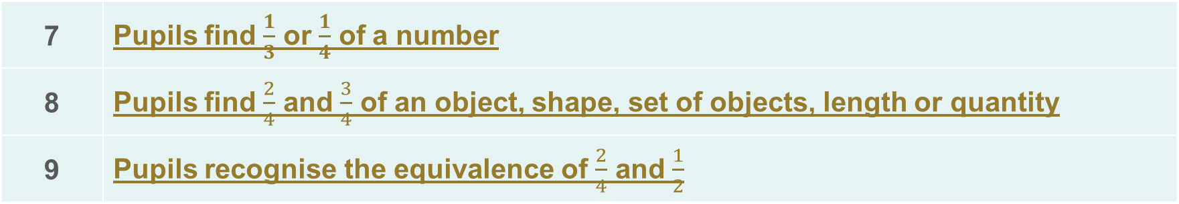
Contents
The links below take you to the starting slide of each learning outcome.
7 | Pupils find $\frac{1}{3}$ or $\frac{1}{4}$ of a number
8 | Pupils find $\frac{2}{4}$ and $\frac{3}{4}$ of an object, shape, set of objects, length or quantity
9 | Pupils recognise the equivalence of $\frac{2}{4}$ and $\frac{1}{2}$
Click the arrow button to return to this Contents slide.

Slide 5
Year 2, Unit 10, Learning Outcome 1
Learning Outcome 1
Pupils identify whether something has or has not been split into equal parts
The following slides have been collated to support the teaching of this learning outcome.

Slide 6
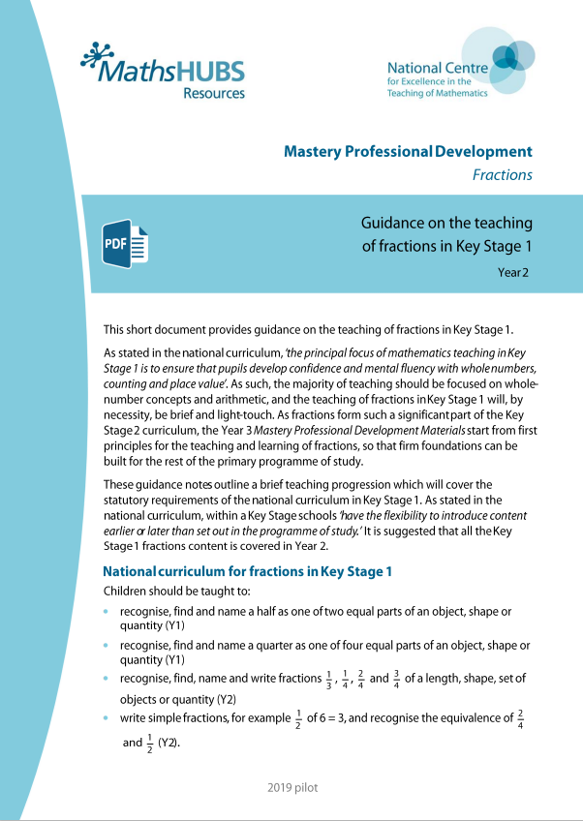
Year 2, Unit 10, Learning Outcome 1
Additional teacher guidance for this outcome should be read first and can be found in this segment of the NCETM Primary Mastery Professional Development Materials:
3.0 Guidance on the teaching of fractions in Key Stage 1
This shorter guidance document contains ‘teaching progression points’ to meet national curriculum objectives.
Teaching progression point | Page
1 | 1

Slide 7
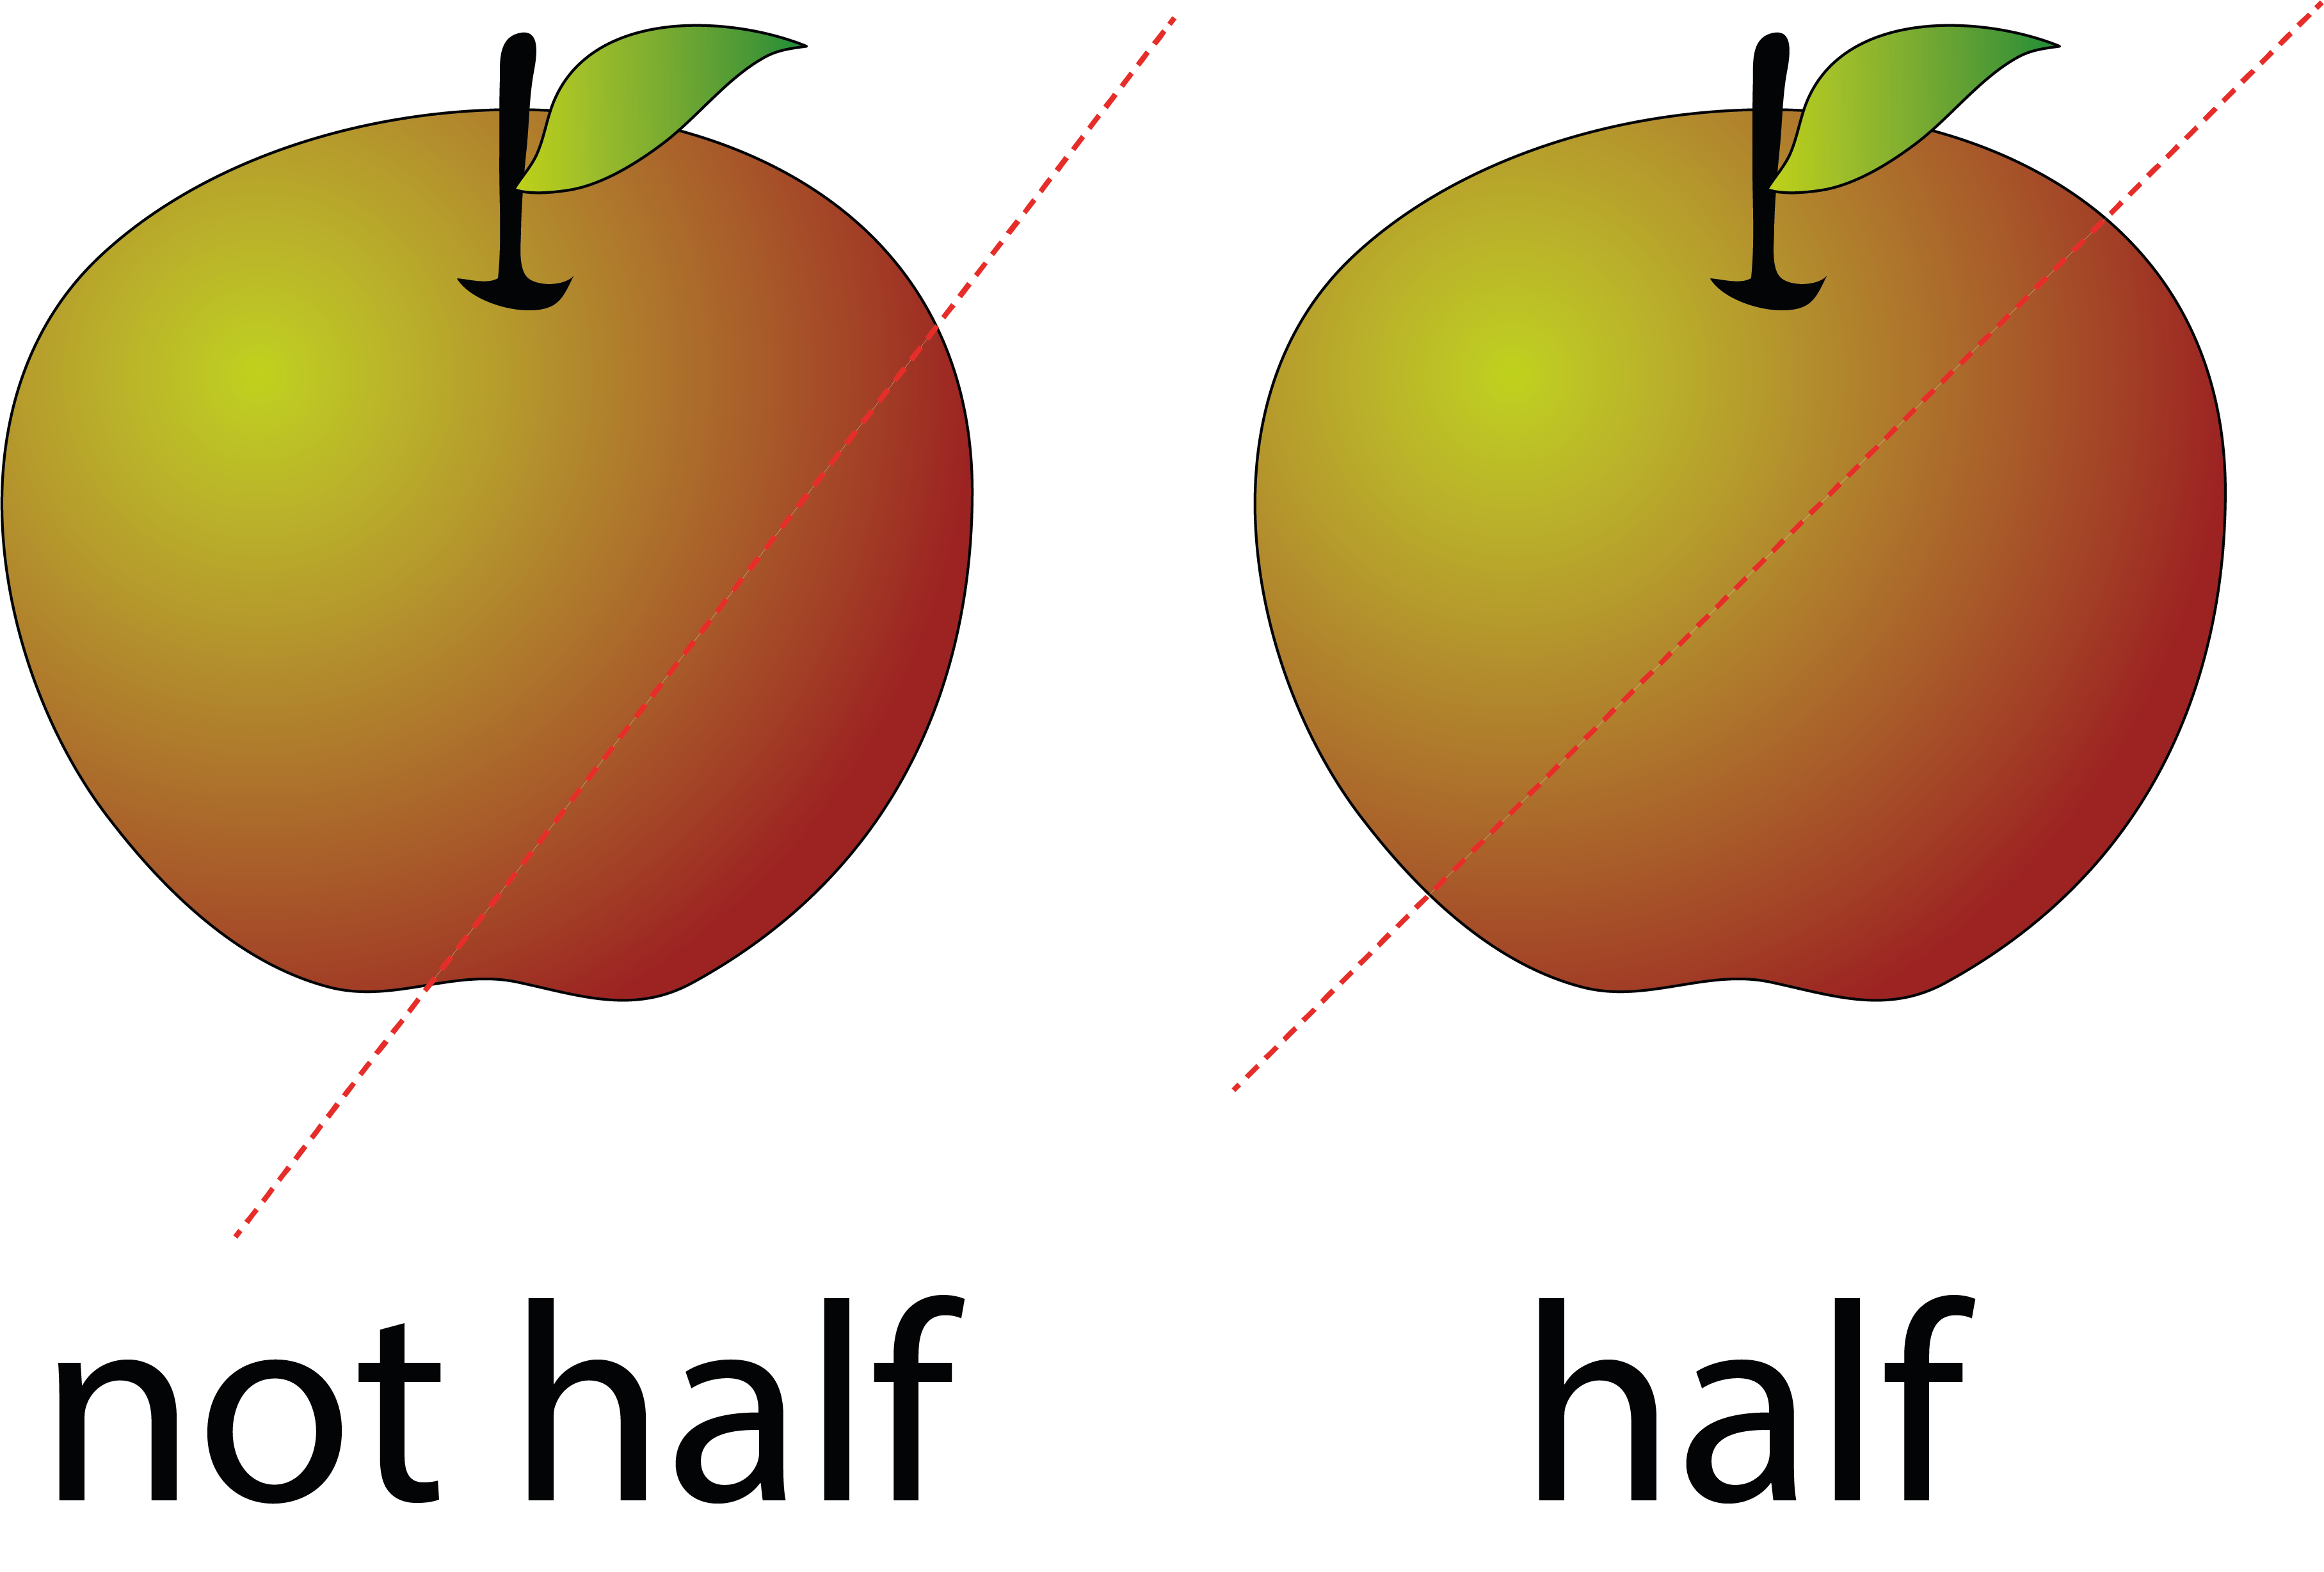
3.0 Guidance on the teaching of fractions in Key Stage 1

Slide 8
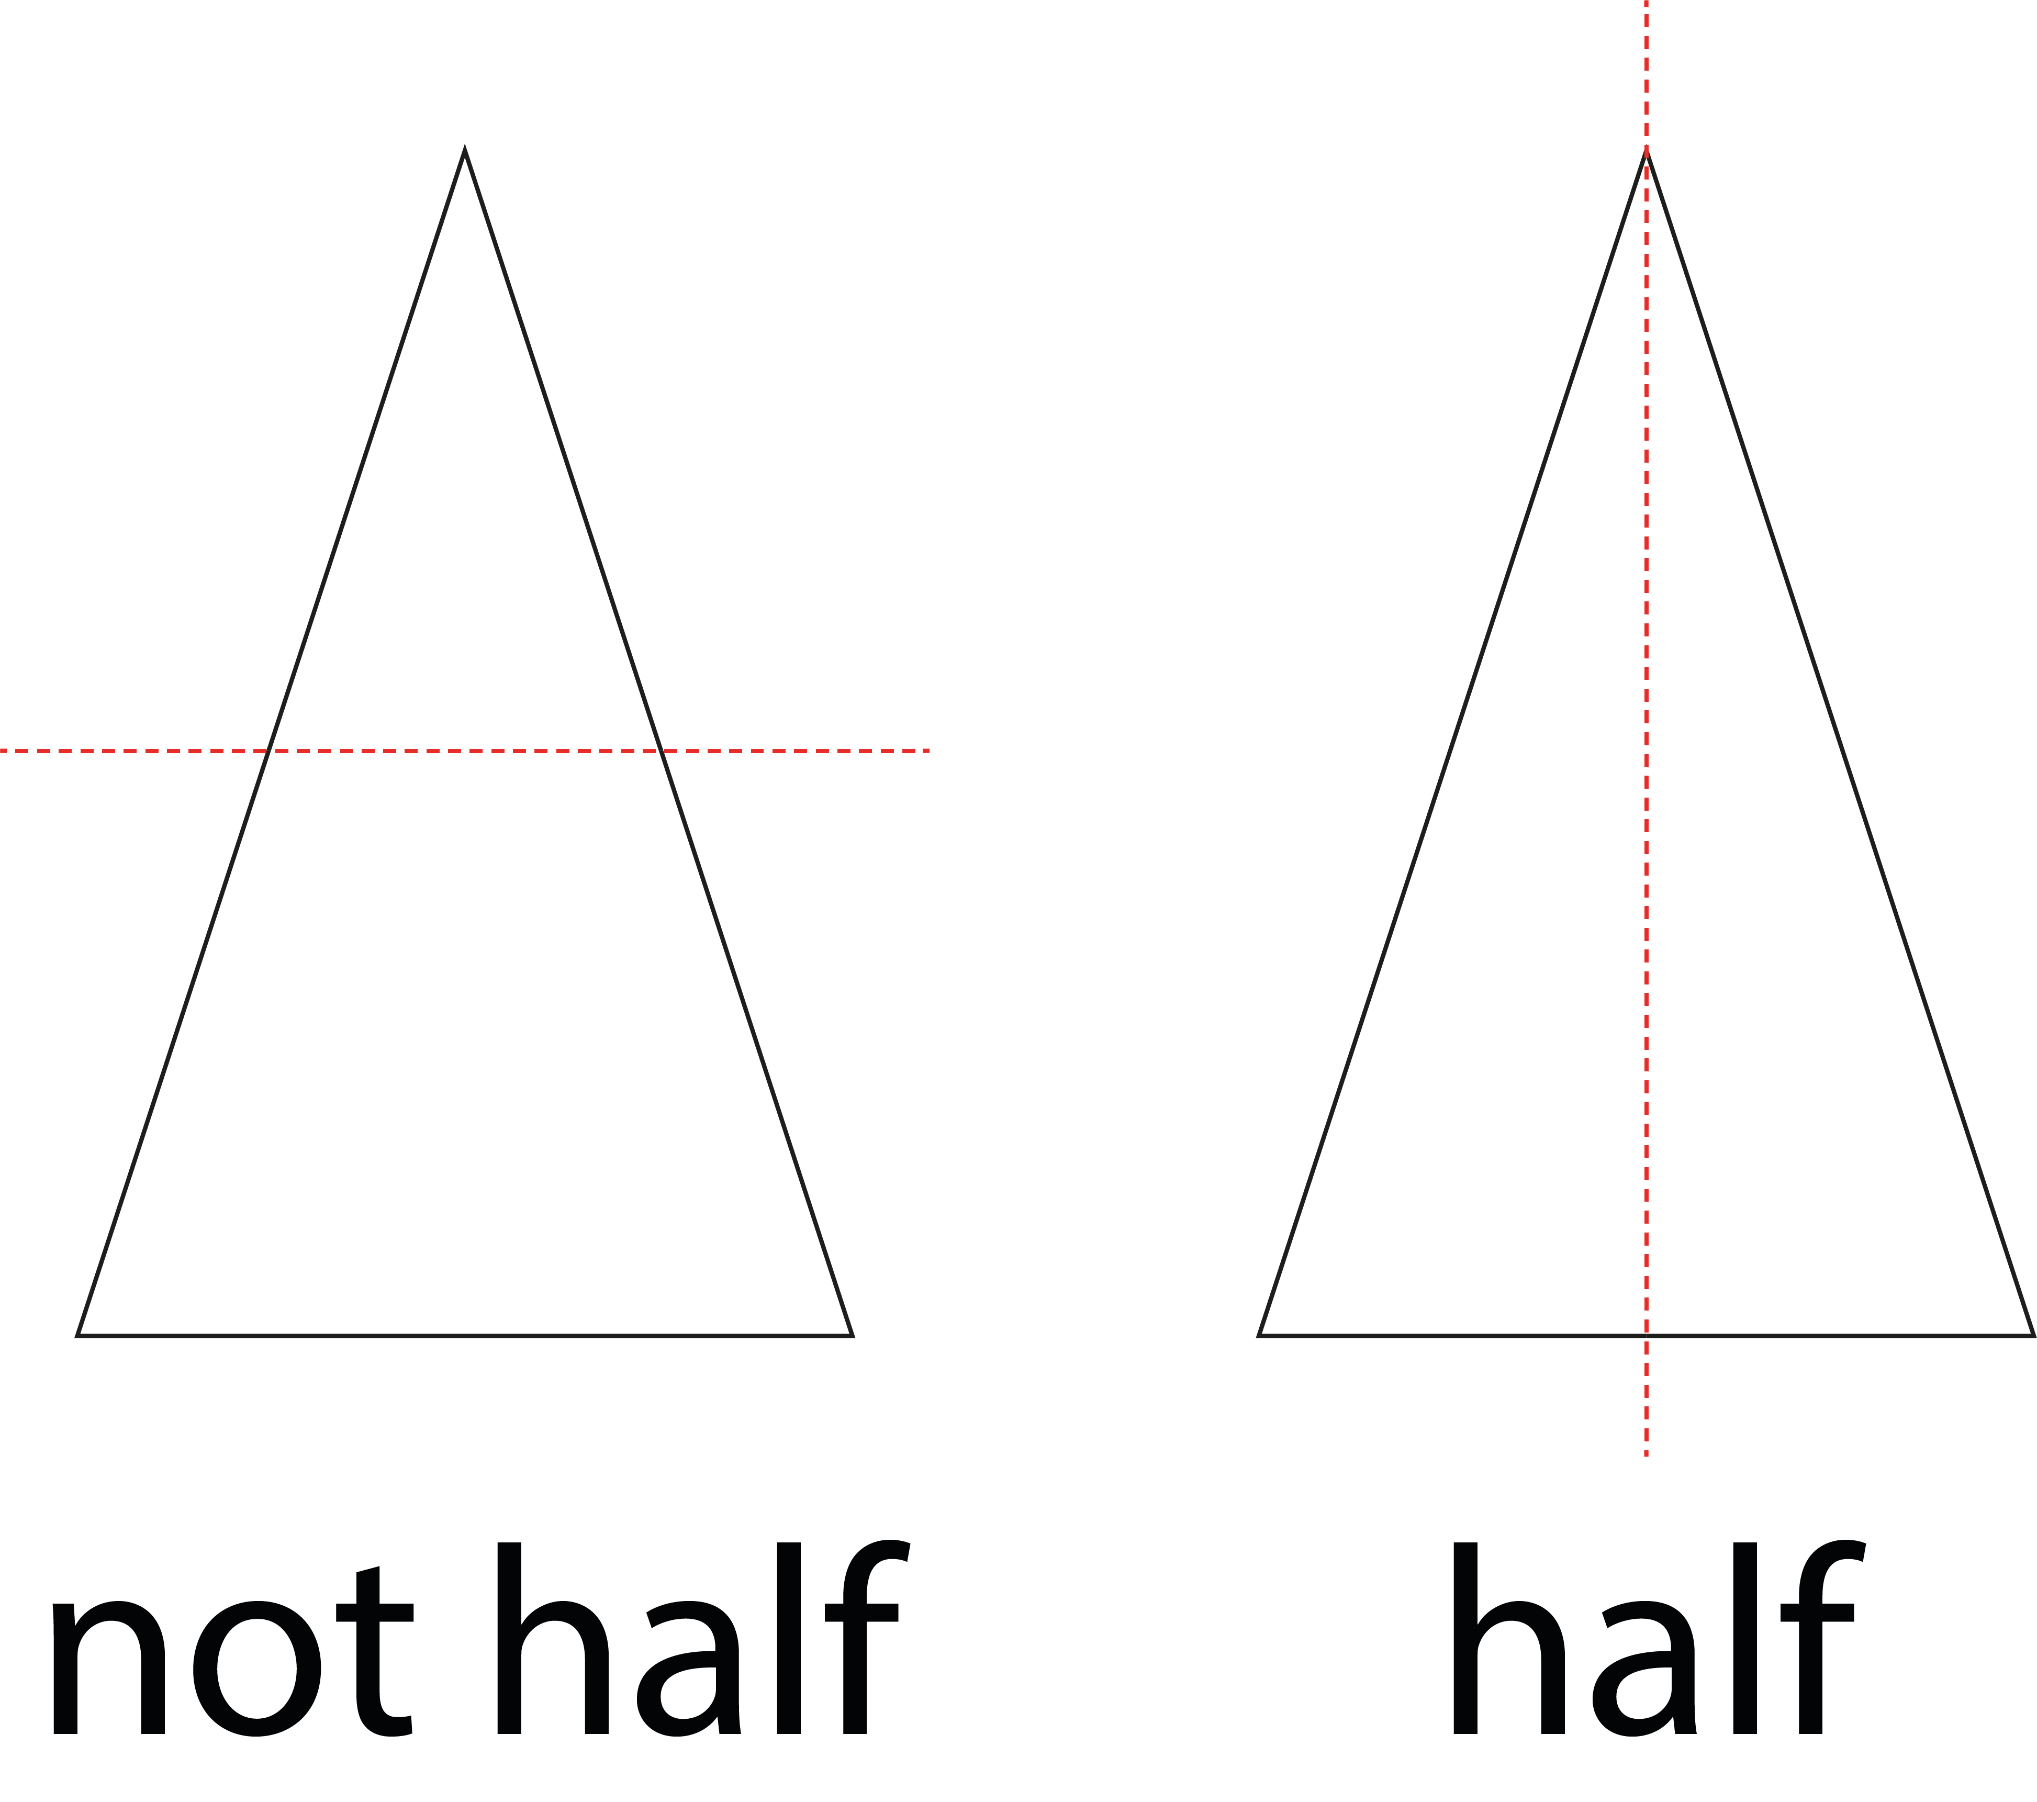
3.0 Guidance on the teaching of fractions in Key Stage 1

Slide 9
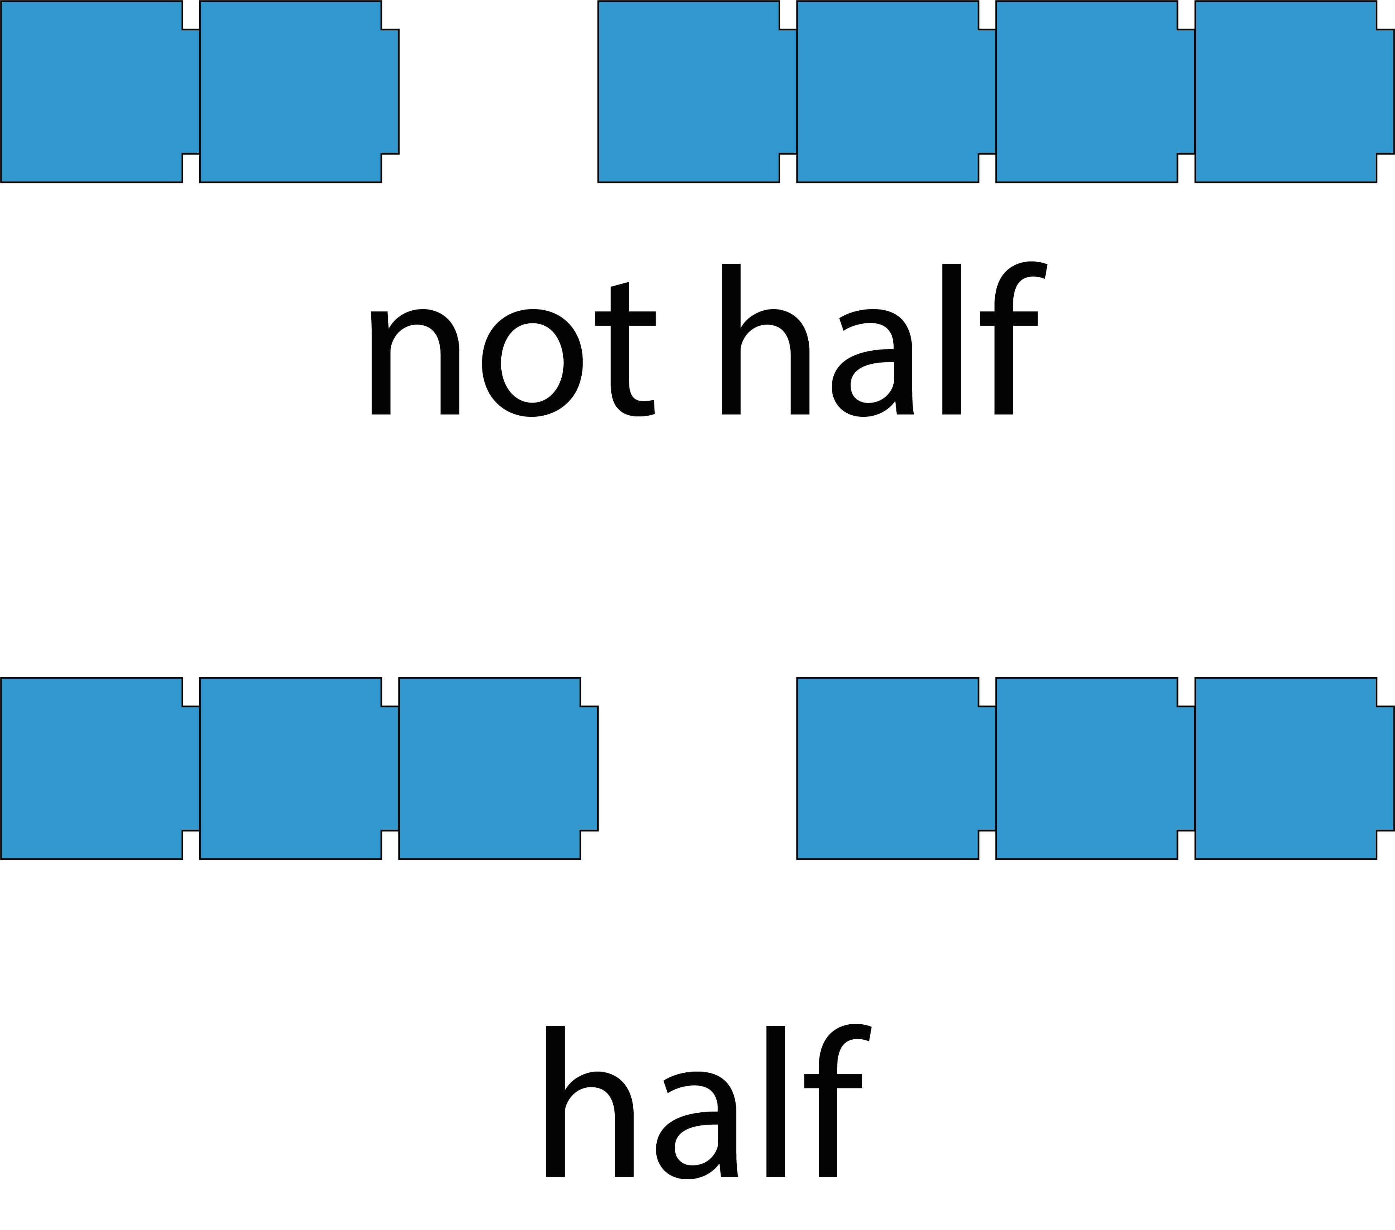
3.0 Guidance on the teaching of fractions in Key Stage 1

Slide 10
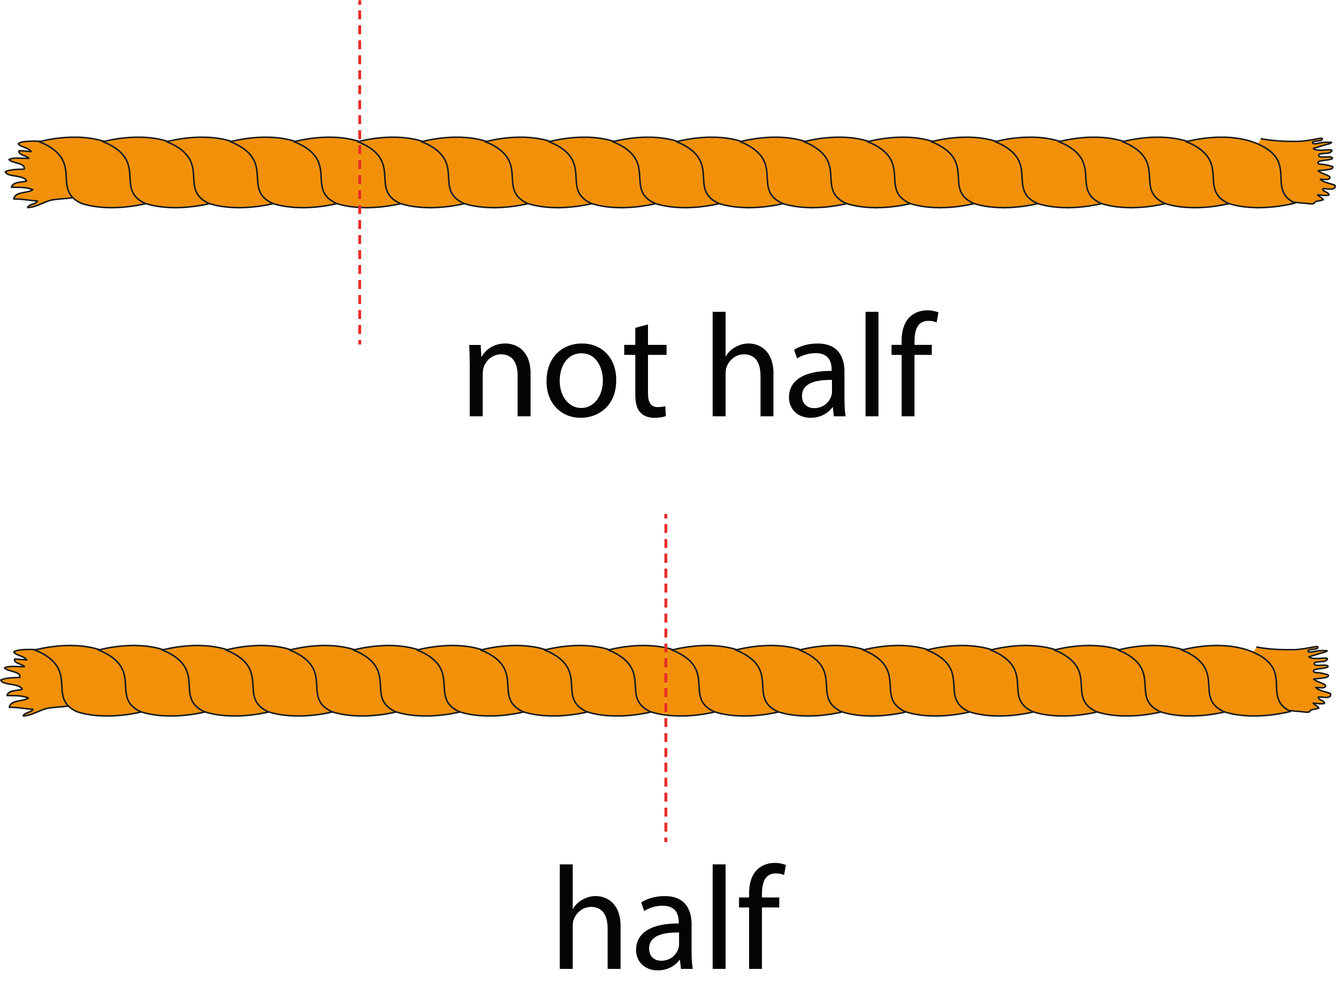
3.0 Guidance on the teaching of fractions in Key Stage 1

Slide 11
Year 2, Unit 10, Learning Outcome 2
Learning Outcome 2
Pupils name the fraction ‘one-half’ in relation to a fraction of a length, shape or set of objects
The following slides have been collated to support the teaching of this learning outcome.

Slide 12
Year 2, Unit 10, Learning Outcome 2
Additional teacher guidance for this outcome should be read first and can be found in this segment of the NCETM Primary Mastery Professional Development Materials:
3.0 Guidance on the teaching of fractions in Key Stage 1
This shorter guidance document contains ‘teaching progression points’ to meet national curriculum objectives.
Teaching progression point | Page
1 | 1

Slide 13
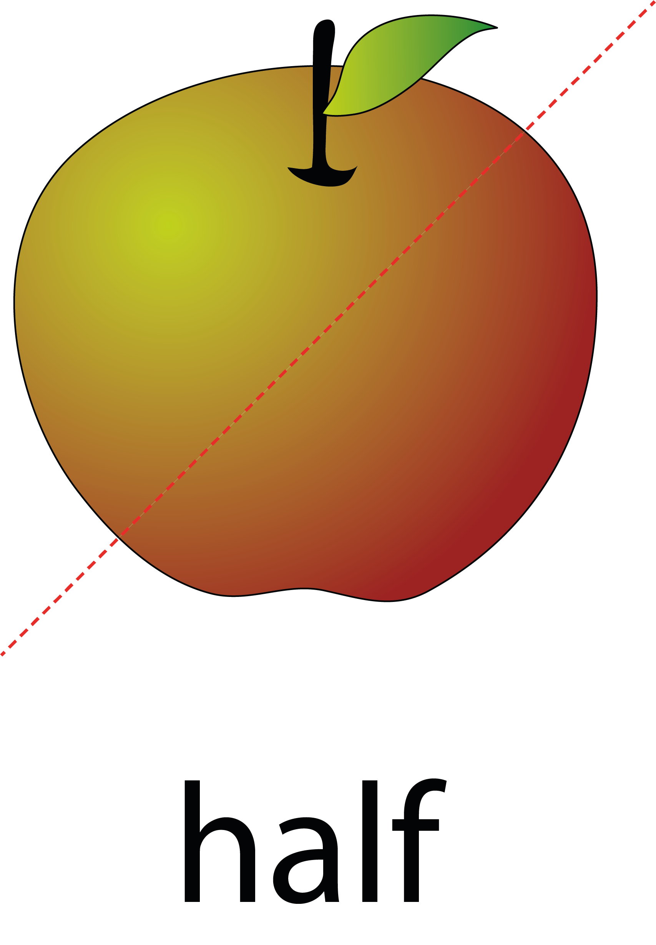
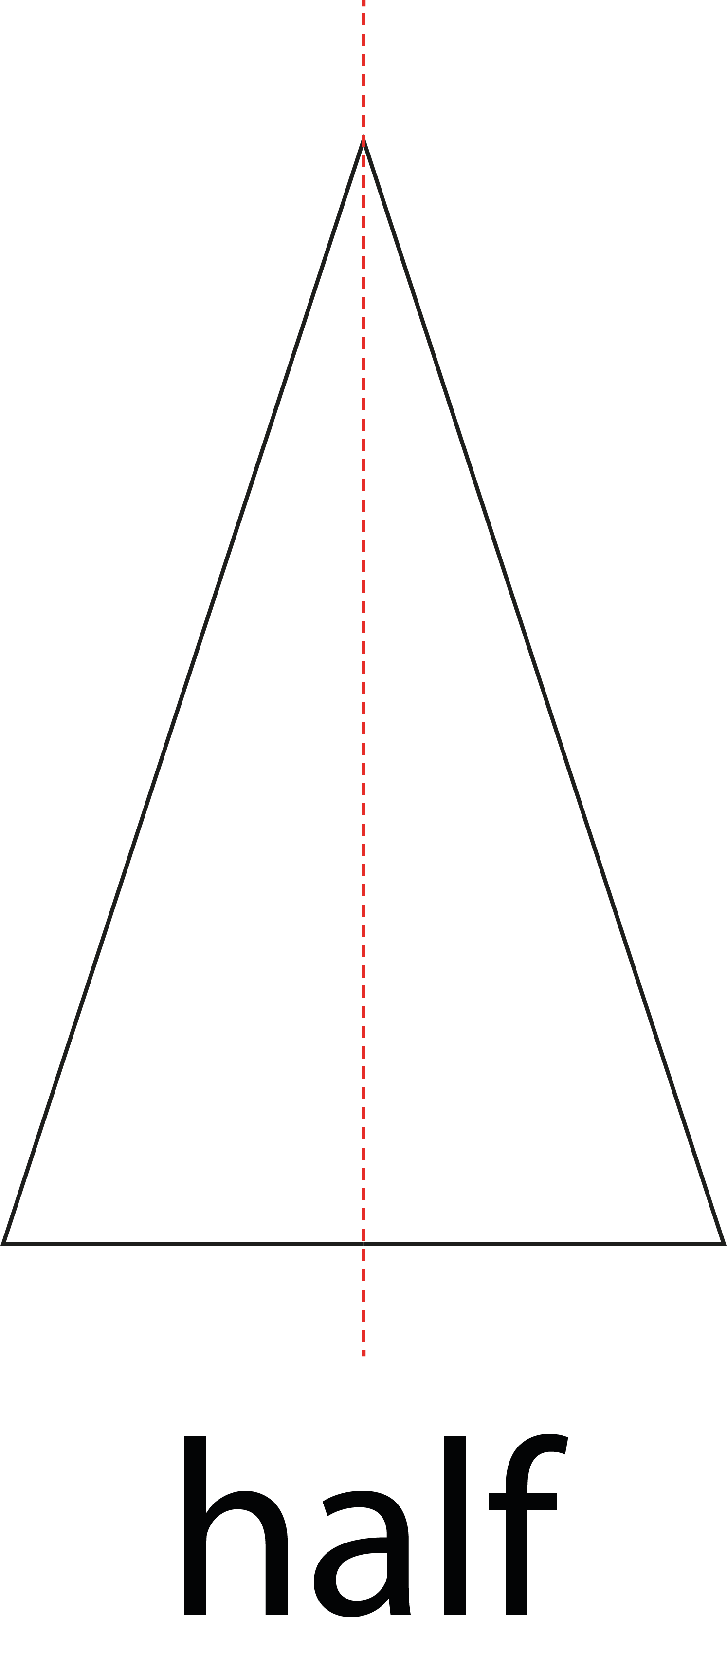
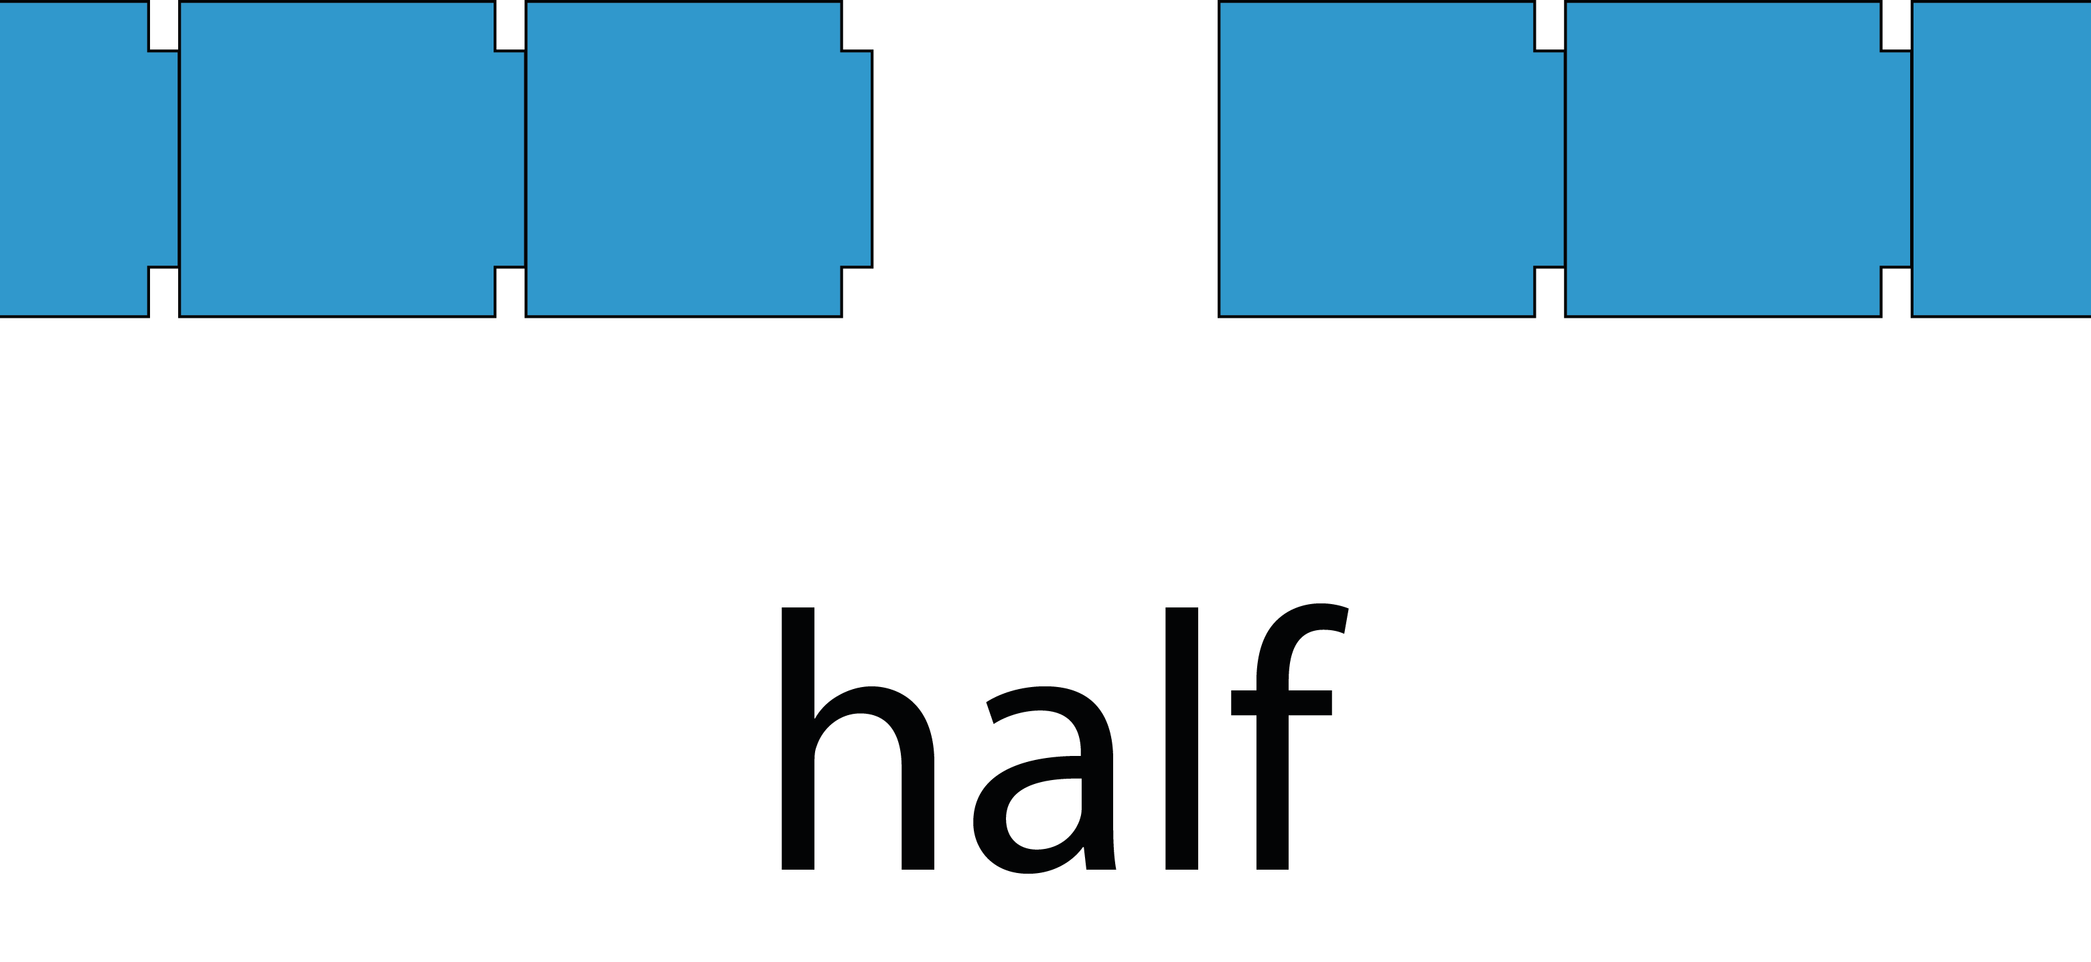
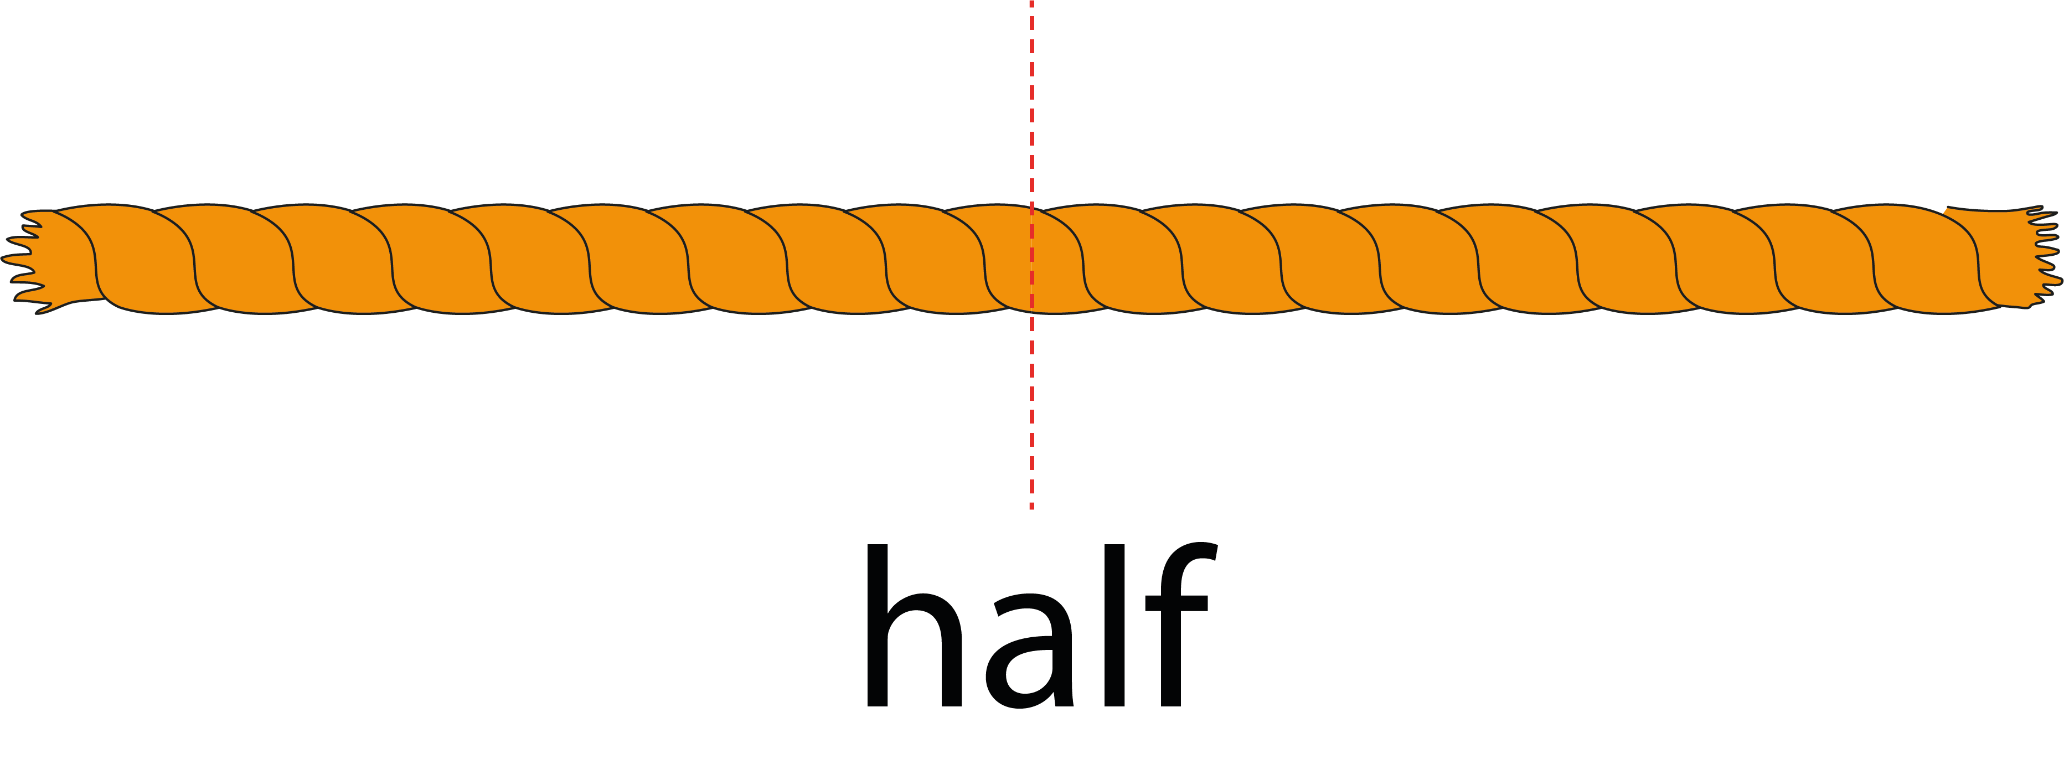
3.0 Guidance on the teaching of fractions in Key Stage 1

Slide 14
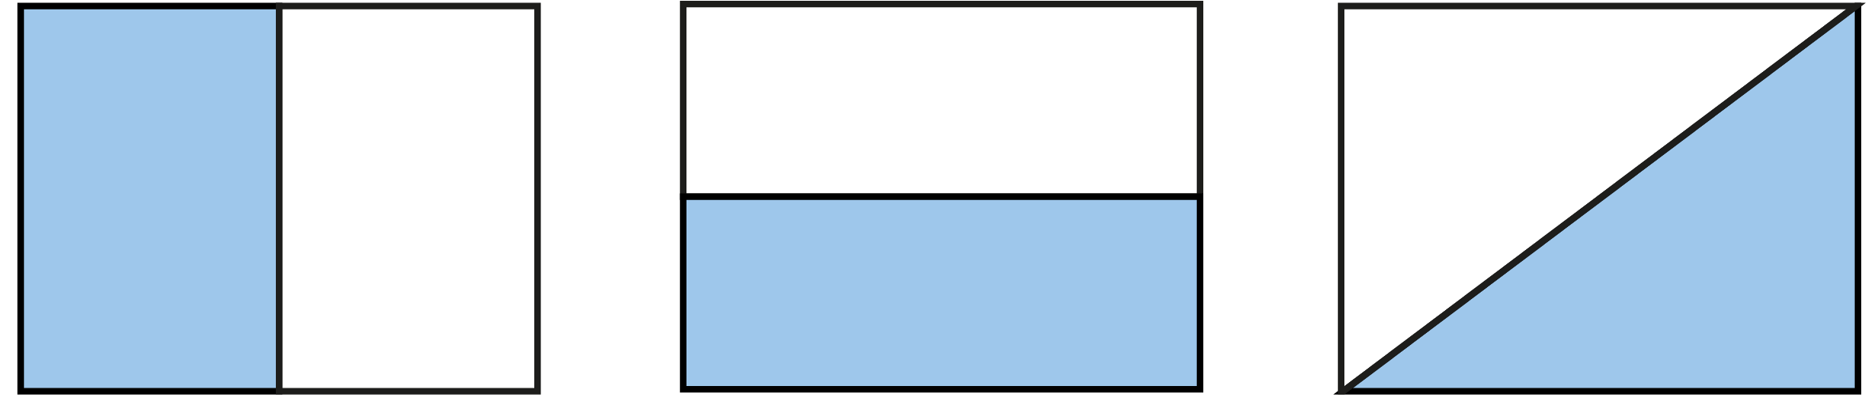
3.0 Guidance on the teaching of fractions in Key Stage 1

Slide 15
Year 2, Unit 10, Learning Outcome 3
Learning Outcome 3
Pupils name the fraction ‘one-quarter’ in relation to a fraction of a length, shape or set of objects
The following slides have been collated to support the teaching of this learning outcome.

Slide 16
Year 2, Unit 10, Learning Outcome 3
Additional teacher guidance for this outcome should be read first and can be found in this segment of the NCETM Primary Mastery Professional Development Materials:
3.0 Guidance on the teaching of fractions in Key Stage 1
This shorter guidance document contains ‘teaching progression points’ to meet national curriculum objectives.
Teaching progression point | Page
1 | 2

Slide 17

3.0 Guidance on the teaching of fractions in Key Stage 1

Slide 18
Year 2, Unit 10, Learning Outcome 4
Learning Outcome 4
Pupils name the fraction ‘one-third’ in relation to a fraction of a length, shape or set of objects
The following slides have been collated to support the teaching of this learning outcome.

Slide 19
Year 2, Unit 10, Learning Outcome 4
Additional teacher guidance for this outcome should be read first and can be found in this segment of the NCETM Primary Mastery Professional Development Materials:
3.0 Guidance on the teaching of fractions in Key Stage 1
This shorter guidance document contains ‘teaching progression points’ to meet national curriculum objectives.
Teaching progression point | Page
1 | 2

Slide 20
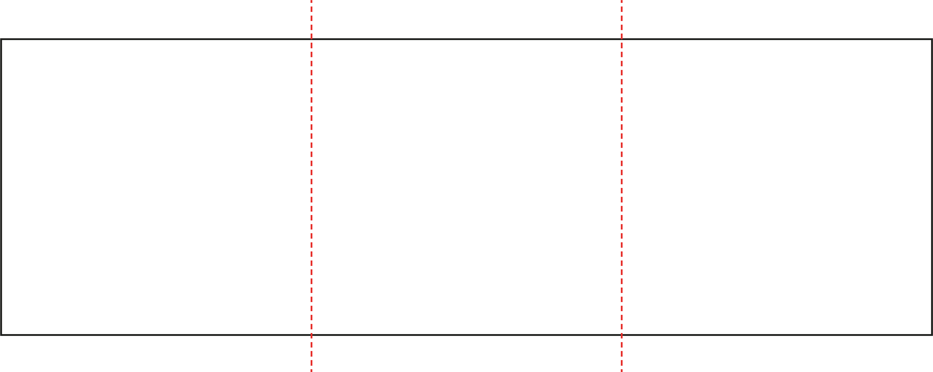
3.0 Guidance on the teaching of fractions in Key Stage 1

Slide 21
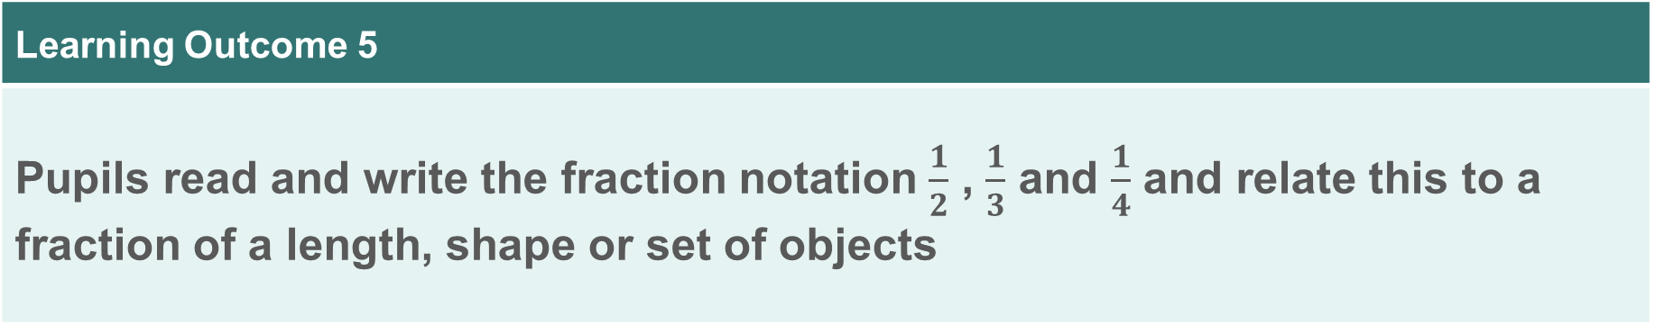
Year 2, Unit 10, Learning Outcome 5
Learning Outcome 5
Pupils read and write the fraction notation $\frac{1}{2}$ , $\frac{1}{3}$ and $\frac{1}{4}$ and relate this to a fraction of a length, shape or set of objects
The following slides have been collated to support the teaching of this learning outcome.

Slide 22
Year 2, Unit 10, Learning Outcome 5
Additional teacher guidance for this outcome should be read first and can be found in this segment of the NCETM Primary Mastery Professional Development Materials:
3.0 Guidance on the teaching of fractions in Key Stage 1
This shorter guidance document contains ‘teaching progression points’ to meet national curriculum objectives.
Teaching progression point | Pages
2 | 2-3

Slide 23
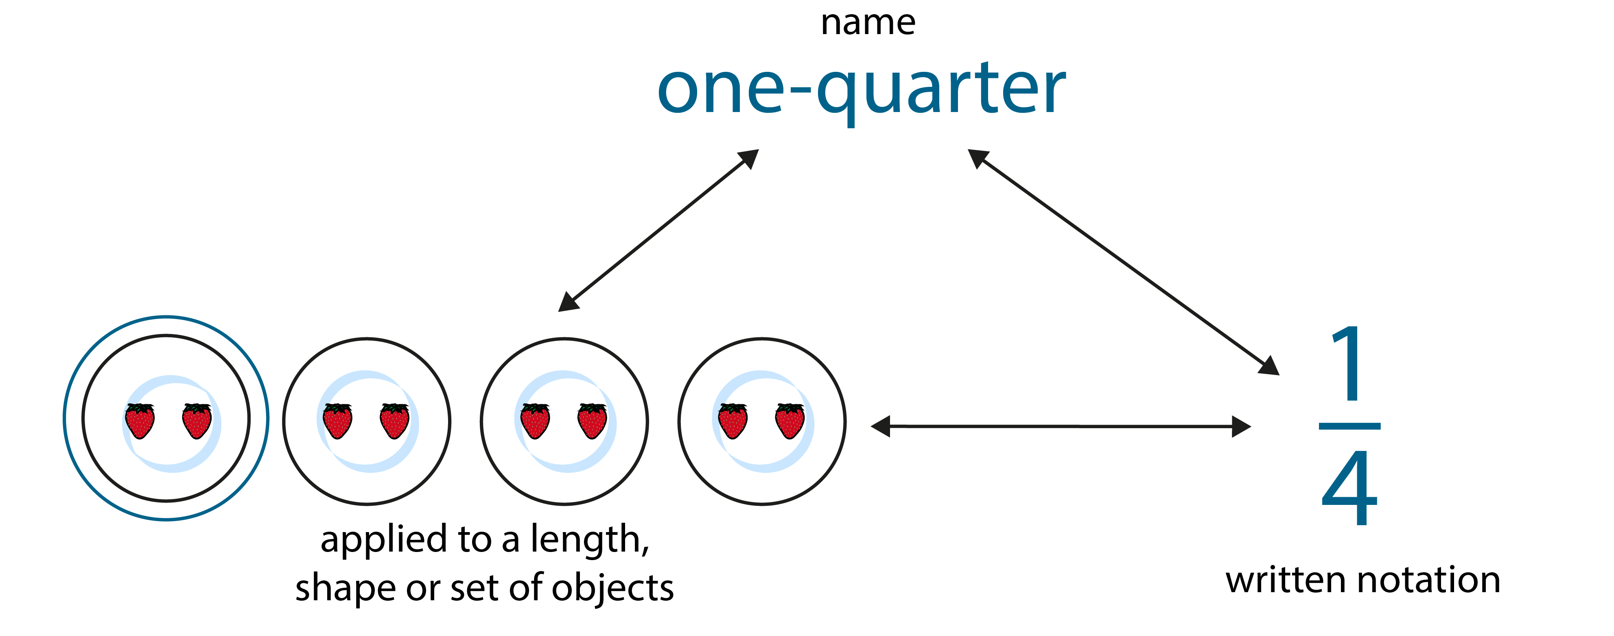
3.0 Guidance on the teaching of fractions in Key Stage 1

Slide 24
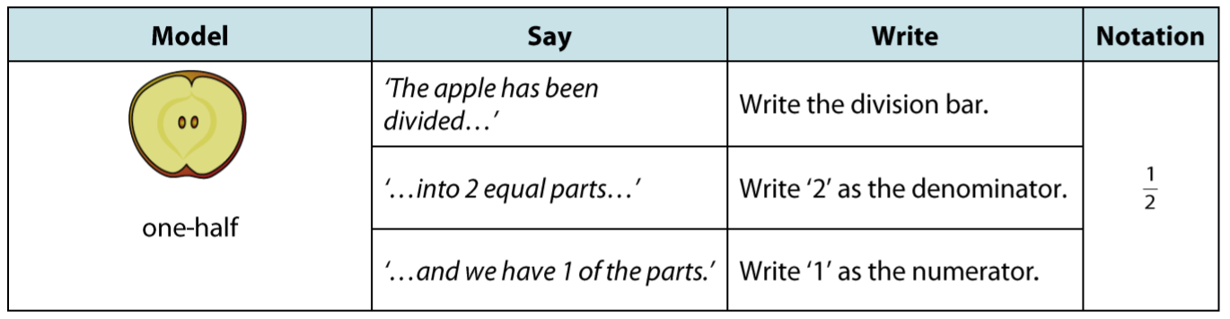
3.0 Guidance on the teaching of fractions in Key Stage 1

Slide 25
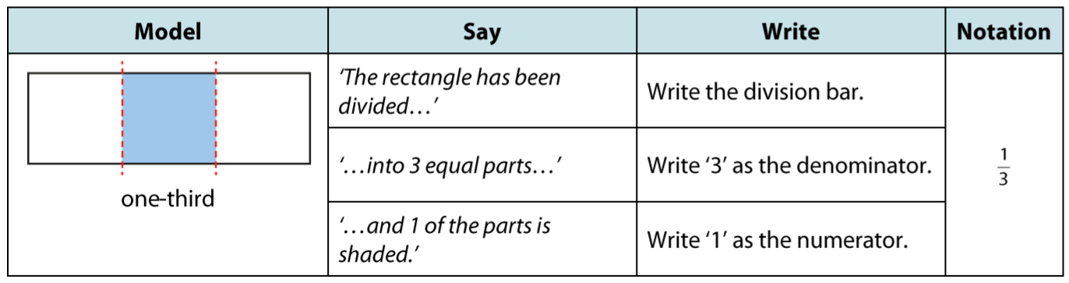
3.0 Guidance on the teaching of fractions in Key Stage 1

Slide 26
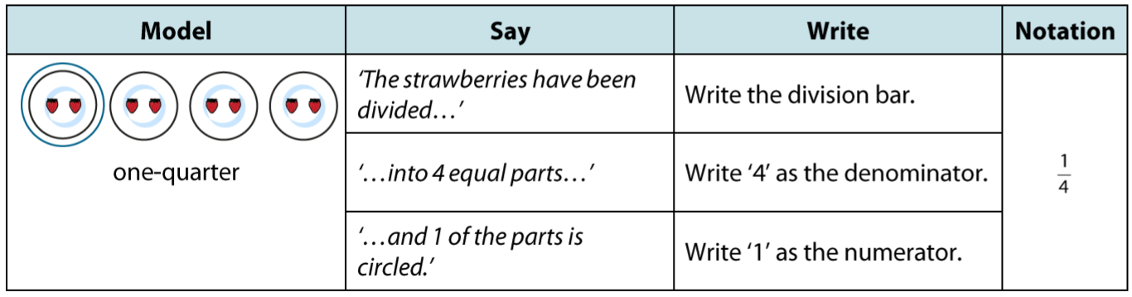
3.0 Guidance on the teaching of fractions in Key Stage 1

Slide 27
Year 2, Unit 10, Learning Outcome 6
Learning Outcome 6
Pupils find half of numbers
The following slides have been collated to support the teaching of this learning outcome.

Slide 28
Year 2, Unit 10, Learning Outcome 6
Additional teacher guidance for this outcome should be read first and can be found in this segment of the NCETM Primary Mastery Professional Development Materials:
3.0 Guidance on the teaching of fractions in Key Stage 1
This shorter guidance document contains ‘teaching progression points’ to meet national curriculum objectives.
Teaching progression point | Page
3 | 4

Slide 29
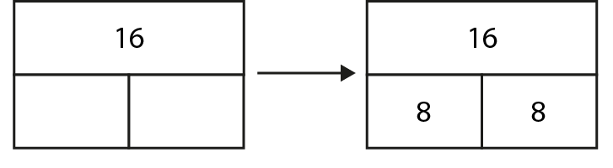
3.0 Guidance on the teaching of fractions in Key Stage 1

Slide 30
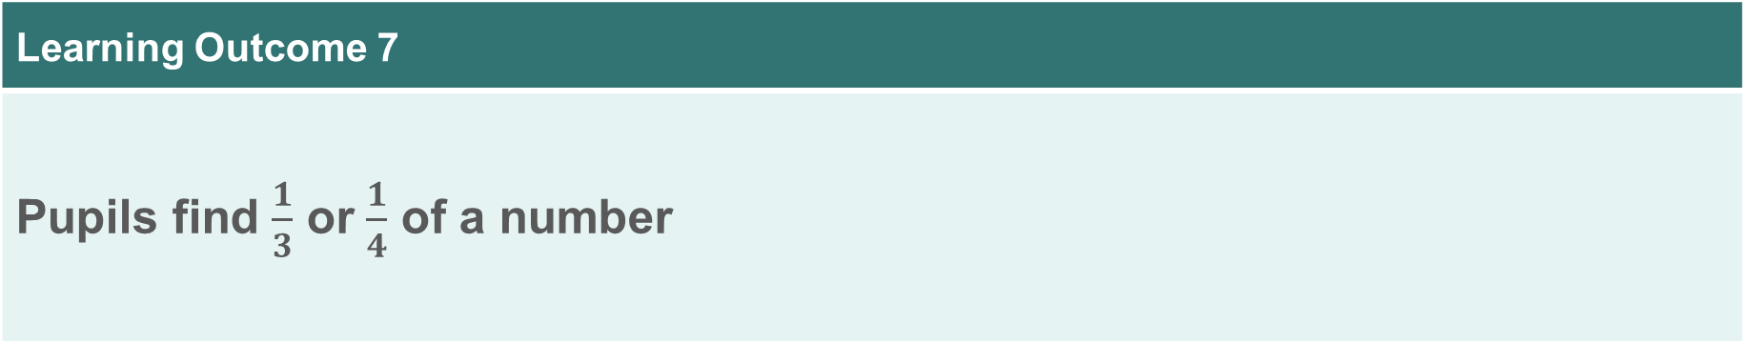
Year 2, Unit 10, Learning Outcome 7
Learning Outcome 7
Pupils find $\frac{1}{3}$ or $\frac{1}{4}$ of a number
The following slides have been collated to support the teaching of this learning outcome.

Slide 31
Year 2, Unit 10, Learning Outcome 7
Additional teacher guidance for this outcome should be read first and can be found in this segment of the NCETM Primary Mastery Professional Development Materials:
3.0 Guidance on the teaching of fractions in Key Stage 1
This shorter guidance document contains ‘teaching progression points’ to meet national curriculum objectives.
Teaching progression point | Pages
4 | 4-6

Slide 32
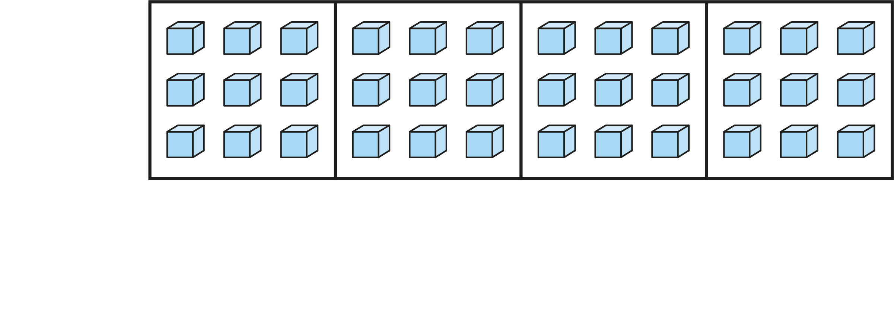
3.0 Guidance on the teaching of fractions in Key Stage 1

Slide 33
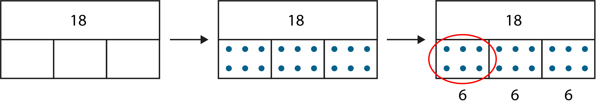
3.0 Guidance on the teaching of fractions in Key Stage 1

Slide 34
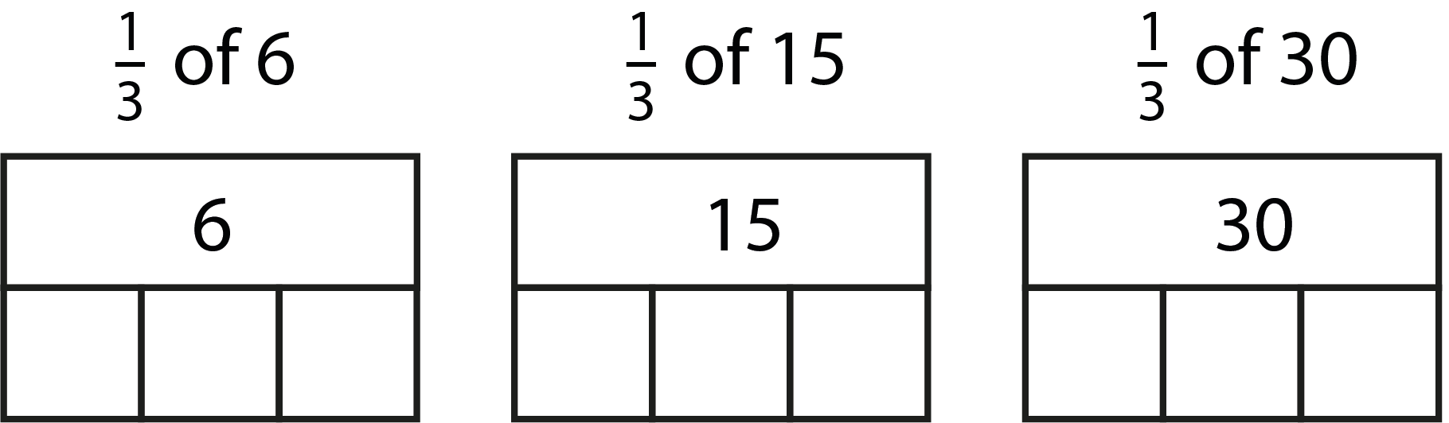
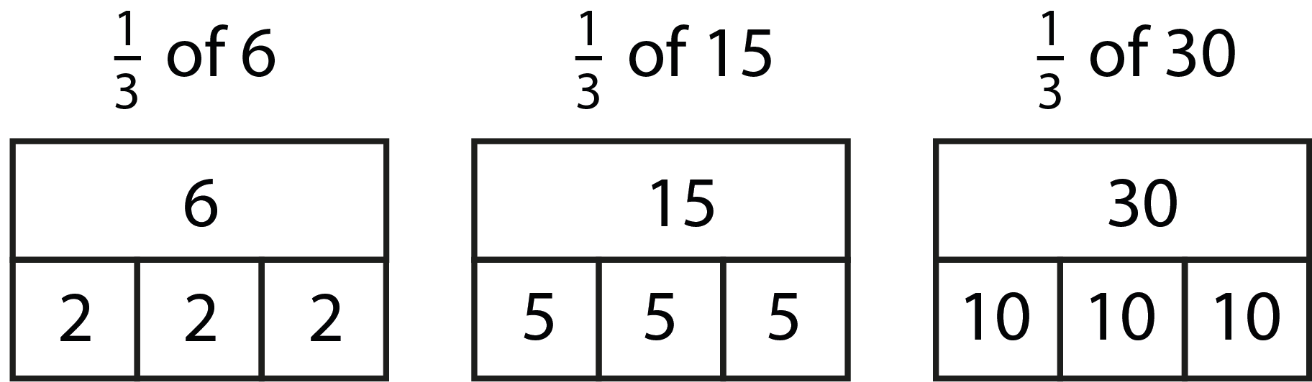
3.0 Guidance on the teaching of fractions in Key Stage 1

Slide 35
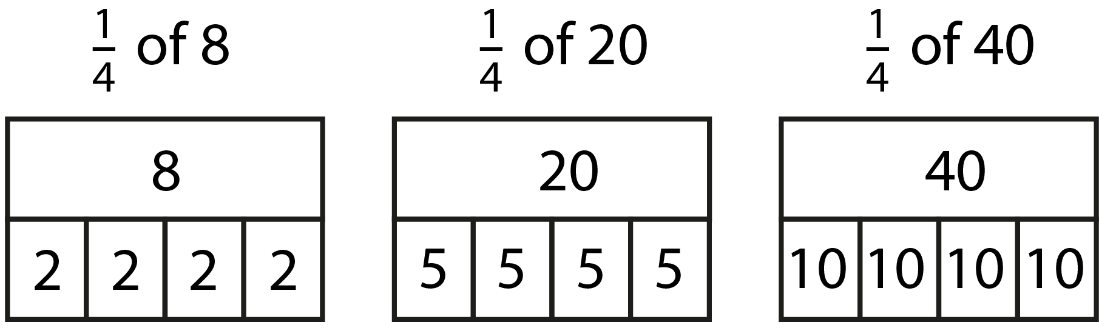
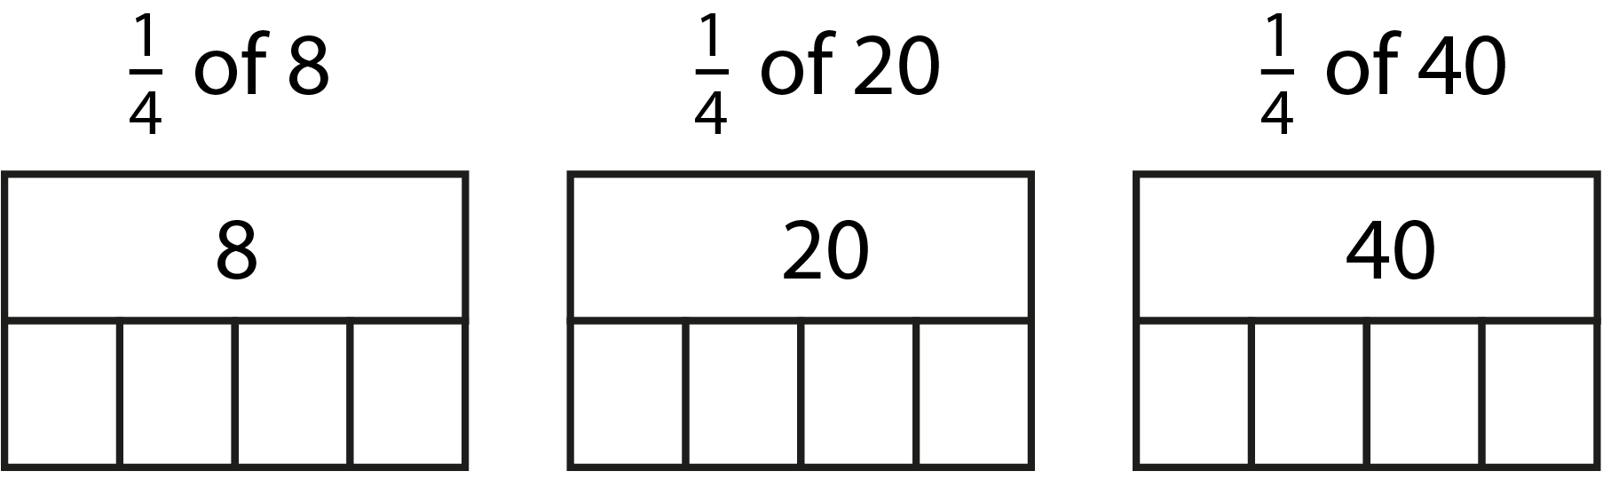
3.0 Guidance on the teaching of fractions in Key Stage 1

Slide 36
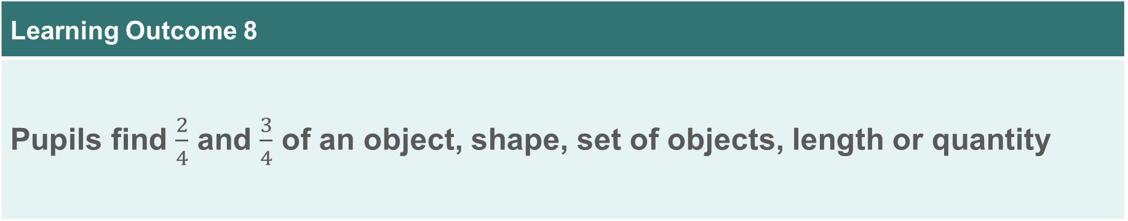
Year 2, Unit 10, Learning Outcome 8
Learning Outcome 8
Pupils find $\frac{2}{4}$ and $\frac{3}{4}$ of an object, shape, set of objects, length or quantity
The following slides have been collated to support the teaching of this learning outcome.

Slide 37
Year 2, Unit 10, Learning Outcome 8
Additional teacher guidance for this outcome should be read first and can be found in this segment of the NCETM Primary Mastery Professional Development Materials:
3.0 Guidance on the teaching of fractions in Key Stage 1
This shorter guidance document contains ‘teaching progression points’ to meet national curriculum objectives.
Teaching progression point | Pages
5 | 6-7

Slide 38

3.0 Guidance on the teaching of fractions in Key Stage 1

Slide 39
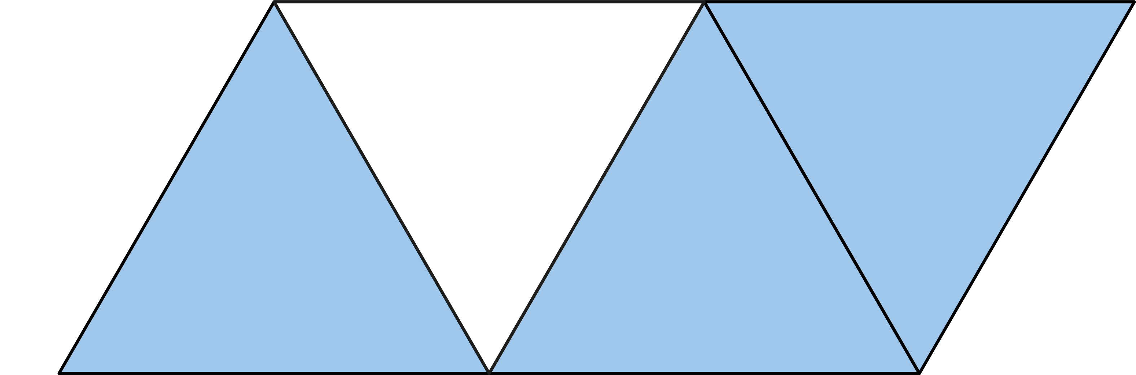
3.0 Guidance on the teaching of fractions in Key Stage 1

Slide 40

3.0 Guidance on the teaching of fractions in Key Stage 1

Slide 41

3.0 Guidance on the teaching of fractions in Key Stage 1

Slide 42

3.0 Guidance on the teaching of fractions in Key Stage 1

Slide 43
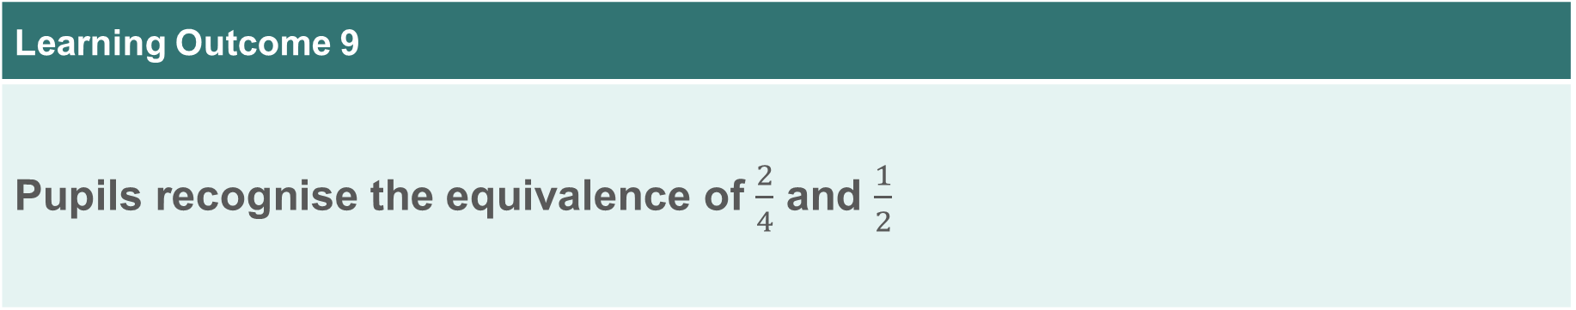
Year 2, Unit 10, Learning Outcome 9
Learning Outcome 9
Pupils recognise the equivalence of $\frac{2}{4}$ and $\frac{1}{2}$
The following slides have been collated to support the teaching of this learning outcome.

Slide 44
Year 2, Unit 10, Learning Outcome 9
Additional teacher guidance for this outcome should be read first and can be found in this segment of the NCETM Primary Mastery Professional Development Materials:
3.0 Guidance on the teaching of fractions in Key Stage 1
This shorter guidance document contains ‘teaching progression points’ to meet national curriculum objectives.
Teaching progression point | Page
5 | 7

Slide 45
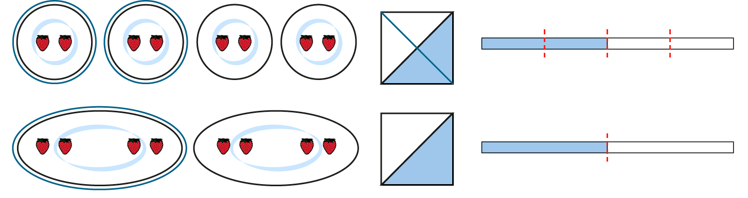
3.0 Guidance on the teaching of fractions in Key Stage 1

Slide 46
3.0 Guidance on the teaching of fractions in Key Stage 1

Slide 47
3.0 Guidance on the teaching of fractions in Key Stage 1

Slide 48
3.0 Guidance on the teaching of fractions in Key Stage 1

Slide 49
3.0 Guidance on the teaching of fractions in Key Stage 1

