Slide 1
Equal and supplementary angles in parallel lines
KS3 Mastery PD Materials: Exemplified Key Ideas
Materials for use in the classroom or to support professional development discussions
(from 6.1 Geometrical properties)
Summer 2021

Slide 2
About this resource
These slides are designed to complement the 6.1 Geometrical properties Core Concept document and its associated Theme Overview document 6 Geometry, both found in the Secondary Mastery Professional Development pages.
These slides re-present the key examples from the Core Concept document so that the examples can be used either directly in the classroom or with a group of teachers. There are prompt questions alongside the examples, and further clarification in the notes.
These slides do not fully replicate the Core Concept document, so should be used alongside it. Reference to specific page numbers, and to other useful NCETM resources, can be found in the notes for each slide.
This slide deck is not designed to be a complete PD session, rather it is a selection of resources that you can adapt and use as needed when planning a session with a group of teachers.

Slide 3


About this resource
The slides are structured as follows:
  The big picture:
    Where does this fit in?
    What do students need to understand?
    Why is this key idea important?
  Prior learning
  Misconceptions
  Exemplified key ideas
  Reflection questions
  Appendices:
    Key vocabulary
    Representations and structure
    Previous and Future learning
    Useful links
The exemplified key idea slides have the following symbols to indicate how they have been designed to be used:
Into the classroom
The examples are presented on these slides so that they could be used in PD, but also directly in the classroom. The notes feature suggested questions and things teachers might consider when using with students.
PD discussion prompts
These slides look at the examples in more detail, with question prompts to promote discussion among maths teachers. The notes feature reference to further information and guidance within the Core Concepts document.

Slide 4
Where does this fit in?
The NCETM has identified a set of six ‘mathematical themes’ within Key Stage 3 mathematics that bring together a group of ‘core concepts’.
The sixth of these themes is Geometry, which covers the following interconnected core concepts:
6.1 Geometrical properties
6.2 Perimeter, area and volume
6.3 Transforming shapes
6.4 Constructions
Notes:
Linked on this slide is the Theme Overview document of Geometry. This document includes why it is important, the key underpinning knowledge and links to prior and future learning. There is also guidance about how the five big ideas of Teaching for Mastery relate specifically to this theme.

Slide 5
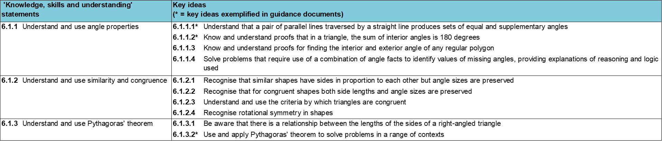
Where does this fit in?
Within this core concept, 6.1 Geometrical properties, there are three statements of knowledge, skills and understanding.
These, in turn, are broken down into ten key ideas. The highlighted key idea is exemplified in this slide deck.
Notes:
For key ideas marked with an asterisk, we exemplified the common difficulties and misconceptions that students might have and included elements of what teaching for mastery may look like. We have provided examples of possible student tasks and teaching approaches.
Within these slides are ‘classroom-ready’ versions of the examples for the key idea that has been highlighted. There are also slides that may be useful for discussion in a professional development session

Slide 6
What do students need to understand?
6.1.1.1 Understand that a pair of parallel lines traversed by a straight line produces sets of equal and supplementary angles
Recognise that two intersecting lines create two pairs of equal and opposite angles.
Recognise that adding another line parallel to the original creates a further two pairs of equal and opposite angles that are identical to the original four.
Identify angles in more complex diagrams.
  What prior knowledge might your students already have?
  What language might they use to describe this key idea?
  What questions might you want to ask to assess their prior learning?

Slide 7
Why is this key idea important? (1)
A 2001 report* about the teaching and learning of geometry from 11–19 set out a number of objectives for a well-taught geometry curriculum, notably:
  to develop spatial awareness, geometrical intuition and the ability to visualise
  to encourage the development and use of conjecture, deductive reasoning and proof.
The geometry of intersecting lines and the connections and deductions that can be made from diagrams, provide rich opportunities in which students can be encouraged to build logical, deductive arguments. Students develop a narrative, connecting and combining known facts in order to generate further mathematical truths.
*The Royal Society / Joint Mathematical Council working group, 2001: xii, 7
Notes:
A more detailed overview of the core concept of Geometrical properties can be found on pages 8-11 of the 6.1 Core Concept document.
The background to each key idea is also explored in more detail on the following pages:
6.1.1 Understand and use angle properties – page 8
6.1.2 Understand and use similarity and congruence – page 9
6.1.3 Understand and use Pythagoras’ theorem – pages 9-11

Slide 8
Why is this key idea important? (2)
In Key Stage 2, students should have studied that vertically opposite angles are equal.
In Key Stage 3, students will use this fact to deduce that a translation of one of the lines will create a second, equivalent pair of vertically opposite angles.
They will then be able to identify pairs of equal angles (some of which are named alternate or corresponding) and other relationships, such as pairs of supplementary angles (i.e. with a sum of 180°).
Throughout Key Stage 3, students are encouraged to use what they know to construct a logical argument and deduce other facts. By offering carefully selected contexts that encourage reasoning, students can construct and understand proofs, such as the angles in a triangle always sum to 180° (see exemplified key idea 6.1.1.2).
Notes:
A more detailed overview of the core concept of Geometrical properties can be found on pages 8-11 of the 6.1 Core Concept document.
The background to each key idea is also explored in more detail on the following pages:
6.1.1 Understand and use angle properties – page 8
6.1.2 Understand and use similarity and congruence – page 9
6.1.3 Understand and use Pythagoras’ theorem – pages 9-11

Slide 9
Prior learning
  What prior knowledge might your students already have?
  What language might they use to describe this key idea?
  What questions might you want to ask to assess their prior learning?
Upper Key Stage 2 Learning Outcome
Recognise angles where they meet at a point, are on a straight line, or are vertically opposite, and find missing angles
Compare and classify geometric shapes based on their properties and sizes and find unknown angles in any triangles, quadrilaterals, and regular polygons
Solve problems involving similar shapes where the scale factor is known or can be found
Notes:
You may find it useful to speak to your partner schools to see how the above has been covered and the language used.
You can find further details regarding prior learning in the following segments of the NCETM primary mastery professional development materials (linked on final slide):
Year 6: 2.27 Scale factors, ratio and proportional reasoning
Within the Geometry Theme Overview document, you can also find a broader description of students’ potential previous learning (page 3), alongside further information about key underpinning knowledge (page 2).

Slide 10
Checking prior learning
The following slides contain questions for checking prior learning.
  What representations might students use to support their understanding of these questions?
  What variation might you put in place for these questions to fully assess students’ understanding of the concept?
  How might changing the language of each question change the difficulty?
  Why are these such crucial pre-requisites for this key idea?

Slide 11
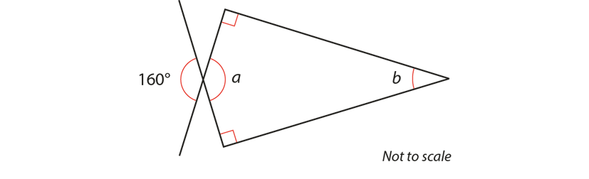
Checking prior learning
a) Calculate the size of angles a and b in this diagram.
Notes:
References to the questions (links on final slide):
a) 2016 Key Stage 2 Mathematics Paper 2: reasoning, Question 17

Slide 12
Common difficulties and misconceptions
What aspects of this key idea might students find challenging?
What misconceptions might students have?
When teaching this topic, you may find students encounter difficulties with…
Confusing alternate and corresponding angles
Not recognising when lines are parallel
More information, and some suggestions for overcoming these challenges, can be found on the following slides.

Slide 13
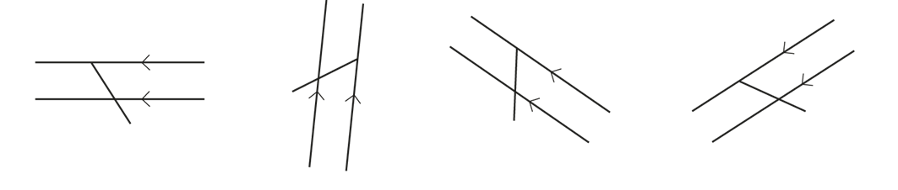
Common difficulties and misconceptions (1)
Students often confuse alternate and corresponding angles and, consequently, may not be able to pick out examples of these in any but the simplest of diagrams and shapes.
Students should be given plenty of opportunities to notice such angles in non-standard diagrams, such as these:
Notes:
More detail can be found on page 12 of the 6.1 Core Concept document.
They should be encouraged to use reasoning based on the inherent geometrical structure rather than memorising standard diagrams and using phrases such as ‘F’ and ‘Z’ angles, which do not support reasoning and mathematical thinking.

Slide 14
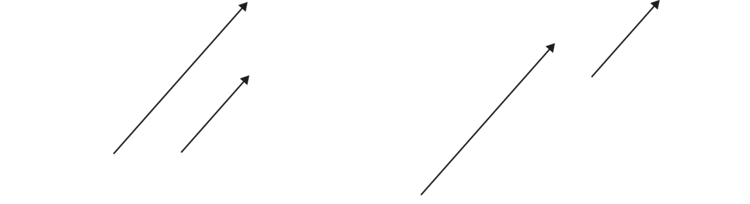
Common difficulties and misconceptions (2)
A common difficulty is that students recognise and accept lines as being parallel only if they are of a similar length and position; off-set lines are often not perceived as being parallel, particularly when there is little overlap, as below:
Notes:
More detail can be found on page 12 of the 6.1 Core Concept document.

Slide 15
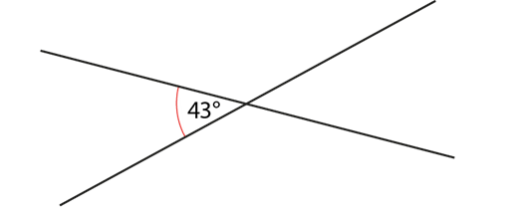
Recognise that two intersecting lines create two pairs of equal and opposite angles
Example 1
Given this one angle, can you find any other angles in the diagram?
Explain your reasoning.
Notes:
Suggested questioning:
Which angle did you find first? Why?
Which angles are the same? How do you know?
What mathematical vocabulary can you use to describe the relationships between these angles?
Things for you to think about:
Example 1 provides a key representation for students to reason with to help them recognise which angles are equal, which are supplementary, and why.

Slide 16
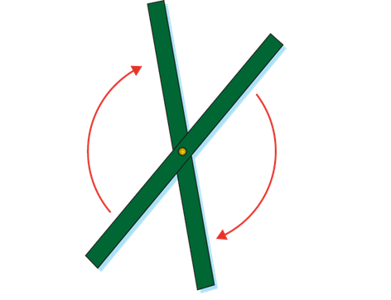
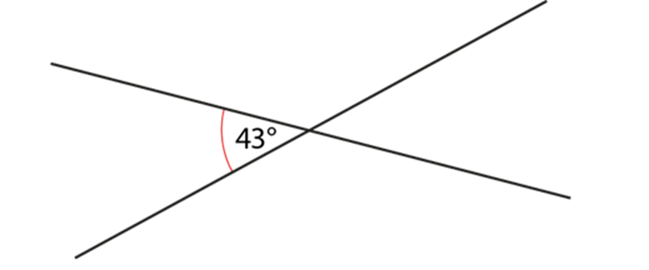
Recognise that two intersecting lines create two pairs of equal and opposite angles
Example 1
Given this one angle, can you find any other angles in the diagram?
Explain your reasoning.
Model the structure of this angle problem using two sticks or thin strips of card hinged at the point of intersection.
When might students benefit from having a physical model of vertically opposite angles?
How might dynamic geometry software be used to demonstrate these relationships?
Notes:
Modelling such a structure using two sticks or thin strips of card hinged at the point of intersection, can help students to see how, as one angle increases so does the other and that they must be equal.
More detail about this example can be found on page 13 of the 6.1 Core Concept document.

Slide 17
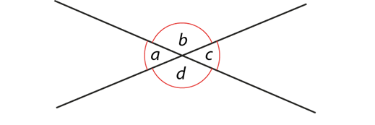
Recognise that two intersecting lines create two pairs of equal and opposite angles
Example 2
Write down as many equations (or statements) as you can to show the relationships between the angles in this diagram.
Notes:
Suggested questioning:
What do you see when you look at this diagram?
Which angles are the same? Which are different?
What angle facts do you know?
Things for you to think about:
There are a number of relationships that could be drawn out
Vertically opposite angles
Angles at a point on a straight line
Angles at a point
It might be helpful to cover over part of the diagram to show the different straight lines.
Draw attention to both pairs of equal angles and highlight both straight lines and the associated supplementary angles at each stage.

Slide 18
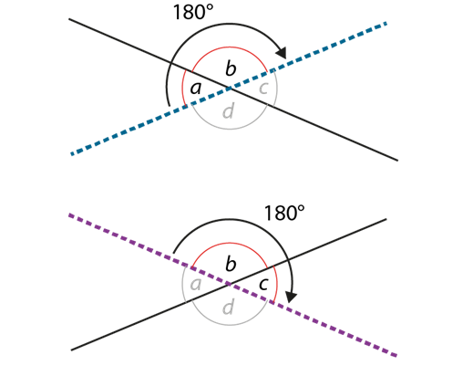
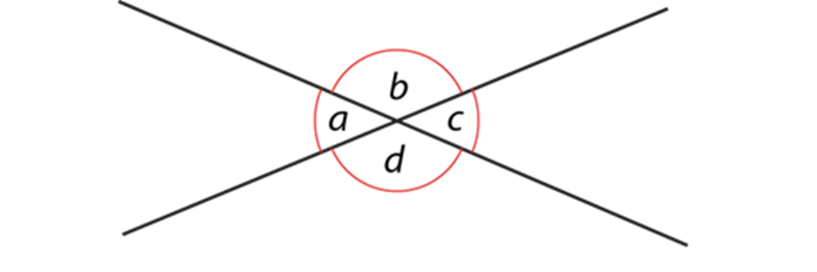
Recognise that two intersecting lines create two pairs of equal and opposite angles
Example 2
Write down as many equations (or statements) as you can to show the relationships between the angles in this diagram.
What language will you expect students to use when describing the relationships between angles?
Why might it be important to draw attention to both pairs of equal angles and highlight both straight lines (as shown)?
Notes:
More detail about this example can be found on page 14 of the 6.1 Core Concept document.

Slide 19
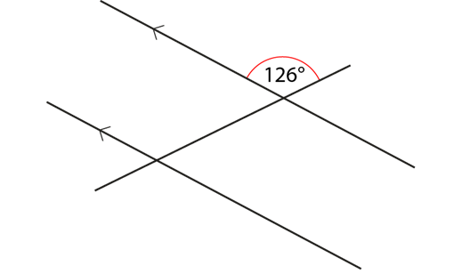
Recognise that adding another line parallel to the original creates a further two pairs of equal and opposite angles that are identical to the original four
Example 3
Given this one angle, can you find any other angles in the diagram?
Explain your reasoning.
Notes:
Suggested questioning:
Which angle did you find first? Why?
Is there an alternative way to approach the task?
Things for you to think about:
Adding a parallel line helps students to see that the angles made are the same as the original four.
Dynamic geometry software would support understanding by sliding one of the parallel lines

Slide 20
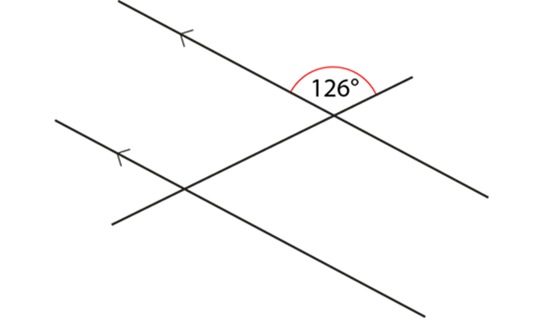
Recognise that adding another line parallel to the original creates a further two pairs of equal and opposite angles that are identical to the original four
Example 3
Given this one angle, can you find any other angles in the diagram?
Explain your reasoning.
This builds on previous examples with just two intersecting lines: sliding one of the parallel lines can support understanding that the angles made are the same as the original four. How might you model this?
What language will you expect students to use when describing the relationships between angles?
Notes:
This example can be found on page 14 of the 6.1 Core Concept document.

Slide 21
Recognise that adding another line parallel to the original creates a further two pairs of equal and opposite angles that are identical to the original four
Example 3 (cont’d)
  How do you approach this task? How would you expect your students to approach it?
  Watch the video of this task in the Mathematical Prompts for Deeper Thinking videos | NCETM
How does the discussion here compare to what you expected?
What aspects of this task could students deduce for themselves? What did they need to be told?
Given this one angle, can you find any other angles in the diagram?
Explain your reasoning.
Notes:
This example can be found on page 14 of the 6.1 Core Concept document.
A downloadable powerpoint, giving more insight into the video and some links to research, can be found on the Mathematical Prompts for Deeper Thinking videos | NCETM page.

Slide 22
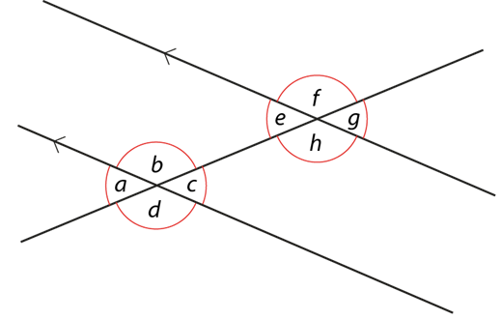
Recognise that adding another line parallel to the original creates a further two pairs of equal and opposite angles that are identical to the original four
Example 4
Write as many equations (or statements) as you can to show the relationships between the angles in this diagram.
Explain your reasoning.
Notes:
Suggested questioning:
What is the same and what is different from example 2 we saw earlier?
How many equations do you think there will be?
Things for you to think about:
Students might be content writing equations about a,b,c,d or e,f,g,h encourage them to make links between for example a and e.

Slide 23
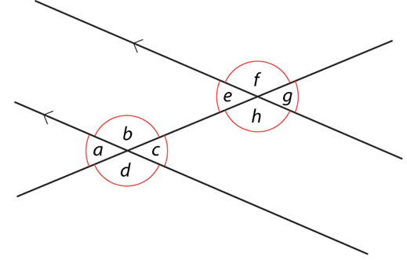
Recognise that adding another line parallel to the original creates a further two pairs of equal and opposite angles that are identical to the original four
Example 4
Write as many equations (or statements) as you can
to show the relationships between the angles in this
diagram.
Explain your reasoning.
  How could tracing paper be used to support students’ understanding?
  What language will you expect students to use when describing the relationships between angles?
Notes:
This example can be found on page 15 of the 6.1 Core Concept document.

Slide 24
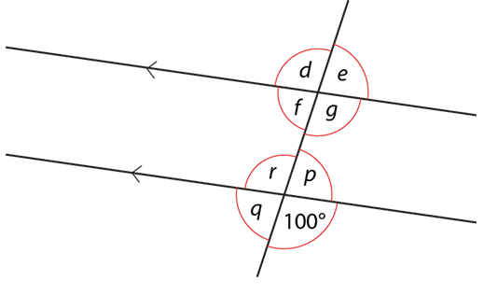
Recognise that adding another line parallel to the original creates a further two pairs of equal and opposite angles that are identical to the original four
Example 5
David thinks angle e = 100° because corresponding angles are equal.
Do you agree?
Explain your answer.
Notes:
Suggested questioning:
Is there another angle that you can deduce immediately from the diagram that you are sure about?
Things for you to think about:
Example 5 gives students an opportunity to explore misconceptions. In particular, it draws attention to the common confusion between alternate and corresponding angles.

Slide 25

Recognise that adding another line parallel to the original creates a further two pairs of equal and opposite angles that are identical to the original four.
Example 5
David thinks angle e = 100°
because corresponding angles are equal.
Do you agree?
Explain your reasoning.
What questions could you ask to draw attention to the structure of the diagram?
What language will you expect students to use when describing the relationships between angles?
Notes:
This example can be found on page 15 of the 6.1 Core Concept document.

Slide 26
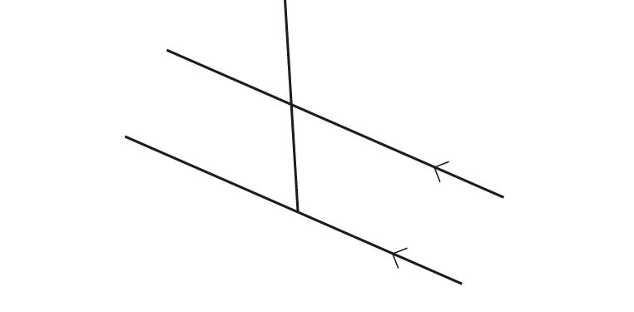
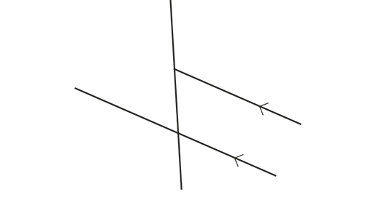
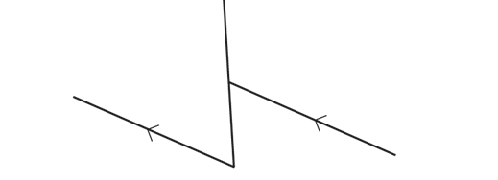
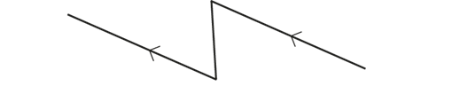
Recognise that adding another line parallel to the original creates a further two pairs of equal and opposite angles that are identical to the original four
Example 6
If the acute angle in each of these diagrams is 50°, what are the other angles?
a)
b)
c)
d)
Notes:
Suggested questioning:
What does acute mean? How can we tell by looking if an angle is acute?
Things for you to think about:
These situations provide opportunities for students to use mental imagery to manipulate the diagram without changing the angle properties.
By systematically making small changes to a diagram, students will be able to see examples of equal and supplementary pairs of angles within the overall structure of two incomplete sets.
Attention can also be drawn to the fact that the reflex angles in parts c) and d) are made up of a combination of one of the acute and two obtuse angles.
Students could be challenged to draw a similar diagram where the reflex angle is made up of one obtuse and two acute angles.

Slide 27
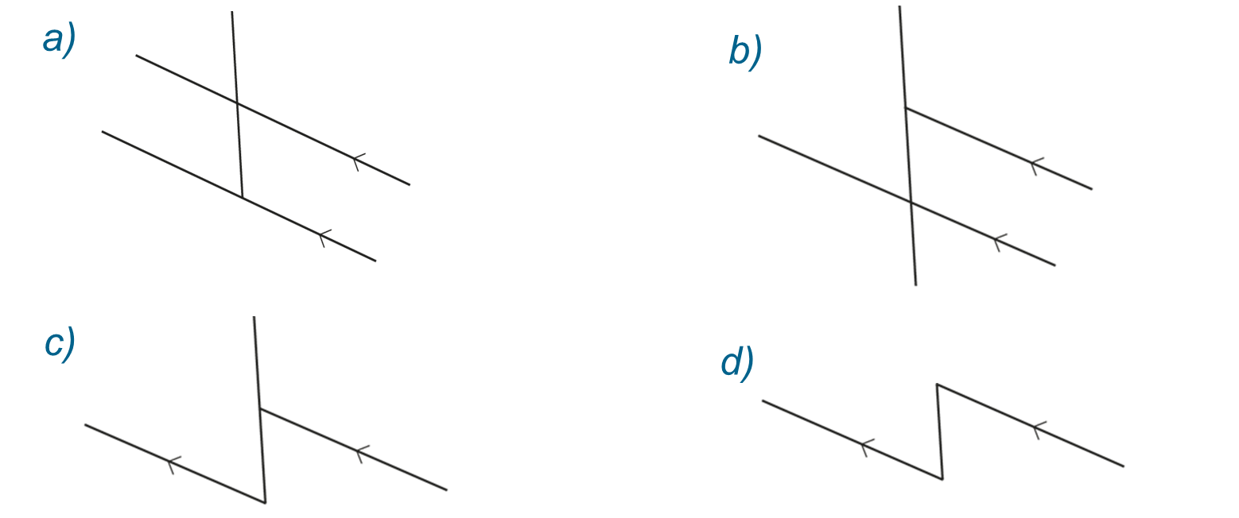
Recognise that adding another line parallel to the original creates a further two pairs of equal and opposite angles that are identical to the original four
Example 6
If the acute angle in each of these diagrams is 50°, what are the other angles?
Why do you think these questions have been designed like this?
What misconceptions might it reveal from students?
Notes:
This example can be found on page 16 of the 6.1 Core Concept document.

Slide 28
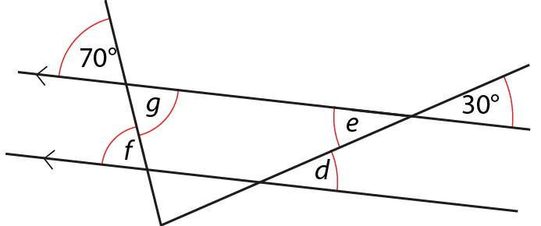
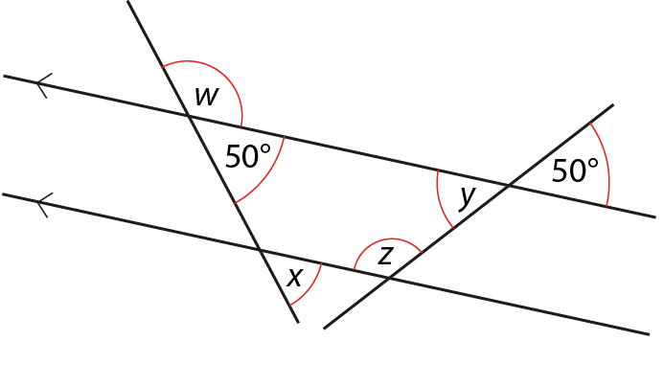
Identify angles in more complex diagrams
Example 7
Find the value of the labelled angles.
a)
b)
Notes:
Suggested questioning:
Which angle facts can you use immediately?
Things for you to think about:
Example 7 has been designed so students use and apply their knowledge and skills of identifying corresponding, alternate, vertically opposite and supplementary angles, rather than using other properties such as the sum of interior angles in a triangle being 180°.
Whole-class discussion based around students’ responses to this example may be deepened by considering other properties.
For example, in part a), attention could be drawn to the acute angle that is neither 30° nor 70° and students could discuss how this might be found. Similarly, in part b), attention could be drawn to the isosceles trapezium and deductions made about other angles, using notions of symmetry and equal length.

Slide 29
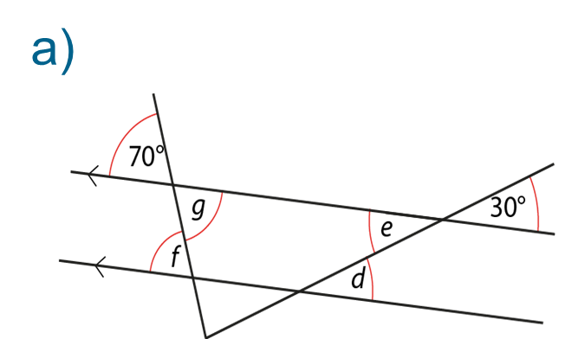
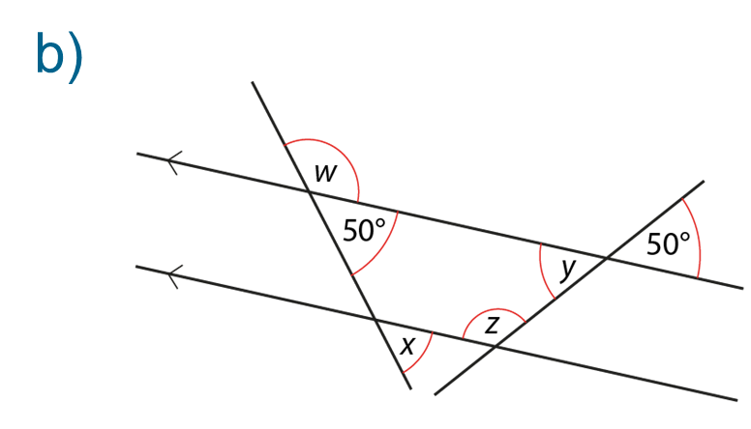
Identify angles in more complex diagrams
Example 7
Find the value of the labelled angles.
  What alternative questions might you ask alongside these?
  What language will you expect students to use when describing the relationships between angles?
Notes:
Due to space constraints, the image on this PD discussion slide is very small. PD Leads might like to use or print the ‘in the classroom’ version of this slide for teachers to access during discussions.
This example can be found on page 17 of the 6.1 Core Concept document.

Slide 30
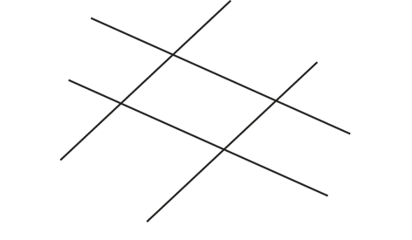
Identify angles in more complex diagrams
Example 8
If all the acute angles in this diagram are equal, what shape is made?
Notes:
Suggested questioning:
How can you tell by looking which angles are acute?
How many acute angles are in this diagram
What is the same and what is different between this diagram and that in Example 5?
Things for you to think about:
Just because lines ‘look’ parallel doesn’t mean they are. This is an example where it can be deduced from the other information.
This example offers an opportunity for students to deduce that opposite lines in this diagram have to be parallel.

Slide 31
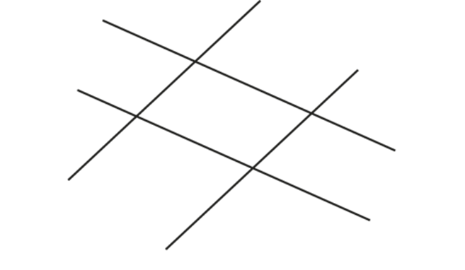
Identify angles in more complex diagrams
Example 8
If all the acute angles in this diagram are
equal, what shape is made?
  How can this image be used to draw out the features of a parallelogram?
  How could you adapt the question / diagram for other quadrilaterals?
Notes:
This example can be found on page 17 of the 6.1 Core Concept document.

Slide 32
Reflection questions
What other mathematical concepts will be supported by students’ stronger understanding of this key idea?
What mathematical language will you continue to use to support students to make connections with other areas?
Which representations might you continue to use to further develop students’ understanding?

Slide 34
Appendices
You may choose to use the following slides when planning or delivering a PD session. They cover:
  Key vocabulary
  Representations and structure
  Previous learning
  Future learning
  Library of links

Slide 35
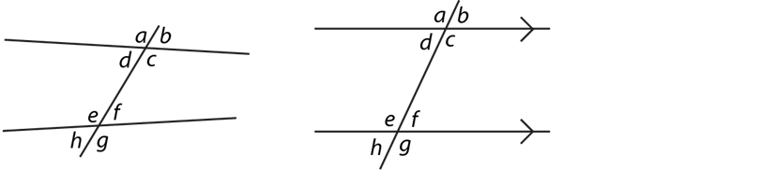
Key vocabulary
Term | Definition
alternate angles | Where two straight lines are cut by a third, as in the diagrams, the angles d and f (also c and e) are alternate. Where the two straight lines are parallel, alternate angles are equal.
corresponding angles | Where two straight-line segments are intersected by a third, as in the diagrams, the angles a and e are corresponding. Similarly, b and f, c and g, and d and h are corresponding. Where parallel lines are cut by a straight line, corresponding angles are equal.
supplementary angle | Two neighbouring angles whose sum is 180°. When two lines intersect each other, the resulting adjacent angles are supplementary.
transversal | A line that cuts across two or more (usually parallel) lines.

Slide 36
Representations and structure
There are a number of different representations that you may wish to use to support students’ understanding of this key idea. These might include:
Dynamic geometry software
  The guided use of dynamic geometry software can provide an environment in which students are able to make and test conjectures. By dragging and changing features, they are able to identify variant and invariant properties, leading to a deeper understanding of generalisations.
Mental imagery
  All concrete and pictorial representations have their limitations in the way they are able to represent the abstract world of mathematics. The ultimate purpose of all representations is to support students’ mental construct of an idea or concept. Students do not use the representation to do the mathematics; rather, the representation supports the student in making a mental representation of the idea.
Notes:
More information about the representations and structure involved in this key idea can be found:
On page 6 of the Theme Overview document
Links to all of these can be found on the final slide.

Slide 37
Previous learning
From Upper Key Stage 2, students will bring experience of:
drawing 2D shapes using given dimensions and angles
recognising, describing and building simple 3D shapes, including making nets
comparing and classifying geometric shapes based on their properties and sizes, and finding unknown angles in any triangles, quadrilaterals and regular polygons
illustrating and naming parts of circles, including radius, diameter and circumference, and knowing that the diameter is twice the radius
recognising angles where they meet at a point, are on a straight line or are vertically opposite, and finding missing angles
drawing and translating simple shapes on the coordinate plane and reflecting them in the axes.
Notes:
Theme 6 Geometry

Slide 38
Future learning (1)
In KS4, students will build on the core concepts in this mathematical theme to:
interpret and use fractional {and negative} scale factors for enlargements
{describe the changes and invariance achieved by combinations of rotations, reflections and translations}
identify and apply circle definitions and properties, including: centre, radius, chord, diameter, circumference, tangent, arc, sector and segment
{apply and prove the standard circle theorems concerning angles, radii, tangents and chords, and use them to prove related results}
construct and interpret plans and elevations of 3D shapes
interpret and use bearings
calculate arc lengths, angles and areas of sectors of circles
calculate surface areas and volumes of spheres, pyramids, cones and composite solids
Please note: Braces { } indicate additional mathematical content to be taught to more highly attaining students.
Notes:
Theme 6 Geometry

Slide 39
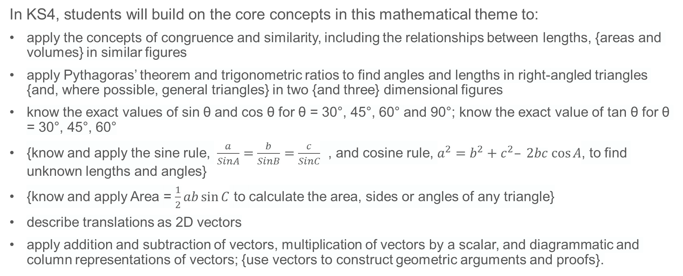
Future learning (2)
In KS4, students will build on the core concepts in this mathematical theme to:
apply the concepts of congruence and similarity, including the relationships between lengths, {areas and volumes} in similar figures
apply Pythagoras’ theorem and trigonometric ratios to find angles and lengths in right-angled triangles {and, where possible, general triangles} in two {and three} dimensional figures
know the exact values of sin θ and cos θ for θ = 30°, 45°, 60° and 90°; know the exact value of tan θ for θ = 30°, 45°, 60°
{know and apply the sine rule, $\frac{a}{SinA}=\frac{b}{SinB}=\frac{c}{SinC}$ , and cosine rule, $a^{2}=b^{2}+c^{2}– 2bc cos⁡A$, to find unknown lengths and angles}
{know and apply Area = $\frac{1}{2}ab\sin{C}$ to calculate the area, sides or angles of any triangle}
describe translations as 2D vectors
apply addition and subtraction of vectors, multiplication of vectors by a scalar, and diagrammatic and column representations of vectors; {use vectors to construct geometric arguments and proofs}.
Please note: Braces { } indicate additional mathematical content to be taught to more highly attaining students.
Notes:
Theme 6 Geometry

Slide 40
Library of links
The following resources from the NCETM website have been referred to within this slide deck:
  NCETM Secondary Mastery Professional Development
    6 Geometry Theme Overview Document
    6.1 Geometrical properties Core Concept Document
  NCETM primary mastery professional development materials
  Insights from experienced teachers | NCETM
There are also references to:
  Standards & Testing Agency’s past mathematics papers

