Slide 1
Deriving sine, cosine and tangent ratios
KS3 Mastery PD Materials: Exemplified Key Ideas
Materials for use in the classroom or to support professional development discussions
(from 3.2 Trigonometry)
Summer 2021

Slide 2
About this resource
These slides are designed to complement the 3.2 Trigonometry Core Concept document and its associated Theme Overview document 3 Multiplicative Reasoning, both found in the Secondary Mastery Professional Development pages.
These slides re-present the key examples from the Core Concept document so that the examples can be used either directly in the classroom or with a group of teachers. There are prompt questions alongside the examples, and further clarification in the notes.
These slides do not fully replicate the Core Concept document, so should be used alongside it. Reference to specific page numbers, and to other useful NCETM resources, can be found in the notes for each slide.
This slide deck is not designed to be a complete PD session, rather it is a selection of resources that you can adapt and use as needed when planning a session with a group of teachers.

Slide 3


About this resource
The slides are structured as follows:
  The big picture:
    Where does this fit in?
    What do students need to understand?
    Why is this key idea important?
  Prior learning
  Misconceptions
  Exemplified key ideas
  Reflection questions
  Appendices:
    Key vocabulary
    Representations and structure
    Previous and Future learning
    Useful links
The exemplified key idea slides have the following symbols to indicate how they have been designed to be used:
Into the classroom
The examples are presented on these slides so that they could be used in PD, but also directly in the classroom. The notes feature suggested questions and things teachers might consider when using with students.
PD discussion prompts
These slides look at the examples in more detail, with question prompts to promote discussion among maths teachers. The notes feature reference to further information and guidance within the Core Concepts document.

Slide 4
Where does this fit in?
The NCETM has identified a set of six ‘mathematical themes’ within Key Stage 3 mathematics that bring together a group of ‘core concepts’.
The third of these themes is Multiplicative reasoning, which covers the following interconnected core concepts:
    3.1 Understanding multiplicative relationships
    3.2 Trigonometry
Notes:
Linked on this slide is the Theme Overview document of Multiplicative reasoning. This document includes why it is important, the key underpinning knowledge and links to prior and future learning. There is also guidance about how the five big ideas of Teaching for Mastery relate specifically to this theme.

Slide 5
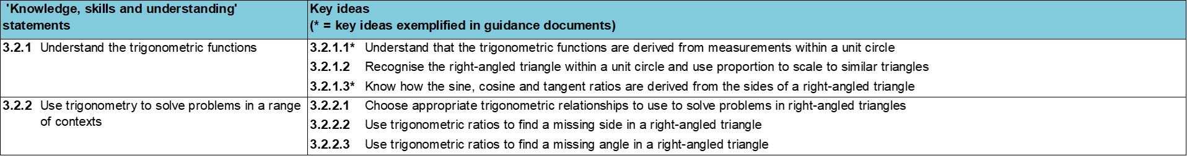
Where does this fit in?
Within this core concept, 3.2 Trigonometry, there are two statements of knowledge, skills and understanding.
These, in turn, are broken down into six key ideas. The highlighted key idea is exemplified in this slide deck.
Notes:
For key ideas marked with an asterisk, we exemplified the common difficulties and misconceptions that students might have and included elements of what teaching for mastery may look like. We have provided examples of possible student tasks and teaching approaches.
Within these slides are ‘classroom-ready’ versions of the examples for the key idea that has been highlighted. There are also slides that may be useful for discussion in a professional development session.

Slide 6
What do students need to understand?
3.2.1.3 Know how the sine, cosine and tangent ratios are derived from the sides of a right-angled triangle
Understand that the multiplicative relationship between sides of a right-angled triangle can be used to find missing sides in similar triangles.
Understand that corresponding sides are in proportion in similar triangles.
Understand the multipliers defined as sine, cosine and tangent refer to the relationships between each pair of sides within a right-angled triangle.
Use the values of sine, cosine and tangent on a calculator to find unknown angles where the lengths of a right-angled triangle are known.
  What prior knowledge might your students already have?
  What language might they use to describe this key idea?
  What questions might you want to ask to assess their prior learning?

Slide 7
Why is this key idea important?
At Key Stage 2, students solved problems involving similar shapes, where the scale factor was known or could be found. At Key Stage 3, this work on similarity and scale factors is linked to the trigonometric functions.
This sense of all right-angled triangles being a scaling of one of the two ‘unit’ right-angled triangles within the unit circle emphasises the multiplicative relationship between triangles. Another important awareness is the multiplicative relationship (or ratio) within each right-angled triangle.
This key idea makes explicit the connection to the unit circle so that trigonometry is connected to previous learning and not perceived as a stand-alone topic.
Notes:
A more detailed overview of the core concept of Trigonometry can be found on page 2 of the 3.2 Core Concept document.
The background to each key idea is also explored in more detail on the following pages:
3.2.1 Understand the trigonometric functions – pages 6-8
3.2.2 Use trigonometry to solve problems in a range of contexts – pages 8-9

Slide 8
Prior learning
Upper Key Stage 2 Learning Outcome
Solve problems involving similar shapes where the scale factor is known or can be found
  What prior knowledge might your students already have?
  What language might they use to describe this key idea?
  What questions might you want to ask to assess their prior learning?
Notes:
You may find it useful to speak to your partner schools to see how the above has been covered and the language used.
You can find further details regarding prior learning in the following segments of the NCETM primary mastery professional development materials (linked on final slide):
Year 4: 2.17 Structures: using measures and comparison to understand scaling
Year 6: 2.27 Scale factors, ratio and proportional reasoning
Year 6: 2.30 Multiplicative contexts: area and perimeter 2
Within the 3 Multiplicative reasoning Theme Overview document, you can also find a broader description of students’ potential previous learning (page 3), alongside further information about key underpinning knowledge (page 2).

Slide 9
Prior learning
Key Stage 3 Learning Outcome
6.1.2 Understand and use similarity and congruence
Please note: Numerical codes refer to statements of knowledge, skills and understanding in the NCETM breakdown of Key Stage 3 mathematics.
  What representations might your students already be familiar with?
  What language might they use?
  How does this fit in with your curriculum progression?

Slide 10
Checking prior learning
The following slides contain questions for checking prior learning.
  What representations might students use to support their understanding of these questions?
  What variation might you put in place for these questions to fully assess students’ understanding of the concept?
  How might changing the language of each question change the difficulty?
  Why are these such crucial pre-requisites for this key idea?

Slide 11
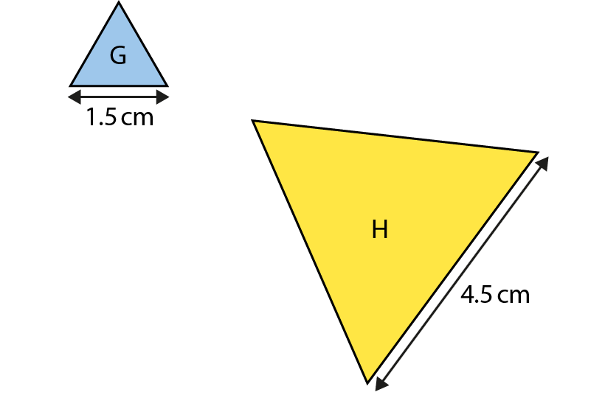
Checking prior learning
a)
What scale factor is used to change the side-lengths of equilateral triangle G into equilateral triangle H?
Notes:
References to the questions (links on final slide):
a) NCETM primary mastery professional development materials: Year 6: 2.27 Slide 40

Slide 12
Common difficulties and misconceptions
What aspects of this key idea might students find challenging?
What misconceptions might students have?
When teaching this topic, you may find students encounter difficulties with…
Seeing the relationships within a triangle
More information, and some suggestions for overcoming these challenges, can be found on the following slides.

Slide 13
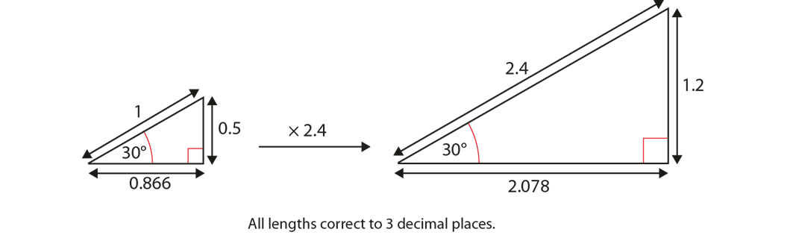

Common difficulties and misconceptions (1)
Students may understand the relationships between similar triangles but struggle to see the same relationships within each triangle.
For example, in these two similar triangles, not only is there a relationship between the two triangles (i.e. a scale factor of 2.4), but also the ratios within each triangle are equal (i.e. $\frac{0.5}{1}=\frac{1.2}{2.4}=0.5$and $\frac{0.866}{1}=\frac{2.078}{2.4}=0.866$).
Notes:
More detail can be found on page 18 of the 3.2 Core Concept document.

Slide 14
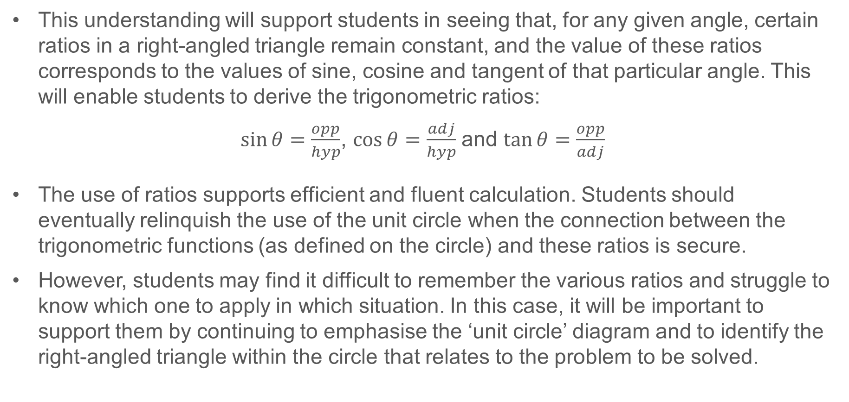
Common difficulties and misconceptions (1 cont.)
This understanding will support students in seeing that, for any given angle, certain ratios in a right-angled triangle remain constant, and the value of these ratios corresponds to the values of sine, cosine and tangent of that particular angle. This will enable students to derive the trigonometric ratios:
$\sin{θ}=\frac{opp}{hyp}$, $\cos{θ=\frac{adj}{hyp}}$ and $\tan{θ}=\frac{opp}{adj}$
The use of ratios supports efficient and fluent calculation. Students should eventually relinquish the use of the unit circle when the connection between the trigonometric functions (as defined on the circle) and these ratios is secure.
However, students may find it difficult to remember the various ratios and struggle to know which one to apply in which situation. In this case, it will be important to support them by continuing to emphasise the ‘unit circle’ diagram and to identify the right-angled triangle within the circle that relates to the problem to be solved.
Notes:
More detail can be found on page 18 of the 3.2 Core Concept document.

Slide 15
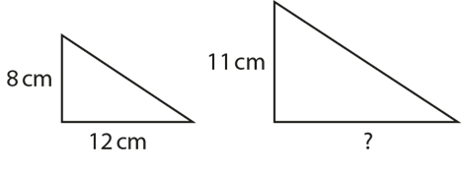
Understand that the multiplicative relationship between sides of a right-angled triangle can be used to find missing sides in similar triangles
Example 1
Consider the shadow created by a vertical stick on a horizontal beach and how this could be represented as a right-angled triangle.
If an 8cm stick casts a 12cm shadow, how long a shadow would an 11cm stick cast at the same time of day?
At a different time of day, a 6cm stick casts a shadow 5cm long. How long would the shadow of a 7cm stick be at this time of day?
Later, the 6cm stick casts a 13cm shadow. What length of stick would cast a 20cm shadow at the same time of day?
Notes:
Suggested questioning:
If an 8cm stick created a 8cm shadow what does that tell you about the angle?
At this same time of day, would all shadows be equal to the height of the objects that make them?
What is the multiplicative relationship between 8 and 12? How can this be used to calculate the missing length?
What is the multiplicative relationship between 8 and 11? How can this be used to calculate the missing length?
In the example given which is the easier method and why?
Things for you to think about:
You could introduce the idea of a shadow of a person or a stick and ask students how the shadow changes at different times of the day. Use of dynamic geometry software can help illustrate this. Through discussion of Example 1, the relationship between the sticks and the shadows can be explored. Focusing on the relationship between the stick and its shadow is not the only way the answer can be deduced. The enlargement scale factor between the two similar triangles can be used. In this example, values have been chosen so that no one strategy is easier at this stage. You may wish to point out alternative methods, but attention should at least be drawn to the relationship between pairs of sides in the same triangle.

Slide 16
Understand that the multiplicative relationship between sides of a right-angled triangle can be used to find missing sides in similar triangles
Example 1
Consider the shadow created by a vertical stick on a horizontal beach and how this could be represented as a right-angled triangle.
  How could you use this representation to draw attention to the relationships between the triangles and between the sides in the same triangle?
If an 8cm stick casts a 12cm shadow, how long a shadow would an 11cm stick cast at the same time of day?
At a different time of day, a 6cm stick casts a shadow 5cm long. How long would the shadow of a 7cm stick be at this time of day?
Later, the 6cm stick casts a 13cm shadow. What length of stick would cast a 20cm shadow at the same time of day?
8 | 11
12
Notes:
Due to space constraints, the image on this PD discussion slide is very small. PD Leads might like to use or print the ‘in the classroom’ version of this slide for teachers to access during discussions.
More detail about the thinking behind this question can be found on page 19-20 of the 3.2 Core Concept document.

Slide 17
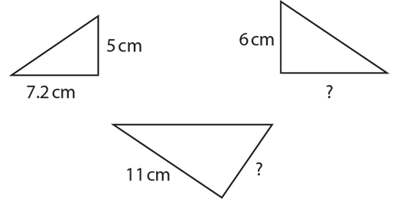
Understand that corresponding sides are in proportion in similar triangles
Example 2
Here are three similar triangles.
What is the multiplier between the pair of labelled values for each triangle?
Find the missing values.
Notes:
Suggested questioning:
What is the multiplier to get from, 5 to 1?
What is the multiplier to get from 1 to 7.2?
What is the single multiplier to get from 5 to 7.2?
Given that triangles are similar what can you deduce?
Things for you to think about:
Encourage students to use strategies they have developed in other aspects of the curriculum that have focused on multiplicative relationships. Students’ attention can be drawn to the fact that, if the relationship between the short and medium sides in each triangle is identified as × 7.2/5, which is equivalent to × 1.44, the inverse relationship can be expressed as ÷ 1.44 or, alternatively, × 0.694 (to 3 significant figures).

Slide 18
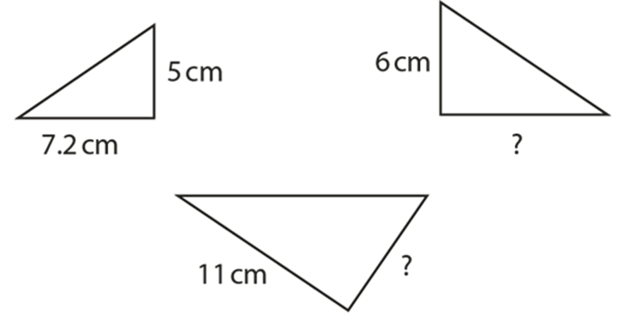
Understand that corresponding sides are in proportion in similar triangles
Example 2
Here are three similar triangles.
  Which relationships do you need to draw attention to within this table?
  What feedback would you give if a student put a 7 in the top right box?
  How could you use a double number line to represent this situation?
5 | 6 | ?
7.2 | ? | 11
What is the multiplier between the pair of labelled values for each triangle?
Find the missing values.
Notes:
Due to space constraints, the image on this PD discussion slide is very small. PD Leads might like to use or print the ‘in the classroom’ version of this slide for teachers to access during discussions.
More detail about the thinking behind this question can be found on page 19 of the 3.2 Core Concept document.

Slide 19
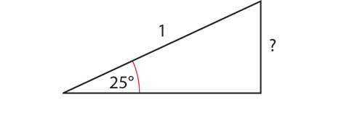
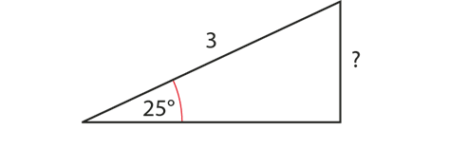
Understand the multipliers defined as sine, cosine and tangent refer to the relationships between each pair of sides within a right-angled triangle
Example 3a, 3b
Angle | Sine | Cosine | Tangent
10 | 0.1736 | 0.9848 | 0.1763
15 | 0.2588 | 0.9659 | 0.2679
20 | 0.3420 | 0.9397 | 0.3640
25 | 0.4226 | 0.9063 | 0.4663
30 | 0.5000 | 0.8660 | 0.5774
35 | 0.5736 | 0.8192 | 0.7002
40 | 0.6428 | 0.7660 | 0.8391
45 | 0.7071 | 0.7071 | 1
50 | 0.7660 | 0.6428 | 1.1918
55 | 0.8192 | 0.5736 | 1.4281
60 | 0.8660 | 0.5000 | 1.7321
65 | 0.9063 | 0.4226 | 2.1445
70 | 0.9397 | 0.3420 | 2.7475
75 | 0.9659 | 0.2588 | 3.7321
80 | 0.9848 | 0.1736 | 5.6713
85 | 0.9962 | 0.0872 | 11.4301
90 | 1 | 0 | ∞
Using the relevant values in the table (or using your calculator), find the missing side lengths.
Notes:
Suggested questioning:
How can you use the image of the unit circle to help answer part a)?
What strategy will you need to apply to calculate the answer to b) ?
Things for you to think about:
The numbers in Example 3 have been chosen to initially allow students to use their image of the unit circle to find the answer to part a). In subsequent parts, the numbers have been chosen to allow for some scaling (both up and down), and in order for students to notice the constant ratio between the opposite and hypotenuse in each case.

Slide 20
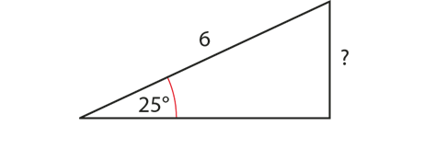
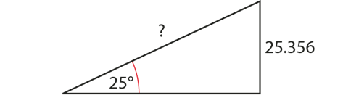
Understand the multipliers defined as sine, cosine and tangent refer to the relationships between each pair of sides within a right-angled triangle
Example 3c, 3d
Angle | Sine | Cosine | Tangent
10 | 0.1736 | 0.9848 | 0.1763
15 | 0.2588 | 0.9659 | 0.2679
20 | 0.3420 | 0.9397 | 0.3640
25 | 0.4226 | 0.9063 | 0.4663
30 | 0.5000 | 0.8660 | 0.5774
35 | 0.5736 | 0.8192 | 0.7002
40 | 0.6428 | 0.7660 | 0.8391
45 | 0.7071 | 0.7071 | 1
50 | 0.7660 | 0.6428 | 1.1918
55 | 0.8192 | 0.5736 | 1.4281
60 | 0.8660 | 0.5000 | 1.7321
65 | 0.9063 | 0.4226 | 2.1445
70 | 0.9397 | 0.3420 | 2.7475
75 | 0.9659 | 0.2588 | 3.7321
80 | 0.9848 | 0.1736 | 5.6713
85 | 0.9962 | 0.0872 | 11.4301
90 | 1 | 0 | ∞
Using the relevant values in the table (or using your calculator), find the missing side lengths.
Notes:
Suggested questioning:
How can you use your answers to a) and b) to calculate the answers to c) and d) ?
Things for you to think about:
The numbers in part a) allowed students to use their image of the unit circle to find the answer to part a). In subsequent parts, the numbers have been chosen to allow for some scaling (both up and down), and in order for students to notice the constant ratio between the opposite and hypotenuse in each case.

Slide 21
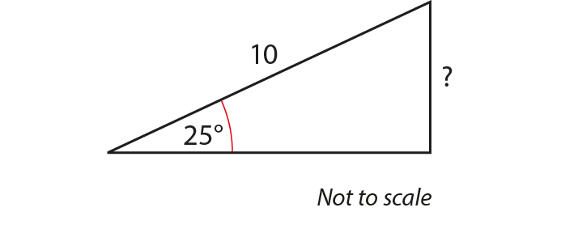
Understand the multipliers defined as sine, cosine and tangent refer to the relationships between each pair of sides within a right-angled triangle
Example 3e
Angle | Sine | Cosine | Tangent
10 | 0.1736 | 0.9848 | 0.1763
15 | 0.2588 | 0.9659 | 0.2679
20 | 0.3420 | 0.9397 | 0.3640
25 | 0.4226 | 0.9063 | 0.4663
30 | 0.5000 | 0.8660 | 0.5774
35 | 0.5736 | 0.8192 | 0.7002
40 | 0.6428 | 0.7660 | 0.8391
45 | 0.7071 | 0.7071 | 1
50 | 0.7660 | 0.6428 | 1.1918
55 | 0.8192 | 0.5736 | 1.4281
60 | 0.8660 | 0.5000 | 1.7321
65 | 0.9063 | 0.4226 | 2.1445
70 | 0.9397 | 0.3420 | 2.7475
75 | 0.9659 | 0.2588 | 3.7321
80 | 0.9848 | 0.1736 | 5.6713
85 | 0.9962 | 0.0872 | 11.4301
90 | 1 | 0 | ∞
Using the relevant values in the table (or using your calculator), find the missing side lengths.
Notes:
Suggested questioning:
Which of the triangles so far is the ‘best’ one to use to help calculate the unknown length here? Why?
Things for you to think about:
Discussion following this activity could usefully include asking, ‘What would happen if these triangles were all drawn to scale and all “nested” together with the 25° angle positioned over each other?’
This could lead to analysing the connection between the opposite and the hypotenuse in each case and drawing students’ attention to the fact that they are all equal to 0.4226 (sin 25°).

Slide 22
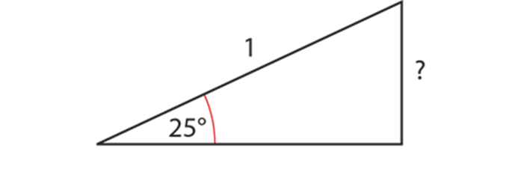
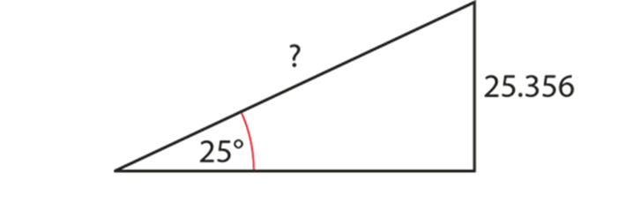
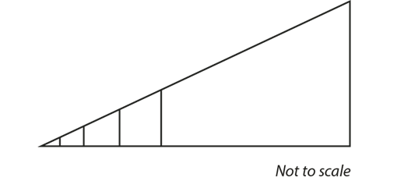
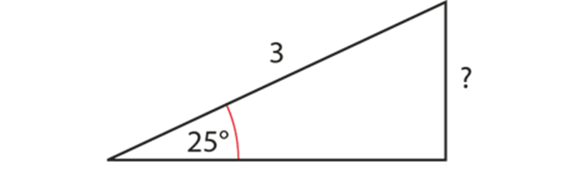
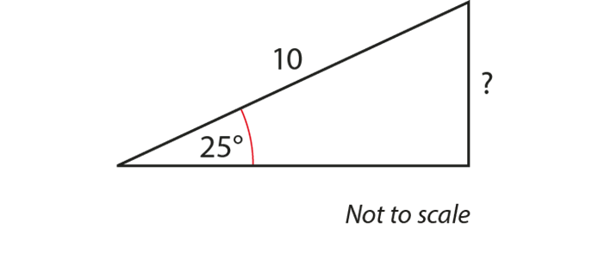
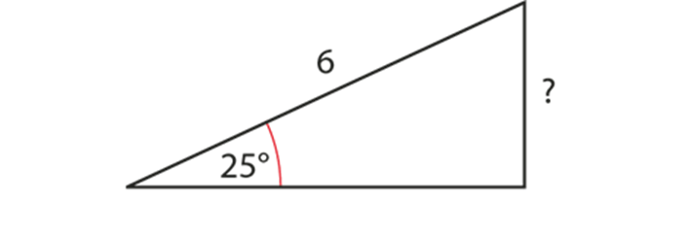
Understand the multipliers defined as sine, cosine and tangent refer to the relationships between each pair of sides within a right-angled triangle
Example 3
Using the relevant values in the table (or using your calculator), find the missing side lengths.
  Imagine these triangles were all drawn to scale and nested together with the 25° angle positioned over each other.
  What connections become explicit?
  How would you guide a discussion to enable students to make these connections for themselves?
Notes:
Due to space constraints, the image on this PD discussion slide is very small. PD Leads might like to use or print the ‘in the classroom’ version of this slide for teachers to access during discussions.
More detail about the thinking behind this question can be found on page 20-21 of the 3.2 Core Concept document.

Slide 23
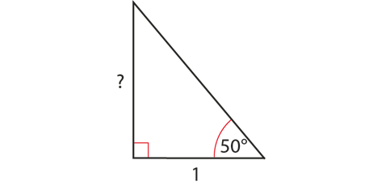
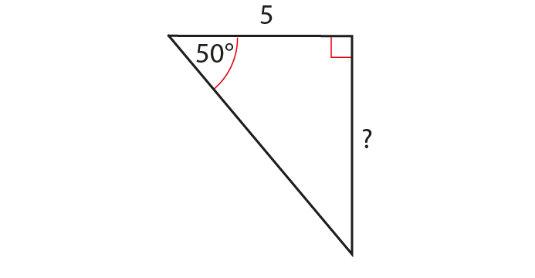
Understand the multipliers defined as sine, cosine and tangent refer to the relationships between each pair of sides within a right-angled triangle
Example 4a, 4b
Angle | Sine | Cosine | Tangent
10 | 0.1736 | 0.9848 | 0.1763
15 | 0.2588 | 0.9659 | 0.2679
20 | 0.3420 | 0.9397 | 0.3640
25 | 0.4226 | 0.9063 | 0.4663
30 | 0.5000 | 0.8660 | 0.5774
35 | 0.5736 | 0.8192 | 0.7002
40 | 0.6428 | 0.7660 | 0.8391
45 | 0.7071 | 0.7071 | 1
50 | 0.7660 | 0.6428 | 1.1918
55 | 0.8192 | 0.5736 | 1.4281
60 | 0.8660 | 0.5000 | 1.7321
65 | 0.9063 | 0.4226 | 2.1445
70 | 0.9397 | 0.3420 | 2.7475
75 | 0.9659 | 0.2588 | 3.7321
80 | 0.9848 | 0.1736 | 5.6713
85 | 0.9962 | 0.0872 | 11.4301
90 | 1 | 0 | ∞
Using the relevant values in the table (or using your calculator), find the missing side lengths.
Notes:
Suggested questioning:
Are these triangles similar?
How do you know?
Which lengths are corresponding?
Things for you to think about:
In Example 4, the lengths have been chosen to prompt discussion about the use of scaling (from the ‘unit’ triangle) and about the ratio between the opposite and the adjacent sides in each triangle being 1.1918 (tan 50°).

Slide 24
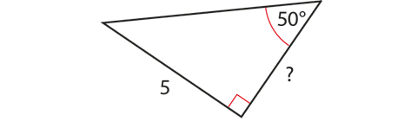
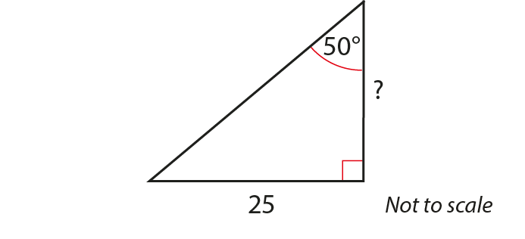
Understand the multipliers defined as sine, cosine and tangent refer to the relationships between each pair of sides within a right-angled triangle
Example 4c, 4d
Angle | Sine | Cosine | Tangent
10 | 0.1736 | 0.9848 | 0.1763
15 | 0.2588 | 0.9659 | 0.2679
20 | 0.3420 | 0.9397 | 0.3640
25 | 0.4226 | 0.9063 | 0.4663
30 | 0.5000 | 0.8660 | 0.5774
35 | 0.5736 | 0.8192 | 0.7002
40 | 0.6428 | 0.7660 | 0.8391
45 | 0.7071 | 0.7071 | 1
50 | 0.7660 | 0.6428 | 1.1918
55 | 0.8192 | 0.5736 | 1.4281
60 | 0.8660 | 0.5000 | 1.7321
65 | 0.9063 | 0.4226 | 2.1445
70 | 0.9397 | 0.3420 | 2.7475
75 | 0.9659 | 0.2588 | 3.7321
80 | 0.9848 | 0.1736 | 5.6713
85 | 0.9962 | 0.0872 | 11.4301
90 | 1 | 0 | ∞
Using the relevant values in the table (or using your calculator), find the missing side lengths.
Notes:
Suggested questioning:
Are these triangles similar?
How do you know?
Which lengths are corresponding?
Things for you to think about:
In Example 4, the lengths have been chosen to prompt discussion about the use of scaling (from the ‘unit’ triangle) and about the ratio between the opposite and the adjacent sides in each triangle being 1.1918 (tan 50°).

Slide 25
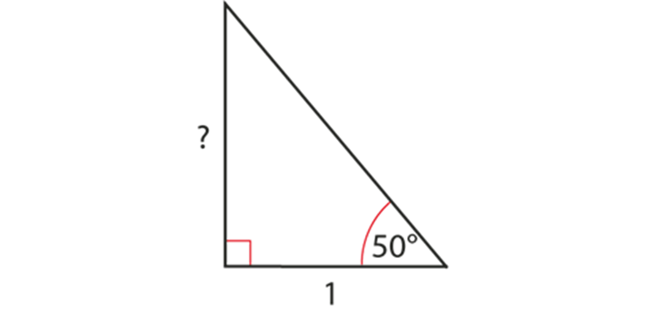
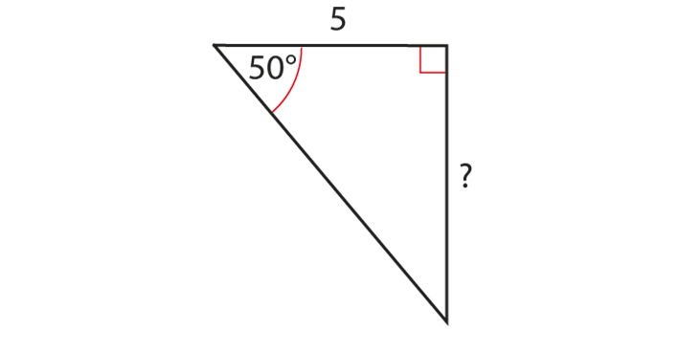
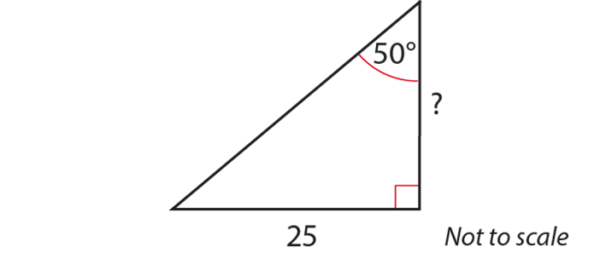
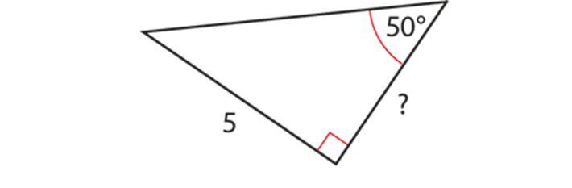
Understand the multipliers defined as sine, cosine and tangent refer to the relationships between each pair of sides within a right-angled triangle
Example 4
Using the relevant values in the table (or using your calculator), find the missing side lengths.
a) b) c) d)
  Why do you think the questions have been sequenced in this way?
  If you were to design another set of questions what angles / lengths / orientation would you choose?
Notes:
Due to space constraints, the image on this PD discussion slide is very small. PD Leads might like to use or print the ‘in the classroom’ version of this slide for teachers to access during discussions.
More detail about the sequencing of this example can be found on page 25 of the 3.2 Core Concept document.

Slide 26
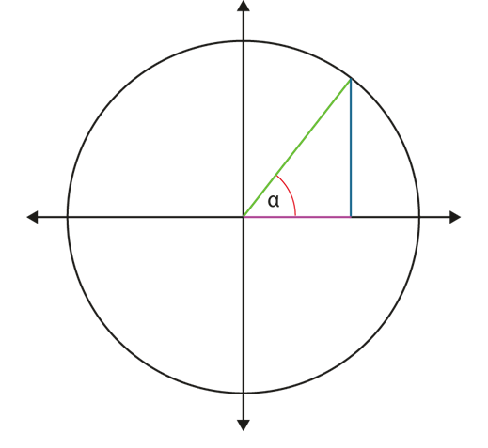
Understand the multipliers defined as sine, cosine and tangent refer to the relationships between each pair of sides within a right-angled triangle
Example 5a
If the adjacent (purple) side has a length of 5cm and the angle α is 70°:
what is the value of tan 70°?
what is the length of the opposite (blue) side?
Notes:
Suggested questioning:
What is the same and what is different from the unit circle seen before?
Which side is the hypotenuse?
Which side is opposite the angle?
How can you use the table of values from example 3 to find tan 70°?
How can you use a calculator to find tan 70°?
Things for you to think about:
Students should understand the convention for naming the sides of a right-angled triangle in a standard triangle orientation and with a given angle, so that they can define sine, cosine and tangent as multipliers between pairs of sides. Attention needs to be drawn to the importance of the angle in each case, because the multiplier changes as the angle changes. Note that a standard orientation of the triangle is used to emphasise the link with the unit circle at this stage.

Slide 27
Understand the multipliers defined as sine, cosine and tangent refer to the relationships between each pair of sides within a right-angled triangle
Example 5b, 5c
If the hypotenuse (green side) has a length of 8cm and the angle α is 60°:
what is the value of sine 60°?
what is the length of the opposite (blue) side?
what is the value of cosine 60°?
what is the length of the adjacent (purple) side?
If the hypotenuse is 1cm and the angle α is 45°, what are the lengths of the opposite and adjacent sides?
Notes:
Suggested questioning:
What is the same and what is different from the unit circle seen before?
Which side is opposite the angle?
Which side is adjacent to the angle?
How can you use the table of values from example 3 to find sin 60°?
How can you use a calculator to find sin 60°?
Things for you to think about:
Students should understand the convention for naming the sides of a right-angled triangle in a standard triangle orientation and with a given angle, so that they can define sine, cosine and tangent as multipliers between pairs of sides. Attention needs to be drawn to the importance of the angle in each case, because the multiplier changes as the angle changes. Note that a standard orientation of the triangle is used to emphasise the link with the unit circle at this stage.

Slide 28
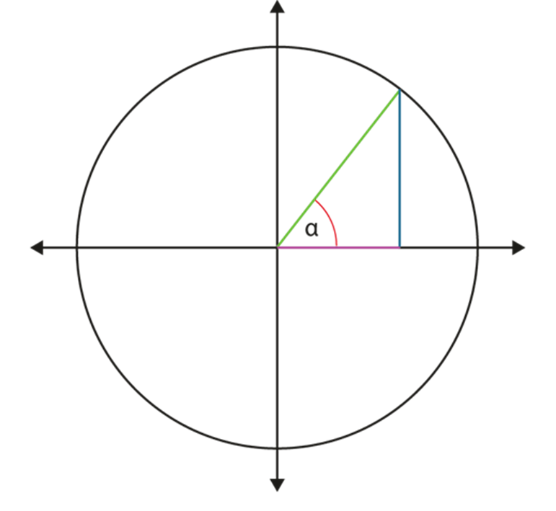
Understand the multipliers defined as sine, cosine and tangent refer to the relationships between each pair of sides within a right-angled triangle
Example 5
If the adjacent (purple) side has a length of 5cm and the angle α is 70°:
what is the value of tan 70°?
what is the length of the opposite (blue) side?
If the hypotenuse (green side) has a length of 8cm and the angle α is 60°:
what is the value of sine 60°?
what is the length of the opposite (blue) side?
what is the value of cosine 60°?
what is the length of the adjacent (purple) side?
If the hypotenuse is 1cm and the angle α is 45°, what are the lengths of the opposite and adjacent sides?
  What strategies do you use to help students understand the conventions for naming the sides in a right angled triangle?
  When would you progress from the ‘standard orientation’ shown here to include ‘non-standard’ examples?
Notes:
Due to space constraints, the image on this PD discussion slide is very small. PD Leads might like to use or print the ‘in the classroom’ version of this slide for teachers to access during discussions.
More detail about the thinking behind this question can be found on page 23 of the 3.2 Core Concept document.

Slide 29
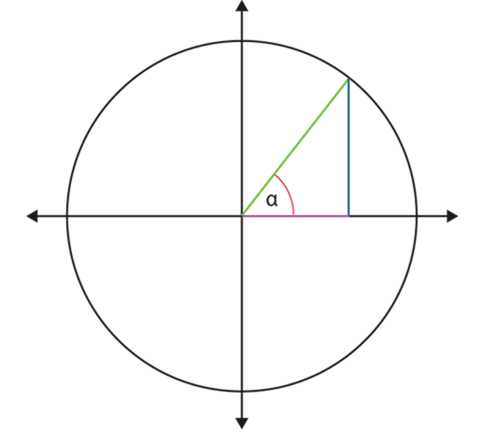
Use the values of sine, cosine and tangent on a calculator to find unknown angles where the lengths of a right-angled triangle are known
Example 6
What are the values of α if the length of the blue line in this unit circle diagram is:
0.5?
0.38?
0.9?
1.2?
What are the values of α if the length of the purple line is:
¾ ?
0.7777?
−0.4?
Notes:
Suggested questioning:
From the table in Example 3, sin 20° = 0.340 and sin 25° = 0.4226
Could you estimate a value for sin 22°?
Given this diagram shows a unit circle what is the maximum height of the blue line?
What could it mean if the length of the line is negative?
Things for you to think about:
You may wish to ask students to tackle Example 6 by first using the table (from Example 3). They can answer part a) and estimate part b) as being between 20 and 25 degrees. However, at some stage, students will need to be shown how they can retrieve this information from a calculator and not only find an angle from a trigonometric value, but also the trigonometric value of any given angle.
Part d) has been chosen to remind students that the value of sine and cosine does not exist beyond 1.
In part e), there is the opportunity for you to point out that values do not have to be decimals; values given in a fractional format are just as acceptable.
You will need to consider whether introducing a negative number at this stage is appropriate for your students. This goes beyond the expectation at Key Stage 3, but may prove useful to link to the work on the unit circle in the previous key idea. Students should realise that the actual answer cannot be found as there are different angles for which −0.4 can be the value of cosine α, including a negative value of α. This understanding can be further deepened by inspecting the graphs of y = sin θ and y = cos θ to remind students that the values are repeated cyclically and there is a pattern they can predict.

Slide 30

Use the values of sine, cosine and tangent on a calculator to find unknown angles where the lengths of a right-angled triangle are known
Example 6
What are the values of α if the length of the blue line in this unit circle diagram is:
0.5?
0.38?
0.9?
1.2?
What are the values of α if the length of the purple line is:
¾ ?
0.7777?
−0.4?
  Students often struggle to understand the inputs and outputs of a calculator when using trigonometric ratios. To what extent might using tables of values be helpful as an intermediate step?
Notes:
Due to space constraints, the image on this PD discussion slide is very small. PD Leads might like to use or print the ‘in the classroom’ version of this slide for teachers to access during discussions.
More detail about the thinking behind this question can be found on page 24-25 of the 3.2 Core Concept document.

Slide 31
Reflection questions
What other mathematical concepts will be supported by students’ stronger understanding of this key idea?
What mathematical language will you continue to use to support pupils to make connections with other areas?
Which representations might you continue to use to further develop students’ understanding?

Slide 33
Appendices
You may choose to use the following slides when planning or delivering a PD session. They cover:
  Key vocabulary
  Representations and structure
  Previous learning
  Future learning
  Library of links

Slide 34
Key vocabulary
Term | Definition
adjacent | In trigonometry, one of the shorter two sides in a right-angled triangle. The side adjacent or next to a given angle.
hypotenuse | In trigonometry, the longest side of a right-angled triangle. The side opposite the right-angle.
opposite | In trigonometry, one of the shorter two sides in a right-angled triangle. The side opposite a given angle.

Slide 35
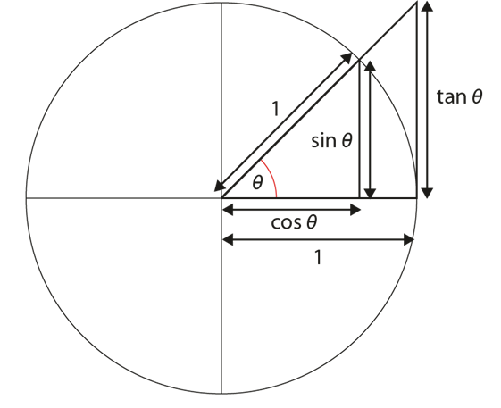



Key vocabulary (2)
Term | Definition
trigonometric functions (sine, cosine, tangent) | Functions of angles. The main trigonometric functions are cosine, sine and tangent. Other functions are reciprocals of these. Trigonometric functions (also called the ‘circular functions’) are functions of an angle. They relate the angles of a triangle to the lengths of its sides. The most familiar trigonometric functions are sine, cosine and tangent in the context of the standard unit circle with radius 1 unit. A triangle is formed by a ray originating at the origin and making some angle with the x-axis; the sine of the angle gives the length of the y-component (rise) of the triangle, the cosine gives the length of the x-component (run), and the tangent function gives the slope (y-component divided by the x-component). Trigonometric functions are commonly defined as ratios of two sides of a right-angled triangle containing the angle. They can equivalently be defined as the lengths of various line segments from a unit circle.

Slide 36
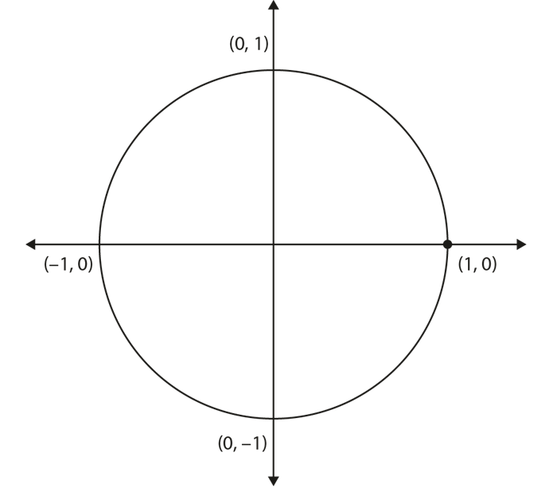
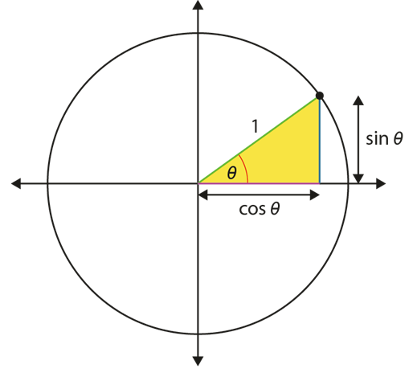
Representations and structure
There are a number of different representations that you may wish to use to support students’ understanding of this key idea. These might include:
The unit circle
A point moving around a unit circle (a circle of radius 1) provides a very rich representation for understanding and visualising the values of the trigonometric (or circular) functions.
When it is placed on a coordinate grid with its centre at the origin, the cosine and sine functions are represented by the x- and y-coordinates, respectively, of the point for different values of the angle θ.
Notes:
More information about the representations and structure involved in this key idea can be found:
On page 11-12 of Theme 3 Multiplicative Reasoning Overview
Links to all of these can be found on the final slide.

Slide 37
Previous learning
From Upper Key Stage 2, students will bring experience of:
multiplying proper fractions and mixed numbers by whole numbers, supported by materials and diagrams
recognising the per cent symbol (%) and understanding that per cent relates to ‘number of parts per hundred’, and writing percentages as a fraction with denominator 100, and as a decimal
using all four operations to solve problems involving measure (for example, length, mass, volume, money) using decimal notation, including scaling
solving problems involving the relative sizes of two quantities where missing values can be found by using integer multiplication and division facts
solving problems involving the calculation of percentages (for example, of measures, and such as 15% of 360) and the use of percentages for comparison
solving problems involving similar shapes where the scale factor is known or can be found
solving problems involving unequal sharing and grouping, using knowledge of fractions and multiples.
Notes:
Theme 3 Multiplicative reasoning

Slide 38
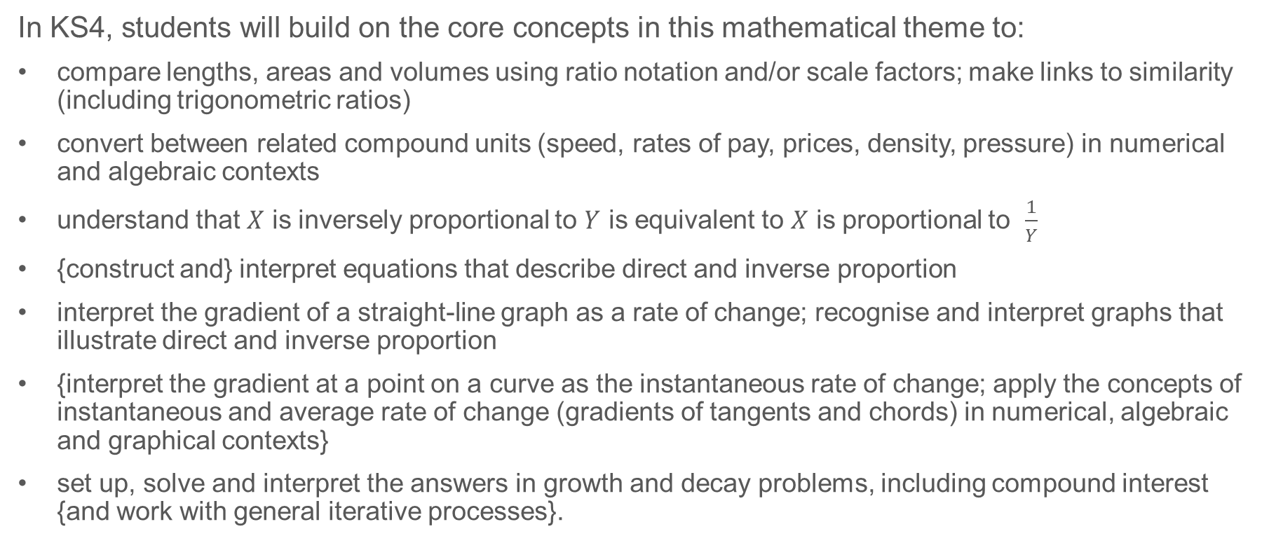
Future learning
In KS4, students will build on the core concepts in this mathematical theme to:
compare lengths, areas and volumes using ratio notation and/or scale factors; make links to similarity (including trigonometric ratios)
convert between related compound units (speed, rates of pay, prices, density, pressure) in numerical and algebraic contexts
understand that $X$ is inversely proportional to $Y$ is equivalent to $X$ is proportional to $\frac{1}{Y}$
{construct and} interpret equations that describe direct and inverse proportion
interpret the gradient of a straight-line graph as a rate of change; recognise and interpret graphs that illustrate direct and inverse proportion
{interpret the gradient at a point on a curve as the instantaneous rate of change; apply the concepts of instantaneous and average rate of change (gradients of tangents and chords) in numerical, algebraic and graphical contexts}
set up, solve and interpret the answers in growth and decay problems, including compound interest {and work with general iterative processes}.
Please note: Braces { } indicate additional mathematical content to be taught to more highly attaining students.
Notes:
Theme 3 Multiplicative reasoning

Slide 39
Library of links
The following resources from the NCETM website have been referred to within this slide deck:
  NCETM Secondary Mastery Professional Development
    3 Multiplicative Reasoning Theme Overview Document
    3.2 Trigonometry Core Concept Document
    6.1 Geometrical properties Core Concept Document
  Using mathematical representations at KS3 | NCETM
  NCETM primary mastery professional development materials
  NCETM primary assessment materials

