Slide 1
The area of a trapezium
KS3 Mastery PD Materials: Exemplified Key Ideas
Materials for use in the classroom or to support professional development discussions
(from 6.2 Perimeter, area and volume)
Summer 2021

Slide 2
About this resource
These slides are designed to complement the 6.2 Area, perimeter and volume Core Concept document and its associated Theme Overview document 6 Geometry, both found in the Secondary Mastery Professional Development pages.
These slides re-present the key examples from the Core Concept document so that the examples can be used either directly in the classroom or with a group of teachers. There are prompt questions alongside the examples, and further clarification in the notes.
These slides do not fully replicate the Core Concept document, so should be used alongside it. Reference to specific page numbers, and to other useful NCETM resources, can be found in the notes for each slide.
This slide deck is not designed to be a complete PD session, rather it is a selection of resources that you can adapt and use as needed when planning a session with a group of teachers.

Slide 3
About this resource
The slides are structured as follows:
The big picture:
Where does this fit in?
What do students need to understand?
Why is this key idea important?
Prior learning
Misconceptions
Exemplified key ideas
Reflection questions
Appendices:
Key vocabulary
Representations and structure
Previous and Future learning
Useful links
The exemplified key idea slides have the following symbols to indicate how they have been designed to be used:
Into the classroom
The examples are presented on these slides so that they could be used in PD, but also directly in the classroom. The notes feature suggested questions and things teachers might consider when using with students.
PD discussion prompts
These slides look at the examples in more detail, with question prompts to promote discussion among maths teachers. The notes feature reference to further information and guidance within the Core Concepts document.

Slide 4
Where does this fit in?
The NCETM has identified a set of six ‘mathematical themes’ within Key Stage 3 mathematics that bring together a group of ‘core concepts’.
The sixth of these themes is Geometry, which covers the following interconnected core concepts:
6.1 Geometrical properties
6.2 Perimeter, area and volume
6.3 Transforming shapes
6.4 Constructions
Notes:
Linked on this slide is the Theme Overview document of Geometry. This document includes why it is important, the key underpinning knowledge and links to prior and future learning. There is also guidance about how the five big ideas of Teaching for Mastery relate specifically to this theme.

Slide 5
Where does this fit in?
Within this core concept, 6.2 Perimeter, area and volume, there are three statements of knowledge, skills and understanding.
These, in turn, are broken down into ten key ideas. The highlighted key idea is exemplified in this slide deck.
Notes:
For key ideas marked with an asterisk, we exemplified the common difficulties and misconceptions that students might have and included elements of what teaching for mastery may look like. We have provided examples of possible student tasks and teaching approaches.
Within these slides are ‘classroom-ready’ versions of the examples for the key idea that has been highlighted. There are also slides that may be useful for discussion in a professional development session

Slide 6
What do students need to understand?
6.2.2.1 Derive and use the formula for the area of a trapezium
Understand that the formula to calculate the area of a trapezium can be applied to any trapezium – isosceles, right-angled or scalene.
The formula for the area of a trapezium can be derived by examining the shape’s geometrical structure.
What prior knowledge might your students already have?
What language might they use to describe this key idea?
What questions might you want to ask to assess their prior learning?

Slide 7
Why is this key idea important?
At Key Stage 2, students should have calculated the area of rectangles, triangles and parallelograms using formulae. They should also have had opportunities to develop their conceptual understanding by relating the area of rectangles to parallelograms and triangles.
These are important ideas because they support students’ developing awareness that all such formulae arise as a result of reasoning about the geometry of the shape and are not arbitrary collections of symbols to be memorised without meaning.
The extent to which students have explored these concepts may vary. There is a danger that the study of this element of the curriculum could be reduced to the mere memorising of formulae and the execution of learnt procedures.
At Key Stage 3, such reasoning will be applied to other shapes. Students should be encouraged to explore how they might find areas in different ways and to see how these ways can all be generalised to a formula. For example, students should fully understand how the formulae for the area of a trapezium = $\frac{1}{2}\left(a+b\right)h$ is derived from other known facts.
It is important that students have a secure and deep understanding of perimeter, area and volume before further developing these ideas in Key Stage 3. Students should fully understand the concepts involved, appreciate how the various formulae are derived and connected, and reason mathematically to solve a wide range of problems, including those in new and unfamiliar situations.
Notes:
A more detailed overview of the core concept of Perimeter, area and volume can be found on page 2 of the 6.2 Core Concept document.
The background to each key idea is also explored in more detail on the following pages:
6.2.1 Understand the concept of perimeter and use it in a range of problem-solving situations – pages 9 and 10
6.2.2 Understand the concept of area and use it in a range of problem-solving situations – page 11
6.2.3 Understand the concept of volume and use it in a range of problem-solving situations – pages 12 and 13

Slide 8
Prior learning
Upper Key Stage 2 Learning Outcome
Find the area of rectilinear shapes by counting squares
Calculate and compare the area of rectangles (including squares), and including using standard units, square centimetres (cm²) and square metres (m²) and estimate the area of irregular shapes
Recognise that shapes with the same areas can have different perimeters and vice versa
Recognise when it is possible to use formulae for area and volume of shapes
Calculate the area of parallelograms and triangles
What prior knowledge might your students already have?
What language might they use to describe this key idea?
What questions might you want to ask to assess their prior learning?
Notes:
You may find it useful to speak to your partner schools to see how the above has been covered and the language used.
You can find further details regarding prior learning in the following segments of the NCETM primary mastery professional development materials (linked on final slide):
• Year 4: 2.16 Multiplicative contexts: area and perimeter 1
• Year 6: 2.30 Multiplicative contexts: area and perimeter 2
Within the Geometry Theme Overview document, you can also find a broader description of students’ potential previous learning (page 3), alongside further information about key underpinning knowledge (page 2).

Slide 9
Checking prior learning
The following slides contain questions for checking prior learning.
What representations might students use to support their understanding of these questions?
What variation might you put in place for these questions to fully assess students’ understanding of the concept?
How might changing the language of each question change the difficulty?
Why are these such crucial pre-requisites for this key idea?

Slide 10
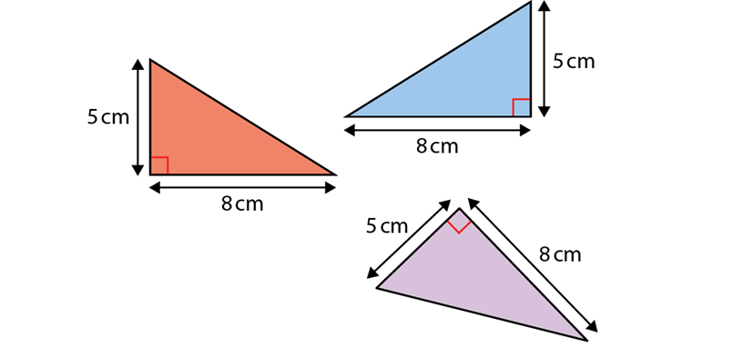
Checking prior learning (1)
a)
Which of these right-angled triangles have an area of 20 cm²?
b)
Draw a triangle/parallelogram with an area of 6cm².
Draw a different triangle/parallelogram with an area of 6cm².
And another…
Notes:
References to the questions (links on final slide):
NCETM primary assessment materials, Year 6 page 32
NCETM secondary assessment materials, page 35

Slide 11
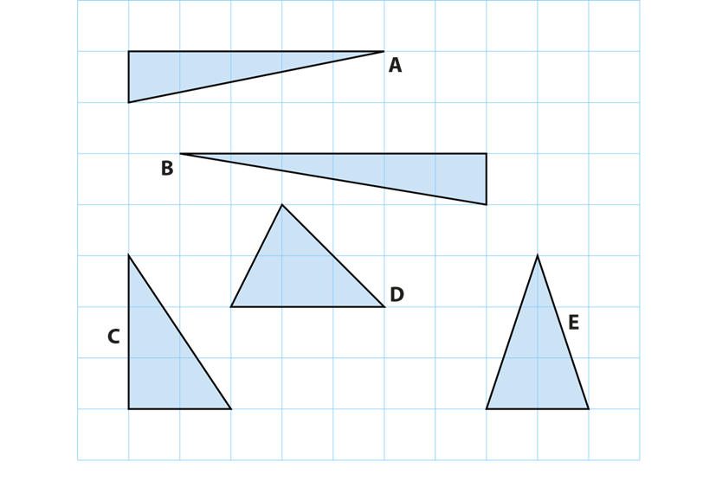
Checking prior learning (2)
c)
Here are five triangles on a square grid.
d)
Think about these rectangles:
a 4 cm by 6 cm rectangle
a 12 cm by 2 cm rectangle
a 3 cm by 8 cm rectangle.
What’s the same?
What’s different?
Four of the triangles have the same area.
Which triangle has a different area?
Notes:
References to the questions (links on final slide):
c) 2016 Key Stage 2 Mathematics Paper 3: reasoning, Question 17
d) NCETM primary assessment materials, Year 6 page 32

Slide 12
Common difficulties and misconceptions
What aspects of this key idea might students find challenging?
What misconceptions might students have?
When teaching this topic, you may find students encounter difficulties with…
Always relying on dividing a trapezium into rectangles/triangles
Memorising the formula without understanding how it is derived
More information, and some suggestions for overcoming these challenges, can be found on the following slides

Slide 13
Common difficulties and misconceptions (1)
When calculating the area of a trapezium, students may think that the only method is to divide the trapezium into rectangles and triangles, based on their experiences of finding the area of rectilinear shapes in Key Stage 2.
It will be important to offer students experience of lots of different trapezia, in various orientations. You can show them how they might not always have sufficient information to separate the shape into rectangles and triangles, and that the formula is a more efficient method.
The examples within this slide deck offer opportunities to explore how the formula for the area of a trapezium is derived.

Slide 14
Common difficulties and misconceptions (2)
Students may simply memorise a formula, and then substitute numbers into that formula, without appreciating the importance of the pair of parallel sides and the significance of the $\frac{1}{2}$ in the formula Area of a trapezium = $\frac{1}{2}\left(a+b\right)h$ .
There are many ways to explore the formula for the area of a trapezium using representations and making connections with the area of a parallelogram, triangle and rectangle. Some suggestions can be found on the ‘representations and structure’ slides in the appendices.

Slide 15
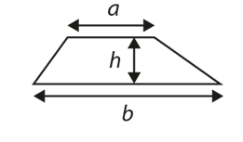
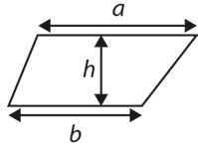
Understand that the formula to calculate the area of a trapezium can be applied to any trapezium – isosceles, right-angled or scalene
Example 1
Find the area of the trapezia below in terms of a, b and h.
a)
c)
b)
d)
Notes:
Suggested questioning:
What is the same and what is different about each trapezium?
How would you describe the relationship between a, b and h in each example?
Could you draw some different examples of trapezia?
Could you draw a non-example of a trapezium?
Things for you to think about:
The variation in these examples is designed to draw attention to certain features of trapezia, including misconceptions that may have arisen from pupils seeing very similar trapezia in the past. You may wish to think about the questioning you will use to encourage students to notice certain features. ‘Always, sometimes, never’ statements may be a helpful tool in this context e.g. “a is the longest side” or “a and b are horizontal”.

Slide 16
Understand that the formula to calculate the area of a trapezium can be applied to any trapezium – isosceles, right-angled or scalene
Example 1
Find the area of the trapezia below in terms of a, b and h.
What features of trapezia might your pupils notice from these four examples?
What other examples might you wish to include and why?
a)
b)
c)
d)
Notes:
More detail about the decisions behind the variation in these examples can be found on page 15 of the 6.2 Core Concept document.

Slide 17
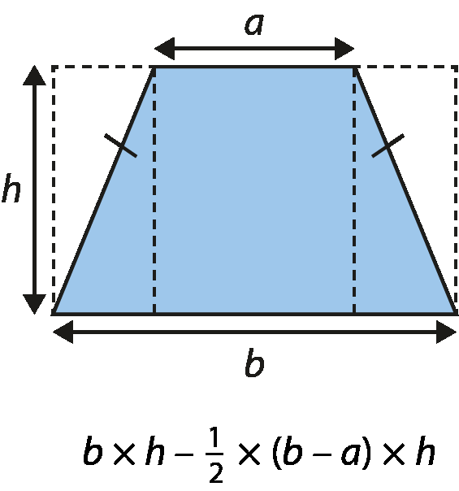
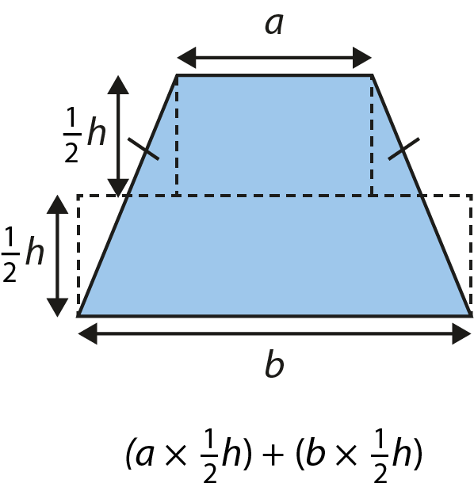
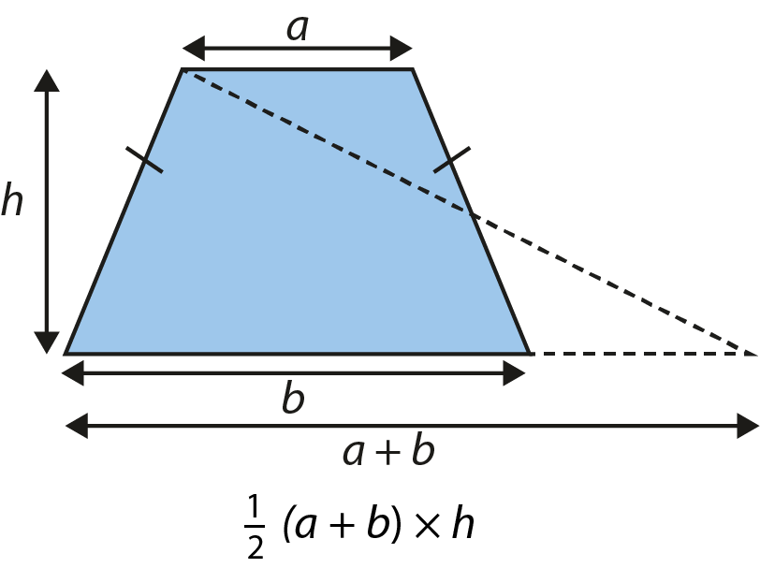
The formula for the area of a trapezium can be derived by examining the shape’s geometrical structure
Example 2
Ayesha:
Bronwyn:
David:
Explain how each person has derived their formula.
Justify that all of these formulae are equivalent to A = $\frac{1}{2}$(a + b)h
Notes:
Step-by-step reasoning for each of these derivations can be found in the Appendices.
Suggested questioning:
What is the same in each example? What is different?
In each example, where is the ½? Where are a, b and h?
How would each person need to adapt their methods if the trapezium was not isosceles?
Things for you to think about:
You may be used to showing students one particular derivation of the formula for the area of a trapezium: what is the benefit of showing multiple derivations? What other derivations could you use?

Slide 18
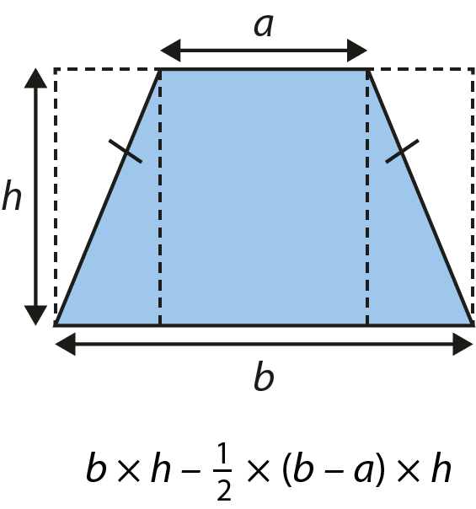
The formula for the area of a trapezium can be derived by examining the shape’s geometrical structure
Example 2
What is the benefit of modelling the derivation of the formula in different ways?
What other opportunities might there be in your curriculum to present students with multiple proofs?
Here, the trapezia are isosceles. What are the limitations of this? Why might you wish to explore proofs with non-isosceles trapezia as well?
Ayesha:
David:
Bronwyn:
Explain how each person has derived their formula.
Justify that all of these formulae are equivalent to $A=\frac{1}{2}\left(a+b\right)h$
Notes:
More detail about the decisions behind the thinking behind this task can be found on page 16 of the 6.2 Core Concept document.

Slide 19
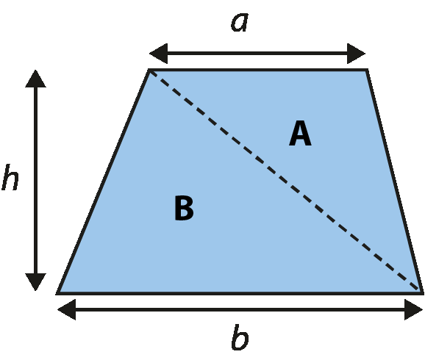
The formula for the area of a trapezium can be derived by examining the shape’s geometrical structure
Example 3
Divide the trapezium into two triangles, A and B
Area of trapezium = $\frac{1}{2}$ h (a + b)
Area of trapezium = $\frac{1}{2}$(ah + bh)
The area of triangle B =$\frac{1}{2}$ × b × h
Area of trapezium = ($\frac{1}{2}$× a × h) + ($\frac{1}{2}$ × b × h)
The area of the trapezium = area of triangle A + area of triangle B
The area of triangle A = $\frac{1}{2}$× a × h
Josh is deriving the formula for the area of a trapezium by thinking of the shape as split into two triangles.
He comes up with the following formula:
$$\text{(}\frac{1}{2} \text{×} \text{a} \text{×} \text{h}\text{)}\text{ +}\text{ (}\frac{1}{2} \text{×} \text{b} \text{×} \text{h}\text{)}$$
Rearrange the statements to show what Josh’s reasoning might have been.
Notes:
Step-by-step reasoning for this derivation can be found in the Appendices.
Suggested questioning:
Could you model this argument with a different trapezium?
How else might Josh write his formula?
Things for you to think about:
Recognising the equivalence of the three different statements for area of trapezium will require a degree of fluency in rearranging expressions; you may need to consider how familiar/confident students are with this.

Slide 20
The formula for the area of a trapezium can be derived by examining the shape’s geometrical structure
Example 3
Josh is deriving the formula for the area of a trapezium by thinking of the shape as split into two triangles.
Divide the trapezium into two triangles, A and B
Area of trapezium = $\frac{1}{2}$ h (a + b)
Area of trapezium = $\frac{1}{2}$(ah + bh)
The area of triangle B =$\frac{1}{2}$ × b × h
Area of trapezium = ($\frac{1}{2}$× a × h) + ($\frac{1}{2}$ × b × h)
The area of the trapezium = area of triangle A + area of triangle B
The area of triangle A = $\frac{1}{2}$× a × h
He comes up with the following formula:
$$\text{(}\frac{1}{2} \text{×} \text{a} \text{×} \text{h}\text{)}\text{ +}\text{ (}\frac{1}{2} \text{×} \text{b} \text{×} \text{h}\text{)}$$
Rearrange the statements to show what Josh’s reasoning might have been.
How does rearranging the statements support pupils to construct an argument?
How might you construct a similar task for a different geometrical formula?
PD questions…
Notes:
More detail about the sequencing of this example can be found on page 17 of the 6.2 Core Concept document.

Slide 21
Reflection questions
What other mathematical concepts will be supported by students’ stronger understanding of this key idea?
What mathematical language will you continue to use to support pupils to make connections with other areas?
Which representations might you continue to use to further develop students’ understanding?

Slide 23
Appendices
You may choose to use the following slides when planning or delivering a PD session. They cover:
Step by step reasoning for the models in Examples 2 and 3
Key vocabulary
Representations and structure
Previous learning
Future learning
Library of links

Slide 24
Step-by-step reasoning for Ayesha’s model in Example 2
Draw a larger rectangle around the trapezium, with dimensions b and h.
The area of the rectangle = b × h
The area of triangle A = $\frac{1}{2}$ × (h × $\frac{1}{2}$ × (b – a))
The area of triangle B = the area of triangle A (as the trapezium is isosceles)
The area of the trapezium = the area of the rectangle – (the area of triangle A + the area of triangle B)
The area of triangle A + the area of triangle B
= $\frac{1}{2}$ × (h × $\frac{1}{2}$ × (b – a)) + $\frac{1}{2}$ × (h × $\frac{1}{2}$ × (b – a))
= h × $\frac{1}{2}$ × (b – a)
= $\frac{1}{2}$ × (b – a) × h
The area of the trapezium = b × h – $\frac{1}{2}$ × (b – a) × h
A
B
$\frac{1}{2}$ × (b – a)
$\frac{1}{2}$ × (b – a)

Slide 25
Justification for Ayesha’s formula in Example 2
The area of the trapezium = b × h – $\frac{1}{2}$ × (b – a) × h
= b × h – $\frac{1}{2}$ × b × h + $\frac{1}{2}$ × a × h
= $\frac{1}{2}$ × b × h + $\frac{1}{2}$ × a × h
= $\frac{1}{2}$ × (a + b) × h

Slide 26
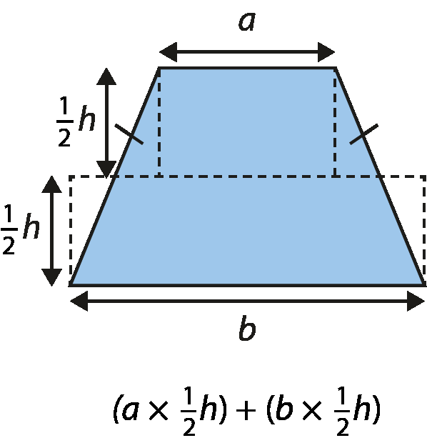
Step-by-step reasoning for Bronwyn’s model in Example 2
Split the trapezium into two rectangles, A and B.
The area of rectangle A = a × $\frac{1}{2}$ h
The area of rectangle B = b × $\frac{1}{2}$ h
The area of the trapezium = the area of rectangle A + the area of rectangle B
The area of the trapezium = (a × $\frac{1}{2}$ h) + (b × $\frac{1}{2}$ h)
A
C
E
D
B
F
Reasoning for step 4:
The blue triangle C is congruent to the white triangle D, because both have a height of $\frac{1}{2}$ h, and all angles are the same (this can be reasoned through rotational symmetry or using vertically opposite/alternate angles).
This holds for triangles E and F, as the trapezium is isosceles and therefore symmetrical.

Slide 27
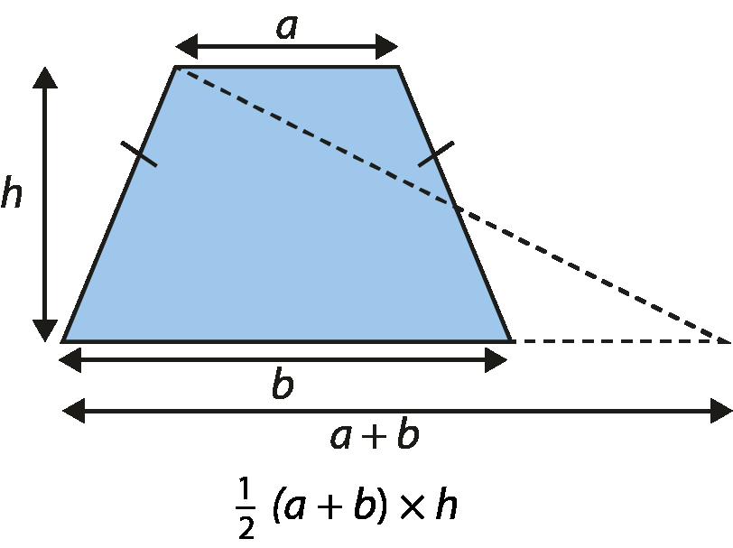
Step-by-step reasoning for David’s model in Example 2
A
D
Extend the length of side b by a to create a triangle with height h and base (a + b)
The area of the trapezium = the area of triangle
The area of the triangle = $\frac{1}{2}$ × (a + b) × h
F
B
C
E
Reasoning for step 2:
ABF and CEF are congruent as
Lines AB and DE are parallel.
$⦟$AFD = $⦟$EFC as vertically opposite angles are equal.
$⦟$FAD = $⦟$FEC and $⦟$FDA = $⦟$FCE as alternate angles are equal.
CE = AB as both are of length a.
Please note that, although the diagram here is an isosceles trapezium (as are all the trapezia in Example 2), this proof does not rely on this property. It can be generalised to all trapezia.

Slide 28
Step-by-step reasoning for Josh’s model in Example 3
Divide the trapezium into two triangles, A and B
The area of triangle A = $\frac{1}{2}$× a × h
The area of triangle B =$\frac{1}{2}$ × b × h
The area of the trapezium = area of triangle A + area of triangle B
Area of trapezium = ($\frac{1}{2}$× a × h) + ($\frac{1}{2}$ × b × h)
Area of trapezium = $\frac{1}{2}$(ah + bh)
Area of trapezium = $\frac{1}{2}$ h (a + b)
$$\text{(}\frac{1}{2} \text{×} \text{a} \text{×} \text{h}\text{)}\text{ +}\text{ (}\frac{1}{2} \text{×} \text{b} \text{×} \text{h}\text{)}$$
Notes:
Suggested questioning:
Could you model this argument with a different trapezium?
How else might Josh write his formula?
Things for you to think about:
Recognising the equivalence of the three different statements for area of trapezium will require a degree of fluency in rearranging expressions; you may need to consider how familiar/confident students are with this.

Slide 29
Key vocabulary
Term | Definition
rectilinear | Bounded by straight lines. A closed rectilinear shape is also a polygon. A rectilinear shape can be divided into rectangles and triangles for the purpose of calculating its area.
surface area | The surface area of a 3D figure is a measure of the area covered by all of the surfaces of the figure.
trapezium | A quadrilateral with exactly one pair of sides parallel.

Slide 30
Representations and structure (1)
There are a number of different representations that you may wish to use to support students’ understanding of area. These might include:
Geoboards
The use of both square and circular grid pin boards can support students’ exploration of the properties of various shapes made by stretching elastic bands around the pins or by drawing lines on a virtual board.
Dynamic geometry software
The guided use of dynamic geometry software can provide an environment in which students are able to make and test conjectures. By dragging and changing features, they are able to identify variant and invariant properties, leading to a deeper understanding of generalisations.
Mental imagery
The ultimate purpose of all representations is to support students’ mental construct of an idea or concept. It is therefore important to engage students in activities which require them to generate and manipulate their own mental images.
Notes:
More information about the representations and structure involved in this key idea can be found:
On pages 6 and 7 of the Geometry theme overview document.
Links can be found on the final slide.

Slide 31
Representations and structure (2)
Making connections to other shapes
There are many ways to explore the formula for the area of a trapezium using representations and making connections with the area of a parallelogram, triangle and rectangle.
Use two congruent trapezia to construct a parallelogram
This is a useful representation to support students’ understanding of the significance of the and the ‘sum of the parallel sides’ parts of the formula for the area of a trapezium. Students should be able to see that, since the area of the parallelogram = (a + b)h, the area of the trapezium must be half, or $\frac{1}{2}\left(a+b\right)h$ .
Notes:
More information about the representations and structure involved in this key idea can be found:
On page 14 of the 6.2 Core Concept document.
Links can be found on the final slide.

Slide 32
Representations and structure (3)
Making connections to other shapes
There are many ways to explore the formula for the area of a trapezium using representations and making connections with the area of a parallelogram, triangle and rectangle.
Partitioning a trapezium into two triangles
This derivation helps to support students’ understanding of the significance of the ‘perpendicular height’ part of the formula as they realise that the area of a trapezium is the sum of the area of two triangles, or $\frac{1}{2}b×h+\frac{1}{2}a×h=\frac{1}{2}\left(a+b\right)h$.
Notes:
More information about the representations and structure involved in this key idea can be found:
On page 14 of the 6.2 Core Concept document.
Links can be found on the final slide.

Slide 33
Previous learning
From Upper Key Stage 2, students will bring experience of:
drawing 2D shapes using given dimensions and angles
recognising, describing and building simple 3D shapes, including making nets
comparing and classifying geometric shapes based on their properties and sizes, and finding unknown angles in any triangles, quadrilaterals and regular polygons
illustrating and naming parts of circles, including radius, diameter and circumference, and knowing that the diameter is twice the radius
recognising angles where they meet at a point, are on a straight line or are vertically opposite, and finding missing angles
drawing and translating simple shapes on the coordinate plane and reflecting them in the axes.
Notes:
Theme 6 Geometry

Slide 34
Future learning (1)
In KS4, students will build on the core concepts in this mathematical theme to:
interpret and use fractional {and negative} scale factors for enlargements
{describe the changes and invariance achieved by combinations of rotations, reflections and translations}
identify and apply circle definitions and properties, including: centre, radius, chord, diameter, circumference, tangent, arc, sector and segment
{apply and prove the standard circle theorems concerning angles, radii, tangents and chords, and use them to prove related results}
construct and interpret plans and elevations of 3D shapes
interpret and use bearings
calculate arc lengths, angles and areas of sectors of circles
calculate surface areas and volumes of spheres, pyramids, cones and composite solids
Please note: Braces { } indicate additional mathematical content to be taught to more highly attaining students.

Slide 35
Future learning (2)
In KS4, students will build on the core concepts in this mathematical theme to:
apply the concepts of congruence and similarity, including the relationships between lengths, {areas and volumes} in similar figures
apply Pythagoras’ theorem and trigonometric ratios to find angles and lengths in right-angled triangles {and, where possible, general triangles} in two {and three} dimensional figures
know the exact values of sin θ and cos θ for θ = 30°, 45°, 60° and 90°; know the exact value of tan θ for θ = 30°, 45°, 60°
{know and apply the sine rule, $\frac{a}{SinA}=\frac{b}{SinB}=\frac{c}{SinC}$ , and cosine rule, $a^{2}=b^{2}+c^{2}– 2bc cos⁡A$, to find unknown lengths and angles}
{know and apply Area = to calculate the area, sides or angles of any triangle}
describe translations as 2D vectors
apply addition and subtraction of vectors, multiplication of vectors by a scalar, and diagrammatic and column representations of vectors; {use vectors to construct geometric arguments and proofs}.
Please note: Braces { } indicate additional mathematical content to be taught to more highly attaining students.
Notes:
Theme 6 Geometry

Slide 36
Library of links
The following resources from the NCETM website have been referred to within this slide deck:
NCETM Secondary Mastery Professional Development
6 Geometry Theme Overview Document
6.2 Area, perimeter and volume Core Concept Document
NCETM primary mastery professional development materials
NCETM primary assessment materials
NCETM secondary assessment materials
There are also references to:
Standards & Testing Agency’s past mathematics papers

