Slide 1
Year 1, Unit 8
Numbers 0 to 20

Slide 2
Year 1, Unit 8
These materials heavily reflect the prioritisation approach of the ready-to-progress criteria in the DfE Primary Mathematics Guidance 2020 and on the PPTs that exemplify them on the NCETM website. They also include other relevant National Curriculum content. Related sections of the NCETM Primary Mastery Professional Development Materials provide small-step teaching guidance.
Ready-to-progress criteria addressed by this unit
Teaching of this unit supports the following criteria from the ‘DfE Mathematics Guidance: key stages 1 & 2’ (the 335-page document available as a download)
1NPV-2 Page 20
Prior learning
This unit builds directly on Year 1, Unit 5: Numbers 0 to 10.

Slide 3
Contents
The links below take you to the starting slide of each learning outcome.
1 | Pupils explain that the digits in the numbers 11 to 19 express quantity
2 | Pupils explain that the digits in the numbers 11 to 19 express position on a number line
3 | Pupils identify the quantity shown in a representation of numbers 11 to 19
4 | Pupils use knowledge of ‘10 and a bit’ to solve problems
5 | Pupils use knowledge of ‘10 and a bit’ to solve problems
6 | Pupils explore odd and even numbers within 20
7 | Pupils double the numbers 6 to 9 and halve the result, explaining what doubling and halving is
Click the arrow button to return to this Contents slide.

Slide 4
Contents
The links below take you to the starting slide of each learning outcome.
8 | Pupils use knowledge of addition facts within 10 to add within 20
9 | Pupils use knowledge of subtraction facts within 10 to subtract within 20
10 | Pupils use knowledge of addition and subtraction facts within 10 to add and subtract within 20
11 | Pupils measure one object with different non-standard measures and record outcomes
12 | Pupils measure items using individual cm cubes (dienes)
13 | Pupils measure length from zero cm using a ruler
14 | Pupils estimate length in cm
15 | Pupils estimate length, measure length and record these values in a table
Click the arrow button to return to this Contents slide.

Slide 5
Year 1, Unit 8, Learning Outcome 1
Learning Outcome 1
Pupils explain that the digits in the numbers 11 to 19 express quantity
The following slides have been collated to support the teaching of this learning outcome.

Slide 6
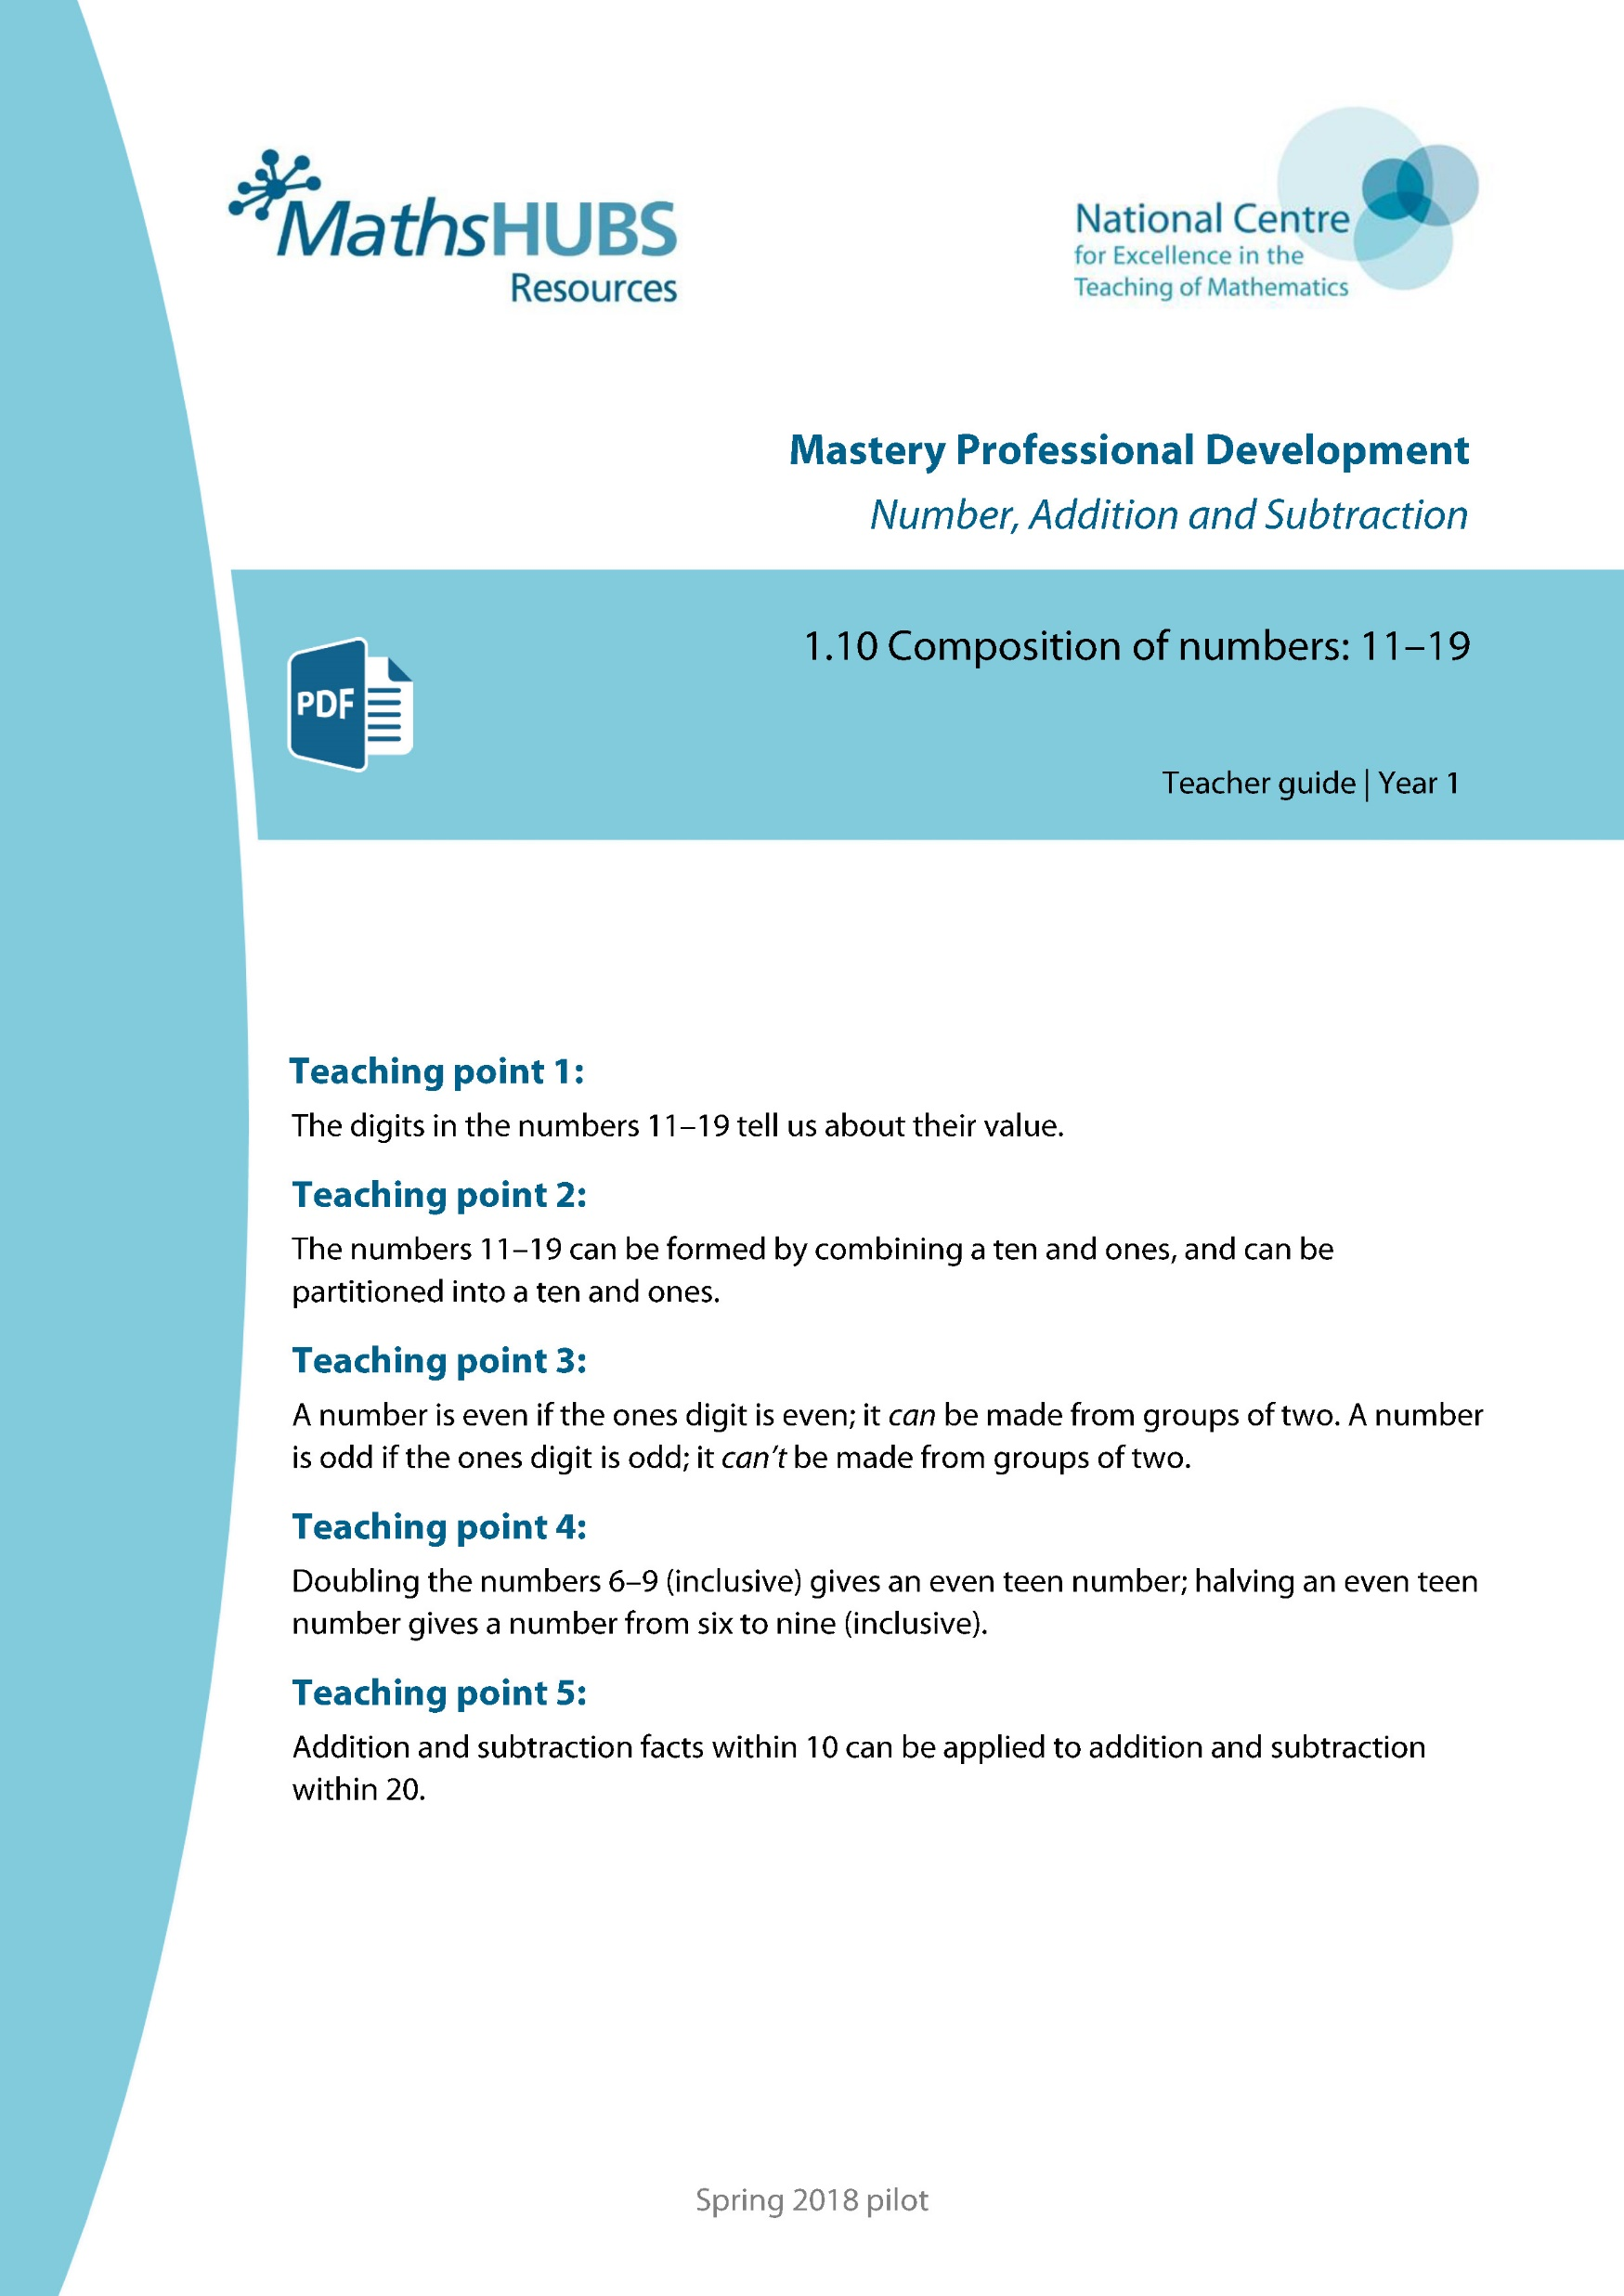
Year 1, Unit 8, Learning Outcome 1
Additional teacher guidance for this outcome should be read first and can be found in this segment of the NCETM Primary Mastery Professional Development Materials:
1:10 Composition of numbers: 11-19
The spine materials are divided into ‘teaching points’ and ‘steps in learning’.
Note than children will not have learnt about the numbers 20 – 100. This will be explored in depth in Year 2.
Teaching point | Steps in learning | Pages
1 | 1:1-1:5 | 3-5

Slide 7
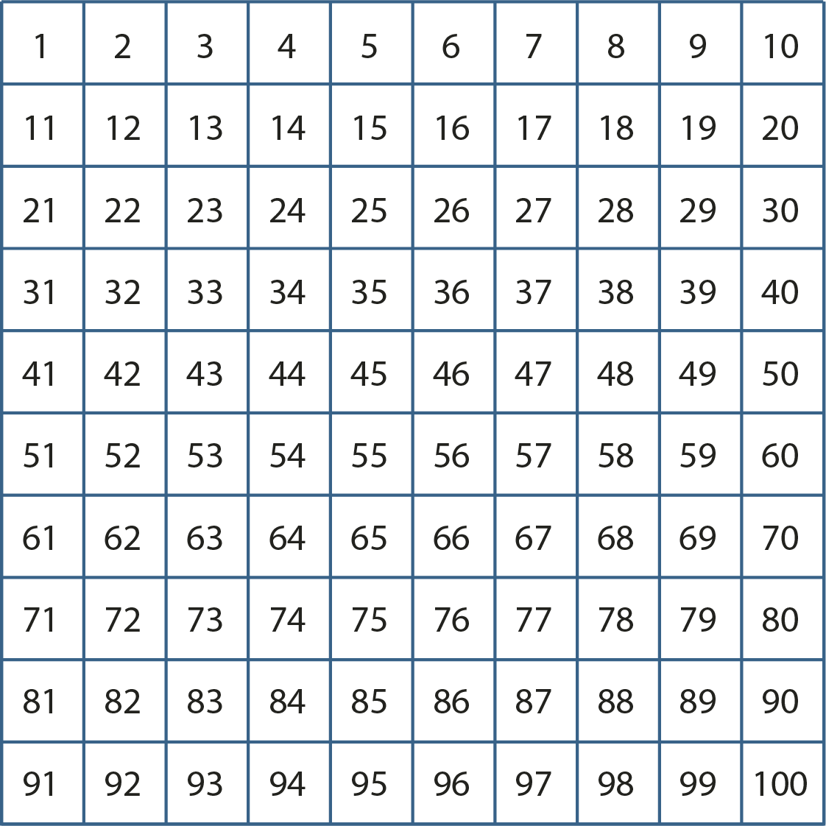
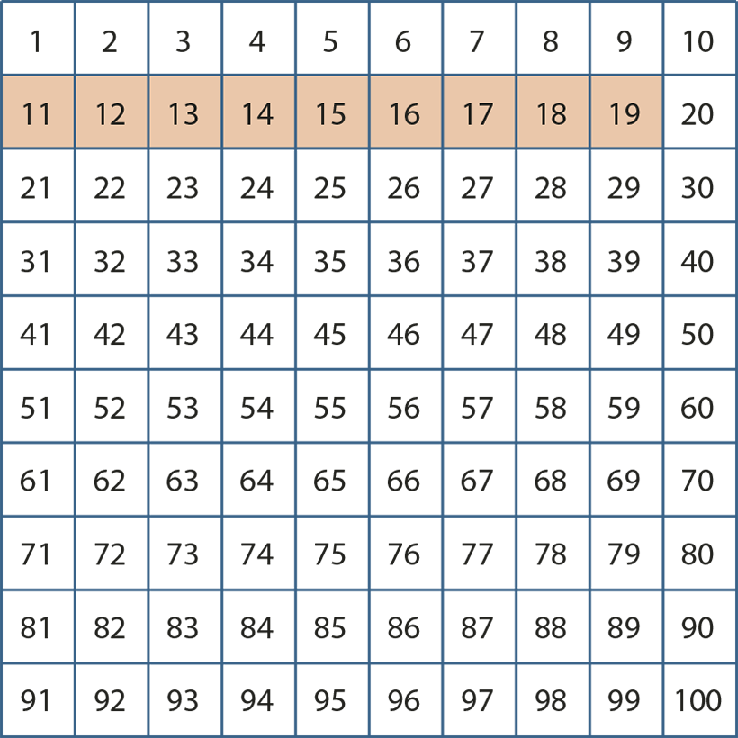
1.10 Composition: 11–19 – step 1:1

Slide 8
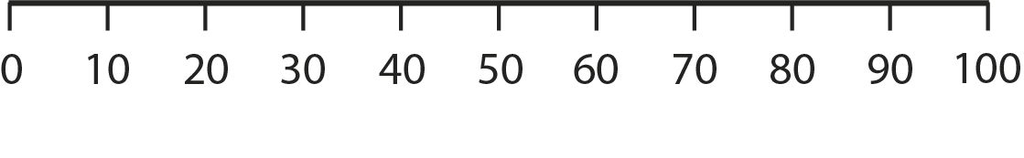

1.10 Composition: 11–19 – step 1:1

Slide 9

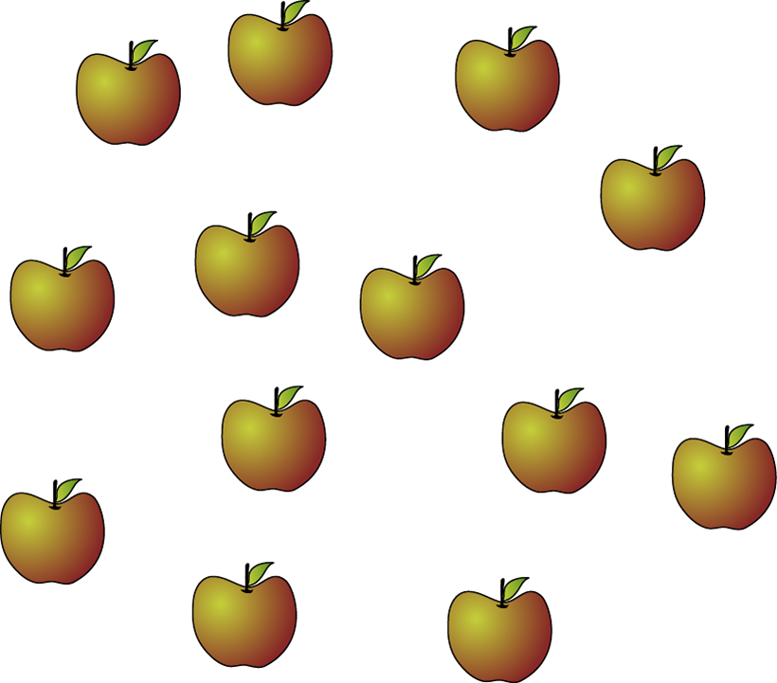
1.10 Composition: 11–19 – step 1:2

Slide 10

1.10 Composition: 11–19 – step 1:3

Slide 11
1.10 Composition: 11–19 – step 1:4
10s | 1s
1 | 5

Slide 12

1.10 Composition: 11–19 – step 1:4
10s | 1s
1 | 4

Slide 13







1.10 Composition: 11–19 – step 1:5

Slide 14
Year 1, Unit 8, Learning Outcome 2
Learning Outcome 2
Pupils explain that the digits in the numbers 11 to 19 express position on a number line
The following slides have been collated to support the teaching of this learning outcome.

Slide 15
Year 1, Unit 8, Learning Outcome 2
Additional teacher guidance for this outcome should be read first and can be found in this segment of the NCETM Primary Mastery Professional Development Materials:
1:10 Composition of numbers: 11-19
The spine materials are divided into ‘teaching points’ and ‘steps in learning’.
Teaching point | Steps in learning | Pages
1 | 1:6-1:9 | 6-9

Slide 16











1.10 Composition: 11–19 – step 1:6

Slide 17
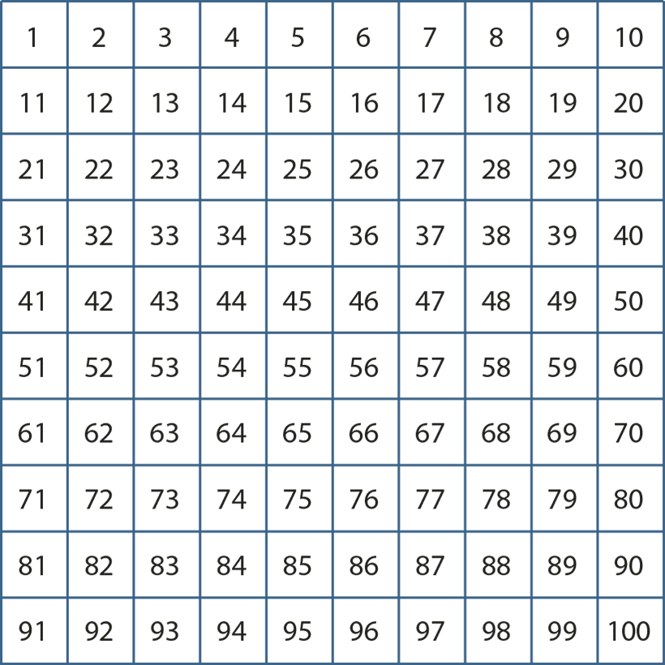
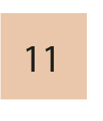
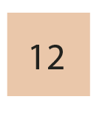
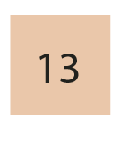
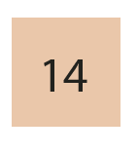
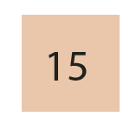
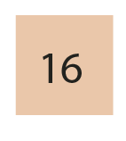
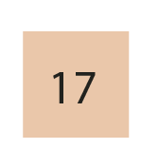
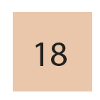

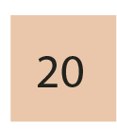
1.10 Composition: 11–19 – step 1:6
10

Slide 18
1.10 Composition: 11–19 – step 1:6
1000 | 2000 | 3000 | 4000 | 5000 | 6000 | 7000 | 8000 | 9000
100 | 200 | 300 | 400 | 500 | 600 | 700 | 800 | 900
10 | 20 | 30 | 40 | 50 | 60 | 70 | 80 | 90
1 | 2 | 3 | 4 | 5 | 6 | 7 | 8 | 9
10
20
1
2
3
4
5
6
7
8
9

Slide 19


1.10 Composition: 11–19 – step 1:8

Slide 20



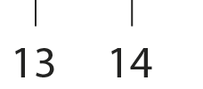


1.10 Composition: 11–19 – step 1:8

Slide 21
1NPV-2 Numbers to 20 in the linear number system
0
1
2
3
4
5
6
7
8
9
10
11
12
13
14
15
16
17
18
19
20
What is different about this number line from the one on the previous slide? What are the smallest and largest numbers shown here?
Which number is half-way between zero and twenty?
What do you notice about the numbers before ten? And the numbers after ten?
Can you find these numbers on a ruler? Is ten half-way between zero and twenty on the ruler?
Ten is half-way between zero and twenty.

Slide 22
1NPV-2 Numbers to 20 in the linear number system
What do you notice about each number line?
Can you remember the number which sits half-way between zero and ten?
Which number sits half-way between ten and twenty?
Look at 9 on the top line, then find 19 on the next line, what do you notice? Repeat for other ‘teen’ numbers.
0
1
2
3
4
5
6
7
8
9
10
10
11
12
13
14
15
16
17
18
19
20

Slide 23
1NPV-2 Numbers to 20 in the linear number system
5
19
0
1
2
3
4
5
6
7
8
9
10
11
12
13
14
15
16
17
18
19
20
Can you remember the numbers which sit half-way between zero and twenty, half-way between zero and ten, and half-way between ten and twenty?
Can you tell me some numbers which sit between zero and ten, and between ten and twenty?
Can you say which numbers sit where the arrow is pointing? Can you explain how you know, without needing to count from zero?

Slide 24
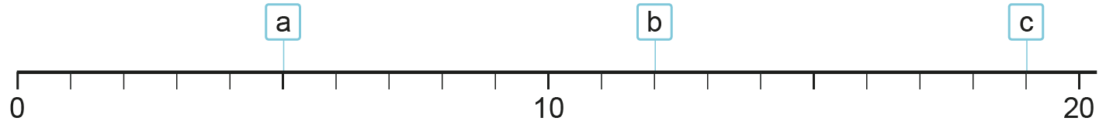
1NPV-2 Numbers to 20 in the linear number system
16
16
16
v
1
2
3
4
5
6
7
8
9
10
11
12
13
14
15
16
17
18
19
What do you notice about the number line?
Can you remember which number sits half-way between zero and twenty?
How can we use what we know about the numbers between 10 and 20 to place 16 on the number line?
Where do you think these numbers sit: 19, 9, 11, 2? Can you explain why?
Ten is half-way between zero and twenty.

Slide 25
Year 1, Unit 8, Learning Outcome 3
Learning Outcome 3
Pupils identify the quantity shown in a representation of numbers 11 to 19
The following slides have been collated to support the teaching of this learning outcome.

Slide 26
Year 1, Unit 8, Learning Outcome 3
Additional teacher guidance for this outcome should be read first and can be found in this segment of the NCETM Primary Mastery Professional Development Materials:
1:10 Composition of numbers: 11-19
The spine materials are divided into ‘teaching points’ and ‘steps in learning’.
Teaching point | Steps in learning | Pages
2 | 2:1-2:3 | 9-10

Slide 27


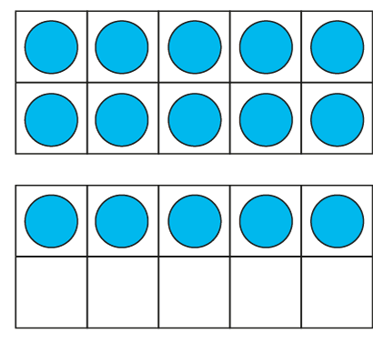
















1.10 Composition: 11–19 – step 2:1

Slide 28
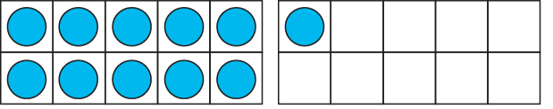
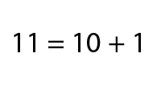
1.10 Composition: 11–19 – step 2:2

Slide 29
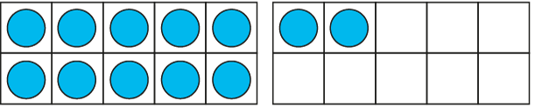
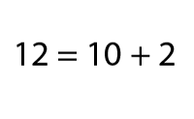
1.10 Composition: 11–19 – step 2:2

Slide 30
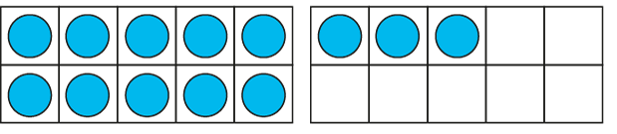
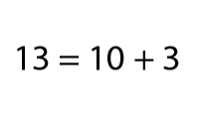
1.10 Composition: 11–19 – step 2:2

Slide 31
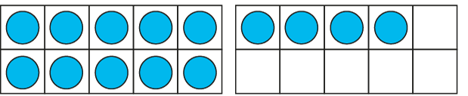
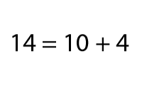
1.10 Composition: 11–19 – step 2:2

Slide 32
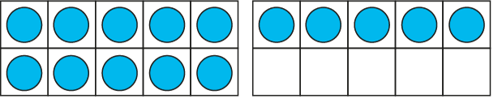
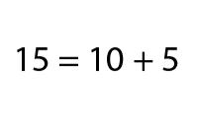
1.10 Composition: 11–19 – step 2:2

Slide 33
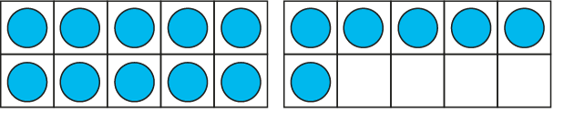
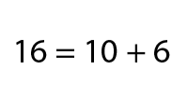
1.10 Composition: 11–19 – step 2:2

Slide 34
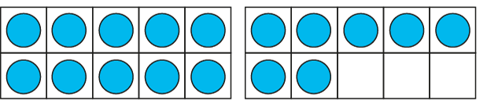
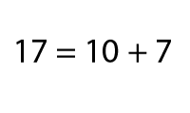
1.10 Composition: 11–19 – step 2:2

Slide 35
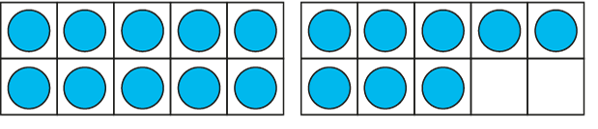
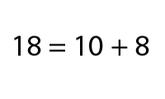
1.10 Composition: 11–19 – step 2:2

Slide 36

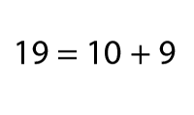
1.10 Composition: 11–19 – step 2:2

Slide 37
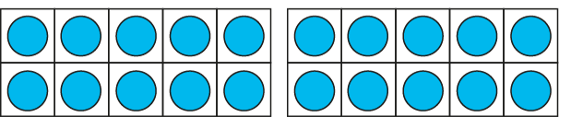
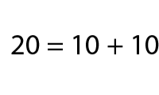
1.10 Composition: 11–19 – step 2:2

Slide 38

1.10 Composition: 11–19 – step 2:3
10
+
7
= 17

Slide 39
Year 1, Unit 8, Learning Outcome 4
Learning Outcome 4
Pupils use knowledge of ‘10 and a bit’ to solve problems
The following slides have been collated to support the teaching of this learning outcome.

Slide 40
Year 1, Unit 8, Learning Outcome 4
Additional teacher guidance for this outcome should be read first and can be found in this segment of the NCETM Primary Mastery Professional Development Materials:
1:10 Composition of numbers: 11-19
The spine materials are divided into ‘teaching points’ and ‘steps in learning’.
Teaching point | Steps in learning | Pages
2 | 2:4-2:6 | 11-13

Slide 41
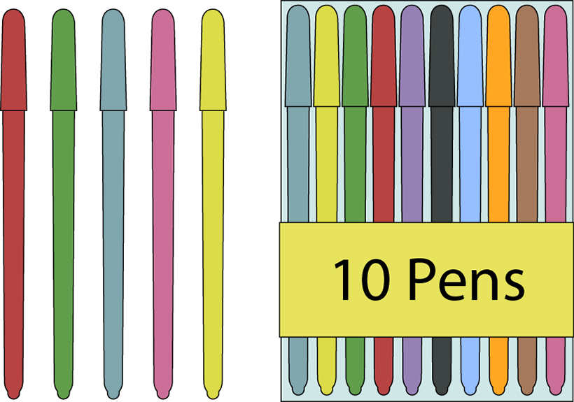
1.10 Composition: 11–19 – step 2:3
5
+
10
= 15

Slide 42
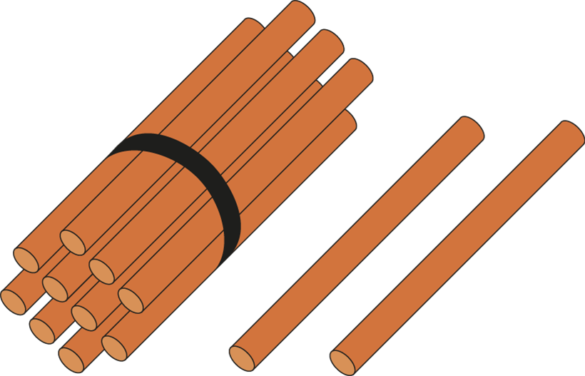
1.10 Composition: 11–19 – step 2:3
10
+
2
= 12

Slide 43

1.10 Composition: 11–19 – step 2:3
8
+
10
= 18

Slide 44


1.10 Composition: 11–19 – step 2:4

Slide 45


1.10 Composition: 11–19 – step 2:4

Slide 46


1.10 Composition: 11–19 – step 2:4

Slide 47



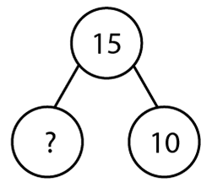
1.10 Composition: 11–19 – step 2:5

Slide 48

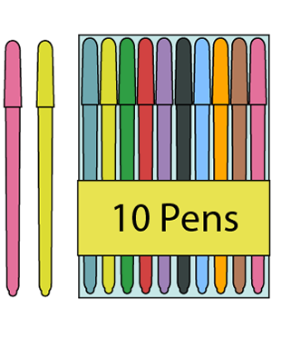
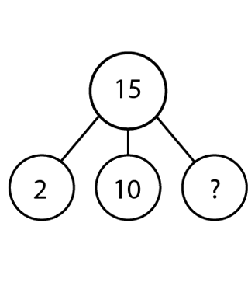
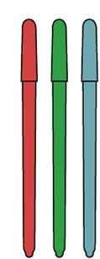
1.10 Composition: 11–19 – step 2:6

Slide 49
Year 1, Unit 8, Learning Outcome 5
Learning Outcome 5
Pupils use knowledge of ‘10 and a bit’ to solve problems
The following slides have been collated to support the teaching of this learning outcome.

Slide 50
Year 1, Unit 8, Learning Outcome 5
Additional teacher guidance for this outcome should be read first and can be found in this segment of the NCETM Primary Mastery Professional Development Materials:
1:10 Composition of numbers: 11-19
The spine materials are divided into ‘teaching points’ and ‘steps in learning’.
Teaching point | Steps in learning | Pages
2 | 2:7-2:9 | 13-14

Slide 51

1.10 Composition: 11–19 – step 2:7

Slide 52


1.10 Composition: 11–19 – step 2:7

Slide 53
Year 1, Unit 8, Learning Outcome 6
Learning Outcome 6
Pupils explore odd and even numbers within 20
The following slides have been collated to support the teaching of this learning outcome.

Slide 54
Year 1, Unit 8, Learning Outcome 6
Additional teacher guidance for this outcome should be read first and can be found in this segment of the NCETM Primary Mastery Professional Development Materials:
1:10 Composition of numbers: 11-19
The spine materials are divided into ‘teaching points’ and ‘steps in learning’.
As this unit focuses on numbers within 20 only use teaching points 3.1 to 3.3. Numbers greater than 20 are looked at in Y2.
Teaching point | Steps in learning | Pages
3 | 3:1-3:3 | 15-18

Slide 55


1.10 Composition: 11–19 – step 3:1

Slide 56
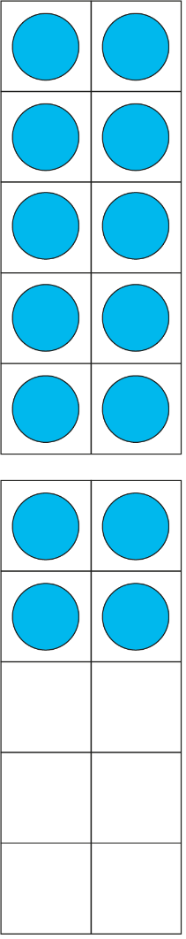
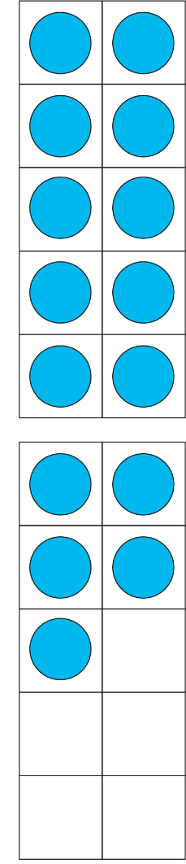






1.10 Composition: 11–19 – step 3:1

Slide 57
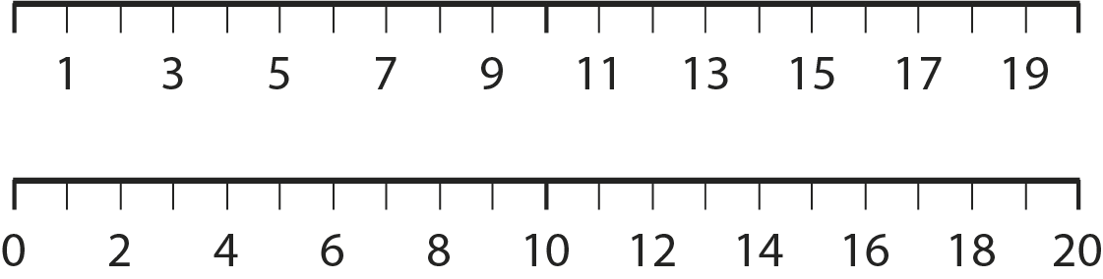
1.10 Composition: 11–19 – step 3:2

Slide 58
1.10 Composition: 11–19 – step 3:3
✓
✗
odd.
This number is
even.

Slide 59



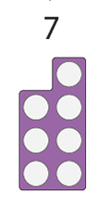

1NF-2 Count forwards and backwards in multiples of 2, 5 and 10
What numbers can you see on the number line? What do you notice about their shapes?
Can you remember what these sorts of numbers are called?
Practise saying the odd numbers forwards and backwards.

Slide 60
1NF-2 Count forwards and backwards in multiples of 2, 5 and 10
0
1
2
3
4
5
6
7
8
9
10
11
12
13
14
15
16
17
18
20
19
Which of the numbers between 10 and 20 are odd numbers?
Let’s say out loud the odd numbers and whisper the even numbers.
Can you do this forwards and backwards?
Can you describe the pattern of odd and even numbers?

Slide 61
1NF-2 Count forwards and backwards in multiples of 2, 5 and 10
1
2
3
4
5
6
7
8
9
10
Can you use the hundred square to practise saying all the odd numbers?
What is the pattern like?
How is this similar to counting in multiples of two? How is it different?
11
12
13
14
15
16
17
18
19
20
21
22
23
24
25
26
27
28
29
30
31
32
33
34
35
36
37
38
39
40
41
42
42
44
45
46
47
48
49
50
51
52
53
54
55
56
57
58
59
60
61
62
63
64
65
66
67
68
69
70
71
72
73
74
75
76
77
78
79
80
81
82
83
84
85
86
87
88
89
90
91
92
93
94
95
96
97
98
99
100

Slide 62
Year 1, Unit 8, Learning Outcome 7
Learning Outcome 7
Pupils double the numbers 6 to 9 and halve the result, explaining what doubling and halving is
The following slides have been collated to support the teaching of this learning outcome.

Slide 63
Year 1, Unit 8, Learning Outcome 7
Additional teacher guidance for this outcome should be read first and can be found in this segment of the NCETM Primary Mastery Professional Development Materials:
1:10 Composition of numbers: 11-19
The spine materials are divided into ‘teaching points’ and ‘steps in learning’.
Teaching point | Steps in learning | Pages
4 | 4:1-4:7 | 21-25

Slide 64
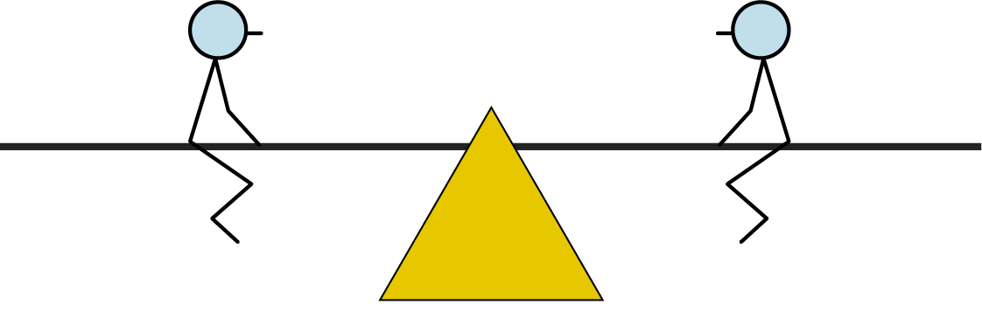
1.10 Composition: 11–19 – step 4:1

Slide 65
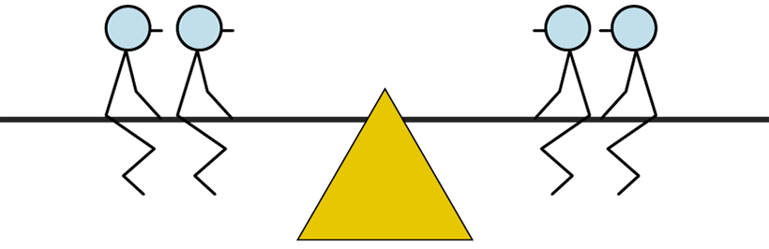

1.10 Composition: 11–19 – step 4:1

Slide 66
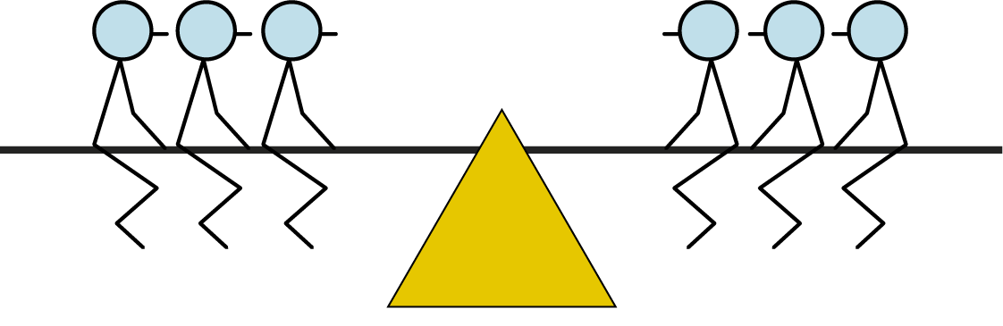
1.10 Composition: 11–19 – step 4:1

Slide 67

1.10 Composition: 11–19 – step 4:1

Slide 68



1.10 Composition: 11–19 – step 4:1

Slide 69






1.10 Composition: 11–19 – step 4:1

Slide 70

1.10 Composition: 11–19 – step 4:2
Number of beans at the start
Number of beans at the end
6
12

Slide 71


1.10 Composition: 11–19 – step 4:2
Number of beans at the start
Number of beans at the end
6
7
12
14

Slide 72
1.10 Composition: 11–19 – step 4:2
Number of beans at the start
Number of beans at the end
6
7
8
12
14
16

Slide 73
1.10 Composition: 11–19 – step 4:2
Number of beans at the start
Number of beans at the end
6
7
8
9
12
14
16
18

Slide 74












1.10 Composition: 11–19 – step 4:4

Slide 75




1.10 Composition: 11–19 – step 4:6

Slide 76


1.10 Composition: 11–19 – step 4:6

Slide 77
Year 1, Unit 8, Learning Outcome 8
Learning Outcome 8
Pupils use knowledge of addition facts within 10 to add within 20
The following slides have been collated to support the teaching of this learning outcome.

Slide 78
Year 1, Unit 8, Learning Outcome 8
Additional teacher guidance for this outcome should be read first and can be found in this segment of the NCETM Primary Mastery Professional Development Materials:
1:10 Composition of numbers: 11-19
The spine materials are divided into ‘teaching points’ and ‘steps in learning’.
Teaching point | Steps in learning | Pages
5 | 5:1-5:3 | 26-27

Slide 79







1.10 Composition: 11–19 – step 5:1

Slide 80












1.10 Composition: 11–19 – step 5:1

Slide 81

1.10 Composition: 11–19 – step 5:1
+ 2 = ?
15
5
10
3

Slide 82





1.10 Composition: 11–19 – step 5:2

Slide 83


1.10 Composition: 11–19 – step 5:2

Slide 84



1.10 Composition: 11–19 – step 5:2

Slide 85
Year 1, Unit 8, Learning Outcome 9
Learning Outcome 9
Pupils use knowledge of subtraction facts within 10 to subtract within 20
The following slides have been collated to support the teaching of this learning outcome.

Slide 86
Year 1, Unit 8, Learning Outcome 9
Additional teacher guidance for this outcome should be read first and can be found in this segment of the NCETM Primary Mastery Professional Development Materials:
1:10 Composition of numbers: 11-19
The spine materials are divided into ‘teaching points’ and ‘steps in learning’.
Teaching point | Steps in learning | Pages
5 | 5:4-5:5 | 28-29

Slide 87







1.10 Composition: 11–19 – step 5:4

Slide 88






1.10 Composition: 11–19 – step 5:4

Slide 89

1.10 Composition: 11–19 – step 5:4
− 3 = ?
16
6
10
9

Slide 90





1.10 Composition: 11–19 – step 5:5

Slide 91




1.10 Composition: 11–19 – step 5:5

Slide 92


1.10 Composition: 11–19 – step 5:5

Slide 93
Year 1, Unit 8, Learning Outcome 10
Learning Outcome 10
Pupils use knowledge of addition and subtraction facts within 10 to add and subtract within 20
The following slide supports the teaching of this learning outcome.

Slide 94
Year 1, Unit 8, Learning Outcome 10
Additional teacher guidance for this outcome should be read first and can be found in this segment of the NCETM Primary Mastery Professional Development Materials:
1:10 Composition of numbers: 11-19
The spine materials are divided into ‘teaching points’ and ‘steps in learning’.
Teaching point | Step in learning | Pages
5 | 5:7 | 29-30

Slide 95
Year 1, Unit 8, Learning Outcome 11
Learning Outcome 11
Pupils measure one object with different non-standard measures and record outcomes
The following slides have been collated to support the teaching of this learning outcome.
Outcomes 11 to 15 provide an opportunity for children to apply their understanding of numbers 0 to 20 in a measures context.

Slide 96

Year 1, Unit 8, Learning Outcome 11
For support with lesson and task design, refer to:
the NCETM National Curriculum Resource Tool
additional planning resources or high-quality textbooks used by your school.

Slide 97
Year 1, Unit 8, Learning Outcome 12
Learning Outcome 12
Pupils measure items using individual cm cubes (dienes)
The following slide supports the teaching of this learning outcome.
Outcomes 11 to 15 provide an opportunity for children to apply their understanding of numbers 0 to 20 in a measures context.

Slide 98
Year 1, Unit 8, Learning Outcome 12
For support with lesson and task design, refer to:
the NCETM National Curriculum Resource Tool
additional planning resources or high-quality textbooks used by your school.

Slide 99
Year 1, Unit 8, Learning Outcome 13
Learning Outcome 13
Pupils measure length from zero cm using a ruler
The following slides have been collated to support the teaching of this learning outcome.
Outcomes 11 to 15 provide an opportunity for children to apply their understanding of numbers 0 to 20 in a measures context.

Slide 100

Year 1, Unit 8, Learning Outcome 13
Additional teacher guidance for this outcome should be read first and can be found in the DfE Mathematics guidance. Page references relate to the 335-page document available as a download at the bottom of this web page.
Ready to progress criteria | Pages
1NPV-2 | 20-23

Slide 101

1NPV-2 Numbers to 20 in the linear number system
What do you notice about the numbers on the picture of the ruler? How is the ruler similar to a number line?
What does the ‘cm’ on the ruler mean?
Can you describe how the leaf is placed against the ruler? Why? So, can you say how long the leaf is, using the word ‘centimetres’?
Let’s look at our classroom rulers! What numbers can we see on them?
Can we use our rulers to measure some things in our classroom? What must we remember to do and say?

Slide 102
Year 1, Unit 8, Learning Outcome 14
Learning Outcome 14
Pupils estimate length in cm
The following slide supports the teaching of this learning outcome.
Outcomes 11 to 15 provide an opportunity for children to apply their understanding of numbers 0 to 20 in a measures context.

Slide 103
Year 1, Unit 8, Learning Outcome 14
Additional teacher guidance for this outcome should be read first and can be found in the DfE Mathematics guidance. Page references relate to the 335-page document available as a download at the bottom of this web page.
Ready to progress criteria | Pages
1NPV-2 | 20-23

Slide 104

1NPV-2 Numbers to 20 in the linear number system
10cm
10cm
Someone has lost their ruler! But they have two strips of paper to use to measure things. What do you notice about the paper strips? How can they use their number knowledge to help them?
Why do you think they might have placed the rubber where they did?
So, about how long is the rubber, do you think? How could they check with a ruler?
Can you use two paper strips to say about how long some classroom objects are?
My [object] is about ____ centimetres long.

Slide 105
Year 1, Unit 8, Learning Outcome 15
Learning Outcome 15
Pupils estimate length, measure length and record these values in a table
The following slide supports the teaching of this learning outcome.
Outcomes 11 to 15 provide an opportunity for children to apply their understanding of numbers 0 to 20 in a measures context.

Slide 106
Year 1, Unit 8, Learning Outcome 15
For support with lesson and task design, refer to:
the NCETM National Curriculum Resource Tool
additional planning resources or high-quality textbooks used by your school.

