Slide 1
1.14 Addition and subtraction: two-digit numbers and multiples of ten
Representations | Year 2
Number, Addition and Subtraction

Slide 2
How to use this presentation
You can find the teacher guide 1.14 Addition and subtraction: two-digit numbers and multiples of ten by following the link below.

Slide 3
1.14 Calculation: two-digit +/− tens – step 1:1

Slide 4
1.14 Calculation: two-digit +/− tens – step 1:2

Slide 5
1.14 Calculation: two-digit +/− tens – step 1:2

Slide 6
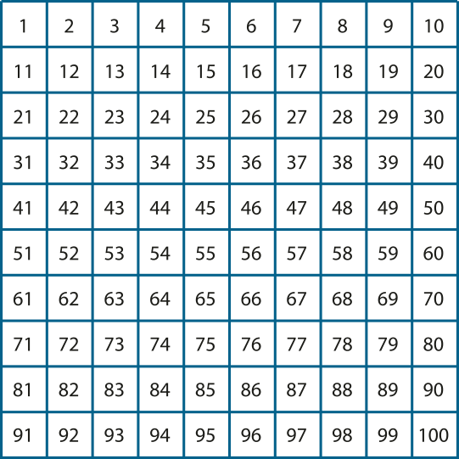
1.14 Calculation: two-digit +/− tens – step 1:3

Slide 7
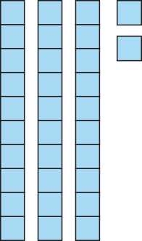
1.14 Calculation: two-digit +/− tens – step 1:4
10 more
32
42

Slide 8
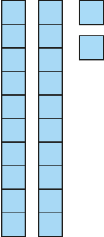
1.14 Calculation: two-digit +/− tens – step 1:4
10 less
32
22

Slide 9
1.14 Calculation: two-digit +/− tens – step 1:5
38
58
78
98

Slide 10
1.14 Calculation: two-digit +/− tens – step 2:1
14 + 10 =
24
24 + 10 =
34
34 + 10 =
44
44 + 10 =
54
54 + 10 =
64
64 + 10 =
74
74 + 10 =
84
84 + 10 =
94

Slide 11
1.14 Calculation: two-digit +/− tens – step 2:1
24 – 10 =
14
34 – 10 =
24
44 – 10 =
34
54 – 10 =
44
64 – 10 =
54
74 – 10 =
64
84 – 10 =
74
94 – 10 =
84

Slide 12
1.14 Calculation: two-digit +/− tens – step 2:1
14 + 10 =
24
24 – 10 =
14
24 + 10 =
34
34 – 10 =
24
34 + 10 =
44
44 – 10 =
34
44 + 10 =
54
54 – 10 =
44
54 + 10 =
64
64 – 10 =
54
64 + 10 =
74
74 – 10 =
64
74 + 10 =
84
84 – 10 =
74
84 + 10 =
94
94 – 10 =
84

Slide 13
1.14 Calculation: two-digit +/− tens – step 2:3
46
46
36
10
10
36
36 + 10 = 46
10 + 36 = 46

Slide 14
1.14 Calculation: two-digit +/− tens – step 2:4

Slide 15
1.14 Calculation: two-digit +/− tens – step 2:4

Slide 16
1.14 Calculation: two-digit +/− tens – step 2:5
82
?
10
72
82
= 10 + 72
72 = – 10
82

Slide 17
1.14 Calculation: two-digit +/− tens – step 2:5
56
46
10
46 = 56 10
–
56 = 46 10
+

Slide 18
1.14 Calculation: two-digit +/− tens – step 3:1
5
5 tens
50
3
2
3 tens
2 tens
30
20

Slide 19
1.14 Calculation: two-digit +/− tens – step 3:2
45
55
65
75

Slide 20
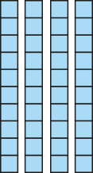
1.14 Calculation: two-digit +/− tens – step 3:3
45 =
40
+ 5

Slide 21
1.14 Calculation: two-digit +/− tens – step 3:3
45
+
30
= 75

Slide 22
1.14 Calculation: two-digit +/− tens – step 3:3
45
+ 30
=
75
40
5
10s | 1s
4
+
7
3
5

Slide 23
1.14 Calculation: two-digit +/− tens – step 3:3
45
+
30
5
40
70
45 + 30 = 75

Slide 24
1.14 Calculation: two-digit +/− tens – step 3:4
42
52
62
32
10
32
20
32
30

Slide 25
1.14 Calculation: two-digit +/− tens – step 3:4
45
55
65
15
30
25
30
35
30

Slide 26
1.14 Calculation: two-digit +/− tens – step 3:5
43
63
?
20

Slide 27
1.14 Calculation: two-digit +/− tens – step 3:5
32
72
?
40

Slide 28
1.14 Calculation: two-digit +/− tens – step 3:5
39
59
?
20

Slide 29
1.14 Calculation: two-digit +/− tens – step 3:6
45
55
65
75

Slide 30
1.14 Calculation: two-digit +/− tens – step 3:7
75 =
70
+ 5

Slide 31
1.14 Calculation: two-digit +/− tens – step 3:7
75
–
30
= 45

Slide 32
1.14 Calculation: two-digit +/− tens – step 3:7
75
– 30
=
45
70
5
10s | 1s
7
4
–
3
5

Slide 33
1.14 Calculation: two-digit +/− tens – step 3:7
75
–
30
5
70
40
75 – 30 = 45

Slide 34
1.14 Calculation: two-digit +/− tens – step 3:8
97
97
97
87
10
77
20
67
30

Slide 35
1.14 Calculation: two-digit +/− tens – step 3:8
47
57
67
17
30
27
30
37
30

Slide 36
1.14 Calculation: two-digit +/− tens – step 3:9
48
68
?
20

Slide 37
1.14 Calculation: two-digit +/− tens – step 3:9
24
74
50
?

Slide 38
1.14 Calculation: two-digit +/− tens – step 3:9
43
?
63
20

Slide 39
1.14 Calculation: two-digit +/− tens – step 4:1
73
30
43
20
53
73
73
73
63
10
53
20
43
30

Slide 40
1.14 Calculation: two-digit +/− tens – step 4:1
20
46
26
?

Slide 41
1.14 Calculation: two-digit +/− tens – step 4:1
30
?
59
29

Slide 42
1.14 Calculation: two-digit +/− tens – step 4:1
31
?
71
40

Slide 43
1.14 Calculation: two-digit +/− tens – step 4:2
73
33
30
10

