Slide 1
Multiplicative structures for positive and negative integers
KS3 Mastery PD Materials: Exemplified Key Ideas
Materials for use in the classroom or to support professional development discussions
(from 2.1 Arithmetic procedures)
Summer 2021

Slide 2
About this resource
These slides are designed to complement the 2.1 Arithmetic procedures Core Concept document and its associated Theme Overview document 2 Operating on number, both found in the Secondary Mastery Professional Development pages.
These slides re-present the key examples from the Core Concept document so that the examples can be used either directly in the classroom or with a group of teachers. There are prompt questions alongside the examples, and further clarification in the notes.
These slides do not fully replicate the Core Concept document, so should be used alongside it. Reference to specific page numbers, and to other useful NCETM resources, can be found in the notes for each slide.
This slide deck is not designed to be a complete PD session, rather it is a selection of resources that you can adapt and use as needed when planning a session with a group of teachers.

Slide 3


About this resource
The slides are structured as follows:
  The big picture:
    Where does this fit in?
    What do students need to understand?
    Why is this key idea important?
  Prior learning
  Misconceptions
  Exemplified key ideas
  Reflection questions
  Appendices:
    Key vocabulary
    Representations and structure
    Previous and Future learning
    Useful links
The exemplified key idea slides have the following symbols to indicate how they have been designed to be used:
Into the classroom
The examples are presented on these slides so that they could be used in PD, but also directly in the classroom. The notes feature suggested questions and things teachers might consider when using with students.
PD discussion prompts
These slides look at the examples in more detail, with question prompts to promote discussion among maths teachers. The notes feature reference to further information and guidance within the Core Concepts document.

Slide 4
Where does this fit in?
The NCETM has identified a set of six ‘mathematical themes’ within Key Stage 3 mathematics that bring together a group of ‘core concepts’.
The second of these themes is Operating on number, which covers the following interconnected core concepts:
2.1 Arithmetic procedures
2.2 Solving linear equations
Notes:
Linked on this slide is the Theme Overview document of Operating on Number. This document includes why it is important, the key underpinning knowledge and links to prior and future learning. There is also guidance about how the five big ideas of Teaching for Mastery relate specifically to this theme.

Slide 5
Where does this fit in?
Within this core concept, 2.1 Arithmetic Procedures, there are five statements of knowledge, skills and understanding.
These, in turn, are broken down into twenty one key ideas. The highlighted key idea is exemplified in this slide deck.
Notes:
For key ideas marked with an asterisk, we exemplified the common difficulties and misconceptions that students might have and included elements of what teaching for mastery may look like. We have provided examples of possible student tasks and teaching approaches.
Within these slides are ‘classroom-ready’ versions of the examples for the key idea that has been highlighted. There are also slides that may be useful for discussion in a professional development session

Slide 6
What do students need to understand?
2.1.2.1 Understand the mathematical structures that underpin multiplication and division of positive and negative integers
Understand multiplication and division with one negative factor
Understand multiplication and division with two negative factors
Use the associative law to calculate the products of positive and negative numbers
  What prior knowledge might your students already have?
  What language might they use to describe this key idea?
  What questions might you want to ask to assess their prior learning?

Slide 7
Why is this key idea important?
The ability to calculate is a fundamental skill in mathematics and this, of course, includes the requirement that students know and use standard methods of calculation. However, students who know these methods solely as a set of memorised steps, without any understanding of why they work and the laws of arithmetic on which they are based, may quickly forget them.
Multiplication and division involving negative integers is introduced in this set of key ideas. The use of negative numbers extends the domain in which students can explore and deepen their understanding of the multiplicative structure.
This can bring to the surface misconceptions based on previous experiences of multiplication and division with positive numbers (i.e. ‘multiplication makes bigger’) and may raise questions about the difference between magnitude and value of a negative number.
It is important to explore why the rules for combining positive and negative numbers work and to avoid rote learning of the rules without meaning. For example, the structure −a × 0 = −a × (+b + −b) together with the application of the distributive law can be used to give meaning to the fact that the product of two negative numbers is a positive number.
Notes:
A more detailed overview of the core concept of arithmetic procedures can be found on page 2 of the 2.1 Core Concept document.
The background to each key idea is also explored in more detail on the following pages:
2.1.1 Understand and use the structures that underpin addition and subtraction strategies – page 10
2.1.2 Understand and use the structures that underpin multiplication and division strategies – pages 10 and 11
2.1.3 Know, understand and use fluently a range of calculation strategies for addition and subtraction of fractions – page 11
2.1.4 Know, understand and use fluently a range of calculation strategies for multiplication and division of fractions – pages 11 and 12
2.1.5 Use the laws and conventions of arithmetic to calculate efficiently – pages 12 and 13

Slide 8
Prior learning
Upper Key Stage 2 Learning Outcome
Multiply and divide whole numbers and those involving decimals by 10, 100 and 1 000
Multiply multi-digit numbers up to four digits by a two-digit whole number using the formal written method of long multiplication
Divide numbers up to four digits by a two-digit whole number using the formal written methods of long or short division, and interpret remainders as whole number remainders, fractions, or by rounding, as appropriate for the context
Use their knowledge of the order of operations to carry out calculations involving the four operations
Solve problems involving addition, subtraction, multiplication and division
Use negative numbers in context, and calculate intervals across zero
  What prior knowledge might your students already have?
  What language might they use to describe this key idea?
  What questions might you want to ask to assess their prior learning?
Notes:
You may find it useful to speak to your partner schools to see how the above has been covered and the language used.
The prior learning is covered in a number of the segments from Spines 1, 2 and 3 of the NCETM primary mastery professional development materials (linked on final slide):
Within the 2 Operating on number Theme Overview document, you can also find a broader description of students’ potential previous learning (page 6), alongside further information about key underpinning knowledge (page 2). More detail about the prior learning objectives from KS2 can also be found on pages 2 and 3 of the 2.1 Core Concept document.

Slide 9
Checking prior learning
The following slides contain questions for checking prior learning.
  What representations might students use to support their understanding of these questions?
  What variation might you put in place for these questions to fully assess students’ understanding of the concept?
  How might changing the language of each question change the difficulty?
  Why are these such crucial pre-requisites for this key idea?

Slide 10
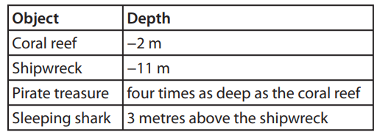
Checking prior learning (1)
a)
Put these numbers in order, from smallest to largest:
-4.4, -4.44, -4.04, -4.404
b)
A scientist measures the depth of some objects below the surface of the sea. She records her measurements using negative numbers.
Which object is deepest? Explain your choice.
Is the sleeping shark deeper than the pirate treasure? Explain your reasoning.
A seagull is hovering 1m above the surface of the sea. How far apart are the seagull and the coral reef?
Notes:
References to the questions (links on final slide):
a) NCETM primary assessment materials: Year 6, page 10
b) NCETM primary assessment materials: Year 6, page 11

Slide 11
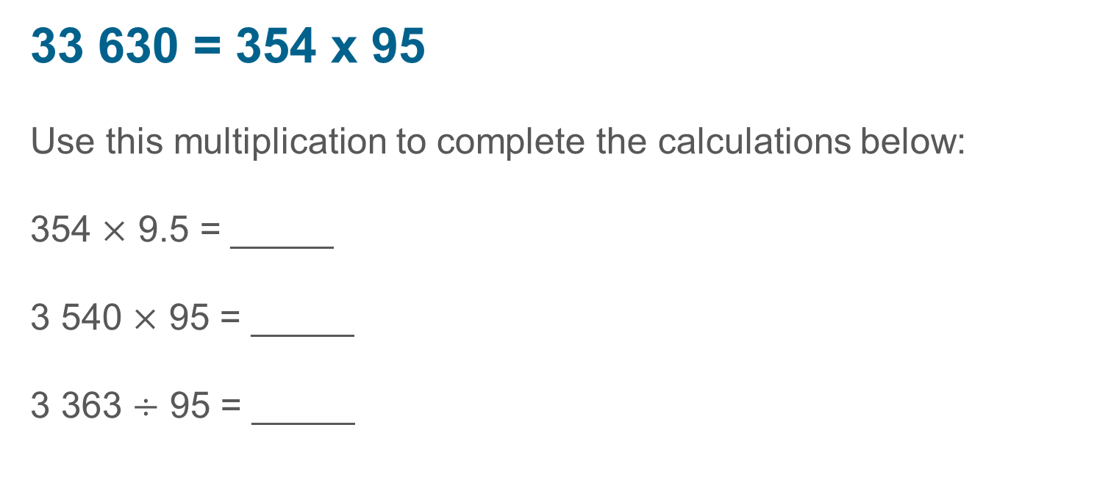
Checking prior learning (2)
c)
33 630 = 354 x 95
Use this multiplication to complete the calculations below:
354 $×$ 9.5 = _____
3 540 $×$ 95 = _____
3 363 $÷$ 95 = _____
Notes:
References to the questions (links on final slide):
c) 2018 Key Stage 2 Mathematics Paper 3: reasoning, Question 19

Slide 12
Common difficulties and misconceptions
What aspects of this key idea might students find challenging?
What misconceptions might students have?
When teaching this topic, you may find students encounter difficulties with…
Challenging the idea that ‘multiplication makes bigger’
Using informal rules such as ‘two negatives make a positive’
More information, and some suggestions for overcoming these challenges, can be found on the following slides

Slide 13
Common difficulties and misconceptions (1)
As discussed in 2.1.1.1, students are likely to have met negative numbers at KS2, but this may only have been in context and they are unlikely to have carried out operations involving negative values.
Many students at KS3 may have the misconception that ‘multiplication makes bigger’ when working with positive numbers.
There may be additional layers added to this when consideration is given to the difference between magnitude and value when working with negative numbers.
For example, until they met negative numbers, students experience would be that numbers closer to zero are ‘smaller’ both in terms of their value and their magnitude. When considering -591 and -3, students may consider that -591 is larger because it’s further from zero but agree that it’s a lower value.
Modelling consistent language around this (for example, by using “greater or less” rather than the more ambiguous “bigger or smaller”) may help students as they deepen their understanding.
Notes:
More detail can be found on page 24 of the 2.1 Core Concept document.

Slide 14
Common difficulties and misconceptions (2)
Some students will come to working with negative numbers knowing some informal rules such as ‘two negatives make a positive’. Exploring the limits of this sort of rule with a class may be of benefit in moving students to a deeper and more connected understanding.
Notes:
More detail can be found on page 24 of the 2.1 Core Concept document.

Slide 15
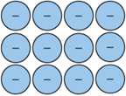
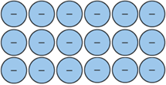
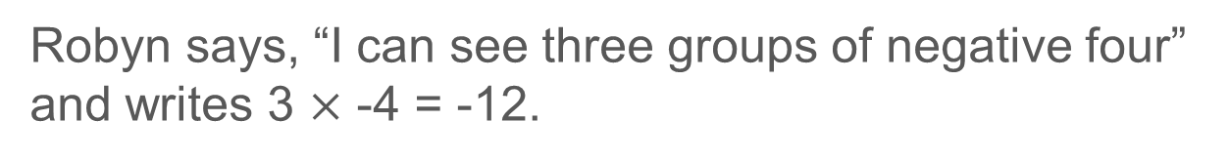
Understand multiplication and division with one negative factor
Example 1
The diagram shows some counters in an array.
Robyn says, “I can see three groups of negative four” and writes 3 $×$ -4 = -12.
Taylor says, “I can see four groups of negative three.”
Write a number sentence for Taylor’s description of the array.
Write two number sentences that might describe this array.
Notes:
Suggested questioning:
Where in the array are the 3 groups of -4? Where are the 4 groups of -3?
What is the same/different about Robyn and Taylor’s interpretation?
What is the product represented in the second array? How do you know?
Things for you to think about:
Here an array is used to connect an existing representation for multiplication and extend it to include products with one negative factor. Robyn and Taylor both use the array to identify groups of values and you might like to work with students to write these as repeated additions (for example, writing Robyn’s statement as -4 + -4 + -4 to also extend this interpretation of multiplication to negative products. The array is a powerful model of multiplication but can be challenging when working with negative numbers.
It is used here with only one negative factor, but the narrative might be continued (using zero pairs) to extend this representation to allow for calculations with two negative factors. An example of how this might be modelled is given on slide 17. However, because of the inconsistencies described, the array has not been used in these materials as a model to multiply two negative numbers. Instead students are asked to reason with mathematical structure in order to justify the outcome for the product of two negative numbers (see Example 4)

Slide 16
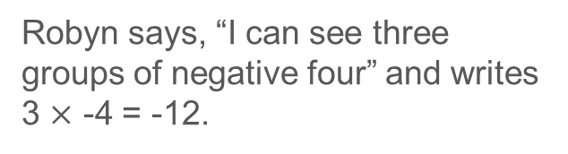
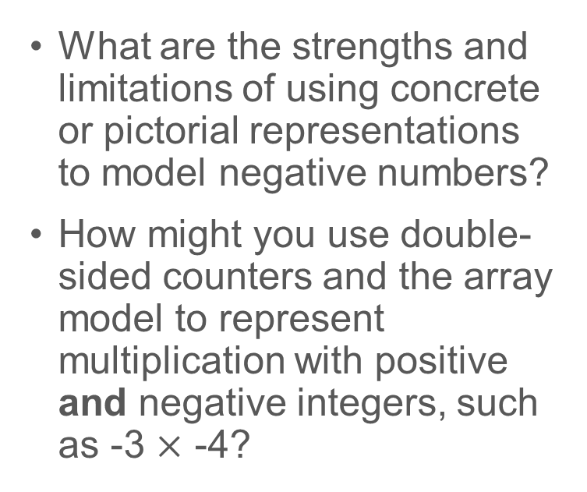
Understand multiplication and division with one negative factor
Example 1
The diagram shows some counters in an array.
  What are the strengths and limitations of using concrete or pictorial representations to model negative numbers?
  How might you use double-sided counters and the array model to represent multiplication with positive and negative integers, such as -3 $×$ -4?
Robyn says, “I can see three groups of negative four” and writes 3 $×$ -4 = -12.
Taylor says, “I can see four groups of negative three.”
Write a number sentence for Taylor’s description of the array.
Write two number sentences that might describe this array.
Notes:
Due to space constraints, the image on this PD discussion slide is very small. PD Leads might like to use or print the ‘in the classroom’ version of this slide for teachers to access during discussions.
This example can be found on pages 24 and 25 of the 2.1 Core Concept document. Some suggestions for modelling multiplication with positive and negative integers, alongside the challenges inherent in these models, are given on the next slide.

Slide 17
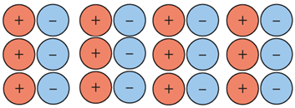
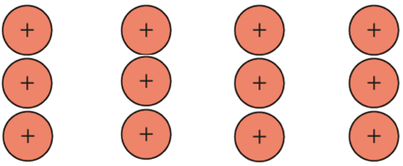
Understand multiplication and division with one negative factor
Example 1 (cont.)
  What do you think of this model for representing a product with two negative factors?
  It might be argued that, if the array is not a productive model for all multiplications involving negative numbers, then it should not be introduced. Do you agree with this interpretation?
Consider -3 × -4.
An array of matching pairs might be used:
With the calculation being read as “subtract three groups of negative four”, the representation becomes:
This can be seen to be positive twelve.
It might be argued that this example is inconsistent in its use of the interpretation of the minus sign. Also, whilst the coherent use of representation can support students in understanding mathematical structure, it is important that the representation is eventually put to one side.
Notes:
The coherent use of representation can support students in understanding mathematical structure, but it is important that the representation is eventually put to one side. It might be argued that this example is also inconsistent in its use of the interpretation of the minus sign.
This example can be found on page 25 of the 2.1 Core Concept document.

Slide 18
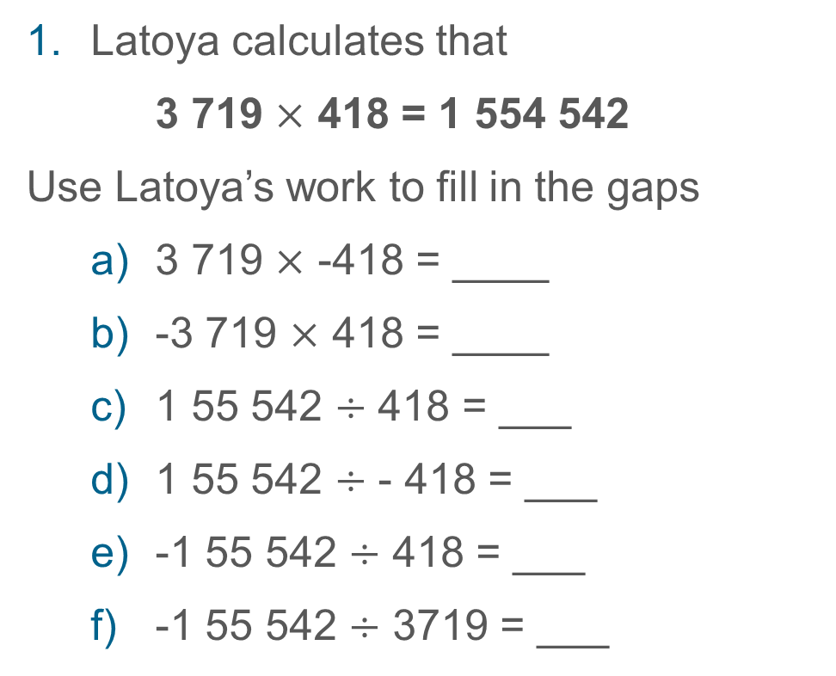
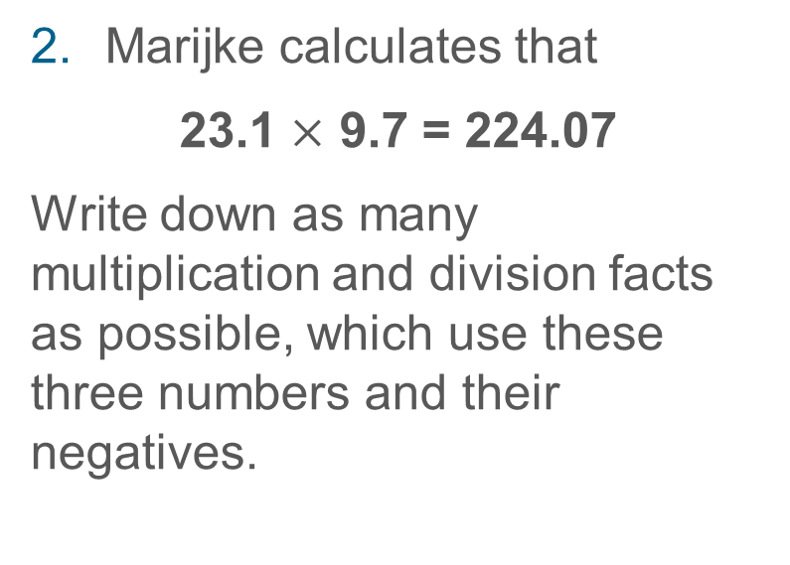
Understand multiplication and division with one negative factor
Example 2
Latoya calculates that
3 719 $×$ 418 = 1 554 542
Use Latoya’s work to fill in the gaps
  3 719 $×$ -418 = ____
  -3 719 $×$ 418 = ____
  1 55 542 $÷$ 418 = ___
  1 55 542 $÷$ - 418 = ___
  -1 55 542 $÷$ 418 = ___
  -1 55 542 $÷$ 3719 = ___
Marijke calculates that
  23.1 $×$ 9.7 = 224.07
Write down as many multiplication and division facts as possible, which use these three numbers and their negatives.
Notes:
Suggested questioning:
What do you know about the magnitude of each answer? (You could ask this a different way, by referring to ‘the digits’ rather than ‘the magnitude’)
Will your answer be positive or negative? How do you know?
Things for you to think about:
In Example 2 the numerical outcome of the calculation is given. The intention here is that students are able to then focus only on the structure of the calculation and reason about whether the result should be positive or negative.
From 1c students are introduced to division with negative numbers. From earlier work, students should understand multiplicative relationships and know that if 3××4 = 12, then 12÷3=4 and 12÷4=3 and it is this structural awareness that is being used here to move beyond multiplication.
The use of large numbers in Q1 and decimals in Q2 is again intended to discourage students from attempting to calculate.

Slide 19
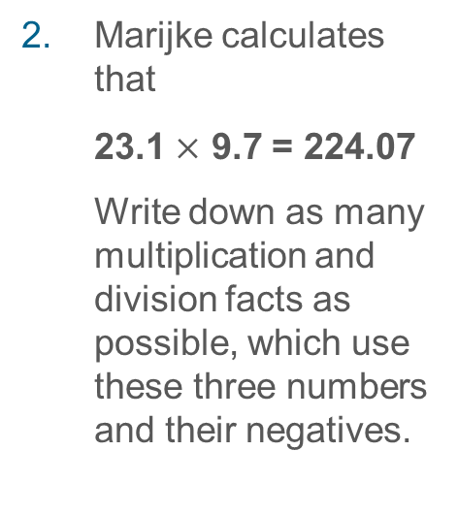

Understand multiplication and division with one negative factor
Example 2
  Why, in this context, might it be helpful to give students large or decimal numbers to work with?
  Will you offer students any further guidance for Question 2? Why or why not?
Latoya calculates that
3 719 $×$ 418 = 1 554 542
Use Latoya’s work to fill in the gaps
  3 719 $×$ -418 = ____
  -3 719 $×$ 418 = ____
  1 55 542 $÷$ 418 = ___
  1 55 542 $÷$ - 418 = ___
  -1 55 542 $÷$ 418 = ___
  -1 55 542 $÷$ 3719 = ___
Marijke calculates that
  23.1 $×$ 9.7 = 224.07
  Write down as many multiplication and division facts as possible, which use these three numbers and their negatives.
Notes:
Due to space constraints, the image on this PD discussion slide is very small. PD Leads might like to use or print the ‘in the classroom’ version of this slide for teachers to access during discussions.
This example can be found on pages 25 and 26 of the 2.1 Core Concept document.

Slide 20
Understand multiplication and division with one negative factor
Example 3
Is it always, sometimes or never true that a negative number divided by a positive number results in a positive number?
Is it always, sometimes or never true that a positive number divided by a negative number results in a positive number?
Notes:
Suggested questioning:
Can you give an example to demonstrate that it is sometimes true? Can you give a counter-example to demonstrate that it is never true?
How else can we model that something is always or never true? (This might offer an opportunity to touch upon proof.)
Can you rewrite these statements so that they are always true?
Things for you to think about:
Moving on from the informal generalisation suggested by using ‘peculiar’ numbers (Mason, Watson, Bills and Bills) in Example 2, Example 3 uses an Always Sometimes Never structure to move towards a more formal generalisation of the outcomes when multiplying and dividing with negative numbers

Slide 21
Understand multiplication and division with one negative factor
Example 3
  What does the structure of ‘always, sometimes, never’ offer for assessing understanding here?
  What responses would you expect from your students here? How will you know if they have understood?
Is it always, sometimes or never true that a negative number divided by a positive number results in a positive number?
Is it always, sometimes or never true that a positive number divided by a negative number results in a positive number?
Notes:
This example can be found on page 26 of the 2.1 Core Concept document.

Slide 22
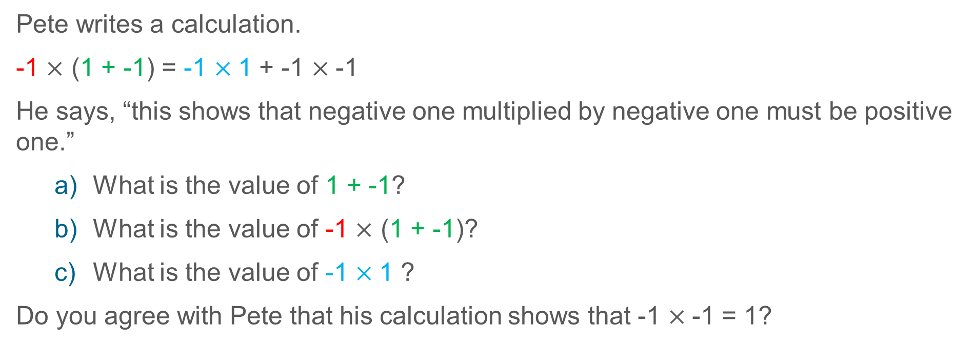
Understand multiplication and division with two negative factors
Example 4
Pete writes a calculation.
-1 $×$ (1 + -1) = -1 $×$1 + -1 $×$-1
He says, “this shows that negative one multiplied by negative one must be positive one.”
  What is the value of 1 + -1?
  What is the value of -1 $×$ (1 + -1)?
  What is the value of -1 $×$1 ?
Do you agree with Pete that his calculation shows that -1 $×$-1 = 1?
Notes:
Suggested questioning:
How did Pete generate the blue product? How about the black product?
What is the value of the left hand side of the calculation? What does this mean for the right hand side?
Things for you to think about:
In Example 4 students are asked to reason with two known properties (the zero property and the distributive law) to create a chain of reasoning justifying why -1 ×-1 = 1. A suggested sequence of questions is offered in Example 4 to allow students to explore and access some of the key elements of the required reasoning. Consider how you might support students in your class to link what they might see as separate questions into one coherent whole.
As discussed in Example 1, a pictorial representation is not offered here, rather students are asked to reason with a symbolic representation. You may like to consider the advantages and disadvantages of extending the pictorial representation when working with two negative numbers.

Slide 23

Understand multiplication and division with two negative factors
Example 4
  A pictorial representation is not offered here; rather, students are asked to reason with a symbolic representation.
  Are there situations or classes that you teach where a symbolic representation is more appropriate than a pictorial one? How about the other way around?
Pete writes a calculation.
-1 $×$ (1 + -1) = -1 $×$1 + -1 $×$-1
He says, “this shows that negative one multiplied by negative one must be positive one.”
  What is the value of 1 + -1?
  What is the value of -1 $×$ (1 + -1)?
  What is the value of -1 $×$1 ?
Do you agree with Pete that his calculation shows that -1 $×$-1 = 1?
Notes:
Due to space constraints, the image on this PD discussion slide is very small. PD Leads might like to use or print the ‘in the classroom’ version of this slide for teachers to access during discussions.
This example can be found on page 26 of the 2.1 Core Concept document.

Slide 24
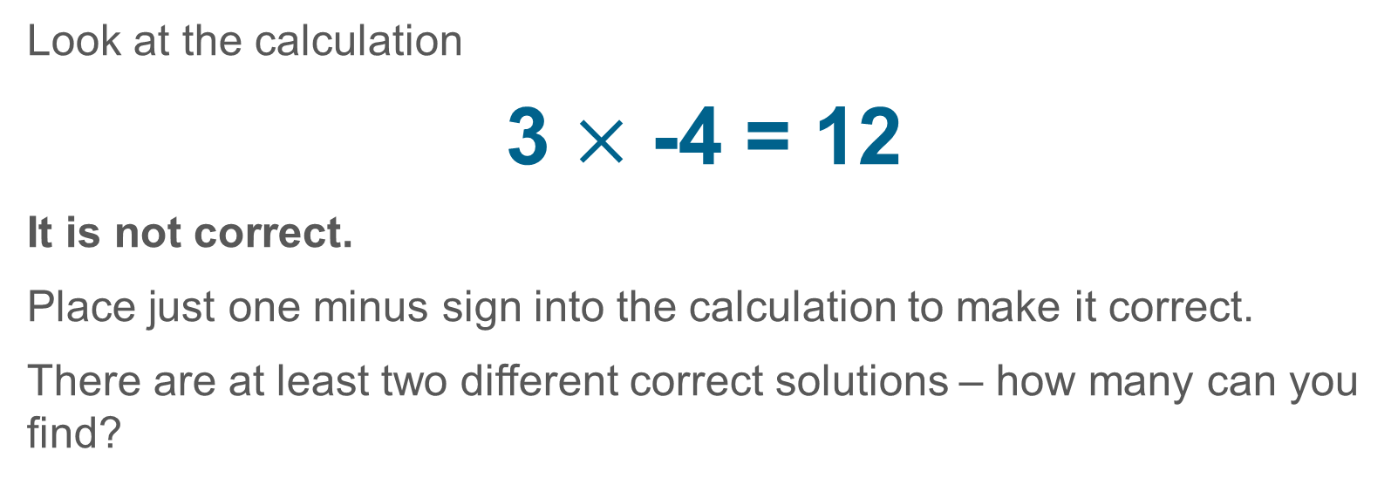
Understand multiplication and division with two negative factors
Example 5
Look at the calculation
3 $×$ -4 = 12
It is not correct.
Place just one minus sign into the calculation to make it correct.
There are at least two different correct solutions – how many can you find?
Notes:
Suggested questioning:
How do you know this calculation is not correct?
What are the different ways to correct this calculation?
Things for you to think about:
The intention here is that, by allowing students an opportunity to explore the dimensions of possible variation, they will work with the structure that underpins multiplication with negative numbers. The prompt suggests that there are ‘at least two different solutions’. The intended correct solutions are -3×-4 = 12 and 3×-4 = -12 but you might like to challenge students, or they might raise, the situation of 3 × - - 4 = 12. Discussing the validity of this suggestion may offer useful insight into students’ understanding and give a context to think deeply about multiplication and negative numbers.

Slide 25

Understand multiplication and division with two negative factors
Example 5
  What is the potential learning benefit of giving students incorrect answers to improve?
  What is the potential learning benefit of giving students examples with multiple solutions?
  Are there any contexts where you wouldn’t give students a ‘correction’ question like this?
Look at the calculation
3 $×$ -4 = 12
It is not correct.
Place just one minus sign into the calculation to make it correct.
There are at least two different correct solutions – how many can you find?
Notes:
This example can be found on pages 26 and 27 of the 2.1 Core Concept document.

Slide 26
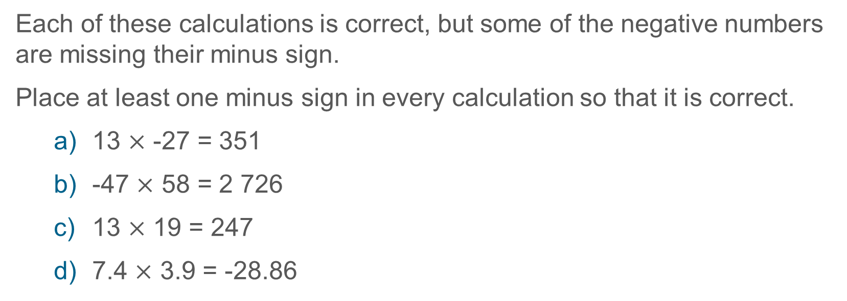
Understand multiplication and division with two negative factors
Example 6
Each of these calculations is correct, but some of the negative numbers are missing their minus sign.
Place at least one minus sign in every calculation so that it is correct.
  13 $×$ -27 = 351
  -47 $×$ 58 = 2 726
  13 $×$ 19 = 247
  7.4 $×$ 3.9 = -28.86
Notes:
Suggested questioning:
How do you know that there are minus signs missing?
Is there more than one way to do this?
How would this question be different if you were also allowed to remove the minus sign?
What other calculations could you write using these?
Things for you to think about:
As in the previous examples, the numerical value of the calculation is already given in order that students are able to focus their attention on the relationship between the positive and negative numbers used in the calculation.
Part c may be particularly valuable in offering an insight into students’ understanding of multiplication with negative numbers as it offers several possible correct solutions.
Each of the questions in Example 6 has at least two correct solutions, with part c having more than that. Is there a benefit to asking students to find all possible solutions rather than using the prompt as it is written?

Slide 27

Understand multiplication and division with two negative factors
Example 6
  Each of the questions in Example 6 has at least two correct solutions, with part c having more than that. Is there a benefit to asking students to find all possible solutions rather than using the prompt as it is written?
  Consider the language of ‘minus’ and ‘negative’ in your classroom. Do your students use them interchangeably or do they differentiate between how the sign is used? Does it matter?
Each of these calculations is correct, but some of the negative numbers are missing their minus sign.
Place at least one minus sign in every calculation so that it is correct.
  13 $×$ -27 = 351
  -47 $×$ 58 = 2 726
  13 $×$ 19 = 247
  7.4 $×$ 3.9 = -28.86
Notes:
This example can be found on page 27 of the 2.1 Core Concept document.

Slide 28
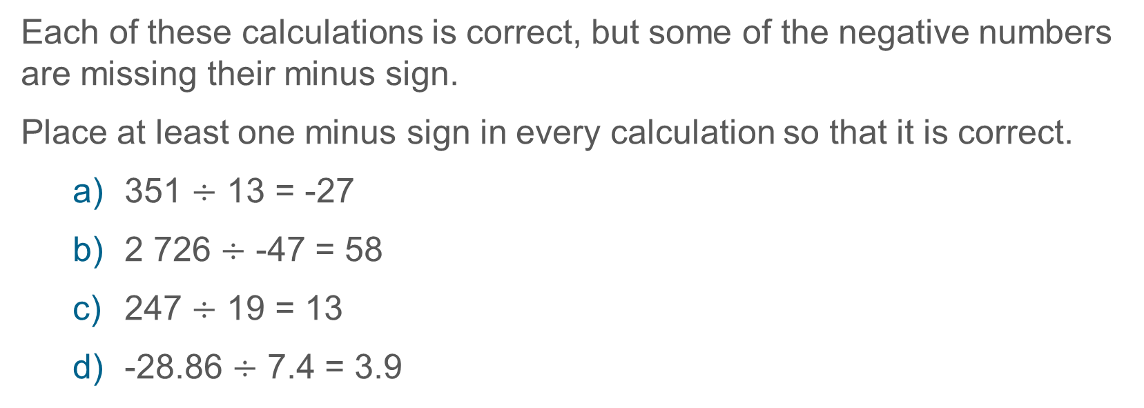
Understand multiplication and division with two negative factors
Example 7
Each of these calculations is correct, but some of the negative numbers are missing their minus sign.
Place at least one minus sign in every calculation so that it is correct.
  351 $÷$ 13 = -27
  2 726 $÷$ -47 = 58
  247 $÷$ 19 = 13
  -28.86 $÷$ 7.4 = 3.9
Notes:
Suggested questioning:
How do you know that there are minus signs missing?
Is there more than one way to do this?
How would this question be different if you were also allowed to remove the minus sign?
What other calculations could you write using these?
Things for you to think about:
Example 7 follows on from Example 6, and uses exactly the same relationships in a different form. The intention here is to allow a context in which students’ awareness can be drawn to the multiplicative relationship in all of its forms, so students understand that there are not different ‘sets of rules’ for multiplication and division

Slide 29

Understand multiplication and division with two negative factors
Example 7
  Understanding that the multiplicative structures work with all positive and negative numbers, whether they are whole numbers or presented as decimals or fractions, is a useful awareness for students to have.
  Would you include fractions in the question for the classes you teach? Why or why not?
  How about using algebraic symbols?
Each of these calculations is correct, but some of the negative numbers are missing their minus sign.
Place at least one minus sign in every calculation so that it is correct.
  351 $÷$ 13 = -27
  2726 $÷$ -47 = 58
  247 $÷$ 19 = 13
  -28.86 $÷$ 7.4 = 3.9
Notes:
This example can be found on page 27 of the 2.1 Core Concept document.

Slide 30
Use the associative law to calculate the products of positive and negative numbers
Example 8
Ursula says,
“All multiplication and division calculations have an even number of minus signs”
Is Ursula correct? Explain how you know.
Notes:
Suggested questioning:
Can you write an example where Ursula is correct? Can you write an example where Ursula is not correct? Why or why not?
What other statements can you say about multiplication and division calculations?
Things for you to think about:
All of the examples used so far have been of the form factor x factor = product. Example 8 offers a context in which students can reason with known facts to generalise and explain a relationship. Ursula is correct since, if there are an odd number of minus signs in the calculation, then the product or quotient will be negative (and therefore there will then be an even number of minus signs). If there are an even number of minus signs in the calculation, then the product or quotient will be positive.

Slide 31
Use the associative law to calculate the products of positive and negative numbers
Example 8
  It might be said that Example 8 is not dissimilar to offering ‘two negatives make a positive’ as it offers students a rule to follow. To what extent do you agree with this perspective?
  What other statements might you want students to explore the truth of?
Ursula says,
“All multiplication and division calculations have an even number of minus signs”
Is Ursula correct? Explain how you know.
Notes:
This example can be found on page 28 of the 2.1 Core Concept document.

Slide 32
Reflection questions
What other mathematical concepts will be supported by students’ stronger understanding of this key idea?
What mathematical language will you continue to use to support pupils to make connections with other areas?
Which representations might you continue to use to further develop students’ understanding?

Slide 34
Appendices
You may choose to use the following slides when planning or delivering a PD session. They cover:
  Key vocabulary
  Representations and structure
  Previous learning
  Future learning
  Library of links

Slide 35
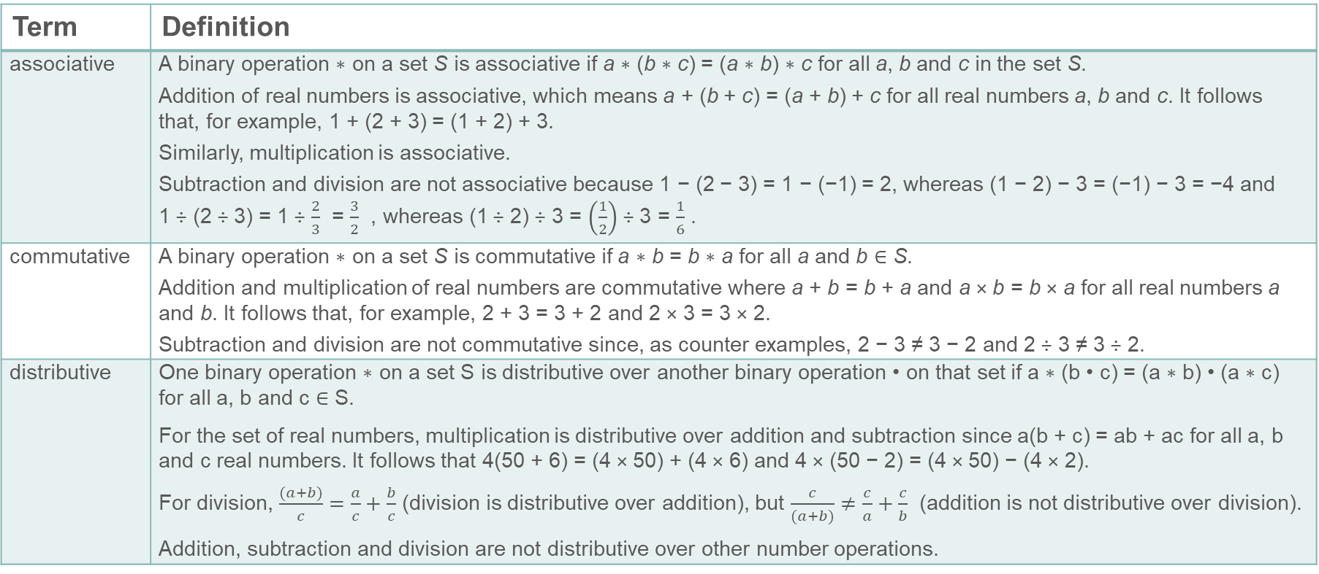
Key vocabulary (1)
Term | Definition
associative | A binary operation ∗ on a set S is associative if a ∗ (b ∗ c) = (a ∗ b) ∗ c for all a, b and c in the set S. Addition of real numbers is associative, which means a + (b + c) = (a + b) + c for all real numbers a, b and c. It follows that, for example, 1 + (2 + 3) = (1 + 2) + 3. Similarly, multiplication is associative. Subtraction and division are not associative because 1 − (2 − 3) = 1 − (−1) = 2, whereas (1 − 2) − 3 = (−1) − 3 = −4 and 1 ÷ (2 ÷ 3) = 1 ÷ $\frac{2}{3}$ = $\frac{3}{2}$ , whereas (1 ÷ 2) ÷ 3 = $\left(\frac{1}{2}\right)$ ÷ 3 = $\frac{1}{6}$ .
commutative | A binary operation ∗ on a set S is commutative if a ∗ b = b ∗ a for all a and b ∈ S. Addition and multiplication of real numbers are commutative where a + b = b + a and a × b = b × a for all real numbers a and b. It follows that, for example, 2 + 3 = 3 + 2 and 2 × 3 = 3 × 2. Subtraction and division are not commutative since, as counter examples, 2 − 3 ≠ 3 − 2 and 2 ÷ 3 ≠ 3 ÷ 2.
distributive | One binary operation ∗ on a set S is distributive over another binary operation • on that set if a ∗ (b • c) = (a ∗ b) • (a ∗ c) for all a, b and c ∈ S. For the set of real numbers, multiplication is distributive over addition and subtraction since a(b + c) = ab + ac for all a, b and c real numbers. It follows that 4(50 + 6) = (4 × 50) + (4 × 6) and 4 × (50 − 2) = (4 × 50) − (4 × 2). For division, $\frac{(a+b)}{c}=\frac{a}{c}+\frac{b}{c}$ (division is distributive over addition), but $\frac{c}{(a+b)}≠\frac{c}{a}+\frac{c}{b}$ (addition is not distributive over division). Addition, subtraction and division are not distributive over other number operations.

Slide 36
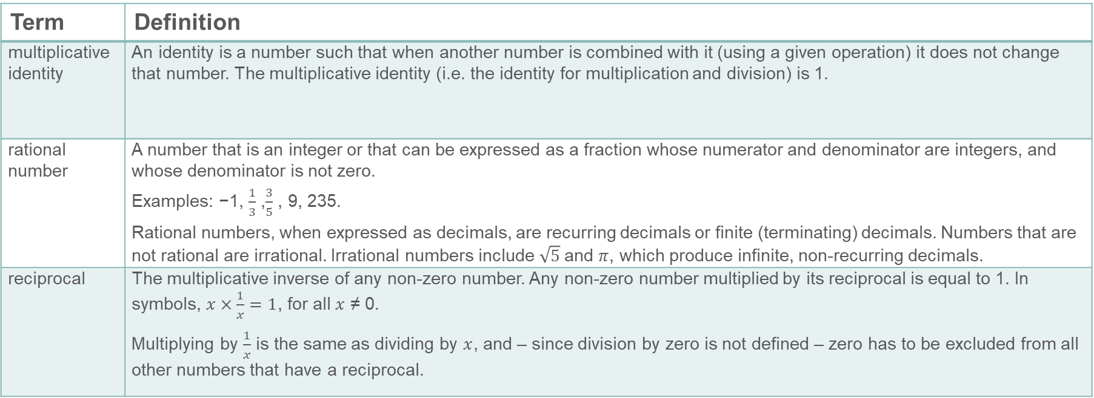
Key vocabulary (2)
Term | Definition
multiplicative identity | An identity is a number such that when another number is combined with it (using a given operation) it does not change that number. The multiplicative identity (i.e. the identity for multiplication and division) is 1.
rational number | A number that is an integer or that can be expressed as a fraction whose numerator and denominator are integers, and whose denominator is not zero. Examples: −1, $\frac{1}{3}$ ,$\frac{3}{5}$ , 9, 235. Rational numbers, when expressed as decimals, are recurring decimals or finite (terminating) decimals. Numbers that are not rational are irrational. Irrational numbers include $\sqrt{5}$and $π$, which produce infinite, non-recurring decimals.
reciprocal | The multiplicative inverse of any non-zero number. Any non-zero number multiplied by its reciprocal is equal to 1. In symbols, $x×\frac{1}{x}=1$, for all $x$ ≠ 0. Multiplying by $\frac{1}{x}$ is the same as dividing by $x$, and – since division by zero is not defined – zero has to be excluded from all other numbers that have a reciprocal.

Slide 37
Representations and structure
There are a number of different representations that you may wish to use to support students’ understanding of this key idea. These might include:
Double-sided (positive and negative) counters
  Counters with different colours can be used to represent positive and negative quantities. By adding and subtracting (i.e. removing) both positive and negative quantities from such collections, students can make sense of the addition and subtraction of directed numbers.
Arrays and area models
  The array is a useful image for revealing the commutative and distributive properties of multiplication.
Notes:
More information about the representations and structure involved in this key idea can be found:
Throughout the 2.1 Core Concept document
On pages 7-9 of the 2 Operating on number Theme Overview document
Within the NCETM’s guidance on Using mathematical representations at KS3
Links to all of these can be found on the final slide.

Slide 38
Previous learning (1)
From Upper Key Stage 2, students will bring experience of:
multiplying multi-digit numbers up to four digits by a two-digit whole number using the formal written method of long multiplication
dividing numbers up to four digits by a two-digit whole number using the formal written method of long division, and interpreting remainders as whole number remainders, fractions, or by rounding, as appropriate for the context
dividing numbers up to four digits by a two-digit number using the formal written method of short division where appropriate, and interpreting remainders according to the context
performing mental calculations, including with mixed operations and large numbers
using their knowledge of the order of operations to carry out calculations involving the four operations
solving addition and subtraction multi-step problems in contexts, deciding which operations and methods to use and why
Notes:
Theme 2 Operating on number

Slide 39
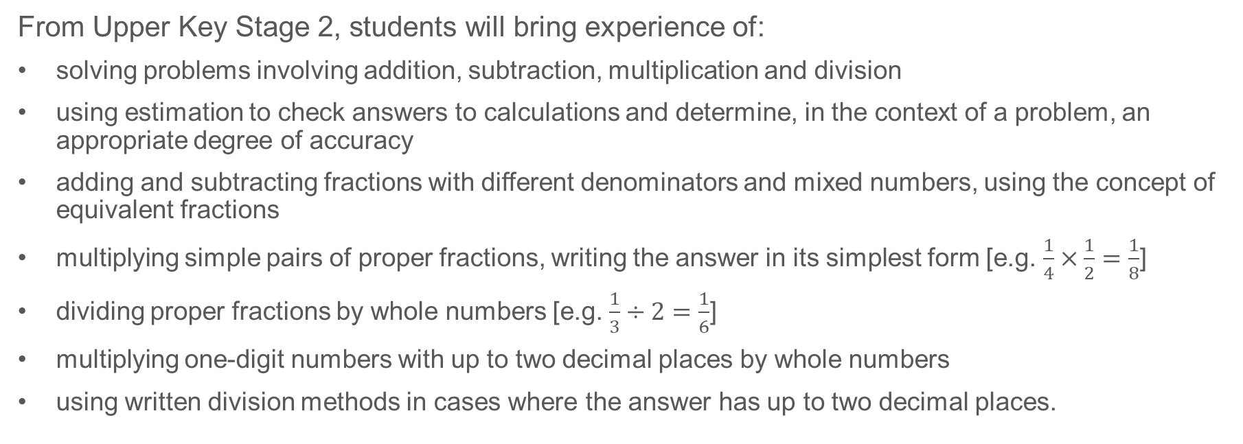
Previous learning (2)
From Upper Key Stage 2, students will bring experience of:
solving problems involving addition, subtraction, multiplication and division
using estimation to check answers to calculations and determine, in the context of a problem, an appropriate degree of accuracy
adding and subtracting fractions with different denominators and mixed numbers, using the concept of equivalent fractions
multiplying simple pairs of proper fractions, writing the answer in its simplest form [e.g. $\frac{1}{4}×\frac{1}{2}=\frac{1}{8}$]
dividing proper fractions by whole numbers [e.g. $\frac{1}{3}÷2=\frac{1}{6}$]
multiplying one-digit numbers with up to two decimal places by whole numbers
using written division methods in cases where the answer has up to two decimal places.
Notes:
Theme 2 Operating on number

Slide 40
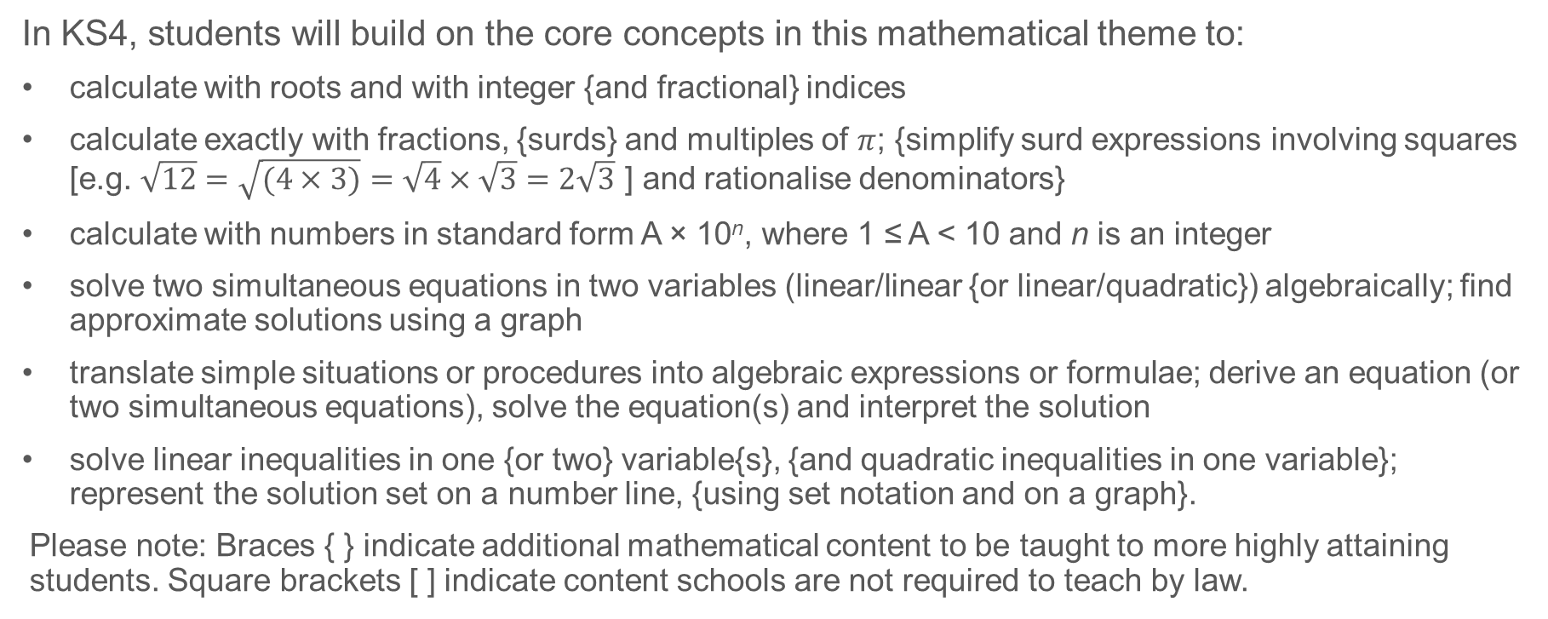
Future learning
In KS4, students will build on the core concepts in this mathematical theme to:
calculate with roots and with integer {and fractional} indices
calculate exactly with fractions, {surds} and multiples of $π$; {simplify surd expressions involving squares [e.g. $\sqrt{12}=\sqrt{(4×3)}=\sqrt{4}×\sqrt{3}=2\sqrt{3}$ ] and rationalise denominators}
calculate with numbers in standard form A × 10^{n}, where 1 ≤ A < 10 and n is an integer
solve two simultaneous equations in two variables (linear/linear {or linear/quadratic}) algebraically; find approximate solutions using a graph
translate simple situations or procedures into algebraic expressions or formulae; derive an equation (or two simultaneous equations), solve the equation(s) and interpret the solution
solve linear inequalities in one {or two} variable{s}, {and quadratic inequalities in one variable}; represent the solution set on a number line, {using set notation and on a graph}.
Please note: Braces { } indicate additional mathematical content to be taught to more highly attaining students. Square brackets [ ] indicate content schools are not required to teach by law.
Notes:
Theme 2 Operating on number

Slide 41
Library of links
The following resources from the NCETM website have been referred to within this slide deck:
  NCETM Secondary Mastery Professional Development
    2 Operating on number Theme Overview Document
    2.1 Arithmetic procedures Core Concept Document
  Using mathematical representations at KS3 | NCETM
  NCETM primary mastery professional development materials
  NCETM primary assessment materials
There are also references to:
  Standards and Testing Agency’s past mathematics papers

