Slide 1
Comparing two data sets
KS3 Mastery PD Materials: Exemplified Key Ideas
Materials for use in the classroom or to support professional development discussions
(from 5.2 Statistical analysis)
Summer 2021

Slide 2
About this resource
These slides are designed to complement the 5.2 Statistical analysis Core Concept document and its associated Theme Overview document 5 Statistics and probability, both found in the Secondary Mastery Professional Development pages.
These slides re-present the key examples from the Core Concept document so that the examples can be used either directly in the classroom or with a group of teachers. There are prompt questions alongside the examples, and further clarification in the notes.
These slides do not fully replicate the Core Concept document, so should be used alongside it. Reference to specific page numbers, and to other useful NCETM resources, can be found in the notes for each slide.
This slide deck is not designed to be a complete PD session, rather it is a selection of resources that you can adapt and use as needed when planning a session with a group of teachers.

Slide 3


About this resource
The slides are structured as follows:
  The big picture:
    Where does this fit in?
    What do students need to understand?
    Why is this key idea important?
  Prior learning
  Misconceptions
  Exemplified key ideas
  Reflection questions
  Appendices:
    Key vocabulary
    Representations and structure
    Previous and Future learning
    Useful links
The exemplified key idea slides have the following symbols to indicate how they have been designed to be used:
Into the classroom
The examples are presented on these slides so that they could be used in PD, but also directly in the classroom. The notes feature suggested questions and things teachers might consider when using with students.
PD discussion prompts
These slides look at the examples in more detail, with question prompts to promote discussion among maths teachers. The notes feature reference to further information and guidance within the Core Concepts document.

Slide 4
Where does this fit in?
The NCETM has identified a set of six ‘mathematical themes’ within Key Stage 3 mathematics that bring together a group of ‘core concepts’.
The fifth of these themes is Statistics and probability, which covers the following interconnected core concepts:
    5.1 Statistical representations and measures
    5.2 Statistical analysis
    5.3 Probability
Notes:
Linked on this slide is the Theme Overview document of Statistics and probability. This document includes why it is important, the key underpinning knowledge and links to prior and future learning. There is also guidance about how the five big ideas of Teaching for Mastery relate specifically to this theme.

Slide 5
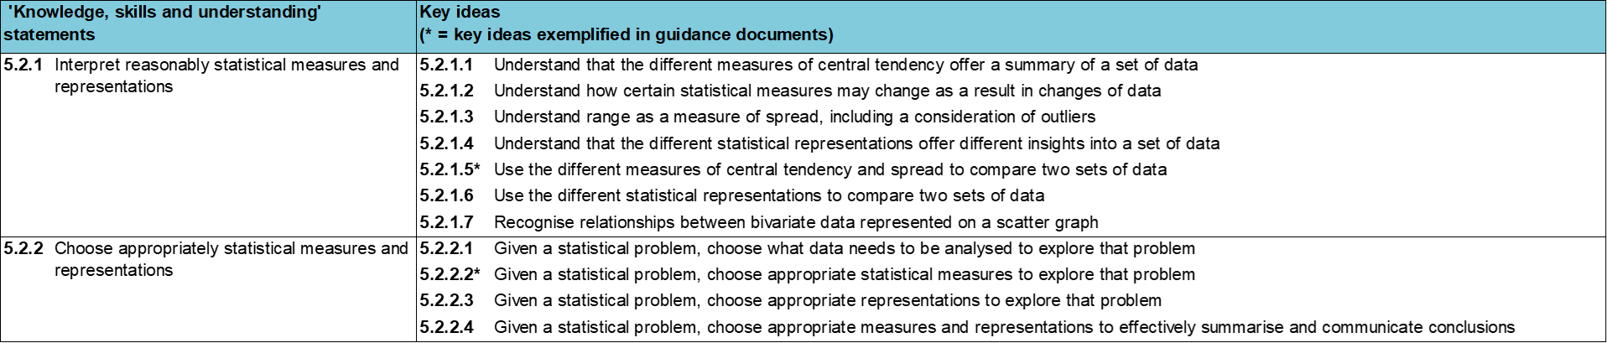
Where does this fit in?
Within this core concept, 5.2 Statistical analysis, there are two statements of knowledge, skills and understanding.
These, in turn, are broken down into eleven key ideas. The highlighted key idea is exemplified in this slide deck.
Notes:
For key ideas marked with an asterisk, we exemplified the common difficulties and misconceptions that students might have and included elements of what teaching for mastery may look like. We have provided examples of possible student tasks and teaching approaches.
Within these slides are ‘classroom-ready’ versions of the examples for the key idea that has been highlighted. There are also slides that may be useful for discussion in a professional development session.

Slide 6
What do students need to understand?
5.2.1.5 Use the different measures of central tendency and spread to compare two sets of data
Accurately compare two data sets using one or more summary statistic.
Understand that data sets can have the same measures of central tendency but a different measure of spread.
Understand range is a measure of spread and not a measure of central tendency.
Solve familiar and unfamiliar problems, including real-life applications.
Solve problems where there is more than one answer and where there are elements of experimentation, investigation, checking, reasoning, proof, etc.
  What prior knowledge might your students already have?
  What language might they use to describe this key idea?
  What questions might you want to ask to assess their prior learning?

Slide 7
Why is this key idea important? (1)
A key skill for students to develop at Key Stage 3 is the ability to make an informed choice of what statistical analysis and representation to use for discrete, continuous and grouped data. Being able to construct representations and calculate values that indicate a measure of central tendency or measure of spread is important in order to represent and summarise data accurately.
Just as important is the need for students to be able to make an informed choice about what statistical tools to use, and understand the effect that these choices have on the interpretation, and misinterpretation, of data, including the potential impact of outliers.
Students should be presented with summary data to interrogate, so they can appreciate the limitations of such information when the raw data is no longer available. Dealing with inaccuracies, outliers and other contextual issues will give students a greater appreciation of the realistic nature of statistical analysis.
Students should appreciate the differences between a frequency-based chart (such as a bar chart or pictogram) and a proportional chart (such as a pie chart) and how different aspects of the data can, and cannot, be inferred from each.
Notes:
A more detailed overview of the core concept of statistical analysis can be found on page 2 of the 5.3 Core Concept document.
The background to each key idea is also explored in more detail on the following pages:
5.2.1 Interpret reasonably statistical measures and representations – page 9
5.2.2 Choose appropriately statistical measures and representations– pages 9-10

Slide 8
Why is this key idea important? (2)
Situations that require statistical techniques to be employed will probably begin with an issue, a question or a problem. These situations require a number of decisions to be made:
  Which data do I need to collect?
  How will I organise this data?
  How will I analyse this data in order to address the original question/problem?
  Which representation should I choose in order to address the original question/problem and communicate clearly my findings?
Students should have the opportunity to consider all of these aspects at different stages of their work on statistics. The use of real-life contexts and issues are important to give statistics meaning.
Students should be given opportunities to solve problems that do not necessarily have a correct answer, but be required to justify decisions made and be prepared to be challenged.
Notes:
A more detailed overview of the core concept of statistical analysis can be found on page 2 of the 5.3 Core Concept document.
The background to each key idea is also explored in more detail on the following pages:
5.2.1 Interpret reasonably statistical measures and representations – page 9
5.2.2 Choose appropriately statistical measures and representations– pages 9-10

Slide 9
Prior learning
Upper Key Stage 2 Learning Outcome
Interpret and present discrete and continuous data using appropriate graphical methods, including bar charts and time graphs
Solve comparison, sum and difference problems using information presented in bar charts, pictograms, tables and other graphs
Solve comparison, sum and difference problems using information presented in a line graph
Complete, read and interpret information in tables, including timetables
Interpret and construct pie charts and line graphs and use these to solve problems
Calculate and interpret the mean as an average
  What prior knowledge might your students already have?
  What language might they use to describe this key idea?
  What questions might you want to ask to assess their prior learning?
Notes:
You may find it useful to speak to your partner schools to see how the above has been covered and the language used.
You can find further details regarding prior learning in the following segments of the NCETM primary mastery professional development materials (linked on final slide):
• Year 2: 1.12 Subtraction as difference
• Year 3: 1.17 Composition and calculation: 100 and bridging 100
• Year 5: 1.27 Negative numbers: counting, comparing and calculating
• Year 6: 2.26 Mean average and equal shares
Within the Theme Overview document, you can also find a broader description of students’ potential previous learning (page 3), alongside further information about key underpinning knowledge (page 2).

Slide 10
Prior learning
Key Stage 3 Learning Outcome
5.1.1 Understand and calculate accurately measures of central tendency and spread
5.1.2 Construct accurately statistical representations
Please note: Numerical codes refer to statements of knowledge, skills and understanding in the NCETM breakdown of Key Stage 3 mathematics.
  What representations might your students already be familiar with?
  What language might they use?
  How does this fit in with your curriculum progression?
Notes:
Within the 5 Statistics and probability Theme Overview document, you can also find a broader description of students’ potential previous learning (page 3), alongside further information about key underpinning knowledge (page 2).

Slide 11
Checking prior learning
The following slides contain questions for checking prior learning.
  What representations might students use to support their understanding of these questions?
  What variation might you put in place for these questions to fully assess students’ understanding of the concept?
  How might changing the language of each question change the difficulty?
  Why are these such crucial pre-requisites for this key idea?

Slide 12
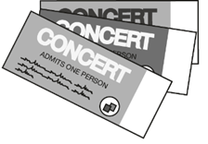

Checking prior learning
c) From 7 March 2016 to 7 March 2017 a swimming club had the same members.
Complete the table to show the information about the members of the club. Explain your reasoning.
(QCA, 2002)
a) Write down five integers with a mean of 6
  …and a median of 4
  …and a mode of 2
  …and a range of 13
Justify your answers.
Age of member | Age of member
Mean (March 2016) | 14 years 7 months
Range (March 2016) | 4 years 2 months
Mean (March 2017)
Range (March 2017)
b) Last year, Jacob went to four concerts.
Three of his tickets cost £5 each.
The other ticket cost £7.
What was the mean cost of the tickets?
Show your method.
Notes:
The above activity offers a useful idea for assessment, which you can use in your classes to check whether prior understanding is secure.
References to the questions (links on final slide):
a) NCETM secondary assessment materials, page 51
b) 2018 Key Stage 2 Mathematics paper 2: reasoning, Question 18
c) NCETM secondary assessment materials, page 51

Slide 13
Common difficulties and misconceptions
What aspects of this key idea might students find challenging?
What misconceptions might students have?
When teaching this topic, you may find students encounter difficulties with…
Understanding that range is NOT a measure of central tendency
Interpreting, and not just calculating, summary values
More information, and some suggestions for overcoming these challenges, can be found on the following slides.

Slide 14
Common difficulties and misconceptions (1)
Students often learn to calculate the range alongside the different averages and do not always understand the distinction between the range as a measure of spread and the averages as a measure of central tendency.
Representing the data as points on a number line can help students to have a visual sense of the range and so more easily distinguish it from a measure of central tendency
Many of the examples in this slide deck provide opportunities to talk explicitly about the range and how it differs from the mean, median and mode – such as example 5, where the range is the only value that is varied whilst the other values stay the same.
Notes:
This can be found on page 11 of the 5.2 Core Concept document.

Slide 15
Common difficulties and misconceptions (2)
Students should be encouraged to interpret summary values and draw conclusions from them rather than just being able to mechanically calculate them. Reversing the process and asking students to construct a data set to match a set of summary statistics gives students a much deeper understanding of the summary values.
Asking students to match a data set, the summary data and an associated graphical representation can be a powerful activity to support students with making connections and going beyond mechanically calculating measures of central tendency. This is exemplified further in example 4 (slide 23).
Notes:
This can be found on page 11 of the 5.2 Core Concept document.

Slide 16
Accurately compare two data sets using one or more summary statistic
Example 1:
The daily temperatures across March last year for two cities are summarised in this table.
City | Mean maximum daily temperature | Range of maximum daily temperature
A | 22 °C | 6 °C
B | 22 °C | 13 °C
Which city should you choose to visit if you want to enjoy high temperatures?
Justify your answer.
Notes:
Suggested questioning:
What is the same about each city’s temperatures? What is different?
What might the minimum/maximum daily temperatures be?
Which city had more consistent temperatures? How do you know?
Things for you to think about:
Example 1 is designed to draw students’ attention to the fact that range is a basic measure of spread and not central tendency. Students should realise that the smaller the range, the more consistent the data. Students will need experience of different data sets with summary statistics. How might you ensure that students experience a variety of measures of central tendency, as well as data sets including outliers?

Slide 17
Accurately compare two data sets using one or more summary statistic
Example 1:
  What language might you want students to use to describe these data sets?
  What examples of data sets with summary statistics do students currently experience?
  How can you broaden this experience?
The daily temperatures across March last year for two cities are summarised in this table.
City | Mean maximum daily temperature | Range of maximum daily temperature
A | 22 °C | 6 °C
B | 22 °C | 13 °C
Which city should you choose to visit if you want to enjoy high temperatures?
Justify your answer.
Notes:
Due to space constraints, the image on this PD discussion slide is very small. PD Leads might like to use or print the ‘in the classroom’ version of this slide for teachers to access during discussions.
More detail about this example can be found on page 11 of the 5.2 Core Concept document.

Slide 18
Accurately compare two data sets using one or more summary statistic
Example 2:
The daily temperatures across March last year for two cities are summarised in this table.
City | Mean maximum daily temperature | Range of maximum daily temperature
C | 12 °C | 8 °C
D | 21 °C | 8 °C
Which city should you choose to visit if you want to enjoy high temperatures?
Justify your answer.
Notes:
Suggested questioning:
What is the same about each city’s temperatures? What is different?
What might the minimum/maximum daily temperatures be?
If the range is the same, what does that mean about the possible temperatures? If the mean is different, what does that mean?
Things for you to think about:
Example 2 is designed to draw students’ attention to the fact that mean is a measure of central tendency and not the spread of the data. Students should realise that the smaller the mean, the colder the average daily temperature.

Slide 19
Accurately compare two data sets using one or more summary statistic
Example 2:
  What language might you want students to use to describe these data sets?
  What questions might you ask to ensure that students understand the difference between what range and mean measure?
The daily temperatures across March last year for two cities are summarised in this table.
City | Mean maximum daily temperature | Range of maximum daily temperature
C | 12 °C | 8 °C
D | 21 °C | 8 °C
Which city should you choose to visit if you want to enjoy high temperatures?
Justify your answer.
Notes:
Due to space constraints, the image on this PD discussion slide is very small. PD Leads might like to use or print the ‘in the classroom’ version of this slide for teachers to access during discussions.
More detail about this example can be found on page 12 of the 5.2 Core Concept document.

Slide 20
Accurately compare two data sets using one or more summary statistic
Example 1:
  What is the same/different about these data sets?
  What are they designed to draw students’ attention to?
  What language might you support pupils to use to describe these data sets?
City | Mean maximum daily temperature | Range of maximum daily temperature
A | 22 °C | 6 °C
B | 22 °C | 13 °C
Example 2:
City | Mean maximum daily temperature | Range of maximum daily temperature
C | 12 °C | 8 °C
D | 21 °C | 8 °C
Notes:
Due to space constraints, the image on this PD discussion slide is very small. PD Leads might like to use or print the ‘in the classroom’ version of this slide for teachers to access during discussions.
More detail about each of these examples can be found on pages 11 and 12 of the 5.2 Core Concept document.

Slide 21
Accurately compare two data sets using one or more summary statistic
Example 3:
The daily temperatures last week for two other cities are summarised in this table.
City | Mean maximum daily temperature | Modal maximum daily temperature
E | 24 °C | 18 °C
F | 20 °C | 23 °C
How would you argue that city E enjoyed warmer days last week?
How could you argue that city F did?
Notes:
Suggested questioning:
What does modal mean?
How can the mean be higher than the mode for one data set, but not for the other?
What possible sets of values would fit these summary statistics?
How does one really warm or really cold day affect the mean? How does it affect the mode?
Things for you to think about:
Example 3 draws students’ attention to the subtle differences in averages. City E has a higher mean maximum daily temperature than city F, but that could be due to one extremely warm day (an outlier). A comparison of the modes might suggest that city F enjoyed warmer days than city E. One strategy, which will encourage students to think more deeply, is to ask students to construct possible data sets for each city. A suggestion for what this might look like can be found on pages 13 and 14 of the 5.2 Core Concept document.

Slide 22
Accurately compare two data sets using one or more summary statistic
Example 3:
The daily temperatures last week for two other cities are summarised in this table.
  How can your questioning support students to understand subtle differences in averages?
  What is the benefit of asking students to argue two different conclusions from the same data set?
City | Mean maximum daily temperature | Modal maximum daily temperature
E | 24 °C | 18 °C
F | 20 °C | 23 °C
How would you argue that city E enjoyed warmer days last week?
How could you argue that city F did?
Notes:
Due to space constraints, the image on this PD discussion slide is very small. PD Leads might like to use or print the ‘in the classroom’ version of this slide for teachers to access during discussions.
More detail about this example, including some suggestions for depth, can be found on page 12 of the 5.2 Core Concept document.

Slide 23
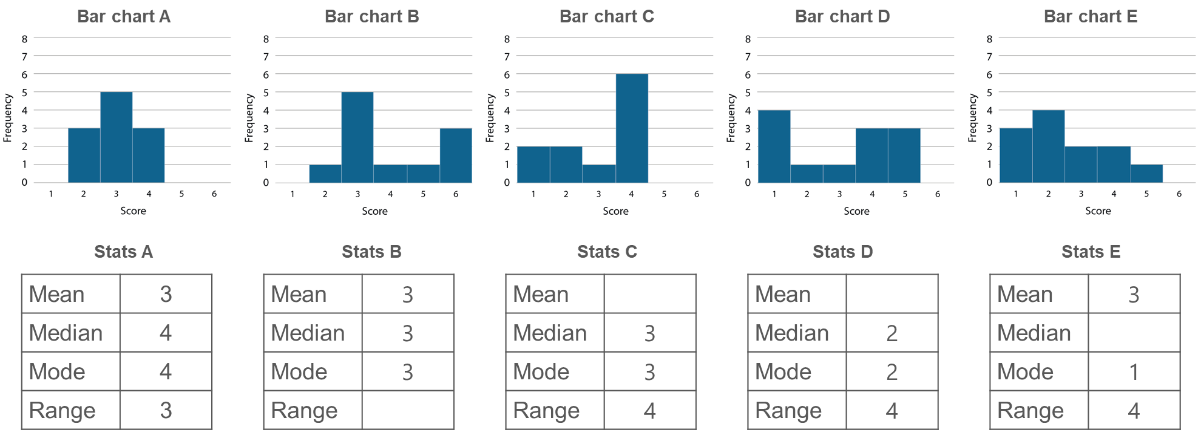
Understand that data sets can have the same measures of central tendency but a different measure of spread
Example 4
Match the charts with the correct measures of central tendency and spread.
Find the missing values.
Source: Adapted from Improving Learning in Mathematics (The Standards Unit box) − S4 Understanding mean, median, mode and range
DfES Standards Unit Public sector information licensed under the Open Government Licence v3.0
Notes:
Suggested questioning:
What is the same? What is different?
Which summary statistic is easiest to ‘see’ on a bar chart? Which is hardest?
Is there more than one possible solution?
What is the same about all of the charts with a range of 4? What is different?
What is the same about all of the charts with a mode of 3? What is different?
Things for you to think about:
Providing the statistical measures and asking students to match the tables with the bar charts actively encourages them to focus on the meaning of these measures and to use reasoning and problem-solving skills, thus deepening their understanding. Before using this task, you may wish to think about which features you wish to draw students’ attention to.

Slide 24
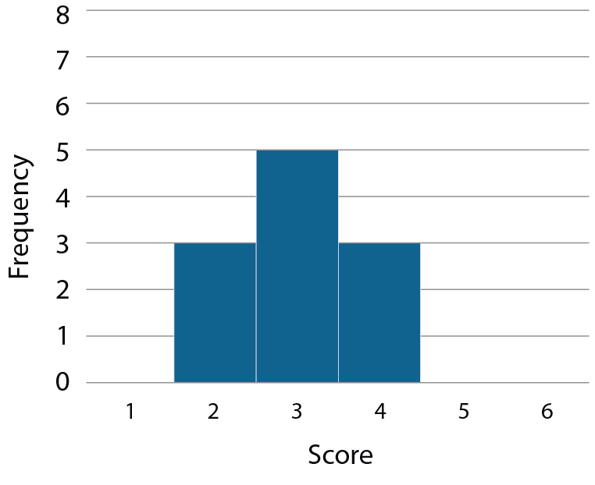
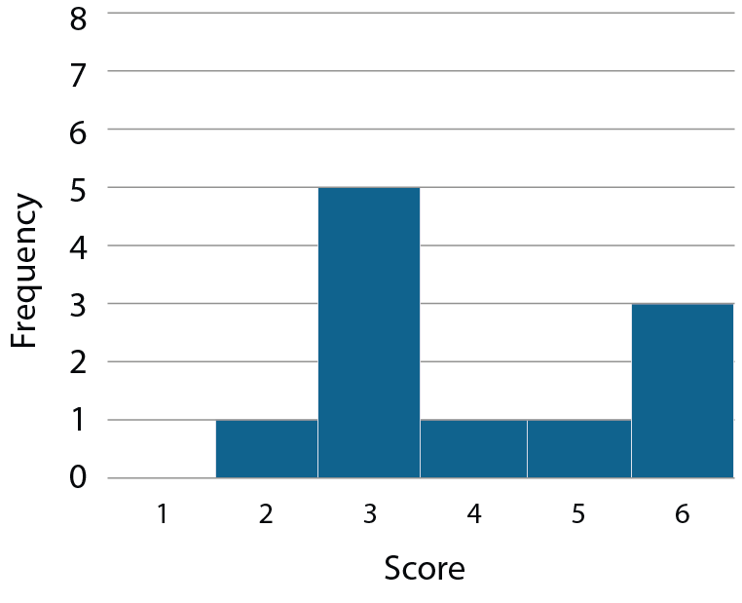
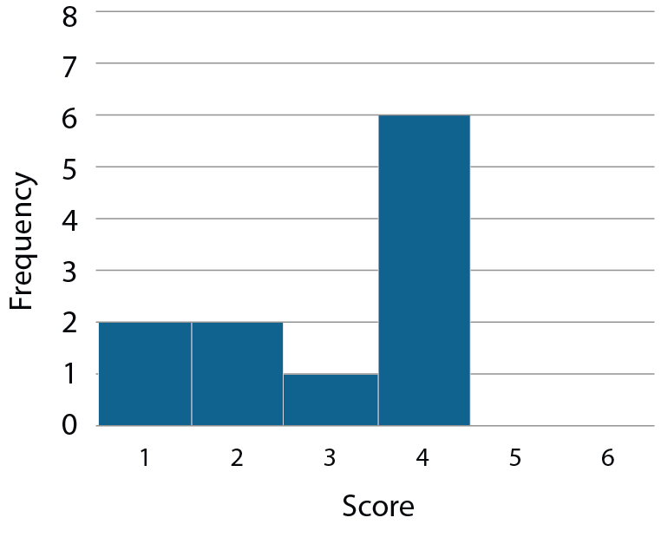
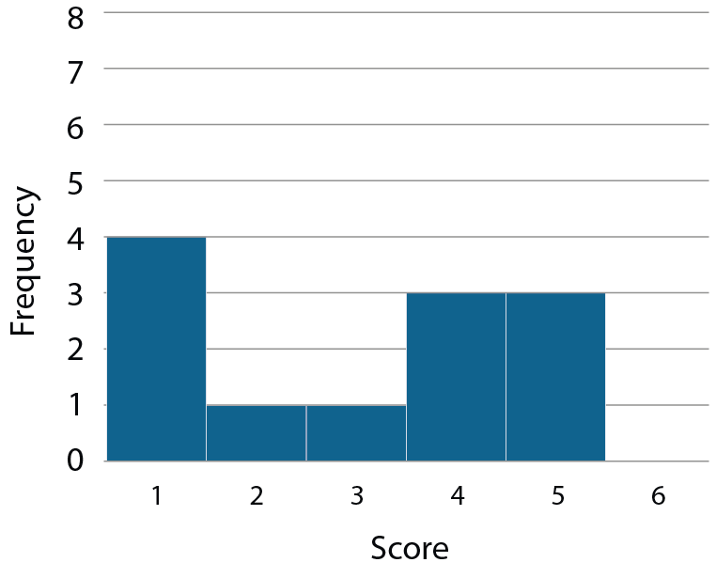
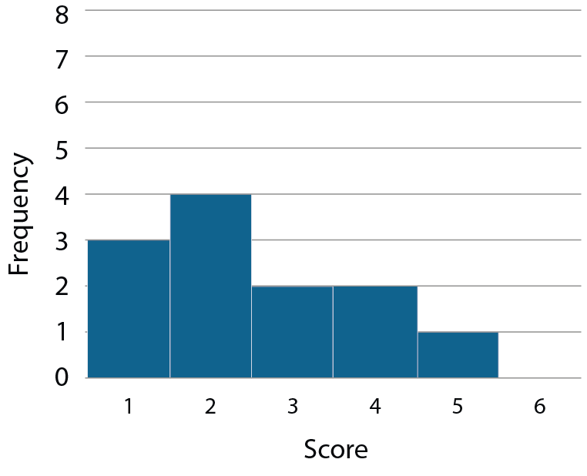
Understand that data sets can have the same measures of central tendency but a different measure of spread
Example 4
Bar chart A
Bar chart B
Bar chart C
Bar chart D
Bar chart E
Stats A
Stats B
Stats C
Stats D
Stats E
Mean | 3
Median | 4
Mode | 4
Range | 3
Mean | 3
Median | 3
Mode | 3
Range
Mean
Median | 3
Mode | 3
Range | 4
Mean
Median | 2
Mode | 2
Range | 4
Mean | 3
Median
Mode | 1
Range | 4
Source: Adapted from Improving Learning in Mathematics (The Standards Unit box) − S4 Understanding mean, median, mode and range
DfES Standards Unit Public sector information licensed under the Open Government Licence v3.0
Notes:
This slide is a slightly larger version of the previous slide for easier on-screen visibility. You may wish to print this task as a card sort – slides 44 to 53 in the appendices feature an ‘easy print’ version of this task, with printing/cutting instructions on slide 43.

Slide 25
Understand that data sets can have the same measures of central tendency but a different measure of spread
Example 4
Match the charts with the correct measures of central tendency and spread.
Find the missing values
  What strategies would you expect students to use?
  What is the effect of the variation in this example?
  What features might you want to draw students’ attention to in your questioning?
Source: Adapted from Improving Learning in Mathematics (The Standards Unit box) − S4 Understanding mean, median, mode and range
DfES Standards Unit Public sector information licensed under the Open Government Licence v3.0
Notes:
Due to space constraints, the image on this PD discussion slide is very small. PD Leads might like to use or print the ‘in the classroom’ version of this slide for teachers to access during discussions.
More detail about this example can be found on pages 13-15 of the 5.2 Core Concept document.

Slide 26
Understand that data sets can have the same measures of central tendency but a different measure of spread
Example 4 (cont.)
  Watch video 2 of Insights from experienced teachers | NCETM. These materials are discussed from 8:00.
  Do you agree with the teachers’ reflections on this task?
  How do you ensure students know the difference between measures of central tendency and spread?
Match the charts with the correct measures of central tendency and spread.
Find the missing values
Source: Adapted from Improving Learning in Mathematics (The Standards Unit box) − S4 Understanding mean, median, mode and range
DfES Standards Unit Public sector information licensed under the Open Government Licence v3.0
Notes:
Due to space constraints, the image on this PD discussion slide is very small. PD Leads might like to use or print the ‘in the classroom’ version of this slide for teachers to access during discussions.
More detail about this example can be found on pages 13-15 of the 5.2 Core Concept document.

Slide 27
Understand range is a measure of spread and not a measure of central tendency
Example 5
The test scores for two classes are summarised in this table.
 | Class A | Class B
Mean | 70 | 70
Mode | 70 | 70
Median | 70 | 70
Range | 15 | 10
Archie thinks some students in class A have scored higher than class B because it has a larger range.
Do you agree? Explain your answer.
Notes:
Suggested questioning:
What does a ‘large range’ mean? Does it mean the same as a ‘large mean/median/mode’?
What could a possible maximum/minimum score be for each class?
Which class is more consistent? What do we mean by the word ‘consistent’?
Things for you to think about:
Example 5 is designed to encourage students to notice that the range is a measure of spread and not a measure of central tendency. It is a good example of variation in practice: by ONLY varying one feature (the range) we draw attention to it. Students might find it easier to understand with some example data that fits these summary statistics.

Slide 28
Understand range is a measure of spread and not a measure of central tendency
Example 5
The test scores for two classes are summarised in this table.
  How would you support students who were struggling with this question?
  What language might you encourage students to use in their explanations?
 | Class A | Class B
Mean | 70 | 70
Mode | 70 | 70
Median | 70 | 70
Range | 15 | 10
Archie thinks some students in class A have scored higher than class B because it has a larger range.
Do you agree? Explain your answer.
Notes:
Due to space constraints, the image on this PD discussion slide is very small. PD Leads might like to use or print the ‘in the classroom’ version of this slide for teachers to access during discussions.
More detail about this example, including some possible max/min values, can be found on page 16 of the 5.2 Core Concept document.

Slide 29
Solve familiar and unfamiliar problems, including real-life applications
Example 6
Three students each run five speed trials. These are the times (in seconds) for their five runs.
Abdul | Beattie | Chris
92 | 99 | 84
86 | 79 | 92
89 | 80 | 90
87 | 96 | 92
91 | 96 | 97
Who is the fastest runner?
Can you provide reasons (with evidence) for why each student might be the fastest?
Notes:
Suggested questioning:
Who has the fastest time? Who has the slowest time? Who has the fastest/slowest mean/median/mode?
Who is the most consistent? What statistic can I use to show this?
What evidence is there for each person to claim to be the fastest?
What summary statistics might you use?
Things for you to think about:
Example 6 provides students with scope to make their own choices and to discuss them. In addition to using averages and range, the maximum and minimum data values might also be justifiable measures in this context. You may want to devise other problems, in contexts suitable for your classes, where the need to use the different measures of central tendency and spread to compare two sets of data is relevant.

Slide 30
Solve familiar and unfamiliar problems, including real-life applications
Example 6
Three students each run five speed trials. These are the times (in seconds) for their five runs.
  What support might students need to get started on this task?
  What other problems could you devise, in contexts suitable for your classes?
Abdul | Beattie | Chris
92 | 99 | 84
86 | 79 | 92
89 | 80 | 90
87 | 96 | 92
91 | 96 | 97
Who is the fastest runner?
Can you provide reasons (with evidence) for why each student might be the fastest?
Notes:
Due to space constraints, the image on this PD discussion slide is very small. PD Leads might like to use or print the ‘in the classroom’ version of this slide for teachers to access during discussions.
More detail about the sequencing of this example can be found on page 16 of the 5.2 Core Concept document.

Slide 31
Solve problems where there is more than one answer and where there are elements of experimentation, investigation, checking, reasoning, proof, etc
Example 7
Is this statement always, sometimes or never true?
‘The measure of spread of a data set is greater than any of the measures of central tendency of the data set.’
Explain your answer.
Notes:
Suggested questioning:
Can you create a data set where this is true? Can you create a data set where this is not true?
What does the measure of the spread of a data set tell you?
What does a measure of the central tendency of a data set tell you?
Things for you to think about:
Students tackling this question will need to explore a range of possibilities. Constructing some possible data sets to illustrate when it is true and when it is not true can be helpful - it will be worth spending time doing this task yourself, to have pre-prepared some examples and counter-examples.

Slide 32
Solve problems where there is more than one answer and where there are elements of experimentation, investigation, checking, reasoning, proof, etc
Example 8
Is this statement always, sometimes or never true?
‘Two data sets with the same measure of spread and measures of central tendency have the same maximum and minimum values.’
Explain your answer.
Notes:
Suggested questioning:
Can you create a data set where this is true? Can you create a data set where this is not true?
What does the measure of the spread of a data set tell you?
What does a measure of the central tendency of a data set tell you?
Can you illustrate your example using a table? A bar chart? Another visualisation?
Things for you to think about:
As with example 7, it will be worth spending time doing this task yourself, to have pre-prepared some examples and counter-examples. For problems such as Examples 7 and 8, students could be encouraged to present a convincing argument or proof.

Slide 33
Solve problems where there is more than one answer and where there are elements of experimentation, investigation, checking, reasoning, proof, etc
Example 7
Is this statement always, sometimes or never true?
‘The measure of spread of a data set is greater than any of the measures of central tendency of the data set.’
Explain your answer.
  What misconceptions or assumptions might these statements expose?
  Can you create your own always, sometimes or never statement to further explore the structure of measures of spread/central tendency?
Example 8
Is this statement always, sometimes or never true?
‘Two data sets with the same measure of spread and measures of central tendency have the same maximum and minimum values.’
Explain your answer.
Notes:
Due to space constraints, the image on this PD discussion slide is very small. PD Leads might like to use or print the ‘in the classroom’ version of this slide for teachers to access during discussions.
More detail about the sequencing of this example can be found on page 17 of the 5.2 Core Concept document.

Slide 34
Reflection questions
What other mathematical concepts will be supported by students’ stronger understanding of this key idea?
What mathematical language will you continue to use to support pupils to make connections with other areas?
Which representations might you continue to use to further develop students’ understanding?

Slide 36
Appendices
You may choose to use the following slides when planning or delivering a PD session. They cover:
  Key vocabulary
  Representations and structure
  Previous learning
  Future learning
  ‘Quick prepare’ card sort for Example 4
  Library of links

Slide 37
Key vocabulary (1)
Term | Definition
(arithmetic) mean | The sum of a set of numbers, or quantities, divided by the number of terms in the set. Example: The arithmetic mean of 5, 6, 14, 15 and 45 is (5 + 6 + 14 + 15 + 45) ÷ 5 i.e. 17.
bivariate | Involving two random variables; used in statistics as a bivariate distribution.
dispersion | Dispersion (also called ‘variability’, ‘scatter’ or ‘spread’) is the extent to which the data in a distribution is spread out. A simple measure of spread is the range. Other common measures are the variance, standard deviation and interquartile range.
measure of central tendency | In statistics, a measure of how the values of a particular variable are located in terms of the values collected for a particular sample, or for the relevant population as a whole. In school mathematics up to Key Stage 4, there are three important measures of central tendency: the arithmetic mean, the median and the mode. These are all statistical averages and often one is more useful than another, depending on the spread of the values under consideration.

Slide 38
Key vocabulary (2)
Term | Definition
median | The middle number or value when all values in a set of data are arranged in ascending order. Example: The median of 5, 6, 14, 15 and 45 is 14. When there is an even number of values, the arithmetic mean of the two middle values is calculated. Example: The median of 5, 6, 7, 8, 14 and 45 is (7 + 8) ÷ 2, i.e. 7.5 The median is one example of an average.
mode | The most commonly occurring value or class with the largest frequency. Example: The mode of this set of data: 2, 3, 3, 3, 4, 4, 5, 5, 6, 7, 8 is 3. Some sets of data may have more than one mode.
outlier | In statistical samples, an outlier is an exceptional trial result that lies beyond where most of the results are clustered. Example: Six people have the following salaries: £20 000, £25 600, £2 000, £19 000, £30 000, £160 000. The salary of £160 000 is clearly out of line with the others and is an outlier. At the other end, £2 000 is also well below the central cluster of values and so may also be considered as an outlier.
range | A measure of spread in statistics. The difference between the greatest value and the least value in a set of numerical data.

Slide 39
Representations and structure
There are a number of different statistical representations that students might encounter as part of their exploration of statistical analysis. It will be important that students understand how to identify measures of central tendency and spread, where possible, in each of these representations.
Pie charts
  Pie charts allow for comparisons between proportions. They are particularly relevant for students when they are working with populations of different sizes, or for making multiplicative comparisons within the same population.
Bar charts
  Bar charts can be used give students a sense of the ‘shape’ of the distribution of the data across a sample, to identify and compare frequencies. They give an opportunity for comparisons to be made using absolute values.
Pictograms
  Pictograms are a simple way of recording frequencies, tabulating images that represent a certain frequency.
Notes:
More information about the representations and structure involved in this key idea can be found on pages 5-8 of the Statistics and probability Theme Overview (link on final slide).

Slide 40
Previous learning
From Upper Key Stage 2, students will bring experience of:
interpreting and presenting discrete and continuous data using appropriate graphical methods, including bar charts, pictograms and time graphs
solving comparison, sum and difference problems using information presented in bar charts, pictograms, tables and other graphs
interpreting and constructing pie charts and line graphs, and using these to solve problems
encountering and drawing graphs relating two variables, arising from their own enquiry and in other subjects (non-statutory guidance)
calculating and interpreting the mean as an average
knowing when it is appropriate to find the mean of a data set (non-statutory guidance).
Notes:
Theme 5 Statistics and probability

Slide 41
Future learning (1)
In KS4, students will build on the core concepts in this mathematical theme to:
infer properties of populations or distributions from a sample, whilst knowing the limitations of sampling
interpret and construct tables and line graphs for time series data
{construct and interpret diagrams for grouped discrete data and continuous data, i.e. histograms with equal and unequal class intervals and cumulative frequency graphs, and know their appropriate use}
Please note: Braces { } indicate additional mathematical content to be taught to more highly attaining students.
Notes:
Theme 5 Statistics and probability

Slide 42
Future learning (2)
In KS4, students will build on the core concepts in this mathematical theme to:
interpret, analyse and compare the distributions of data sets from univariate empirical distributions through:
  appropriate graphical representation involving discrete, continuous and grouped data, {including box plots}
  appropriate measures of central tendency (including modal class) and spread {including quartiles and inter-quartile range}
apply statistics to describe a population
use and interpret scatter graphs of bivariate data; recognise correlation and know that it does not indicate causation; draw estimated lines of best fit; make predictions; interpolate and extrapolate apparent trends whilst knowing the dangers of so doing
Please note: Braces { } indicate additional mathematical content to be taught to more highly attaining students.
Notes:
Theme 5 Statistics and probability

Slide 43
Instructions for ‘quick prepare’ card sort for Example 4
Example 4 asks students/teachers to match bar charts with data sets.
Slides 23-24 provide an on-screen version of this task.
You may find it helpful for students/teachers to be able to physically manoeuvre each bar chart/data set as a card sort.
Card sorts can be time consuming to prepare, but if you feel they will be beneficial to the purpose of the activity, this method should save some time:
  Print slides 44-53 (single sided, 1 slide per page)
  Stack the ten pages on top of each other.
  Place paper clips at the end of each of the three rows (to keep them together when cut).
  Use a guillotine to carefully slice into three rows.
  Place paper clips in each of the remaining four squares of each strip of paper.
  Slice the three rows into five squares – you should now have 15 sets of card sorts, without any sorting!

Slide 44
Bar chart A
Bar chart A
Bar chart A
Bar chart A
Bar chart A
Bar chart A
Bar chart A
Bar chart A
Bar chart A
Bar chart A
Bar chart A
Bar chart A
Bar chart A
Bar chart A
Bar chart A

Slide 45
Bar chart B
Bar chart B
Bar chart B
Bar chart B
Bar chart B
Bar chart B
Bar chart B
Bar chart B
Bar chart B
Bar chart B
Bar chart B
Bar chart B
Bar chart B
Bar chart B
Bar chart B

Slide 46
Bar chart C
Bar chart C
Bar chart C
Bar chart C
Bar chart C
Bar chart C
Bar chart C
Bar chart C
Bar chart C
Bar chart C
Bar chart C
Bar chart C
Bar chart C
Bar chart C
Bar chart C

Slide 47
Bar chart D
Bar chart D
Bar chart D
Bar chart D
Bar chart D
Bar chart D
Bar chart D
Bar chart D
Bar chart D
Bar chart D
Bar chart D
Bar chart D
Bar chart D
Bar chart D
Bar chart D

Slide 48
Bar chart E
Bar chart E
Bar chart E
Bar chart E
Bar chart E
Bar chart E
Bar chart E
Bar chart E
Bar chart E
Bar chart E
Bar chart E
Bar chart E
Bar chart E
Bar chart E
Bar chart E

Slide 49
Stats A
Stats A
Stats A
Stats A
Stats A
Mean | 3
Median | 4
Mode | 4
Range | 3
Mean | 3
Median | 4
Mode | 4
Range | 3
Mean | 3
Median | 4
Mode | 4
Range | 3
Mean | 3
Median | 4
Mode | 4
Range | 3
Mean | 3
Median | 4
Mode | 4
Range | 3
Stats A
Stats A
Stats A
Stats A
Stats A
Mean | 3
Median | 4
Mode | 4
Range | 3
Mean | 3
Median | 4
Mode | 4
Range | 3
Mean | 3
Median | 4
Mode | 4
Range | 3
Mean | 3
Median | 4
Mode | 4
Range | 3
Mean | 3
Median | 4
Mode | 4
Range | 3
Stats A
Stats A
Stats A
Stats A
Stats A
Mean | 3
Median | 4
Mode | 4
Range | 3
Mean | 3
Median | 4
Mode | 4
Range | 3
Mean | 3
Median | 4
Mode | 4
Range | 3
Mean | 3
Median | 4
Mode | 4
Range | 3
Mean | 3
Median | 4
Mode | 4
Range | 3

Slide 50
Stats B
Stats B
Stats B
Stats B
Stats B
Mean | 3
Median | 3
Mode | 3
Range
Mean | 3
Median | 3
Mode | 3
Range
Mean | 3
Median | 3
Mode | 3
Range
Mean | 3
Median | 3
Mode | 3
Range
Mean | 3
Median | 3
Mode | 3
Range
Stats B
Stats B
Stats B
Stats B
Stats B
Mean | 3
Median | 3
Mode | 3
Range
Mean | 3
Median | 3
Mode | 3
Range
Mean | 3
Median | 3
Mode | 3
Range
Mean | 3
Median | 3
Mode | 3
Range
Mean | 3
Median | 3
Mode | 3
Range
Stats B
Stats B
Stats B
Stats B
Stats B
Mean | 3
Median | 3
Mode | 3
Range
Mean | 3
Median | 3
Mode | 3
Range
Mean | 3
Median | 3
Mode | 3
Range
Mean | 3
Median | 3
Mode | 3
Range
Mean | 3
Median | 3
Mode | 3
Range

Slide 51
Stats C
Stats C
Stats C
Stats C
Stats C
Mean
Median | 3
Mode | 3
Range | 4
Mean
Median | 3
Mode | 3
Range | 4
Mean
Median | 3
Mode | 3
Range | 4
Mean
Median | 3
Mode | 3
Range | 4
Mean
Median | 3
Mode | 3
Range | 4
Stats C
Stats C
Stats C
Stats C
Stats C
Mean
Median | 3
Mode | 3
Range | 4
Mean
Median | 3
Mode | 3
Range | 4
Mean
Median | 3
Mode | 3
Range | 4
Mean
Median | 3
Mode | 3
Range | 4
Mean
Median | 3
Mode | 3
Range | 4
Stats C
Stats C
Stats C
Stats C
Stats C
Mean
Median | 3
Mode | 3
Range | 4
Mean
Median | 3
Mode | 3
Range | 4
Mean
Median | 3
Mode | 3
Range | 4
Mean
Median | 3
Mode | 3
Range | 4
Mean
Median | 3
Mode | 3
Range | 4

Slide 52
Stats D
Stats D
Stats D
Stats D
Stats D
Mean
Median | 2
Mode | 2
Range | 4
Mean
Median | 2
Mode | 2
Range | 4
Mean
Median | 2
Mode | 2
Range | 4
Mean
Median | 2
Mode | 2
Range | 4
Mean
Median | 2
Mode | 2
Range | 4
Stats D
Stats D
Stats D
Stats D
Stats D
Mean
Median | 2
Mode | 2
Range | 4
Mean
Median | 2
Mode | 2
Range | 4
Mean
Median | 2
Mode | 2
Range | 4
Mean
Median | 2
Mode | 2
Range | 4
Mean
Median | 2
Mode | 2
Range | 4
Stats D
Stats D
Stats D
Stats D
Stats D
Mean
Median | 2
Mode | 2
Range | 4
Mean
Median | 2
Mode | 2
Range | 4
Mean
Median | 2
Mode | 2
Range | 4
Mean
Median | 2
Mode | 2
Range | 4
Mean
Median | 2
Mode | 2
Range | 4

Slide 53
Stats E
Stats E
Stats E
Stats E
Stats E
Mean | 3
Median
Mode | 1
Range | 4
Mean | 3
Median
Mode | 1
Range | 4
Mean | 3
Median
Mode | 1
Range | 4
Mean | 3
Median
Mode | 1
Range | 4
Mean | 3
Median
Mode | 1
Range | 4
Stats E
Stats E
Stats E
Stats E
Stats E
Mean | 3
Median
Mode | 1
Range | 4
Mean | 3
Median
Mode | 1
Range | 4
Mean | 3
Median
Mode | 1
Range | 4
Mean | 3
Median
Mode | 1
Range | 4
Mean | 3
Median
Mode | 1
Range | 4
Stats E
Stats E
Stats E
Stats E
Stats E
Mean | 3
Median
Mode | 1
Range | 4
Mean | 3
Median
Mode | 1
Range | 4
Mean | 3
Median
Mode | 1
Range | 4
Mean | 3
Median
Mode | 1
Range | 4
Mean | 3
Median
Mode | 1
Range | 4

Slide 54
Library of links
The following resources from the NCETM website have been referred to within this slide deck:
  NCETM Secondary Mastery Professional Development
    5 Statistics and probability Theme Overview Document
    5.2 Statistical analysis Core Concept Document
    5.1 Statistical representations and measures Core Concept Document
  Insights from experienced teachers | NCETM
  Using mathematical representations at KS3 | NCETM
  NCETM primary mastery professional development materials
  NCETM secondary assessment materials
There are also references to:
  Standards & Testing Agency’s past mathematics papers

