Slide 1
Additive structures for positive and negative integers
KS3 Mastery PD Materials: Exemplified Key Ideas
Materials for use in the classroom or to support professional development discussions
(from 2.1. Arithmetic procedures)
Summer 2021

Slide 2
About this resource
These slides are designed to complement the 2.1 Arithmetic procedures Core Concept document and its associated Theme Overview document 2 Operating on Number, both found in the Secondary Mastery Professional Development pages.
These slides re-present the key examples from the Core Concept document so that the examples can be used either directly in the classroom or with a group of teachers. There are prompt questions alongside the examples, and further clarification in the notes.
These slides do not fully replicate the Core Concept document, so should be used alongside it. Reference to specific page numbers, and to other useful NCETM resources, can be found in the notes for each slide.
This slide deck is not designed to be a complete PD session, rather it is a selection of resources that you can adapt and use as needed when planning a session with a group of teachers.

Slide 3


About this resource
The slides are structured as follows:
  The big picture:
    Where does this fit in?
    What do students need to understand?
    Why is this key idea important?
  Prior learning
  Misconceptions
  Exemplified key ideas
  Reflection questions
  Appendices:
    Key vocabulary
    Representations and structure
    Previous and Future learning
    Useful links
The exemplified key idea slides have the following symbols to indicate how they have been designed to be used:
Into the classroom
The examples are presented on these slides so that they could be used in PD, but also directly in the classroom. The notes feature suggested questions and things teachers might consider when using with students.
PD discussion prompts
These slides look at the examples in more detail, with question prompts to promote discussion among maths teachers. The notes feature reference to further information and guidance within the Core Concepts document.

Slide 4
Where does this fit in?
The NCETM has identified a set of six ‘mathematical themes’ within Key Stage 3 mathematics that bring together a group of ‘core concepts’.
The second of these themes is Operating on number, which covers the following interconnected core concepts:
2.1 Arithmetic procedures
2.2 Solving linear equations
Notes:
Linked on this slide is the Theme Overview document of Operating on number. This document includes why it is important, the key underpinning knowledge and links to prior and future learning. There is also guidance about how the five big ideas of Teaching for Mastery relate specifically to this theme.

Slide 5
Where does this fit in?
Within this core concept, 2.1 Arithmetic Procedures, there are five statements of knowledge, skills and understanding.
These, in turn, are broken down into twenty one key ideas. The highlighted key idea is exemplified in this slide deck.
Notes:
For key ideas marked with an asterisk, we exemplified the common difficulties and misconceptions that students might have and included elements of what teaching for mastery may look like. We have provided examples of possible student tasks and teaching approaches.
Within these slides are ‘classroom-ready’ versions of the examples for the key idea that has been highlighted. There are also slides that may be useful for discussion in a professional development session

Slide 6
What do students need to understand?
2.1.1.1 Understand the mathematical structures that underpin addition and subtraction of positive and negative integers
Use ‘zero pairs’ to partition a number.
Expand understanding of addition and subtraction to include calculation with negative numbers.
Solve problems where there is more than one answer and there are elements of experimentation, investigation, checking, reasoning, proof, etc.
  What prior knowledge might your students already have?
  What language might they use to describe this key idea?
  What questions might you want to ask to assess their prior learning?

Slide 7
Why is this key idea important?
The ability to calculate is a fundamental skill in mathematics and this, of course, includes the requirement that students know and use standard methods of calculation. However, students who know these methods solely as a set of memorised steps, without any understanding of why they work and the laws of arithmetic on which they are based, may quickly forget them.
Adding and subtracting integers and, to some extent, decimals using the standard columnar format will be familiar to students from Key Stage 2.
The focus in Key Stage 3 is on deeply understanding the structures underpinning the standard columnar format and generalising fully to decimals (i.e. not regarding calculation with decimals as a separate method).
The use of negative numbers extends the domain in which students can explore and deepen their understanding of the additive structure. This can bring to the surface misconceptions based on previous experiences of addition and subtraction with positive numbers (i.e. adding a number always increases and subtracting a number always decreases).
Broadening the range of possible examples students explore and work with will deepen their understanding of the underlying additive structures
Notes:
A more detailed overview of the core concept of arithmetic procedures can be found on page 2 of the 2.1 Core Concept document.
The background to each key idea is also explored in more detail on the following pages:
2.1.1 Understand and use the structures that underpin addition and subtraction strategies – page XX
2.1.2 Understand and use the structures that underpin multiplication and division strategies – pages XX
2.1.3 Know, understand and use fluently a range of calculation strategies for addition and subtraction of fractions – pages XX
2.1.4 Know, understand and use fluently a range of calculation strategies for multiplication and division of fractions – pages XX
2.1.5 Use the laws and conventions of arithmetic to calculate efficiently – pages XX

Slide 8
Prior learning
Upper Key Stage 2 Learning Outcome
Add and subtract whole numbers with more than four digits, including using formal written methods (columnar addition and subtraction)
Use their knowledge of the order of operations to carry out calculations involving the four operations
Solve addition and subtraction multi-step problems in contexts, deciding which operations and methods to use and why
Solve problems involving addition, subtraction, multiplication and division
Use negative numbers in context, and calculate intervals across zero
  What prior knowledge might your students already have?
  What language might they use to describe this key idea?
  What questions might you want to ask to assess their prior learning?
Notes:
You may find it useful to speak to your partner schools to see how the above has been covered and the language used.
The prior learning is covered in a number of the segments from Spines 1, 2 and 3 of the NCETM primary mastery professional development materials (linked on final slide):
Within the 2 Operating on number Theme Overview document, you can also find a broader description of students’ potential previous learning (page 6), alongside further information about key underpinning knowledge (page 2). More detail about the prior learning objectives from KS2 can also be found on page X of the 2.1 Core Concept document.

Slide 9
Checking prior learning
The following slides contain questions for checking prior learning.
  What representations might students use to support their understanding of these questions?
  What variation might you put in place for these questions to fully assess students’ understanding of the concept?
  How might changing the language of each question change the difficulty?
  Why are these such crucial pre-requisites for this key idea?

Slide 10
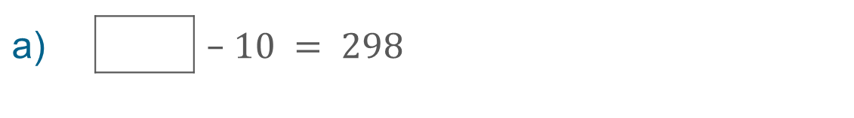
Checking prior learning
a) |  |  |  | $$10 = 298$$
 |  |  | $$−$$
b)
What temperature is 20 degrees lower than 6 degrees Celsius?
c)
The temperature at 6am was recorded each day for one week.
What was the coldest morning? What was the warmest morning?
What is the difference in temperature between Monday and Tuesday?
Place the recorded temperatures in order from smallest to largest.
Day | Mon | Tues | Wed | Thurs | Fri | Sat | Sun
Temp (°C) | 1 | -1 | 0 | 3 | 2 | -2 | -3
Notes:
References to the questions (links on final slide):
a) 2018 Key Stage 2 Mathematics Paper 1: arithmetic, question 10
b) NCETM primary assessment materials: Year 4, page 10
c) NCETM primary assessment materials: Year 5, page 10

Slide 11
Common difficulties and misconceptions
What aspects of this key idea might students find challenging?
What misconceptions might students have?
When teaching this topic, you may find students encounter difficulties with:
Challenging the idea that ‘addition makes larger and subtraction makes smaller’
Attempting to determine the sign of the answer using rules
More information, and some suggestions for overcoming these challenges, can be found on the following slides.

Slide 12
Common difficulties and misconceptions (1)
Although students have been introduced to negative numbers at Key Stage 2, their experience is likely to have been set in a context, and it is unlikely that they will have carried out operations with negative numbers.
Students are now working with a new ‘type’ of number and, in doing so, challenging and extending their understanding of additive operations. Until the introduction of negative numbers, students’ experience will have been that addition makes larger and subtraction makes smaller. The inclusion of situations in which this is not the case can be problematic.
Examples 2 and 3 use double-sided counters to counter this misconception.
Notes:
More detail can be found on page XX of the 2.1 Core Concept document

Slide 13
Common difficulties and misconceptions (2)
When assessing students’ understanding of operations with negative numbers, Hart (1981)* records that, when subtracting a positive integer from either a positive or negative number, many students simply subtract the numerals and then attempt to determine the sign for the answer while, when subtracting a negative integer, many students used the rule that ‘two negatives make a positive’.
Examining the structure of such calculations (using classroom examples, such as the ones offered below) rather than teaching such rules will help students overcome these difficulties.
Example 5 explicitly challenges this misconception, presenting students with two incorrect statements to discuss.
*K. M. Hart (ed.), 1981, Children's Understanding of Mathematics: 11–16, London, John Murray
Notes:
More detail can be found on page XX of the 2.1 Core Concept document

Slide 14
Use ‘zero pairs’ to partition a number
Example 1
Fill in the blanks to make the calculations correct.
a)
3 + 4 – 4 –
= 0
d)
10 – 7 –
= 0
b)
3 – 3 + 1 –
= 0
e)
182 – 82 –
= -1
c)
15 + 7 – 15 =
Notes:
Suggested questioning:
What do you notice about questions a, b and c?
How could you rewrite question d to be more like the others?
Can you write your own examples?
Things for you to think about:
For question d, students need to identify that the calculation can be thought of as (3 + 7) – 7 – __ = 0. You may want to think about how fluent they are with partitioning, and whether you need to draw their attention to this structure more explicitly.

Slide 15
Use ‘zero pairs’ to partition a number
Example 1
Fill in the blanks to make the calculations correct.
  What representations might you want to use alongside these calculations?
  How can you support pupils to be more aware of partitioning as a strategy?
a)
3 + 4 – 4 –
= 0
b)
3 – 3 + 1 –
= 0
c)
15 + 7 – 15 =
d)
10 – 7 –
= 0
e)
182 – 82 –
= -1
Notes:
More detail about the decisions behind the sequencing of the questions, and the importance of awareness of partitioning, can be found on page XX of the 2.1 Core Concept Document

Slide 16


Use ‘zero pairs’ to partition a number
Example 2
These counters show -2.
These counters also show -2.
Find more arrangements of counters to show -2.
Describe how you found these arrangements.
Notes:
Suggested questioning:
What is the same and what is different about your arrangements?
What is the general rule for arranging counters to show -2?
How would your arrangements change if you were showing +2 instead?
How would your arrangements change if you were showing -3/+3 instead?
Things for you to think about:
The intention of Example 2 is for students to have a flexible understanding of numbers and be able to exploit mathematical structures to manipulate numbers in order to calculate efficiently. You might want to think about what questions you will use with students to extend their understanding of partitioning to include negative numbers, or to draw attention to the symmetry of the number line around zero.

Slide 17
Use ‘zero pairs’ to partition a number
Example 2
  How might you link this representation to the symmetry of the number line around zero?
  How might you use this representation to extend student’s understanding of partitioning numbers to include negative numbers?
These counters show -2.
These counters also show -2.
Find more arrangements of counters to show -2.
Describe how you found these arrangements.
Notes:
More detail about this representation can be found on page XX of the 2.1 Core Concept Document

Slide 18
Expand understanding of addition and subtraction to include calculation with negative numbers
Example 3a
These counters show -2.
Another counter is added and the value changes to −1.
(i) | Was the counter a positive or a negative? Explain how you know.
(ii) | Write a number sentence to describe this.
Notes:
Suggested questioning:
How did you know whether a positive or negative counter had been added/taken away?
Is there always two ways to change the total of the counters?
What might be the general rule for adding/subtracting negative numbers?
Things for you to think about:
These questions are designed to build students’ towards recognising that adding +1 is equivalent to subtracting -1. What further questions might you ask to draw out this understanding?

Slide 19
Expand understanding of addition and subtraction to include calculation with negative numbers
Example 3b
These counters show -2.
One of the counters is taken away and the value changes to –1.
(i) | Was the counter a positive or a negative? Explain how you know.
(ii) | Write a number sentence to describe this.
Notes:
Suggested questioning:
How did you know whether a positive or negative counter had been added/taken away?
Is there always two ways to change the total of the counters?
What might be the general rule for adding/subtracting negative numbers?
Things for you to think about:
These questions are designed to build students’ towards recognising that adding +1 is equivalent to subtracting -1. What further questions might you ask to draw out this understanding?

Slide 20
Expand understanding of addition and subtraction to include calculation with negative numbers
Example 3c
These counters show -2.
Find two different ways to change the total of the counters to –3.
(i) | Explain how you know that you are correct.
(ii) | Write a number sentence to describe each of your strategies.
Notes:
Suggested questioning:
How did you know whether a positive or negative counter had been added/taken away?
Is there always two ways to change the total of the counters?
What might be the general rule for adding/subtracting negative numbers?
Things for you to think about:
These questions are designed to build students’ towards recognising that adding +1 is equivalent to subtracting -1. What further questions might you ask to draw out this understanding?

Slide 21
Expand understanding of addition and subtraction to include calculation with negative numbers
Example 3
a) | Another counter is added and the value changes to −1.
 | (i) | Was the counter a positive or a negative? Explain how you know.
 | (ii) | Write a number sentence to describe this.
  Does this strategy, or other strategies that you have used, offer access to the additive structure that underpins this topic?
  Does this strategy, or other strategies that you have used, support your students in calculating with negative numbers?
  What are the benefits and disadvantages of each?
These counters show -2.
b) | One of the counters is taken away and the value changes to –1. Repeat parts (i) and (ii) for this situation.
c) | Find two different ways to change the total of the counters to –3.
 | (i) | Explain how you know that you are correct.
 | (ii) | Write a number sentence to describe each of your strategies.
Notes:
More detail about how to use this representation to support understanding of addition and subtraction with negative numbers can be found on page XX of the 2.1 Core Concept Document. There is also a link to a useful blog which details lots of different strategies for modelling addition and subtraction with negative numbers, which you may wish to read before reflecting upon the questions on this slide.

Slide 22
Use ‘zero pairs’ to partition a number. Expand understanding of addition and subtraction to include calculation with negative numbers
Example 2
Example 3
These counters show -2.
These counters also show -2.
These counters show -2.
a) | Another counter is added and the value changes to −1.
 | (i) | Was the counter a positive or a negative? Explain how you know.
 | (ii) | Write a number sentence to describe this.
b) | One of the counters is taken away and the value changes to –1. Repeat parts (i) and (ii) for this situation
Find more arrangements of counters to show -2.
Describe how you found these arrangements.
c) | Find two different ways to change the total of the counters to –3.
 | (i) | Explain how you know that you are correct.
 | (ii) | Write a number sentence to describe each of your strategies.
  Watch video 5 from the Insights from experienced teachers.
  Reflect on the discussion. What are your main takeaways? How does this compare with your experience of teaching negative numbers?
Notes:
Double sided counters are also discussed from 8:20 in video 7 on the Insights from experienced teachers page.

Slide 23
Expand understanding of addition and subtraction to include calculation with negative numbers
Example 4
Each of these calculations is missing at least one negative sign.
Place the negative sign(s) to make each calculation correct.
12 + 3 = 9
12 + 3 = −9
772 + 158 = 930
772 − 158 = 614
2 937.2 − 10.71 = 2 947.91
Notes:
Suggested questioning:
How can you answer all of these questions without needing to calculate them?
Is there more than one way to make each calculation correct? Why or why not?
Things for you to think about:
By specifying that the calculations have been carried out correctly, students are able to focus on the relationships between the numbers and the implications for the position of the negative sign(s).

Slide 24
Expand understanding of addition and subtraction to include calculation with negative numbers
Example 4
Each of these calculations is missing at least one negative sign.
Place the negative sign(s) to make each calculation correct.
  What questions might you ask alongside this example?
  What is the effect of using the same values for the addition in parts a and b of this example?
  What is the effect of increasing the values in parts c, d and e of this example?
12 + 3 = 9
12 + 3 = −9
772 + 158 = 930
772 − 158 = 614
2 937.2 − 10.71 = 2 947.91
Notes:
Detail about the decisions behind the sequencing of the questions can also be found on page XX of the 2.1 Core Concept Document

Slide 25
Expand understanding of addition and subtraction to include calculation with negative numbers
Example 5
–6 – –4 =
Mia says, ‘Two negatives make a positive, so this is the same as 6 + 4 and the answer is 10.’
Sasha says, ‘Two negatives make a positive, so this is the same as 6 − 4 and the answer is 2.’
Mia and Sasha are both wrong.
How would you help them to understand that the correct answer is −2?
Notes:
Suggested questioning:
What models or representations might you use to explain the correct answer to Mia and Sasha?
Why might Mia and Sasha have made these mistakes?
Things for you to think about:
Phrases like “two negatives make a positive” can lead to misconceptions; you may want to think about the language you and your students use when describing general rules.

Slide 26
Expand understanding of addition and subtraction to include calculation with negative numbers
Example 5
  What misconceptions might ‘Mia’ and ‘Sasha’ have, and how might these have developed?
  What representations or language might you use to challenge this misconception?
  What do you do when you know a common misconception is likely?
–6 – –4 =
Mia says, ‘Two negatives make a positive, so this is the same as 6 + 4 and the answer is 10.’
Sasha says, ‘Two negatives make a positive, so this is the same as 6 − 4 and the answer is 2.’
Mia and Sasha are both wrong.
How would you help them to understand that the correct answer is −2?
Notes:
More detail about the decisions behind discussing misconceptions can be found on page XX of the 2.1 Core Concept Document

Slide 27
Solve problems where there is more than one answer and there are elements of experimentation, investigation, checking, reasoning, proof, etc
Example 6
Find some possible values for a and b (where a and b are integers).
a) a + b = −4 and a < b
b) a − b = 3 and a < b
Notes:
Suggested questioning:
If a + b is negative, how are a and b related?
How would your answer to part a change if a = b?
If a – b is positive, how are a and b related?
How can you change part b to have possible values?
Can you write your own possible and impossible questions?
Things for you to think about:
In part a, asking students to reason about what values will work when a = b might help them reason the value for when a < b.
By giving students a question for which there are no possible values that work, part b really encourages them to reason why

Slide 28
Solve problems where there is more than one answer and there are elements of experimentation, investigation, checking, reasoning, proof, etc
Example 6
  How do the constraints in these questions force students to think more deeply?
  Can you create some other ’find all possible values’-type questions that force your students to think about relationships?
Find some possible values for a and b (where a and b are integers).
a) a + b = −4 and a < b
b) a − b = 3 and a < b
Notes:
More details about how example 6 challenges students to think more deeply can be found on pages XX of the 2.1 Core Concept Document.

Slide 29
Reflection questions
What other mathematical concepts will be supported by students’ stronger understanding of this key idea?
What mathematical language will you continue to use to support pupils to make connections with other areas?
Which representations might you continue to use to further develop students’ understanding?

Slide 31
Appendices
You may choose to use the following slides when planning or delivering a PD session. They cover:
  Key vocabulary
  Representations and structure
  Previous learning
  Future learning
  Library of links

Slide 32
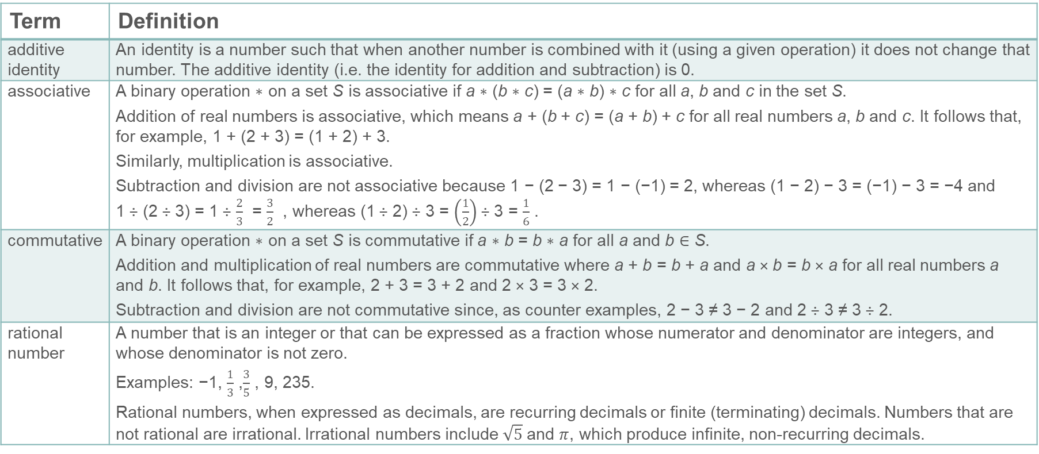
Key vocabulary
Term | Definition
additive identity | An identity is a number such that when another number is combined with it (using a given operation) it does not change that number. The additive identity (i.e. the identity for addition and subtraction) is 0.
associative | A binary operation ∗ on a set S is associative if a ∗ (b ∗ c) = (a ∗ b) ∗ c for all a, b and c in the set S. Addition of real numbers is associative, which means a + (b + c) = (a + b) + c for all real numbers a, b and c. It follows that, for example, 1 + (2 + 3) = (1 + 2) + 3. Similarly, multiplication is associative. Subtraction and division are not associative because 1 − (2 − 3) = 1 − (−1) = 2, whereas (1 − 2) − 3 = (−1) − 3 = −4 and 1 ÷ (2 ÷ 3) = 1 ÷ $\frac{2}{3}$ = $\frac{3}{2}$ , whereas (1 ÷ 2) ÷ 3 = $\left(\frac{1}{2}\right)$ ÷ 3 = $\frac{1}{6}$ .
commutative | A binary operation ∗ on a set S is commutative if a ∗ b = b ∗ a for all a and b ∈ S. Addition and multiplication of real numbers are commutative where a + b = b + a and a × b = b × a for all real numbers a and b. It follows that, for example, 2 + 3 = 3 + 2 and 2 × 3 = 3 × 2. Subtraction and division are not commutative since, as counter examples, 2 − 3 ≠ 3 − 2 and 2 ÷ 3 ≠ 3 ÷ 2.
rational number | A number that is an integer or that can be expressed as a fraction whose numerator and denominator are integers, and whose denominator is not zero. Examples: −1, $\frac{1}{3}$ ,$\frac{3}{5}$ , 9, 235. Rational numbers, when expressed as decimals, are recurring decimals or finite (terminating) decimals. Numbers that are not rational are irrational. Irrational numbers include $\sqrt{5}$and $π$, which produce infinite, non-recurring decimals.

Slide 33


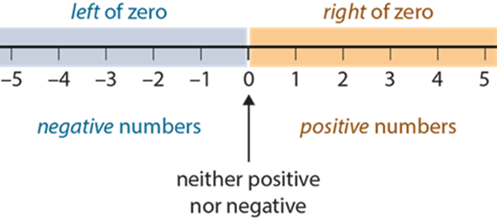
Representations and structure
There are a number of different representations that you may wish to use to support students’ understanding of additive structure with negative numbers. These might include:
Double-sided (positive and negative) counters
  Counters with different colours can be used to represent positive and negative quantities. By adding and subtracting (i.e. removing) both positive and negative quantities from such collections, students can make sense of the addition and subtraction of directed numbers.
Single number lines
  Single number lines are straight lines with numbers evenly spaced, in order, along their length. The number line is not a device for measuring but a representation to support students’ understanding of the number system.
Notes:
More information about the representations and structure involved in this key idea can be found:
On page 13 of the Operating on number theme overview document (double sided counters)
Within the NCETM’s Using mathematical representations at KS3 document (single number lines)
Links to all of these can be found on the final slide.

Slide 34
Previous learning (1)
From Upper Key Stage 2, students will bring experience of:
multiplying multi-digit numbers up to four digits by a two-digit whole number using the formal written method of long multiplication
dividing numbers up to four digits by a two-digit whole number using the formal written method of long division, and interpreting remainders as whole number remainders, fractions, or by rounding, as appropriate for the context
dividing numbers up to four digits by a two-digit number using the formal written method of short division where appropriate, and interpreting remainders according to the context
performing mental calculations, including with mixed operations and large numbers
using their knowledge of the order of operations to carry out calculations involving the four operations
solving addition and subtraction multi-step problems in contexts, deciding which operations and methods to use and why
Notes:
Theme 2 Operating on number

Slide 35
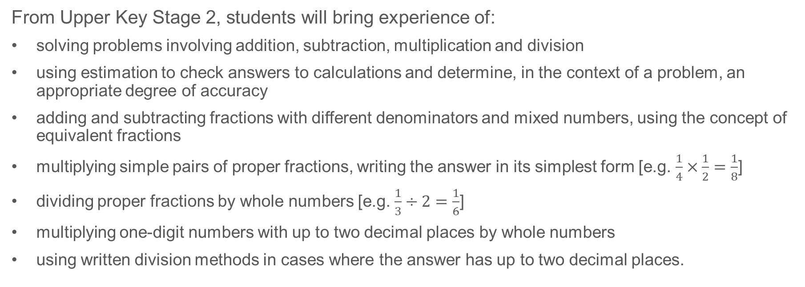
Previous learning (2)
From Upper Key Stage 2, students will bring experience of:
solving problems involving addition, subtraction, multiplication and division
using estimation to check answers to calculations and determine, in the context of a problem, an appropriate degree of accuracy
adding and subtracting fractions with different denominators and mixed numbers, using the concept of equivalent fractions
multiplying simple pairs of proper fractions, writing the answer in its simplest form [e.g. $\frac{1}{4}×\frac{1}{2}=\frac{1}{8}$]
dividing proper fractions by whole numbers [e.g. $\frac{1}{3}÷2=\frac{1}{6}$]
multiplying one-digit numbers with up to two decimal places by whole numbers
using written division methods in cases where the answer has up to two decimal places.
Notes:
Theme 2 Operating on number

Slide 36
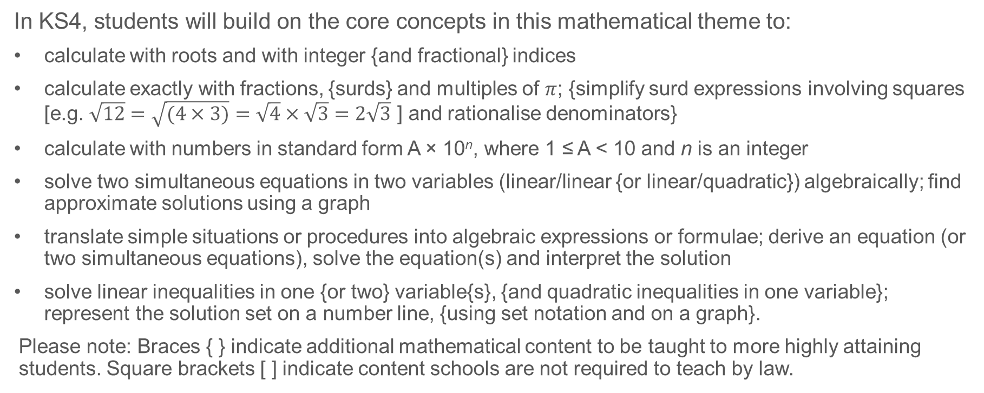
Future learning
In KS4, students will build on the core concepts in this mathematical theme to:
calculate with roots and with integer {and fractional} indices
calculate exactly with fractions, {surds} and multiples of $π$; {simplify surd expressions involving squares [e.g. $\sqrt{12}=\sqrt{(4×3)}=\sqrt{4}×\sqrt{3}=2\sqrt{3}$ ] and rationalise denominators}
calculate with numbers in standard form A × 10^{n}, where 1 ≤ A < 10 and n is an integer
solve two simultaneous equations in two variables (linear/linear {or linear/quadratic}) algebraically; find approximate solutions using a graph
translate simple situations or procedures into algebraic expressions or formulae; derive an equation (or two simultaneous equations), solve the equation(s) and interpret the solution
solve linear inequalities in one {or two} variable{s}, {and quadratic inequalities in one variable}; represent the solution set on a number line, {using set notation and on a graph}.
Please note: Braces { } indicate additional mathematical content to be taught to more highly attaining students. Square brackets [ ] indicate content schools are not required to teach by law.
Notes:
Theme 2 Operating on Number

Slide 37
Library of links
The following resources from the NCETM website have been referred to within this slide deck:
  NCETM Secondary Mastery Professional Development
    2 Operating on Number Theme Overview Document
    2.1 Arithmetic procedures Core Concept Document
  Using mathematical representations at KS3 | NCETM
  Insights from experienced teachers | NCETM
  NCETM primary mastery professional development materials
  NCETM primary assessment materials
There are also references to:
  Standards & Testing Agency’s past mathematics papers

