Slide 1
Solving problems using the associative, distributive and commutative laws
KS3 Mastery PD Materials: Exemplified Key Ideas
Materials for use in the classroom or to support professional development discussions
(from 2.1 Arithmetic procedures)
Summer 2021

Slide 2
About this resource
These slides are designed to complement the 2.1 Arithmetic procedures Core Concept document and its associated Theme Overview document 2 Operating on number, both found in the Secondary Mastery Professional Development pages.
These slides re-present the key examples from the Core Concept document so that the examples can be used either directly in the classroom or with a group of teachers. There are prompt questions alongside the examples, and further clarification in the notes.
These slides do not fully replicate the Core Concept document, so should be used alongside it. Reference to specific page numbers, and to other useful NCETM resources, can be found in the notes for each slide.
This slide deck is not designed to be a complete PD session, rather it is a selection of resources that you can adapt and use as needed when planning a session with a group of teachers.

Slide 3


About this resource
The slides are structured as follows:
  The big picture:
    Where does this fit in?
    What do students need to understand?
    Why is this key idea important?
  Prior learning
  Misconceptions
  Exemplified key ideas
  Reflection questions
  Appendices:
    Key vocabulary
    Representations and structure
    Previous and Future learning
    Useful links
The exemplified key idea slides have the following symbols to indicate how they have been designed to be used:
Into the classroom
The examples are presented on these slides so that they could be used in PD, but also directly in the classroom. The notes feature suggested questions and things teachers might consider when using with students.
PD discussion prompts
These slides look at the examples in more detail, with question prompts to promote discussion among maths teachers. The notes feature reference to further information and guidance within the Core Concepts document.

Slide 4
Where does this fit in?
The NCETM has identified a set of six ‘mathematical themes’ within Key Stage 3 mathematics that bring together a group of ‘core concepts’.
The second of these themes is Operating on number, which covers the following interconnected core concepts:
2.1 Arithmetic procedures
2.2 Solving linear equations
Notes:
Linked on this slide is the Theme Overview document of Operating on number. This document includes why it is important, the key underpinning knowledge and links to prior and future learning. There is also guidance about how the five big ideas of Teaching for Mastery relate specifically to this theme.

Slide 5
Where does this fit in?
Within this core concept, 2.1 Arithmetic Procedures, there are five statements of knowledge, skills and understanding.
These, in turn, are broken down into twenty one key ideas. The highlighted key idea is exemplified in this slide deck.
Notes:
For key ideas marked with an asterisk, we exemplified the common difficulties and misconceptions that students might have and included elements of what teaching for mastery may look like. We have provided examples of possible student tasks and teaching approaches.
Within these slides are ‘classroom-ready’ versions of the examples for the key idea that has been highlighted. There are also slides that may be useful for discussion in a professional development session

Slide 6
What do students need to understand?
2.1.5.5 Use the associative, distributive and commutative laws to flexibly and efficiently solve problems
Identify relationships so that known facts can be used to simplify calculations.
  What prior knowledge might your students already have?
  What language might they use to describe this key idea?
  What questions might you want to ask to assess their prior learning?

Slide 7
Why is this key idea important?
The ability to calculate is a fundamental skill in mathematics and this, of course, includes the requirement that students know and use standard methods of calculation.
However, students who know these methods solely as a set of memorised steps, without any understanding of why they work and the laws of arithmetic on which they are based, may quickly forget them.
There is a danger that students see the mathematics curriculum as a set of separate topics, each with its own set of rules and techniques. This unconnected view of the curriculum can result in an entirely instrumental and procedural approach to mathematics, with no sense of conceptual coherence.
Students should both know and notice examples of the commutative [ab = ba, a + b = b + a], associative [abc = (ab)c = a(bc); a + b + c = (a + b) + c = a + (b + c)] and distributive laws [a(b + c) = ab + ac] and need to be able to calculate fluently with the full range of different types of numbers in a wide range of contexts and problem-solving situations, exploiting these laws to increase the efficiency of calculation.
Notes:
A more detailed overview of the core concept of arithmetic procedures can be found on page 2 of the 2.1 Core Concept document.
The background to each key idea is also explored in more detail on the following pages:
2.1.1 Understand and use the structures that underpin addition and subtraction strategies – page 10
2.1.2 Understand and use the structures that underpin multiplication and division strategies – pages 10 and 11
2.1.3 Know, understand and use fluently a range of calculation strategies for addition and subtraction of fractions – page 11
2.1.4 Know, understand and use fluently a range of calculation strategies for multiplication and division of fractions – pages 11 and 12
2.1.5 Use the laws and conventions of arithmetic to calculate efficiently – pages 12 and 13

Slide 8
Prior learning
Upper Key Stage 2 Learning Outcome
Use formal written methods for the four operations (see notes below)
Solve problems involving addition, subtraction, multiplication and division
Multiply and divide whole numbers and those involving decimals by 10, 100 and 1 000
Use their knowledge of the order of operations to carry out calculations involving the four operations
Use estimation to check answers to calculations and determine, in the context of a problem, an appropriate degree of accuracy
Multiply one-digit numbers with up to two decimal places by whole numbers
Use written division methods in cases where the answer has up to two decimal places
  What prior knowledge might your students already have?
  What language might they use to describe this key idea?
  What questions might you want to ask to assess their prior learning?
Notes:
The KS2 curriculum includes the following detail about calculations involving the four operations:
Add and subtract whole numbers with more than four digits, including using formal written methods (columnar addition and subtraction)
Multiply multi-digit numbers up to four digits by a two-digit whole number using the formal written method of long multiplication
Divide numbers up to four digits by a two-digit whole number using the formal written method of long division, and interpret remainders as whole number remainders, fractions, or by rounding, as appropriate for the context
Divide numbers up to four digits by a two-digit number using the formal written method of short division where appropriate, interpreting remainders according to the context
You may find it useful to speak to your partner schools to see how the above has been covered and the language used.
The prior learning is covered in a number of the segments from Spines 1, 2 and 3 of the NCETM primary mastery professional development materials (linked on final slide).
Within the Operating on Number Theme Overview document, you can also find a broader description of students’ potential previous learning (page 6), alongside further information about key underpinning knowledge (page 2).

Slide 9
Checking prior learning
The following slides contain questions for checking prior learning.
  What representations might students use to support their understanding of these questions?
  What variation might you put in place for these questions to fully assess students’ understanding of the concept?
  How might changing the language of each question change the difficulty?
  Why are these such crucial pre-requisites for this key idea?

Slide 10
Checking prior learning
Find numbers to complete these number sentences.
Work out:
  8.4 × 3 + 8.4 × 7
  6.7 × 5 − 0.67 × 50
  93 × 0.2 + 0.8 × 93
  7.2 × 4 + 3.6 × 8
736 ÷ 23 =
× 100 = 2 400
× 100 = 10 ×
7 360 ÷ 230 =
25 × = 200
25 × = 4 ×
230 × 24 =
23 × = 161
23 × = 161 ×
240 × 23 =
24 × = 168
24 × = 168 ×
1 668 ÷ 8 =
161 ÷ = 23
161 ÷ = 23 ×
208.5 × 8 =
÷ 25 = 9
÷ 25 = 9 ×
Notes:
References to the questions (links on final slide):
a) NCETM Primary assessment materials: Year 6, page 15
b) NCETM Primary assessment materials: Year 6, page 16

Slide 11
Common difficulties and misconceptions
What aspects of this key idea might students find challenging?
What misconceptions might students have?
When teaching this topic, you may find students encounter difficulties with…
Identifying strategic ways to solve a problem
More information, and some suggestions for overcoming these challenges, can be found on the following slides.

Slide 12
Common difficulties and misconceptions (1)
Students’ understanding of the laws of arithmetic is crucial if they are to be able to work flexibly to evaluate calculations.
A key idea here is that students are able to identify known facts, connections and relationships and use them to strategically simplify calculations. For some students, whose experience of mathematics may be that there is only one correct process that should be followed, this may prove challenging.
The strategy of inviting students to solve problems ‘in as many different ways as you can’ helps to develop the skill of making sensible choices based on the numbers involved and the relationships between them. It is also helpful to choose examples that draw students’ attention to certain, useful connections and asking them, ‘What do you notice?’, e.g. 9 999 + 999 + 99 + 9 + 5 or 2.75 × 5.4 + 27.5 × 0.46.
Notes:
This can be found on page 44 of the 2.1 Core Concept document.

Slide 13
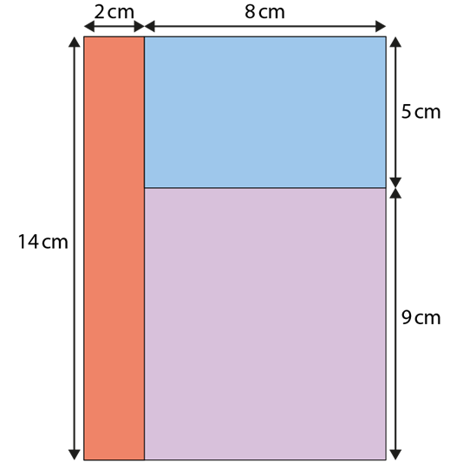
Identify relationships so that known facts can be used to simplify calculations
Example 1
The area of the shape can be found by calculating 2 × 14 + 8 × 5 + 9 × 8.
Find the area of the shape in cm².
Write down some other calculations that represent the area of the shape.
Notes:
Suggested questioning:
Which rectangle is referred to by each product?
How else could you write this calculation?
Is there a way to rewrite 8 x 5 + 9 x 8? What do you notice?
Things for you to think about:
In Example 1, the area model for multiplication is used as a context to give students an opportunity to consider different calculation strategies. You might like to ask students which area of the shape is being calculated by each of the products in the number sentence, giving them an opportunity to make sense of the representation and connect it to the symbols. Then, discuss the different strategies students have found to simplify their calculation.
If it does not arise during the discussion, draw students’ attention to the way that the commutative and associative laws can be used to identify that 8 × 5 + 9 × 8 = 8 × 14 and that the distributive law can be used to simplify the overall expression to 10 × 14.

Slide 14
Identify relationships so that known facts can be used to simplify calculations
Example 1
  How might using the area representation support students to recognise situations where the commutative, associative and distributive laws can be used to simplify?
  If students do not notice how they can simplify this expression, what might you do to help guide them?
The area of the shape can be found by calculating
2 × 14 + 8 × 5 + 9 × 8.
Find the area of the shape in cm².
Write down some other calculations that represent the area of the shape.
Notes:
Due to space constraints, the image on this PD discussion slide is very small. PD Leads might like to use or print the ‘in the classroom’ version of this slide for teachers to access during discussions.
This example can be found on page 44 of the 2.1 Core Concept document.

Slide 15
Identify relationships so that known facts can be used to simplify calculations
Examples 2a and 2b
Which of these is correct?
  13 × 99 = 10 × 90 + 3 × 9
  13 × 99 = 13 × 100 − 13 × 1
  13 × 99 = 13 × 90 + 13 × 9
  13 × 99 = 10 × 99 + 3 × 99
  13 × 99 = 15 × 99 − 2 × 99
Which method do you prefer to calculate this product? Why?
Which of these is correct?
  19 × 99 = 25 × 99 − 6 × 99
  19 × 99 = 20 × 99 − 1 × 99
  19 × 99 = 19 × 100 − 19 × 1
  19 × 99 = 10 × 90 + 9 × 9
  19 × 99 = 10 × 90 + 9 × 90
  19 × 99 = 19 × 90 + 19 × 9
Which method do you prefer to calculate this product? Why?
Notes:
Suggested questioning:
Is there more than one valid answer?
Where there are two or more ways to rewrite a question, which do you prefer?
Which facts are you more confident/speedy in using?
Things for you to think about:
In Example 2, students are required to think flexibly to evaluate whether the different methods are correct or not, before choosing their preferred method for calculating the product or quotient. The invalid methods have each been chosen to highlight and draw out a particular misconception, while the valid ones show a range of different possibilities.
It is important that students understand that while each of the valid methods gives a correct solution, some may be more efficient at reaching it than others. It is also worth noting that the most efficient method for one student may not be the most efficient for another. Students’ preferences will depend on what facts they are able to recall fluently.

Slide 16
Identify relationships so that known facts can be used to simplify calculations
Examples 2c and 2d
Which of these is correct?
  77 068 ÷ 5 ÷ 2 = (77 068 ÷ 5) ÷ 2
  77 068 ÷ 5 ÷ 2 = 77 068 ÷ (5 ÷ 2)
  77 068 ÷ 5 ÷ 2 = 77 068 ÷ 2 ÷ 5
  77 068 ÷ 5 ÷ 2 = 77 068 ÷ (5 × 2)
Which method do you prefer to calculate this quotient? Why?
Which of these is correct?
  7 742 ÷ 14 = (7 742 ÷ 7) ÷ 2
  7 742 ÷ 14 = (7 742 ÷ 2) ÷ 7
  7 742 ÷ 14 = (7 742 ÷ 10) ÷ 4
Which method do you prefer to calculate this product? Why?
Notes:
Suggested questioning:
Is there more than one valid answer?
Where there are two or more ways to rewrite a question, which do you prefer?
Which facts are you more confident/speedy in using?
Things for you to think about:
In Example 2, students are required to think flexibly to evaluate whether the different methods are correct or not, before choosing their preferred method for calculating the product or quotient. The invalid methods have each been chosen to highlight and draw out a particular misconception, while the valid ones show a range of different possibilities.
It is important that students understand that while each of the valid methods gives a correct solution, some may be more efficient at reaching it than others. It is also worth noting that the most efficient method for one student may not be the most efficient for another. Students’ preferences will depend on what facts they are able to recall fluently.

Slide 17
Identify relationships so that known facts can be used to simplify calculations
Example 2 (printable version)
a) | Which of these is correct? | b) | Which of these is correct?
 | 13 × 99 = 10 × 90 + 3 × 9 13 × 99 = 13 × 100 − 13 × 1 13 × 99 = 13 × 90 + 13 × 9 13 × 99 = 10 × 99 + 3 × 99 13 × 99 = 15 × 99 − 2 × 99 |  | 19 × 99 = 25 × 99 − 6 × 99 19 × 99 = 20 × 99 − 1 × 99 19 × 99 = 19 × 100 − 19 × 1 19 × 99 = 10 × 90 + 9 × 9 19 × 99 = 10 × 90 + 9 × 90 19 × 99 = 19 × 90 + 19 × 9
Which method do you prefer to calculate this product? Why? | Which method do you prefer to calculate this product? Why? | Which method do you prefer to calculate this product? Why?
c) | Which of these is correct? | d) | Which of these is correct?
 | 77 068 ÷ 5 ÷ 2 = (77 068 ÷ 5) ÷ 2 77 068 ÷ 5 ÷ 2 = 77 068 ÷ (5 ÷ 2) 77 068 ÷ 5 ÷ 2 = 77 068 ÷ 2 ÷ 5 77 068 ÷ 5 ÷ 2 = 77 068 ÷ (5 × 2) |  | 7 742 ÷ 14 = (7 742 ÷ 7) ÷ 2 7 742 ÷ 14 = (7 742 ÷ 2) ÷ 7 7 742 ÷ 14 = (7 742 ÷ 10) ÷ 4
 |  | Which method do you prefer to calculate this product? Why?
Which method do you prefer to calculate this quotient? Why?
Notes:
This slide is a version of example 2 that might be more suited to printing.

Slide 18
Identify relationships so that known facts can be used to simplify calculations
Example 2a and 2b
Which of these is correct?
  13 × 99 = 10 × 90 + 3 × 9
  13 × 99 = 13 × 100 − 13 × 1
  13 × 99 = 13 × 90 + 13 × 9
  13 × 99 = 10 × 99 + 3 × 99
  13 × 99 = 15 × 99 − 2 × 99
Which method do you prefer to calculate this product? Why?
Which of these is correct?
  19 × 99 = 25 × 99 − 6 × 99
  19 × 99 = 20 × 99 − 1 × 99
  19 × 99 = 19 × 100 − 19 × 1
  19 × 99 = 10 × 90 + 9 × 9
  19 × 99 = 10 × 90 + 9 × 90
  19 × 99 = 19 × 90 + 19 × 9
Which method do you prefer to calculate this product? Why?
  What misconceptions might the invalid methods be trying to highlight?
  Which methods do your students prefer? Are there any differences in which facts they are able to recall most fluently?
Notes:
Due to space constraints, the image on this PD discussion slide is very small. PD Leads might like to use or print the ‘in the classroom’ version of this slide for teachers to access during discussions.
This example can be found on page 45 of the 2.1 Core Concept document.

Slide 19
Identify relationships so that known facts can be used to simplify calculations
Example 2
Which of these is correct?
  77 068 ÷ 5 ÷ 2 = (77 068 ÷ 5) ÷ 2
  77 068 ÷ 5 ÷ 2 = 77 068 ÷ (5 ÷ 2)
  77 068 ÷ 5 ÷ 2 = 77 068 ÷ 2 ÷ 5
  77 068 ÷ 5 ÷ 2 = 77 068 ÷ (5 × 2)
Which method do you prefer to calculate this quotient? Why?
Which of these is correct?
  7 742 ÷ 14 = (7 742 ÷ 7) ÷ 2
  7 742 ÷ 14 = (7 742 ÷ 2) ÷ 7
  7 742 ÷ 14 = (7 742 ÷ 10) ÷ 4
Which method do you prefer to calculate this product? Why?
  What misconceptions might the invalid methods be trying to highlight?
  Which methods do your students prefer? Are there any differences in which facts they are able to recall most fluently?
Notes:
Due to space constraints, the image on this PD discussion slide is very small. PD Leads might like to use or print the ‘in the classroom’ version of this slide for teachers to access during discussions.
This example can be found on page 45 of the 2.1 Core Concept document.

Slide 20
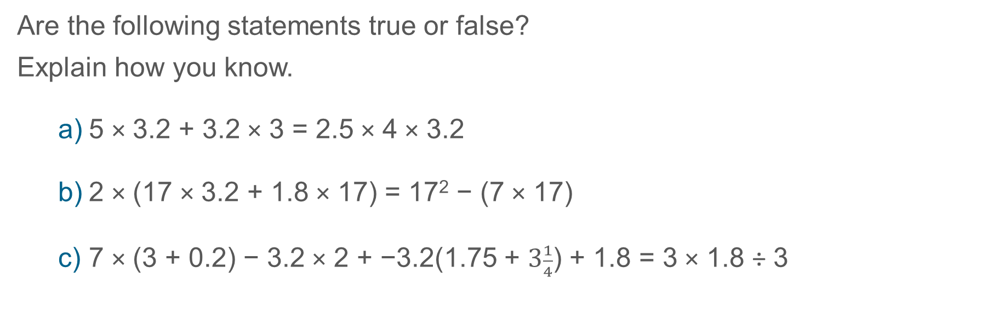
Identify relationships so that known facts can be used to simplify calculations
Example 3
Are the following statements true or false?
Explain how you know.
  5 × 3.2 + 3.2 × 3 = 2.5 × 4 × 3.2
  2 × (17 × 3.2 + 1.8 × 17) = 17² − (7 × 17)
  7 × (3 + 0.2) − 3.2 × 2 + −3.2(1.75 + $3\frac{1}{4}$) + 1.8 = 3 × 1.8 ÷ 3
Notes:
Suggested questioning:
How can you rewrite these equations? What laws are you using to do this?
(If students are struggling: Can you pick one part of the equation to rewrite/simplify? Which part might you do first?)
How can we rewrite __ (e.g. 17^2)?
Why is it helpful to be able to simplify some calculations, rather than always using a calculator?
What relationships/facts are you using each time?
Things for you to think about:
In Example 3, students are required to bring together the commutative, distributive and associative laws to simplify complex calculations. A key awareness for students here is that some calculations can be simplified. Students should not automatically reach for their calculator; instead, they should consider each calculation as a whole in order to identify relationships and possible known facts, so reducing the amount of calculation necessary. Rather than focus on the final result of each calculation, it will be more helpful to emphasise the laws of arithmetic that have been used to simplify the calculations.

Slide 21

Identify relationships so that known facts can be used to simplify calculations
Example 3
  Consider the prompts and scaffolds that you might use in your class to support students who find these questions challenging. What strategies might you use to help them move forward?
  What known facts are students using to simplify these calculations? How fluent are your students in these facts?
Are the following statements true or false?
Explain how you know.
5 × 3.2 + 3.2 × 3 = 2.5 × 4 × 3.2
2 × (17 × 3.2 + 1.8 × 17) = 17² − (7 × 17)
7 × (3 + 0.2) − 3.2 × 2 + −3.2(1.75 + $3\frac{1}{4}$) + 1.8 = 3 × 1.8 ÷ 3
Notes:
Due to space constraints, the image on this PD discussion slide is very small. PD Leads might like to use or print the ‘in the classroom’ version of this slide for teachers to access during discussions.
This example can be found on page 46 of the 2.1 Core Concept document.

Slide 22
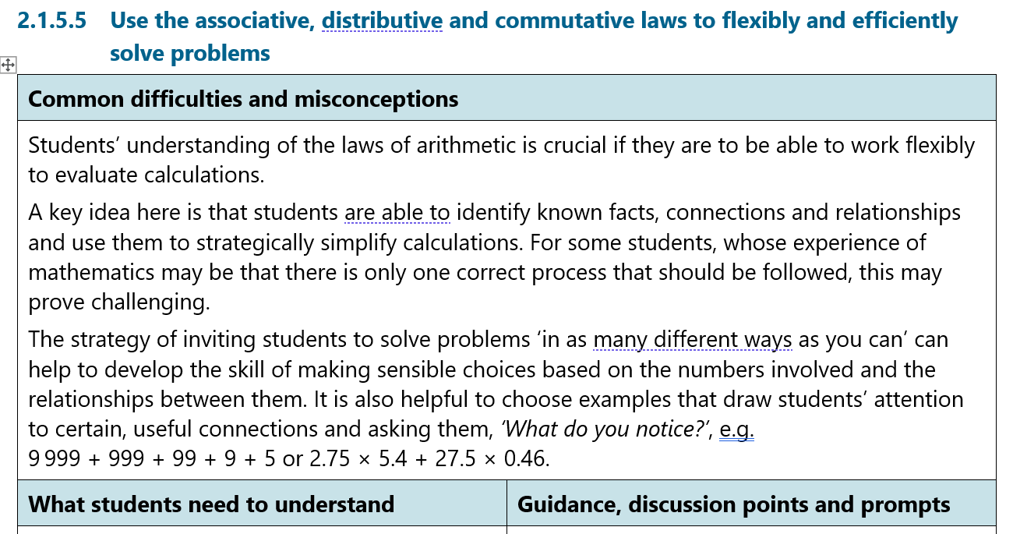
Identify relationships so that known facts can be used to simplify calculations
Examples 1, 2 and 3
  This key idea, including all of the examples, is discussed in video 4 of the Insights from experienced teachers. How do their reflections compare with your experience?

Slide 23
Reflection questions
What other mathematical concepts will be supported by students’ stronger understanding of this key idea?
What mathematical language will you continue to use to support pupils to make connections with other areas?
Which representations might you continue to use to further develop students’ understanding?

Slide 25
Appendices
You may choose to use the following slides when planning or delivering a PD session. They cover:
  Key vocabulary
  Representations and structure
  Previous learning
  Future learning
  Library of links

Slide 26
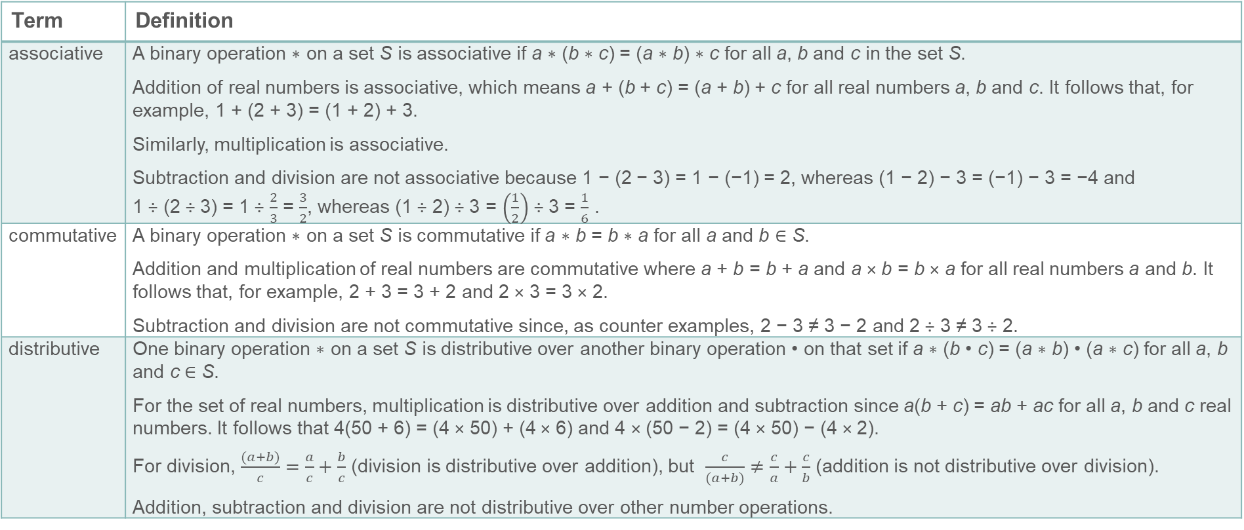
Key vocabulary (1)
Term | Definition
associative | A binary operation ∗ on a set S is associative if a ∗ (b ∗ c) = (a ∗ b) ∗ c for all a, b and c in the set S. Addition of real numbers is associative, which means a + (b + c) = (a + b) + c for all real numbers a, b and c. It follows that, for example, 1 + (2 + 3) = (1 + 2) + 3. Similarly, multiplication is associative. Subtraction and division are not associative because 1 − (2 − 3) = 1 − (−1) = 2, whereas (1 − 2) − 3 = (−1) − 3 = −4 and 1 ÷ (2 ÷ 3) = 1 ÷ $\frac{2}{3}$ = $\frac{3}{2}$, whereas (1 ÷ 2) ÷ 3 = $\left(\frac{1}{2}\right)$ ÷ 3 = $\frac{1}{6}$ .
commutative | A binary operation ∗ on a set S is commutative if a ∗ b = b ∗ a for all a and b ∈ S. Addition and multiplication of real numbers are commutative where a + b = b + a and a × b = b × a for all real numbers a and b. It follows that, for example, 2 + 3 = 3 + 2 and 2 × 3 = 3 × 2. Subtraction and division are not commutative since, as counter examples, 2 − 3 ≠ 3 − 2 and 2 ÷ 3 ≠ 3 ÷ 2.
distributive | One binary operation ∗ on a set S is distributive over another binary operation • on that set if a ∗ (b • c) = (a ∗ b) • (a ∗ c) for all a, b and c ∈ S. For the set of real numbers, multiplication is distributive over addition and subtraction since a(b + c) = ab + ac for all a, b and c real numbers. It follows that 4(50 + 6) = (4 × 50) + (4 × 6) and 4 × (50 − 2) = (4 × 50) − (4 × 2). For division, $\frac{(a+b)}{c}=\frac{a}{c}+\frac{b}{c}$ (division is distributive over addition), but $\frac{c}{(a+b)}≠\frac{c}{a}+\frac{c}{b}$ (addition is not distributive over division). Addition, subtraction and division are not distributive over other number operations.

Slide 27
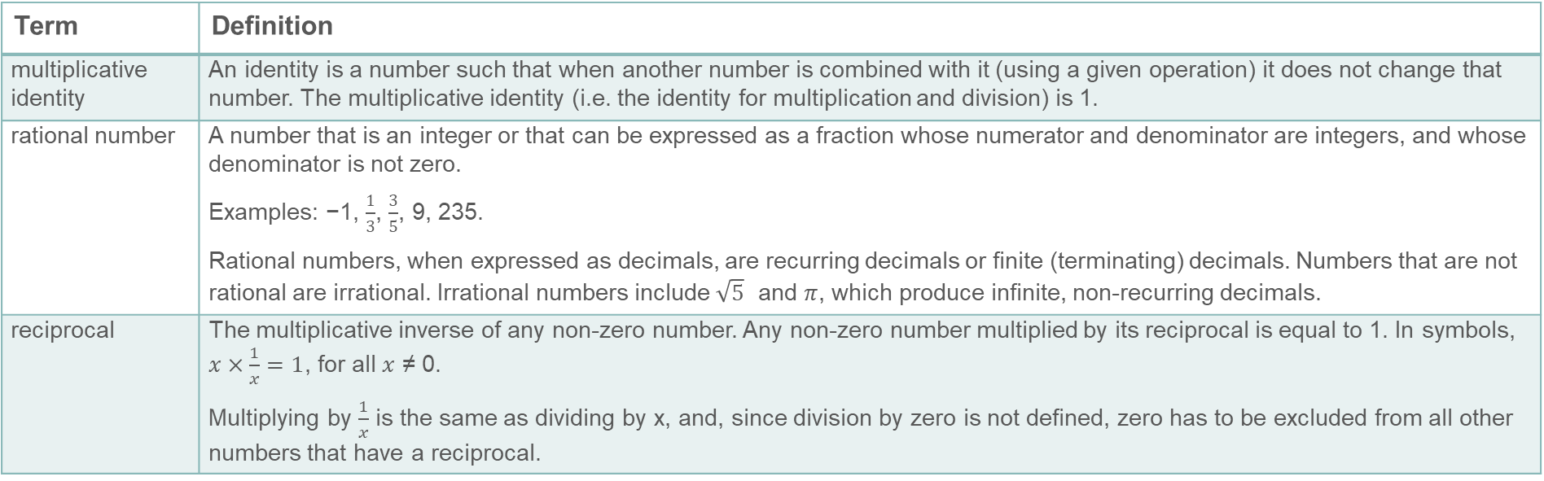
Key vocabulary (2)
Term | Definition
multiplicative identity | An identity is a number such that when another number is combined with it (using a given operation) it does not change that number. The multiplicative identity (i.e. the identity for multiplication and division) is 1.
rational number | A number that is an integer or that can be expressed as a fraction whose numerator and denominator are integers, and whose denominator is not zero. Examples: −1, $\frac{1}{3}$, $\frac{3}{5}$, 9, 235. Rational numbers, when expressed as decimals, are recurring decimals or finite (terminating) decimals. Numbers that are not rational are irrational. Irrational numbers include $\sqrt{5}$ and $π$, which produce infinite, non-recurring decimals.
reciprocal | The multiplicative inverse of any non-zero number. Any non-zero number multiplied by its reciprocal is equal to 1. In symbols, $x×\frac{1}{x}=1$, for all $x$ ≠ 0. Multiplying by $\frac{1}{x}$ is the same as dividing by x, and, since division by zero is not defined, zero has to be excluded from all other numbers that have a reciprocal.

Slide 28

Representations and structure
There are a number of different representations that you may wish to use to support students’ understanding of this key idea. These might include:
Arrays and area models
  The array is a useful image for revealing the commutative and distributive properties of multiplication. When the rectangle has continuous measures for the dimensions, it becomes a useful way of thinking about the product of any two numbers including decimals and fractions.
Notes:
More information about the representations and structure involved in this key idea can be found:
On page 11 and 12 of the Theme Overview document.
In the ‘Using mathematical representations at KS3’ documents
Links to all of these can be found on the final slide.

Slide 29
Previous learning (1)
From Upper Key Stage 2, students will bring experience of:
multiplying multi-digit numbers up to four digits by a two-digit whole number using the formal written method of long multiplication
dividing numbers up to four digits by a two-digit whole number using the formal written method of long division, and interpreting remainders as whole number remainders, fractions, or by rounding, as appropriate for the context
dividing numbers up to four digits by a two-digit number using the formal written method of short division where appropriate, and interpreting remainders according to the context
performing mental calculations, including with mixed operations and large numbers
using their knowledge of the order of operations to carry out calculations involving the four operations
solving addition and subtraction multi-step problems in contexts, deciding which operations and methods to use and why
Notes:
Theme 2 Operating on number

Slide 30
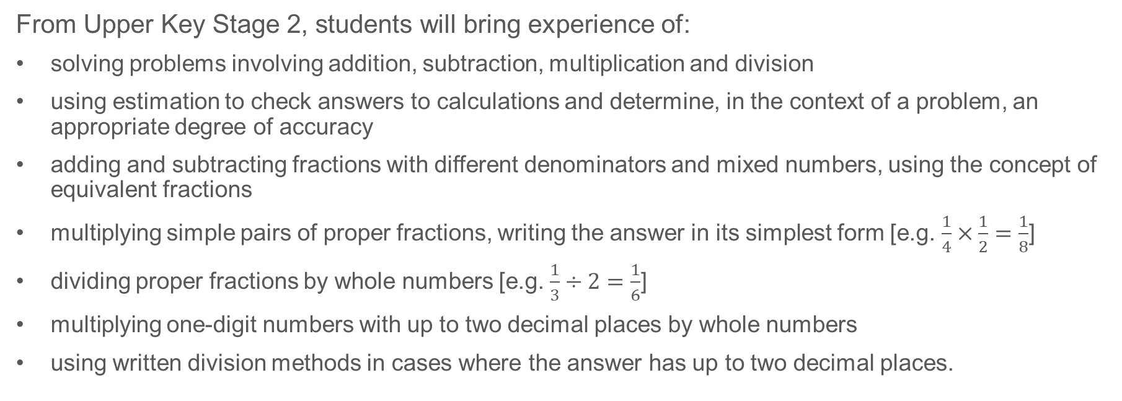
Previous learning (2)
From Upper Key Stage 2, students will bring experience of:
solving problems involving addition, subtraction, multiplication and division
using estimation to check answers to calculations and determine, in the context of a problem, an appropriate degree of accuracy
adding and subtracting fractions with different denominators and mixed numbers, using the concept of equivalent fractions
multiplying simple pairs of proper fractions, writing the answer in its simplest form [e.g. $\frac{1}{4}×\frac{1}{2}=\frac{1}{8}$]
dividing proper fractions by whole numbers [e.g. $\frac{1}{3}÷2=\frac{1}{6}$]
multiplying one-digit numbers with up to two decimal places by whole numbers
using written division methods in cases where the answer has up to two decimal places.
Notes:
Theme 2 Operating on number

Slide 31
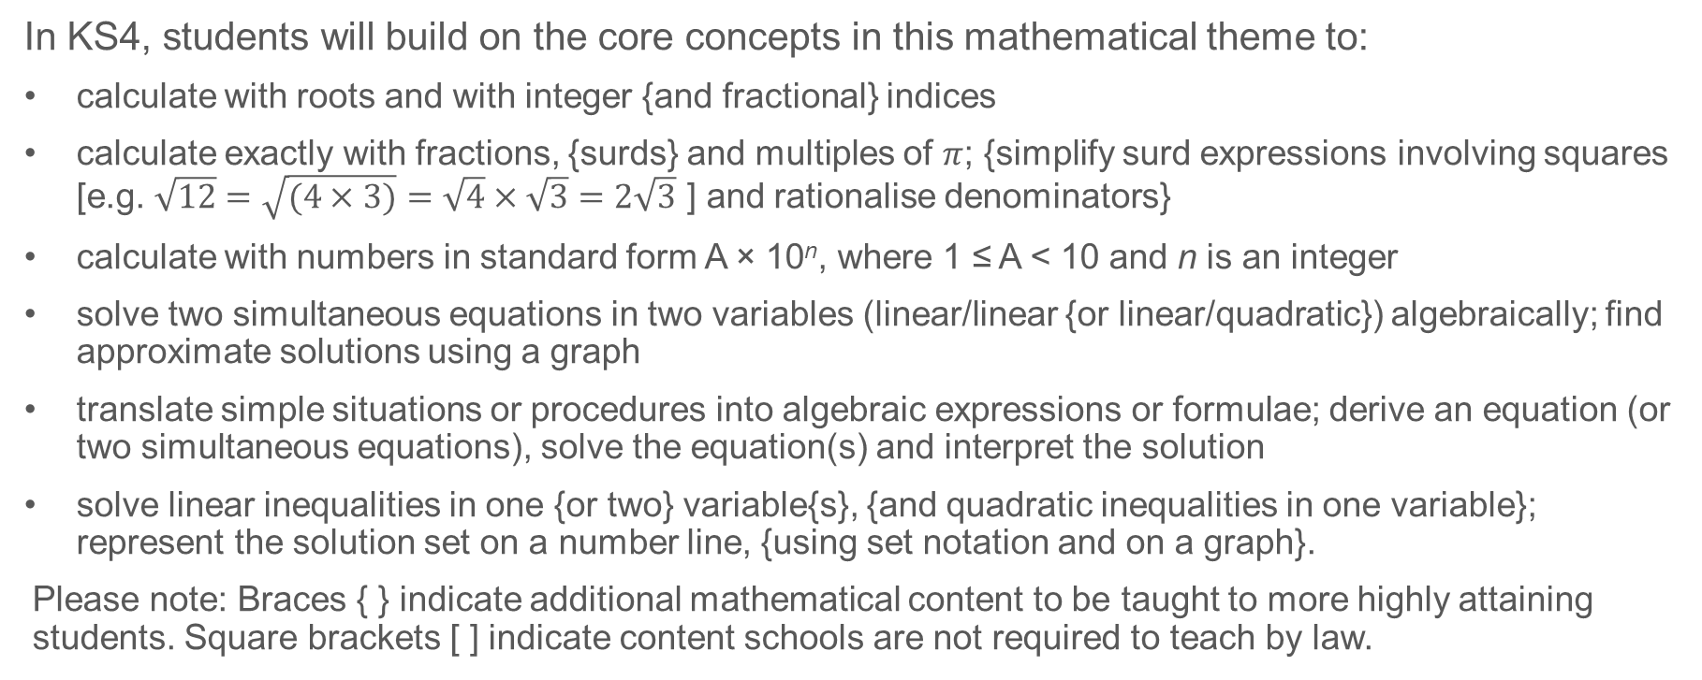
Future learning
In KS4, students will build on the core concepts in this mathematical theme to:
calculate with roots and with integer {and fractional} indices
calculate exactly with fractions, {surds} and multiples of $π$; {simplify surd expressions involving squares [e.g. $\sqrt{12}=\sqrt{(4×3)}=\sqrt{4}×\sqrt{3}=2\sqrt{3}$ ] and rationalise denominators}
calculate with numbers in standard form A × 10^{n}, where 1 ≤ A < 10 and n is an integer
solve two simultaneous equations in two variables (linear/linear {or linear/quadratic}) algebraically; find approximate solutions using a graph
translate simple situations or procedures into algebraic expressions or formulae; derive an equation (or two simultaneous equations), solve the equation(s) and interpret the solution
solve linear inequalities in one {or two} variable{s}, {and quadratic inequalities in one variable}; represent the solution set on a number line, {using set notation and on a graph}.
Please note: Braces { } indicate additional mathematical content to be taught to more highly attaining students. Square brackets [ ] indicate content schools are not required to teach by law.
Notes:
Theme 2 Operating on number

Slide 32
Library of links
The following resources from the NCETM website have been referred to within this slide deck:
  NCETM Secondary Mastery Professional Development
    2 Operating on number Theme Overview Document
    2.1 Arithmetic procedures Core Concept Document
  Using mathematical representations at KS3 | NCETM
  Insights from experienced teachers | NCETM
  NCETM primary mastery professional development materials
  NCETM primary assessment materials

