Slide 1
2.30 Multiplicative contexts: area and perimeter 2
Representations | Year 6
Multiplication and Division

Slide 2
How to use this presentation
You can find the teacher guide 2.30 Multiplicative contexts:
area and perimeter 2 by following the link below.

Slide 3
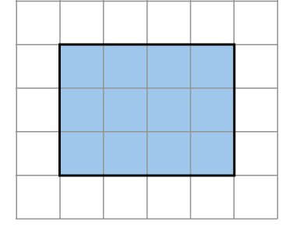
2.30 Area and perimeter 2
Step 1:1
Shape A
Notes:
The area is twelve square units.
You could count the squares.
You could multiply the length by the width.
3 × 4 = 12
You could multiply the width by the length.
4 × 3 = 12

Slide 4
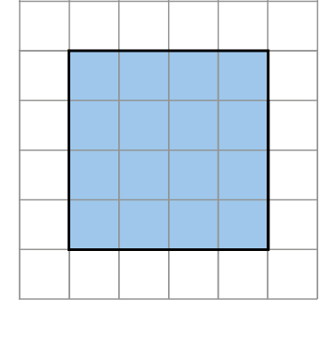
2.30 Area and perimeter 2
Step 1:1
Shape A
Shape B
Notes:
The area of shape B is sixteen square units.
This shape has a larger area than shape A.
You could count the squares.
You could multiply the length by the width.
4 × 4 = 12

Slide 5
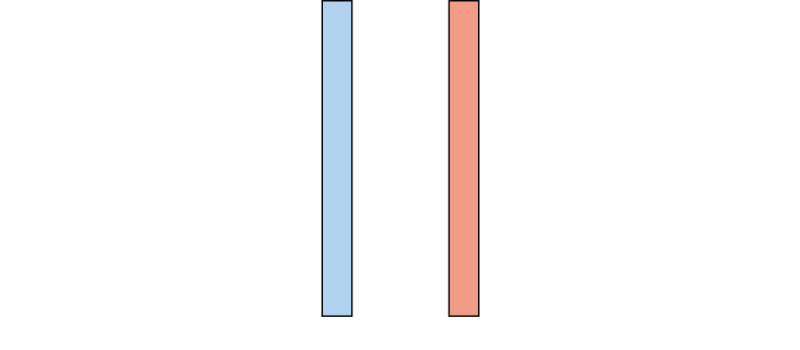
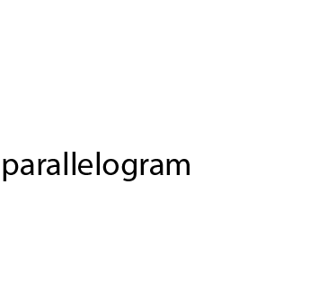
2.30 Area and perimeter 2
Step 1:2

Slide 6
2.30 Area and perimeter 2
Step 1:2

Slide 7

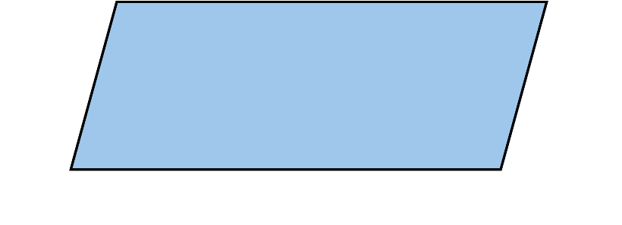
2.30 Area and perimeter 2
Step 1:2

Slide 8
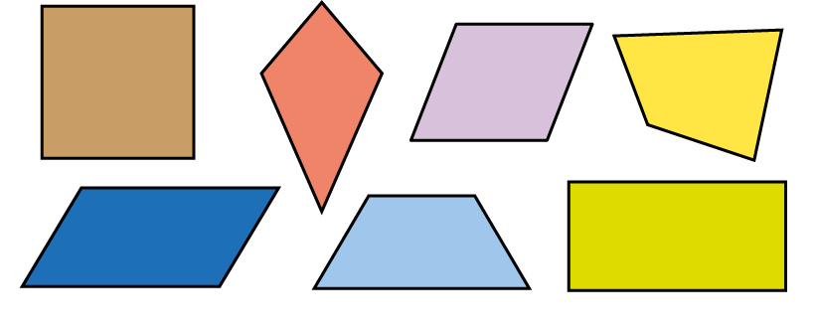
2.30 Area and perimeter 2
Step 1:2
Notes:
Which shapes are parallelograms?
How do you know?
A square is a parallelogram because it has opposite sides that are parallel and equal in length.

Slide 9
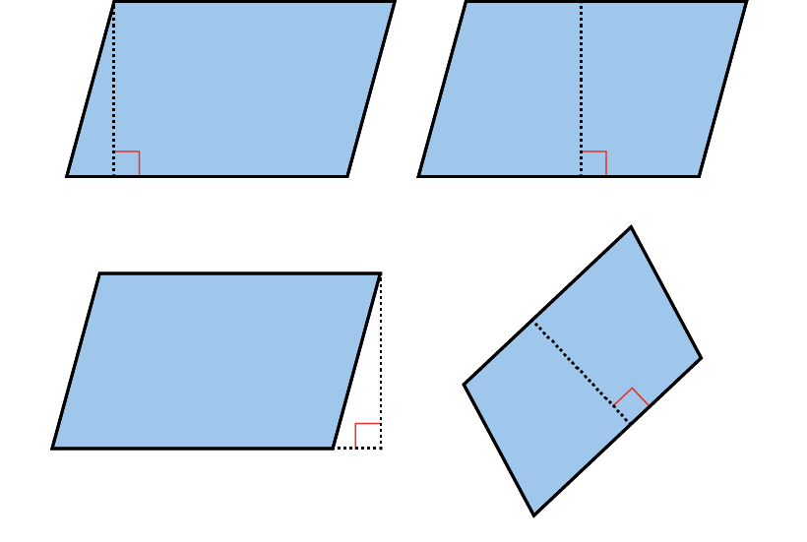
2.30 Area and perimeter 2
Step 1:3
The perpendicular height of parallelograms:

Slide 10
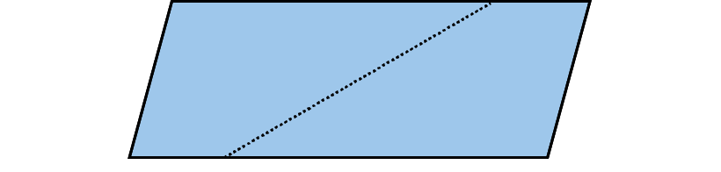
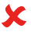
2.30 Area and perimeter 2
Step 1:3
Does this show the perpendicular height?

Slide 11
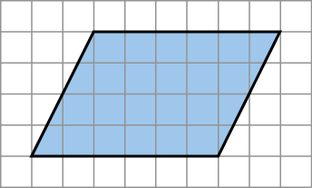
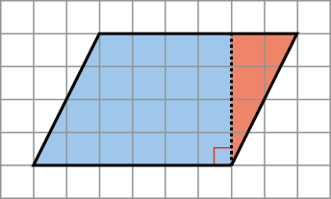
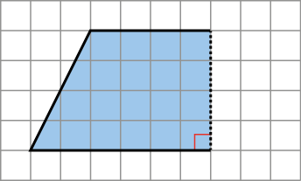

2.30 Area and perimeter 2
Step 1:4
Changing a parallelogram into a rectangle by cutting shapes:

Slide 12
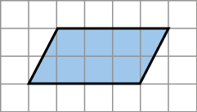
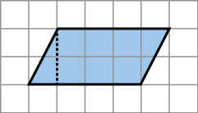
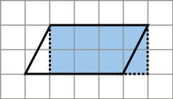
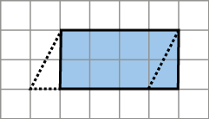
2.30 Area and perimeter 2
Step 1:4
Changing a parallelogram into a rectangle by drawing lines:

Slide 13
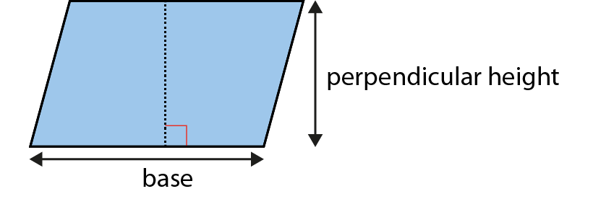
2.30 Area and perimeter 2
Step 1:5
Finding the area of a parallelogram:
Notes:
Multiply the base by the perpendicular height.

Slide 14
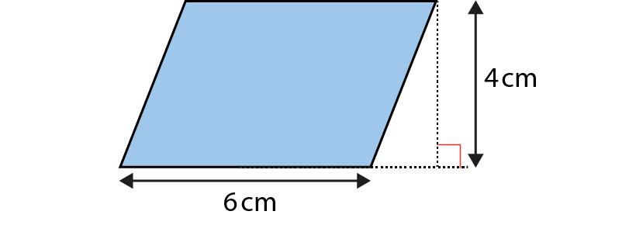
2.30 Area and perimeter 2
Step 1:5
Notes:
Find the area of this parallelogram.
The base is 6 cm.
The perpendicular height is 4 cm.
The area is 6 × 4 = 24 cm².

Slide 15
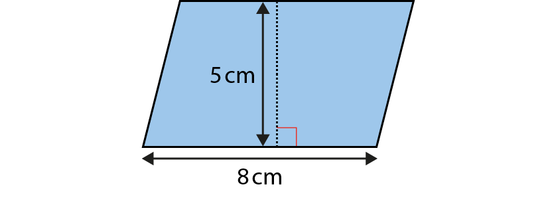
2.30 Area and perimeter 2
Step 1:5
Notes:
Find the area of this parallelogram.
The base is 8 cm.
The perpendicular height is 5 cm.
The area is 8 × 5 = 40 cm².

Slide 16
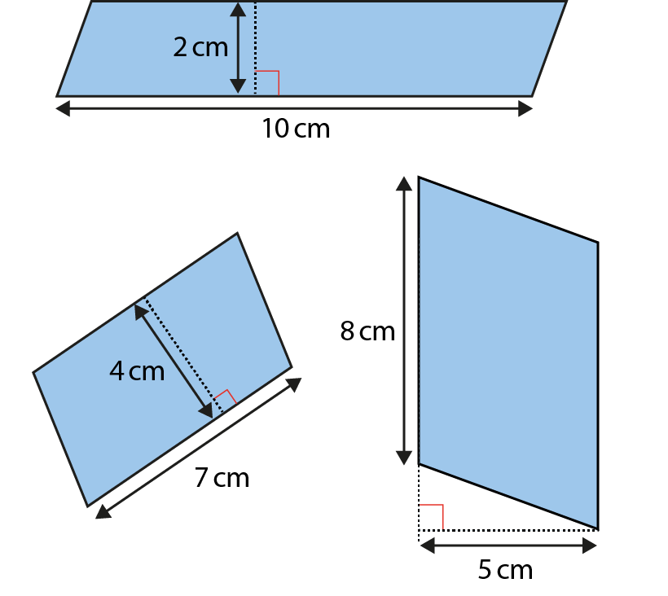
2.30 Area and perimeter 2
Step 1:6
Notes:
Find the area of these parallelograms.

Slide 17
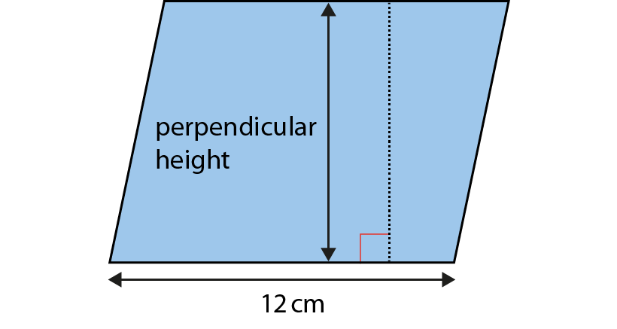
2.30 Area and perimeter 2
Step 1:7
A = 108 cm². What is the perpendicular height?
Notes:
area ÷ base = perpendicular height
108 ÷ 12 = 9
The perpendicular height is 9 cm.

Slide 18
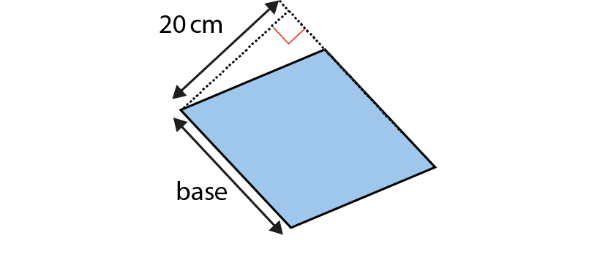
2.30 Area and perimeter 2
Step 1:7
A = 440 cm². What is the length of the base?
Notes:
area ÷ perpendicular height = base
440 ÷ 20 = 22
The base is 22 cm.

Slide 19
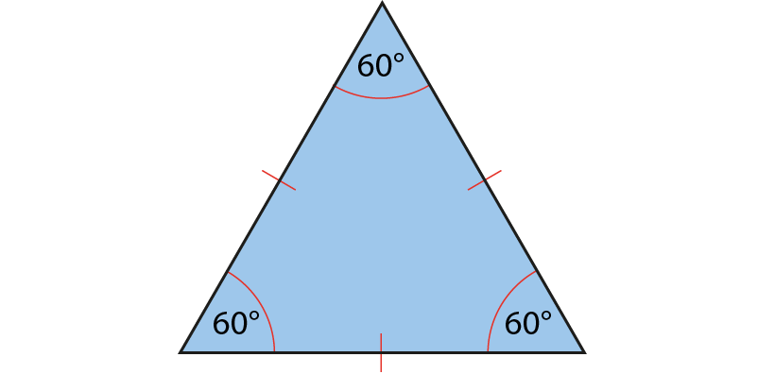
2.30 Area and perimeter 2
Step 2:1
Notes:
Equilateral triangles have three equal sides and three equal angles.

Slide 20
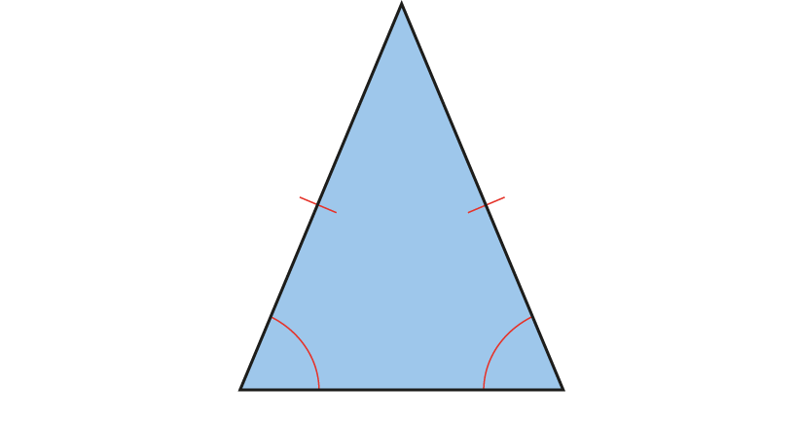
2.30 Area and perimeter 2
Step 2:1
Notes:
Isosceles triangles have two equal sides and two equal angles.

Slide 21

2.30 Area and perimeter 2
Step 2:1
Notes:
Scalene triangles have no equal sides and no equal angles.

Slide 22
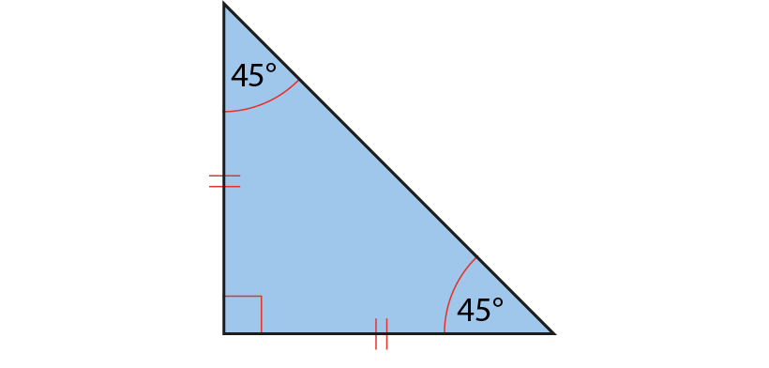
2.30 Area and perimeter 2
Step 2:1
Notes:
Right-angled isosceles triangles have two equal sides, two equal angles and a right angle.

Slide 23
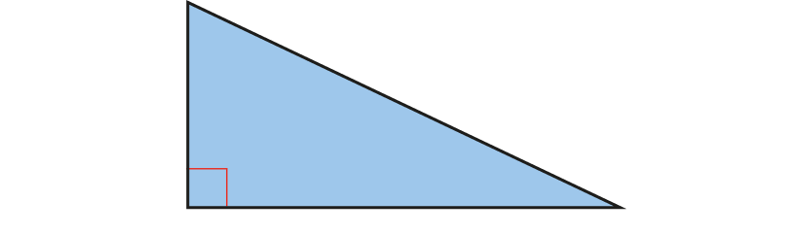
2.30 Area and perimeter 2
Step 2:1
Notes:
Right-angled scalene triangles have no equal sides, no equal angles and a right angle.

Slide 24
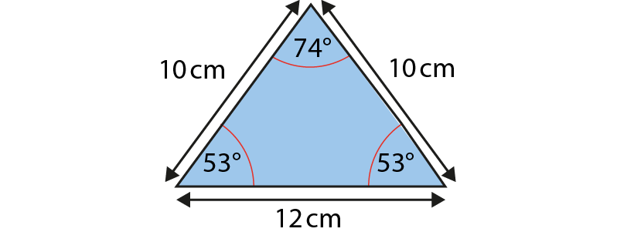
2.30 Area and perimeter 2
Step 2:1
Notes:
This is an isosceles triangle because it has two equal sides and two equal angles.

Slide 25
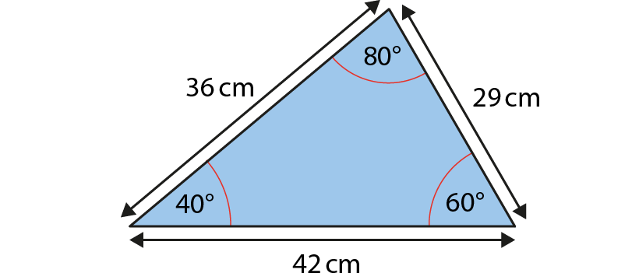
2.30 Area and perimeter 2
Step 2:1
Notes:
This is a scalene triangle because it has no equal sides and no equal angles.

Slide 26

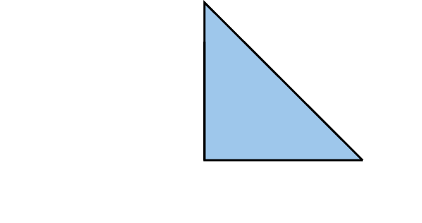
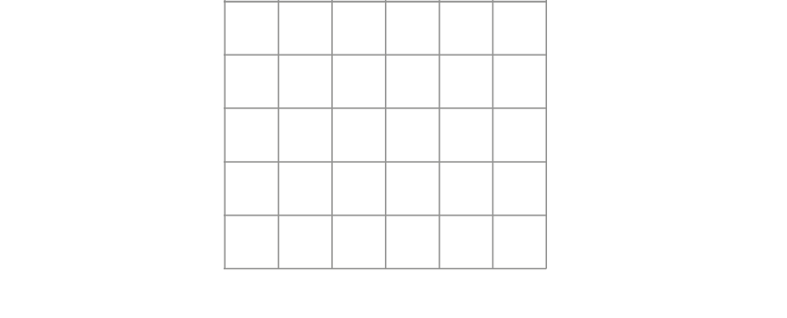
2.30 Area and perimeter 2
Step 2:2
Find the area of the triangle:
Notes:
The area is eight square units.

Slide 27
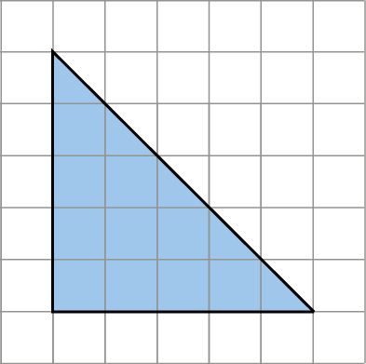
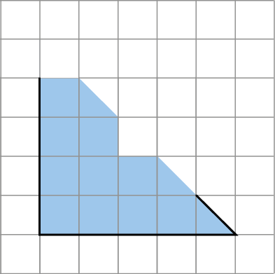
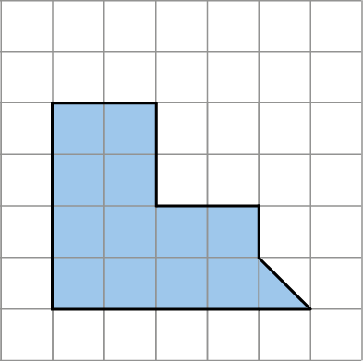

2.30 Area and perimeter 2
Step 2:2
Find the area of the triangle:
Notes:
The area is twelve and a half square units.

Slide 28
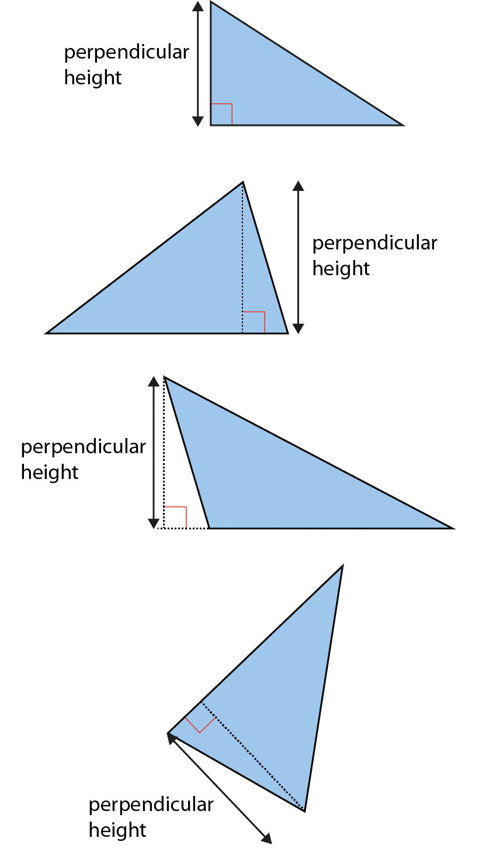
2.30 Area and perimeter 2
Step 2:2
The perpendicular height of triangles:

Slide 29
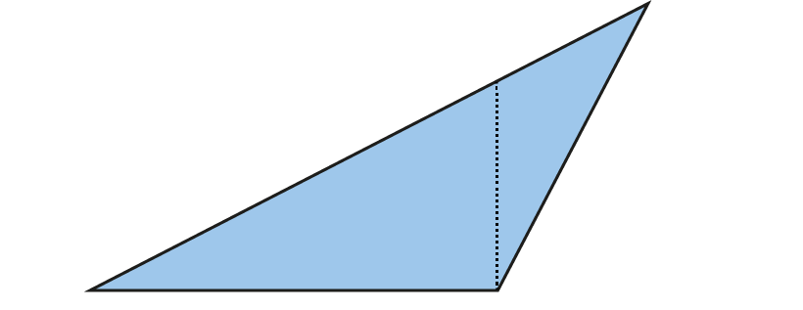
2.30 Area and perimeter 2
Step 2:3
Does this show the perpendicular height?

Slide 30
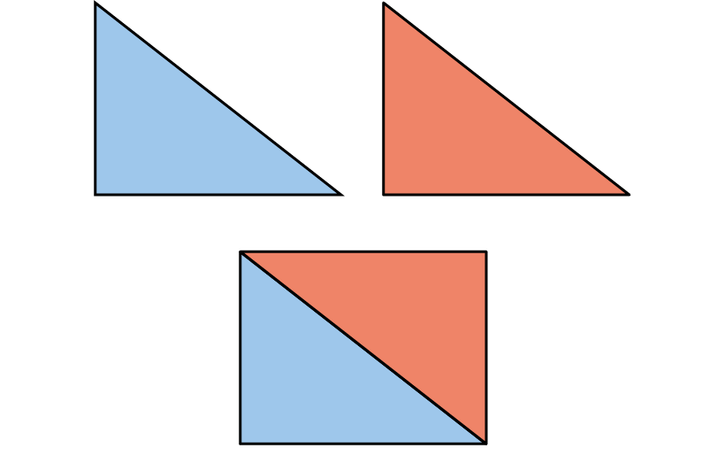
2.30 Area and perimeter 2
Step 2:4
Combining two triangles to make a rectangle:

Slide 31
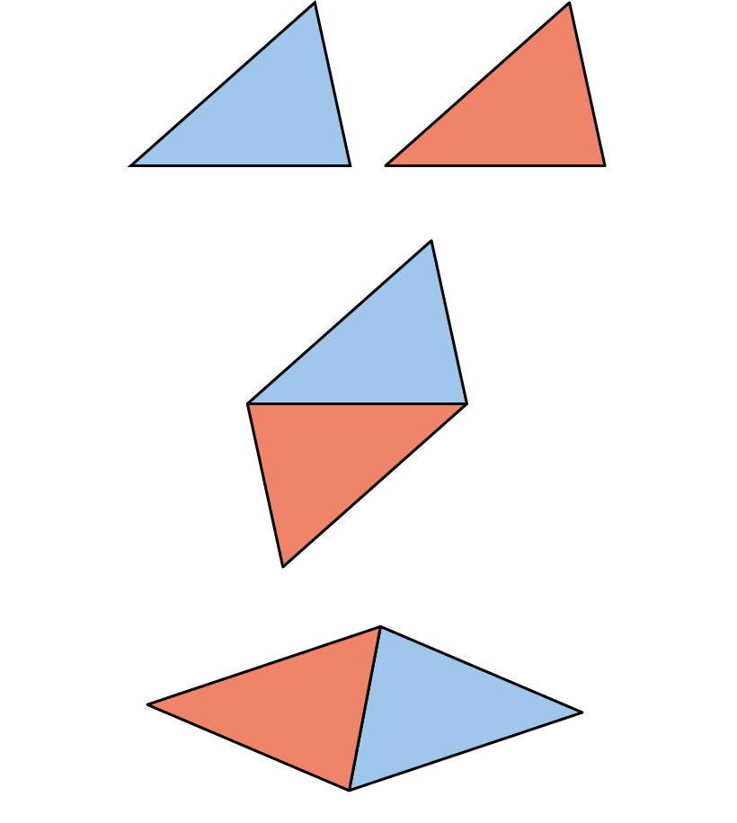
2.30 Area and perimeter 2
Step 2:5
Combining two triangles to make a parallelogram:

Slide 32
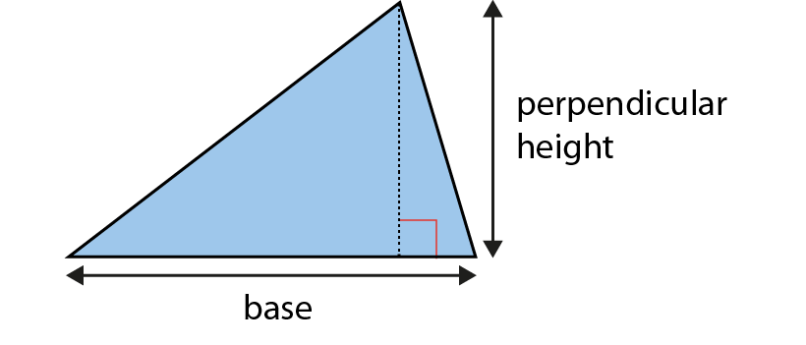
2.30 Area and perimeter 2
Step 2:6
Finding the area of a triangle:
Notes:
area = base × perpendicular height ÷ 2

Slide 33
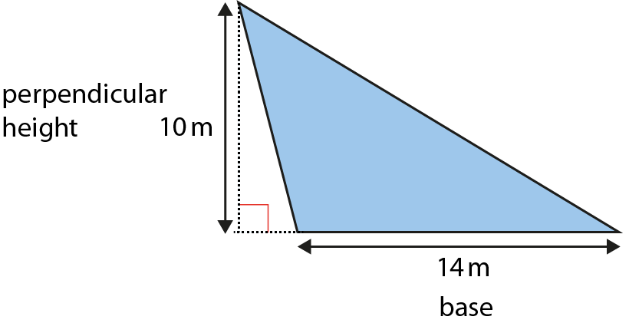
2.30 Area and perimeter 2
Step 2:6
Notes:
Find the area of this triangle.
The base is 14 m.
The perpendicular height is 10 m.
The area is 14 × 10 ÷ 2 = 140 ÷ 2 = 70 m².

Slide 34
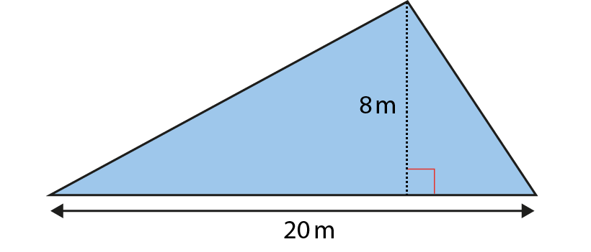
2.30 Area and perimeter 2
Step 2:6
Notes:
Find the area of this triangle.
The base is 20 m.
The perpendicular height is 8 m.
The area is 20 × 8 ÷ 2 = 160 ÷ 2 = 80 m².

Slide 35
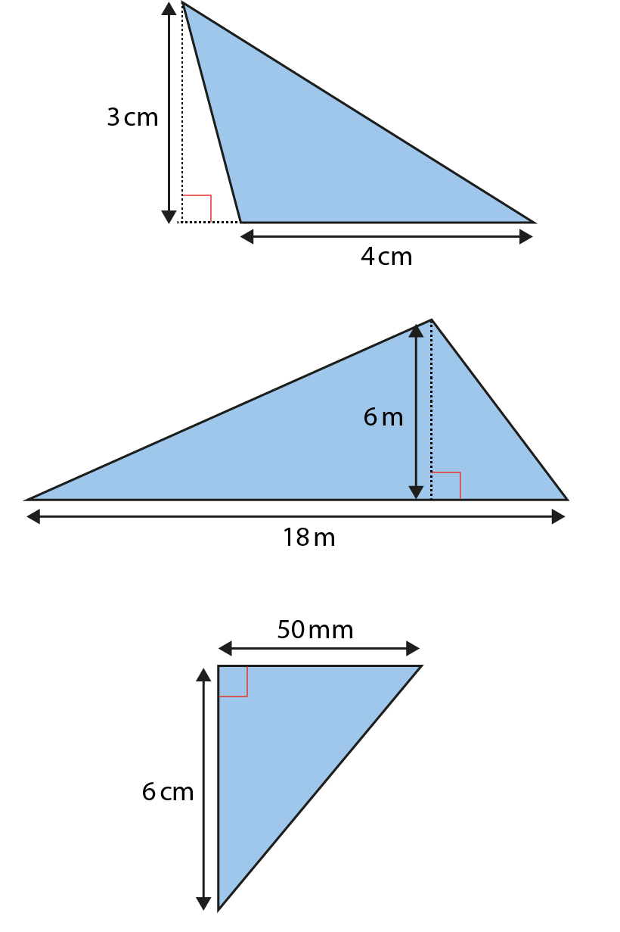
2.30 Area and perimeter 2
Step 2:7
Notes:
Find the area of these triangles.

Slide 36
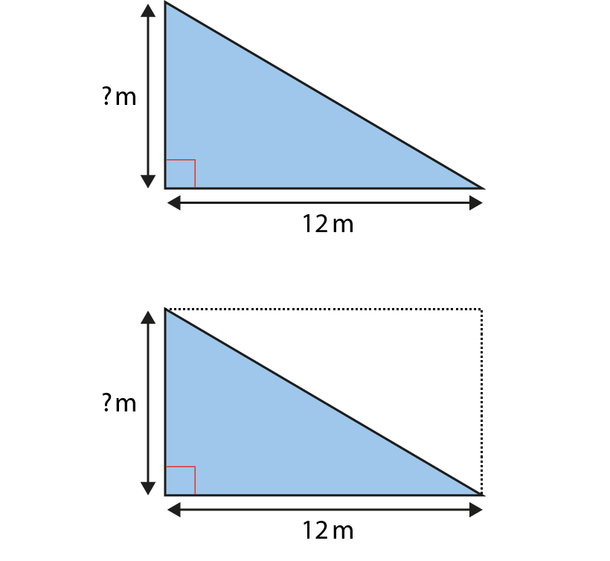
2.30 Area and perimeter 2
Step 2:8
A = 42 m². What is the perpendicular height?
Notes:
42 m² × 2 = 84 m²
84 ÷ 12 = 7
The perpendicular height of the triangle is 7 m.

Slide 37
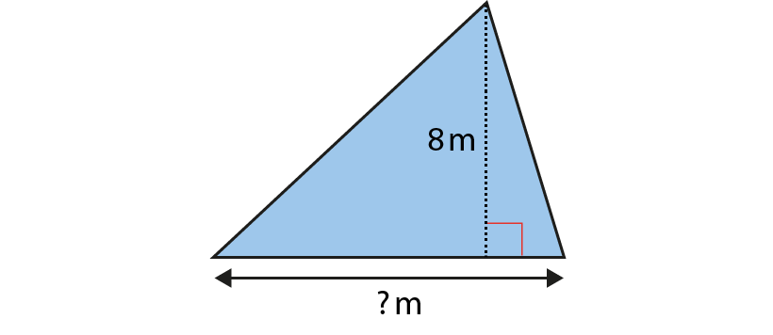
2.30 Area and perimeter 2
Step 2:8
A = 44 m². How long is the base?
Notes:
44 m² × 2 = 88 m²
88 ÷ 8 = 11
The base of the triangle is 11 m.

Slide 38
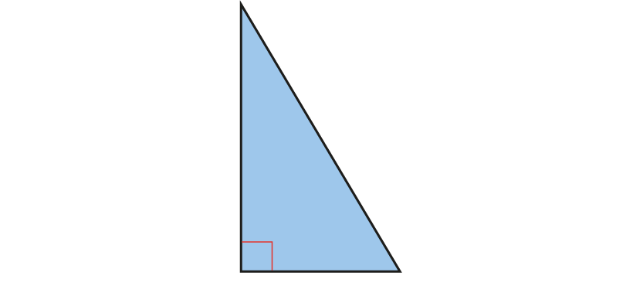
2.30 Area and perimeter 2
Step 2:8
A = 54 cm². What could the base and height be?

Slide 39
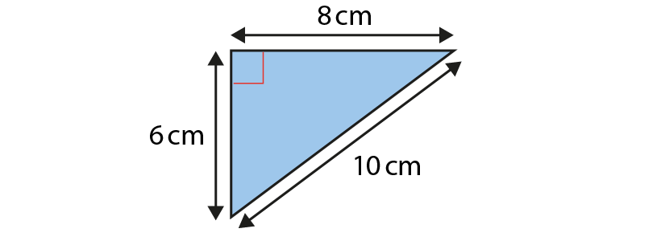
2.30 Area and perimeter 2
Step 2:9
Notes:
Sonnie says the area of this triangle is 40 cm².
Brittany says the area of the triangle is 30 cm².
Tom says the area of the triangle is 24 cm².
Who is right? Explain your answer.

Slide 40
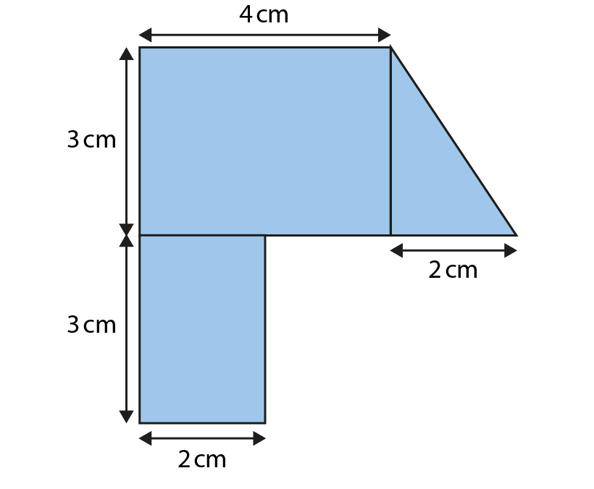
2.30 Area and perimeter 2
Step 2:9
Notes:
What is the total area of this shape?

Slide 41
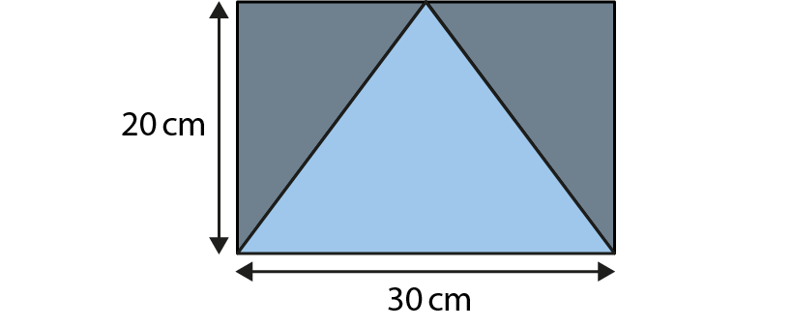
2.30 Area and perimeter 2
Step 2:9
Notes:
What is the total area of the shaded sections?

Slide 42
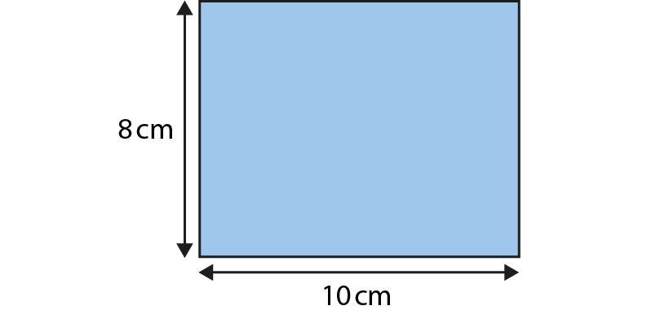
2.30 Area and perimeter 2
Step 3:1
Comparing perimeter and area:
Notes:
The distance around the edge of the rectangle is its perimeter.
P = (10 × 2) + (8 × 2) = 20 + 16 = 36 cm
A = 10 × 8 = 80 cm²

Slide 43
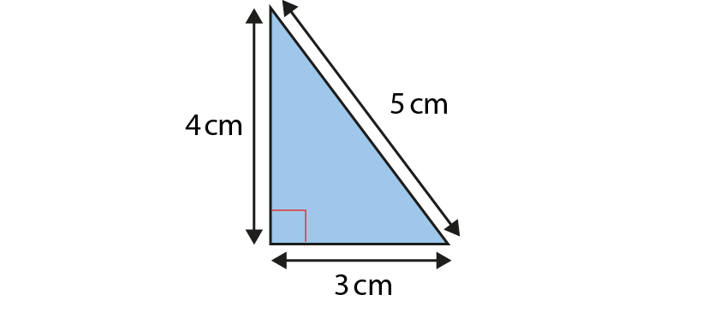
2.30 Area and perimeter 2
Step 3:1
Comparing perimeter and area:
Notes:
The distance around the edge of the triangle is its perimeter.
P = 3 + 4 + 5 = 12 cm
A = 4 × 3 ÷ 2 = 6 cm²

Slide 44
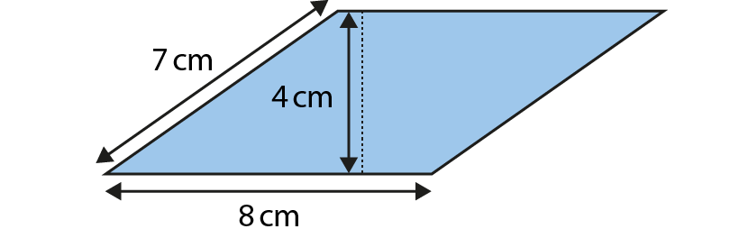
2.30 Area and perimeter 2
Step 3:1
Comparing perimeter and area:
Notes:
The distance around the edge of the parallelogram is its perimeter.
P = (7 × 2) + (8 × 2) = 14 + 16 = 30 cm
A = 8 × 4 = 32 cm²

Slide 45

2.30 Area and perimeter 2
Step 3:1
Notes:
Find the area and perimeter of this shape.

Slide 46

2.30 Area and perimeter 2
Step 3:1
Notes:
Find the area and perimeter of this shape.

Slide 47

2.30 Area and perimeter 2
Step 3:2
Same perimeter, different area:
Notes:
P = 12 units
A = 5 units²

Slide 48

2.30 Area and perimeter 2
Step 3:2
Same perimeter, different area:
Notes:
P = 12 units
A = 8 units²

Slide 49

2.30 Area and perimeter 2
Step 3:2
Same perimeter, different area:
Notes:
P = 12 units
A = 9 units²

Slide 50

2.30 Area and perimeter 2
Step 3:2
Same perimeter, different area:
Notes:
P = 12 units
A = 5 units²

Slide 51

2.30 Area and perimeter 2
Step 3:4
Same area, different perimeter:
Notes:
P = 34 units
A = 16 units²

Slide 52

2.30 Area and perimeter 2
Step 3:4
Same area, different perimeter:
Notes:
P = 20 units
A = 16 units²

Slide 53

2.30 Area and perimeter 2
Step 3:4
Same area, different perimeter:
Notes:
P = 16 units
A = 16 units²

Slide 54

2.30 Area and perimeter 2
Step 3:4
Same area, different perimeter:
Notes:
P = 26 units
A = 16 units²

Slide 55

2.30 Area and perimeter 2
Step 4:1
Applying a scale factor:
Example 1
Notes:
To change shape A into shape B, scale the side-lengths by a scale factor of two.

Slide 56

2.30 Area and perimeter 2
Step 4:1
Applying a scale factor:
Example 2
Notes:
To change shape C into shape D, scale the side-lengths by a scale factor of one quarter.

Slide 57

2.30 Area and perimeter 2
Step 4:2
Notes:
Enlarge this shape by scaling the side-lengths by a scale factor of three.

Slide 58

2.30 Area and perimeter 2
Step 4:2
Notes:
What scale factor has been used to change shape A into shape B?

Slide 59

2.30 Area and perimeter 2
Step 4:2
Notes:
The side-lengths of shape C have been scaled to make shape D.
What is the unknown measurement?

Slide 60
2.30 Area and perimeter 2
Step 4:3
Applying scale factors to perimeter:
Example 1
Notes:
P = 10 + 10+ 15 + 15 = 50 cm
P = 20 + 20+ 30 + 30 = 100 cm
50 × 2 = 100
The perimeter has changed by a scale factor of two.

Slide 61
2.30 Area and perimeter 2
Step 4:3
Applying scale factors to perimeter:
Example 2
Notes:
P = 40 + 40+ 60 + 60 = 200 cm
P = 10 + 10 + 15 + 15 = 50 cm
200 ÷ 4 = 50
The perimeter has changed by a scale factor of one quarter; it has been divided by four.

Slide 62
2.30 Area and perimeter 2
Step 4:3
Using scale factor to calculate perimeter:
Notes:
If the side-lengths of this shape are scaled by a scale factor of three, what will the perimeter of the new shape be?

Slide 63

2.30 Area and perimeter 2
Step 4:3
Using scale factor to calculate perimeter:
Notes:
If the side-lengths of this shape are scaled by a scale factor of four, what will the perimeter of the new shape be?

Slide 64

2.30 Area and perimeter 2
Step 4:3
Using scale factor to calculate perimeter:
Notes:
If the side-lengths of this shape are scaled by a scale factor of one-half, what will the perimeter of the new shape be?’

Slide 65

2.30 Area and perimeter 2
Step 4:4
Applying scale factors to area:
Example 1
Notes:
scale factor = 2
A = 10 cm × 15 cm = 150 cm²
A = 20 cm × 30 cm = 600 cm²
150 × 4 = 600

Slide 66
2.30 Area and perimeter 2
Step 4:4
Applying scale factors to area:
Example 1
Notes:
scale factor = 2
A = 10 cm × 15 cm = 150 cm²
A = 20 cm × 30 cm = 600 cm²
150 × 4 = 600

Slide 67


2.30 Area and perimeter 2
Step 4:5
Complete the table.
4
Notes:
Hint: use the perimeter to work out all three side-lengths of triangle A.

