Slide 1
2.5 Commutativity (part 2), doubling and halving
Representations | Year 2
Multiplication and Division

Slide 2
How to use this presentation
You can find the teacher guide 2.5 Commutativity (part 2), doubling and halving by following the link below.

Slide 3

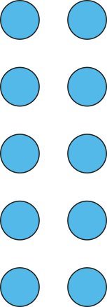
2.5 Commutativity, doubling and halving Step 1:1
5 × 2 = 10
5 groups of 2
2, five times

Slide 4

2.5 Commutativity, doubling and halving Step 1:1
5 × 2 = 10
2 groups of 5
5, two times

Slide 5
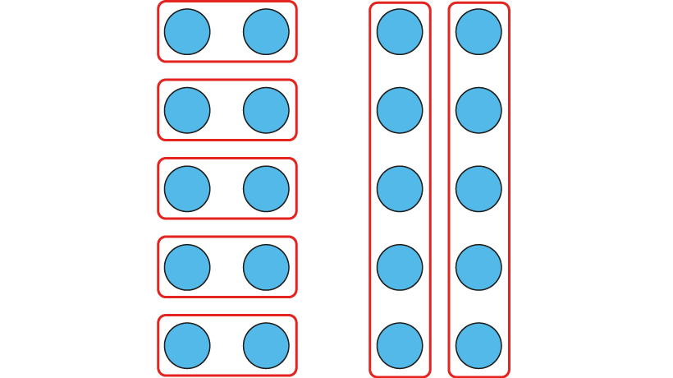
2.5 Commutativity, doubling and halving Step 1:1
Notes:
What’s the same?
What’s different?

Slide 6
2.5 Commutativity, doubling and halving Step 1:2
2 × 5 = 10
2 groups of 5
5, two times

Slide 7
2.5 Commutativity, doubling and halving Step 1:2
2 × 5 = 10
5 groups of 2
2, five times

Slide 8

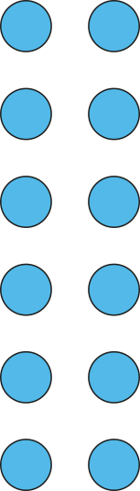
2.5 Commutativity, doubling and halving Step 1:3
6 groups of 2
6 × 2 = 12
6, two times

Slide 9

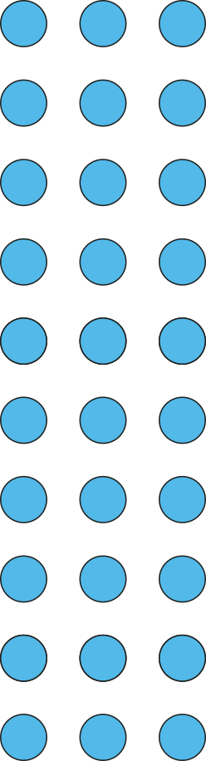
2.5 Commutativity, doubling and halving Step 1:3
3 groups of 10
3 × 10 = 30
3, ten times

Slide 10
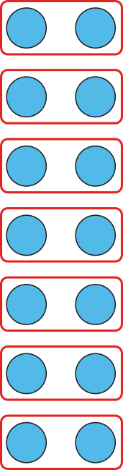


2.5 Commutativity, doubling and halving Step 1:4
7 × 2 = 14
7 groups of 2
2, seven times
Notes:
There are some eggs in some nests. What situations can the equation represent?

Slide 11
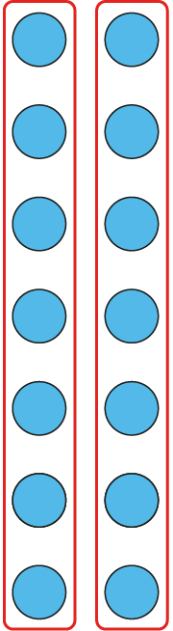


2.5 Commutativity, doubling and halving Step 1:4
7 × 2 = 14
2 groups of 7
7, two times
Notes:
There are some eggs in some nests. What situations can the equation represent?

Slide 12
2.5 Commutativity, doubling and halving Step 1:4
7 × 2 = 14

Slide 13
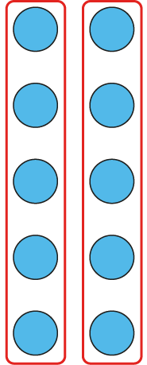
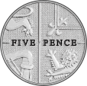
2.5 Commutativity, doubling and halving Step 1:4
2 × 5 = 10
2 groups of 5
5, two times
5 p
5 p
Notes:
I have some coins. What situations can the equation represent?

Slide 14
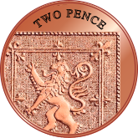
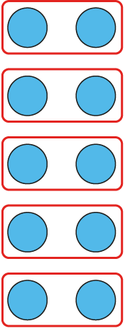
2.5 Commutativity, doubling and halving Step 1:4
2 × 5 = 10
5 groups of 2
2, five times
2 p
2 p
2 p
2 p
2 p
Notes:
I have some coins. What situations can the equation represent?

Slide 15
2.5 Commutativity, doubling and halving Step 1:4
2 × 5 = 10
2 p
2 p
2 p
2 p
2 p
5 p
5 p

Slide 16
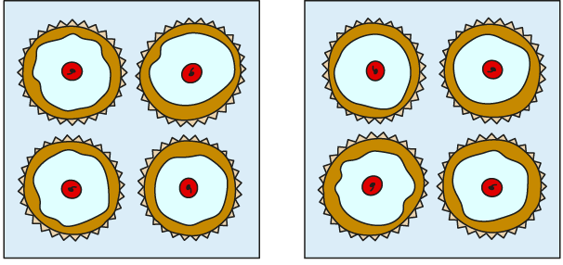

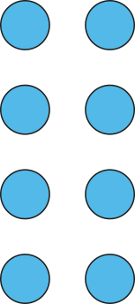

2.5 Commutativity, doubling and halving Step 1:5
2 boxes, 4 cakes in each. How many cakes?
2 × 4 =
8
2 groups of 4 is equal to 2, four times
I know that 2, four times, is equal to 8,
so I know that 2 groups of 4 is equal to 8.
Notes:
There are two boxes of cakes.
Each box contains four cakes.
How many cakes are there altogether?

Slide 17


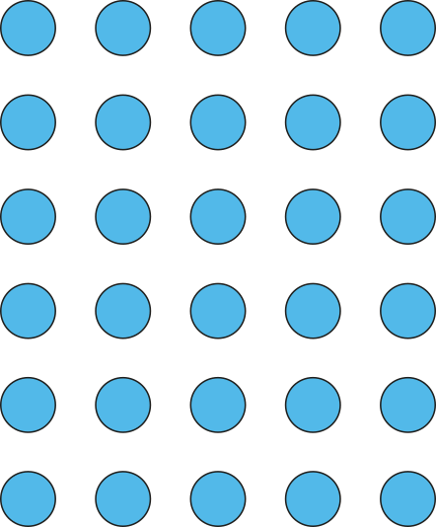


2.5 Commutativity, doubling and halving Step 1:6
5 sheets of stickers, 6 stickers on each. How many stickers?
5 × 6 =
30
5 groups of 6 is equal to 5, six times
I know that 5, six times, is equal to 30,
so I know that 5 groups of 6 is equal to 30.
Notes:
There are five sheets of stickers.
Each sheet contains six stickers.
How many stickers are there altogether?

Slide 18

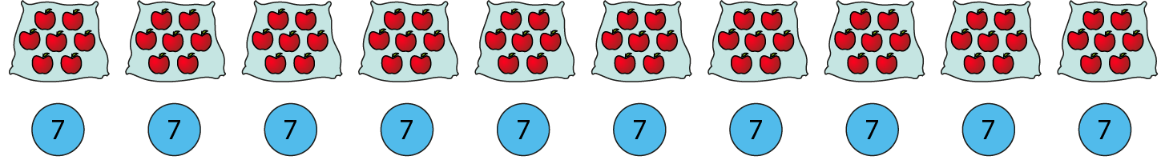
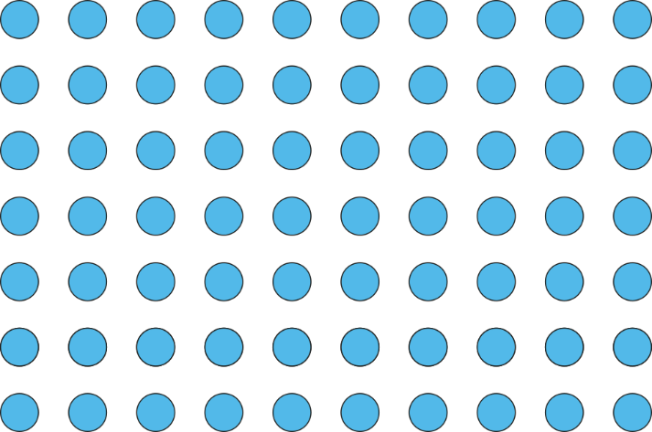
2.5 Commutativity, doubling and halving Step 1:7
10 bags of apples, 7 apples in each. How many apples?
10 × 7 =
70
10 groups of 7 is equal to 10, seven times
I know that 10, seven times, is equal to 70,
so I know that 10 groups of 7 is equal to 70.
Notes:
There are ten bags of apples.
Each bag contains seven apples.
How many apples are there altogether?

Slide 19
2.5 Commutativity, doubling and halving Step 1:8
Problem | Known times table I can use (2, 5 or 10)
There are 5 children. Each child has 4 conkers. How many conkers are there altogether?
There are 2 teams. Each team has
12 bean bags. How many bean bags
are there altogether?
5 children each have 3 balloons.
How many balloons is this
altogether?
10 children each have 3 meatballs
on their plate. How many meatballs
are there altogether?
10 times table
5 times table
2 times table

Slide 20
2.5 Commutativity, doubling and halving Step 1:8
Put each calculation in the correct column
5 × 4
2 × 9
7 × 5
10 × 12
6 × 2
10 × 8
12 × 5
2 × 7
3 × 10
5 × 11
Can use 2 times table | Can use 5 times table | Can use 10 times table

Slide 21
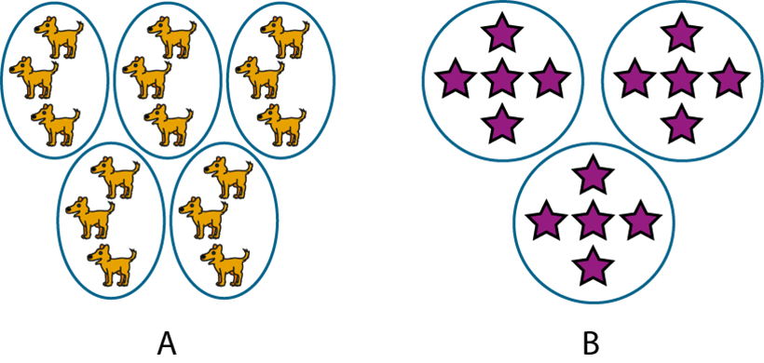
2.5 Commutativity, doubling and halving Step 1:9
Write one equation to represent both pictures.
5 × 3 = 15
Notes:
Five threes are fifteen.
Five, three times is fifteen.

Slide 22
2.5 Commutativity, doubling and halving Step 1:9
Write one equation to represent both pictures.
3 × 5 = 15
Notes:
Three, five times is fifteen.
Three fives are fifteen.

Slide 23
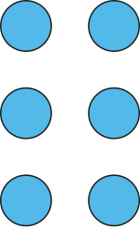
2.5 Commutativity, doubling and halving Step 1:9
3 × 2 = 6
Draw an array to match the equation.
Notes:
This can represent:
Three groups of two
Three, two times

Slide 24
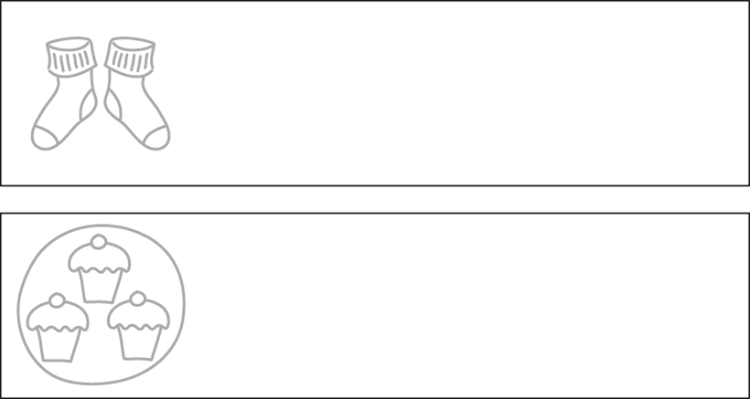


2.5 Commutativity, doubling and halving Step 1:9
3 × 2 = 6
Complete the two pictures to match the equation.

Slide 25

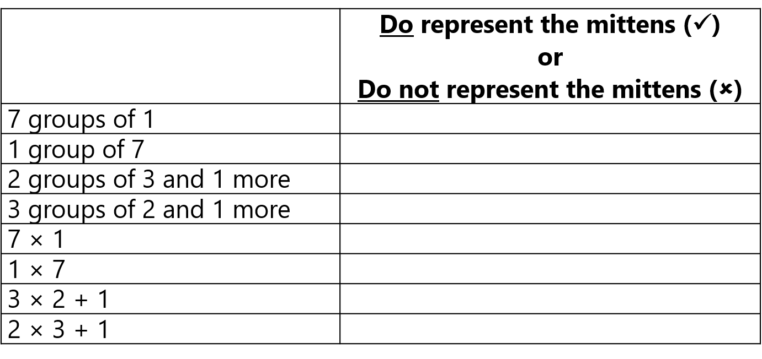


2.5 Commutativity, doubling and halving Step 1:9

Slide 26

2.5 Commutativity, doubling and halving Step 1:10
4 groups of 3
3 + 3 + 3 + 3 = 12
4 × 3 = 12
3, four times
3 × 4 = 12

Slide 27
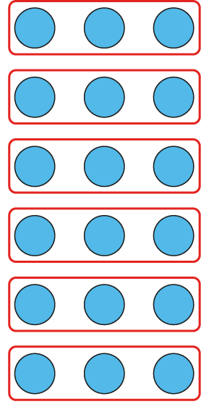

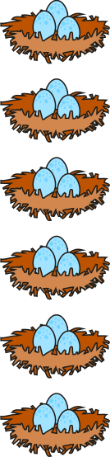
2.5 Commutativity, doubling and halving Step 1:11
6 × 3 = 18
Notes:
There are some eggs in some nests. What situations can the equation represent?

Slide 28
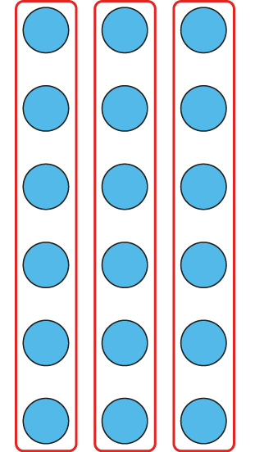


2.5 Commutativity, doubling and halving Step 1:11
6 × 3 = 18

Slide 29

2.5 Commutativity, doubling and halving Step 1:11
6 × 3 = 18

Slide 30

2.5 Commutativity, doubling and halving Step 1:12
Who has represented the picture correctly?
Sally:
3 × 4
✓
Ahmed:
4 × 3
✓
Kumiko:
4 + 4 + 4
✗
Notes:
Who has represented the picture correctly?
Note: Kumiko’s expression, whilst giving the correct total number of butterflies, does not
represent the grouping shown in the picture.

Slide 31



2.5 Commutativity, doubling and halving Step 1:13
6 × 1 = 6
© 2017 Alphablocks Ltd.
All rights reserved.

Slide 32



2.5 Commutativity, doubling and halving Step 1:13
6 × 1 = 6
6
© 2017 Alphablocks Ltd.
All rights reserved.

Slide 33
2.5 Commutativity, doubling and halving Step 1:13
6 × 1 = 6
6
© 2017 Alphablocks Ltd.
All rights reserved.
© 2017 Alphablocks Ltd.
All rights reserved.

Slide 34

2.5 Commutativity, doubling and halving Step 1:13
1 × 5 = 5
1 group of 5
5, one time
5 p

Slide 35
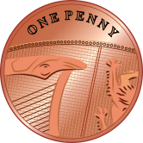

2.5 Commutativity, doubling and halving Step 1:13
1 × 5 = 5
5 groups of 1
1, five times
1 p
1 p
1 p
1 p
1 p

Slide 36
2.5 Commutativity, doubling and halving Step 1:13
1 × 5 = 5
1 p
1 p
1 p
1 p
1 p
5 p

Slide 37
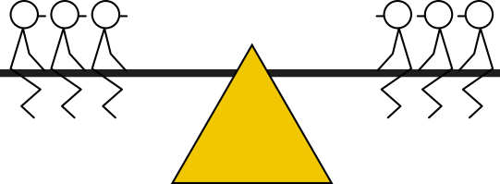
2.5 Commutativity, doubling and halving Step 2:1
2 groups of 3
2 × 3 = 6
3, two times
3 × 2 = 6
3, doubled
3 + 3 = 6

Slide 38

2.5 Commutativity, doubling and halving Step 2:1
2 groups of 5
2 × 5 = 10
5, two times
5 × 2 = 10
5, doubled
5 + 5 = 10

Slide 39
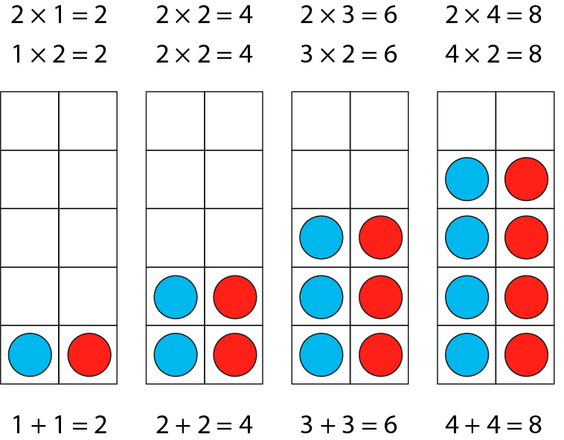



2.5 Commutativity, doubling and halving Step 2:2
1 + 1 = 2
2 + 2 = 4
3 + 3 = 6
4 + 4 = 8
2
3
4
1
2
4
6
2 ×
=
8
2
× 2 =
3
4
1
2
4
6
8

Slide 40
2.5 Commutativity, doubling and halving Step 2:3
6
?
3
3
2 × 3 =
6
2 groups of 3
3, two times
3, doubled

Slide 41
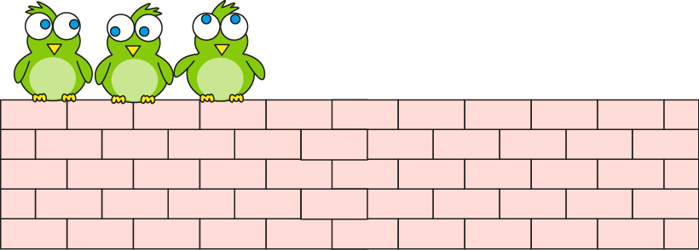

2.5 Commutativity, doubling and halving Step 2:4
There were 3 birds. Now there are double that number.
How many birds now?
6
?
Double 3 is the same as
2 groups of 3.
3
3
2 × 3
= 6
2 times 3 = 6
Notes:
This morning there were three birds on the wall.
Now there are double that number.
How many birds are on the wall now?

Slide 42
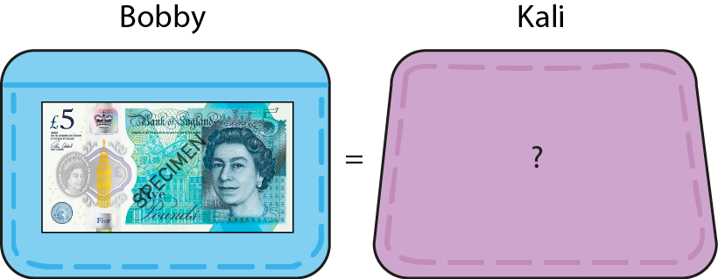
2.5 Commutativity, doubling and halving Step 2:4
How much money does Kali have?
10
?
twice as much
as Bobby
£10
5
5
Twice as much means double.
2 × 5
= 10
2 times 5 = 10
double 5 = 10
Notes:
Bobby has £5. Kali has twice as much as Bobby. How much does Kali have?

Slide 43
2.5 Commutativity, doubling and halving Step 2:5
10
8
6
4
2
5
1
2
3
4
5
1
2
3
4

Slide 44
2.5 Commutativity, doubling and halving Step 2:5
double 6
12
= 6 + 6
5 + 5 = 10
1 + 1 = 2
10 + 2 = 12
Notes:
Six is five plus one more, so double six is double five plus double one.

Slide 45
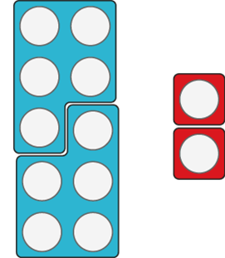


2.5 Commutativity, doubling and halving Step 2:5
double 6
12
= 6 + 6
5 + 5 = 10
1 + 1 = 2
10 + 2 = 12
Notes:
Six is five plus one more, so double six is double five plus double one.

Slide 46
2.5 Commutativity, doubling and halving Step 2:5
double 9
18
= 9 + 9
5 + 5 = 10
4 + 4 = 8
10 + 8 = 18
Notes:
Nine is five plus four more, so double nine is double five plus double four.

Slide 47
2.5 Commutativity, doubling and halving Step 2:5
double 9 = 9 + 9
= 18
10 + 10 = 20
1 + 1 = 2
20 − 2 = 18
Notes:
Nine is ten minus one, so double nine is double ten minus double one.

Slide 48
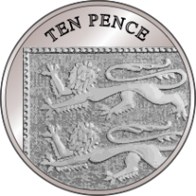
2.5 Commutativity, doubling and halving Step 2:6
Double two 10s is four 10s.
Double three 10s is six 10s.
Double one 10 is two 10s.
Double 20 is 40.
Double 30 is 60.
Double 10 is 20.
20 + 20 = 40
30 + 30 = 60
10 + 10 = 20

Slide 49
2.5 Commutativity, doubling and halving Step 2:6
double 11
= 22
double 10
+ double 1
20 + 2
= 22

Slide 50
2.5 Commutativity, doubling and halving Step 2:6
double 12
= 24
double 10
+ double 2
20 + 4
= 24

Slide 51
2.5 Commutativity, doubling and halving Step 2:6
double 13
= 26
double 10
+ double 3
20 + 6
= 26

Slide 52
2.5 Commutativity, doubling and halving Step 2:6
double 14
= 28
double 10
+ double 4
20 + 8
= 28

Slide 53
2.5 Commutativity, doubling and halving Step 2:6
double 15
= 30
double 10
+ double 5
20 + 10
= 30

Slide 54
2.5 Commutativity, doubling and halving Step 2:6
double 25
= 50
10
double 20 + double 5
40 + 10
= 50

Slide 55
2.5 Commutativity, doubling and halving Step 2:6
double 35
= 70
10
double 30 + double 5
60 + 10
= 70

Slide 56


2.5 Commutativity, doubling and halving Step 2:7
2 packets, 6 bones in each. How many bones?
12
?
6
6
2 × 6 =
12
Double 6 is 12, so 2 groups of 6 is 12.
Notes:
There are two packets of dog bones. There are six bones in each packet. How many bones are there altogether?

Slide 57
2.5 Commutativity, doubling and halving Step 2:9
The parts are equal. Fill in the missing numbers.
10
?
?
5
5
Notes:
In all these diagrams the parts are equal. Fill in the missing numbers.

Slide 58
2.5 Commutativity, doubling and halving Step 2:9
The parts are equal. Fill in the missing numbers.
?
20
10
10
Notes:
In all these diagrams the parts are equal. Fill in the missing numbers.

Slide 59
2.5 Commutativity, doubling and halving Step 2:9
The parts are equal. Fill in the missing numbers.
?
14
7
7
Notes:
In all these diagrams the parts are equal. Fill in the missing numbers.

Slide 60
2.5 Commutativity, doubling and halving Step 2:9
The parts are equal. Fill in the missing numbers.
?
6
3
3
Notes:
In all these diagrams the parts are equal. Fill in the missing numbers.

Slide 61
2.5 Commutativity, doubling and halving Step 2:9
The parts are equal. Fill in the missing numbers.
?
12
?
6
6
Notes:
In all these diagrams the parts are equal. Fill in the missing numbers.

Slide 62
2.5 Commutativity, doubling and halving Step 2:9
The parts are equal. Fill in the missing numbers.
1000
500
?
500
Notes:
In all these diagrams the parts are equal. Fill in the missing numbers.

Slide 63
2.5 Commutativity, doubling and halving Step 2:9
The parts are equal. Fill in the missing numbers.
14
7
?
7
?
Notes:
In all these diagrams the parts are equal. Fill in the missing numbers.

Slide 64
2.5 Commutativity, doubling and halving Step 2:9
The parts are equal. Fill in the missing numbers.
18
?
9
9
Notes:
In all these diagrams the parts are equal. Fill in the missing numbers.

Slide 65
2.5 Commutativity, doubling and halving Step 2:9
Double 4 – true or false?
4 × 2
✓
true

Slide 66
2.5 Commutativity, doubling and halving Step 2:9
Double 4 – true or false?
4 + 4
✓
true

Slide 67
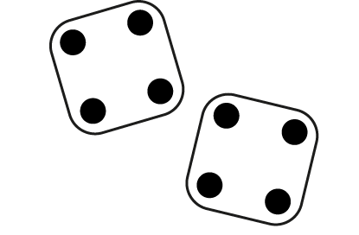
2.5 Commutativity, doubling and halving Step 2:9
Double 4 – true or false?
✓
true

Slide 68
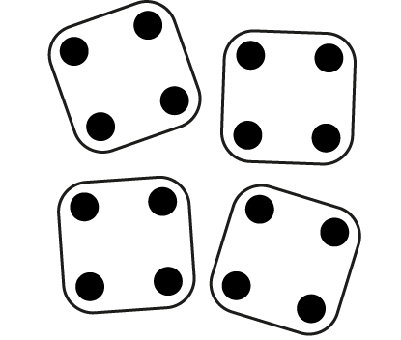
2.5 Commutativity, doubling and halving Step 2:9
Double 4 – true or false?
✗
false

Slide 69
2.5 Commutativity, doubling and halving Step 2:9
Double 4 – true or false?
2 × 4
✓
true

Slide 70
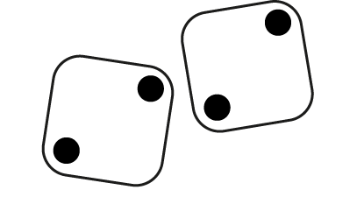
2.5 Commutativity, doubling and halving Step 2:9
Double 4 – true or false?
✗
false

Slide 71
2.5 Commutativity, doubling and halving Step 2:9
There are double the number of children outside
as there are inside. There are 20 children outside.
Which diagram shows this?
40
20
20
20
10
10

Slide 72
2.5 Commutativity, doubling and halving Step 2:9
This diagram shows doubling, because there are two parts.
True or false?
?
✗
false
9
6

Slide 73
2.5 Commutativity, doubling and halving Step 3:1
whole
half
half

Slide 74


2.5 Commutativity, doubling and halving Step 3:1
How many is half of 6 children?
3
2 × = 6
3
× 2 = 6
Notes:
There are six children who want to play on the seesaw.
Half of the children should sit on each side.
How many is half of six children?

Slide 75
2.5 Commutativity, doubling and halving Step 3:2
2
1
1
Half of 2 is equal to 1.
Double 1 is equal to 2.

Slide 76
2.5 Commutativity, doubling and halving Step 3:2
4
2
2
Half of 4 is equal to 2.
Double 2 is equal to 4.

Slide 77
2.5 Commutativity, doubling and halving Step 3:2
6
3
3
Half of 6 is equal to 3.
Double 3 is equal to 6.

Slide 78
2.5 Commutativity, doubling and halving Step 3:3
2
1
1
2 × 1 = 2
Half of 2 is equal to 1.
Double 1 is equal to 2.

Slide 79
2.5 Commutativity, doubling and halving Step 3:3
4
2
2
2 × 2 = 4
Half of 4 is equal to 2.
Double 2 is equal to 4.

Slide 80
2.5 Commutativity, doubling and halving Step 3:3
6
3
3
2 × 3 = 6
Half of 6 is equal to 3.
Double 3 is equal to 6.

Slide 81
2.5 Commutativity, doubling and halving Step 3:3
8
4
4
2 × 4 = 8
4
Half of 8 is equal to .
4
Double is equal to 8.

Slide 82
2.5 Commutativity, doubling and halving Step 3:3
2
4
1
1
2
2
2 × 1 = 2
2 × 2 = 4
half of 2 = 1
half of 4 = 2
double 1 = 2
double 2 = 4
6
8
3
3
4
4
2 × 3 = 6
2 × 4 = 8
half of 6 = 3
half of 8 = 4
double 3 = 6
double 4 = 8

Slide 83

2.5 Commutativity, doubling and halving Step 3:3
double
factor
×
2
=
product
half

Slide 84

2.5 Commutativity, doubling and halving Step 3:3
double
2
×
factor
=
product
half

Slide 85
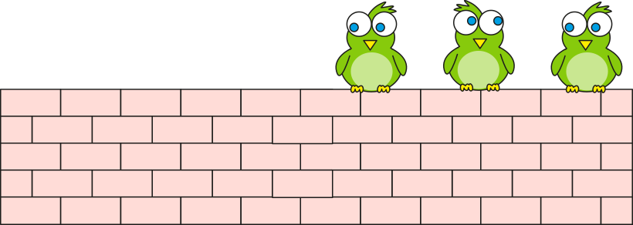

2.5 Commutativity, doubling and halving Step 3:4
There were 6 birds.
Now there are half that number.
How many birds now?
6
?
?
3
3
Half that number of birds.
2, three times, is equal to 6.
3, twice is equal to 6.
3
3
2 × = 6
× 2 = 6
Notes:
This morning there were six birds on the wall.
Now there are half that number.
How many birds are on the wall now?

Slide 86
2.5 Commutativity, doubling and halving Step 3:5
half of 8
= 4
8
4
4
4
4
Double is equal to 8; so half of 8 is equal to .

Slide 87
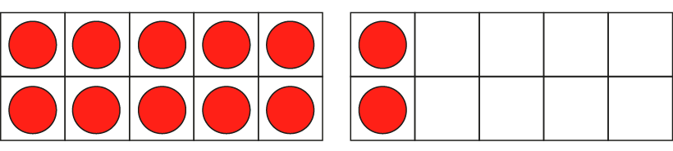
2.5 Commutativity, doubling and halving Step 3:5
half of 12
= 6
half of 10
+
half of 2
5
+
1
= 6

Slide 88


2.5 Commutativity, doubling and halving Step 3:6
12 bones, 2 equal packs.
How many in each pack?
12
?
6
?
?
6
?
6
2 × = 12
6
× 2 = 12
Notes:
There are two packs of bones.
There are twelve bones altogether.
How many bones are there in each pack?
One of the factors is 2, so the other factor is half of the product.
Half of the biscuits are in each pack.
I know that half of 12 is equal to 6.
So there are 6 biscuits in each pack.

Slide 89
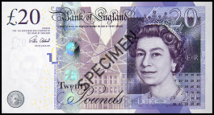

2.5 Commutativity, doubling and halving Step 3:6
Each money-box has the same amount of money.
How much is in each?
20
?
10
£10
10
?
?
£10
?
10
2 × = 20
10
× 2 = 20
Notes:
Emily has £20 in total, kept in two money-boxes.
Each money-box contains the same amount of money.
How much is in each money-box?

Slide 90
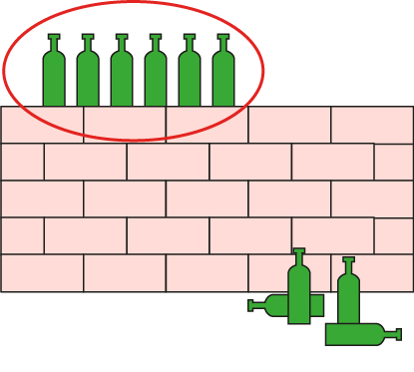
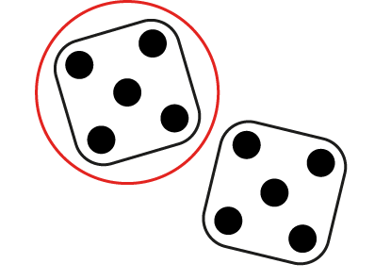
2.5 Commutativity, doubling and halving Step 3:8
True or false – half of 10?
✗
false
5
✓
true
20
✗
false
✓
true

Slide 91

2.5 Commutativity, doubling and halving Step 3:8
Half of these ducks are mine.
How many ducks do I have?
3

Slide 92
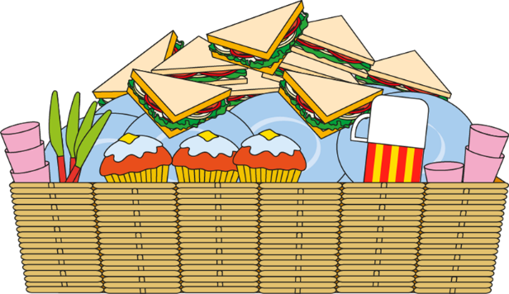
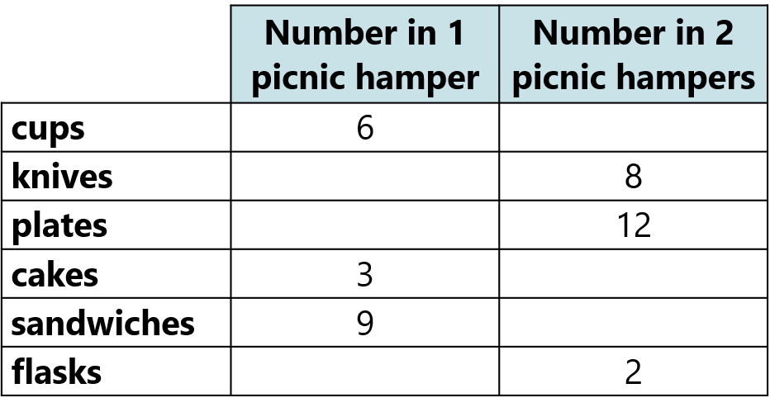
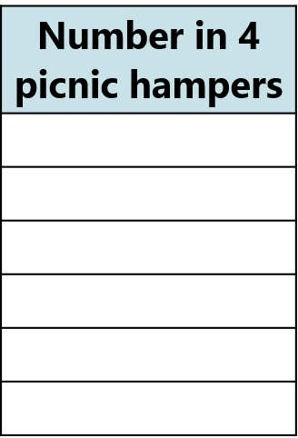








2.5 Commutativity, doubling and halving Step 3:9
Fill in the gaps in the table.

Slide 93



2.5 Commutativity, doubling and halving Step 4:1
10
5
5
For every 1 group of 10 there are 2 groups of 5.

Slide 94
2.5 Commutativity, doubling and halving Step 4:1
0 × 5 = 0 | 0 × 10 = 0
1 × 5 = 5 | 1 × 10 = 10
2 × 5 = 10 | 2 × 10 = 20
3 × 5 = 15 | 3 × 10 = 30
4 × 5 = 20 | 4 × 10 = 40
5 × 5 = 25 | 5 × 10 = 50
6 × 5 = 30 | 6 × 10 = 60
7 × 5 = 35 | 7 × 10 = 70
8 × 5 = 40 | 8 × 10 = 80
9 × 5 = 45 | 9 × 10 = 90
10 × 5 = 50 | 10 × 10 = 100
11 × 5 = 55 | 11 × 10 = 110
12 × 5 = 60 | 12 × 10 = 120
Notes:
Products in the ten times table are also in the five times table.

Slide 95
2.5 Commutativity, doubling and halving Step 4:1
0
2
4
6
8
10
12
× 5 = | 0
 | 10
 | 20
 | 30
 | 40
 | 50
 | 60
= 10 × | 0
 | 1
 | 2
 | 3
 | 4
 | 5
 | 6
Notes:
Even multiples of five are also multiples of ten.

Slide 96


2.5 Commutativity, doubling and halving Step 4:2
2
×
5
=
10
half
double
2
×
10
=
20

Slide 97

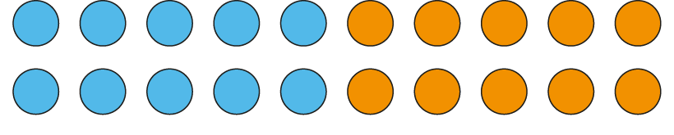
2.5 Commutativity, doubling and halving Step 4:3
2 × 10 = 20
two 10s are 20
10 × 2 = 20
10, two times, is 20
2 × 5 = 10
two 5s are 10
5 × 2 = 10
5, two times, is 10
10 is double 5, so two 10s is double two 5s.
5 is half of 10, so two 5s is half of two 10s.

Slide 98

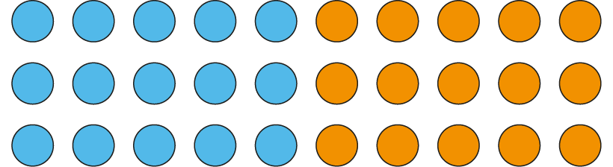
2.5 Commutativity, doubling and halving Step 4:3
3 × 10 = 30
three 10s are 30
10 × 3 = 30
10, three times, is 30
3 × 5 = 15
three 5s are 15
5 × 3 = 15
5, three times, is 15
10 is double 5, so three 10s is double three 5s.
5 is half of 10, so three 5s is half of three 10s.

Slide 99
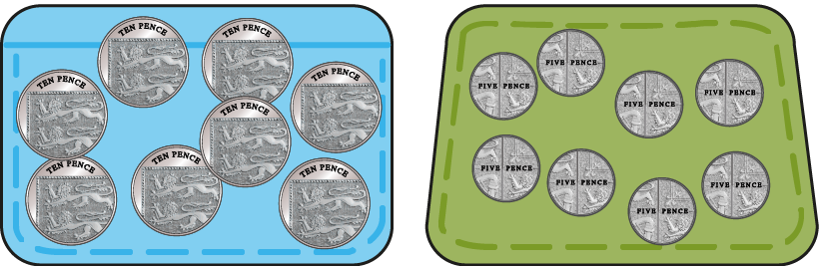
2.5 Commutativity, doubling and halving Step 4:4
How much money does Martin have altogether?
Felicity
Martin
eight 10 p coins
eight 5 p coins
80 p
40 p
? p
Felicity: 8 × 10 = 80
Martin: 8 × 5 =
40
5 is half of 10, so eight 5s is half of eight 10s.
Half of 8 is 4, so half of eight 10s is four 10s.
Notes:
Felicity has eight ten-pence coins; she has 80 p altogether.
Martin has eight five-pence coins.
How much money does Martin have altogether?

Slide 100






2.5 Commutativity, doubling and halving Step 4:5
4 × 5 = 20
2 × 10 = 20
four 5s
0
5
10
15
20
two 10s

Slide 101
2.5 Commutativity, doubling and halving Step 4:6
How many 10 p coins does Bo have?
Olaf’s money
Bo’s money
6 ×
=
3
×
6 × 5 =
3
× 10
6 times 5 is equal to half of 6 times 10.
Notes:
Olaf has six five-pence coins.
Bo has some ten-pence coins.
Olaf and Bo have the same amount of money.
How many ten-pence coins does Bo have?

