Slide 1
Year 2, Unit 5
Introduction to multiplication

Slide 2
Year 2, Unit 5
These materials heavily reflect the prioritisation approach of the ready-to-progress criteria in the DfE Primary Mathematics Guidance 2020 and on the PPTs that exemplify them on the NCETM website. They also include other relevant National Curriculum content. Related sections of the NCETM Primary Mastery Professional Development Materials provide small-step teaching guidance.
Ready-to-progress criteria addressed by this unit
Teaching of this unit supports the following criteria from the ‘DfE Mathematics Guidance: key stages 1 & 2’ (the 335-page document available as a download)
2MD-1 Page 69
Prior learning
Recognise repeated addition contexts and represent them with multiplication equations. Relate grouping problems where the number of groups is unknown to multiplication equations with a missing factor, and to division equations (quotitive division).

Slide 3
Contents
The links below take you to the starting slide of each learning outcome.
1 | Pupils explain that objects can be grouped in different ways
2 | Pupils describe how objects have been grouped
3 | Pupils represent equal groups as repeated addition
4 | Pupils represent equal groups as repeated addition and multiplication
5 | Pupils represent equal groups as multiplication
6 | Pupils explain and represent multiplication when a group contains zero or one items
7 | Pupils identify and explain each part of a multiplication equation
8 | Pupils use knowledge of multiplication to calculate the product
Click the arrow button to return to this Contents slide.

Slide 4
Contents
The links below take you to the starting slide of each learning outcome.
9 | Pupils represent the two times table in different ways
10 | Pupils use knowledge of the two times table to solve problems
11 | Pupils explain the relationship between adjacent multiples of two
12 | Pupils explain that factor pairs can be written in any order
13 | Pupils represent counting in tens as the ten times table
14 | Pupils represent the ten times table in different ways
15 | Pupils explain the relationship between adjacent multiples of ten
16 | Pupils represent counting in fives as the five times table
Click the arrow button to return to this Contents slide.

Slide 5
Contents
The links below take you to the starting slide of each learning outcome.
17 | Pupils represent the five times table in different ways
18 | Pupils explain the relationship between adjacent multiples of five
19 | Pupils explain how groups of five and ten are related
20 | Pupils explain the relationship between multiples of five and ten
21 | Pupils use knowledge of the relationships between the five and ten times tables to solve problems
22 | Pupils explain how a factor of zero or one affect the product
23 | Pupils represent multiplication equations in different ways
24 | Pupils use knowledge of the two, five and ten times tables to solve problems (1)
Click the arrow button to return to this Contents slide.

Slide 6
Contents
The links below take you to the starting slide of each learning outcome.
25 | Pupils use knowledge of the two, five and ten times tables to solve problems (2)
26 | Pupils explain what each factor represents in a multiplication story
27 | Pupils explain what each factor represents in a multiplication story when one of the factors is one
28 | Pupils explain how a multiplication equation with two as a factor is related to doubling
29 | Pupils double two-digit numbers
30 | Pupils multiply efficiently when one of the factors is two
31 | Pupils explain how halving and doubling are related
32 | Pupils explain the relationship between factors and products
Click the arrow button to return to this Contents slide.

Slide 7
Contents
The links below take you to the starting slide of each learning outcome.
33 | Pupils halve two-digit numbers
34 | Pupils use knowledge of doubling, halving and the two times table to solve problems
Click the arrow button to return to this Contents slide.

Slide 8
Year 2, Unit 5, Learning Outcome 1
Learning Outcome 1
Pupils explain that objects can be grouped in different ways
The following slides have been collated to support the teaching of this learning outcome.

Slide 9
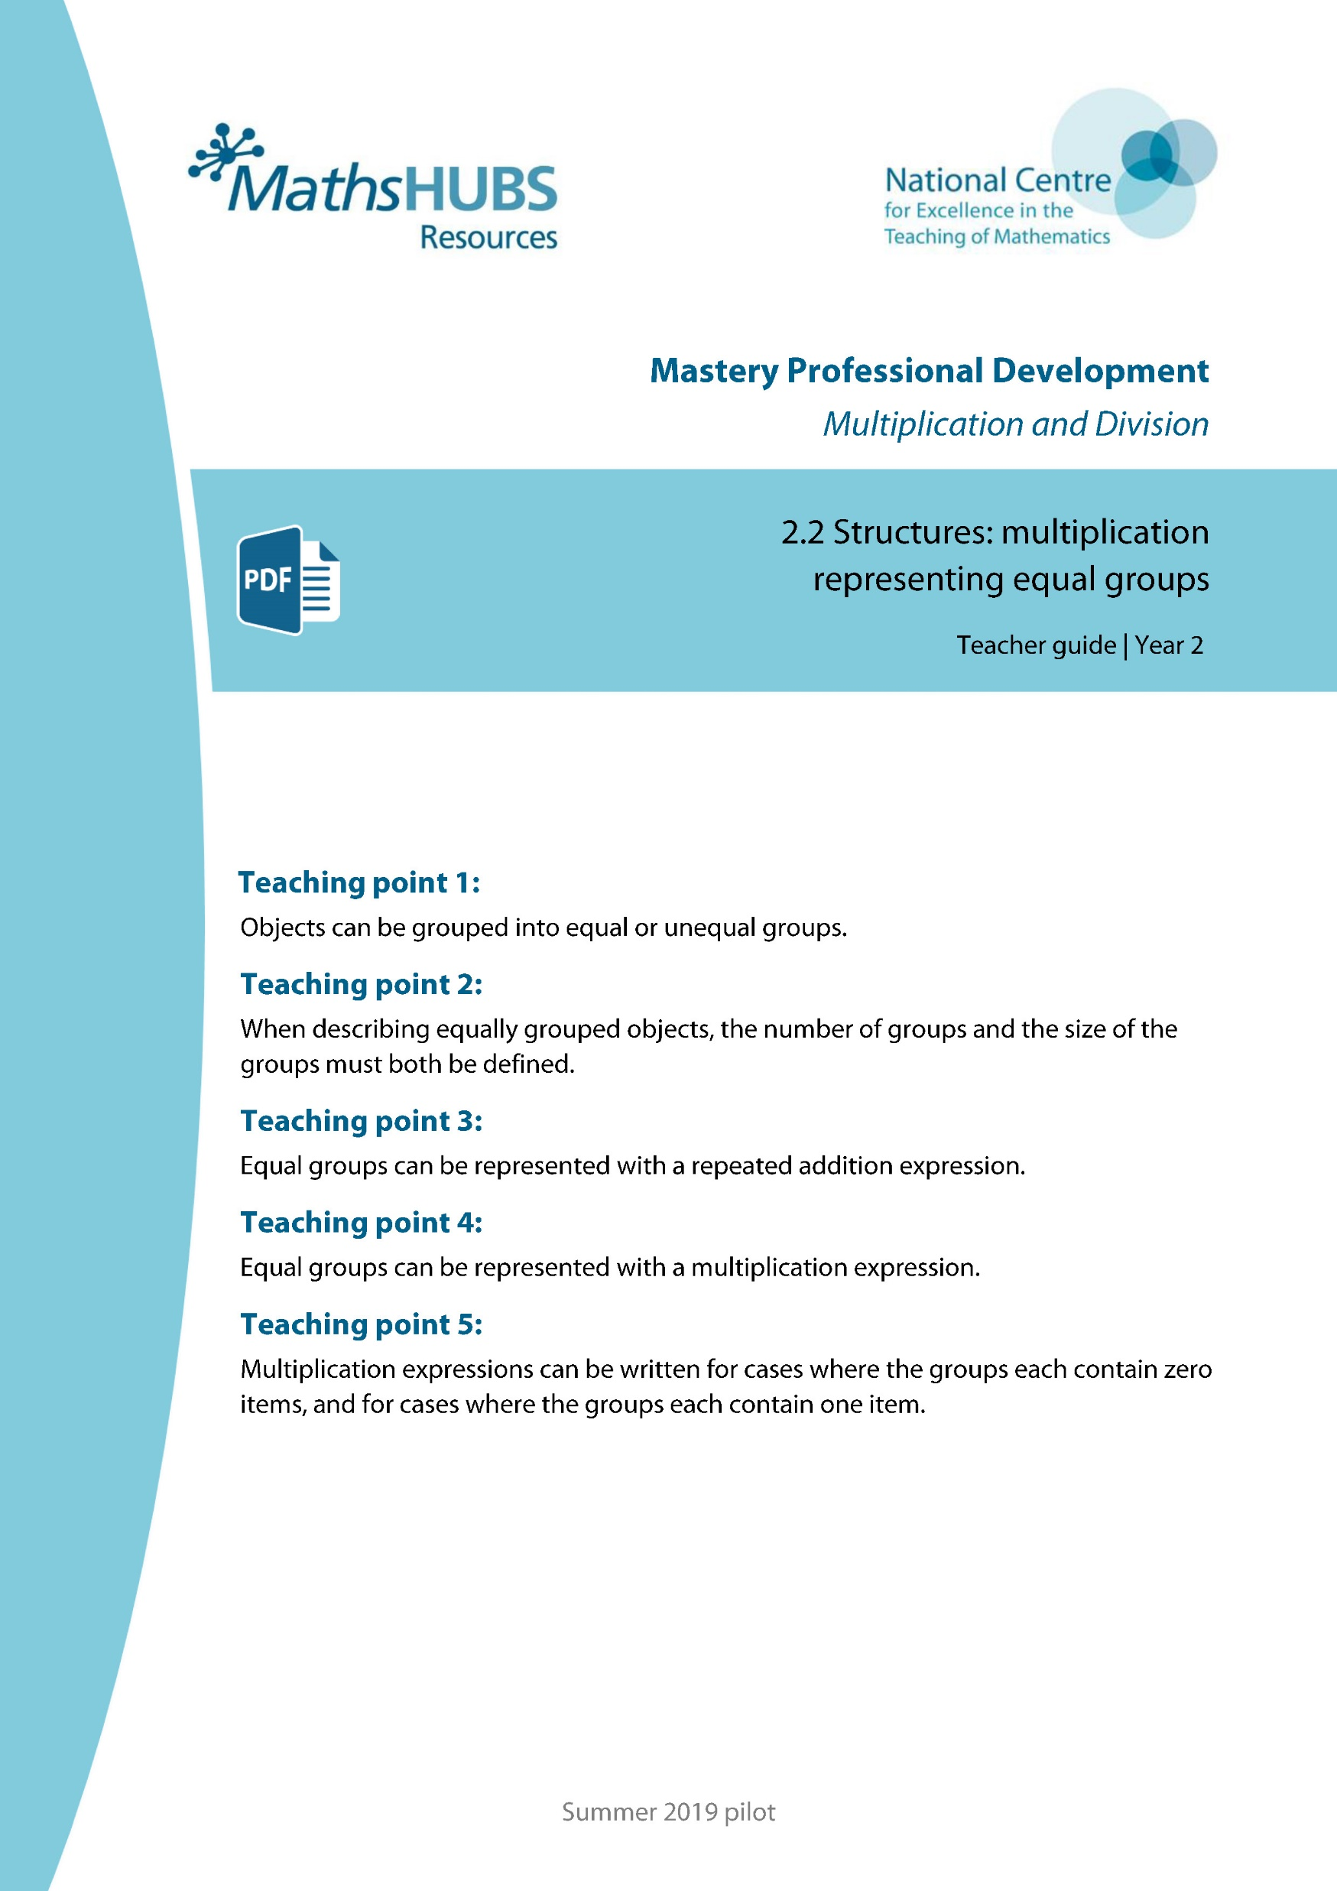
Year 2, Unit 5, Learning Outcome 1
Additional teacher guidance for this outcome should be read first and can be found in this segment of the NCETM Primary Mastery Professional Development Materials:
2.2 Structures: multiplication representing equal groups
The spine materials are divided into ‘teaching points’ and ‘steps in learning’.
Teaching point | Steps in learning | Pages
1 | 1:1 - 1:4 | 3-7

Slide 10




2.2 Multiplication: equal groups Step 1:1
Notes:
Here are some pencils.
The pencils have been grouped.

Slide 11




2.2 Multiplication: equal groups Step 1:1
Notes:
Here are some footballs.
The footballs have been grouped.

Slide 12
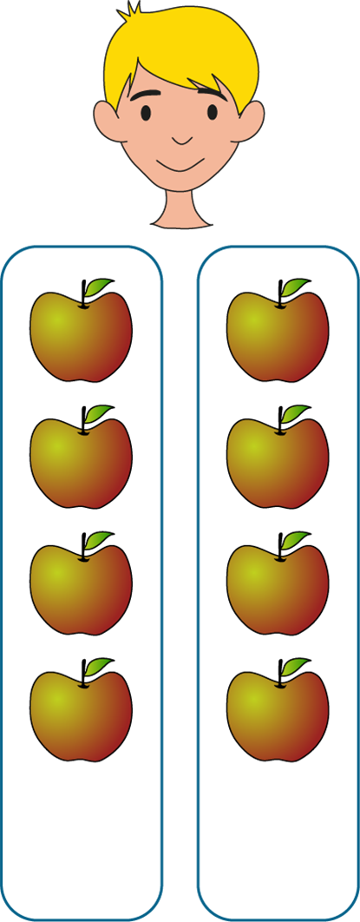
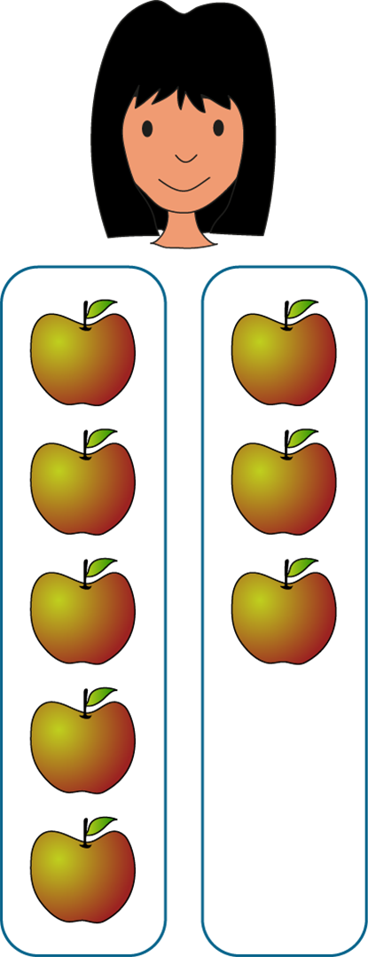
2.2 Multiplication: equal groups Step 1:2
Max
Lucia
Equal
groups
Unequal
groups
Notes:
Max and Lucia each have some apples.
Each of them has put their apples into two groups.
What do you notice about Max’s and Lucia’s apples?
What’s the same?
What’s different?

Slide 13

2.2 Multiplication: equal groups Step 1:3
✓
Equal groups
Unequal groups
Notes:
Tick to say whether the objects are in equal or unequal groups.

Slide 14

2.2 Multiplication: equal groups Step 1:3
✓
Equal groups
Unequal groups
Notes:
Tick to say whether the objects are in equal or unequal groups.

Slide 15

2.2 Multiplication: equal groups Step 1:3
✓
Equal groups
Unequal groups
Notes:
Tick to say whether the objects are in equal or unequal groups.

Slide 16
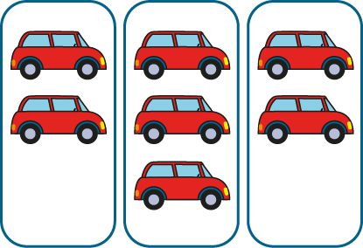
2.2 Multiplication: equal groups Step 1:3
Equal groups
✓
Unequal groups
Notes:
Tick to say whether the objects are in equal or unequal groups.

Slide 17

2.2 Multiplication: equal groups Step 1:3
Equal groups
✓
Unequal groups
Notes:
Tick to say whether the objects are in equal or unequal groups.

Slide 18
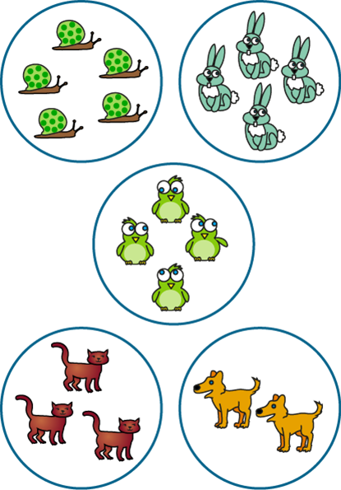
2.2 Multiplication: equal groups Step 1:3
Equal groups
✓
Unequal groups
Notes:
Tick to say whether the objects are in equal or unequal groups.

Slide 19


2.2 Multiplication: equal groups Step 1:3
Notes:
Jess is arranging twelve cubes into equal groups. Can you complete her drawing?

Slide 20


2.2 Multiplication: equal groups Step 1:3
Notes:
Now, Jess is arranging twelve cubes into unequal groups. Can you complete her drawing?

Slide 21
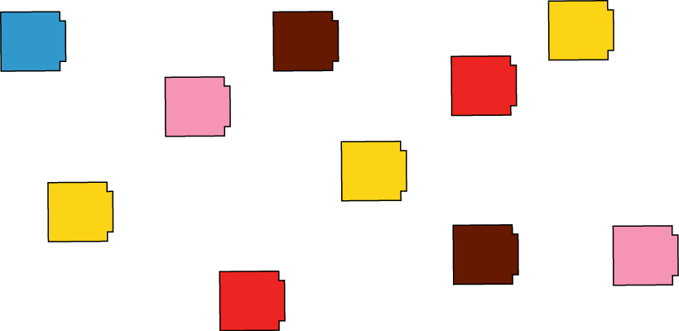
2.2 Multiplication: equal groups Step 1:3
Notes:
Count out ten cubes. How many different ways can you find to arrange them into equal groups?

Slide 22


2.2 Multiplication: equal groups Step 1:4
Notes:
Make these groups equal.

Slide 23
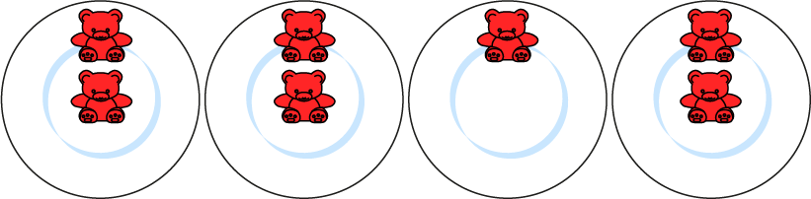

2.2 Multiplication: equal groups Step 1:4
Notes:
Make these groups equal.

Slide 24
2MD-1 Multiplication as repeated addition
Watch the pictures and see if you can spot some equal groups. Can you explain what we mean by an equal group? Which groups are equal and which groups are not equal?
Can you say how many items there are in each of the equal groups?
Can you say how many groups there are?
Equal groups have the same number of objects in each group.

Slide 25
Year 2, Unit 5, Learning Outcome 2
Learning Outcome 2
Pupils describe how objects have been grouped
The following slides have been collated to support the teaching of this learning outcome.

Slide 26
Year 2, Unit 5, Learning Outcome 2
Additional teacher guidance for this outcome should be read first and can be found in this segment of the NCETM Primary Mastery Professional Development Materials:
2.2 Structures: multiplication representing equal groups
The spine materials are divided into ‘teaching points’ and ‘steps in learning’.
Teaching point | Steps in learning | Pages
2 | 2:1 - 2:4 | 8-11

Slide 27
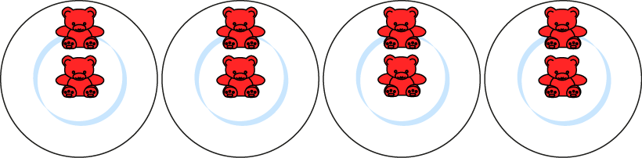
2.2 Multiplication: equal groups Step 2:1
Notes:
How many equal groups are there?
How many bears are there in each group?
There are four equal groups of bears.
There are two bears in each group.
There are four groups of two.

Slide 28
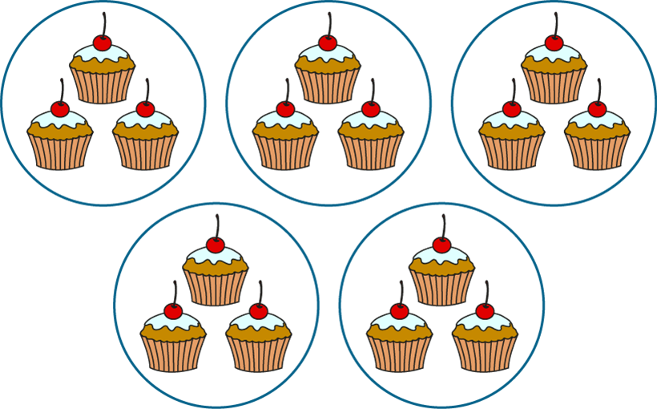
2.2 Multiplication: equal groups Step 2:1
Notes:
How many equal groups are there?
How many cakes are there in each group?
There are five equal groups of cakes.
There are three cakes in each group.
There are five groups of three.

Slide 29
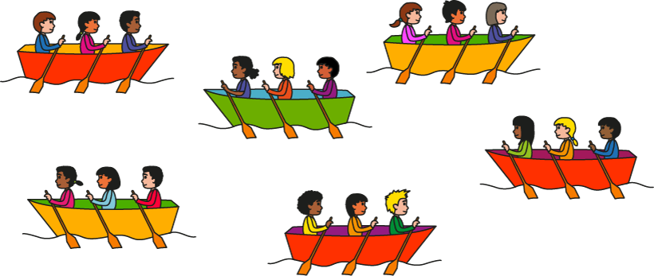
2.2 Multiplication: equal groups Step 2:3
Which sentence correctly describes the picture?
✓
There are 6 equal groups.
There are 3 equal groups.
✗

Slide 30
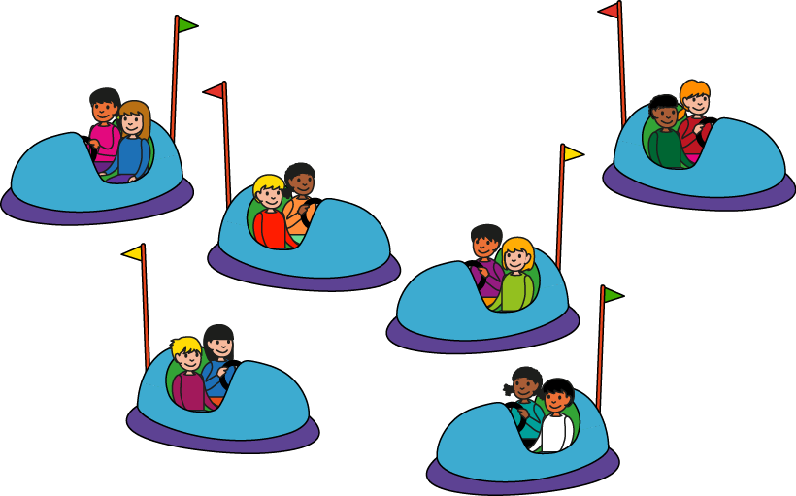
2.2 Multiplication: equal groups Step 2:3
Which sentence correctly describes the picture?
✗
There are 2 groups of 6.
There are 6 groups of 2.
✓
Notes:
Which sentence correctly describes the picture?

Slide 31


2.2 Multiplication: equal groups Step 2:3
Complete the drawing.
I have 4 groups of 3.
Notes:
James started to draw some equal groups. Complete his drawing.

Slide 32

2.2 Multiplication: equal groups Step 2:3
3
There are ___ equal groups of eggs.
5
There are ___ eggs in each group.
3
5
There are ___ groups of ___ .

Slide 33
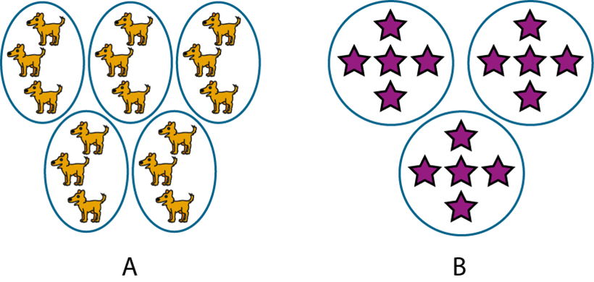
2.2 Multiplication: equal groups Step 2:3
Circle the representation that matches the description.
There are 3 groups of 5.

Slide 34
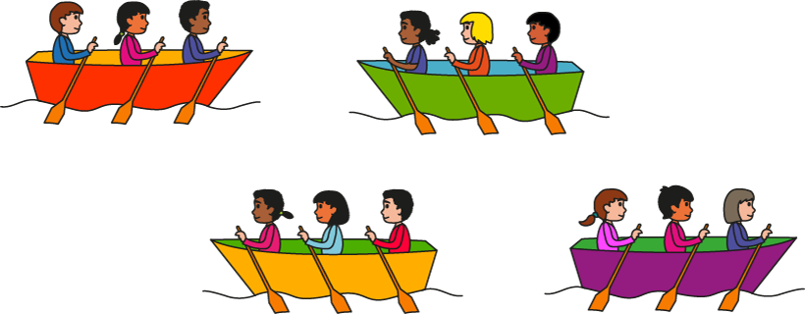
2.2 Multiplication: equal groups Step 2:4
True or false?
There are 4 groups of 3.
True
✓

Slide 35

2.2 Multiplication: equal groups Step 2:4
True or false?
There are 5 groups of 2.
✗
False

Slide 36
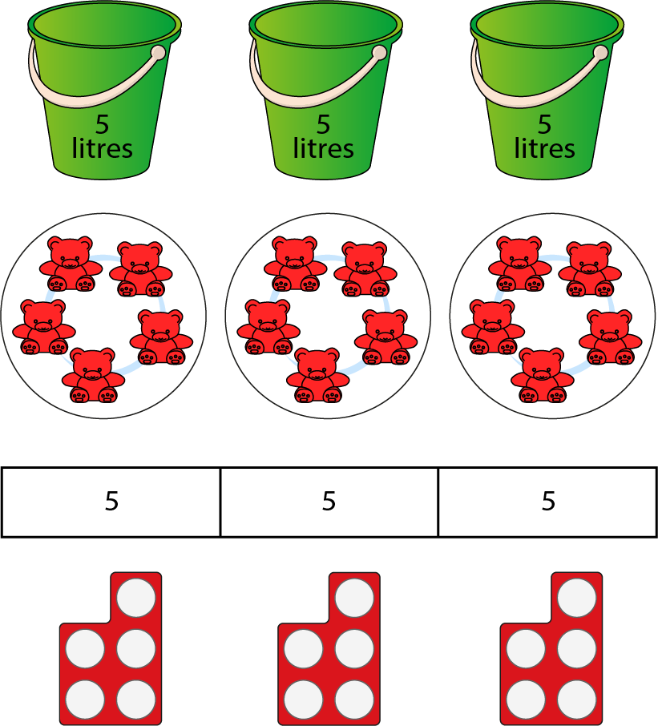
2.2 Multiplication: equal groups Step 2:4
Notes:
Look at these representations.
What’s the same?
What’s different?

Slide 37
Year 2, Unit 5, Learning Outcome 3
Learning Outcome 3
Pupils represent equal groups as repeated addition
The following slides have been collated to support the teaching of this learning outcome.

Slide 38
Year 2, Unit 5, Learning Outcome 3
Additional teacher guidance for this outcome should be read first and can be found in this segment of the NCETM Primary Mastery Professional Development Materials:
2.2 Structures: multiplication representing equal groups
The spine materials are divided into ‘teaching points’ and ‘steps in learning’.
Teaching point | Steps in learning | Pages
3 | 3:1 - 3:4 | 12-16

Slide 39

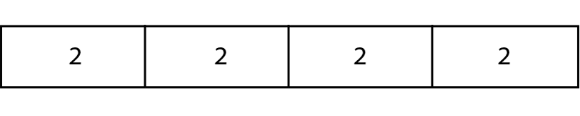
2.2 Multiplication: equal groups Step 3:1

Slide 40
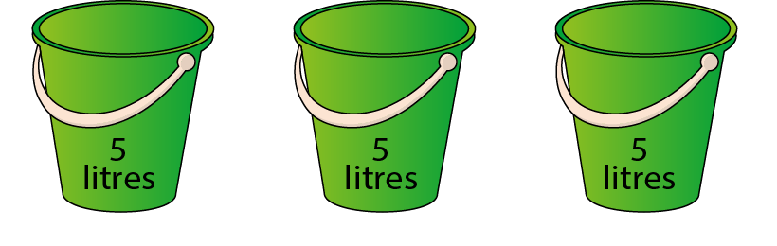
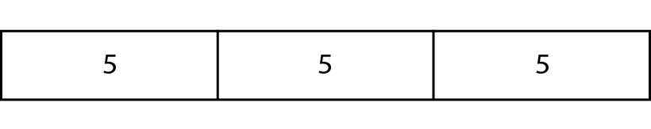
2.2 Multiplication: equal groups Step 3:1

Slide 41
2.2 Multiplication: equal groups Step 3:3
Circle the expression that correctly describes the picture.
6 + 6 + 6
3 + 3 + 3 + 3 + 3 + 3

Slide 42
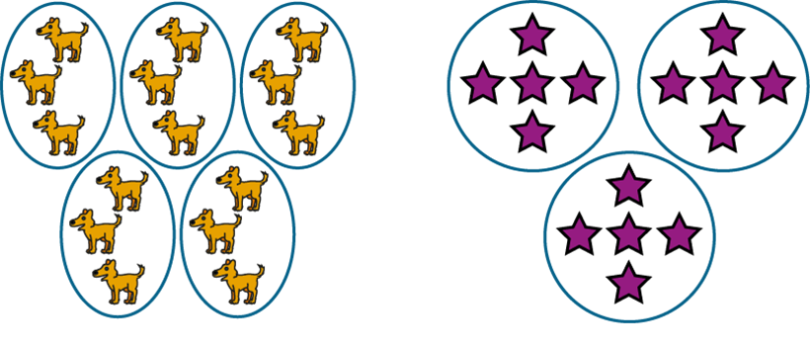
2.2 Multiplication: equal groups Step 3:3
Circle the representation that matches the expression.
5 + 5 + 5

Slide 43
2.2 Multiplication: equal groups Step 3:3
Complete the drawing.
I have 3 + 3 + 3 + 3.
Notes:
James started to draw some equal groups. Complete his drawing.

Slide 44
2.2 Multiplication: equal groups Step 3:3
5
+
5
+
5
Notes:
Complete the expression to match the picture.

Slide 45
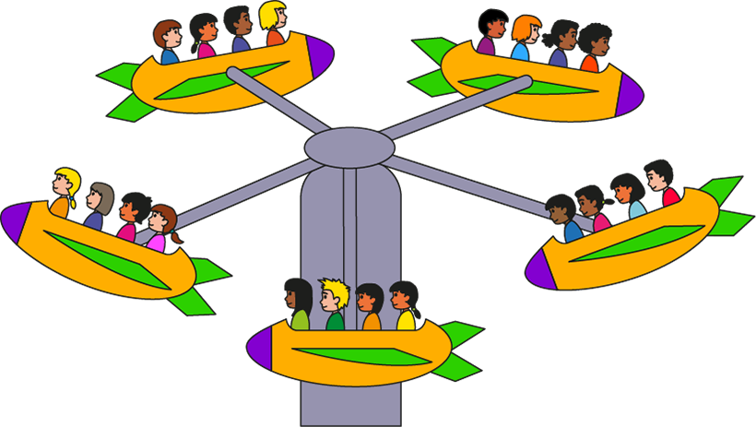
2.2 Multiplication: equal groups Step 3:3
4 + 4 + 4 + 4 + 4
Notes:
Write a repeated addition expression to match the picture.

Slide 46

2.2 Multiplication: equal groups Step 3:3
7 + 7 + 7 + 7 + 7
Notes:
Write a repeated addition expression to match the bar model.

Slide 47
2.2 Multiplication: equal groups Step 3:3
Circle the expression that matches the sentence.
There are 2 groups of 5.
2 + 5
5 + 2
5 + 5
2 + 2 + 2 + 2 + 2
Notes:
Circle the expression that matches the sentence.

Slide 48
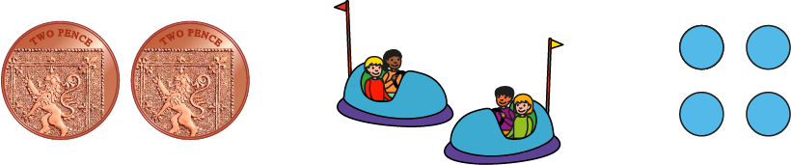
2.2 Multiplication: equal groups Step 3:4
two 2p coins
2 + 2
4
Notes:
What’s the same?
What’s different?

Slide 49
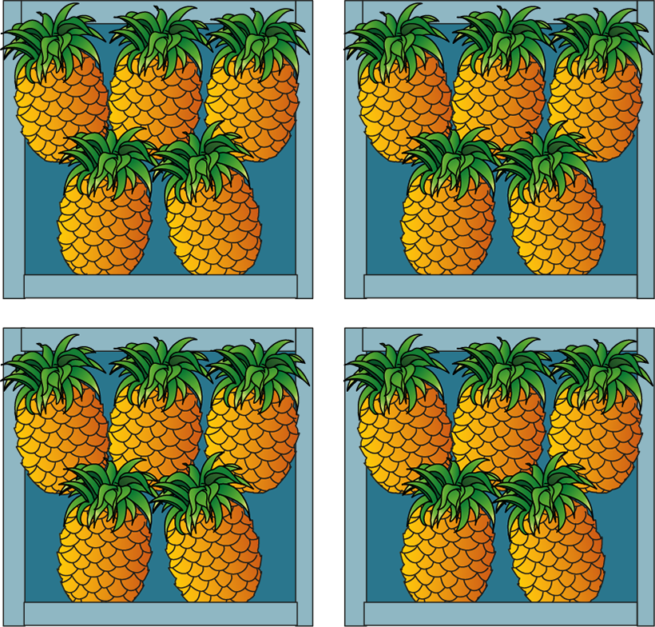
2.2 Multiplication: equal groups Step 3:4
True or false?
This picture shows 5 + 5 + 5 + 5
True
✓

Slide 50

2.2 Multiplication: equal groups Step 3:4
True or false?
There are 6 groups of 2. We can write this as 6 + 6.
True
✓

Slide 51
Year 2, Unit 5, Learning Outcome 4
Learning Outcome 4
Pupils represent equal groups as repeated addition and multiplication
The following slides have been collated to support the teaching of this learning outcome.

Slide 52
Year 2, Unit 5, Learning Outcome 4
Additional teacher guidance for this outcome should be read first and can be found in this segment of the NCETM Primary Mastery Professional Development Materials:
2.2 Structures: multiplication representing equal groups
The spine materials are divided into ‘teaching points’ and ‘steps in learning’.
Teaching point | Steps in learning | Pages
4 | 4:1 - 4:2 | 17-19

Slide 53
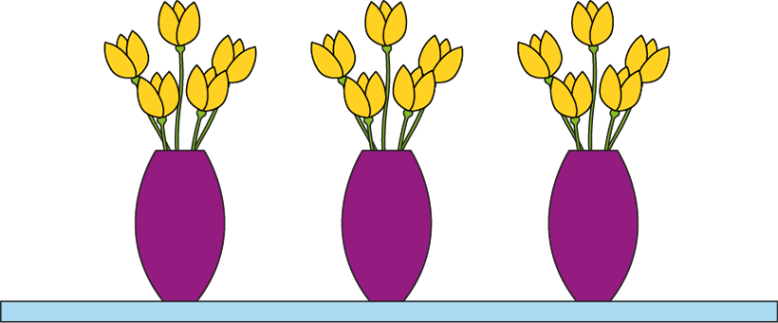
2.2 Multiplication: equal groups Step 4:1
5 + 5 + 5
3 × 5
Notes:
There are three groups of five.
We can write this as five plus five plus five.
We can also write this as three times five.
The ‘3’ represents the number of groups.
The ‘5’ represents the number of flowers in each group.
We can also write this as three times five.
3 x 5
What does the ‘3’ represent?
The ‘3’ represents the number of groups.
What does the ‘5’ represent?
The ‘5’ represents the number of flowers in each group.’

Slide 54

2.2 Multiplication: equal groups Step 4:1
10 + 10 + 10 + 10
4 × 10
Notes:
There are four groups of ten.
We can write this as ten plus ten plus ten plus ten.
We can also write this as four times ten.

Slide 55

2MD-1 Multiplication as repeated addition
How could we represent the equal groups using a multiplication expression?
What does the 3 mean? What does the 5 mean?
Read the final equation. Do you agree that 5 plus 5 plus 5 is equal to 3 times 5? Why?
5 + 5 + 5
3 × 5
5 + 5 + 5 = 3 × 5
We can represent repeated addition using multiplication.

Slide 56
2MD-1 Multiplication as repeated addition
There are 2 groups of 5.
Which expressions match this statement?
Can you draw a picture of this?
Can you draw pictures to match the other expressions?
2 + 5
5 + 2
5 + 5
2 + 2 + 2 + 2 + 2
2 × 5

Slide 57
Year 2, Unit 5, Learning Outcome 5
Learning Outcome 5
Pupils represent equal groups as multiplication
The following slides have been collated to support the teaching of this learning outcome.

Slide 58
Year 2, Unit 5, Learning Outcome 5
Additional teacher guidance for this outcome should be read first and can be found in this segment of the NCETM Primary Mastery Professional Development Materials:
2.2 Structures: multiplication representing equal groups
The spine materials are divided into ‘teaching points’ and ‘steps in learning’.
Teaching point | Steps in learning | Pages
4 | 4:3 - 4:4 | 19-22

Slide 59
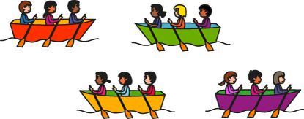

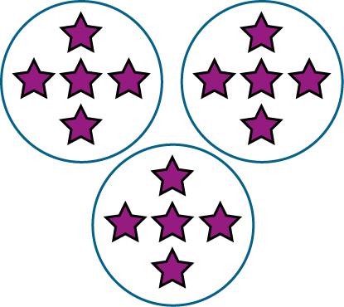
2.2 Multiplication: equal groups Step 4:3
4 × 3
3 × 5
2 × 5
Notes:
Draw lines connecting each picture with the correct multiplication expression.

Slide 60



2.2 Multiplication: equal groups Step 4:3
Complete the drawing.
I have 4 × 3.
Notes:
Antonella started to draw some equal groups. Complete her drawing.

Slide 61

2.2 Multiplication: equal groups Step 4:3
6
× 3
Notes:
Complete the expression to match the picture.

Slide 62
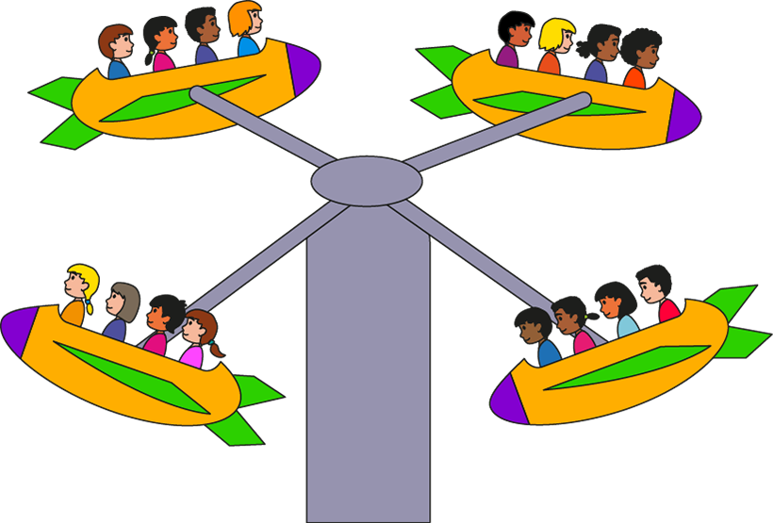
2.2 Multiplication: equal groups Step 4:3
4 × 4
Notes:
Write a multiplication expression to match the picture.

Slide 63

2.2 Multiplication: equal groups Step 4:3
3 × 8
Notes:
Write a multiplication expression to match the bar model.

Slide 64
2.2 Multiplication: equal groups Step 4:3
Circle the expression that matches the sentence.
There are 4 groups of 7.
4 + 7
7 + 4
4 × 7

Slide 65
2.2 Multiplication: equal groups Step 4:4
Does this show 3 x 5 or 5 x 5?
3 × 5
5 × 5

Slide 66






2.2 Multiplication: equal groups Step 4:4
Agree or disagree?
2 × 6
Agree
✓

Slide 67

2.2 Multiplication: equal groups Step 4:4
True or false?
3 × 4
False
✗

Slide 68
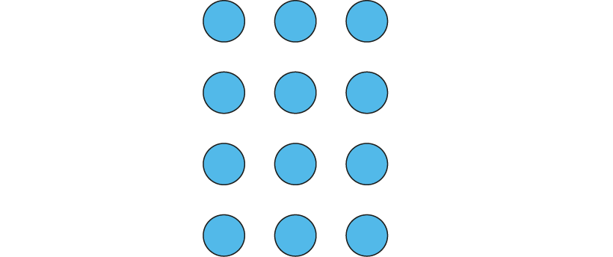
2.2 Multiplication: equal groups Step 4:4
Does this show 3 × 4 or 4 × 3?
Notes:
Dòng nǎo jīn

Slide 69
Year 2, Unit 5, Learning Outcome 6
Learning Outcome 6
Pupils explain and represent multiplication when a group contains zero or one items
The following slides have been collated to support the teaching of this learning outcome.

Slide 70
Year 2, Unit 5, Learning Outcome 6
Additional teacher guidance for this outcome should be read first and can be found in this segment of the NCETM Primary Mastery Professional Development Materials:
2.2 Structures: multiplication representing equal groups
The spine materials are divided into ‘teaching points’ and ‘steps in learning’.
Teaching point | Steps in learning | Pages
5 | 5:1 - 5:4 | 23-27

Slide 71

2.2 Multiplication: equal groups Step 5:1
2
2
2
2
2 + 2 + 2 + 2
4 × 2
Notes:
There are four groups of two children.
We can write this as two plus two plus two plus two.
We can write this as four times two.

Slide 72
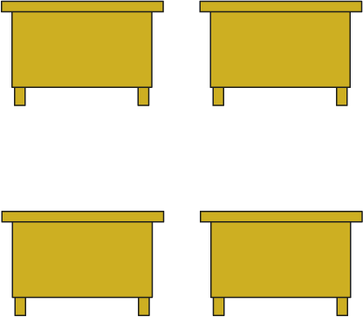
2.2 Multiplication: equal groups Step 5:1
0
0
0
0
0 + 0 + 0 + 0
4 × 0
Notes:
There are four groups of zero children.
We can write this as zero plus zero plus zero plus zero.
We can write this as four times zero.

Slide 73
2.2 Multiplication: equal groups Step 5:1
2
2
0
0
2
2
0
0
2 + 2 + 2 + 2
0 + 0 + 0 + 0
4 × 2
4 × 0

Slide 74
2.2 Multiplication: equal groups Step 5:1
5 + 5 + 5
3 × 5
Notes:
There are three groups of five eggs.
We can write this as five plus five plus five.
We can write this as three times five.

Slide 75

2.2 Multiplication: equal groups Step 5:1
0 + 0 + 0
3 × 0
Notes:
There are three groups of zero eggs.
We can write this as zero plus zero plus zero.
We can write this as three times zero.

Slide 76
2.2 Multiplication: equal groups Step 5:1
5 + 5 + 5
0 + 0 + 0
3 × 5
3 × 0

Slide 77
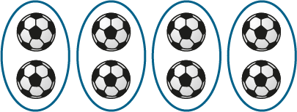
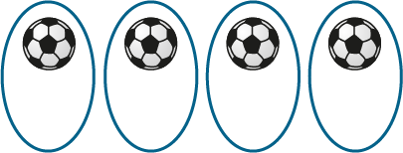



2.2 Multiplication: equal groups Step 5:2
2
2
2
2
1
1
1
1
1 + 1 + 1 + 1
2 + 2 + 2 + 2
2 + 2 + 2 + 2
1 + 1 + 1 + 1
4 ×
2
4 × 2
4 ×
4 × 1
1
Notes:
There are four groups of two footballs.
There are four groups of one football.

Slide 78
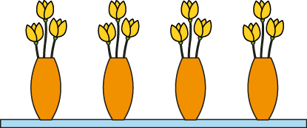

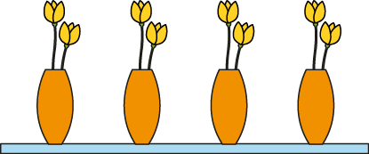
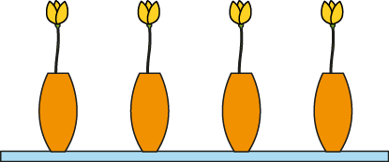
2.2 Multiplication: equal groups Step 5:3
4 × 1
4 × 3
4 × 0
4 ×2
Notes:
Draw lines connecting each picture of flowers with the correct multiplication expression.

Slide 79


2.2 Multiplication: equal groups Step 5:3
Complete the drawing.
I have 6 × 1.
Notes:
Aisha started to draw some equal groups. Complete her drawing.

Slide 80
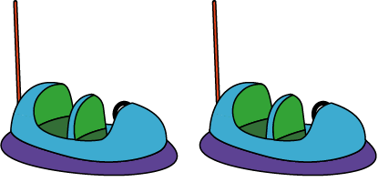

2.2 Multiplication: equal groups Step 5:3
× 3
2 ×
0
2
Notes:
Complete the expressions to describe the children in the dodgem cars.

Slide 81

2.2 Multiplication: equal groups Step 5:3
3 × 1
Notes:
Write a multiplication expression to match the bar model.

Slide 82
2.2 Multiplication: equal groups Step 5:3
Circle the expression that matches the sentence.
There are 7 groups of 0.
0 + 7
7 + 0
7 × 0
Notes:
Circle the expression that matches the sentence.

Slide 83
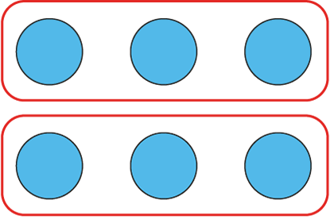
2.2 Multiplication: equal groups Step 5:4
2 × 3
This represents 3 + 3.
Notes:
Tanek has written this. How could he improve what he has written?

Slide 84


2.2 Multiplication: equal groups Step 5:4
4 × 2
Notes:
Can you write a multiplication expression for this image?
What would we need to do to make it match the multiplication expression?

Slide 85
Year 2, Unit 5, Learning Outcome 7
Learning Outcome 7
Pupils identify and explain each part of a multiplication equation
The following slides have been collated to support the teaching of this learning outcome.

Slide 86
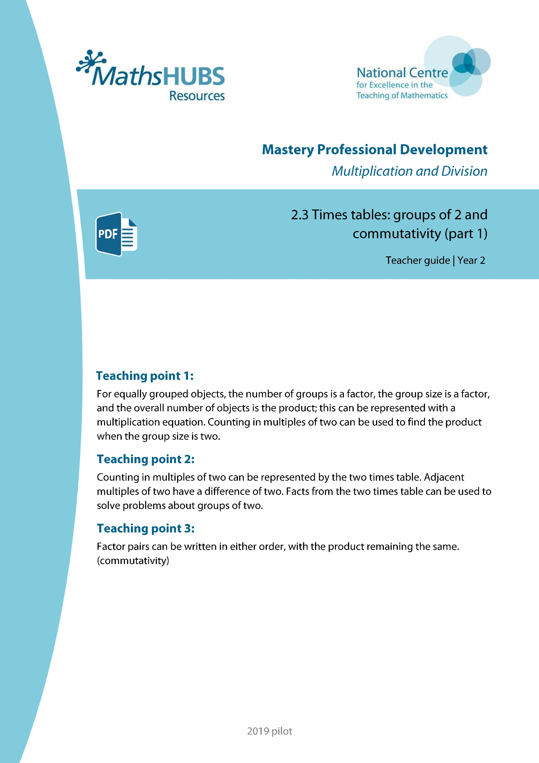
Year 2, Unit 5, Learning Outcome 7
Additional teacher guidance for this outcome should be read first and can be found in this segment of the NCETM Primary Mastery Professional Development Materials:
2.3 Times tables: groups of 2 and commutativity (part 1)
The spine materials are divided into ‘teaching points’ and ‘steps in learning’.
Teaching point | Steps in learning | Pages
1 | 1:1 - 1:3 | 3-6

Slide 87
2.3 The 2 times table and commutativity Step 1:1
0
2
4
6
8
10
12
14
16
18
20
22
24

Slide 88
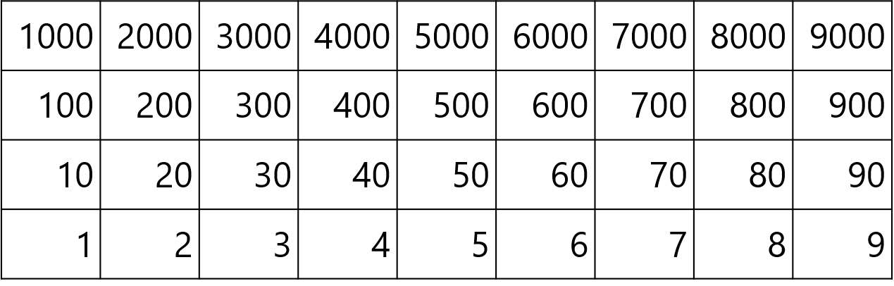
2.3 The 2 times table and commutativity Step 1:1

Slide 89






2.3 The 2 times table and commutativity Step 1:1
10
12
14
16
18
20
22
24
0
4
2
6
8
twenty-four
twenty-two
eighteen
fourteen
sixteen
twenty
twelve
eight
zero
four
two
ten
six

Slide 90
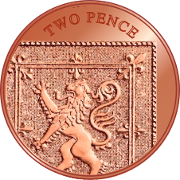
2.3 The 2 times table and commutativity Step 1:1
10
12
14
16
18
20
22
24
0
4
2
6
8
twenty-four
twenty-two
eighteen
fourteen
sixteen
twenty
twelve
eight
zero
four
two
ten
six

Slide 91



2.3 The 2 times table and commutativity Step 1:2
3 × 2 = 6
6 = 3 × 2
Notes:
How many shoes are there? Count in groups of two.
There are six shoes.
How many groups of shoes are there? How many shoes are there in each group?
‘There are three groups of shoes. There are two shoes in each group.‘
There are three groups of two; there are six altogether.

Slide 92
2.3 The 2 times table and commutativity Step 1:3
3 | × | 2 | = | 6
factor | × | factor | = | product
6 | = | 3 | × | 2
product | = | factor | × | factor

Slide 93
Year 2, Unit 5, Learning Outcome 8
Learning Outcome 8
Pupils use knowledge of multiplication to calculate the product
The following slides have been collated to support the teaching of this learning outcome.

Slide 94
Year 2, Unit 5, Learning Outcome 8
Additional teacher guidance for this outcome should be read first and can be found in this segment of the NCETM Primary Mastery Professional Development Materials:
2.3 Times tables: groups of 2 and commutativity (part 1)
The spine materials are divided into ‘teaching points’ and ‘steps in learning’.
Teaching point | Steps in learning | Pages
1 | 1:4 - 1:6 | 6-8

Slide 95

2.3 The 2 times table and commutativity Step 1:4
4 × 2 = 8
8 = 4 × 2
Notes:
There are four bicycles.
Each bicycle has two wheels.
There are four groups of two.
How many wheels are there altogether?
Two, four, six, eight
There are eight wheels
Four is a factor. Two is a factor.
The product of four and two is eight.
Eight is the product of four and two.

Slide 96





2.3 The 2 times table and commutativity Step 1:5
2 × 2 = 4
1 × 2 = 2
0 × 2 = 0
3 × 2 = 6

Slide 97


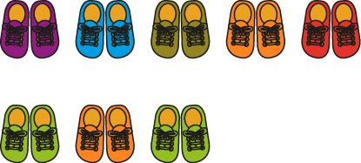
2.3 The 2 times table and commutativity Step 1:6
8 × 2 = 16
5 × 2 = 10
3 × 2 = 6
Notes:
Match each equation with the correct picture.

Slide 98

2.3 The 2 times table and commutativity Step 1:6
Complete the drawing
12 = 6 × 2
Notes:
Iniko started drawing some pairs of mittens. Complete his drawing to match the equation.

Slide 99
2MD-1 Multiplication as repeated addition
Look at the picture and expression.
How can we find out the total number of eggs without needing to count in ones?
If we skip count in multiples of five, how many fives would we need to count?
So, 5, 10, 15… there are ____ eggs in total.
So, 3 times 5 is equal to…?
15
3 × 5 = 15
The 3 represents the number of groups.
The 5 represents the number of eggs in each group.
The 15 represents the total number of eggs.

Slide 100
Year 2, Unit 5, Learning Outcome 9
Learning Outcome 9
Pupils represent the two times table in different ways
The following slides have been collated to support the teaching of this learning outcome.

Slide 101
Year 2, Unit 5, Learning Outcome 9
Additional teacher guidance for this outcome should be read first and can be found in this segment of the NCETM Primary Mastery Professional Development Materials:
2.3 Times tables: groups of 2 and commutativity (part 1)
The spine materials are divided into ‘teaching points’ and ‘steps in learning’.
Teaching point | Steps in learning | Pages
2 | 2:1 - 2:4 | 9-11

Slide 102

2.3 The 2 times table and commutativity Step 2:1
Number of pairs of shoes | Number of shoes
0 × 2 = 0
0
0
1 × 2 = 2
1
2
2 × 2 = 4
2
4
3 × 2 = 6
3
6
4 × 2 = 8
4
8

Slide 103
2.3 The 2 times table and commutativity Step 2:2
Number of pairs of shoes | Number of shoes
0 | 0
1 | 2
2 | 4
3 | 6
4 | 8
5 | 10
6 | 12
7 | 14
8 | 16
9 | 18
10 | 20
11 | 22
12 | 24
0 × 2 = 0
1 × 2 = 2
2 × 2 = 4
3 × 2 = 6
4 × 2 = 8
5 × 2 = 10
6 × 2 = 12
7 × 2 = 14
8 × 2 = 16
9 × 2 = 18
10 × 2 = 20
11 × 2 = 22
12 × 2 = 24

Slide 104



2.3 The 2 times table and commutativity Step 2:4
one 2 is 2
two 2s are 4
three 2s are 6
four 2s are 8
five 2s are 10
eleven 2s are 22
twelve 2s are 24
seven 2s are 14
eight 2s are 16
nine 2s are 18
ten 2s are 20
six 2s are 12
1 × 2 = 2
2 × 2 = 4
3 × 2 = 6
4 × 2 = 8
5 × 2 = 10
10 × 2 = 20
11 × 2 = 22
12 × 2 = 24
6 × 2 = 12
7 × 2 = 14
8 × 2 = 16
9 × 2 = 18

Slide 105
Year 2, Unit 5, Learning Outcome 10
Learning Outcome 10
Pupils use knowledge of the two times table to solve problems
The following slides have been collated to support the teaching of this learning outcome.

Slide 106
Year 2, Unit 5, Learning Outcome 10
Additional teacher guidance for this outcome should be read first and can be found in this segment of the NCETM Primary Mastery Professional Development Materials:
2.3 Times tables: groups of 2 and commutativity (part 1)
The spine materials are divided into ‘teaching points’ and ‘steps in learning’.
Teaching point | Steps in learning | Pages
2 | 2:5 | 11-12

Slide 107

2.3 The 2 times table and commutativity Step 2:5
How many eyes do the children have altogether?
3 × 2 =
6
Notes:
Complete the equation to show how many eyes the children have altogether.

Slide 108

2.3 The 2 times table and commutativity Step 2:5
How many eyes do the children have altogether?
4
× 2 =
8
Notes:
Complete the equation to show how many eyes the children have altogether.

Slide 109

2.3 The 2 times table and commutativity Step 2:5
How many eyes do the children have altogether?
5
×
2
=
10
Notes:
Complete the equation to show how many eyes the children have altogether.

Slide 110

2MD-1 Multiplication as repeated addition
What expression can we write to match the picture?
Can you tell me what multiple we need to skip count in to find out how many wheels there are altogether on the bikes?
How many twos will you need to count?
So, 7 times 2 is equal to ____.
Can you say what each number in the equation means?
7 × 2 = 14

Slide 111
Year 2, Unit 5, Learning Outcome 11
Learning Outcome 11
Pupils explain the relationship between adjacent multiples of two
The following slides have been collated to support the teaching of this learning outcome.

Slide 112
Year 2, Unit 5, Learning Outcome 11
Additional teacher guidance for this outcome should be read first and can be found in this segment of the NCETM Primary Mastery Professional Development Materials:
2.3 Times tables: groups of 2 and commutativity (part 1)
The spine materials are divided into ‘teaching points’ and ‘steps in learning’.
Teaching point | Steps in learning | Pages
2 | 2:6 - 2:8 | 12-15

Slide 113


2.3 The 2 times table and commutativity Step 2:7
 | × 2
0 | 0
1 | 2
2 | 4
3
4 | 8
5 | 10
6 | 12
7
8 | 16
9 | 18
10 | 20
11 | 22
12 | 24
 | × 2
2 | 4
3
14
↑ − 2
↓ + 2
3 × 2 = 2 × 2 + 2
7 × 2 = 8 × 2 − 2
6
 | × 2
7
8 | 16
+ 2
− 2
0
2
4
6
8
10
12
14
16
18
20

Slide 114
2.3 The 2 times table and commutativity Step 2:7
 |  | Factor
 | × | 1 | 2
Factor | 1
 | 2
 | 3
 | 4
 | 5
 | 6
 |  | Factor
 | × | 1 | 2
Factor | 1
 | 2
 | 3
 | 4
 | 5
5 × 2 =
10
6 × 2 =
5 × 2 +
2
6 × 2 =
10 +
2
6 × 2 =
12

Slide 115
Year 2, Unit 5, Learning Outcome 12
Learning Outcome 12
Pupils explain that factor pairs can be written in any order
The following slides have been collated to support the teaching of this learning outcome.

Slide 116
Year 2, Unit 5, Learning Outcome 12
Additional teacher guidance for this outcome should be read first and can be found in this segment of the NCETM Primary Mastery Professional Development Materials:
2.3 Times tables: groups of 2 and commutativity (part 1)
The spine materials are divided into ‘teaching points’ and ‘steps in learning’.
Teaching point | Steps in learning | Pages
3 | 3:1 - 3:4 | 16-18

Slide 117
2.3 The 2 times table and commutativity Step 3:1
0 × 2 = 0
1 × 2 = 2
2 × 2 = 4
3 × 2 = 6
4 × 2 = 8
5 × 2 = 10
6 × 2 = 12
7 × 2 = 14
8 × 2 = 16
9 × 2 = 18
10 × 2 = 20
11 × 2 = 22
12 × 2 = 24
2 × 0 = 0
2 × 1 = 2
2 × 2 = 4
2 × 3 = 6
2 × 4 = 8
2 × 5 = 10
2 × 6 = 12
2 × 7 = 14
2 × 8 = 16
2 × 9 = 18
2 × 10 = 20
2 × 11 = 22
2 × 12 = 24

Slide 118
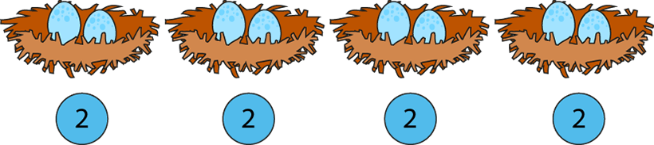
2.3 The 2 times table and commutativity Step 3:3
2 + 2 + 2 + 2 = 8
4 × 2 = 8
2 × 4 = 8
Notes:
There are four groups of two eggs. There are eight eggs altogether.
There are two eggs, four times. There are eight eggs altogether.

Slide 119

2.3 The 2 times table and commutativity Step 3:4
4 × 2 =
8
2 × 4 =
8

Slide 120
2.3 The 2 times table and commutativity Step 3:4
9
×
2
=
18
2
×
9
=
18

Slide 121
2.3 The 2 times table and commutativity Step 3:4
7 × 2 = 14
2 × 7 = 14

Slide 122
Year 2, Unit 5, Learning Outcome 13
Learning Outcome 13
Pupils represent counting in tens as the ten times table
The following slides have been collated to support the teaching of this learning outcome.

Slide 123
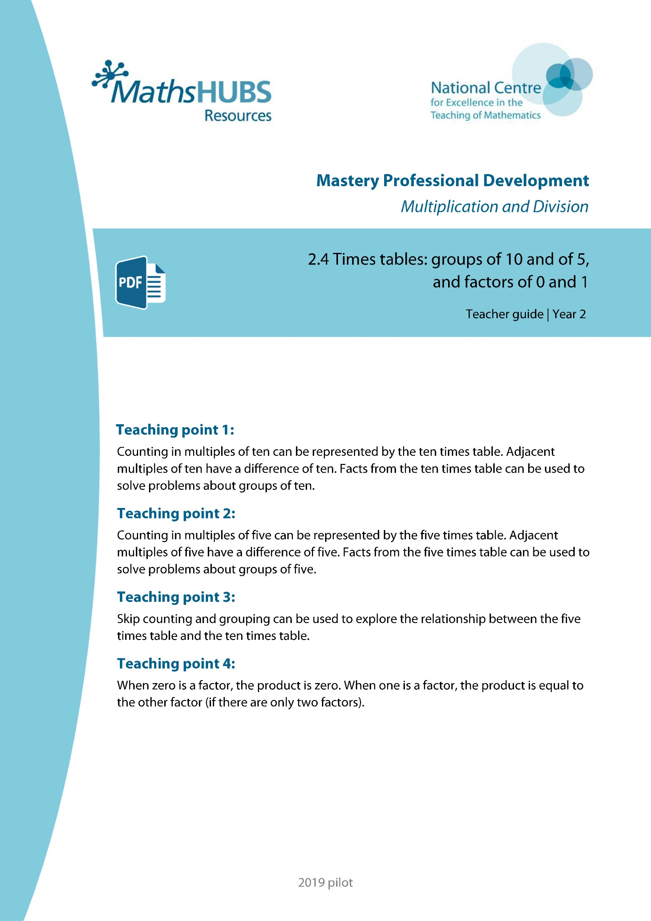
Year 2, Unit 5, Learning Outcome 13
Additional teacher guidance for this outcome should be read first and can be found in this segment of the NCETM Primary Mastery Professional Development Materials:
2.4 Times tables: groups of 10 and of 5, and factors of 0 and 1
The spine materials are divided into ‘teaching points’ and ‘steps in learning’.
Teaching point | Steps in learning | Pages
1 | 1:1 - 1:5 | 3-7

Slide 124
2.4 The 10 and 5 time tables Step 1:1
0
10
20
30
40
50
60
70
80
90
100
110
120

Slide 125
2.4 The 10 and 5 time tables Step 1:1

Slide 126

2.4 The 10 and 5 time tables Step 1:1
100
110
120
10
20
30
40
50
60
70
80
90
0
one hundred and twenty
one hundred and ten
one hundred
seventy
twenty
eighty
ninety
thirty
forty
sixty
zero
fifty
ten

Slide 127

2.4 The 10 and 5 time tables Step 1:1
100
110
120
10
20
30
40
50
60
70
80
90
0
one hundred and twenty
one hundred and ten
one hundred
seventy
twenty
eighty
ninety
thirty
forty
sixty
zero
fifty
ten

Slide 128
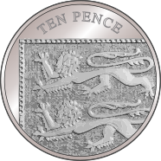
2.4 The 10 and 5 time tables Step 1:1
100
110
120
10
20
30
40
50
60
70
80
90
0
one hundred and twenty
one hundred and ten
one hundred
seventy
twenty
eighty
ninety
thirty
forty
sixty
zero
fifty
ten

Slide 129
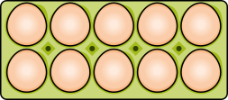

2.4 The 10 and 5 time tables Step 1:2
10
ten
20
twenty
30
thirty
3 × 10 = 30
Notes:
How many eggs are there? Count in groups of ten.

Slide 130
2.4 The 10 and 5 time tables Step 1:2
10
ten
20
twenty
30
thirty
40
forty
4 × 10 = 40
Notes:
Show me four groups of ten.
How many is this altogether?

Slide 131
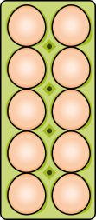

2.4 The 10 and 5 time tables Step 1:3
3 × 10 = 30
2 × 10 = 20
1 × 10 = 10
0 × 10 = 0

Slide 132





2.4 The 10 and 5 time tables Step 1:4
Number of children | 0
Number of fingers | 0
1
2
3
4
5
6
10
20
30
40
50
60
0 × 10 = 0
10 × 0 = 0
1 × 10 = 10
10 × 1 = 10
2 × 10 = 20
10 × 2 = 20
3 × 10 = 30
10 × 3 = 30
4 × 10 = 40
10 × 4 = 40
5 × 10 = 50
10 × 5 = 50
6 × 10 = 60
10 × 6 = 60

Slide 133
2.4 The 10 and 5 time tables Step 1:4
Number of children
Number of fingers
7
8
9
10
11
12
70
80
90
100
110
120
6 × 10 = 60
10 × 6 = 60
7 × 10 = 70
10 × 7 = 70
8 × 10 = 80
10 × 8 = 80
9 × 10 = 90
10 × 9 = 90
10 × 10 = 100
10 × 10 = 100
11 × 10 = 110
10 × 11 = 110
12 × 10 = 120
10 × 12 = 120

Slide 134
2.4 The 10 and 5 time tables Step 1:5
Number of children | Number of fingers
0 | 0
1 | 10
2 | 20
3 | 30
4 | 40
5 | 50
6 | 60
7 | 70
8 | 80
9 | 90
10 | 100
11 | 110
12 | 120
0 × 10 = 0 | 10 × 0 = 0
1 × 10 = 10 | 10 × 1 = 10
2 × 10 = 20 | 10 × 2 = 20
3 × 10 = 30 | 10 × 3 = 30
4 × 10 = 40 | 10 × 4 = 40
5 × 10 = 50 | 10 × 5 = 50
6 × 10 = 60 | 10 × 6 = 60
7 × 10 = 70 | 10 × 7 = 70
8 × 10 = 80 | 10 × 8 = 80
9 × 10 = 90 | 10 × 9 = 90
10 × 10 = 100 | 10 × 10 = 100
11 × 10 = 110 | 10 × 11 = 110
12 × 10 = 120 | 10 × 12 = 120

Slide 135

2MD-1 Multiplication as repeated addition
Can you say what the expression to match the picture should be?
What multiple do we need to skip count in to find out how many pencils there are altogether?
If we skip count in multiples of 10, how many 10s will we need to count?
So, 10, 20, 30, 40, 50, 60, 70, 80, 90… there are ____ pencils altogether.
90
9 × 10 = 90
The 9 represents the number of groups.
The 10 represents the number of pencils in each group.
The 90 represents the total number of pencils.

Slide 136
Year 2, Unit 5, Learning Outcome 14
Learning Outcome 14
Pupils represent the ten times table in different ways
The following slides have been collated to support the teaching of this learning outcome.

Slide 137
Year 2, Unit 5, Learning Outcome 14
Additional teacher guidance for this outcome should be read first and can be found in this segment of the NCETM Primary Mastery Professional Development Materials:
2.4 Times tables: groups of 10 and of 5, and factors of 0 and 1
The spine materials are divided into ‘teaching points’ and ‘steps in learning’.
Teaching point | Steps in learning | Pages
1 | 1:6 - 1:7 | 7-11

Slide 138
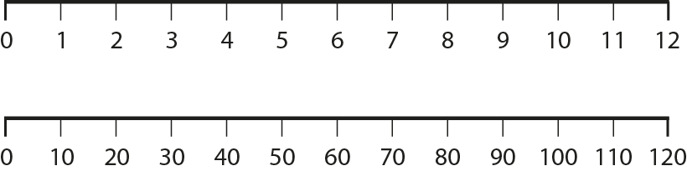
2.4 The 10 and 5 time tables Step 1:6

Slide 139
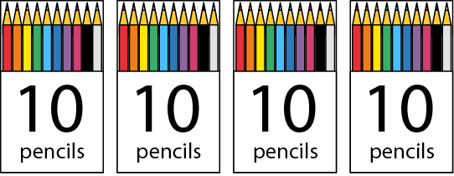
2.4 The 10 and 5 time tables Step 1:7
4 × 10 =
40
10 × 4 =
40
Notes:
Complete the equations to show how many pencils there are altogether.

Slide 140
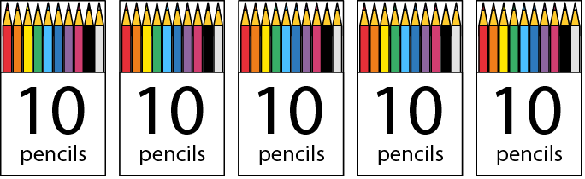
2.4 The 10 and 5 time tables Step 1:7
5
× 10 =
50
10 ×
5
=
50
Notes:
Complete the equations to show how many pencils there are altogether.

Slide 141
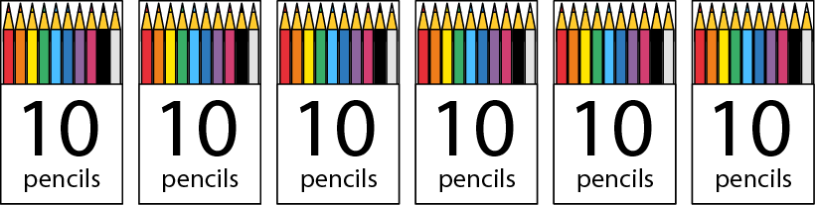
2.4 The 10 and 5 time tables Step 1:7
6
×
10
=
60
10
×
6
=
60
Notes:
Complete the equations to show how many pencils there are altogether.

Slide 142

2.4 The 10 and 5 time tables Step 1:7
There are 10 birds on each wire.
Altogether there are 30 birds. How many wires are there?
3
× 10 = 30
Notes:
There are ten birds on each wire. Altogether there are 30 birds. How many wires are there?

Slide 143
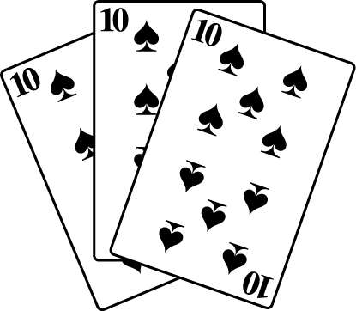
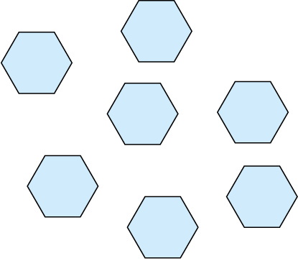
2.4 The 10 and 5 time tables Step 1:7
Facts in the 10 times table?
✓
✗
✗
4 + 10 = 40
✓
✓
✓
10 × 9 = 90
4 × 10 = 40
Notes:
Tick the examples that represent facts in the ten times table.

Slide 144
Year 2, Unit 5, Learning Outcome 15
Learning Outcome 15
Pupils explain the relationship between adjacent multiples of ten
The following slides have been collated to support the teaching of this learning outcome.

Slide 145
Year 2, Unit 5, Learning Outcome 15
Additional teacher guidance for this outcome should be read first and can be found in this segment of the NCETM Primary Mastery Professional Development Materials:
2.4 Times tables: groups of 10 and of 5, and factors of 0 and 1
The spine materials are divided into ‘teaching points’ and ‘steps in learning’.
Teaching point | Steps in learning | Pages
1 | 1:8 - 1:9 | 11-14

Slide 146
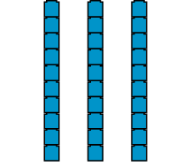


2.4 The 10 and 5 time tables Step 1:8
30 | 40 | 50
←
multiple of
10
→
10 less
10 more

Slide 147
2.4 The 10 and 5 time tables Step 1:8
 | × 10
0 | 0
1 | 10
2 | 20
3
4 | 40
5 | 50
6 | 60
7
8 | 80
9 | 90
10 | 100
11 | 110
12 | 120
 | × 10
2 | 20
3
70
↑ − 10
↓ + 10
3 × 10 = 2 × 10 + 10
7 × 10 = 8 × 10 − 10
30
 | × 10
7
8 | 80
+ 10
− 10
0
10
20
30
40
50
60
70
80
90
100

Slide 148
2.4 The 10 and 5 time tables Step 1:8
 |  | Factor
 | × | 1 | 2 | 3 | 4 | 5 | 6 | 7 | 8 | 9 | 10
Factor | 1
 | 2
 | 3
 | 4
 | 5
 | 6
 |  | Factor
 | × | 1 | 2 | 3 | 4 | 5 | 6 | 7 | 8 | 9 | 10
Factor | 1
 | 2
 | 3
 | 4
 | 5
6 × 10 = 5 × 10 +10
5 × 10 = 50
6 × 10 = 60

Slide 149










2.4 The 10 and 5 time tables Step 1:9
Notes:
Fill in the missing numbers.

Slide 150

2.4 The 10 and 5 time tables Step 1:9
Which expression(s) match this picture?
4 × 10
✗
4 × 3
✗
10 × 3 + 3
✓
3 × 10 + 3
✓
Notes:
Which expression(s) match this picture? Explain why.

Slide 151
Year 2, Unit 5, Learning Outcome 16
Learning Outcome 16
Pupils represent counting in fives as the five times table
The following slides have been collated to support the teaching of this learning outcome.

Slide 152
Year 2, Unit 5, Learning Outcome 16
Additional teacher guidance for this outcome should be read first and can be found in this segment of the NCETM Primary Mastery Professional Development Materials:
2.4 Times tables: groups of 10 and of 5, and factors of 0 and 1
The spine materials are divided into ‘teaching points’ and ‘steps in learning’.
Teaching point | Steps in learning | Pages
2 | 2:1 - 2:5 | 16-19

Slide 153
2.4 The 10 and 5 time tables Step 2:1
0
5
10
15
20
25
30
35
40
45
50
55
60

Slide 154

2.4 The 10 and 5 time tables Step 2:1
10
15
20
25
35
40
45
50
55
60
30
0
5
twenty-five
thirty-five
forty-five
fifty-five
twenty
fifteen
thirty
forty
sixty
zero
fifty
five
ten

Slide 155

2.4 The 10 and 5 time tables Step 2:1
10
15
20
25
35
40
45
50
55
60
30
0
5
twenty-five
thirty-five
forty-five
fifty-five
twenty
fifteen
thirty
forty
sixty
zero
fifty
five
ten

Slide 156

2.4 The 10 and 5 time tables Step 2:1
10
15
20
25
35
40
45
50
55
60
30
0
5
twenty-five
thirty-five
forty-five
fifty-five
twenty
fifteen
thirty
forty
sixty
zero
fifty
five
ten

Slide 157


2.4 The 10 and 5 time tables Step 2:2
5
five
10
ten
15
fifteen
3 × 5 = 15
Notes:
How many dots are there? Count in groups of five.

Slide 158


2.4 The 10 and 5 time tables Step 2:2
5
five
10
ten
15
fifteen
20
twenty
25
twenty-five
30
thirty
6 × 5 = 30
Notes:
Show me six groups of five. How many is this altogether? Count in groups of five.

Slide 159
2.4 The 10 and 5 time tables Step 2:3
3 × 5 = 15
2 × 5 = 10
1 × 5 = 5
0 × 5 = 0

Slide 160


2.4 The 10 and 5 time tables Step 2:4
Number of hands | 0
Number of fingers | 0
1
2
3
4
5
6
5
10
15
20
25
30
0 × 5 = 0
5 × 0 = 0
1 × 5 = 5
5 × 1 = 5
2 × 5 = 10
5 × 2 = 10
3 × 5 = 15
5 × 3 = 15
4 × 5 = 20
5 × 4 = 20
5 × 5 = 25
5 × 5 = 25
6 × 5 = 30
5 × 6 = 30

Slide 161
2.4 The 10 and 5 time tables Step 2:4
Number of hands
Number of fingers
7
8
9
10
11
12
35
40
45
50
55
60
6 × 5 = 30
5 × 6 = 30
7 × 5 = 35
5 × 7 = 35
8 × 5 = 40
5 × 8 = 40
9 × 5 = 45
5 × 9 = 45
10 × 5 = 50
5 × 10 = 50
11 × 5 = 55
5 × 11 = 55
12 × 5 = 60
5 × 12 = 60

Slide 162
2.4 The 10 and 5 time tables Step 2:5
Number of hands | Number of fingers
0 | 0
1 | 5
2 | 10
3 | 15
4 | 20
5 | 25
6 | 30
7 | 35
8 | 40
9 | 45
10 | 50
11 | 55
12 | 60
0 × 5 = 0 | 5 × 0 = 0
1 × 5 = 5 | 5 × 1 = 5
2 × 5 = 10 | 5 × 2 = 10
3 × 5 = 15 | 5 × 3 = 15
4 × 5 = 20 | 5 × 4 = 20
5 × 5 = 25 | 5 × 5 = 25
6 × 5 = 30 | 5 × 6 = 30
7 × 5 = 35 | 5 × 7 = 35
8 × 5 = 40 | 5 × 8 = 40
9 × 5 = 45 | 5 × 9 = 45
10 × 5 = 50 | 5 × 10 = 50
11 × 5 = 55 | 5 × 11 = 55
12 × 5 = 60 | 5 × 12 = 60

Slide 163
Year 2, Unit 5, Learning Outcome 17
Learning Outcome 17
Pupils represent the five times table in different ways
The following slides have been collated to support the teaching of this learning outcome.

Slide 164
Year 2, Unit 5, Learning Outcome 17
Additional teacher guidance for this outcome should be read first and can be found in this segment of the NCETM Primary Mastery Professional Development Materials:
2.4 Times tables: groups of 10 and of 5, and factors of 0 and 1
The spine materials are divided into ‘teaching points’ and ‘steps in learning’.
Teaching point | Steps in learning | Pages
2 | 2:6 - 2:7 | 20-22

Slide 165

2.4 The 10 and 5 time tables Step 2:6

Slide 166



2.4 The 10 and 5 time tables Step 2:6
Notes:
If the minute hand is pointing at “3”, how many minutes past the hour is it?

Slide 167

2.4 The 10 and 5 time tables Step 2:6
Notes:
If the minute hand is pointing at “4”, how many minutes past the hour is it?

Slide 168
2.4 The 10 and 5 time tables Step 2:6
Notes:
What about if the minute hand is pointing at “2”?

Slide 169
2.4 The 10 and 5 time tables Step 2:6
Notes:
What about if the minute hand is pointing at “5”?

Slide 170
2.4 The 10 and 5 time tables Step 2:6
Notes:
If the minute hand is pointing at “10”, how many minutes before the hour is it?

Slide 171

2.4 The 10 and 5 time tables Step 2:7
1 × 5 = 5
5 × 1 = 5

Slide 172


2.4 The 10 and 5 time tables Step 2:7
Facts in the 5 times table?
✓
✗
✗
9 + 5 = 45
✓
✓
✓
5 × 9 = 45
9 × 5 = 45
Notes:
Tick the examples that represent facts in the five times table.

Slide 173
Year 2, Unit 5, Learning Outcome 18
Learning Outcome 18
Pupils explain the relationship between adjacent multiples of five
The following slides have been collated to support the teaching of this learning outcome.

Slide 174
Year 2, Unit 5, Learning Outcome 18
Additional teacher guidance for this outcome should be read first and can be found in this segment of the NCETM Primary Mastery Professional Development Materials:
2.4 Times tables: groups of 10 and of 5, and factors of 0 and 1
The spine materials are divided into ‘teaching points’ and ‘steps in learning’.
Teaching point | Steps in learning | Pages
2 | 2:8 - 2:9 | 22-25

Slide 175
2.4 The 10 and 5 time tables Step 2:8
 | × 5
0 | 0
1 | 5
2 | 10
3
4 | 20
5 | 25
6 | 30
7
8 | 40
9 | 45
10 | 50
11 | 55
12 | 60
 | × 5
2 | 10
3
35
↑ − 5
↓ + 5
3 × 5 = 2 × 5 + 5
7 × 5 = 8 × 5 − 5
15
 | × 5
7
8 | 40
+ 5
− 5
0
5
10
15
20
25
30
35
40
45
50

Slide 176
2.4 The 10 and 5 time tables Step 2:8
 |  | Factor
 | × | 1 | 2 | 3 | 4 | 5
Factor | 1
 | 2
 | 3
 | 4
 | 5
 | 6
 |  | Factor
 | × | 1 | 2 | 3 | 4 | 5
Factor | 1
 | 2
 | 3
 | 4
 | 5
6 × 5 = 5 × 5 + 5
5 × 5 = 25
6 × 5 = 30

Slide 177





2.4 The 10 and 5 time tables Step 2:9

Slide 178
Year 2, Unit 5, Learning Outcome 19
Learning Outcome 19
Pupils explain how groups of five and ten are related
The following slides have been collated to support the teaching of this learning outcome.

Slide 179
Year 2, Unit 5, Learning Outcome 19
Additional teacher guidance for this outcome should be read first and can be found in this segment of the NCETM Primary Mastery Professional Development Materials:
2.4 Times tables: groups of 10 and of 5, and factors of 0 and 1
The spine materials are divided into ‘teaching points’ and ‘steps in learning’.
Teaching point | Steps in learning | Pages
3 | 3:1 - 3:3 | 26-28

Slide 180
2.4 The 10 and 5 time tables Step 3:1
0
5
10
15
20
25
30
35
40
45
50
55
60

Slide 181
2.4 The 10 and 5 time tables Step 3:1

Slide 182



2.4 The 10 and 5 time tables Step 3:1

Slide 183
2.4 The 10 and 5 time tables Step 3:1
Number | 0 | 1 | 2 | 3 | 4 | 5 | 6 | 7 | 8 | 9 | 10 | 11 | 12 | 13 | 14 | 15 | 16 | 17 | 18 | 19 | 20 | 21 | 22 | 23 | 24 | 25
Counting in 5s
Counting in 10s
✓
✓
✓
✓
✓
✓
✓
✓
✓

Slide 184



2.4 The 10 and 5 time tables Step 3:2
Notes:
How many groups of five are there?
How many groups of ten are there?

Slide 185
2.4 The 10 and 5 time tables Step 3:3
10 cm
10 cm
10 cm
5 cm
5 cm
5 cm
5 cm
5 cm
5 cm
Notes:
There are three ten centimetre lengths of ribbon.
How many five centimetre lengths can be made?

Slide 186



2.4 The 10 and 5 time tables Step 3:3
4 × 5 p
2
× 10 p
Notes:
Amelia has four five-pence coins.
Freddie has the same amount of money, in ten-pence coins.
How many ten-pence coins does Freddie have?

Slide 187
Year 2, Unit 5, Learning Outcome 20
Learning Outcome 20
Pupils explain the relationship between multiples of five and ten
The following slides have been collated to support the teaching of this learning outcome.

Slide 188
Year 2, Unit 5, Learning Outcome 20
Additional teacher guidance for this outcome should be read first and can be found in this segment of the NCETM Primary Mastery Professional Development Materials:
2.4 Times tables: groups of 10 and of 5, and factors of 0 and 1
The spine materials are divided into ‘teaching points’ and ‘steps in learning’.
Teaching point | Steps in learning | Pages
3 | 3:4 - 3:6 | 28-29

Slide 189



2.4 The 10 and 5 time tables Step 3:4
6 × 5 = 30
3 × 10 = 30

Slide 190
2.4 The 10 and 5 time tables Step 3:4
0 × 5 = 0 | 0 × 10 = 0
1 × 5 = 5 | 1 × 10 = 10
2 × 5 = 10 | 2 × 10 = 20
3 × 5 = 15 | 3 × 10 = 30
4 × 5 = 20 | 4 × 10 = 40
5 × 5 = 25 | 5 × 10 = 50
6 × 5 = 30 | 6 × 10 = 60
7 × 5 = 35 | 7 × 10 = 70
8 × 5 = 40 | 8 × 10 = 80
9 × 5 = 45 | 9 × 10 = 90
10 × 5 = 50 | 10 × 10 = 100
11 × 5 = 55 | 11 × 10 = 110
12 × 5 = 60 | 12 × 10 = 120

Slide 191

2.4 The 10 and 5 time tables Step 3:5
0
5
10
27
35
31
40
15
100

Slide 192
2.4 The 10 and 5 time tables Step 3:6
0 | × 5 = | 0 | = 10 × | 0
2 |  | 10 |  | 1
4 |  |  |  | 2
6 |  |  |  | 3
8 |  |  |  | 4
10 |  |  |  | 5
12 |  |  |  | 6
20
30
40
50
60

Slide 193
Year 2, Unit 5, Learning Outcome 21
Learning Outcome 21
Pupils use knowledge of the relationships between the five and ten times tables to solve problems
The following slide supports the teaching of this learning outcome.

Slide 194
Year 2, Unit 5, Learning Outcome 21
Additional teacher guidance for this outcome should be read first and can be found in this segment of the NCETM Primary Mastery Professional Development Materials:
2.4 Times tables: groups of 10 and of 5, and factors of 0 and 1
The spine materials are divided into ‘teaching points’ and ‘steps in learning’.
Teaching point | Steps in learning | Pages
3 | 3:7 | 29-30

Slide 195
Year 2, Unit 5, Learning Outcome 22
Learning Outcome 22
Pupils explain how a factor of zero or one affect the product
The following slides have been collated to support the teaching of this learning outcome.

Slide 196
Year 2, Unit 5, Learning Outcome 22
Additional teacher guidance for this outcome should be read first and can be found in this segment of the NCETM Primary Mastery Professional Development Materials:
2.4 Times tables: groups of 10 and of 5, and factors of 0 and 1
The spine materials are divided into ‘teaching points’ and ‘steps in learning’.
Teaching point | Steps in learning | Pages
4 | 4:1 - 4:6 | 31-35

Slide 197
2.4 The 10 and 5 time tables Step 4:1
2 times table |  | 5 times table |  | 10 times table
0 × 2 = 0 | 2 × 0 = 0 | 0 × 5 = 0 | 5 × 0 = 0 | 0 × 10 = 0 | 0 × 10 = 0
1 × 2 = 2 | 2 × 1 = 2 | 1 × 5 = 5 | 5 × 1 = 5 | 1 × 10 = 10 | 1 × 10 = 10
2 × 2 = 4 | 2 × 2 = 4 | 2 × 5 = 10 | 5 × 2 = 10 | 2 × 10 = 20 | 2 × 10 = 20

Slide 198


2.4 The 10 and 5 time tables Step 4:2

Slide 199
2.4 The 10 and 5 time tables Step 4:4
2 times table |  | 5 times table |  | 10 times table
0 × 2 = 0 | 2 × 0 = 0 | 0 × 5 = 0 | 5 × 0 = 0 | 0 × 10 = 0 | 0 × 10 = 0
1 × 2 = 2 | 2 × 1 = 2 | 1 × 5 = 5 | 5 × 1 = 5 | 1 × 10 = 10 | 1 × 10 = 10
2 × 2 = 4 | 2 × 2 = 4 | 2 × 5 = 10 | 5 × 2 = 10 | 2 × 10 = 20 | 2 × 10 = 20

Slide 200













2.4 The 10 and 5 time tables Step 4:5

Slide 201
2.4 The 10 and 5 time tables Step 4:6
 | factor | factor | product
factor |  |  | 0
factor |  |  | 5
product | 0 | 10
0
10
5
1
Notes:
Fill in the missing numbers.

Slide 202
Year 2, Unit 5, Learning Outcome 23
Learning Outcome 23
Pupils represent multiplication equations in different ways
The following slides have been collated to support the teaching of this learning outcome.

Slide 203

Year 2, Unit 5, Learning Outcome 23
Additional teacher guidance for this outcome should be read first and can be found in this segment of the NCETM Primary Mastery Professional Development Materials:
2.5 Commutativity (part 2), doubling and halving
The spine materials are divided into ‘teaching points’ and ‘steps in learning’.
Teaching point | Steps in learning | Pages
1 | 1:1 - 1:4 | 3-9

Slide 204


2.5 Commutativity, doubling and halving Step 1:1
5 × 2 = 10
5 groups of 2
2, five times

Slide 205

2.5 Commutativity, doubling and halving Step 1:1
5 × 2 = 10
2 groups of 5
5, two times

Slide 206

2.5 Commutativity, doubling and halving Step 1:1
Notes:
What’s the same?
What’s different?

Slide 207
2.5 Commutativity, doubling and halving Step 1:2
2 × 5 = 10
2 groups of 5
5, two times

Slide 208
2.5 Commutativity, doubling and halving Step 1:2
2 × 5 = 10
5 groups of 2
2, five times

Slide 209


2.5 Commutativity, doubling and halving Step 1:3
6 groups of 2
6 × 2 = 12
6, two times

Slide 210


2.5 Commutativity, doubling and halving Step 1:3
3 groups of 10
3 × 10 = 30
3, ten times

Slide 211



2.5 Commutativity, doubling and halving Step 1:4
7 × 2 = 14
7 groups of 2
2, seven times
Notes:
There are some eggs in some nests. What situations can the equation represent?

Slide 212



2.5 Commutativity, doubling and halving Step 1:4
7 × 2 = 14
2 groups of 7
7, two times
Notes:
There are some eggs in some nests. What situations can the equation represent?

Slide 213
2.5 Commutativity, doubling and halving Step 1:4
7 × 2 = 14

Slide 214


2.5 Commutativity, doubling and halving Step 1:4
2 × 5 = 10
2 groups of 5
5, two times
5 p
5 p
Notes:
I have some coins. What situations can the equation represent?

Slide 215


2.5 Commutativity, doubling and halving Step 1:4
2 × 5 = 10
5 groups of 2
2, five times
2 p
2 p
2 p
2 p
2 p
Notes:
I have some coins. What situations can the equation represent?

Slide 216
2.5 Commutativity, doubling and halving Step 1:4
2 × 5 = 10
2 p
2 p
2 p
2 p
2 p
5 p
5 p

Slide 217
Year 2, Unit 5, Learning Outcome 24
Learning Outcome 24
Pupils use knowledge of the two, five and ten times tables to solve problems (1)
The following slides have been collated to support the teaching of this learning outcome.

Slide 218
Year 2, Unit 5, Learning Outcome 24
Additional teacher guidance for this outcome should be read first and can be found in this segment of the NCETM Primary Mastery Professional Development Materials:
2.5 Commutativity (part 2), doubling and halving
The spine materials are divided into ‘teaching points’ and ‘steps in learning’.
Teaching point | Steps in learning | Pages
1 | 1:5 - 1:8 | 10-13

Slide 219




2.5 Commutativity, doubling and halving Step 1:5
2 boxes, 4 cakes in each. How many cakes?
2 × 4 =
8
2 groups of 4 is equal to 2, four times
I know that 2, four times, is equal to 8,
so I know that 2 groups of 4 is equal to 8.
Notes:
There are two boxes of cakes.
Each box contains four cakes.
How many cakes are there altogether?

Slide 220





2.5 Commutativity, doubling and halving Step 1:6
5 sheets of stickers, 6 stickers on each. How many stickers?
5 × 6 =
30
5 groups of 6 is equal to 5, six times
I know that 5, six times, is equal to 30,
so I know that 5 groups of 6 is equal to 30.
Notes:
There are five sheets of stickers.
Each sheet contains six stickers.
How many stickers are there altogether?

Slide 221



2.5 Commutativity, doubling and halving Step 1:7
10 bags of apples, 7 apples in each. How many apples?
10 × 7 =
70
10 groups of 7 is equal to 10, seven times
I know that 10, seven times, is equal to 70,
so I know that 10 groups of 7 is equal to 70.
Notes:
There are ten bags of apples.
Each bag contains seven apples.
How many apples are there altogether?

Slide 222
2.5 Commutativity, doubling and halving Step 1:8
Problem | Known times table I can use (2, 5 or 10)
There are 5 children. Each child has 4 conkers. How many conkers are there altogether?
There are 2 teams. Each team has
12 bean bags. How many bean bags
are there altogether?
10 children each have 3 meatballs
on their plate. How many meatballs
are there altogether?
5 children each have 3 balloons.
How many balloons is this
altogether?
10 times table
5 times table
2 times table

Slide 223
2.5 Commutativity, doubling and halving Step 1:8
Put each calculation in the correct column
5 × 4
2 × 9
7 × 5
10 × 12
6 × 2
10 × 8
12 × 5
2 × 7
3 × 10
5 × 11
Can use 2 times table | Can use 5 times table | Can use 10 times table

Slide 224
Year 2, Unit 5, Learning Outcome 25
Learning Outcome 25
Pupils use knowledge of the two, five and ten times tables to solve problems (2)
The following slides have been collated to support the teaching of this learning outcome.

Slide 225
Year 2, Unit 5, Learning Outcome 25
Additional teacher guidance for this outcome should be read first and can be found in this segment of the NCETM Primary Mastery Professional Development Materials:
2.5 Commutativity (part 2), doubling and halving
The spine materials are divided into ‘teaching points’ and ‘steps in learning’.
Teaching point | Steps in learning | Pages
1 | 1:9 | 14-15

Slide 226
2.5 Commutativity, doubling and halving Step 1:9
Write one equation to represent both pictures.
5 × 3 = 15
Notes:
Five threes are fifteen.
Five, three times is fifteen.

Slide 227
2.5 Commutativity, doubling and halving Step 1:9
Write one equation to represent both pictures.
3 × 5 = 15
Notes:
Three, five times is fifteen.
Three fives are fifteen.

Slide 228

2.5 Commutativity, doubling and halving Step 1:9
3 × 2 = 6
Draw an array to match the equation.
Notes:
This can represent:
Three groups of two
Three, two times

Slide 229



2.5 Commutativity, doubling and halving Step 1:9
3 × 2 = 6
Complete the two pictures to match the equation.

Slide 230




2.5 Commutativity, doubling and halving Step 1:9

Slide 231
Year 2, Unit 5, Learning Outcome 26
Learning Outcome 26
Pupils explain what each factor represents in a multiplication story
The following slides have been collated to support the teaching of this learning outcome.

Slide 232
Year 2, Unit 5, Learning Outcome 26
Additional teacher guidance for this outcome should be read first and can be found in this segment of the NCETM Primary Mastery Professional Development Materials:
2.5 Commutativity (part 2), doubling and halving
The spine materials are divided into ‘teaching points’ and ‘steps in learning’.
Teaching point | Steps in learning | Pages
1 | 1:10 - 1:12 | 16-18

Slide 233

2.5 Commutativity, doubling and halving Step 1:10
4 groups of 3
3 + 3 + 3 + 3 = 12
4 × 3 = 12
3, four times
3 × 4 = 12

Slide 234



2.5 Commutativity, doubling and halving Step 1:11
6 × 3 = 18
Notes:
There are some eggs in some nests. What situations can the equation represent?

Slide 235



2.5 Commutativity, doubling and halving Step 1:11
6 × 3 = 18

Slide 236

2.5 Commutativity, doubling and halving Step 1:11
6 × 3 = 18

Slide 237

2.5 Commutativity, doubling and halving Step 1:12
Who has represented the picture correctly?
Sally:
3 × 4
✓
Ahmed:
4 × 3
✓
Kumiko:
4 + 4 + 4
✗
Notes:
Who has represented the picture correctly?
Note: Kumiko’s expression, whilst giving the correct total number of butterflies, does not
represent the grouping shown in the picture.

Slide 238
Year 2, Unit 5, Learning Outcome 27
Learning Outcome 27
Pupils explain what each factor represents in a multiplication story when one of the factors is one
The following slides have been collated to support the teaching of this learning outcome.

Slide 239
Year 2, Unit 5, Learning Outcome 27
Additional teacher guidance for this outcome should be read first and can be found in this segment of the NCETM Primary Mastery Professional Development Materials:
2.5 Commutativity (part 2), doubling and halving
The spine materials are divided into ‘teaching points’ and ‘steps in learning’.
Teaching point | Steps in learning | Pages
1 | 1:13 | 19-21

Slide 240



2.5 Commutativity, doubling and halving Step 1:13
6 × 1 = 6
© 2017 Alphablocks Ltd.
All rights reserved.

Slide 241



2.5 Commutativity, doubling and halving Step 1:13
6 × 1 = 6
6
© 2017 Alphablocks Ltd.
All rights reserved.

Slide 242
2.5 Commutativity, doubling and halving Step 1:13
6 × 1 = 6
6
© 2017 Alphablocks Ltd.
All rights reserved.
© 2017 Alphablocks Ltd.
All rights reserved.

Slide 243

2.5 Commutativity, doubling and halving Step 1:13
1 × 5 = 5
1 group of 5
5, one time
5 p

Slide 244


2.5 Commutativity, doubling and halving Step 1:13
1 × 5 = 5
5 groups of 1
1, five times
1 p
1 p
1 p
1 p
1 p

Slide 245
2.5 Commutativity, doubling and halving Step 1:13
1 × 5 = 5
1 p
1 p
1 p
1 p
1 p
5 p

Slide 246
Year 2, Unit 5, Learning Outcome 28
Learning Outcome 28
Pupils explain how a multiplication equation with two as a factor is related to doubling
The following slides have been collated to support the teaching of this learning outcome.

Slide 247
Year 2, Unit 5, Learning Outcome 28
Additional teacher guidance for this outcome should be read first and can be found in this segment of the NCETM Primary Mastery Professional Development Materials:
2.5 Commutativity (part 2), doubling and halving
The spine materials are divided into ‘teaching points’ and ‘steps in learning’.
Teaching point | Steps in learning | Pages
2 | 2:1 - 2:4 | 22-25

Slide 248

2.5 Commutativity, doubling and halving Step 2:1
2 groups of 3
2 × 3 = 6
3, two times
3 × 2 = 6
3, doubled
3 + 3 = 6

Slide 249

2.5 Commutativity, doubling and halving Step 2:1
2 groups of 5
2 × 5 = 10
5, two times
5 × 2 = 10
5, doubled
5 + 5 = 10

Slide 250




2.5 Commutativity, doubling and halving Step 2:2
1 + 1 = 2
2 + 2 = 4
3 + 3 = 6
4 + 4 = 8
1
2
3
4
2
4
6
2 ×
=
8
2
× 2 =
3
4
1
4
6
8
2

Slide 251
2.5 Commutativity, doubling and halving Step 2:3
6
?
3
3
2 × 3 =
6
2 groups of 3
3, two times
3, doubled

Slide 252


2.5 Commutativity, doubling and halving Step 2:4
There were 3 birds. Now there are double that number.
How many birds now?
6
?
Double 3 is the same as
2 groups of 3.
3
3
2 × 3
= 6
2 times 3 = 6
Notes:
This morning there were three birds on the wall.
Now there are double that number.
How many birds are on the wall now?

Slide 253

2.5 Commutativity, doubling and halving Step 2:4
How much money does Kali have?
10
?
twice as much
as Bobby
£10
5
5
Twice as much means double.
2 × 5
= 10
2 times 5 = 10
double 5 = 10
Notes:
Bobby has £5. Kali has twice as much as Bobby. How much does Kali have?

Slide 254
Year 2, Unit 5, Learning Outcome 29
Learning Outcome 29
Pupils double two-digit numbers
The following slides have been collated to support the teaching of this learning outcome.

Slide 255
Year 2, Unit 5, Learning Outcome 29
Additional teacher guidance for this outcome should be read first and can be found in this segment of the NCETM Primary Mastery Professional Development Materials:
2.5 Commutativity (part 2), doubling and halving
The spine materials are divided into ‘teaching points’ and ‘steps in learning’.
Teaching point | Steps in learning | Pages
2 | 2:5 - 2:7 | 26-29

Slide 256
2.5 Commutativity, doubling and halving Step 2:5
10
8
6
4
2
5
1
2
3
4
5
1
2
3
4

Slide 257
2.5 Commutativity, doubling and halving Step 2:5
double 6
12
= 6 + 6
5 + 5 = 10
1 + 1 = 2
10 + 2 = 12
Notes:
Six is five plus one more, so double six is double five plus double one.

Slide 258



2.5 Commutativity, doubling and halving Step 2:5
double 6
12
= 6 + 6
5 + 5 = 10
1 + 1 = 2
10 + 2 = 12
Notes:
Six is five plus one more, so double six is double five plus double one.

Slide 259
2.5 Commutativity, doubling and halving Step 2:5
double 9
18
= 9 + 9
5 + 5 = 10
4 + 4 = 8
10 + 8 = 18
Notes:
Nine is five plus four more, so double nine is double five plus double four.

Slide 260
2.5 Commutativity, doubling and halving Step 2:5
double 9 = 9 + 9
= 18
10 + 10 = 20
1 + 1 = 2
20 − 2 = 18
Notes:
Nine is ten minus one, so double nine is double ten minus double one.

Slide 261

2.5 Commutativity, doubling and halving Step 2:6
Double two 10s is four 10s.
Double three 10s is six 10s.
Double one 10 is two 10s.
Double 20 is 40.
Double 30 is 60.
Double 10 is 20.
20 + 20 = 40
30 + 30 = 60
10 + 10 = 20

Slide 262
2.5 Commutativity, doubling and halving Step 2:6
double 11
= 22
double 10
+ double 1
20 + 2
= 22

Slide 263
2.5 Commutativity, doubling and halving Step 2:6
double 12
= 24
double 10
+ double 2
20 + 4
= 24

Slide 264
2.5 Commutativity, doubling and halving Step 2:6
double 13
= 26
double 10
+ double 3
20 + 6
= 26

Slide 265
2.5 Commutativity, doubling and halving Step 2:6
double 14
= 28
double 10
+ double 4
20 + 8
= 28

Slide 266
2.5 Commutativity, doubling and halving Step 2:6
double 15
= 30
double 10
+ double 5
20 + 10
= 30

Slide 267
2.5 Commutativity, doubling and halving Step 2:6
double 25
= 50
10
double 20 + double 5
40 + 10
= 50

Slide 268
2.5 Commutativity, doubling and halving Step 2:6
double 35
= 70
10
double 30 + double 5
60 + 10
= 70

Slide 269


2.5 Commutativity, doubling and halving Step 2:7
2 packets, 6 bones in each. How many bones?
12
?
6
6
2 × 6 =
12
Double 6 is 12, so 2 groups of 6 is 12.
Notes:
There are two packets of dog bones. There are six bones in each packet. How many bones are there altogether?

Slide 270
Year 2, Unit 5, Learning Outcome 30
Learning Outcome 30
Pupils multiply efficiently when one of the factors is two
The following slides have been collated to support the teaching of this learning outcome.

Slide 271
Year 2, Unit 5, Learning Outcome 30
Additional teacher guidance for this outcome should be read first and can be found in this segment of the NCETM Primary Mastery Professional Development Materials:
2.5 Commutativity (part 2), doubling and halving
The spine materials are divided into ‘teaching points’ and ‘steps in learning’.
Teaching point | Steps in learning | Pages
2 | 2:8 - 2:9 | 29-33

Slide 272
2.5 Commutativity, doubling and halving Step 2:9
The parts are equal. Fill in the missing numbers.
10
?
?
5
5
Notes:
In all these diagrams the parts are equal. Fill in the missing numbers.

Slide 273
2.5 Commutativity, doubling and halving Step 2:9
The parts are equal. Fill in the missing numbers.
?
20
10
10
Notes:
In all these diagrams the parts are equal. Fill in the missing numbers.

Slide 274
2.5 Commutativity, doubling and halving Step 2:9
The parts are equal. Fill in the missing numbers.
?
14
7
7
Notes:
In all these diagrams the parts are equal. Fill in the missing numbers.

Slide 275
2.5 Commutativity, doubling and halving Step 2:9
The parts are equal. Fill in the missing numbers.
?
6
3
3
Notes:
In all these diagrams the parts are equal. Fill in the missing numbers.

Slide 276
2.5 Commutativity, doubling and halving Step 2:9
The parts are equal. Fill in the missing numbers.
?
12
?
6
6
Notes:
In all these diagrams the parts are equal. Fill in the missing numbers.

Slide 277
2.5 Commutativity, doubling and halving Step 2:9
The parts are equal. Fill in the missing numbers.
1000
500
?
500
Notes:
In all these diagrams the parts are equal. Fill in the missing numbers.

Slide 278
2.5 Commutativity, doubling and halving Step 2:9
The parts are equal. Fill in the missing numbers.
14
7
?
7
?
Notes:
In all these diagrams the parts are equal. Fill in the missing numbers.

Slide 279
2.5 Commutativity, doubling and halving Step 2:9
The parts are equal. Fill in the missing numbers.
18
?
9
9
Notes:
In all these diagrams the parts are equal. Fill in the missing numbers.

Slide 280
2.5 Commutativity, doubling and halving Step 2:9
Double 4 – true or false?
4 × 2
✓
true

Slide 281
2.5 Commutativity, doubling and halving Step 2:9
Double 4 – true or false?
4 + 4
✓
true

Slide 282

2.5 Commutativity, doubling and halving Step 2:9
Double 4 – true or false?
✓
true

Slide 283

2.5 Commutativity, doubling and halving Step 2:9
Double 4 – true or false?
✗
false

Slide 284
2.5 Commutativity, doubling and halving Step 2:9
Double 4 – true or false?
2 × 4
✓
true

Slide 285

2.5 Commutativity, doubling and halving Step 2:9
Double 4 – true or false?
✗
false

Slide 286
2.5 Commutativity, doubling and halving Step 2:9
There are double the number of children outside
as there are inside. There are 20 children outside.
Which diagram shows this?
40
20
20
20
10
10

Slide 287
2.5 Commutativity, doubling and halving Step 2:9
This diagram shows doubling, because there are two parts.
True or false?
?
✗
false
9
6

Slide 288
Year 2, Unit 5, Learning Outcome 31
Learning Outcome 31
Pupils explain how halving and doubling are related
The following slides have been collated to support the teaching of this learning outcome.

Slide 289
Year 2, Unit 5, Learning Outcome 31
Additional teacher guidance for this outcome should be read first and can be found in this segment of the NCETM Primary Mastery Professional Development Materials:
2.5 Commutativity (part 2), doubling and halving
The spine materials are divided into ‘teaching points’ and ‘steps in learning’.
Teaching point | Steps in learning | Pages
3 | 3:1 - 3:2 | 34-36

Slide 290
2.5 Commutativity, doubling and halving Step 3:1
whole
half
half

Slide 291


2.5 Commutativity, doubling and halving Step 3:1
How many is half of 6 children?
3
2 × = 6
3
× 2 = 6
Notes:
There are six children who want to play on the seesaw.
Half of the children should sit on each side.
How many is half of six children?

Slide 292
2.5 Commutativity, doubling and halving Step 3:2
2
1
1
Half of 2 is equal to 1.
Double 1 is equal to 2.

Slide 293
2.5 Commutativity, doubling and halving Step 3:2
4
2
2
Half of 4 is equal to 2.
Double 2 is equal to 4.

Slide 294
2.5 Commutativity, doubling and halving Step 3:2
6
3
3
Half of 6 is equal to 3.
Double 3 is equal to 6.

Slide 295
Year 2, Unit 5, Learning Outcome 32
Learning Outcome 32
Pupils explain the relationship between factors and products
The following slides have been collated to support the teaching of this learning outcome.

Slide 296
Year 2, Unit 5, Learning Outcome 32
Additional teacher guidance for this outcome should be read first and can be found in this segment of the NCETM Primary Mastery Professional Development Materials:
2.5 Commutativity (part 2), doubling and halving
The spine materials are divided into ‘teaching points’ and ‘steps in learning’.
Teaching point | Steps in learning | Pages
3 | 3:3 - 3:4 | 36-37

Slide 297
2.5 Commutativity, doubling and halving Step 3:3
2
1
1
2 × 1 = 2
Half of 2 is equal to 1.
Double 1 is equal to 2.

Slide 298
2.5 Commutativity, doubling and halving Step 3:3
4
2
2
2 × 2 = 4
Half of 4 is equal to 2.
Double 2 is equal to 4.

Slide 299
2.5 Commutativity, doubling and halving Step 3:3
6
3
3
2 × 3 = 6
Half of 6 is equal to 3.
Double 3 is equal to 6.

Slide 300
2.5 Commutativity, doubling and halving Step 3:3
8
4
4
2 × 4 = 8
4
Half of 8 is equal to .
4
Double is equal to 8.

Slide 301
2.5 Commutativity, doubling and halving Step 3:3
2
4
1
1
2
2
2 × 1 = 2
2 × 2 = 4
half of 2 = 1
half of 4 = 2
double 1 = 2
double 2 = 4
6
8
3
3
4
4
2 × 3 = 6
2 × 4 = 8
half of 6 = 3
half of 8 = 4
double 3 = 6
double 4 = 8

Slide 302

2.5 Commutativity, doubling and halving Step 3:3
double
factor
×
2
=
product
half

Slide 303

2.5 Commutativity, doubling and halving Step 3:3
double
2
×
factor
=
product
half

Slide 304


2.5 Commutativity, doubling and halving Step 3:4
There were 6 birds.
Now there are half that number.
How many birds now?
6
?
?
3
3
Half that number of birds.
2, three times, is equal to 6.
3, twice is equal to 6.
3
3
2 × = 6
× 2 = 6
Notes:
This morning there were six birds on the wall.
Now there are half that number.
How many birds are on the wall now?

Slide 305
Year 2, Unit 5, Learning Outcome 33
Learning Outcome 33
Pupils halve two-digit numbers
The following slides have been collated to support the teaching of this learning outcome.

Slide 306
Year 2, Unit 5, Learning Outcome 33
Additional teacher guidance for this outcome should be read first and can be found in this segment of the NCETM Primary Mastery Professional Development Materials:
2.5 Commutativity (part 2), doubling and halving
The spine materials are divided into ‘teaching points’ and ‘steps in learning’.
Teaching point | Steps in learning | Pages
3 | 3:5 - 3:7 | 38-40

Slide 307
2.5 Commutativity, doubling and halving Step 3:5
half of 8
= 4
8
4
4
4
4
Double is equal to 8; so half of 8 is equal to .

Slide 308

2.5 Commutativity, doubling and halving Step 3:5
half of 12
= 6
half of 10
+
half of 2
5
+
1
= 6

Slide 309


2.5 Commutativity, doubling and halving Step 3:6
12 bones, 2 equal packs.
How many in each pack?
12
?
6
?
?
6
?
6
2 × = 12
6
× 2 = 12
Notes:
There are two packs of bones.
There are twelve bones altogether.
How many bones are there in each pack?
One of the factors is 2, so the other factor is half of the product.
Half of the biscuits are in each pack.
I know that half of 12 is equal to 6.
So there are 6 biscuits in each pack.

Slide 310


2.5 Commutativity, doubling and halving Step 3:6
Each money-box has the same amount of money.
How much is in each?
20
?
10
£10
10
?
?
£10
?
10
2 × = 20
10
× 2 = 20
Notes:
Emily has £20 in total, kept in two money-boxes.
Each money-box contains the same amount of money.
How much is in each money-box?

Slide 311
Year 2, Unit 5, Learning Outcome 34
Learning Outcome 34
Pupils use knowledge of doubling, halving and the two times table to solve problems
The following slides have been collated to support the teaching of this learning outcome.

Slide 312
Year 2, Unit 5, Learning Outcome 34
Additional teacher guidance for this outcome should be read first and can be found in this segment of the NCETM Primary Mastery Professional Development Materials:
2.5 Commutativity (part 2), doubling and halving
The spine materials are divided into ‘teaching points’ and ‘steps in learning’.
Teaching point | Steps in learning | Pages
3 | 3:8 - 3:9 | 40-42

Slide 313


2.5 Commutativity, doubling and halving Step 3:8
True or false – half of 10?
✗
false
5
✓
true
20
✗
false
✓
true

Slide 314

2.5 Commutativity, doubling and halving Step 3:8
Half of these ducks are mine.
How many ducks do I have?
3

Slide 315











2.5 Commutativity, doubling and halving Step 3:9
Fill in the gaps in the table.

