Slide 1
Year 1, Unit 5
Unit Numbers 0 to 10

Slide 2
Year 1, Unit 5
These materials heavily reflect the prioritisation approach of the ready-to-progress criteria in the DfE Primary Mathematics Guidance 2020 and on the PPTs that exemplify them on the NCETM website. They also include other relevant National Curriculum content. Related sections of the NCETM Primary Mastery Professional Development Materials provide small-step teaching guidance.
Ready-to-progress criteria addressed by this unit
Teaching of this unit supports the following criteria from the ‘DfE Mathematics Guidance: key stages 1 & 2’ (the 335-page document available as a download)
1NPV-2 Page 20
1AS-1 Page 30
Prior learning
This unit builds directly on Year 1, Unit 3: Numbers 0 to 5.

Slide 3
Contents
The links below take you to the starting slide of each learning outcome.
1 | Pupils count a set of objects and match the spoken number to the written numeral and number name
2 | Pupils represent the numbers 6 to 10 using a five and a bit structure
3 | Pupils identify the whole and parts of the numbers 6 to 10 using the five and a bit structure
4 | Pupils explore the numbers 6 to 10 using the part whole model and the five and a bit structure
5 | Pupils explain where 6, 7, 8 and 9 lie on a number line
Click the arrow button to return to this Contents slide.

Slide 4
Contents
The links below take you to the starting slide of each learning outcome.
6 | Pupils explain what odd and even numbers are and the difference between them
7 | Pupils explain how even and odd numbers can be partitioned
8 | Pupils partition numbers 6 to 10 in different ways
9 | Pupils partition the numbers 6 to 10 in a systematic way
10 | Pupils identify a missing part when a whole is partitioned into two parts
Click the arrow button to return to this Contents slide.

Slide 5
Year 1, Unit 5, Learning Outcome 1
Learning Outcome 1
Pupils count a set of objects and match the spoken number to the written numeral and number name
The following slides have been collated to support the teaching of this learning outcome.

Slide 6
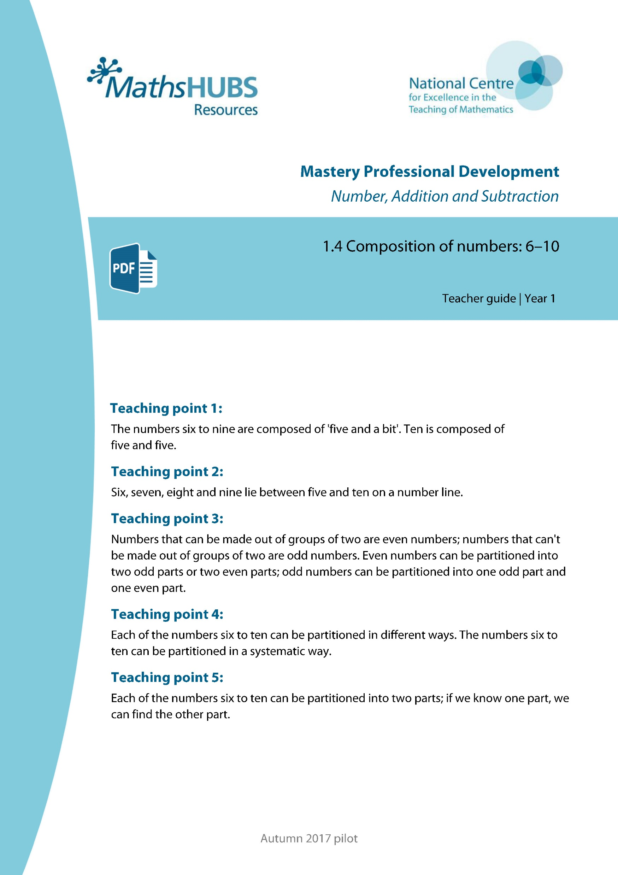
Year 1, Unit 5, Learning Outcome 1
Additional teacher guidance for this outcome should be read first and can be found in this segment of the NCETM Primary Mastery Professional Development Materials:
1.4 Composition of numbers: 6 to 10
The spine materials are divided into ‘teaching points’ and ‘steps in learning’.
Teaching point | Steps in learning | Pages
1 | 1:1-1:2 | 3-4

Slide 7
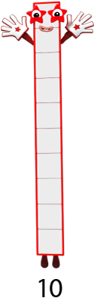









1.4 Composition: 6–10 – step 1:1
Images © 2017 Alphablocks Ltd. All Rights Reserved.

Slide 8









1.4 Composition: 6–10 – step 1:1
1
2
3
4
5
6
7
8
9
10

Slide 9










1.4 Composition: 6–10 – step 1:1

Slide 10





1.4 Composition: 6–10 – step 1:2

Slide 11

1.4 Composition: 6–10 – step 1:2
8
eight

Slide 12

1.4 Composition: 6–10 – step 1:2
6
six

Slide 13
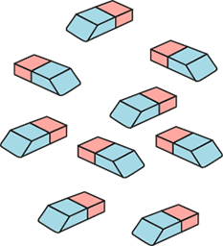
1.4 Composition: 6–10 – step 1:2
9
nine

Slide 14
Year 1, Unit 5, Learning Outcome 2
Learning Outcome 2
Pupils represent the numbers 6 to 10 using a five and a bit structure
The following slides have been collated to support the teaching of this learning outcome.

Slide 15
Year 1, Unit 5, Learning Outcome 2
Additional teacher guidance for this outcome should be read first and can be found in this segment of the NCETM Primary Mastery Professional Development Materials:
1.4 Composition of numbers: 6 to 10
The spine materials are divided into ‘teaching points’ and ‘steps in learning’.
Teaching point | Steps in learning | Pages
1 | 1:3-1:6 | 5-8

Slide 16






1.4 Composition: 6–10 – step 1:3
6

Slide 17

1.4 Composition: 6–10 – step 1:3
7

Slide 18
1.4 Composition: 6–10 – step 1:3
8

Slide 19
1.4 Composition: 6–10 – step 1:3
9

Slide 20
1.4 Composition: 6–10 – step 1:3
10

Slide 21
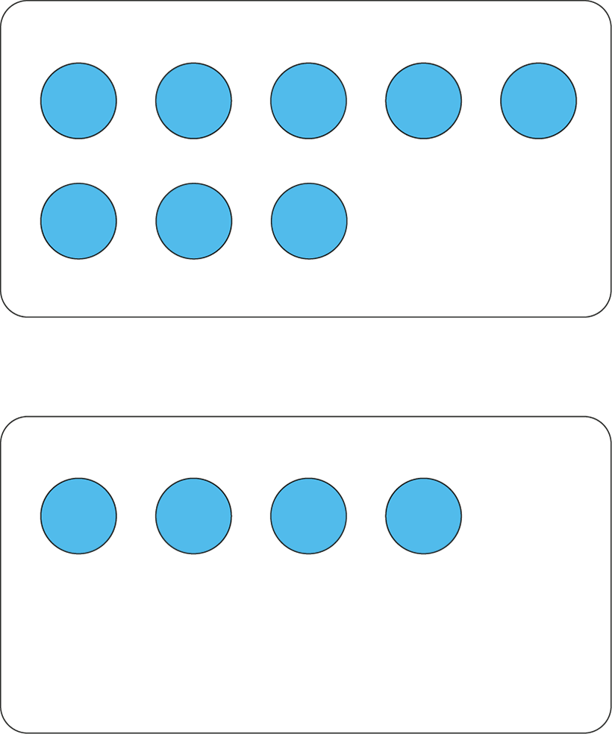
1.4 Composition: 6–10 – step 1:4

Slide 22
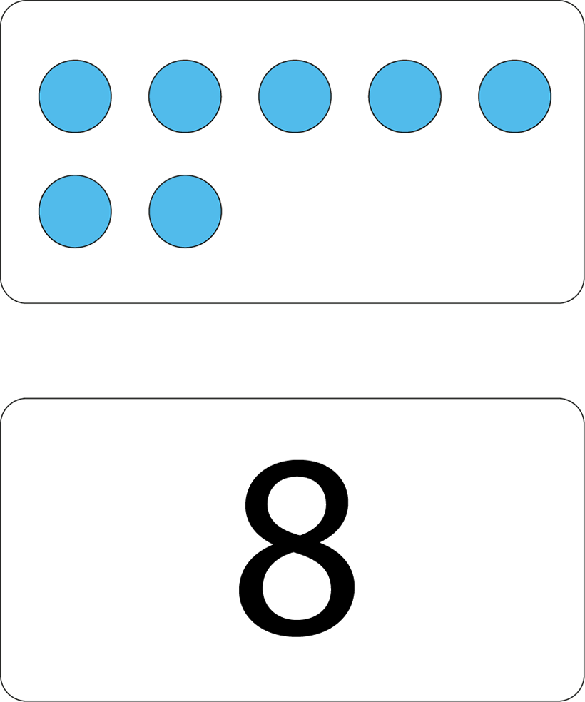
1.4 Composition: 6–10 – step 1:4

Slide 23
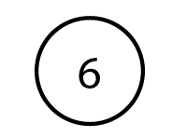









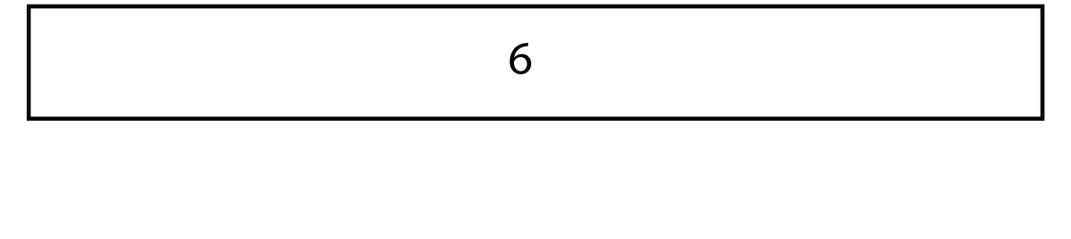
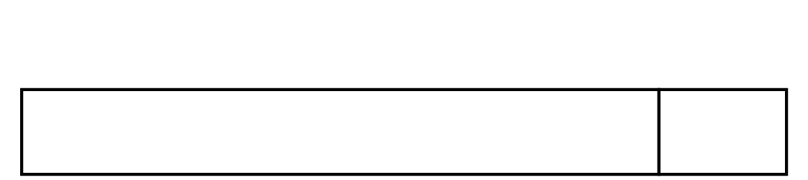


1.4 Composition: 6–10 – step 1:5

Slide 24






1.4 Composition: 6–10 – step 1:6

Slide 25

1.4 Composition: 6–10 – step 1:6

Slide 26
Year 1, Unit 5, Learning Outcome 3
Learning Outcome 3
Pupils identify the whole and parts of the numbers 6 to 10 using the five and a bit structure
The following slides have been collated to support the teaching of this learning outcome.

Slide 27
Year 1, Unit 5, Learning Outcome 3
Additional teacher guidance for this outcome should be read first and can be found in this segment of the NCETM Primary Mastery Professional Development Materials:
1.4 Composition of numbers: 6 to 10
The spine materials are divided into ‘teaching points’ and ‘steps in learning’.
Teaching point | Steps in learning | Pages
1 | 1:7-1:8 | 8-9

Slide 28

1.4 Composition: 6–10 – step 1:8

Slide 29

1.4 Composition: 6–10 – step 1:8

Slide 30
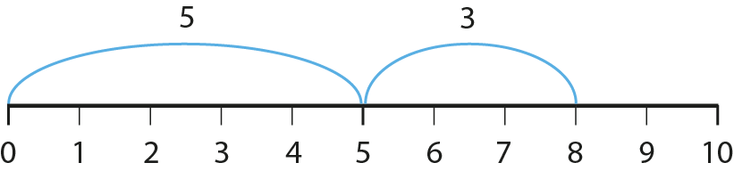
1.4 Composition: 6–10 – step 1:8

Slide 31
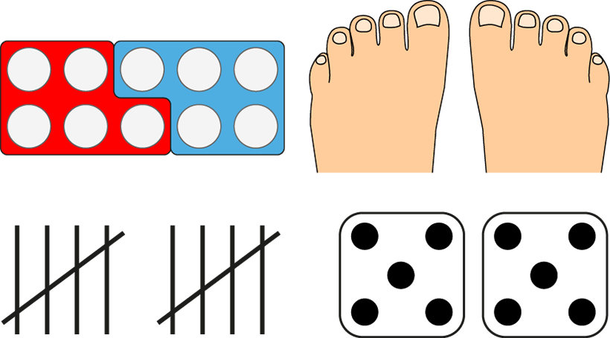
1.4 Composition: 6–10 – step 1:8

Slide 32
1AS-1 Compose and partition numbers to 10
Which numbers can you see here? Show them on your fingers in the same way.
What do you notice about the ten frames? Do they all have the top row filled? Why?
Use your ten frames to make these numbers. You could use a different colour for the top row so you can see 5 as a part.
Show me 5! Can you quickly change 5
into… 6, 9, 7, 8, 10? Try not to count!
6
7
8
9
10
Five is a part of 6, 7, 8, 9 and 10.

Slide 33

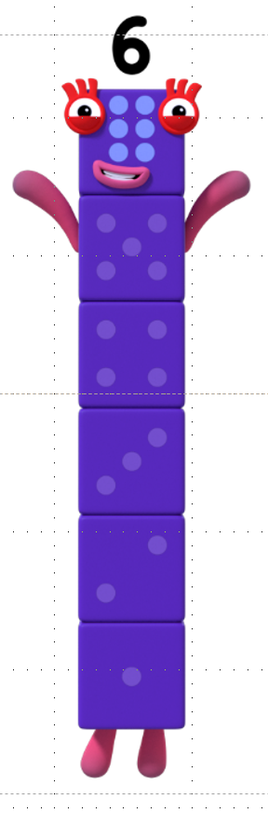


1AS-1 Compose and partition numbers to 10
Numberblock Five wants to become Five and a bit! Can you help her?
What can she make if she joins with Numberblock One? Get out some of your own cubes and see if you can help her find out. Use five of one colour and one of a different colour.
Let’s use the Numberblocks to count the blocks in Six and find the Five inside!
Repeat for 5 and 2, 5 and 3, 5 and 4, and 5 and 5.
Play my game! Count some cubes into a bag. Can we take out five? If so, how many would be left? If not, how many more do we need to put in the bag?
Images © 2017 Alphablocks Ltd. All Rights Reserved.

Slide 34
Year 1, Unit 5, Learning Outcome 4
Learning Outcome 4
Pupils explore the numbers 6 to 10 using the part whole model and the five and a bit structure
The following slides have been collated to support the teaching of this learning outcome.

Slide 35
Year 1, Unit 5, Learning Outcome 4
Additional teacher guidance for this outcome should be read first and can be found in this segment of the NCETM Primary Mastery Professional Development Materials:
1.4 Composition of numbers: 6 to 10
The spine materials are divided into ‘teaching points’ and ‘steps in learning’.
Teaching point | Steps in learning | Pages
1 | 1:9-1:10 | 9-10

Slide 36
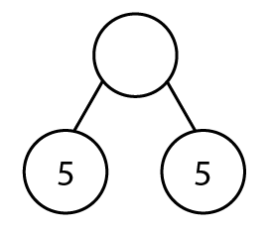
1.4 Composition: 6–10 – step 1:9
?
10
5
5

Slide 37
1.4 Composition: 6–10 – step 1:9
6
5
?
1

Slide 38
1.4 Composition: 6–10 – step 1:9
9
4
5
?

Slide 39
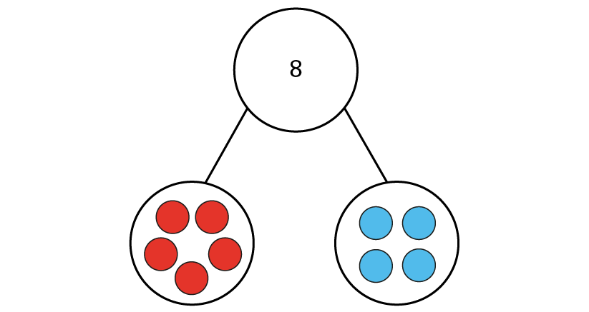

1.4 Composition: 6–10 – step 1:10
8
✓
✗

Slide 40


1.4 Composition: 6–10 – step 1:10
7
8
✗
✓
5
3

Slide 41
Year 1, Unit 5, Learning Outcome 5
Learning Outcome 5
Pupils explain where 6, 7, 9 and 9 lie on a number line
The following slides have been collated to support the teaching of this learning outcome.

Slide 42
Year 1, Unit 5, Learning Outcome 5
Additional teacher guidance for this outcome should be read first and can be found in this segment of the NCETM Primary Mastery Professional Development Materials:
1.4 Composition of numbers: 6 to 10
The spine materials are divided into ‘teaching points’ and ‘steps in learning’.
Teaching point | Steps in learning | Pages
2 | 2:1-2:6 | 11-13

Slide 43




1.4 Composition: 6–10 – step 2:2
?

Slide 44
1.4 Composition: 6–10 – step 2:3

Slide 45



1.4 Composition: 6–10 – step 2:4
1
2
4
6
8
9

Slide 46



1.4 Composition: 6–10 – step 2:4
1
3
4
5
7
8

Slide 47
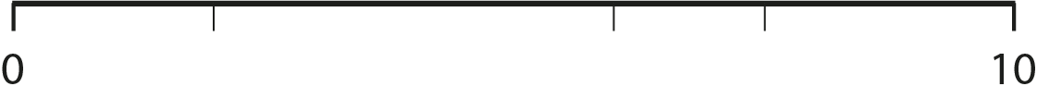



1.4 Composition: 6–10 – step 2:4
1
2
4
5
6
8

Slide 48
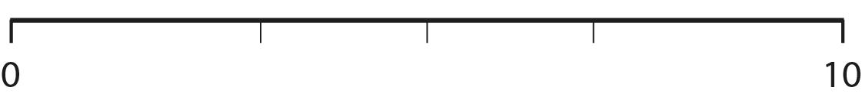



1.4 Composition: 6–10 – step 2:5
1
3
5
7
8
9

Slide 49
1.4 Composition: 6–10 – step 2:6
1
2
3
5
6
7
8
9

Slide 50
1NPV-2 Numbers to 20 in the linear number system
0
1
2
3
4
5
6
7
8
9
10
1
2
4
6
8
9
What is the smallest number shown on the number line? What is the largest?
Which number is half-way between 0 and 10?
Can you join in with me as we count forwards and backwards?
Can you tell me some of the numbers between 1 and 5? And those between 5 and 10? Where do 7, 3 and 5 sit on the number line? How do you know?
Five is half-way between zero and ten.

Slide 51
Year 1, Unit 5, Learning Outcome 6
Learning Outcome 6
Pupils explain what odd and even numbers are and the difference between them
The following slides have been collated to support the teaching of this learning outcome.

Slide 52
Year 1, Unit 5, Learning Outcome 6
Additional teacher guidance for this outcome should be read first and can be found in this segment of the NCETM Primary Mastery Professional Development Materials:
1.4 Composition of numbers: 6 to 10
The spine materials are divided into ‘teaching points’ and ‘steps in learning’.
Teaching point | Steps in learning | Pages
3 | 3:1-3:6 | 14-17

Slide 53










1.4 Composition: 6–10 – step 3:1

Slide 54
1.4 Composition: 6–10 – step 3:1

Slide 55
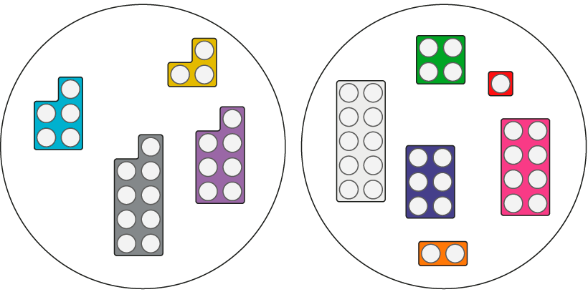

1.4 Composition: 6–10 – step 3:2
odd
even
✓
✗

Slide 56
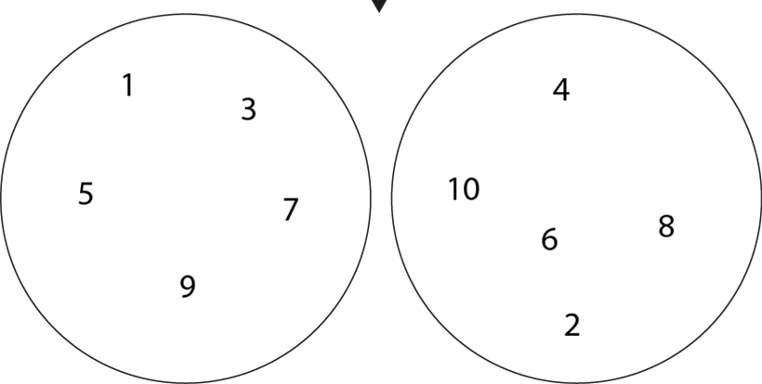
1.4 Composition: 6–10 – step 3:3
odd
even
1
4
3
5
10
7
6
8
9
2

Slide 57
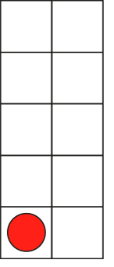




1.4 Composition: 6–10 – step 3:4
1
2
3
10
4
5
6
7
8
9

Slide 58




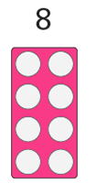

1.4 Composition: 6–10 – step 3:5

Slide 59



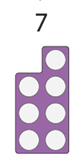

1.4 Composition: 6–10 – step 3:5

Slide 60

1.4 Composition: 6–10 – step 3:5

Slide 61
1.4 Composition: 6–10 – step 3:5

Slide 62
Year 1, Unit 5, Learning Outcome 7
Learning Outcome 7
Pupils explain how even and odd numbers can be partitioned
The following slides have been collated to support the teaching of this learning outcome.

Slide 63
Year 1, Unit 5, Learning Outcome 7
Additional teacher guidance for this outcome should be read first and can be found in this segment of the NCETM Primary Mastery Professional Development Materials:
1.4 Composition of numbers: 6 to 10
The spine materials are divided into ‘teaching points’ and ‘steps in learning’.
Teaching point | Steps in learning | Pages
3 | 3:7-3:8 | 17-18

Slide 64
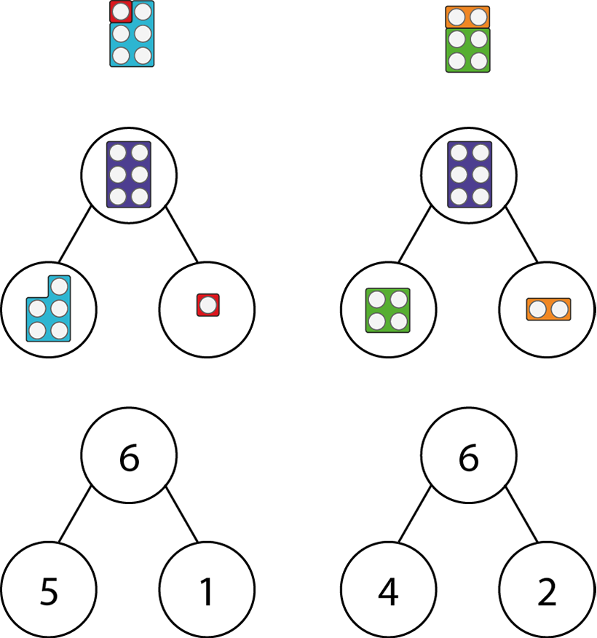
1.4 Composition: 6–10 – step 3:7

Slide 65
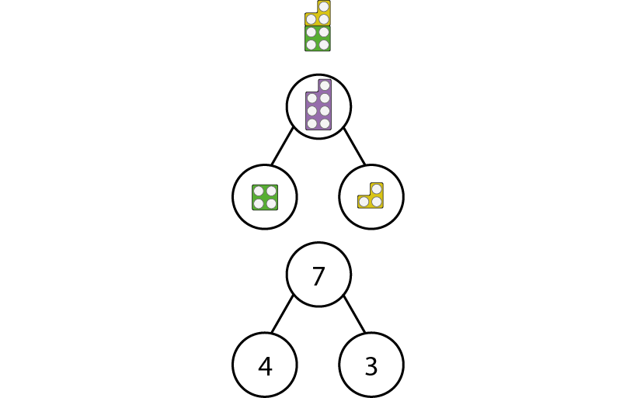
1.4 Composition: 6–10 – step 3:8

Slide 66
Year 1, Unit 5, Learning Outcome 8
Learning Outcome 8
Pupils partition numbers 6 to 10 in different ways
The following slides have been collated to support the teaching of this learning outcome.

Slide 67
Year 1, Unit 5, Learning Outcome 8
Additional teacher guidance for this outcome should be read first and can be found in this segment of the NCETM Primary Mastery Professional Development Materials:
1.4 Composition of numbers: 6 to 10
The spine materials are divided into ‘teaching points’ and ‘steps in learning’.
Teaching point | Steps in learning | Pages
4 | 4:1-4:2 | 19-20

Slide 68


1.4 Composition: 6–10 – step 4:2

Slide 69
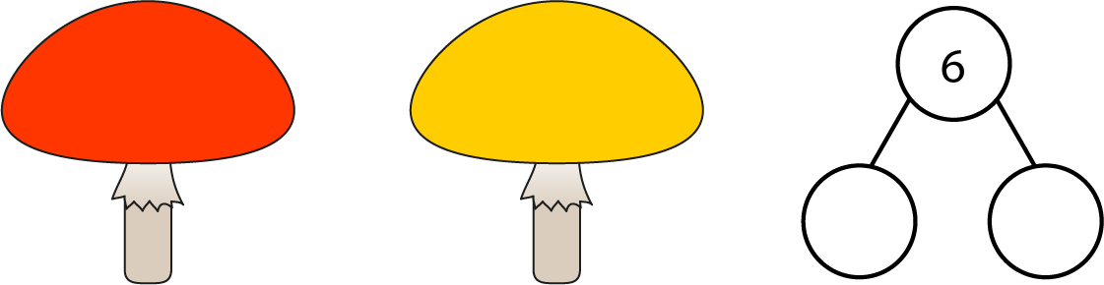
1.4 Composition: 6–10 – step 4:2

Slide 70
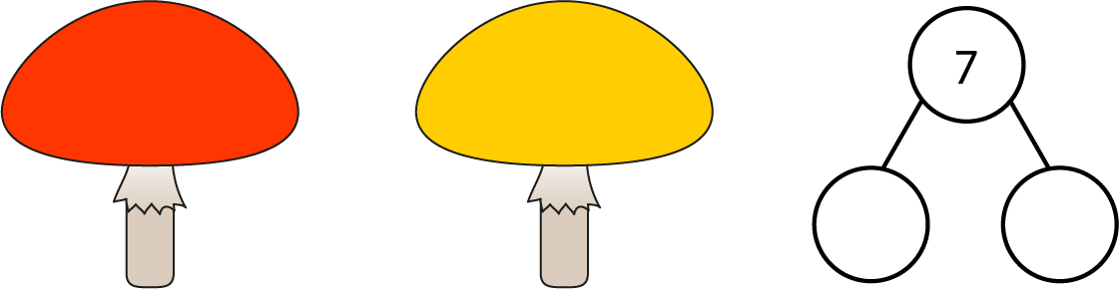
1.4 Composition: 6–10 – step 4:2

Slide 71

1.4 Composition: 6–10 – step 4:2

Slide 72

1.4 Composition: 6–10 – step 4:2

Slide 73
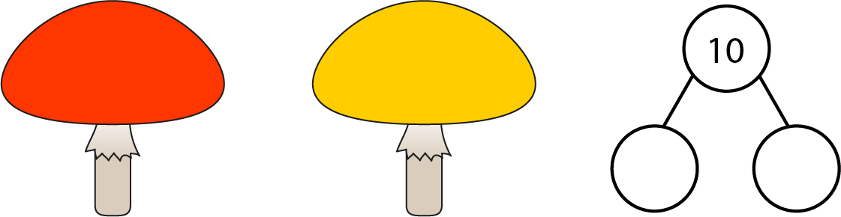
1.4 Composition: 6–10 – step 4:2

Slide 74
Year 1, Unit 5, Learning Outcome 9
Learning Outcome 9
Pupils partition the numbers 6 to 10 in a systematic way
The following slides have been collated to support the teaching of this learning outcome.

Slide 75
Year 1, Unit 5, Learning Outcome 9
Additional teacher guidance for this outcome should be read first and can be found in this segment of the NCETM Primary Mastery Professional Development Materials:
1.4 Composition of numbers: 6 to 10
The spine materials are divided into ‘teaching points’ and ‘steps in learning’.
Teaching point | Steps in learning | Pages
4 | 4:3 | 20

Slide 76


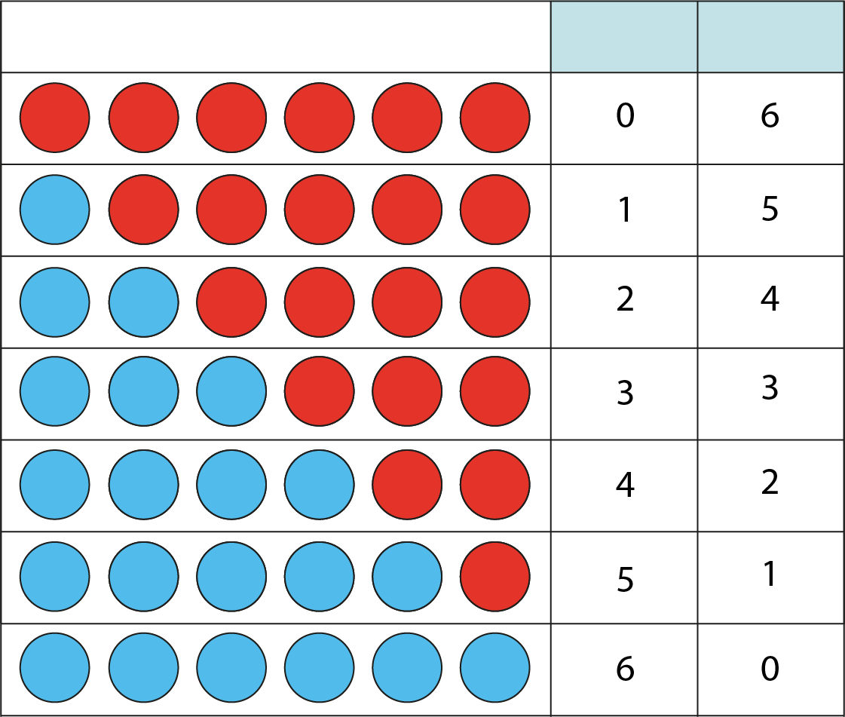

1.4 Composition: 6–10 – step 4:3
0
6
1
5
2
4
3
3
4
2
5
1
6
0

Slide 77
Year 1, Unit 5, Learning Outcome 10
Learning Outcome 10
Pupils identify a missing part when a whole is partitioned into two parts
The following slides have been collated to support the teaching of this learning outcome.

Slide 78
Year 1, Unit 5, Learning Outcome 10
Additional teacher guidance for this outcome should be read first and can be found in this segment of the NCETM Primary Mastery Professional Development Materials:
1.4 Composition of numbers: 6 to 10
The spine materials are divided into ‘teaching points’ and ‘steps in learning’.
Teaching point | Steps in learning | Pages
5 | 5:1-5:2 | 21-22

Slide 79



1.4 Composition: 6–10 – step 5:1

Slide 80
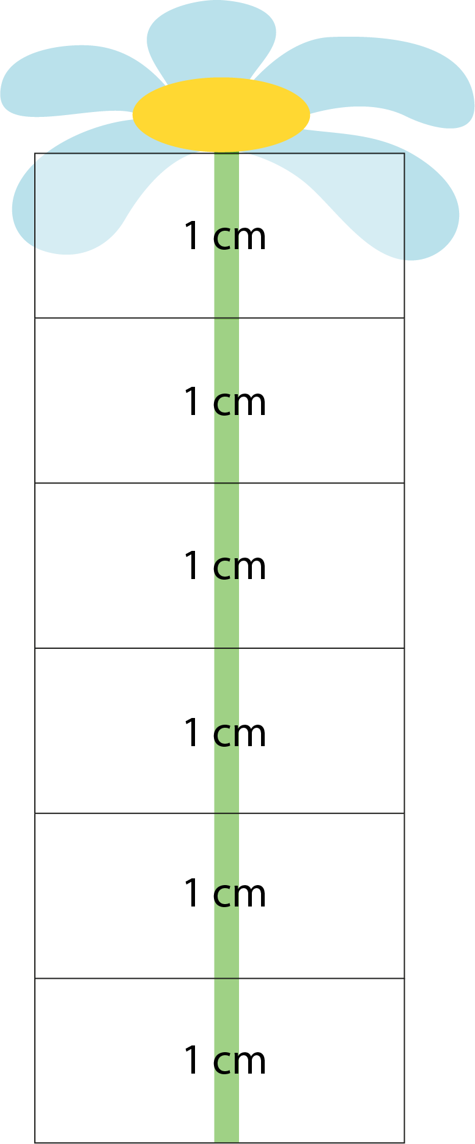

1.4 Composition: 6–10 – step 5:1
3 cm

