Slide 1
Year 6, Unit 6
Area, perimeter, position and direction

Slide 2
Year 6, Unit 6
These materials heavily reflect the prioritisation approach of the ready-to-progress criteria in the DfE Primary Mathematics Guidance 2020 and on the PPTs that exemplify them on the NCETM website. They also include other relevant National Curriculum content. Related sections of the NCETM Primary Mastery Professional Development Materials provide small-step teaching guidance.
There are no specific ready-to-progress criteria supported by this unit.

Slide 3
Contents
The links below take you to the starting slide of each learning outcome.
1 | Pupils explain how to calculate the area of a parallelogram
2 | Pupils explain how to calculate the area of a triangle
3 | Pupils explain why shapes can have the same perimeters but different areas
4 | Pupils explain why shapes can have the same areas but different perimeters
5 | Pupils describe the relationship between scale factors and side lengths of two shapes
Click the arrow button to return to this Contents slide.

Slide 4
Contents
The links below take you to the starting slide of each learning outcome.
6 | Pupils describe the relationship between scale factors and perimeters of two shapes
7 | Pupils describe positions on the full coordinate grid (all four quadrants)
8 | Pupils draw and translate simple shapes on the coordinate plane and reflect them in the axes
Click the arrow button to return to this Contents slide.

Slide 5
Year 6, Unit 6, Learning Outcome 1
Learning Outcome 1
Pupils explain how to calculate the area of a parallelogram
The following slides have been collated to support the teaching of this learning outcome.

Slide 6
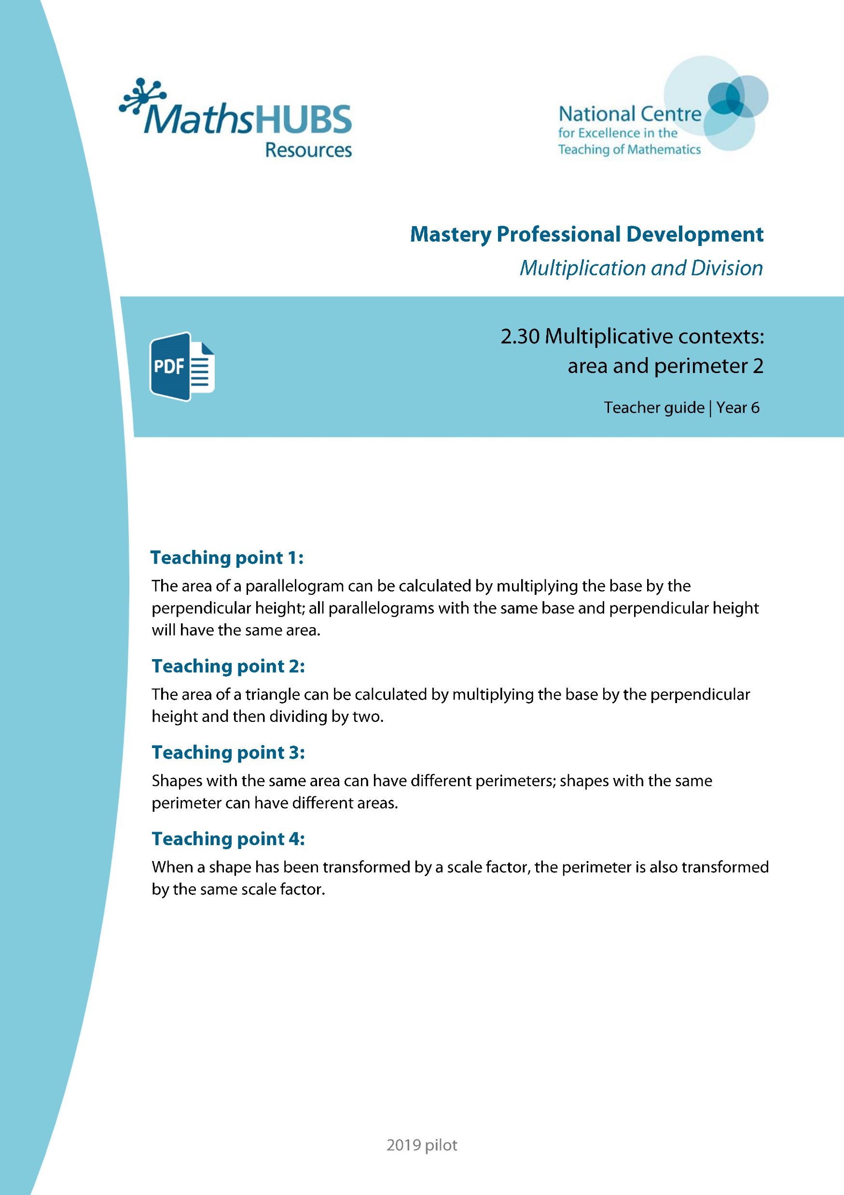
Year 6, Unit 6, Learning Outcome 1
Additional teacher guidance for this outcome should be read first and can be found in this segment of the NCETM Primary Mastery Professional Development Materials:
2.30 Multiplicative contexts: area and perimeter 2
The spine materials are divided into ‘teaching points’ and ‘steps in learning’.
Teaching point | Steps in learning | Pages
1 | 1:1-1:7 | 3-9

Slide 7
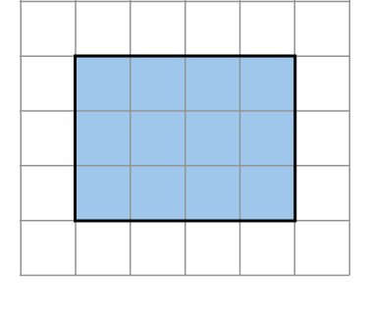
2.30 Area and perimeter 2
Step 1:1
Shape A
Notes:
The area is twelve square units.
You could count the squares.
You could multiply the length by the width.
3 × 4 = 12
You could multiply the width by the length.
4 × 3 = 12

Slide 8
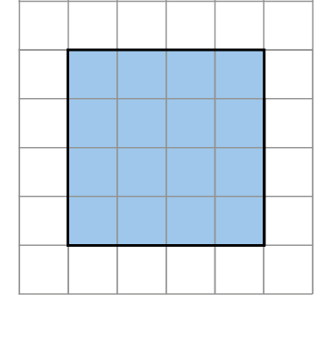
2.30 Area and perimeter 2
Step 1:1
Shape A
Shape B
Notes:
The area of shape B is sixteen square units.
This shape has a larger area than shape A.
You could count the squares.
You could multiply the length by the width.
4 × 4 = 12

Slide 9
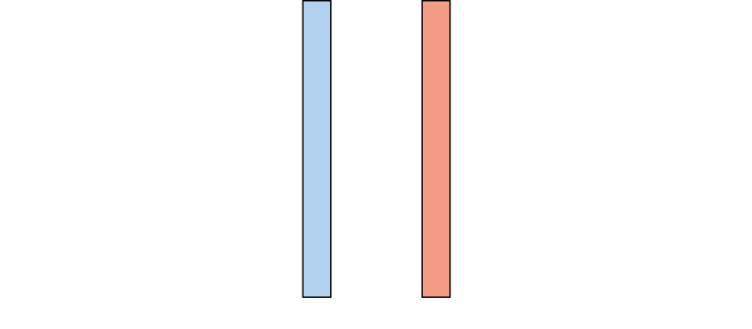
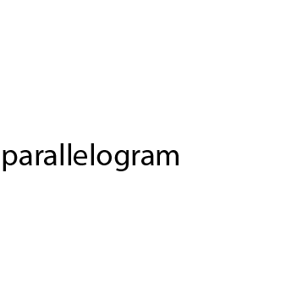
2.30 Area and perimeter 2
Step 1:2

Slide 10
2.30 Area and perimeter 2
Step 1:2

Slide 11

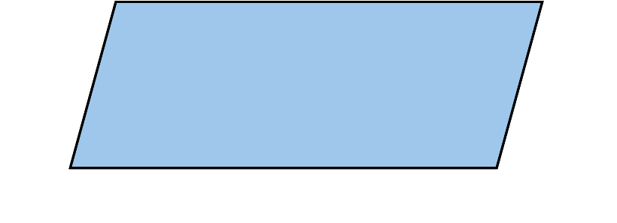
2.30 Area and perimeter 2
Step 1:2

Slide 12
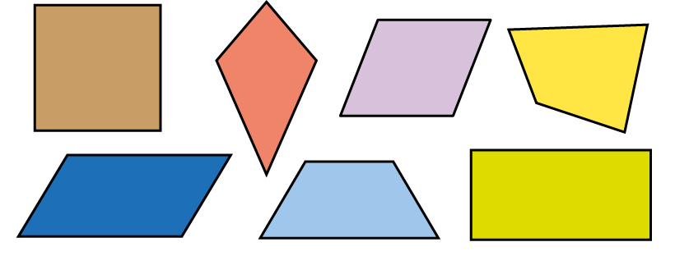
2.30 Area and perimeter 2
Step 1:2
Notes:
Which shapes are parallelograms?
How do you know?
A square is a parallelogram because it has opposite sides that are parallel and equal in length.

Slide 13
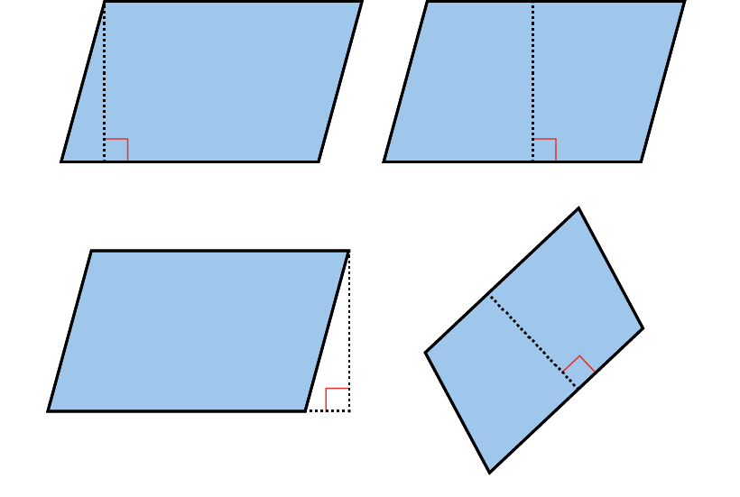
2.30 Area and perimeter 2
Step 1:3
The perpendicular height of parallelograms:

Slide 14
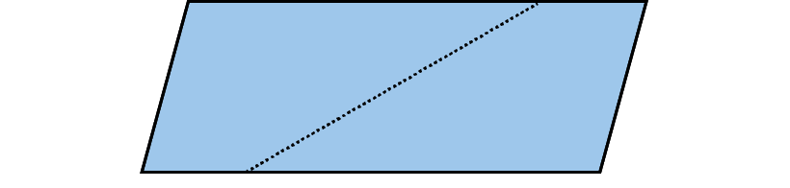
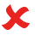
2.30 Area and perimeter 2
Step 1:3
Does this show the perpendicular height?

Slide 15
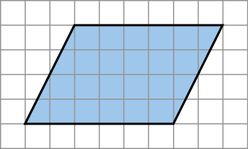
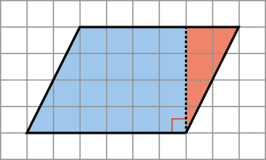
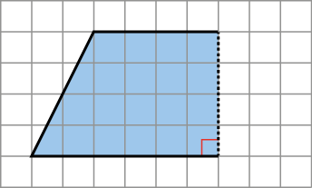

2.30 Area and perimeter 2
Step 1:4
Changing a parallelogram into a rectangle by cutting shapes:

Slide 16
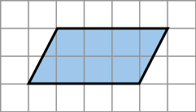
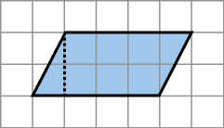
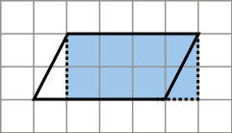
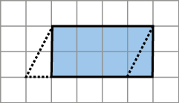
2.30 Area and perimeter 2
Step 1:4
Changing a parallelogram into a rectangle by drawing lines:

Slide 17
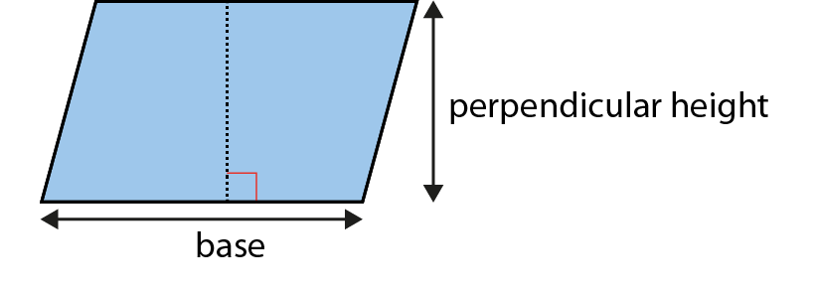
2.30 Area and perimeter 2
Step 1:5
Finding the area of a parallelogram:
Notes:
Multiply the base by the perpendicular height.

Slide 18
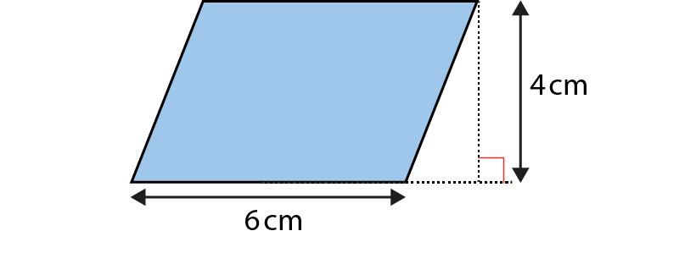
2.30 Area and perimeter 2
Step 1:5
Notes:
Find the area of this parallelogram.
The base is 6 cm.
The perpendicular height is 4 cm.
The area is 6 × 4 = 24 cm².

Slide 19
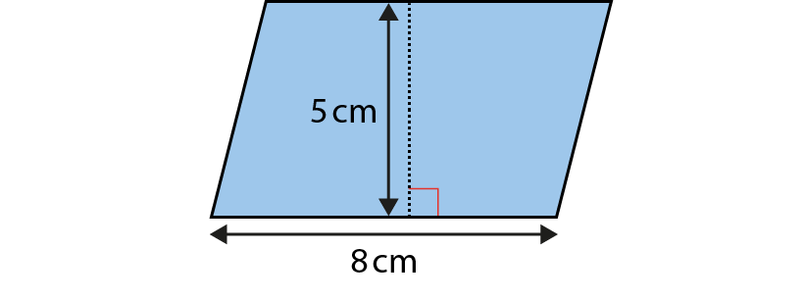
2.30 Area and perimeter 2
Step 1:5
Notes:
Find the area of this parallelogram.
The base is 8 cm.
The perpendicular height is 5 cm.
The area is 8 × 5 = 40 cm².

Slide 20
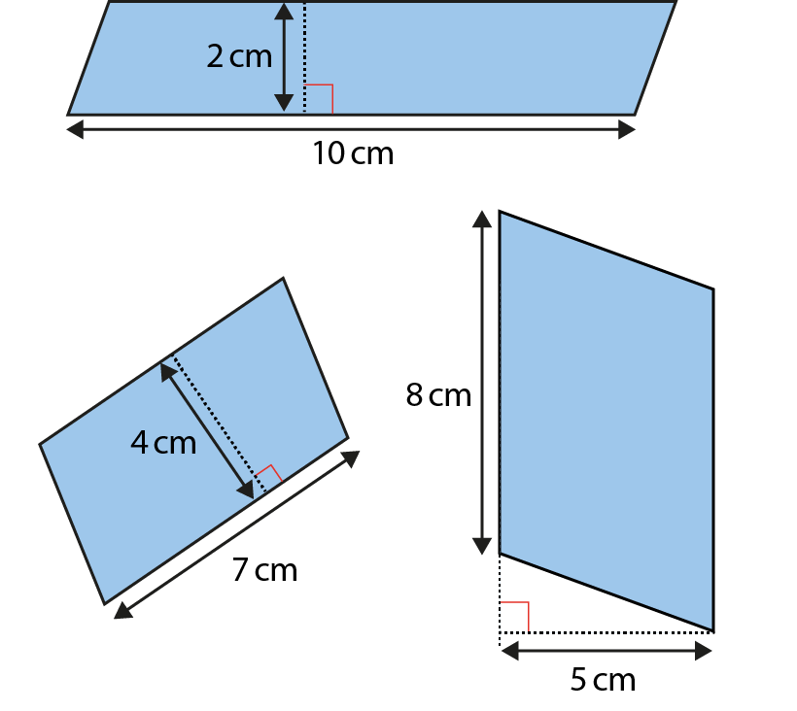
2.30 Area and perimeter 2
Step 1:6
Notes:
Find the area of these parallelograms.

Slide 21
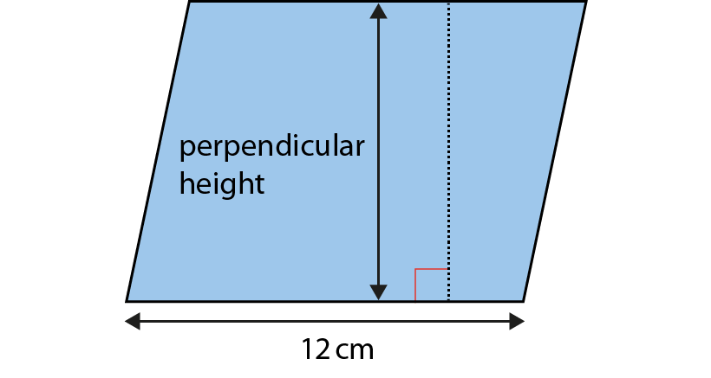
2.30 Area and perimeter 2
Step 1:7
A = 108 cm². What is the perpendicular height?
Notes:
area ÷ base = perpendicular height
108 ÷ 12 = 9
The perpendicular height is 9 cm.

Slide 22
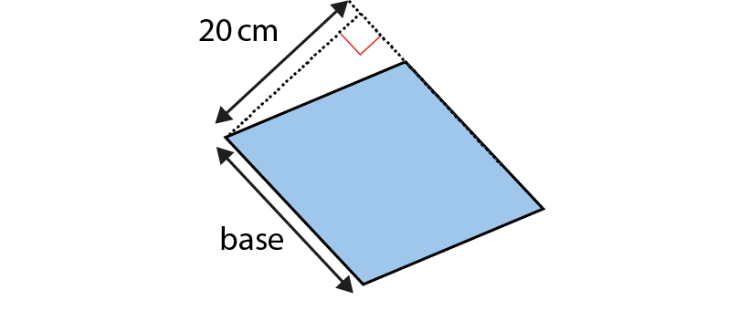
2.30 Area and perimeter 2
Step 1:7
A = 440 cm². What is the length of the base?
Notes:
area ÷ perpendicular height = base
440 ÷ 20 = 22
The base is 22 cm.

Slide 23
Year 6, Unit 6, Learning Outcome 2
Learning Outcome 2
Pupils explain how to calculate the area of a triangle
The following slides have been collated to support the teaching of this learning outcome.

Slide 24
Year 6, Unit 6, Learning Outcome 2
Additional teacher guidance for this outcome should be read first and can be found in this segment of the NCETM Primary Mastery Professional Development Materials:
2.30 Multiplicative contexts: area and perimeter 2
The spine materials are divided into ‘teaching points’ and ‘steps in learning’.
Teaching point | Steps in learning | Pages
2 | 2:1-2:9 | 10-19

Slide 25
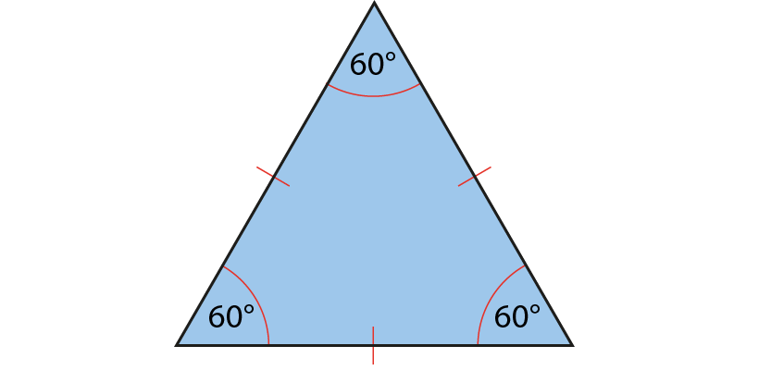
2.30 Area and perimeter 2
Step 2:1
Notes:
Equilateral triangles have three equal sides and three equal angles.

Slide 26
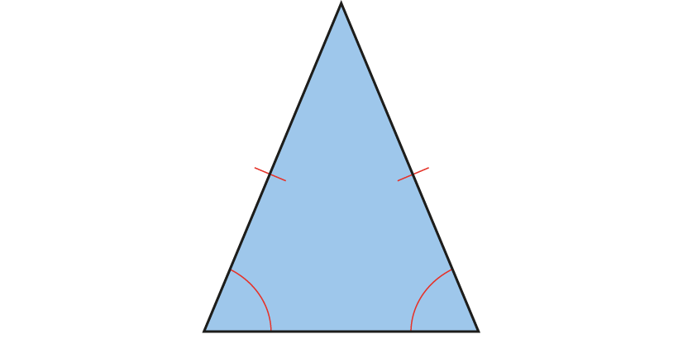
2.30 Area and perimeter 2
Step 2:1
Notes:
Isosceles triangles have two equal sides and two equal angles.

Slide 27
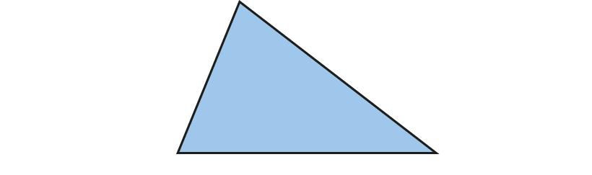
2.30 Area and perimeter 2
Step 2:1
Notes:
Scalene triangles have no equal sides and no equal angles.

Slide 28
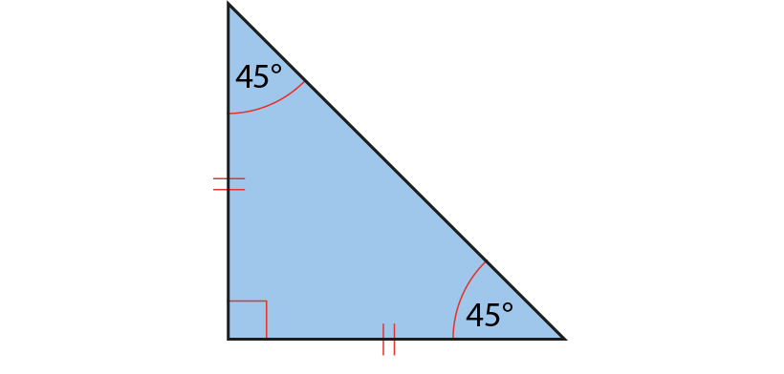
2.30 Area and perimeter 2
Step 2:1
Notes:
Right-angled isosceles triangles have two equal sides, two equal angles and a right angle.

Slide 29
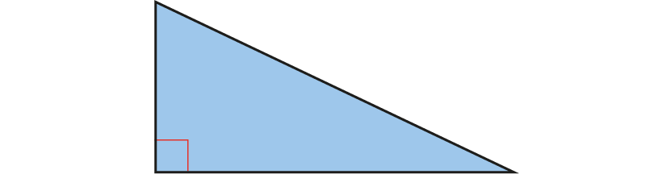
2.30 Area and perimeter 2
Step 2:1
Notes:
Right-angled scalene triangles have no equal sides, no equal angles and a right angle.

Slide 30
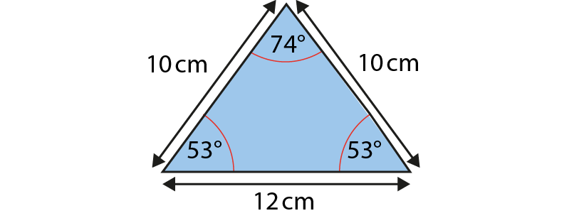
2.30 Area and perimeter 2
Step 2:1
Notes:
This is an isosceles triangle because it has two equal sides and two equal angles.

Slide 31
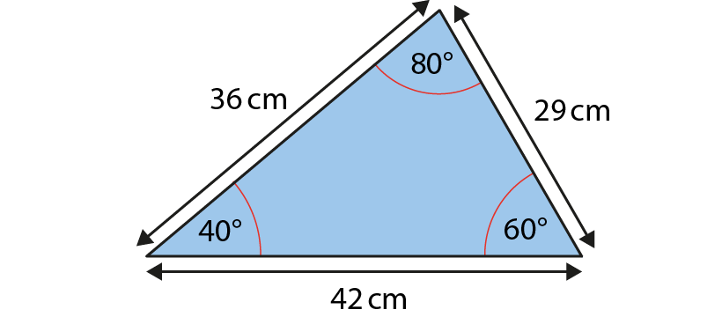
2.30 Area and perimeter 2
Step 2:1
Notes:
This is a scalene triangle because it has no equal sides and no equal angles.

Slide 32

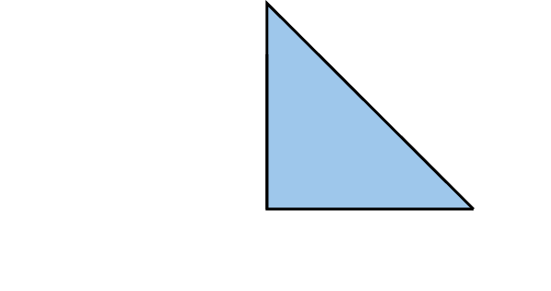
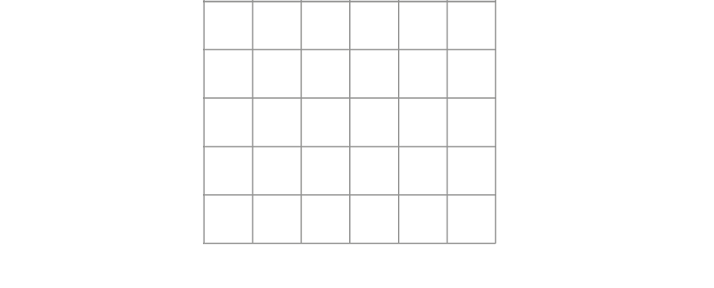
2.30 Area and perimeter 2
Step 2:2
Find the area of the triangle:
Notes:
The area is eight square units.

Slide 33
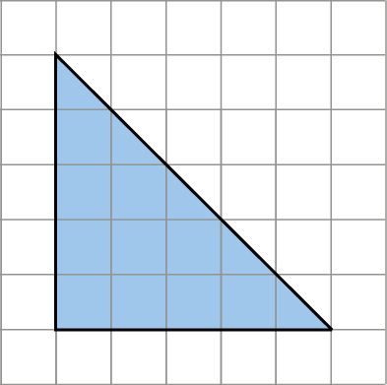
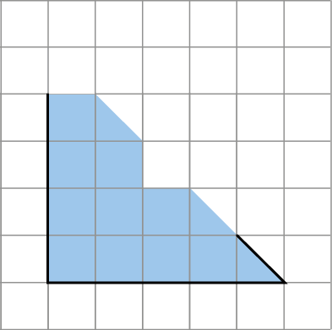
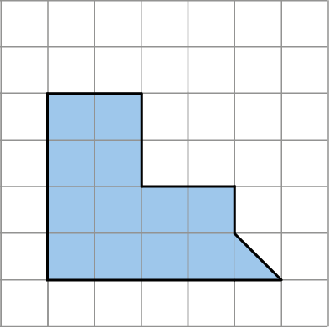

2.30 Area and perimeter 2
Step 2:2
Find the area of the triangle:
Notes:
The area is twelve and a half square units.

Slide 34
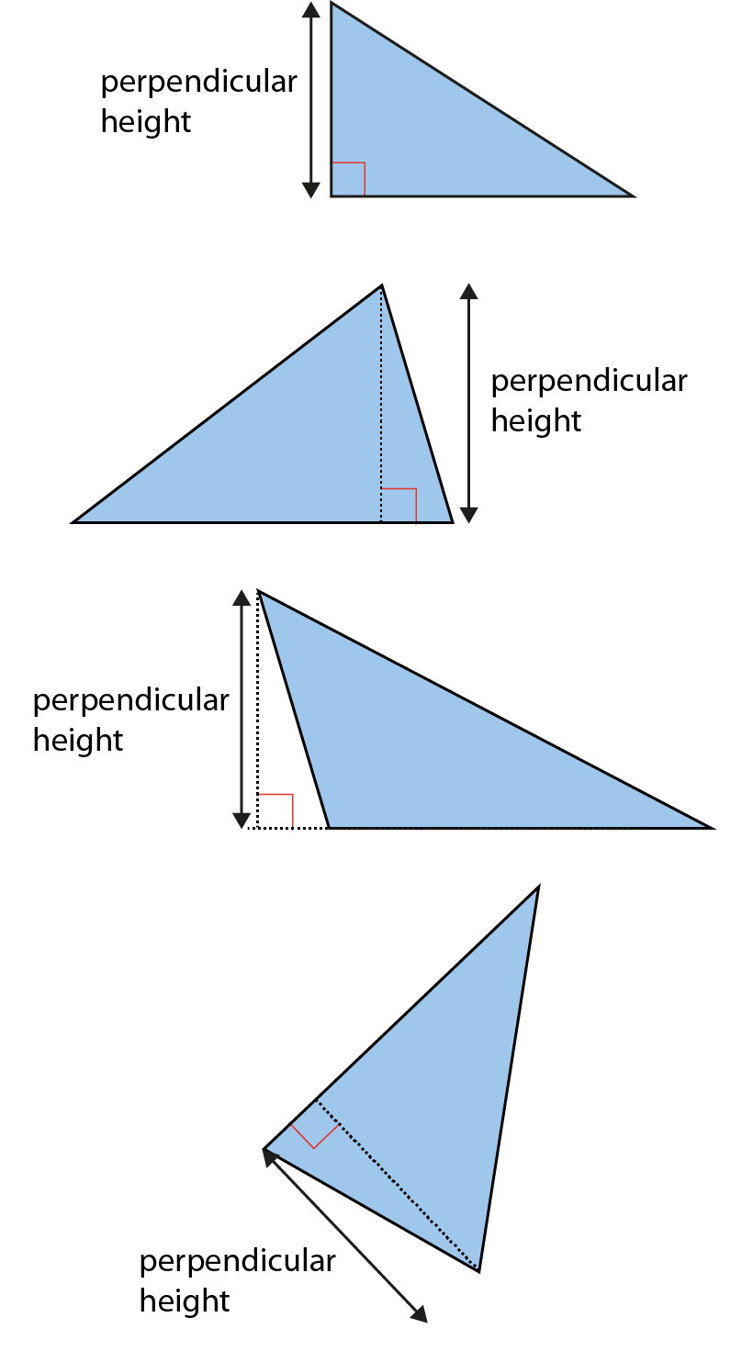
2.30 Area and perimeter 2
Step 2:2
The perpendicular height of triangles:

Slide 35
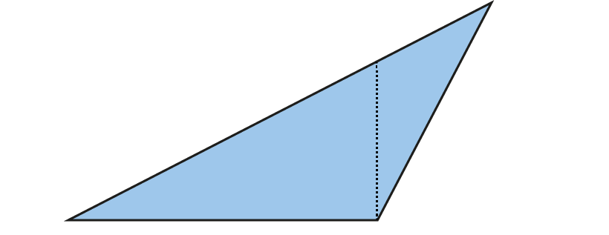
2.30 Area and perimeter 2
Step 2:3
Does this show the perpendicular height?

Slide 36
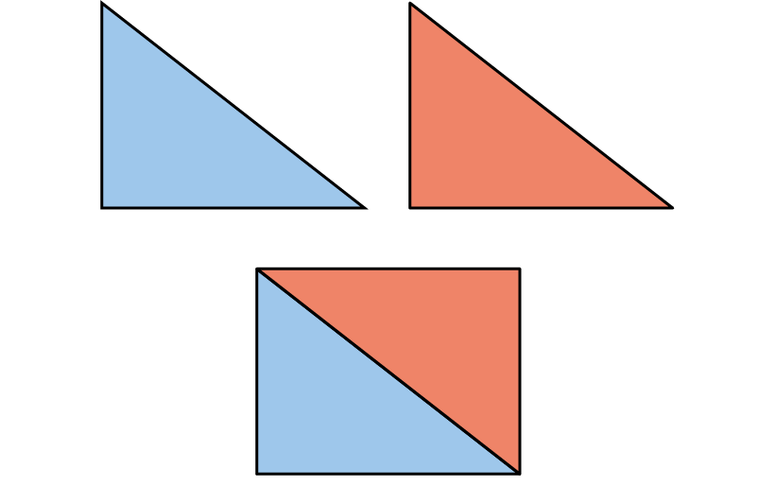
2.30 Area and perimeter 2
Step 2:4
Combining two triangles to make a rectangle:

Slide 37
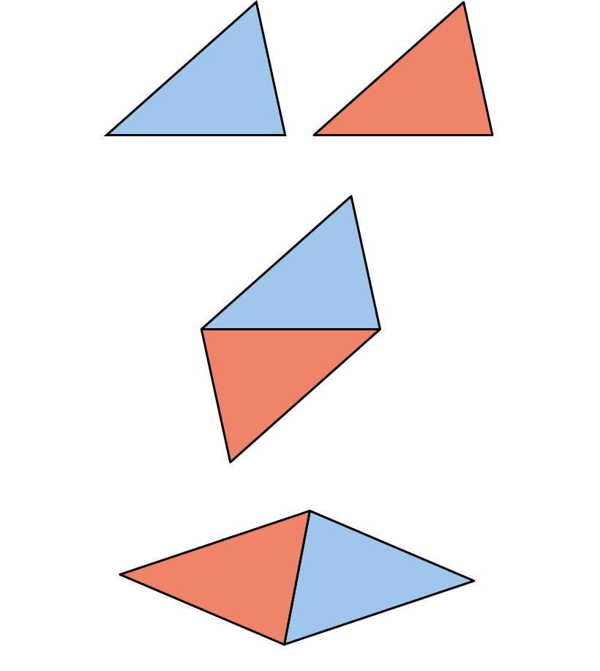
2.30 Area and perimeter 2
Step 2:5
Combining two triangles to make a parallelogram:

Slide 38
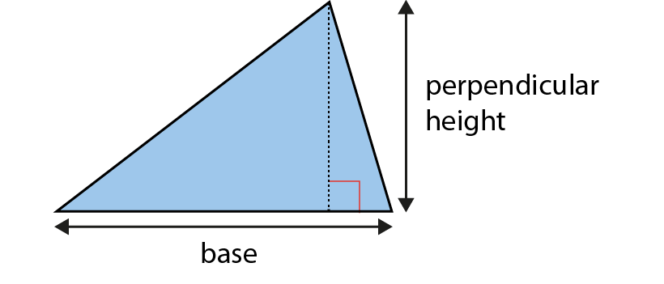
2.30 Area and perimeter 2
Step 2:6
Finding the area of a triangle:
Notes:
area = base × perpendicular height ÷ 2

Slide 39
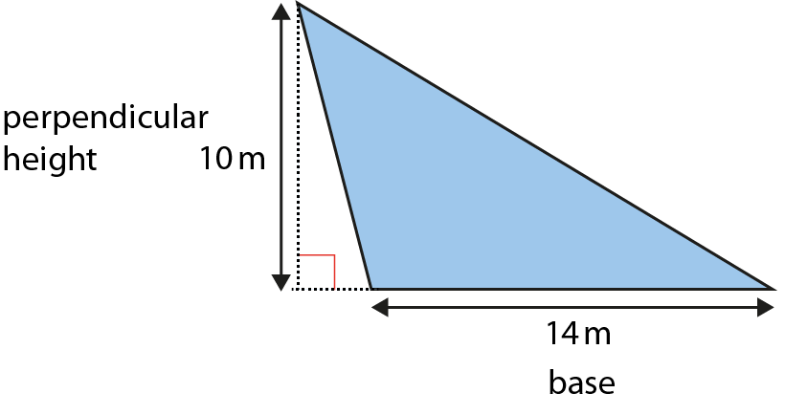
2.30 Area and perimeter 2
Step 2:6
Notes:
Find the area of this triangle.
The base is 14 m.
The perpendicular height is 10 m.
The area is 14 × 10 ÷ 2 = 140 ÷ 2 = 70 m².

Slide 40
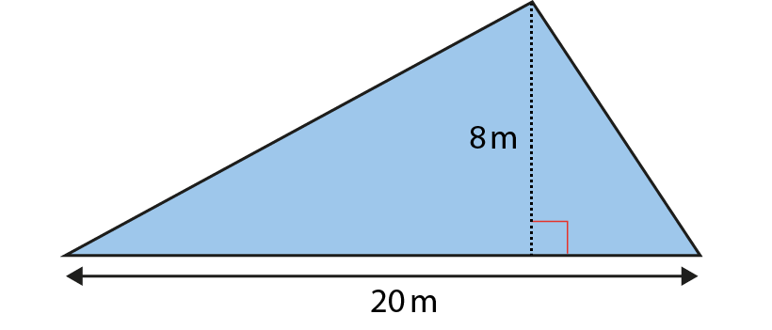
2.30 Area and perimeter 2
Step 2:6
Notes:
Find the area of this triangle.
The base is 20 m.
The perpendicular height is 8 m.
The area is 20 × 8 ÷ 2 = 160 ÷ 2 = 80 m².

Slide 41
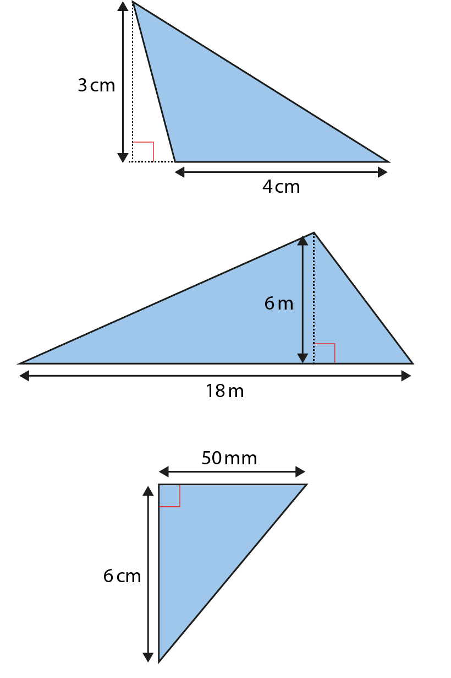
2.30 Area and perimeter 2
Step 2:7
Notes:
Find the area of these triangles.

Slide 42
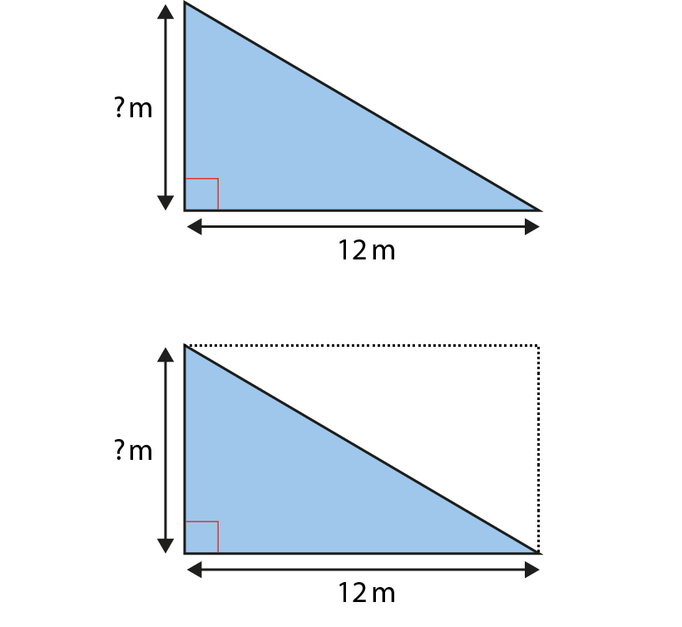
2.30 Area and perimeter 2
Step 2:8
A = 42 m². What is the perpendicular height?
Notes:
42 m² × 2 = 84 m²
84 ÷ 12 = 7
The perpendicular height of the triangle is 7 m.

Slide 43
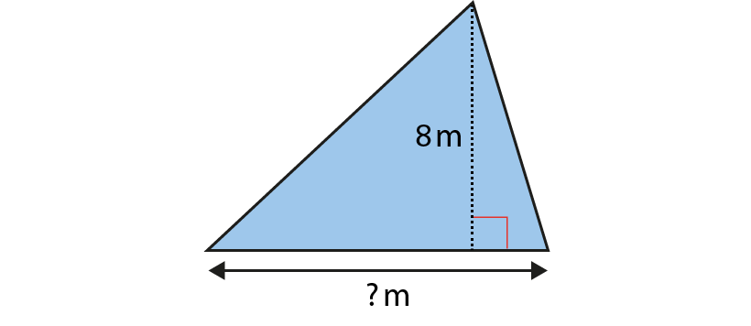
2.30 Area and perimeter 2
Step 2:8
A = 44 m². How long is the base?
Notes:
44 m² × 2 = 88 m²
88 ÷ 8 = 11
The base of the triangle is 11 m.

Slide 44
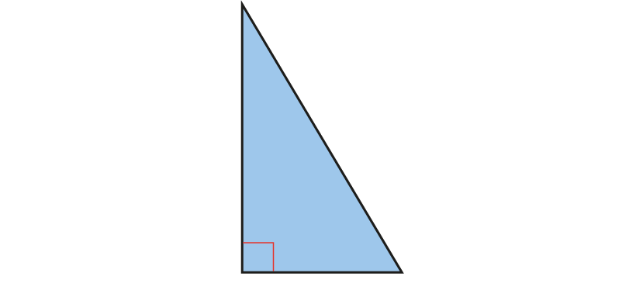
2.30 Area and perimeter 2
Step 2:8
A = 54 cm². What could the base and height be?

Slide 45
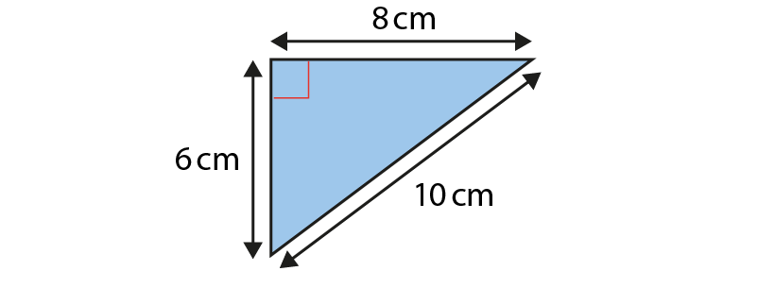
2.30 Area and perimeter 2
Step 2:9
Notes:
Sonnie says the area of this triangle is 40 cm².
Brittany says the area of the triangle is 30 cm².
Tom says the area of the triangle is 24 cm².
Who is right? Explain your answer.

Slide 46
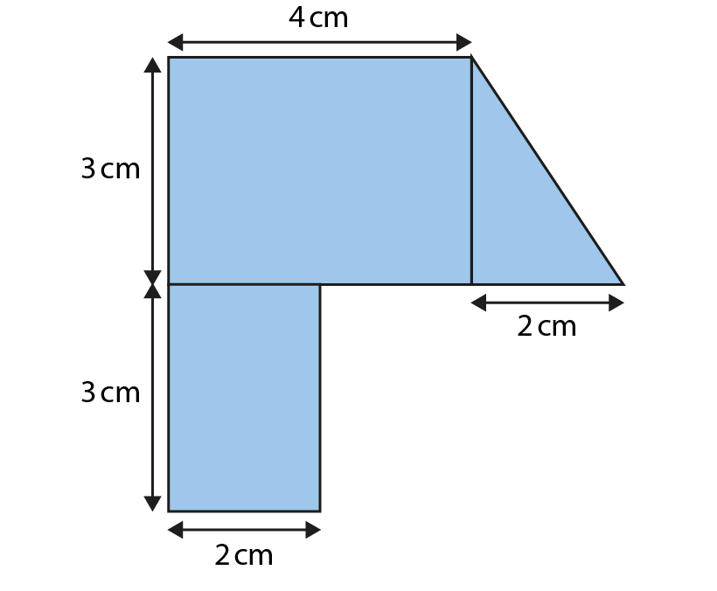
2.30 Area and perimeter 2
Step 2:9
Notes:
What is the total area of this shape?

Slide 47
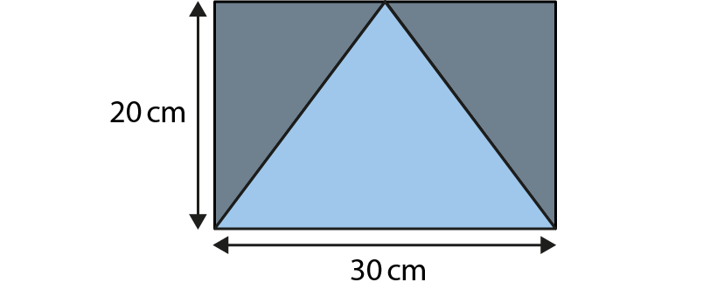
2.30 Area and perimeter 2
Step 2:9
Notes:
What is the total area of the shaded sections?

Slide 48
Year 6, Unit 6, Learning Outcome 3
Learning Outcome 3
Pupils explain why shapes can have the same perimeters but different areas
The following slides have been collated to support the teaching of this learning outcome.

Slide 49
Year 6, Unit 6, Learning Outcome 3
Additional teacher guidance for this outcome should be read first and can be found in this segment of the NCETM Primary Mastery Professional Development Materials:
2.30 Multiplicative contexts: area and perimeter 2
The spine materials are divided into ‘teaching points’ and ‘steps in learning’.
Teaching point | Steps in learning | Pages
3 | 3:1-3:3 | 20-22

Slide 50
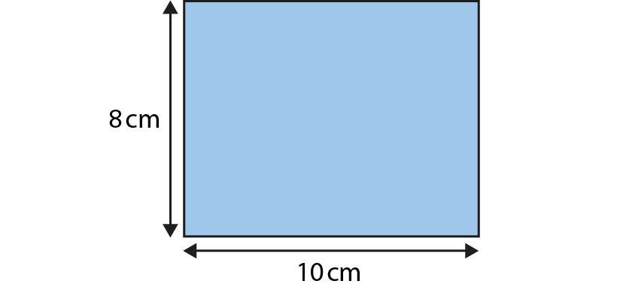
2.30 Area and perimeter 2
Step 3:1
Comparing perimeter and area:
Notes:
The distance around the edge of the rectangle is its perimeter.
P = (10 × 2) + (8 × 2) = 20 + 16 = 36 cm
A = 10 × 8 = 80 cm²

Slide 51

2.30 Area and perimeter 2
Step 3:1
Comparing perimeter and area:
Notes:
The distance around the edge of the triangle is its perimeter.
P = 3 + 4 + 5 = 12 cm
A = 4 × 3 ÷ 2 = 6 cm²

Slide 52

2.30 Area and perimeter 2
Step 3:1
Comparing perimeter and area:
Notes:
The distance around the edge of the parallelogram is its perimeter.
P = (7 × 2) + (8 × 2) = 14 + 16 = 30 cm
A = 8 × 4 = 32 cm²

Slide 53

2.30 Area and perimeter 2
Step 3:1
Notes:
Find the area and perimeter of this shape.

Slide 54

2.30 Area and perimeter 2
Step 3:1
Notes:
Find the area and perimeter of this shape.

Slide 55

2.30 Area and perimeter 2
Step 3:2
Same perimeter, different area:
Notes:
P = 12 units
A = 5 units²

Slide 56

2.30 Area and perimeter 2
Step 3:2
Same perimeter, different area:
Notes:
P = 12 units
A = 8 units²

Slide 57

2.30 Area and perimeter 2
Step 3:2
Same perimeter, different area:
Notes:
P = 12 units
A = 9 units²

Slide 58

2.30 Area and perimeter 2
Step 3:2
Same perimeter, different area:
Notes:
P = 12 units
A = 5 units²

Slide 59
Year 6, Unit 6, Learning Outcome 4
Learning Outcome 4
Pupils explain why shapes can have the same areas but different perimeters
The following slides have been collated to support the teaching of this learning outcome.

Slide 60
Year 6, Unit 6, Learning Outcome 4
Additional teacher guidance for this outcome should be read first and can be found in this segment of the NCETM Primary Mastery Professional Development Materials:
2.30 Multiplicative contexts: area and perimeter 2
The spine materials are divided into ‘teaching points’ and ‘steps in learning’.
Teaching point | Steps in learning | Pages
3 | 3:4-3:5 | 23-24

Slide 61

2.30 Area and perimeter 2
Step 3:4
Same area, different perimeter:
Notes:
P = 34 units
A = 16 units²

Slide 62

2.30 Area and perimeter 2
Step 3:4
Same area, different perimeter:
Notes:
P = 20 units
A = 16 units²

Slide 63

2.30 Area and perimeter 2
Step 3:4
Same area, different perimeter:
Notes:
P = 16 units
A = 16 units²

Slide 64

2.30 Area and perimeter 2
Step 3:4
Same area, different perimeter:
Notes:
P = 26 units
A = 16 units²

Slide 65

2.30 Area and perimeter 2
Step 4:1
Applying a scale factor:
Example 1
Notes:
To change shape A into shape B, scale the side-lengths by a scale factor of two.

Slide 66
Year 6, Unit 6, Learning Outcome 5
Learning Outcome 5
Pupils describe the relationship between scale factors and side lengths of two shapes
The following slides have been collated to support the teaching of this learning outcome.

Slide 67
Year 6, Unit 6, Learning Outcome 5
Additional teacher guidance for this outcome should be read first and can be found in this segment of the NCETM Primary Mastery Professional Development Materials:
2.30 Multiplicative contexts: area and perimeter 2
The spine materials are divided into ‘teaching points’ and ‘steps in learning’.
Teaching point | Steps in learning | Pages
4 | 4:1-4:2 | 25-26

Slide 68

2.30 Area and perimeter 2
Step 4:1
Applying a scale factor:
Example 2
Notes:
To change shape C into shape D, scale the side-lengths by a scale factor of one quarter.

Slide 69

2.30 Area and perimeter 2
Step 4:2
Notes:
Enlarge this shape by scaling the side-lengths by a scale factor of three.

Slide 70

2.30 Area and perimeter 2
Step 4:2
Notes:
What scale factor has been used to change shape A into shape B?

Slide 71

2.30 Area and perimeter 2
Step 4:2
Notes:
The side-lengths of shape C have been scaled to make shape D.
What is the unknown measurement?

Slide 72
Year 6, Unit 6, Learning Outcome 6
Learning Outcome 6
Pupils describe the relationship between scale factors and perimeters of two shapes
The following slides have been collated to support the teaching of this learning outcome.

Slide 73
Year 6, Unit 6, Learning Outcome 6
Additional teacher guidance for this outcome should be read first and can be found in this segment of the NCETM Primary Mastery Professional Development Materials:
2.30 Multiplicative contexts: area and perimeter 2
The spine materials are divided into ‘teaching points’ and ‘steps in learning’.
Teaching point | Steps in learning | Pages
4 | 4:3-4:5 | 27-29

Slide 74
2.30 Area and perimeter 2
Step 4:3
Applying scale factors to perimeter:
Example 1
Notes:
P = 10 + 10+ 15 + 15 = 50 cm
P = 20 + 20+ 30 + 30 = 100 cm
50 × 2 = 100
The perimeter has changed by a scale factor of two.

Slide 75
2.30 Area and perimeter 2
Step 4:3
Applying scale factors to perimeter:
Example 2
Notes:
P = 40 + 40+ 60 + 60 = 200 cm
P = 10 + 10 + 15 + 15 = 50 cm
200 ÷ 4 = 50
The perimeter has changed by a scale factor of one quarter; it has been divided by four.

Slide 76
2.30 Area and perimeter 2
Step 4:3
Using scale factor to calculate perimeter:
Notes:
If the side-lengths of this shape are scaled by a scale factor of three, what will the perimeter of the new shape be?

Slide 77

2.30 Area and perimeter 2
Step 4:3
Using scale factor to calculate perimeter:
Notes:
If the side-lengths of this shape are scaled by a scale factor of four, what will the perimeter of the new shape be?

Slide 78

2.30 Area and perimeter 2
Step 4:3
Using scale factor to calculate perimeter:
Notes:
If the side-lengths of this shape are scaled by a scale factor of one-half, what will the perimeter of the new shape be?’

Slide 79

2.30 Area and perimeter 2
Step 4:4
Applying scale factors to area:
Example 1
Notes:
scale factor = 2
A = 10 cm × 15 cm = 150 cm²
A = 20 cm × 30 cm = 600 cm²
150 × 4 = 600

Slide 80
2.30 Area and perimeter 2
Step 4:4
Applying scale factors to area:
Example 1
Notes:
scale factor = 2
A = 10 cm × 15 cm = 150 cm²
A = 20 cm × 30 cm = 600 cm²
150 × 4 = 600

Slide 81


2.30 Area and perimeter 2
Step 4:5
Complete the table.
4
Notes:
Hint: use the perimeter to work out all three side-lengths of triangle A.

Slide 82
Year 6, Unit 6, Learning Outcome 7
Learning Outcome 7
Pupils describe positions on the full coordinate grid (all four quadrants)
The following slide supports the teaching of this outcome.

Slide 83

Year 6, Unit 6, Learning Outcome 7
For support with lesson and task design, refer to:
the NCETM National Curriculum Resource Tool
additional planning resources or high-quality textbooks used by your school.

Slide 84
Year 6, Unit 6, Learning Outcome 8
Learning Outcome 8
Pupils draw and translate simple shapes on the coordinate plane and reflect them in the axes
The following slide supports the teaching of this outcome.

Slide 85
Year 6, Unit 6, Learning Outcome 8
For support with lesson and task design, refer to:
the NCETM National Curriculum Resource Tool
additional planning resources or high-quality textbooks used by your school.

