Slide 1
Year 6, Unit 3
Numbers up to 10,000,000

Slide 2
Year 6, Unit 3
These materials heavily reflect the prioritisation approach of the ready-to-progress criteria in the DfE Primary Mathematics Guidance 2020 and on the PPTs that exemplify them on the NCETM website. They also include other relevant National Curriculum content. Related sections of the NCETM Primary Mastery Professional Development Materials provide small-step teaching guidance.
Ready-to-progress criteria addressed by this unit
Teaching of this unit supports the following criteria from the ‘DfE Mathematics Guidance: key stages 1 & 2’ (the 335-page document available as a download)
6NPV-1 Page 282
6NPV-2 Page 286
6NPV-3 Page 289
6NPV-4 Page 294
Prior learning
If the following ready-to-progress criteria, contained in the same DfE guidance document as above, were secured in Year 5, children will be ready to start on this unit.
5NPV-1 Page 212
5NPV-2 Page 216
5NPV-3 Page 219
5NPV-4 Page 225

Slide 3
Contents
The links below take you to the starting slide of each learning outcome.
1 | Pupils use representations to identify and explain patterns in powers of 10
2 | Pupils compose seven or eight-digit numbers using common intervals
3 | Pupils use their knowledge of the composition of up to eight-digit numbers to solve problems
4 | Pupils explain how to read numbers with up to seven digits efficiently
5 | Pupils recognise and create numbers that contain place-holding zeros
6 | Pupils determine the value of digits in numbers up to tens of millions
7 | Pupils explain how to compare up to eight-digit numbers
8 | Pupils use their knowledge of the composition of seven-digit numbers to solve problems
9 | Pupils add and subtract mentally without bridging a boundary (only one and more than one digit changes)
Click the arrow button to return to this Contents slide.

Slide 4
Contents
The links below take you to the starting slide of each learning outcome.
10 | Pupils add numbers whilst crossing the millions boundary
11 | Pupils subtract numbers whilst crossing the millions boundary (multiples of 100,000 and different powers of 10)
12 | Pupils explain how a seven-digit number can be composed and decomposed into parts
13 | Pupils identify and explain a pattern in a counting sequence
14 | Pupils identify numbers with up to seven digits on marked number lines
15 | Pupils estimate the value and position of numbers on unmarked or partially marked number lines
16 | Pupils explain why we round and how to round seven-digit numbers to the nearest million
Click the arrow button to return to this Contents slide.

Slide 5
Contents
The links below take you to the starting slide of each learning outcome.
17 | Pupils explain how to round seven-digit numbers to the nearest hundred thousand
18 | Pupils explain how to round up to seven-digit numbers to any power of 10 in context
19 | Pupils identify and explain the most efficient way to solve a calculation
20 | Pupils add and subtract numbers with up to seven digits using column addition and subtraction
21 | Pupils explore and explain different written and mental strategies to solving addition and subtraction problems
22 | Pupils solve addition and subtraction problems and explain whether a mental or written strategy would be most efficient
Click the arrow button to return to this Contents slide.

Slide 6
Year 6, Unit 3, Learning Outcome 1
Learning Outcome 1
Pupils use representations to identify and explain patterns in powers of 10
The following slides have been collated to support the teaching of this learning outcome.

Slide 7
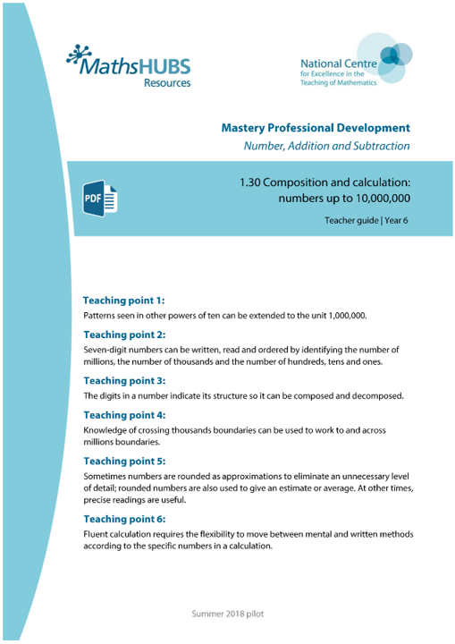
Year 6, Unit 3, Learning Outcome 1
Additional teacher guidance for this outcome should be read first and can be found in this segment of the NCETM Primary Mastery Professional Development Materials:
1.30 Numbers up to 10,000,000
The spine materials are divided into ‘teaching points’ and ‘steps in learning’.
Teaching point | Steps in learning | Pages
1 | 1:1 - 1:3 | 3-6

Slide 8
1.30 Numbers up to 10,000,000 – step 1:1
Millions |  |  | Thousands |  |  | Ones
100s | 10s | 1s | 100s | 10s | 1s | 100s | 10s | 1s
 |  | 1 | 0 | 0 | 0 | 0 | 0 | 0

Slide 9
1.30 Numbers up to 10,000,000 – step 1:1
999
,000
(999 thousands)
1,000
,000
(1,000 thousands)

Slide 10
1.30 Numbers up to 10,000,000 – step 1:1
0
1,000,000
1,000,000
1 million
2,000,000
2,000,000
2 million
3,000,000
3,000,000
3 million
4,000,000
4,000,000
4 million
5,000,000
5,000,000
5 million
6,000,000
6,000,000
6 million
7,000,000
7,000,000
7 million
8,000,000
8,000,000
8 million
9,000,000
9,000,000
9 million
10,000,000
10,000,000
10 million

Slide 11
1.30 Numbers up to 10,000,000 – step 1:2
Millions |  |  | Thousands |  |  | Ones |  |  | -ths
100s | 10s | 1s | 100s | 10s | 1s | 100s | 10s | 1s
 |  |  |  |  |  |  |  | 0 | 0 | 1
 |  |  |  |  |  |  |  | 0 | 1
 |  |  |  |  |  |  |  | 1
 |  |  |  |  |  |  | 1 | 0
 |  |  |  |  |  | 1 | 0 | 0
 |  |  |  |  | 1 | 0 | 0 | 0
 |  |  |  | 1 | 0 | 0 | 0 | 0
 |  |  | 1 | 0 | 0 | 0 | 0 | 0
 |  | 1 | 0 | 0 | 0 | 0 | 0 | 0
 | 1 | 0 | 0 | 0 | 0 | 0 | 0 | 0
1
1
.
10
100
.

Slide 12
1.30 Numbers up to 10,000,000 – step 1:2
 |  |  |  |  |  |  |  |  | 0 | . | 0 | 1 |  | one hundredth
 |  |  |  |  |  |  |  |  | 0 | . | 1 |  |  | one tenth
 |  |  |  |  |  |  |  |  | 1 |  |  |  |  | one
 |  |  |  |  |  |  |  | 1 | 0 |  |  |  |  | ten
 |  |  |  |  |  |  | 1 | 0 | 0 |  |  |  |  | one hundred
 |  |  |  |  | 1 | , | 0 | 0 | 0 |  |  |  |  | one thousand
 |  |  |  | 1 | 0 | , | 0 | 0 | 0 |  |  |  |  | ten thousand
 |  |  | 1 | 0 | 0 | , | 0 | 0 | 0 |  |  |  |  | one hundred thousand
 | 1 | , | 0 | 0 | 0 | , | 0 | 0 | 0 |  |  |  |  | one million
1 | 0 | , | 0 | 0 | 0 | , | 0 | 0 | 0 |  |  |  |  | ten million

Slide 13
1.30 Numbers up to 10,000,000 – step 1:3
10,000,000.00 | 20,000,000.00 | 30,000,000.00 | 40,000,000.00 | 50,000,000.00 | 60,000,000.00 | 70,000,000.00 | 80,000,000.00 | 90,000,000.00
1,000,000.00 | 2,000,000.00 | 3,000,000.00 | 4,000,000.00 | 5,000,000.00 | 6,000,000.00 | 7,000,000.00 | 8,000,000.00 | 9,000,000.00
100,000.00 | 200,000.00 | 300,000.00 | 400,000.00 | 500,000.00 | 600,000.00 | 700,000.00 | 800,000.00 | 900,000.00
10,000.00 | 20,000.00 | 30,000.00 | 40,000.00 | 50,000.00 | 60,000.00 | 70,000.00 | 80,000.00 | 90,000.00
1,000.00 | 2,000.00 | 3,000.00 | 4,000.00 | 5,000.00 | 6,000.00 | 7,000.00 | 8,000.00 | 9,000.00
100.00 | 200.00 | 300.00 | 400.00 | 500.00 | 600.00 | 700.00 | 800.00 | 900.00
10.00 | 20.00 | 30.00 | 40.00 | 50.00 | 60.00 | 70.00 | 80.00 | 90.00
1.00 | 2.00 | 3.00 | 4.00 | 5.00 | 6.00 | 70.00 | 8.00 | 9.00
0.10 | 0.20 | 0.30 | 0.40 | 0.50 | 0.60 | 0.70 | 0.80 | 0.90
0.01 | 0.02 | 0.03 | 0.04 | 0.05 | 0.06 | 0.07 | 0.08 | 0.09

Slide 14
6NPV-1 Powers of 10
Millions |  |  | Thousands |  |  | Ones |  |  | -ths
100s | 10s | 1s | 100s | 10s | 1s | 100s | 10s | 1s
 |  |  |  |  |  |  |  | 0 | 0 | 1
 |  |  |  |  |  |  |  | 0 | 1
 |  |  |  |  |  |  |  | 1
 |  |  |  |  |  |  | 1 | 0
 |  |  |  |  |  | 1 | 0 | 0
 |  |  |  |  | 1 | 0 | 0 | 0
 |  |  |  | 1 | 0 | 0 | 0 | 0
 |  |  | 1 | 0 | 0 | 0 | 0 | 0
 |  | 1 | 0 | 0 | 0 | 0 | 0 | 0
 | 1 | 0 | 0 | 0 | 0 | 0 | 0 | 0
The 1 becomes 10 times the size as it moves one place to the left. 1,000 is ten times the size of 100.
.
.
What is the value of the 1 in each column?
How does the value of the 1 increase as it moves one place to the left ?

Slide 15
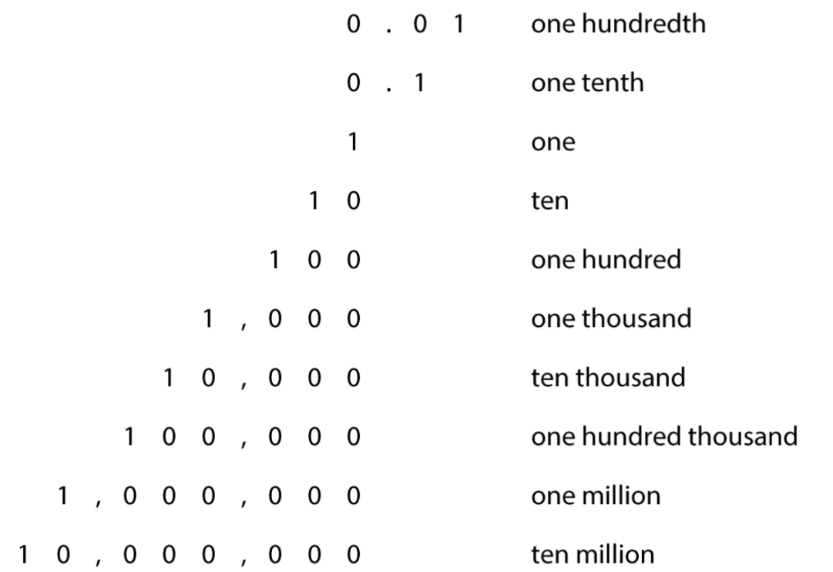
6NPV-1 Powers of 10
Read each row from top to bottom and then repeat in reverse order.
What do you notice about each row of the table?
What happens to the value of the digit one as you move down each row?
What happens to the value of the digit one as you move up each row?
How are the commas used to separate the digits in the larger numbers? How does this help our place value understanding?

Slide 16
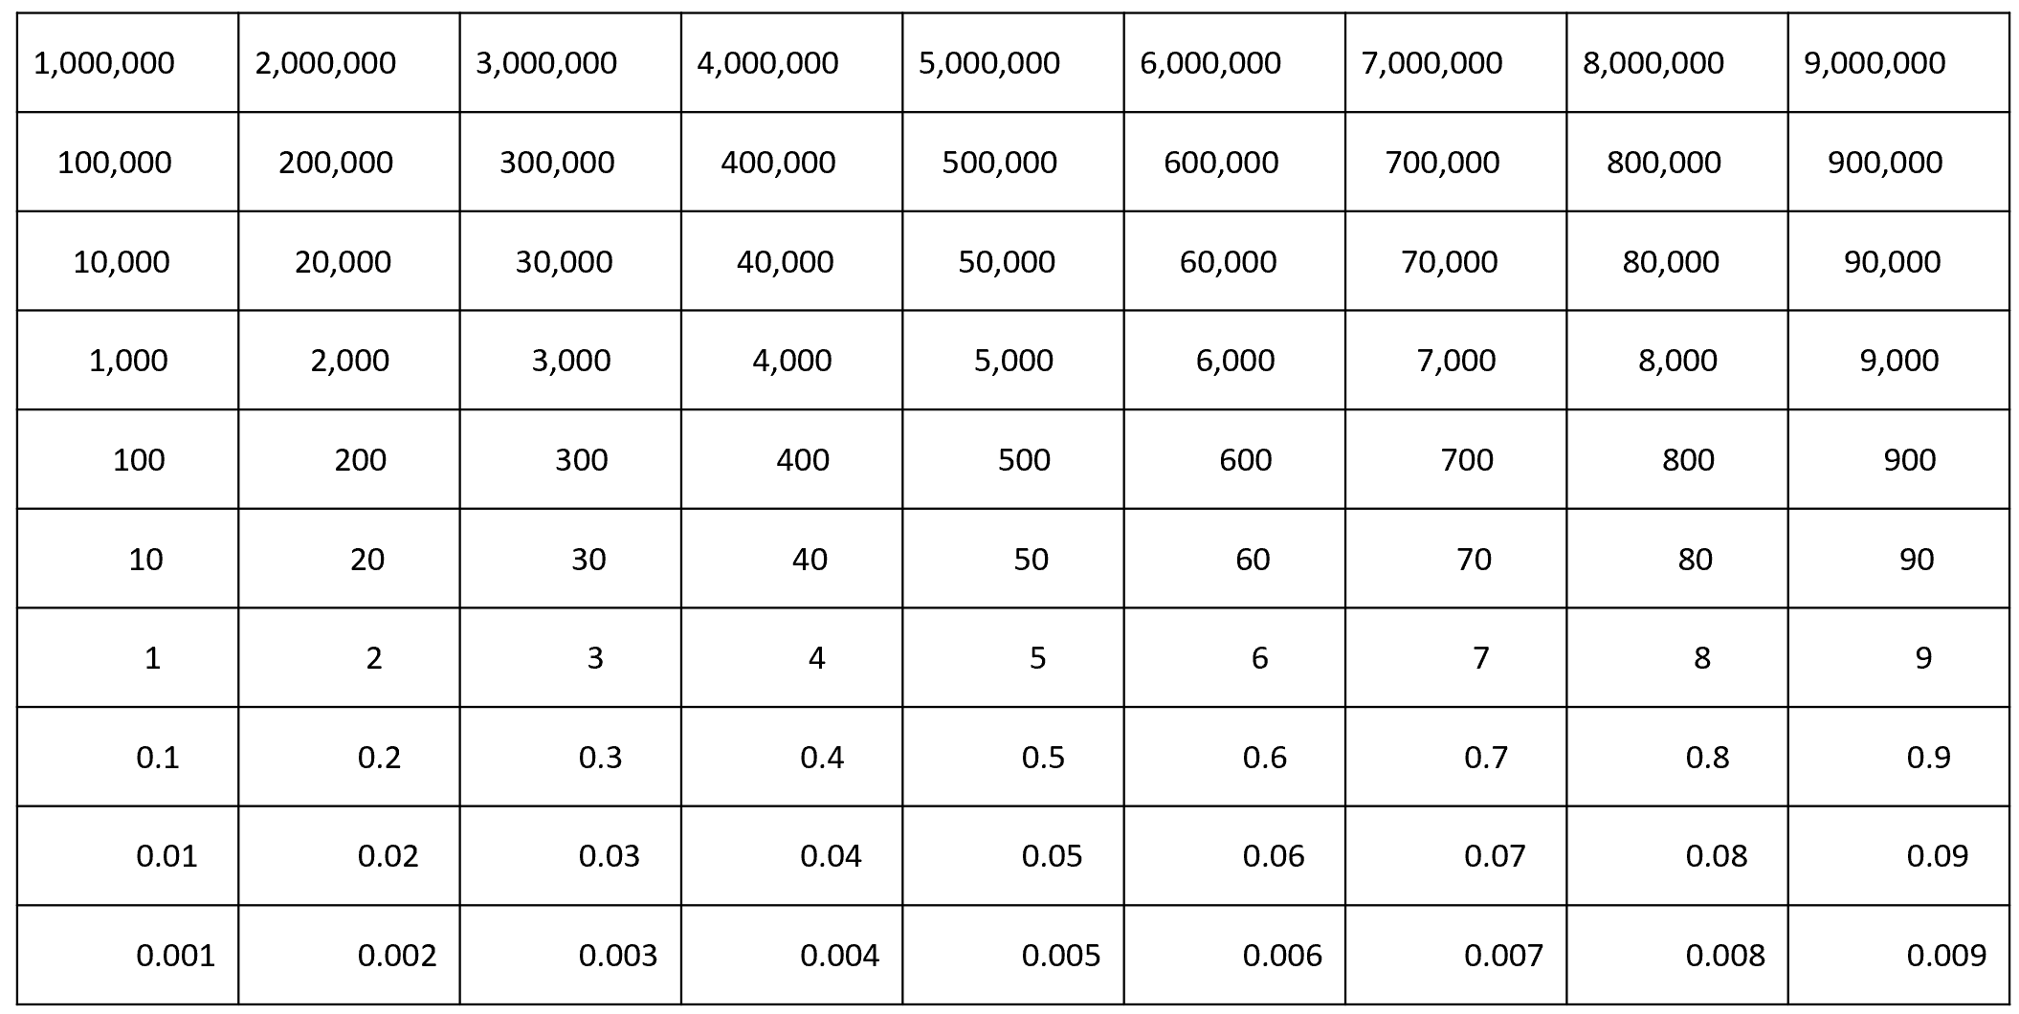
6NPV-1 Powers of 10
The number above is ten times the size.
The number below is one tenth the size.
400 is ten times the size of 40.
40 is one tenth the size of 400.
Look at the Gattegno chart. What do you notice? Can you explain the patterns in it?
How does the value change when we move one cell up or one cell down?

Slide 17
6NPV-1 Powers of 10
Count in steps of 0.01 to 0.1.
How many steps did you count?
How many hundredths are equivalent to 0.1?
0.01
0.01
0.01
0.01
0.01
0.01
0.01
0.01
0.01
0.01
10 hundredths are equivalent to 0.1 or one tenth.
0.1

Slide 18
6NPV-1 Powers of 10
Count in steps of 0.1 to 1.
How many steps did you count?
How many tenths are equivalent to 1?
0.1
0.1
0.1
0.1
0.1
0.1
0.1
0.1
0.1
0.1
10 tenths are equivalent to 1.
1

Slide 19
6NPV-1 Powers of 10
Count in steps of 1 to 10.
How many steps did you count?
How many ones are equivalent to10?
1
1
1
1
1
1
1
1
1
1
10 ones are equivalent to 10.
10

Slide 20
6NPV-1 Powers of 10
Count in steps of 10 to 100.
How many steps did you count?
How many tens are equivalent to 100?
10
10
10
10
10
10
10
10
10
10
10 tens are equivalent to 100.
100

Slide 21
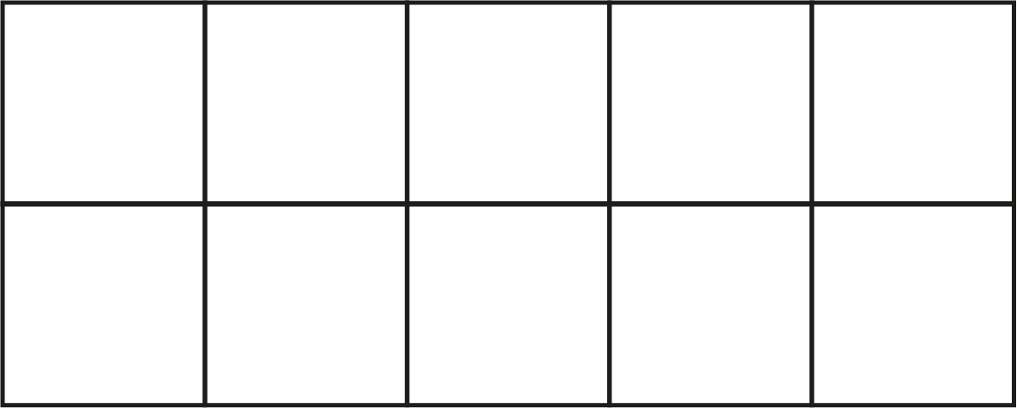

6NPV-1 Powers of 10
Count in steps of 100.
How many steps did you count?
How many hundreds are equivalent to 1,000?
10 hundreds are equivalent to 1,000.
1,000

Slide 22
6NPV-1 Powers of 10
Count in steps of 1,000.
How many steps did you count?
How many thousands are equivalent to 10,000?
1,000
1,000
1,000
1,000
1,000
1,000
1,000
1,000
1,000
1,000
10 thousands are equivalent to 10,000.
10,000

Slide 23
6NPV-1 Powers of 10
Count in steps of 10,000.
How many steps did you count?
How many ten thousands are equivalent to 100,000?
10,000
10,000
10,000
10,000
10,000
10,000
10,000
10,000
10,000
10,000
10 ten thousands are equivalent to 100,000.
100,000

Slide 24
6NPV-1 Powers of 10
Count in steps of 100,000.
How many steps did you count?
How many hundred thousands are equivalent to 1,000,000?
100,000
100,000
100,000
100,000
100,000
100,000
100,000
100,000
100,000
100,000
10 hundred thousands are equivalent to 1,000,000 or 1 million
1,000,000

Slide 25
6NPV-1 Powers of 10
Count in steps of 1,000,000.
How many steps did you count?
How many millions are equivalent to 10,000,000?
1,000,000
1,000,000
1,000,000
1,000,000
1,000,000
1,000,000
1,000,000
1,000,000
1,000,000
1,000,000
10 millions are equivalent to 10,000,000 or 10 million.
10,000,000

Slide 26
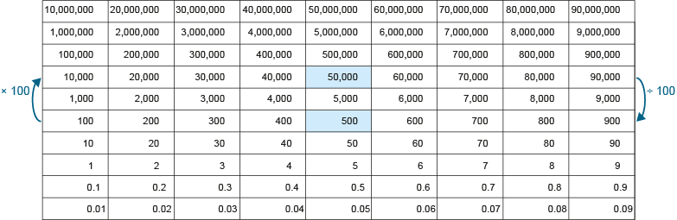
6NPV-1 Powers of 10
50,000
× 100
500
10
1
0.1
÷ 100
How many times greater is 10 than 0.1?
How many times smaller is 0.1 than 10?
Repeat for other numbers found two rows apart on the Gattegno chart.
Ten is one hundred times the size of 0.1. 0.1 multiplied by 100 is equal to 10.
0.1 is one-hundredth of the size of 10. 10 divided by 100 is equal to 0.1.

Slide 27
6NPV-1 Powers of 10
× 100
50,000
5,000
500
÷ 100
How many times greater is 50,000 than 500?
How many times smaller is 500 than 50,000?
Repeat for other numbers found two rows apart on the Gattegno chart.
50,000 is one hundred times the size of 500. 500 multiplied by 100 is equal to 50,000.
500 is one-hundredth of the size of 50,000. 50,000 divided by 100 is equal to 500.

Slide 28
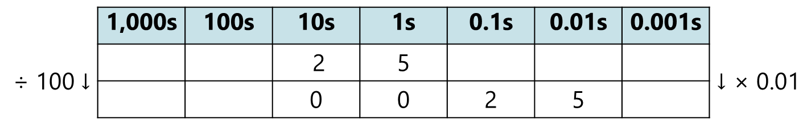
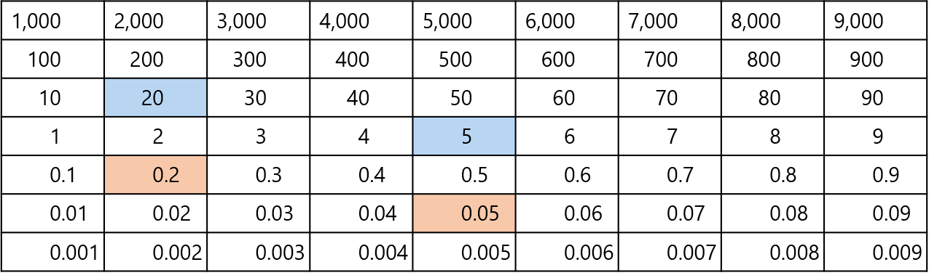
6NPV-1 Powers of 10
What do you notice about the digits two and five in both numbers?
What is the relationship between 25 and 0.25?
Repeat, including with other larger numbers.
0.25
×
100
=
25
25 is one hundred times the size of 0.25.
0.25 is one-hundredth of the size of 25.

Slide 29
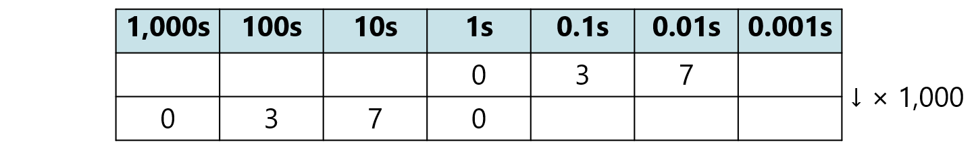
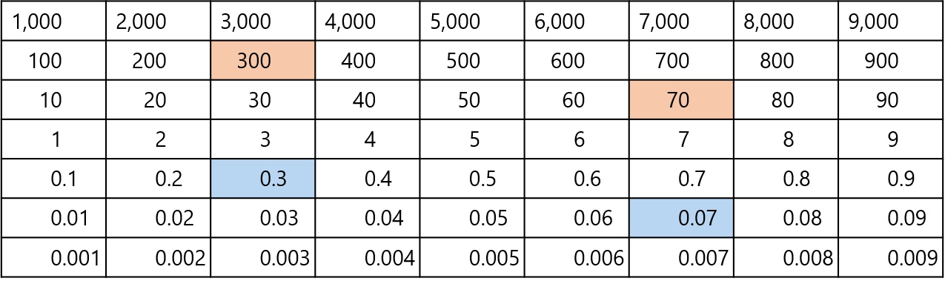
6NPV-1 Powers of 10
What do you notice about the digits three and seven in both numbers?
What is the relationship between 370 and 0.37?
Repeat, including with other larger numbers.
÷ 1000
370
÷
1,000
=
0.37
370 is one thousand times the size of 0.37.
0.37 is one-thousandth of the size of 370.

Slide 30
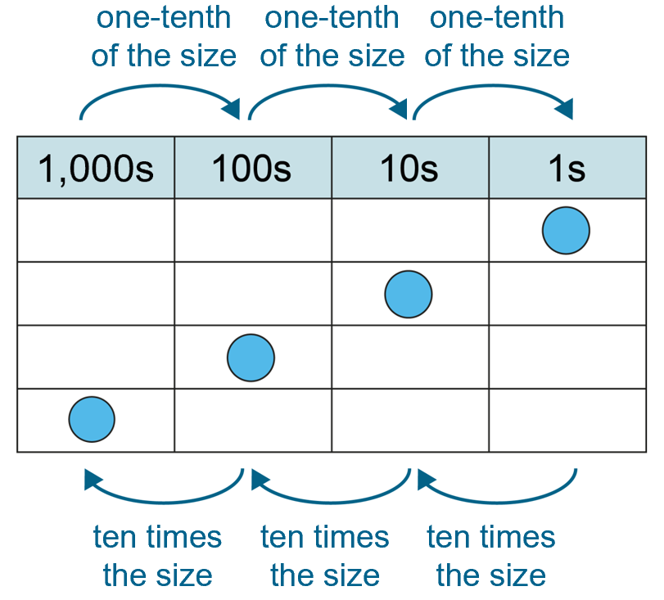
6NPV-1 Powers of 10
Grouping and exchange model
Scaling model
Practise describing the relationship between 100 and 1,000 in these two different ways.
Now describe the relationship between other powers of 10 using these two models.
10 hundreds are equivalent to
1 thousand.
1,000 is ten times the size of 100.
100 is one-tenth the size of 1,000.

Slide 31
6NPV-1 Powers of 10
Make a set of cards and look at the patterns and relationships between these numbers.
Use the patterns and relationships to help memorise these equivalencies.
Can you put your cards in order?
Play with a friend and read out half of the sentence and see if your friend can complete the sentence, for example:10 hundreds are equivalent to…
Which ones do you already know?
Identify the ones you don’t know and practise saying these. Draw the tens frames to help commit them to memory.
10 hundredths are equivalent to 0.1 or one tenth.
10 tenths are equivalent to 1.
10 ones are equivalent to 10.
10 tens are equivalent to 100.
10 hundreds are equivalent to 1000.
10 thousands are equivalent to 10,000.
10 ten thousands are equivalent to 100,000.
10 hundred thousands are equivalent to 1,000,000 or 1 million.
10 millions are equivalent to 10,000,000 or 10 million.

Slide 32
Year 6, Unit 3, Learning Outcome 2
Learning Outcome 2
Pupils compose seven or eight-digit numbers using common intervals
The following slides have been collated to support the teaching of this learning outcome.

Slide 33
Year 6, Unit 3, Learning Outcome 2
Additional teacher guidance for this outcome should be read first and can be found in this segment of the NCETM Primary Mastery Professional Development Materials:
1.30 Numbers up to 10,000,000
The spine materials are divided into ‘teaching points’ and ‘steps in learning’.
Teaching point | Steps in learning | Pages
1 | 1:4 - 1:7 | 6-10

Slide 34
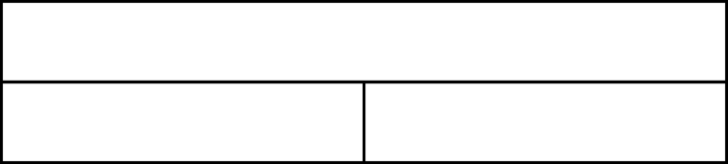
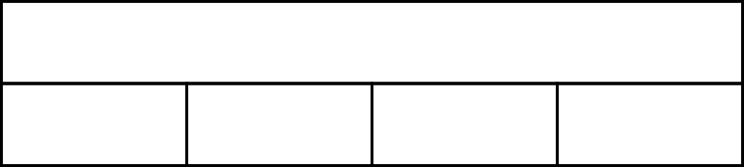
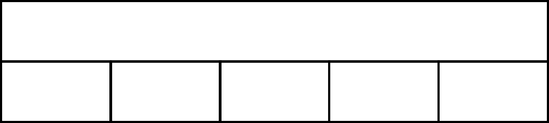
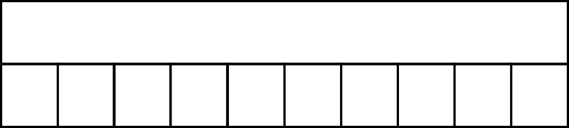
1.30 Numbers up to 10,000,000 – step 1:4
1,000
1,000
500
500
250
250
250
250
1,000
1,000
200
200
200
200
200
100
100
100
100
100
100
100
100
100
100

Slide 35
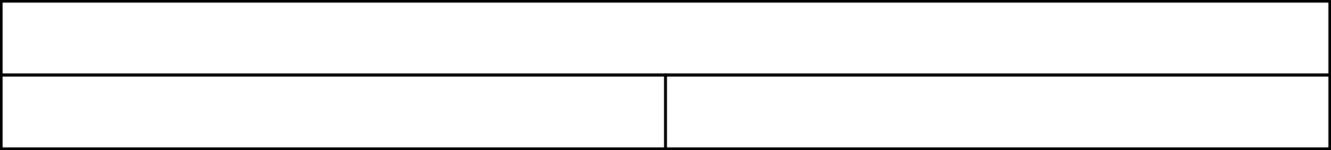
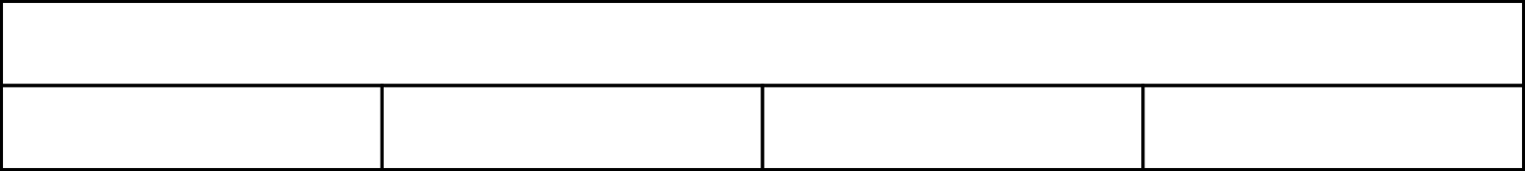
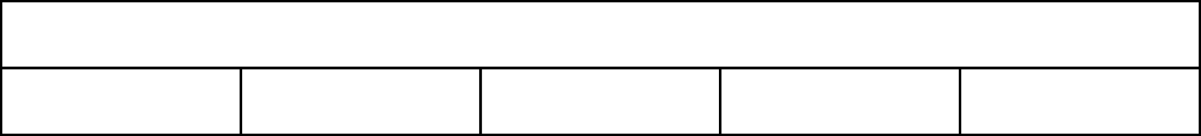
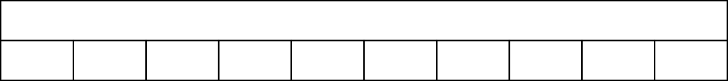
1.30 Numbers up to 10,000,000 – step 1:5
1,000,000
500,000
500,000
1,000,000
250,000
250,000
250,000
250,000
1,000,000
200,000
200,000
200,000
200,000
200,000
1,000,000
100,000
100,000
100,000
100,000
100,000
100,000
100,000
100,000
100,000
100,000

Slide 36
1.30 Numbers up to 10,000,000 – step 1:6
10,000
5,000
5,000
10,000
2,500
2,500
2,500
2,500
10,000
2,000
2,000
2,000
2,000
2,000
10,000
1,000
1,000
1,000
1,000
1,000
1,000
1,000
1,000
1,000
1,000

Slide 37
1.30 Numbers up to 10,000,000 – step 1:7
10,000,000
5,000,000
5,000,000
10,000,000
2,500,000
2,500,000
2,500,000
2,500,000
10,000,000
2,000,000
2,000,000
2,000,000
2,000,000
2,000,000
10,000,000
1,000,000
1,000,000
1,000,000
1,000,000
1,000,000
1,000,000
1,000,000
1,000,000
1,000,000
1,000,000

Slide 38
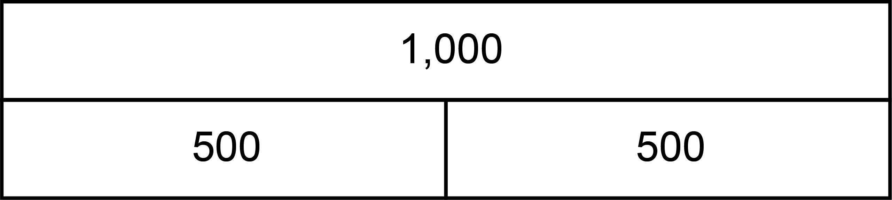
6NPV-4 Reading scales with 2, 4, 5 or 10 intervals
10,000,000
5,000,000
5,000,000
What do you notice about the bar models shown? What’s the same? What’s different?
How can we use the known information to work out the value of each unknown part?
Calculate the value of each unknown part.
1,000,000
500,000
500,000
1,000
Each whole has been divided into two equal parts.To find the value of each part, the whole can be halved or divided by two.
500
500
100
50
50
1
0.5
0.5

Slide 39
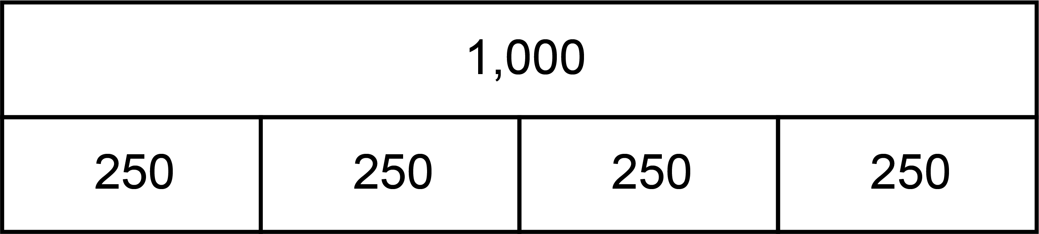
6NPV-4 Reading scales with 2, 4, 5 or 10 intervals
10,000,000
2,500,000
2,500,000
2,500,000
2,500,000
What do you notice about the bar models shown? What’s the same? What’s different?
How can we use the known information to work out the value of each unknown part?
Calculate the value of each unknown part.
1,000,000
250,000
250,000
250,000
250,000
1,000
Each whole has been divided into four equal parts. To find the value of each part, the whole can be divided by four.
250
250
250
250
100
25
25
25
25
1
0.25
0.25
0.25
0.25

Slide 40
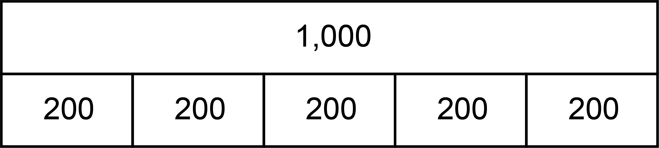
6NPV-4 Reading scales with 2, 4, 5 or 10 intervals
10,000,000
2,000,000
2,000,000
2,000,000
2,000,000
2,000,000
What do you notice about the bar models shown? What’s the same? What’s different?
How can we use the known information to work out the value of each unknown part?
Calculate the value of each unknown part.
1,000,000
200,000
200,000
200,000
200,000
200,000
1,000
Each whole has been divided into five equal parts. To find the value of each part, the whole can be divided by five.
200
200
200
200
200
100
20
20
20
20
20
1
0.2
0.2
0.2
0.2
0.2

Slide 41
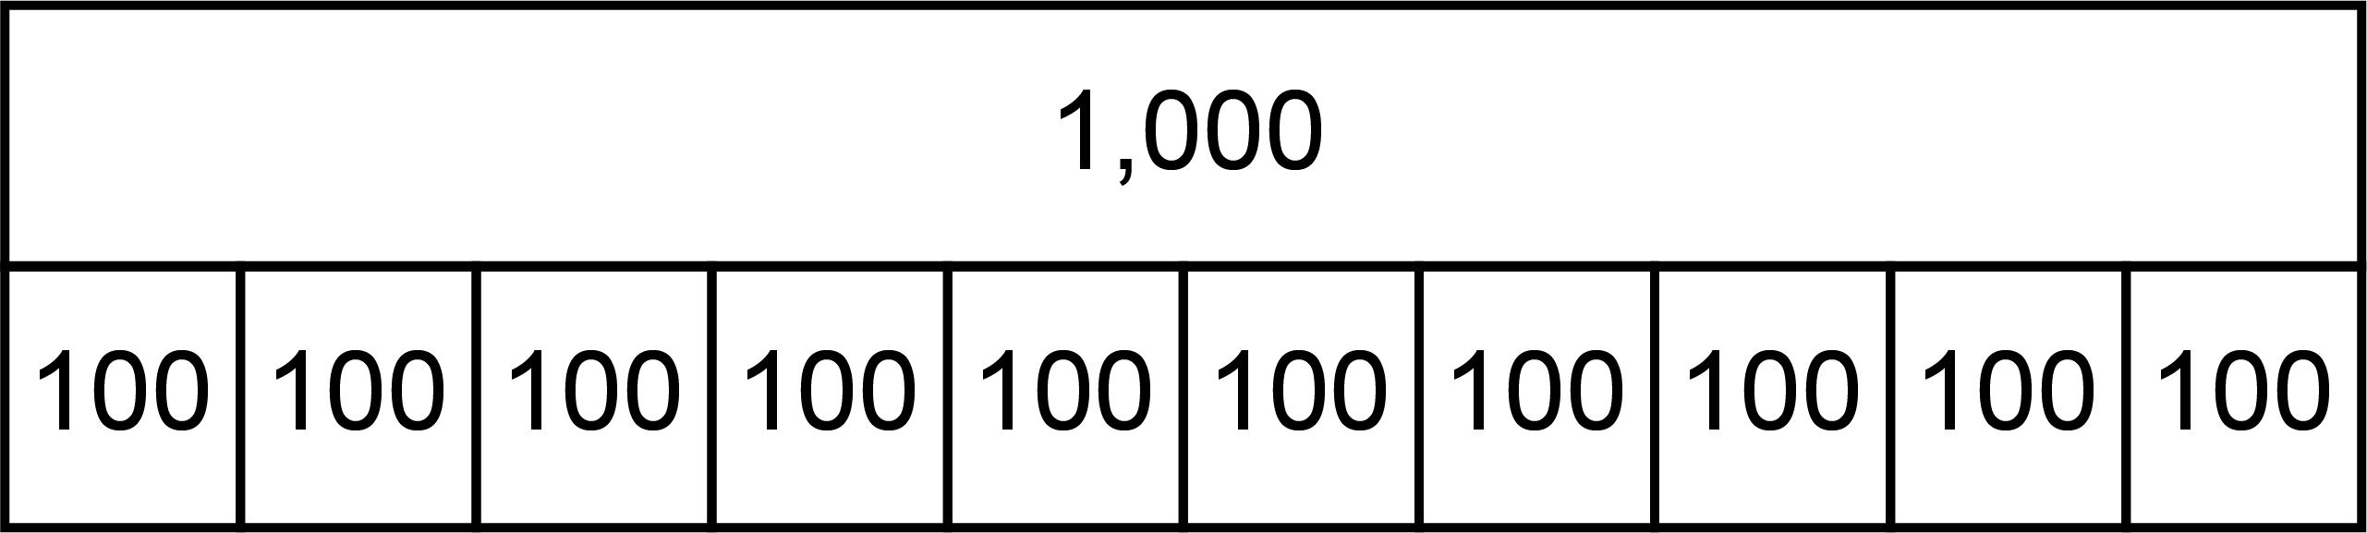
6NPV-4 Reading scales with 2, 4, 5 or 10 intervals
10,000,000
v
v
v
v
v
v
v
v
v
v
What do you notice about the bar models shown? What’s the same? What’s different?
How can we use the known information to work out the value of each unknown part?
Calculate the value of each unknown part.
v
v
v
v
v
v
v
v
v
v
1,000,000
1,000,000
1,000,000
1,000,000
1,000,000
1,000,000
1,000,000
1,000,000
1,000,000
1,000,000
1,000,000
v
v
v
v
v
v
v
v
v
v
v
v
v
v
v
v
v
v
v
v
100,000
100,000
100,000
100,000
100,000
100,000
100,000
100,000
100,000
100,000
1,000
Each whole has been divided into ten equal parts. To find the value of each part, the whole can be divided by ten.
v
v
v
v
v
v
v
v
v
v
v
v
v
v
v
v
v
v
v
v
100
100
100
100
100
100
100
100
100
100
100
v
v
v
v
v
v
v
v
v
v
v
v
v
v
v
v
v
v
v
v
10
10
10
10
10
10
10
10
10
10
1
0.1
0.1
0.1
0.1
0.1
0.1
0.1
0.1
0.1
0.1
v
v
v
v
v
v
v
v
v
v
v
v
v
v
v
v
v
v
v
v

Slide 42
6NPV-4 Reading scales with 2, 4, 5 or 10 intervals
100,000
1,000,000
1
1,000
Let’s count in fifty-thousands from zero to one hundred-thousand.
Now let’s count in steps of two-hundred and fifty thousand, two-tenths and one-hundred. Can you count backwards from each of these?
If I count in steps of two-hundred, what comes after 400? Before 1,000?
If I count in one hundreds, what comes between 400 and 600?
900
0.8
800
Zero, fifty-thousand, one hundred-thousand.
750,000
700
0.6
600
50,000
500,000
500
0.4
400
300
250,000
0.2
200
100
0
0
0
0

Slide 43
6NPV-4 Reading scales with 2, 4, 5 or 10 intervals
Is the number before or after three hundred thousand? How do you know?
How many intervals are there on the number line? How can we use this to decide what we are counting in?
Let’s check by counting from the lower multiple of one-hundred thousand.
Repeat for other number lines.
400,000
10,000,000
7
2,000
1,900
6.8
1,800
The number is between ___ and ___.
9,750,000
1,700
6.6
1,600
350,000
9,500,000
1,500
6.4
1,400
1,300
9,250,000
6.2
1,200
1,100
300,000
9,000,000
6
1,000

Slide 44
Year 6, Unit 3, Learning Outcome 3
Learning Outcome 3
Pupils use their knowledge of the composition of up to eight-digit numbers to solve problems
The following slides have been collated to support the teaching of this learning outcome.

Slide 45
Year 6, Unit 3, Learning Outcome 3
Additional teacher guidance for this outcome should be read first and can be found in this segment of the NCETM Primary Mastery Professional Development Materials:
1.30 Numbers up to 10,000,000
The spine materials are divided into ‘teaching points’ and ‘steps in learning’.
Teaching point | Steps in learning | Pages
1 | 1:8 | 10-13

Slide 46
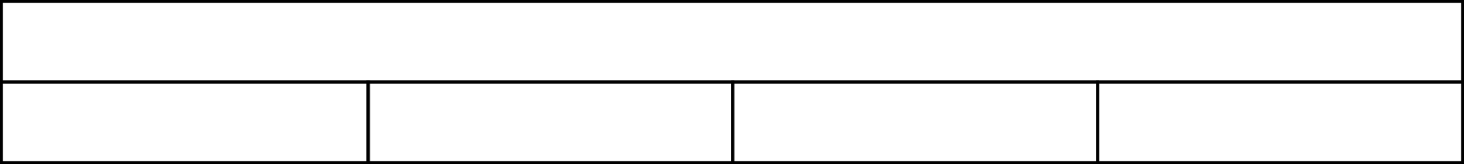
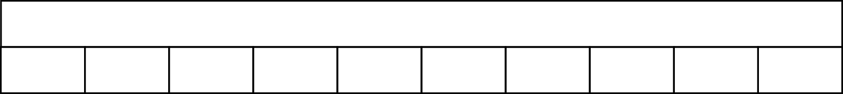
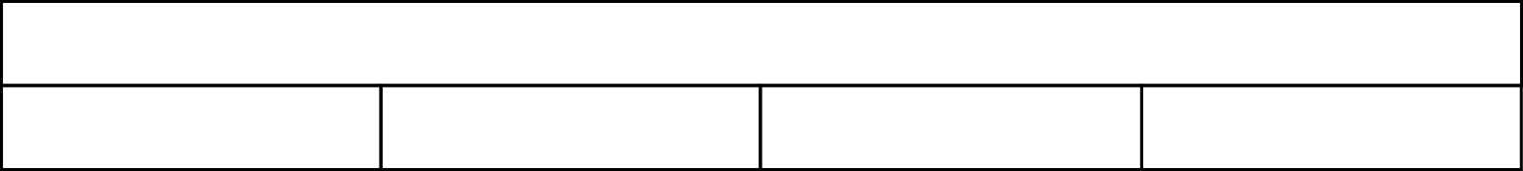
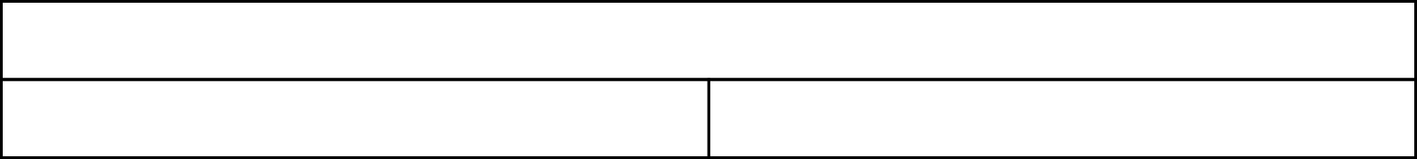
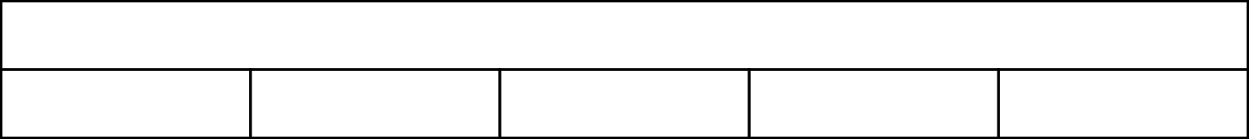
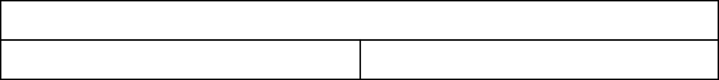
1.30 Numbers up to 10,000,000 – step 1:8
10,000,000
2,500,000
2,500,000
2,500,000
2,500,000
1,000
100
100
100
100
100
100
100
100
100
100
1,000,000
250,000
250,000
250,000
250,000
0.1
0.05
0.05
1,000,000
200,000
200,000
200,000
200,000
200,000
1
0.5
0.5

Slide 47



1.30 Numbers up to 10,000,000 – step 1:8
10,000
35,000
45,000

Slide 48
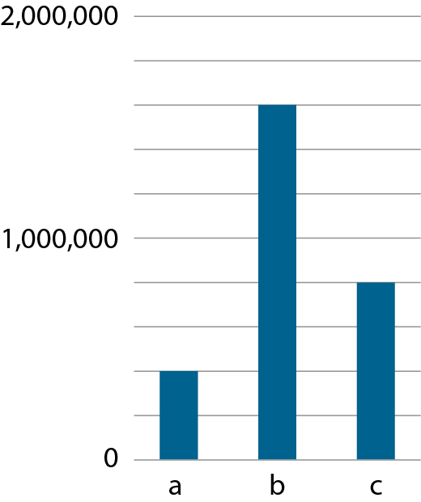
1.30 Numbers up to 10,000,000 – step 1:8
1,600,000
800,000
400,000

Slide 49
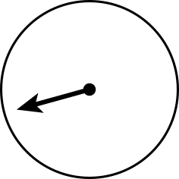
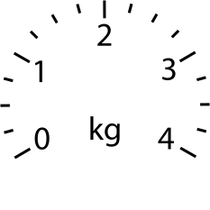
1.30 Numbers up to 10,000,000 – step 1:8
1.75 kg
3.5 kg
0.25 kg

Slide 50
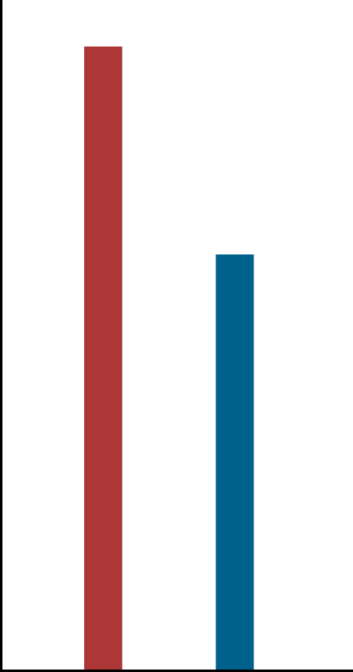
1.30 Numbers up to 10,000,000 – step 1:8
R
B

Slide 51
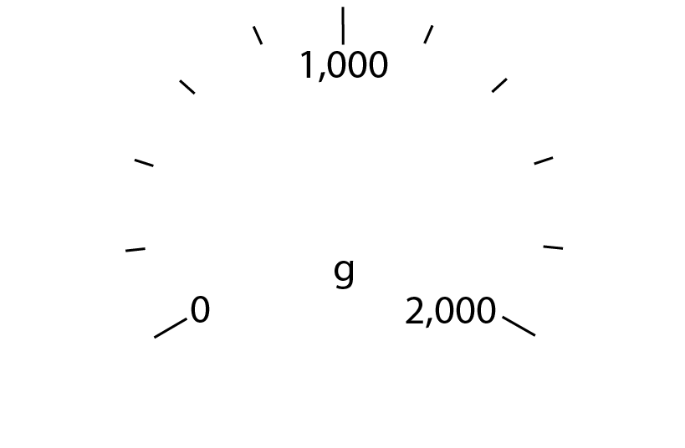
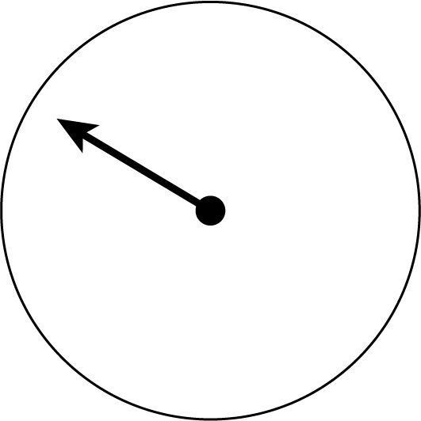

6NPV-4 Reading scales with 2, 4, 5 or 10 intervals
Where has the arrow stopped? Is it before or after 1,000? How do you know?
How many intervals are there between zero and 1,000? So what interval do we need to count in?
Could the arrow be pointing to 600? Why not?
If the answer is 1,400g, can you count in steps of 200 from zero to check if you are correct?

Slide 52
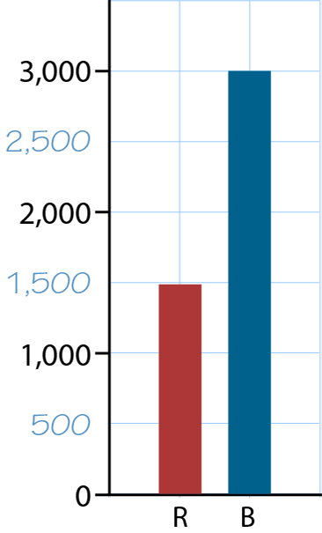

6NPV-4 Reading scales with 2, 4, 5 or 10 intervals
Could each square be worth 100? Why not?
What is the correct value of each square? How do you know?
What are the mid-points between each labelled value?
What is the value of the red bar? What is the value of the blue bar?
What is the difference in value between the bars? Explain how you know.

Slide 53
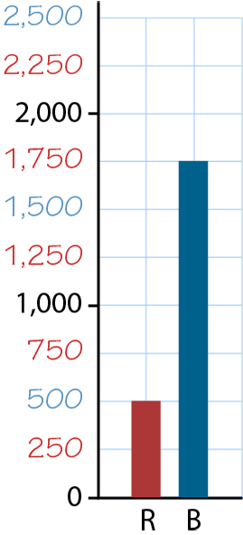
6NPV-4 Reading scales with 2, 4, 5 or 10 intervals
How do the squares help you? Could each square be worth 200? Why not?
What is the correct value of each square? How do you know?
What are the mid-points between each labelled value? Click to repeat.
What is the value of the red bar? What is the value of the blue bar?
What is the difference in value between the bars? Can you do this without having to subtract? Explain how.

Slide 54
6NPV-4 Reading scales with 2, 4, 5 or 10 intervals
10,000
35,000
45,000
How many intervals are there between zero and 20,000? So what intervals do we need to count in?
What value does the letter a represent? How do you know? Are there multiple ways to calculate the value of the letter?
Repeat for other letters and on different partially labelled number lines.
a is half-way between zero and 20,000. Half of 20,000 is equal to 10,000.
a is two intervals after zero. There are four intervals between zero and 20,000. This means each interval is worth 5,000. Two lots of 5,000 is equal to 10,000.

Slide 55
6NPV-4 Reading scales with 2, 4, 5 or 10 intervals
How many intervals are there between zero and one million? So what intervals do we need to count in?
What is the value of each bar? Are there multiple ways to calculate the value of each?
What is the difference between the greatest and smallest bars? In how many different ways can this be calculated?
1,600,000
800,000
400,000

Slide 56
6NPV-4 Reading scales with 2, 4, 5 or 10 intervals
1.75 kg
3.5 kg
0.25 kg
Are all of the scales the same? What is the value of each interval?
Click to reveal the final location of each arrow. What value is it pointing at? How do you know?
Each kilogram has been split into four equal parts. Each interval is worth 0.25kg.
The first arrow has moved one interval, it is pointing at 0.25kg.
The second arrow is one interval before 2kg, it is pointing at 1.75kg

Slide 57
Year 6, Unit 3, Learning Outcome 4
Learning Outcome 4
Pupils explain how to read numbers with up to seven digits efficiently
The following slides have been collated to support the teaching of this learning outcome.

Slide 58
Year 6, Unit 3, Learning Outcome 4
Additional teacher guidance for this outcome should be read first and can be found in this segment of the NCETM Primary Mastery Professional Development Materials:
1.30 Numbers up to 10,000,000
The spine materials are divided into ‘teaching points’ and ‘steps in learning’.
Teaching point | Steps in learning | Pages
2 | 2:1 – 2:3 | 14-16

Slide 59
1.30 Numbers up to 10,000,000 – steps 2:1 and 2:2
Millions |  |  | Thousands |  |  | Ones
100s | 10s | 1s | 100s | 10s | 1s | 100s | 10s | 1s
 |  |  |  |  | 1 | 9 | 3 | 7
 |  |  |  | 5 | 1 | 9 | 3 | 7
 |  |  | 4 | 5 | 1 | 9 | 3 | 7
 |  | 5 | 4 | 5 | 1 | 9 | 3 | 7
1,937 (one thousand, nine hundred and thirty-seven)
51,937 (fifty-one thousand, nine hundred and thirty-seven)
451,937 (four hundred and fifty-one thousand, nine hundred
and thirty-seven)
5,451,937 (five million, four hundred and fifty-one thousand,
nine hundred and thirty-seven)

Slide 60
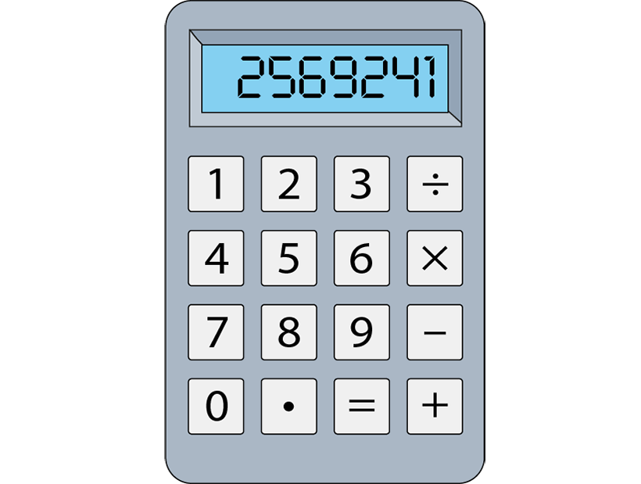
1.30 Numbers up to 10,000,000 – step 2:3
What number has been entered on the calculator? Write it with commas used as separators correctly and say the number out loud.
Create other numbers on a calculator, up to 7 digits, by multiplying different combinations of numbers with different numbers of digits. Record each number created, using commas correctly.
2,569,241
The number shown is two million, five hundred and sixty-nine thousand, two hundred and forty-one.

Slide 61
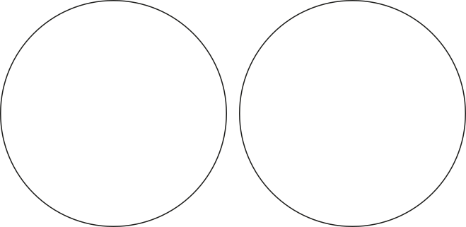
1.30 Numbers up to 10,000,000 – step 2:3
Correctly
written
Incorrectly
written
Sort the numbers.
Explain the reasons why each incorrectly written number is incorrect.
736,1.8
6,439.1
185,72
763,148
4,826,591

Slide 62
6NPV-2 Place value in numbers up t0 10,000,000
Millions |  |  | Thousands |  |  | Ones
100s | 10s | 1s | 100s | 10s | 1s | 100s | 10s | 1s
 |  |  |  |  | 1 | 9 | 3 | 7
Read each number that is shown in turn.
Why are some words shown in bold? What is the significance of these words?
Say a number containing up to 9 digits and ask children to write the number in an empty place value chart. Repeat with different numbers.
 |  |  |  | 5 | 1 | 9 | 3 | 7
 |  |  | 4 | 5 | 1 | 9 | 3 | 7
 |  | 5 | 4 | 5 | 1 | 9 | 3 | 7
1,937 (one thousand, nine hundred and thirty-seven)
51,937 (fifty-one thousand, nine hundred and thirty-seven)
451,937 (four hundred and fifty-one thousand, nine hundred
and thirty-seven)
5,451,937 (five million, four hundred and fifty-one thousand,
nine hundred and thirty-seven)

Slide 63
6NPV-2 Place value in numbers up to 10,000,000
3,870,291.46
Millions |  |  | Thousands |  |  | Ones
100s | 10s | 1s | 100s | 10s | 1s | 100s | 10s | 1s | 0.1s | 0.01s
 |  | 3 | 8 | 7 | 0 | 2 | 9 | 1 | 4 | 6
Write the number shown in words.
What place value column is the digit 3 in? What is the value of this digit?
Repeat with other numbers, including those with multiple digits of the same value in different place value columns. For example, 2,332,572.
The digit in the millions place is 3. It has a value of 3,000,000.

Slide 64
Year 6, Unit 3, Learning Outcome 5
Learning Outcome 5
Pupils recognise and create numbers that contain place-holding zeros
The following slides have been collated to support the teaching of this learning outcome.

Slide 65
Year 6, Unit 3, Learning Outcome 5
Additional teacher guidance for this outcome should be read first and can be found in this segment of the NCETM Primary Mastery Professional Development Materials:
1.30 Numbers up to 10,000,000
The spine materials are divided into ‘teaching points’ and ‘steps in learning’.
Teaching point | Steps in learning | Pages
2 | 2:4 - 2:6 | 16-18

Slide 66
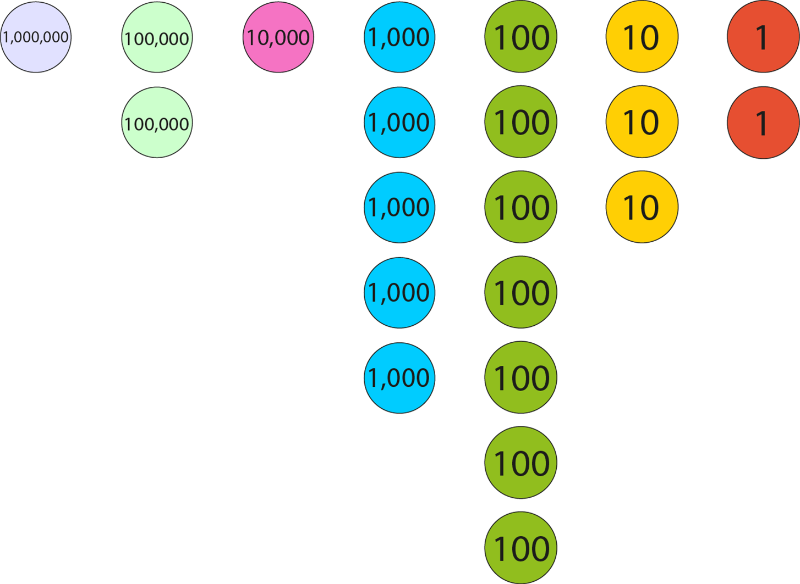
1.30 Numbers up to 10,000,000 – step 2:4
1,215,732

Slide 67
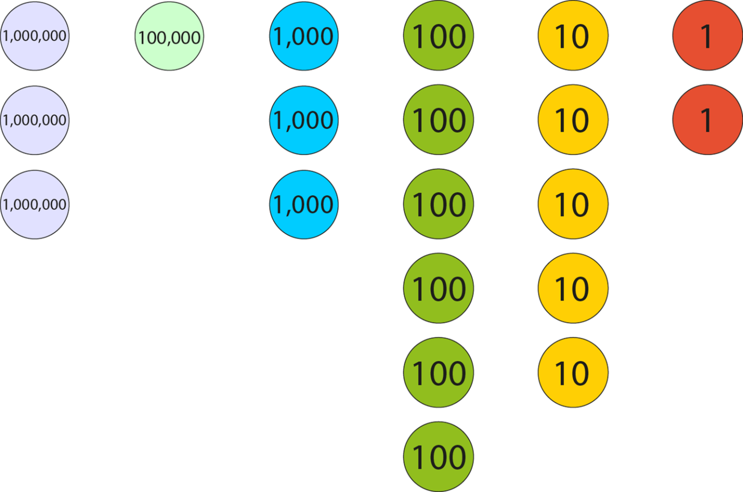
1.30 Numbers up to 10,000,000 – step 2:5
3,103,652

Slide 68
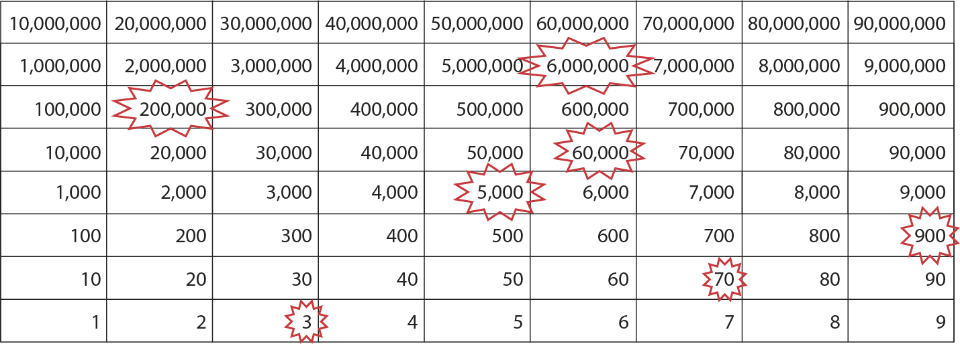
1.30 Numbers up to 10,000,000 – step 2:6
6,265,973

Slide 69
Year 6, Unit 3, Learning Outcome 6
Learning Outcome 6
Pupils determine the value of digits in numbers up to tens of millions
The following slides have been collated to support the teaching of this learning outcome.

Slide 70
Year 6, Unit 3, Learning Outcome 6
Additional teacher guidance for this outcome should be read first and can be found in this segment of the NCETM Primary Mastery Professional Development Materials:
1.30 Numbers up to 10,000,000
The spine materials are divided into ‘teaching points’ and ‘steps in learning’.
Teaching point | Steps in learning | Pages
2 | 2:7 – 2:8 | 19

Slide 71

1.30 Numbers up to 10,000,000 – step 2:8
Millions |  |  | Thousands |  |  | Ones
100s | 10s | 1s | 100s | 10s | 1s | 100s | 10s | 1s

Slide 72
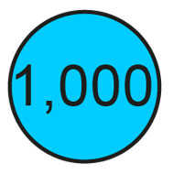


6NPV-2 Place value in numbers up to 10,000,000
Represent this number using place value counters and a part-part-whole model.
What digit is in the thousands place? What is the value of the hundred thousands digit?
What does the 8 represent?
Repeat for different 5-digit numbers.
Show children representations of numbers either using part-part-whole or place value counters and ask them to write the value of each number represented.
381,920
300,000
80,000
1,000
900
20
100,000
10,000
10,000
The 8 represents eight ten thousands.
100,000
10,000
10,000
100,000
10,000
10,000
10,000
10,000

Slide 73
6NPV-2 Place value in numbers up to 10,000,000
What number has been represented on the following slide using place value counters?
How do the place value counters and sections of the Gattegno chart that are highlighted match?
How many ten thousands, tens, ones and tenths are found in this number?
Repeat with other numbers, working from different combinations of place value counters as well as identifying the number shown from different highlighted sections of a Gattegno chart.
There are 3 ten thousands, 5 tens, 1 one and 2 tenths in the number 30,051.2.

Slide 74
6NPV-2 Place value in numbers up to 10,000,000
10,000
10,000
10,000
1
0.1
0.1
30 thousand and 51 and 2 tenths
30,051.2

Slide 75
Year 6, Unit 3, Learning Outcome 7
Learning Outcome 7
Pupils explain how to compare up to eight-digit numbers
The following slides have been collated to support the teaching of this learning outcome.

Slide 76
Year 6, Unit 3, Learning Outcome 7
Additional teacher guidance for this outcome should be read first and can be found in this segment of the NCETM Primary Mastery Professional Development Materials:
1.30 Numbers up to 10,000,000
The spine materials are divided into ‘teaching points’ and ‘steps in learning’.
Teaching point | Steps in learning | Pages
2 | 2:9 - 2:10 | 19-21

Slide 77
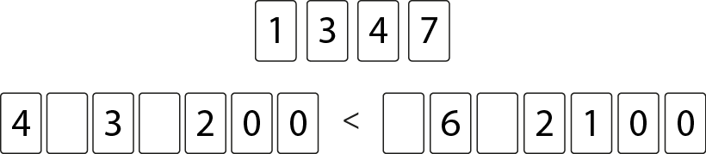
1.30 Numbers up to 10,000,000 – step 2:10
Notes:
‘How many ways can you arrange these digit cards so that the inequality is true?’

Slide 78
Year 6, Unit 3, Learning Outcome 8
Learning Outcome 8
Pupils use their knowledge of the composition of seven-digit numbers to solve problems
The following slides have been collated to support the teaching of this learning outcome.

Slide 79
Year 6, Unit 3, Learning Outcome 8
Additional teacher guidance for this outcome should be read first and can be found in this segment of the NCETM Primary Mastery Professional Development Materials:
1.30 Numbers up to 10,000,000
The spine materials are divided into ‘teaching points’ and ‘steps in learning’.
Teaching point | Steps in learning | Pages
3 | 3:1 - 3:4 | 24-25

Slide 80
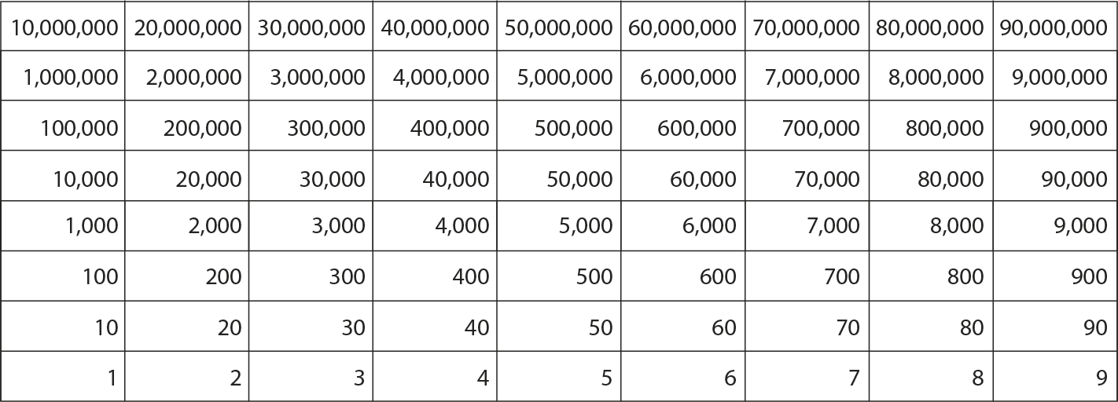





1.30 Numbers up to 10,000,000 – step 3:1
5,381,492
Millions |  |  | Thousands |  |  | Ones
100s | 10s | 1s | 100s | 10s | 1s | 100s | 10s | 1s
5
3
8
1
4
9
2
5,381,492 =
5,000,000 +
300,000 +
80,000 +
1,000 +
400 +
90 +
2

Slide 81
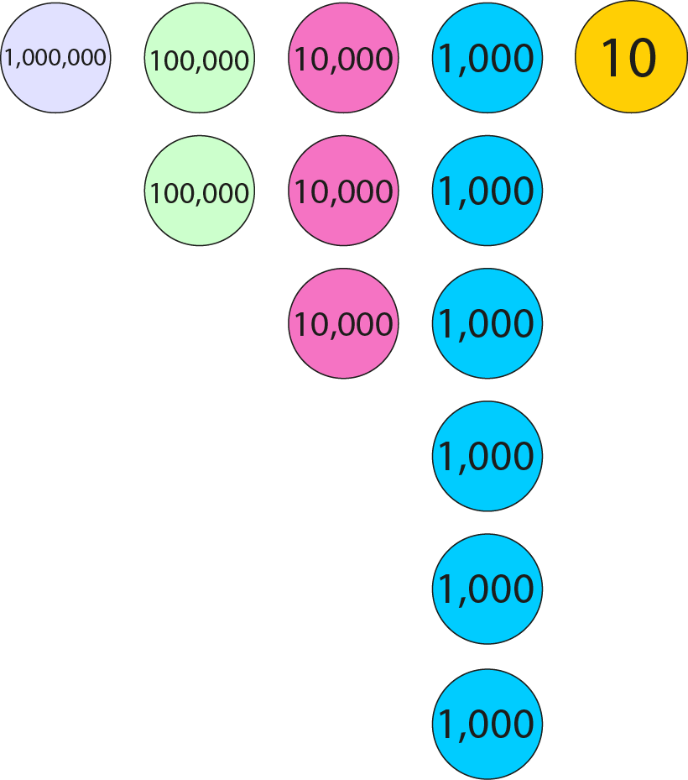
1.30 Numbers up to 10,000,000 – step 3:2
1,000,000
+ 200,000
+ 30,000
+ 6,000
+ 10
= 1,236,010

Slide 82
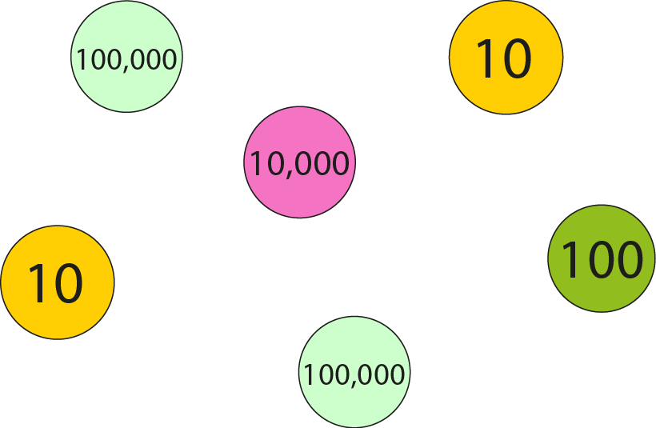
1.30 Numbers up to 10,000,000 – step 3:2
200,000
+ 10,000
+ 100
+ 20
= 210,120

Slide 83
6NPV-2 Place value in numbers up to 10,000,000
Say the number that has been created on the following slide.
Re-write this number in an empty place value chart.
Circle the necessary parts of the Gattegno chart to create this number.
Write the total value as an addition equation including all of its parts.
What is the value of the digit 3?
Repeat using different numbers.
The 3 represents three hundred-thousands.

Slide 84
6NPV-2 Place value in numbers up to 10,000,000
5,381,492
Millions |  |  | Thousands |  |  | Ones
100s | 10s | 1s | 100s | 10s | 1s | 100s | 10s | 1s
5
3
8
1
4
9
2
5,381,492 =
5,000,000 +
300,000 +
80,000 +
1,000 +
400 +
90 +
2

Slide 85
6NPV-2 Place value in numbers up to 10,000,000
Say the value of each column of counters.
Write the total value as an addition equation including all of its parts.
What is the value of the 3?
Repeat using representations of other numbers between 0 and 1,000,000, including up to two decimal places.
The 3 represents three ten thousands.
1,000,000
+ 200,000
+ 30,000
+ 6,000
+ 10
= 1,236,010

Slide 86
6NPV-2 Place value in numbers up to 10,000,000
What is the total value of the place value counters shown?
What would be a sensible first step to easily identify the sum of the counters?
Write the total value as an addition equation including all of its parts.
Repeat for other numbers.
200,000
+ 10,000
+ 100
+ 20
= 210,120

Slide 87
6NPV-2 Place value in numbers up to 10,000,000
Play ‘zap the digit’.
Enter the number shown on a calculator.
Using subtract on the calculator, zap the digit 4 and write the equation that you entered.
Repeat with other digits.
Repeat with other numbers.
7,348,562
7,348,562 – 40,000 = 7,308,562

Slide 88
Year 6, Unit 3, Learning Outcome 9
Learning Outcome 9
Pupils add and subtract mentally without bridging a boundary (only one and more than one digit changes)
The following slides have been collated to support the teaching of this learning outcome.

Slide 89
Year 6, Unit 3, Learning Outcome 9
Additional teacher guidance for this outcome should be read first and can be found in this segment of the NCETM Primary Mastery Professional Development Materials:
1.30 Numbers up to 10,000,000
The spine materials are divided into ‘teaching points’ and ‘steps in learning’.
Teaching point | Steps in learning | Pages
3 | 3:5 - 3:6 | 25-29

Slide 90
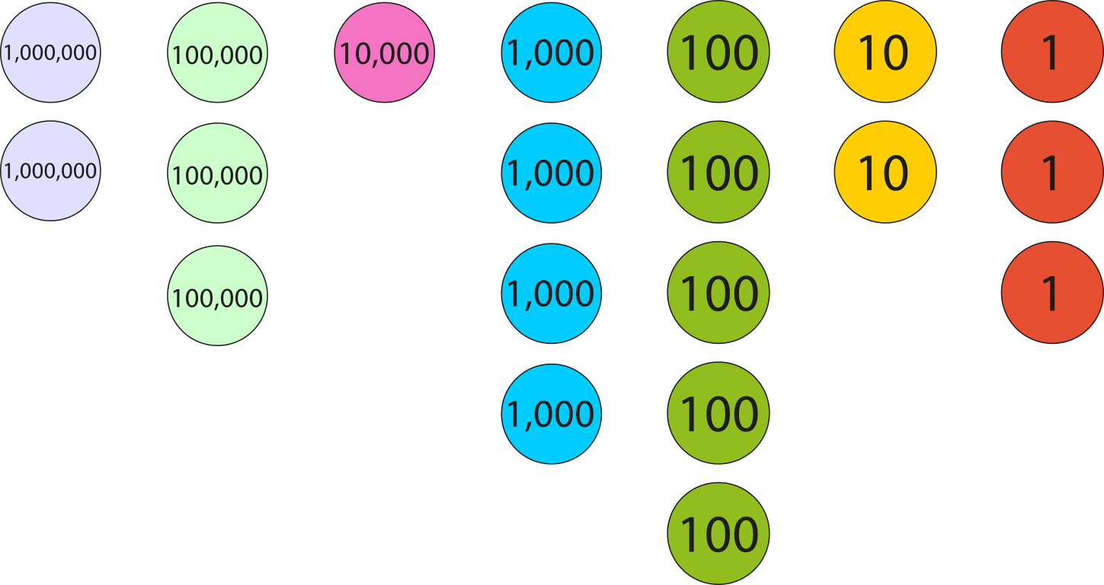
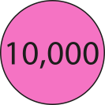
1.30 Numbers up to 10,000,000 – step 3:5
2,314,523
+ 30,000
= 2,344,523

Slide 91
1.30 Numbers up to 10,000,000 – step 3:5
523,810
− 20,000
= 503,810
Millions |  |  | Thousands |  |  | Ones
100s | 10s | 1s | 100s | 10s | 1s | 100s | 10s | 1s
 |  |  | 5 |  | 3 | 8 | 1 | 0
2
0

Slide 92
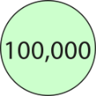

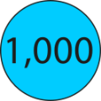



1.30 Numbers up to 10,000,000 – step 3:6
124,000
+ 362
= 124,362
Millions |  |  | Thousands |  |  | Ones
100s | 10s | 1s | 100s | 10s | 1s | 100s | 10s | 1s
1
2
4
0
0
0
3
6
2

Slide 93
Year 6, Unit 3, Learning Outcome 10
Learning Outcome 10
Pupils add numbers whilst crossing the millions boundary
The following slides have been collated to support the teaching of this learning outcome.

Slide 94
Year 6, Unit 3, Learning Outcome 10
Additional teacher guidance for this outcome should be read first and can be found in this segment of the NCETM Primary Mastery Professional Development Materials:
1.30 Numbers up to 10,000,000
The spine materials are divided into ‘teaching points’ and ‘steps in learning’.
Teaching point | Steps in learning | Pages
4 | 4:1 - 4:3 | 30-32

Slide 95



1.30 Numbers up to 10,000,000 – step 4:1

Slide 96


1.30 Numbers up to 10,000,000 – step 4:2
500,000 + 600,000
= 1,100,000
+ 500,000
+ 100,000
500,000
1,000,000
1,100,000

Slide 97


1.30 Numbers up to 10,000,000 – step 4:3
500,000 + 700,000
= 1,200,000
+ 500,000
+ 200,000
500,000
1,000,000
1,200,000

Slide 98
1.30 Numbers up to 10,000,000 – step 4:3
1,500,000 + 700,000
= 2,200,000
+ 500,000
+ 200,000
1,500,000
2,000,000
2,200,000

Slide 99
1.30 Numbers up to 10,000,000 – step 4:3
2,500,000 + 700,000
= 3,200,000
+ 500,000
+ 200,000
2,500,000
3,000,000
3,200,000

Slide 100



1.30 Numbers up to 10,000,000 – step 4:3

Slide 101
Year 6, Unit 3, Learning Outcome 11
Learning Outcome 11
Pupils subtract numbers whilst crossing the millions boundary (multiples of 100,000 and different powers of 10)
The following slides have been collated to support the teaching of this learning outcome.

Slide 102
Year 6, Unit 3, Learning Outcome 11
Additional teacher guidance for this outcome should be read first and can be found in this segment of the NCETM Primary Mastery Professional Development Materials:
1.30 Numbers up to 10,000,000
The spine materials are divided into ‘teaching points’ and ‘steps in learning’.
Teaching point | Steps in learning | Pages
4 | 4:4 - 4:6 | 32-34

Slide 103
1.30 Numbers up to 10,000,000 – step 4:4
3,200,000 − 700,000
= 2,500,000
− 500,000
− 200,000
2,500,000
3,000,000
3,200,000

Slide 104

1.30 Numbers up to 10,000,000 – step 4:4
1,200,000 or 1,200 thousand
700,000
500,000
?
700 thousand
500 thousand
?

Slide 105
Year 6, Unit 3, Learning Outcome 12
Learning Outcome 12
Pupils explain how a seven-digit number can be composed and decomposed into parts
The following slide supports the teaching of this learning outcome.

Slide 106
Year 6, Unit 3, Learning Outcome 12
Additional teacher guidance for this outcome should be read first and can be found in this segment of the NCETM Primary Mastery Professional Development Materials:
1.30 Numbers up to 10,000,000
The spine materials are divided into ‘teaching points’ and ‘steps in learning’.
Teaching point | Steps in learning | Pages
4 | 4:7 | 34

Slide 107
Year 6, Unit 3, Learning Outcome 13
Learning Outcome 13
Pupils identify and explain a pattern in a counting sequence
The following slides have been collated to support the teaching of this learning outcome.

Slide 108
Year 6, Unit 3, Learning Outcome 13
Additional teacher guidance for this outcome should be read first and can be found in this segment of the NCETM Primary Mastery Professional Development Materials:
1.30 Numbers up to 10,000,000
The spine materials are divided into ‘teaching points’ and ‘steps in learning’.
Teaching point | Steps in learning | Pages
4 | 4:8 | 34-35

Slide 109
1.30 Numbers up to 10,000,000 – step 4:8
2,4
02,159
2,3
02,159
2,2
02,159
2,1
02,159
2,0
02,159
1,9
02,159
1,8
02,159
…

Slide 110
Year 6, Unit 3, Learning Outcome 14
Learning Outcome 14
Pupils identify numbers with up to seven digits on marked number lines
The following slides have been collated to support the teaching of this learning outcome.

Slide 111

Year 6, Unit 3, Learning Outcome 14
Additional teacher guidance for this outcome should be read first and can be found in the DfE Mathematics guidance. Page references relate to the 335-page document available as a download at the bottom of this web page.
Ready to progress criteria | Pages
6NPV-3 | 289-293

Slide 112
6NPV-3 Numbers up to 10,000,000 in the linear number system
0
1
2
3
4
5
6
7
8
9
10
What does each interval on the number line increase by?
What number do you estimate the arrow is pointing to? What information helped your estimate?
Which multiples of one is the arrow in between? Which multiple is it closest to? Is it before or after the unlabelled half-way point between the two known values? What about the quarter and three-quarter points? Repeat for all the arrows.
Where would 1.4 be located? 4.9? 7.85? Repeat for other values.

Slide 113
6NPV-3 Numbers up to 10,000,000 in the linear number system
0
10
20
30
40
50
60
70
80
90
100
What does each interval on the number line increase by?
What number do you estimate the arrow is pointing to? What information helped your estimate?
Which multiples of ten is the arrow in between? Which multiple is it closest to? Is it before or after the unlabelled half-way point between the two known values? What about the quarter and three-quarter points? Repeat for all the arrows.
Where would 14 be located? 93? 66? Repeat for other values.

Slide 114
6NPV-3 Numbers up to 10,000,000 in the linear number system
0
100
200
300
400
500
600
700
800
900
1,000
What does each interval on the number line increase by?
What number do you estimate the arrow is pointing to? What information helped your estimate?
Which multiples of one hundred is the arrow in between? Which multiple is it closest to? Is it before or after the unlabelled half-way point between the two known values? What about the quarter and three-quarter points? Repeat for all the arrows.
Where would 250 be located? 910? 475? Repeat for other values.

Slide 115
6NPV-3 Numbers up to 10,000,000 in the linear number system
0
1,000
2,000
3,000
4,000
5,000
6,000
7,000
8,000
9,000
10,000
What does each interval on the number line increase by?
What number do you estimate the arrow is pointing to? What information helped your estimate?
Which multiples of one thousand is the arrow in between? Which multiple is it closest to? Is it before or after the unlabelled half-way point between the two known values? What about the quarter and three-quarter points? Repeat for all the arrows.
Where would 100 be located? 2,900? 7,990? Repeat for other values.

Slide 116
6NPV-3 Numbers up to 10,000,000 in the linear number system
0
10,000
20,000
30,000
40,000
50,000
60,000
70,000
80,000
90,000
100,000
What does each interval on the number line increase by?
What number do you estimate the arrow is pointing to? What information helped your estimate?
Which multiples of ten thousand is the arrow in between? Which multiple is it closest to? Is it before or after the unlabelled half-way point between the two known values? What about the quarter and three-quarter points? Repeat for all the arrows.
Where would 4,000 be located? 14,000? 74,000? Repeat for other values.

Slide 117
6NPV-3 Numbers up to 10,000,000 in the linear number system
0
100,000
200,000
300,000
400,000
500,000
600,000
700,000
800,000
900,000
1,000,000
What does each interval on the number line increase by?
What number do you estimate the arrow is pointing to? What information helped your estimate?
Which multiples of one hundred thousand is the arrow in between? Which multiple is it closest to? Is it before or after the unlabelled half-way point between the two known values? What about the quarter and three-quarter points? Repeat for all the arrows.
Where would 225,000 be located? 720,000? 999,000? Repeat for other values.

Slide 118
6NPV-3 Numbers up to 10,000,000 in the linear number system
0
1,000,000
2,000,000
3,000,000
4,000,000
5,000,000
6,000,000
7,000,000
8,000,000
9,000,000
10,000,000
What does each interval on the number line increase by?
What number do you estimate the arrow is pointing to? What information helped your estimate?
Which multiples of one million is the arrow in between? Which multiple is it closest to? Is it before or after the unlabelled half-way point between the two known values? What about the quarter and three-quarter points? Repeat for all the arrows.
Where would 4,250,000 be located? 1,750,000? 7,999,000? Repeat for other values.

Slide 119
6NPV-3 Numbers up to 10,000,000 in the linear number system
0
0.1
0.2
0.3
0.4
0.5
0.6
0.7
0.8
0.9
1
What does each interval on the number line increase by?
What number do you estimate the arrow is pointing to? What information helped your estimate?
Which multiples of one tenth is the arrow in between? Which multiple is it closest to? Is it before or after the unlabelled half-way point between the two known values? What about the quarter and three-quarter points? Repeat for all the arrows.
Where would 0.25 be located? 0.69? 0.73? Repeat for other values.

Slide 120
Year 6, Unit 3, Learning Outcome 15
Learning Outcome 15
Pupils estimate the value and position of numbers on unmarked or partially marked number lines
The following slides have been collated to support the teaching of this learning outcome.

Slide 121
Year 6, Unit 3, Learning Outcome 15
Additional teacher guidance for this outcome should be read first and can be found in the DfE Mathematics guidance. Page references relate to the 335-page document available as a download at the bottom of this web page.
Ready to progress criteria | Pages
6NPV-3 | 289-293

Slide 122
6NPV-3 Numbers up to 10,000,000 in the linear number system
0
1
2
3
4
5
6
7
8
9
10
What does each interval on the number line increase by?
What number do you estimate the arrow is pointing to? What information helped your estimate?
Which multiples of one is the arrow in between? Which multiple is it closest to? Is it before or after the unlabelled half-way point between the two known values? What about the quarter and three-quarter points? Repeat for all the arrows.
Where would 1.4 be located? 4.9? 7.85? Repeat for other values.

Slide 123
6NPV-3 Numbers up to 10,000,000 in the linear number system
0
10
20
30
40
50
60
70
80
90
100
What does each interval on the number line increase by?
What number do you estimate the arrow is pointing to? What information helped your estimate?
Which multiples of ten is the arrow in between? Which multiple is it closest to? Is it before or after the unlabelled half-way point between the two known values? What about the quarter and three-quarter points? Repeat for all the arrows.
Where would 14 be located? 93? 66? Repeat for other values.

Slide 124
6NPV-3 Numbers up to 10,000,000 in the linear number system
0
100
200
300
400
500
600
700
800
900
1,000
What does each interval on the number line increase by?
What number do you estimate the arrow is pointing to? What information helped your estimate?
Which multiples of one hundred is the arrow in between? Which multiple is it closest to? Is it before or after the unlabelled half-way point between the two known values? What about the quarter and three-quarter points? Repeat for all the arrows.
Where would 250 be located? 910? 475? Repeat for other values.

Slide 125
6NPV-3 Numbers up to 10,000,000 in the linear number system
0
1,000
2,000
3,000
4,000
5,000
6,000
7,000
8,000
9,000
10,000
What does each interval on the number line increase by?
What number do you estimate the arrow is pointing to? What information helped your estimate?
Which multiples of one thousand is the arrow in between? Which multiple is it closest to? Is it before or after the unlabelled half-way point between the two known values? What about the quarter and three-quarter points? Repeat for all the arrows.
Where would 100 be located? 2,900? 7,990? Repeat for other values.

Slide 126
6NPV-3 Numbers up to 10,000,000 in the linear number system
0
10,000
20,000
30,000
40,000
50,000
60,000
70,000
80,000
90,000
100,000
What does each interval on the number line increase by?
What number do you estimate the arrow is pointing to? What information helped your estimate?
Which multiples of ten thousand is the arrow in between? Which multiple is it closest to? Is it before or after the unlabelled half-way point between the two known values? What about the quarter and three-quarter points? Repeat for all the arrows.
Where would 4,000 be located? 14,000? 74,000? Repeat for other values.

Slide 127
6NPV-3 Numbers up to 10,000,000 in the linear number system
0
100,000
200,000
300,000
400,000
500,000
600,000
700,000
800,000
900,000
1,000,000
What does each interval on the number line increase by?
What number do you estimate the arrow is pointing to? What information helped your estimate?
Which multiples of one hundred thousand is the arrow in between? Which multiple is it closest to? Is it before or after the unlabelled half-way point between the two known values? What about the quarter and three-quarter points? Repeat for all the arrows.
Where would 225,000 be located? 720,000? 999,000? Repeat for other values.

Slide 128
6NPV-3 Numbers up to 10,000,000 in the linear number system
0
1,000,000
2,000,000
3,000,000
4,000,000
5,000,000
6,000,000
7,000,000
8,000,000
9,000,000
10,000,000
What does each interval on the number line increase by?
What number do you estimate the arrow is pointing to? What information helped your estimate?
Which multiples of one million is the arrow in between? Which multiple is it closest to? Is it before or after the unlabelled half-way point between the two known values? What about the quarter and three-quarter points? Repeat for all the arrows.
Where would 4,250,000 be located? 1,750,000? 7,999,000? Repeat for other values.

Slide 129
6NPV-3 Numbers up to 10,000,000 in the linear number system
0
0.1
0.2
0.3
0.4
0.5
0.6
0.7
0.8
0.9
1
What does each interval on the number line increase by?
What number do you estimate the arrow is pointing to? What information helped your estimate?
Which multiples of one tenth is the arrow in between? Which multiple is it closest to? Is it before or after the unlabelled half-way point between the two known values? What about the quarter and three-quarter points? Repeat for all the arrows.
Where would 0.25 be located? 0.69? 0.73? Repeat for other values.

Slide 130
Year 6, Unit 3, Learning Outcome 16
Learning Outcome 16
Pupils explain why we round and how to round seven-digit numbers to the nearest million
The following slides have been collated to support the teaching of this learning outcome.

Slide 131
Year 6, Unit 3, Learning Outcome 16
Additional teacher guidance for this outcome should be read first and can be found in this segment of the NCETM Primary Mastery Professional Development Materials:
1.30 Numbers up to 10,000,000
The spine materials are divided into ‘teaching points’ and ‘steps in learning’.
Teaching point | Steps in learning | Pages
5 | 5:1 - 5:8 | 36-40

Slide 132

1.30 Numbers up to 10,000,000 – step 5:1
Source: Comic Relief, 2018

Slide 133

1.30 Numbers up to 10,000,000 – step 5:1

Slide 134

1.30 Numbers up to 10,000,000 – step 5:1

Slide 135

1.30 Numbers up to 10,000,000 – step 5:1
Source: The Official Charts Company, 2018

Slide 136

1.30 Numbers up to 10,000,000 – step 5:2

Slide 137

1.30 Numbers up to 10,000,000 – step 5:2

Slide 138

1.30 Numbers up to 10,000,000 – step 5:3

Slide 139

1.30 Numbers up to 10,000,000 – step 5:3
Source: Reebok, 2018

Slide 140

1.30 Numbers up to 10,000,000 – step 5:4
previous
multiple of
1,000,000
next
multiple of
1,000,000
2,000,000
5,000,000
7,000,000
3,000,000
6,000,000
<
a
<
8,000,000
b
c
d

Slide 141
1.30 Numbers up to 10,000,000 – step 5:5
previous
multiple of
1,000,000
next
multiple of
1,000,000
2,000,000
5,000,000
7,000,000
3,000,000
6,000,000
<
a
<
8,000,000
b
c
d

Slide 142

1.30 Numbers up to 10,000,000 – step 5:6
previous
multiple of
1,000,000
next
multiple of
1,000,000
2,000,000
5,000,000
7,000,000
3,000,000
6,000,000
<
2,783,450
<
8,000,000
5,192,012
5,811,159
7,683,102

Slide 143
1.30 Numbers up to 10,000,000 – step 5:7
previous
multiple of
1,000,000
next
multiple of
1,000,000
2,000,000
<
2,783,450
3,000,000
7
<
5,000,000
<
5,192,012
6,000,000
1
<
5,000,000
<
5,811,159
6,000,000
8
<
7,000,000
<
7,683,102
8,000,000
6
<

Slide 144
Year 6, Unit 3, Learning Outcome 17
Learning Outcome 17
Pupils explain how to round seven-digit numbers to the nearest hundred thousand
The following slides have been collated to support the teaching of this learning outcome.

Slide 145
Year 6, Unit 3, Learning Outcome 17
Additional teacher guidance for this outcome should be read first and can be found in this segment of the NCETM Primary Mastery Professional Development Materials:
1.30 Numbers up to 10,000,000
The spine materials are divided into ‘teaching points’ and ‘steps in learning’.
Teaching point | Steps in learning | Pages
5 | 5:9 - 5:10 | 41-42

Slide 146

1.30 Numbers up to 10,000,000 – step 5:9
previous
multiple of
100,000
next
multiple of
100,000
3,000,000
3,300,000
3,700,000
3,400,000
3,100,000
3,400,000
3,800,000
<
a
<
3,500,000
b
c
d

Slide 147
1.30 Numbers up to 10,000,000 – step 5:9
previous
multiple of
100,000
next
multiple of
100,000
3,000,000
3,300,000
3,700,000
3,400,000
3,100,000
3,400,000
3,800,000
<
3,015,465
<
3,500,000
3,379,163
3,421,188
3,762,001
2
6
1
7

Slide 148
6NPV-3 Numbers up to 10,000,000 in the linear number system
This guidance is for the following two slides. For each of the missing numbers represented by a letter, ask children:
What is the previous multiple of one hundred thousand?
What is the next multiple of one hundred thousand?
Which multiple of one hundred thousand is the number nearest to? The slides are scaffolded with the number line shown – make reference to this useful visual. When the number is known, draw attention to the ten thousands digit as being the critical digit when rounding to the nearest hundred thousand.
Discuss the use of the greater than and less than signs and use the language structure below, each time populating it with the appropriate letter and values.
The previous multiple of one hundred thousand is ___. The next multiple of one hundred thousand is ___. a is greater than ___ and less than ___. a is nearest to ___.

Slide 149
6NPV-3 Numbers up to 10,000,000 in the linear number system
previous
multiple of
100,000
next
multiple of
100,000
3,000,000
3,300,000
3,700,000
3,400,000
3,100,000
3,400,000
3,800,000
<
a
<
3,500,000
b
c
d

Slide 150
6NPV-3 Numbers up to 10,000,000 in the linear number system
previous
multiple of
100,000
next
multiple of
100,000
3,000,000
3,300,000
3,700,000
3,400,000
3,100,000
3,400,000
3,800,000
<
3,015,465
<
3,500,000
3,379,163
3,421,188
3,762,001
2
6
1
7

Slide 151
Year 6, Unit 3, Learning Outcome 18
Learning Outcome 18
Pupils explain how to round up to seven-digit numbers to any power of 10 in context
The following slides have been collated to support the teaching of this learning outcome.

Slide 152
Year 6, Unit 3, Learning Outcome 18
Additional teacher guidance for this outcome should be read first and can be found in this segment of the NCETM Primary Mastery Professional Development Materials:
1.30 Numbers up to 10,000,000
The spine materials are divided into ‘teaching points’ and ‘steps in learning’.
Teaching point | Steps in learning | Pages
5 | 5:11 - 5:13 | 42-45

Slide 153
1.30 Numbers up to 10,000,000 – step 5:11
1 | , | 7 | 5 | 6 | , | 4 | 5 | 1
1 | , | 7 | 5 | 6 | , | 4 | 5 | 0
nearest ten
1 | , | 7 | 5 | 6 | , | 5 | 0 | 0
nearest hundred
1 | , | 7 | 5 | 6 | , | 0 | 0 | 0
nearest thousand
1 | , | 7 | 6 | 0 | , | 0 | 0 | 0
nearest ten thousand
1 | , | 8 | 0 | 0 | , | 0 | 0 | 0
nearest hundred thousand
2 | , | 0 | 0 | 0 | , | 0 | 0 | 0
nearest million

Slide 154
1.30 Numbers up to 10,000,000 – step 5:12
£ | 2 | 8 | 9 | , | 9 | 1 | 0
£ | 2 | 8 | 9 | , | 9 | 1 | 0
nearest £10
£ | 2 | 8 | 9 | , | 9 | 0 | 0
nearest £100
£ | 2 | 9 | 0 | , | 0 | 0 | 0
nearest £1,000
£ | 2 | 9 | 0 | , | 0 | 0 | 0
nearest £10,000
£ | 3 | 0 | 0 | , | 0 | 0 | 0
nearest £100,000

Slide 155

1.30 Numbers up to 10,000,000 – step 5:13
✗
✗
✓
✗
✓

Slide 156



1.30 Numbers up to 10,000,000 – step 5:13
Notes:
‘Use the digit cards zero to nine to create two numbers. You may use each card only once.
The first number rounds to thirteen thousand when rounded to the nearest thousand.
The second number rounds to thirty thousand when rounded to the nearest ten thousand.’

Slide 157
6NPV-3 Numbers up to 10,000,000 in the linear number system
Identify the multiple of one million before and after the given value.
Identify which multiple of one million the given value is closer to and therefore which multiple of one million it rounds to.
Repeat, rounding to the nearest multiple of one hundred thousand.
How does the critical digit change?
Previous multiple of 1,000,000
Next multiple of 1,000,000
5,000,000
5,192,012
6,000,000
The previous multiple of 1,000,000 is ___. The next multiple of 1,000,000 is ___.
___ is greater than ___ and less than ___.
___ is rounded to ___.
Previous multiple of 100,000
Next multiple of 100,000
5,100,000
5,192,012
5,200,000

Slide 158
6NPV-3 Numbers up to 10,000,000 in the linear number system
When rounding to the nearest hundred thousand, which digit is critical? Why? What does the number round to?
When rounding to the nearest million, which digit is critical? Why? What does the number round to?
What do you notice can happen when you round a number to different multiples? What happens to the critical digit?
1 | , | 7 | 5 | 6 | , | 4 | 5 | 1
1 | , | 8 | 0 | 0 | , | 0 | 0 | 0
nearest hundred thousand
2 | , | 0 | 0 | 0 | , | 0 | 0 | 0
nearest million
£ | 2 | 8 | 9 | , | 9 | 1 | 0
£ | 2 | 9 | 0 | , | 0 | 0 | 0
nearest £10,000
When rounding to the nearest __, the critical digit is the __ digit.
£ | 3 | 0 | 0 | , | 0 | 0 | 0
nearest £100,000

Slide 159
Year 6, Unit 3, Learning Outcome 19
Learning Outcome 19
Pupils identify and explain the most efficient way to solve a calculation
The following slides have been collated to support the teaching of this learning outcome.

Slide 160
Year 6, Unit 3, Learning Outcome 19
Additional teacher guidance for this outcome should be read first and can be found in this segment of the NCETM Primary Mastery Professional Development Materials:
1.30 Numbers up to 10,000,000
The spine materials are divided into ‘teaching points’ and ‘steps in learning’.
Teaching point | Steps in learning | Pages
6 | 6:1 - 6:4 | 46-48

Slide 161

1.30 Numbers up to 10,000,000 – step 6:1
Species of whale | Average mass (kg)
Beluga | 1,400
Killer | 4,000
Humpback | 30,000
Sperm | 40,000
Blue | 140,000
40,000
30,000
?
10,000
30,000 + 10,000 = 40,000
10,000
40,000 − 30,000 = 10,000
10,000

Slide 162

1.30 Numbers up to 10,000,000 – step 6:3
European country | Area (km²)
France | 643,801
Spain | 505,370
Sweden | 450,295
Germany | 357,022
United Kingdom | 243,610
357,022
243,610
?
Source: The World Factbook 2018
Washington, DC: Central Intelligence Agency, 2018
243,610 + 113,412 = 357,022
357,022 − 243,610 = 113,412
Notes:
Source: The World Factbook 2018.
Washington, DC: Central Intelligence Agency, 2018.
https://www.cia.gov/library/publications/the-world-factbook/fields/2147.html

Slide 163
Year 6, Unit 3, Learning Outcome 20
Learning Outcome 20
Pupils add and subtract numbers with up to seven digits using column addition and subtraction
The following slides have been collated to support the teaching of this learning outcome.

Slide 164
Year 6, Unit 3, Learning Outcome 20
Additional teacher guidance for this outcome should be read first and can be found in this segment of the NCETM Primary Mastery Professional Development Materials:
1.30 Numbers up to 10,000,000
The spine materials are divided into ‘teaching points’ and ‘steps in learning’.
Teaching point | Steps in learning | Pages
6 | 6:5 - 6:7 | 48-49

Slide 165
1.30 Numbers up to 10,000,000 – step 6:5
357,022 − 243,610
= 113,412
6
1
 |  |  |  | ,
− |  |  |  | ,
3
5
7
0
2
2
2
4
3
6
1
0
1
1
3
,
4
1
2

Slide 166
1.30 Numbers up to 10,000,000 – step 6:6
643,801 + 505,370
= 1,149,171
 |  |  |  |  |  | ,
+ |  |  |  |  |  | ,
6
4
3
8
0
1
5
0
5
3
7
0
1
,
1
4
9
,
1
7
1
1
1

Slide 167
Year 6, Unit 3, Learning Outcome 21
Learning Outcome 21
Pupils explore and explain different written and mental strategies to solving addition and subtraction problems
The following slides have been collated to support the teaching of this learning outcome.

Slide 168
Year 6, Unit 3, Learning Outcome 21
Additional teacher guidance for this outcome should be read first and can be found in this segment of the NCETM Primary Mastery Professional Development Materials:
1.30 Numbers up to 10,000,000
The spine materials are divided into ‘teaching points’ and ‘steps in learning’.
Teaching point | Steps in learning | Pages
6 | 6:8 - 6:10 | 49-51

Slide 169


1.30 Numbers up to 10,000,000 – step 6:8
+ 1
+ 10,000
29,999
30,000
40,000
40,000
29,999
10,001
?

Slide 170

1.30 Numbers up to 10,000,000 – step 6:9
Notes:
‘A charity aims to raise £200,000. So far it has raised £158,436. How much more does the charity need to raise to reach its target amount?’

Slide 171


1.30 Numbers up to 10,000,000 – step 6:9
200,000 − 158,436

Slide 172
1.30 Numbers up to 10,000,000 – step 6:10
200,000 − 158,436
= 41,564
 | 2 | 0 | 0 | , | 0 | 0 | 0
− | 1 | 5 | 8 | , | 4 | 3 | 6
− 1
 | 1 | 9 | 9 | , | 9 | 9 | 9
− | 1 | 5 | 8 | , | 4 | 3 | 5
− 1
0
4
1
,
5
6
4

Slide 173
Year 6, Unit 3, Learning Outcome 22
Learning Outcome 22
Pupils solve addition and subtraction problems and explain whether a mental or written strategy would be most efficient
The following slides have been collated to support the teaching of this learning outcome.

Slide 174
Year 6, Unit 3, Learning Outcome 22
Additional teacher guidance for this outcome should be read first and can be found in this segment of the NCETM Primary Mastery Professional Development Materials:
1.30 Numbers up to 10,000,000
The spine materials are divided into ‘teaching points’ and ‘steps in learning’.
Teaching point | Steps in learning | Pages
6 | 6:12 - 6:13 | 51-53

Slide 175

1.30 Numbers up to 10,000,000 – step 6:12
Mental
method
Written
method
308,724 − 10,000
103,436 + 45,618
20,000 − 9,999
43,701 − 34,067
426 + 784,000 + 3,000,000
78,921 − 3,000
1,070,640 − 65,231
9,000,000 − 437,208

