Slide 1
Year 6, Unit 1
Calculating using knowledge of structures 1

Slide 2
Year 6, Unit 1
These materials heavily reflect the prioritisation approach of the ready-to-progress criteria in the DfE Primary Mathematics Guidance 2020 and on the PPTs that exemplify them on the NCETM website. They also include other relevant National Curriculum content. Related sections of the NCETM Primary Mastery Professional Development Materials provide small-step teaching guidance.
Ready-to-progress criteria addressed by this unit
Teaching of this unit supports the following criteria from the ‘DfE Mathematics Guidance: key stages 1 & 2’ (the 335-page document available as a download)
6AS/MD-1 Page 298
6AS/MD-2 Page 302

Slide 3
Contents
The links below take you to the starting slide of each learning outcome.
1 | Pupils explain how a combination of different parts can be equivalent to the same whole and can represent this in an expression
2 | Pupils identify structures within stories and use their knowledge of structures to create stories
3 | Pupils identify the missing part using their knowledge of part-whole relationships and structures
4 | Pupils interpret and represent a part-whole problem with 3 addends using a model
5 | Pupils create stories to correctly match a structure presented in a model
6 | Pupils use their knowledge of additive structures to solve problems
Click the arrow button to return to this Contents slide.

Slide 4
Contents
The links below take you to the starting slide of each learning outcome.
7 | Pupils calculate the value of a missing part (1)
8 | Pupils calculate the value of a missing part (2)
9 | Pupils correctly represent an equation in a part-whole model
10 | Pupils explain how adjusting both addends affects the sum (2 digit numbers)
11 | Pupils explain how adjusting both addends affects the sum (decimal fractions)
12 | Pupils use the ‘same sum’ rule to balance equations
Click the arrow button to return to this Contents slide.

Slide 5
Contents
The links below take you to the starting slide of each learning outcome.
13 | Pupils use the ‘same sum’ rule to balance equations with an unknown
14 | Pupils explain how adjusting one addend affects the sum
15 | Pupils solve addition calculations mentally by using known facts
16 | Pupils solve calculations with missing addends
17 | Pupils explain how adjusting both the minuend and subtrahend by the same amount affects the difference
18 | Pupils explain how using the ‘same difference’ rule can make mental calculation easier (1)
Click the arrow button to return to this Contents slide.

Slide 6
Contents
The links below take you to the starting slide of each learning outcome.
19 | Pupils explain how using the ‘same difference’ rule can make written calculation easier (2)
20 | Pupils use the ‘same difference’ rule to balance equations
21 | Pupils explain how increasing or decreasing the minuend affects the difference (1)
22 | Pupils explain how increasing or decreasing the minuend affects the difference (2)
23 | Pupils solve subtraction calculations mentally by using known facts
24 | Pupils explain how adjusting the minuend can make mental calculation easier
Click the arrow button to return to this Contents slide.

Slide 7
Contents
The links below take you to the starting slide of each learning outcome.
25 | Pupils explain how adjusting the subtrahend affects the difference
26 | Pupils explain how increasing or decreasing the subtrahend affects the difference
27 | Pupils calculate the difference using their knowledge of an adjusted subtrahend (1)
28 | Pupils calculate the difference using their knowledge of an adjusted subtrahend (2)
Click the arrow button to return to this Contents slide.

Slide 8
Year 6, Unit 1, Learning Outcome 1
Learning Outcome 1
Pupils explain how a combination of different parts can be equivalent to the same whole and can represent this in an expression
The following slides have been collated to support the teaching of this learning outcome.

Slide 9
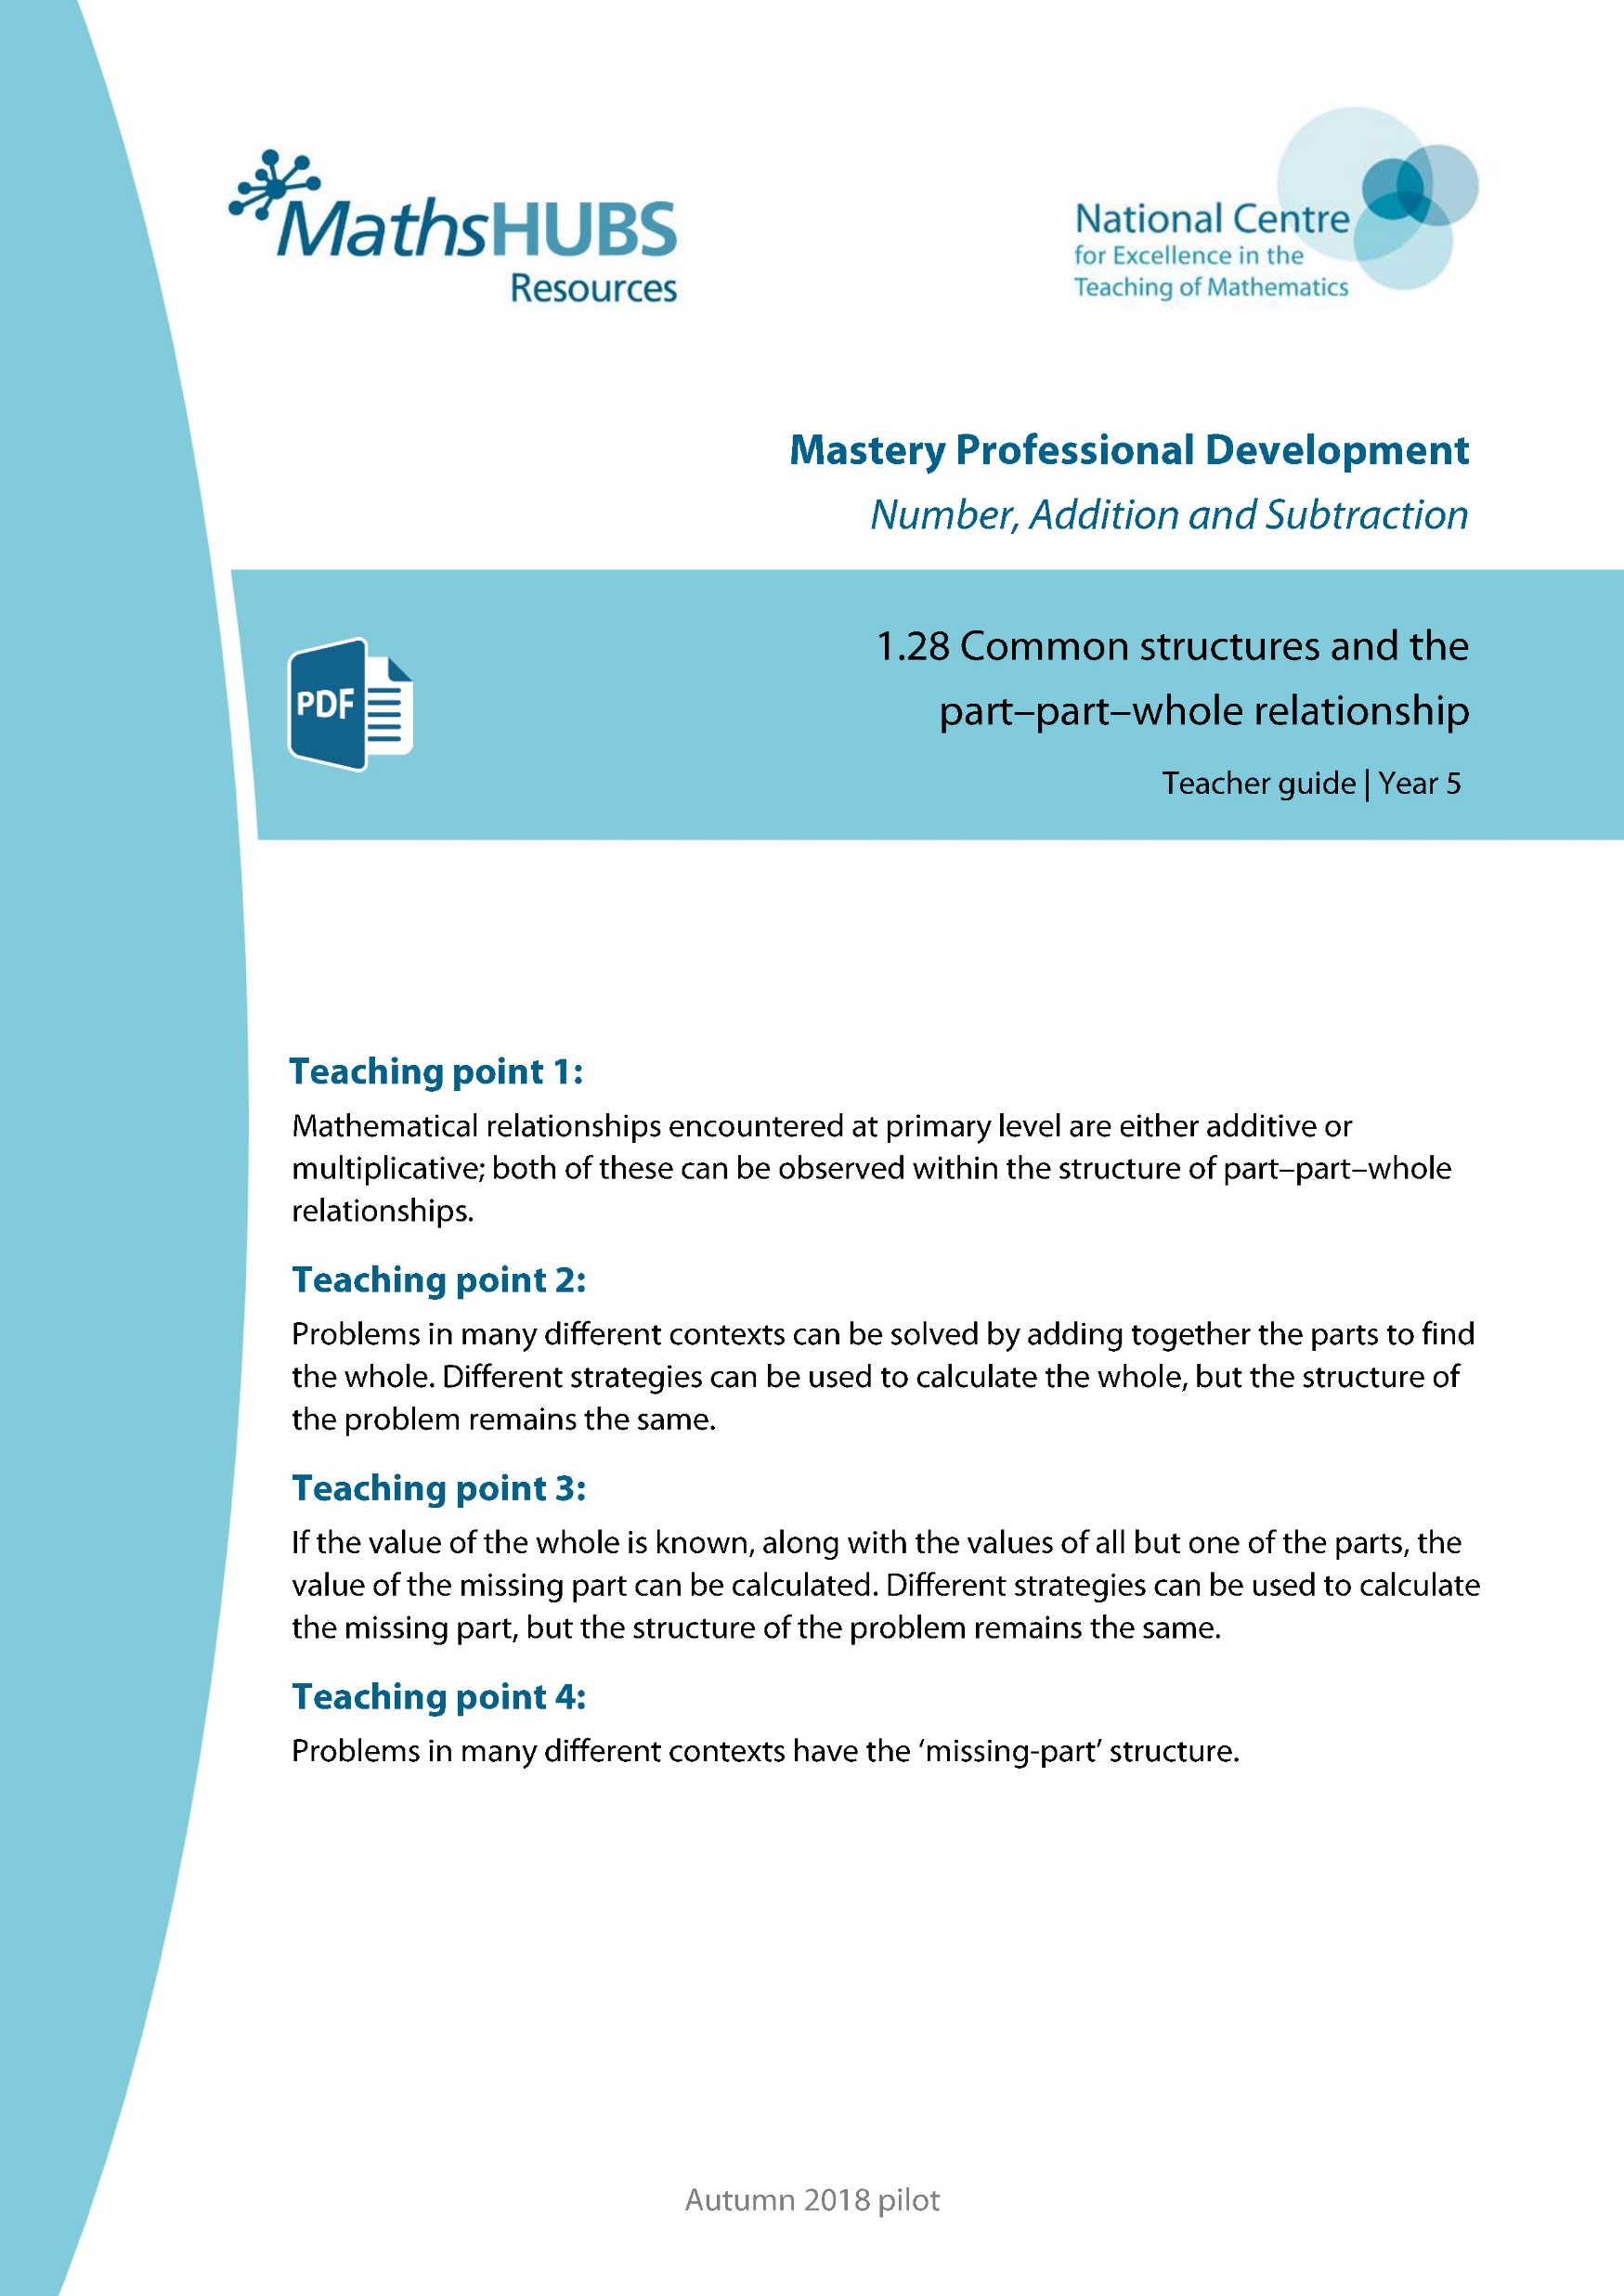
Year 6, Unit 1, Learning Outcome 1
Additional teacher guidance for this outcome should be read first and can be found in this segment of the NCETM Primary Mastery Professional Development Materials:
1.28 Common structures and the part-part-whole relationship
The spine materials are divided into ‘teaching points’ and ‘steps in learning’.
Teaching point | Steps in learning | Pages
1 | 1:1 - 1:3 | 4-7

Slide 10
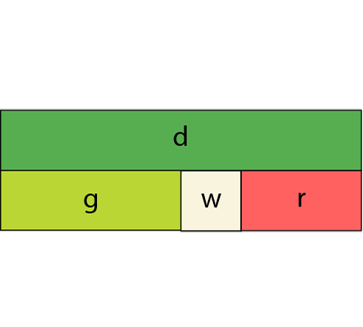
1.28 Common structures – step 1:1
Notes:
Additive – combining or partitioning

Slide 11
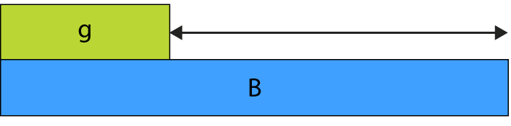
1.28 Common structures – step 1:1
Notes:
Additive – comparative

Slide 12
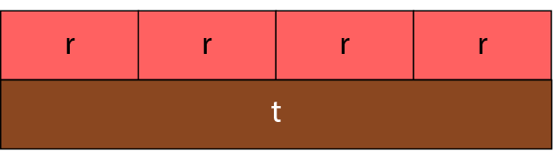
1.28 Common structures – step 1:1
Notes:
Additive or multiplicative

Slide 13
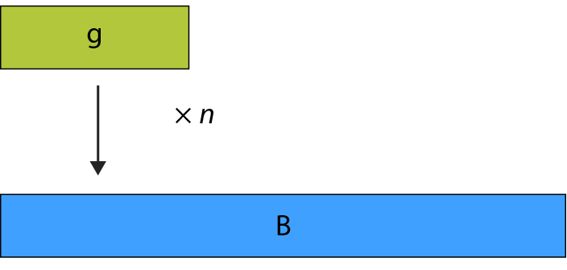
1.28 Common structures – step 1:1
Notes:
Multiplicative – scaling

Slide 14
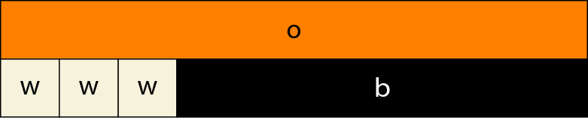
1.28 Common structures – step 1:1
Notes:
Additive and multiplicative combined

Slide 15
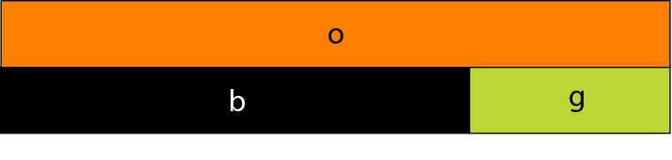
1.28 Common structures – step 1:2
black + light green = orange
b + g = o
orange = black + light green
o = b + g
Notes:
Pair of two different rods (additive)

Slide 16
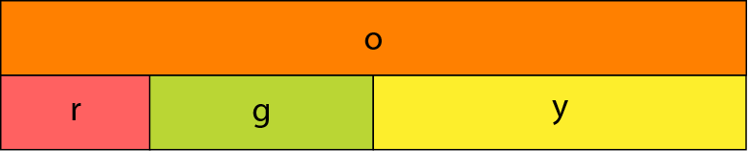
1.28 Common structures – step 1:2
red + light green + yellow = orange
r + g + y = o
Notes:
Group of three different rods (additive)

Slide 17
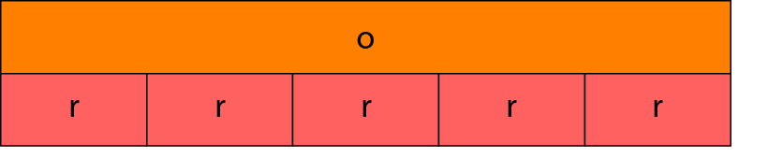
1.28 Common structures – step 1:2
5 × r = o
or
r + r + r + r + r = o
Notes:
Group of identical rods (multiplicative/repeated addition)

Slide 18
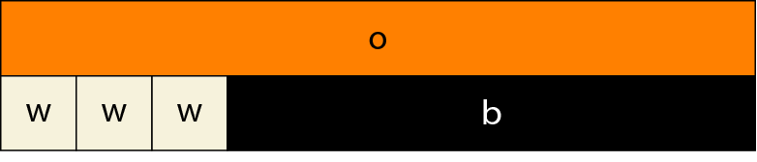
1.28 Common structures – step 1:2
3 × w + b = o
or
w + w + w + b = o
Notes:
A group of identical rods and a different rod (additive and multiplicative)

Slide 19
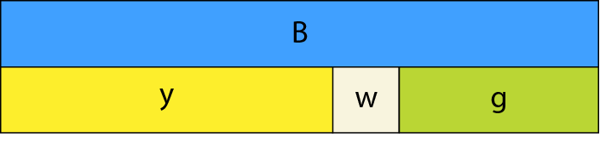
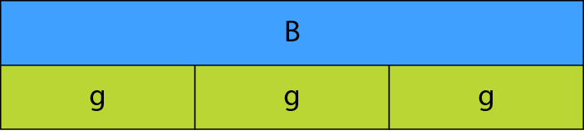
1.28 Common structures – step 1:3
B = y + w + g
B = g + g + g
B = 3 × g
Notes:
Model A (top): additive
Model B (bottom): multiplicative/repeated addition

Slide 20
Year 6, Unit 1, Learning Outcome 2
Learning Outcome 2
Pupils identify structures within stories and use their knowledge of structures to create stories
The following slides have been collated to support the teaching of this learning outcome.

Slide 21
Year 6, Unit 1, Learning Outcome 2
Additional teacher guidance for this outcome should be read first and can be found in this segment of the NCETM Primary Mastery Professional Development Materials:
1.28 Common structures and the part-part-whole relationship
The spine materials are divided into ‘teaching points’ and ‘steps in learning’.
Teaching point | Steps in learning | Pages
1 | 1:4 – 1:6 | 7-10

Slide 22
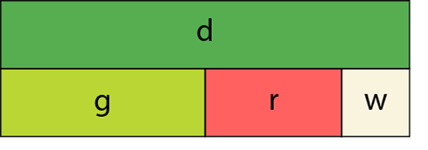
1.28 Common structures – step 1:4
Notes:
Additive: A bowl of fruit contains more apples than oranges, and more oranges than bananas.

Slide 23
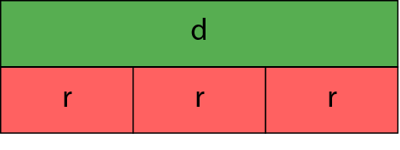
1.28 Common structures – step 1:4
Notes:
Multiplicative/repeated addition: A bowl of fruit contains equal quantities of apples, oranges and bananas.

Slide 24
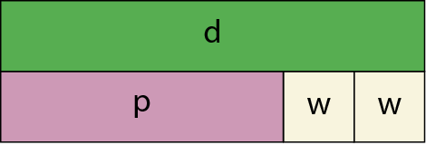
1.28 Common structures – step 1:4
Notes:
Additive and multiplicative combined: A bowl of fruit contains mostly apples, and equal numbers of oranges and bananas.

Slide 25
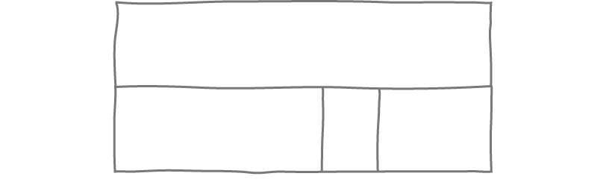
1.28 Common structures – step 1:5
Notes:
Additive: I have a four-metre length of wood. I cut it into three pieces of 2.2 m, 0.6 m and 1.2 m.

Slide 26
Year 6, Unit 1, Learning Outcome 3
Learning Outcome 3
Pupils identify the missing part using their knowledge of part-whole relationships and structures
The following slides have been collated to support the teaching of this learning outcome.

Slide 27
Year 6, Unit 1, Learning Outcome 3
Additional teacher guidance for this outcome should be read first and can be found in this segment of the NCETM Primary Mastery Professional Development Materials:
1.28 Common structures and the part-part-whole relationship
The spine materials are divided into ‘teaching points’ and ‘steps in learning’.
Teaching point | Steps in learning | Pages
1 | 1:7 | 11

Slide 28
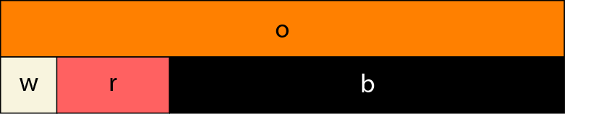
1.28 Common structures – step 1:7
Notes:
All parts known/no missing parts

Slide 29
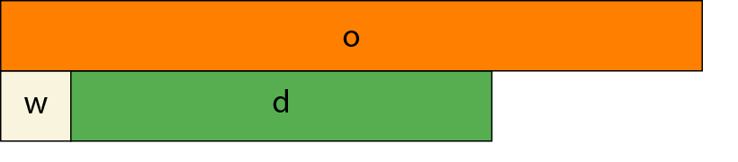
1.28 Common structures – step 1:7
Notes:
Two parts known/one part missing

Slide 30

1.28 Common structures – step 1:7
Notes:
One part known/two parts missing

Slide 31
6AS/MD-1 Quantify additive and multiplicative relationships
Click to reveal both bar models and related equations. What’s the same? What’s different?
Which bar model shows an additive relationship? Why? Explain how you know.
Which bar model shows a multiplicative relationship? Why? Explain how you know.
What does this tell us about how the relationship between two numbers can be expressed?
1,000
250
750
250 + 750 = 1,000
1,000 – 750 = 250
1,000
250
The relationship between two numbers can be expressed additively or multiplicatively.
250 x 4 = 1,000
1000 ÷ 4 = 250

Slide 32
6AS/MD-1 Quantify additive and multiplicative relationships
+
750
Does this representations show an additive or multiplicative relationship? Why?
What known facts help us to complete the representation?
How can we describe this additive relationship?
What addition and subtraction equations can be written from the representation?
250
1,000
–
750
1,000 is 750 more than 250.
250 is 750 less than 1,000.
+ 750
250 = 1,000
1,000 = 250
– 750

Slide 33

6AS/MD-1 Quantify additive and multiplicative relationships
Does this representations show an additive or multiplicative relationship? Why?
What known facts help us to complete the representation?
How can we describe this multiplicative relationship?
What multiplication and division equations can be written from the representation?
×
4
250
1,000
1,000 is four times the size of 250.
250 is one-quarter of 1,000.
÷
4
× 4
250 = 1,000
To find $\frac{1}{4}$of a number we divide by 4.
1,000 = 250
÷ 4

Slide 34
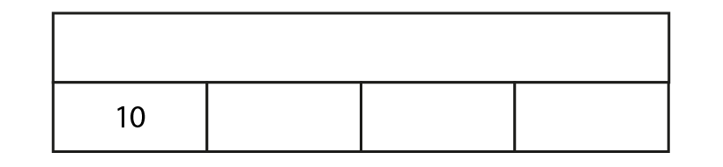
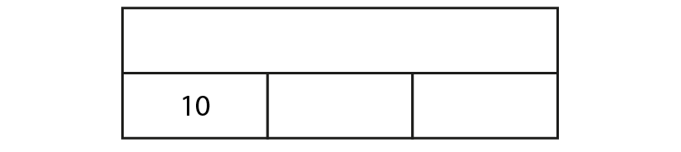


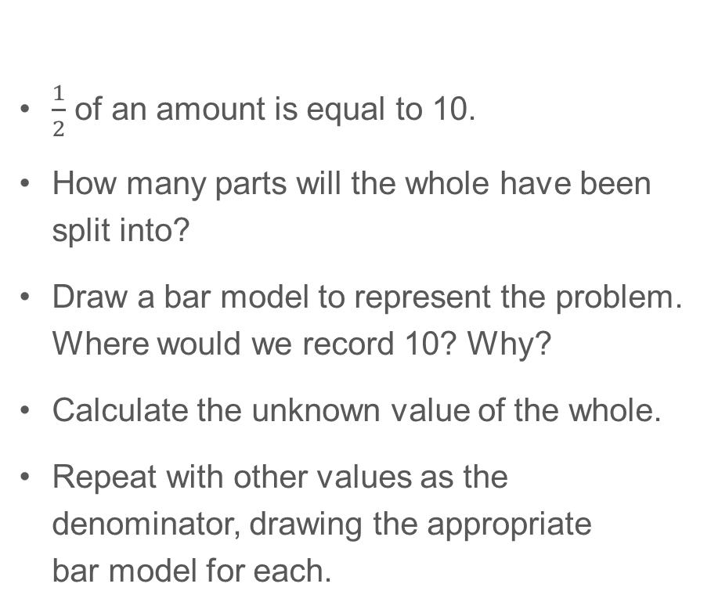
6AS/MD-1 Quantify additive and multiplicative relationships
$\frac{1}{2}$ of an amount is equal to 10.
How many parts will the whole have been split into?
Draw a bar model to represent the problem. Where would we record 10? Why?
Calculate the unknown value of the whole.
Repeat with other values as the denominator, drawing the appropriate bar model for each.
40 = 10
30 = 10
20 = 10
4
3
2

Slide 35
6AS/MD-1 Quantify additive and multiplicative relationships
200 + = 1,200 200 x = 1,200
30 = 3 + 30 = 3 x
+ 0.1 = 1 x 0.1 = 1
Complete these calculations and consider the difference between additive and multiplicative relationships.

Slide 36
Year 6, Unit 1, Learning Outcome 4
Learning Outcome 4
Pupils interpret and represent a part whole problem with 3 addends using a model
The following slides have been collated to support the teaching of this learning outcome.

Slide 37
Year 6, Unit 1, Learning Outcome 4
Additional teacher guidance for this outcome should be read first and can be found in this segment of the NCETM Primary Mastery Professional Development Materials:
1.28 Common structures and the part-part-whole relationship
The spine materials are divided into ‘teaching points’ and ‘steps in learning’.
Teaching point | Steps in learning | Pages
2 | 2:1 – 2:4 | 12-15

Slide 38
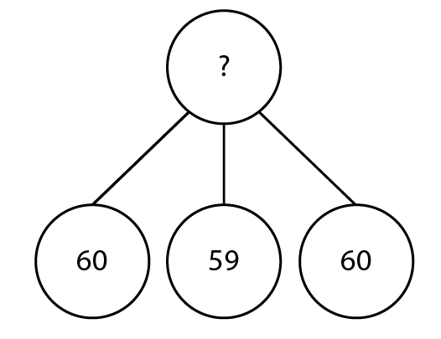
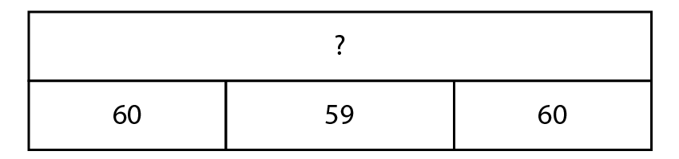
1.28 Common structures – step 2:1
Year group | Number of children
Reception | 60
Year 1 | 59
Year 2 | 60
Notes:
Draw a diagram to represent the total number of children in Reception, Year One and Year Two.

Slide 39
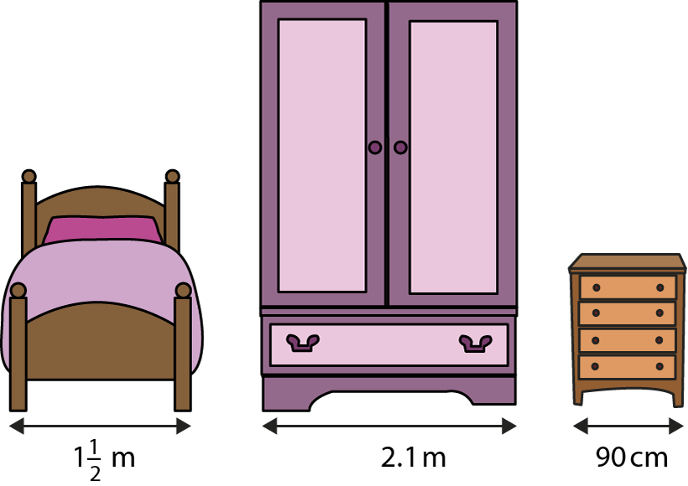
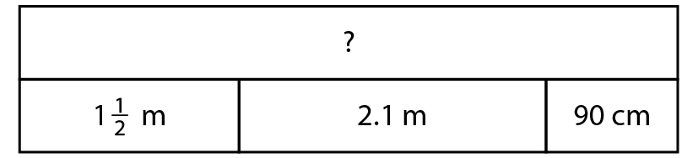
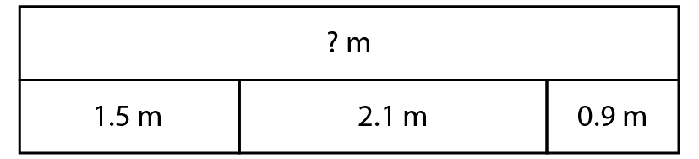
1.28 Common structures – step 2:3
Notes:
If I line the three pieces of furniture up along a wall, side-by-side, how much width do they take up?

Slide 40
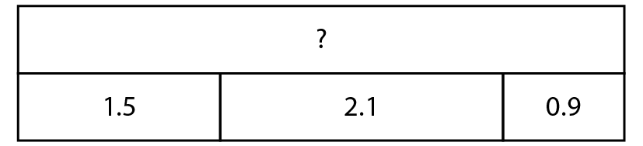
1.28 Common structures – step 2:4
Notes:
Tell a story to go with this representation.

Slide 41
Year 6, Unit 1, Learning Outcome 5
Learning Outcome 5
Pupils create stories to correctly match a structure presented in a model
The following slides have been collated to support the teaching of this learning outcome.

Slide 42
Year 6, Unit 1, Learning Outcome 5
Additional teacher guidance for this outcome should be read first and can be found in this segment of the NCETM Primary Mastery Professional Development Materials:
1.28 Common structures and the part-part-whole relationship
The spine materials are divided into ‘teaching points’ and ‘steps in learning’.
Teaching point | Steps in learning | Pages
2 | 2:5 – 2:6 | 16

Slide 43
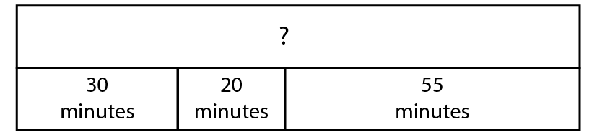
1.28 Common structures – step 2:5
30 + 20 + 55
= 50 + 55
= 105
60
45
= 1 hr 45 mins
55 + 5 = 60
1 hr 45 mins
30 + 15 = 45
Notes:
Tell a story to go with this representation.

Slide 44
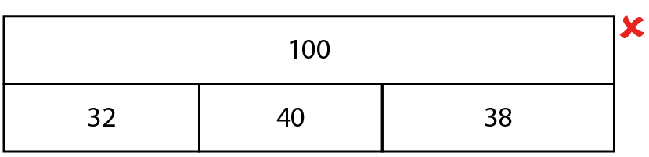
1.28 Common structures – step 2:6
Notes:
100 children choose a sport at an activity afternoon. 32 choose football, 40 choose basketball and 38 choose rounders.
How could you change the bar model to make it correct?

Slide 45
Year 6, Unit 1, Learning Outcome 6
Learning Outcome 6
Pupils use their knowledge of additive structures to solve problems
The following slides have been collated to support the teaching of this learning outcome.

Slide 46
Year 6, Unit 1, Learning Outcome 6
Additional teacher guidance for this outcome should be read first and can be found in this segment of the NCETM Primary Mastery Professional Development Materials:
1.28 Common structures and the part-part-whole relationship
The spine materials are divided into ‘teaching points’ and ‘steps in learning’.
Teaching point | Steps in learning | Pages
2 | 2:7 | 17-18

Slide 47
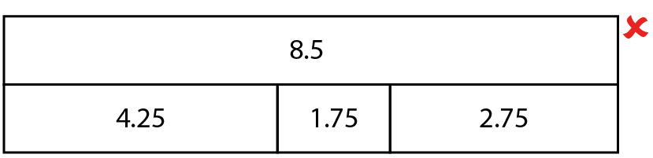
1.28 Common structures – step 2:7
Notes:
Noah draws this diagram.
Is it correct?
How could you change it to make it correct?
Can you think of another way?
And another?

Slide 48
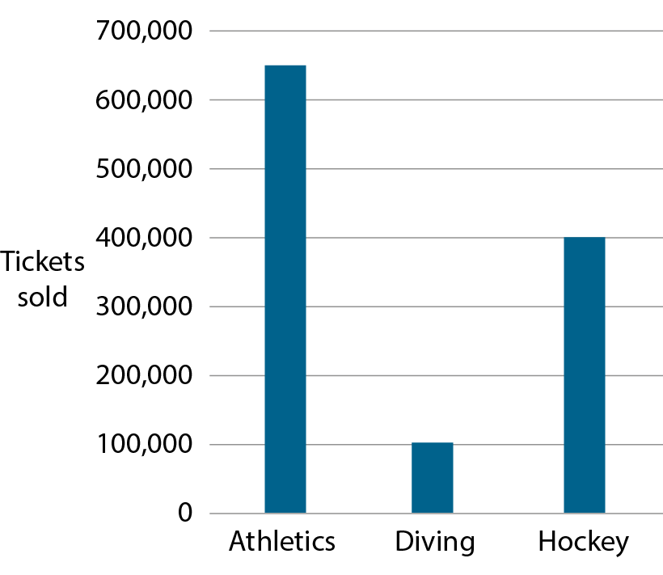
1.28 Common structures – step 2:7
Source: London Datastore
Public sector information licensed under the
Open Government Licence v2.0
Notes:
The graph shows the approximate number of tickets sold for three different events at the 2012 London Olympics. Each value is rounded to the nearest 50,000.
Felicity says that about 1,100,000 tickets were sold in total for these three events. Is she correct?
Source: London Datastore, Public sector information licensed under the Open Government Licence v2.0
http://www.nationalarchives.gov.uk/doc/open-government-licence/version/2/

Slide 49
1.28 Common structures – step 2:7
Island | Approximate population in 2016 (thousands)
Isle of Wight
Isle of Man
Guernsey
Jersey
140
83
62
104
Notes:
The table shows the population of four islands. What is the total population of all four islands?

Slide 50
Year 6, Unit 1, Learning Outcome 7
Learning Outcome 7
Pupils calculate the value of a missing part (1)
The following slides have been collated to support the teaching of this learning outcome.

Slide 51
Year 6, Unit 1, Learning Outcome 7
Additional teacher guidance for this outcome should be read first and can be found in this segment of the NCETM Primary Mastery Professional Development Materials:
1.28 Common structures and the part-part-whole relationship
The spine materials are divided into ‘teaching points’ and ‘steps in learning’.
Teaching point | Steps in learning | Pages
3 | 3:1 – 3:3 | 19-22

Slide 52
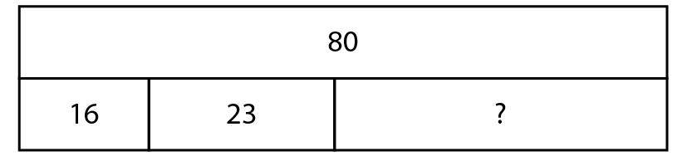

1.28 Common structures – step 3:1
80 – 16 = 64
64 – 23 = 41
16 + 23 = 39
80 – 39 = 41
Notes:
80 children chose an orange, apple or banana for fruit break. 16 children chose oranges and 23 chose apples. How many chose bananas?

Slide 53
Year 6, Unit 1, Learning Outcome 8
Learning Outcome 8
Pupils calculate the value of a missing part (2)
The following slides have been collated to support the teaching of this learning outcome.

Slide 54
Year 6, Unit 1, Learning Outcome 8
Additional teacher guidance for this outcome should be read first and can be found in this segment of the NCETM Primary Mastery Professional Development Materials:
1.28 Common structures and the part-part-whole relationship
The spine materials are divided into ‘teaching points’ and ‘steps in learning’.
Teaching point | Steps in learning | Pages
3 | 3:4 – 3:5 | 22-23

Slide 55
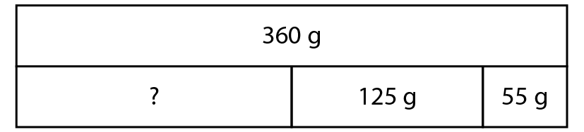

1.28 Common structures – step 3:4
0
Notes:
Jack mixes together some flour, 125 g butter and 55 g sugar. All the ingredients together weigh 360 g. How much flour does Jack use?

Slide 56
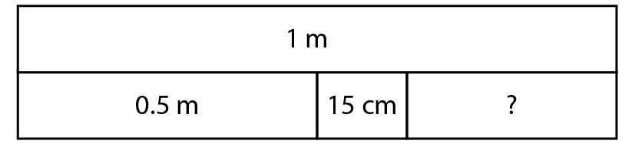
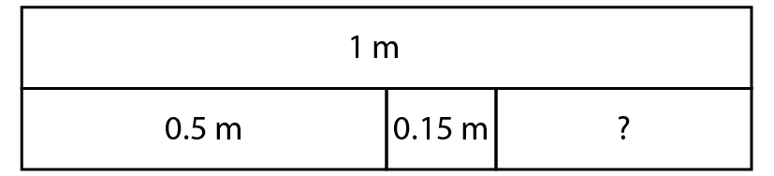

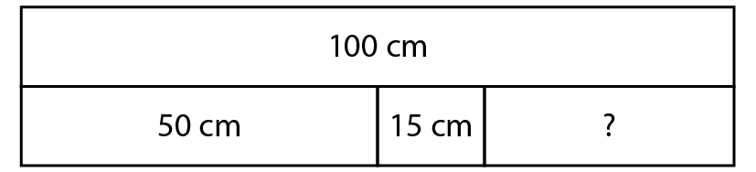

1.28 Common structures – step 3:4
0
0
0
Notes:
I have 1 m of ribbon. I cut off 0.5 m to use for a hair tie and another 15 cm to use for a bracelet. How much do I have left?

Slide 57
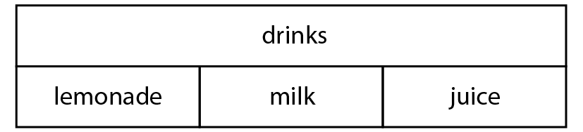

1.28 Common structures – step 3:5
 | True or false?
lemonade + milk + juice = drinks
drinks – lemonade = milk + juice
milk = drinks – juice
✓
✓
Notes:
Rahul is solving a word problem involving favourite drinks. He draws this representation.
Use Rahul’s model to decide whether the following equations are true or false.

Slide 58
1.28 Common structures – step 3:5
juice = drinks – lemonade – milk
_______ = drinks – lemonade – juice
milk
lemonade = _______ – milk – ______
drinks
juice
Notes:
Rahul writes a correct equation. Complete the similar equations.

Slide 59
1.28 Common structures – step 3:5
 | Year 1 | Year 2 | Year 3
Number of children asked about their favourite drink | 62 | 58 | 59
Number who like milk best |  | 13 | 21
Number who like lemonade best | 20 |  | 18
Number who like juice best | 12 | 35
30
10
20
Notes:
Use the equations to complete this table of data about different year groups’ favourite drinks.

Slide 60
Year 6, Unit 1, Learning Outcome 9
Learning Outcome 9
Pupils correctly represent an equation in a part-whole model
The following slides have been collated to support the teaching of this learning outcome.

Slide 61
Year 6, Unit 1, Learning Outcome 9
Additional teacher guidance for this outcome should be read first and can be found in this segment of the NCETM Primary Mastery Professional Development Materials:
1.28 Common structures and the part-part-whole relationship
The spine materials are divided into ‘teaching points’ and ‘steps in learning’.
Teaching point | Steps in learning | Pages
3 | 3:6 – 3:7 | 24-26

Slide 62
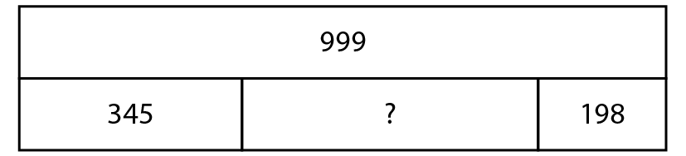
1.28 Common structures – step 3:6
999
=
345 + +198
whole
three parts

Slide 63
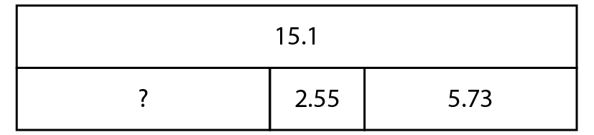
1.28 Common structures – step 3:6
15.1
=
+ 2.55 + 5.73
whole
three parts

Slide 64
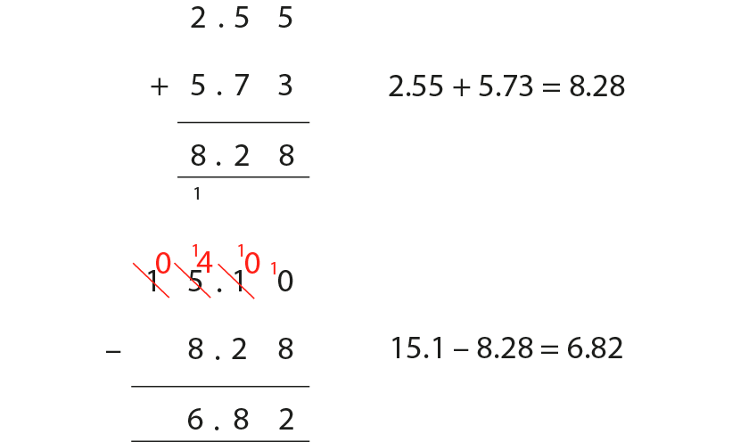
1.28 Common structures – step 3:6

Slide 65
Year 6, Unit 1, Learning Outcome 10
Learning Outcome 10
Pupils explain how adjusting both addends affects the sum (2 digit numbers)
The following slides have been collated to support the teaching of this learning outcome.

Slide 66
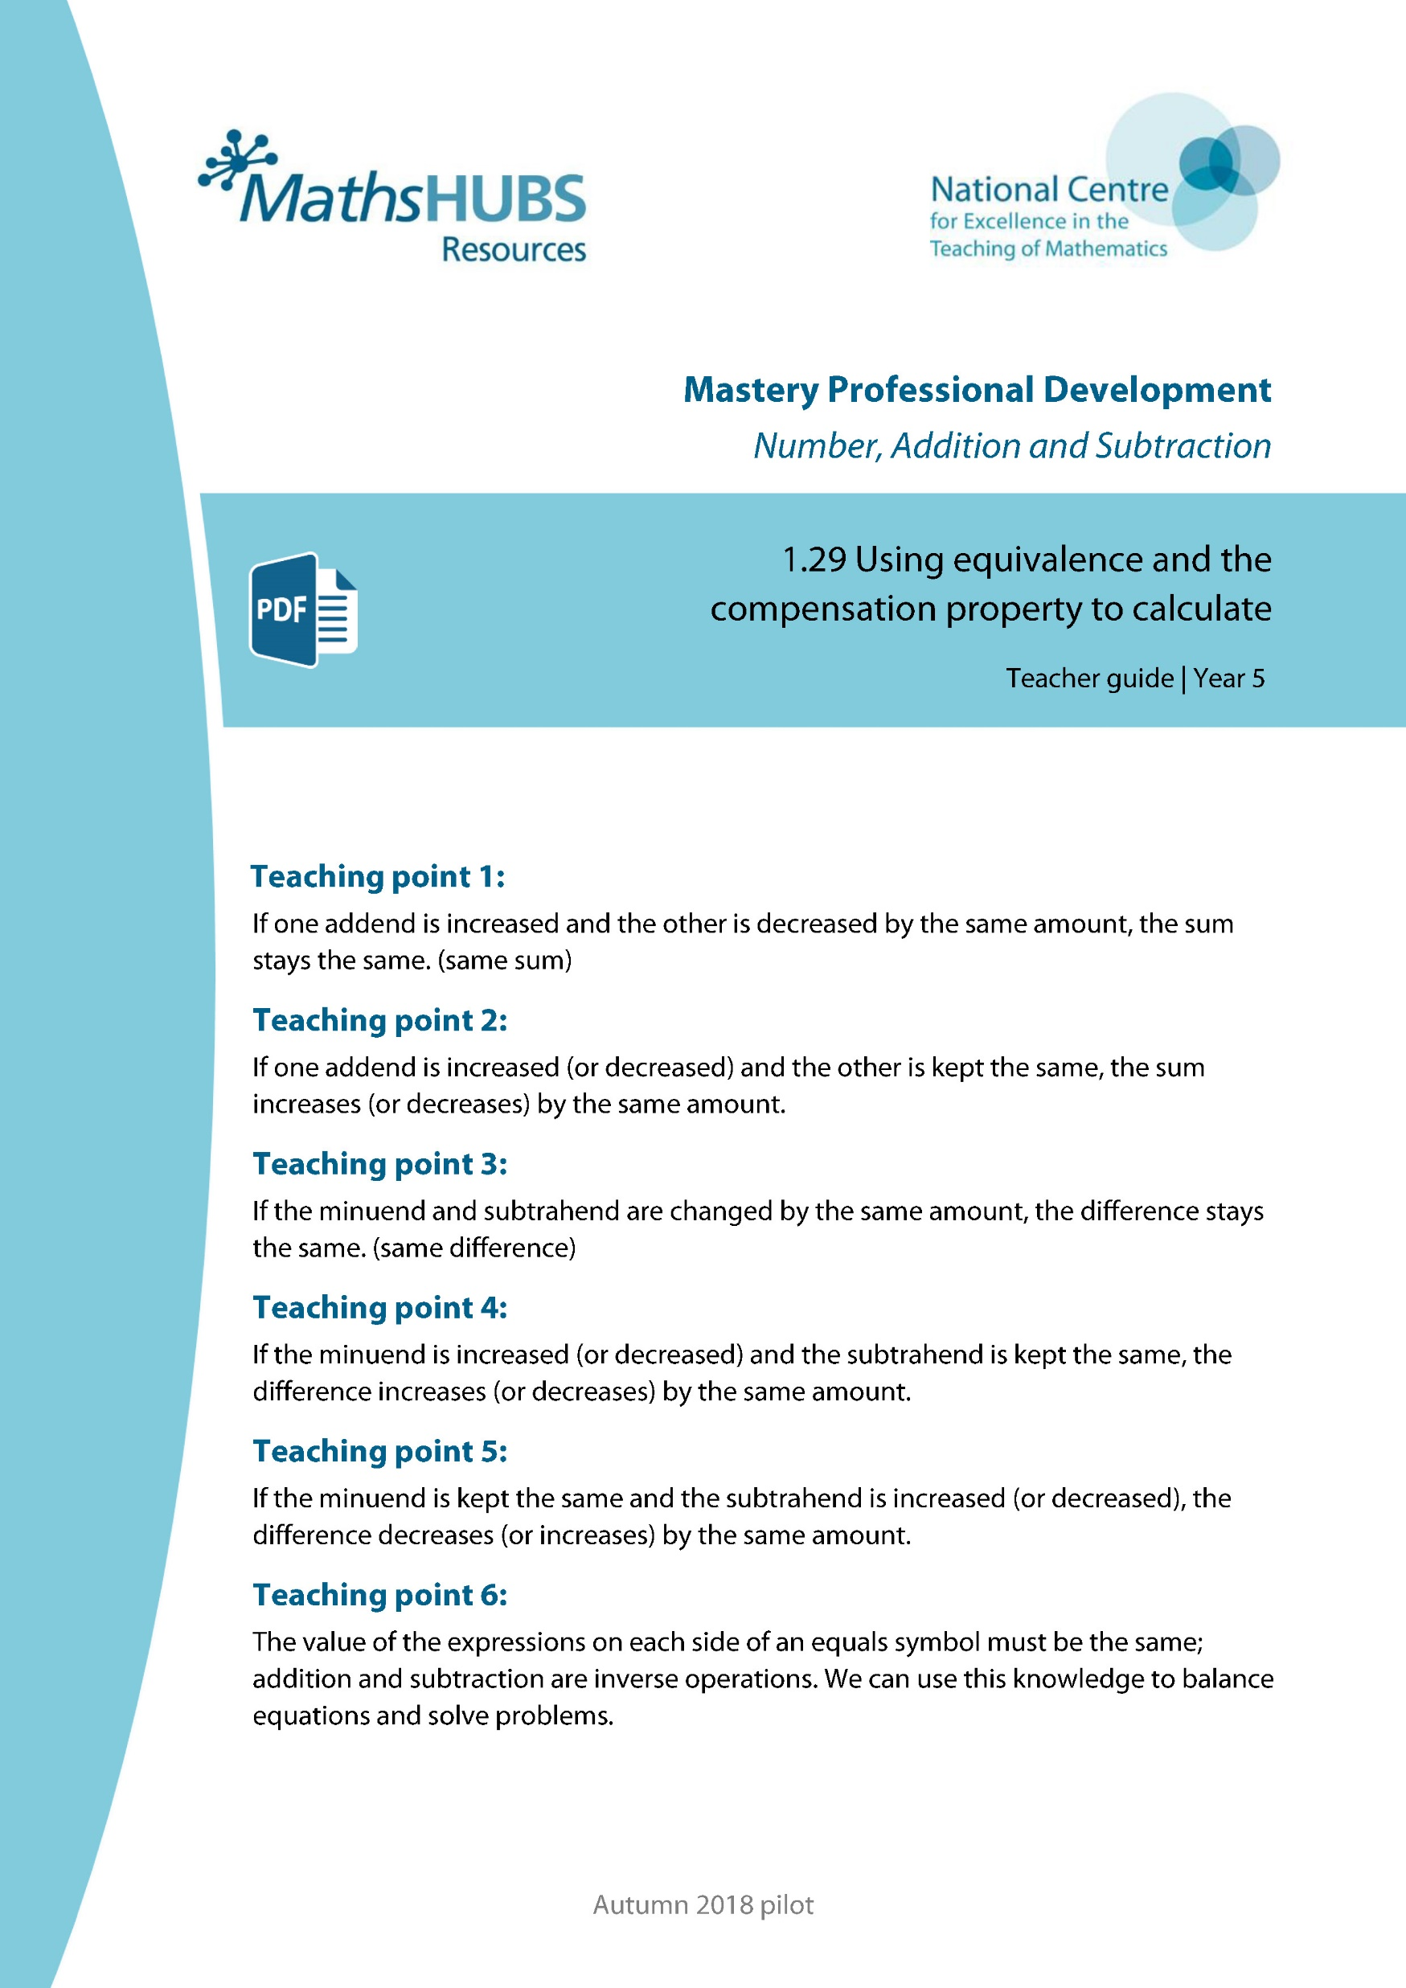
Year 6, Unit 1, Learning Outcome 10
Additional teacher guidance for this outcome should be read first and can be found in this segment of the NCETM Primary Mastery Professional Development Materials:
1.29 Using equivalence and the compensation category to calculate
The spine materials are divided into ‘teaching points’ and ‘steps in learning’.
Teaching point | Steps in learning | Pages
1 | 1:1 – 1:2 & 1:10 | 4-6 & 11-12

Slide 67
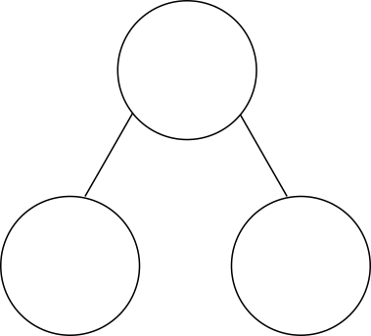


1.29 Equivalence and compensation – step 1:1
27 + 18
= 25 + 20
= 45
45

Slide 68

1.29 Equivalence and compensation – step 1:1
27 + 18
= 25 + 20
= 45
27
+
18
=
45
− 2
+ 2
25
+
20
=
45

Slide 69
1.29 Equivalence and compensation – step 1:2
199,999 + 345,222
= 200,000 + 345,221
= 545,221
1
345,221

Slide 70
1.29 Equivalence and compensation – step 1:2
199,999 + 345,222
= 200,000 + 345,221
= 545,221
199,999
+
345,222
=
545,221
+ 1
− 1
200,000
+
345,221
=
545,221

Slide 71
1.29 Equivalence and compensation – step 1:2
7,656 + 89,994
= 7,650 + 90,000
= 97,650
7,650
6

Slide 72
1.29 Equivalence and compensation – step 1:2
7,656 + 89,994
= 7,650 + 90,000
= 97,650
7,656
+
89,994
=
97,650
− 6
+ 6
7,650
+
90,000
=
97,650

Slide 73
1.29 Equivalence and compensation – step 1:10
 | ✓ or ✗
101 + 99 = 100 + 100 | ✓
27 + 56 = 28 + 57 | ✗
248,000 + 564,000 = 148,000 + 464,000 | ✗
0.27 + 0.56 = 0.23 + 0.6 | ✓
✓
✗
✗
✓

Slide 74
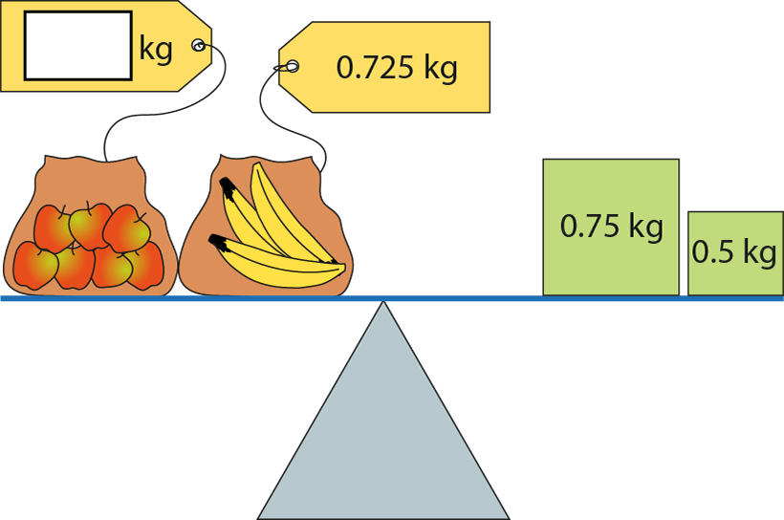
1.29 Equivalence and compensation – step 1:10
0.525

Slide 75
Year 6, Unit 1, Learning Outcome 11
Learning Outcome 11
Pupils explain how adjusting both addends affects the sum (decimal fractions)
The following slides have been collated to support the teaching of this learning outcome.

Slide 76
Year 6, Unit 1, Learning Outcome 11
Additional teacher guidance for this outcome should be read first and can be found in this segment of the NCETM Primary Mastery Professional Development Materials:
1.29 Using equivalence and the compensation category to calculate
The spine materials are divided into ‘teaching points’ and ‘steps in learning’.
Teaching point | Steps in learning | Pages
1 | 1:3 – 1:4 & 1:10 | 6-7 & 11-12

Slide 77
1.29 Equivalence and compensation – step 1:3
5.3 + 3.98
= 5.28 + 4.0
= 9.28
5.3
+
3.98
=
9.28
− 0.02
+ 0.02
5.28
+
4.0
=
9.28

Slide 78
1.29 Equivalence and compensation – step 1:3
5.3 + 3.98
= 5.0 + 4.28
= 9.28
5.3
+
3.98
=
9.28
− 0.3
+ 0.3
5.0
+
4.28
=
9.28

Slide 79
1.29 Equivalence and compensation – step 1:10
 | ✓ or ✗
101 + 99 = 100 + 100 | ✓
27 + 56 = 28 + 57 | ✗
248,000 + 564,000 = 148,000 + 464,000 | ✗
0.27 + 0.56 = 0.23 + 0.6 | ✓
✓
✗
✗
✓

Slide 80
1.29 Equivalence and compensation – step 1:10
0.525

Slide 81
6AS/MD-2 Derive related calculations
Use the first calculation to derive the missing term in the second calculation.
Explain your reasoning.
14.8 + 7.6 = 22.4
12.8 + = 22.4
12.8 + 9.6 = 22.4

Slide 82
Year 6, Unit 1, Learning Outcome 12
Learning Outcome 12
Pupils use the ‘same sum’ rule to balance equations
The following slides have been collated to support the teaching of this learning outcome.

Slide 83
Year 6, Unit 1, Learning Outcome 12
Additional teacher guidance for this outcome should be read first and can be found in this segment of the NCETM Primary Mastery Professional Development Materials:
1.29 Using equivalence and the compensation category to calculate
The spine materials are divided into ‘teaching points’ and ‘steps in learning’.
Teaching point | Steps in learning | Pages
1 | 1:5 – 1:7 & 1:10 | 7-9 & 11-12

Slide 84
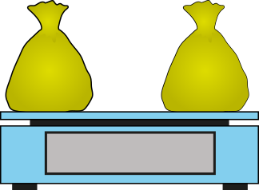

1.29 Equivalence and compensation – step 1:5
45 g

Slide 85
1.29 Equivalence and compensation – step 1:5
5 g
35
+
10
=
45
30 g
15 g
35 g
10 g
− 5
+ 5
45 g
30
+
15
=
45
So 35 + 10 = 30 + 15

Slide 86
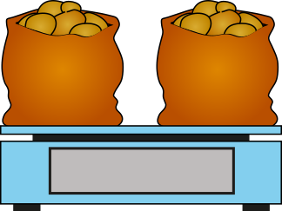
1.29 Equivalence and compensation – step 1:6
340 g
5,300
+
4,700
=
10,000
4,960 g
5,040 g
5,300 g
4,700 g
− 340
+ 340
10,000 g
4,960
+
5,040
=
10,000
So 5,300 + 4,700 = 4,960 + 5,040

Slide 87
1.29 Equivalence and compensation – step 1:6
0.34 kg
5.3
+
4.7
=
10
4.96 kg
5.04 kg
5.3 kg
4.7 kg
− 0.34
+ 0.34
10 kg
4.96
+
5.04
=
10
So 5.3 + 4.7 = 4.96 + 5.04

Slide 88

1.29 Equivalence and compensation – step 1:7
5,300 − 340 + 4,700 + 340
=
10,000

Slide 89
1.29 Equivalence and compensation – step 1:10
 | ✓ or ✗
101 + 99 = 100 + 100 | ✓
27 + 56 = 28 + 57 | ✗
248,000 + 564,000 = 148,000 + 464,000 | ✗
0.27 + 0.56 = 0.23 + 0.6 | ✓
✓
✗
✗
✓

Slide 90
1.29 Equivalence and compensation – step 1:10
0.525

Slide 91
Year 6, Unit 1, Learning Outcome 13
Learning Outcome 13
Pupils use the ‘same sum’ rule to balance equations with an unknown
The following slides have been collated to support the teaching of this learning outcome.

Slide 92
Year 6, Unit 1, Learning Outcome 13
Additional teacher guidance for this outcome should be read first and can be found in this segment of the NCETM Primary Mastery Professional Development Materials:
1.29 Using equivalence and the compensation category to calculate
The spine materials are divided into ‘teaching points’ and ‘steps in learning’.
Teaching point | Steps in learning | Pages
1 | 1:8 – 1:10 | 9-12

Slide 93



1.29 Equivalence and compensation – step 1:8
28 + 32
=
29 +
31
+ 1
28
+
32
=
29
+
31
− 1
Notes:
There is the same number of children in Year 5 as there is in Year 6. In Year 5, there are 28 boys and 32 girls. In Year 6, there are 29 boys. How many girls are there in Year 6?

Slide 94
1.29 Equivalence and compensation – step 1:8
30 + 25
=
40
+ 15
+ 10
30
+
25
=
40
+
15
− 10
Notes:
Sally plans to buy 30 bottles of cola and 25 bottles of juice for a party. When she gets to the shop, they only have 15 bottles of juice, but she wants to buy the same number of bottles of drink in total. If she buys all 15 bottles of juice, how many bottles of cola will she need to buy?

Slide 95


1.29 Equivalence and compensation – step 1:9
46.25
+ 0.45
=
16.45 + 30.25
+ 16
46.25
+
0.45
=
16.45
+
30.25
− 16

Slide 96
1.29 Equivalence and compensation – step 1:10
 | ✓ or ✗
101 + 99 = 100 + 100 | ✓
27 + 56 = 28 + 57 | ✗
248,000 + 564,000 = 148,000 + 464,000 | ✗
0.27 + 0.56 = 0.23 + 0.6 | ✓
✓
✗
✗
✓

Slide 97
1.29 Equivalence and compensation – step 1:10
0.525

Slide 98
Year 6, Unit 1, Learning Outcome 14
Learning Outcome 14
Pupils explain how adjusting one addend affects the sum
The following slides have been collated to support the teaching of this learning outcome.

Slide 99
Year 6, Unit 1, Learning Outcome 14
Additional teacher guidance for this outcome should be read first and can be found in this segment of the NCETM Primary Mastery Professional Development Materials:
1.29 Using equivalence and the compensation category to calculate
The spine materials are divided into ‘teaching points’ and ‘steps in learning’.
Teaching point | Steps in learning | Pages
2 | 2:1 – 2:4 | 13-16

Slide 100

1.29 Equivalence and compensation – step 2:1
3
+
6
=
9
23
+
6
=
29
Notes:
Diego walked for three minutes to get to his friend’s house, and then walked for another six minutes to get to school. His journey took nine minutes altogether.
Dana walked for twenty-three minutes to get to her friend’s house, and then walked for another six minutes to get to school. Her journey took twenty nine minutes altogether.

Slide 101
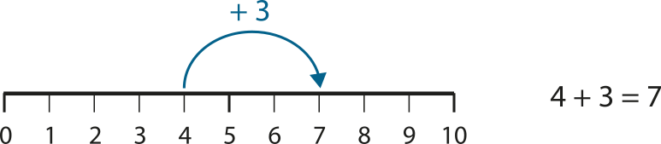
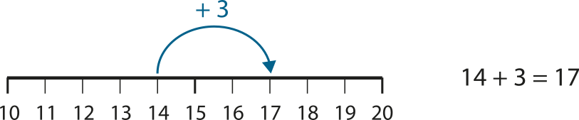
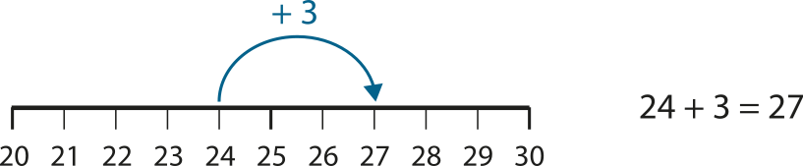
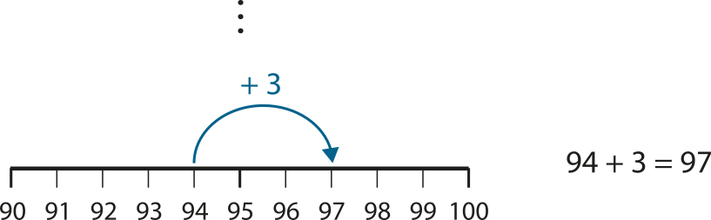
1.29 Equivalence and compensation – step 2:1

Slide 102
1.29 Equivalence and compensation – step 2:1
4
+
3
=
7
+ 10
+ 10
14
+
3
=
17

Slide 103
1.29 Equivalence and compensation – step 2:2
96
+
4
=
100
− 30
− 30
66
+
4
=
70

Slide 104


1.29 Equivalence and compensation – step 2:3
100
57
43
110
57 + 10
43
57
+
43
=
100
+ 10
+ 10
67
+
43
=
110
Notes:
Together two children have saved £100. Yameena has saved £57 and Tom has saved £43. Yameena is given another £10. How much do they have now?

Slide 105
1.29 Equivalence and compensation – step 2:3
16
+
14
=
30
− 1
− 1
15
+
14
=
29
Notes:
There were 30 children in a class: 16 boys and 14 girls. Then a boy left. How many children are there in the class now?

Slide 106
1.29 Equivalence and compensation – step 2:4
10
10.8
+
0.8
4.6
4.6
+
0.8
5.4
5.4
+
0.8
4.6 + 0.8 + 5.4 = 10 + 0.8
+ 0.8
+ 0.8
= 10.8
4.6 + 5.4 + 0.8 = 10 + 0.8
+ 0.8
+ 0.8
= 10.8
Notes:
The combined mass of two cats is 10 kg. The mass of one cat is 4.6 kg and the mass of the other cat is 5.4 kg. One of the cats gains 0.8 kg. What is their combined mass now?

Slide 107
Year 6, Unit 1, Learning Outcome 15
Learning Outcome 15
Pupils solve addition calculations mentally by using known facts
The following slides have been collated to support the teaching of this learning outcome.

Slide 108
Year 6, Unit 1, Learning Outcome 15
Additional teacher guidance for this outcome should be read first and can be found in this segment of the NCETM Primary Mastery Professional Development Materials:
1.29 Using equivalence and the compensation category to calculate
The spine materials are divided into ‘teaching points’ and ‘steps in learning’.
Teaching point | Steps in learning | Pages
2 | 2:5 – 2:6 | 16-18

Slide 109
1.29 Equivalence and compensation – step 2:5
0.29
+
28.71
=
29
+ 28
+ 28
0.29
+
0.71
=
1

Slide 110
1.29 Equivalence and compensation – step 2:5
646,000
+
54,000
=
700,000
+ 600,000
+ 600,000
46,000
+
54,000
=
100,000

Slide 111
Year 6, Unit 1, Learning Outcome 16
Learning Outcome 16
Pupils solve calculations with missing addends
The following slides have been collated to support the teaching of this learning outcome.

Slide 112
Year 6, Unit 1, Learning Outcome 16
Additional teacher guidance for this outcome should be read first and can be found in this segment of the NCETM Primary Mastery Professional Development Materials:
1.29 Using equivalence and the compensation category to calculate
The spine materials are divided into ‘teaching points’ and ‘steps in learning’.
Teaching point | Steps in learning | Pages
2 | 2:7 – 2:9 | 18-20

Slide 113
1.29 Equivalence and compensation – step 2:7
36
+
47
=
83
+ 2
+ 2
36
+
49
=
85

Slide 114
1.29 Equivalence and compensation – step 2:7
83
85
+ 2
36
47
49
+ 2

Slide 115
1.29 Equivalence and compensation – step 2:7
125
+
239
=
364
− 4
− 4
121
+
239
=
360

Slide 116
1.29 Equivalence and compensation – step 2:7
364
360
− 4
125
121
− 4
239

Slide 117
Year 6, Unit 1, Learning Outcome 17
Learning Outcome 17
Pupils explain how adjusting both the minuend and subtrahend by the same amount affects the difference
The following slides have been collated to support the teaching of this learning outcome.

Slide 118
Year 6, Unit 1, Learning Outcome 17
Additional teacher guidance for this outcome should be read first and can be found in this segment of the NCETM Primary Mastery Professional Development Materials:
1.29 Using equivalence and the compensation category to calculate
The spine materials are divided into ‘teaching points’ and ‘steps in learning’.
Teaching point | Steps in learning | Pages
3 | 3:1 – 3:5 | 21-25

Slide 119

1.29 Equivalence and compensation – step 3:1

Slide 120

1.29 Equivalence and compensation – step 3:1

Slide 121

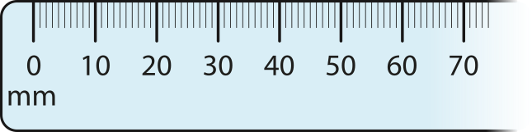
1.29 Equivalence and compensation – step 3:1
45 − 0 = 45
55 − 10 = 45
65 − 20 = 45

Slide 122

1.29 Equivalence and compensation – step 3:2
Notes:
Jim was 25 years old when his son, Max, was born. What is the difference between their ages?
When Jim is 30, Max is 5. What is the difference between their ages?
When Jim is 35, Max is 10. What is the difference between their ages?
When Jim is 40, Max is 15. What is the difference between their ages?
Is the difference between their ages always going to remain the same?
How old will Max be when Jim is 75?

Slide 123

1.29 Equivalence and compensation – step 3:2
Amount in Jack’s bottle (ml) | Amount in Sila’s bottle (ml) | Difference between Jack and Sila’s bottles (ml)
3,000
2,000
1,000
2,750
1,750
1,000
2,500
1,500
1,000
2,250
1,250
1,000
Notes:
Jack has a three-litre bottle of drink and Sila has a two-litre bottle of drink. They both pour out three 250 ml glasses of drink. What is the difference between the amounts in their bottles after each glass is poured?

Slide 124
1.29 Equivalence and compensation – step 3:3
4 | − | 1 | = | 3
↑ minuend |  | ↑ subtrahend |  | ↑ difference

Slide 125



1.29 Equivalence and compensation – step 3:3
4 − 1 = 3
5 − 2 = 3
6 − 3 = 3
7 − 4 = 3

Slide 126



1.29 Equivalence and compensation – step 3:4
7 − 4 = 3
6 − 3 = 3
5 − 2 = 3
4 − 1 = 3

Slide 127
Year 6, Unit 1, Learning Outcome 18
Learning Outcome 18
Pupils explain how using the ‘same difference’ rule can make mental calculation easier (1)
The following slides have been collated to support the teaching of this learning outcome.

Slide 128
Year 6, Unit 1, Learning Outcome 18
Additional teacher guidance for this outcome should be read first and can be found in this segment of the NCETM Primary Mastery Professional Development Materials:
1.29 Using equivalence and the compensation category to calculate
The spine materials are divided into ‘teaching points’ and ‘steps in learning’.
Teaching point | Steps in learning | Pages
3 | 3:6 – 3:8 | 25-27

Slide 129


1.29 Equivalence and compensation – step 3:6
53 − 39
= 54 − 40
= 14
14
14

Slide 130
1.29 Equivalence and compensation – step 3:6
53
−
39
=
14
+ 1
+ 1
54
−
40
=
14

Slide 131
1.29 Equivalence and compensation – step 3:7
356
−
289
=
67
+ 11
+ 11
367
−
300
=
67

Slide 132
1.29 Equivalence and compensation – step 3:7
45,228
−
25,203
=
20,025
− 3
− 3
45,225
−
25,200
=
20,025

Slide 133
1.29 Equivalence and compensation – step 3:7
19.72
−
4.94
=
14.78
+ 0.06
+ 0.06
19.78
−
5
=
14.78

Slide 134
Year 6, Unit 1, Learning Outcome 19
Learning Outcome 19
Pupils explain how using the ‘same difference’ rule can make written calculation easier (2)
The following slides have been collated to support the teaching of this learning outcome.

Slide 135
Year 6, Unit 1, Learning Outcome 19
Additional teacher guidance for this outcome should be read first and can be found in this segment of the NCETM Primary Mastery Professional Development Materials:
1.29 Using equivalence and the compensation category to calculate
The spine materials are divided into ‘teaching points’ and ‘steps in learning’.
Teaching point | Steps in learning | Pages
3 | 3:9 – 3:11 | 27-29

Slide 136
1.29 Equivalence and compensation – step 3:9
20,000 − 1,658
1
9
9
9
1
1
1
1
 | 2 | 0 | , | 0 | 0 | 0
− |  | 1 | , | 6 | 5 | 8
1
8
,
3
4
2

Slide 137
1.29 Equivalence and compensation – step 3:9
20,000 − 1,658 = 19,999 − 1,657
20,000 − 1,658
= 18,342
1
9
9
9
1
1
1
1
 | 2 | 0 | , | 0 | 0 | 0
− |  | 1 | , | 6 | 5 | 8
 | 1 | 9 | , | 9 | 9 | 9
− |  | 1 | , | 6 | 5 | 7
1
8
,
3
4
2
1
8
,
3
4
2
18,342
18,342

Slide 138
Year 6, Unit 1, Learning Outcome 20
Learning Outcome 20
Pupils use the ‘same difference’ rule to balance equations
The following slides have been collated to support the teaching of this learning outcome.

Slide 139
Year 6, Unit 1, Learning Outcome 20
Additional teacher guidance for this outcome should be read first and can be found in this segment of the NCETM Primary Mastery Professional Development Materials:
1.29 Using equivalence and the compensation category to calculate
The spine materials are divided into ‘teaching points’ and ‘steps in learning’.
Teaching point | Steps in learning | Pages
3 | 3:12 – 3:13 | 30-31

Slide 140


1.29 Equivalence and compensation – step 3:12

Slide 141
1.29 Equivalence and compensation – step 3:13
10 − 3
=
45 −
38
+ 35
10
−
3
=
45
−
38
+ 35

Slide 142
1.29 Equivalence and compensation – step 3:13
10 − 3
=
54
− 47
+ 44
10
−
3
=
54
−
47
+ 44

Slide 143
Year 6, Unit 1, Learning Outcome 21
Learning Outcome 21
Pupils explain how increasing or decreasing the minuend affects the difference (1)
The following slides have been collated to support the teaching of this learning outcome.

Slide 144
Year 6, Unit 1, Learning Outcome 21
Additional teacher guidance for this outcome should be read first and can be found in this segment of the NCETM Primary Mastery Professional Development Materials:
1.29 Using equivalence and the compensation category to calculate
The spine materials are divided into ‘teaching points’ and ‘steps in learning’.
Teaching point | Steps in learning | Pages
4 | 4:1 – 4:2 | 32-34

Slide 145





1.29 Equivalence and compensation – step 4:1
2
3
1
0
−
3
=
1
2
7
10 − 3 = 7
20 − 3 = 17
30 − 3 = 27
Notes:
Jon has 10 p in his money box. Misha has 3 p in hers. Jon has 7 p more than Misha.
Jon adds 10 p to his money box. He now has 17 p more than Misha.
Jon adds another 10 p to his money box. He now has 17 p more than Misha.

Slide 146
1.29 Equivalence and compensation – step 4:1
10
−
3
=
7
+ 10
+ 10
20
−
3
=
17
+ 10
+ 10
30
−
3
=
27

Slide 147

1.29 Equivalence and compensation – step 4:1
30
20
10
7
7
7
7

Slide 148


1.29 Equivalence and compensation – step 4:2
78
88
98
100 − 2
90 − 2
80 − 2
= 98
= 88
= 78
Notes:
Evie has 100 p in her money box and Hari has 2 p, so Evie has 98 p more than Hari.
On Monday, Evie spends 10 p. She now has 88 p more than Hari.
On Tuesday, Evie spends another 10 p. She now has 78 p more than Hari.

Slide 149
1.29 Equivalence and compensation – step 4:2
100
−
2
=
98
− 10
− 10
90
−
2
=
88
− 10
− 10
80
−
2
=
78

Slide 150
Year 6, Unit 1, Learning Outcome 22
Learning Outcome 22
Pupils explain how increasing or decreasing the minuend affects the difference (2)
The following slides have been collated to support the teaching of this learning outcome.

Slide 151
Year 6, Unit 1, Learning Outcome 22
Additional teacher guidance for this outcome should be read first and can be found in this segment of the NCETM Primary Mastery Professional Development Materials:
1.29 Using equivalence and the compensation category to calculate
The spine materials are divided into ‘teaching points’ and ‘steps in learning’.
Teaching point | Steps in learning | Pages
4 | 4:3 – 4:4 | 35-36

Slide 152
1.29 Equivalence and compensation – step 4:3
16
−
14
=
2
+ 2
+2
18
−
14
=
4
Notes:
There were 16 boys and 14 girls in a class. The difference between the number of boys and girls was 2. Now there are 18 boys in the class, but the number of girls is the same. How many more boys than girls are there now?

Slide 153
1.29 Equivalence and compensation – step 4:3
172
−
138
=
34
− 20
− 20
152
−
138
=
14
Notes:
A blue ribbon was 1 m 72 cm long and a red ribbon was 1 m 38 cm long; so the blue ribbon was 34 cm longer than the red ribbon. Then the blue ribbon was cut down to 1 m 52 cm. How much longer than the red ribbon is the blue ribbon now?

Slide 154
6AS/MD-2 Derive related calculations
Use the first calculation to derive the missing term in the second calculation.
Explain your reasoning.
625 – 148 = 477
625 – 248 =
625 – 248 = 377

Slide 155
Year 6, Unit 1, Learning Outcome 23
Learning Outcome 23
Pupils solve subtraction calculations mentally by using known facts
The following slides have been collated to support the teaching of this learning outcome.

Slide 156
Year 6, Unit 1, Learning Outcome 23
Additional teacher guidance for this outcome should be read first and can be found in this segment of the NCETM Primary Mastery Professional Development Materials:
1.29 Using equivalence and the compensation category to calculate
The spine materials are divided into ‘teaching points’ and ‘steps in learning’.
Teaching point | Steps in learning | Pages
4 | 4:5 | 37-38

Slide 157
1.29 Equivalence and compensation – step 4:5
124
−
0.26
=
123.74
− 123
− 123
+ 123
1
−
0.26
=
0.74

Slide 158
1.29 Equivalence and compensation – step 4:5
374,000
−
24,000
=
350,000
− 300,000
− 300,000
+ 300,000
74,000
−
24,000
=
50,000

Slide 159
6AS/MD-2 Derive related calculations
Use the first calculation to derive the missing term in the second calculation.
Explain your reasoning.
14.8 + 7.6 = 22.4
– 7.6 = 14.8
22.4 – 7.6 = 14.8

Slide 160
Year 6, Unit 1, Learning Outcome 24
Learning Outcome 24
Pupils explain how adjusting the minuend can make mental calculation easier
The following slides have been collated to support the teaching of this learning outcome.

Slide 161
Year 6, Unit 1, Learning Outcome 24
Additional teacher guidance for this outcome should be read first and can be found in this segment of the NCETM Primary Mastery Professional Development Materials:
1.29 Using equivalence and the compensation category to calculate
The spine materials are divided into ‘teaching points’ and ‘steps in learning’.
Teaching point | Steps in learning | Pages
4 | 4:6 – 4:8 | 38-40

Slide 162
1.29 Equivalence and compensation – step 4:6
183
−
49
=
134
+ 6
+ 6
− 6
189
−
49
=
140

Slide 163
1.29 Equivalence and compensation – step 4:6
185
−
46
=
139
+ 1
+ 1
− 1
186
−
46
=
140

Slide 164
1.29 Equivalence and compensation – step 4:7
18
−
0.75
=
17.25
+ 17
+
17
1
−
0.75
=
0.25

Slide 165

1.29 Equivalence and compensation – step 4:8
Week | Standing reach (cm) | Jumping reach (cm) | Score (difference in cm)
1 |  |  | 9
2 |  |  | 8
3 |  |  | 8
4 |  |  | 10
5 | 143 | 154
143
152
143
151
143
151
143
153
11
Notes:
Stephanie wants to learn to jump higher. She records her standing reach height, then the height she reaches when she jumps, to calculate how high she can jump.
Stephanie tests herself each week for five weeks. Stephanie doesn’t get any taller during the five weeks, so her standing reach doesn’t change. Her results are shown in the table, but some of the values are missing. Fill in the missing information.

Slide 166
Year 6, Unit 1, Learning Outcome 25
Learning Outcome 25
Pupils explain how adjusting the subtrahend affects the difference
The following slides have been collated to support the teaching of this learning outcome.

Slide 167
Year 6, Unit 1, Learning Outcome 25
Additional teacher guidance for this outcome should be read first and can be found in this segment of the NCETM Primary Mastery Professional Development Materials:
1.29 Using equivalence and the compensation category to calculate
The spine materials are divided into ‘teaching points’ and ‘steps in learning’.
Teaching point | Steps in learning | Pages
5 | 5:1 | 41-42

Slide 168

1.29 Equivalence and compensation – step 5:1
10 − 4
>
10 − 5
Notes:
Sebastian has 10 marbles. He gives away 4 of them.
Megan also has 10 marbles. If she gives away 5 marbles, will she be left with more or fewer marbles than Sebastian?

Slide 169
1.29 Equivalence and compensation – step 5:1
10 − 4
<
10 − 3
Notes:
Peter also has 10 marbles. If he gives away 3 marbles, will he be left with more or fewer marbles than Sebastian?

Slide 170
Year 6, Unit 1, Learning Outcome 26
Learning Outcome 26
Pupils explain how increasing or decreasing the subtrahend affects the difference
The following slides have been collated to support the teaching of this learning outcome.

Slide 171
Year 6, Unit 1, Learning Outcome 26
Additional teacher guidance for this outcome should be read first and can be found in this segment of the NCETM Primary Mastery Professional Development Materials:
1.29 Using equivalence and the compensation category to calculate
The spine materials are divided into ‘teaching points’ and ‘steps in learning’.
Teaching point | Steps in learning | Pages
5 | 5:2 – 5:3 | 42-44

Slide 172






1.29 Equivalence and compensation – step 5:2
78
98 − 20
= 78
98 − 30
= 68
68
Notes:
Harvey is buying groceries. The bill is £98, but he thinks he has a voucher for £20 off so will only have to pay £78.
Harvey’s voucher is actually worth £30. How much will he have to pay for his groceries?

Slide 173
1.29 Equivalence and compensation – step 5:2
98
20
30
+ 10
78
68
− 10
98
−
20
=
78
+ 10
− 10
98
−
30
=
68

Slide 174







1.29 Equivalence and compensation – step 5:3
200
350 − 150
= 200
350 − 130
= 220
220
Notes:
Raf has saved £150. He wants to buy a game console that costs £350. How much more does he need to save?
Raf goes out with his friends and spends £20 of his savings. He now has £130. How much does he now need to save before he can buy the game console?

Slide 175
1.29 Equivalence and compensation – step 5:3
350
150
130
− 20
200
220
+ 20
350
−
150
=
200
− 20
+ 20
350
−
130
=
220

Slide 176
Year 6, Unit 1, Learning Outcome 27
Learning Outcome 27
Pupils calculate the difference using their knowledge of an adjusted subtrahend (1)
The following slides have been collated to support the teaching of this learning outcome.

Slide 177
Year 6, Unit 1, Learning Outcome 27
Additional teacher guidance for this outcome should be read first and can be found in this segment of the NCETM Primary Mastery Professional Development Materials:
1.29 Using equivalence and the compensation category to calculate
The spine materials are divided into ‘teaching points’ and ‘steps in learning’.
Teaching point | Steps in learning | Pages
5 | 5:4 – 5:5 | 44-46

Slide 178
1.29 Equivalence and compensation – step 5:4
85
−
45
=
40
85
+ 10
− 10
45
+ 10
40
30
− 10
same
30
Notes:
Ciara has 85 marbles; 45 of them are red and the rest are blue, so she has 40 blue marbles. Arjun also has 85 marbles; some of them are red and some of them are blue. He has ten more red marbles than Ciara. How many blue marbles does Arjun have?

Slide 179
1.29 Equivalence and compensation – step 5:4
£5
−
£3.50
=
£1.50
£5
− 50 p
+ 50 p
£3.50
− 50 p
£1.50
£2
+ 50 p
same
£2
Notes:
Leah gets £5 to spend on lunch each day. On Monday she spends £3.50, so she is left with £1.50 to put in her savings. On Tuesday Leah spends 50 p less than she did on Monday. How much does she have left on Tuesday to put in her savings?

Slide 180
Year 6, Unit 1, Learning Outcome 28
Learning Outcome 28
Pupils calculate the difference using their knowledge of an adjusted subtrahend (2)
The following slides have been collated to support the teaching of this learning outcome.

Slide 181
Year 6, Unit 1, Learning Outcome 28
Additional teacher guidance for this outcome should be read first and can be found in this segment of the NCETM Primary Mastery Professional Development Materials:
1.29 Using equivalence and the compensation category to calculate
The spine materials are divided into ‘teaching points’ and ‘steps in learning’.
Teaching point | Steps in learning | Pages
5 | 5:6 – 5:7 | 46-47

Slide 182
1.29 Equivalence and compensation – step 5:6
375,861
−
300,000
=
75,861
+ 100,000
− 100,000
375,861
−
200,000
=
175,861
− 100,000
+ 100,000
375,861
−
100,000
=
275,861

