Slide 1
Series 3 Episode 2
Blockzilla

Slide 2
Practitioner Notes

Slide 3
Episode Description
Blockzilla loves the bigger things in life. Each time he chooses between two things, he has to compare them to find out which is greater. Blockzilla's mouth gives us a clue to some new symbols that helps us to compare quantities.

Slide 4
Maths in the Episode
Greater than or less than
In this episode the inequality symbols are introduced along with the equals symbol. The episode progresses from comparing the size of objects using comparative language e.g. bigger than, taller than etc. to using greater than. The animation of two Numberblocks walking inside the inequality symbol provides memorable imagery to distinguish which is which:
> means is greater than
< means is less than

Slide 5
Using Mathematical Language
Use these stem sentences to rehearse the mathematical ideas in the programme:
“The <tree> is taller than the <house>.”
“<5> is greater than <3>”
“<3> is less than <5>”
Notes:
< > indicates what can be changed in the stem sentence.
Ensure that children hear practitioners say ‘than’ clearly and check that children repeat ‘than’ correctly (not ‘then’).
Talk about how the words ‘taller than’, ‘shorter than’, greater than’ or ‘less than’ are useful when we are comparing the sizes of objects or the number of objects in a set.

Slide 6
Talk and Discuss Together

Slide 7
Talk and Discuss Together
Watch the episode of Numberblocks. Use the following picture as a stimulus. First ask the children what they noticed about Blockzilla and allow them to talk to you and each other.
Blockzilla loves to choose the biggest.
The following slides are designed to stimulate children and adults to talk about the episode and draw out some key aspects of the mathematics.

Slide 8
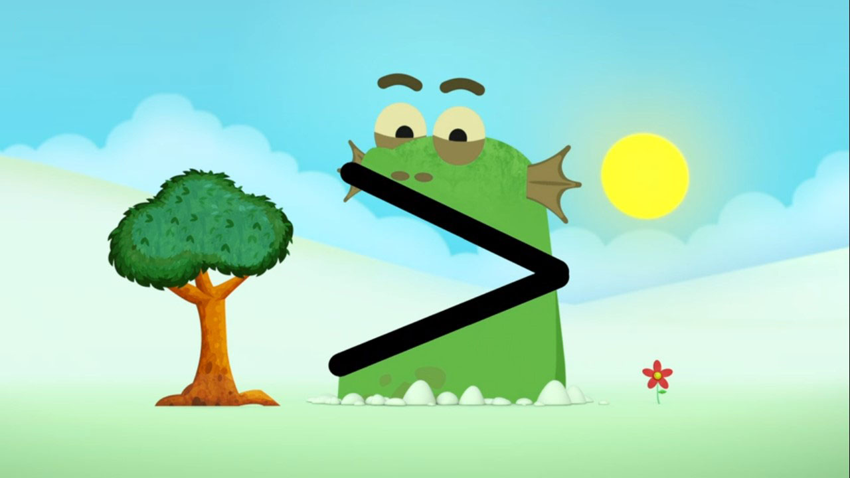
Images © 2017 Alphablocks Ltd. All Rights Reserved.
Notes:
Use this picture as the stimulus for Talk and Discussion (slide 7).
Is Blockzilla always facing this way? No, sometimes he faces the other way.
Discuss how part of Blockzilla’s cave is wider on one side and narrower on the other.
Different Numberblocks fit better in different parts of his cave, depending how tall they are.

Slide 9
Enabling Environments in Reception

Slide 10
Enabling Environments
Playing and Exploring
Create an area in the setting to compare the heights of the children throughout the year so that children can compare their heights and say who they are taller than or shorter than. This can also be done by ordering photos by birth date and describing who they are older than or younger than.
Active Learning
Set a height limit for certain activities in the setting taller than this or shorter than this. (Make sure to vary the limits so that all children have access over time!)
Creating and Thinking Critically
Use a feely bag with towers of connecting blocks 1 up to 10. Play a comparing game with 3 or 4 children. Each child takes out a tower and then they compare their tower to each other person by saying “my tower is taller than/ short than <name>’s tower.
Play a comparing game using animal toys; roll a die and collect that number of objects for each animal (e.g. conkers for some squirrels). Compare which animal has most. Count to check if needed.

Slide 11
Learning Together in Y1

Slide 12
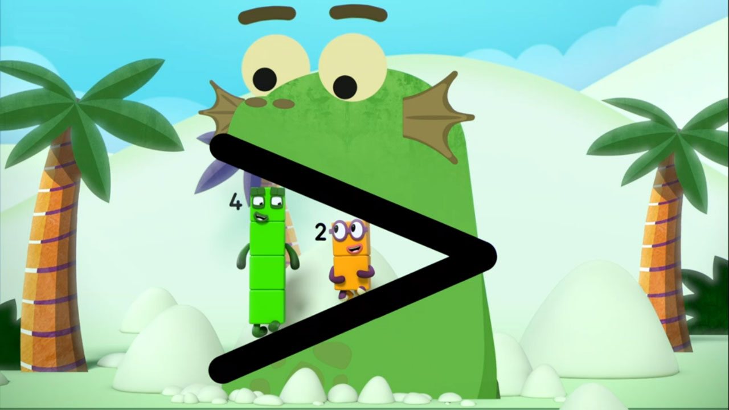
I am bigger than you!
Images © 2017 Alphablocks Ltd. All Rights Reserved.
Notes:
Discuss together:
What shape does Blockzilla’s cave make? Introduce the idea that we can use this sign to show which number is ‘bigger than’ or ‘greater than’ another one just like Blockzilla did.
Use two lolly sticks to make the > symbol, fix sticks together at one end with blu-tac. Ask children to help make the sticks face the same way as in the image.
We read from left to right like we do in a book.
Who walked inside Blockzilla’s cave first? Two
Who went inside Blockzilla’s cave last? Four
Four goes in last because 4 is greater than 2 (reading L-R).

Slide 13
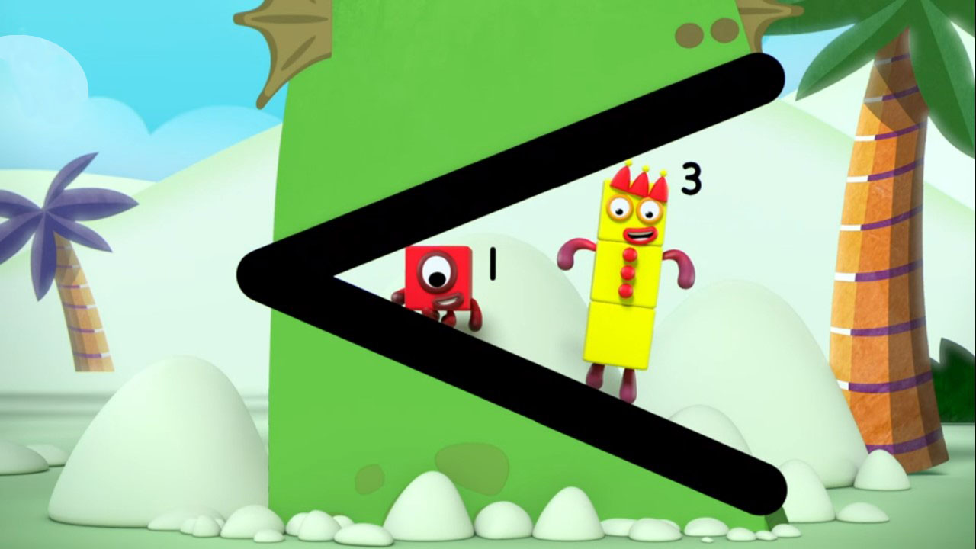
I am smaller than you!
Images © 2017 Alphablocks Ltd. All Rights Reserved.
Notes:
Use this slide to discuss what < means.
What can we do with our lolly stick symbol to change it to < ? (Turn it round.)
We still read the symbol from left to right like we do in a book even though it has turned around.
Who walked inside Blockzilla’s cave first? One
Who went inside Blockzilla’s cave last? Three
One went in first because One is smaller than Three. (reading L-R)

Slide 14
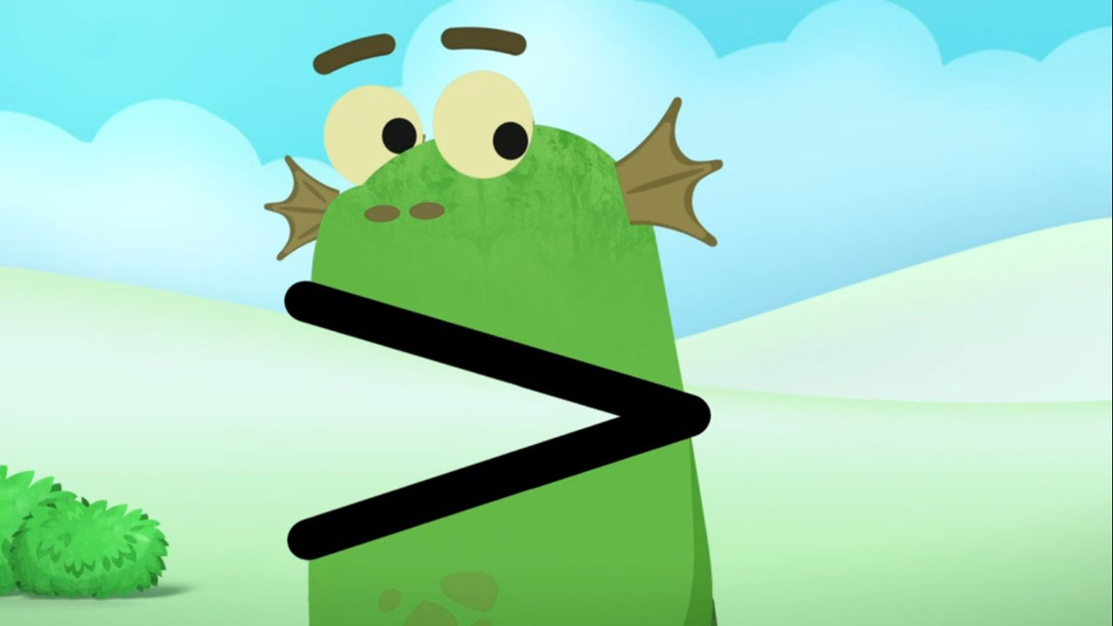
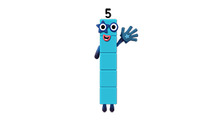
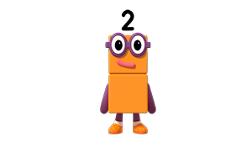



I am ______ than you!
Five is bigger than Two.
I am bigger than you!
Five is greater than Two.
Images © 2017 Alphablocks Ltd. All Rights Reserved.
Notes:
Use this slide to introduce the language ‘is greater than’ linked to the symbol.
What do you notice about Blockzilla’s cave/ sign and the way the Numberblocks are standing?
How do we make our lolly stick symbol the same as the image? (Turn it round again.)
Read the expression 5 > 2 saying: “5 is greater than 2”.

Slide 15
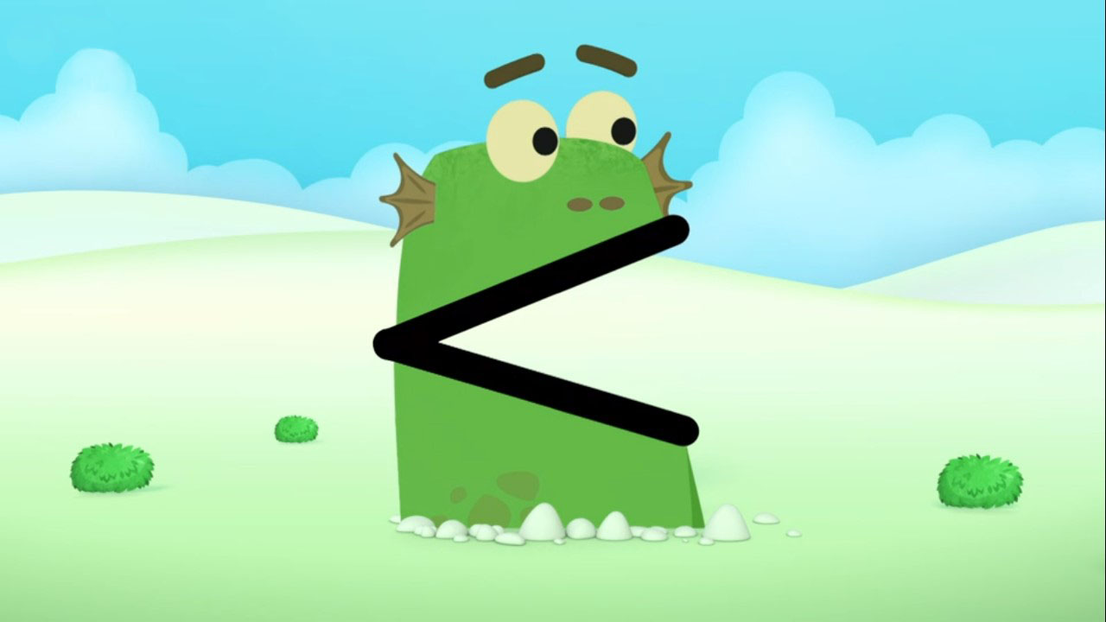
Two is smaller than Five.
Two is less than Five.
I am smaller than you!
I am _______ than you!
Images © 2017 Alphablocks Ltd. All Rights Reserved.
Notes:
Use this slide to introduce the language ‘is less than’ linked to the symbol.
What do you notice about the cave/ symbol?
Read 2 < 5 saying: “2 is less than 5”.

Slide 16

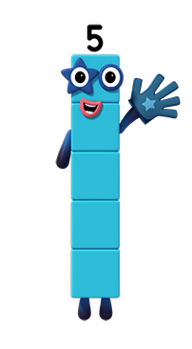
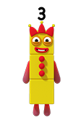


I am greater than you!
I am _______ than you!
Who goes in first?
Five is greater than Three.
Images © 2017 Alphablocks Ltd. All Rights Reserved.
Notes:
This slide uses the context of the episode when the Numberblocks enter Blockzilla’s cave.
Use pre-made Numberblocks and the lolly stick symbol to model the image.
Who will go in first? Why?
What could Five say? Accept ‘bigger than’ and ‘greater than’.
What is the missing word?
Practise reading the expression using the words ‘greater than’.

Slide 17
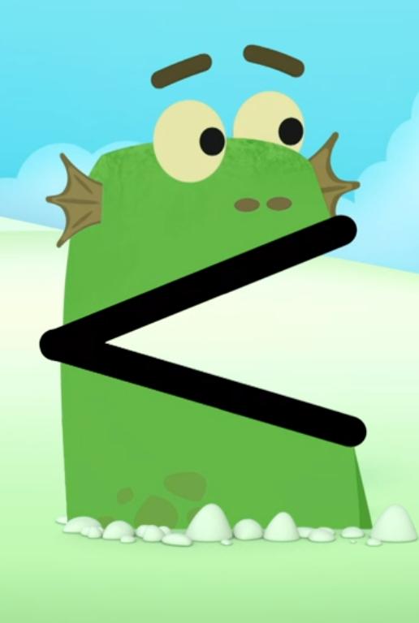
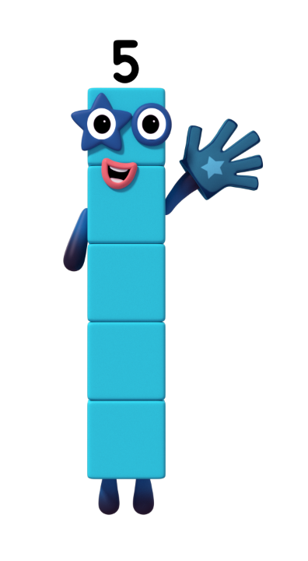
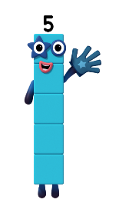
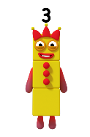
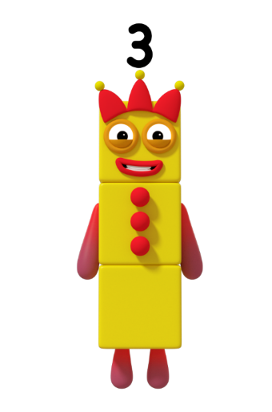
Who goes in first?
I am _______ than you!
I am smaller than you!
Three is less than Five.
Images © 2017 Alphablocks Ltd. All Rights Reserved.
Notes:
As for previous slide, ask: Who will go in first? Why?
Continue to use pre-made Numberblocks and lolly stick symbol to model the image if needed.
What could Three say? (Accept ‘smaller than’ and ‘less than’.)
When reading 3 < 5 say: “3 is less than 5.”

Slide 18
is less than .
Images © 2017 Alphablocks Ltd. All Rights Reserved.
Notes:
Use this slide to compare two Numberblocks picked out of a feely bag by two different children.
Who will go in first? Why? (Use the language from the previous slides.)

Slide 19
is greater than .
Images © 2017 Alphablocks Ltd. All Rights Reserved.
Notes:
Use this slide to compare two Numberblocks picked out of a feely bag by two different children.
Who will go in first? Why? (Use the language from the previous slides.)

Slide 20
Further activities for Y1
Use greater than and less than Blockzilla baseboards (see next two slides) so that children can compare two Numberblock towers and practise using the correct language of ‘greater than’ and ‘less than’. Compare other quantities using the Blockzilla baseboards.
Give pairs of children lolly sticks to make the inequality symbol. Use them with towers of cubes to make mathematical statements on large sheets of plain paper. Children could begin to record their models with numerals and draw the sign (drawing along the inside of each lolly stick) to write inequality expressions and practise reading the expression with the correct language.
Compare quantities of familiar items, including coins/ natural objects such as acorns/ counters that are not presented in a linear representation by rearranging in lines and matching using 1:1 correspondence.
Use the inequality symbol during classroom routines, e.g. to compare the number of girls/ boys in class each day during register time or to show how many children having a school dinner/ sandwiches.
Compare other numbers (with which children are already familiar) using the inequality symbols.

Slide 21
Images © 2017 Alphablocks Ltd. All Rights Reserved.
Notes:
Hidden slide.
Use this slide to compare two Numberblocks picked out of a feely bag by two different children. Continue to use lolly stick symbol if needed.
Who will go in first? Why? (Use the language from the previous slides)

Slide 22
Images © 2017 Alphablocks Ltd. All Rights Reserved.
Notes:
Hidden slide.
Use this slide to compare two Numberblocks picked out of a feely bag by two different children. Continue to use lolly stick symbol if needed.
Who will go in first? Why? (Use the language from the previous slides)

Slide 23
Learning Together in Y2

Slide 24
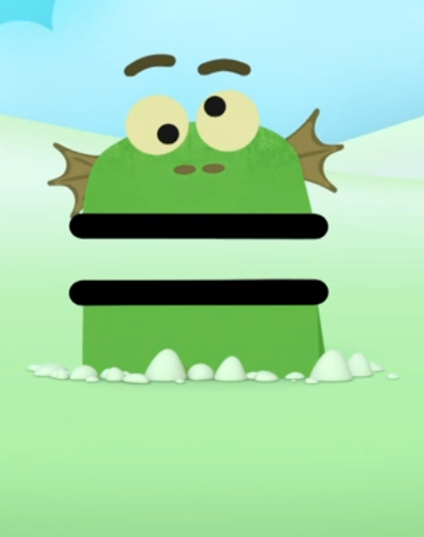
A
B
C
… is equal to …
… is greater than …
… is less than …
Images © 2017 Alphablocks Ltd. All Rights Reserved.
Notes:
Can you match the symbols shown in Blockzilla’s cave to the correct words?
Use this as an opportunity to explore children’s understanding of the symbols.
Use the lolly sticks to show how all of the symbols can be made with two straight lines but that sticks do not need to be joined to make the = symbol.

Slide 25
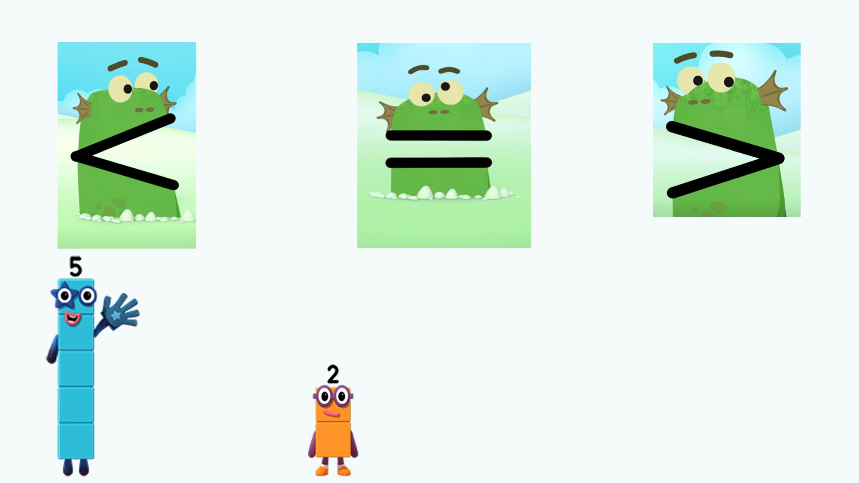
Compare these Numberblocks
… is greater than …
… is equal to …
… is less than …
Images © 2017 Alphablocks Ltd. All Rights Reserved.
Notes:
Use this slide to compare Five with Two.
What symbol is missing?
Read the inequality expression aloud. “5 is greater than 2.”

Slide 26
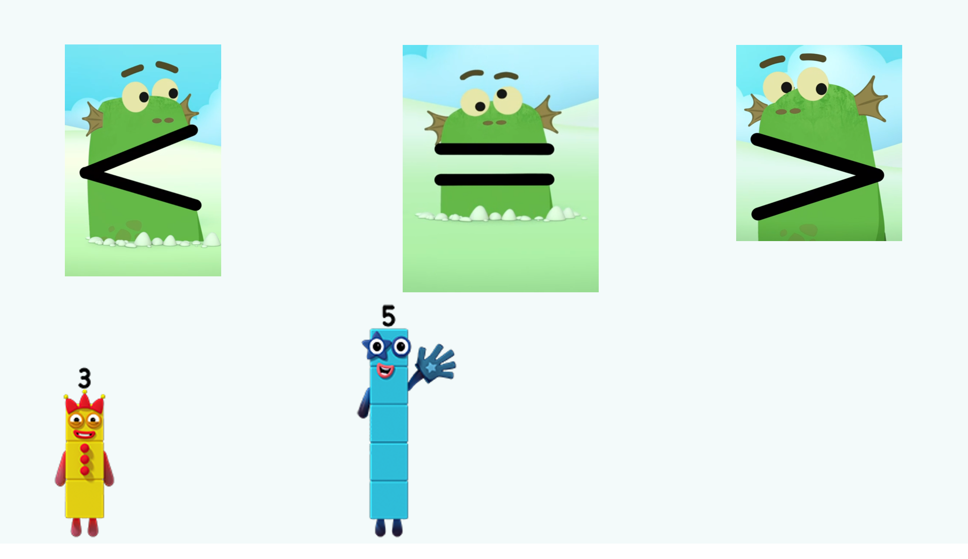
Compare these Numberblocks
… is greater than …
… is equal to …
… is less than …
Images © 2017 Alphablocks Ltd. All Rights Reserved.
Notes:
Use this slide to compare Three with Five.
What is missing between Three and Five?
Read the inequality expression aloud. “3 is less than 5.”

Slide 27
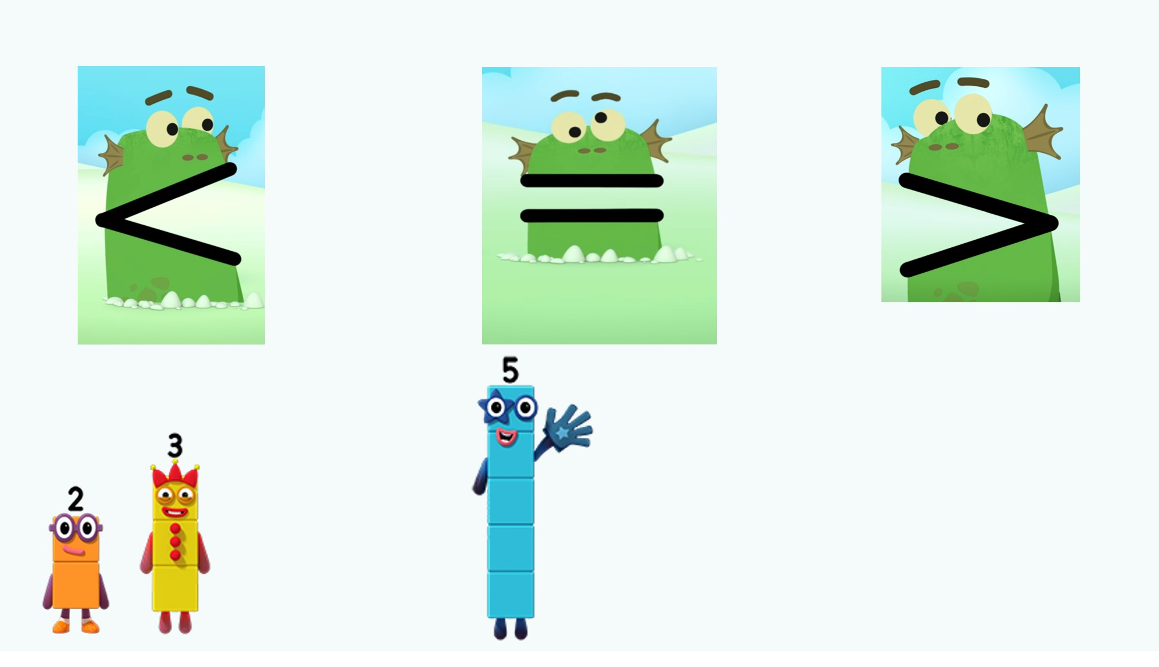


Compare these Numberblocks
… is greater than …
… is equal to …
… is less than …
Images © 2017 Alphablocks Ltd. All Rights Reserved.
Notes:
Use this slide to compare Two and Three with Five.
What is different about this picture? (There are two Numberblocks together before the missing symbol.)
Make all three Numberblocks with towers of cubes.
If we combine Two and Three and compare it to Five, what do you think we will notice?
Use cubes to model combining 2 and 3 and comparing to 5.
How can this help us find out what the missing symbol is?
Read expression saying: “2 plus 3 is equal to 5.”
Why does this expression not need a < or > symbol?

Slide 28
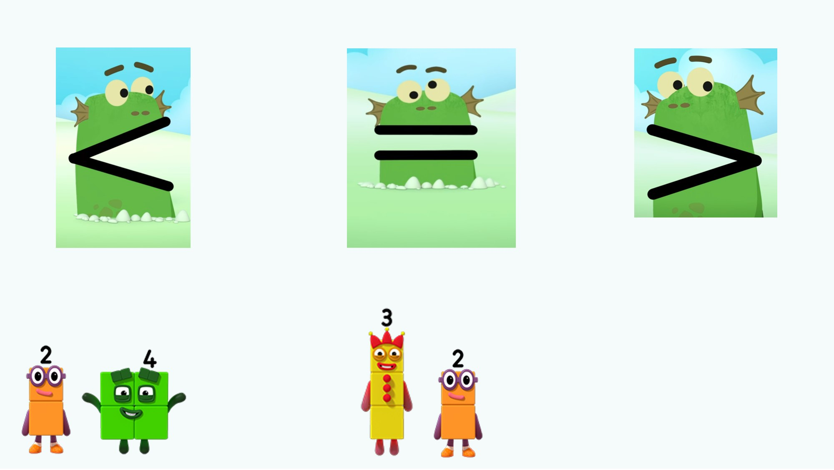

Compare these Numberblocks
… is greater than …
… is equal to …
… is less than …
Images © 2017 Alphablocks Ltd. All Rights Reserved.
Notes:
Use this slide to compare Two and Four with Three and Two
Make towers and combine them to help explore which symbol is needed.
Read the inequality expression aloud. “2 plus 4 is greater than 3 plus 2.”
What if we didn’t have cubes to combine? Can we find another way to compare? (e.g. using reasoning: 3 is less than 4 so when they each combine with 2, 3 plus 2 will be less than 4 plus 2.)

Slide 29
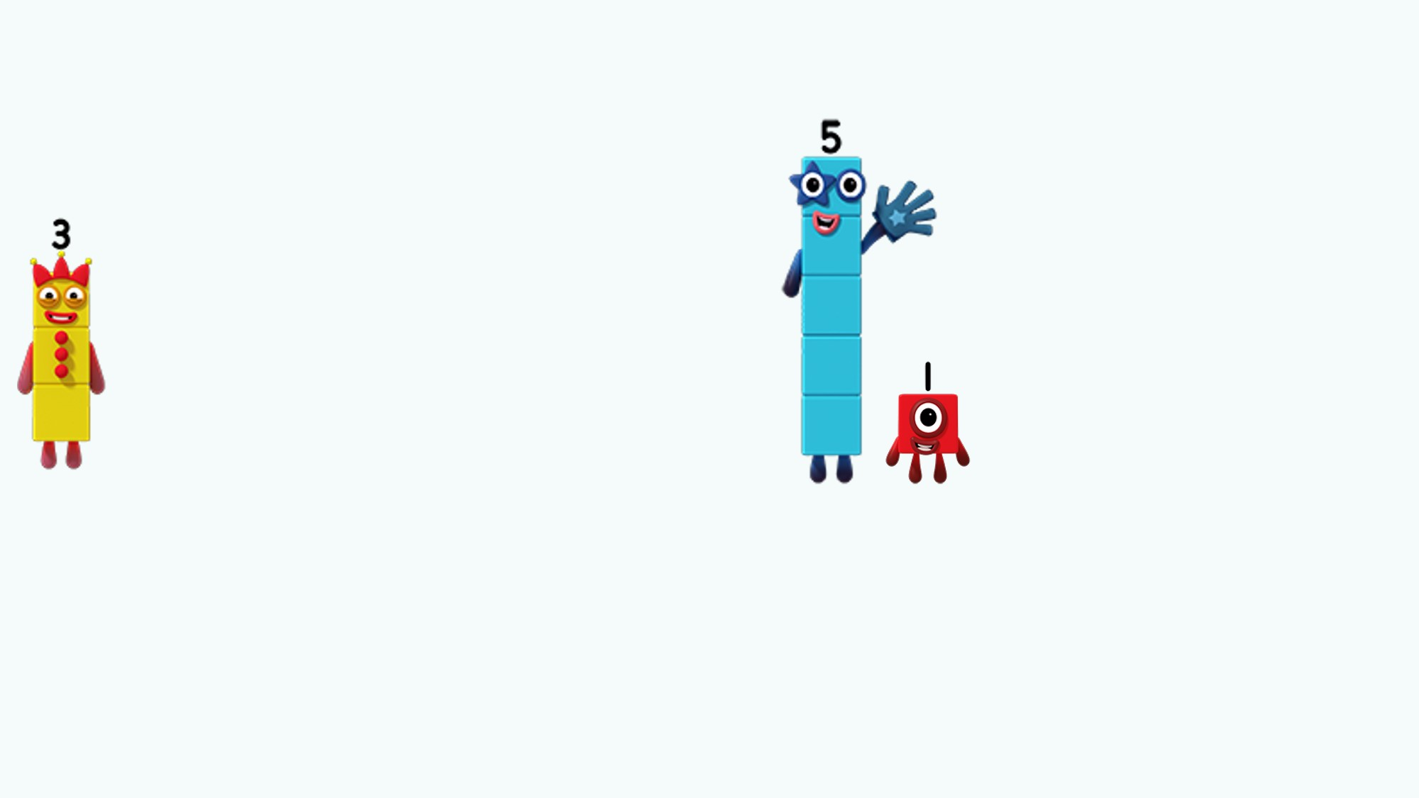


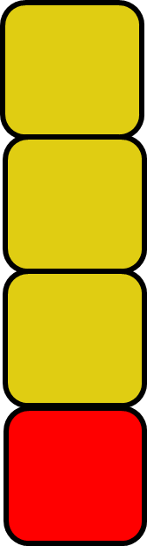

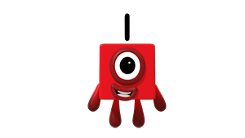

Compare these Numberblocks
Images © 2017 Alphablocks Ltd. All Rights Reserved.
Notes:
Use this slide to investigate the possible Numberblocks that could combine with Three to be less than Five and One combined.
Which Numberblock could go in this big white box so that the expression is correct?
Explore using Numberblock towers.
Read the expressions together.

Slide 30
Further activities for Y2
Use Numberblocks or weighted number plates in balance scales to compare amounts using the language ‘greater than’ or ‘less than’. Begin to write own expressions to match practical work.
Using the numbers 3, 4, 5, 6 write as many different expressions as you can you use using +, =, <, >
Select and write the correct inequality/ equals symbol to complete expressions, including those with.
  two numbers: 8 3
  an addition symbol: 2 + 5 7
  two addition symbols. 2 + 5 1 + 4

