Slide 1
Series 3 Episode 14
Octoblock to the Rescue!

Slide 2
Practitioner Notes

Slide 3
Episode Description
When Octoblock gets trapped by the Terrible Twos his Octoblock powers are broken. But he manages to send out an Octo-signal to some of his Numberblock friends and they come to the rescue but not without their own challenges. The Terrible Twos try to prevent One and Seven, Two and Six, Three and Five and two Fours from helping Eight. These Numberblocks discover their own Octoblock powers when they combine and successfully come to Octoblock’s rescue and sort out the four Terrible Twos disguised as Octonaughty.

Slide 4
Maths in the Episode
Combining parts to make 8
In this episode the Numberblocks One and Seven, Two and Six, Three and Five, Four and Four, combine to make Octoblock Eight. This episode explores the parts that combine to make 8.

Slide 5
Using Mathematical Language
Use these stem sentences to rehearse the mathematical ideas in the programme:
“8 is the whole, <7> is a part and <1> is a part”.
“<1> and <7> make 8”.
“<7> plus <1> is equal to 8”.
Notes:
< > indicates what can be changed in the stem sentence.

Slide 6
Talk and Discuss Together

Slide 7
Talk and Discuss Together
Watch the episode of Numberblocks. Use the following picture as a stimulus. If you had Octoblock powers what would they be? How would you use them?
The following slides are designed to stimulate children and adults to talk about the episode and draw out some key aspects of the mathematics.

Slide 8
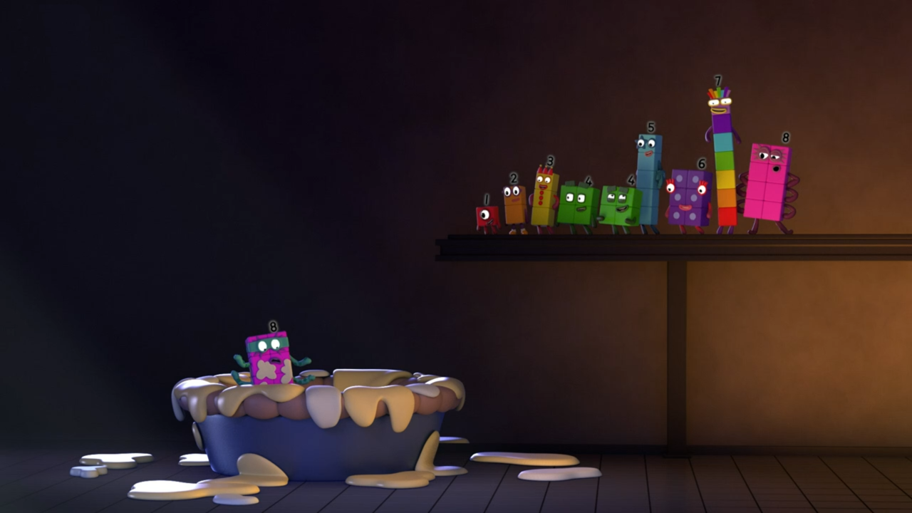
Images © 2017 Alphablocks Ltd. All Rights Reserved.
Notes:
Use this picture as the stimulus for Talk and Discussion (slide 7).

Slide 9
Enabling Environments in Reception

Slide 10
Enabling Environments
Playing and Exploring
Provide children with opportunities to explore ways of making eight in lots of different ways by providing a selection of objects for them to arrange. For example, 8 counters/ leaves/ conkers/ small-world animals. They might make an array which reveals eight as four twos or two fours or partition 8 into two parts. Providing structured equipment which children can fill (for example, a large egg box cut down into 8 parts) can support them finding different ways to make 8. Discuss their way of making and ‘seeing’ eight.
Active Learning
Play ‘throw the beanbag into the hoop’ game with 8 beanbags; children can record how many beanbags land in the hoop and how many do not, by making marks or writing numerals.
Creating and Thinking Critically
Fill a bag with cubes combined into towers of 1, 2, 3, 4, 5, 6 and 7. One child takes out a tower, can another child feel for the tower which will make 8? They could check the new tower against a tower of 8 - is it the same? Identify the two numbers which made 8.

Slide 11
Learning Together in Y1

Slide 12
Images © 2017 Alphablocks Ltd. All Rights Reserved.
Notes:
Use this slide to compare different representations of how 8 can be composed of 2 and 6.
What do you notice?
What is the same and what is different about each arrangement? (The whole is still 8 and the parts are 6 and 2 but the arrangements are different.)
Say together: “8 is the whole, 6 is a part and 2 is a part.”

Slide 13
Images © 2017 Alphablocks Ltd. All Rights Reserved.
Notes:
Use this slide to compare different representations of how 8 can be composed of 1 and 7.
What do you notice?
What is the same and what is different about each arrangement? (The whole is still 8 and the parts are 7 and 1 but the arrangements are different.)
Say together: “8 is the whole; 1 is a part and 7 is a part.”

Slide 14
Images © 2017 Alphablocks Ltd. All Rights Reserved.
Notes:
Use this slide to find bonds of 8.
Children could use cubes or double-sided counters to find all the number pairs which make 8.

Slide 15
Images © 2017 Alphablocks Ltd. All Rights Reserved.
Notes:
Complete the first two rows together modelling with a tower of 8 cubes; work systematically to make two towers, moving one block at a time to the other tower.
If we put the two towers back together, will we still have 8 altogether?
Ask children to find the other pairs of numbers which total 8.
Click to fill in numbers, look at the patterns and discuss:
What is happening in the first column? (The numbers are increasing by one each time.)
What is happening in the second column? (The numbers are decreasing by one each time.)
Why do you think this happens? (Each time we move a cube, one tower decreases by one and the other increases by one.)

Slide 16
Images © 2017 Alphablocks Ltd. All Rights Reserved.
Notes:
Use this slide printed out to extend the previous task.
Explore what happens to the patterns in each column when the ‘number house’ is extended past 0-4. Children can work with a tower of 8 cubes or 8 double-sided counters.
Is the pattern the same as in the previous number house? (Yes, the first column in increasing by one each time and the second column is decreasing by one each time.)
Notice and discuss:
Can you see any pairs of numbers which are similar? (2 and 6/ 6 and 2) Why does this happen?
Can you see any numbers which are the same? (4/4) What do we call this? (A double)

Slide 17
Further activities for Y1
Fill a bag with cubes combined into towers of 1, 2, 3, 4, 5, 6 and 7. Take 2 towers out of the bag, identify the number of cubes in each tower and predict if they will combine to make 8, or take out one tower and ask the children to ‘feel’ the tower they need to make 8.
Play matching games with dot (subitising) cards or numeral cards with the numbers 1-7. Either place cards face up and see if children can pick combinations which make 8, or place cards face down to provide further challenge.
Represent combinations of 2 parts that make 8 with different resources, for example, connecting cubes, coloured rods, coloured tiles
Colour in 8 squares in different arrangements with two colours to represent 2 parts which combine to make 8.

Slide 18
Learning Together in Y2

Slide 19
Images © 2017 Alphablocks Ltd. All Rights Reserved.
Notes:
Use this slide to introduce the task.
How many ways can you find to make Eight using the other blocks? You can use the other blocks as many times as you like – for example, you can use Three twice with a Two.
Work in small groups to find as many different ways as they can.
Share ideas with the whole class.

Slide 20
Images © 2017 Alphablocks Ltd. All Rights Reserved.
Notes:
This slide could be used to represent with equations some of the findings in the previous task.
Model that if we know 8 can be composed of 1 and 7, we can split the 7 again so that we have three numbers making 8.
How else could we do it?

Slide 21
Further activities for Y2
Use concrete resources to explore all the ways to make 8 partitioned into 3 parts. Discuss how to check all possibilities have been found.
Find all the ways to make 8 to complete the equation 8 = o+o+o.
Play ‘matching pairs’ with digit cards. Turn over 3 sets of 0-8 digit cards face down. Turn over two cards. If the pair adds up to 8 keep them, if not return to the same place. The winner is the person with the most pairs that sum to 8.
Play matching triples with digits cards. Turn over 3 sets of 0-8 digit cards face down. Turn over three cards. If the total is 8 keep the 3 cards. The winner is the person with the most triples that sum to 8.

