Slide 1
1.17 Composition and calculation:
100 and bridging 100
Representations | Year 3
Number, Addition and Subtraction

Slide 2
How to use this presentation
You can find the teacher guide 1.17 Composition and calculation: 100 and bridging 100 by following the link below.

Slide 3
1.17 Composition and calculation: 100 – step 1:1
10s | 1s
1 | 0
10

Slide 4
1.17 Composition and calculation: 100 – step 1:1
100s | 10s | 1s
1 | 0 | 0
100

Slide 5

1.17 Composition and calculation: 100 – step 1:2
100
10
20
30
40
50
60
70
80
90

Slide 6

1.17 Composition and calculation: 100 – step 1:2

Slide 7













1.17 Composition and calculation: 100 – step 1:2

Slide 8
1.17 Composition and calculation: 100 – step 1:3
Digits | What it means
10
1 ten
20
2 tens
30
3 tens
100
40
4 tens
50
5 tens
10
10
10
10
10
10
10
10
10
10
60
6 tens
70
7 tens
80
8 tens
100 = 10 + 10 + 10 + 10 + 10 + 10 + 10 + 10 + 10 + 10
90
9 tens
100 = 10 × 10
100
10 tens
100 ÷ 10 = 10

Slide 9
1.17 Composition and calculation: 100 – step 1:5
100
50
50
100 = 50 + 50
100 = 2 × 50
100 = 50 × 2
100 ÷ 2 = 50
100 ÷ 50 = 2

Slide 10
1.17 Composition and calculation: 100 – step 1:5
100
25
25
25
25
100 = 25 + 25 + 25 +25
100 = 4 × 25
100 = 25 × 4
100 ÷ 4 = 25
100 ÷ 25 = 4

Slide 11

1.17 Composition and calculation: 100 – step 1:5
25 stickers
25 stickers
25 stickers
25 stickers
25 stickers
25 stickers
25 stickers
25 stickers
25
50
75
100
125
150
175
200
stickers

Slide 12
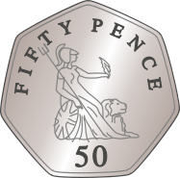
1.17 Composition and calculation: 100 – step 1:5
50
pence
50
pence
50
pence
50
pence
50
100
150
200
pence

Slide 13
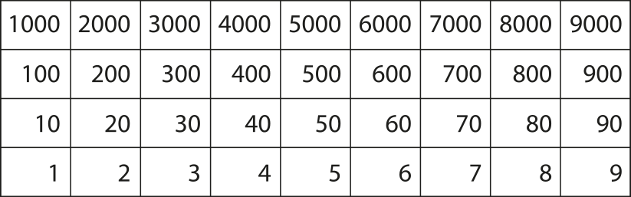
1.17 Composition and calculation: 100 – step 1:5
Counting in multiples of 50

Slide 14
1.17 Composition and calculation: 100 – step 1:5
Counting in multiples of 25

Slide 15
1.17 Composition and calculation: 100 – step 1:6
100
20
20
20
20
20
100 = 20 + 20 + 20 +20 + 20
100 = 5 × 20
100 = 20 × 5
100 ÷ 5 = 20
100 ÷ 20 = 5

Slide 16
1.17 Composition and calculation: 100 – step 1:6

Slide 17
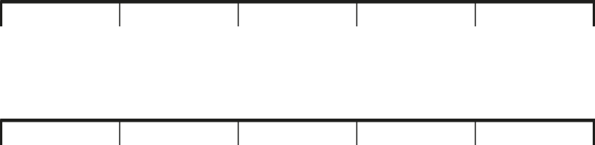
1.17 Composition and calculation: 100 – step 1:6
0
2
4
6
8
10
0
20
40
60
80
100

Slide 18
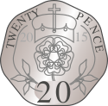
1.17 Composition and calculation: 100 – step 1:6
20
pence
20
pence
20
pence
20
pence
20
pence
20
pence
20
pence
20
pence
20
pence
20
pence
20
40
60
80
100
120
140
160
180
200
pence

Slide 19
1.17 Composition and calculation: 100 – step 1:6
Counting in multiples of 20

Slide 20
1.17 Composition and calculation: 100 – step 1:7
100 = 4 ×
?
25
100
25
25
25
25

Slide 21
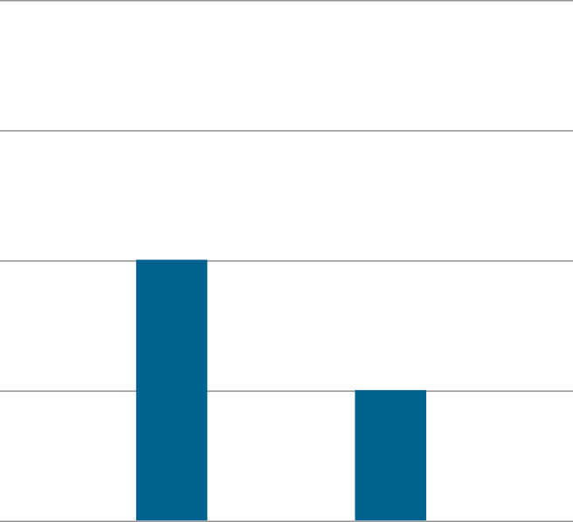
1.17 Composition and calculation: 100 – step 1:7
100
75
50
Score
50
25
25
0
Jenny
Asif

Slide 22
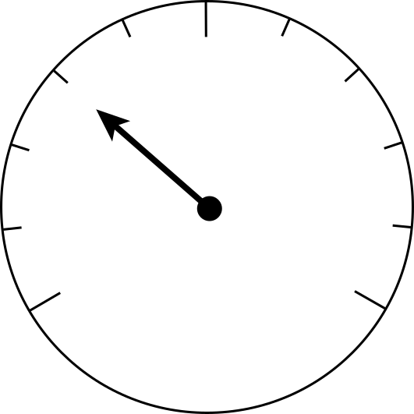
1.17 Composition and calculation: 100 – step 1:7
80
100
120
60
140
40
160
20
kg
180
0
200

Slide 23
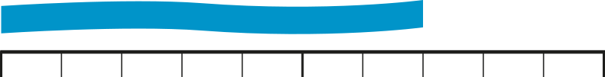
1.17 Composition and calculation: 100 – step 1:7
0
10 cm
20 cm
30 cm
40 cm
50 cm
60 cm
70 cm
80 cm
90 cm
1 m

Slide 24
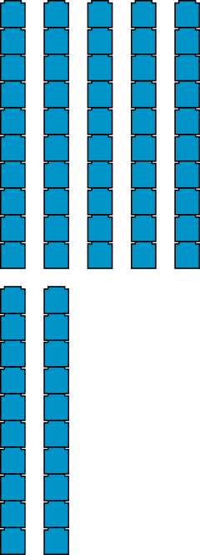
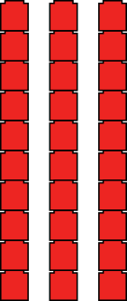
1.17 Composition and calculation: 100 – step 2:1
10
7
3
10 tens
7 tens
3 tens

Slide 25
1.17 Composition and calculation: 100 – step 2:1
60
+
40
=
100
?

Slide 26
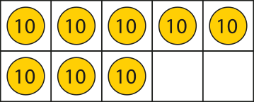

1.17 Composition and calculation: 100 – step 2:1
100
– 20
= 80

Slide 27

1.17 Composition and calculation: 100 – step 2:1
100
– 40
= 60

Slide 28
1.17 Composition and calculation: 100 – step 2:2
100 = 10 +
90
?
100 – 10 =
90
?
100
10
90
?

Slide 29
1.17 Composition and calculation: 100 – step 2:2
100 = 50 +
50
?
100 – 50 =
50
?
100
50
50
?

Slide 30


1.17 Composition and calculation: 100 – step 2:2
1 m
30 cm
70 cm

Slide 31
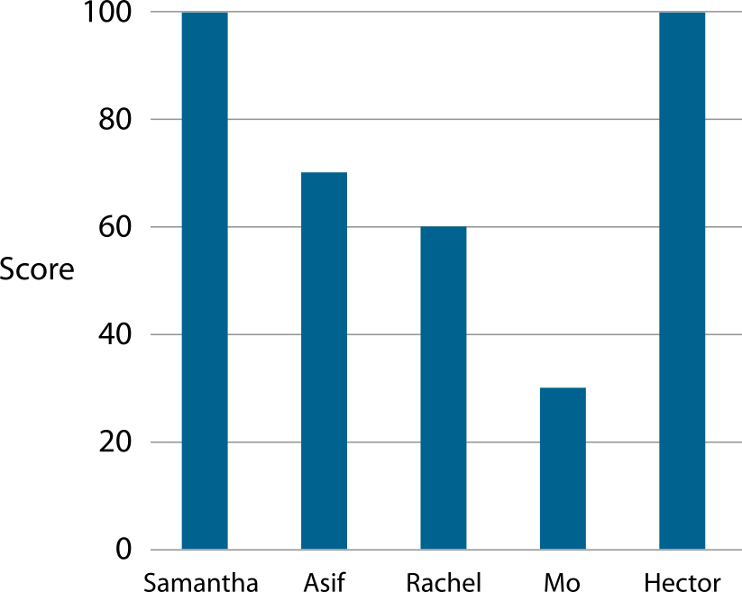
1.17 Composition and calculation: 100 – step 2:2
Notes:
How much more did Samantha score than Asif?
How much less did Rachel score than Hector?
What was Asif and Mo’s combined score?

Slide 32
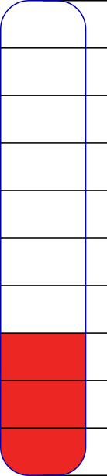
1.17 Composition and calculation: 100 – step 2:2
£100
£70
£30

Slide 33
1.17 Composition and calculation: 100 – step 2:2
100
30
?
60
10

Slide 34
1.17 Composition and calculation: 100 – step 2:2
100
20
50
?
30

Slide 35



1.17 Composition and calculation: 100 – step 2:3
+ 3
7 + 3
= 10
+ 3
97 + 3
= 100

Slide 36

1.17 Composition and calculation: 100 – step 2:3
− 4
10 – 4
= 6
− 4
100 – 4
= 96

Slide 37
1.17 Composition and calculation: 100 – step 2:4
100
96
4

Slide 38
1.17 Composition and calculation: 100 – step 2:4
100
100
7
?
7
93
?
93

Slide 39
1.17 Composition and calculation: 100 – step 2:5
100 =
97 + 3
90
7
10
90
10

Slide 40
1.17 Composition and calculation: 100 – step 2:6
24
+
76
=
100
20
4
6
70
10

Slide 41
1.17 Composition and calculation: 100 – step 2:6
24
+
76
=
100
20
10
70

Slide 42
1.17 Composition and calculation: 100 – step 2:7
100
100
62
48
62
38
Sienna
Jasleen
✗
100 = 62 + 48
100 = 62 + 38
Notes:
Year 3 need to earn 100 class points for a treat. They have 62 already. Sienna says they need 48 more. Jasleen says they need 38 more. Who is right?

Slide 43
1.17 Composition and calculation: 100 – step 2:7
62
+
48
=
110
62
+
38
=
100
60
2
8
40
60
2
8
30
10
10

Slide 44
1.17 Composition and calculation: 100 – step 2:7
100
=
62
+
38
?
60
10
30

Slide 45
1.17 Composition and calculation: 100 – step 2:8
Correct bond to 100 | Incorrect bond to 100
62 + 48
43 + 67
28 + 72
39 + 71
55 + 45
84 + 16

Slide 46
1.17 Composition and calculation – step 2:9
100
=
32
+
6
8
30
100
10
60
32
6
8

Slide 47
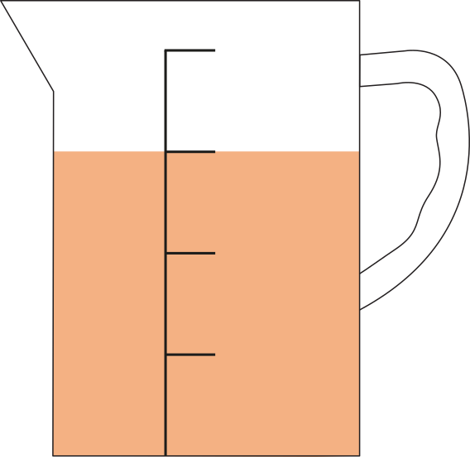
1.17 Composition and calculation: 100 – step 2:11
100 ml
25 ml
75 ml
50 ml
25 ml

Slide 48
1.17 Composition and calculation: 100 – step 3:1

Slide 49
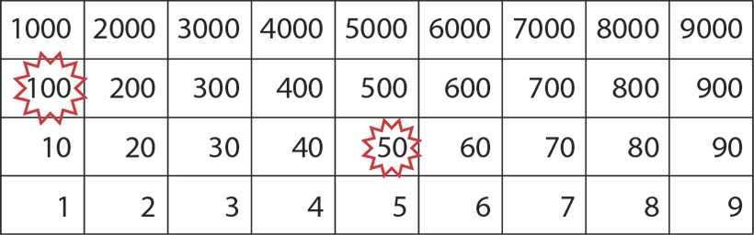
1.17 Composition and calculation: 100 – step 3:1

Slide 50

1.17 Composition and calculation: 100 – step 3:2
10
20
30
40
50
60
70
80
90
100
110
120
130
140
150
160
1 ten
3 tens
4 tens
5 tens
6 tens
7 tens
8 tens
9 tens
10 tens
11 tens
12 tens
13 tens
14 tens
15 tens
16 tens
2 tens

Slide 51
1.17 Composition and calculation: 100 – step 3:1
10
20
30
40
50
60
70
80
90
100
110
120
130
140
150
160
1 ten
3 tens
4 tens
5 tens
6 tens
7 tens
8 tens
9 tens
10 tens
11 tens
12 tens
13 tens
14 tens
15 tens
16 tens
2 tens

Slide 52
1.17 Composition and calculation: 100 – step 3:2
10
20
30
40
50
60
70
80
90
100
110
120
130
140
1 ten
3 tens
4 tens
5 tens
6 tens
7 tens
8 tens
9 tens
10 tens
11 tens
12 tens
13 tens
14 tens
2 tens

Slide 53
1.17 Composition and calculation: 100 – step 3:3
10
20
30
40
50
60
70
80
90
100
110
120
130
140
1 ten
3 tens
4 tens
5 tens
6 tens
7 tens
8 tens
9 tens
10 tens
11 tens
12 tens
13 tens
14 tens
2 tens

Slide 54
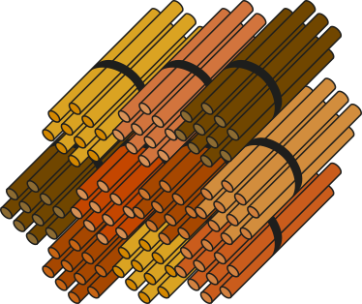
1.17 Composition and calculation: 100 – step 3:3
140
14 tens

Slide 55
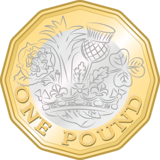
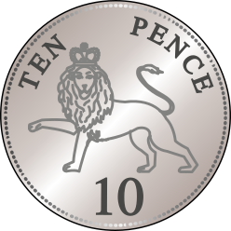
1.17 Composition and calculation: 100 – step 3:3

Slide 56
1.17 Composition and calculation: 100 – step 3:3
100s | 10s | 1s
1
4
0
140

Slide 57
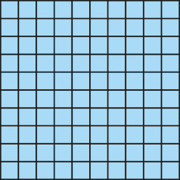
1.17 Composition and calculation: 100 – step 3:5
130

Slide 58
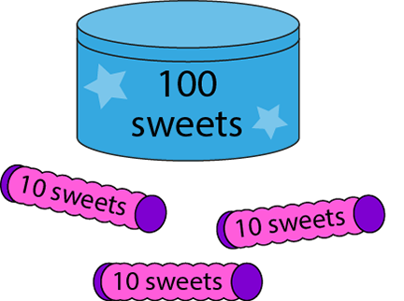
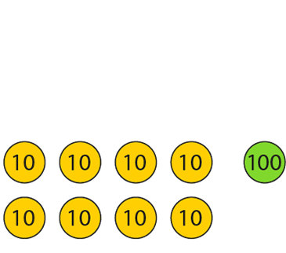
1.17 Composition and calculation: 100 – step 3:5
130
180

Slide 59
1.17 Composition and calculation: 100 – step 3:7
160
160
160
10 tens
6 tens
100
60

Slide 60
1.17 Composition and calculation: 100 – step 3:8
150
100
50
?

Slide 61
1.17 Composition and calculation: 100 – step 3:8
180
?
10
tens
8 tens

Slide 62
1.17 Composition and calculation: 100 – step 3:8
13
tens
30
100
?

Slide 63
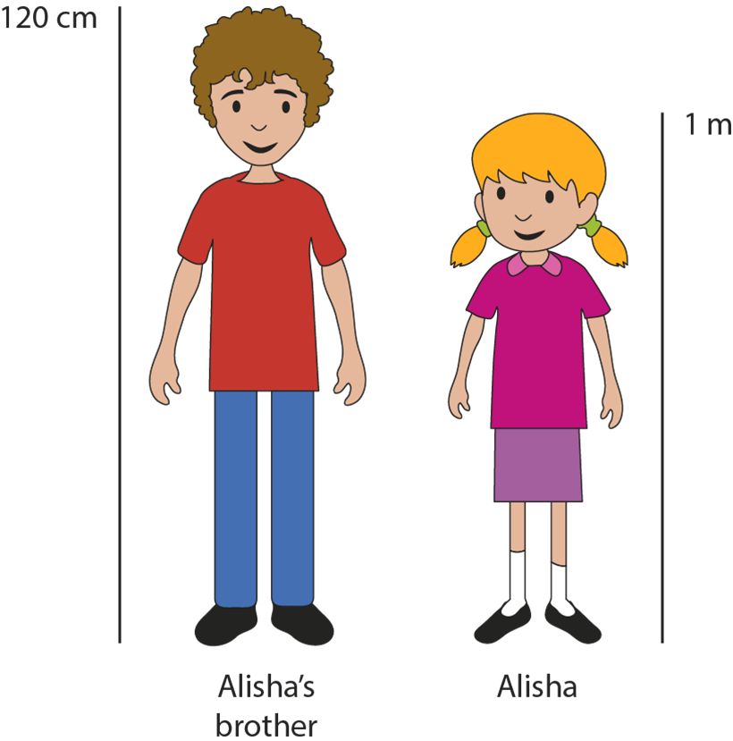
1.17 Composition and calculation: 100 – step 3:8
20 cm

Slide 64
1.17 Composition and calculation: 100 – step 3:9
70
+
50
=
120
7
+
5
=
12
tens
tens
tens

Slide 65
1.17 Composition and calculation: 100 – step 3:10
70 + 50
= 120
100
30
20
70
30
20

Slide 66



1.17 Composition and calculation: 100 – step 3:10
70 + 50
= 120
100
30
20
+ 30
+ 20
70
100
120
+ 50

Slide 67
1.17 Composition and calculation: 100 – step 3:10
70 + 50
= 120
20
50
100

Slide 68
1.17 Composition and calculation: 100 – step 3:10
80
+
50
=
130
100
20
30

Slide 69
1.17 Composition and calculation: 100 – step 3:10
70
+
40
=
110
100
30
10

Slide 70
1.17 Composition and calculation: 100 – step 3:12
120 – 30 =
90
?
12
–
3
=
9
tens
tens
tens

Slide 71

1.17 Composition and calculation: 100 – step 3:12
120 – 30
= 90
100
20
10
− 10
− 20
90
100
120
− 30

Slide 72
1.17 Composition and calculation: 100 – step 3:13
160
70
90
?

Slide 73
1.17 Composition and calculation: 100 – step 3:13
140
?
80
60

Slide 74
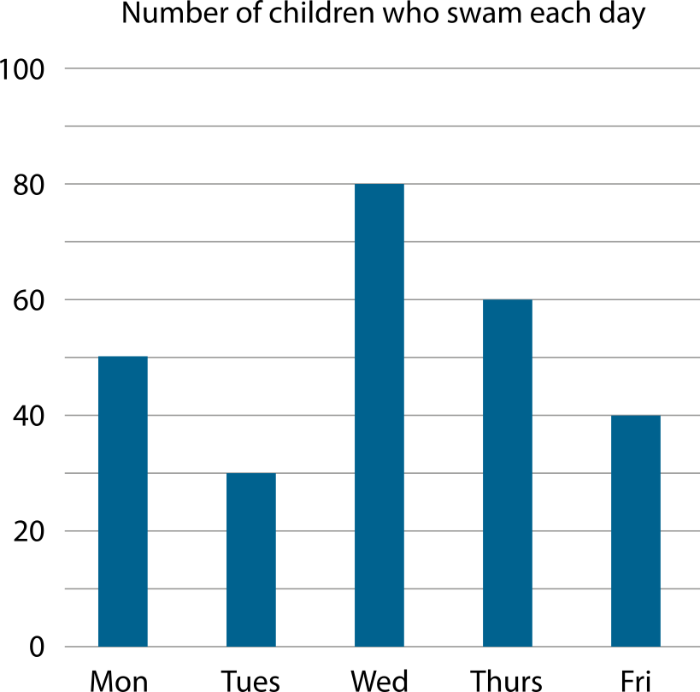
1.17 Composition and calculation: 100 – step 3:13

Slide 75
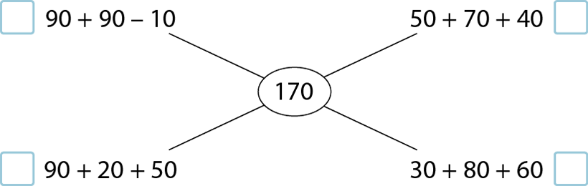
1.17 Composition and calculation: 100 – step 3:13
✓
✗
✗
✓

Slide 76
1.17 Composition and calculation: 100 – step 3:13
120
?
?
Notes:
‘How many different ways can you split the bar into multiples of ten so that each part is less than one hundred?’

Slide 77
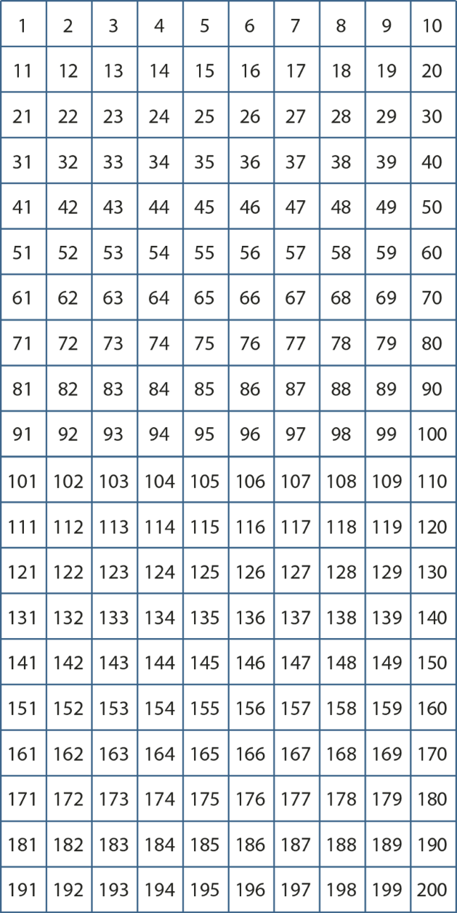
1.17 Composition and calculation: 100 – step 4:1

Slide 78


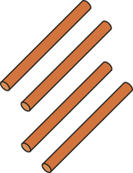
1.17 Composition and calculation: 100 – step 4:2
one hundred
and
twenty
-four

Slide 79
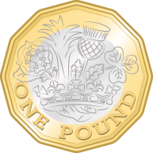

1.17 Composition and calculation: 100 – step 4:2
one hundred and three pence

Slide 80
1.17 Composition and calculation: 100 – step 4:3
100s | 10s | 1s
1
2
4
124

Slide 81
1.17 Composition and calculation: 100 – step 4:3
103

Slide 82
1.17 Composition and calculation: 100 – step 4:5
98 + 7
= 105
100
2
5

Slide 83



1.17 Composition and calculation: 100 – step 4:5
98 + 7
= 105
100
2
5
+ 2
+ 5
98
100
105
+ 7

Slide 84
1.17 Composition and calculation: 100 – step 4:6
104 – 6
= 98
100
4
2

Slide 85


1.17 Composition and calculation: 100 – step 4:6
104 – 6
= 98
100
4
2
− 2
− 4
98
100
104
− 6

Slide 86
1.17 Composition and calculation: 100 – step 4:7

Slide 87
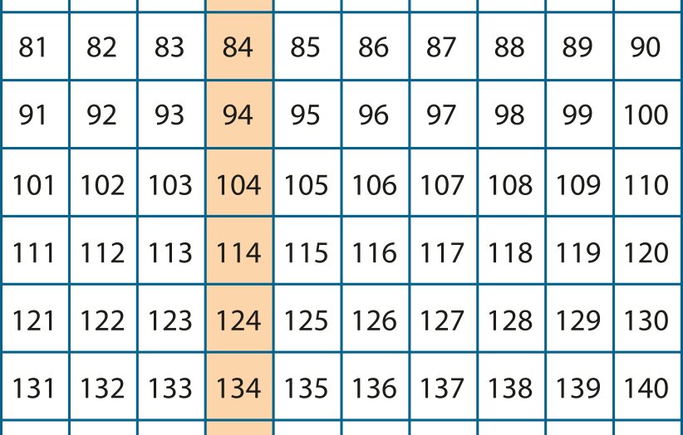
1.17 Composition and calculation: 100 – step 4:7

Slide 88

1.17 Composition and calculation: 100 – step 4:8
87
+
30
= 117
7
80
110

Slide 89

1.17 Composition and calculation: 100 – step 4:9
126
–
70
= 56
6
120
50

Slide 90
1.17 Composition and calculation: 100 – step 4:9
126
–
70
= 56
26
100
30

Slide 91
1.17 Composition and calculation: 100 – step 4:10
105
?
97
3
5

Slide 92
1.17 Composition and calculation: 100 – step 4:10
107
7
96
?
4

Slide 93
1.17 Composition and calculation: 100 – step 4:10
?
106
97
9

Slide 94
1.17 Composition and calculation: 100 – step 4:10
102
96
6
?

Slide 95
1.17 Composition and calculation: 100 – step 4:10
136
?
70
60
6

Slide 96
1.17 Composition and calculation: 100 – step 4:10
136
–
60
=
40
+
36
=
76
100
36

Slide 97
1.17 Composition and calculation: 100 – step 4:10
121
–
40
=
60
+
21
=
81
100
21

