Slide 1
Year 2, Unit 3
Fluently add and subtract within ten

Slide 2
Year 2, Unit 3
These materials heavily reflect the prioritisation approach of the ready-to-progress criteria in the DfE Primary Mathematics Guidance 2020 and on the PPTs that exemplify them on the NCETM website. They also include other relevant National Curriculum content. Related sections of the NCETM Primary Mastery Professional Development Materials provide small-step teaching guidance.
Ready-to-progress criteria addressed by this unit
Teaching of this unit supports the following criteria from the ‘DfE Mathematics Guidance: key stages 1 & 2’ (the 335-page document available as a download)
2NF-1 Page 55
Prior learning
If the following ready-to-progress criteria, contained in the same DfE guidance document as above, were secured in Year 1, children will be ready to start on this unit.
1NF-1 Page 24

Slide 3
Contents
The links below take you to the starting slide of each learning outcome.
1 | Pupils demonstrate their fluency of addition and subtraction within ten
2 | Pupils practise addition and subtraction strategies as required
Click the arrow button to return to this Contents slide.

Slide 4
Year 2, Unit 3, Learning Outcome 1
Learning Outcome 1
Pupils demonstrate their fluency of addition and subtraction within ten
The following slides have been collated to support the teaching of this learning outcome.

Slide 5

Year 2, Unit 3, Learning Outcome 1
Additional teacher guidance for this outcome should be read first and can be found in the DfE Mathematics guidance. Page references relate to the 335-page document available as a download at the bottom of this web page.
Ready to progress criteria | Pages
2NF-1 | 55-56

Slide 6
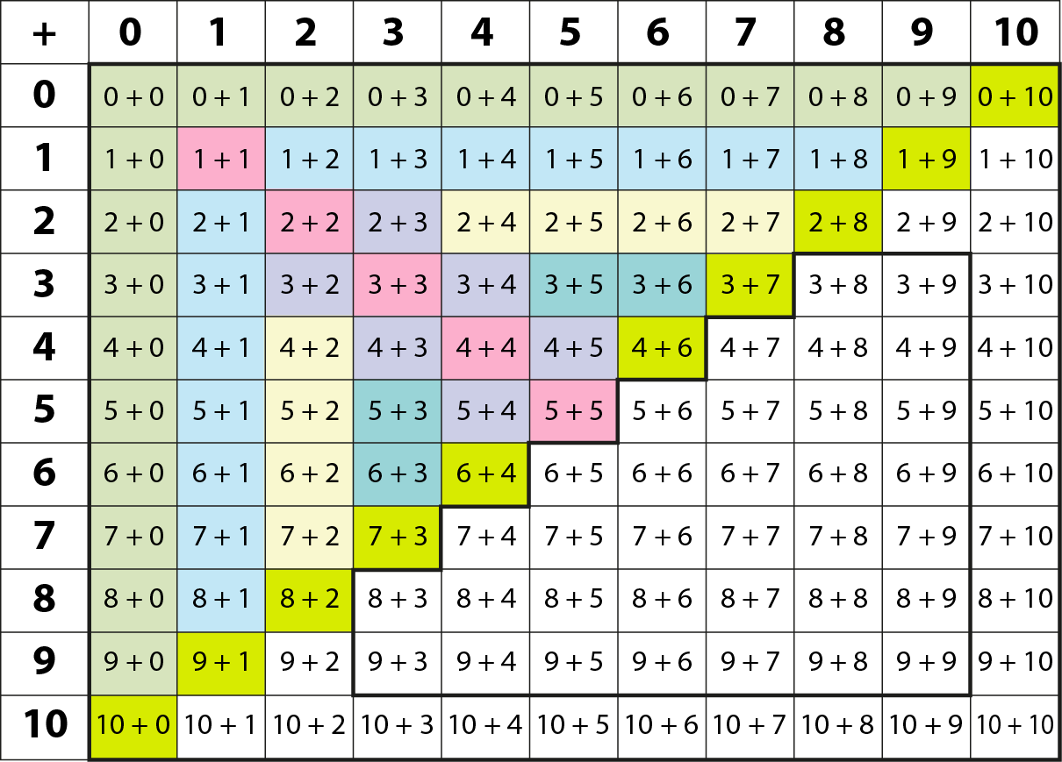
2NF-1 Fluently add and subtract within 10
Y1 facts
Y2
facts
This grid shows the addition facts within 10 and strategies to recall or derive them that children learn in Year 1.
Children should also practise the corresponding subtractions.
Adding 1
Adding 2
Bonds to 10
Adding 0
Doubles
Near doubles

Slide 7
2NF-1 Fluently add and subtract within 10
9 – 2 =
7

Slide 8
2NF-1 Fluently add and subtract within 10
1 + 9 =
10

Slide 9
2NF-1 Fluently add and subtract within 10
7 – 2 =
5

Slide 10
2NF-1 Fluently add and subtract within 10
5 + 5 =
10

Slide 11
2NF-1 Fluently add and subtract within 10
7 – 6 =
1

Slide 12
2NF-1 Fluently add and subtract within 10
0 + 3 =
3

Slide 13
2NF-1 Fluently add and subtract within 10
2 – 0 =
2

Slide 14
2NF-1 Fluently add and subtract within 10
3 + 2 =
5

Slide 15
2NF-1 Fluently add and subtract within 10
5 – 1 =
4

Slide 16
2NF-1 Fluently add and subtract within 10
3 + 7 =
10

Slide 17
2NF-1 Fluently add and subtract within 10
8 – 4 =
4

Slide 18
2NF-1 Fluently add and subtract within 10
3 + 5 =
8

Slide 19
2NF-1 Fluently add and subtract within 10
10 – 4 =
6

Slide 20
2NF-1 Fluently add and subtract within 10
6 + 3 =
9

Slide 21
2NF-1 Fluently add and subtract within 10
7 – 0 =
7

Slide 22
2NF-1 Fluently add and subtract within 10
9 – 9 =
0

Slide 23
2NF-1 Fluently add and subtract within 10
4 + 3 =
7

Slide 24
2NF-1 Fluently add and subtract within 10
6 – 4 =
2

Slide 25
2NF-1 Fluently add and subtract within 10
9 – 5 =
4

Slide 26
2NF-1 Fluently add and subtract within 10
2 + 7 =
9

Slide 27
2NF-1 Fluently add and subtract within 10
10 – 8 =
2

Slide 28
2NF-1 Fluently add and subtract within 10
8 – 3 =
5

Slide 29
2NF-1 Fluently add and subtract within 10
3 + 6 =
9

Slide 30
2NF-1 Fluently add and subtract within 10
9 + 1 =
10

Slide 31
2NF-1 Fluently add and subtract within 10
7 + 0 =
7

Slide 32
2NF-1 Fluently add and subtract within 10
10 – 1 =
9

Slide 33
2NF-1 Fluently add and subtract within 10
2 + 8 =
10

Slide 34
2NF-1 Fluently add and subtract within 10
10 – 6 =
4

Slide 35
2NF-1 Fluently add and subtract within 10
4 + 1 =
5

Slide 36
2NF-1 Fluently add and subtract within 10
6 + 4 =
10

Slide 37
2NF-1 Fluently add and subtract within 10
1 + 6 =
7

Slide 38
2NF-1 Fluently add and subtract within 10
3 + 4 =
7

Slide 39
2NF-1 Fluently add and subtract within 10
2 + 0 =
2

Slide 40
2NF-1 Fluently add and subtract within 10
8 – 1 =
7

Slide 41
2NF-1 Fluently add and subtract within 10
2 + 1 =
3

Slide 42
2NF-1 Fluently add and subtract within 10
8 + 2 =
10

Slide 43
2NF-1 Fluently add and subtract within 10
3 – 3 =
0

Slide 44
2NF-1 Fluently add and subtract within 10
10 – 3 =
7

Slide 45
2NF-1 Fluently add and subtract within 10
7 + 1 =
8

Slide 46
2NF-1 Fluently add and subtract within 10
1 + 3 =
4

Slide 47
2NF-1 Fluently add and subtract within 10
0 + 4 =
4

Slide 48
2NF-1 Fluently add and subtract within 10
4 + 6 =
10

Slide 49
2NF-1 Fluently add and subtract within 10
4 – 3 =
1

Slide 50
2NF-1 Fluently add and subtract within 10
7 – 4 =
3

Slide 51
2NF-1 Fluently add and subtract within 10
5 + 2 =
7

Slide 52
2NF-1 Fluently add and subtract within 10
10 – 7 =
3

Slide 53
2NF-1 Fluently add and subtract within 10
5 – 2 =
3

Slide 54
2NF-1 Fluently add and subtract within 10
2 + 6 =
8

Slide 55
2NF-1 Fluently add and subtract within 10
9 – 3 =
6

Slide 56
2NF-1 Fluently add and subtract within 10
3 + 2 =
5

Slide 57
2NF-1 Fluently add and subtract within 10
9 – 6 =
3

Slide 58
2NF-1 Fluently add and subtract within 10
7 – 1 =
6

Slide 59
2NF-1 Fluently add and subtract within 10
5 + 5 =
10

Slide 60
2NF-1 Fluently add and subtract within 10
2 + 4 =
6

Slide 61
2NF-1 Fluently add and subtract within 10
6 – 2 =
4

Slide 62
2NF-1 Fluently add and subtract within 10
8 + 2 =
10

Slide 63
2NF-1 Fluently add and subtract within 10
9 – 8 =
1

Slide 64
2NF-1 Fluently add and subtract within 10
4 + 4 =
8

Slide 65
2NF-1 Fluently add and subtract within 10
4 – 2 =
2

Slide 66
2NF-1 Fluently add and subtract within 10
9 – 7 =
2

Slide 67
2NF-1 Fluently add and subtract within 10
10 – 9 =
1

Slide 68
2NF-1 Fluently add and subtract within 10
8 – 6 =
2

Slide 69
2NF-1 Fluently add and subtract within 10
1 + 9 =
10

Slide 70
2NF-1 Fluently add and subtract within 10
5 + 0 =
5

Slide 71
2NF-1 Fluently add and subtract within 10
0 + 8 =
8

Slide 72
2NF-1 Fluently add and subtract within 10
5 – 5 =
0

Slide 73
2NF-1 Fluently add and subtract within 10
10 – 5 =
5

Slide 74
2NF-1 Fluently add and subtract within 10
2 – 1 =
1

Slide 75
2NF-1 Fluently add and subtract within 10
2 + 2 =
4

Slide 76
2NF-1 Fluently add and subtract within 10
6 – 3 =
3

Slide 77
2NF-1 Fluently add and subtract within 10
4 + 5 =
9

Slide 78
2NF-1 Fluently add and subtract within 10
1 + 1 =
2

Slide 79
2NF-1 Fluently add and subtract within 10
2 + 3 =
5

Slide 80
2NF-1 Fluently add and subtract within 10
5 + 4 =
9

Slide 81
2NF-1 Fluently add and subtract within 10
10 – 2 =
8

Slide 82
2NF-1 Fluently add and subtract within 10
7 + 3 =
10

Slide 83
2NF-1 Fluently add and subtract within 10
9 – 4 =
5

Slide 84
2NF-1 Fluently add and subtract within 10
3 + 3 =
6

Slide 85
2NF-1 Fluently add and subtract within 10
10 – 5 =
5

Slide 86
2NF-1 Fluently add and subtract within 10
5 + 3 =
8

Slide 87
2NF-1 Fluently add and subtract within 10
7 – 3 =
4

Slide 88
2NF-1 Fluently add and subtract within 10
5 – 3 =
2

Slide 89
2NF-1 Fluently add and subtract within 10
8 – 5 =
3

Slide 90
Year 2, Unit 3, Learning Outcomes 2 to 5
Learning Outcome 2
Pupils practise addition and subtraction strategies as required.
The following slide supports the teaching of this learning outcome.

Slide 91
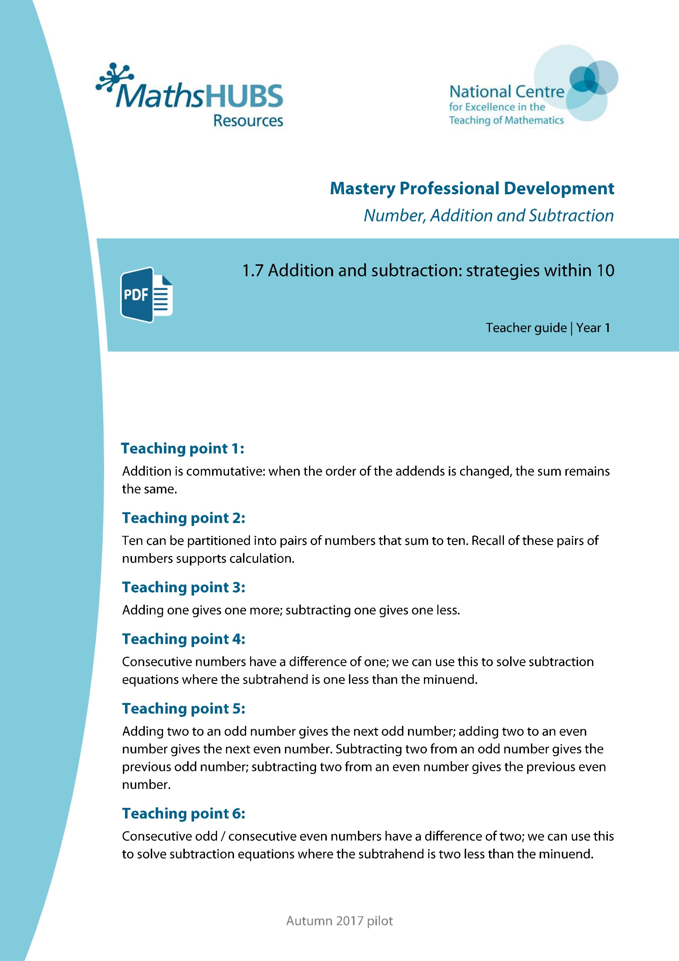
Year 2, Unit 3, Learning Outcomes 1 and 2
Additional teacher guidance for this outcome should be read first and can be found in this segment of the NCETM Primary Mastery Professional Development Materials:
1.7 Addition and Subtraction: strategies within ten
The spine materials are divided into ‘teaching points’ and ‘steps in learning’.
Focus on areas identified in small group assessments within the previous learning outcome, from the teaching points within this teacher guidance.
Teaching points | Steps in learning | Pages
1 to 6 | As required | 4-37

