Slide 1
The language and notation of ratio
KS3 Mastery PD Materials: Exemplified Key Ideas
Materials for use in the classroom or to support professional development discussions
(from 3.1 Understanding multiplicative relationships)
Summer 2021

Slide 2
About this resource
These slides are designed to complement the 3.1 Understanding Multiplicative Relationships Core Concept document and its associated Theme Overview document 3 Multiplicative Reasoning, both found in the Secondary Mastery Professional Development pages.
These slides re-present the key examples from the Core Concept document so that the examples can be used either directly in the classroom or with a group of teachers. There are prompt questions alongside the examples, and further clarification in the notes.
These slides do not fully replicate the Core Concept document, so should be used alongside it. Reference to specific page numbers, and to other useful NCETM resources, can be found in the notes for each slide.
This slide deck is not designed to be a complete PD session, rather it is a selection of resources that you can adapt and use as needed when planning a session with a group of teachers.

Slide 3


About this resource
The slides are structured as follows:
  The big picture:
    Where does this fit in?
    What do students need to understand?
    Why is this key idea important?
  Prior learning
  Misconceptions
  Exemplified key ideas
  Reflection questions
  Appendices:
    Key vocabulary
    Representations and structure
    Previous and Future learning
    Useful links
The exemplified key idea slides have the following symbols to indicate how they have been designed to be used:
Into the classroom
The examples are presented on these slides so that they could be used in PD, but also directly in the classroom. The notes feature suggested questions and things teachers might consider when using with students.
PD discussion prompts
These slides look at the examples in more detail, with question prompts to promote discussion among maths teachers. The notes feature reference to further information and guidance within the Core Concepts document.

Slide 4
Where does this fit in?
The NCETM has identified a set of six ‘mathematical themes’ within Key Stage 3 mathematics that bring together a group of ‘core concepts’.
The third of these themes is Multiplicative reasoning, which covers the following interconnected core concepts:
    3.1 Understanding multiplicative relationships
    3.2 Trigonometry
Notes:
Linked on this slide is the Theme Overview document of Multiplicative reasoning. This document includes why it is important, the key underpinning knowledge and links to prior and future learning. There is also guidance about how the five big ideas of Teaching for Mastery relate specifically to this theme.

Slide 5
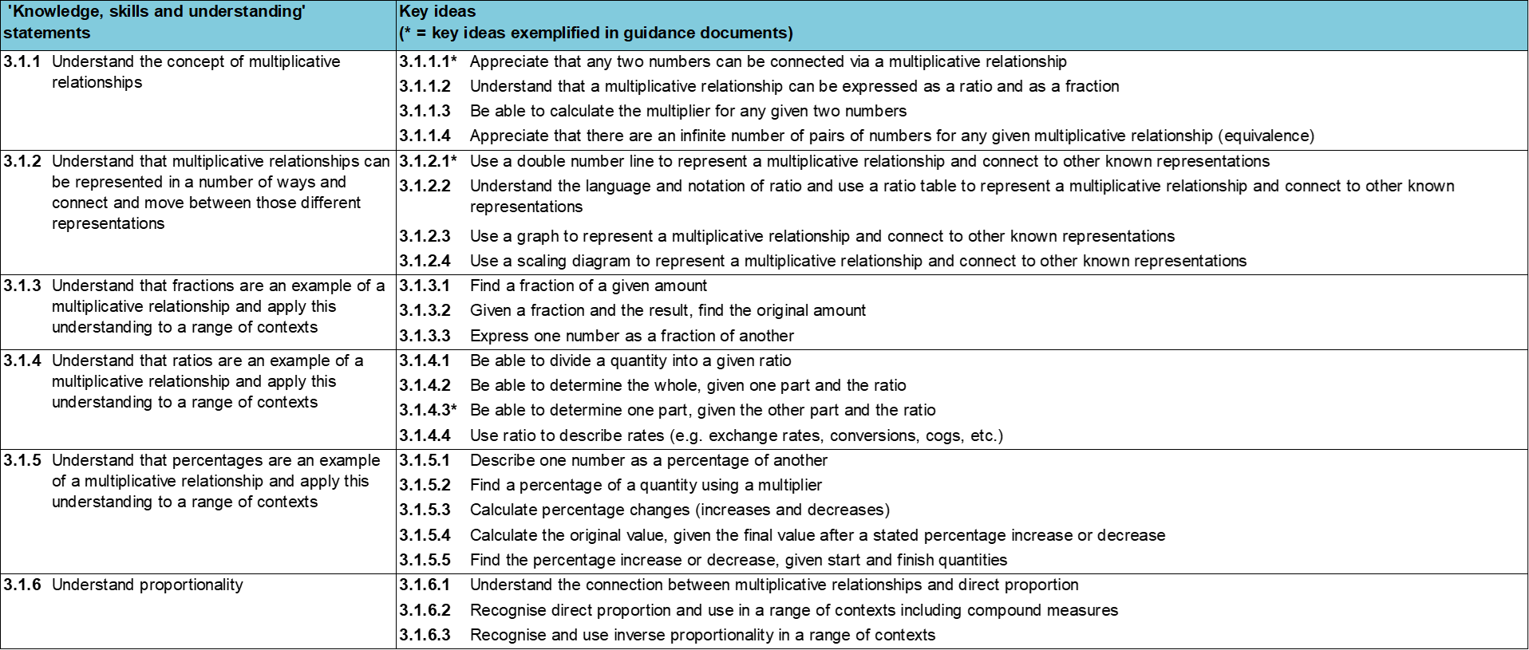
Where does this fit in?
Within this core concept, 3.1 Understanding multiplicative relationships, there are six statements of knowledge, skills and understanding.
These, in turn, are broken down into twenty three key ideas. The highlighted key idea is exemplified in this slide deck.
Notes:
For key ideas marked with an asterisk, we exemplified the common difficulties and misconceptions that students might have and included elements of what teaching for mastery may look like. We have provided examples of possible student tasks and teaching approaches.
Within these slides are ‘classroom-ready’ versions of the examples for the key idea that has been highlighted. There are also slides that may be useful for discussion in a professional development session.

Slide 6
What do students need to understand?
3.1.2.2. Understand the language and notation of ratio and use a ratio table to represent a multiplicative relationship and connect to other known representations
Identify the multipliers for information arranged in a ratio table
Understand ratio tables as an abstraction of the double number line
Identify situations in which the ratio table is a suitable model
  What prior knowledge might your students already have?
  What language might they use to describe this key idea?
  What questions might you want to ask to assess their prior learning?

Slide 7
Why is this key idea important?
Students may have previously met the idea of multiplication by thinking about equal groupings of objects and counting on in equal amounts from zero.
As the numbers with which students work with extend beyond integers to include fractions and decimals, the scaling view of multiplication becomes increasingly important.
This key idea explores the ratio table as a representation of multiplicative relationships between four quantities, and the two multipliers that connect them. These are sometimes referred to as the functional and scalar multipliers.
It is important to keep in mind that the purpose of this representation is to reveal the underpinning mathematical structure, rather than to provide a method to achieve an answer.
Multiplicative transformations give rise to ideas of ratio, proportionality, percentage increase and decrease, rates of change, enlargement and similarity, and trigonometric ratios.
Notes:
A more detailed overview of the core concept of Multiplicative reasoning can be found on page 2 of the 3.1 Core Concept document.
The background to each key idea is also explored in more detail on the following pages:
3.1.1 Understand the concept of multiplicative relationships – page 5
3.1.2 Understand that multiplicative relationships can be represented in a number of ways and connect and move between those different representations – page 5
3.1.3 Understand that fractions are an example of a multiplicative relationship and apply this understanding to a range of contexts – pages 5 and 6
3.1.4 Understand that ratios are an example of a multiplicative relationship and apply this understanding to a range of contexts – page 6
3.1.5 Understand that percentages are an example of a multiplicative relationship and apply this understanding to a range of contexts – pages 6 and 7
3.1.6 Understand proportionality – page 7

Slide 8
Prior learning
Upper Key Stage 2 Learning Outcome
Multiply proper fractions and mixed numbers by whole numbers, supported by materials and diagrams
Recognise the per cent symbol (%) and understand that per cent relates to ‘number of parts per hundred’, and write percentages as a fraction with denominator 100, and as a decimal
Use all four operations to solve problems involving measure (for example, length, mass, volume, money) using decimal notation, including scaling
Solve problems involving the relative sizes of two quantities where missing values can be found by using integer multiplication and division facts
Solve problems involving the calculation of percentages (for example, of measures, and such as 15% of 360) and the use of percentages for comparison
Solve problems involving similar shapes where the scale factor is known or can be found
Solve problems involving unequal sharing and grouping, using knowledge of fractions and multiples
  What prior knowledge might your students already have?
  What language might they use to describe this key idea?
  What questions might you want to ask to assess their prior learning?
Notes:
You may find it useful to speak to your partner schools to see how the above has been covered and the language used.
You can find further details regarding prior learning in the following segments of the NCETM primary mastery professional development materials (linked on final slide):
Year 4: 2.17 Structures: using measures and comparison to understand scaling
Year 6: 2.27 Scale factors, ratio and proportional reasoning
Year 6: 3.10 Linking fractions, decimals and percentages
Within the Multiplicative Reasoning Theme Overview document, you can also find a broader description of students’ potential previous learning (page 3), alongside further information about key underpinning knowledge (page 2).

Slide 9
Checking prior learning
The following slides contain questions for checking prior learning.
  What representations might students use to support their understanding of these questions?
  What variation might you put in place for these questions to fully assess students’ understanding of the concept?
  How might changing the language of each question change the difficulty?
  Why are these such crucial pre-requisites for this key idea?

Slide 10
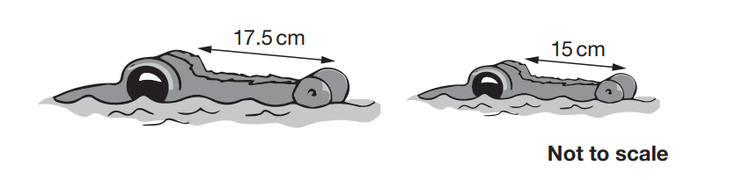
Checking prior learning (1)
a)
A machine pours 250 millilitres of juice every 4 seconds.
How many litres of juice does the machine pour every minute?
b)
The length of an alligator can be estimated by:
measuring the distance from its eyes to its nose
then multiplying that distance by 12
What is the difference in the estimated lengths of these two alligators?
Notes:
References to the questions (links on final slide):
a) 2019 Key Stage 2 Mathematics Paper 2: reasoning, question 19
b) 2018 Key Stage 2 Mathematics Paper 2: reasoning, question 20

Slide 11
Checking prior learning (2)
c)
All the pupils in a school were asked to choose between an adventure park and the seaside for a school trip.
They voted, and the result was a ratio of 5:3 in favour of the adventure park.
125 children voted in favour of going to the adventure park.
How many children voted in favour of going to the seaside?
Notes:
References to the questions (links on final slide):
c) NCETM Primary Assessment Materials, Year 6 Page 16

Slide 12
Common difficulties and misconceptions
What aspects of this key idea might pupils find challenging?
What misconceptions might pupils have?
When teaching this topic, you may find students encounter difficulties with…
Recognising multiplication problems as four-term relationships
Understanding ratio tables as a representation of structure not a ‘method’
More information, and some suggestions for overcoming these challenges, can be found on the following slides.

Slide 13
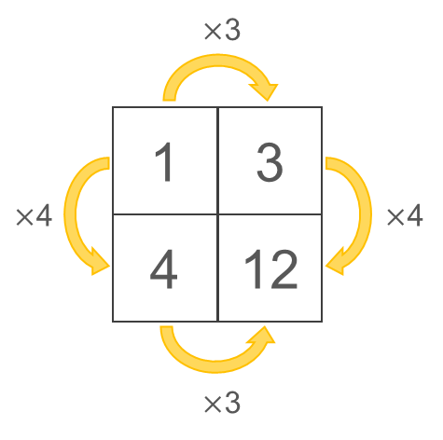
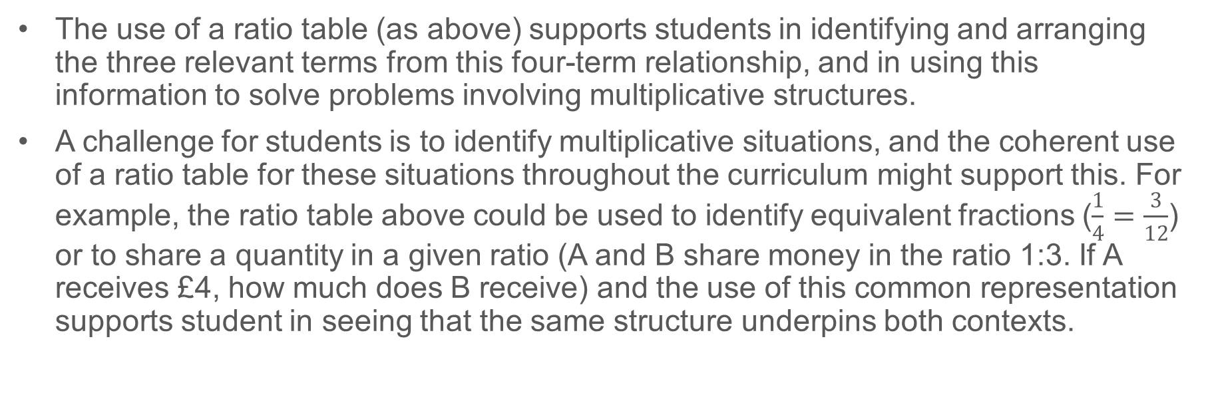
Common difficulties and misconceptions (1)
Vergnaud (1983) suggests that multiplication problems do not consist of a three-term relationship, rather a four-term relationship from which three relevant terms have to be extracted. In some simple situations, one of the terms may be 1, for example:
The use of a ratio table (as above) supports students in identifying and arranging the three relevant terms from this four-term relationship, and in using this information to solve problems involving multiplicative structures.
A challenge for students is to identify multiplicative situations, and the coherent use of a ratio table for these situations throughout the curriculum might support this. For example, the ratio table above could be used to identify equivalent fractions ($\frac{1}{4}=\frac{3}{12}$) or to share a quantity in a given ratio (A and B share money in the ratio 1:3. If A receives £4, how much does B receive) and the use of this common representation supports student in seeing that the same structure underpins both contexts.
Notes:
More detail can be found on page 23 of the 3.1 Core Concept document.

Slide 14
Common difficulties and misconceptions (2)
It is important that students understand the structure that underpins the ratio table and that it is not viewed as a ‘method’.
Ratio tables are an abstraction of the double number line and, while a double number line drawn to scale has the advantage of allowing estimation, it is unlikely to be an efficient representation to solve a problem accurately. The ratio table allows for the multipliers to be quickly identified and for a solution to be found to a multiplicative problem.
Giving students opportunities to connect ratio tables with double numbers lines and the relevant symbolic notation is a key idea.
Notes:
More detail can be found on page 23 of the 3.1 Core Concept document.

Slide 15
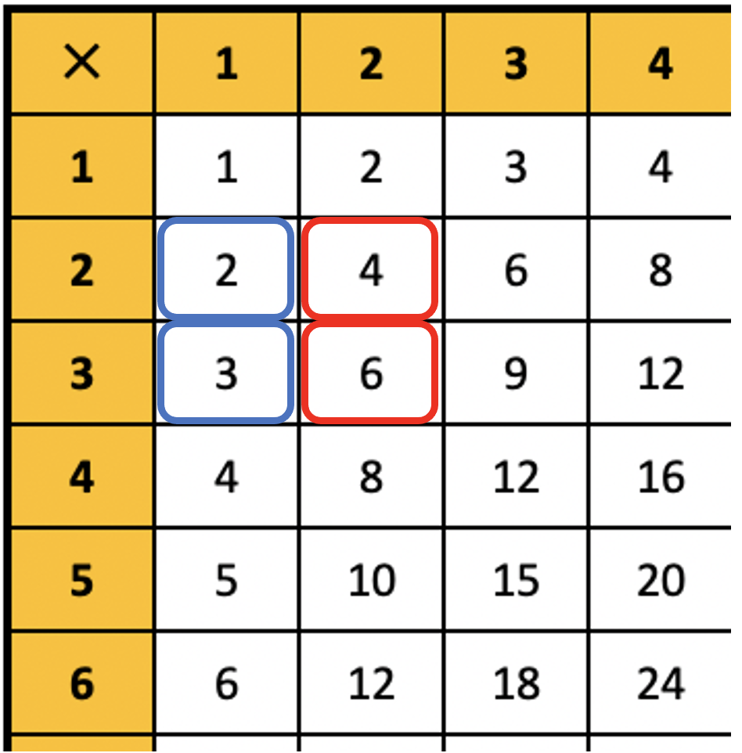
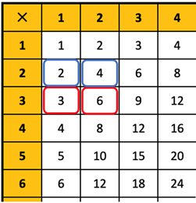
Identify the multipliers for information arranged in a ratio table
Example 1
Here is a section from a times-table square. A set of four numbers is highlighted. In this diagram, there is a constant multiplier to move from the numbers in blue to those in red:
2 × 2 = 4 3 × 2 = 6
Here the same section coloured differently. In this diagram there is also a constant multiplier to move from the numbers in blue to those in red.
Find the constant multiplier to move from the blue to red.
Shift the group of four numbers to a different position on the table-square. Is there always a constant multiplier to move from left to right? From top to bottom?
Notes:
Suggested questioning:
What is the same and different about the pairs of numbers that are coloured each time?
What is the multiplier to move from blue to red?
What is the multiplier to move from red to blue?
Are you more confident using one or other multiplier?
Things for you to think about:
The use of the familiar times-table square is intended to remind students that it is multiplicative relationships that underpin this work. Moving the four connected points around the table square allows the multipliers to become less familiar (bringing in fractions for example) while reinforcing that the ratio table ‘works’ for any set of connected numbers.
In the same way that the table-square is intended to remind students of the multiplicative nature of the relationships, this can also be supported by the language used. Reference to multipliers and multiplicative relationships can be helpful in this work.
As students shift the set of four numbers around the grid, they can be encouraged to separate the numbers so that they form the corners of a rectangle, for example as shown on the next slide.

Slide 16
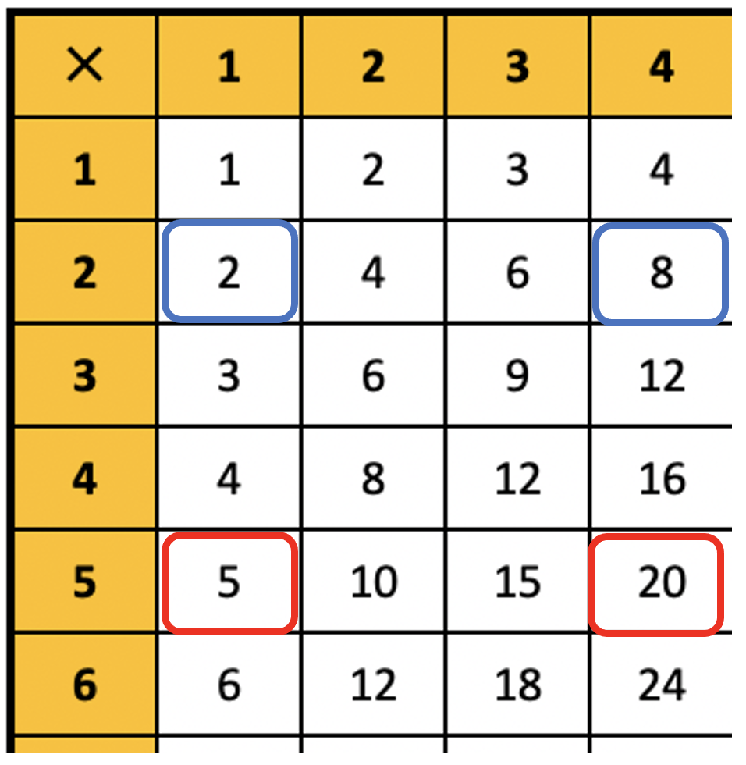
Identify the multipliers for information arranged in a ratio table
Example 1 (alternative)
Here is a section from a times-table square. A set of four numbers is highlighted.
In this diagram there is a constant multiplier to move from the numbers in blue to those in red.
Find the constant multiplier to move from the blue to red.
Find the constant multiplier to move from the red to blue.
Shift the group of four numbers to a different position on the table-square. Is there always a constant multiplier to move from left to right? From top to bottom?
Notes:
Slide 16 offers an alternative version of Example 1, highlighting numbers that are not adjacent.
Suggested questioning:
What is the same and different about this diagram and the previous diagram?
What is the multiplier to move from left to right? How about top to bottom?
Do you find one or other multiplier easier to think about?
Things for you to think about:
The use of the familiar times-table square is intended to remind students that it is multiplicative relationships that underpin this work. Moving the four connected points around the table square allows the multipliers to become less familiar (bringing in fractions for example) while reinforcing that the ratio table ‘works’ for any set of connected numbers.
In the same way that the table-square is intended to remind students of the multiplicative nature of the relationships, this can also be supported by the language used. Reference to multipliers and multiplicative relationships can be helpful in this work.
As students shift the set of four numbers around the grid, they can be encouraged to separate the numbers so that they form the corners of a rectangle, for example as shown on the next slide.

Slide 17
Identify the multipliers for information arranged in a ratio table
Example 1
Here is a section from a times-table square. A set of four numbers is highlighted. In this diagram, there is a constant multiplier to move from the numbers in blue to those in red:
2 × 2 = 4 3 × 2 = 6
Here the same section coloured differently. In this diagram there is also a constant multiplier to move from the numbers in blue to those in red.
Find the constant multiplier to move from the blue to red.
Shift the group of four numbers to a different position on the table-square. Is there always a constant multiplier to move from left to right? From top to bottom?
  Reflect on your teaching of topics that involve multiplicative relationships. Do you draw students’ attention to both multipliers in the relationship? Why or why not?
  What are the benefits and disadvantages of doing this?
Notes:
Due to space constraints, the image on this PD discussion slide is very small. PD Leads might like to use or print the ‘in the classroom’ version of this slide for teachers to access during discussions.
This example can be found on pages 23 and 24 of the 3.1 Core Concept document.

Slide 18
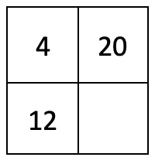
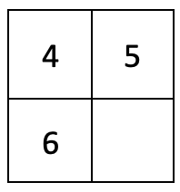
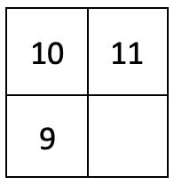
Identify the multipliers for information arranged in a ratio table
Example 2
Write down the multipliers and find the missing values in these ratio tables.
a)
b)
c)
Notes:
Suggested questioning:
Which multiplier did you use?
What would the other multiplier be?
Is the same multiplier always the ‘easier’ multiplier?
How can you find a multiplier when the two numbers are not in the same multiplication table (other than 1!)?
Things for you to think about:
The examples here have been chosen to draw attention to the multiplicative connections that exist. In part a both of the multipliers are familiar integers, allowing students to easily notice ×5 and ×3. Part b then draws on this and students might be asked to consider the connections between the two different ratio tables. To move from 4 to 5, students may suggest a strategy of ×5 then ÷4. Encouraging students to shift from this two-step process and work with the single operation of ×$\frac{5}{4}$ is important. In moving from 4 to 6, students might describe the multiplier as “add half of 4” and, while correct, it is important that they are also able to see the multiplicative connection of ×$\frac{3}{2}$.
Part c then moves away from familiar multipliers and includes a move from 10 to 9, an instance where multiplication makes smaller, which some students may find challenging.

Slide 19
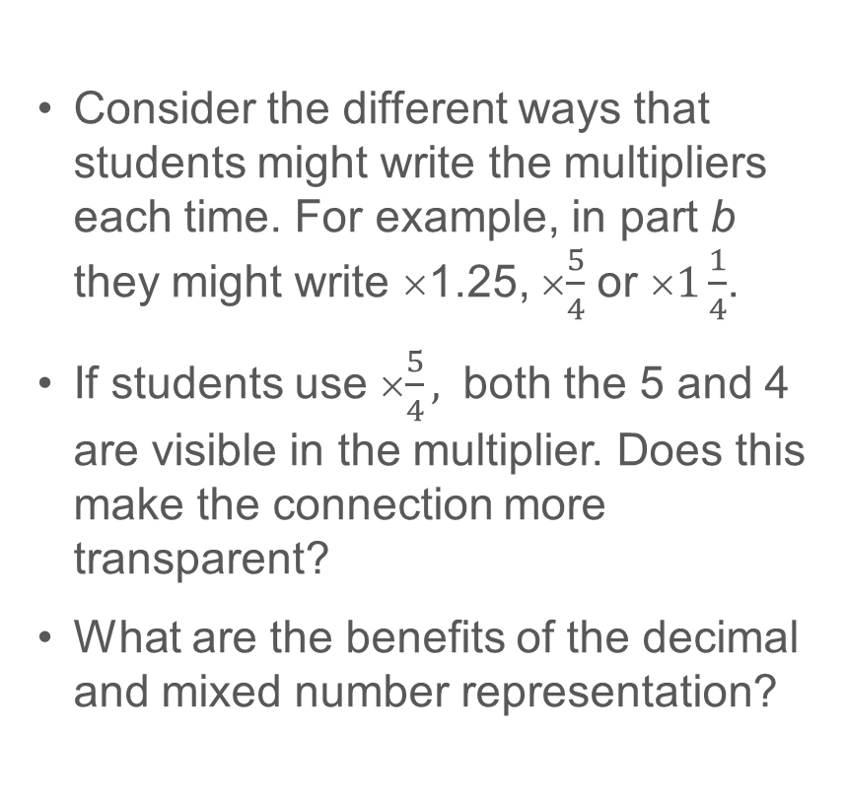
Identify the multipliers for information arranged in a ratio table
Example 2
  Consider the different ways that students might write the multipliers each time. For example, in part b they might write ×1.25, ×$\frac{5}{4}$ or ×$1\frac{1}{4}$.
  If students use ×$\frac{5}{4},$ both the 5 and 4 are visible in the multiplier. Does this make the connection more transparent?
  What are the benefits of the decimal and mixed number representation?
Write down the multipliers and find the missing values in these ratio tables.
a)
b)
c)
Notes:
This example can be found on pages 24 and 25 of the 3.1 Core Concept document.

Slide 20
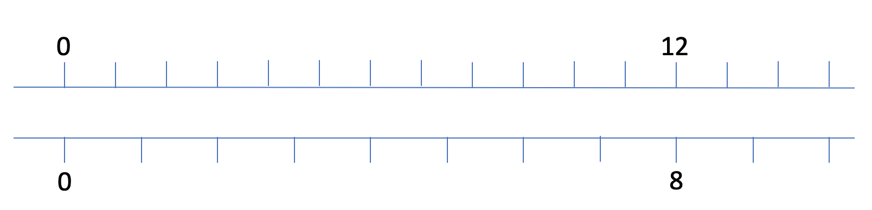








Understand ratio tables as an abstraction of the double number line
Example 3
For a birthday party, Pete buys 8 identical packets of cakes. The total cost is £12.
Use the double number line to estimate the cost of 9 packets of cakes.
Which of these ratio tables could be used to calculate the cost of 9 packets of cakes?
$$×\frac{9}{8}$$
$$×\frac{9}{12}$$
12
?
12
9
$$×\frac{8}{12}$$
$$×\frac{8}{12}$$
$$×\frac{8}{12}$$
$$×\frac{8}{12}$$
8
9
8
?
$$×\frac{9}{8}$$
$$×\frac{9}{12}$$
Notes:
Suggested questioning:
Where on the double number line can you see each multiplier?
Which of the ratio tables can you use?
Why can you not use the one with green arrows?
Why is it important to place the numbers in the right sections?
Is there a relationship between 9 and 12 in this problem?
Things for you to think about:
This context is taken from Example 2 of the exemplification for Key Idea 3.1.2.1. In revisiting this task the intention is to support students in working between the different representations and making connections in order that they identify the underpinning mathematical structure rather than see the ratio table as a ‘method’.

Slide 21
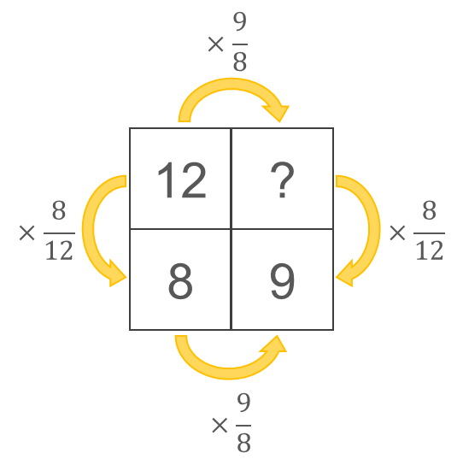
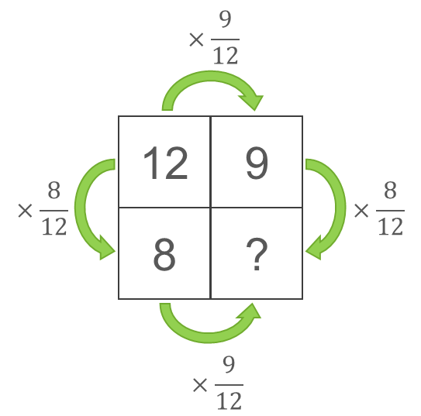
Understand ratio tables as an abstraction of the double number line
Example 3
For a birthday party, Pete buys 8 identical packets of cakes. The total cost is £12.
  Why might showing students a ratio table with incorrect placement of values be helpful?
  What do you think your students will do to identify the correct relationships here?
  What will you do to explain?
Use the double number line to estimate the cost of 9 cakes.
Which of these ratio tables could be used to calculate the cost of 9 cakes?
Notes:
Due to space constraints, the image on this PD discussion slide is very small. PD Leads might like to use or print the ‘in the classroom’ version of this slide for teachers to access during discussions.
This example can be found on page 25 of the 3.1 Core Concept document.

Slide 22
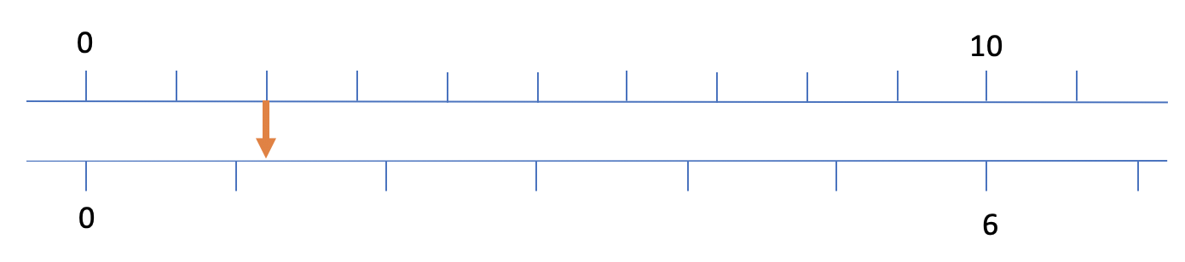
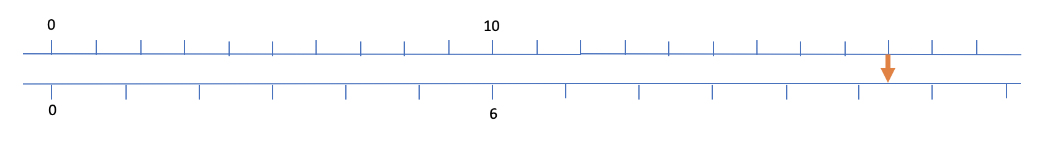
Understand ratio tables as an abstraction of the double number line
Example 4
Look at these double number lines:
For each of the double number lines:
Estimate the number that the arrow is pointing to.
Construct a ratio table and use it to calculate the number that the arrow is pointing to.
Notes:
Suggested questioning:
What number is the red arrow closest do? What do you estimate it would be?
What is the relationship between 10 and 6?
What number will you pair with your red arrow number?
How close was your estimate?
Things for you to think about:
Example 4 also draws on the exemplification for Key Idea 3.1.2.1. The two double number lines bring different challenges for students. In rewriting the first as a ratio table, students may find placement of the 2 challenging and the unknown value may be represented in an unfamiliar position. For example, writing the 2 in the top left hand corner and the unknown in the bottom left hand corner like this:
2 10
? 6
This offers an opportunity to explore what it is possible to change within the structure underpinning the ratio table - for example, is this a valid representation for the double number line?
10 2
6 ?
The second double number line offered here is in a more familiar arrangement, but the multiplier is less familiar and may be perceived to be more challenging to work with.

Slide 23
Understand ratio tables as an abstraction of the double number line
Example 4a
Look at this double number line:
Estimate the number that the arrow is pointing to.
Construct a ratio table and use it to calculate the number that the arrow is pointing to.
Notes:
This slide presents the first double number line from Example 4 on its own so that the image can be bigger. For suggested questioning and things to think about, see slide 21.

Slide 24
Understand ratio tables as an abstraction of the double number line
Example 4b
Look at this double number line:
Estimate the number that the arrow is pointing to.
Construct a ratio table and use it to calculate the number that the arrow is pointing to.
Notes:
This slide presents the second double number line from Example 4 on its own so that the image can be bigger. For suggested questioning and things to think about, see slide 21.

Slide 25
Understand ratio tables as an abstraction of the double number line
Example 4
Look at these double number lines:
For each of the double number lines:
Estimate the number that the arrow is pointing to.
Construct a ratio table and use it to calculate the number that the arrow is pointing to.
  How might the inclusion of the estimation question support students’ understanding?
  Without the ratio table, what might students do here? How might the ratio table help them to identify the most straightforward multiplier to use?
Notes:
Due to space constraints, the image on this PD discussion slide is very small. PD Leads might like to use or print the ‘in the classroom’ version of this slide for teachers to access during discussions.
This example can be found on page 26 of the 3.1 Core Concept document.

Slide 26
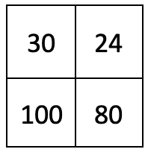
Identify situations in which the ratio table is a suitable model
Example 5a
This ratio table is filled in correctly.
Which of the following situations could be calculated using the ratio table?
The full price of a shirt is £30 but it is reduced by 20%. What is the new price?
Steve is 30 years old and Paul is 24. When Steve is 100, how old will Paul be?
A rectangle is 30cm long and 1m high. How long is a similar rectangle that is 80cm high?
Notes:
Suggested questioning:
Where is the ‘20’ in this ratio table?
Why are Steve and Paul’s ages not a multiplicative relationship?
What does the word ‘similar’ mean in mathematics?
Things for you to think about:
Example 5 offers some contexts in which a ratio table can be used, and also some examples of ‘what it’s not’, offering some situations which are not proportional and so cannot be represented in a ratio table. The use of a common representation such as a ratio table can support students in making connections between apparently different topics.

Slide 27
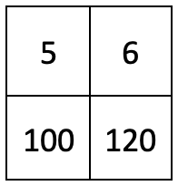
Identify situations in which the ratio table is a suitable model
Example 5b
This ratio table is filled in correctly.
Which of the following situations could be calculated using the ratio table?
The 5th term of the linear sequence 10n+50 is 100. What is the 6th term?
A can of paint is on offer with 20% extra free. This new can contains 6 litres of paint. How much paint does the standard can contain?
Kay and Grace share some money in the ratio 5:6. If Kay gets £100, how much does Grace get?
Notes:
Suggested questioning:
Why is a linear sequence not a multiplicative relationship? What would the 5th term really be?
Where is the ’20’ in this ratio table? Would all pairs of numbers with a difference of 20 represent a ‘20% increase’?
What other questions could you ask about Kay and Grace?
Things for you to think about:
Example 5 offers some contexts in which a ratio table can be used, and also some examples of ‘what it’s not’, offering some situations which are not proportional and so cannot be represented in a ratio table. The use of a common representation such as a ratio table can support students in making connections between apparently different topics.

Slide 28
Identify situations in which the ratio table is a suitable model
Example 5
The ratio tables are filled in correctly. Which of the following situations could be calculated using each ratio table?
The full price of a shirt is £30 but it is reduced by 20%. What is the new price?
Steve is 30 years old and Paul is 24. When Steve is 100, how old will Paul be?
A rectangle is 30cm long and 1m high. How long is a similar rectangle that is 80cm high?
The 5th term of the linear sequence 10n+50 is 100. What is the 6th term?
A can of paint is on offer with 20% extra free. This new can contains 6 litres of paint. How much paint does the standard can contain?
Kay and Grace share some money in the ratio 5:6. If Kay gets £100, how much does Grace get?
  Consider the different contexts in which ratio tables might be used: would the use of a ratio table in these contexts support students in your school?
  To be effective, it is likely that this representation should be consistent across the department (and school) – what are the barriers to this?
Notes:
Due to space constraints, the image on this PD discussion slide is very small. PD Leads might like to use or print the ‘in the classroom’ version of this slide for teachers to access during discussions.
This example can be found on pages 26 and 27 of the 3.1 Core Concept document.

Slide 29
Reflection questions
What other mathematical concepts will be supported by students’ stronger understanding of this key idea?
What mathematical language will you continue to use to support pupils to make connections with other areas?
Which representations might you continue to use to further develop students’ understanding?

Slide 31
Appendices
You may choose to use the following slides when planning or delivering a PD session. They cover:
  Key vocabulary
  Representations and structure
  Previous learning
  Future learning
  Library of links

Slide 32
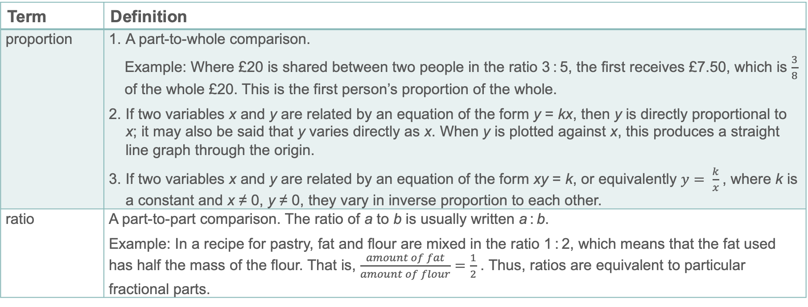
Key vocabulary
Term | Definition
proportion | A part-to-whole comparison. Example: Where £20 is shared between two people in the ratio 3 : 5, the first receives £7.50, which is $\frac{3}{8}$ of the whole £20. This is the first person’s proportion of the whole. If two variables x and y are related by an equation of the form y = kx, then y is directly proportional to x; it may also be said that y varies directly as x. When y is plotted against x, this produces a straight line graph through the origin. If two variables x and y are related by an equation of the form xy = k, or equivalently $y= \frac{k}{x}$, where k is a constant and x ≠ 0, y ≠ 0, they vary in inverse proportion to each other.
ratio | A part-to-part comparison. The ratio of a to b is usually written a : b. Example: In a recipe for pastry, fat and flour are mixed in the ratio 1 : 2, which means that the fat used has half the mass of the flour. That is, $\frac{amount of fat}{amount of flour}=\frac{1}{2}$ . Thus, ratios are equivalent to particular fractional parts.

Slide 33
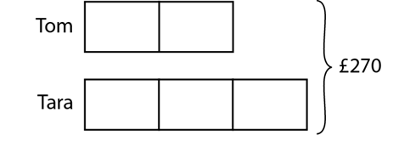
Representations and structure
There are a number of different representations that you may wish to use to support students’ understanding of this key idea. These might include:
Bar models
  Bar models can be very useful to support students in representing (literally, re-presenting) problems in order to reveal multiplicative structures (as appropriate) and thus become aware of how to proceed to a solution.
Ratio tables and double number lines (also known as ‘stacked number lines’)
  The comparison of corresponding entries in two different sets of multiples, such as from a multiplication table, can be a useful context in which to explore multiplicative relationships.
Tom and Tara share £270 between them in the ratio 2 : 3. How much do they each receive?
Notes:
More information about the representations and structure involved in this key idea can be found:
On page 7 of the Multiplicative Reasoning Theme Overview document
Links to all of these can be found on the final slide.

Slide 34
Previous learning
From Upper Key Stage 2, students will bring experience of:
multiplying proper fractions and mixed numbers by whole numbers, supported by materials and diagrams
recognising the per cent symbol (%) and understanding that per cent relates to ‘number of parts per hundred’, and writing percentages as a fraction with denominator 100, and as a decimal
using all four operations to solve problems involving measure (for example, length, mass, volume, money) using decimal notation, including scaling
solving problems involving the relative sizes of two quantities where missing values can be found by using integer multiplication and division facts
solving problems involving the calculation of percentages (for example, of measures, and such as 15% of 360) and the use of percentages for comparison
solving problems involving similar shapes where the scale factor is known or can be found
solving problems involving unequal sharing and grouping, using knowledge of fractions and multiples.
Notes:
Theme 3 Multiplicative reasoning

Slide 35
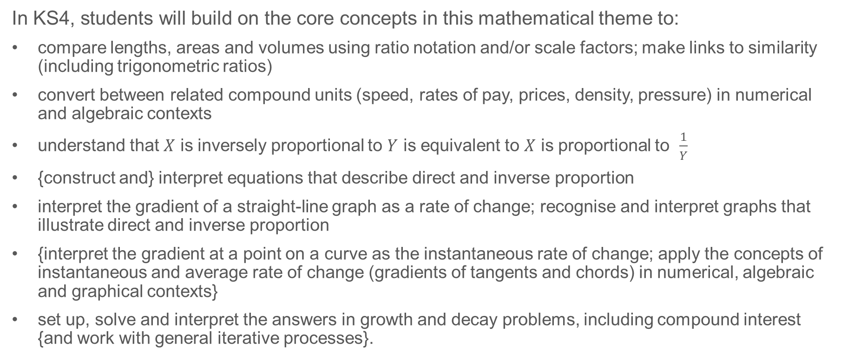
Future learning
In KS4, students will build on the core concepts in this mathematical theme to:
compare lengths, areas and volumes using ratio notation and/or scale factors; make links to similarity (including trigonometric ratios)
convert between related compound units (speed, rates of pay, prices, density, pressure) in numerical and algebraic contexts
understand that $X$ is inversely proportional to $Y$ is equivalent to $X$ is proportional to $\frac{1}{Y}$
{construct and} interpret equations that describe direct and inverse proportion
interpret the gradient of a straight-line graph as a rate of change; recognise and interpret graphs that illustrate direct and inverse proportion
{interpret the gradient at a point on a curve as the instantaneous rate of change; apply the concepts of instantaneous and average rate of change (gradients of tangents and chords) in numerical, algebraic and graphical contexts}
set up, solve and interpret the answers in growth and decay problems, including compound interest {and work with general iterative processes}.
Please note: Braces { } indicate additional mathematical content to be taught to more highly attaining students.
Notes:
Theme 3 Multiplicative reasoning

Slide 36
Library of links
The following resources from the NCETM website have been referred to within this slide deck:
  NCETM Secondary Mastery Professional Development
    3 Multiplicative Reasoning Theme Overview Document
    3.1 Understanding Multiplicative Relationships Core Concept Document
  Using mathematical representations at KS3 | NCETM
  Insights from experienced teachers | NCETM
  NCETM primary mastery professional development materials
  NCETM primary assessment materials
There are also references to:
  Standards & Testing Agency’s past mathematics papers

