Slide 1
Estimating numerical calculations
KS3 Mastery PD Materials: Exemplified Key Ideas
Materials for use in the classroom or to support professional development discussions
(from 1.1 Place value, estimation and rounding)
Summer 2021

Slide 2
About this resource
These slides are designed to complement the 1.1 Place value, estimation and rounding Core Concept document and its associated Theme Overview document 1 The Structure of the number system, both found in the Secondary Mastery Professional Development pages.
These slides re-present the key examples from the Core Concept document so that the examples can be used either directly in the classroom or with a group of teachers. There are prompt questions alongside the examples, and further clarification in the notes.
These slides do not fully replicate the Core Concept document, so should be used alongside it. Reference to specific page numbers, and to other useful NCETM resources, can be found in the notes for each slide.
This slide deck is not designed to be a complete PD session, rather it is a selection of resources that you can adapt and use as needed when planning a session with a group of teachers.

Slide 3


About this resource
The slides are structured as follows:
  The big picture:
    Where does this fit in?
    What do students need to understand?
    Why is this key idea important?
  Prior learning
  Misconceptions
  Exemplified key ideas
  Reflection questions
  Appendices:
    Key vocabulary
    Representations and structure
    Previous and Future learning
    Useful links
The exemplified key idea slides have the following symbols to indicate how they have been designed to be used:
Into the classroom
The examples are presented on these slides so that they could be used in PD, but also directly in the classroom. The notes feature suggested questions and things teachers might consider when using with students.
PD discussion prompts
These slides look at the examples in more detail, with question prompts to promote discussion among maths teachers. The notes feature reference to further information and guidance within the Core Concepts document.

Slide 4
Where does this fit in?
The NCETM has identified a set of six ‘mathematical themes’ within Key Stage 3 mathematics that bring together a group of ‘core concepts’.
The first of these themes is The structure of the number system, which covers the following interconnected core concepts:
    1.1 Place value, estimation and rounding
    1.2 Properties of number
    1.3 Ordering and comparing
    1.4 Simplifying and manipulating expressions, equations and formulae
Notes:
Linked on this slide is the Theme Overview document of The structure of the number system. This document includes why it is important, the key underpinning knowledge and links to prior and future learning. There is also guidance about how the five big ideas of Teaching for Mastery relate specifically to this theme.

Slide 5
Where does this fit in?
Within this core concept, 1.1 Place value, estimation and rounding, there are four statements of knowledge, skills and understanding.
These, in turn, are broken down into fifteen key ideas. The highlighted key idea is exemplified in this slide deck.
Notes:
For key ideas marked with an asterisk, we exemplified the common difficulties and misconceptions that students might have and included elements of what teaching for mastery may look like. We have provided examples of possible student tasks and teaching approaches.
Within these slides are ‘classroom-ready’ versions of the examples for the key idea that has been highlighted. There are also slides that may be useful for discussion in a professional development session.

Slide 6
What do students need to understand?
1.1.4.2 Estimate numerical calculations
Understand what estimation is and how it is useful.
Understand how to estimate answers to numerical calculations.
Understand how to apply estimation to problems in a given context.
Understand how to use and apply estimation in problem-solving situations.
  What prior knowledge might your students already have?
  What language might they use to describe this key idea?
  What questions might you want to ask to assess their prior learning?

Slide 7
Why is this key idea important?
Students need to understand why rounding is necessary and that it is a valuable tool for estimating number to varying degrees of accuracy.
Estimation is a key skill that contributes to students’ fluency in calculation. Fluency demands that students have strategies for checking the validity of their answers. Students who are proficient in carrying out algorithms, but who have no idea whether the answer to a calculation is sensible or not, are not fully fluent.
Notes:
A more detailed overview of the core concept of Place value, estimation and rounding can be found on page 2 of the 1.1 Core Concept document.
The background to each key idea is also explored in more detail on the following pages:
1.1.1 Understand the value of digits in decimals, measures and integers – page 4
1.1.2 Round numbers to a required number of decimal places – page 5
1.1.3 Round numbers to a required number of significant figures – page 5
1.1.4 Estimate calculations by rounding – page 6

Slide 8
Prior learning
  What prior knowledge might your students already have?
  What language might they use to describe this key idea?
  What questions might you want to ask to assess their prior learning?
Upper Key Stage 2 Learning Outcome
Read, write, order and compare numbers up to 10 000 000 and determine the value of each digit
Round any whole number to a required degree of accuracy
Identify the value of each digit in numbers given to three decimal places and multiply and divide numbers by 10, 100 and 1 000 giving answers up to three decimal places
Notes:
You may find it useful to speak to your partner schools to see how the above has been covered and the language used.
You can find further details regarding prior learning in the following segments of the NCETM primary mastery professional development materials (linked on final slide):
Year 4: 2.13 Calculation: multiplying and dividing by 10 or 100
Year 5: 1.26 Composition and calculation: multiples of 1 000 up to 1 000 000
Year 6: 1.30 Composition and calculation: numbers up to 10 000 000
Within the Theme Overview document, you can also find a broader description of students’ potential previous learning (page 4), alongside further information about key underpinning knowledge (page 2).

Slide 9
Checking prior learning
The following slides contain questions for checking prior learning.
  What representations might students use to support their understanding of these questions?
  What variation might you put in place for these questions to fully assess students’ understanding of the concept?
  How might changing the language of each question change the difficulty?
  Why are these such crucial pre-requisites for this key idea?

Slide 10
Checking prior learning
a)
Estimate the answer to 4243 + 1734 by rounding the numbers to:
the nearest 1000
the nearest 100
the nearest 50
the nearest 10.
b)
The population in England is 53 million, rounded to the nearest million.
What is the largest that the population could be?
What is the smallest that the population could be?
Explain how you decided.
c)
When I round 0.0020499 to 3 significant figures, the answer is
a. 0.002 b. 0.00205 c. 0.00204
Explain your answer.
Notes:
References to the questions (links on final slide):
NCETM primary assessment materials: year 6, page 10
NCETM secondary assessment materials: page 5
NCETM secondary assessment materials: page 6

Slide 11
Common difficulties and misconceptions
What aspects of this key idea might pupils find challenging?
What misconceptions might pupils have?
When teaching this topic, you may find students encounter difficulties with…
Knowing at what stage to round
Rounding (particularly of decimals)
More information, and some suggestions for overcoming these challenges, can be found on the following slides.
Notes:
More information can be found on page 18 of the 1.1 Core Concept document.

Slide 12
Common difficulties and misconceptions (1)
It is important that students acquire a secure conceptual understanding of estimation, what it is and why it is useful, alongside developing procedural fluency.
If the focus is purely on the need for rounding, then some students may find it hard to recall at which stage the rounding should take place. This can result in the misconception that estimation involves rounding the final result of a calculation, rather than rounding the numbers involved prior to calculating.
Students might find it easier to make sense of the concepts involved when they are given problems set in familiar contexts (see Examples 5 and 6). You may be able to design further questions which are better suited to the needs and interests of your students. This allows them to see clearly the usefulness of estimation and make connections to other areas of mathematics.
It will also lay the foundations for future learning about how estimation can be used to check the relative size of answers and will provide opportunities for students to justify whether it is an underestimate or overestimate.

Slide 13
Common difficulties and misconceptions (2)
Estimation builds upon prior learning of rounding (usually to one significant figure), so it is imperative that students have a deep and secure understanding of this before approaching this key idea.
Some students find rounding decimals (e.g. 0.541) problematic and so it is worthwhile addressing this explicitly (as in Example 3).
Students can find it especially challenging if the calculation requires a division by a decimal less than one, so it is worth assessing prior understanding of this skill before introducing questions such as those in Example 4.

Slide 14
Understand what estimation is and how it is useful
Example 1
Livia says that estimating is just guessing the answer. Do you agree with Livia?
Anton says 3.6273 + 52.99184 = 56.61914 and this can then be estimated as 60. Do you agree with Anton?
Betty says 579.304 − 102.968 can be estimated as 600 − 100 = 500. Do you agree with Betty?
Discuss this with your partner and come up with an accurate definition for estimation. Consider how and why estimation might be useful. Try to give some examples of when estimating might be helpful.
Notes:
Suggested questioning:
When might it be helpful to estimate?
Who has the best understanding of estimation?
Why has Anton NOT estimated?
Things for you to think about:
Students can misunderstand estimation as just guessing or approximating answers without recognising the process involved. Drawing students’ attention both to what estimation is and what it is not, allows them to form a more comprehensive understanding of the concept. If students are given time to both consider why estimation is useful and some real-life applications of estimation, then they are less likely to calculate without rounding first.

Slide 15
Understand what estimation is and how it is useful
Example 1
  What misconceptions around estimating do these statements aim to expose?
  What real-life applications of estimation might students suggest?
Livia says that estimating is just guessing the answer. Do you agree with Livia?
Anton says 3.6273 + 52.99184 = 56.61914 and this can then be estimated as 60. Do you agree with Anton?
Betty says 579.304 − 102.968 can be estimated as 600 − 100 = 500. Do you agree with Betty?
Discuss this with your partner and come up with an accurate definition for estimation. Consider how and why estimation might be useful. Try to give some examples of when estimating might be helpful.
Notes:
Due to space constraints, the image on this PD discussion slide is very small. PD Leads might like to use or print the ‘in the classroom’ version of this slide for teachers to access during discussions.
More detail about the decisions behind the choice of statements can be found on pages 18 of the 1.1 Core Concept document.

Slide 16
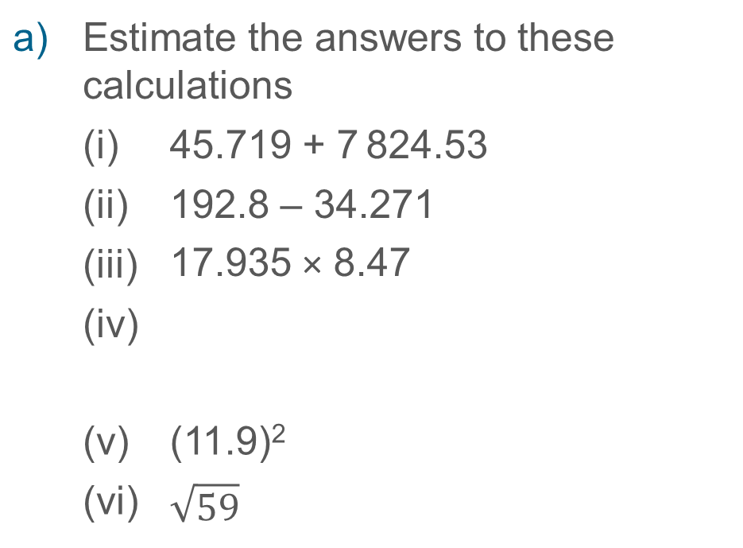
Understand how to estimate answers to numerical calculations
Example 2
a) | Estimate the answers to these calculations
 | (i) | 45.719 + 7 824.53
 | (ii) | 192.8 – 34.271
 | (iii) | 17.935 × 8.47
 | (iv)
 | (v) | (11.9)²
 | (vi) | $$\sqrt{59}$$
b) | Did you get the same estimates as your partner? Discuss the methods you used.
c) | Why might someone have a different estimate to you?
77.1
1.63
Notes:
Suggested questioning:
What degree of accuracy did you round to? Was it the same each time? Why or why not?
Why might someone have a different answer to you? Which of your estimates is ‘better’? Why?
Things for you to think about:
Consider giving students time to compare methods and answers with their peers and discuss whether there might be more than one acceptable answer. In a topic such as estimation, students should explore what constitutes an appropriate degree of accuracy in different contexts. They should consider why they might be estimating in the first place and, therefore, how accurate they need to be in their rounding.

Slide 17
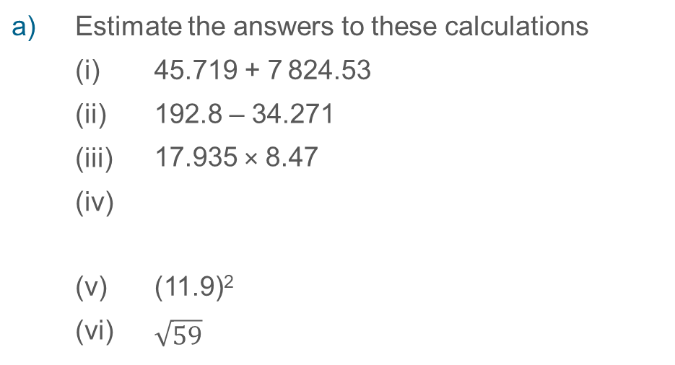
Understand how to estimate answers to numerical calculations
Example 2
a) | Estimate the answers to these calculations
 | (i) | 45.719 + 7 824.53
 | (ii) | 192.8 – 34.271
 | (iii) | 17.935 × 8.47
 | (iv)
 | (v) | (11.9)²
 | (vi) | $$\sqrt{59}$$
  What discussions might students have for parts b and c?
  How could you use these examples to introduce the idea of appropriate degrees of accuracy?
77.1
1.63
b) | Did you get the same estimates as your partner? Discuss the methods you used.
c) | Why might someone have a different estimate to you?
Notes:
Due to space constraints, the image on this PD discussion slide is very small. PD Leads might like to use or print the ‘in the classroom’ version of this slide for teachers to access during discussions.
More detail about the decisions behind the sequencing of the questions can be found on page 19 of the 1.1 Core Concept document.

Slide 18
Understand how to estimate answers to numerical calculations
Example 3
14.5
0.512
Martha estimates that .
Martha is incorrect.
= 14.5
What misconception might Martha have?
What would be a more appropriate estimate?
Notes:
Suggested questioning:
What has Martha rounded her denominator to? What should she have done?
Why are significant figures important here?
Things for you to think about:
This is an example of a common misconception: since 0.5 rounds to 1, many students incorrectly assume that 0.512 also rounds to 1 when rounded to one significant figure. Consider spending time assessing students’ understanding of rounding decimals to one significant figure and revisiting learning if required, before progressing. Where do these topics sit in your scheme of learning? How long has it been since students first learnt rounding to significant figures? What is the best method to recap prior learning?

Slide 19
Understand how to estimate answers to numerical calculations
Example 3
  What misconceptions might this question expose?
  Consider where rounding and estimating sit in your scheme of learning:
    How long has it been since students first learnt rounding to significant figures?
    How will you recap prior learning?
14.5
0.512
Martha estimates that .
Martha is incorrect.
= 14.5
What misconception might Martha have?
What would be a more appropriate estimate?
Notes:
More detail about the thinking behind this question can be found on page 19 of the 1.1 Core Concept document.

Slide 20
Understand how to estimate answers to numerical calculations
Example 4
Estimate the answers to these calculations.
a)
5742 × 34.7
875.21
b)
15.3 – 7.81
0.24
c)
(46.32)² + 7 326
9.6 + 16.51
(7.51)² – 3.997
d)
e)
(61.35 – 84.2)²
Notes:
Suggested questioning:
What order do you need to do the steps in these calculations?
What is an appropriate degree of accuracy to round to?
Things for you to think about:
The numbers involved here are of varying sizes, so students will need to practise rounding accordingly.

Slide 21
Understand how to estimate answers to numerical calculations
Example 4
Estimate the answers to these calculations.
  Are you confident that your students have enough fluency in rounding/multi-step calculations for these questions?
  What might you wish to recap first?
a)
5742 × 34.7
875.21
b)
15.3 – 7.81
0.24
c)
(46.32)² + 7 326
d)
(61.35 – 84.2)²
e)
9.6 + 16.51
(7.51)² – 3.997
Notes:
More detail about these questions can be found on page 19 of the 1.1 Core Concept document.

Slide 22
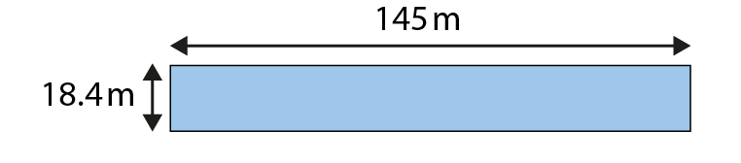
Understand how to apply estimation to problems in a given context
Example 5
A rectangle has dimensions 145m by 18.4m.
Which calculation would give a suitable estimate for the area of this rectangle?
a) 150 × 18 b) 150 × 20 c) 100 × 20 d) 18 × 145
Notes:
Suggested questioning:
What degree of accuracy has the calculation been rounded to each time?
Which is the most appropriate degree of accuracy?
Things for you to think about:
In Example 5, students must select an appropriate calculation, with options designed to identify common misconceptions. It could be argued that all of the options are suitable estimations for this question. How could you facilitate discussion in your classroom, so that students present their opinions and understand that the nature of estimation means there is often more than one correct answer? As a department, how have you decided what you deem to be an appropriate level of accuracy when estimating? How do you communicate this with your students?

Slide 23
Understand how to apply estimation to problems in a given context
Example 5
A rectangle has dimensions 145m by 18.4m.
  As a department, how have you decided what you deem to be an appropriate level of accuracy when estimating?
  How do you communicate this with your students?
  What other contexts would your students find useful?
  How can you make connections to other areas of mathematics?
Which calculation would give a suitable estimate for the area of this rectangle?
a) 150 × 18 b) 150 × 20
c) 100 × 20 d) 18 × 145
Notes:
More detail about the misconceptions being identified in this question can be found on page 20 of the 1.1 Core Concept document.

Slide 24
Understand how to apply estimation to problems in a given context
Example 6
A school puts on a show and charges £4.50 per seat. The school hall has capacity for 27 rows of chairs with 48 chairs in each row.
Estimate the amount of money the school will take if the show is sold out.
Calculate the amount of money the school will take if the show is sold out.
Compare your answers to parts a) and b) above. Explain why they are different.
Olivia calculates the total income for the school as £583 200. Explain how Olivia could use estimation to help check her answer.
Notes:
Suggested questioning:
What might you round the numbers to for part a? Why?
Which is going to be the most accurate estimate? Which is going to be the easiest calculation?
When will you have an overestimate? When will you have an underestimate?
Things for you to think about:
Students will inevitably come up with different estimates for part a), so it will be important to discuss these and encourage students to justify different methods and judge their relative merit.
For example:
•30 × 50 × 4.5 for a factor of 100 to be removed, giving 15 × 450
•30 × 50 × 5 might be too much rounding up, resulting in an excessive overestimate
•25 × 50 × 4.5 might be a better estimate as one number has been rounded up and the other rounded down.
It is often through the discussion after students have worked on a set of examples that the real learning takes place, so it will be important to give enough time to this element of the classroom activity.

Slide 25
Understand how to apply estimation to problems in a given context
Example 6
A school puts on a show and charges £4.50 per seat. The school hall has capacity for 27 rows of chairs with 48 chairs in each row.
  What different estimates might your students come up with for part a? Why?
  This example may lead to discussions related to future work on underestimates and overestimates. What questions might you ask to prepare the ground for this?
Estimate the amount of money the school will take if the show is sold out.
Calculate the amount of money the school will take if the show is sold out.
Compare your answers to parts a) and b) above. Explain why they are different.
Olivia calculates the total income for the school as £583 200. Explain how Olivia could use estimation to help check her answer.
Notes:
Due to space constraints, the image on this PD discussion slide is very small. PD Leads might like to use or print the ‘in the classroom’ version of this slide for teachers to access during discussions.
More detail about the thinking behind these questions be found on pages 20-21 of the 1.1 Core Concept document.

Slide 26
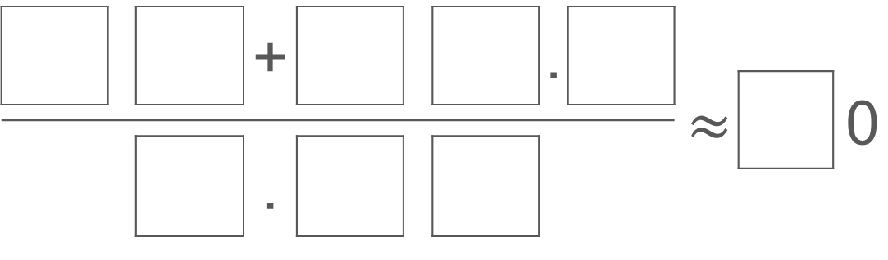
Understand how to use and apply estimation in problem-solving situations
Example 7
Use the digits 1–9 once only to create a calculation that would produce the following estimate:
 |  |  | + |  |  |  | .
 |  |  |  |  |  |  | . |  | $$≈$$ |  | 0
 |  |  | .
 |  |  | .
Notes:
Suggested questioning:
Where might you start with this question?
There is more than one possible answer – how many solutions can you find?
What digits might you choose to ensure the denominator rounds to 1? How might this help you find your first solution? How about if you wanted the denominator to round to 2?
The quotient here is a multiple of 10. What does that tell you about the relationship between the numerator and the denominator?
Things for you to think about:
Example 7 is an empty box problem which has more than one solution. Questions like these encourage students to consider the overall structure of the calculation. Asking students to explain the process they went through to find a solution will also help to refine their mathematical thinking.

Slide 27
Understand how to use and apply estimation in problem-solving situations
Example 7
  How would you manage a question like this with your classes?
  How long would you give them before you intervene and support?
  What prompts could you offer?
  How can you support students who are struggling to access the task?
Use the digits 1–9 once only to create a calculation that would produce the following estimate:
Notes:
This question can be found on page 21 of the 1.1 Core Concept document.

Slide 28
Reflection questions
What other mathematical concepts will be supported by students’ stronger understanding of this key idea?
What mathematical language will you continue to use to support pupils to make connections with other areas?
Which representations might you continue to use to further develop students’ understanding?

Slide 30
Appendices
You may choose to use the following slides when planning or delivering a PD session. They cover:
  Key vocabulary
  Representations and structure
  Previous learning
  Future learning
  Library of links

Slide 31
Key vocabulary
Term | Definition
decimal | Relating to the base ten. Most commonly used synonymously with decimal fractions where the number of tenths, hundredths, thousandths, etc. are represented as digits following a decimal point. The decimal point is placed at the right of the ones column. Each column after the decimal point is a decimal place. Example: The decimal fraction 0.275 is said to have three decimal places. The system of recording with a decimal point is decimal notation. Where a number is rounded to a required number of decimal places, to 2 decimal places for example, this may be recorded as 2 d.p.
significant figures | The run of digits in a number that are needed to specify the number to a required degree of accuracy. Additional zero digits may also be needed to indicate the number’s magnitude. Examples: To the nearest thousand, the numbers 125 000, 2 376 000 and 22 000 have 3, 4 and 2 significant figures respectively; to 3 significant figures 98.765 is written 98.8

Slide 32

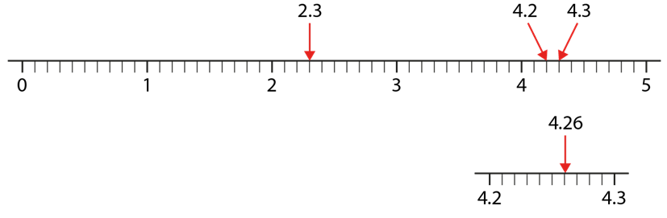
Representations and structure
There are a number of different representations that you may wish to use to support students’ understanding of this key idea. These might include:
Single number lines
  Number lines provide a powerful visual image and can be used to support students’ understanding of rounding. Locate the number to be rounded on the line and identify the critical values either side of it.
Notes:
More information about the representations and structure involved in this key idea can be found:
In the Using mathematical representations at KS3 document
On page 6 of The structure of the number system Theme Overview document. Links to both can be found on the final slide.
Links to all of these can be found on the final slide.

Slide 33
Previous learning
From Upper Key Stage 2, students will bring experience of:
  reading, writing, ordering and comparing numbers up to 10 000 000 and determining the value of each digit
  rounding any whole number to a required degree of accuracy
  using negative numbers in context
  identifying the value of each digit in numbers given to three decimal places and multiplying and dividing numbers by 10, 100 and 1 000, giving answers up to three decimal places
  using, reading, writing and converting between standard units, converting measurements of length, mass, volume and time from a smaller unit of measure to a larger unit and vice versa, using decimal notation up to three decimal places
  using symbols and letters to represent variables and unknowns in mathematical situations that they already understand, such as:
    missing numbers, lengths, coordinates and angles
    formulae in mathematics and science

Slide 34
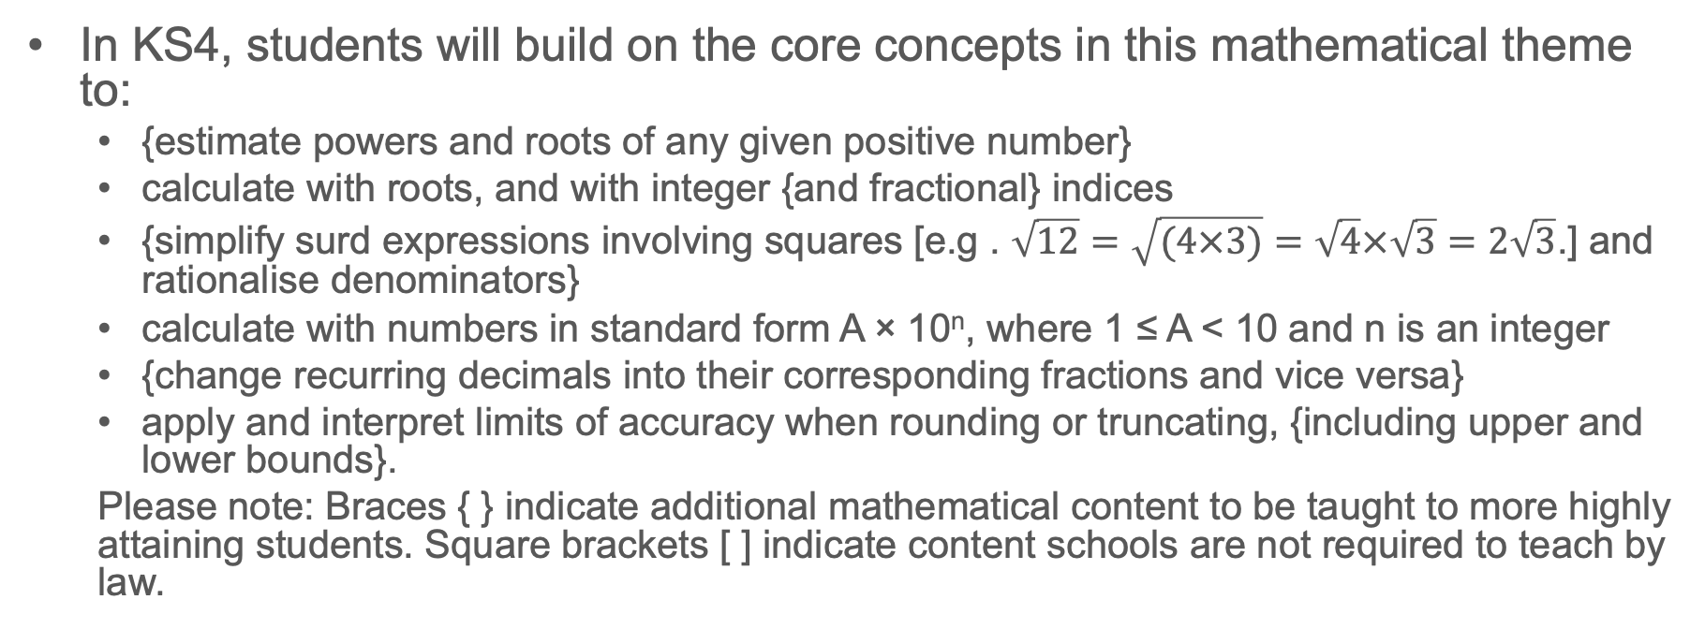
Future learning
In KS4, students will build on the core concepts in this mathematical theme to:
  {estimate powers and roots of any given positive number}
  calculate with roots, and with integer {and fractional} indices
  {simplify surd expressions involving squares [e.g . $\sqrt{12}=\sqrt{(4×3)}=\sqrt{4}×\sqrt{3}=2\sqrt{3}$.] and rationalise denominators}
  calculate with numbers in standard form A × 10^{n}, where 1 ≤ A < 10 and n is an integer
  {change recurring decimals into their corresponding fractions and vice versa}
  apply and interpret limits of accuracy when rounding or truncating, {including upper and lower bounds}.
  Please note: Braces { } indicate additional mathematical content to be taught to more highly attaining students. Square brackets [ ] indicate content schools are not required to teach by law.

Slide 35
Library of links
The following resources from the NCETM website have been referred to within this slide deck:
  NCETM Secondary Mastery Professional Development
    1 The structure of the number system Theme Overview Document
    1.1 Place value, estimation and rounding Core Concept Document
  Using mathematical representations at KS3 | NCETM
  NCETM primary mastery professional development materials
  NCETM primary assessment materials
  NCETM secondary assessment materials

