Slide 1
2.22 Combining multiplication with addition and subtraction
Representations | Year 5
Multiplication and Division

Slide 2
How to use this presentation
You can find the teacher guide 2.22 Combining multiplication with addition and subtraction by following the link below.

Slide 3
2.22 Combining operations: ×, + and − Step 1:1
How many children altogether?
5
5
5
4 × 5
5
5
3
5
+
5
3
2 × 3
3
3
5
= 20 + 6 = 26

Slide 4
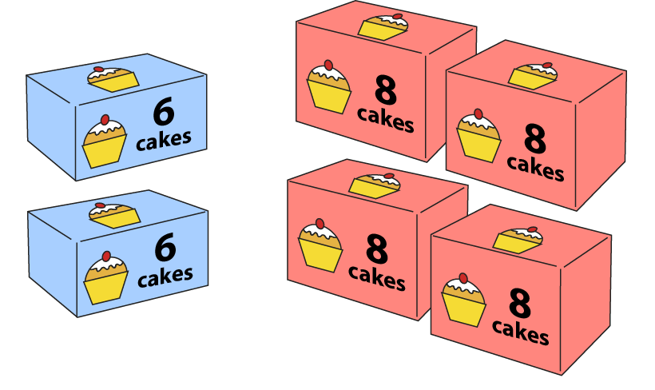
2.22 Combining operations: ×, + and − Step 1:1
2 boxes each contain 6 cakes; 4 boxes each contain 8 cakes.
How many cakes altogether?
2 × 6 + 4 × 8
12
+
32
= 44

Slide 5
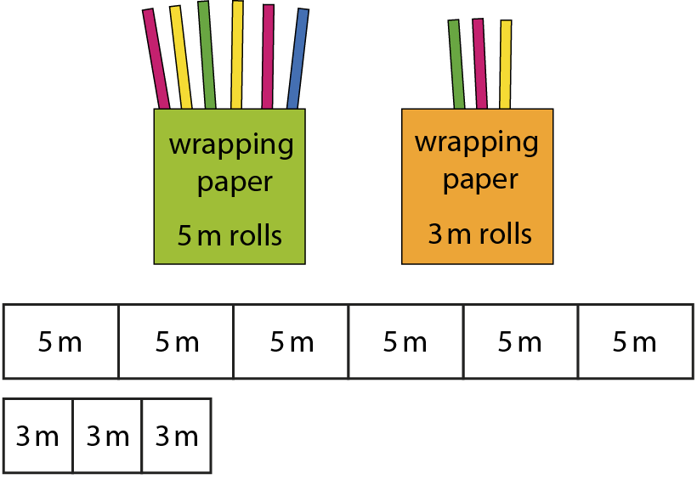
2.22 Combining operations: ×, + and − Step 1:1
30 m
9 m
30 m + 9 m = 39 m
Notes:
I buy six 5 m rolls of wrapping paper and three 3 m rolls of wrapping paper.
How much paper will I have altogether?

Slide 6
2.22 Combining operations: ×, + and − Step 1:1
Notes:
A class is organised into three teams of five children and two teams of four children.
How many children are in the class?

Slide 7
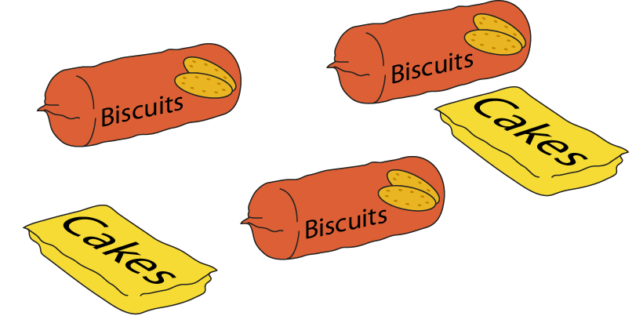
2.22 Combining operations: ×, + and − Step 1:1
Notes:
A pack of biscuits weighs 260 g. A pack of cakes weighs half this amount.
What is the total weight of this shopping?

Slide 8
2.22 Combining operations: ×, + and − Step 1:1
Notes:
I buy four cherry cakes and three chocolate cakes. I spend £6.20 in total.
The cherry cakes cost 80 p each. How much does each chocolate cake cost?

Slide 9
2.22 Combining operations: ×, + and − Step 1:2
20 × 2 − 10 × 3 = 40 − 30 = 10
Notes:
I have three packs of ten stickers. You have two packs of twenty stickers.
How many more stickers do you have?

Slide 10
2.22 Combining operations: ×, + and − Step 1:2
10 × 5 = 50
8 × 7 = 56
56 − 50 = 6
Notes:
Miss Grey runs 10 km a day for five days.
Mr Green runs 8 km a day for seven days.
Who has run further and by how much?

Slide 11
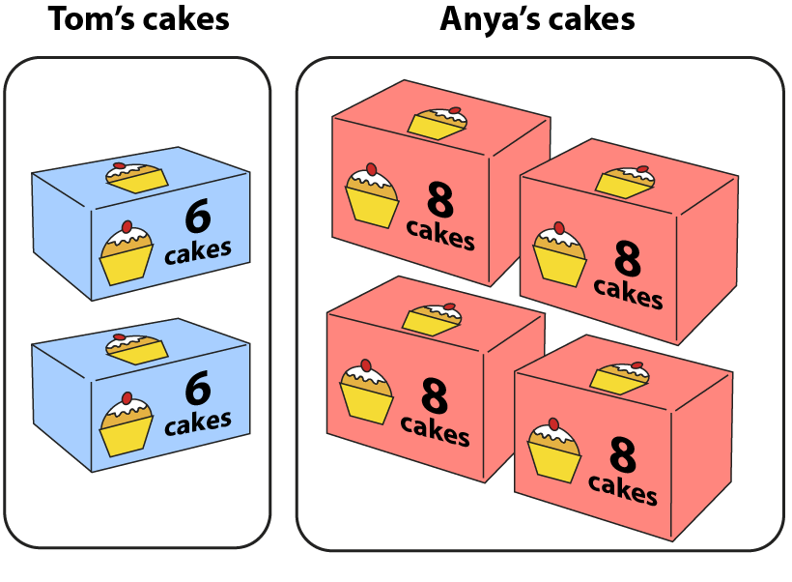
2.22 Combining operations: ×, + and − Step 1:2
6 × 2 = 12
8 × 4 = 32
32 − 12 = 20
Notes:
Who has the most cakes, and by how many?

Slide 12
2.22 Combining operations: ×, + and − Step 1:4
3 × 5 + 7 × 2 =
29
Joseph:
Megan:
Becca:
Notes:
Joseph says: 3 × 5 + 7 × 2 = 15 + 14 = 29
Megan says: 3 × 5 + 7 × 2 = 36 × 2 = 72
Becca says: 3 × 5 + 7 × 2 = 3 × 24 = 72
Joseph is correct, because he has multiplied before adding as there are no brackets.

Slide 13
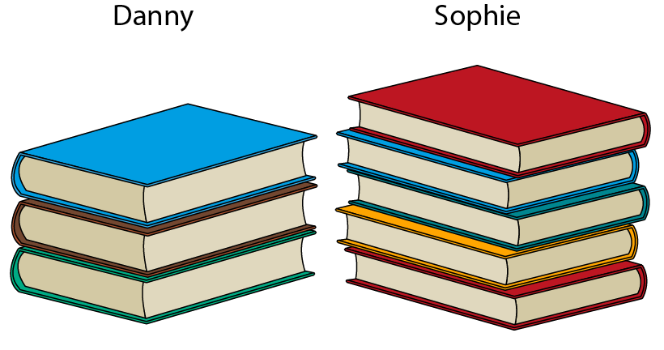
2.22 Combining operations: ×, + and − Step 1:5
Notes:
Each of Danny’s books have fifty pages. Each of Sophie’s books have thirty pages.
Whose books have the most pages in total, and by how many?

Slide 14
2.22 Combining operations: ×, + and − Step 2:1
50 × 2 + 50 × 5
<
50 × 8

Slide 15
2.22 Combining operations: ×, + and − Step 2:2
How much money in total?
Method 1:
Method 2:
80 p × 4 + 80 p × 3
80 p ×
(
4 + 3
)
£3.20 + £2.40
80 p × 7
= £5.60
= £5.60
Notes:
Apples cost 80p each. Amelia buy four apples at first. Then she goes back and buys three more apples.
How could you work out how much money Amelia has spent in total?
Which method is correct? Explain your answer.

Slide 16
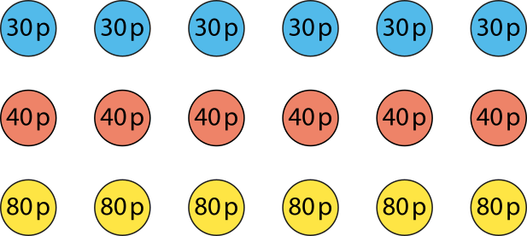
2.22 Combining operations: ×, + and − Step 2:3
Method 1:
Method 2:
30 p × 6 = £1.80
40 p × 6 = £2.40
80 p × 6 = £4.80
30 p + 40 p + 80 p
= £1.50
£1.80 + £2.40 + £4.80 = £9
£1.50 × 6 = £9
Notes:
Robyn needs to make six party bags.
She buys six pencils costing 30 p each, six erasers costing 40 p each and six notebooks costing 80 p each.
How much has she spent altogether?

Slide 17
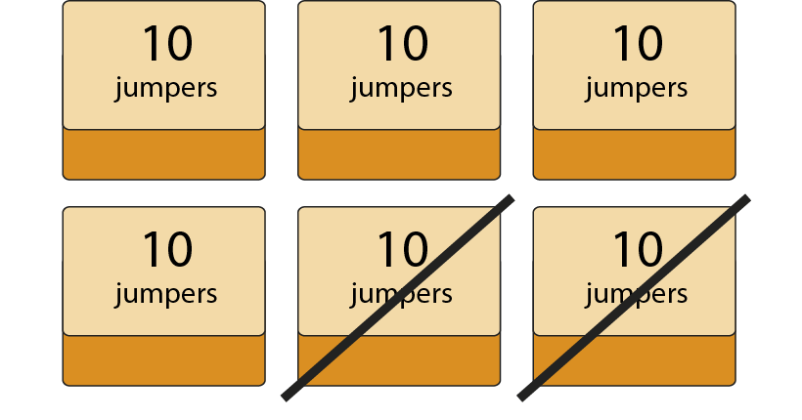
2.22 Combining operations: ×, + and − Step 2:4
10 × 6 − 10 × 2
= 10 × (6 − 2)
= 10 × 4 = 40
Notes:
There are six boxes of jumpers in the school office with ten jumpers in each box.
Two of the boxes are sold.
How many jumpers are left?

Slide 18
2.22 Combining operations: ×, + and − Step 2:4
£1.80 × 5 − £1.50 × 5
= (£1.80 − £1.50) × 5
= 30 p × 5 = £1.50
Notes:
Easter eggs cost £1.80 each. Katya buys five Easter eggs. After Easter, the same eggs are reduced to £1.50 each.
How much would she have saved if she had bought the eggs after Easter?

