Slide 1
Year 5, Unit 5
Area and scaling

Slide 2
Year 5, Unit 5
These materials heavily reflect the prioritisation approach of the ready-to-progress criteria in the DfE Primary Mathematics Guidance 2020 and on the PPTs that exemplify them on the NCETM website. They also include other relevant National Curriculum content. Related sections of the NCETM Primary Mastery Professional Development Materials provide small-step teaching guidance.
Ready-to-progress criteria addressed by this unit
Teaching of this unit supports the following criteria from the ‘DfE Mathematics Guidance: key stages 1 & 2’ (the 335-page document available as a download)
5G-2 Page 269

Slide 3
Contents
The links below take you to the starting slide of each learning outcome.
1 | Pupils explain what area is and can measure using counting as a strategy (I)
2 | Pupils explain what area is and can measure using counting as a strategy (II)
3 | Pupils explain how to make different shapes with the same area
4 | Pupils explain how to compare the area of different shapes
5 | Pupils measure the area of flat shapes area using square centimetres
6 | Pupils measure the area of flat shapes area using square metres
Click the arrow button to return to this Contents slide.

Slide 4
Contents
The links below take you to the starting slide of each learning outcome.
7 | Pupils calculate the area of a rectangle using multiplication
8 | Pupils calculate the area of rectilinear shapes
9 | Pupils use their knowledge of area to solve problems
10 | Pupils compare and describe lengths by using their knowledge of multiplication
11 | Pupils use their knowledge of multiplication to solve comparison and change problems
12 | Pupils compare and describe lengths by using their knowledge of division
Click the arrow button to return to this Contents slide.

Slide 5
Contents
The links below take you to the starting slide of each learning outcome.
13 | Pupils use their knowledge of division to solve comparison and change problems
14 | Pupils compare and describe measurements by using their knowledge of multiplication and division (mass/capacity/time) (I)
15 | Pupils compare and describe measurements by using their knowledge of multiplication and division (mass/capacity/time) (II)
16 | Pupils describe the changes in measurements using their knowledge of multiplication and division
17 | Pupils use their knowledge of multiplication and division to solve comparison and change problems
Click the arrow button to return to this Contents slide.

Slide 6
Year 5, Unit 5, Learning Outcome 1
Learning Outcome 1
Pupils explain what area is and can measure using counting as a strategy (I)
The following slides have been collated to support the teaching of this learning outcome.

Slide 7
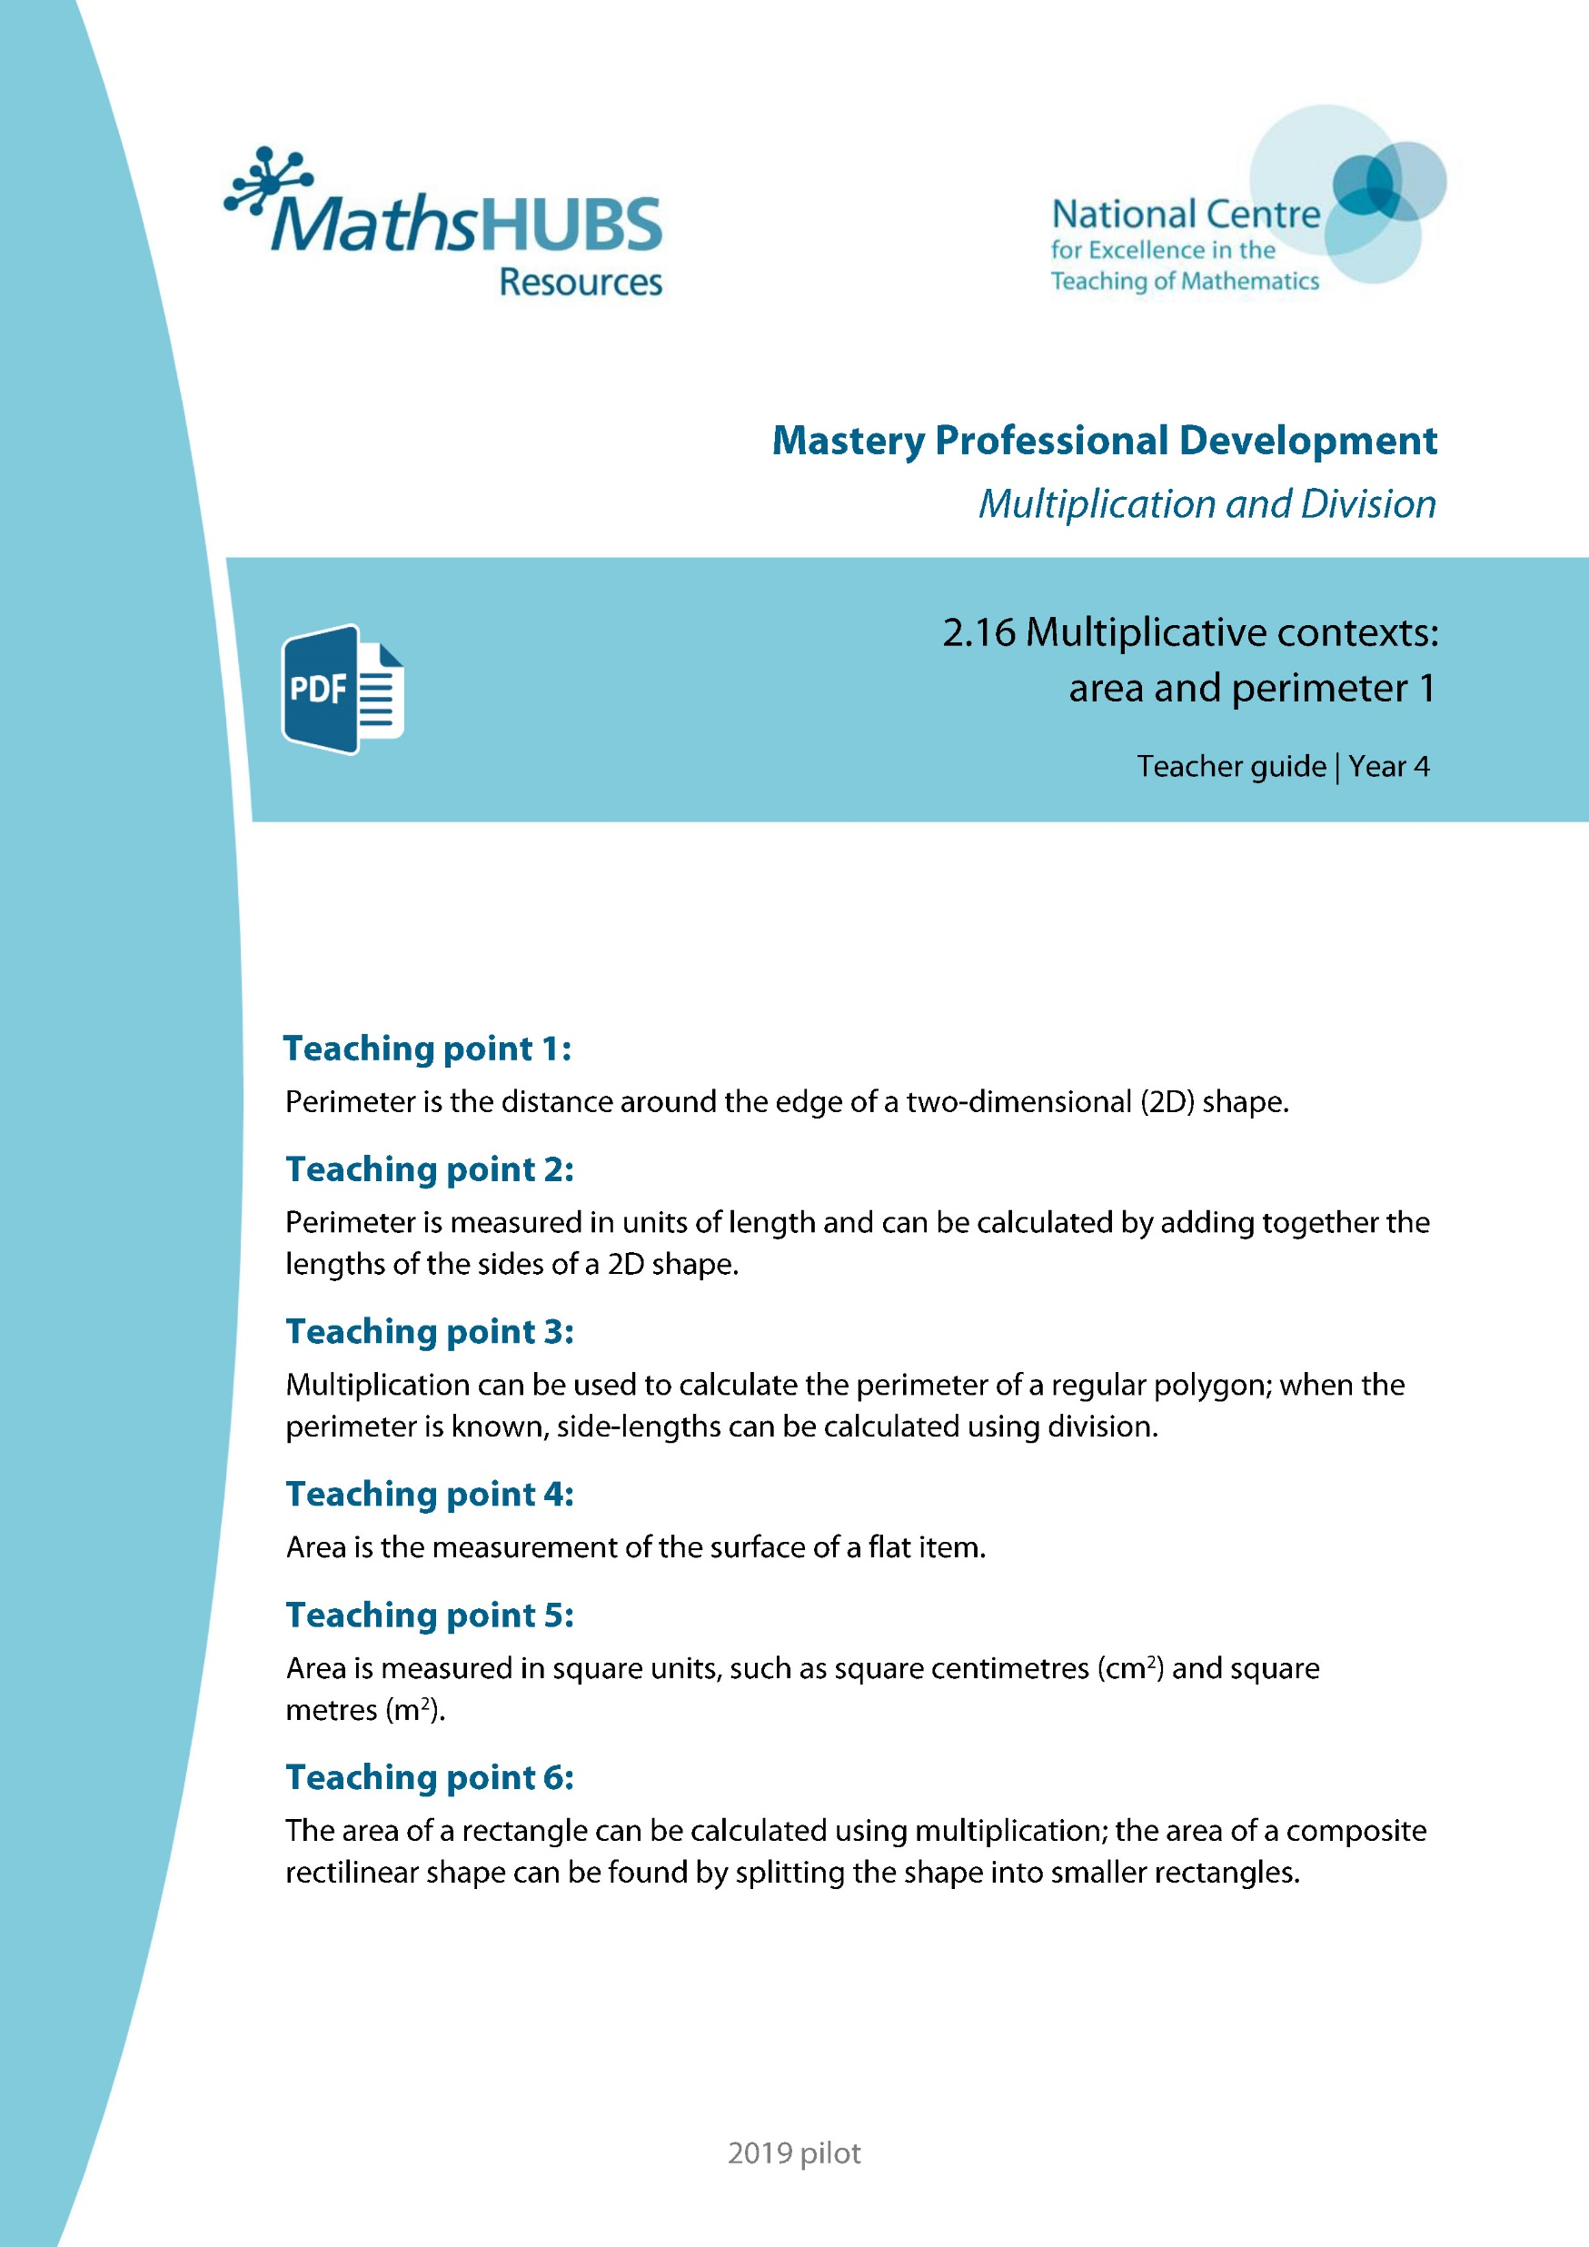
Year 5, Unit 5, Learning Outcome 1
Additional teacher guidance for this outcome should be read first and can be found in this segment of the NCETM Primary Mastery Professional Development Materials:
2.16 Multiplicative contexts: area and perimeter 1
The spine materials are divided into ‘teaching points’ and ‘steps in learning’.
Teaching point | Steps in learning | Pages
4 | 4:1-4:4 | 21-22

Slide 8
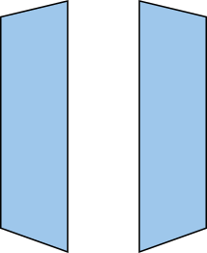
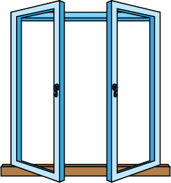

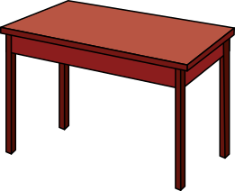
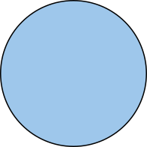
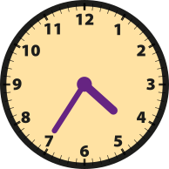
2.16 Area and perimeter 1 Step 4:1

Slide 9
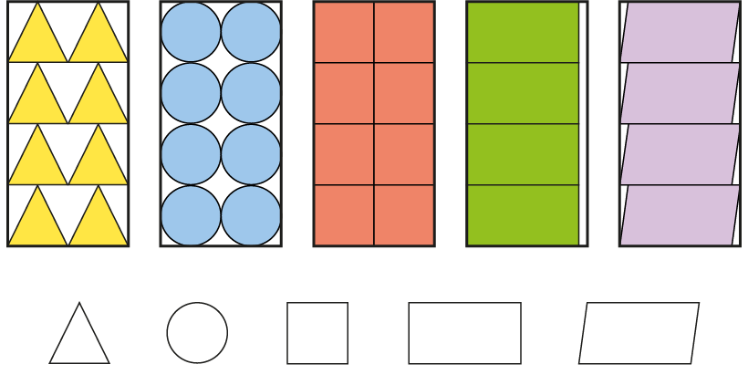











2.16 Area and perimeter 1 Step 4:2

Slide 10
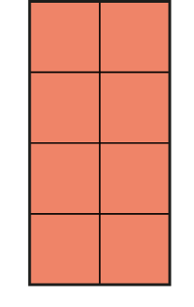
2.16 Area and perimeter 1 Step 4:3
Notes:
What is the area of this table?
This table has an area of eight square units.

Slide 11
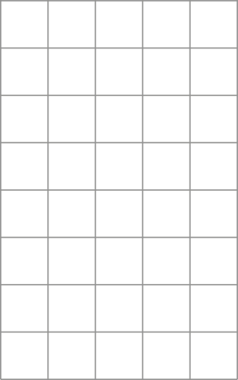

2.16 Area and perimeter 1 Step 4:4
Notes:
What is the area of this shape?
This shape has an area of fourteen square units.

Slide 12
5G-2 Compare and calculate areas
Ask children to take three shapes out of a tray of 3D shapes.
Can you see by looking at your shapes which one has the largest area? Can you see which one has the smallest area? How did you make your judgements?
Is it harder comparing the areas of two of the three shapes? Why?
What can you do to help you compare the area of two shapes?
Can you find two shapes which look quite different but which you think have a similar area?
How could placing the shapes on squared paper help inform your decision on their area?

Slide 13

5G-2 Compare and calculate areas
Which of the two shapes shown has a larger area?
How were you able to make this judgement?
The circle has a larger area that the decagon.

Slide 14
Year 5, Unit 5, Learning Outcome 2
Learning Outcome 2
Pupils explain what area is and can measure using counting as a strategy (II)
The following slides have been collated to support the teaching of this learning outcome.

Slide 15
Year 5, Unit 5, Learning Outcome 2
Additional teacher guidance for this outcome should be read first and can be found in this segment of the NCETM Primary Mastery Professional Development Materials:
2.16 Multiplicative contexts: area and perimeter 1
The spine materials are divided into ‘teaching points’ and ‘steps in learning’.
Teaching point | Steps in learning | Pages
4 | 4:5-4:7 | 22-24

Slide 16



2.16 Area and perimeter 1 Step 4:5
Notes:
What is the area of this shape?
This shape has an area of eleven square units.

Slide 17
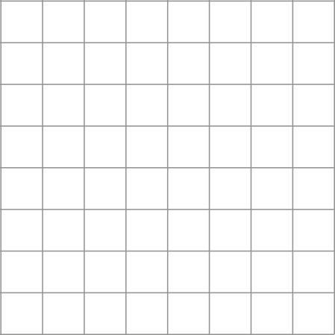
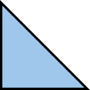
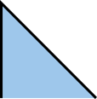

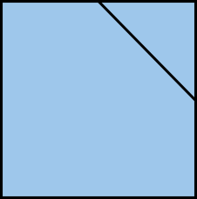
2.16 Area and perimeter 1 Step 4:5
Notes:
What is the area of this shape?
This shape has an area of sixteen square units.

Slide 18
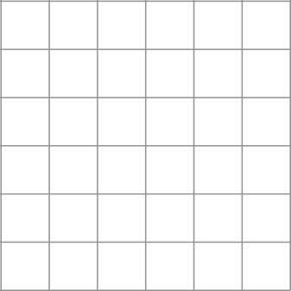


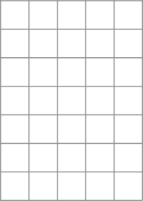
2.16 Area and perimeter 1 Step 4:6
Notes:
Does one shape look bigger?

Slide 19


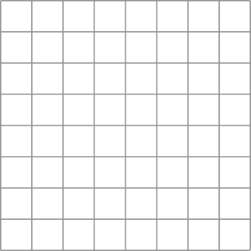
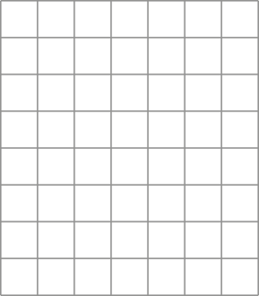

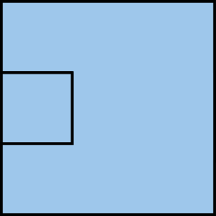
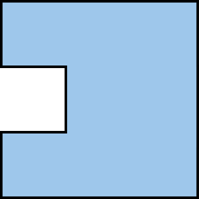





2.16 Area and perimeter 1 Step 4:7

Slide 20
Year 5, Unit 5, Learning Outcome 3
Learning Outcome 3
Pupils explain how to make different shapes with the same area
The following slides have been collated to support the teaching of this learning outcome.

Slide 21

Year 5, Unit 5, Learning Outcome 3
For support with lesson and task design, refer to:
the NCETM National Curriculum Resource Tool
additional planning resources or high-quality textbooks used by your school.

Slide 22
Year 5, Unit 5, Learning Outcome 4
Learning Outcome 4
Pupils explain how to compare the area of different shapes
The following slides have been collated to support the teaching of this learning outcome.

Slide 23
Year 5, Unit 5, Learning Outcome 4
For support with lesson and task design, refer to:
the NCETM National Curriculum Resource Tool
additional planning resources or high-quality textbooks used by your school.

Slide 24
Year 5, Unit 5, Learning Outcome 5
Learning Outcome 5
Pupils measure the area of flat shapes area using square centimetres
The following slides have been collated to support the teaching of this learning outcome.

Slide 25
Year 5, Unit 5, Learning Outcome 5
Additional teacher guidance for this outcome should be read first and can be found in this segment of the NCETM Primary Mastery Professional Development Materials:
2.16 Multiplicative contexts: area and perimeter 1
The spine materials are divided into ‘teaching points’ and ‘steps in learning’.
Teaching point | Steps in learning | Pages
5 | 5:1-5:4 | 25-26

Slide 26
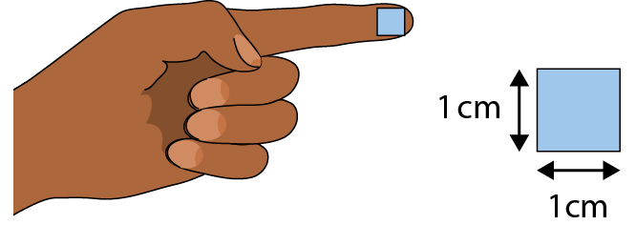
2.16 Area and perimeter 1 Step 5:1

Slide 27
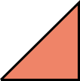
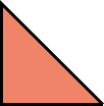

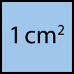
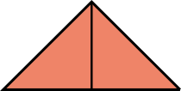
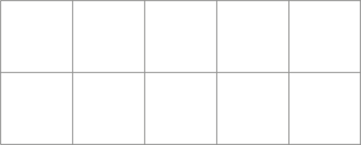
2.16 Area and perimeter 1 Step 5:4

Slide 28
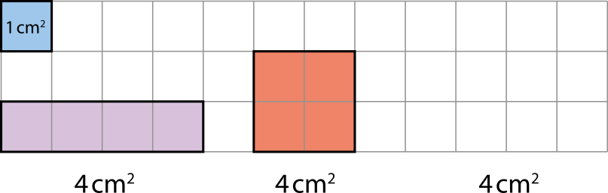





2.16 Area and perimeter 1 Step 5:4

Slide 29
5G-2 Compare and calculate areas
The purple, red and yellow shapes above are drawn on centimetre squared paper. The blue square shows each square has an area of 1cm². How does this help to know that the area of each shape is 4cm²?
It is possible to count four squares inside the red and purple shapes.
It is possible to count two whole squares and visualize another two made from the four triangles inside the yellow shape.

Slide 30

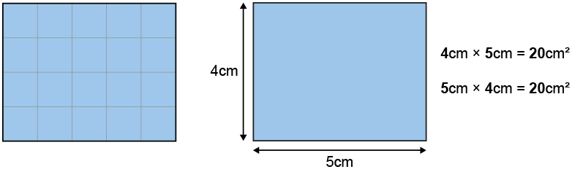
5G-2 Compare and calculate areas
Draw the shape shown on squared paper. Count the number of squares found within the shape using your finger tip that covers roughly the area of one squared centimetre (1cm²).
Is it possible to calculate the area in a more efficient way? Can the number of columns and rows of squares help?
The area of the rectangle is equal to 4 rows of 5 square centimetres,
or 5 columns of 4 square centimetres.
4 cm x 5 cm = 5 cm x 4 cm = 20 cm²

Slide 31
Year 5, Unit 5, Learning Outcome 6
Learning Outcome 6
Pupils measure the area of flat shapes area using square metres
The following slides have been collated to support the teaching of this learning outcome.

Slide 32
Year 5, Unit 5, Learning Outcome 6
Additional teacher guidance for this outcome should be read first and can be found in this segment of the NCETM Primary Mastery Professional Development Materials:
2.16 Multiplicative contexts: area and perimeter 1
The spine materials are divided into ‘teaching points’ and ‘steps in learning’.
Teaching point | Steps in learning | Pages
5 | 5:5 (5:1-5:4) | 25-26

Slide 33
2.16 Area and perimeter 1 Step 5:1

Slide 34
2.16 Area and perimeter 1 Step 5:4

Slide 35
2.16 Area and perimeter 1 Step 5:4

Slide 36
5G-2 Compare and calculate areas
The purple, red and yellow shapes above are drawn on centimetre squared paper. The blue square shows each square has an area of 1cm². How does this help to know that the area of each shape is 4cm²?
It is possible to count four squares inside the red and purple shapes.
It is possible to count two whole squares and visualize another two made from the four triangles inside the yellow shape.

Slide 37
5G-2 Compare and calculate areas
Draw the shape shown on squared paper. Count the number of squares found within the shape using your finger tip that covers roughly the area of one squared centimetre (1cm²).
Is it possible to calculate the area in a more efficient way? Can the number of columns and rows of squares help?
The area of the rectangle is equal to 4 rows of 5 square centimetres,
or 5 columns of 4 square centimetres.
4 cm x 5 cm = 5 cm x 4 cm = 20 cm²

Slide 38
Year 5, Unit 5, Learning Outcome 7
Learning Outcome 7
Pupils calculate the area of a rectangle using multiplication
The following slides have been collated to support the teaching of this learning outcome.

Slide 39
Year 5, Unit 5, Learning Outcome 7
Additional teacher guidance for this outcome should be read first and can be found in this segment of the NCETM Primary Mastery Professional Development Materials:
2.16 Multiplicative contexts: area and perimeter 1
The spine materials are divided into ‘teaching points’ and ‘steps in learning’.
Teaching point | Steps in learning | Pages
6 | 6:1-6:6 | 27-29

Slide 40
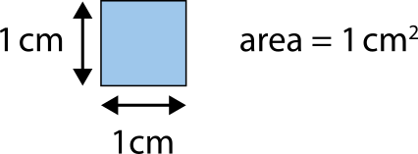
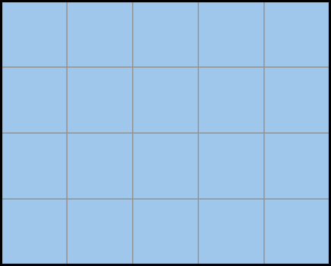

2.16 Area and perimeter 1 Step 6:1
How many squares?
A = 20 cm²
Notes:
There are twenty 1 cm squares, so A = 20 cm².

Slide 41
2.16 Area and perimeter 1 Step 6:2
How many squares?
A = 20 cm²

Slide 42


2.16 Area and perimeter 1 Step 6:4
5 cm × 4 cm = 20 cm²
4 cm × 5 cm = 20 cm²
A = 20 cm²
Notes:
The ‘5 cm’ represents the width.
The ‘4 cm’ represents the length.
The ’20 cm’ represents the area.

Slide 43
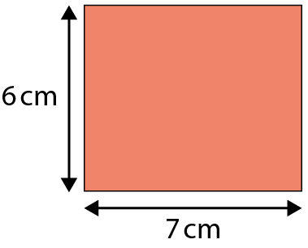
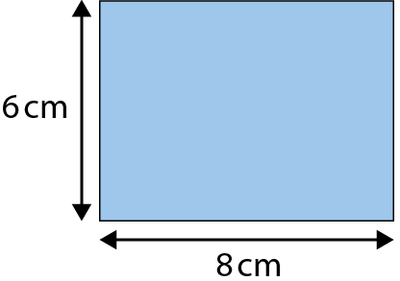

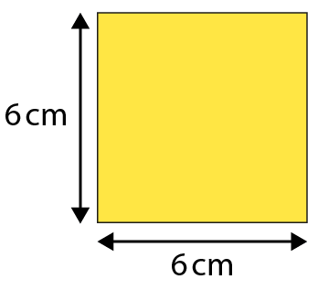


2.16 Area and perimeter 1 Step 6:5

Slide 44
5G-2 Compare and calculate areas
Draw the shape shown on squared paper. Count the number of squares found within the shape using your finger tip that covers roughly the area of one squared centimetre (1cm²).
Is it possible to calculate the area in a more efficient way? Can the number of columns and rows of squares help?
The area of the rectangle is equal to 4 rows of 5 square centimetres,
or 5 columns of 4 square centimetres.
4 cm x 5 cm = 5 cm x 4 cm = 20 cm²

Slide 45
Year 5, Unit 5, Learning Outcome 8
Learning Outcome 8
Pupils calculate the area of rectilinear shapes
The following slides have been collated to support the teaching of this learning outcome.

Slide 46
Year 5, Unit 5, Learning Outcome 8
Additional teacher guidance for this outcome should be read first and can be found in this segment of the NCETM Primary Mastery Professional Development Materials:
2.16 Multiplicative contexts: area and perimeter 1
The spine materials are divided into ‘teaching points’ and ‘steps in learning’.
Teaching point | Steps in learning | Pages
6 | 6:7-6:8 | 30-31

Slide 47
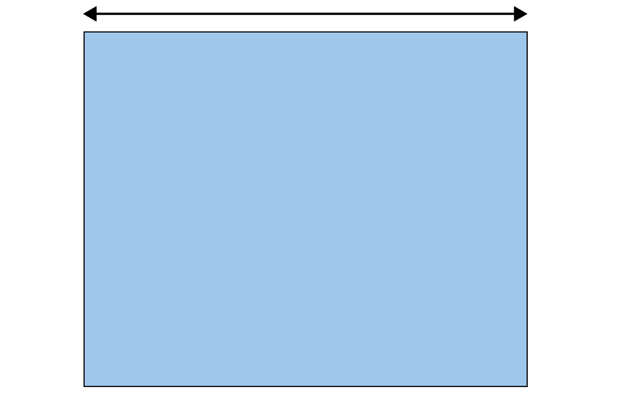
2.16 Area and perimeter 1 Step 6:7
The area of this rectangle is 80 cm². How long is the short side?
10 cm
8 cm
?
A = 80 cm²
80 ÷ 10 = 8
short side = 8 cm

Slide 48
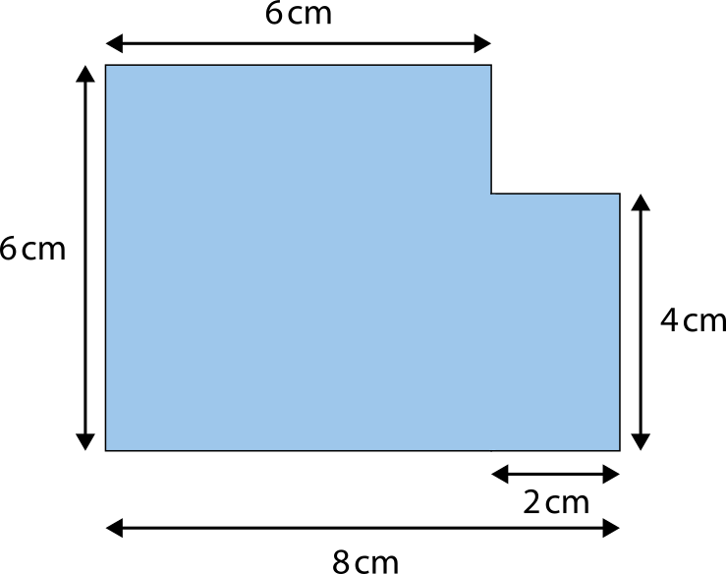
2.16 Area and perimeter 1 Step 6:8
What is the area of this shape?
A = 6 cm × 6 cm + 2 cm × 4 cm
= 44 cm²

Slide 49


2.16 Area and perimeter 1 Step 6:8
What is the area of this shape?
A = 8 cm × 6 cm − 2 cm × 2 cm
= 44 cm²

Slide 50
Year 5, Unit 5, Learning Outcome 9
Learning Outcome 9
Pupils use their knowledge of area to solve problems
The following slides have been collated to support the teaching of this learning outcome.

Slide 51
Year 5, Unit 5, Learning Outcome 9
Additional teacher guidance for this outcome should be read first and can be found in this segment of the NCETM Primary Mastery Professional Development Materials:
2.16 Multiplicative contexts: area and perimeter 1
The spine materials are divided into ‘teaching points’ and ‘steps in learning’.
Teaching point | Steps in learning | Pages
6 | 6:9 | 31-33

Slide 52
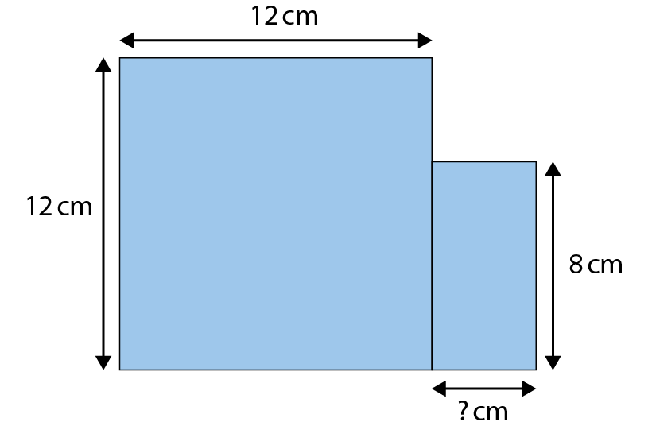
2.16 Area and perimeter 1 Step 6:9
The area of this shape is 176 cm².
Find the missing side-length.
A = 176 cm²
4
12 × 12 + × 8 = 176 cm²

Slide 53
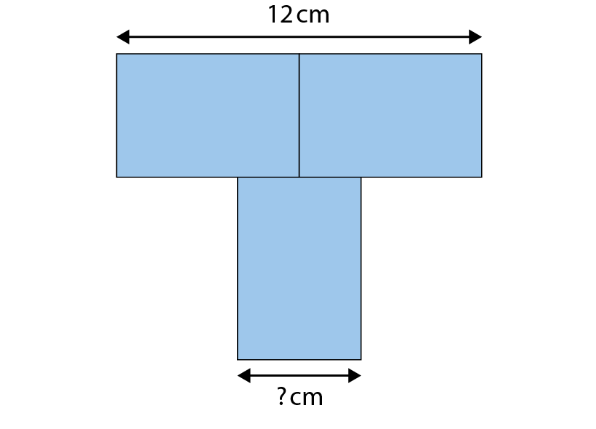
2.16 Area and perimeter 1 Step 6:9
Here is a T-shape made from three identical rectangles.
The area of the shape is 90 cm².
What is the missing side-length?
A = 90 cm²

Slide 54
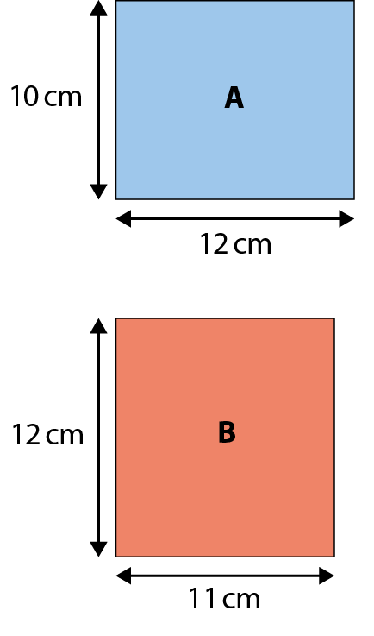
2.16 Area and perimeter 1 Step 6:9
area of rectangle A > area of rectangle B
True or false?
✗
A = 120 cm²
A = 132 cm²

Slide 55
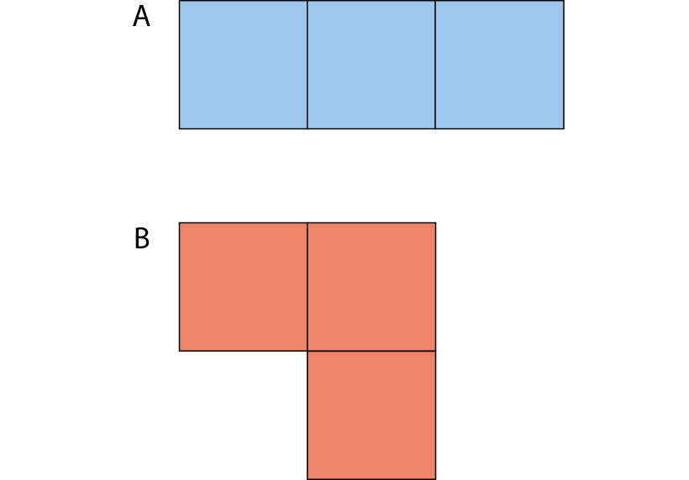
2.16 Area and perimeter 1 Step 6:9
Each square has a side-length of 6 cm.
What are the area (A) and perimeter (P) of shape A and shape B?
A = 108 cm²
P = 48 cm
A = 108 cm²
P = 48 cm
Notes:
What’s the same?
What’s different?

Slide 56
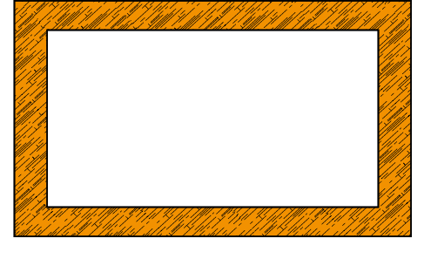
2.16 Area and perimeter 1 Step 6:9
Notes:
This picture frame has an area of 48 cm².
What could the dimensions of the outer rectangle and
the inner rectangle be?

Slide 57
Year 5, Unit 5, Learning Outcome 10
Learning Outcome 10
Pupils compare and describe lengths by using their knowledge of multiplication
The following slides have been collated to support the teaching of this learning outcome.

Slide 58
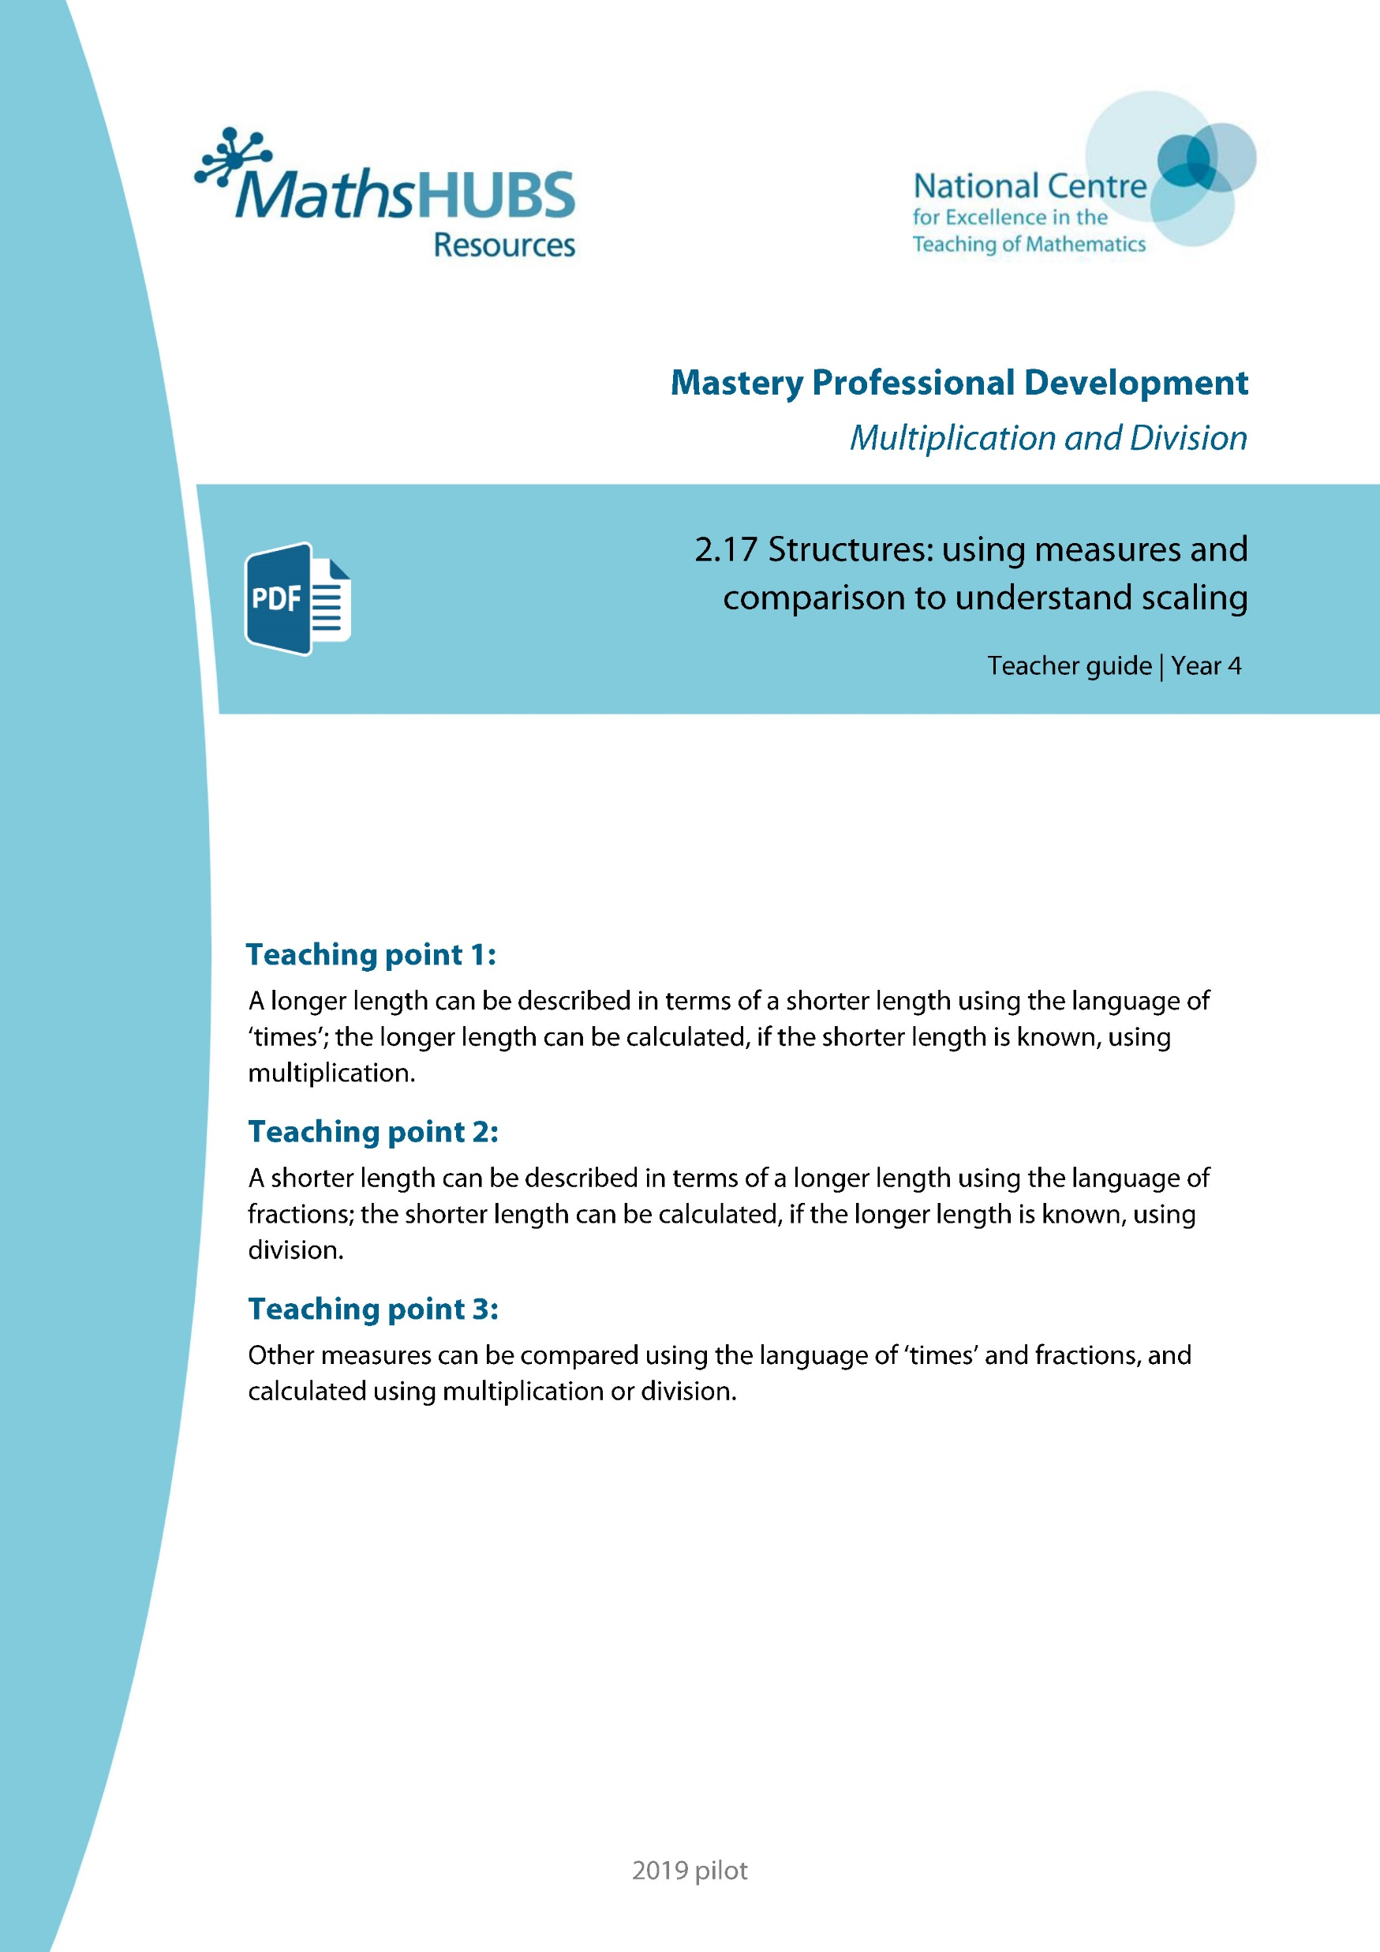
Year 5, Unit 5, Learning Outcome 10
Additional teacher guidance for this outcome should be read first and can be found in this segment of the NCETM Primary Mastery Professional Development Materials:
2.17 Structures: using measures and comparison to understand scaling
The spine materials are divided into ‘teaching points’ and ‘steps in learning’.
Teaching point | Steps in learning | Pages
1 | 1:1-1:3 | 2-5

Slide 59
2.17 Scaling: measures and comparison Step 1:1
5 cm
5 cm
5 cm
15 cm
5 cm × 3 = 15 cm
Notes:
The spotty ribbon is shorter than the plain ribbon.
The plain ribbon is longer than the spotty ribbon.
The spotty ribbon is 5 cm long.
The length of three spotty ribbons is equal to the length of the plain ribbon.
The combined length of three spotty ribbons is fifteen centimetres.
Five centimetres times by three is equal to fifteen centimetres.
Five centimetres multiplied by three is equal to fifteen centimetres.
So the plain ribbon is fifteen centimetres long.
The plain ribbon is three times the length of the spotty ribbon.

Slide 60
2.17 Scaling: measures and comparison Step 1:2
Notes:
The stripy ribbon is two times the length of the plain ribbon.
The stripy ribbon is twice the length of the plain ribbon.
The stripy ribbon is double the length of the plain ribbon.

Slide 61

2.17 Scaling: measures and comparison Step 1:3
8 cm
8 cm
8 cm × 1 = 8 cm
Notes:
The patterned ribbon is the same length as the plain ribbon.
The length of one plain ribbon is equal to the length of the patterned ribbon.
The patterned ribbon is one times the length of the plain ribbon.

Slide 62
Year 5, Unit 5, Learning Outcome 11
Learning Outcome 11
Pupils use their knowledge of multiplication to solve comparison and change problems
The following slides have been collated to support the teaching of this learning outcome.

Slide 63
Year 5, Unit 5, Learning Outcome 11
Additional teacher guidance for this outcome should be read first and can be found in this segment of the NCETM Primary Mastery Professional Development Materials:
2.17 Structures: using measures and comparison to understand scaling
The spine materials are divided into ‘teaching points’ and ‘steps in learning’.
Teaching point | Steps in learning | Pages
1 | 1:4-1:7 | 5-7

Slide 64


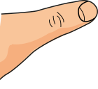
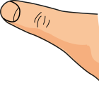
2.17 Scaling: measures and comparison Step 1:4
10 cm × 2
10 cm
20 cm
10 cm × 2 = 20 cm
Notes:
The elastic is ten centimetres long.
We stretch it to two times the original length.
Ten centimetres times/multiplied by two is equal to twenty centimetres.
The elastic is now twenty centimetres long.

Slide 65
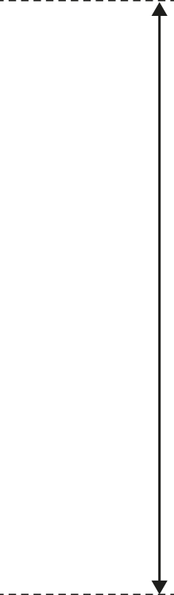



2.17 Scaling: measures and comparison Step 1:5
By June it is 10 times the original height.
12 cm sunflower in April.
12 cm × 10 = 120 cm
120 cm
12 cm
April
June
Notes:
Twelve centimetres times/multiplied by ten is equal to
one hundred and twenty centimetres.

Slide 66
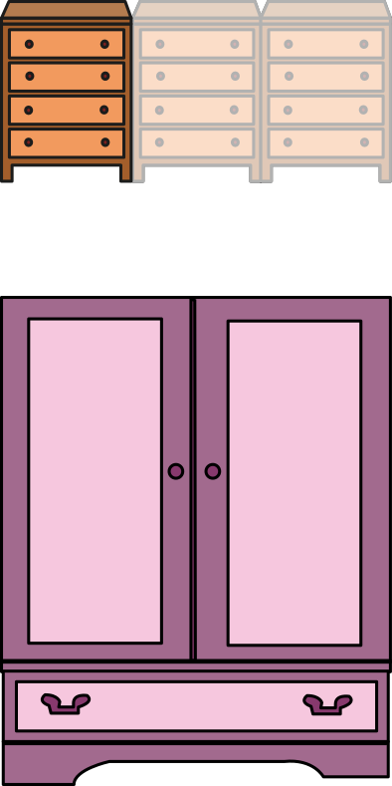
2.17 Scaling: measures and comparison Step 1:7
The wardrobe is 3 times the width of the cabinet. How wide is the wardrobe?
40 cm × 3 = 120 cm
40 cm
40 cm
40 cm
120 cm

Slide 67
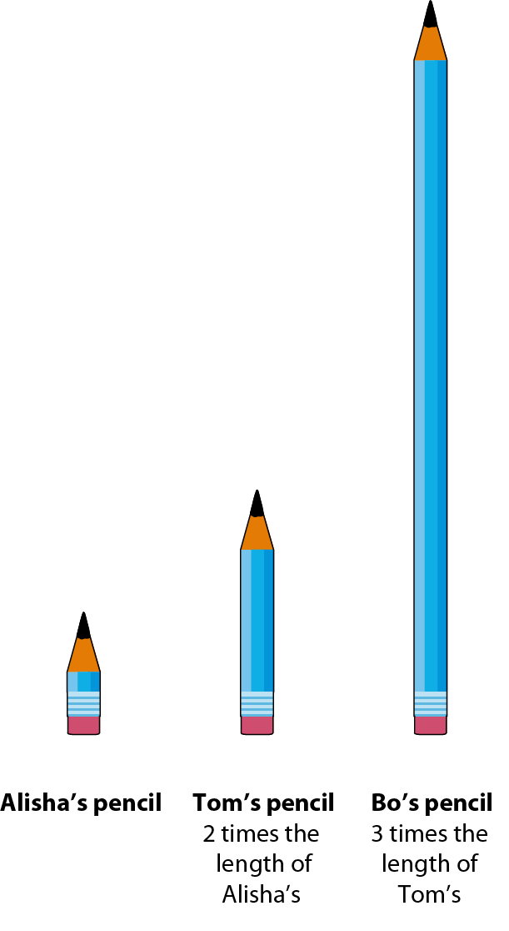
2.17 Scaling: measures and comparison Step 1:7
Bo’s pencil is times
the length of Alisha’s pencil.
6

Slide 68
Year 5, Unit 5, Learning Outcome 12
Learning Outcome 12
Pupils compare and describe lengths by using their knowledge of division
The following slides have been collated to support the teaching of this learning outcome.

Slide 69
Year 5, Unit 5, Learning Outcome 12
Additional teacher guidance for this outcome should be read first and can be found in this segment of the NCETM Primary Mastery Professional Development Materials:
2.17 Structures: using measures and comparison to understand scaling
The spine materials are divided into ‘teaching points’ and ‘steps in learning’.
Teaching point | Steps in learning | Pages
2 | 2:1-2:3 | 8-10

Slide 70
2.17 Scaling: measures and comparison Step 2:1
Describe the length of the plain ribbon.
5 cm
5 cm
5 cm
15 cm
The plain ribbon is 3 times the length of the spotty ribbon.
5 cm × 3 = 15 cm
Notes:
The plain ribbon is three times the length of the spotty ribbon.

Slide 71
2.17 Scaling: measures and comparison Step 2:1
Describe the length of the spotty ribbon.
5 cm
of the
of the
of the
whole
whole
whole
15 cm
whole
Notes:
The plain ribbon is three times the length of the spotty ribbon.
The spotty ribbon is one-third times the length of the plain ribbon.

Slide 72
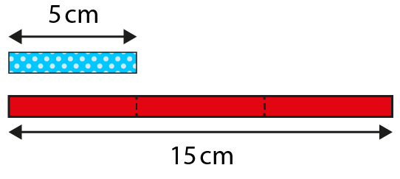
2.17 Scaling: measures and comparison Step 2:2

Slide 73
2.17 Scaling: measures and comparison Step 2:3
Describe the length of the stripey ribbon.
The stripey ribbon is two times the length of the plain ribbon.
Notes:
The stripy ribbon is two times the length of the plain ribbon.
The stripy ribbon is twice the length of the plain ribbon.
The stripy ribbon is double the length of the plain ribbon.

Slide 74
2.17 Scaling: measures and comparison Step 2:3
Describe the length of the plain ribbon.
of the
of the
whole
whole
whole
Notes:
The plain ribbon is one-half times the length of the striped ribbon.

Slide 75
Year 5, Unit 5, Learning Outcome 13
Learning Outcome 13
Pupils use their knowledge of division to solve comparison and change problems
The following slides have been collated to support the teaching of this learning outcome.

Slide 76
Year 5, Unit 5, Learning Outcome 13
Additional teacher guidance for this outcome should be read first and can be found in this segment of the NCETM Primary Mastery Professional Development Materials:
2.17 Structures: using measures and comparison to understand scaling
The spine materials are divided into ‘teaching points’ and ‘steps in learning’.
Teaching point | Steps in learning | Pages
2 | 2:4-2:6 | 11-12

Slide 77
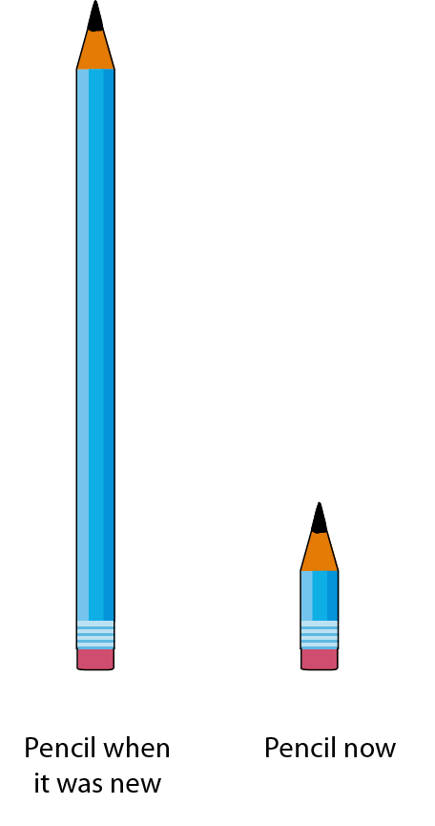
2.17 Scaling: measures and comparison Step 2:4

Slide 78
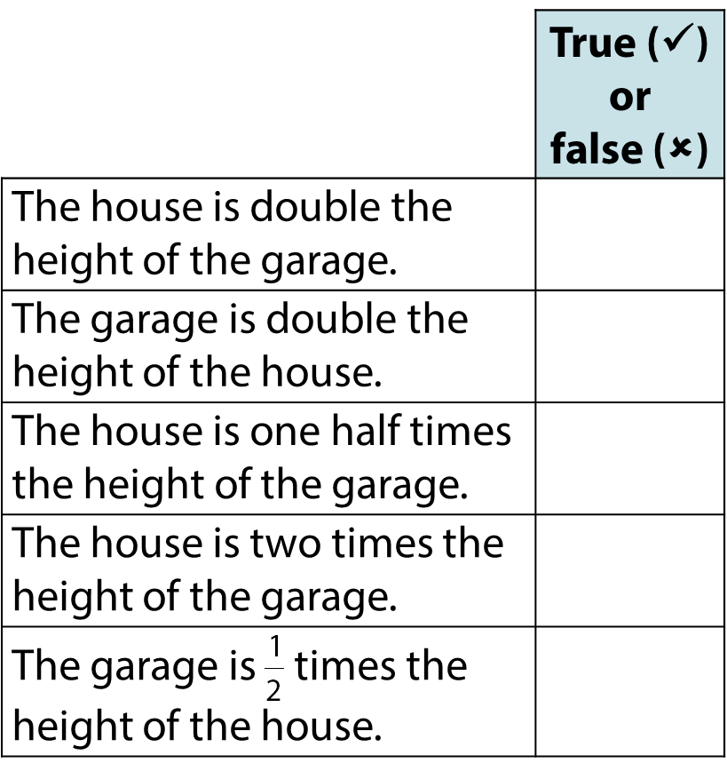

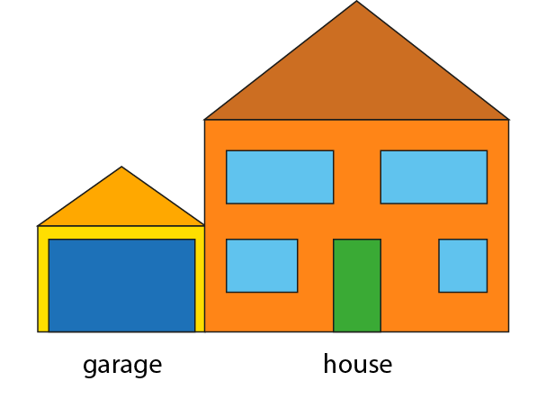

2.17 Scaling: measures and comparison Step 2:6

Slide 79

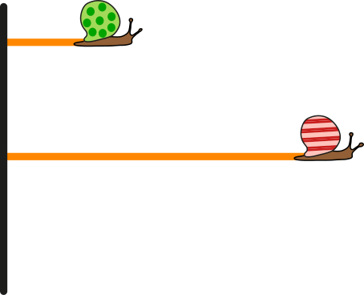


2.17 Scaling: measures and comparison Step 2:6

Slide 80
Year 5, Unit 5, Learning Outcome 14
Learning Outcome 14
Pupils compare and describe measurements by using their knowledge of multiplication and division (mass/capacity/time) (I)
The following slides have been collated to support the teaching of this learning outcome.

Slide 81
Year 5, Unit 5, Learning Outcome 14
Additional teacher guidance for this outcome should be read first and can be found in this segment of the NCETM Primary Mastery Professional Development Materials:
2.17 Structures: using measures and comparison to understand scaling
The spine materials are divided into ‘teaching points’ and ‘steps in learning’.
Teaching point | Steps in learning | Pages
3 | 3:1 | 13-14

Slide 82


2.17 Scaling: measures and comparison Step 3:1
25 kg × 4 = kg
100
Notes:
The mass of a mother bear is four times the mass of her cub.

Slide 83


2.17 Scaling: measures and comparison Step 3:1
25
kg
100 kg ÷ 4 = kg
25
Notes:
The mass of a bear cub is one quarter the mass of his mother.

Slide 84
Year 5, Unit 5, Learning Outcome 15
Learning Outcome 15
Pupils compare and describe measurements by using their knowledge of multiplication and division (mass/capacity/time) (II)
The following slides have been collated to support the teaching of this learning outcome.

Slide 85
Year 5, Unit 5, Learning Outcome 15
Additional teacher guidance for this outcome should be read first and can be found in this segment of the NCETM Primary Mastery Professional Development Materials:
2.17 Structures: using measures and comparison to understand scaling
The spine materials are divided into ‘teaching points’ and ‘steps in learning’.
Teaching point | Steps in learning | Pages
3 | 3:2 (1:2-1:3; 2:2-2:3) | 14-16

Slide 86

2.17 Scaling: measures and comparison Step 3:2
150 ml × 3 = 450 ml
450 ml ÷ 3 = 150 ml
Notes:
The volume of orange juice is three times the volume of cranberry juice.
The volume of cranberry juice is one third the volume of orange juice.

Slide 87

2.17 Scaling: measures and comparison Step 3:2
How much does the sugar weigh?
500 g
1000 g
× 2 =
? g
Notes:
The weight of the sugar is two times/twice/double the weight of the butter.
How much does the sugar weigh?

Slide 88
Year 5, Unit 5, Learning Outcome 16
Learning Outcome 16
Pupils describe the changes in measurements using their knowledge of multiplication and division
The following slides have been collated to support the teaching of this learning outcome.

Slide 89
Year 5, Unit 5, Learning Outcome 16
Additional teacher guidance for this outcome should be read first and can be found in this segment of the NCETM Primary Mastery Professional Development Materials:
2.17 Structures: using measures and comparison to understand scaling
The spine materials are divided into ‘teaching points’ and ‘steps in learning’.
Teaching point | Steps in learning | Pages
3 | 3:2 (1:4-1:6 and 2:4-2:5) | 14-16

Slide 90
2.17 Scaling: measures and comparison Step 3:2
150 ml × 3 = 450 ml
450 ml ÷ 3 = 150 ml
Notes:
The volume of orange juice is three times the volume of cranberry juice.
The volume of cranberry juice is one third the volume of orange juice.

Slide 91
2.17 Scaling: measures and comparison Step 3:2
How much does the sugar weigh?
500 g
1000 g
× 2 =
? g
Notes:
The weight of the sugar is two times/twice/double the weight of the butter.
How much does the sugar weigh?

Slide 92
Year 5, Unit 5, Learning Outcome 17
Learning Outcome 17
Pupils use their knowledge of multiplication and division to solve comparison and change problems
The following slides have been collated to support the teaching of this learning outcome.

Slide 93
Year 5, Unit 5, Learning Outcome 17
Additional teacher guidance for this outcome should be read first and can be found in this segment of the NCETM Primary Mastery Professional Development Materials:
2.17 Structures: using measures and comparison to understand scaling
The spine materials are divided into ‘teaching points’ and ‘steps in learning’.
Teaching point | Steps in learning | Pages
3 | 3:3 (1:7 and 2:6) | 16

Slide 94

2.17 Scaling: measures and comparison Step 3:3
2
A duck is times as heavy as a brick
3
A duck is times as heavy as a bear
3
bears weigh the same as 2 bricks.

