Slide 1
Year 4, Unit 10
Symmetry in 2D shapes

Slide 2
Year 4, Unit 10
These materials heavily reflect the prioritisation approach of the ready-to-progress criteria in the DfE Primary Mathematics Guidance 2020 and on the PPTs that exemplify them on the NCETM website. They also include other relevant National Curriculum content. Related sections of the NCETM Primary Mastery Professional Development Materials provide small-step teaching guidance.
Ready-to-progress criteria addressed by this unit
Teaching of this unit supports the following criteria from the ‘DfE Mathematics Guidance: key stages 1 & 2’ (the 335-page document available as a download)
4G-3 Page 201

Slide 3
Contents
The links below take you to the starting slide of each learning outcome.
1 | Pupils complete a symmetrical pattern
2 | Pupils compose symmetrical shapes from two congruent shapes
3 | Pupils investigate lines of symmetry in 2D shapes by folding paper shape cut-outs
4 | Pupils find lines of symmetry in 2D shapes using a mirror
5 | Pupils reflect polygons in a line of symmetry
6 | Pupils reflect polygons that are dissected by a line of symmetry
Click the arrow button to return to this Contents slide.

Slide 4
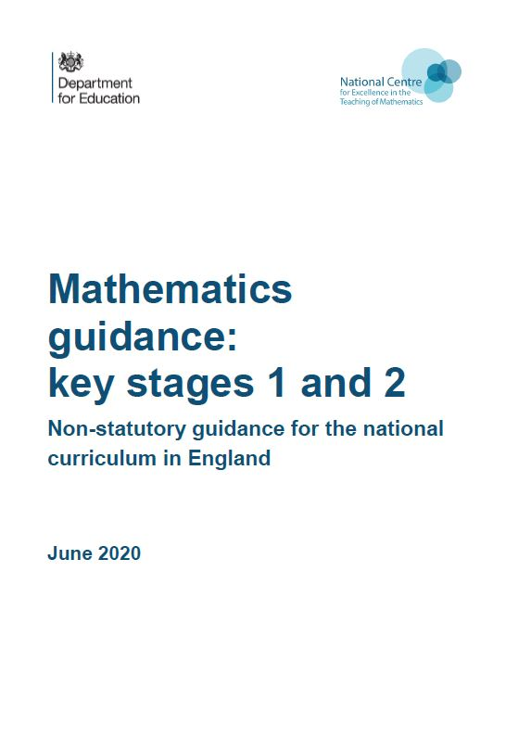
Year 4, Unit 10, Learning Outcomes 1 – 6
Additional teacher guidance for this outcome should be read first and can be found in the DfE Mathematics guidance. Page references relate to the 335-page document available as a download at the bottom of this web page.
Ready to progress criteria | Pages
4G-3 | 201-204

Slide 5
Year 4, Unit 10, Learning Outcome 1
Learning Outcome 1
Pupils complete a symmetrical pattern
The following slide supports the teaching of this learning outcome.

Slide 6
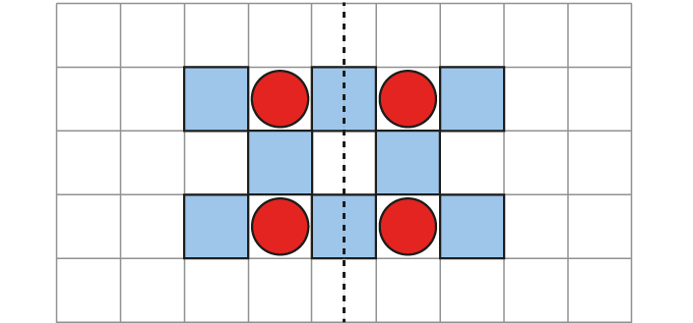


4G-3 Identify line symmetry in 2D shapes
Can you complete the symmetrical pattern?
What is your strategy? Can you start closest to the mirror line?
How can you check your answer?
Can you see another line of symmetry?
Repeat for other patterns.

Slide 7
Year 4, Unit 10, Learning Outcome 2
Learning Outcome 2
Pupils compose symmetrical shapes from two congruent shapes
The following slide supports the teaching of this learning outcome.

Slide 8
4G-3 Identify line symmetry in 2D shapes
Choose two shapes that are identical. How many different ways can you find to fit these two shapes together to make a shape.
Now use a mirror to decide which of these have a line symmetry. Do any of your shapes have more than one line of symmetry?
“This is a line of symmetry because it splits the shape into two equal parts which are mirror images.”

Slide 9
Year 4, Unit 10, Learning Outcome 3
Learning Outcome 3
Pupils investigate lines of symmetry in 2D shapes by folding paper shape cut-outs
The following slide supports the teaching of this learning outcome.

Slide 10
4G-3 Identify line symmetry in 2D shapes
Provide children with a selection of 2D paper shapes which have one or more lines of symmetry. Ask them to fold the shapes to identify lines of symmetry. When you open the shape out, can you see that each part either side of the fold (line of symmetry) is a reflection of the other? Can you fold the shape in more than one way to find another line of symmetry?
Can you explain why a shape is/is not symmetrical?
Non-square rectangles are a particularly good shape to include. What happens when a rectangle is folded on the diagonal? Is the diagonal of a non-square rectangle a line of symmetry? Is the diagonal of a square rectangle a line of symmetry?
“This is a line of symmetry because it splits the shape into two equal parts which are mirror images.”

Slide 11
Year 4, Unit 10, Learning Outcome 4
Learning Outcome 4
Pupils find lines of symmetry in 2D shapes using a mirror
The following slide supports the teaching of this learning outcome.

Slide 12
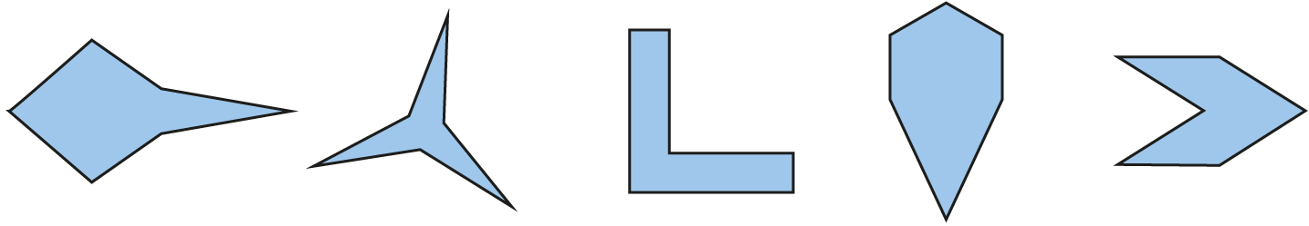


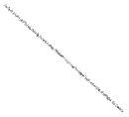

4G-3 Identify line symmetry in 2D shapes
Look at the lines of symmetry in the first two shapes. How many do they have?
On the print out in front of you, place a mirror on each of these lines. Can you see how each time the reflection is the same as the other half of the actual shape?
Use your mirror to help you identify the lines of symmetry in the final three shapes.

Slide 13
Year 4, Unit 10, Learning Outcome 5
Learning Outcome 5
Pupils reflect polygons in a line of symmetry
The following slide supports the teaching of this learning outcome.

Slide 14

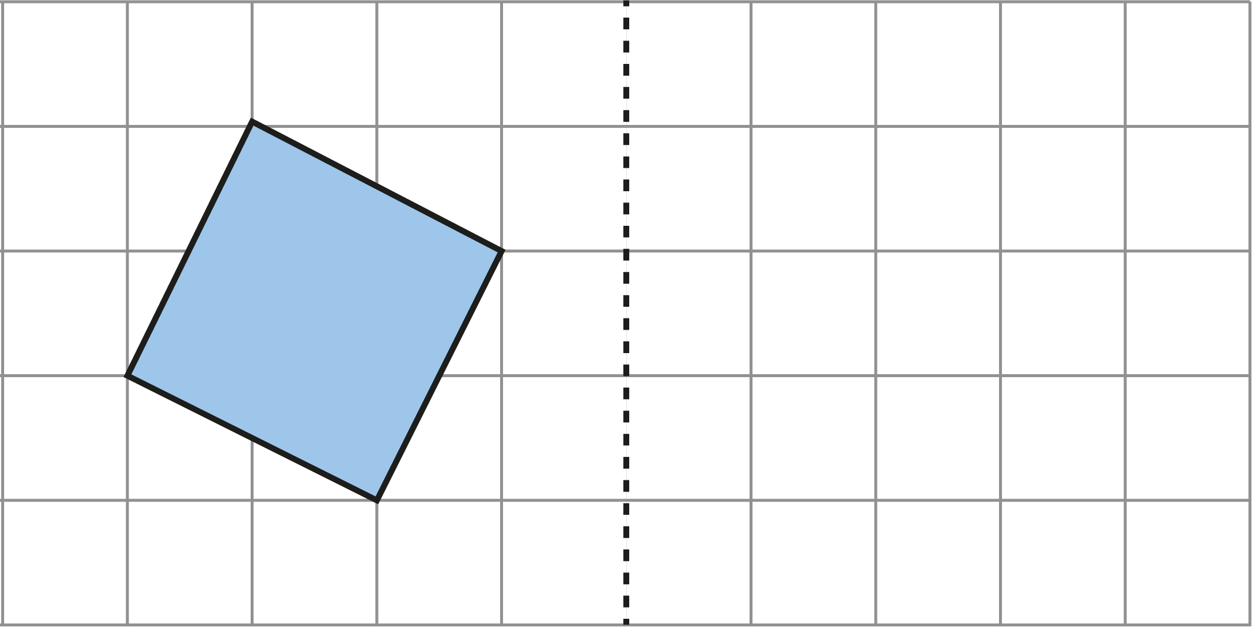




4G-3 Identify line symmetry in 2D shapes
Reflect both shapes in the mirror line by counting the position of each vertex and making a mark. Now join the marks to make your reflected shape.
How could you check your answer?
Repeat the above for other shapes using horizontal, vertical and diagonal mirror lines.

Slide 15
Year 4, Unit 10, Learning Outcome 6
Learning Outcome 6
Pupils reflect polygons that are dissected by a line of symmetry
The following slide supports the teaching of this learning outcome.

Slide 16
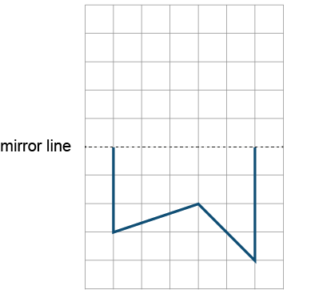


4G-3 Identify line symmetry in 2D shapes
Can you reflect this shape in the mirror line? What is your strategy?
Take one of the points, count how far this is from the mirror line, then reflect on the other side of the mirror line by counting the same. Repeat for the other points.
Name the polygon you have completed.
Progress to diagonal lines of symmetry.

Slide 17
Year 4, Unit 10

Slide 18
Year 4, Unit 10

Slide 19
Year 4, Unit 10

Slide 20
Year 4, Unit 10

