Slide 1
Year 2, Unit 7
Shape

Slide 2
Year 2, Unit 7
These materials heavily reflect the prioritisation approach of the ready-to-progress criteria in the DfE Primary Mathematics Guidance 2020 and on the PPTs that exemplify them on the NCETM website. They also include other relevant National Curriculum content. Related sections of the NCETM Primary Mastery Professional Development Materials provide small-step teaching guidance.
Ready-to-progress criteria addressed by this unit
Teaching of this unit supports the following criteria from the ‘DfE Mathematics Guidance: key stages 1 & 2’ (the 335-page document available as a download)
2G-1 Page 74
Prior learning
If the following ready-to-progress criteria, contained in the same DfE guidance document as above, were secured in Year 1, children will be ready to start on this unit.
1G-1 Page 42

Slide 3
Contents
The links below take you to the starting slide of each learning outcome.
1 | Pupils learn that a polygon is a 2D shape with straight sides that meet at vertices
2 | Pupils describe polygons and find different ways to sort them
3 | Pupils learn that polygons can be sorted and named according to the number of sides and vertices
4 | Pupils discuss, and compare by direct comparison, the shape and size of polygons
5 | Pupils discuss, and compare by direct comparison, the vertices of polygons
Click the arrow button to return to this Contents slide.

Slide 4
Contents
The links below take you to the starting slide of each learning outcome.
6 | Pupils investigate how polygons can be joined and folded to form 3 dimensional shapes
7 | Pupils describe 3-dimensional shapes and find different ways to sort them
8 | Pupils discuss, and compare by direct comparison, the shape and size of 3-dimensional shapes
Click the arrow button to return to this Contents slide.

Slide 5
Year 2, Unit 7, Learning Outcome 1
Learning Outcome 1
Pupils learn that a polygon is a 2D shape with straight sides that meet at vertices
The following slides have been collated to support the teaching of this learning outcome.

Slide 6
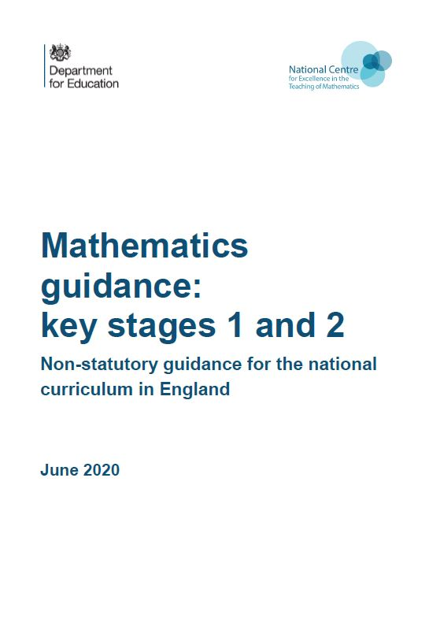
Year 2, Unit 7, Learning Outcome 1
Additional teacher guidance for this outcome should be read first and can be found in the DfE Mathematics guidance. Page references relate to the 335-page document available as a download at the bottom of this web page.
Ready to progress criteria | Pages
2G-1 | 74

Slide 7

Year 2, Unit 7, Learning Outcome 1
Polygon or not a polygon? Explain your reasoning.
A polygon is 2 dimensional shape with straight sides that meet at vertices

Slide 8
Year 2, Unit 7, Learning Outcome 2
Learning Outcome 2
Pupils describe polygons and find different ways to sort them
The following slides have been collated to support the teaching of this learning outcome.

Slide 9
Year 2, Unit 7, Learning Outcome 2
Additional teacher guidance for this outcome should be read first and can be found in the DfE Mathematics guidance. Page references relate to the 335-page document available as a download at the bottom of this web page.
Ready to progress criteria | Pages
2G-1 | 74

Slide 10
Year 2, Unit 7, Learning Outcome 2
Look at the shape cut-outs on your table. Can you think of a rule you can use to sort them into two groups?
Now I am going to sort the shape cut-outs. What do you think my rule is?

Slide 11
Year 2, Unit 7, Learning Outcome 3
Learning Outcome 3
Pupils learn that polygons can be sorted and named according to the number of sides and vertices
The following slides have been collated to support the teaching of this learning outcome.

Slide 12
Year 2, Unit 7, Learning Outcome 3
Additional teacher guidance for this outcome should be read first and can be found in the DfE Mathematics guidance. Page references relate to the 335-page document available as a download at the bottom of this web page.
Ready to progress criteria | Pages
2G-1 | 74

Slide 13
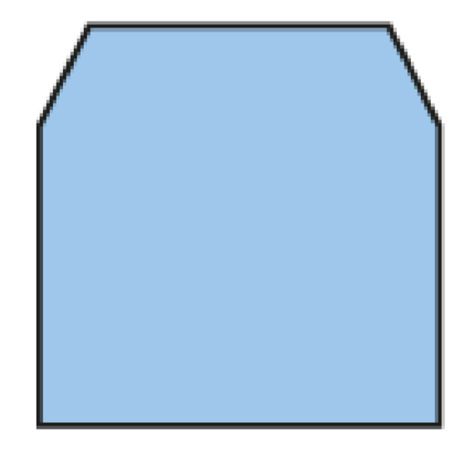
2G-1 Describe and compare 2D and 3D shapes
Look at my 2D shape. What can you tell me about the shape? Does it remind you of any other shapes you know?
Can you find out how many sides it has by running your finger carefully along each one? Remember to count them as you go!
Can you count each vertex by touching each one? How many vertices are there altogether?
Now we know the shape has 6 straight sides and 6 vertices, can you say what its name is?
Now try finding out how many sides and vertices other 2D shapes have!
This shape is a hexagon because it has exactly 6 straight sides.

Slide 14
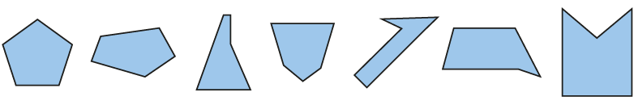
2G-1 Describe and compare 2D and 3D shapes
Put out a range of pentagons for children to explore.
Look at the shapes on the table. What do you notice about them?
What’s the same about each shape? Can we give these shapes the same name?
Can you describe how some of the shapes are different?
Look at the sides on the first and last shape. What can you say about how long the sides are?
Can you find a shape which you think has sides which are all different lengths?
These shapes are all pentagons because they all have exactly 5 straight sides.

Slide 15
Year 2, Unit 7, Learning Outcome 4
Learning Outcome 4
Pupils discuss, and compare by direct comparison, the shape and size of polygons
The following slides have been collated to support the teaching of this learning outcome.

Slide 16
Year 2, Unit 7, Learning Outcome 4
Additional teacher guidance for this outcome should be read first and can be found in the DfE Mathematics guidance. Page references relate to the 335-page document available as a download at the bottom of this web page.
Ready to progress criteria | Pages
2G-1 | 75

Slide 17
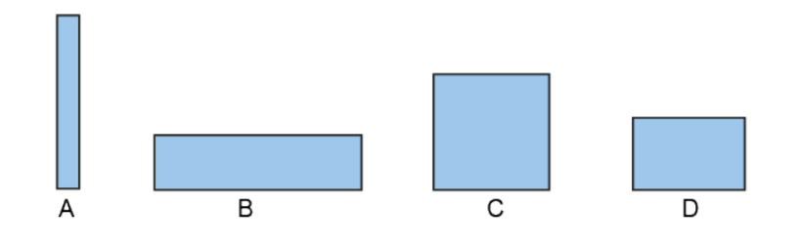
2G-1 Describe and compare 2D and 3D shapes
Look at these rectangles. What do you notice?
Which do you think is the smallest rectangle? Which is the largest? Can you explain why you think that?
If each rectangle was a slice of your favourite food, which one would give you the most to eat?

Slide 18
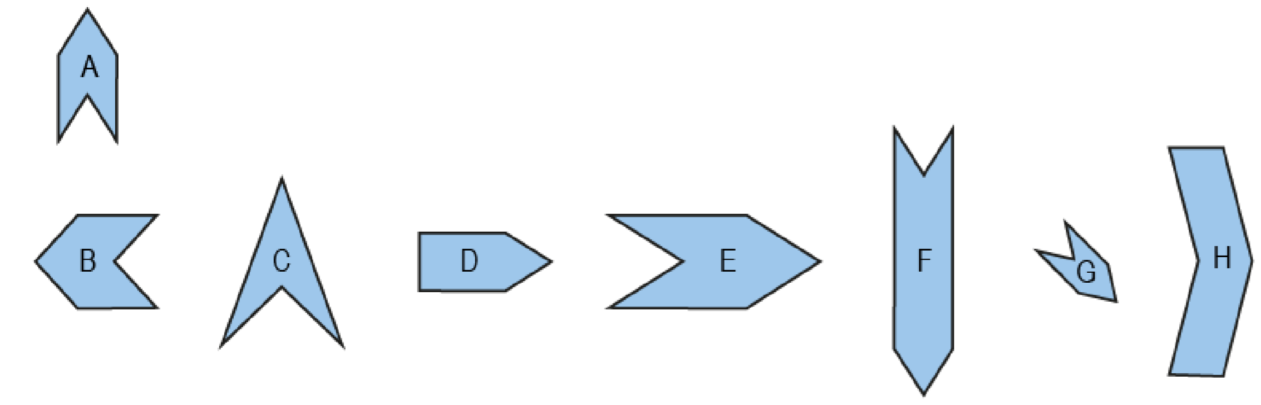
2G-1 Describe and compare 2D and 3D shapes
Look at these shapes. What is similar about them all?
Can you find two shapes which have the same number of sides and look almost the same? What is the same about them and what is different?
Which shapes do you think have the most space inside them? Which do not have much space?

Slide 19
Year 2, Unit 7, Learning Outcome 5
Learning Outcome 5
Pupils discuss, and compare by direct comparison, the vertices of polygons
The following slides have been collated to support the teaching of this learning outcome.

Slide 20
Year 2, Unit 7, Learning Outcome 5
Additional teacher guidance for this outcome should be read first and can be found in the DfE Mathematics guidance. Page references relate to the 335-page document available as a download at the bottom of this web page.
Ready to progress criteria | Pages
2G-1 | 75

Slide 21
Year 2, Unit 7, Learning Outcome 5
Have a look at these cut-outs of pentagons again. How many vertices does each have?
Which do you think looks like the ‘sharpest’ vertex? I wonder how we could compare them to check.
I wonder what we could call the opposite of a ‘sharp’ vertex? A ‘fat’ vertex? Which of these vertices looks the fattest to you?
Are there any vertices that you can see which look like the corner of a square?
Are there any of the pentagons where you think the vertices are all different sizes?
Are there any where you think the vertices all look the same size?

Slide 22
Year 2, Unit 7, Learning Outcome 6
Learning Outcome 6
Pupils investigate how polygons can be joined and folded to form 3-dimensional shapes
The following slides have been collated to support the teaching of this learning outcome.

Slide 23
Year 2, Unit 7, Learning Outcome 6
Additional teacher guidance for this outcome should be read first and can be found in the DfE Mathematics guidance. Page references relate to the 335-page document available as a download at the bottom of this web page.
Ready to progress criteria | Pages
2G-1 | 74-75

Slide 24
Year 2, Unit 7, Learning Outcome 6
On your table you have some 2D shape tiles.
Find different ways that you can join them together so that you can fold them up exactly to make a closed 3D shape. Describe the shape that you have made.
Have a look at these 3D shapes I have at the front of the class. Which of these 3D shapes do you think you might be able to make from the flat 2D shape tiles? Which of the 3D shapes will I definitely not be able to make with the flat 2D shape tiles?
Can you make a 3D shape that has:
  more than one square face? What is the greatest number of squares faces you can use in a closed 3D shape?
  more than one triangular face? What is the greatest number of triangular faces you can use in a closed 3D shape?

Slide 25
Year 2, Unit 7, Learning Outcome 7
Learning Outcome 7
Pupils describe 3-dimensional shapes and find different ways to sort them
The following slides have been collated to support the teaching of this learning outcome.

Slide 26
Year 2, Unit 7, Learning Outcome 7
Additional teacher guidance for this outcome should be read first and can be found in the DfE Mathematics guidance. Page references relate to the 335-page document available as a download at the bottom of this web page.
Ready to progress criteria | Pages
2G-1 | 75

Slide 27


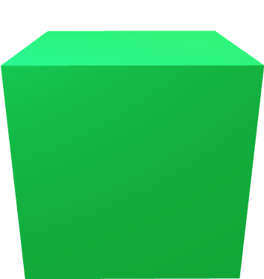


2G-1 Describe and compare 2D and 3D shapes
Look at the 3D shapes on the table. Can you pick one up and tell me about it?
Can you run your finger along the edges and count them as you touch each one? Now do the same with each vertex to find out how many vertices it has.
Can you find out how many faces it has? You might need to put sticky paper on each one to make sure you don’t count a face more than once!
Can you find two shapes which have the same number of faces but look different? How are they the same and how are they different? Can you name the shapes?

Slide 28
Year 2, Unit 7, Learning Outcome 8
Learning Outcome 8
Pupils discuss, and compare by direct comparison, the shape and size of 3-dimensional shapes
The following slides have been collated to support the teaching of this learning outcome.

Slide 29
Year 2, Unit 7, Learning Outcome 8
Additional teacher guidance for this outcome should be read first and can be found in the DfE Mathematics guidance. Page references relate to the 335-page document available as a download at the bottom of this web page.
Ready to progress criteria | Pages
2G-1 | 75

Slide 30
Year 2, Unit 7, Learning Outcome 8
Here is a cone and here is a cylinder.
How are they similar? How are they different?
Which is taller? Which is wider? What about if I turn them around?
If I could fill both up with water, which do you think would have more water in it?
Imagine they are both made of modelling clay. Describe how I could change one shape into the other.

Slide 31
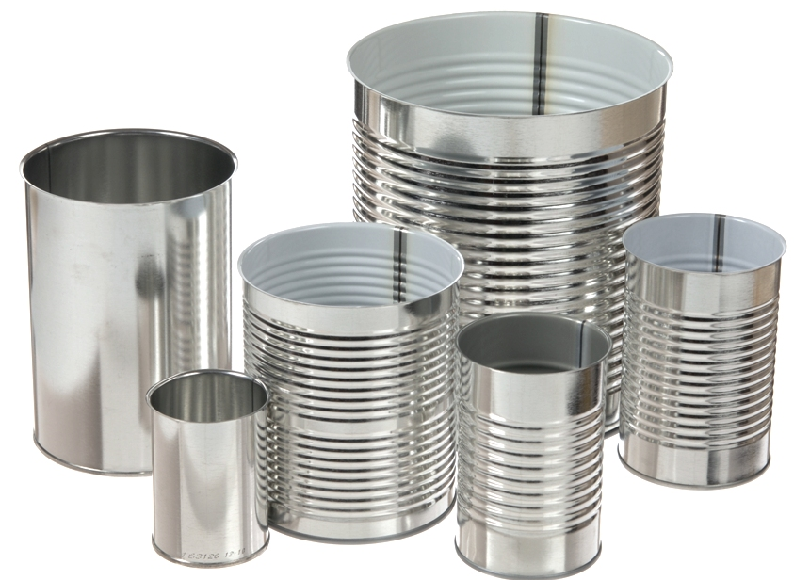
Year 2, Unit 7, Learning Outcome 8
Here are lots of different cylinders. Let’s compare them.
Which is tallest? Which is widest?
I think some of these cylinders look ‘fatter’ and some look ‘thinner’. Which look ‘fat’ and ‘thin’ to you?
Are there any of the cylinders that you think look very different to one another?
Are there any pairs of cylinders that are different sizes but somehow still look the same as each other, like the small one is a scale model of the large one?

