Slide 1
Writing linear equations in the form y = mx + c
KS3 Mastery PD Materials: Exemplified Key Ideas
Materials for use in the classroom or to support professional development discussions
(from 4.2 Graphical representations)
Summer 2021

Slide 2
About this resource
These slides are designed to complement the 4.2 Graphical representations Core Concept document and its associated Theme Overview document 4 Sequences and Graphs, both found in the Secondary Mastery Professional Development pages.
These slides re-present the key examples from the Core Concept document so that the examples can be used either directly in the classroom or with a group of teachers. There are prompt questions alongside the examples, and further clarification in the notes.
These slides do not fully replicate the Core Concept document, so should be used alongside it. Reference to specific page numbers, and to other useful NCETM resources, can be found in the notes for each slide.
This slide deck is not designed to be a complete PD session, rather it is a selection of resources that you can adapt and use as needed when planning a session with a group of teachers.

Slide 3


About this resource
The slides are structured as follows:
  The big picture:
    Where does this fit in?
    What do students need to understand?
    Why is this key idea important?
  Prior learning
  Misconceptions
  Exemplified key ideas
  Reflection questions
  Appendices:
    Key vocabulary
    Representations and structure
    Previous and Future learning
    Useful links
The exemplified key idea slides have the following symbols to indicate how they have been designed to be used:
Into the classroom
The examples are presented on these slides so that they could be used in PD, but also directly in the classroom. The notes feature suggested questions and things teachers might consider when using with students.
PD discussion prompts
These slides look at the examples in more detail, with question prompts to promote discussion among maths teachers. The notes feature reference to further information and guidance within the Core Concepts document.

Slide 4
Where does this fit in?
The NCETM has identified a set of six ‘mathematical themes’ within Key Stage 3 mathematics that bring together a group of ‘core concepts’.
The fourth of these themes is Sequences and graphs, which covers the following interconnected core concepts:
      4.1 Sequences
      4.2 Graphical representations
Notes:
Linked on this slide is the Theme Overview document of Sequences and graphs. This document includes why it is important, the key underpinning knowledge and links to prior and future learning. There is also guidance about how the five big ideas of Teaching for Mastery relate specifically to this theme.

Slide 5
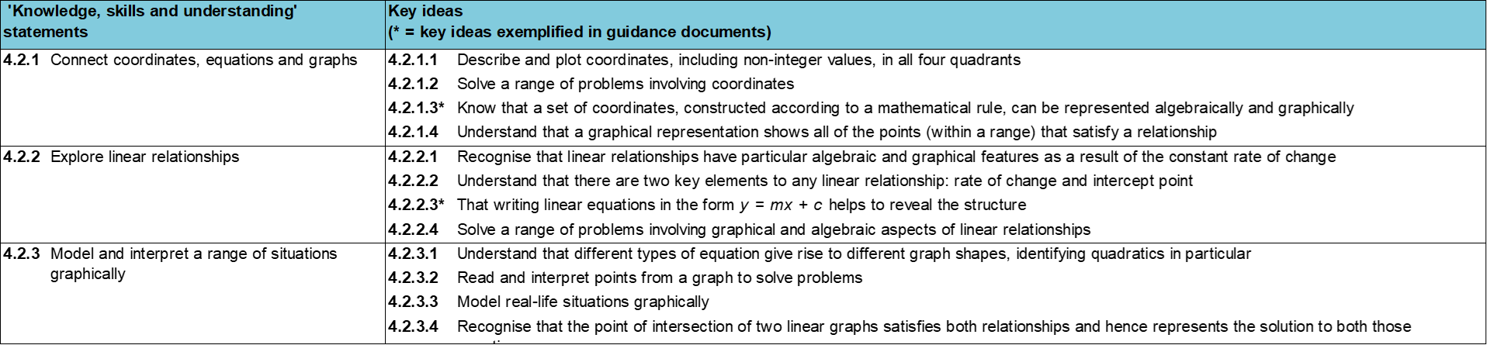
Where does this fit in?
Within this core concept, 4.2 Graphical representations, there are three statements of knowledge, skills and understanding.
These, in turn, are broken down into twelve key ideas. The highlighted key idea is exemplified in this slide deck.
Notes:
For key ideas marked with an asterisk, we exemplified the common difficulties and misconceptions that students might have and included elements of what teaching for mastery may look like. We have provided examples of possible student tasks and teaching approaches.
Within these slides are ‘classroom-ready’ versions of the examples for the key idea that has been highlighted. There are also slides that may be useful for discussion in a professional development session.

Slide 6
What do students need to understand?
4.2.2.3 That writing linear equations in the form y = mx + c helps to reveal the structure
The value of the constant term is the y-intercept when the equation is in the form y = mx + c.
Equations with a y-intercept of zero pass through the origin.
The value of the coefficient of x is the gradient, when the equation is in the form y = mx + c.
Identify the gradient and the y-intercept from equations in various forms.
  What prior knowledge might your students already have?
  What language might they use to describe this key idea?
  What questions might you want to ask to assess their prior learning?

Slide 7
Why is this key idea important?
Students will have begun to explore simple algebraic relationships and number patterns in Key Stage 2. This is taken further in Key Stage 3, where students will write the relationship between the x- and y-values in a set of coordinates using algebra and recognise when it is a linear relationship.
They should become fluent at plotting and identifying straight line graphs and make connections between the equation of the line and the coordinates of points on the corresponding line. To achieve this, students should be given equations presented in a range of forms and opportunities to think about how many points are required to plot a straight line and to choose appropriately scaled axes.
Students should also be given opportunities to explore the connections between the equation of a line, its gradient and its y-intercept. By looking at the features of particular graphs, the corresponding set of points and the equation of the line, certain key features can be identified and discussed.
When students are confident transitioning between a graph and its corresponding equation written in the standard form y = mx + c, they should be encouraged to do the same when the equation is written in a different form, such as ax + by = c.
Notes:
A more detailed overview of the core concept 4.2 Connect coordinates, equations and graphs can be found on pages 7-8 of the 4.2 Core Concept document.
The background to each key idea is also explored in more detail on the following pages:
4.2.1 Connect coordinates, equations and graphs – pages 7-8
4.2.2 Explore linear relationships – pages 8-9
4.2.3 Model and interpret a range of situations graphically – page 9

Slide 8
Prior learning
  What prior knowledge might your students already have?
  What language or representations might they use for this key idea?
  What questions might you want to ask to assess their prior learning?
  How does this fit in with your curriculum progression?
Upper Key Stage 2 Learning Outcome
Describe positions on the full coordinate grid (all four quadrants)
Find pairs of numbers that satisfy an equation with two unknowns
Enumerate possibilities of combinations of two variables
Key Stage 3 Learning Outcome
1.4.1 Understand and use the conventions and vocabulary of algebra, including forming and interpreting algebraic expressions and equations
1.4.5 Rearrange formulae to change the subject
Please note: Numerical codes refer to statements of knowledge, skills and understanding in the NCETM breakdown of Key Stage 3 mathematics.
Notes:
You may find it useful to speak to your partner schools to see how the above has been covered and the language used.
You can find further details regarding prior learning in the following segments of the NCETM primary mastery professional development materials (linked on final slide):
Year 5: 1.27 Negative numbers: counting, comparing and calculating
Year 5: 1.28 Common structures and the part–part–whole relationship
Within the 4 Sequences and graphs Theme Overview document, you can also find a broader description of students’ potential previous learning (page 2), alongside further information about key underpinning knowledge (page 3).

Slide 9
Checking prior learning
The following slides contain questions for checking prior learning.
  What representations might students use to support their understanding of these questions?
  What variation might you put in place for these questions to fully assess students’ understanding of the concept?
  How might changing the language of each question change the difficulty?
  Why are these such crucial pre-requisites for this key idea?

Slide 10
Checking prior learning (1)
a)
Which of the following points lie on the line 2x + y = 7:
(1,5) (5,1) (3,1) (4,1) (5,3) (5,-3)?
Can you explain why or why not?
Can you show this with a calculation as well as a drawing?
Notes:
References to the questions (links on final slide):
a) NCETM secondary assessment materials, page 18

Slide 11
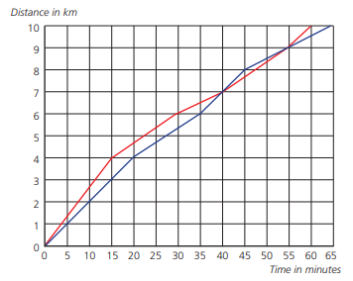
Checking prior learning (2)
b)
Two women, Rose and Violet, are running a 10km road race. Rose is shown in red and Violet is shown in blue.
Who starts off faster? How do you know?
Do they ever run at the same speed? How do you know?
Did one ever overtake the other? When?
Who wins the race?
How far behind her was the loser?
Notes:
References to the questions (links on final slide):
b) NCETM secondary assessment materials, page 19

Slide 12
Common difficulties and misconceptions
What aspects of this key idea might students find challenging?
What misconceptions might students have?
When teaching this topic, you may find students encounter difficulties with…
Assuming the difference between consecutive x co-ordinates can be written into the equation as an addition
The role of the y-intercept and the gradient
More information, and some suggestions for overcoming these challenges, can be found on the following slides.

Slide 13
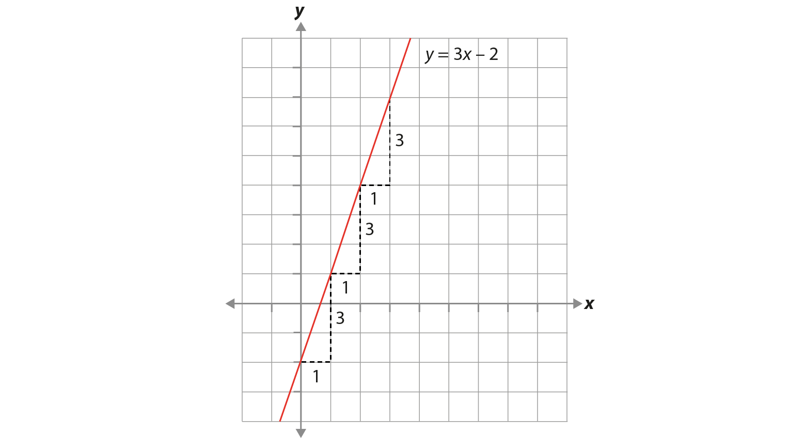
Common difficulties and misconceptions (1)
When examining a set of coordinates, particularly when offered in a table such as this:
Drawing students’ attention to the relationship between the x- and y-values, and using a graph to illustrate the role that the ‘3’ is playing, will support students in overcoming these difficulties.
x | … | −1 | 0 | 1 | 2 | 3 | …
y | … | −5 | −2 | 1 | 4 | 7 | …
students may attend to the ‘add 3’ in the sequence of y-values and conclude that the equation of the line is y = x + 3, rather than the correct y = 3x − 2.
Notes:
More detail can be found on page 18 of the 4.2 Core Concept document.

Slide 14
Common difficulties and misconceptions (2)
Students should understand the key idea that the gradient is a measure of the rate at which the function is changing (i.e. as x increases by one, how is y increasing – or decreasing?) and that the y-intercept is a fixed point (i.e. the value of y when x is zero). Students should be aware that these two pieces of information uniquely define any straight line.
Another difficulty is the perceived randomness of ‘m’ and ‘c’ to represent the value of the gradient and y-intercept. Why not y = gx + i? Exploring the historical and cultural connections, such as ‘m’ representing the French word ‘monter’ (to climb or ascend) and ‘c’ representing the French word ‘commencer’ (to start), helps students to understand this mathematical convention and make connections with y = ax + b used in statistics.
Notes:
More detail can be found on page 18 of the 4.2 Core Concept document.

Slide 15

The value of the constant term is the y-intercept when the equation is in the form y = mx + c
Example 1
Find the value of the y-intercept for each of these equations:
  y = 3x + 4
  y = 3x − 4
  y = 3x
  y = 3
  y = 0.5 − 3x
  3x + 4 = y
  2y = 4x − $\frac{1}{3}$
Notes:
Suggested questioning:
What is the same and what is different (e.g. …between a and b? …between a, b and c? …between c and d?)
Is the y intercept 4 for both a and b? Why not?
Does the order in which the equation is written matter? Why or why not?
Why isn’t they y-intercept 1/3 for question g? Can you write some more equations where you need to manipulate the equation first to get the y-intercept?
Can you write an equation where the y intercept is 0.25? And another? And another? Can you write one no-one in the class will have? Can you re-write someone else’s example another way?
Things for you to think about:
In Example 1, students are asked to find the value of the y-intercept. The equations are originally given in the standard y = mx + c form, but this changes as the questions progress. These equations have been carefully chosen to draw out the following nuances:
• For part a) the y-intercept is +4. Students who might initially state an intercept of ‘4’ might not realise the importance of the sign; this will become clear in part b), if students continue to state +4 rather than −4.
• Part c) has a y-intercept of zero.
• Part d) has a y-intercept of three (it is a horizontal line). Note, you may wish to ask students, ‘What is the gradient of this graph?’ at this point.
• Part e) has a decimal y-intercept and the order of terms has changed.
• Part f) has the same values as part a) and is designed to challenge students’ understanding of an equation.
• Part g) has a fractional y-intercept and the equation needs rearranging to get it into the form y = mx + c.
All of the numbers chosen are small, so that students can visualise the lines, and so that you can sketch the graphs easily if needed.
Students might find it beneficial to sketch or be shown sketches of these graphs and to use the images to support their mathematical thinking.

Slide 16

The value of the constant term is the y-intercept when the equation is in the form y = mx + c
Example 1
  Consider the variation in this example:
    What has stayed the same? What is different?
    What nuances are being drawn out?
    What discussion points might there be for each part?
Find the value of the y-intercept for each of these equations:
  y = 3x + 4
  y = 3x − 4
  y = 3x
  y = 3
  y = 0.5 − 3x
  3x + 4 = y
  2y = 4x − $\frac{1}{3}$
Notes:
Due to space constraints, the image on this PD discussion slide is very small. PD Leads might like to use or print the ‘in the classroom’ version of this slide for teachers to access during discussions.
More detail about the sequencing of this example can be found on page 19 of the 4.2 Core Concept document.

Slide 17
Equations with a y-intercept of zero pass through the origin.
Example 2
Which of these straight lines pass through the origin?
y = 0x + 4
y = 3x + 0
2y = 4
y = −2x
3y + 5x = 0
Notes:
Suggested questioning:
What is the origin?
What is the same about all of the lines that pass through the origin? What is different?
For those lines that don’t go through the origin, at what point do they pass through the y axis? How can you tell?
Things for you to think about:
The options have been carefully chosen, and there are three correct answers.
Students might choose part a) or part c) if they confuse the y-intercept with the gradient and, consequently, think the coefficient of x should be zero.
In part a), the gradient is explicitly shown as zero, whereas in part c) there is no x term.
Parts b), d) and e) are all correct, but are all slightly different.
Part b) explicitly shows a y-intercept of zero and is the most obvious correct answer.
Part d) has no constant term
Part e) needs some rearranging to get it into the standard y = mx + c form.
Asking students to draw a pair of axes and mark the origin may help to support them in making the connection between the origin and a y-intercept of zero.
Questions with more than one correct answer are worth spending time on, and challenging students to find another correct answer will help them to think more deeply. Asking students to discuss the misconceptions behind the incorrect answer(s) will also help them to develop a deep understanding of what the concept is and what it is not.

Slide 18
Equations with a y-intercept of zero pass through the origin
Example 2
Which of these straight lines pass through the origin?
  What might you do to model or explain this example?
  Can you write similar questions with more than one correct answer to help students develop a secure understanding of the concept?
y = 0x + 4
y = 3x + 0
2y = 4
y = −2x
3y + 5x = 0
Notes:
Due to space constraints, the image on this PD discussion slide is very small. PD Leads might like to use or print the ‘in the classroom’ version of this slide for teachers to access during discussions.
More detail about the sequencing of this example can be found on page 19-20 of the 4.2 Core Concept document.

Slide 19
The value of the coefficient of x is the gradient, when the equation is in the form y = mx + c
Example 3
Find the gradient for each of these equations.
y = 2x + 5
y = x + 3.2
y = −x − 7
y = −2x − 7
y = −5
y = 10 + 0.5x
2x + 5 = y
2y = x + 4
Notes:
Suggested questioning:
What is the same/what is different about… (e.g. …parts a) and b)? …parts b) and c)? …parts c) and d)?)
What might each of these look like on a graph?
(Draw a line with e.g. a negative gradient.) Which of the equations could this line be?
What do you notice about the question that has a gradient of zero. What might this look like on a graph?
Things for you to think about:
In Example 3, students are asked to find the value of the gradient. Again, equations are originally given in the standard y = mx + c form, but this changes as the questions progress. The equations have been carefully designed to draw students’ attention to key features:
For part a), the gradient is positive (2).
Part b) has a gradient of 1. Some students may find it challenging if there does not appear to be a coefficient for the x term.
In part c), the gradient is −1. Can students apply understanding of part b) to part c)?
For part d) the gradient is −2. This might be a good time to stop students and ask them what they notice about parts a) to d). What is the same? What is different?
Part e) has a gradient of zero. Some students may need to visualise the horizontal line to understand why this is true.
Part f) has a decimal gradient, and the order of the terms has changed.
Part g) has the same values as part a) and is designed to challenge students’ understanding of an equation.
Part h) has a fractional gradient and the equation needs rearranging to get it into the form y = mx + c.
Students might find it beneficial to sketch or be shown sketches of these graphs and use the images to support their mathematical thinking.
Students could use the gradients found in this example to put the equations into a logical order; sketches of the graphs might support this. They should be encouraged to discuss different methods of doing this (ascending or descending order, or by steepness, irrespective of whether it is a positive or negative gradient).

Slide 20
The value of the coefficient of x is the gradient, when the equation is in the form y = mx + c
Example 3
  Consider the variation in this question:
    What is each part drawing students’ attention to?
    What might you do to ensure that students’ have understood the point being raised?
    Which of these do you think will challenge students the most?
    What might you do to address these challenges?
Find the gradient for each of these equations.
y = 2x + 5
y = x + 3.2
y = −x − 7
y = −2x − 7
y = −5
y = 10 + 0.5x
2x + 5 = y
2y = x + 4
Notes:
Due to space constraints, the image on this PD discussion slide is very small. PD Leads might like to use or print the ‘in the classroom’ version of this slide for teachers to access during discussions.
More detail about the sequencing of this example can be found on pages 20-21 of the 4.2 Core Concept document.

Slide 21
The value of the coefficient of x is the gradient, when the equation is in the form y = mx + c
Example 4
y = 4x − 3
y = 8 − 4x
2y = 4x + 3
y − 4x = 3
2y + 8x = 0
y = −4x + 3
Match lines which have the same gradient.
If there are any equations that do not have a match, write an equation with the same gradient.
Notes:
Suggested questioning:
What is the same? What is different?
Does every equation have a matching pair? Why or why not?
Do a) and b) have the same gradient? Why or why not?
Write another equation to match each set.
Things for you to think about:
Example 4 targets students’ understanding of the gradient of a straight line. It has been written so that students might think they are matching pairs of equations; however, three lines – parts b), e) and f) – have the same gradient (−4); another pair – parts a) and d) –share the same gradient (+4); and one line –part c) – does not match any of the others (it has a gradient of 2). The numbers have been selected so that similar integers are used throughout.

Slide 22
The value of the coefficient of x is the gradient, when the equation is in the form y = mx + c
Example 4
  How does this example differ from ‘traditional’ exercises you’ve seen before?
  You might want to particularly think about…
    the effect of using similar integers throughout
    the effect of a ‘matching’ exercise where the equations do not match neatly into pairs
Match lines which have the same gradient.
If there are any equations that do not have a match, write an equation with the same gradient.
y = 4x − 3
y = 8 − 4x
2y = 4x + 3
y − 4x = 3
2y + 8x = 0
y = −4x + 3
Notes:
Due to space constraints, the image on this PD discussion slide is very small. PD Leads might like to use or print the ‘in the classroom’ version of this slide for teachers to access during discussions.
This example can be found on page 21 of the 4.2 Core Concept document.

Slide 23
The value of the coefficient of x is the gradient, when the equation is in the form y = mx + c
Example 5
a) Grace thinks that the gradient of the line with equation y = 7x + 3 is 7x.
Dylan says it is +3.
Who is correct?
b) Evie thinks the gradient of the line with equation 4y + 2x = −5 is +2.
Ffion says it is −2.
Who is correct?
c) Billy thinks the gradient of the line with equation x = 7 is 0.
Haider thinks the gradient is 7.
Who is correct?
Notes:
Suggested questioning:
Who is correct? Why? What has the person with the incorrect answer done wrong?
If there is no correct answer, what would you do differently? How would you explain it?
Things for you to think about:
Example 5 has been chosen to address common misconceptions relating to the gradient.
In part a), students may think that the x term is the gradient rather than the coefficient of x. This example can not only be used to assess whether students know the difference between the gradient and the y-intercept, but also whether they spot that Grace has incorrectly stated the x term rather than the coefficient of x.
Part b) requires students to rearrange the equation correctly to match the form y = mx + c. Again, neither statement is correct, but the example could stimulate discussion about how best to rearrange the equation.
Part c) challenges the understanding of an undefined gradient as occurs in a vertical line. Students often mistakenly identify vertical lines as having a gradient of zero. A sketch can help them to understand why this is not the case.
Asking students to discuss the statements of others is one method that allows them to engage with misconceptions without having to admit to having them themselves. Can you write similar statements to help students discuss other common misconceptions?

Slide 24
The value of the coefficient of x is the gradient, when the equation is in the form y = mx + c
Example 5
a)
Grace thinks that the gradient of the line with equation y = 7x + 3 is 7x. Dylan says it is +3.
Who is correct?
Evie thinks the gradient of the line with equation 4y + 2x = −5 is +2. Ffion says it is −2.
Who is correct?
Billy thinks the gradient of the line with equation x = 7 is 0. Haider thinks the gradient is 7.
Who is correct?
b)
c)
  What misconceptions are being addressed by each part?
  Can you write similar statements to help students discuss other common misconceptions?
Notes:
Due to space constraints, the image on this PD discussion slide is very small. PD Leads might like to use or print the ‘in the classroom’ version of this slide for teachers to access during discussions.
This example can be found on page 22 of the 4.2 Core Concept document.

Slide 25
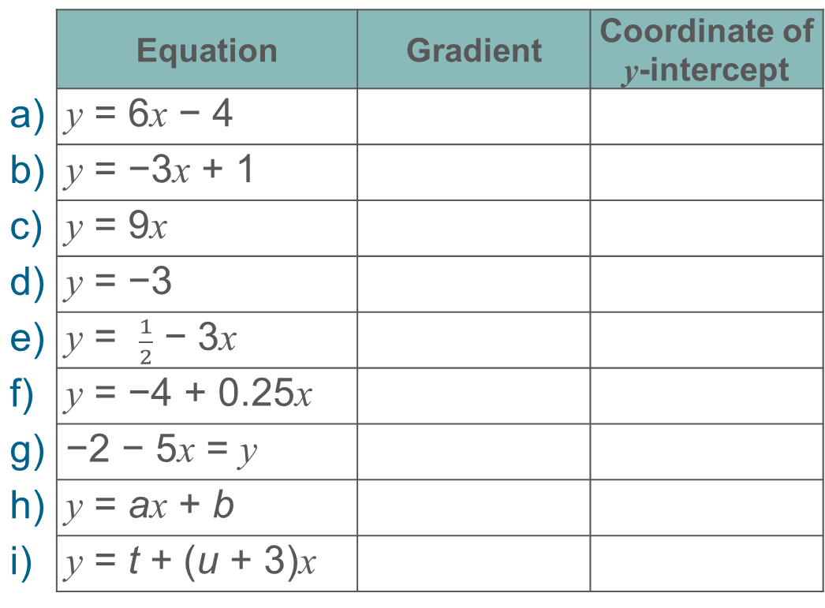
Identify the gradient and the y-intercept from equations in various forms
Example 6
 | Equation | Gradient | Coordinate of y-intercept
a) | y = 6x − 4
b) | y = −3x + 1
c) | y = 9x
d) | y = −3
e) | y = $\frac{1}{2}$ − 3x
f) | y = −4 + 0.25x
g) | −2 − 5x = y
h) | y = ax + b
i) | y = t + (u + 3)x
Complete this table by finding the gradient and the coordinate of the y-intercept for each of the equations given.
Notes:
Suggested questioning:
What is the y-intercept? What is the co-ordinate of the y-intercept?
What might each of these lines look like on a graph?
What do you notice about part g)? Does this matter?
Which of these lines have negative gradients? How do you know?
Which of these lines is the steepest? How do you know?
Things for you to think about:
Example 6 asks students to identify both the gradient and the coordinate of the y-intercept from a series of equations. This is slightly different from Example 1, as students will need to express the y-intercept as a coordinate and not just read the constant value from the equation.
The equations have been carefully chosen to cover a range of options with positive, negative and zero gradients and y-intercepts, as well as integer and decimal values. Part g) challenges students’ understanding of an equation. Can students verbalise why swapping the left and right sides of an equation in their entirety does not affect the gradient or y-intercept?
Parts h) and i) are opportunities for students to explore the use of algebraic variables. These examples draw attention to the fact that it does not matter whether the coefficient of x or the constant term are known values or variables.

Slide 26
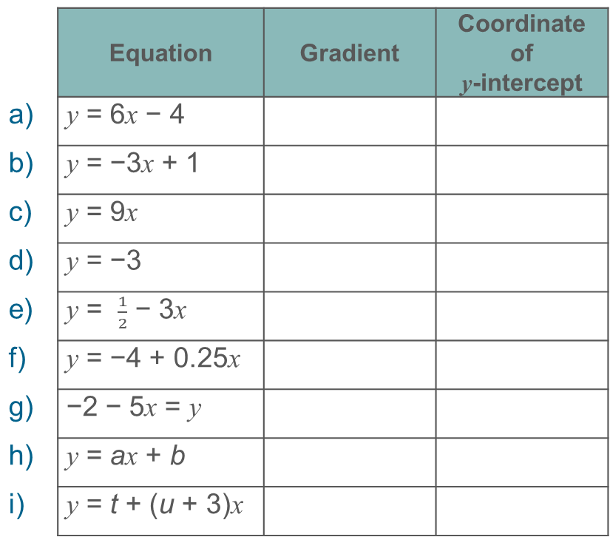
Identify the gradient and the y-intercept from equations in various forms
Example 6
  What is the potential value in asking for the coordinate of the y-intercept?
  Which of these do you think your students would find most challenging? Why? How can you address these challenges?
 | Equation | Gradient | Coordinate of y-intercept
a) | y = 6x − 4
b) | y = −3x + 1
c) | y = 9x
d) | y = −3
e) | y = $\frac{1}{2}$ − 3x
f) | y = −4 + 0.25x
g) | −2 − 5x = y
h) | y = ax + b
i) | y = t + (u + 3)x
Complete this table by finding the gradient and the coordinate of the y-intercept for each of the equations given.
Notes:
Due to space constraints, the image on this PD discussion slide is very small. PD Leads might like to use or print the ‘in the classroom’ version of this slide for teachers to access during discussions.
This example can be found on page 23 of the 4.2 Core Concept document.

Slide 27
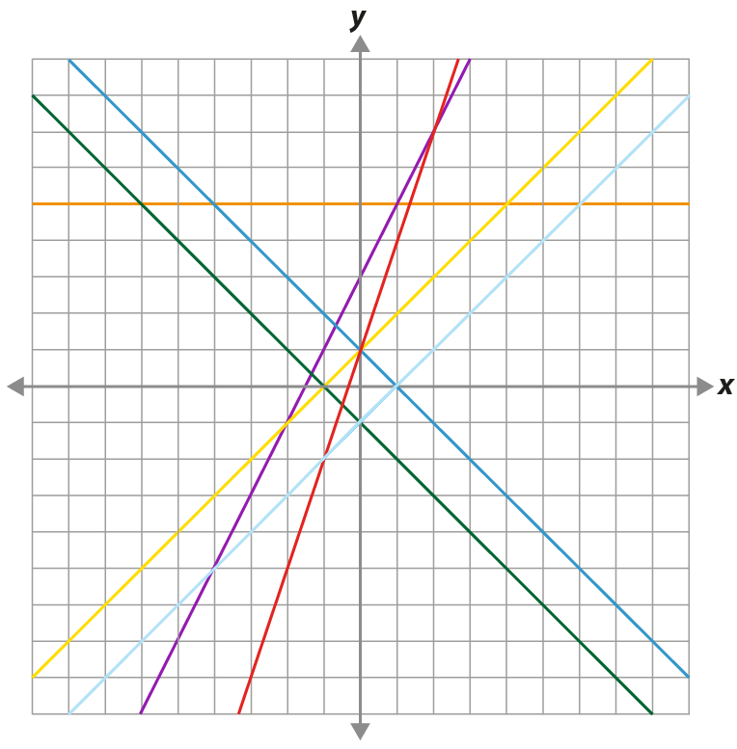
Identify the gradient and the y-intercept from equations in various forms
Example 7
Match these equations to the lines on the graph.
y = 3x + 1
y = 2x + 1
y = 2x + 3
y = x + 1
y = x − 1
y = 1 − x
y = 5
Notes:
Suggested questioning:
Which of these equations cannot be represented on the graph? How do you know
What would the missing lines look like?
What do you think the scale on the axes might be? Why?
Which lines are parallel? What does this mean for their equations?
Things for you to think about:
It is important that students can make the connection between the gradient and the y-intercept of a line from an equation and what this looks like on a graph. Problems such as Example 7, where no scales are given on the axes, really challenge students to consider the links between equations and lines.
There are many ways that students could approach this example and it is important to explore the different strategies. Some students may begin by paying attention to the y-intercepts and see that there are not enough lines passing through what could be (0, 1). Others may begin by looking at the gradients and see that there are two pairs of parallel lines – one set with a positive gradient, and another with a negative gradient – yet only one equation has a negative gradient.
Problems such as this one, where the initial wording suggests that all the equations should match with lines and yet one equation does not, encourage students to question their understanding. What prompts could you offer students to help them with this? Encouraging students to verbalise their mathematical thinking by asking them to explain why something cannot be true is key to developing their understanding of a concept.

Slide 28
Identify the gradient and the y-intercept from equations in various forms
Example 7
Match these equations to the lines on the graph.
y = 3x + 1
y = 2x + 1
y = 2x + 3
y = x + 1
y = x − 1
y = 1 − x
y = 5
  Why might this example have been designed with no scale on the axis? How would the inclusion of the scale have changed the demand or open-ness of the task?
  What prompts could you offer students to help them with this?
Notes:
Due to space constraints, the image on this PD discussion slide is very small. PD Leads might like to use or print the ‘in the classroom’ version of this slide for teachers to access during discussions.
This example can be found on page 24 of the 4.2 Core Concept document.

Slide 29
Identify the gradient and the y-intercept from equations in various forms
Example 8
y = cx + m
Kayla says that the gradient is m and the y-intercept is c, because the gradient is always m and the y-intercept is always c.
Luka says that the gradient is c and the y-intercept is m, because the gradient is always the coefficient of x and the y-intercept is always the constant term.
Are either Kayla or Luka correct?
Justify your answer.
Notes:
Suggested questioning:
Why might Kayla think this? Why might Luka think this? Who is correct?
Why do you think we conventionally use specific letters for gradient and intercept?
What do ‘gradient’, ‘co-efficient’, ‘y-intercept’ and ‘constant term’ mean? Could you use these terms in a sentence?
Things for you to think about:
Example 8 is designed to challenge students’ understanding, raising awareness that the letter name is irrelevant; it is the role it plays in the formula that is important. Students may identify Luka’s statement as correct, but it is important to explore his reasoning. Asking students whether it is always the case and encouraging them to consider examples when it is not (depending on the format of the equation) will help to develop a deep and secure understanding.

Slide 30
Identify the gradient and the y-intercept from equations in various forms
Example 8
y = cx + m
Kayla says that the gradient is m and the y-intercept is c, because the gradient is always m and the y-intercept is always c.
Luka says that the gradient is c and the y-intercept is m, because the gradient is always the coefficient of x and the y-intercept is always the constant term.
Are either Kayla or Luka correct?
Justify your answer.
  Do you recognise this potential misconception?
  What other misconceptions can you think of that might easily go unnoticed? What tasks or questions might you use to expose and address them?
Notes:
Due to space constraints, the image on this PD discussion slide is very small. PD Leads might like to use or print the ‘in the classroom’ version of this slide for teachers to access during discussions.
This example can be found on page 24 of the 4.2 Core Concept document.

Slide 31
Reflection questions
What other mathematical concepts will be supported by students’ stronger understanding of this key idea?
What mathematical language will you continue to use to support pupils to make connections with other areas?
Which representations might you continue to use to further develop students’ understanding?

Slide 33
Appendices
You may choose to use the following slides when planning or delivering a PD session. They cover:
  Key vocabulary
  Representations and structure
  Previous learning
  Future learning
  Library of links

Slide 34
Key vocabulary (1)
Term | Definition
Cartesian coordinate system | A system used to define the position of a point in 2- or 3-dimensional space: Two axes at right angles to each other are used to define the position of a point in a plane. The usual conventions are to label the horizontal axis as the x-axis and the vertical axis as the y-axis, with the origin at the intersection of the axes. The ordered pair of numbers (x, y) that defines the position of a point is the coordinate pair. The origin is the point (0, 0); positive values of x are to the right of the origin and negative values are to the left of the origin; positive values of y are above the origin and negative values below the origin. Each of the numbers is a coordinate. The numbers are also known as ‘Cartesian coordinates’, after the French mathematician, René Descartes (1596–1650). Three mutually perpendicular axes, conventionally labelled x, y and z, and coordinates (x, y, z) can be used to define the position of a point in space.

Slide 35
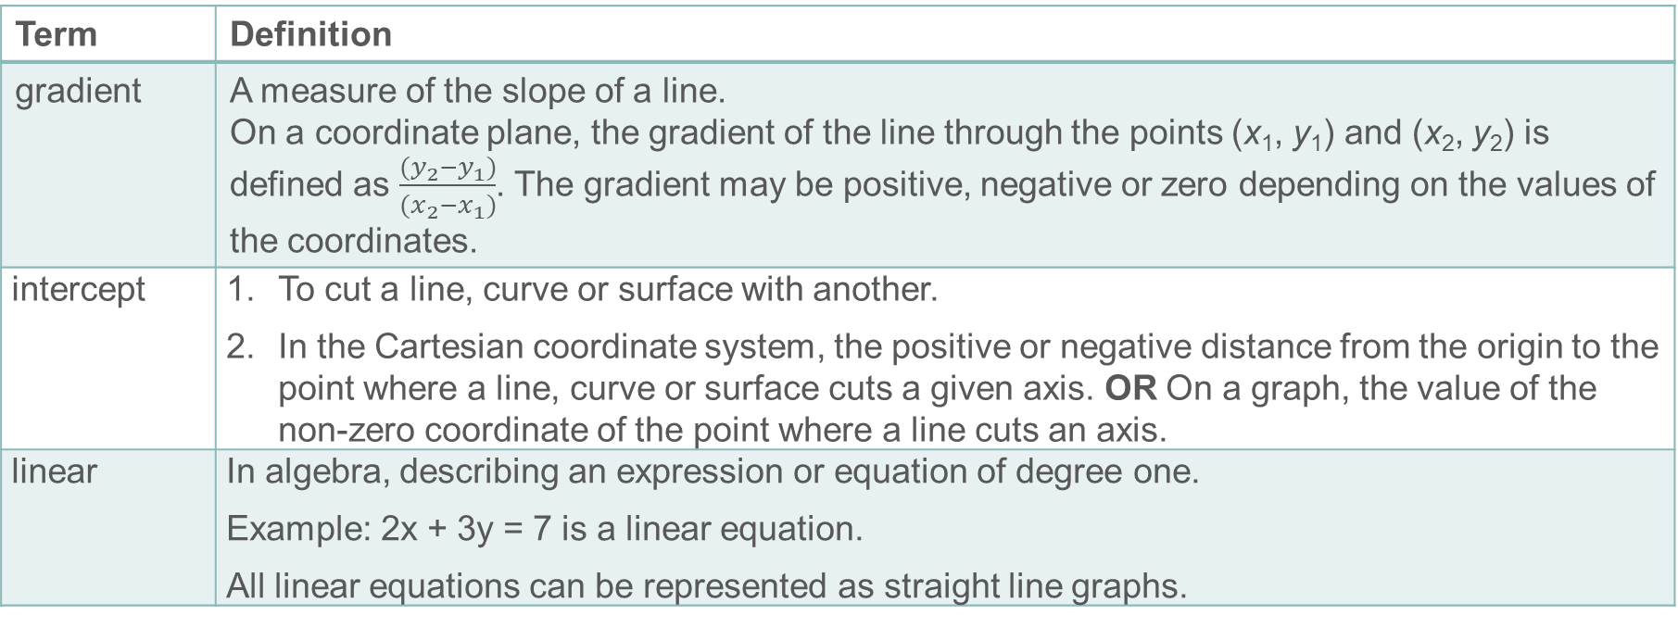
Key vocabulary (2)
Term | Definition
gradient | A measure of the slope of a line. On a coordinate plane, the gradient of the line through the points (x₁, y₁) and (x₂, y₂) is defined as $\frac{(y_{2}−y_{1})}{(x_{2}−x_{1})}$. The gradient may be positive, negative or zero depending on the values of the coordinates.
intercept | To cut a line, curve or surface with another. In the Cartesian coordinate system, the positive or negative distance from the origin to the point where a line, curve or surface cuts a given axis. OR On a graph, the value of the non-zero coordinate of the point where a line cuts an axis.
linear | In algebra, describing an expression or equation of degree one. Example: 2x + 3y = 7 is a linear equation. All linear equations can be represented as straight line graphs.

Slide 36
Key vocabulary (3)
Term | Definition
quadratic | Describing an expression of the form ax² + bx + c where a, b and c are real numbers. The function y = ax² + bx + c is a quadratic function; its graph is a parabola.
simultaneous equations | Two linear equations that apply simultaneously to given variables. The solution to the simultaneous equations is the pair of values for the variables that satisfies both equations. The graphical solution to simultaneous equations is a point where the lines representing the equations intersect. Example: x + y = 6 and y = 2x is a set of simultaneous equations. The solution is the value of x and y which satisfies both simultaneously – i.e. x = 2 and y = 4.

Slide 37
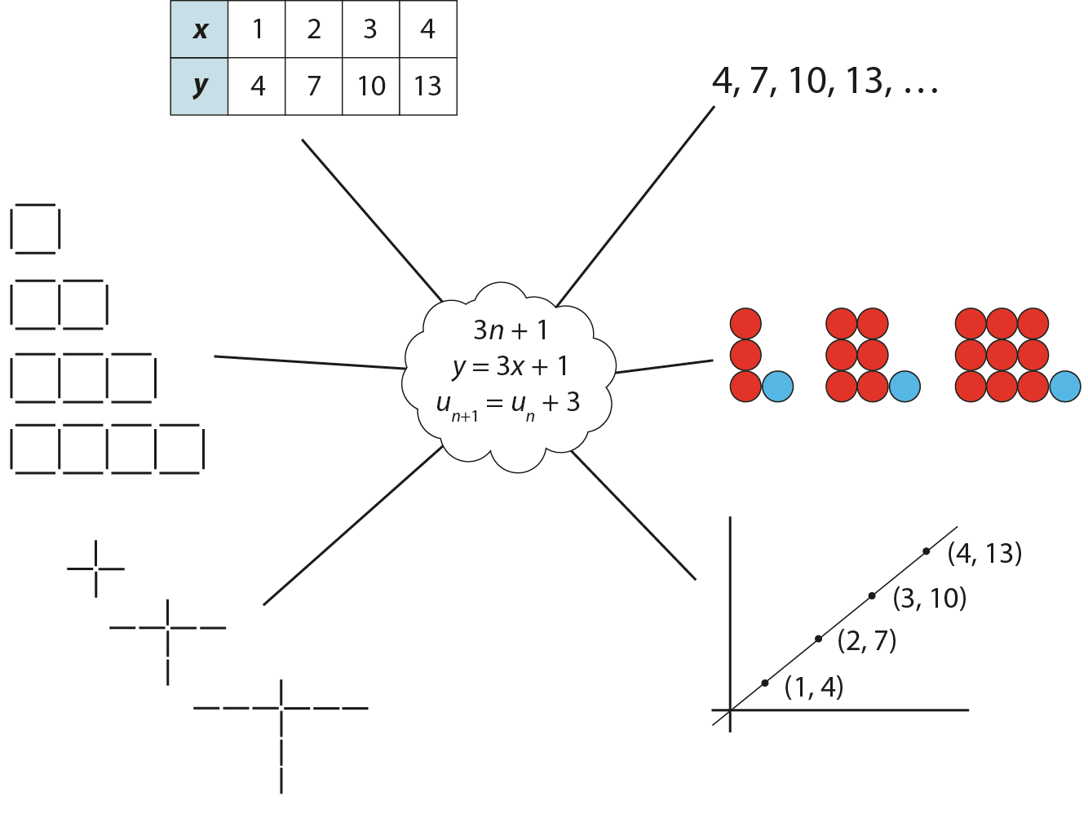
Representations and structure
There are a number of different representations that you may wish to use to support students’ understanding of this key idea. These might include:
Tables of values, graphs, sequences and structured pictorial arrangements
  It is important for students to see multiple representations of the same structure, as in the diagram, and to connect them. Prompts such as ‘Where is the 3 in this representation?’ and ‘Where is the 1?’ can support students in making these connections and understanding that each representation has the same underpinning structure.
Notes:
More information about the representations and structure involved in this key idea can be found:
On page 5 of the 4 Sequences and graphs Theme Overview document
Links to all of these can be found on the final slide.

Slide 38
Previous learning
From Upper Key Stage 2, students will bring experience of:
using simple formulae
generating and describing linear number sequences
describing positions on the full coordinate grid (all four quadrants).
Notes:
Theme 4 Sequences and graphs

Slide 39
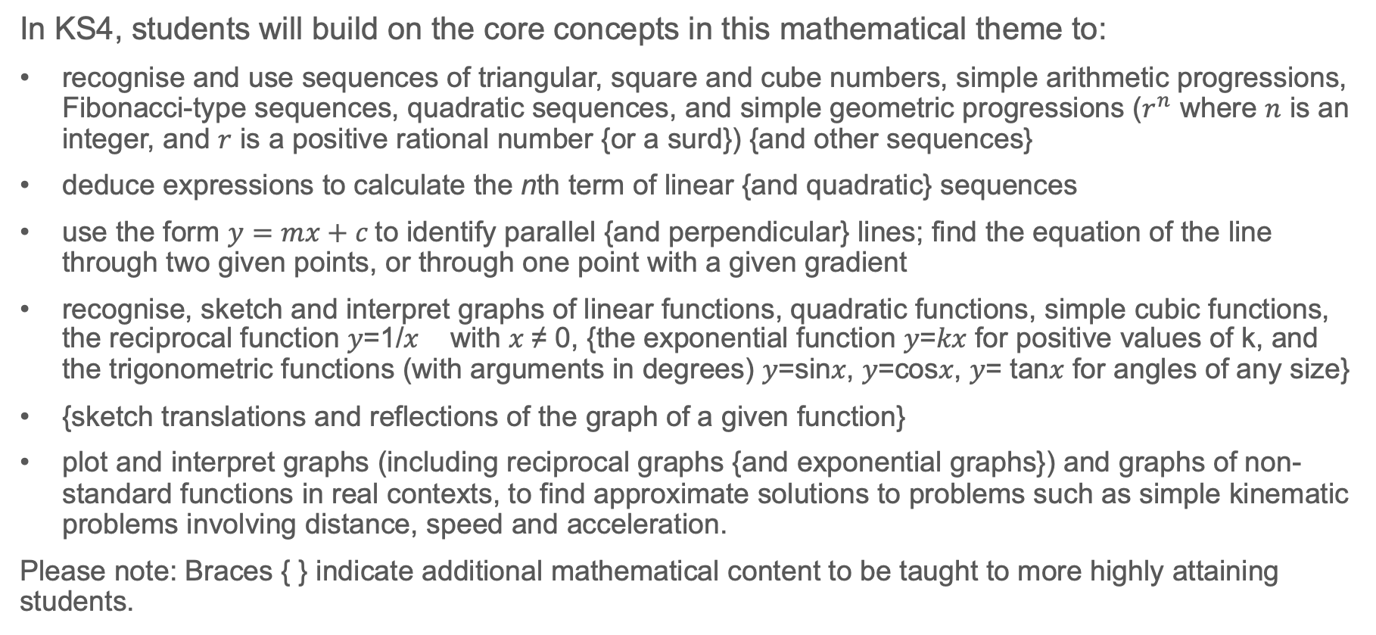
Future learning
In KS4, students will build on the core concepts in this mathematical theme to:
recognise and use sequences of triangular, square and cube numbers, simple arithmetic progressions, Fibonacci-type sequences, quadratic sequences, and simple geometric progressions ($r^{n}$ where $n$ is an integer, and $r$ is a positive rational number {or a surd}) {and other sequences}
deduce expressions to calculate the nth term of linear {and quadratic} sequences
use the form $y=mx+c$to identify parallel {and perpendicular} lines; find the equation of the line through two given points, or through one point with a given gradient
recognise, sketch and interpret graphs of linear functions, quadratic functions, simple cubic functions, the reciprocal function 𝑦=1/𝑥 with 𝑥 ≠ 0, {the exponential function 𝑦=𝑘𝑥 for positive values of k, and the trigonometric functions (with arguments in degrees) 𝑦=sin𝑥, 𝑦=cos𝑥, 𝑦= tan𝑥 for angles of any size}
{sketch translations and reflections of the graph of a given function}
plot and interpret graphs (including reciprocal graphs {and exponential graphs}) and graphs of non-standard functions in real contexts, to find approximate solutions to problems such as simple kinematic problems involving distance, speed and acceleration.
Please note: Braces { } indicate additional mathematical content to be taught to more highly attaining students.
Notes:
Theme 4 Sequences and graphs

Slide 40
Library of links
The following resources from the NCETM website have been referred to within this slide deck:
  NCETM Secondary Mastery Professional Development
    4 Sequences and Graphs Theme Overview Document
    4.2 Graphical representations Core Concept Document
    1.4 Simplifying and manipulating expressions, equations and formuale Core Concept Document
  NCETM primary mastery professional development materials
  NCETM secondary assessment materials

