Slide 1
Calculating percentage changes
KS3 Mastery PD Materials: Exemplified Key Ideas
Materials for use in the classroom or to support professional development discussions
(from 3.1 Multiplicative reasoning)
Summer 2021

Slide 2
About this resource
These slides are designed to complement the 3.1 Understanding Multiplicative Relationships Core Concept document and its associated Theme Overview document 3 Multiplicative Reasoning, both found in the Secondary Mastery Professional Development page.
These slides re-present the key examples from the Core Concept document so that the examples can be used either directly in the classroom or with a group of teachers. There are prompt questions alongside the examples, and further clarification in the notes.
These slides do not fully replicate the Core Concept document, so should be used alongside it. Reference to specific page numbers, and to other useful NCETM resources, can be found in the notes for each slide.
This slide deck is not designed to be a complete PD session, rather it is a selection of resources that you can adapt and use as needed when planning a session with a group of teachers.

Slide 3


About this resource
The slides are structured as follows:
  The big picture:
    Where does this fit in?
    What do students need to understand?
    Why is this key idea important?
  Prior learning
  Misconceptions
  Exemplified key ideas
  Reflection questions
  Appendices:
    Key vocabulary
    Representations and structure
    Previous and Future learning
    Useful links
The exemplified key idea slides have the following symbols to indicate how they have been designed to be used:
Into the classroom
The examples are presented on these slides so that they could be used in PD, but also directly in the classroom. The notes feature suggested questions and things teachers might consider when using with students.
PD discussion prompts
These slides look at the examples in more detail, with question prompts to promote discussion among maths teachers. The notes feature reference to further information and guidance within the Core Concepts document.

Slide 4
Where does this fit in?
The NCETM has identified a set of six ‘mathematical themes’ within Key Stage 3 mathematics that bring together a group of ‘core concepts’.
The third of these themes is Multiplicative reasoning, which covers the following interconnected core concepts:
    3.1 Understanding multiplicative relationships
    3.2 Trigonometry
Notes:
Linked on this slide is the Theme Overview document of Multiplicative reasoning. This document includes why it is important, the key underpinning knowledge and links to prior and future learning. There is also guidance about how the five big ideas of Teaching for Mastery relate specifically to this theme.

Slide 5
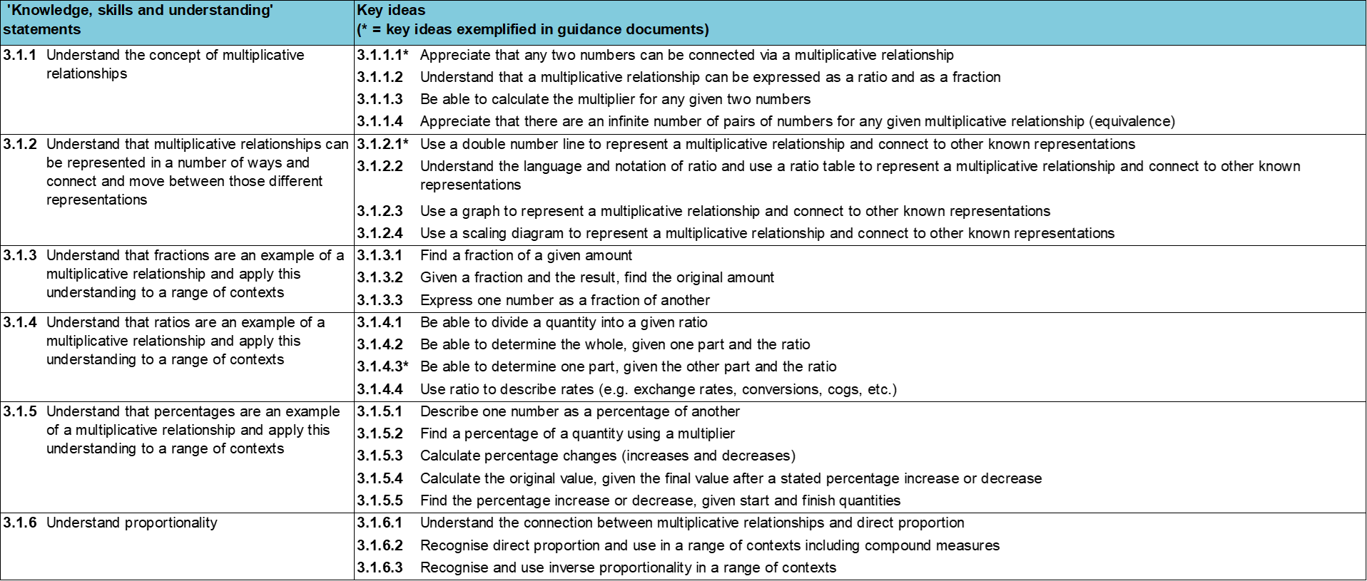
Where does this fit in?
Within this core concept, 3.1 Understanding multiplicative relationships, there are six statements of knowledge, skills and understanding.
These, in turn, are broken down into twenty three key ideas. The highlighted key idea is exemplified in this slide deck.
Notes:
For key ideas marked with an asterisk, we exemplified the common difficulties and misconceptions that students might have and included elements of what teaching for mastery may look like. We have provided examples of possible student tasks and teaching approaches.
Within these slides are ‘classroom-ready’ versions of the examples for the key idea that has been highlighted. There are also slides that may be useful for discussion in a professional development session.

Slide 6
What do students need to understand?
3.1.5.3 Calculate percentage changes (increases and decreases)
Find a percentage increase or decrease using an additive method.
Use multipliers to calculate percentage increase or decrease.
Solve familiar and unfamiliar problems, including real-life applications.
  What prior knowledge might your students already have?
  What language might they use to describe this key idea?
  What questions might you want to ask to assess their prior learning?

Slide 7
Why is this key idea important? (1)
Multiplicative relationships underpin many aspects of mathematics at Key Stage 3, but students often experience them as distinct topics with no obvious connections. Percentages, fractions, proportionality and ratio, for example, can all be considered as contexts in which multiplicative relationships are used and explored.
It is, therefore, important that the vocabulary and imagery used in all contexts is consistent in order to support students in their understanding that the same mathematical principles are involved.
Students will have met fractions and percentages at Key Stage 2, while proportionality and ratio may be new to them. A key idea in Key Stage 3 will be to connect fractions, percentages, proportionality and ratio together through the overarching idea of multiplicative relationships.
This is one of a set of key ideas, where the use of percentages to represent multiplicative relationships is explored.
Notes:
A more detailed overview of the core concept of Multiplicative reasoning can be found on page 2 of the 3.1 Core Concept document.
The background to each key idea is also explored in more detail on the following pages:
3.1.1 Understand the concept of multiplicative relationships – page 5
3.1.2 Understand that multiplicative relationships can be represented in a number of ways and connect and move between those different representations – page 5
3.1.3 Understand that fractions are an example of a multiplicative relationship and apply this understanding to a range of contexts – pages 5 and 6
3.1.4 Understand that ratios are an example of a multiplicative relationship and apply this understanding to a range of contexts – page 6
3.1.5 Understand that percentages are an example of a multiplicative relationship and apply this understanding to a range of contexts – pages 6 and 7
3.1.6 Understand proportionality – page 7

Slide 8
Why is this key idea important? (2)
Students may use informal additive methods to calculate percentages. For example, to find 16% of a total they will find 10%, find 5%, find 1% and add these together. While it is important for students to know this, and to be able to work flexibly with percentages, it is also important for efficiency and depth of understanding that they recognise them as multiplicative relationships and understand that there exists a single multiplier linked to any percentage.
As with ratio, the double number line and ratio table representations are useful in supporting students in identifying and working with the multiplier, and consistent use of these representations through ratio, percentages and proportion may make the connections between these apparently different topics more obvious for students.
Throughout 3.1.5 students are again working on the relationship ab = c, where a or b is written as, or interpreted as, a percentage, and are exploring this in different contexts and with different representations.
Notes:
A more detailed overview of the core concept of Multiplicative reasoning can be found on page 2 of the 3.1 Core Concept document.
The background to each key idea is also explored in more detail on the following pages:
3.1.1 Understand the concept of multiplicative relationships – page 5
3.1.2 Understand that multiplicative relationships can be represented in a number of ways and connect and move between those different representations – page 5
3.1.3 Understand that fractions are an example of a multiplicative relationship and apply this understanding to a range of contexts – pages 5 and 6
3.1.4 Understand that ratios are an example of a multiplicative relationship and apply this understanding to a range of contexts – page 6
3.1.5 Understand that percentages are an example of a multiplicative relationship and apply this understanding to a range of contexts – pages 6 and 7
3.1.6 Understand proportionality – page 7

Slide 9
Prior learning
Upper Key Stage 2 Learning Outcome
Multiply proper fractions and mixed numbers by whole numbers, supported by materials and diagrams
Recognise the per cent symbol (%) and understand that per cent relates to ‘number of parts per hundred’, and write percentages as a fraction with denominator 100, and as a decimal
Use all four operations to solve problems involving measure (for example, length, mass, volume, money) using decimal notation, including scaling
Solve problems involving the relative sizes of two quantities where missing values can be found by using integer multiplication and division facts
Solve problems involving the calculation of percentages (for example, of measures, and such as 15% of 360) and the use of percentages for comparison
Solve problems involving similar shapes where the scale factor is known or can be found
Solve problems involving unequal sharing and grouping, using knowledge of fractions and multiples
  What prior knowledge might your students already have?
  What language might they use to describe this key idea?
  What questions might you want to ask to assess their prior learning?
Notes:
You may find it useful to speak to your partner schools to see how the above has been covered and the language used.
You can find further details regarding prior learning in the following segments of the NCETM primary mastery professional development materials (linked on final slide):
Year 4: 2.17 Structures: using measures and comparison to understand scaling
Year 6: 2.27 Scale factors, ratio and proportional reasoning
Year 6: 3.10 Linking fractions, decimals and percentages
Within the Multiplicative Reasoning Theme Overview document, you can also find a broader description of students’ potential previous learning (page 3), alongside further information about key underpinning knowledge (page 2).

Slide 10
Checking prior learning
The following slides contain questions for checking prior learning.
  What representations might students use to support their understanding of these questions?
  What variation might you put in place for these questions to fully assess students’ understanding of the concept?
  How might changing the language of each question change the difficulty?
  Why are these such crucial pre-requisites for this key idea?

Slide 11
Checking prior learning
In Year 1 there are 50 pupils, of whom 16 are boys.
What percentage of the pupils are girls?
In a class of children 25% are boys and the rest are girls.
There are 18 girls. How many children are in the class?
Notes:
References to the questions (links on final slide):
a) NCETM Primary assessment materials, Year 6 page 24
b) NCETM Primary assessment materials, Year 6 page 24 (‘Mastery with greater depth’)

Slide 12

Checking prior learning
Tick the fractions that are equal to 20%.
□ $\frac{1}{20}$ □ $\frac{20}{40}$ □ $\frac{1}{5}$ □ $\frac{3}{15}$ □ $\frac{2}{100}$
Jack has £400.
He spends 35% of his money on a new bike.
How much does Jack spend on his new bike?
Notes:
References to the questions (links on final slide):
c) 2019 Key Stage 2 Mathematics Paper 2: reasoning, question 20
d) 2019 Key Stage 2 Mathematics Paper 3: reasoning, question 8

Slide 13
Common difficulties and misconceptions
What aspects of this key idea might pupils find challenging?
What misconceptions might pupils have?
When teaching this topic, you may find students encounter difficulties with…
Finding the final amount with additive methods
Using multipliers for percentage change
More information, and some suggestions for overcoming these challenges, can be found on the following slides.

Slide 14
Common difficulties and misconceptions (1)
Students should be confident with using informal additive methods to increase or decrease an amount using a percentage.
Some students have difficulties using the additive method as they fail to find the final amount by adding or subtracting the increase/decrease to/from the original amount (see Example 1).
Notes:
More detail can be found on page 34 of the 3.1 Core Concept document.

Slide 15
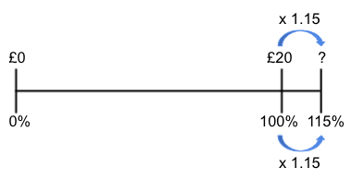
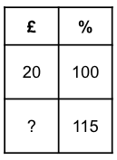
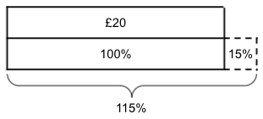
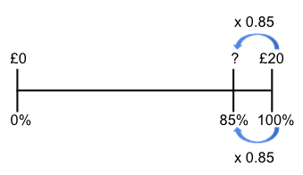
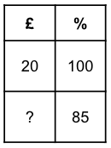
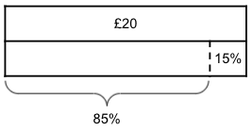
Common difficulties and misconceptions (2)
While it is important that students can work flexibly with percentages, it is also important for efficiency and depth of understanding that they know there is a single multiplier linked to any percentage change and recognise this as an example of multiplicative relationships.
Some students have difficulties with identifying the multiplier for single digit percentages such as 5% (see Example 4 on slide 22).
Bar models, double number lines and ratio tables are all powerful representations that can help students work ‘beyond 100%’ and identify the both the whole, and the multiplier linked to the percentage.
Notes:
More detail can be found on page 34 of the 3.1 Core Concept document.

Slide 16
Find a percentage increase or decrease using an additive method
Example 1
Increase:
  £30 by 50%
  £50 by 30%
Notes:
Suggested questioning:
What is 50% of 30?
What is 30% of 50?
Does this mean the answers to a and b will be the same? Why or why not?
What do you need to do to find the final answer? How would this be different if the question said to ‘decrease’?
Things for you to think about:
The questions in Example 1 have been designed to help students notice that although the percentage of the amount is the same value (£15), the outcome is different.

Slide 17
Find a percentage increase or decrease using an additive method
Example 1
  Finding 50% of 30 gives the same answer as finding 30% of 50, how would you expect students to justify this?
  How would you expect students to change their reasoning for the increase questions shown to demonstrate they don’t give the same answer?
Increase:
  £30 by 50%
  £50 by 30%
Notes:
This example can be found on page 34 of the 3.1 Core Concept document.

Slide 18
Find a percentage increase or decrease using an additive method
Example 2
Mary is decreasing 40kg by 20%.
She says that the answer is 8kg because 20% of 40kg is 8kg.
Do you agree? Explain your answer.
Notes:
Suggested questioning:
What is 20% of 40kg? Does this mean Mary is right?
What does Mary need to do?
Is there another way to do this?
Things for you to think about:
The ‘what’s it’s not’ question in Example 2 supports students’ awareness of the need to decrease the original amount by the proportion and not just find the proportion.

Slide 19
Find a percentage increase or decrease using an additive method
Example 2
  Here students are introduced to percentage changes using an additive approach before the use of a single multiplier to calculate the change. Consider the benefits and disadvantages of this route to understanding percentage change.
Mary is decreasing 40kg by 20%.
She says that the answer is 8kg because 20% of 40kg is 8kg.
Do you agree? Explain your answer.
Notes:
This example can be found on page 35 of the 3.1 Core Concept document.

Slide 20
Use multipliers to calculate percentage increase or decrease
Example 3
Tick the correct statements:
 | Calculation | Tick
Increase £20 by 35% | 20 × 1.35
Decrease £20 by 35% | 20 × 0.35
Increase £35 by 20% | 35 × 0.2
Decrease £35 by 20% | 35 × 0.8
Increase £45 by 1% | 45 × 1.1
Decrease £35 by 1% | 45 × 0.99
Notes:
Suggested questioning:
Which of these are correct/incorrect?
For the incorrect ones, can you correct them by changing the calculation?
Could you correct them by changing the sentence instead?
What common errors have been made here?
Things for you to think about:
The questions in Example 3 will help students recognise that there is a single multiplier linked to any percentage. Multiplicative reasoning can increase a quantity by a percentage more efficiently than the additive methods in Examples 1 and 2.

Slide 21
Use multipliers to calculate percentage increase or decrease
Example 3
  Students need to be confident and fluent with recognising that a single multiplier exists linked to any percentage. How might you assess this before starting Example 3?
  Which of the incorrect answers here do you think are the most likely misconceptions for students to encounter?
Tick the correct statements:
 | Calculation | Tick
Increase £20 by 35% | 20 × 1.35
Decrease £20 by 35% | 20 × 0.35
Increase £35 by 20% | 35 × 0.2
Decrease £35 by 20% | 35 × 0.8
Increase £45 by 1% | 45 × 1.1
Decrease £35 by 1% | 45 × 0.99
Notes:
Due to space constraints, the image on this PD discussion slide is very small. PD Leads might like to use or print the ‘in the classroom’ version of this slide for teachers to access during discussions.
This example can be found on page 35 of the 3.1 Core Concept document.

Slide 22
Use multipliers to calculate percentage increase or decrease
Example 4
Sandra tries to increase £40 by 5% by working out 40 × 1.5. Explain why she is incorrect.
Nicola tries to decrease £40 by 5% by working out 40 × 0.05. Explain why she is incorrect.
Notes:
Suggested questioning:
What percentage increase has Sandra found?
What percentage decrease has Nicola found?
What is 5% as a fraction of 100? What is this as a decimal?
Things for you to think about:
Example 4 provides opportunities to assess students’ understanding of the single multiplier linked to any percentage and to discuss some common misconceptions.

Slide 23
Use multipliers to calculate percentage increase or decrease
Example 4
  Do you value the importance of asking students to discuss and explain why statements are incorrect, or asking them to improve upon given answers?
  How do you become aware of common misconceptions such as those addressed here?
  Are there other misconceptions you might address in a similar way?
Sandra tries to increase £40 by 5% by working out 40 × 1.5. Explain why she is incorrect.
Nicola tries to decrease £40 by 5% by working out 40 × 0.05. Explain why she is incorrect.
Notes:
This example can be found on page 35 of the 3.1 Core Concept document.

Slide 24
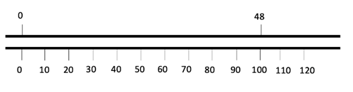
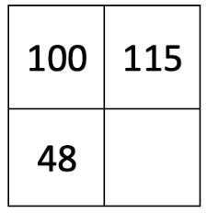
Use multipliers to calculate percentage increase or decrease
Example 5
A chocolate bar that usually weighs 48g is on special offer and now includes ‘15% extra free’.
Mark the new weight on the double number line.
Use the double number line to estimate the new weight
The same percentage increase can be calculated using this ratio table.
Mark the multipliers on the ratio table.
Use the ratio table to calculate the new weight.
Notes:
This slide is animated. The second section, featuring parts c and d, will appear separately.
Suggested questioning:
Where is 15% on the number line? Where is 115%? Which of these represents ‘15% extra free’?
How does the double number line help you to estimate the weight?
Which multiplier will you use on the ratio table?
How does the ratio table help you to calculate the weight exactly?
Could you use the double number line to do this?
Which representation do you prefer?
Things for you to think about:
Example 5 provides an opportunity to connect ratio tables and double number lines to percentage changes.
Your students may be familiar with ratio tables as representations of multiplicative relationships. Their use here will support students in connecting percentage changes with other situations that share the same mathematical structure, even though they initially look different.

Slide 25
Use multipliers to calculate percentage increase or decrease
Example 5
  It could be argued that the double number line allows an insight into the structure while the ratio table (which is an abstraction of the double number line) allows easy identification of the multiplier and hence calculation of the solution. To what extent do you agree with this perspective?
  Which representations do you (or will you) use with your students? Why?
A chocolate bar that usually weighs 48g is on special offer and now includes ‘15% extra free’.
The same percentage increase can be calculated using this ratio table.
Mark the multipliers on the ratio table.
Use the ratio table to calculate the new weight.
Notes:
Due to space constraints, the image on this PD discussion slide is very small. PD Leads might like to use or print the ‘in the classroom’ version of this slide for teachers to access during discussions.
This example can be found on page 36 of the 3.1 Core Concept document.

Slide 26
Solve familiar and unfamiliar problems, including real-life applications
Example 6
A ball is dropped from a height of 200m.
After each bounce, the ball reaches 10% of its previous height.
How high does it reach after the third bounce?
A shop is offering 25% off items in a summer sale.
On the final day of the sale, all prices are reduced by 10%.
Debbie buys a shirt on the final day.
Work out the overall percentage reduction on the price of the shirt.
Notes:
Suggested questioning:
Is question a the same as a 30% decrease from 200? Why not?
What is the percentage calculation after 1 bounce? 2 bounces? 3 bounces? Is there more than one way to write this?
Is question b the same as a 35% decrease from the original price? Why not?
Are you working out the final price or the final percentage? How can you do this without knowing the cost?
Things for you to think about:
Example 6 provide two opportunities for students to apply their understanding to solve unfamiliar problems. Part b) does not include a quantity, to focus students’ awareness on the effect of combining more than one multiplier rather than calculating an answer.

Slide 27
Solve familiar and unfamiliar problems, including real-life applications
Example 6
  What incorrect answers are students likely to give here? What misconceptions might have caused them?
  How will you explain these questions to students? What representations will you use? What will your workings look like?
A ball is dropped from a height of 200m.
After each bounce, the ball reaches 10% of its previous height.
How high does it reach after the third bounce?
A shop is offering 25% off items in a summer sale.
On the final day of the sale, all prices are reduced by 10%.
Debbie buys a shirt on the final day.
Work out the overall percentage reduction on the price of the shirt.
Notes:
Due to space constraints, the image on this PD discussion slide is very small. PD Leads might like to use or print the ‘in the classroom’ version of this slide for teachers to access during discussions.
This example can be found on page 36 of the 3.1 Core Concept document.

Slide 28
Solve familiar and unfamiliar problems, including real-life applications
Example 7
Complete the statements in several different ways:
  Increase £__ by __% = £80
  Decrease £__ by __% = £80
Notes:
Suggested questioning:
What numbers are needed if the percentages are the same?
What percentages are needed if you start with e.g. 60 for a and e.g. 100 for b?
Is it possible for the start numbers to be the same for a and b?
How many ways can you complete this? Can you complete this in a way that no one else has?
Things for you to think about:
Example 7 offers two empty box problems that have more than one solution. Questions like these can encourage students to consider the overall structure of increasing and decreasing a quantity by a percentage.
Students might need prompted to consider percentages greater than 100%, but this can also offer a useful insight into their understanding. Asking students to communicate the process they went through to find a solution will also help refine their mathematical thinking.

Slide 29
Solve familiar and unfamiliar problems, including real-life applications
Example 7
  How do you manage questions like this with your classes?
  How long would you give them before you intervene and support?
  What prompts could you give to students who were struggling to get started?
  Once students had successfully found some examples, what further prompts could you use encourage deeper thinking?
Complete the statements in several different ways:
  Increase £__ by __% = £80
  Decrease £__ by __% = £80
Notes:
This example can be found on pages 36 and 37 of the 3.1 Core Concept document.

Slide 30
Solve familiar and unfamiliar problems, including real-life applications
Example 8
Is the following statement always true, sometimes true or never true? Explain your thinking.
‘Increasing a quantity by x% and then reducing the new quantity by x % will give an answer that is the same value as the original quantity.’
Notes:
Suggested questioning:
If x was 20%, what would the new percentage be after the increase? What is 20% of this?
Why might someone think this is true? How might you convince them that it is not true?
What representations might be most useful for explaining this question?
Things for you to think about:
Statements such as the one in Example 8 provide opportunities for students to ‘play’ and conjecture when increasing and decreasing quantities by a percentage and explore the structure to greater depth. Using a representation such as a double number line or ratio table can help make sense of this structure.

Slide 31
Solve familiar and unfamiliar problems, including real-life applications
Example 8
  Is this a misconception you have encountered before?
  What representations might you use to model this example?
  Would you use numerical examples? Why or why not?
Is the following statement always true, sometimes true or never true?
Explain your thinking.
‘Increasing a quantity by x% and then reducing the new quantity by x% will give an answer that is the same value as the original quantity.’
Notes:
This example can be found on page 37 of the 3.1 Core Concept document.

Slide 32
Reflection questions
What other mathematical concepts will be supported by students’ stronger understanding of this key idea?
What mathematical language will you continue to use to support pupils to make connections with other areas?
Which representations might you continue to use to further develop students’ understanding?

Slide 34
Appendices
You may choose to use the following slides when planning or delivering a PD session. They cover:
  Key vocabulary
  Representations and structure
  Previous learning
  Future learning
  Library of links

Slide 35
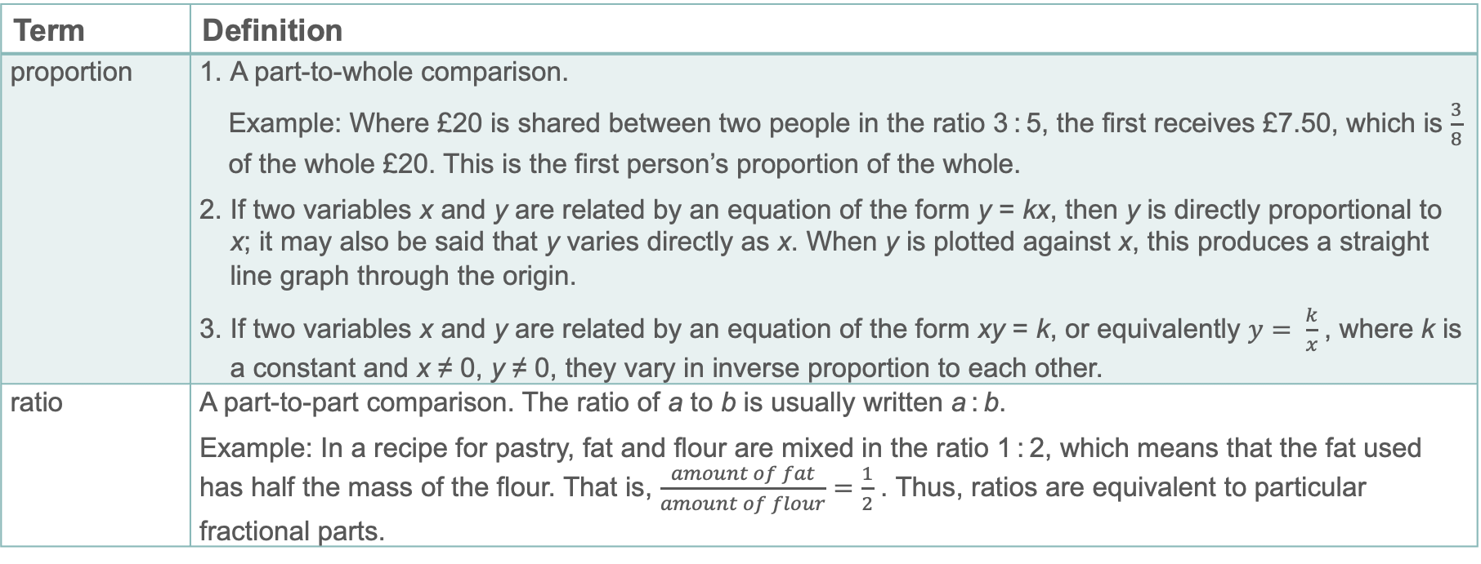
Key vocabulary
Term | Definition
proportion | A part-to-whole comparison. Example: Where £20 is shared between two people in the ratio 3 : 5, the first receives £7.50, which is $\frac{3}{8}$ of the whole £20. This is the first person’s proportion of the whole. If two variables x and y are related by an equation of the form y = kx, then y is directly proportional to x; it may also be said that y varies directly as x. When y is plotted against x, this produces a straight line graph through the origin. If two variables x and y are related by an equation of the form xy = k, or equivalently $y= \frac{k}{x}$, where k is a constant and x ≠ 0, y ≠ 0, they vary in inverse proportion to each other.
ratio | A part-to-part comparison. The ratio of a to b is usually written a : b. Example: In a recipe for pastry, fat and flour are mixed in the ratio 1 : 2, which means that the fat used has half the mass of the flour. That is, $\frac{amount of fat}{amount of flour}=\frac{1}{2}$ . Thus, ratios are equivalent to particular fractional parts.

Slide 36
Representations and structure (1)
There are a number of different representations that you may wish to use to support students’ understanding of this key idea. These might include:
Bar models
  Bar models can be very useful to support students in representing (literally, re-presenting) problems in order to reveal multiplicative structures (as appropriate) and thus become aware of how to proceed to a solution. In the case of percentage increase, they can help students work ‘beyond 100%’ and identify the both the whole, and the multiplier linked to the percentage.
Notes:
More information about the representations and structure involved in this key idea can be found:
On page 7 of the Multiplicative Reasoning Theme Overview document
Links to all of these can be found on the final slide.

Slide 37
Representations and structure (2)
There are a number of different representations that you may wish to use to support students’ understanding of this key idea. These might include:
Ratio tables and double number lines (also known as ‘stacked number lines’)
  The comparison of corresponding entries in two different sets of multiples, such as from a multiplication table, can be a useful context in which to explore multiplicative relationships. The ratio table is an abstraction of the double number line, with the same information represented but without the scale.
Notes:
More information about the representations and structure involved in this key idea can be found:
On page 7 of the Multiplicative Reasoning Theme Overview document
Links to all of these can be found on the final slide.

Slide 38
Previous learning
From Upper Key Stage 2, students will bring experience of:
multiplying proper fractions and mixed numbers by whole numbers, supported by materials and diagrams
recognising the per cent symbol (%) and understanding that per cent relates to ‘number of parts per hundred’, and writing percentages as a fraction with denominator 100, and as a decimal
using all four operations to solve problems involving measure (for example, length, mass, volume, money) using decimal notation, including scaling
solving problems involving the relative sizes of two quantities where missing values can be found by using integer multiplication and division facts
solving problems involving the calculation of percentages (for example, of measures, and such as 15% of 360) and the use of percentages for comparison
solving problems involving similar shapes where the scale factor is known or can be found
solving problems involving unequal sharing and grouping, using knowledge of fractions and multiples.
Notes:
Theme 3 Multiplicative reasoning

Slide 39
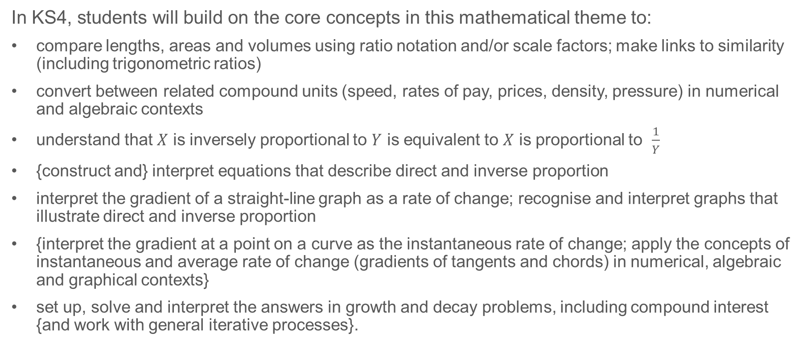
Future learning
In KS4, students will build on the core concepts in this mathematical theme to:
compare lengths, areas and volumes using ratio notation and/or scale factors; make links to similarity (including trigonometric ratios)
convert between related compound units (speed, rates of pay, prices, density, pressure) in numerical and algebraic contexts
understand that $X$ is inversely proportional to $Y$ is equivalent to $X$ is proportional to $\frac{1}{Y}$
{construct and} interpret equations that describe direct and inverse proportion
interpret the gradient of a straight-line graph as a rate of change; recognise and interpret graphs that illustrate direct and inverse proportion
{interpret the gradient at a point on a curve as the instantaneous rate of change; apply the concepts of instantaneous and average rate of change (gradients of tangents and chords) in numerical, algebraic and graphical contexts}
set up, solve and interpret the answers in growth and decay problems, including compound interest {and work with general iterative processes}.
Please note: Braces { } indicate additional mathematical content to be taught to more highly attaining students.
Notes:
Theme 3 Multiplicative reasoning

Slide 40
Library of links
The following resources from the NCETM website have been referred to within this slide deck:
  NCETM Secondary Mastery Professional Development
    3 Multiplicative Reasoning Theme Overview Document
    3.1 Understanding Multiplicative Relationships Core Concept Document
  Using mathematical representations at KS3 | NCETM
  Insights from experienced teachers | NCETM
  NCETM primary mastery professional development materials
  NCETM primary assessment materials
There are also references to:
  Standards & Testing Agency’s past mathematics papers

