Slide 1
Year 1, Unit 6
Additive Structures

Slide 2
Year 1, Unit 6
These materials heavily reflect the prioritisation approach of the ready-to-progress criteria in the DfE Primary Mathematics Guidance 2020 and on the PPTs that exemplify them on the NCETM website. They also include other relevant National Curriculum content. Related sections of the NCETM Primary Mastery Professional Development Materials provide small-step teaching guidance.
Ready-to-progress criteria addressed by this unit
Teaching of this unit supports the following criteria from the ‘DfE Mathematics Guidance: key stages 1 & 2’ (the 335-page document available as a download)
1AS-2 Page 36
Prior learning
If the children have the following previous experience, contained in the same DfE guidance document as above, they will be ready to start this unit.
Previous experience prior to 1AS-2 Page 17

Slide 3
Contents
The links below take you to the starting slide of each learning outcome.
1 | Pupils combine two or more parts to make a whole
2 | Pupils explain that addends can be represented in any order. This is called the commutative law.
3 | Pupils explain that the = sign can be used to show that the whole and the sum of the parts are equal (1)
4 | Pupils explain that the = sign can be used to show that the whole and the sum of the parts are equal (2)
5 | Pupils add parts to find the value of the whole and write the equation
6 | Pupils find the missing addend in an equation
Click the arrow button to return to this Contents slide.

Slide 4
Contents
The links below take you to the starting slide of each learning outcome.
7 | Pupils partition a whole into two parts and express this with a subtraction equation
8 | Pupils make addition and subtraction stories and write equations to match
9 | Pupils represent ‘first, then, now’ stories with addition equations (1)
10 | Pupils represent ‘first, then, now’ stories with addition equations (2)
11 | Pupils represent ‘first, then, now’ stories with subtraction equations (1)
12 | Pupils represent ‘first, then, now’ stories with subtraction equations (2)
Click the arrow button to return to this Contents slide.

Slide 5
Contents
The links below take you to the starting slide of each learning outcome.
13 | Pupils represent different types of stories with subtraction calculations
14 | Pupils make addition and subtraction stories, writing equations to match
15 | Pupils work out the missing part of an addition story and equation if the other two parts are known
16 | Pupils work out the missing part of a subtraction story and equation if the other two parts are known
17 | Pupils explain that addition and subtraction are inverse operations (1)
18 | Pupils explain that addition and subtraction are inverse operations (2)
19 | Pupils use additive structures to think about addition and subtraction equations in different ways
Click the arrow button to return to this Contents slide.

Slide 6
Year 1, Unit 6, Learning Outcome 1
Learning Outcome 1
Pupils combine two or more parts to make a whole
The following slides have been collated to support the teaching of this learning outcome.

Slide 7
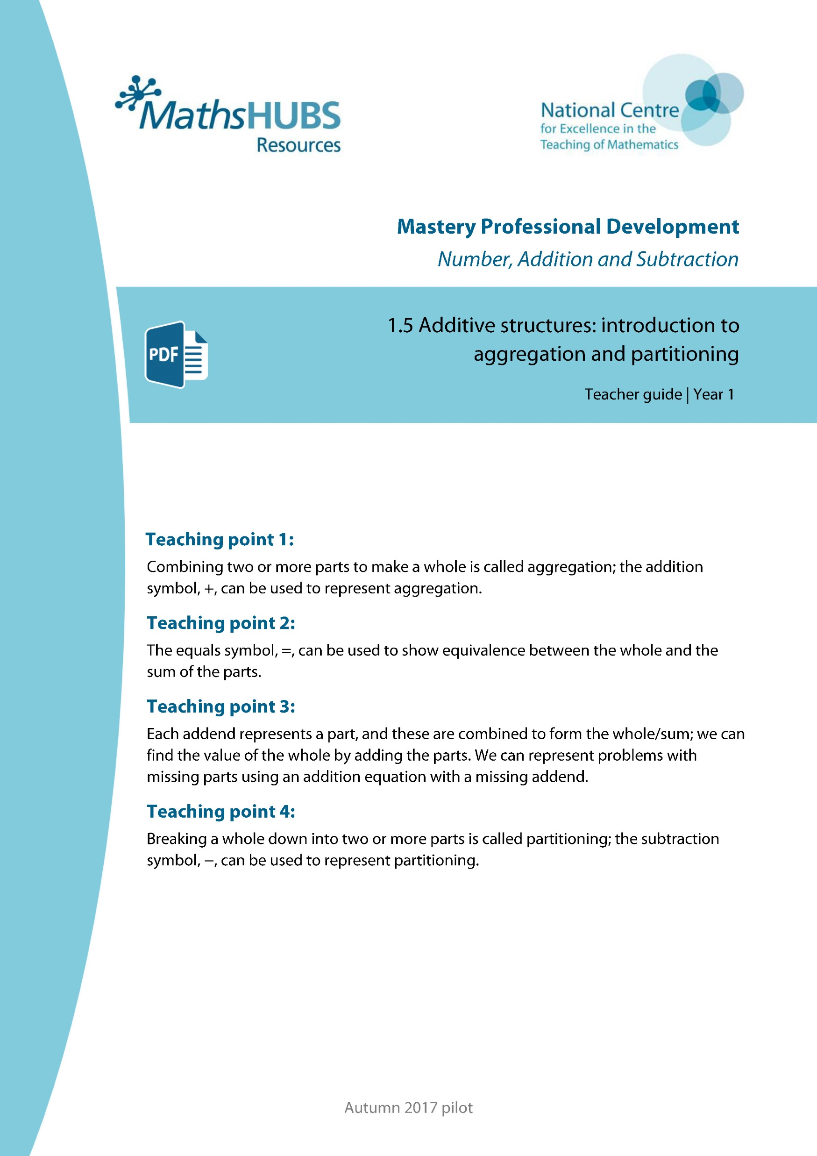
Year 1, Unit 6, Learning Outcome 1
Additional teacher guidance for this outcome should be read first and can be found in this segment of the NCETM Primary Mastery Professional Development Materials:
1.5 Additive structures: introduction to aggregation and partitioning
The spine materials are divided into ‘teaching points’ and ‘steps in learning’.
Teaching point | Steps in learning | Pages
1 | 1:1-1:3 | 3-6

Slide 8
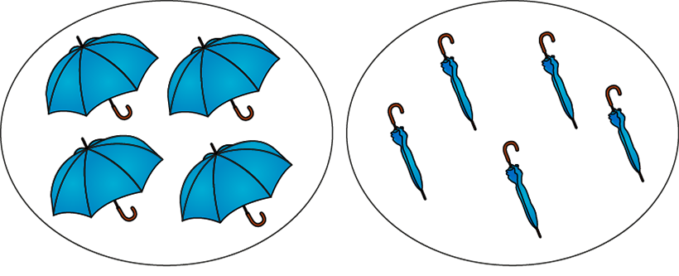
1.5 Aggregation and partitioning – step 1:1
4
+
5

Slide 9


1.5 Aggregation and partitioning – step 1:2
3
+
2

Slide 10

1.5 Aggregation and partitioning – step 1:2
2
+
4
4
+
2

Slide 11

1.5 Aggregation and partitioning – step 1:2
4
+
3
3
+
4

Slide 12




1.5 Aggregation and partitioning – step 1:3
5
+
2
2
+
5

Slide 13
Year 1, Unit 6, Learning Outcome 2
Learning Outcome 2
Pupils explain that addends can be represented in any order. This is called the commutative law.
The following slides have been collated to support the teaching of this learning outcome.

Slide 14
Year 1, Unit 6, Learning Outcome 2
Additional teacher guidance for this outcome should be read first and can be found in this segment of the NCETM Primary Mastery Professional Development Materials:
1.5 Additive structures: introduction to aggregation and partitioning
The spine materials are divided into ‘teaching points’ and ‘steps in learning’.
Teaching point | Steps in learning | Pages
1 | 1:4-1:6 | 6-8

Slide 15
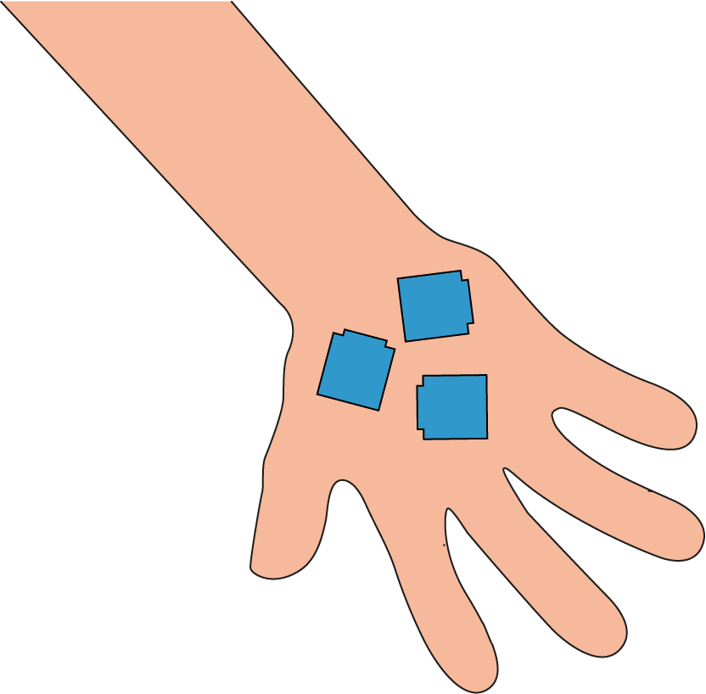
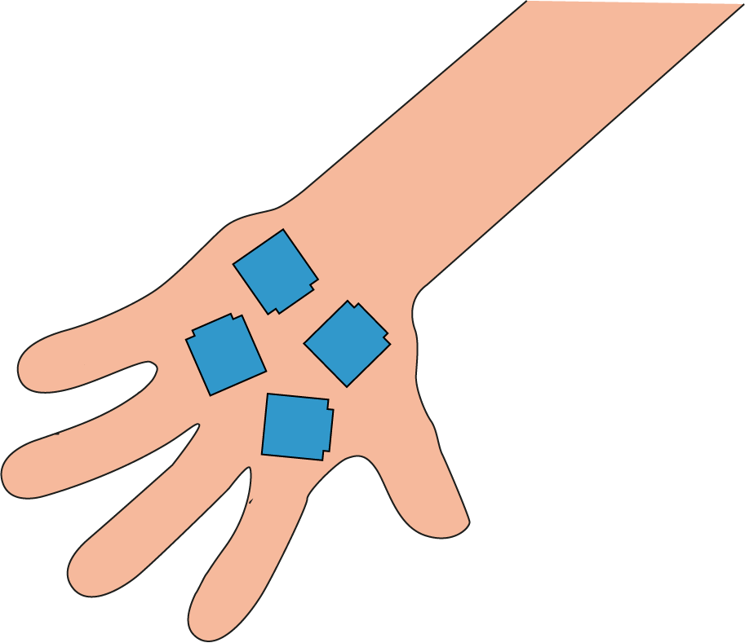
1.5 Aggregation and partitioning – step 1:4
3
+
4

Slide 16
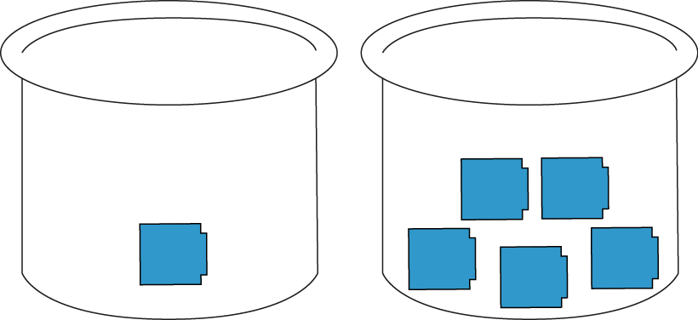
1.5 Aggregation and partitioning – step 1:4
1
+
5
5
+
1

Slide 17







1.5 Aggregation and partitioning – step 1:6
2
5
+
+
5
5
2
4
+
+
3
2
3
+
4
2
+
5

Slide 18
Year 1, Unit 6, Learning Outcome 3
Learning Outcome 3
Pupils explain that the = sign can be used to show that the whole and the sum of the parts are equal (1)
The following slides have been collated to support the teaching of this learning outcome.

Slide 19
Year 1, Unit 6, Learning Outcome 3
Additional teacher guidance for this outcome should be read first and can be found in this segment of the NCETM Primary Mastery Professional Development Materials:
1.5 Additive structures: introduction to aggregation and partitioning
The spine materials are divided into ‘teaching points’ and ‘steps in learning’.
Teaching point | Steps in learning | Pages
2 | 2:1-2:3 | 9-11

Slide 20





1.5 Aggregation and partitioning – step 2:1
5
=
2
+
3
2
+
3
=
5

Slide 21
1.5 Aggregation and partitioning – step 2:1
2
3
5
+
+
=
3
2
3
=
=
+
5
5
2

Slide 22
1.5 Aggregation and partitioning – step 2:1
2
2
+
+
5
5
3
=
5
4
+
+
3
2
5
=
2
+
3
3
+
2
=
5
5
=
3
=
2

Slide 23
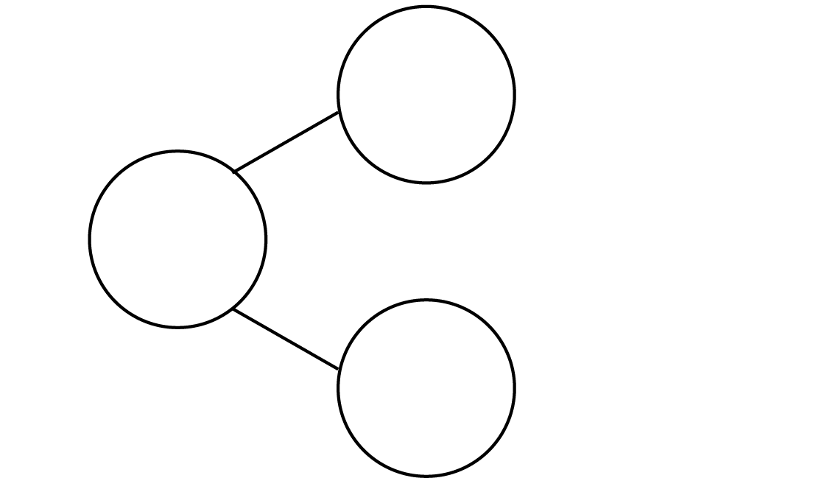





1.5 Aggregation and partitioning – step 2:2
3
5
2

Slide 24
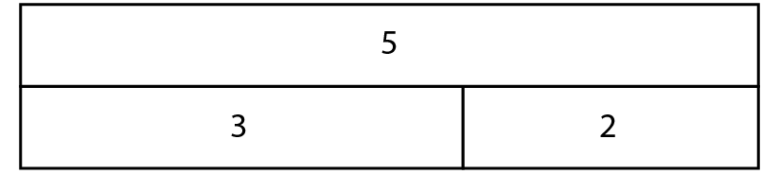


1.5 Aggregation and partitioning – step 2:2
5
3
2

Slide 25
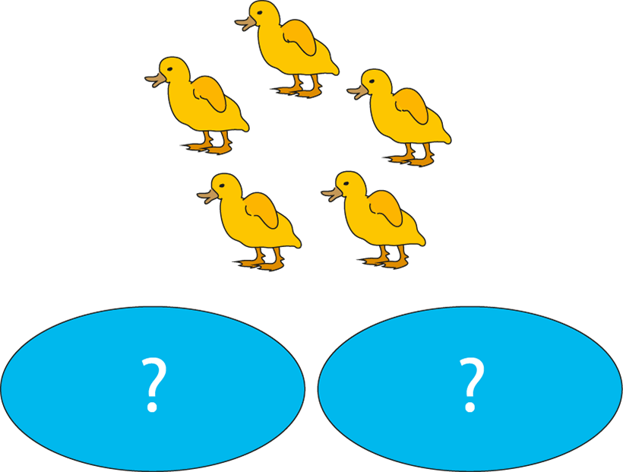
1.5 Aggregation and partitioning – step 2:3

Slide 26
Year 1, Unit 6, Learning Outcome 4
Learning Outcome 4
Pupils explain that the = sign can be used to show that the whole and the sum of the parts are equal (2)
The following slides have been collated to support the teaching of this learning outcome.

Slide 27
Year 1, Unit 6, Learning Outcome 4
Additional teacher guidance for this outcome should be read first and can be found in this segment of the NCETM Primary Mastery Professional Development Materials:
1.5 Additive structures: introduction to aggregation and partitioning
The spine materials are divided into ‘teaching points’ and ‘steps in learning’.
Teaching point | Steps in learning | Pages
2 | 2:4-2:6 | 11-12

Slide 28


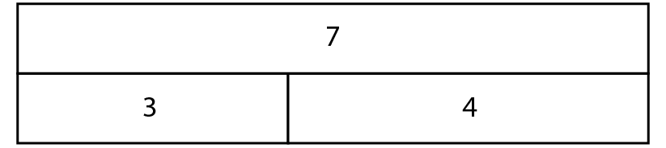
1.5 Aggregation and partitioning – step 2:4

Slide 29



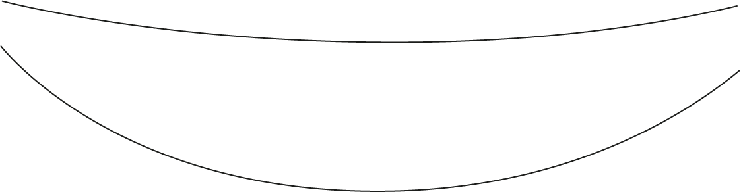






1.5 Aggregation and partitioning – step 2:6
9
4
9
=
+
=
3
5
3
+
=
+
6
9
2
6
9
+
=
3
3
=
+
5
6
4
+
5
=
9

Slide 30
Year 1, Unit 6, Learning Outcome 5
Learning Outcome 5
Pupils add parts to find the value of the whole and write the equation
The following slides have been collated to support the teaching of this learning outcome.

Slide 31
Year 1, Unit 6, Learning Outcome 5
Additional teacher guidance for this outcome should be read first and can be found in this segment of the NCETM Primary Mastery Professional Development Materials:
1.5 Additive structures: introduction to aggregation and partitioning
The spine materials are divided into ‘teaching points’ and ‘steps in learning’.
Teaching point | Steps in learning | Pages
3 | 3:1-3:3 | 13-15

Slide 32
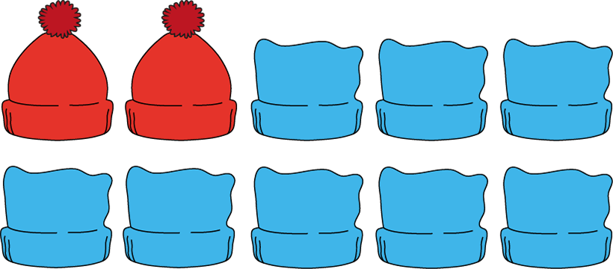

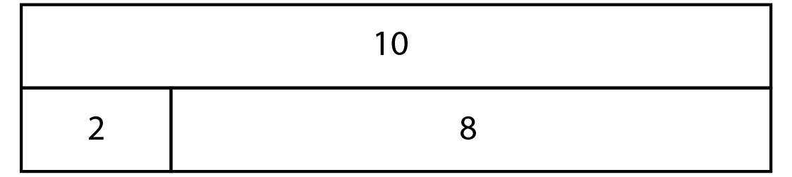
1.5 Aggregation and partitioning – step 3:1
?
?

Slide 33

1.5 Aggregation and partitioning – step 3:2
8
3
5

Slide 34

1.5 Aggregation and partitioning – step 3:2
3
+
5
=
8
5
+
3
=
8
8
=
3
+
5
8
=
5
+
3

Slide 35
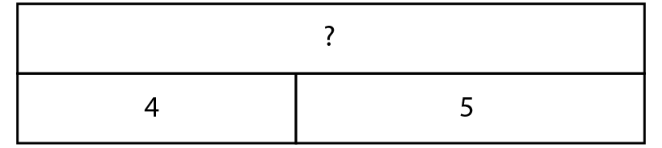
1.5 Aggregation and partitioning – step 3:2

Slide 36


1.5 Aggregation and partitioning – step 3:2
4
+
5
=
9
5
+
4
=
9
9
=
4
+
5
9
=
5
+
4

Slide 37

1.5 Aggregation and partitioning – step 3:3
3
+
3
=
6
4
+
3
=
7
5
=
4
+
1
8
=
4
+
3

Slide 38
Year 1, Unit 6, Learning Outcome 6
Learning Outcome 6
Pupils find the missing addend in an equation
The following slides have been collated to support the teaching of this learning outcome.

Slide 39
Year 1, Unit 6, Learning Outcome 6
Additional teacher guidance for this outcome should be read first and can be found in this segment of the NCETM Primary Mastery Professional Development Materials:
1.5 Additive structures: introduction to aggregation and partitioning
The spine materials are divided into ‘teaching points’ and ‘steps in learning’.
Teaching point | Steps in learning | Pages
3 | 3:4-3:6 | 15-17

Slide 40






1.5 Aggregation and partitioning – step 3:4
5
=
5
+
0
5
=
4
+
1
5
=
3
+
2
5
=
2
+
3
5
=
1
+
4
5
=
0
+
5

Slide 41
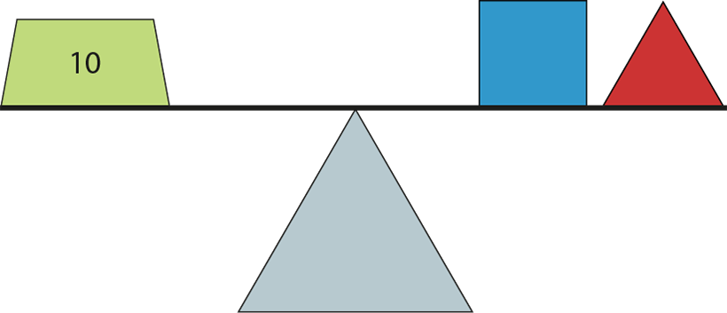
1.5 Aggregation and partitioning – step 3:6

Slide 42
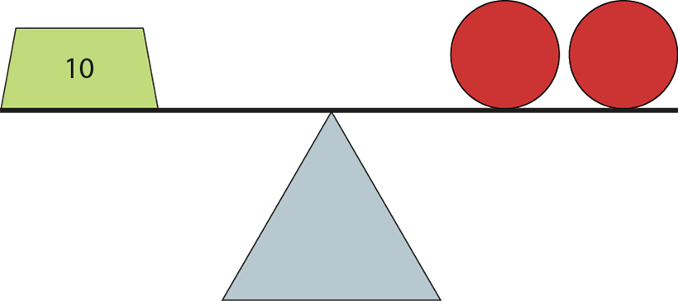
1.5 Aggregation and partitioning – step 3:6
5
5
10
=
5
+
5

Slide 43
Year 1, Unit 6, Learning Outcome 7
Learning Outcome 7
Pupils partition a whole into two parts and express this with a subtraction equation
The following slides have been collated to support the teaching of this learning outcome.

Slide 44
Year 1, Unit 6, Learning Outcome 7
Additional teacher guidance for this outcome should be read first and can be found in this segment of the NCETM Primary Mastery Professional Development Materials:
1.5 Additive structures: introduction to aggregation and partitioning
The spine materials are divided into ‘teaching points’ and ‘steps in learning’.
Teaching point | Steps in learning | Pages
4 | 4:1-4:3 | 18-20

Slide 45


1.5 Aggregation and partitioning – step 4:1
5
?
3

Slide 46






1.5 Aggregation and partitioning – step 4:2
6
−
2
=
4

Slide 47
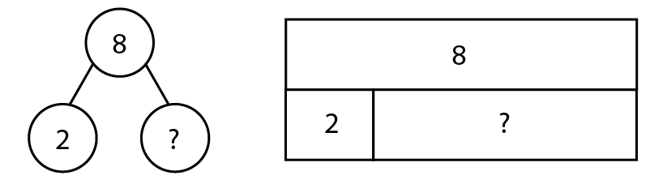
1.5 Aggregation and partitioning – step 4:3
8
8
2
6
?
?
2
6
8
−
2
=
?
6

Slide 48
Year 1, Unit 6, Learning Outcome 8
Learning Outcome 8
Pupils make addition and subtraction stories and write equations to match
The following slides have been collated to support the teaching of this learning outcome.

Slide 49
Year 1, Unit 6, Learning Outcome 8
Additional teacher guidance for this outcome should be read first and can be found in this segment of the NCETM Primary Mastery Professional Development Materials:
1.5 Additive structures: introduction to aggregation and partitioning
The spine materials are divided into ‘teaching points’ and ‘steps in learning’.
Teaching point | Steps in learning | Pages
4 | 4:4 | 20-21

Slide 50


1.5 Aggregation and partitioning – step 4:4
Putting together
Taking apart
Addition
Subtraction

Slide 51
1AS-2 Read, write and interpret additive equations
We can use addition and subtraction when we combine and partition the same set of objects.
Look at how the cakes have been partitioned.
What is the whole if we combine them again?
Partitioning and combining undo each other!
3
5
2

Slide 52
1AS-2 Read, write and interpret additive equations
Now we can use addition and subtraction equations to tell us about number stories for combining and partitioning!
Can you read each equation using the correct words: plus, minus, is equal to?
Can you describe each equation? What does each number represent? Does it tell us about a partitioning or combining story?
2 + 3 = 5
3 + 2 = 5
5 – 3 = 2
5 – 2 = 3

Slide 53

1.5 Aggregation and partitioning – step 4:4

Slide 54
Year 1, Unit 6, Learning Outcome 9
Learning Outcome 9
Pupils represent ‘first, then, now’ stories with addition equations (1)
The following slides have been collated to support the teaching of this learning outcome.

Slide 55
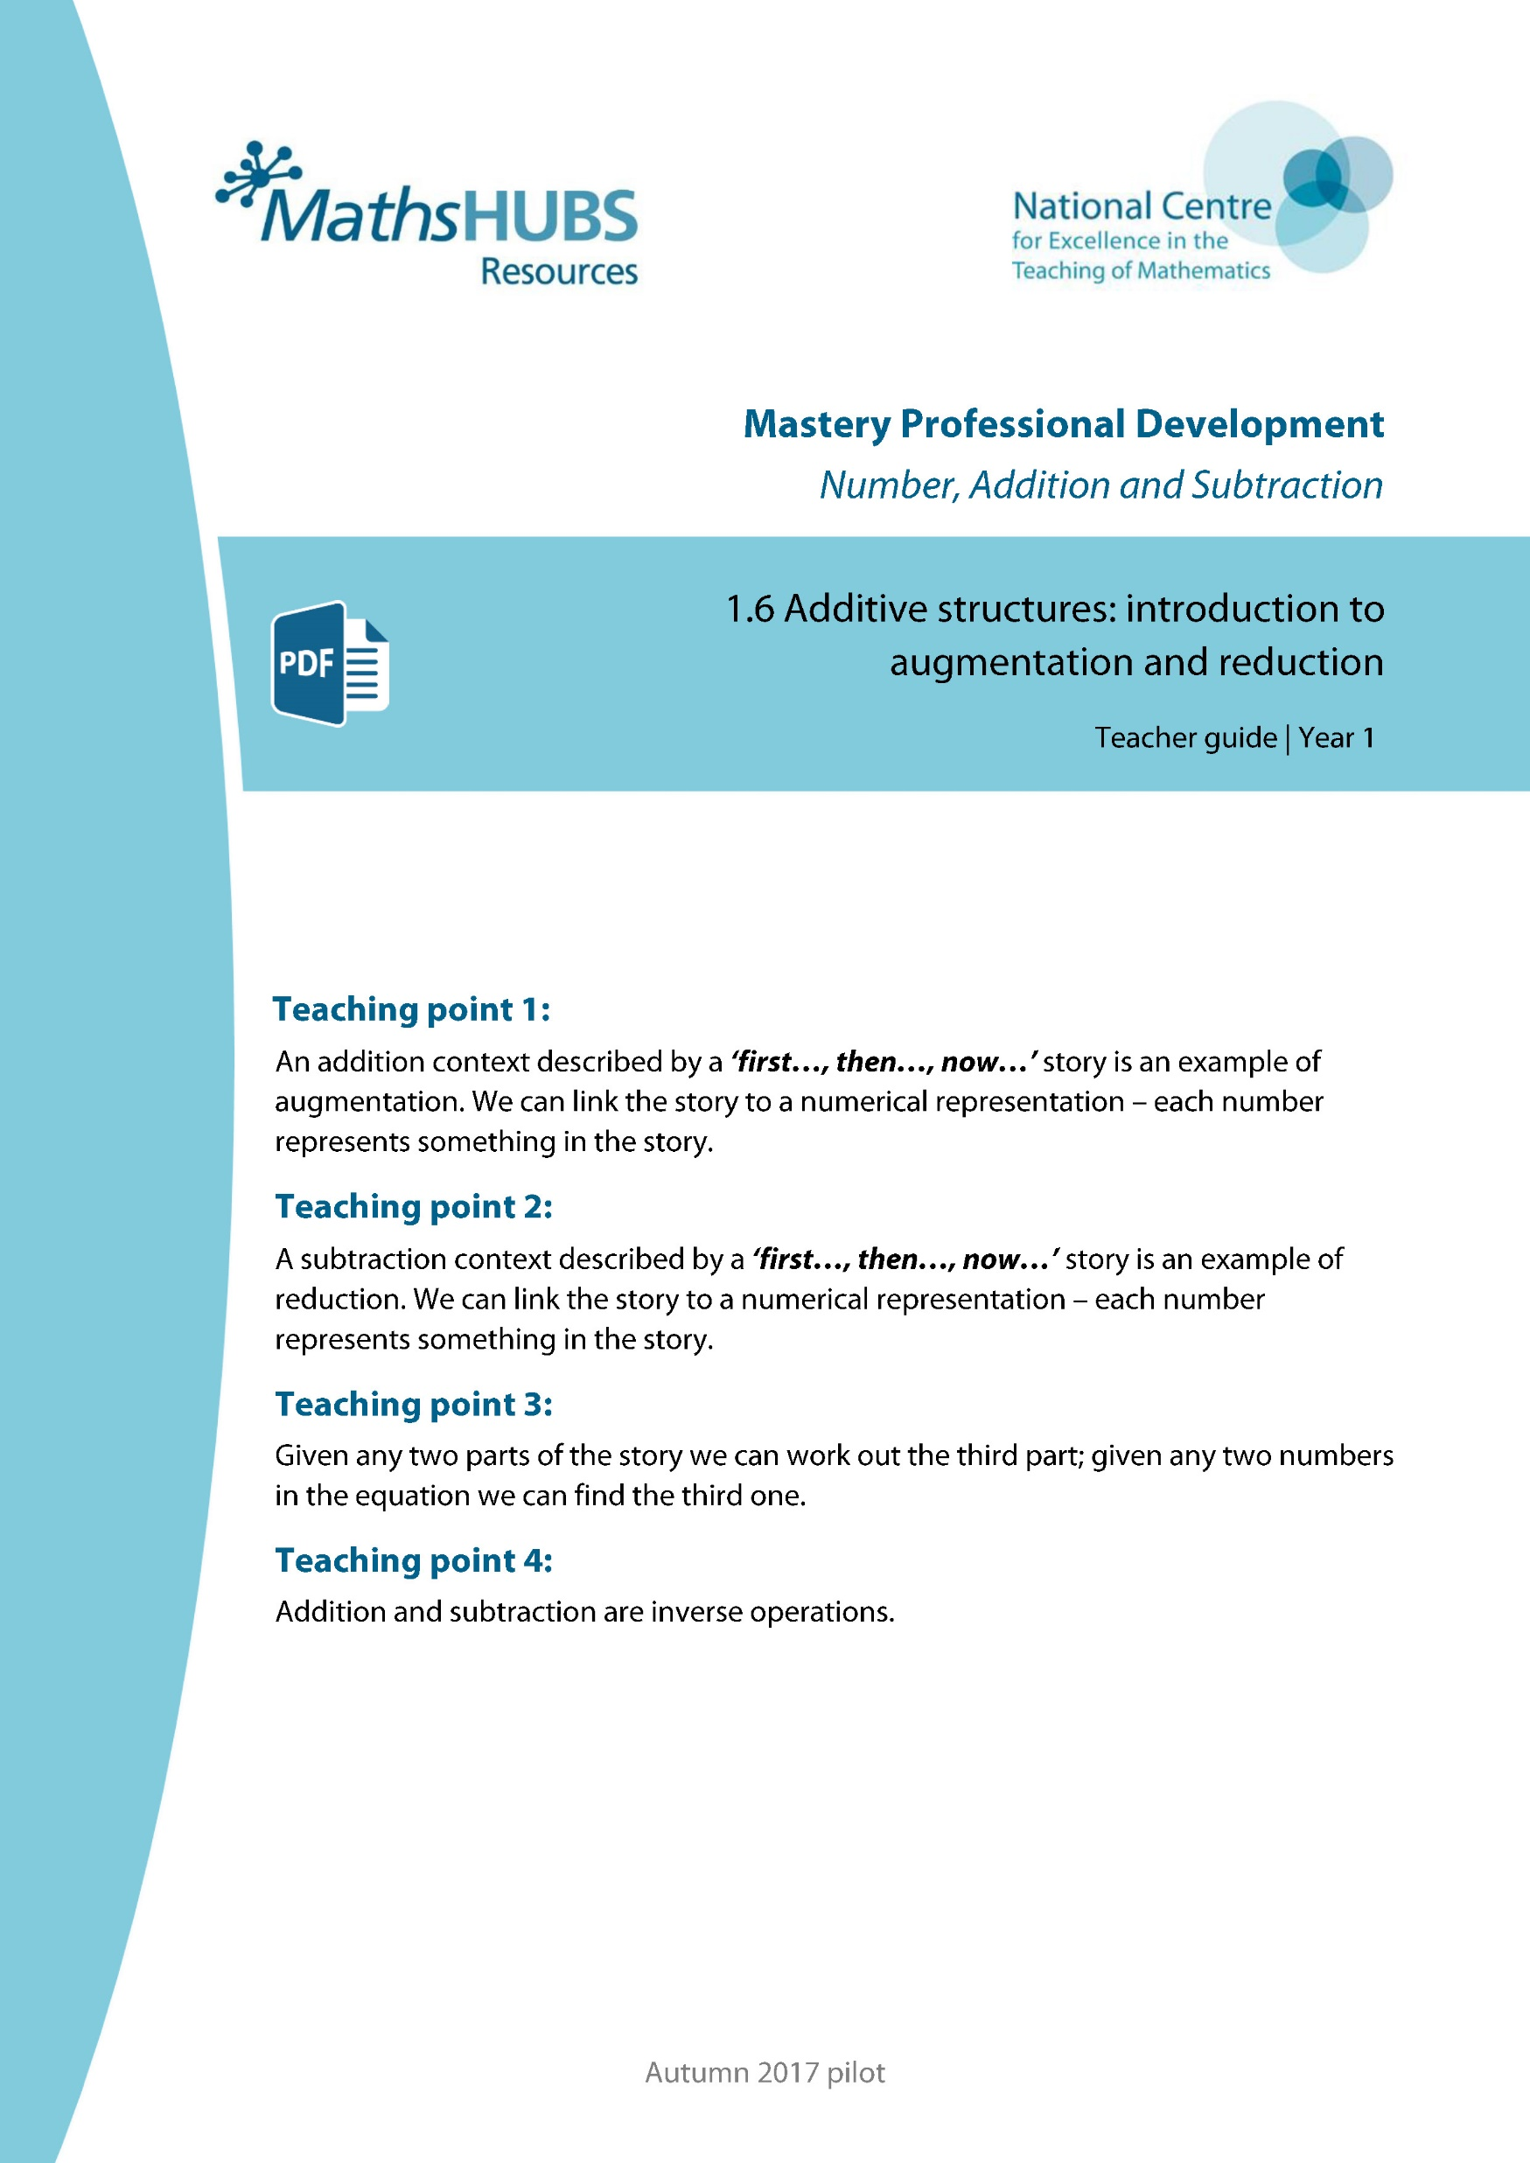
Year 1, Unit 6, Learning Outcome 9
Additional teacher guidance for this outcome should be read first and can be found in this segment of the NCETM Primary Mastery Professional Development Materials:
1.6 Additive structures: introduction to augmentation and reduction
The spine materials are divided into ‘teaching points’ and ‘steps in learning’.
Teaching point | Steps in learning | Pages
1 | 1:1-1:6 | 3-6

Slide 56

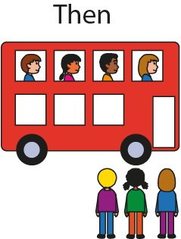

1AS-2 Read, write and interpret additive equations
Now
Look at the picture - how many people are on the bus at first?
What happens then? Do you think the number of people on the bus will change when the other children get on?
How many people are on the bus now?
Do you think this is an addition or subtraction story? Let’s use equations to record some first, then, now addition stories.
Then
First
Addition can tell us about a quantity increasing.

Slide 57



1.6 Augmentation and reduction – steps 1:2–1:3

Slide 58
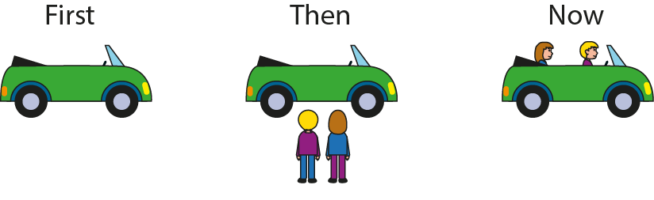


1.6 Augmentation and reduction – step 1:4

Slide 59
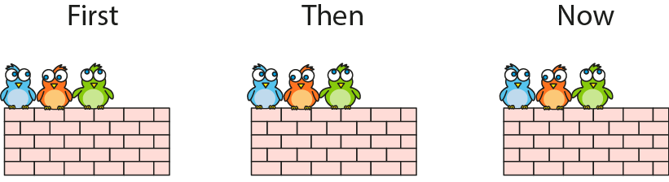

1.6 Augmentation and reduction – step 1:4

Slide 60
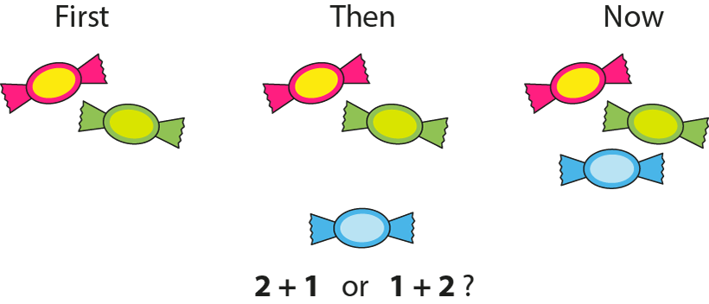
1AS-2 Read, write and interpret additive equations
2
+ 1
3
2 + 1 = 3

Slide 61
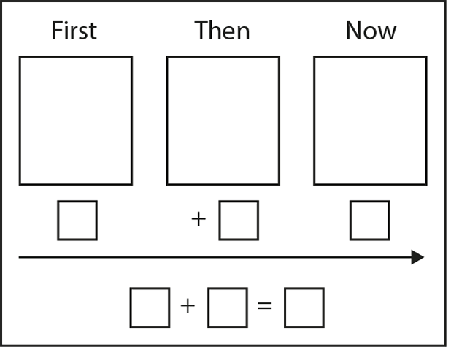
1.6 Augmentation and reduction – step 1:5

Slide 62

1.6 Augmentation and reduction – step 1:5

Slide 63
1.6 Augmentation and reduction – step 1:6

Slide 64
Year 1, Unit 6, Learning Outcome 10
Learning Outcome 10
Pupils represent ‘first, then, now’ stories with addition equations (2)
The following slides have been collated to support the teaching of this learning outcome.

Slide 65
Year 1, Unit 6, Learning Outcome 10
Additional teacher guidance for this outcome should be read first and can be found in this segment of the NCETM Primary Mastery Professional Development Materials:
1.6 Additive structures: introduction to augmentation and reduction
The spine materials are divided into ‘teaching points’ and ‘steps in learning’.
Teaching point | Steps in learning | Pages
1 | 1:7 | 6-7

Slide 66
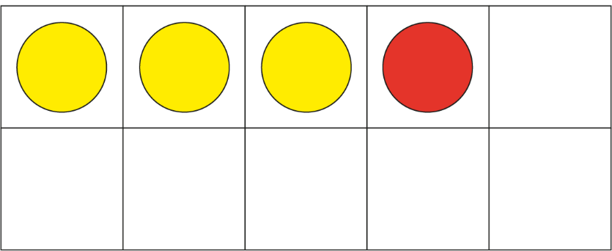




1.6 Augmentation and reduction – step 1:7
3 + 1 = 4
Notes:
First, James wrote three sentences. Then, he wrote one more sentence. Now, he has four sentences written down.

Slide 67
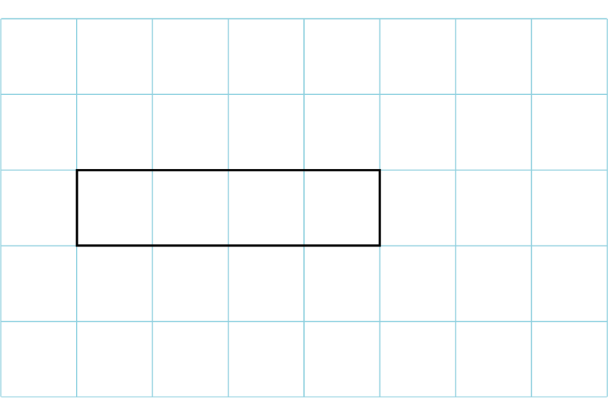





1.6 Augmentation and reduction – step 1:7
4 + 2 = 6
Notes:
First, Sarah had four pounds. Then, she was given two pounds more. Now, she has six pounds.

Slide 68


1.6 Augmentation and reduction – step 1:7
2 + 3 = 5
Notes:
At first, the tower was two bricks tall. Then, three more bricks were added. Now, the tower is five bricks tall.

Slide 69
Year 1, Unit 6, Learning Outcome 11
Learning Outcome 11
Pupils represent ‘first, then, now’ stories with subtraction equations (1)
The following slides have been collated to support the teaching of this learning outcome.

Slide 70
Year 1, Unit 6, Learning Outcome 11
Additional teacher guidance for this outcome should be read first and can be found in this segment of the NCETM Primary Mastery Professional Development Materials:
1.6 Additive structures: introduction to augmentation and reduction
The spine materials are divided into ‘teaching points’ and ‘steps in learning’.
Teaching point | Steps in learning | Pages
2 | 2:1-2:6 | 8-10

Slide 71



1AS-2 Read, write and interpret additive equations
Look at the children in the car at first.
What happens then? How many are in the car now?
Is this an addition or subtraction story?
Try acting out the story!
Can you write a subtraction equation to match this first, then, now story?
Say what each number and sign means.
Now
First
Then
Subtraction can tell us about taking away
We can write this as 4 minus 1 is equal to 3.

Slide 72
1.6 Augmentation and reduction – step 2:2

Slide 73

1.6 Augmentation and reduction – step 2:3

Slide 74



1.6 Augmentation and reduction – step 2:4

Slide 75




1.6 Augmentation and reduction – step 2:4

Slide 76

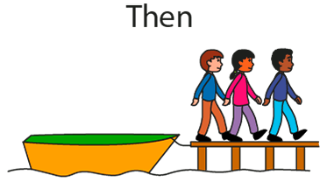
1.6 Augmentation and reduction – step 2:4

Slide 77
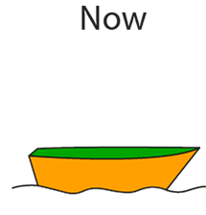


1.6 Augmentation and reduction – step 2:4
3 – 3 = 0

Slide 78
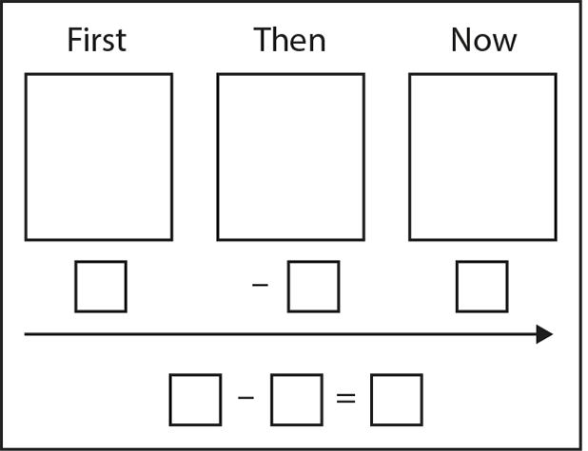
1.6 Augmentation and reduction – step 2:5

Slide 79
1.6 Augmentation and reduction – step 2:5

Slide 80
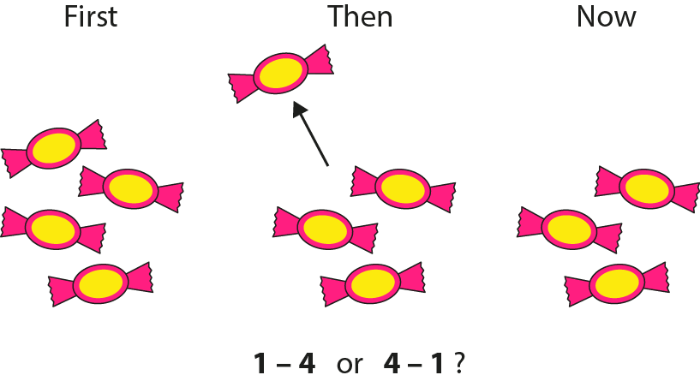
1.6 Augmentation and reduction – step 2:6

Slide 81
Year 1, Unit 6, Learning Outcome 12
Learning Outcome 12
Pupils represent ‘first, then, now’ stories with subtraction equations (2)
The following slide supports the teaching of this learning outcome.

Slide 82
Year 1, Unit 6, Learning Outcome 12
Additional teacher guidance for this outcome should be read first and can be found in this segment of the NCETM Primary Mastery Professional Development Materials:
1.6 Additive structures: introduction to augmentation and reduction
The spine materials are divided into ‘teaching points’ and ‘steps in learning’.
Teaching point | Steps in learning | Pages
2 | 2:7 | 11

Slide 83
1AS-2 Read, write and interpret additive equations
It’s your turn to practise telling some first, then, now stories for subtraction!
Use a set of objects (e.g. toy cars in a car-park, animals in a field, bears on a picnic rug) and make up and tell your own simple story.
See if you can record your story in different ways - as a picture and as an equation. Make sure you say what each number and symbol means.

Slide 84
Year 1, Unit 6, Learning Outcome 13
Learning Outcome 13
Pupils represent different types of stories with subtraction calculations
The following slides have been collated to support the teaching of this learning outcome.

Slide 85
Year 1, Unit 6, Learning Outcome 13
Additional teacher guidance for this outcome should be read first and can be found in this segment of the NCETM Primary Mastery Professional Development Materials:
1.6 Additive structures: introduction to augmentation and reduction
The spine materials are divided into ‘teaching points’ and ‘steps in learning’.
Teaching point | Steps in learning | Pages
2 | 2:8 | 11

Slide 86
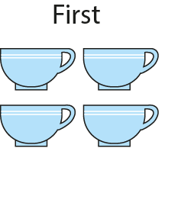
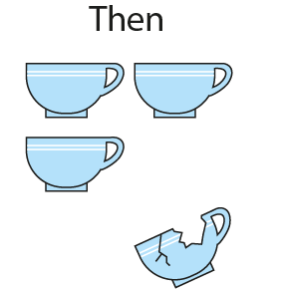
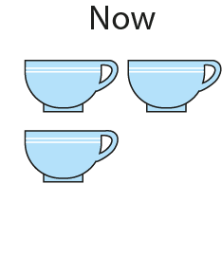


1.6 Augmentation and reduction – step 2:8

Slide 87

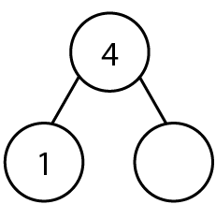


1.6 Augmentation and reduction – step 2:8
3

Slide 88
Year 1, Unit 6, Learning Outcome 14
Learning Outcome 14
Pupils make addition and subtraction stories, writing equations to match
The following slides have been collated to support the teaching of this learning outcome.

Slide 89
Year 1, Unit 6, Learning Outcome 14
Additional teacher guidance for this outcome should be read first and can be found in this segment of the NCETM Primary Mastery Professional Development Materials:
1.6 Additive structures: introduction to augmentation and reduction
The spine materials are divided into ‘teaching points’ and ‘steps in learning’.
Teaching point | Steps in learning | Pages
2 | 2:9 | 12

Slide 90
1AS-2 Read, write and interpret additive equations
It’s your turn to practise telling some first, then, now stories for addition!
Use a set of objects (e.g. toy cars in a car-park, animals in a field, bears on a picnic rug) and make up and tell your own simple story.
See if you can record your story in different ways - as a picture and as an equation. Make sure you say what each number and symbol means.
+
+

Slide 91
1AS-2 Read, write and interpret additive equations
It’s your turn to practise telling some first, then, now stories for subtraction!
Use a set of objects (e.g. toy cars in a car-park, animals in a field, bears on a picnic rug) and make up and tell your own simple story.
See if you can record your story in different ways - as a picture and as an equation. Make sure you say what each number and symbol means.

Slide 92
Year 1, Unit 6, Learning Outcome 15
Learning Outcome 15
Pupils work out the missing part of an addition story and equation if the other two parts are known
The following slides have been collated to support the teaching of this learning outcome.

Slide 93
Year 1, Unit 6, Learning Outcome 15
Additional teacher guidance for this outcome should be read first and can be found in this segment of the NCETM Primary Mastery Professional Development Materials:
1.6 Additive structures: introduction to augmentation and reduction
The spine materials are divided into ‘teaching points’ and ‘steps in learning’.
Teaching point | Steps in learning | Pages
3 | 3:1 and 3:3-3:4 | 13-15

Slide 94
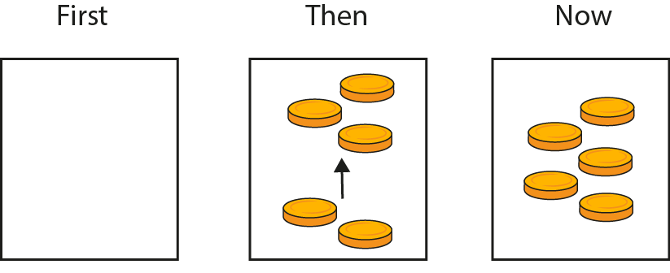




1.6 Augmentation and reduction – step 3:1
?
?
3
?
3

Slide 95
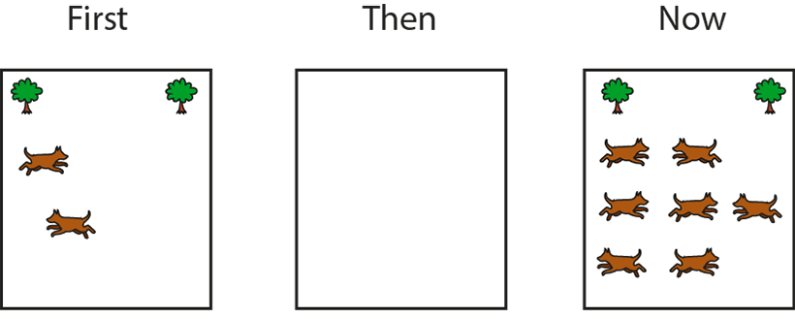






1.6 Augmentation and reduction – step 3:1
?
5
?
?
5

Slide 96
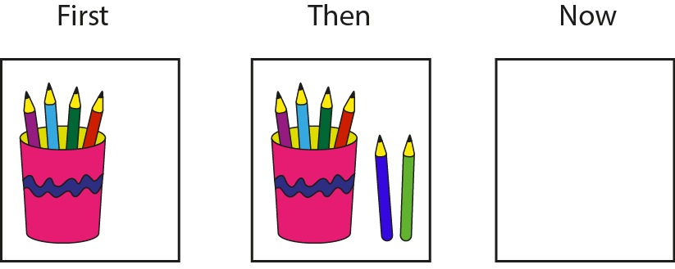





1.6 Augmentation and reduction – step 3:1
?
?
6
?
6

Slide 97
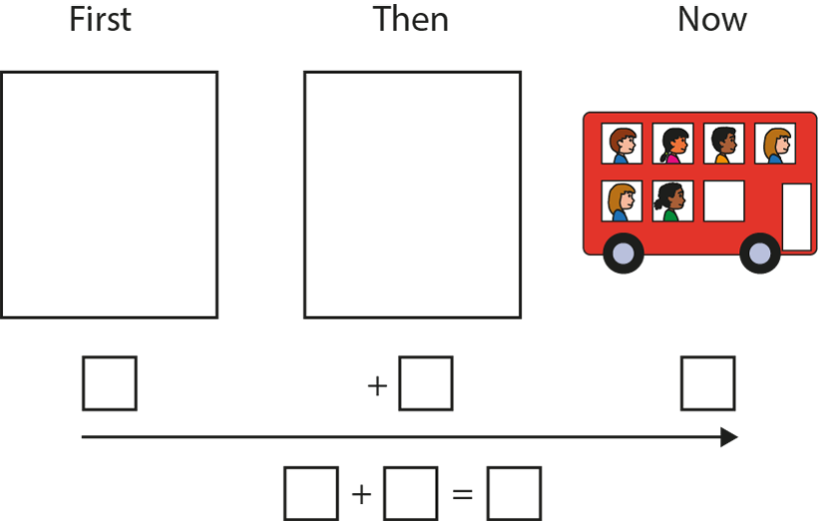
1.6 Augmentation and reduction – step 3:4
Can you write a story that ends with six children on the bus?

Slide 98
Year 1, Unit 6, Learning Outcome 16
Learning Outcome 16
Pupils work out the missing part of a subtraction story and equation if the other two parts are known
The following slide supports the teaching of this learning outcome.

Slide 99
Year 1, Unit 6, Learning Outcome 16
Additional teacher guidance for this outcome should be read first and can be found in this segment of the NCETM Primary Mastery Professional Development Materials:
1.6 Additive structures: introduction to augmentation and reduction
The spine materials are divided into ‘teaching points’ and ‘steps in learning’.
Teaching point | Steps in learning | Pages
3 | 3:2-3:4 | 13-15

Slide 100
Year 1, Unit 6, Learning Outcome 17
Learning Outcome 17
Pupils explain that addition and subtraction are inverse operations (1)
The following slides have been collated to support the teaching of this learning outcome.

Slide 101
Year 1, Unit 6, Learning Outcome 17
Additional teacher guidance for this outcome should be read first and can be found in this segment of the NCETM Primary Mastery Professional Development Materials:
1.6 Additive structures: introduction to augmentation and reduction
The spine materials are divided into ‘teaching points’ and ‘steps in learning’.
Teaching point | Steps in learning | Pages
4 | 4:1-4:4 | 16-18

Slide 102
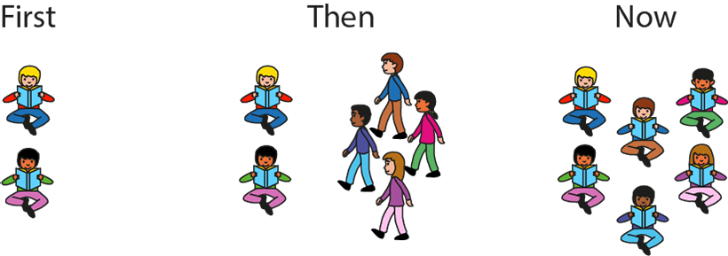
1.6 Augmentation and reduction – step 4:2

Slide 103
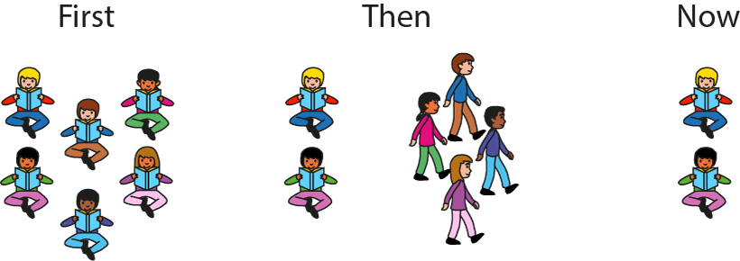
1.6 Augmentation and reduction – step 4:2

Slide 104
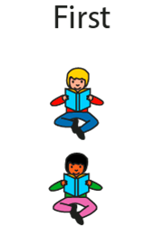
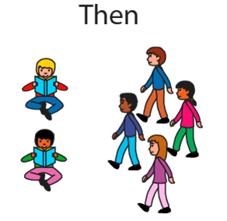
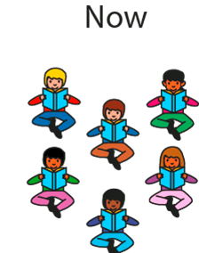


1.6 Augmentation and reduction – step 4:3

Slide 105
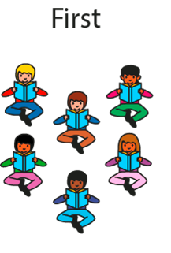
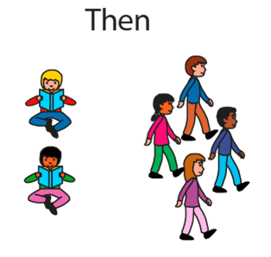





1.6 Augmentation and reduction – step 4:3

Slide 106




1.6 Augmentation and reduction – step 4:3

Slide 107
Year 1, Unit 6, Learning Outcome 18
Learning Outcome 18
Pupils explain that addition and subtraction are inverse operations (2)
The following slides have been collated to support the teaching of this learning outcome.

Slide 108
Year 1, Unit 6, Learning Outcome 18
Additional teacher guidance for this outcome should be read first and can be found in this segment of the NCETM Primary Mastery Professional Development Materials:
1.6 Additive structures: introduction to augmentation and reduction
The spine materials are divided into ‘teaching points’ and ‘steps in learning’.
Teaching point | Steps in learning | Pages
4 | 4:5-4:6 | 18-20

Slide 109






1.6 Augmentation and reduction – step 4:5
6
8
Notes:
First, there were six apples in the bowl. Then, two apples were added to the bowl. Now, there are eight apples in the bowl. Then, two apples were taken out of the bowl. Now, there are six apples in the bowl.

Slide 110




1.6 Augmentation and reduction – step 4:5
Notes:
First, there were three marbles in the jar. Then, two marbles were put into the jar. Now, there are five marbles in the jar. Then, two marbles were taken out of the jar. Now, there are three marbles in the jar.

Slide 111


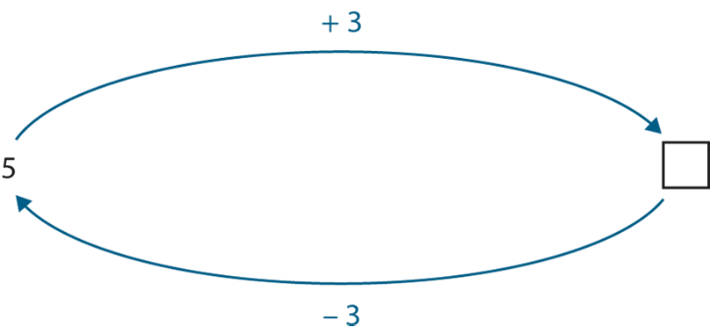
1.6 Augmentation and reduction – step 4:6
8
5
8

Slide 112
Year 1, Unit 6, Learning Outcome 19
Learning Outcome 19
Pupils use additive structures to think about addition and subtraction equations in different ways
The following slides have been collated to support the teaching of this learning outcome.

Slide 113

Year 1, Unit 6, Learning Outcome 19
Additional teacher guidance for this outcome should be read first and can be found in the DfE Mathematics guidance. Page references relate to the 335-page document available as a download at the bottom of this web page.
Ready to progress criteria | Pages
1AS-2 | 36-41

Slide 114
1AS-2 Read, write and interpret additive equations
Complete these calculations. How do you think about them? Do you think about adding on, combining, partitioning or take away?
Can you think of the same equation in different ways?
5 + 2 =
2 + 5 =
9 – 3 =
9 – 4 =
9 – 5 =
6 – 4 =
6 – 5 =
6 + 1 =
6 + 2 =
6 + 3 =
6 + 4 =
6 – 1 =
6 – 2 =
6 – 3 =

