Slide 1
3.8 Common denomination: more adding and subtracting
Representations | Year 5
Fractions

Slide 2
How to use this presentation
You can find the teacher guide 3.8 Common denomination: more adding and subtracting by following the link below.

Slide 3
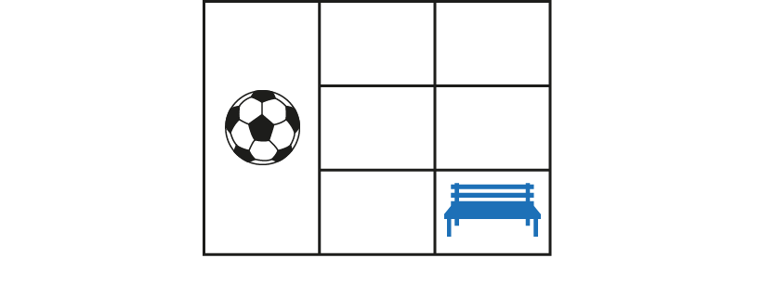
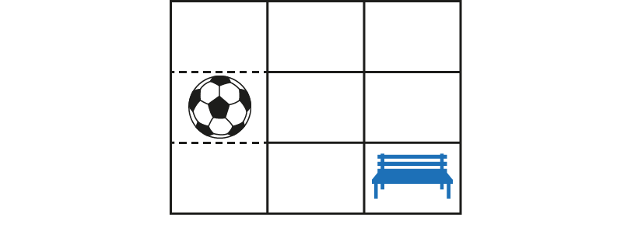
3.8 Common denomination
Step 1:1
Notes:
What fraction of the playground is the ball-game zone?
What fraction of the playground is the quiet zone?
Do we have equal parts?

Slide 4
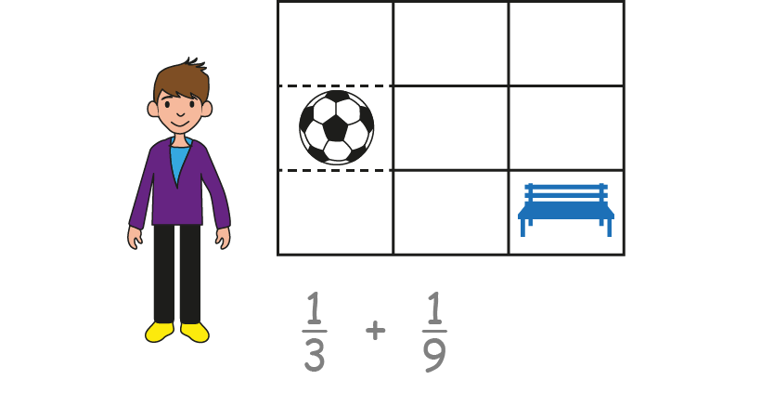
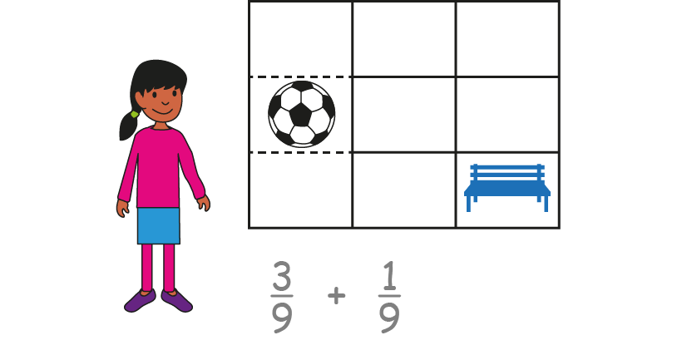
3.8 Common denomination
Step 1:2
Notes:
Will writes this calculation: $\frac{1}{3}+ \frac{1}{9}$
Ella writes this calculation: $\frac{3}{9}+ \frac{1}{9}$
Whose calculation is correct? Can you explain your thoughts, using the diagram to help you?

Slide 5
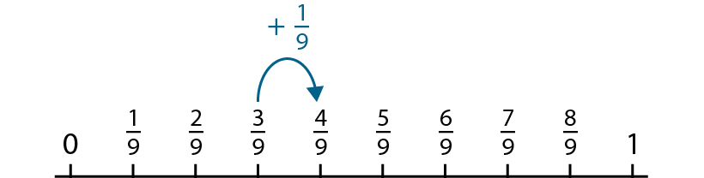
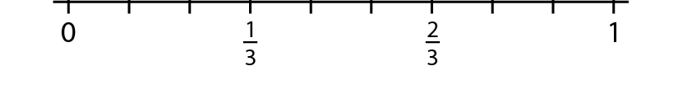
3.8 Common denomination
Step 1:3

Slide 6
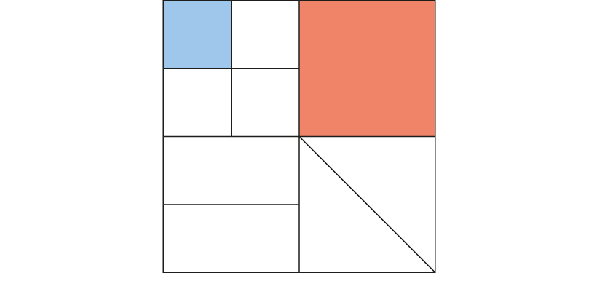
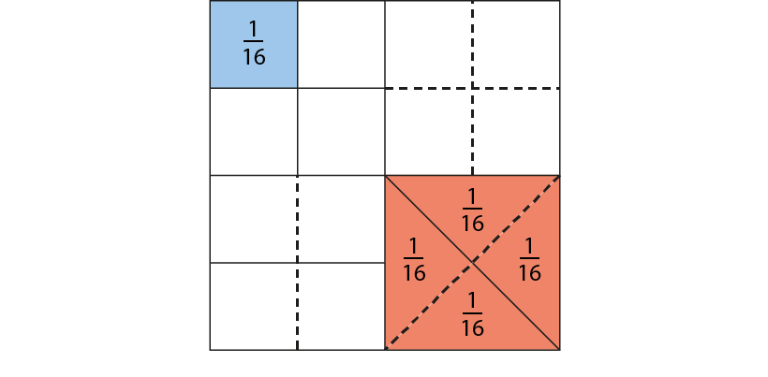
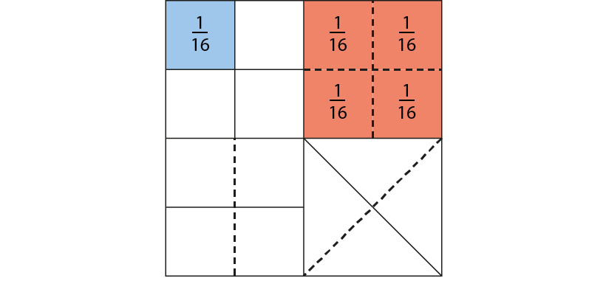
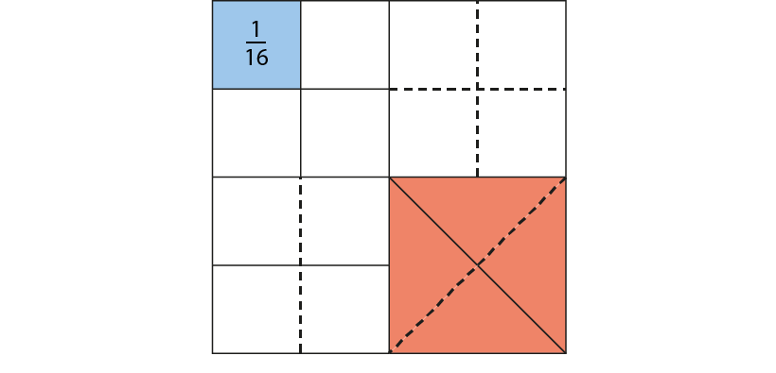

3.8 Common denomination
Step 1:4
Notes:
What fraction of the whole does each of the shaded parts represent?
Can we say what fraction of the whole is shaded altogether?
Can we also say that five-sixteenths of the first diagram is shaded?

Slide 7
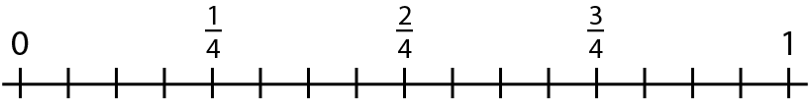


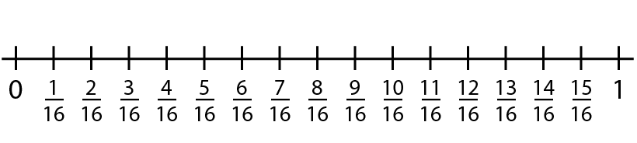
3.8 Common denomination
Step 1:5

Slide 8
3.8 Common denomination
Step 1:6
Notes:
Related fractions have denominators where one denominator is a multiple of the other.

Slide 9
3.8 Common denomination
Step 1:6
Notes:
Related fractions have denominators where one denominator is a multiple of the other.

Slide 10
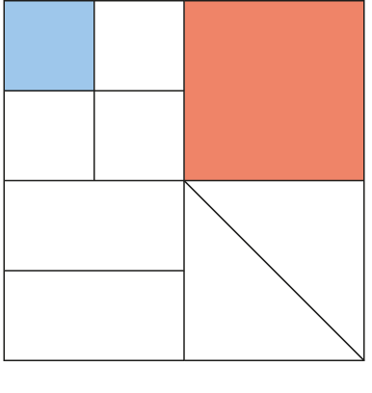
3.8 Common denomination
Step 1:8
Notes:
$\frac{1}{16}$ and $\frac{1}{4}$ are related fractions because the denominator, ’16’, is a multiple of the other denominator, ‘4.’

Slide 11
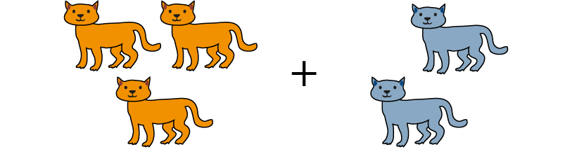
3.8 Common denomination
Step 1:9
Notes:
In order to add a number of things with different names together,
it is necessary to find a name that is common to both things.

Slide 12
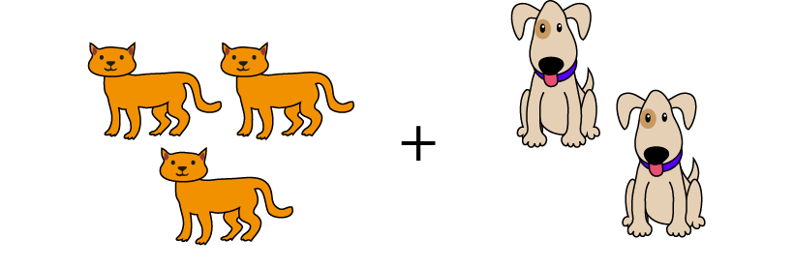
3.8 Common denomination
Step 1:9
Notes:
In order to add a number of things with different names together,
it is necessary to find a name that is common to both things.

Slide 13

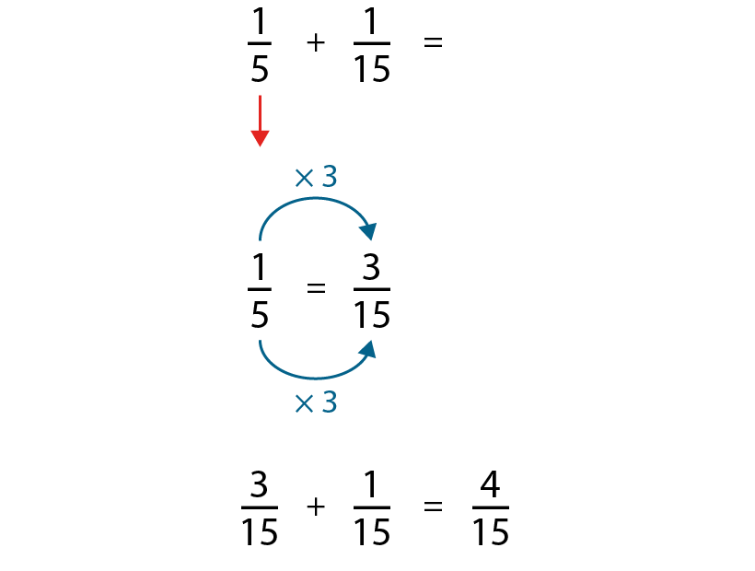
3.8 Common denomination
Step 1:12

Slide 14
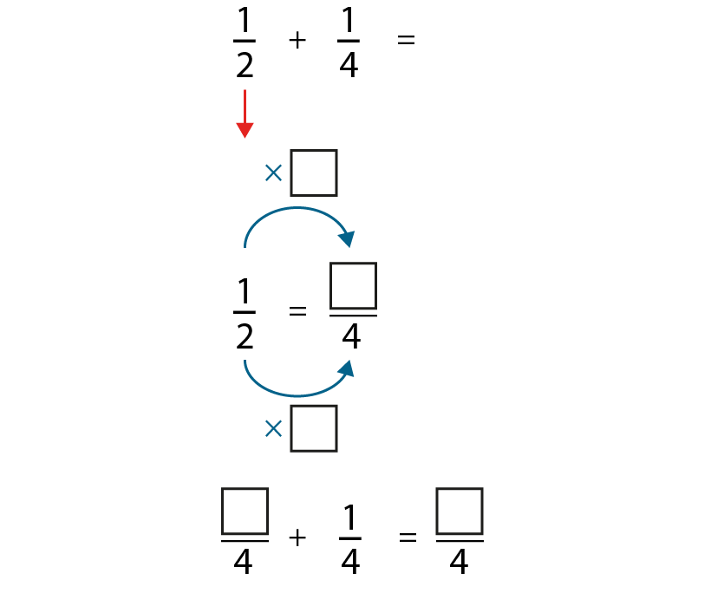
3.8 Common denomination
Step 1:13

Slide 15

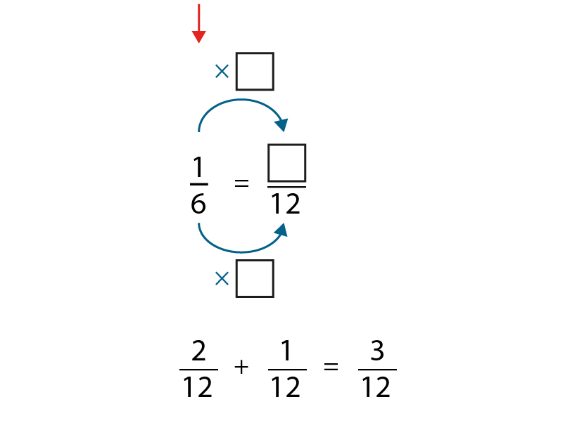
3.8 Common denomination
Step 1:13

Slide 16
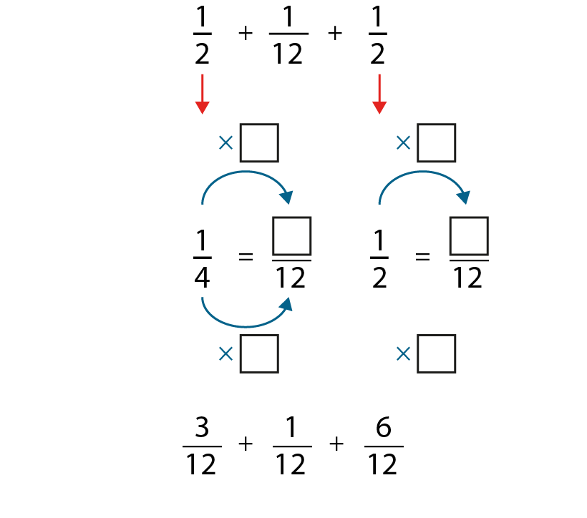



3.8 Common denomination
Step 1:13

Slide 17
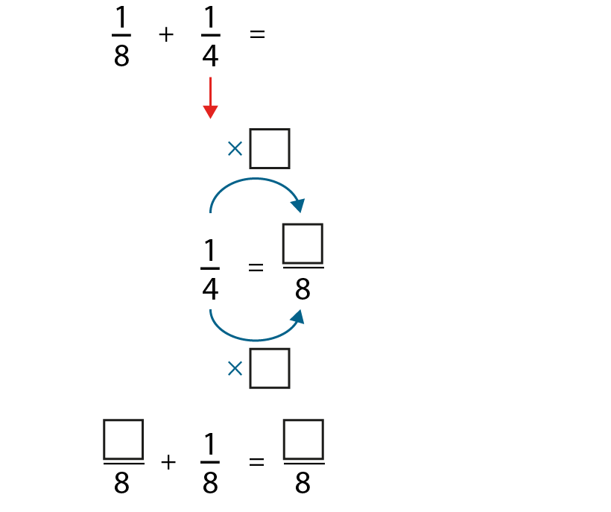


3.8 Common denomination
Step 1:14

Slide 18
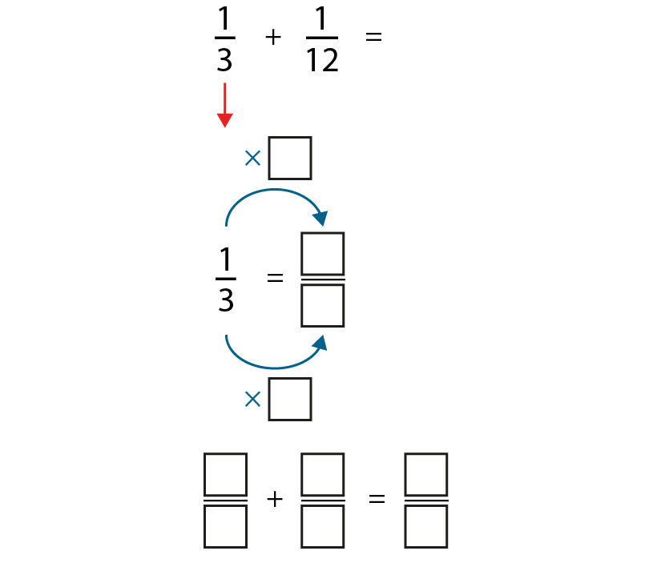
3.8 Common denomination
Step 1:14

Slide 19
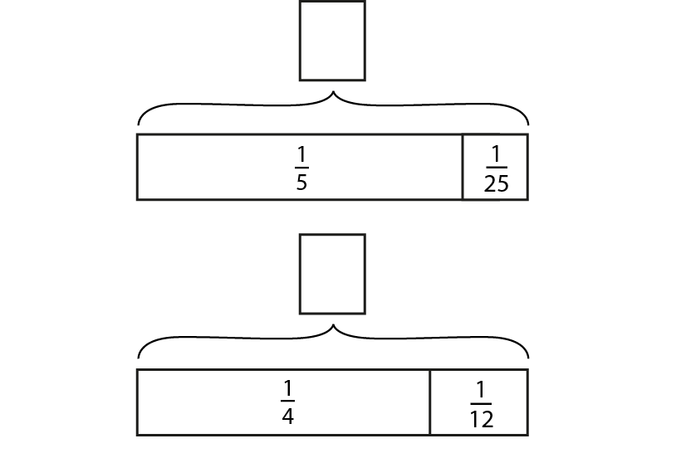
3.8 Common denomination
Step 1:14

Slide 20
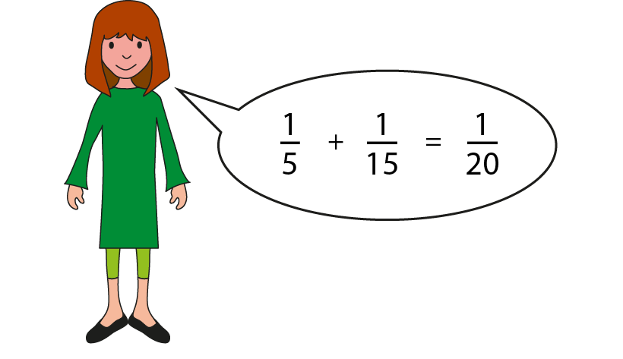
3.8 Common denomination
Step 1:14
Notes:
Can you explain Hannah’s mistake?

Slide 21
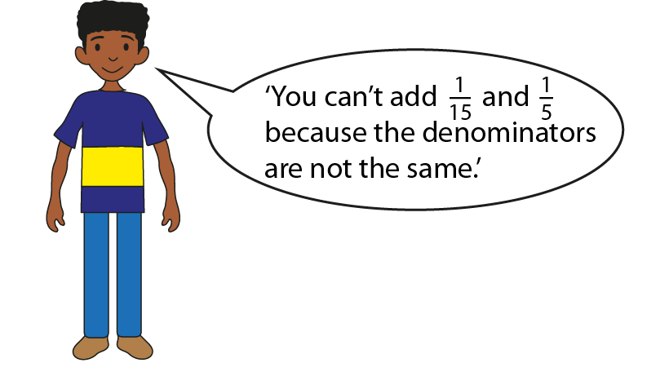
3.8 Common denomination
Step 1:14
Notes:
Complete the following sentences.
Ahmed is partly correct in that ___.
Ahmed is partly wrong in that____.

Slide 22
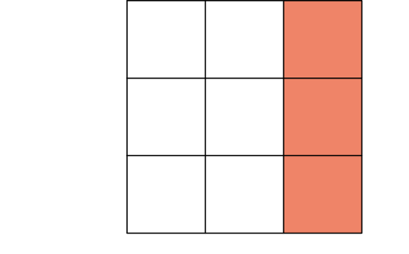
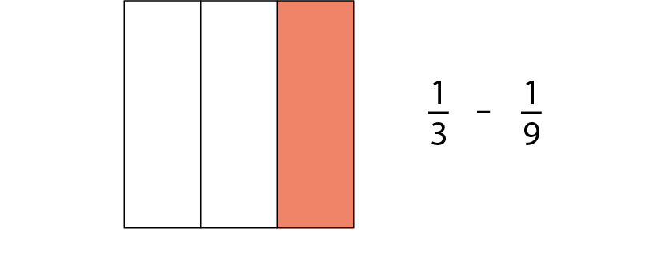
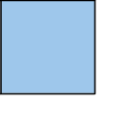
3.8 Common denomination
Step 2:2

Slide 23
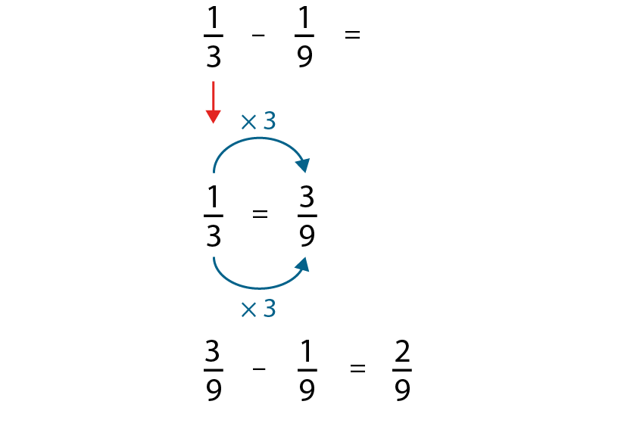
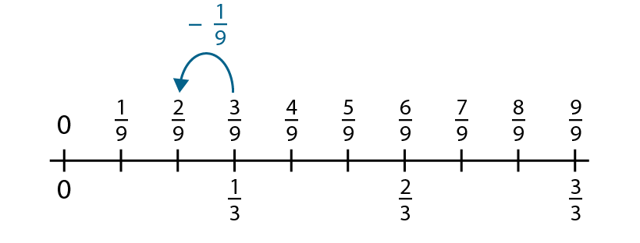
3.8 Common denomination
Step 2:2
Notes:
How could we rewrite one-third so that the denominators of both fractions in our calculation are the same?

Slide 24
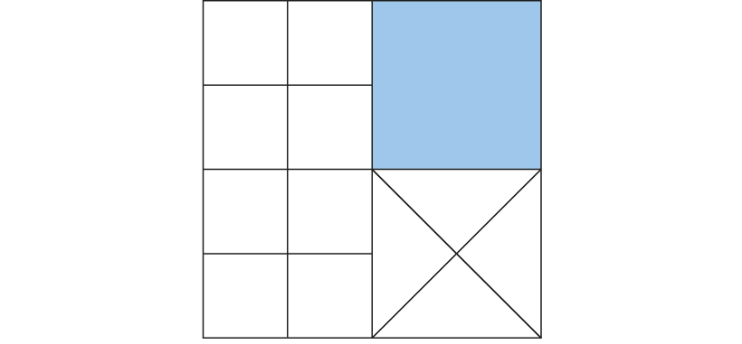
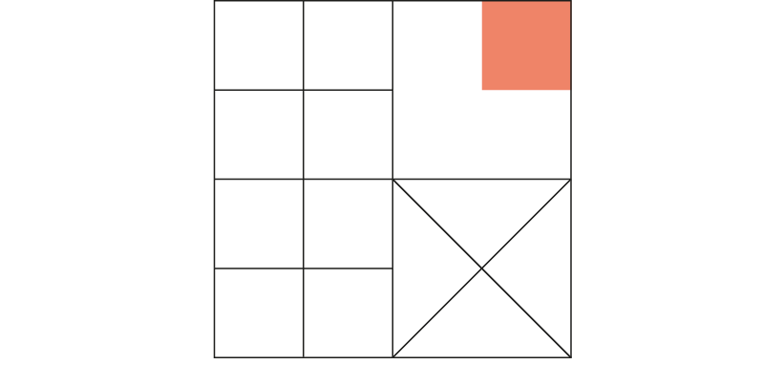
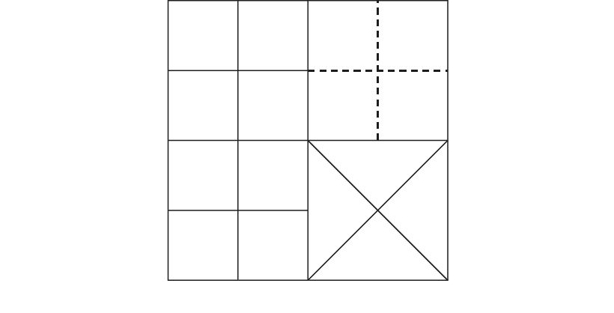
3.8 Common denomination
Step 2:4

Slide 25
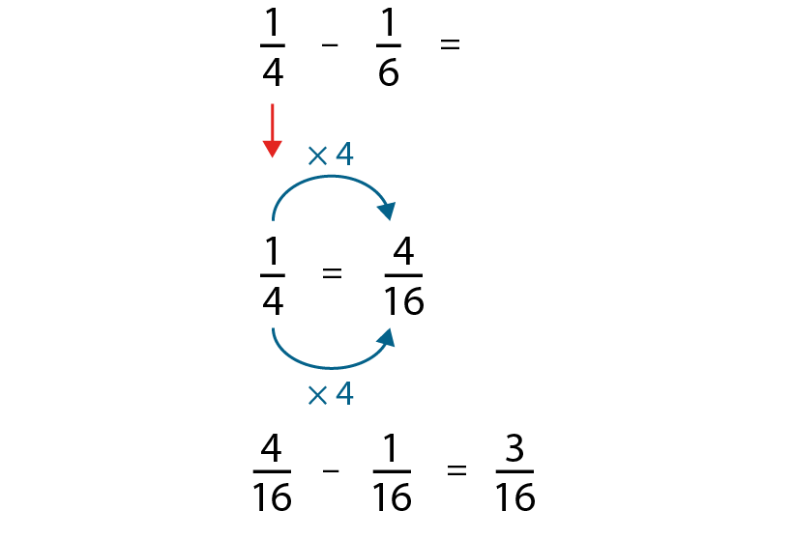


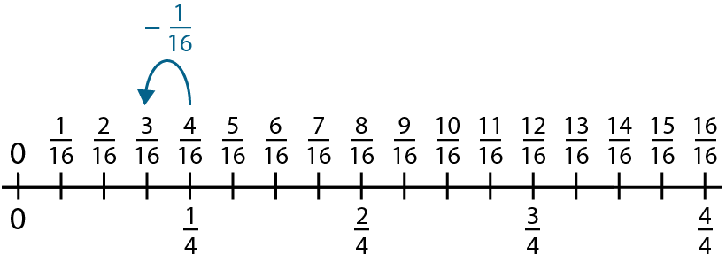
3.8 Common denomination
Step 2:4

Slide 26
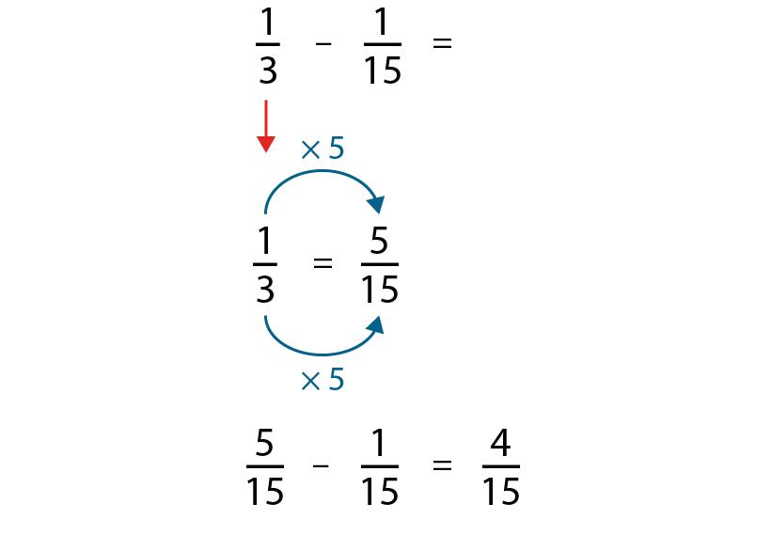
3.8 Common denomination
Step 2:5

Slide 27
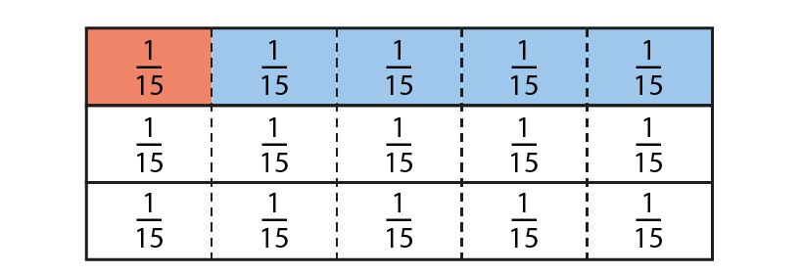
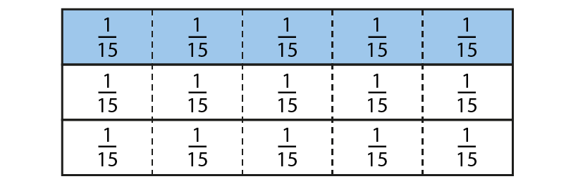
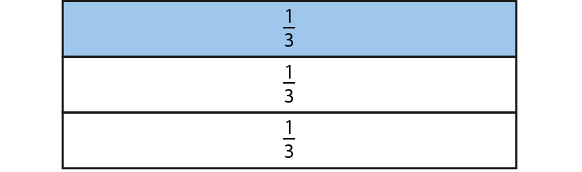
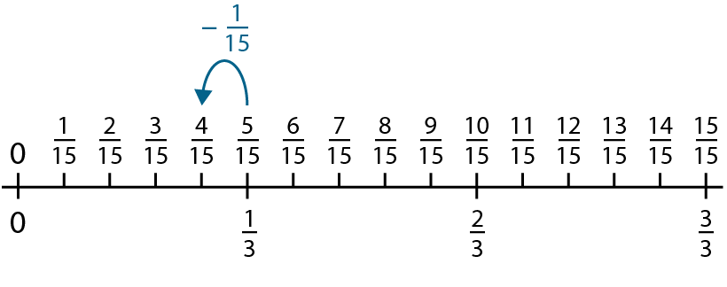
3.8 Common denomination
Step 2:6

Slide 28


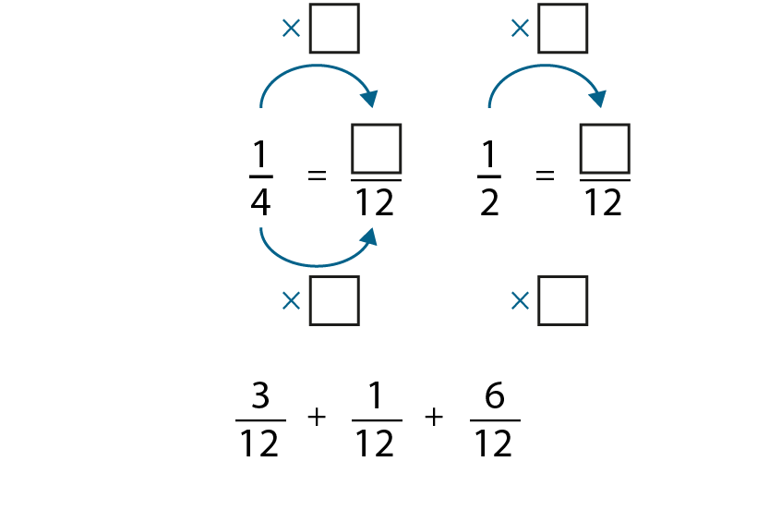


3.8 Common denomination
Step 2:7

Slide 29
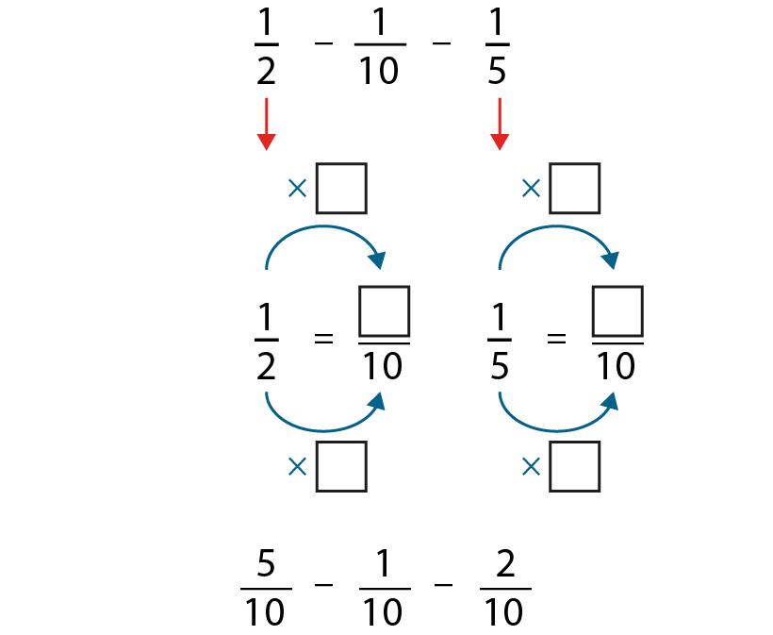
3.8 Common denomination
Step 2:7

Slide 30
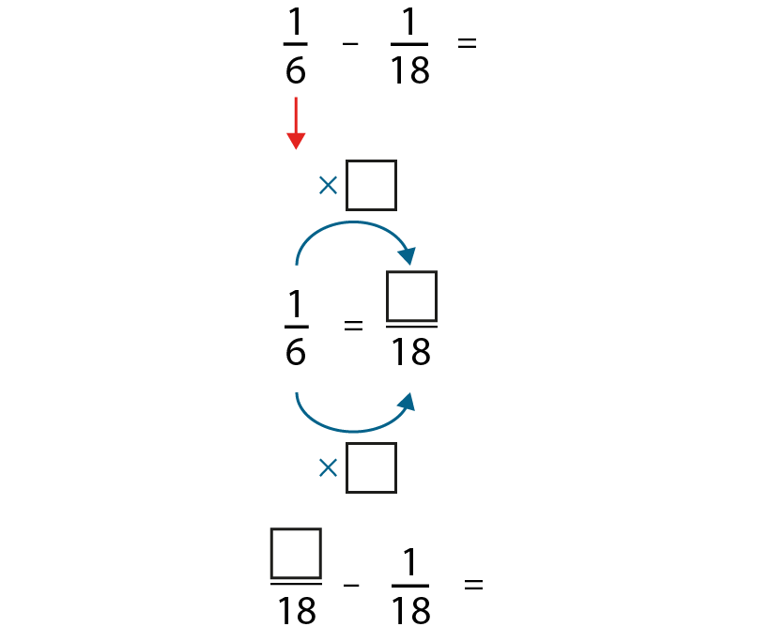
3.8 Common denomination
Step 2:8

Slide 31
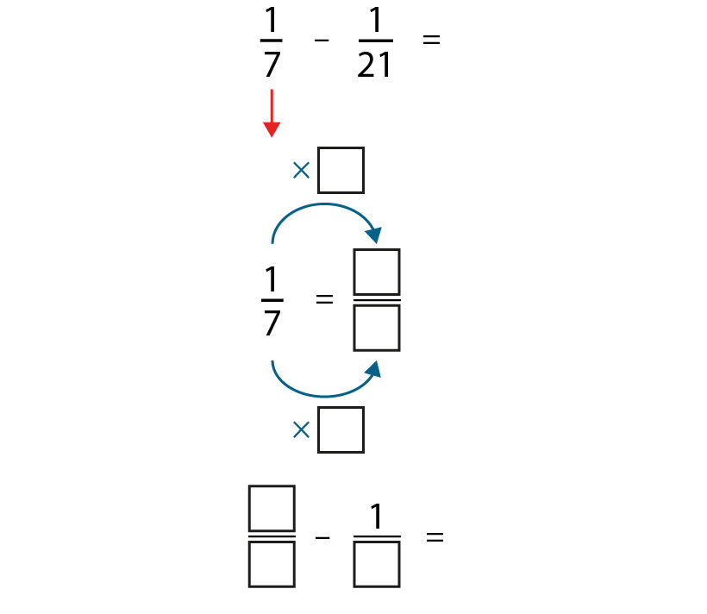
3.8 Common denomination
Step 2:8

Slide 32
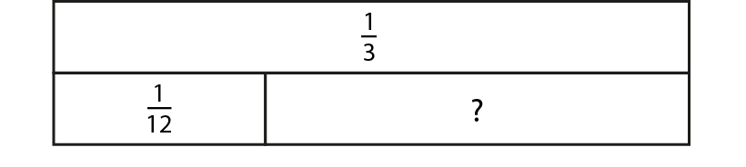
3.8 Common denomination
Step 2:8
Notes:
Write the calculation represented by the bar model.

Slide 33
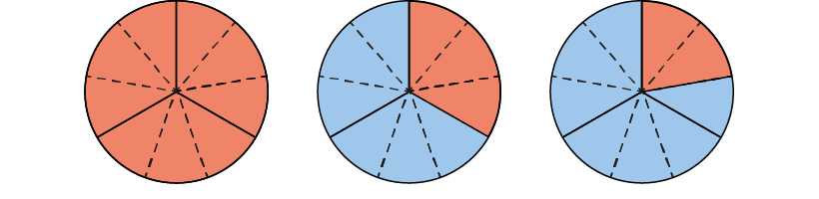
3.8 Common denomination
Step 2:10
Notes:
Dad makes a chocolate cake. When Sam gets home from school there is $\frac{1}{3}$ of the cake left. Sam eats a piece and there is $\frac{2}{9}$ left. How much has Sam eaten?

Slide 34
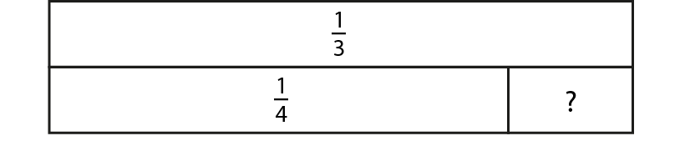
3.8 Common denomination
Step 2:10
Notes:
Find the value of the missing part.

Slide 35
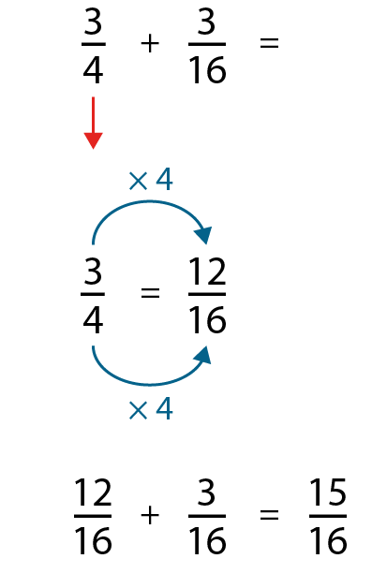
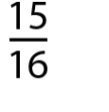
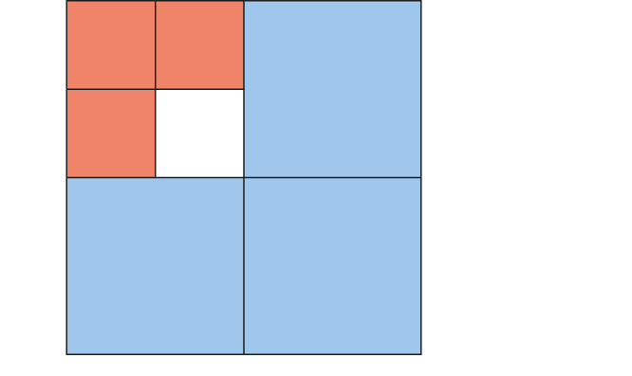
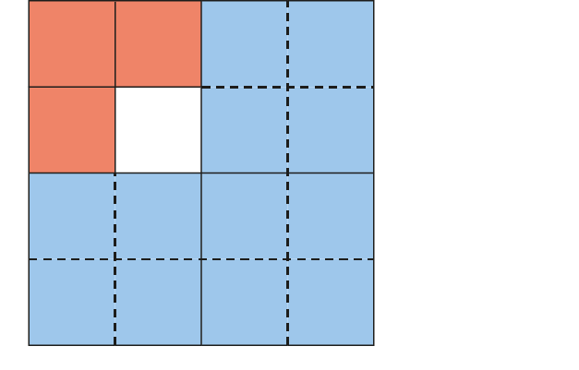
3.8 Common denomination
Step 3:1
Notes:
Can you see the $\frac{3}{4}$?
Can you see the $\frac{3}{16}?$
Do we have equal parts?

Slide 36

3.8 Common denomination
Step 3:2

Slide 37




3.8 Common denomination
Step 3:3

Slide 38


3.8 Common denomination
Step 3:6
Notes:
Sam calculated $\frac{3}{4}$ + $\frac{7}{12}$ and got $\frac{16}{12}$ as his answer.
Maisa calculated $\frac{3}{4}$ + $\frac{7}{12}$ and got $1\frac{4}{12}$ as her answer.
Whose answer is correct?
What is the same about both answers? What is different?
What has Maisa done to her answer?

Slide 39

3.8 Common denomination
Step 3:8
Notes:
Class 5 conducted a survey to find out the different ways pupils travel to school. Here is a pie chart of their findings. What fraction of the children walk to school?

Slide 40

3.8 Common denomination
Step 3:8
Notes:
Farmer Nishi grows fruit and vegetables on her farm. What fraction of the farm is used to grow apples?

Slide 41

3.8 Common denomination
Step 3:8
Notes:
Find the mid-points of these pairs of numbers.

Slide 42


3.8 Common denomination
Step 4:1
Notes:
Will has made a pie chart to show how he spends his free time in a week. In total, what fraction of the week does Will spend playing computer games and watching TV?
What do you think of Will’s answer?
Can you convince me that Will’s answer is wrong?
What would a reasonable answer be?

Slide 43

3.8 Common denomination
Step 4:3

Slide 44

3.8 Common denomination
Step 4:5

Slide 45

3.8 Common denomination
Step 4:6

Slide 46


3.8 Common denomination
Step 4:7
Notes:
We buy two equal-sized boxes of cereal. In one week, my family eats $\frac{2}{3}$ of the box of Weet-o-flakes and $\frac{3}{5}$ of the box of Corn Puffs for breakfast. How many boxes of cereal do we eat in total in one week?
For additional support you can use the stem sentence:
The whole is divided into ___ equal parts, and we have eaten ___ of them.

Slide 47


3.8 Common denomination
Step 4:9

Slide 48



3.8 Common denomination
Step 4:10
Notes:
You can’t add fractions with different denominators. Discuss whether you agree or disagree.
(You can add fractions with different denominators, but you need to convert to a common denominator in order to do this.)

Slide 49

3.8 Common denomination
Step 4:11
Notes:
I have $\frac{3}{8}$ of a tank of petrol in my car. I use $\frac{1}{5}$ of a tank driving to see my friend. What fraction of a tank of petrol remains?

Slide 50

3.8 Common denomination
Step 4:11
Notes:
To add or subtract fractions with different denominators, first convert to fractions with a common denominator.

Slide 51

3.8 Common denomination
Step 4:14
Notes:
The pie chart shows how much of the evening viewing time is spent on different types of programmes.
What fraction of the viewing time was spent on news?

Slide 52

3.8 Common denomination
Step 4:14
What fraction of the wall is white tiles?
Notes:
If $\frac{2}{5}$ of the wall are blue tiles, $\frac{1}{4}$ of the wall are red tiles and $\frac{1}{10}$ of the wall are yellow tiles, what fraction of the wall are white tiles?

Slide 53


3.8 Common denomination
Step 5:1
Notes:
Jack and Jane are tiling identical sized walls.
Jack has tiled $\frac{10}{15}$ of his wall and Jane has tiled $\frac{9}{15}$ of her wall.
Who has tiled the larger area?

Slide 54



3.8 Common denomination
Step 5:2
Notes:
Are Jack’s and Jane’s claims correct?

Slide 55
3.8 Common denomination
Step 5:3
Notes:
So, which is larger, two-thirds or three-fifths?

Slide 56

3.8 Common denomination
Step 5:3
Notes:
So, which is larger, two-thirds or three-fifths?

Slide 57

3.8 Common denomination
Step 5:4
Notes:
What if the walls that Jack and Jane were tiling were different sizes? Who has tiled the larger share now?

Slide 58

3.8 Common denomination
Step 5:5

Slide 59

3.8 Common denomination
Step 5:7

Slide 60

3.8 Common denomination
Step 5:7
Notes:
Did converting to a common denominator help us compare?
Did using reasoning by drawing and placing on a number line help us compare?
Which strategy is best here?

Slide 61

3.8 Common denomination
Step 5:7

Slide 62

3.8 Common denomination
Step 5:11
Notes:
Compare the fractions $\frac{2}{5}$ and $\frac{1}{6}$. Which is greater?

Slide 63



3.8 Common denomination
Step 5:12
Notes:
Danny and Dev had identical bottles of juice. Danny drank $\frac{4}{5}$ of his juice. Dev drank $\frac{3}{4}$ of his juice. Who drank more of their juice?

Slide 64

3.8 Common denomination
Step 5:13
Notes:
Sort the pairs of equations according to the method you would use to compare them.

Slide 65



3.8 Common denomination
Step 5:14
Notes:
Which side of $\frac{1}{2}$ does the fraction sit?
How much of the whole is this? Is it the large part or the small part?
Is it quite a big part of the whole or quite a small part of the whole?
How far away from $\frac{1}{2}$ is the fraction?

Slide 66

3.8 Common denomination
Step 5:15
✓
✓
✓
✓
Notes:
For each sequence, tick the correct box to show if the fractions in each pattern are increasing, decreasing or neither.

Slide 67

3.8 Common denomination
Step 5:15
Notes:
Use these number cards to make two different fractions that complete the inequality statement.

