Slide 1
1.7 Addition and subtraction: strategies within 10
Representations | Year 1
Number, Addition and Subtraction

Slide 2
How to use this presentation
You can find the teacher guide 1.7 Addition and subtraction: strategies within 10 by following the link below.

Slide 3
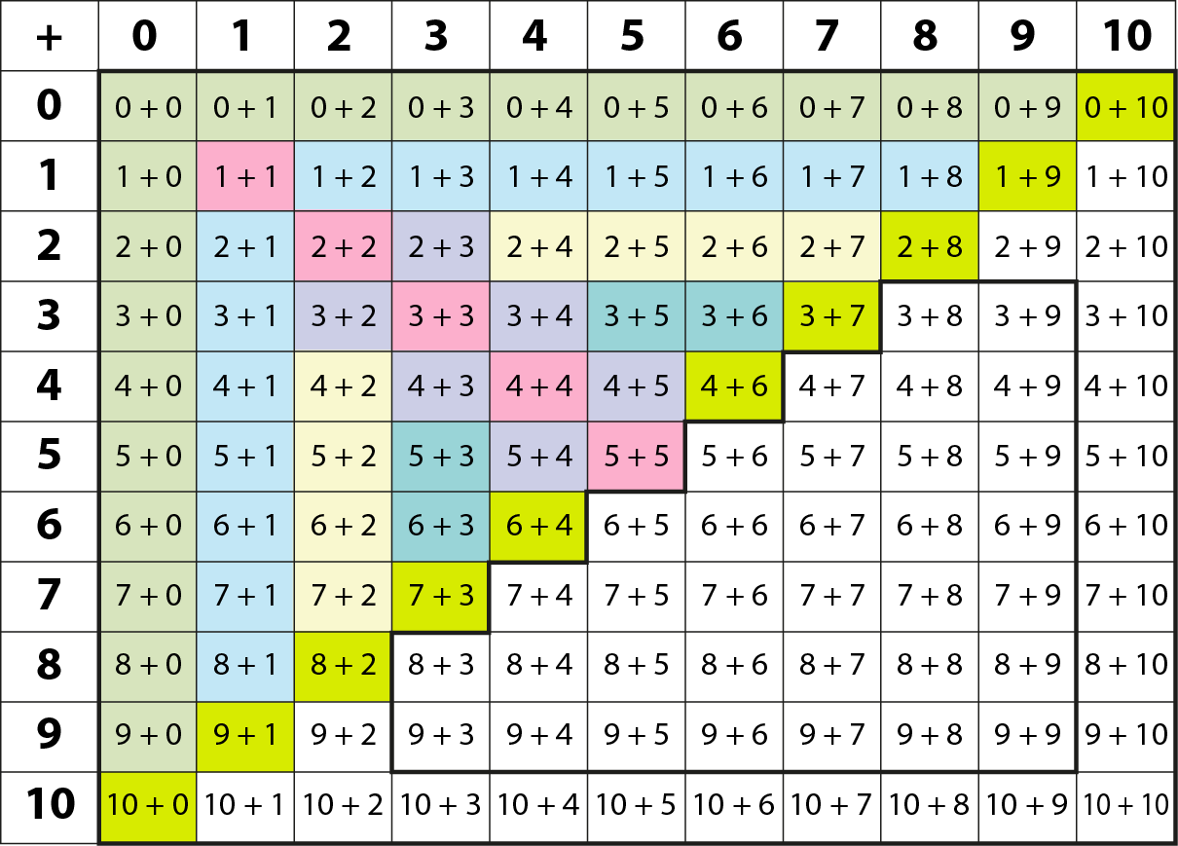
1.7 Calculation: strategies within 10 – overview

Slide 4

1.7 Calculation: strategies within 10 – step 1:1
2 + 4 = 6
4 + 2 = 6
2 + 4 = 4 + 2

Slide 5
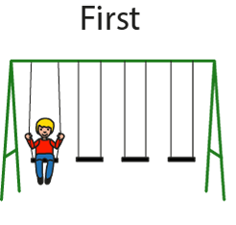
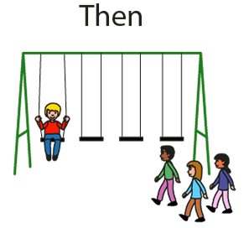







1.7 Calculation: strategies within 10 – step 1:2

Slide 6
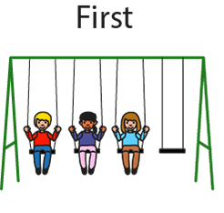
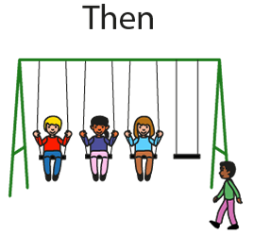




1.7 Calculation: strategies within 10 – step 1:2

Slide 7


1.7 Calculation: strategies within 10 – step 1:2
1 + 3 = 3 + 1

Slide 8
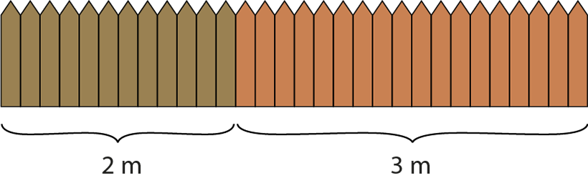


1.7 Calculation: strategies within 10 – step 1:3
2 + 3 = 5

Slide 9
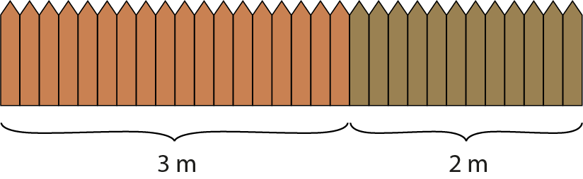


1.7 Calculation: strategies within 10 – step 1:3
3 + 2 = 5

Slide 10
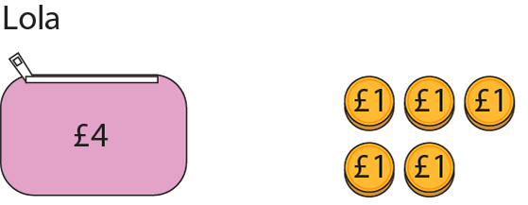
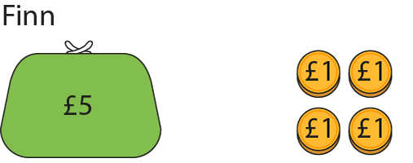
1.7 Calculation: strategies within 10 – step 1:3

Slide 11













1.7 Calculation: strategies within 10 – step 2:1

Slide 12
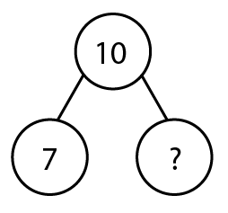
1.7 Calculation: strategies within 10 – step 2:1

Slide 13
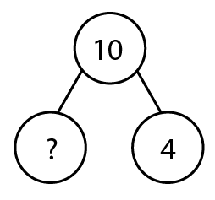
1.7 Calculation: strategies within 10 – step 2:1

Slide 14
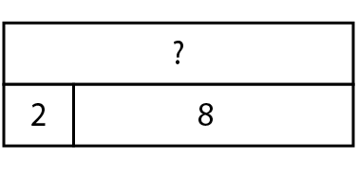

1.7 Calculation: strategies within 10 – step 2:1

Slide 15
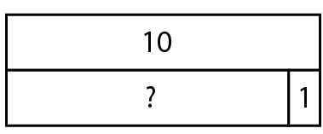
1.7 Calculation: strategies within 10 – step 2:1

Slide 16







1.7 Calculation: strategies within 10 – step 2:3
10 − 6 =
4

Slide 17
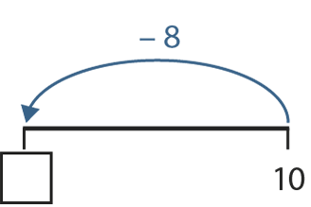
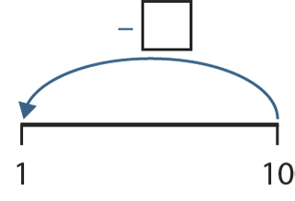
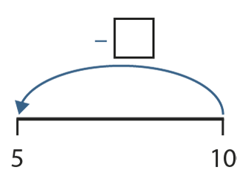
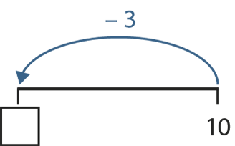
1.7 Calculation: strategies within 10 – step 2:4
9
2
5
7

Slide 18

1.7 Calculation: strategies within 10 – step 3:1
3
5

Slide 19







1.7 Calculation: strategies within 10 – step 3:2

Slide 20
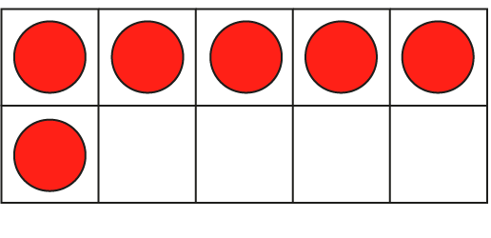




1.7 Calculation: strategies within 10 – step 3:2

Slide 21
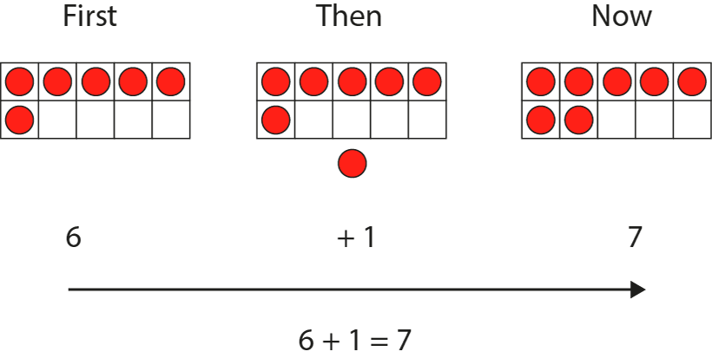
1.7 Calculation: strategies within 10 – step 3:2

Slide 22
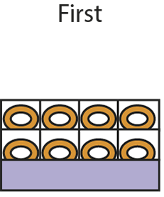
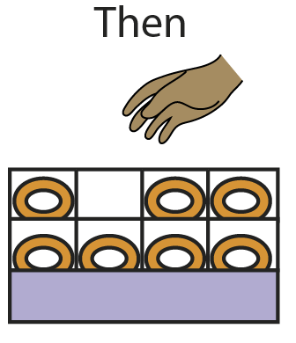
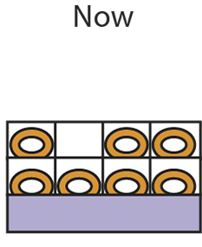






1.7 Calculation: strategies within 10 – step 3:5

Slide 23
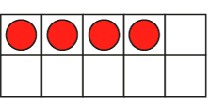




1.7 Calculation: strategies within 10 – step 3:5

Slide 24
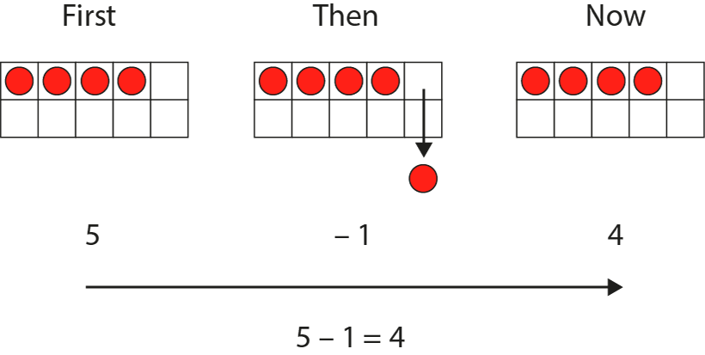
1.7 Calculation: strategies within 10 – step 3:5

Slide 25
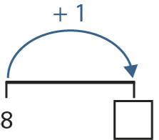
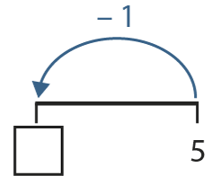
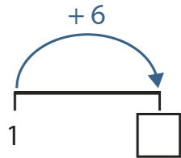
1.7 Calculation: strategies within 10 – step 3:7
9
4
7

Slide 26
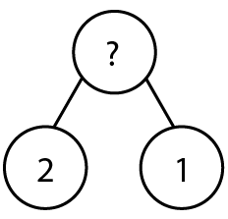
1.7 Calculation: strategies within 10 – step 3:7

Slide 27
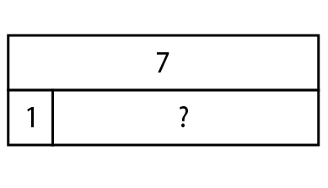
1.7 Calculation: strategies within 10 – step 3:7

Slide 28

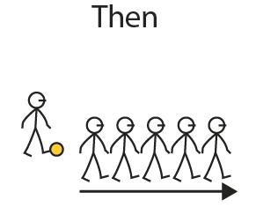





1.7 Calculation: strategies within 10 – step 4:1

Slide 29
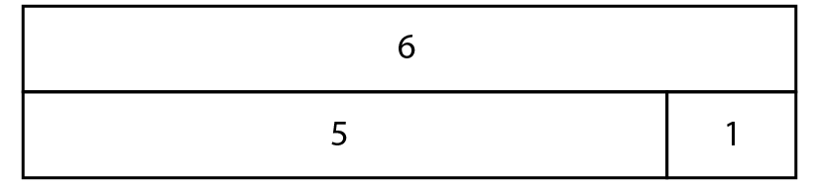

1.7 Calculation: strategies within 10 – step 4:1
?

Slide 30
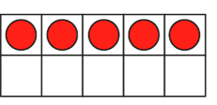



1.7 Calculation: strategies within 10 – step 4:1

Slide 31
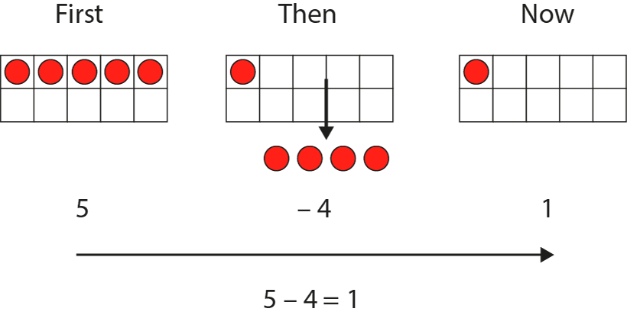
1.7 Calculation: strategies within 10 – step 4:1

Slide 32


1.7 Calculation: strategies within 10 – step 4:2

Slide 33
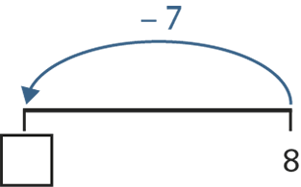
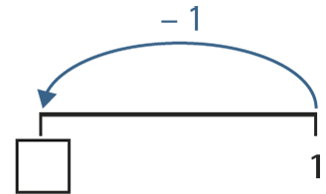
1.7 Calculation: strategies within 10 – step 4:5
1
0

Slide 34
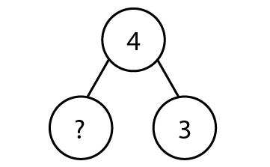

1.7 Calculation: strategies within 10 – step 4:5

Slide 35
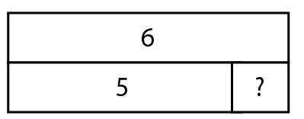

1.7 Calculation: strategies within 10 – step 4:5

Slide 36




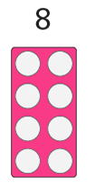

1.7 Calculation: strategies within 10 – step 5:1

Slide 37



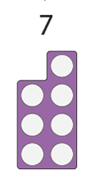

1.7 Calculation: strategies within 10 – step 5:1

Slide 38
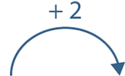
1.7 Calculation: strategies within 10 – step 5:2

Slide 39
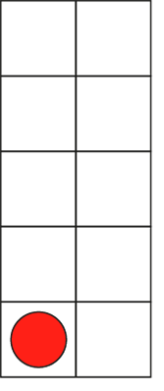

1.7 Calculation: strategies within 10 – step 5:2
0
+ 2
= 2

Slide 40

1.7 Calculation: strategies within 10 – step 5:2
0
+ 2
=
4
2

Slide 41
1.7 Calculation: strategies within 10 – step 5:2
6
2
4
+ 2
=

Slide 42
1.7 Calculation: strategies within 10 – step 5:2
=
8
4
6
+ 2
=

Slide 43
1.7 Calculation: strategies within 10 – step 5:2
8
6
=
10
+ 2
=

Slide 44



1.7 Calculation: strategies within 10 – step 5:2

Slide 45

1.7 Calculation: strategies within 10 – step 5:2
1
+ 2
=
3

Slide 46
1.7 Calculation: strategies within 10 – step 5:2
1
+ 2
=
3
5

Slide 47
1.7 Calculation: strategies within 10 – step 5:2
3
+ 2
=
5
7

Slide 48
1.7 Calculation: strategies within 10 – step 5:2
5
9
+ 2
=
7

Slide 49
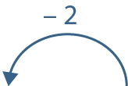
1.7 Calculation: strategies within 10 – step 5:5

Slide 50
1.7 Calculation: strategies within 10 – step 5:5
10
− 2
8
=

Slide 51
1.7 Calculation: strategies within 10 – step 5:5
8
10
− 2
6
=

Slide 52
1.7 Calculation: strategies within 10 – step 5:5
8
6
− 2
4
=

Slide 53
1.7 Calculation: strategies within 10 – step 5:5
6
2
− 2
4
=

Slide 54
1.7 Calculation: strategies within 10 – step 5:5
4
2
− 2
0
=

Slide 55
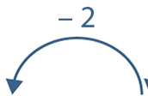
1.7 Calculation: strategies within 10 – step 5:5

Slide 56
1.7 Calculation: strategies within 10 – step 5:5
9
− 2
=
7

Slide 57
1.7 Calculation: strategies within 10 – step 5:5
9
5
− 2
=
7

Slide 58
1.7 Calculation: strategies within 10 – step 5:5
7
3
− 2
=
5

Slide 59
1.7 Calculation: strategies within 10 – step 5:5
5
1
− 2
=
3

Slide 60
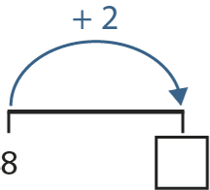
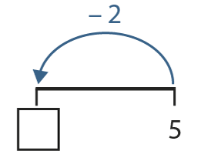
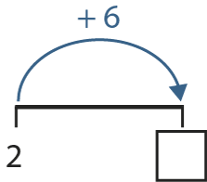
1.7 Calculation: strategies within 10 – step 5:7
10
3
8

Slide 61
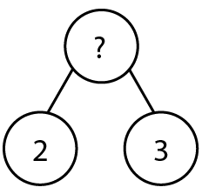

1.7 Calculation: strategies within 10 – step 5:7

Slide 62
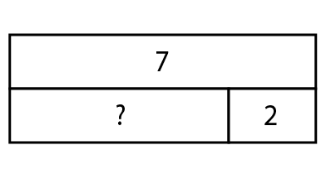
1.7 Calculation: strategies within 10 – step 5:7

Slide 63






1.7 Calculation: strategies within 10 – step 7:1

Slide 64
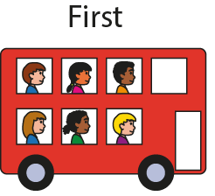
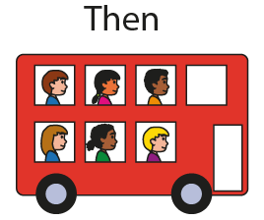





1.7 Calculation: strategies within 10 – step 7:1

Slide 65






1.7 Calculation: strategies within 10 – step 7:1

Slide 66







1.7 Calculation: strategies within 10 – step 7:3

Slide 67










1.7 Calculation: strategies within 10 – step 7:3

Slide 68


1.7 Calculation: strategies within 10 – step 8:1

Slide 69
1.7 Calculation: strategies within 10 – step 9:1

Slide 70

1.7 Calculation: strategies within 10 – step 9:2

Slide 71


1.7 Calculation: strategies within 10 – step 9:2

Slide 72

1.7 Calculation: strategies within 10 – step 9:2

Slide 73

1.7 Calculation: strategies within 10 – step 9:2

Slide 74



1.7 Calculation: strategies within 10 – step 9:2

Slide 75
















1.7 Calculation: strategies within 10 – step 9:3

Slide 76






1.7 Calculation: strategies within 10 – step 9:3

Slide 77


1.7 Calculation: strategies within 10 – step 9:3

Slide 78








1.7 Calculation: strategies within 10 – step 9:4

Slide 79




1.7 Calculation: strategies within 10 – step 9:5
4
2 + = 4
2
4 − 2 =
2

Slide 80

1.7 Calculation: strategies within 10 – step 9:5

Slide 81

1.7 Calculation: strategies within 10 – step 9:5
4 + = 8
4
8 − = 4
4

Slide 82


1.7 Calculation: strategies within 10 – step 9:5

Slide 83



1.7 Calculation: strategies within 10 – step 9:6

Slide 84



1.7 Calculation: strategies within 10 – step 9:6

Slide 85


1.7 Calculation: strategies within 10 – step 9:6

Slide 86

1.7 Calculation: strategies within 10 – step 9:8

Slide 87


1.7 Calculation: strategies within 10 – step 9:8

Slide 88

1.7 Calculation: strategies within 10 – step 9:8

Slide 89

1.7 Calculation: strategies within 10 – step 9:8

Slide 90



1.7 Calculation: strategies within 10 – step 9:8

Slide 91




1.7 Calculation: strategies within 10 – step 9:8

Slide 92




1.7 Calculation: strategies within 10 – step 10:1

Slide 93





1.7 Calculation: strategies within 10 – step 10:1

Slide 94



1.7 Calculation: strategies within 10 – step 10:2

Slide 95


1.7 Calculation: strategies within 10 – step 10:3
3
9

Slide 96


1.7 Calculation: strategies within 10 – step 10:3

Slide 97



1.7 Calculation: strategies within 10 – step 10:3

