Slide 1
Support Materials
Series 1 Episode 3
Two

Slide 2
Practitioner Notes

Slide 3
Episode Description
Numberblock One finds one sock and then one shoe, and wonders what's missing. She runs off in search of Numberblock Two, and meets him, walking lopsidedly in the other sock and shoe. One gives Two her sock and shoe so Two can complete the pairs. He puts them on and discovers the shoes are magic dancing shoes. He starts dancing and sings a song, Everything is better with two. He sings about friendship and how things go better in pairs, like shoes and wings, and counts lots of twos of things. We see them in a 'becoming friends' montage of activities for two - riding a tandem, playing football, piggyback, singing a duet, hide and seek, and more - and they end by declaring they are best friends.

Slide 4
Maths in the Episode
Counting to 2
Counting involves knowing the order of the number names and assigning one number tag to one object or event. This episode builds on Episode 2, using “one, two” to count one and two objects.
‘Twoness’ of 2
This episode provides examples of things that happen or come in ones and twos. There are lots of examples of twos, e.g. dancing together, riding a tandem, riding piggy back, singing a duet, setting a table for two. By also providing examples of one alongside, children can begin to distinguish what two is and what two is not.

Slide 5
Using Mathematical Language
During this episode children will experience objects and activities that occur in twos and ones.
Encourage the children to describe what they see in the episode and any follow-on experiences by using the phrases
“I have two …”
“I have one …”

Slide 6
Talk and Discuss Together

Slide 7
Talk and Discuss Together
Watch the episode of Numberblocks. First ask the children what they noticed and allow them to talk to you and each other. The following slides are designed to stimulate children and adults to talk about the episode and draw out some key aspects of the mathematics.

Slide 8
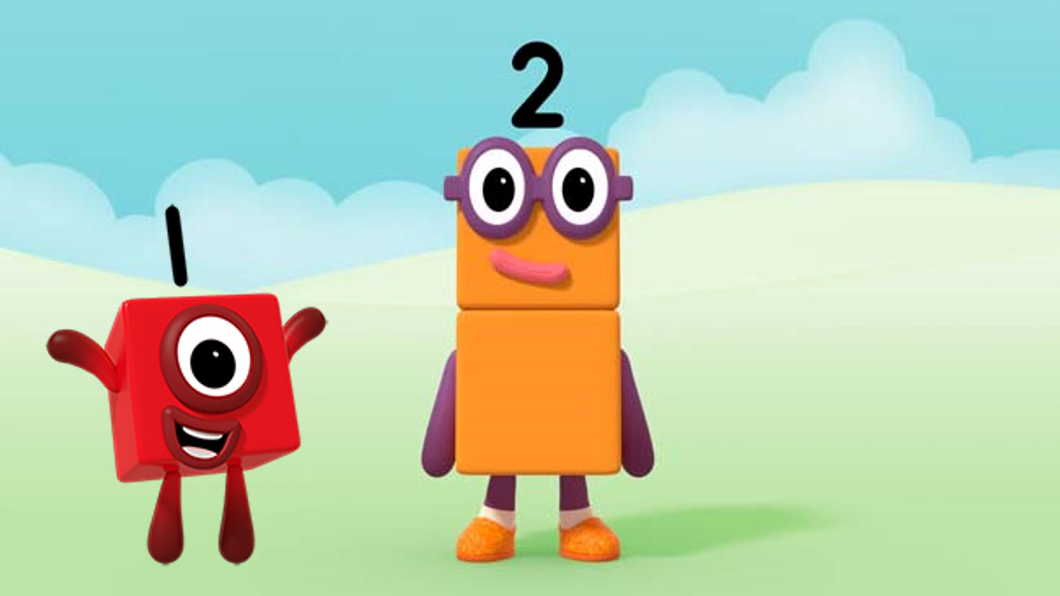
Images © 2017 Alphablocks Ltd. All Rights Reserved.
Notes:
Discuss what the children noticed about the programme. What did they like about it? Has anyone done any of the activities that One and Two did together?
One and Two are becoming best friends. Discuss why having a friend is a nice thing.

Slide 9
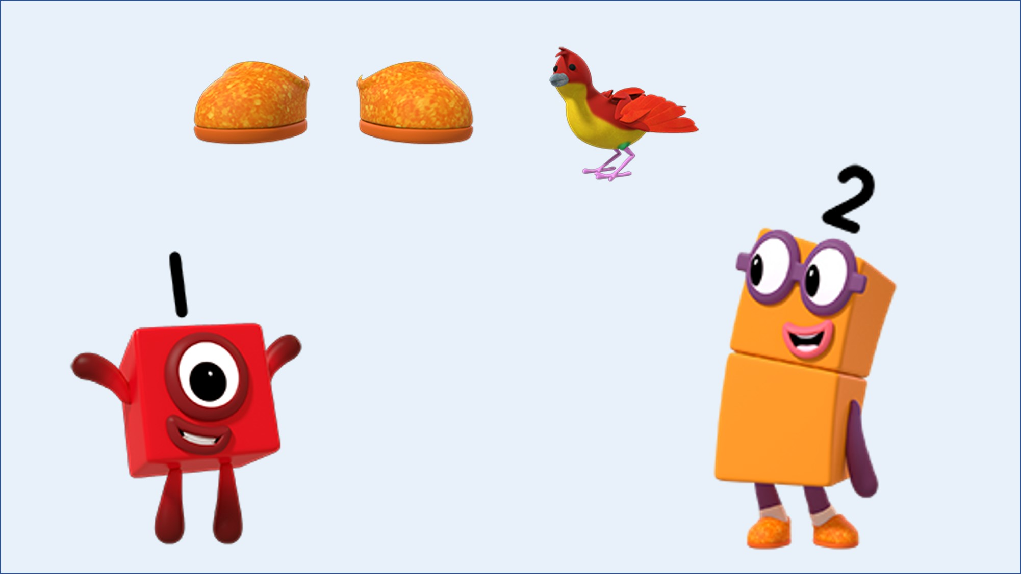
Images © 2017 Alphablocks Ltd. All Rights Reserved.
Notes:
Which picture, the bird or the shoes, would you match to the Numberblock? Why?

Slide 10
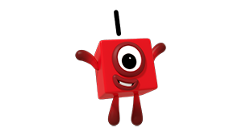
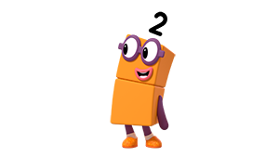
Images © 2017 Alphablocks Ltd. All Rights Reserved.
Notes:
Ask the children to think of things that they can see in the classroom that there are two of, and that there are one of. Use this slide to insert pictures of the things that they found (taking pictures) or use two boxes with One and Two as labels on the front of each and hunt around the classroom to collect one of something and two of something. Put them in the correct box.
Sort through the 'boxes' and check that there are only one or two of each type of thing.

Slide 11
Enabling Environments

Slide 12
Enabling Environments
Playing and Exploring
Encourage children to explore examples of two in multiple contexts, including counting objects, sounds, movements.
Encourage children to make a print pattern using two of something, e.g. hands, feet, thumbs.
Active Learning
Notice children choosing to count one and two objects in their play.
Creating and Thinking Critically
Encourage children to notice that their body has two of lots of different things. Encourage children to imagine what it would be like with only one leg or arm, etc.
Encourage children to count two objects in a different order, rearrange the objects and recount. What do they notice?

Slide 13
Learning Together in Y1

Slide 14
Images © 2017 Alphablocks Ltd. All Rights Reserved.
Notes:
Before watching the episode ask the children to look carefully for things that One and Two DID together.
Watch the episode and ask the children to provide examples.
What happened in this episode?
When you click on to the next slide; the following 10 slides will run as a slide show and reveal either 1 or 2 represented in different ways. The slide advances after 2.5 seconds. The purpose of the speed is to encourage the children to SUBITISE 1 and 2 - that is, to recognise the arrangement of two without the need for counting. This skill will also enable learners to consider two as a single unit of 2 ones. This concept is known as UNITISING and will be used throughout the KS1 and KS2 curriculum.
You can also add other representations for number that you might use in your school.
Before running the slide show, ask the children say the amount that they see as quickly as possible. This can be done as a class, in groups, or individually. Some of the slides might stimulate more of a discussion, e.g.: “the slide with One and another One – is this 1 or 2?”

Slide 15
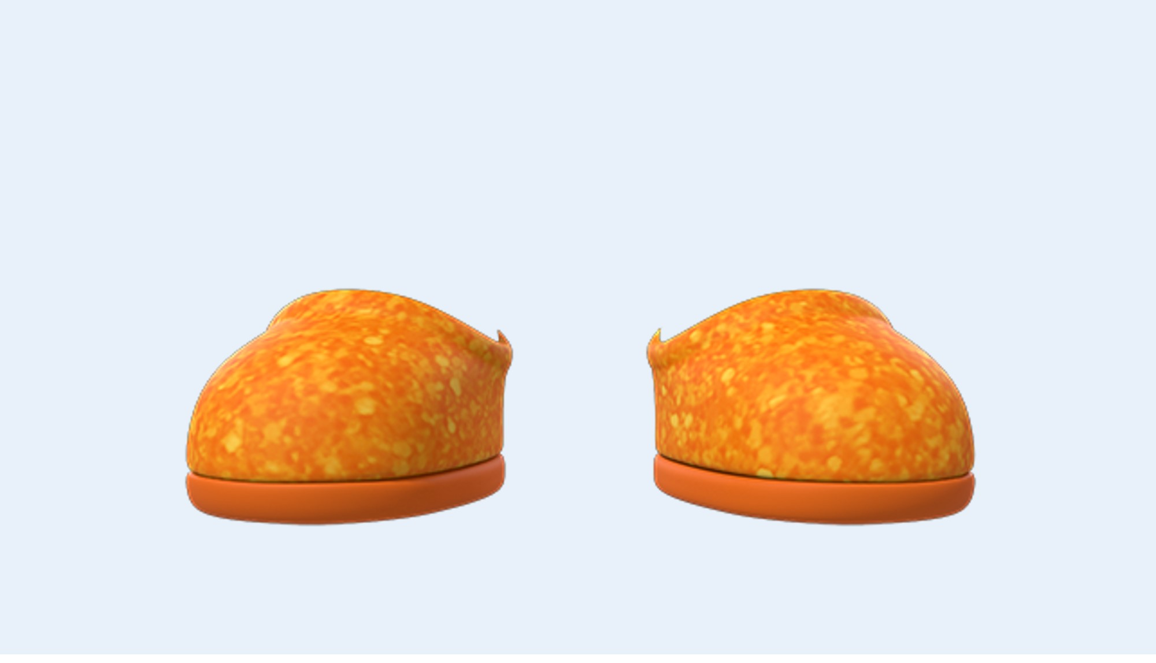
Click to start the following automated sequence of slides. Press ‘Esc’ to leave presentation mode.
Images © 2017 Alphablocks Ltd. All Rights Reserved.

Slide 16

Images © 2017 Alphablocks Ltd. All Rights Reserved.

Slide 17
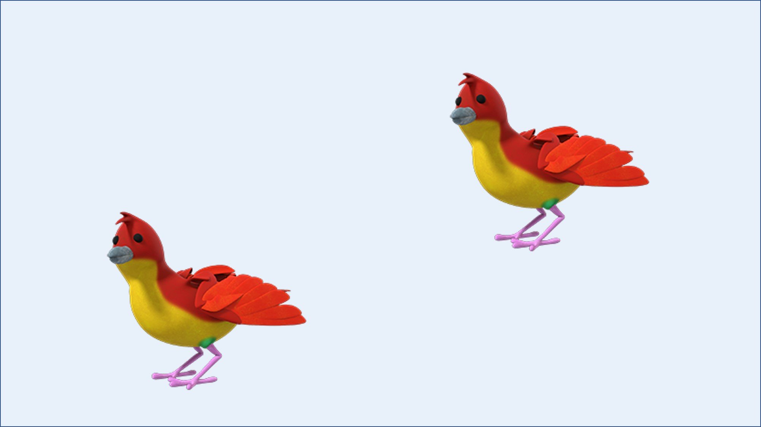
Images © 2017 Alphablocks Ltd. All Rights Reserved.

Slide 18
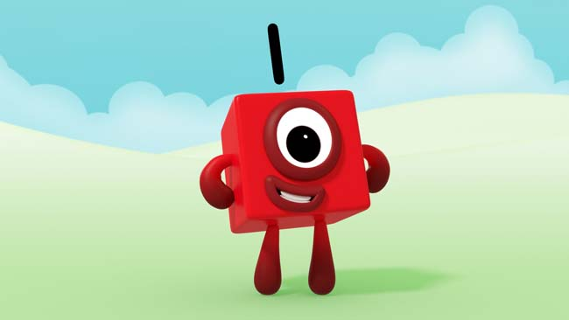
Images © 2017 Alphablocks Ltd. All Rights Reserved.

Slide 19
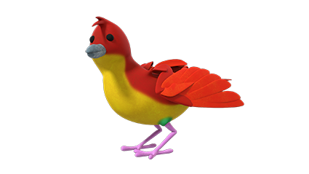
Images © 2017 Alphablocks Ltd. All Rights Reserved.

Slide 20

Images © 2017 Alphablocks Ltd. All Rights Reserved.

Slide 23
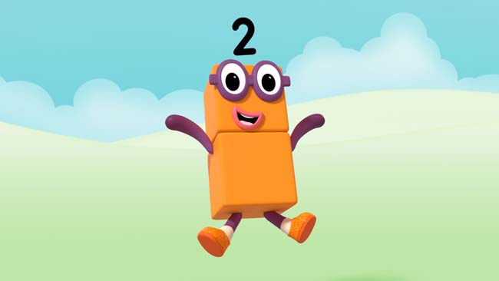
Images © 2017 Alphablocks Ltd. All Rights Reserved.

Slide 24
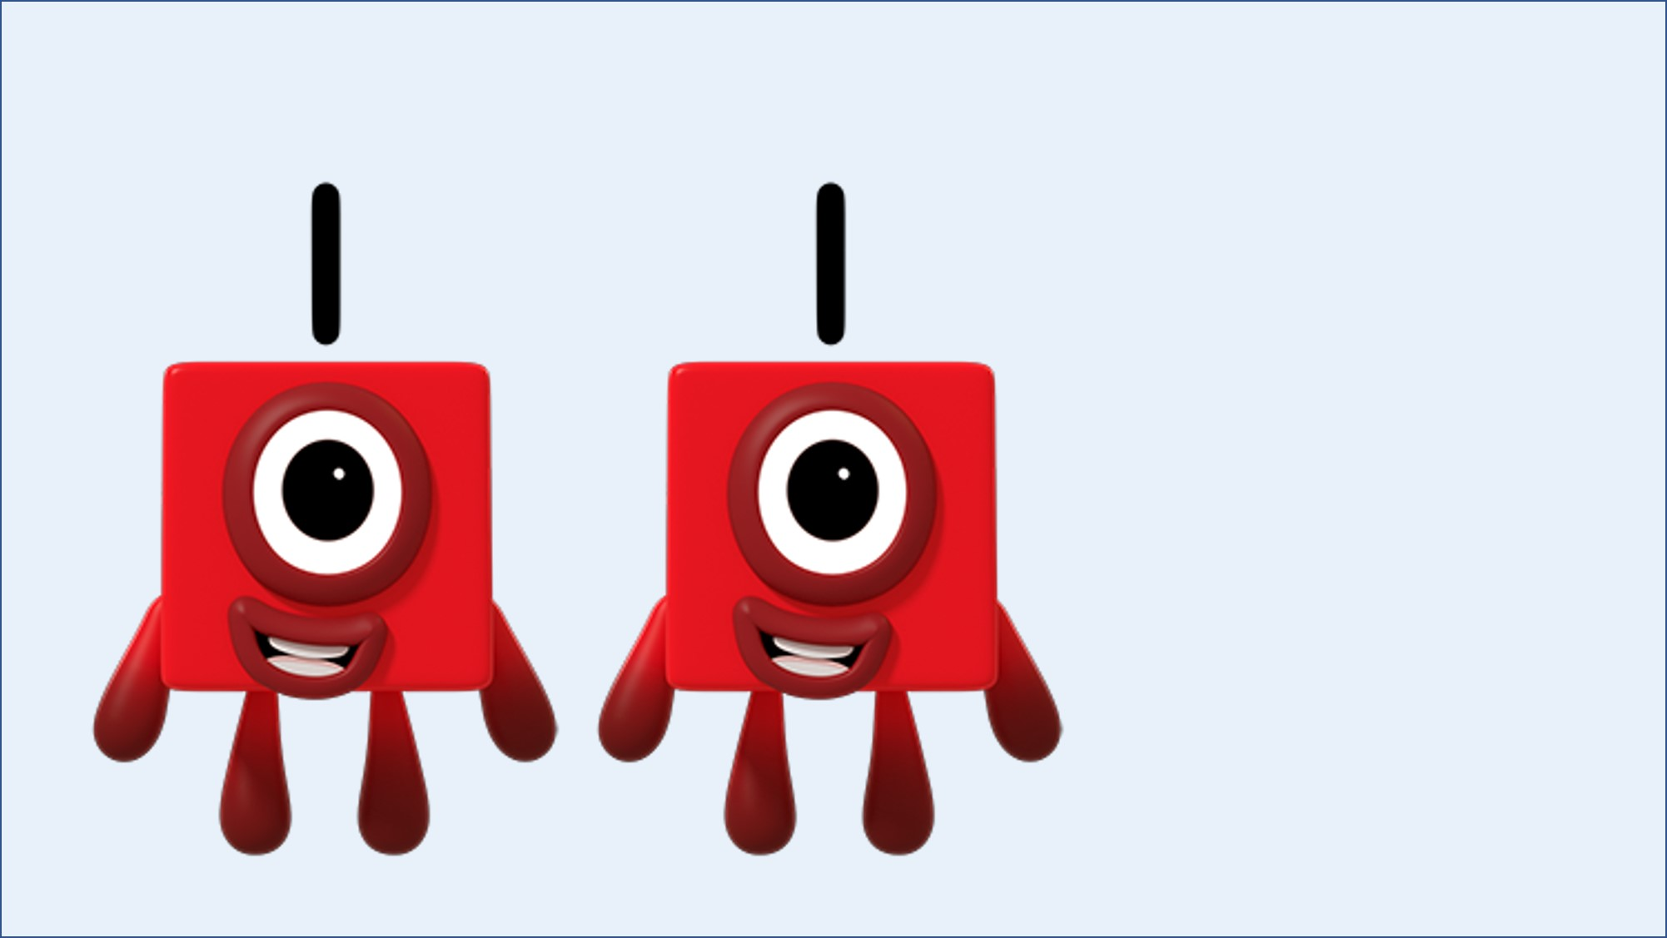
Images © 2017 Alphablocks Ltd. All Rights Reserved.

Slide 25

Images © 2017 Alphablocks Ltd. All Rights Reserved.

Slide 26

Images © 2017 Alphablocks Ltd. All Rights Reserved.

Slide 27
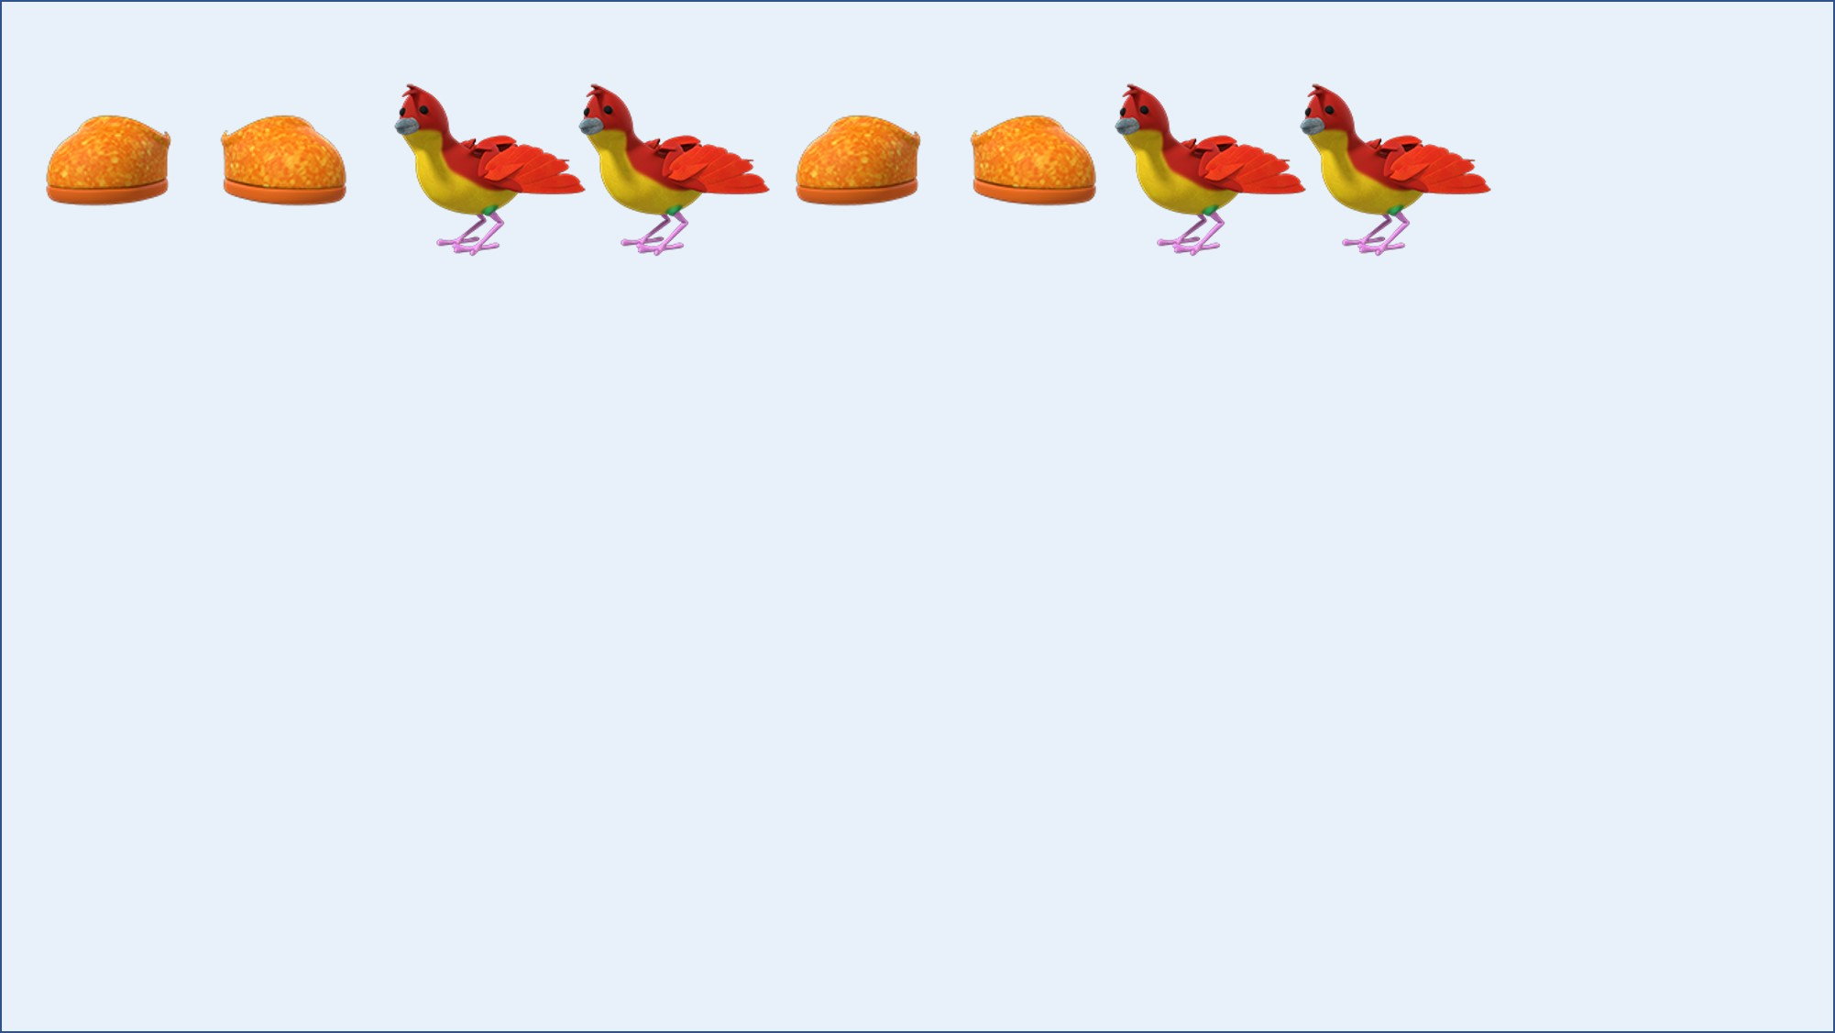
Images © 2017 Alphablocks Ltd. All Rights Reserved.
Notes:
In this slide there is a pattern of 2 shoes, 2 birds. Ask the children to read aloud the pattern.
Encourage them to create a different pattern using 2 of something, 2 of something else.
Then extend to 2 of something and 1 of something.

