Slide 1
Numberblocks
Support Materials
Series 2, Episode 2
Seven

Slide 2
Practitioner Notes

Slide 3
Episode Description
Numberblocks One to Six are having a picnic but, unluckily, it starts to rain. One has one umbrella and she tries to shelter all of the others, hopping on top of them in turn. She slips and collides with Six to make new Numberblock Seven. Lucky Seven brings them luck: the rain stops and a rainbow comes out, bathing Seven in light and turning his blocks the seven colours of the rainbow. He sings a song about how lucky he is - Lucky Number Seven - counting lots of seven-things including ducks, days of the week, golden tickets, and lucky pants on a washing line. Along the way, he walks a very, very low tightrope blindfolded, scoots along an empty path with traffic lights, and the others fall up to their necks in puddles before Seven magically lifts them out. Finally, they arrive at an even better picnic.

Slide 4
Maths in the Episode
Counting (1 to 7)
In this episode the children experience the relationship between Seven and the other Numberblocks. There are opportunities to practise counting numbers to 7 and to say the ordinal number names (first, second, third). 7 is also related to the number of the colours of the rainbow and the days of the week.
7 is one more than 6
As with the previous numbers, Seven is created through adding one to the previous number, combining Six and One. Each consecutive number is one more than the previous number.

Slide 5
Using Mathematical Language
During this episode children will experience counting to 7.
Use these stem sentences to support their experiences:
“I have counted seven … colours.”
“I have counted seven … ducks.”
Children will begin to compare 7 with other numbers.
“Seven is taller than Six.”
“7 is 1 more than 6.”

Slide 6
Talk and Discuss Together

Slide 7
Talk and Discuss Together
Watch the episode of Numberblocks. First ask the children what they noticed and allow them to talk to you and each other. The following slides are designed to stimulate children and adults to talk about the episode and draw out some key aspects of the mathematics.

Slide 8
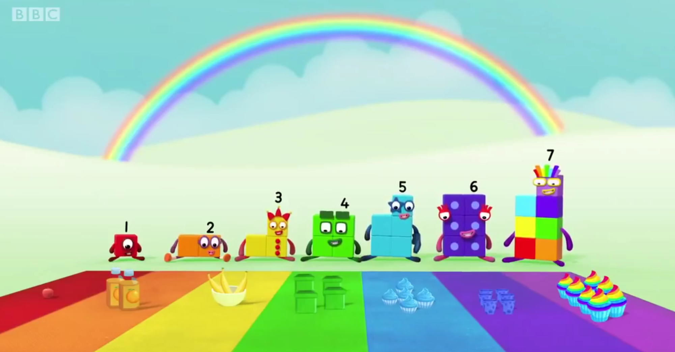
Images © 2017 Alphablocks Ltd. All Rights Reserved.
Images © 2017 Alphablocks Ltd. All Rights Reserved.
Notes:
Use this slide to discuss the episode.
What did you notice?
Have you ever been on a picnic? What sort of food do you take? How do you make sure you have enough food for everyone? What do you notice about the picnic food in this picture (the Numberblocks have the amount of food items to match their own number)? Is this fair?
Use A3 coloured paper laid out on the carpet or table to match the colours of the seven colours of the Numberblocks. On some trays put some food items for each Numberblock, e.g.
1 strawberry for One,
2 carrots for Two
3 cheese cubes for Three
4 pieces of kiwi fruit for Four
5 blueberries for Five
6 (dark red) grapes for Six
7 one of each thing for Seven.
Ask the children to look at their trays in groups and work out which food items go with which Numberblock by counting them (there will be one of everything left for Seven to have, but that won’t be obvious to begin with).
Count out and hand out the picnic food on to plates on the coloured paper.

Slide 9
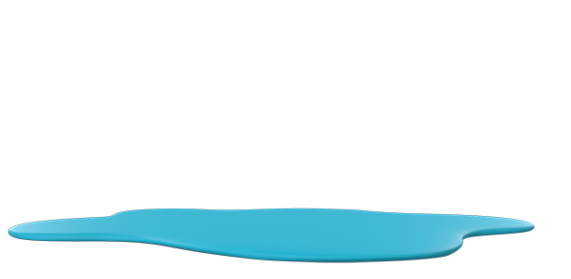
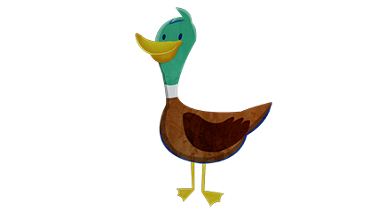
Images © 2017 Alphablocks Ltd. All Rights Reserved.
Notes:
Use this slide to practise counting by observing movement.
Count the ducks as they land on the pond.
This slide is animated.
Click 1: ducks fly on to the pond, one after another.

Slide 10
Images © 2017 Alphablocks Ltd. All Rights Reserved.
Notes:
These are the colours of the rainbow (red, orange, yellow, green, blue, indigo, and violet).
Count and name the colours. How could you count these without touching the colours?
Name the colours and tag with fingers. Count the fingers from the inside out, or the outside in.

Slide 11
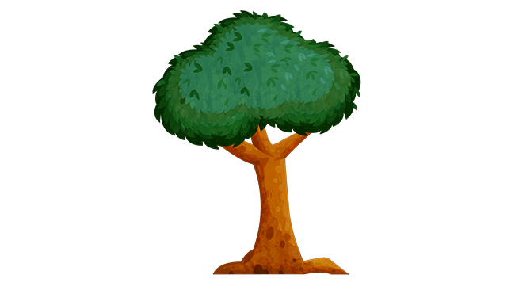
Click on the apples
Images © 2017 Alphablocks Ltd. All Rights Reserved.
Notes:
Use this slide to discuss how to count the apples arranged unevenly.
How could we count these apples?
Model counting incorrectly by tagging an apple twice and saying there are eight apples.
How can we make sure we only count each apple once?
Suggest that counting in a line makes it easier to see what has been counted and what hasn’t.
Click on the apples for them to fall from the tree and form a line.

Slide 12
Enabling Environments

Slide 13
Enabling Environments
Playing and Exploring
Leave out the picnic rug for the Numberblocks and allow the children to make and prepare food for the Numberblocks to 7.
Active Learning
Notice how the children count out items when gathering from collections. Do they count out one by one, or do they take a handful to estimate a quantity? Do they line up items to count them? Suggest: I wonder if I have the right amount?
Creating and Thinking Critically
Encourage the children to sort collections of objects into groups of 7 or not 7. Compare quantities to 7. How could you check to see if there are more than or less than 7 objects?

Slide 14
Learning Together in Y1

Slide 15
Images © 2017 Alphablocks Ltd. All Rights Reserved.
Notes:
Use this slide to discuss the episode.
What did you notice?
Have you ever been on a picnic? What sort of food do you take? How do you make sure you have enough food for everyone? What do you notice about the picnic food in this picture (the Numberblocks have the amount of food items to match their own number)? Is this fair?

Slide 16
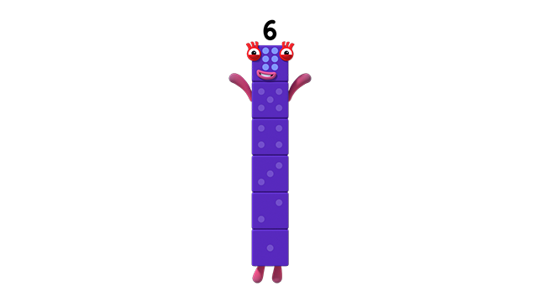
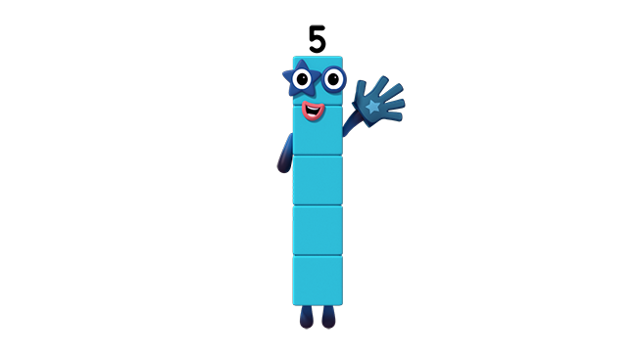
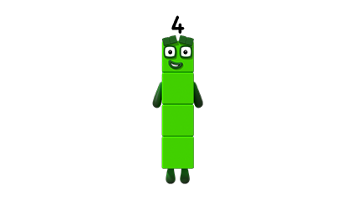
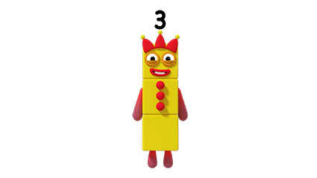
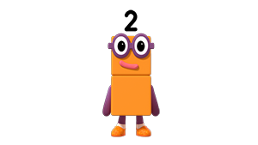
Click just once
Images © 2017 Alphablocks Ltd. All Rights Reserved.
Notes:
Ask the children to make Seven from linking cubes using colours as close as possible to the ones in the rainbow.
When the children have made them, use the animation to describe how to build Seven.
The red is first,
The orange is second,
The yellow is third, etc.
Only one click is needed for all the Numberblocks to appear.

Slide 17
Images © 2017 Alphablocks Ltd. All Rights Reserved.
Notes:
In small groups ask the children to build a staircase from the Numberblocks colours.
What patterns can you see?
Notice how each number is one more than the previous number.
7 is one more than 6.

Slide 18
7 is 1 more than 6.
7 is 2 more than 5.
7 is 3 more than 4.
7 is 4 more than 3.
7 is 5 more than 2.
7 is 6 more than 1.
Images © 2017 Alphablocks Ltd. All Rights Reserved.
Notes:
Use this slide to compare 7 to other numbers less than 7.
Each child should have a stick of seven cubes. Children work in pairs where one child keeps their 7 whole, and the other reduces their stick in turn to match the number that 7 is being compared to.
This slide is animated.
What do you notice (Seven is taller than Six)?
Seven is one block taller than Six.
Click 1: the violet block jumps up and down. This shows that when one block is removed the two towers are the same.
Click 2: the stem sentence appears. Read it aloud together. Ask the children to model this comparison with their sticks of linking cubes.
The animation continues with 7 being compared to each number less than 7.

Slide 19
6 is 1 less than 7.
5 is 2 less than 7.
4 is 3 less than 7.
3 is 4 less than 7.
2 is 5 less than 7.
1 is 6 less than 7.
Images © 2017 Alphablocks Ltd. All Rights Reserved.
Notes:
Use this slide in a similar way to the previous slide, but this time focus on how much less the smaller number is compared to 7.
This slide is animated.
What do you notice (Six is shorter than Seven)?
Six is one block shorter than Seven.

Slide 20
is 1 more than
is more than
is 1 less than
is less than
is more than
is more than
is less than
is less than .
Notes:
Use this slide for independent practice, and then complete together to check understanding.

