Slide 1
2.24 Division: dividing by two-digit divisors
Representations | Year 6
Multiplication and Division

Slide 2
How to use this presentation
You can find the teacher guide 2.24 Division: dividing by two-digit divisors by following the link below.

Slide 3
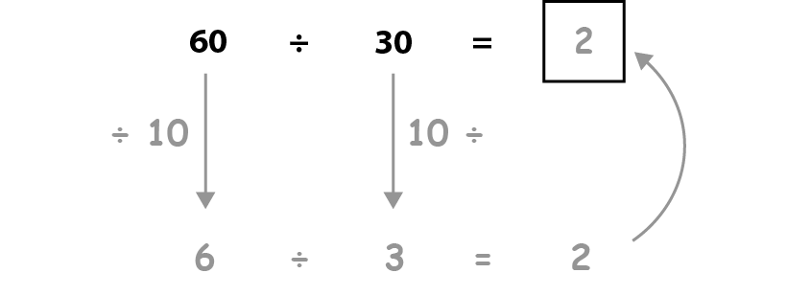
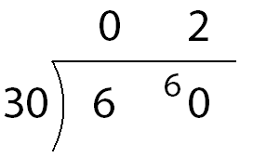
2.24 Division: 2-digit divisors Step 1:1
Notes:
Sixty children are placed into classes of thirty.
How many classes are there?

Slide 4
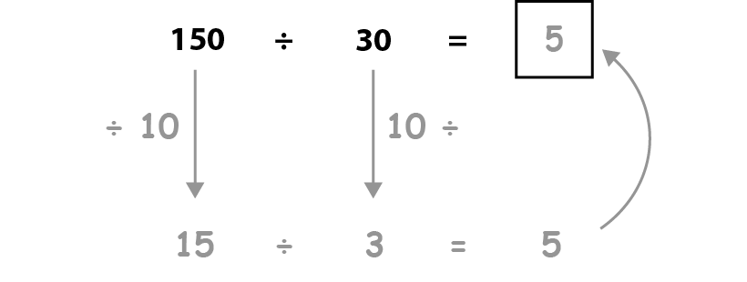
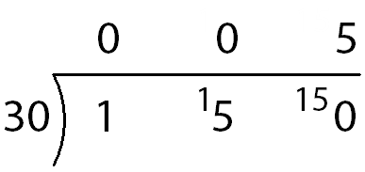
2.24 Division: 2-digit divisors Step 1:1

Slide 5
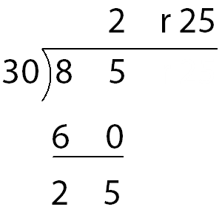
2.24 Division: 2-digit divisors Step 1:2
Notes:
Eighty-five conkers are shared equally between thirty children.
How many conkers does each child get?

Slide 6
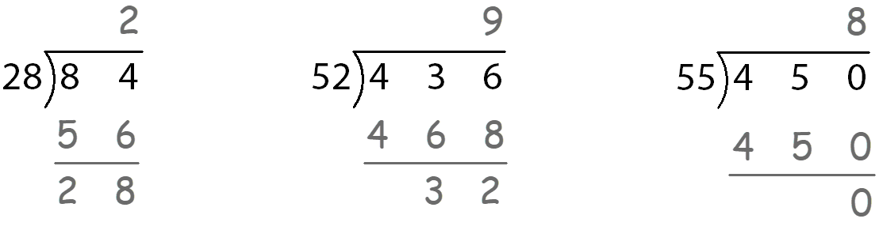
2.24 Division: 2-digit divisors Step 1:7
Spot the mistakes.
Notes:
Spot the mistakes.
Explain your answers and correct the calculations.

Slide 7
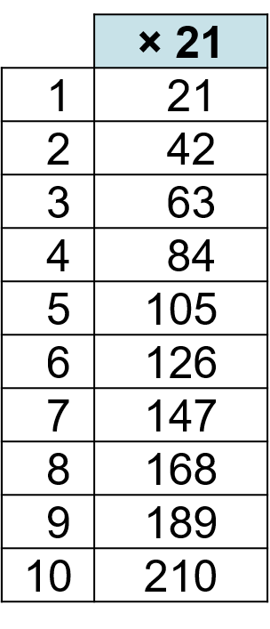
2.24 Division: 2-digit divisors Step 2:1

Slide 8

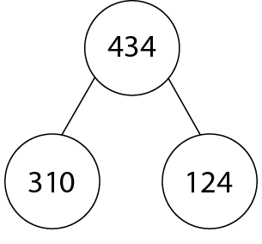
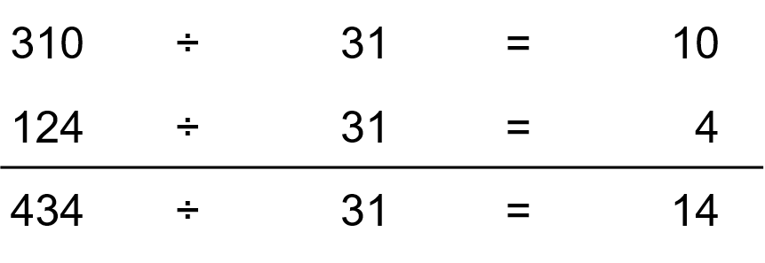
2.24 Division: 2-digit divisors Step 2:2
434 ÷ 31 =
14
Notes:
Becky has 434 cm of ribbon to wrap up prizes for a school competition.
Each prize needs 31 cm of ribbon.
How many prizes can she wrap?

Slide 9
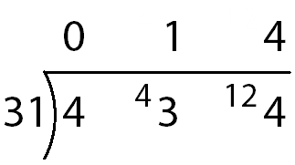
2.24 Division: 2-digit divisors Step 2:3
4 hundreds ÷ 31 = 0 hundreds r 4 hundreds
Notes:
Write ‘0’ in the hundreds column…

Slide 10
2.24 Division: 2-digit divisors Step 2:3
4 hundreds = 40 tens
4 hundreds ÷ 31 = 0 hundreds r 4 hundreds
Notes:
… and write ‘4’ to the left of the tens digit of the dividend.

Slide 11
2.24 Division: 2-digit divisors Step 2:3
43 tens ÷ 31 = 1 ten r 12 tens
4 hundreds = 40 tens
Notes:
Write ‘1’ in the tens column…

Slide 12
2.24 Division: 2-digit divisors Step 2:3
12 tens = 120 ones
43 tens ÷ 31 = 1 ten r 12 tens
Notes:
… and write ‘12’ to the left of the ones digit of the dividend.

Slide 13
2.24 Division: 2-digit divisors Step 2:3
124 ones ÷ 31 = 4 ones
12 tens = 120 ones
Notes:
Write ‘4’ in the ones column.

Slide 14
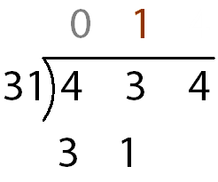
2.24 Division: 2-digit divisors Step 2:4
Step 1 – write the divisor, frame and dividend

Slide 15
2.24 Division: 2-digit divisors Step 2:4
Step 1 – write the divisor, frame and dividend
Step 2 – divide the 100s
Notes:
Write ‘0’ in the hundreds column of the answer line.

Slide 16
2.24 Division: 2-digit divisors Step 2:4
Step 3 – exchange 100s for 10s,
combine with the existing 10s and divide…
Step 2 – divide the 100s
1 ten × 31 = 31 tens
Notes:
Write ‘1’ in the tens column of the answer line and write ‘31’ underneath the ‘43’.

Slide 17
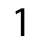
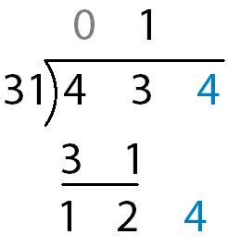
2.24 Division: 2-digit divisors Step 2:4
Step 3 – exchange 100s for 10s,
combine with the existing 10s and divide…
Step 4 – subtract to find the remainder
1 ten × 31 = 31 tens
1 ten × 31 = 31 tens
Notes:
Write ‘12’ underneath the ‘31’.

Slide 18
2.24 Division: 2-digit divisors Step 2:4
Step 4 – subtract to find the remainder
Step 5 – exchange 10s for 1s and
combine with the existing 1s
1 ten × 31 = 31 tens
1 ten × 31 = 31 tens
Notes:
Write ‘4’ after the ‘12’.

Slide 19
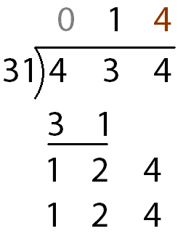
2.24 Division: 2-digit divisors Step 2:4
Step 5 – exchange 10s for 1s and
combine with the existing 1s
Step 6 – divide the 1s
1 ten × 31 = 31 tens
1 ten × 31 = 31 tens
4 ones × 31 = 124 ones
Notes:
Write ‘4’ in the ones column of the answer line and write ‘124’ underneath the ‘124’, aligning the digits.

Slide 20
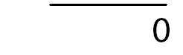
2.24 Division: 2-digit divisors Step 2:4
Step 6 – divide the 1s
Step 7 – subtract to show there is no remainder
1 ten × 31 = 31 tens
1 ten × 31 = 31 tens
4 ones × 31 = 124 ones
4 ones
Notes:
Write ‘0’ underneath the ‘124’.

Slide 21
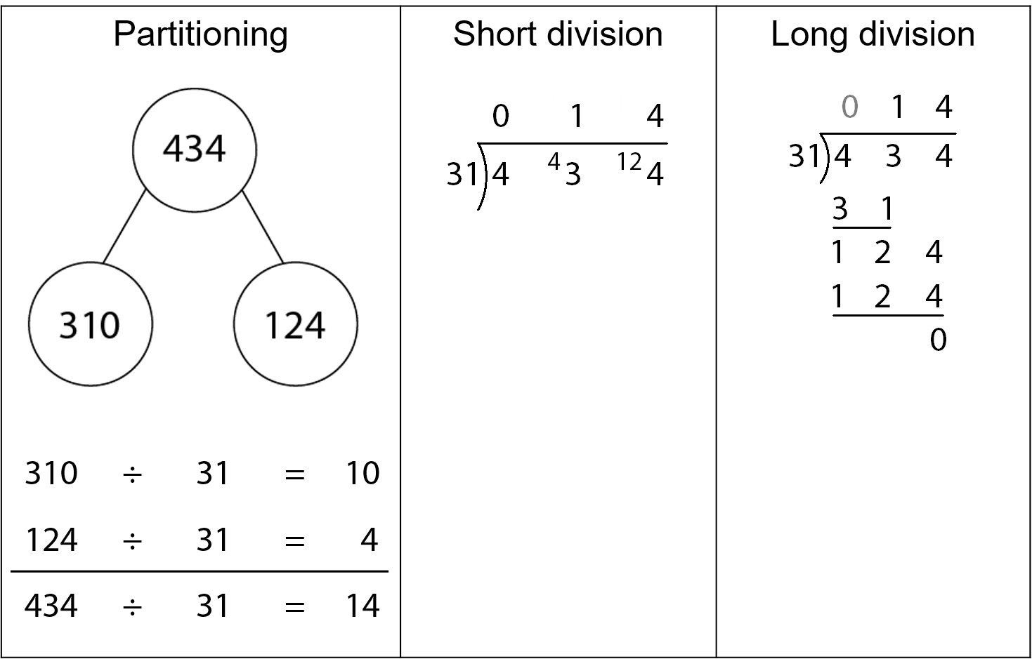
2.24 Division: 2-digit divisors Step 2:5

Slide 22
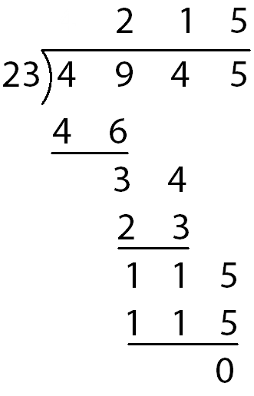
2.24 Division: 2-digit divisors Step 2:8

Slide 23
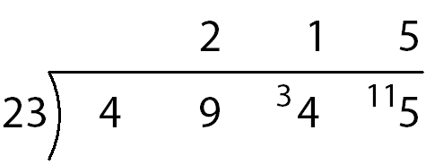
2.24 Division: 2-digit divisors Step 2:8

Slide 24
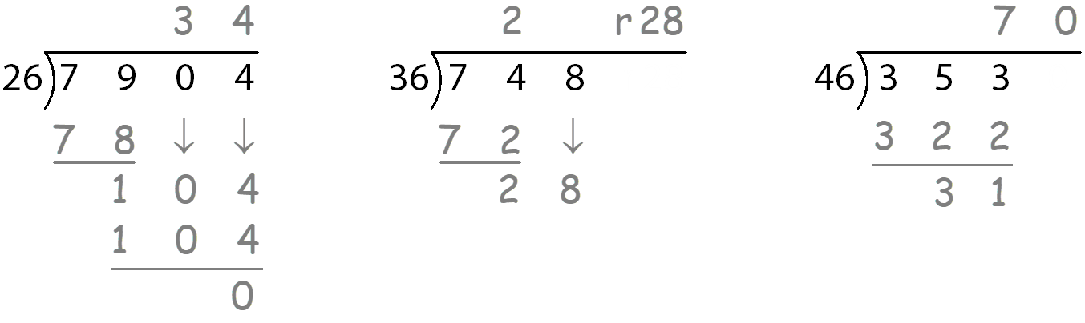
2.24 Division: 2-digit divisors Step 2:9
Spot the mistakes.
Notes:
Spot the mistakes.
Explain your answers and correct the calculations.

Slide 25
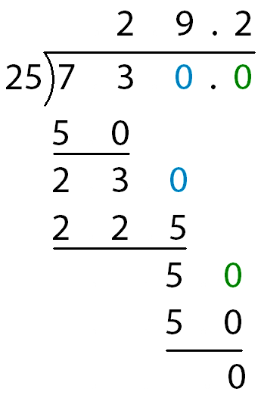
2.24 Division: 2-digit divisors Step 3:2
730 ÷ 25
Step 1 – calculate the whole-number quotient
Notes:
Long division – remainder converted to decimal fraction

Slide 26
2.24 Division: 2-digit divisors Step 3:2
730 ÷ 25
Step 1 – calculate the whole-number quotient
Step 2 – introduce the decimal point
Notes:
Long division – remainder converted to decimal fraction
There is a remainder.
To represent this as a decimal fraction, first write a decimal point after the ones digit of both the dividend and the quotient.
Write a place-holder zero in the tenths column of the dividend.

Slide 27
2.24 Division: 2-digit divisors Step 3:2
730 ÷ 25
Step 3 – continue
Step 2 – introduce the decimal point
Notes:
Long division – remainder converted to decimal fraction
Write ‘0’ after the ‘5’.

Slide 28
2.24 Division: 2-digit divisors Step 3:2
730 ÷ 25
Step 3 – continue
Step 4 – complete the calculation
Notes:
Long division – remainder converted to decimal fraction
Write ‘2’ in the tenths column of the answer line and write ‘50’ underneath the ‘50’.
Write ‘0’ underneath the ‘50’.

Slide 29
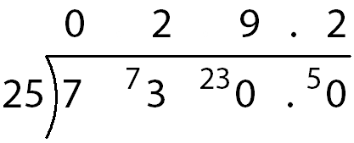
2.24 Division: 2-digit divisors Step 3:2
730 ÷ 25
Notes:
Short division – remainder converted to decimal fraction

Slide 30

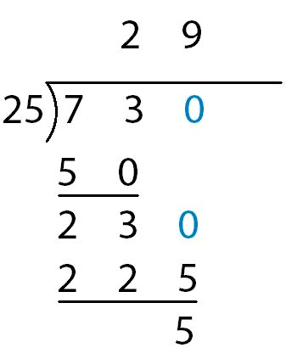
2.24 Division: 2-digit divisors Step 3:3
Step 1 – calculate the whole-number quotient
Notes:
Long division – remainder converted to proper fraction

Slide 31
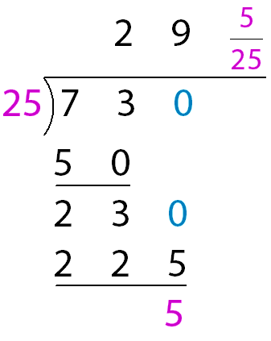
2.24 Division: 2-digit divisors Step 3:3
Step 1 – calculate the whole-number quotient
Step 2 – represent the remainder as a fraction
Notes:
Long division – remainder converted to proper fraction
There is a remainder.
To represent this as a fraction, write the remainder as the numerator and the divisor as the denominator.

Slide 32
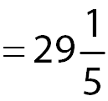
2.24 Division: 2-digit divisors Step 3:3
Step 2 – represent the remainder as a fraction
Step 3 – simplify the fraction
Notes:
Long division – remainder converted to proper fraction

Slide 33
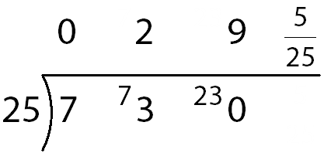
2.24 Division: 2-digit divisors Step 3:3
r 5
Notes:
Short division – remainder converted to proper fraction

Slide 34
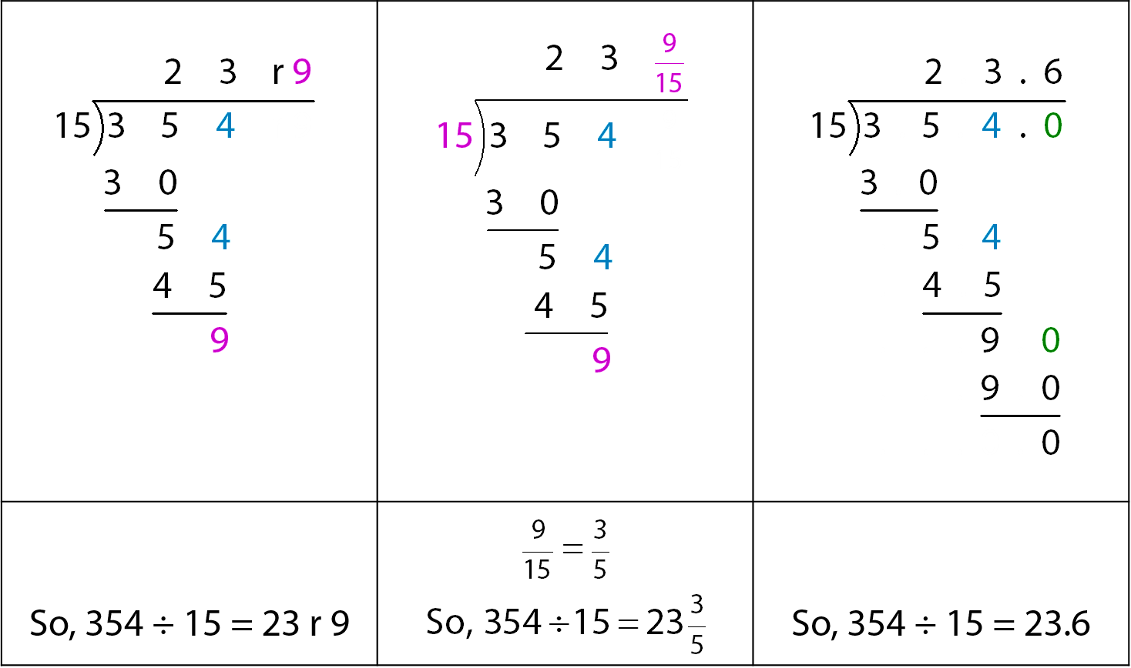
2.24 Division: 2-digit divisors Step 3:4
354 ÷ 15 = ?

Slide 35
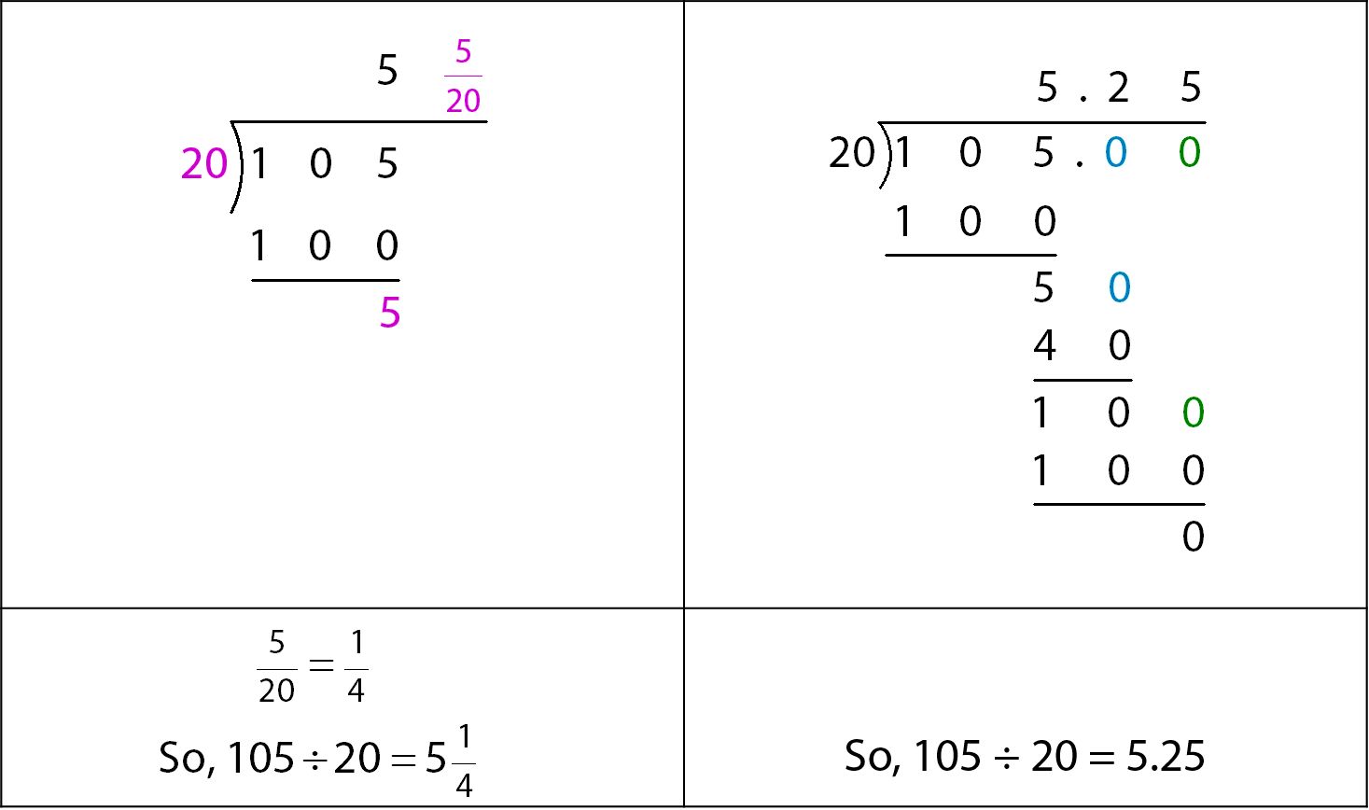
2.24 Division: 2-digit divisors Step 3:5
105 ÷ 20 = ?

Slide 36
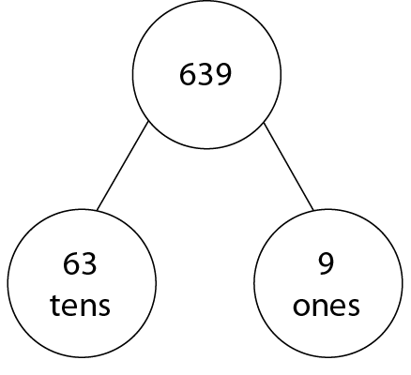
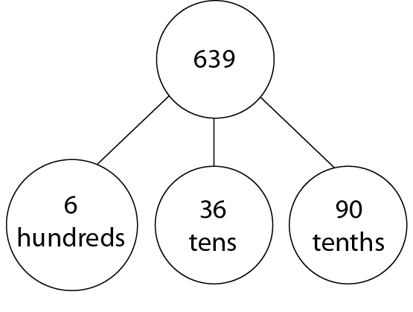
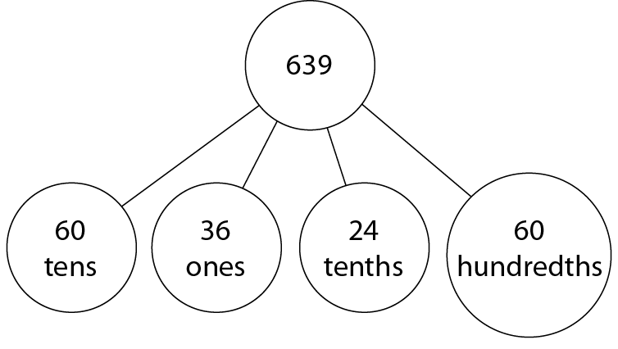
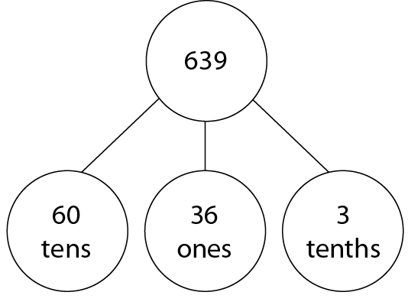
2.24 Division: 2-digit divisors Step 3:7
639 ÷ 12
Notes:
Sammy calculates 639 ÷ 12 using long division.
She realises that this is the same as partitioning 639, but not as 6 hundreds, 3 tens and 9 ones.
Which way has 639 been partitioned?

