Slide 1
Year 4, Unit 8
Review of Fractions

Slide 2
Year 4, Unit 8
These materials heavily reflect the prioritisation approach of the ready-to-progress criteria in the DfE Primary Mathematics Guidance 2020 and on the PPTs that exemplify them on the NCETM website. They also include other relevant National Curriculum content. Related sections of the NCETM Primary Mastery Professional Development Materials provide small-step teaching guidance.
Ready-to-progress criteria addressed by this unit
Teaching of this unit supports the following criteria from the ‘DfE Mathematics Guidance: key stages 1 & 2’ (the 335-page document available as a download)
3F-1 Page 120
Prior learning
There are no specific ready-to-progress criteria supporting the prior learning for this unit.

Slide 3
Contents
The links below take you to the starting slide of each learning outcome.
1 | Pupils identify a whole and the parts that make it up
2 | Pupils explain why a part can only be defined when in relation to a whole
3 | Pupils identify the number of equal or unequal parts in a whole
4 | Pupils identify equal parts when they do not look the same
5 | Pupils explain the size of the part in relation to the whole
6 | Pupils construct a whole when given a part and the number of parts
Click the arrow button to return to this Contents slide.

Slide 4
Year 4, Unit 8, Learning Outcome 1
Learning Outcome 1
Pupils identify a whole and the parts that make it up
The following slides have been collated to support the teaching of this learning outcome.

Slide 5
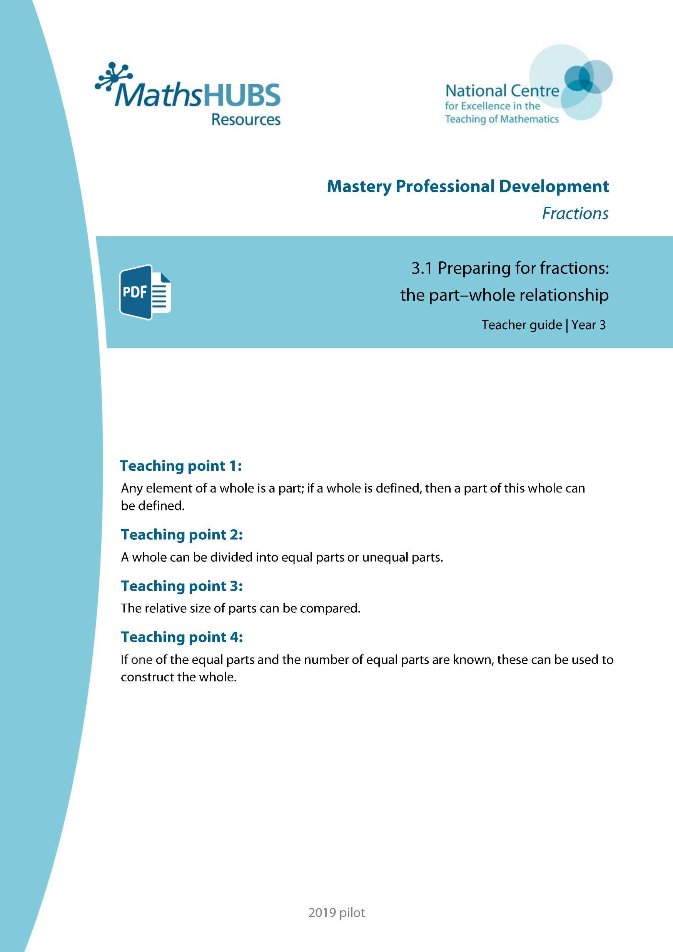
Year 4, Unit 8, Learning Outcome 1
Additional teacher guidance for this outcome should be read first and can be found in this segment of the NCETM Primary Mastery Professional Development Materials:
3.1 Preparing for fractions: the part whole relationship
The spine materials are divided into ‘teaching points’ and ‘steps in learning’.
Teaching point | Steps in learning | Pages
1 | 1:1-1:4 | 3-6

Slide 6
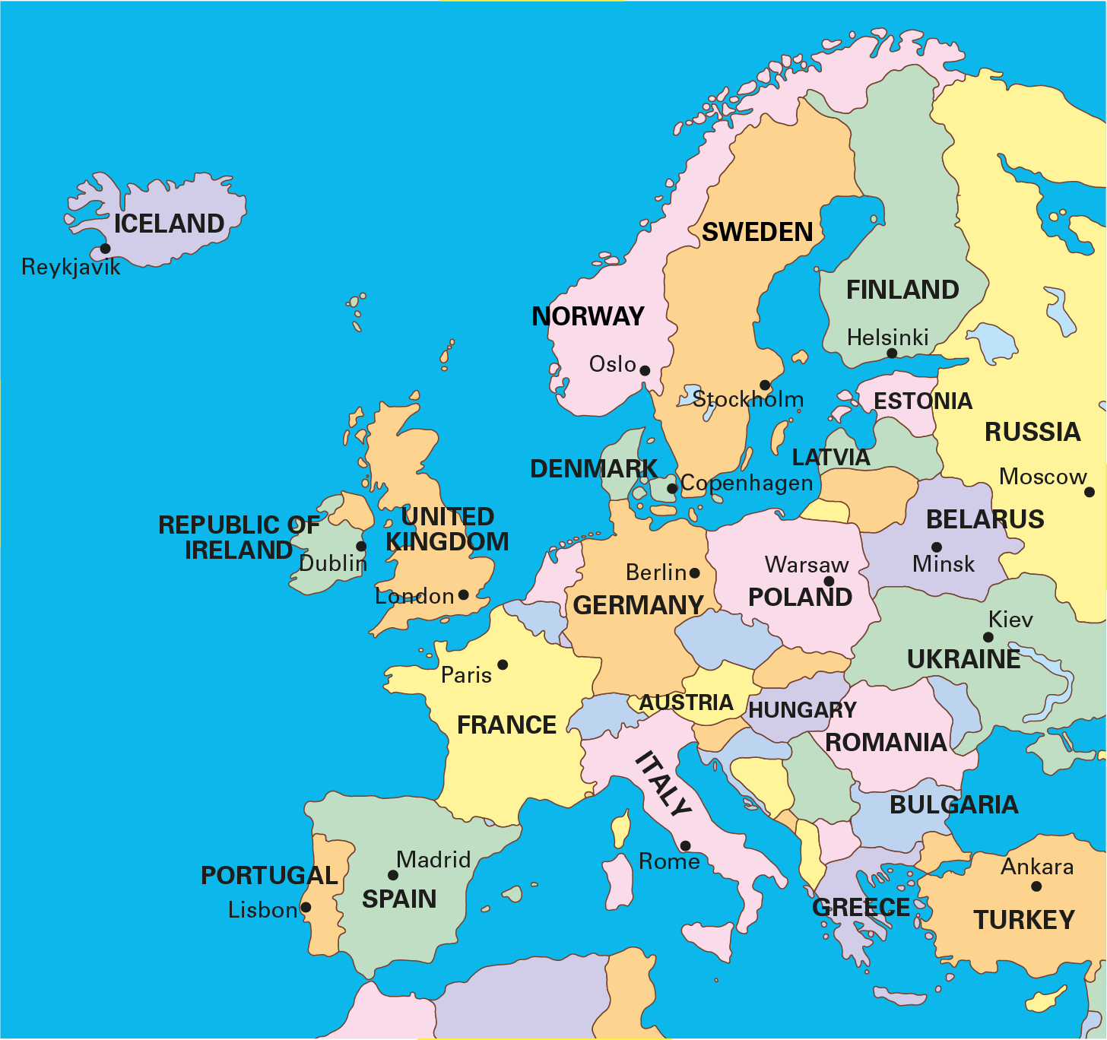
3.1 The part–whole relationship Step 1:1
Notes:
If Europe is the whole, then the United Kingdom is part of the whole.

Slide 7
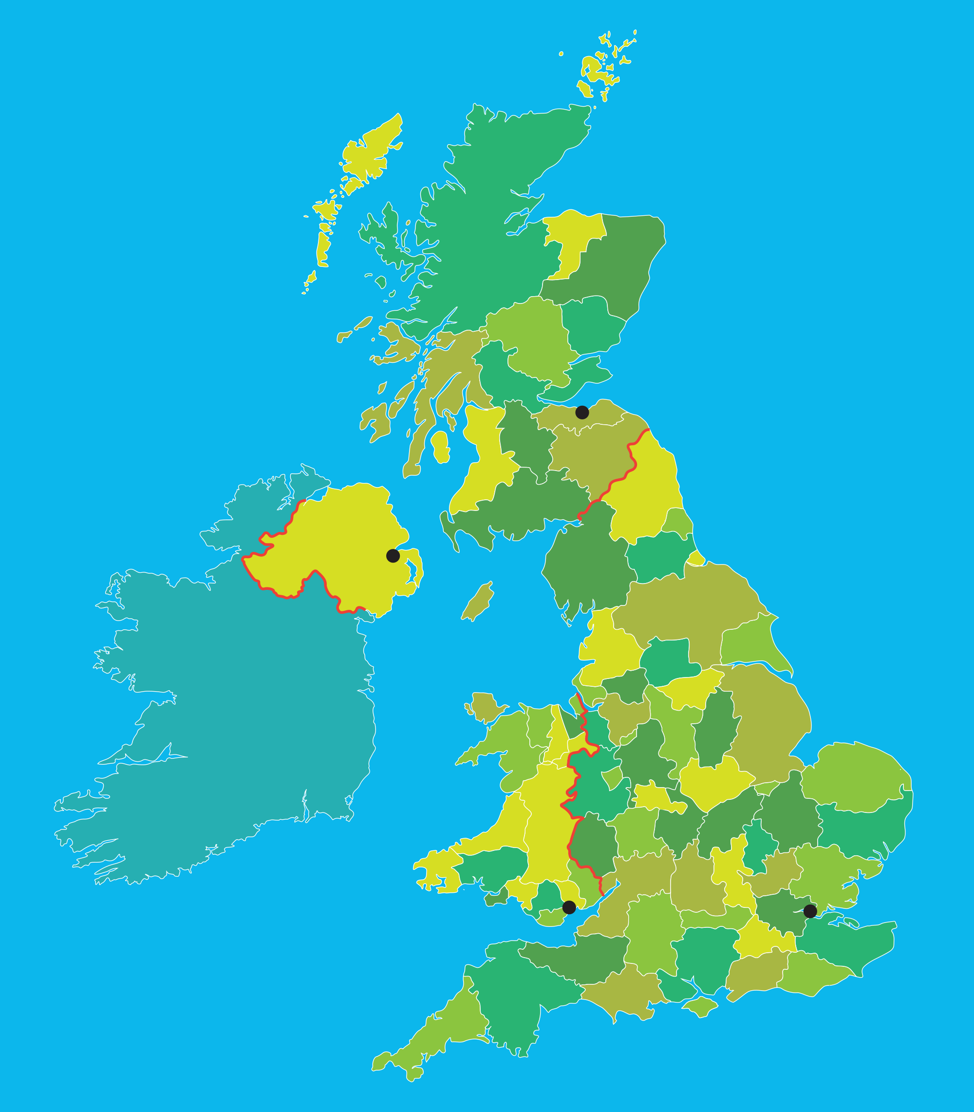
3.1 The part–whole relationship Step 1:2
Scotland
Edinburgh
Northern
Ireland
Belfast
Wales
England
Cardiff
London
Notes:
If the United Kingdom is the whole, then London is part of the whole.

Slide 8
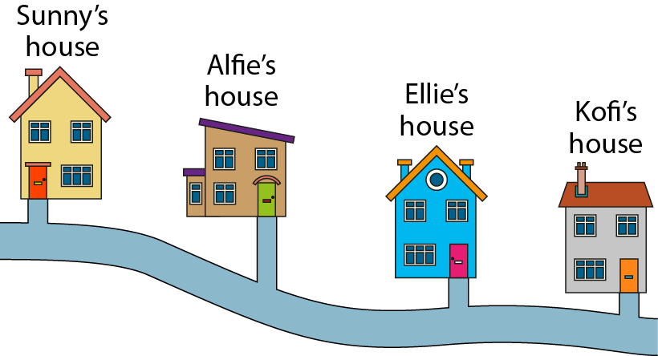
3.1 The part–whole relationship Step 1:4
Notes:
If the journey from Sunny’s house to Kofi’s house is the whole, then the
journey from Sunny’s house to Alfie’s house is part of the whole.

Slide 9
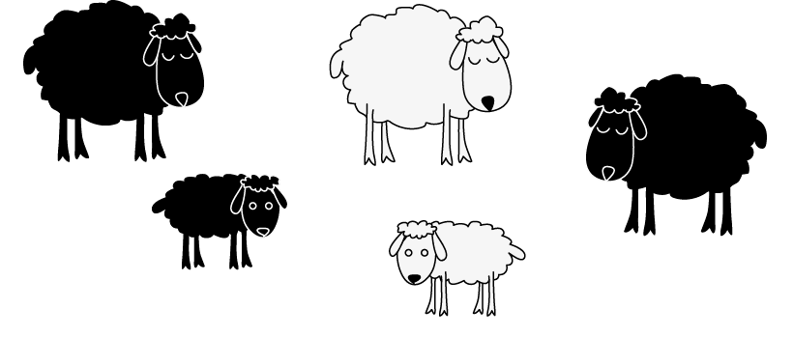
3.1 The part–whole relationship Step 1:4
Notes:
If the group of sheep is the whole, then the black sheep are part of the whole.

Slide 10

3.1 The part–whole relationship Step 1:4
Notes:
If the week is the whole, then Tuesday is part of the whole.

Slide 11
Year 4, Unit 8, Learning Outcome 2
Learning Outcome 2
Pupils explain why a part can only be defined when in relation to a whole
The following slides have been collated to support the teaching of this learning outcome.

Slide 12
Year 4, Unit 8, Learning Outcome 2
Additional teacher guidance for this outcome should be read first and can be found in this segment of the NCETM Primary Mastery Professional Development Materials:
3.1 Preparing for fractions: the part whole relationship
The spine materials are divided into ‘teaching points’ and ‘steps in learning’.
Teaching point | Steps in learning | Pages
1 | 1:5 -1:7 | 6-9

Slide 13


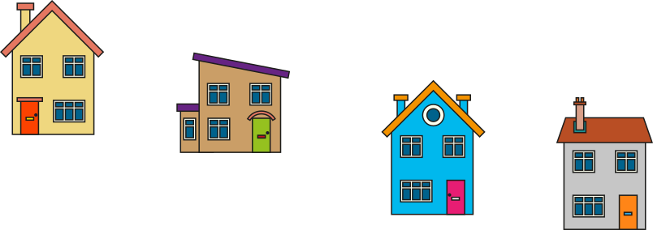


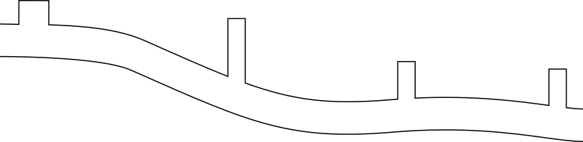





3.1 The part–whole relationship Step 1:5
Notes:
If the journey from Sunny’s house to Kofi’s house is the whole, then the
journey from Sunny’s house to Alfie’s house is part of the whole.
The part is smaller than the whole.

Slide 14
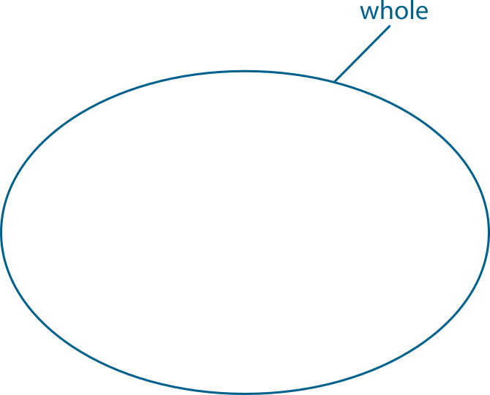
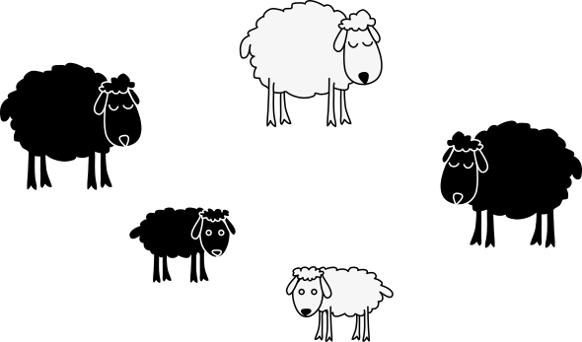
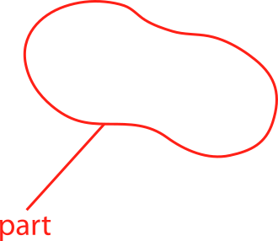
3.1 The part–whole relationship Step 1:5
Notes:
If the group of sheep is the whole, then the lambs are part of the whole.
The part is smaller than the whole.

Slide 15
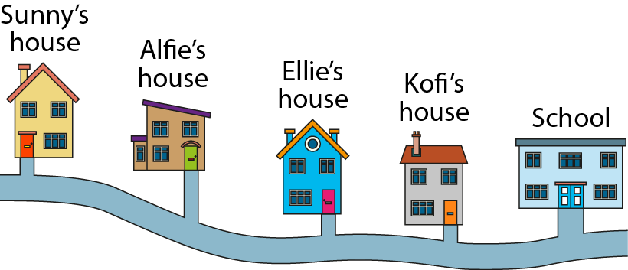
3.1 The part–whole relationship Step 1:6
Notes:
If the journey from Sunny’s house to Kofi’s house is the whole, then the journey from Sunny’s house to Alfie’s house is part of the whole.
If the journey from Sunny’s house to school is the whole, then the journey from Sunny’s house to Kofi’s house is part of the whole.
If the journey from Sunny’s house to school is the whole, then the journey from Sunny’s house to Alfie’s house is part of the whole.

Slide 16
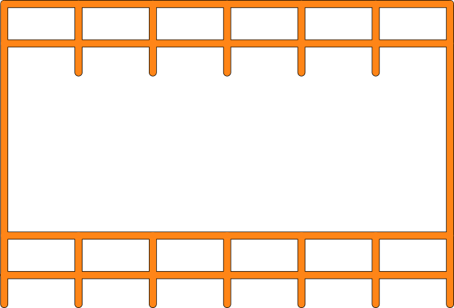
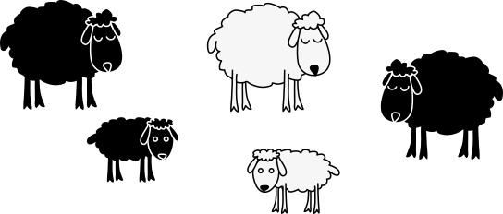
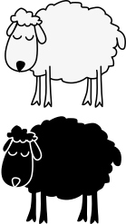
3.1 The part–whole relationship Step 1:6
Notes:
Look at our original group of sheep. Extend the group of sheep.
If all the sheep is the whole, then the sheep in the pen are part of the whole.
If the sheep in the pen are the whole, then the white sheep in the pen are part of the whole.
If the black sheep are the whole, then the black lamb is part of the whole.

Slide 17
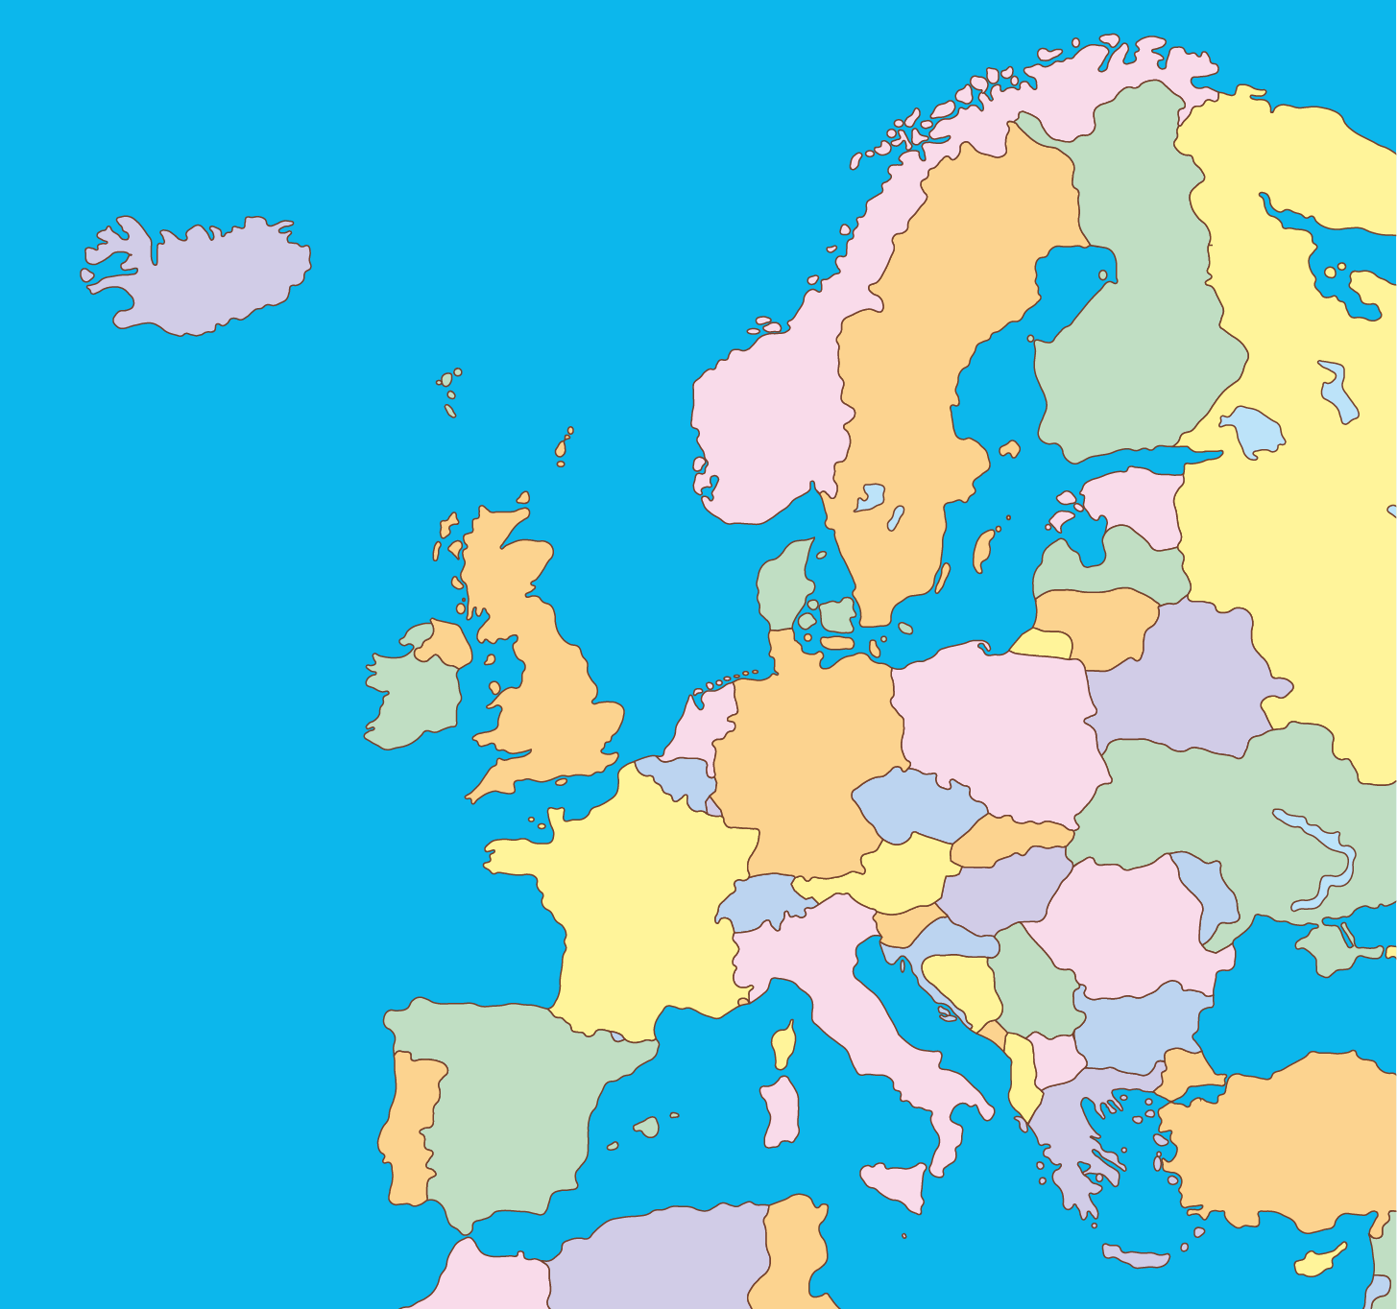
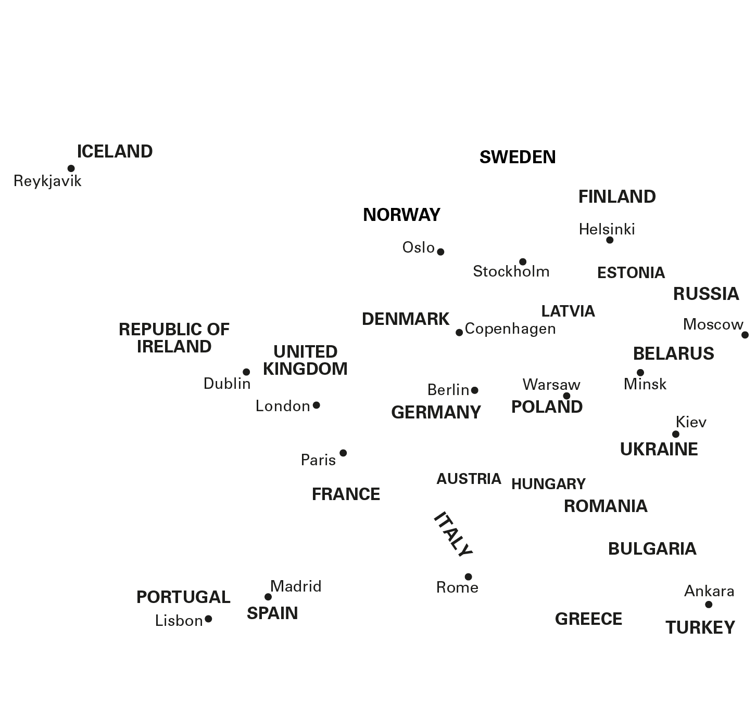
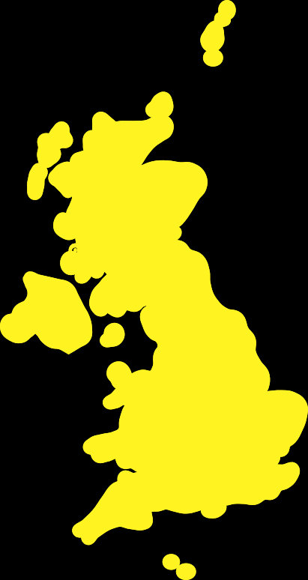

3.1 The part–whole relationship Step 1:7
If the UK is the whole,
then Italy is part of the whole.
✗
✓
then Italy is not part of the whole.

Slide 18
Year 4, Unit 8, Learning Outcome 3
Learning Outcome 3
Pupils identify the number of equal or unequal parts in a whole
The following slides have been collated to support the teaching of this learning outcome.

Slide 19
Year 4, Unit 8, Learning Outcome 3
Additional teacher guidance for this outcome should be read first and can be found in this segment of the NCETM Primary Mastery Professional Development Materials:
3.1 Preparing for fractions: the part whole relationship
The spine materials are divided into ‘teaching points’ and ‘steps in learning’.
Teaching point | Steps in learning | Pages
2 | 2:1-2:4 | 10-13

Slide 20
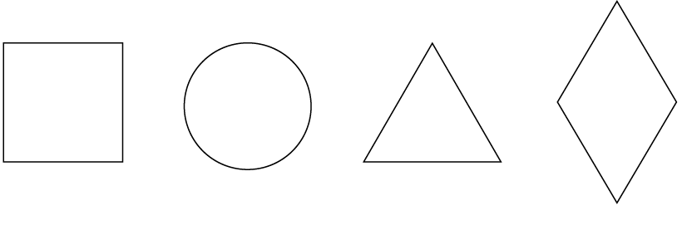
3.1 The part–whole relationship Step 2:1

Slide 21
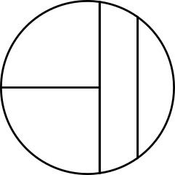
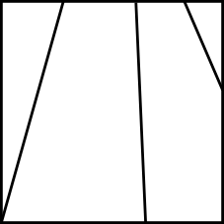

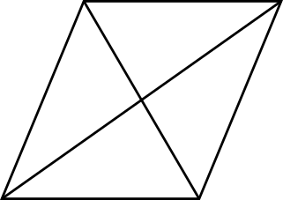
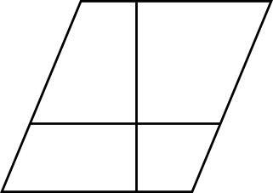
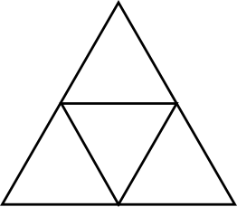
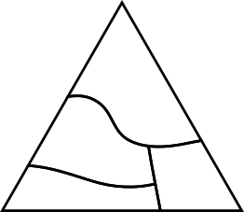
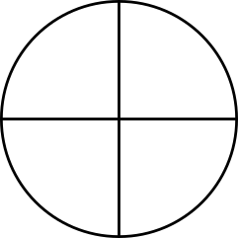
3.1 The part–whole relationship Step 2:2
Equal parts
Unequal parts

Slide 22
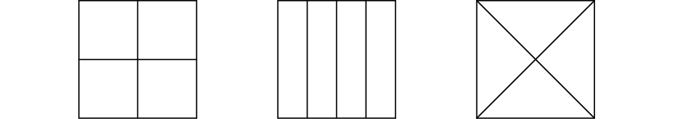
3.1 The part–whole relationship Step 2:2
Equal or unequal parts?
Notes:
Explain to children that these are three equal-sized squares.

Slide 23

3.1 The part–whole relationship Step 2:2
Equal or unequal parts?

Slide 24
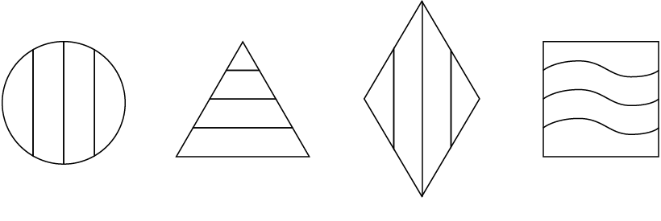
3.1 The part–whole relationship Step 2:2
Equal or unequal parts?

Slide 25
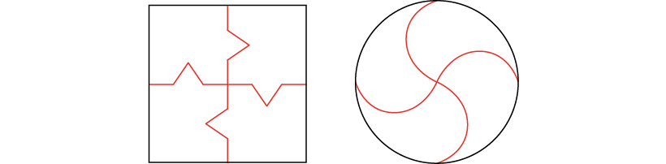
3.1 The part–whole relationship Step 2:3
Notes:
It is only possible to divide a whole into parts using straight lines.
Do you agree with this statement?

Slide 26


3.1 The part–whole relationship Step 2:4
4 equal parts
4 unequal parts

Slide 27
3.1 The part–whole relationship Step 2:4
Are all the parts of equal size?

Slide 28
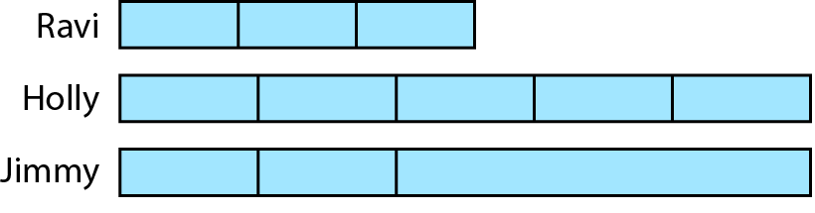
3.1 The part–whole relationship Step 2:4
Odd one out?
Notes:
Three children have folded their paper strips in different ways.
Which strip is the odd one out?
Can you find a way to make each of the strips the odd one out?

Slide 29
Year 4, Unit 8, Learning Outcome 4
Learning Outcome 4
Pupils identify equal parts when they do not look the same
The following slides have been collated to support the teaching of this learning outcome.

Slide 30
Year 4, Unit 8, Learning Outcome 4
Additional teacher guidance for this outcome should be read first and can be found in this segment of the NCETM Primary Mastery Professional Development Materials:
3.1 Preparing for fractions: the part whole relationship
The spine materials are divided into ‘teaching points’ and ‘steps in learning’.
Teaching point | Steps in learning | Pages
2 | 2:5 - 2:7 | 14-18

Slide 31
3.1 The part–whole relationship Step 2:5

Slide 32
3.1 The part–whole relationship Step 2:5

Slide 33

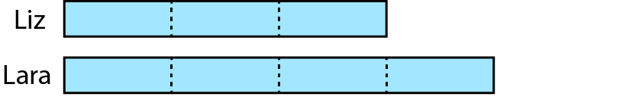
3.1 The part–whole relationship Step 2:5
Equal parts. Which is longer?
Notes:
Liz has folded her paper strip into three equal parts.
Lara has folded her paper strip into four equal parts.
Part of their strips are hidden.
Whose paper strip is longer?

Slide 34
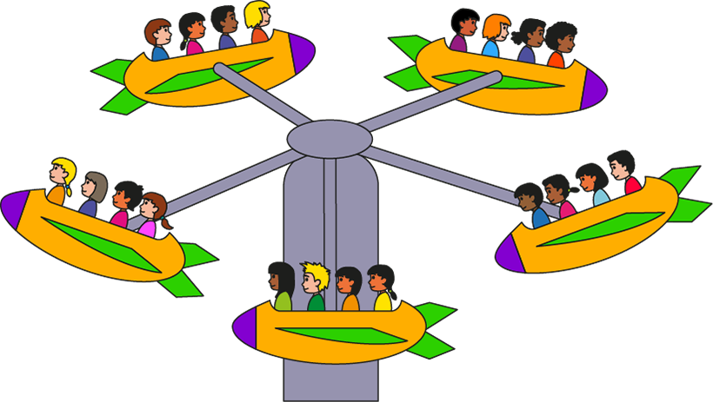
3.1 The part–whole relationship Step 2:6
Notes:
The parts are equal. I know this because the number of people in each part is the same.

Slide 35
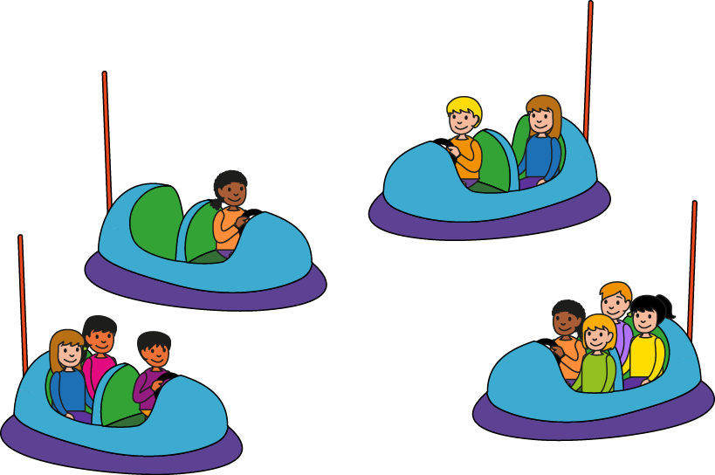
3.1 The part–whole relationship Step 2:6
Notes:
The parts are unequal. I know this because the number of people in each part is not the same.

Slide 36
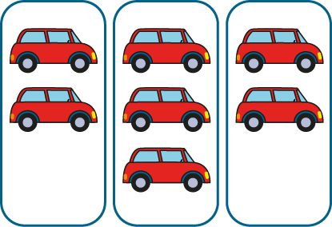
3.1 The part–whole relationship Step 2:6
Notes:
The parts are unequal. I know this because the number of cars in each part is not the same.

Slide 37


3.1 The part–whole relationship Step 2:6
Arrange into equal parts.
Notes:
Can we rearrange the objects so the parts become equal?

Slide 38
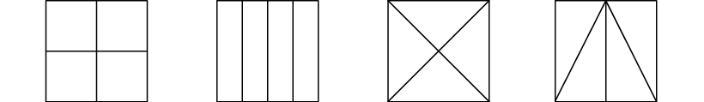
3.1 The part–whole relationship Step 2:7
Equal or unequal parts?

Slide 39
3.1 The part–whole relationship Step 2:7
What is the same about each part? What is different?

Slide 40
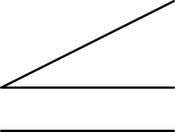

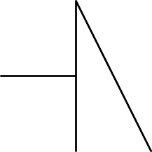
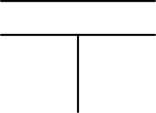
3.1 The part–whole relationship Step 2:7
Equal or unequal parts?
Notes:
Has the square been divided into equal or unequal parts?
What is the same about each part? What is different?

Slide 41
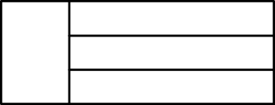
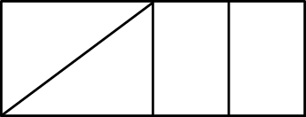

3.1 The part–whole relationship Step 2:7
Equal parts?
✗
✓

Slide 42
Year 4, Unit 8, Learning Outcome 5
Learning Outcome 5
Pupils explain the size of the part in relation to the whole
The following slides have been collated to support the teaching of this learning outcome.

Slide 43
Year 4, Unit 8, Learning Outcome 5
Additional teacher guidance for this outcome should be read first and can be found in this segment of the NCETM Primary Mastery Professional Development Materials:
3.1 Preparing for fractions: the part whole relationship
The spine materials are divided into ‘teaching points’ and ‘steps in learning’.
Teaching point | Steps in learning | Pages
3 | 3:1-3:6 | 19-24

Slide 44

3.1 The part–whole relationship Step 3:1
What is the same? What is different?
Notes:
The yellow part is a larger part of the whole circle than the red part.
The red part and the blue part are equally-sized parts of the whole circle.

Slide 45
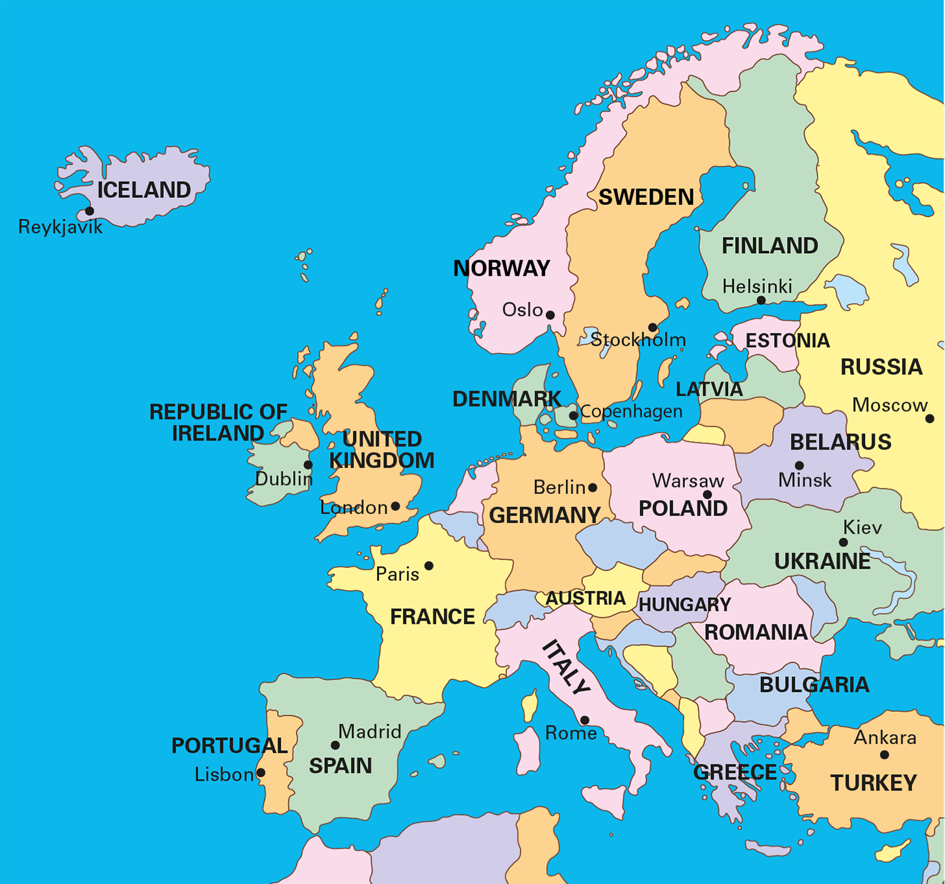
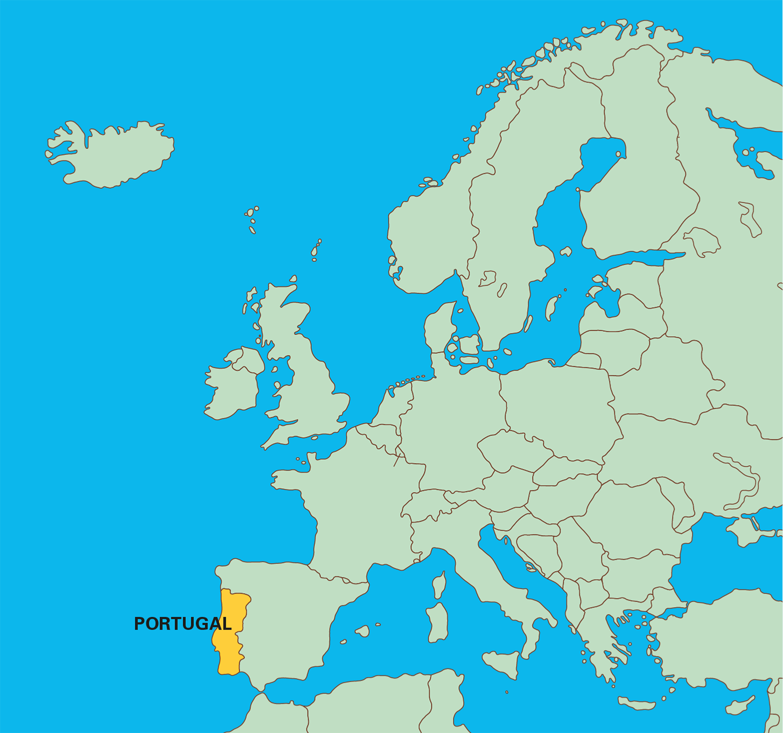
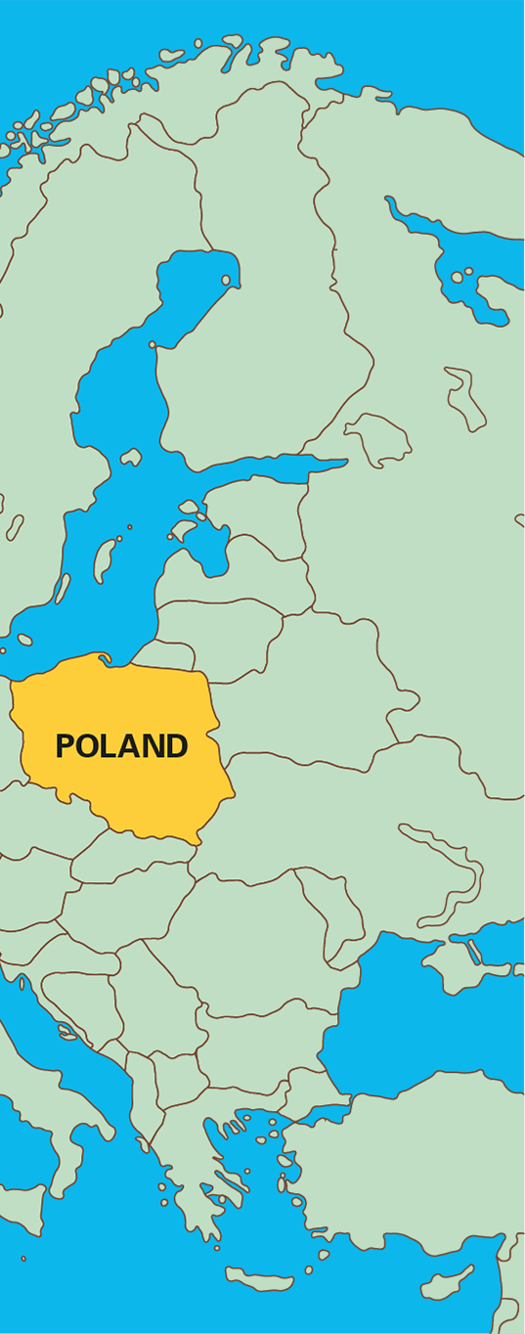
3.1 The part–whole relationship Step 3:2
Notes:
Poland is a bigger part of Europe than Portugal is.

Slide 46
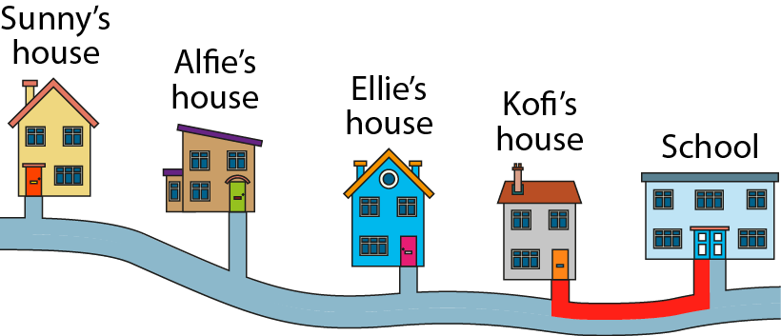
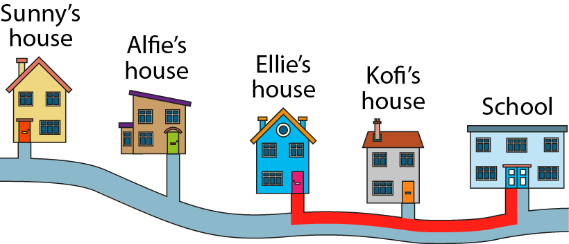
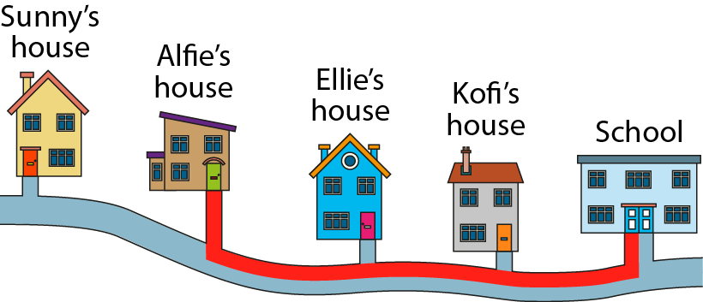
3.1 The part–whole relationship Step 3:2

Slide 47



3.1 The part–whole relationship Step 3:2
Notes:
In the first set of counters, the yellow counters make up a smaller part of the whole than in the second set.

Slide 48
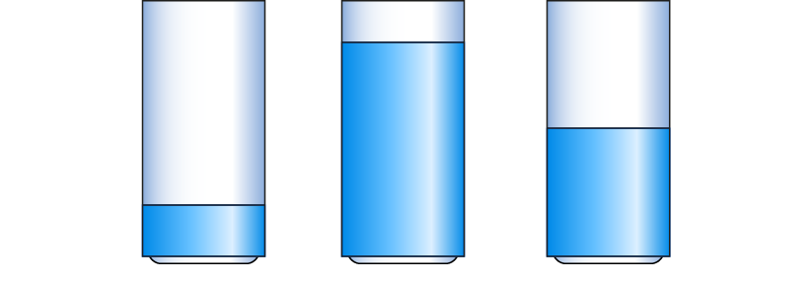
3.1 The part–whole relationship Step 3:2

Slide 49




3.1 The part–whole relationship Step 3:3
What is the same? What is different?
Notes:
• Basil says 'One part is shaded in each image. This means the same amount of each whole is shaded'.
• Jess says 'Each whole is one part larger than the previous whole. Only one part of each whole is shaded. This means that each time a smaller amount of the whole is shaded'.
Who is correct?

Slide 50




3.1 The part–whole relationship Step 3:4
What is the same? What is different?

Slide 51


3.1 The part–whole relationship Step 3:4
What is the same? What is different?

Slide 52




3.1 The part–whole relationship Step 3:4
What is the same? What is different?

Slide 53



3.1 The part–whole relationship Step 3:5
What is the same? What is different?

Slide 54
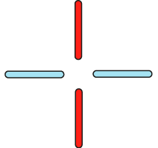


3.1 The part–whole relationship Step 3:5
What is the same? What is different?

Slide 55
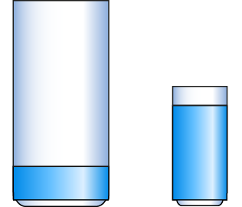
3.1 The part–whole relationship Step 3:6
Notes:
The large glass is nearly empty. A smaller part of the glass has water in it.
The small glass is nearly full. A larger part of the glass has water in it.

Slide 56
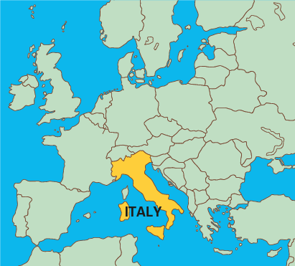
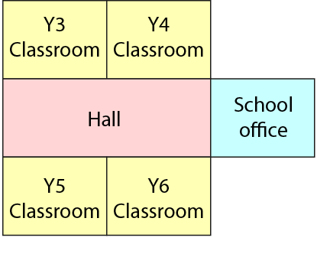
3.1 The part–whole relationship Step 3:6
Notes:
The classrooms make up quite a large part of the whole school building.
Italy is quite a small part of the whole (Europe).

Slide 57
Year 4, Unit 8, Learning Outcome 6
Learning Outcome 6
Pupils construct a whole when given a part and the number of parts
The following slides have been collated to support the teaching of this learning outcome.

Slide 58
Year 4, Unit 8, Learning Outcome 6
Additional teacher guidance for this outcome should be read first and can be found in this segment of the NCETM Primary Mastery Professional Development Materials:
3.1 Preparing for fractions: the part whole relationship
The spine materials are divided into ‘teaching points’ and ‘steps in learning’.
Teaching point | Steps in learning | Pages
4 | 4:1-4:5 | 25-28

Slide 59

3.1 The part–whole relationship Step 4:1
What is the whole?
one part

Slide 60

3.1 The part–whole relationship Step 4:1
The wholes might be…

Slide 61



3.1 The part–whole relationship Step 4:2
What is the whole?
Notes:
This triangle is one part of a whole made out of three equal parts.

Slide 62




3.1 The part–whole relationship Step 4:2
What is the whole?
What is the same? What is different?
Notes:
The rhombus is one part of a whole made out of three equal parts.

Slide 63


3.1 The part–whole relationship Step 4:2
Who has drawn the correct shape? Why?
One part of
a whole made out of
three equal parts.
Max
Beth
Ellen
Florent
✗
✓
✓
✗
Notes:
Four children have been given a part of a shape and have been asked to
draw the whole shape. Who has drawn a correct shape? Why?

Slide 64

3.1 The part–whole relationship Step 4:3
What is the whole?
one of 5 parts

Slide 65
3.1 The part–whole relationship Step 4:4
1 part of 5 parts. Draw the whole ribbon.
Notes:
I have cut a ribbon into five equal parts.
Here is one part of my ribbon.
How long was my ribbon to start with?

Slide 66



3.1 The part–whole relationship Step 4:4
1 part of 4 parts. What is the whole rod?
Notes:
Here is a red Cuisenaire® rod. It is one of four equal parts of another rod.
What is the whole rod?

Slide 67

3.1 The part–whole relationship Step 4:4
1 of 4 equal teams in the class. Draw the whole class.
Notes:
The class has been divided into four equal teams. Here is one of the teams.
How many children are in the class? Draw the whole class.

Slide 68

3.1 The part–whole relationship Step 4:5

