Slide 1
Describing a reflection
KS3 Mastery PD Materials: Exemplified Key Ideas
Materials for use in the classroom or to support professional development discussions
(from 6.3 Transforming shapes)
Summer 2021

Slide 2
About this resource
These slides are designed to complement the 6.3 Transforming shapes Core Concept document and its associated Theme Overview document 6 Geometry, both found in the Secondary Mastery Professional Development pages.
These slides re-present the key examples from the Core Concept document so that the examples can be used either directly in the classroom or with a group of teachers. There are prompt questions alongside the examples, and further clarification in the notes.
These slides do not fully replicate the Core Concept document, so should be used alongside it. Reference to specific page numbers, and to other useful NCETM resources, can be found in the notes for each slide.
This slide deck is not designed to be a complete PD session, rather it is a selection of resources that you can adapt and use as needed when planning a session with a group of teachers.

Slide 3


About this resource
The slides are structured as follows:
  The big picture:
    Where does this fit in?
    What do students need to understand?
    Why is this key idea important?
  Prior learning
  Misconceptions
  Exemplified key ideas
  Reflection questions
  Appendices:
    Key vocabulary
    Representations and structure
    Previous and Future learning
    Useful links
The exemplified key idea slides have the following symbols to indicate how they have been designed to be used:
Into the classroom
The examples are presented on these slides so that they could be used in PD, but also directly in the classroom. The notes feature suggested questions and things teachers might consider when using with students.
PD discussion prompts
These slides look at the examples in more detail, with question prompts to promote discussion among maths teachers. The notes feature reference to further information and guidance within the Core Concepts document.

Slide 4
Where does this fit in?
The NCETM has identified a set of six ‘mathematical themes’ within Key Stage 3 mathematics that bring together a group of ‘core concepts’.
The sixth of these themes is Geometry, which covers the following interconnected core concepts:
6.1 Geometrical properties
6.2 Perimeter, area and volume
6.3 Transforming shapes
6.4 Constructions
Notes:
Linked on this slide is the Theme Overview document of Geometry. This document includes why it is important, the key underpinning knowledge and links to prior and future learning. There is also guidance about how the five big ideas of Teaching for Mastery relate specifically to this theme.

Slide 5
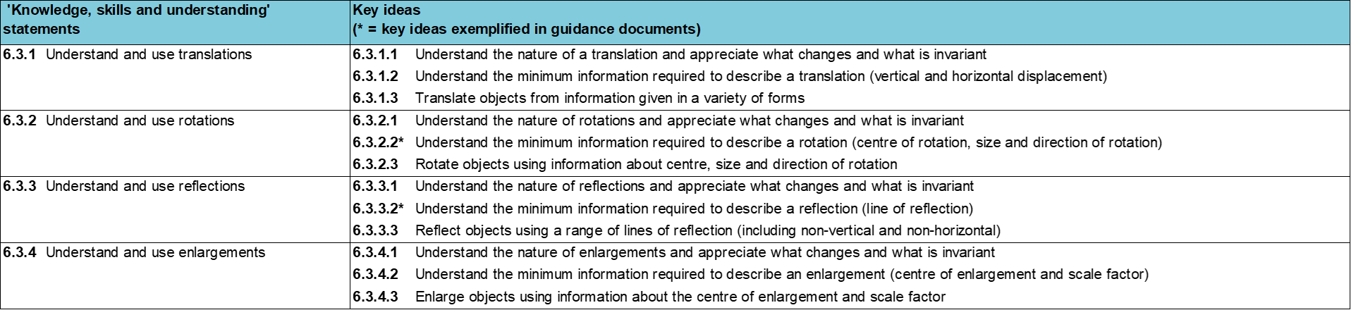
Where does this fit in?
Within this core concept, 6.3 Transforming shapes, there are four statements of knowledge, skills and understanding.
These, in turn, are broken down into twelve key ideas. The highlighted key idea is exemplified in this slide deck.
Notes:
For key ideas marked with an asterisk, we exemplified the common difficulties and misconceptions that students might have and included elements of what teaching for mastery may look like. We have provided examples of possible student tasks and teaching approaches.
Within these slides are ‘classroom-ready’ versions of the examples for the key idea that has been highlighted. There are also slides that may be useful for discussion in a professional development session

Slide 6
What do students need to understand?
6.3.3.2 Understand the minimum information required to describe a reflection (line of reflection)
Recognise transformations that are reflections.
Describe reflections on a coordinate grid with mirror lines that are parallel to an axis.
Identify that the mirror line is perpendicular to lines joining points on the object and image.
Describe reflections on a coordinate grid with mirror lines that are of the form y = x + c.
  What prior knowledge might your students already have?
  What language might they use to describe this key idea?
  What questions might you want to ask to assess their prior learning?

Slide 7
Why is this key idea important?
Geometry is a central part of mathematics. Geometrical thinking is a fundamental and often intuitive and accessible way to engage students in mathematical activity. The study of geometry helps to develop students’ spatial awareness, intuition and visualisation
Encouraging students to draw diagrams and to see problems in a visual and geometrical form can help them gain insights and hence solve many types of problems.
Transformations allow students to explore the key mathematical ideas of variance and invariance, considering what’s the same and what’s different when looking at objects and their images. This also allows for discussion about congruence and similarity.
Notes:
A more detailed overview of the core concept of transforming shapes can be found on page 2 of the 6.3 Core Concept document.
The background to each key idea is also explored in more detail on the following pages:
6.3.1 Understand and use translations - page 5
6.3.2 Understand and use rotations - page 5
6.3.3 Understand and use reflections - page 6
6.3.4 Understand and use enlargements - page 6

Slide 8
Prior learning
  What prior knowledge might your students already have?
  What language might they use to describe this key idea?
  What questions might you want to ask to assess their prior learning?
Upper Key Stage 2 Learning Outcome
Identify, describe and represent the position of a shape following a reflection or translation, using the appropriate language, and know that the shape has not changed
Draw and translate simple shapes on the coordinate plane, and reflect them in the axes
Solve problems involving similar shapes where the scale factor is known or can be found
Notes:
You may find it useful to speak to your partner schools to see how the above has been covered and the language used.
You can find further details regarding prior learning in the following segments of the NCETM primary mastery professional development materials (linked on final slide):
Year 4: 2.17 Structures: using measures and comparison to understand scaling
Year 6: 2.27 Scale factors, ratio and proportional reasoning
Within the Geometry Theme Overview document, you can also find a broader description of students’ potential previous learning (page 3).

Slide 9
Checking prior learning
The following slides contain questions for checking prior learning.
  What representations might students use to support their understanding of these questions?
  What variation might you put in place for these questions to fully assess students’ understanding of the concept?
  How might changing the language of each question change the difficulty?
  Why are these such crucial pre-requisites for this key idea?

Slide 10
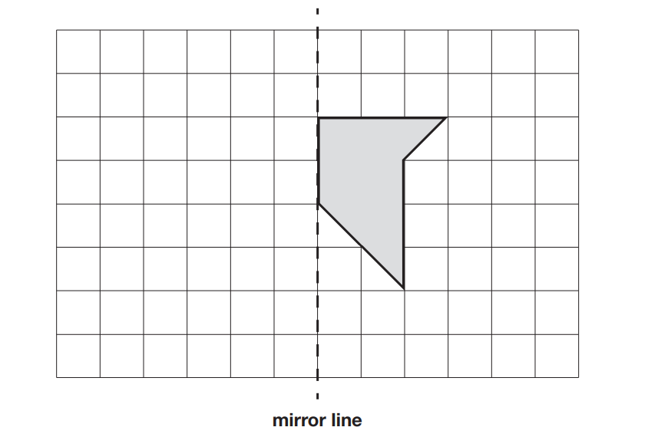
Checking prior learning (1)
a) Here is a shape on a grid.
Complete the design so that it is symmetrical about the mirror line.
Use a ruler.
Notes:
References to the questions (links on final slide):
a) 2018 Key Stage 2 Mathematics Paper 2: Reasoning, question 1

Slide 11
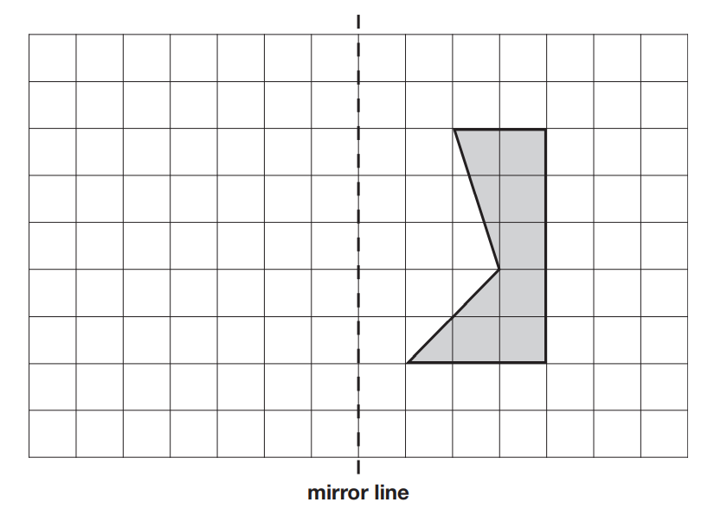
Checking prior learning (2)
b) Here is a shaded shape on a square grid.
Reflect the shape in the mirror line.
Use a ruler.
Notes:
References to the questions (links on final slide):
2019 Key Stage 2 Mathematics Paper 2: Reasoning Paper Q4

Slide 12
Common difficulties and misconceptions
What aspects of this key idea might students find challenging?
What misconceptions might students have?
When teaching this topic, you may find students encounter difficulties with…
Reflection of an object in a line that is not vertical or horizontal
More information, and some suggestions for overcoming these challenges, can be found on the following slides

Slide 13
Common difficulties and misconceptions (1)
Many students are able to intuitively reflect an object in a vertical or horizontal mirror line, but the reflection of an object in a line that is not vertical or horizontal often proves a challenge. A common misconception is that the image will remain in the same vertical (or horizontal) plane.
This misconception may well be due to an overuse of vertical (or horizontal) lines of reflection, so it will be important to offer students a wide range of non-standard, as well as standard, examples of lines of reflection.
When offering students examples where the line of reflection is either vertical or horizontal, it will be important to avoid explanations that refer to reflecting ‘straight across’ or ‘straight down’. Instead, draw students’ attention to the fact that every line which joins a point on the object to its image is perpendicular to the line of reflection.
Notes:
More detail can be found on page 13-14 of the 6.3 Core Concept document.

Slide 14
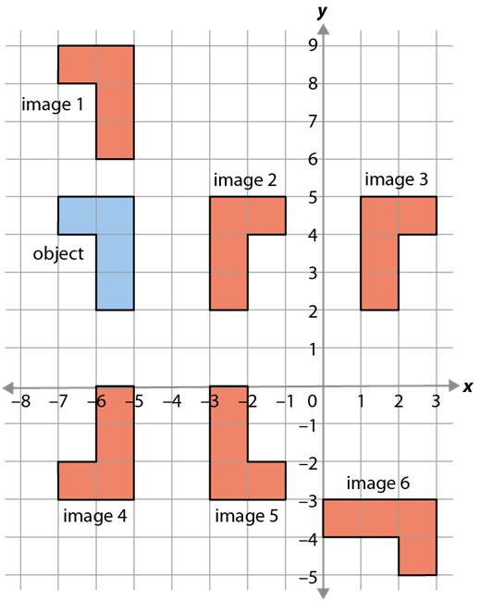
Recognise transformations that are reflections
Example 1
Which images are reflections of the object?
Notes:
Suggested questioning:
Which objects are congruent?
Which objects are the same orientation?
Where would the mirror line be to get to image 2?
Things for you to think about:
Example 1 shows reflections of the object in different positions and orientations. Images 2, 3, 4 and 6 are reflections. Image 5 has been chosen to raise questions around reflections that are not aligned horizontally and/or vertically with the object and should be compared with image 6 (a reflection in a line with a gradient of one). Meanwhile, image 1 has been chosen to draw attention to the change in ‘sense’ that is a necessary feature of a reflection.

Slide 15
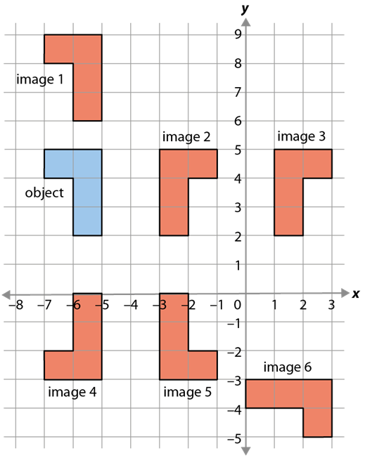
Recognise transformations that are reflections.
Example 1
  Why do you think each of the images have been chosen?
  What is varying in each of the examples?
  What additional questions could you ask students to check they understand the change in ‘sense’ that happens under a reflection?
Which images are reflections of the object?
Notes:
This example can be found on page 14 of the 6.3 Core Concept document.

Slide 16
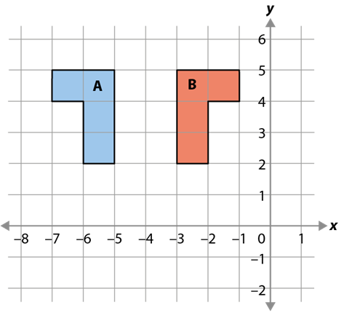
Describe reflections on a coordinate grid with mirror lines that are parallel to an axis
Example 2
Draw the mirror line to reflect shape A onto shape B.
Describe the reflection of shape A onto shape B.
Notes:
Suggested questioning:
What does it mean to describe in mathematics?
How much information is needed to describe in this case?
How would we name the mirror line with an equation?
Things for you to think about:
Example 2 focuses on different aspects of finding a mirror line. In part a), students are asked to identify the mirror line and draw it in, so that the focus in part b) can be on communicating their answer accurately and efficiently (this is likely to be by giving the equation of the line).
Encourage students to use precise language to describe a reflection. For example: ‘Shape A is reflected in the line x = −4.’

Slide 17
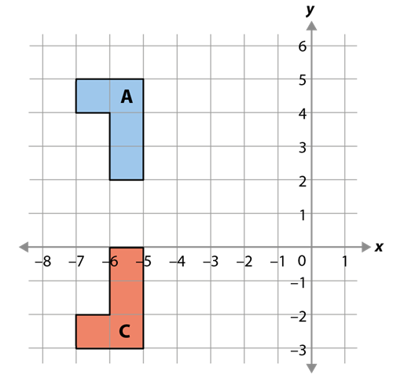
Describe reflections on a coordinate grid with mirror lines that are parallel to an axis
Example 3
Describe the transformation of shape A onto shape C.
Notes:
Suggested questioning:
What does it mean to describe in mathematics?
How much information is needed to describe in this case?
How would we name the mirror line with an equation?
Things for you to think about:
In Example 3, ‘transformation’ is used to prompt students to think about the possibility of the transformation being something other than a reflection. Students should be encouraged to reason why it cannot be a rotation or a translation, and to think about whether it could possibly be an enlargement.
Once students have solved the problem, you might encourage them to reflect on some of the decisions they made. Prompts might include:
• ‘What did you look for to identify that this was a reflection rather than a different transformation?’
• ‘Once you had spotted it was a reflection, what did you look for to identify the mirror line?’
What is the best way to describe the mirror line to someone else?’

Slide 18

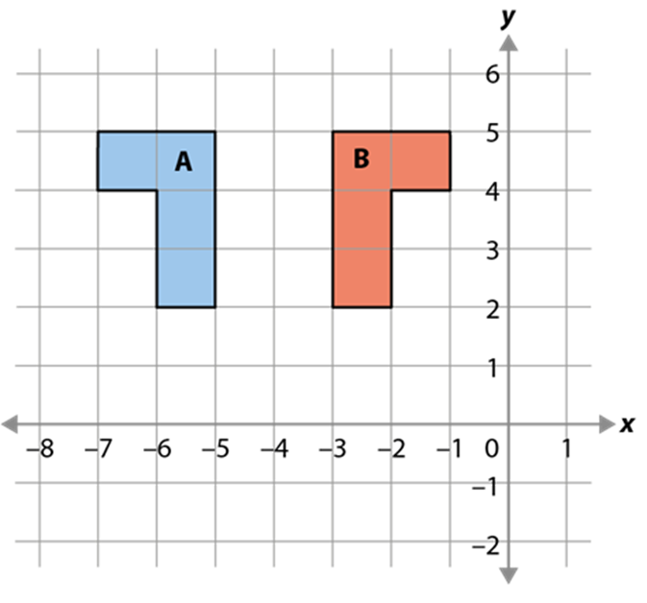
Describe reflections on a coordinate grid with mirror lines that are parallel to an axis
Example 2
Example 3
Draw the mirror line to reflect shape A onto shape B.
Describe the reflection of shape A onto shape B.
Describe the transformation of shape A onto shape C.
  What language would you expect students to use to articulate their descriptions?
  What strategies do you use to support student in naming horizontal and vertical lines?
Notes:
This example can be found on page 15 of the 6.3 Core Concept document.

Slide 19
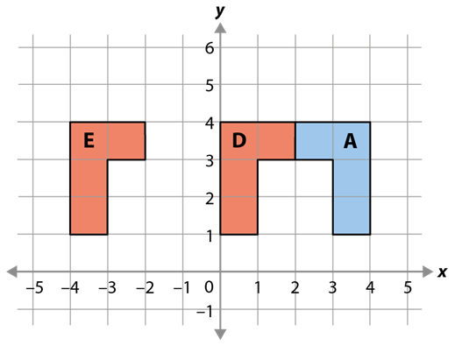
Describe reflections on a coordinate grid with mirror lines that are parallel to an axis
Example 4
Describe the transformations of shape A onto shape D and shape E.
Notes:
Suggested questioning:
What is significant about the coordinate (2,3) when transforming A to D?
Are there any other points with this same property?
Things for you to think about:
Example 4 presents two non-standard transformations to students. Image D is in contact with object A, highlighting that there does not need to be a space between the object (and image) and the mirror line. Image E is a reflection in the y-axis.
To deepen understanding there is an opportunity here for students to describe the axis of reflection of A onto E as either ‘the y-axis’ or ‘x = 0’.
Students could consider whether objects and their images can overlap when reflected. By imagining the change in the mirror line from E to D as a dynamic change, students may be able to visualise the impact of moving the line and so consider the impact of moving the line even further right than that for image D. Once given the chance to discuss and visualise the situation, students should then test their ideas either by drawing or using dynamic geometry software.

Slide 20
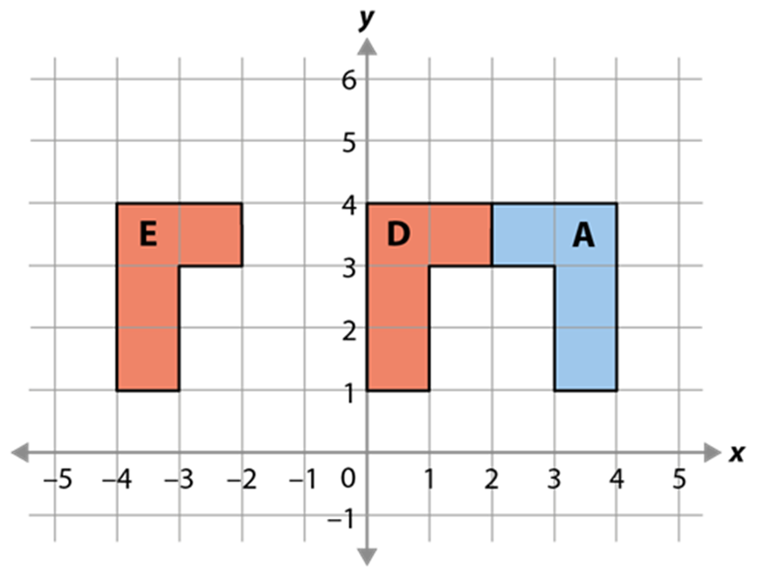
Describe reflections on a coordinate grid with mirror lines that are parallel to an axis
Example 4
Describe the transformations of shape A onto shape D and shape E.
  Would you prefer students described the mirror line from A to E as x=0 or the y axis? Why?
  If using dynamic geometry to progress on from these examples – where would you choose for your next vertical mirror line? Why?
Notes:
This example can be found on page 16 of the 6.3 Core Concept document.

Slide 21
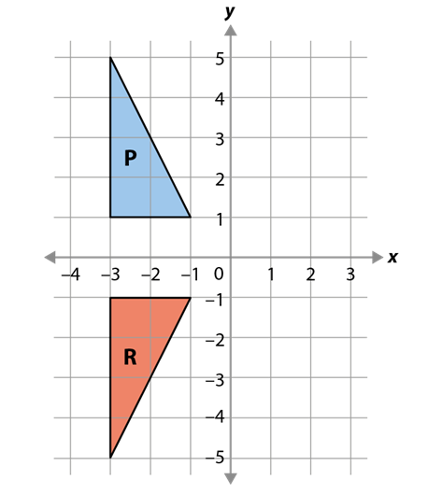
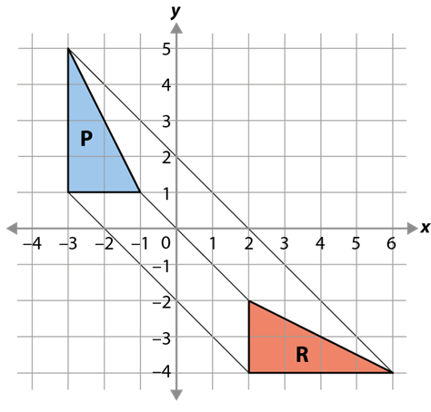
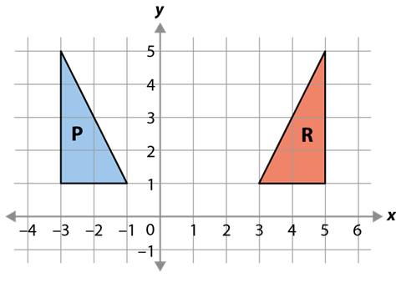
Identify that the mirror line is perpendicular to lines joining points on the object and image
Example 5
In the diagram a), object P has been reflected to give the image R. The vertices of P and R have been joined. For diagrams b) and c):
(i) Join the vertices of the object, P, to the vertices of the image, R.
(ii) Mark the mirror line.
(iii) What do you notice about the angle between the mirror line and the lines joining the vertices?
a) b) c)
Notes:
Suggested questioning:
How do you know which vertices join to which? Does it matter?
What have your lines got in common? Is this always going to be the case?
Things for you to think about:
All of the representations used so far have been aligned in such a way that the angle of the mirror line has not been an explicit consideration. By changing the angle of the mirror line, greater depth of understanding about the angle between the object and line can be revealed.
Draw students’ attention to the way in which lines joining equivalent points on the object and image are parallel. This insight, combined with their understanding so far, should allow them to predict the position of the mirror line.
Students should be made aware that the mirror line is always perpendicular to the lines joining the equivalent vertices. This can be shown effectively using dynamic geometry software.
A printable version of this example is available in the appendices.

Slide 22
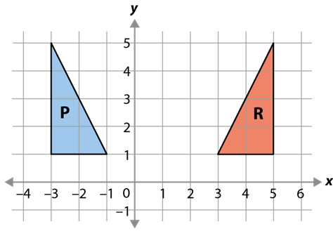

Identify that the mirror line is perpendicular to lines joining points on the object and image
Example 5
In the diagram a), object P has been reflected to give the image R. The vertices of P and R have been joined. For diagrams b) and c):
(i) Join the vertices of the object, P, to the vertices of the image, R.
(ii) Mark the mirror line.
What do you notice about the angle between the mirror line and the lines joining the vertices?
a) b) c)
  How does the activity of drawing the vertices from object to image build on students prior knowledge?
  What examples would you provide next to deepen the concept?
Notes:
This example can be found on page 16-17 of the 6.3 Core Concept document.

Slide 23
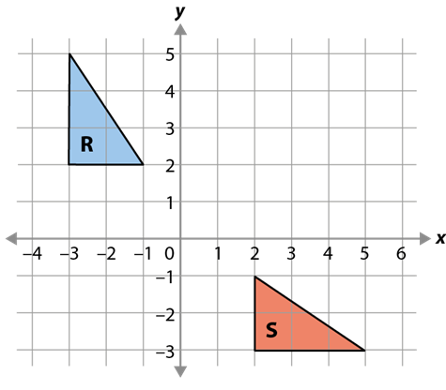
Describe reflections on a coordinate grid with mirror lines that are of the form y = x + c
Example 6
Draw the mirror line to reflect shape R onto shape S.
Describe the reflection of shape R onto shape S.
Notes:
Suggested questioning:
How do you know where the mirror line will be?
How can you check without a physical mirror?
What does it mean to describe a reflection? How can you ensure your description is mathematical?
Things for you to think about:
As in Example 2, this question is structured to focus students’ attention on identifying the mirror line, before describing it. Whether students describe the mirror line using its equation is a decision that will be driven by their prior knowledge.
You might like to direct students to join the equivalent vertices in the object and the image (as in Example 5) before asking them to draw the mirror line. The key awareness for students is that the mirror line is perpendicular to lines joining points on the object and image.

Slide 24
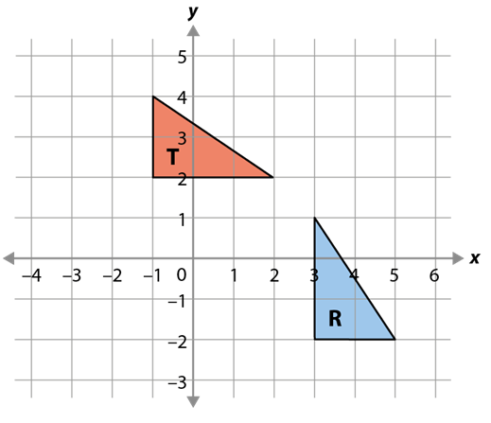
Describe reflections on a coordinate grid with mirror lines that are of the form y = x + c
Example 7
Describe the transformation of shape R onto shape T.
Notes:
Suggested questioning:
How do you know where the mirror line will be?
How can you check without a physical mirror?
What does it mean to describe a reflection? How can you ensure your description is mathematical?
Things for you to think about:
In Example 7, the object and image appear in a non-standard position – they are placed over the axes.
It is important not to always present students with standard examples where mirror lines are vertical or horizontal, or, when sloping, always placed at y = x or y = −x, etc., as this tends to promote a lack of analysis and reasoning.

Slide 25

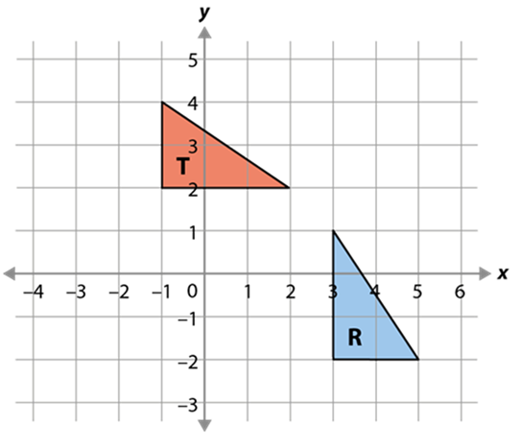
Describe reflections on a coordinate grid with mirror lines that are of the form y = x + c
Example 6
Example 7
Draw the mirror line to reflect shape R onto shape S.
Describe the reflection of shape R onto shape S.
Describe the transformation of shape R onto shape T.
  What mistakes might students make with Example 7?
  How can you adapt teaching to overcome these?
  What questions would you ask to build up to students understanding invariant points and invariant lines?
Notes:
This example can be found on page 18 of the 6.3 Core Concept document.

Slide 26
Reflection questions
What other mathematical concepts will be supported by students’ stronger understanding of this key idea?
What mathematical language will you continue to use to support pupils to make connections with other areas?
Which representations might you continue to use to further develop students’ understanding?

Slide 28
Appendices
You may choose to use the following slides when planning or delivering a PD session. They cover:
  Key vocabulary
  Representations and structure
  Previous learning
  Future learning
  Printable version of example 5
  Library of links

Slide 29
Key vocabulary
Copy relevant terms from CC document
Term | Definition
congruent (figures) | Two or more geometric figures are said to be congruent when they are the same in every way except their position in space.
image | When a transformation is applied to a shape, the transformed shape is called the ‘image’. The original shape is called the ‘object’.
object | When a transformation is applied to a shape, the original shape is called the ‘object’. The transformed shape is called the ‘image’.

Slide 30
Representations and structure
There are a number of different representations that you may wish to use to support students’ understanding of this key idea. These might include:
Dynamic geometry software
  The guided use of dynamic geometry software can provide an environment in which students are able to make and test conjectures. By dragging and changing features, they are able to identify variant and invariant properties, leading to a deeper understanding of generalisations.
Mental imagery
  All concrete and pictorial representations have their limitations in the way they are able to represent the abstract world of mathematics. The ultimate purpose of all representations is to support students’ mental construct of an idea or concept. Students do not use the representation to do the mathematics; rather, the representation supports the student in making a mental representation of the idea.
Notes:
More information about the representations and structure involved in this key idea can be found:
On page 6 of the Theme Overview document
Links to all of these can be found on the final slide.

Slide 31
Previous learning
From Upper Key Stage 2, students will bring experience of:
drawing 2D shapes using given dimensions and angles
recognising, describing and building simple 3D shapes, including making nets
comparing and classifying geometric shapes based on their properties and sizes, and finding unknown angles in any triangles, quadrilaterals and regular polygons
illustrating and naming parts of circles, including radius, diameter and circumference, and knowing that the diameter is twice the radius
recognising angles where they meet at a point, are on a straight line or are vertically opposite, and finding missing angles
drawing and translating simple shapes on the coordinate plane and reflecting them in the axes.
Notes:
Theme 6 Geometry

Slide 32
Future learning (1)
In KS4, students will build on the core concepts in this mathematical theme to:
interpret and use fractional {and negative} scale factors for enlargements
{describe the changes and invariance achieved by combinations of rotations, reflections and translations}
identify and apply circle definitions and properties, including: centre, radius, chord, diameter, circumference, tangent, arc, sector and segment
{apply and prove the standard circle theorems concerning angles, radii, tangents and chords, and use them to prove related results}
construct and interpret plans and elevations of 3D shapes
interpret and use bearings
calculate arc lengths, angles and areas of sectors of circles
calculate surface areas and volumes of spheres, pyramids, cones and composite solids
Please note: Braces { } indicate additional mathematical content to be taught to more highly attaining students.

Slide 33
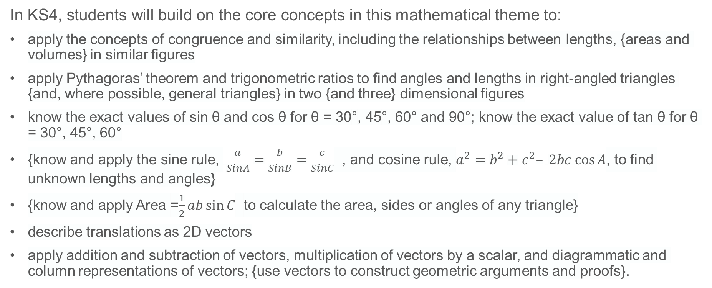
Future Learning (2)
In KS4, students will build on the core concepts in this mathematical theme to:
apply the concepts of congruence and similarity, including the relationships between lengths, {areas and volumes} in similar figures
apply Pythagoras’ theorem and trigonometric ratios to find angles and lengths in right-angled triangles {and, where possible, general triangles} in two {and three} dimensional figures
know the exact values of sin θ and cos θ for θ = 30°, 45°, 60° and 90°; know the exact value of tan θ for θ = 30°, 45°, 60°
{know and apply the sine rule, $\frac{a}{SinA}=\frac{b}{SinB}=\frac{c}{SinC}$ , and cosine rule, $a^{2}=b^{2}+c^{2}– 2bc cos⁡A$, to find unknown lengths and angles}
{know and apply Area =$\frac{1}{2}ab\sin{C}$ to calculate the area, sides or angles of any triangle}
describe translations as 2D vectors
apply addition and subtraction of vectors, multiplication of vectors by a scalar, and diagrammatic and column representations of vectors; {use vectors to construct geometric arguments and proofs}.
Please note: Braces { } indicate additional mathematical content to be taught to more highly attaining students.
Notes:
Theme 6 Geometry

Slide 34
Example 5: printable version
In the diagram a), object P has been reflected to give the image R. The vertices of P and R have been joined.
a)
b)
c)
For diagrams b) and c):
Join the vertices of the object, P, to the vertices of the image, R.
Mark the mirror line.
What do you notice about the angle between the mirror line and the lines joining the vertices?

Slide 35
Library of links
The following resources from the NCETM website have been referred to within this slide deck:
  NCETM Secondary Mastery Professional Development
    6 Geometry Theme Overview Document
    6.1 Geometrical properties Core Concept Document
  NCETM primary mastery professional development materials
There are also references to:
  Standards & Testing Agency’s past mathematics papers

