Slide 1
Series 3 Episode 28
Tween Scenes

Slide 2
Practitioner Notes

Slide 3
Episode Description
Time for a tale all about the new Numberblocks, Eleven, Twelve, Thirteen, Fourteen and Fifteen. This episode reminds us what we know about the new characters and their mathematical properties.

Slide 4
Maths in the Episode
Numbers 11 to 15
In this episode Fifteen reads a story from chapter 11 through to chapter 15. We experience the five new Numberblocks in order and in relation to one another as well as remembering their composition of ten and some more.

Slide 5
Using Mathematical Language
Use these stem sentences to rehearse the mathematical ideas in the programme:
“I am <eleven>. I am ten and <one>.”
“Ten and <one> is <eleven>.”
Notes:
Text inside < > indicates what can be changed in the stem sentence.

Slide 6
Talk and Discuss Together

Slide 7
Talk and Discuss Together
Watch the episode of Numberblocks. Use the following picture as a stimulus. Do you have a bedtime story? Which story is your favourite?
Which of these Numberblocks do you like best? Why?
The following slides are designed to stimulate children and adults to talk about the episode and draw out some key aspects of the mathematics.

Slide 8
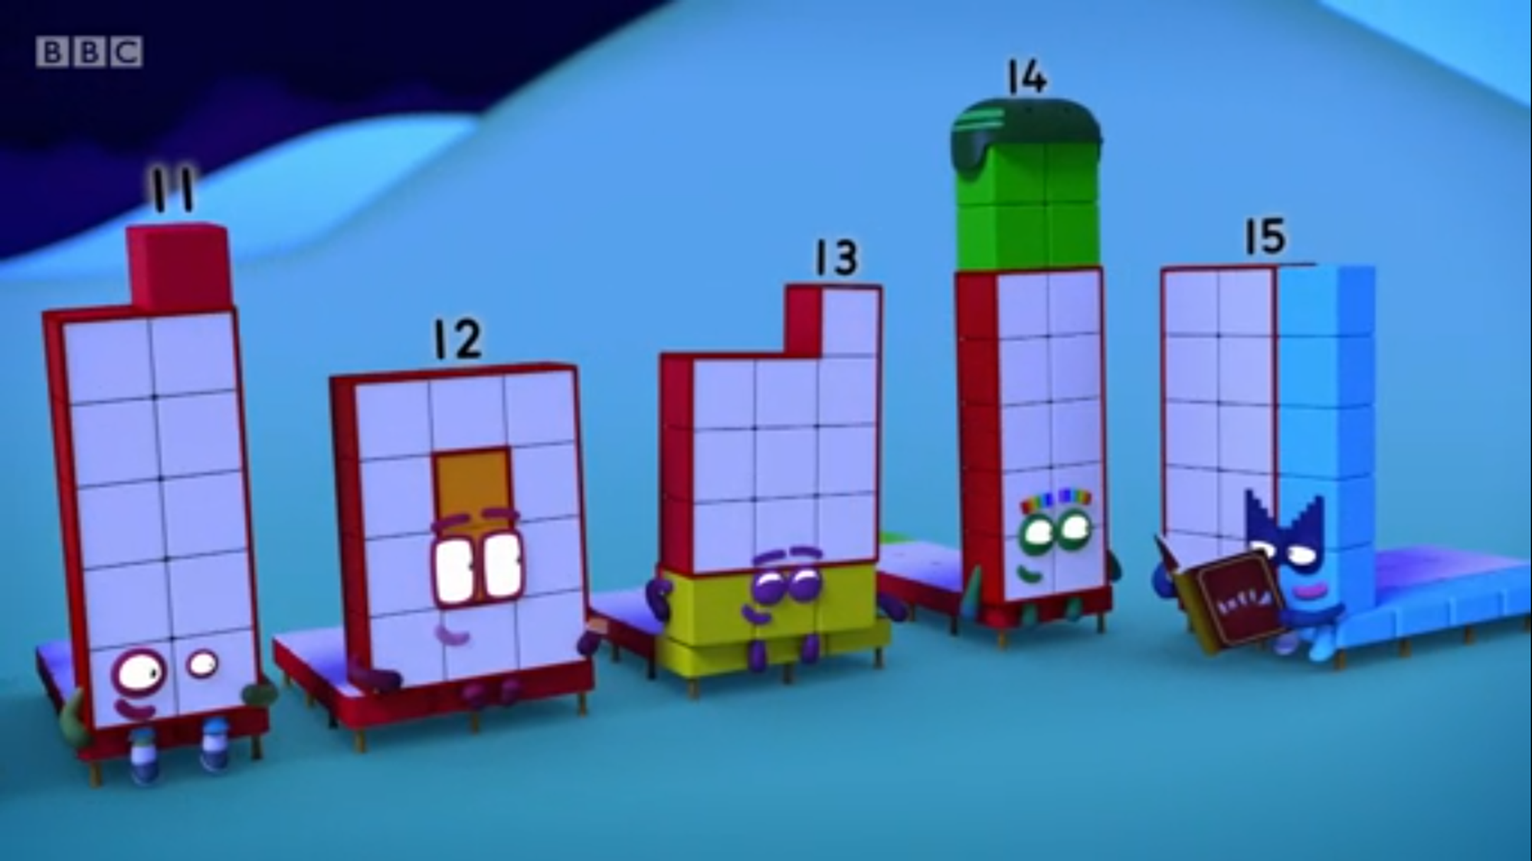
Images © 2017 Alphablocks Ltd. All Rights Reserved.
Notes:
Use this picture as the stimulus for Talk and Discussion (slide 7).

Slide 9
Enabling Environments in Reception

Slide 10
Enabling Environments
Playing and Exploring
Set up the home corner as a bedroom space to put the toys to bed in. Encourage the children to explore what tasks need to be done in five steps to get the toys ready for bed.
Active Learning
Look for the 11-15 Numberblock numberlings on pages in books when reading in the book corner.
Creating and Thinking Critically
Hand out the 5 picture cards of the Numberblocks getting ready for bed (Slides 11 and 12) to five children. Can they get themselves in order and describe the step on their card?

Slide 11
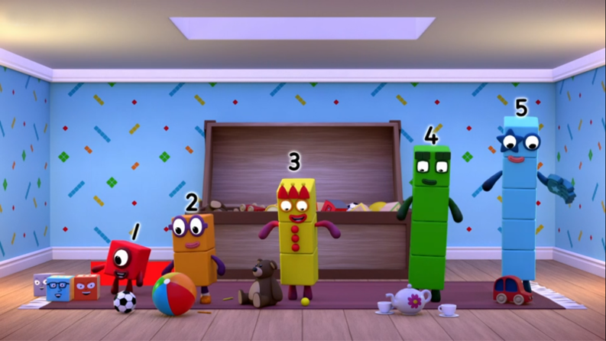
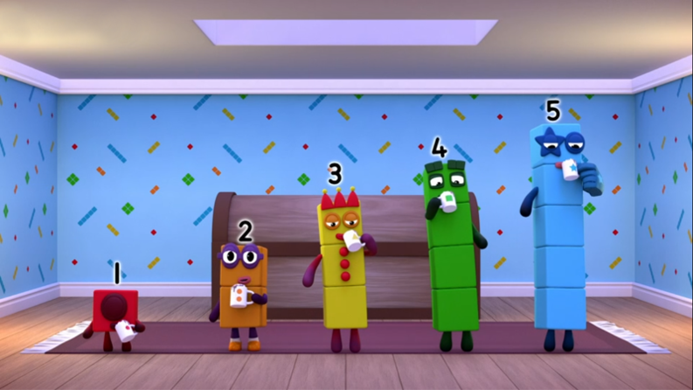
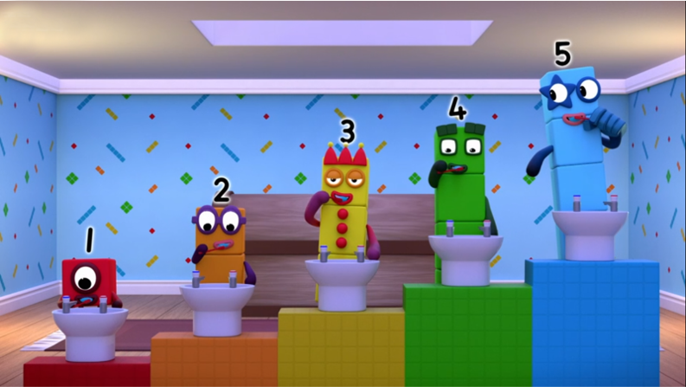
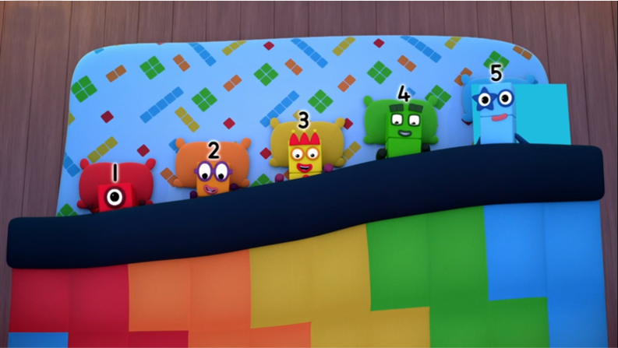
Images © 2017 Alphablocks Ltd. All Rights Reserved.
Notes:
Hidden Slide: Set 1a: Print and cut along dotted line and use with set 1b.

Slide 12
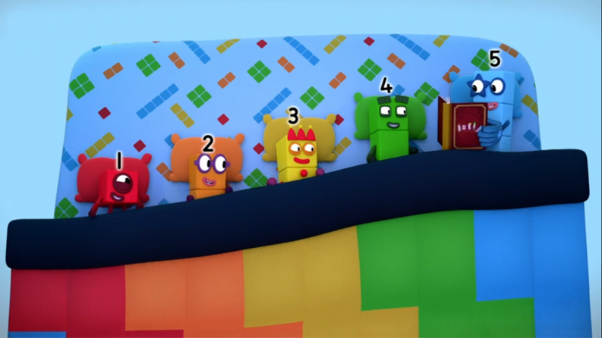
Images © 2017 Alphablocks Ltd. All Rights Reserved.
Notes:
Hidden slide. Set 1b: Print and cut along dotted line and use with set 1a.

Slide 13
Learning Together in Y1

Slide 14
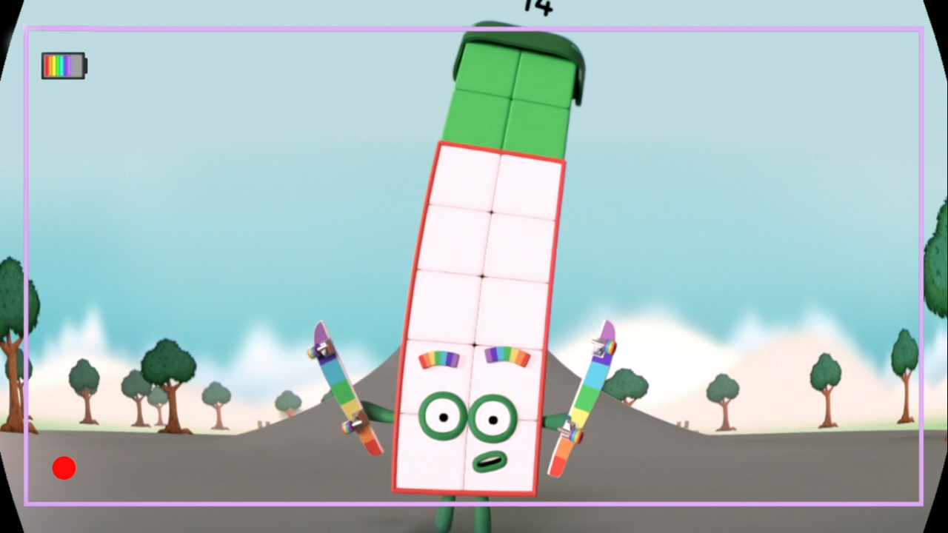

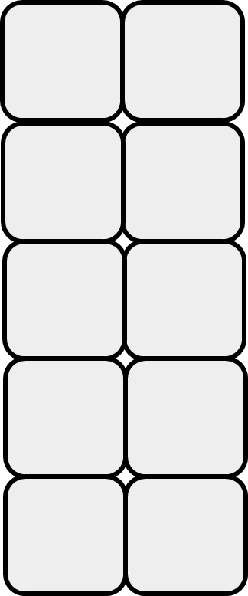

Who am I?
I am ten and four
Images © 2017 Alphablocks Ltd. All Rights Reserved.
Notes:
Use these slides to reveal clues about a Numberblock between 11 and 15.
Discuss as the slide animates:
Can you remember which Numberblock is made of ten and four?
Does the skateboard help you remember? Does it match what you first thought?

Slide 15
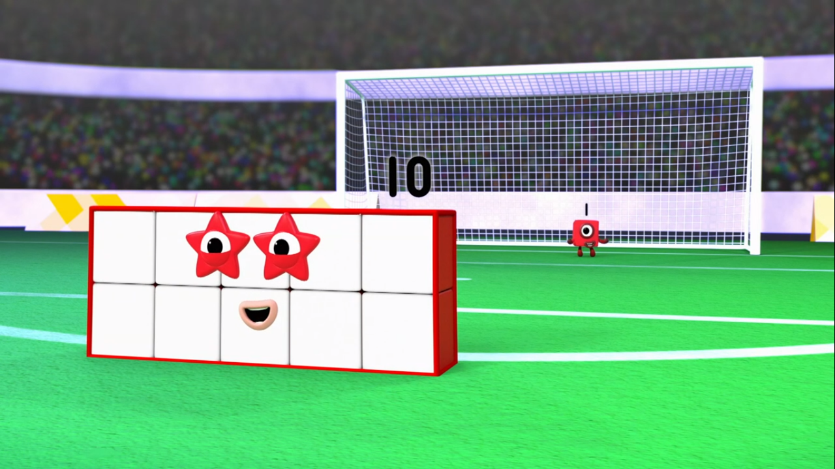

Who am I?
I am ten and one
Images © 2017 Alphablocks Ltd. All Rights Reserved.
Notes:
Discuss as the slide animates:
Can you remember which Numberblock is made of ten and one?
Does the football pitch help you remember? Does it match what you first thought?

Slide 16
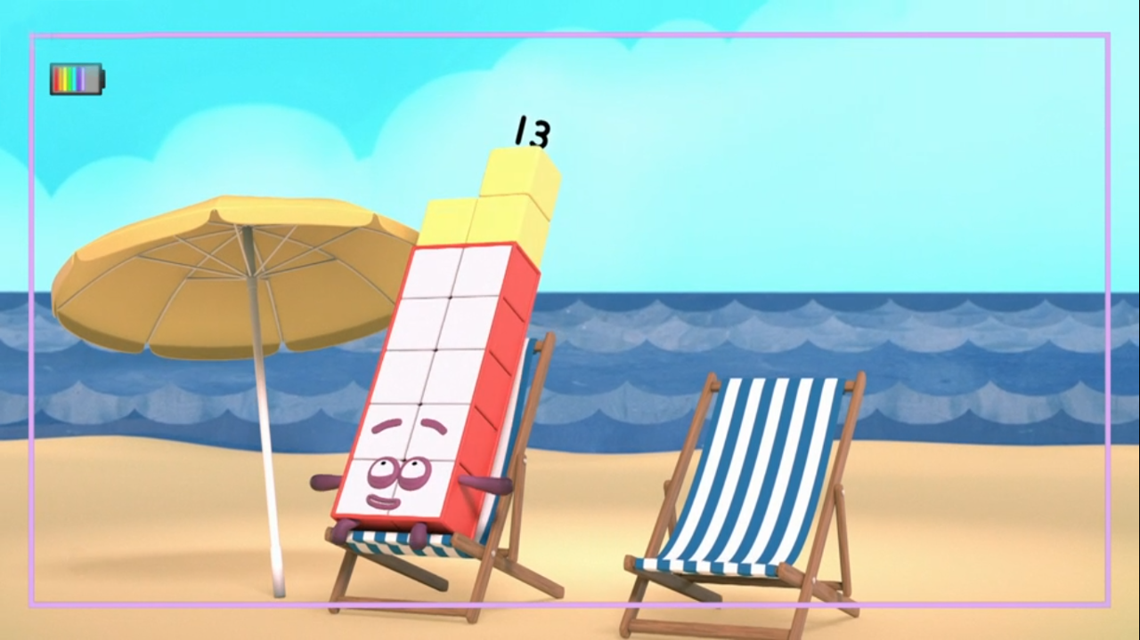

Who am I?
I am ten and three
Images © 2017 Alphablocks Ltd. All Rights Reserved.
Notes:
Discuss as the slide animates:
Can you remember which Numberblock is made of ten and three?
Does the banana skin help you remember? Does it match what you first thought?
Which Numberblock have you found easiest to guess so far?

Slide 17
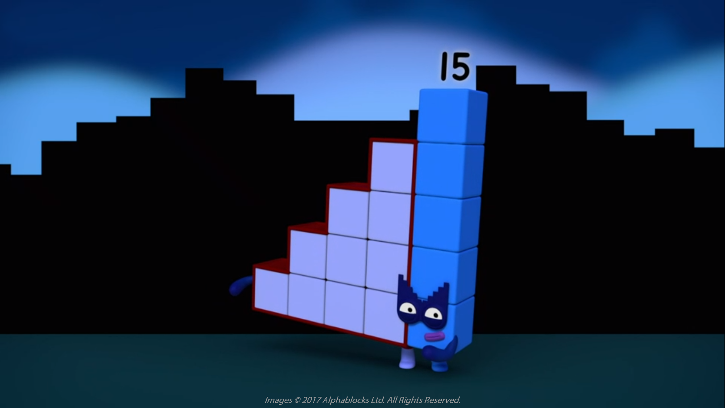
Who am I?
I am ten and five
Images © 2017 Alphablocks Ltd. All Rights Reserved.
Notes:
Discuss as the slide animates:
Can you remember which Numberblock is made of ten and five?
Do the steps help you remember? Does it match what you first thought?
Which Numberblock so far have you found the hardest to guess? Can you think why you found it more difficult? (Children at this stage might be confusing thirteen and fifteen as these number words sound similar.)

Slide 18
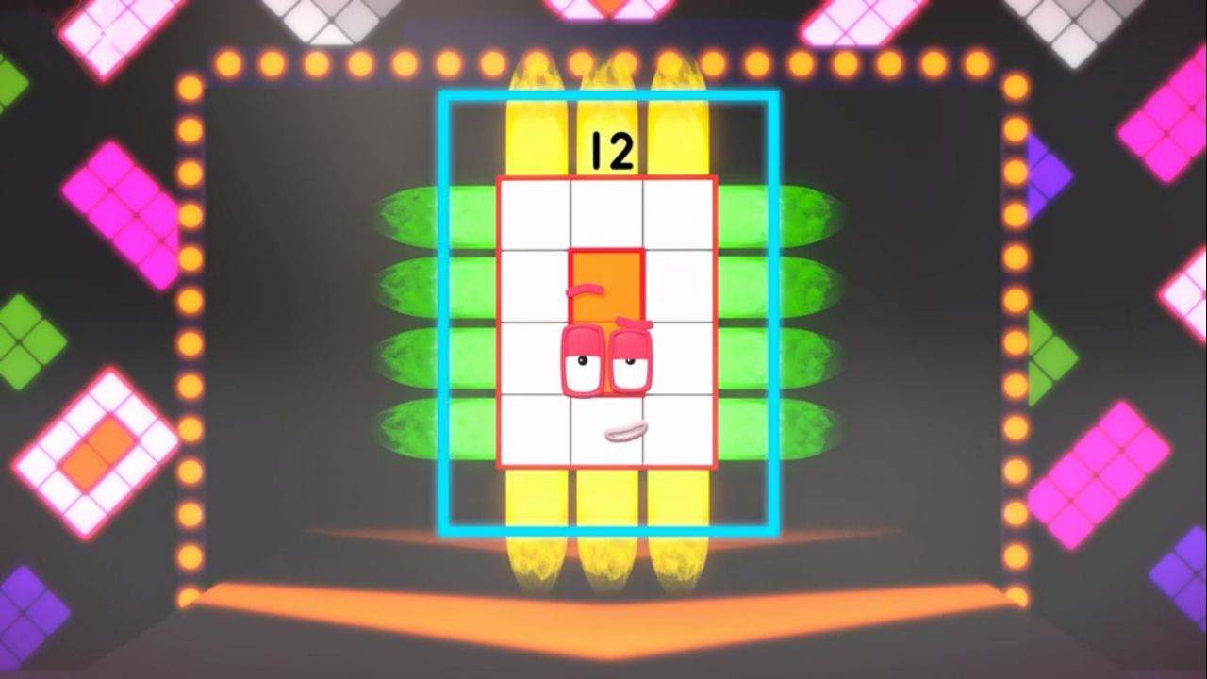
Who am I?
I am three by four
Images © 2017 Alphablocks Ltd. All Rights Reserved.
Notes:
Discuss as the slide animates:
Can you remember which Numberblock is made of ten and two?
Do the rays help you remember? Does it match what you first thought?
Think about all the Numberblocks we have seen (Eleven, Twelve, Thirteen, Fourteen, Fifteen) and encourage children to discuss:
Which of the number names help you think about the parts of the Numberblock?
Which number names do not help us think about the parts so easily?
Can you hear ‘teen’ in any of the numbers 11-15? Which ones can you not hear ‘teen’?

Slide 19
Further activities for Y1
From a set of cards with clues and images, sort into sets for each number 11-15.
Write clues for each number.
Place the cards in order.
Make a book of 11-15 with a page per number and images to represent that number.

Slide 20
Learning Together in Y2

Slide 21
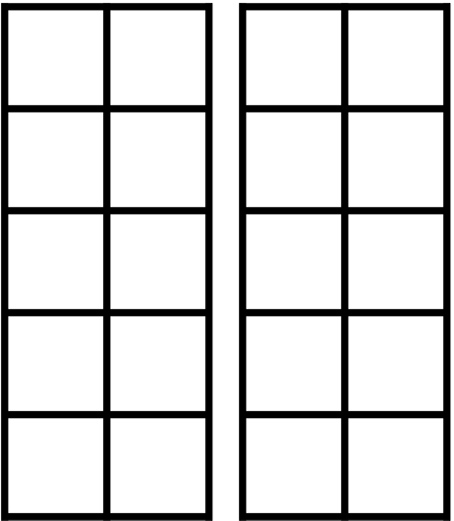

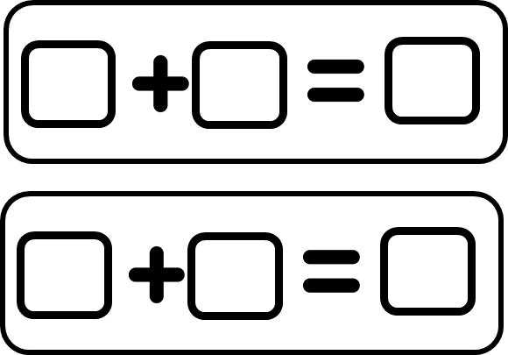
Images © 2017 Alphablocks Ltd. All Rights Reserved.
Notes:
Hidden slide. Print this slide and cut along dotted line.
Give pairs or groups of children 5 strips each to accompany slides 22-31.

Slide 22
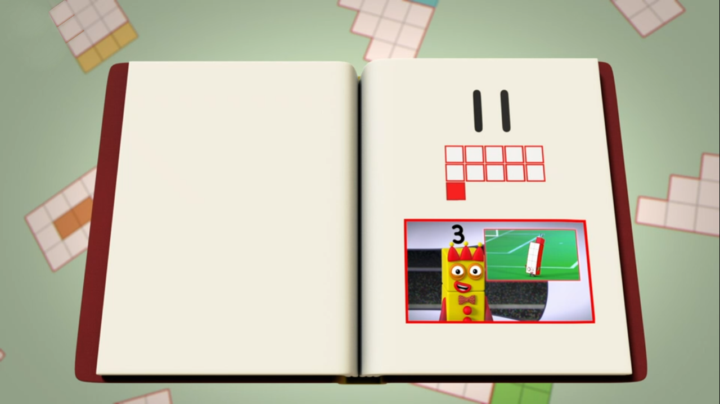
Images © 2017 Alphablocks Ltd. All Rights Reserved.
Notes:
Ask the children to complete a strip (from slide 21) in pairs or groups. What information can we put in these representations for 11?

Slide 23
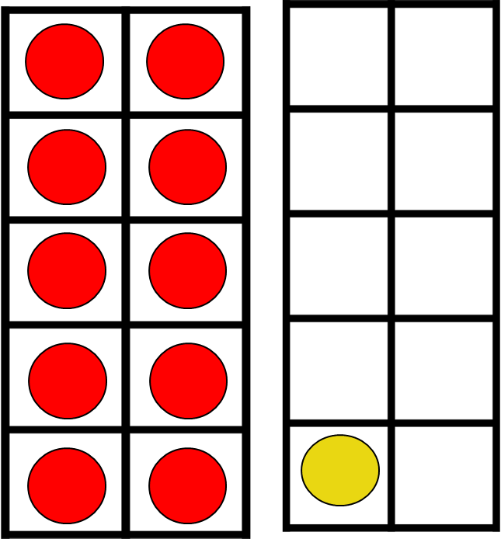




Images © 2017 Alphablocks Ltd. All Rights Reserved.
Notes:
Use this slide to check the children’s representations. Ask the children to describe what the representations mean in their own words.
Encourage use of language of part/whole: ten is a part, one is a part, eleven is the whole.
Use stem sentence: ten and one is eleven.
Read equations: ten plus one is equal to eleven.

Slide 24
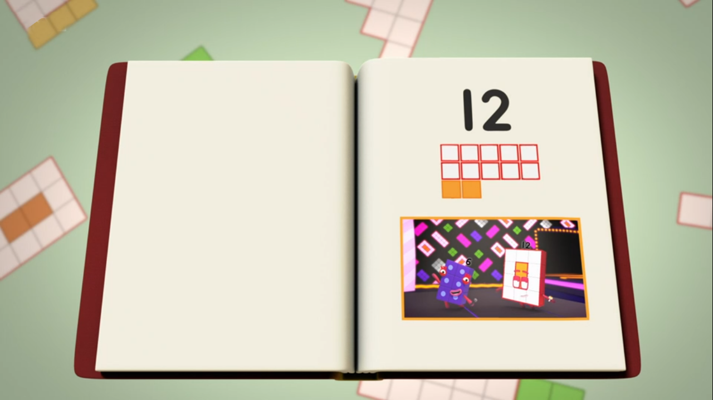
Images © 2017 Alphablocks Ltd. All Rights Reserved.
Notes:
Ask the children to complete a strip (from slide 21) in pairs or groups. What information can we put in these representations for 12?

Slide 25


Images © 2017 Alphablocks Ltd. All Rights Reserved.
Notes:
Use this slide to check the children’s representations. Ask the children to describe what the representations mean in their own words. They might be able to describe what is the same as, or different to, the previous slide.
Encourage use of language of part/whole: ten is a part, two is a part, twelve is the whole.
Use stem sentence: ten and two is twelve.
Read equations: ten plus two is equal to twelve.

Slide 26
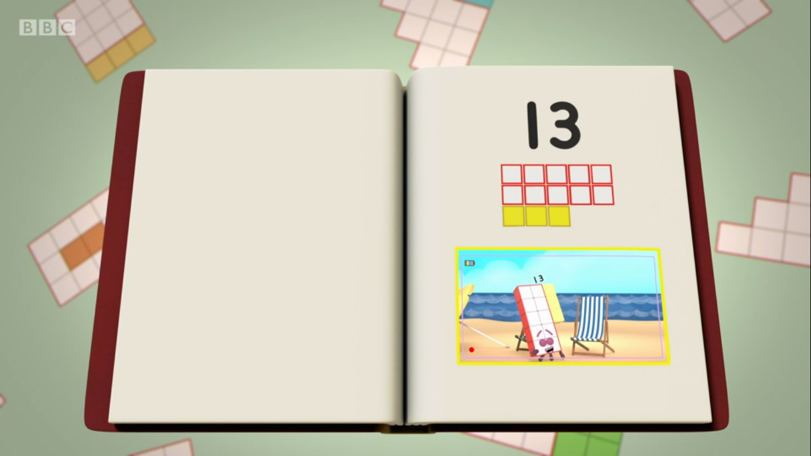
Images © 2017 Alphablocks Ltd. All Rights Reserved.
Notes:
Ask the children to complete a strip (from slide 21) in pairs or groups. What information can we put in these representations for 13?

Slide 27

Images © 2017 Alphablocks Ltd. All Rights Reserved.
Notes:
Use this slide to check the children’s representations. Ask the children to describe what the representations mean in their own words. They might be able to describe what is the same as, or different to, the previous slide.
Encourage use of language of part/whole: ten is a part, three is a part, thirteen is the whole.
Use stem sentence: ten and three is thirteen.
Read equations: ten plus three is equal to thirteen.

Slide 28
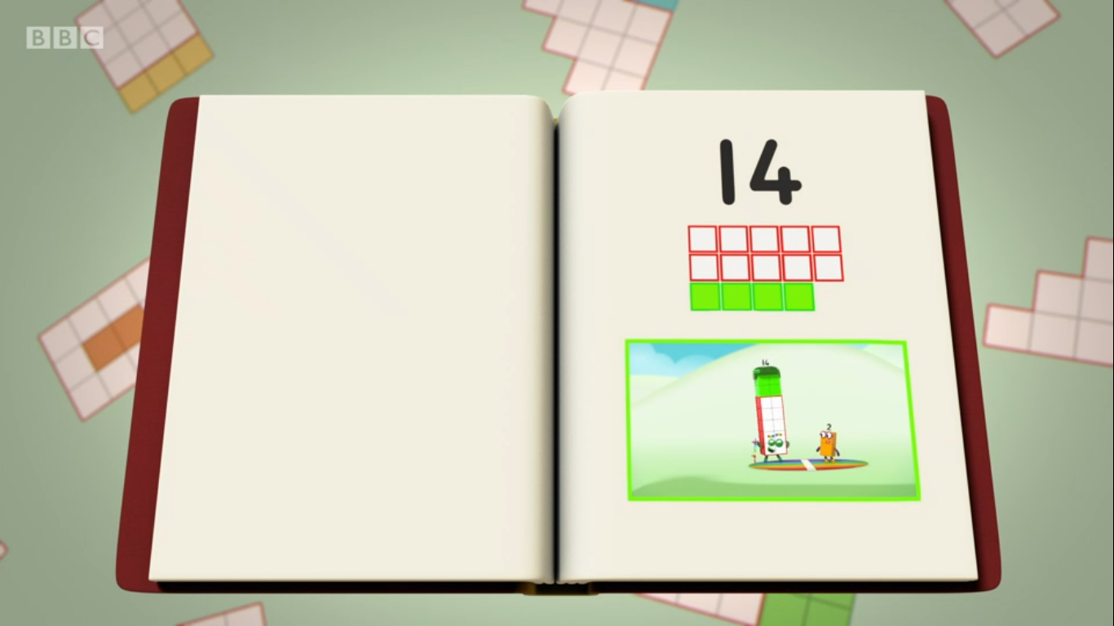
Images © 2017 Alphablocks Ltd. All Rights Reserved.
Notes:
Ask the children to complete a strip (from slide 21) in pairs or groups. What information can we put in these representations for 14?

Slide 29

Images © 2017 Alphablocks Ltd. All Rights Reserved.
Notes:
Use this slide to check the children’s representations. Ask the children to describe what the representations mean in their own words.
Encourage use of language of part/whole: ten is a part, four is a part, fourteen is the whole.
Use stem sentence: ten and four is fourteen.
Read equations: ten plus four is equal to fourteen.
Children might notice that they can hear the ‘four’ in the number word ‘fourteen’. Use this as an opportunity for discussing that although we can hear the four first, we write the digit 1 (for the ten part) first.

Slide 30
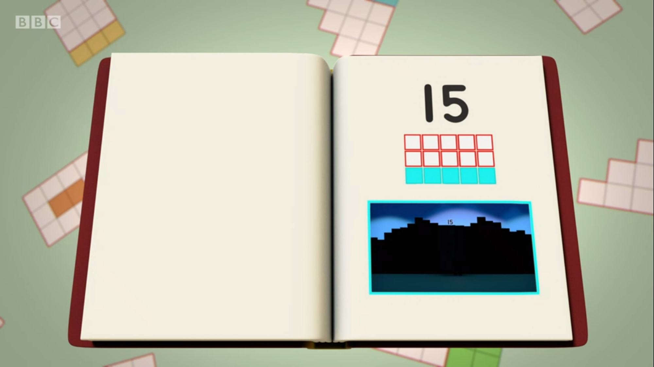
Images © 2017 Alphablocks Ltd. All Rights Reserved.
Notes:
Ask the children to complete a strip (from slide 22) in pairs or groups. What information can we put in these representations for 15?

Slide 31

Images © 2017 Alphablocks Ltd. All Rights Reserved.
Notes:
Use this slide to check the children’s representations. Ask the children to describe what the representations mean in their own words.
Encourage use of language of part/whole: ten is a part, five is a part, fifteen is the whole.
Use stem sentence: ten and five is fifteen.
Read equations: ten plus five is equal to fifteen.

Slide 32
Further activities for Y2
Order addition expressions involving numbers 11 to 15. You could attach them to the appropriate numbers on a class number track or number line.
For example, 10 + 1; 10 + 2; 10 + 3 …
Identify missing numbers between 11 and 15 on a number line.
Make and order different representations of 11-15, for example, using money.
Compare numbers 11 to 15 using inequality symbols, <>
Compare addition equations for numbers 11 to 15 using inequality symbols.

