Slide 1
Year 5, Unit 3
Negative Numbers

Slide 2
Year 5, Unit 3
These materials heavily reflect the prioritisation approach of the ready-to-progress criteria in the DfE Primary Mathematics Guidance 2020 and on the PPTs that exemplify them on the NCETM website. They also include other relevant National Curriculum content. Related sections of the NCETM Primary Mastery Professional Development Materials provide small-step teaching guidance.
There are no specific ready-to-progress criteria supported by this unit.

Slide 3
Contents
The links below take you to the starting slide of each learning outcome.
1 | Pupils represent a change story using addition and subtraction symbols
2 | Pupils interpret numbers greater than and less than zero in different contexts
3 | Pupils read and write negative numbers
4 | Pupils explain how the value of a number relates to its position from zero
5 | Pupils identify and place negative numbers on a number line
6 | Pupils interpret sets of negative and positive numbers in a range of contexts
7 | Pupils use their knowledge of positive and negative numbers to calculate intervals
8 | Pupils explain how negative numbers are used on a coordinate grid
9 | Pupils use their knowledge of positive and negative numbers to interpret graphs
Click the arrow button to return to this Contents slide.

Slide 4
Year 5, Unit 3, Learning Outcome 1
Learning Outcome 1
Pupils represent a change story using addition and subtraction symbols
The following slides have been collated to support the teaching of this learning outcome.

Slide 5
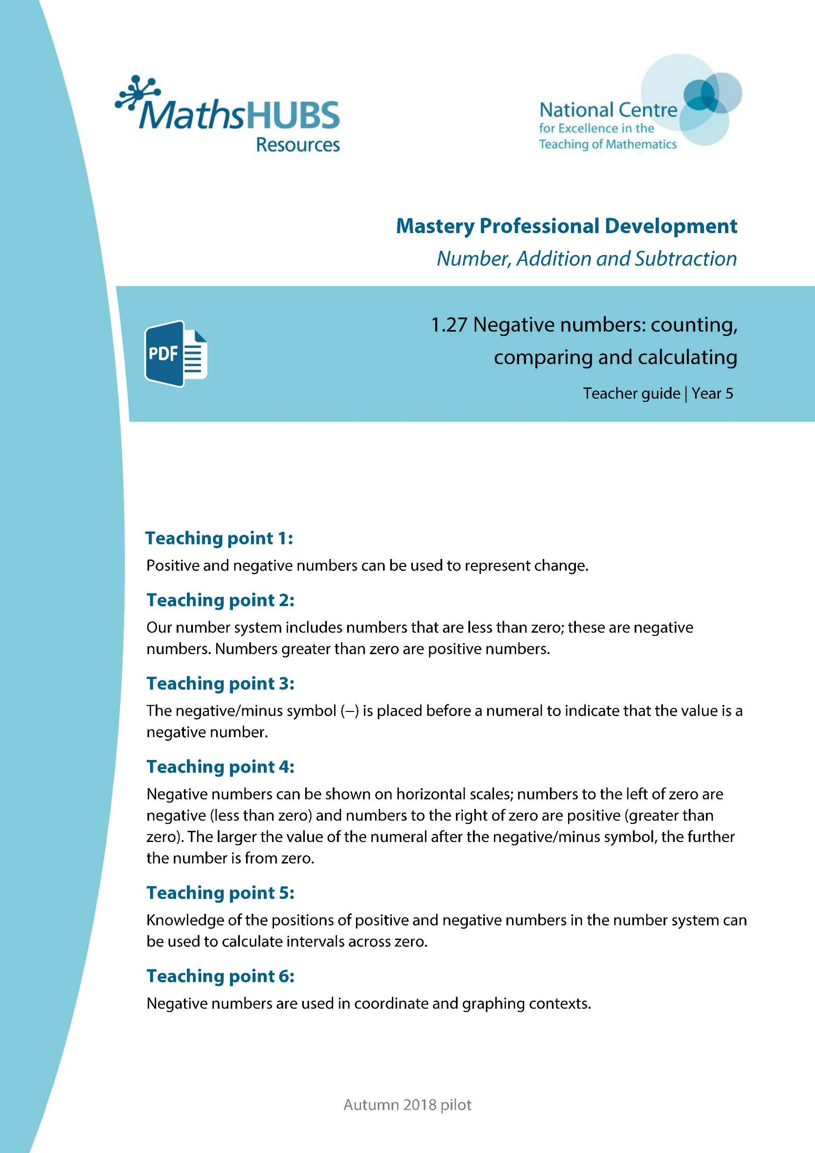
Year 5, Unit 3, Learning Outcome 1
Additional teacher guidance for this outcome should be read first and can be found in this segment of the NCETM Primary Mastery Professional Development Materials:
1.27 Negative numbers: counting, comparing and calculating
The spine materials are divided into ‘teaching points’ and ‘steps in learning’.
Teaching point | Steps in learning | Pages
1 | 1:1-1:4 | 3-5

Slide 6
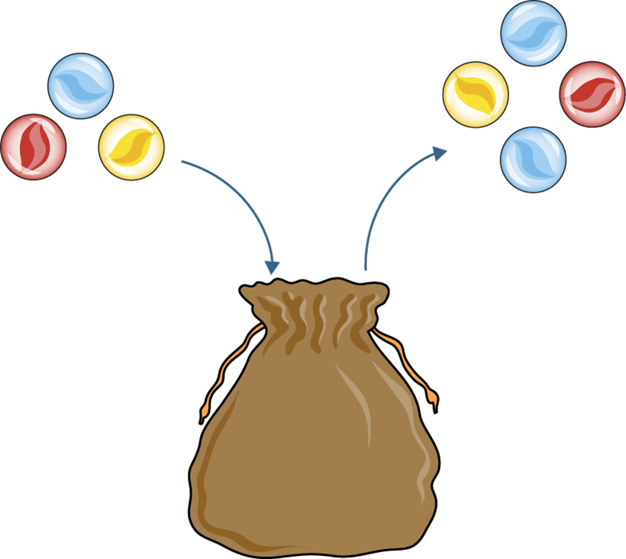
1.27 Negative numbers – step 1:1
3 − 4 = −1

Slide 7
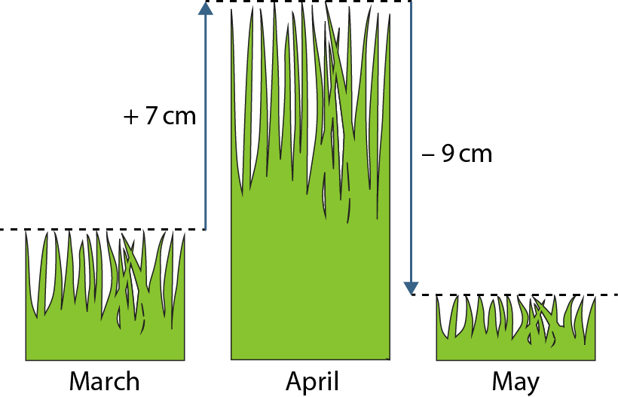
1.27 Negative numbers – step 1:7
−2 cm
7 − 9 = −2
Notes:
Between March and April, the grass in Bill’s garden grew 7 cm. At the beginning of May, Bill cut the grass by 9 cm. How long is the grass in May compared to March?

Slide 8
Year 5, Unit 3, Learning Outcome 2
Learning Outcome 2
Pupils interpret numbers greater than and less than zero in different contexts
The following slides have been collated to support the teaching of this learning outcome.

Slide 9
Year 5, Unit 3, Learning Outcome 2
Additional teacher guidance for this outcome should be read first and can be found in this segment of the NCETM Primary Mastery Professional Development Materials:
1.27 Negative numbers: counting, comparing and calculating
The spine materials are divided into ‘teaching points’ and ‘steps in learning’.
Teaching point | Steps in learning | Pages
2 | 2:1-2:3 | 6-8

Slide 10



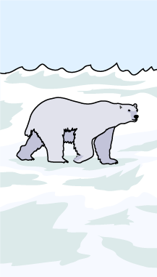


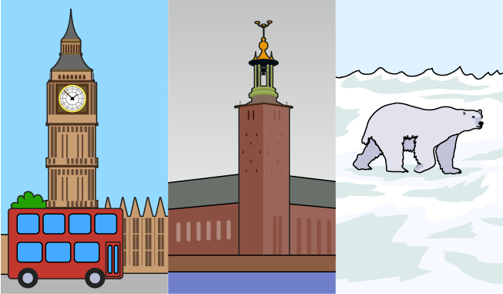
1.27 Negative numbers – step 2:1
North Pole
Stockholm, Sweden
London, England

Slide 11
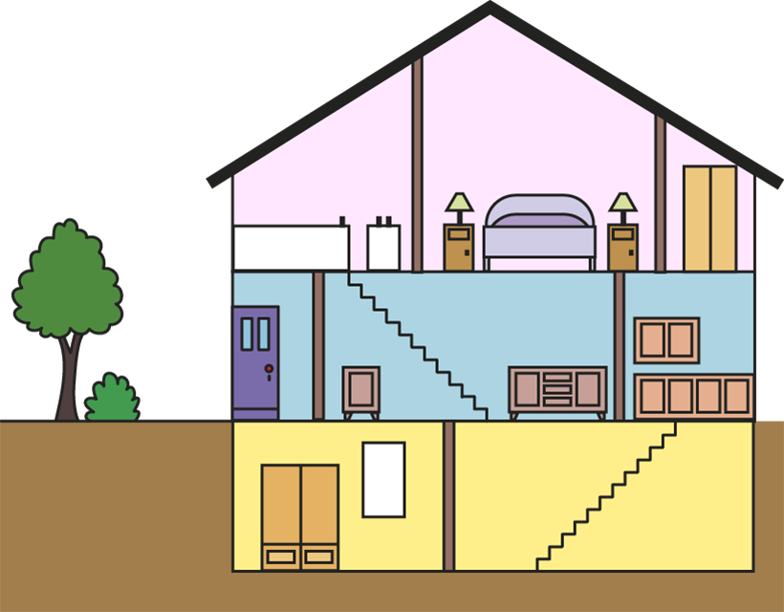
1.27 Negative numbers – step 2:2

Slide 12
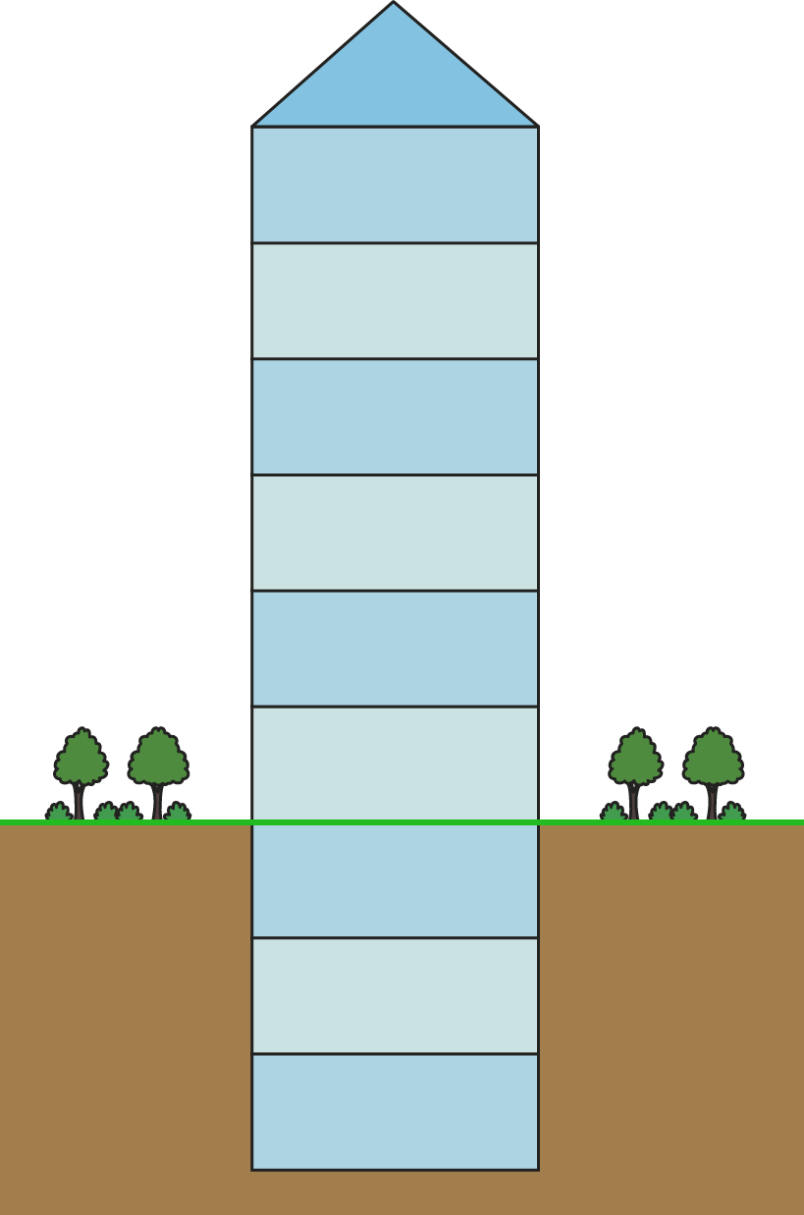
1.27 Negative numbers – step 2:2

Slide 13
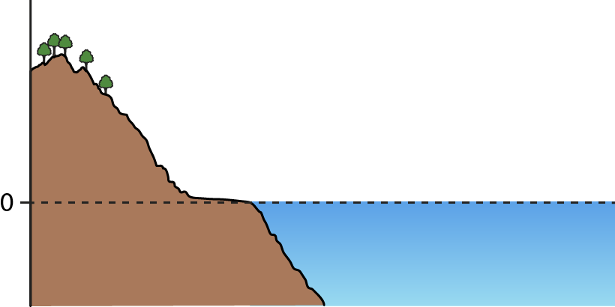
1.27 Negative numbers – step 2:3

Slide 14
Year 5, Unit 3, Learning Outcome 3
Learning Outcome 3
Pupils read and write negative numbers
The following slides have been collated to support the teaching of this learning outcome.

Slide 15
Year 5, Unit 3, Learning Outcome 3
Additional teacher guidance for this outcome should be read first and can be found in this segment of the NCETM Primary Mastery Professional Development Materials:
1.27 Negative numbers: counting, comparing and calculating
The spine materials are divided into ‘teaching points’ and ‘steps in learning’.
Teaching point | Steps in learning | Pages
3 | 3:1-3:3 | 9-12

Slide 16
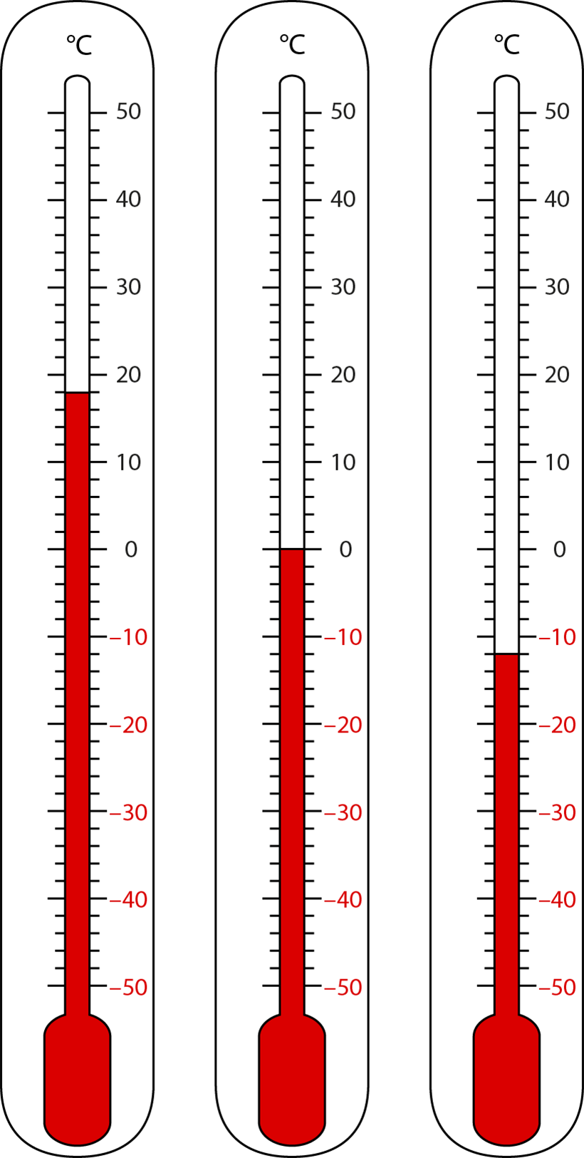
1.27 Negative numbers – step 3:1

Slide 17
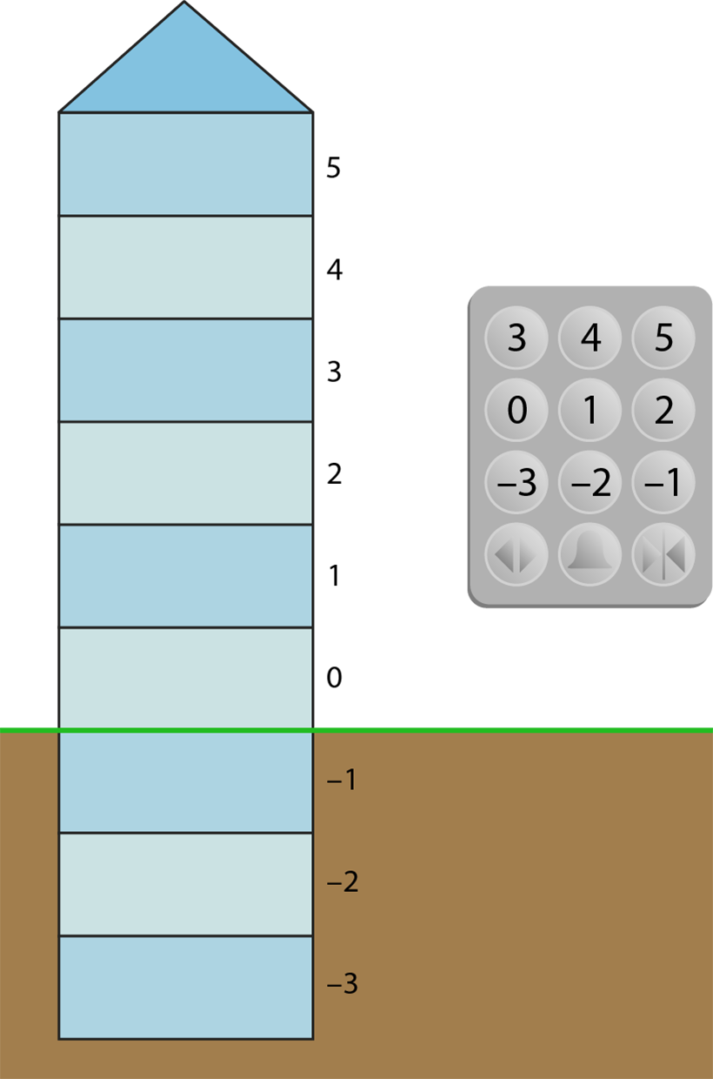
1.27 Negative numbers – step 3:1

Slide 18
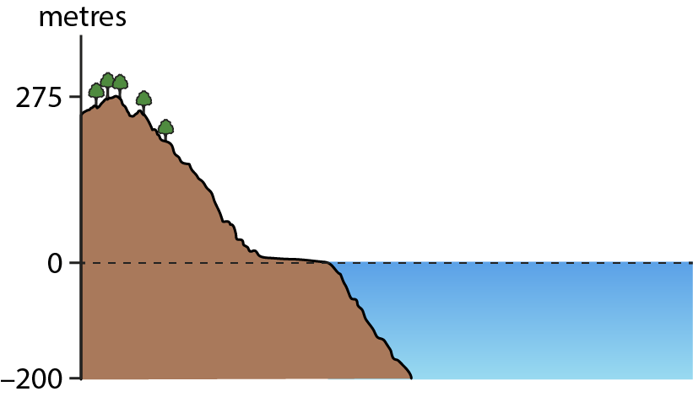
1.27 Negative numbers – step 3:1

Slide 19
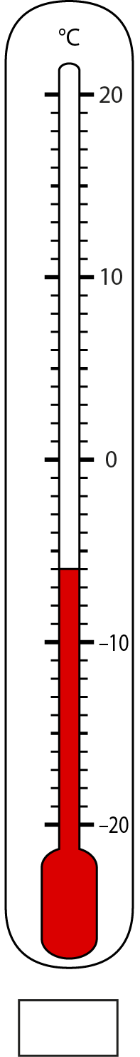
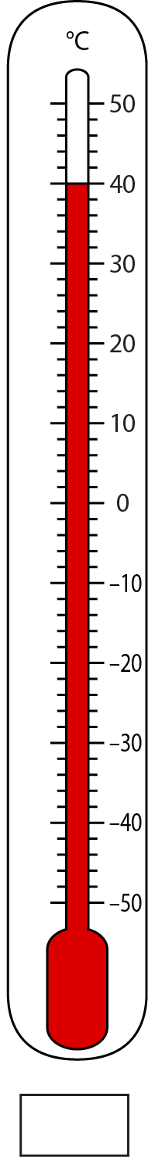
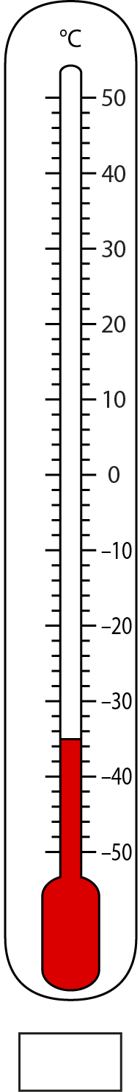
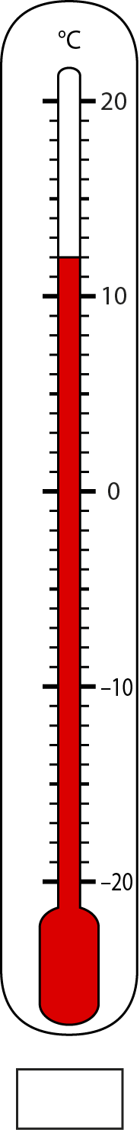
1.27 Negative numbers – step 3:3
−35
−6
40
12
Notes:
Write down the temperature shown on each thermometer, in degrees Celsius.

Slide 20
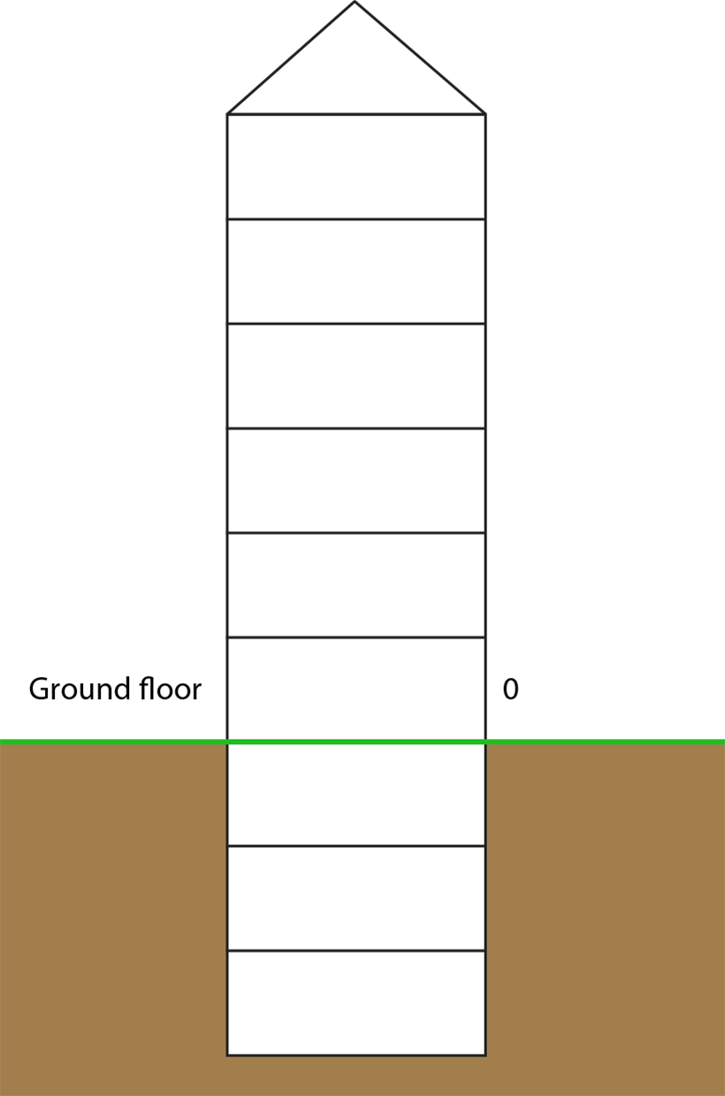
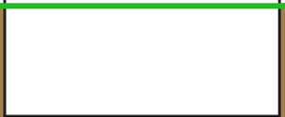
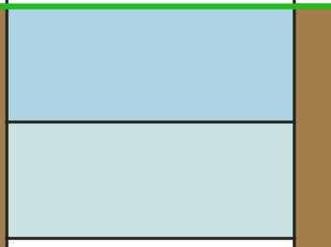
1.27 Negative numbers – step 3:3
−2
Notes:
Nicky gets into a lift at the ground floor. She presses the button labelled ‘−2’. Shade in the floor the lift takes her to.’

Slide 21
1.27 Negative numbers – step 3:3
Elevation
Object
15 m
submarine
0 m
kite
−30 m
boat
Notes:
Match each elevation, relative to sea level, to the correct object.

Slide 22
Year 5, Unit 3, Learning Outcome 4
Learning Outcome 4
Pupils explain how the value of a number relates to its position from zero
The following slides have been collated to support the teaching of this learning outcome.

Slide 23
Year 5, Unit 3, Learning Outcome 4
Additional teacher guidance for this outcome should be read first and can be found in this segment of the NCETM Primary Mastery Professional Development Materials:
1.27 Negative numbers: counting, comparing and calculating
The spine materials are divided into ‘teaching points’ and ‘steps in learning’.
Teaching point | Steps in learning | Pages
4 | 4:1-4:3 | 13-15

Slide 24
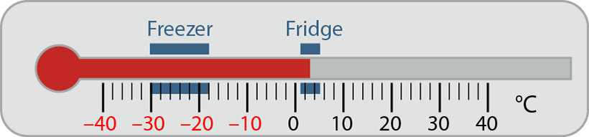
1.27 Negative numbers – step 4:1

Slide 25
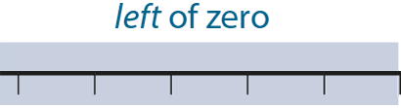
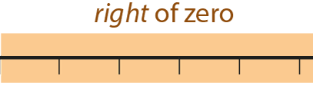









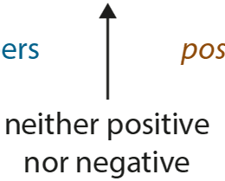



Slide 26






1.27 Negative numbers – step 4:3

Slide 27
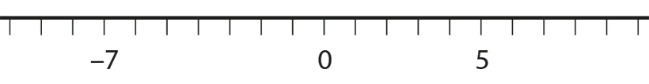

1.27 Negative numbers – step 4:3
Circle the number that is further from zero.
Notes:
For each number line, circle the number that is further from zero.

Slide 28
1.27 Negative numbers – step 4:3
Number pair |  | Positive number further from zero | Negative number further from zero | Both numbers same distance from zero
−6 | 12
−12 | 6
−6 | 6
10 | −1
10 | −10
10 | −100
✓
✓
✓
✓
✓
✓
Notes:
For each pair, put a tick in the correct column.

Slide 29
Year 5, Unit 3, Learning Outcome 5
Learning Outcome 5
Pupils identify and place negative numbers on a number line
The following slides have been collated to support the teaching of this learning outcome.

Slide 30
Year 5, Unit 3, Learning Outcome 5
Additional teacher guidance for this outcome should be read first and can be found in this segment of the NCETM Primary Mastery Professional Development Materials:
1.27 Negative numbers: counting, comparing and calculating
The spine materials are divided into ‘teaching points’ and ‘steps in learning’.
Teaching point | Steps in learning | Pages
4 | 4:4-4:6 | 16-17

Slide 31
1.27 Negative numbers – step 4:4

Slide 32

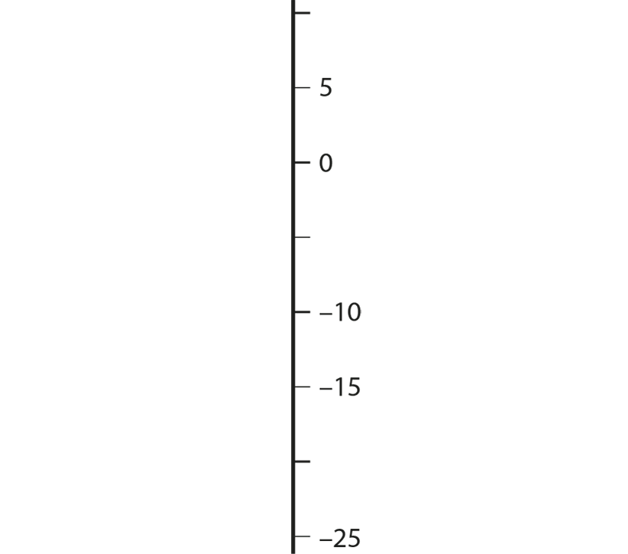


1.27 Negative numbers – step 4:4

Slide 33




1.27 Negative numbers – step 4:4

Slide 34




1.27 Negative numbers – step 4:5
Notes:
Fill in the missing numbers.

Slide 35
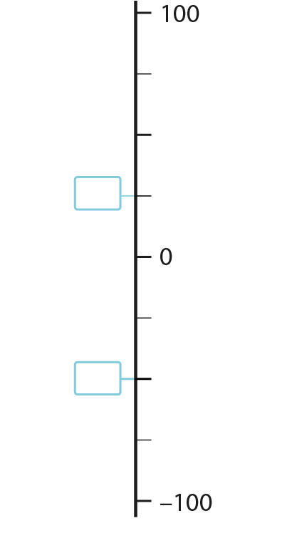

1.27 Negative numbers – step 4:5
Notes:
Fill in the missing numbers.

Slide 36
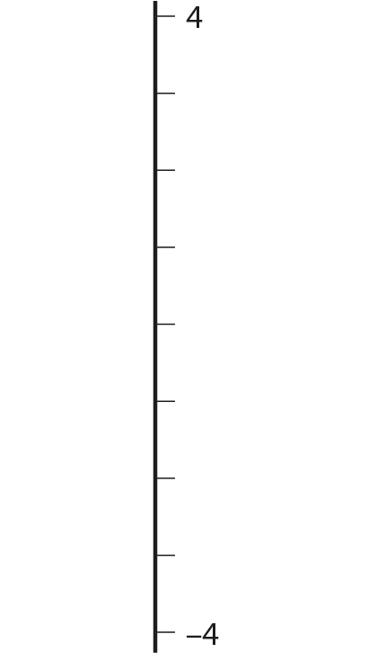




1.27 Negative numbers – step 4:5
Notes:
Place negative two on this number line.

Slide 37

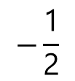
1.27 Negative numbers – step 4:6
0.5
$$−\frac{\text{1}}{\text{2}}$$
$$\frac{\text{1}}{\text{4}}$$
1.5
−2.5
Notes:
Place the following numbers on the number line.

Slide 38
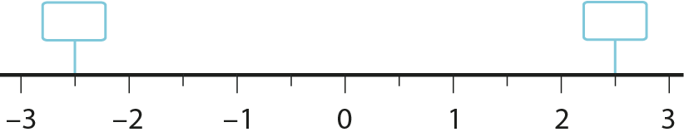




1.27 Negative numbers – step 4:6
−2
$$\frac{\text{1}}{\text{2}}$$
2
$$\frac{\text{1}}{\text{2}}$$
Notes:
Fill in the missing numbers.

Slide 39
Year 5, Unit 3, Learning Outcome 6
Learning Outcome 6
Pupils interpret sets of negative and positive numbers in a range of contexts
The following slides have been collated to support the teaching of this learning outcome.

Slide 40
Year 5, Unit 3, Learning Outcome 6
Additional teacher guidance for this outcome should be read first and can be found in this segment of the NCETM Primary Mastery Professional Development Materials:
1.27 Negative numbers: counting, comparing and calculating
The spine materials are divided into ‘teaching points’ and ‘steps in learning’.
Teaching point | Steps in learning | Pages
4 | 4:7-4:8 | 18-20

Slide 41
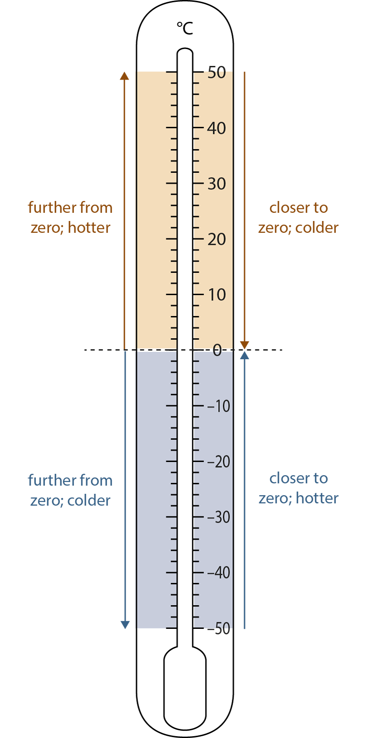
1.27 Negative numbers – step 4:7
 | South Pole |  | London
 | Min (°C) | Max (°C) | Min (°C) | Max (°C)
Jan | −30 | −26 | 2 | 8
Feb | −43 | −38 | 2 | 8
Mar | −57 | −50 | 4 | 11
Apr | −61 | −53 | 6 | 14
May | −62 | −54 | 9 | 18
Jun | −63 | −54 | 12 | 21
Jul | −63 | −55 | 14 | 23
Aug | −63 | −55 | 14 | 23
Sep | −62 | −54 | 11 | 20
Oct | −54 | −48 | 8 | 16
Nov | −40 | −36 | 5 | 11
Dec | −29 | −26 | 3 | 8
Notes:
Table: Average monthly temperatures for the South Pole and London.

Slide 42
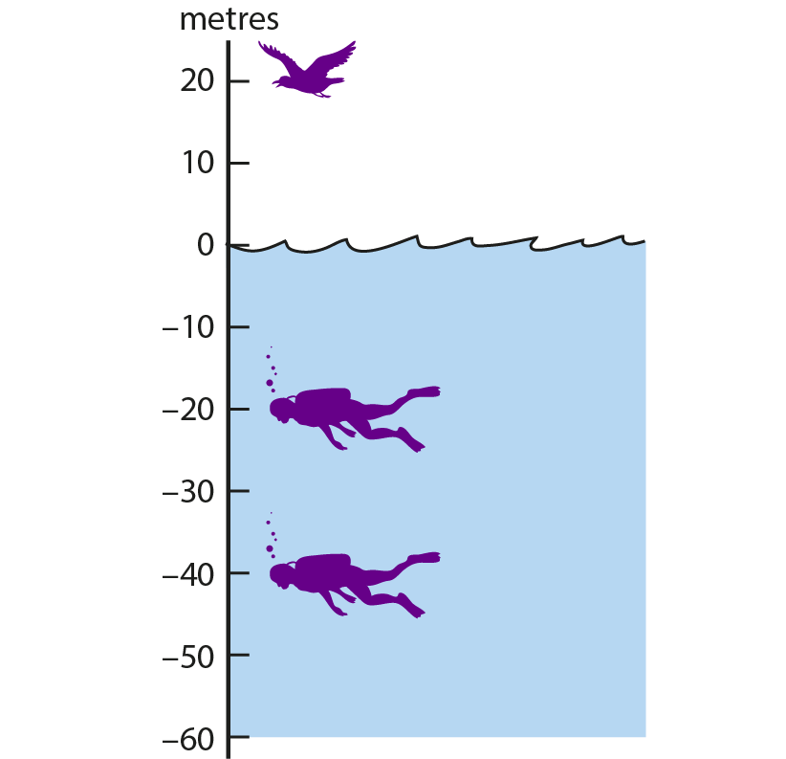
1.27 Negative numbers – step 4:7

Slide 43
Year 5, Unit 3, Learning Outcome 7
Learning Outcome 7
Pupils use their knowledge of positive and negative numbers to calculate intervals
The following slides have been collated to support the teaching of this learning outcome.

Slide 44
Year 5, Unit 3, Learning Outcome 7
Additional teacher guidance for this outcome should be read first and can be found in this segment of the NCETM Primary Mastery Professional Development Materials:
1.27 Negative numbers: counting, comparing and calculating
The spine materials are divided into ‘teaching points’ and ‘steps in learning’.
Teaching point | Steps in learning | Pages
5 | 5:1-5:3 | 21-23

Slide 45
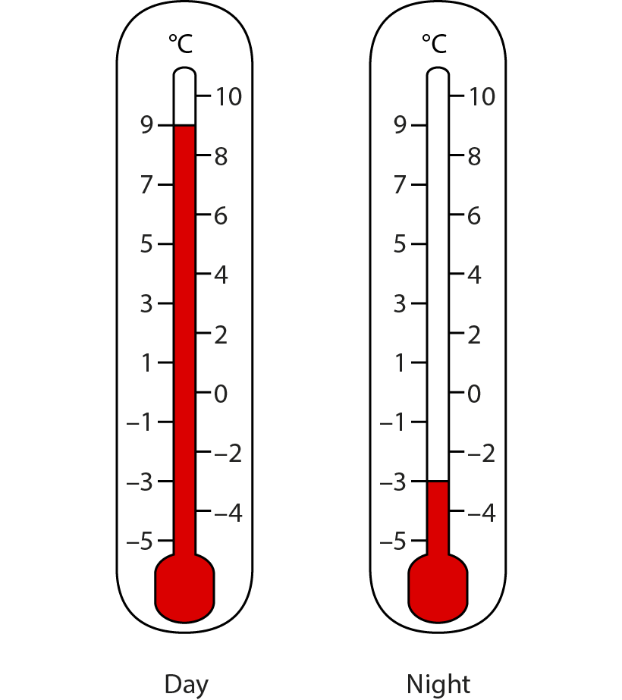




1.27 Negative numbers – step 5:1
9
12
3
9 ˚C
−3 ˚C
Notes:
The temperature was 9 ˚C in the day, then it dropped to −3 ˚C at night. What was the change in temperature?

Slide 46



1.27 Negative numbers – step 5:1
3
9
12
9˚C
−3˚C
Notes:
The temperature was 9 ˚C in the day, then it dropped to −3 ˚C at night. What was the change in temperature?

Slide 47

1.27 Negative numbers – step 5:2
Notes:
What temperature does the thermometer show?
The temperature rises by 16 °C. Mark the new temperature reading on the thermometer.
The temperature falls from 14 °C to –4 °C. By how many degrees does the temperature fall?
The temperature rises from −4 °C by 10 °C. What is the new temperature?
The temperature falls from 10 °C by 16 °C. What is the new temperature?
The temperature falls from −6 °C by 3 °C. What is the new temperature?
The temperature is −9 °C. By how much must it rise to reach −2 °C?

Slide 48
1.27 Negative numbers – step 5:3
Date | Paid in | Paid out | Amount in account
31 December |  |  | £150
5 January |  | £30
10 January |  | £50 | £70
11 January |  | £100
12 January | £10 |  | −£20
16 January | £20 | £130
£120
−£30
−£130
Notes:
Mr Money has £150 in his bank account at the end of December. The table shows money he paid in and out, and the amount in the account over the next few weeks. Fill in the missing numbers.

Slide 49
Year 5, Unit 3, Learning Outcome 8
Learning Outcome 8
Pupils explain how negative numbers are used on a coordinate grid
The following slides have been collated to support the teaching of this learning outcome.

Slide 50
Year 5, Unit 3, Learning Outcome 8
Additional teacher guidance for this outcome should be read first and can be found in this segment of the NCETM Primary Mastery Professional Development Materials:
1.27 Negative numbers: counting, comparing and calculating
The spine materials are divided into ‘teaching points’ and ‘steps in learning’.
Teaching point | Steps in learning | Pages
6 | 6:1-6:2 | 25-27

Slide 51
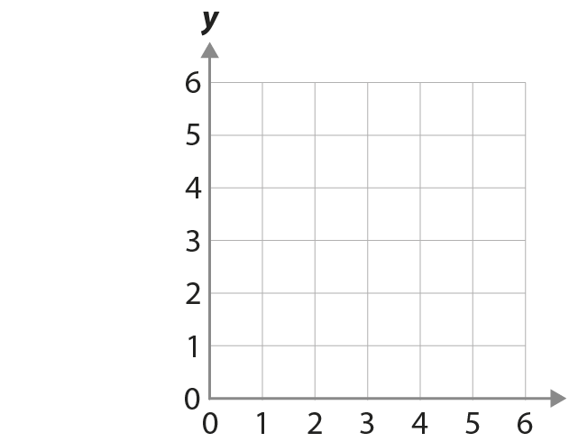









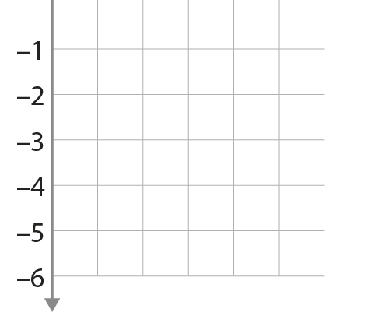



1.27 Negative numbers – step 6:1

Slide 52
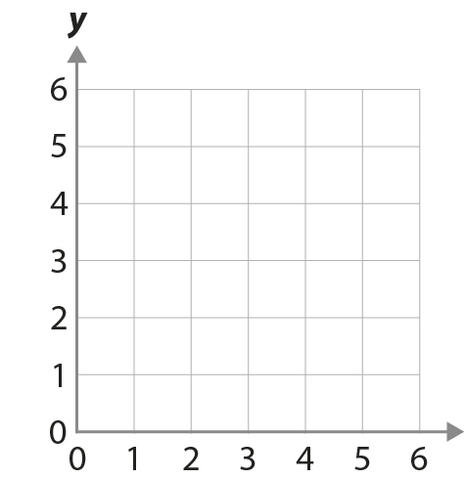
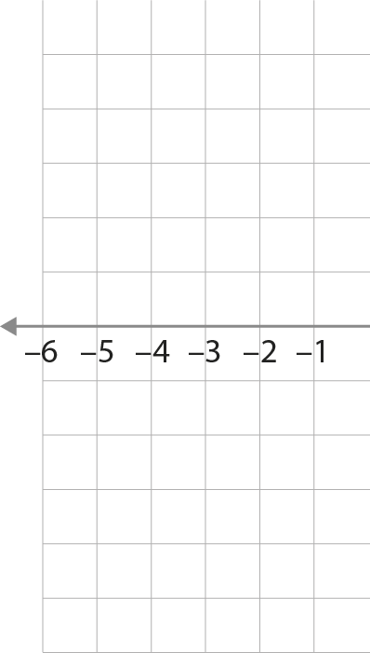












1.27 Negative numbers – step 6:2

Slide 53


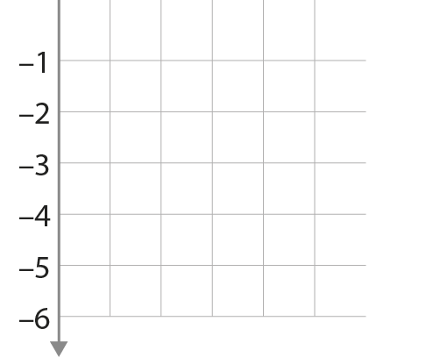


1.27 Negative numbers – step 6:2

Slide 54
Year 5, Unit 3, Learning Outcome 9
Learning Outcome 9
Pupils use their knowledge of positive and negative numbers to interpret graphs
The following slides have been collated to support the teaching of this learning outcome.

Slide 55
Year 5, Unit 3, Learning Outcome 9
Additional teacher guidance for this outcome should be read first and can be found in this segment of the NCETM Primary Mastery Professional Development Materials:
1.27 Negative numbers: counting, comparing and calculating
The spine materials are divided into ‘teaching points’ and ‘steps in learning’.
Teaching point | Steps in learning | Pages
6 | 6:4 | 28-30

Slide 56
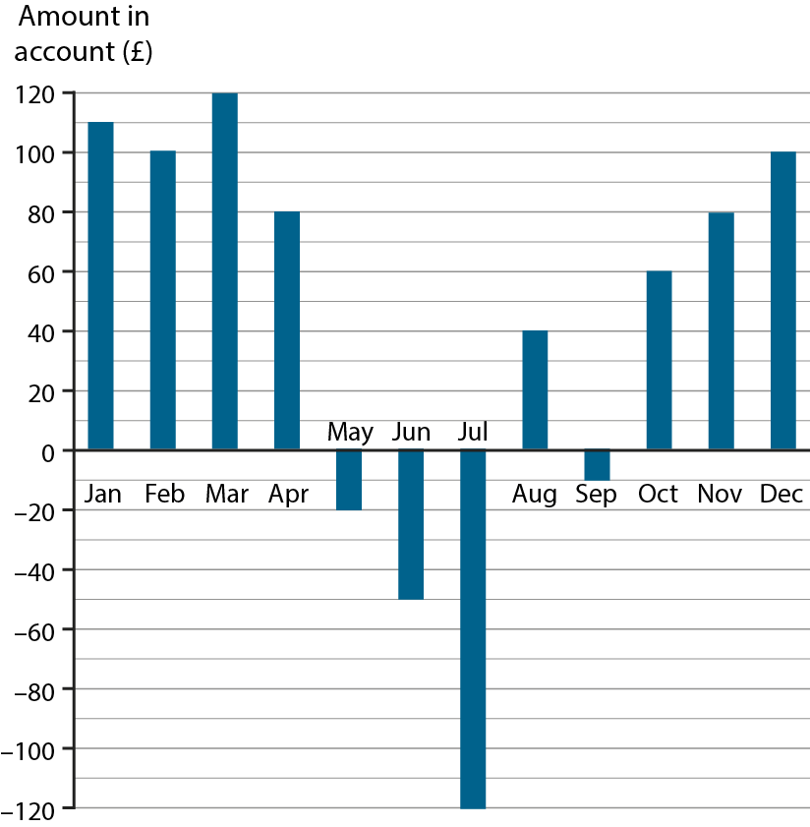
1.27 Negative numbers – step 6:4
Notes:
The bar chart shows the amount of money in a bank account at the end of each month.
What and when was the most amount of money in the account?
What and when was the least amount of money in the account?
What was the difference between the most and least amounts in the account?
How much money was paid into the account between July and August?
How much money was paid out of the account between August and September?

Slide 57
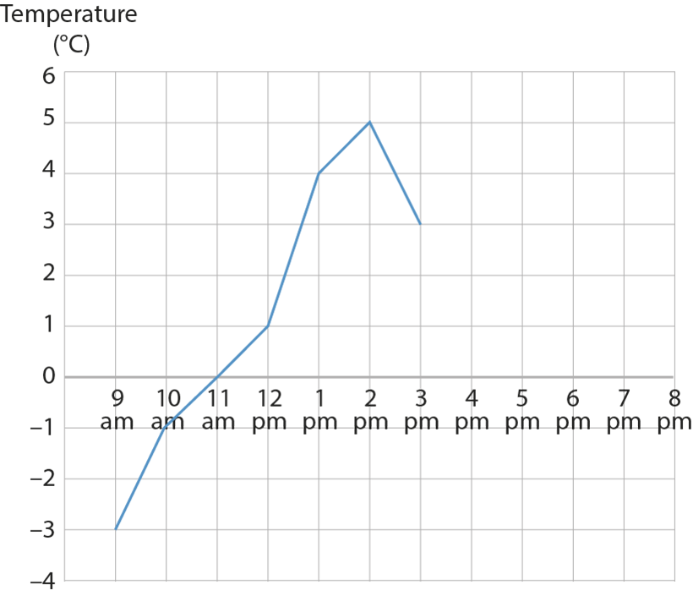
1.27 Negative numbers – step 6:4
Notes:
The graph shows the temperature in a school’s nature garden during one day.
What was the lowest temperature?
What was the highest temperature?
What was the difference between the lowest and highest temperatures?
By 8 pm the temperature had dropped to −1 °C. Plot this point on the graph. What was the change in temperature between 3 pm and 8 pm?

Slide 58
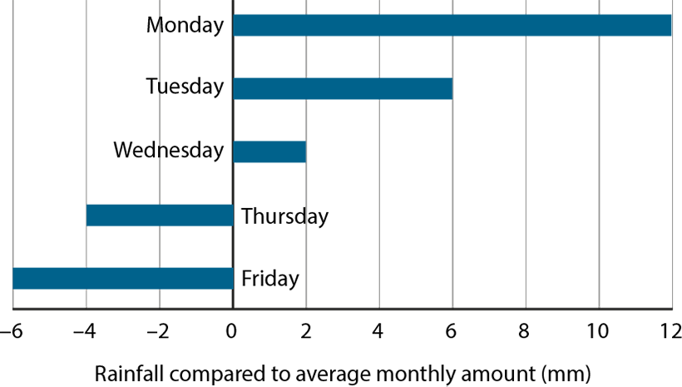
1.27 Negative numbers – step 6:4
Notes:
The bar chart shows the amount of rain that fell in the nature garden on different days of the week. The amounts are measured compared to the average monthly rainfall for that time of year.
What is the difference in rainfall between Wednesday and Thursday?
If the average monthly rainfall is 8 mm, how much rain fell on each day?
Why couldn’t the average monthly rainfall for this period be 4 mm?

