Slide 1
Series 3 Episode 11
What’s the Difference?

Slide 2
Practitioner Notes

Slide 3
Episode Description
In this episode we learn about finding the difference. One, Three and Five want to be like Seven. But how can they? They are different. They discover that they need to find a friend to jump on their head to be like Seven. What happens when Seven, Eight and Five want to be like Two? What can they do? They discover that they need a friend to jump off them to make Two.

Slide 4
Maths in the Episode
Subtraction as difference
Understanding difference is complex for young learners. Finding a numerical difference is the result of determining how many more or fewer one quantity is compared to another. Finding the difference requires experience of equalising* two quantities by changing one quantity by adding or subtracting to make it equal to the compared quantity. This episode introduces strategies for finding the (numerical) difference between two quantities:
adding blocks to make the same – how many added?
aligning and identifying the number of ‘missing’ blocks – how many less/ fewer?
subtracting blocks to make the same – how many taken away?
aligning and counting the extra blocks – how many more?
* See this open access article on additive relation problems

Slide 5
Using Mathematical Language
Use these stem sentences to rehearse the mathematical ideas in the programme:
“<7> is <4> more than <3>”.
The difference between <3> and <7> is 4.
“<3> is <4> less than 7.”
The difference between <7> and <3> is 4.
“The difference between <7> and <3> is <4>.”
“The difference between <4> and <7> is <3>.”
Notes:
< > indicates what can be changed in the stem sentence.

Slide 6
Talk and Discuss Together

Slide 7
Talk and Discuss Together
Watch the episode of Numberblocks. Use the following picture to stimulate discussion. How are you different from other people? We can compare ourselves in all sorts of ways, but the Numberblocks have a special way of comparing because they are made of blocks that we can count! How was One different from Seven?
The following slides are designed to stimulate children and adults to talk about the episode and draw out some key aspects of the mathematics.

Slide 8
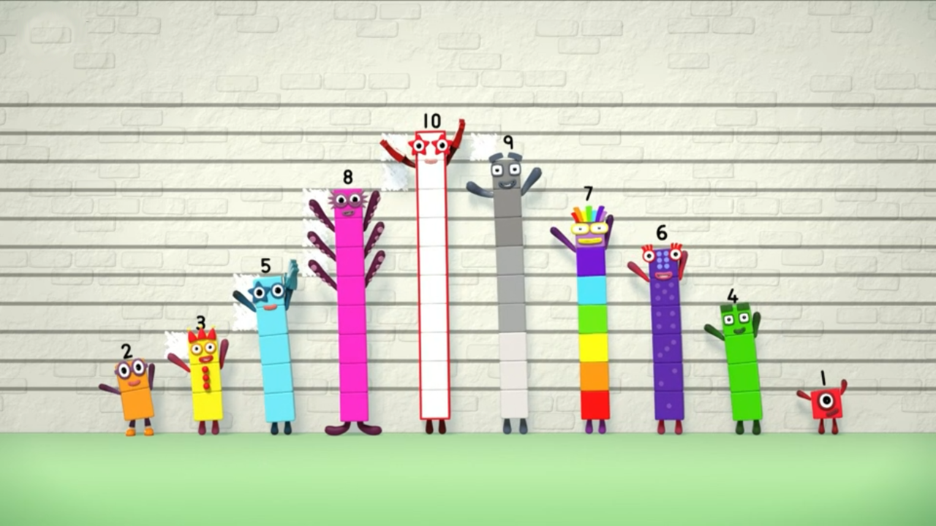
Images © 2017 Alphablocks Ltd. All Rights Reserved.
Notes:
Use this picture as the stimulus for Talk and Discussion (slide 7).

Slide 9
Enabling Environments in Reception

Slide 10
Enabling Environments
Playing and Exploring
Provide opportunities for children to play with sets of objects which can be compared, for example, play ‘Who can win the most flies?’ Put out a set of plastic frogs and flies. Roll a dice, pick up that number of frogs, roll again for the flies, find out how many more flies there are by lining up the frogs and flies, the winner is the person who has the most ‘left-over’ flies.
Active Learning
In everyday routines there are many opportunities to compare small quantities and use the language of comparison - 6 children and only 2 pencils, how many more do we need? 4 children can play in the mud kitchen, there is only 1 child there, how many more can go and play?
Creating and Thinking Critically
Explore coloured rods (for example, Cuisenaire). Pick 2 rods and line them up vertically or horizontally, ensuring that the ends are placed side by side. Which is the longer rod? Which is the shorter rod? Find the rod to fill the gap. (See illustration on next slide.) See if children can find different pairs of rods which have the same (difference) rod.

Slide 11

Rods placed horizontally with the ends at the same point
Rods placed vertically with the ends at the same point
Notes:
This slide is an illustration to support the Creating and thinking critically section of slide 10.

Slide 12
Learning Together in Y1

Slide 13

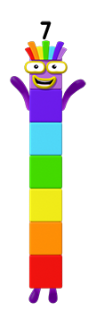
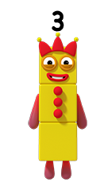
I want to be like you.
Images © 2017 Alphablocks Ltd. All Rights Reserved.
Notes:
The following slides are used to develop the ‘make up the difference’ strategy for finding the difference.
Let’s compare Three and Seven.
How is Seven different from Three?
What does Three need to become the same as Seven?

Slide 14
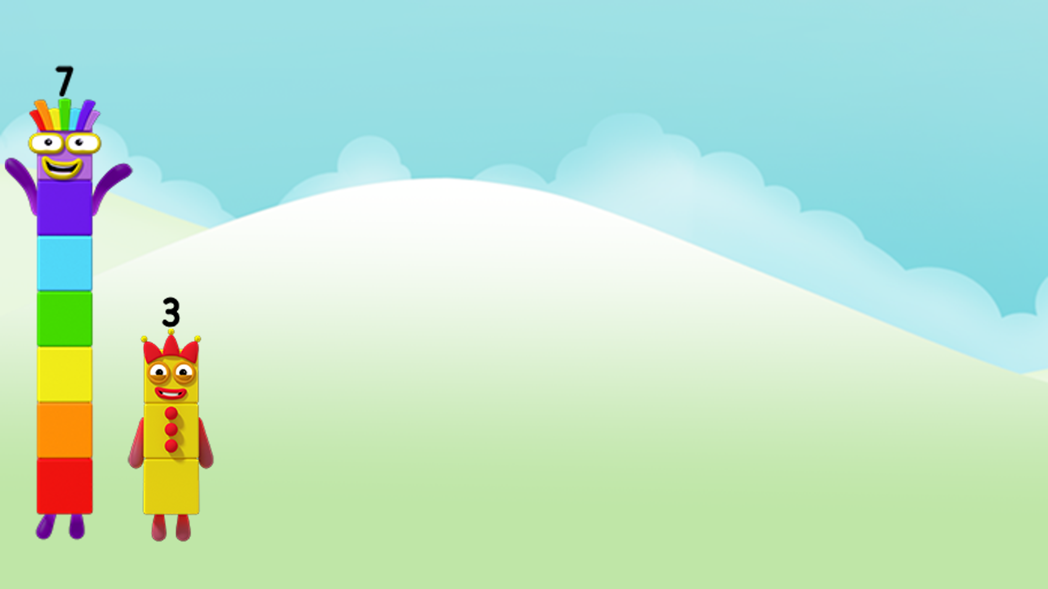
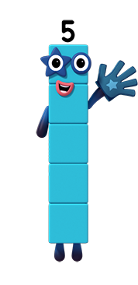
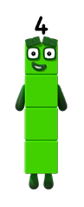
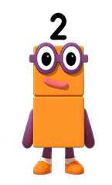
That’s the one!
Too tall!
Find a friend to jump on you.
Too small!
I am the difference.
Images © 2017 Alphablocks Ltd. All Rights Reserved.
Notes:
Use this slide to test possible Numberblocks to jump on Three to make Seven.
Clicking on each Numberblock makes it ‘jump’ on top of Three.
Click between each ‘jump’ to reveal ‘too small/ tall/ that’s the one’.
Let’s read together what Four says: “I am the difference.”
Why does Four say that he is ‘the difference’?

Slide 15
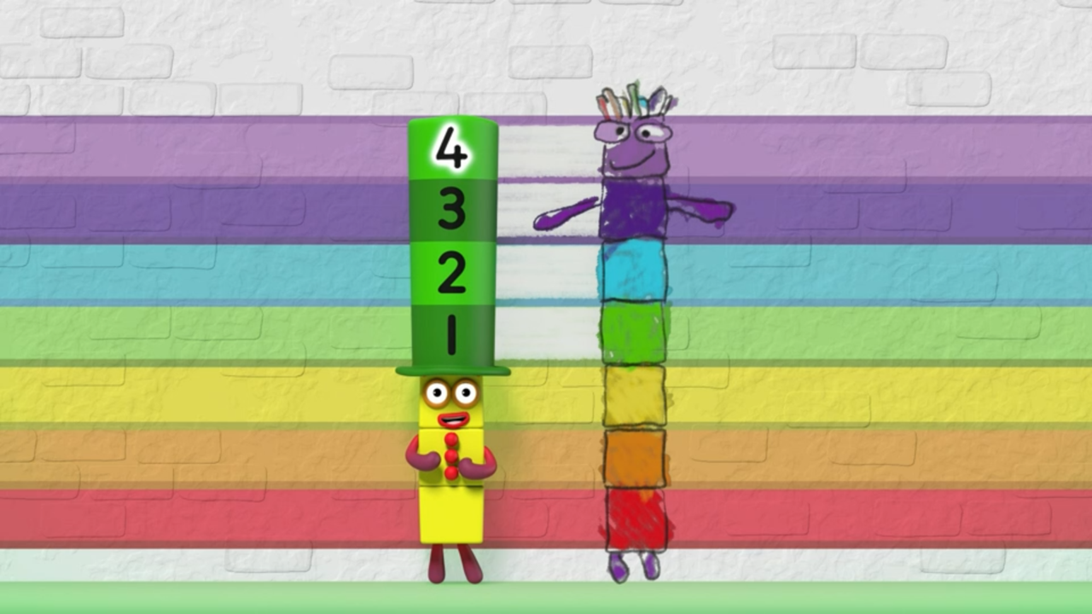
Images © 2017 Alphablocks Ltd. All Rights Reserved.
Notes:
Use this slide to show with another picture that the difference between 3 and 7 is 4.
What happens when Three wears a hat made from Four’s blocks? (He is the same height as Seven.)
Why did the hat need to have four blocks? (Because the difference between three and seven is four.)

Slide 16
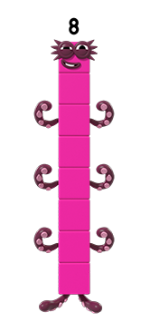
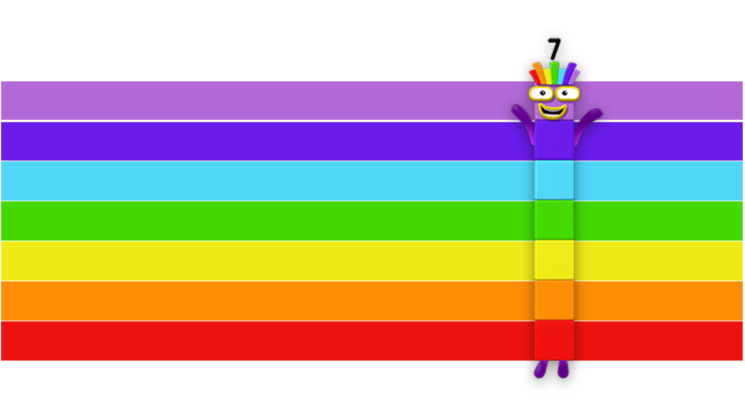
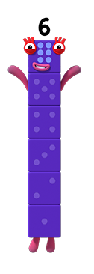

That’s the one!
Too tall!
Too small!
Images © 2017 Alphablocks Ltd. All Rights Reserved.
Notes:
Use this slide test possible Numberblocks to jump on One to make Seven.
Model language of difference: ‘One wants to be the same as Seven. Let’s help her find the right friend. We need to find the difference between 1 and 7.’
Click through the slide and different Numberblocks will jump onto One, arrows will match up the ‘extra’ blocks to see if they match with Seven.

Slide 17
Further activities for Y1
Model in everyday life the concept of difference where a countable quantity is involved and can be compared. For example, There are 10 children but only 8 pencils, how many more do we need? There are 5 children and the cook has made 8 packed lunches, he made 3 too many!
Explore difference by taking off – that is, by making a larger Numberblock into a smaller Numberblock.
Represent the difference by aligning Numberblocks or quantities horizontally.
Represent “How many more are needed?” number stories using cubes or counters by making two lines of objects, ensuring one-to-one correspondence, to find how many are needed to make the quantities equal.
Represent “How many must be removed” number stories using cubes or counters.
Show the comparison of two quantities by saying how many more one quantity is than another, for example, 7 is 3 more than 4; 3 is 4 fewer than 7.

Slide 18
Learning Together in Y2

Slide 19
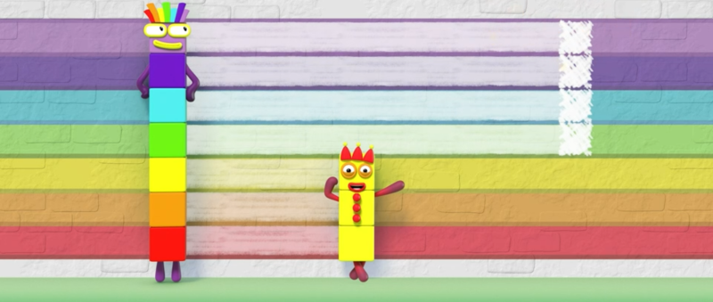





What’s the difference?
Think about the missing blocks.
The difference between 3 and 7 is 4.
I want to be like you.
Images © 2017 Alphablocks Ltd. All Rights Reserved.
Notes:
Use these sets of slides to explore different ways to find the difference.
Use this slide to find the difference by thinking about the missing blocks.
What do you notice?
How many blocks would we need to put on top of Three to make her the same as/ equal to Seven?
‘Three needs 4 more to be equal to Seven, so the difference between 3 and 7 is 4.’
Click through to model this with a bar model and also with a missing number in an addition equation.

Slide 20

What’s the difference?
Take off the extra blocks.
The difference between 7 and 3 is 4.
I want to be like you.
Images © 2017 Alphablocks Ltd. All Rights Reserved.
Notes:
Use this slide to find the difference by removing the extra blocks from the larger amount.
What do you notice?
How can we help Seven to be like Three? (Seven needs to take off some blocks.)
Talk about and emphasise: We are still finding the difference between Seven and Three. We can describe it as’ the difference between 3 and 7’ or ‘the difference between 7 and 3’.
We can record it as a subtraction.

Slide 21
What’s the difference?
Take off what we’ve both got.
I have 4 more blocks than you.
How am I different from you?
The difference between 7 and 3 is 4.
Images © 2017 Alphablocks Ltd. All Rights Reserved.
Notes:
Use this slide to find the difference by removing the number of blocks that are common to both.
What do you notice?
Click through the slide to hide the bottom 3 blocks in Seven and the bar model and subtraction equation.

Slide 22
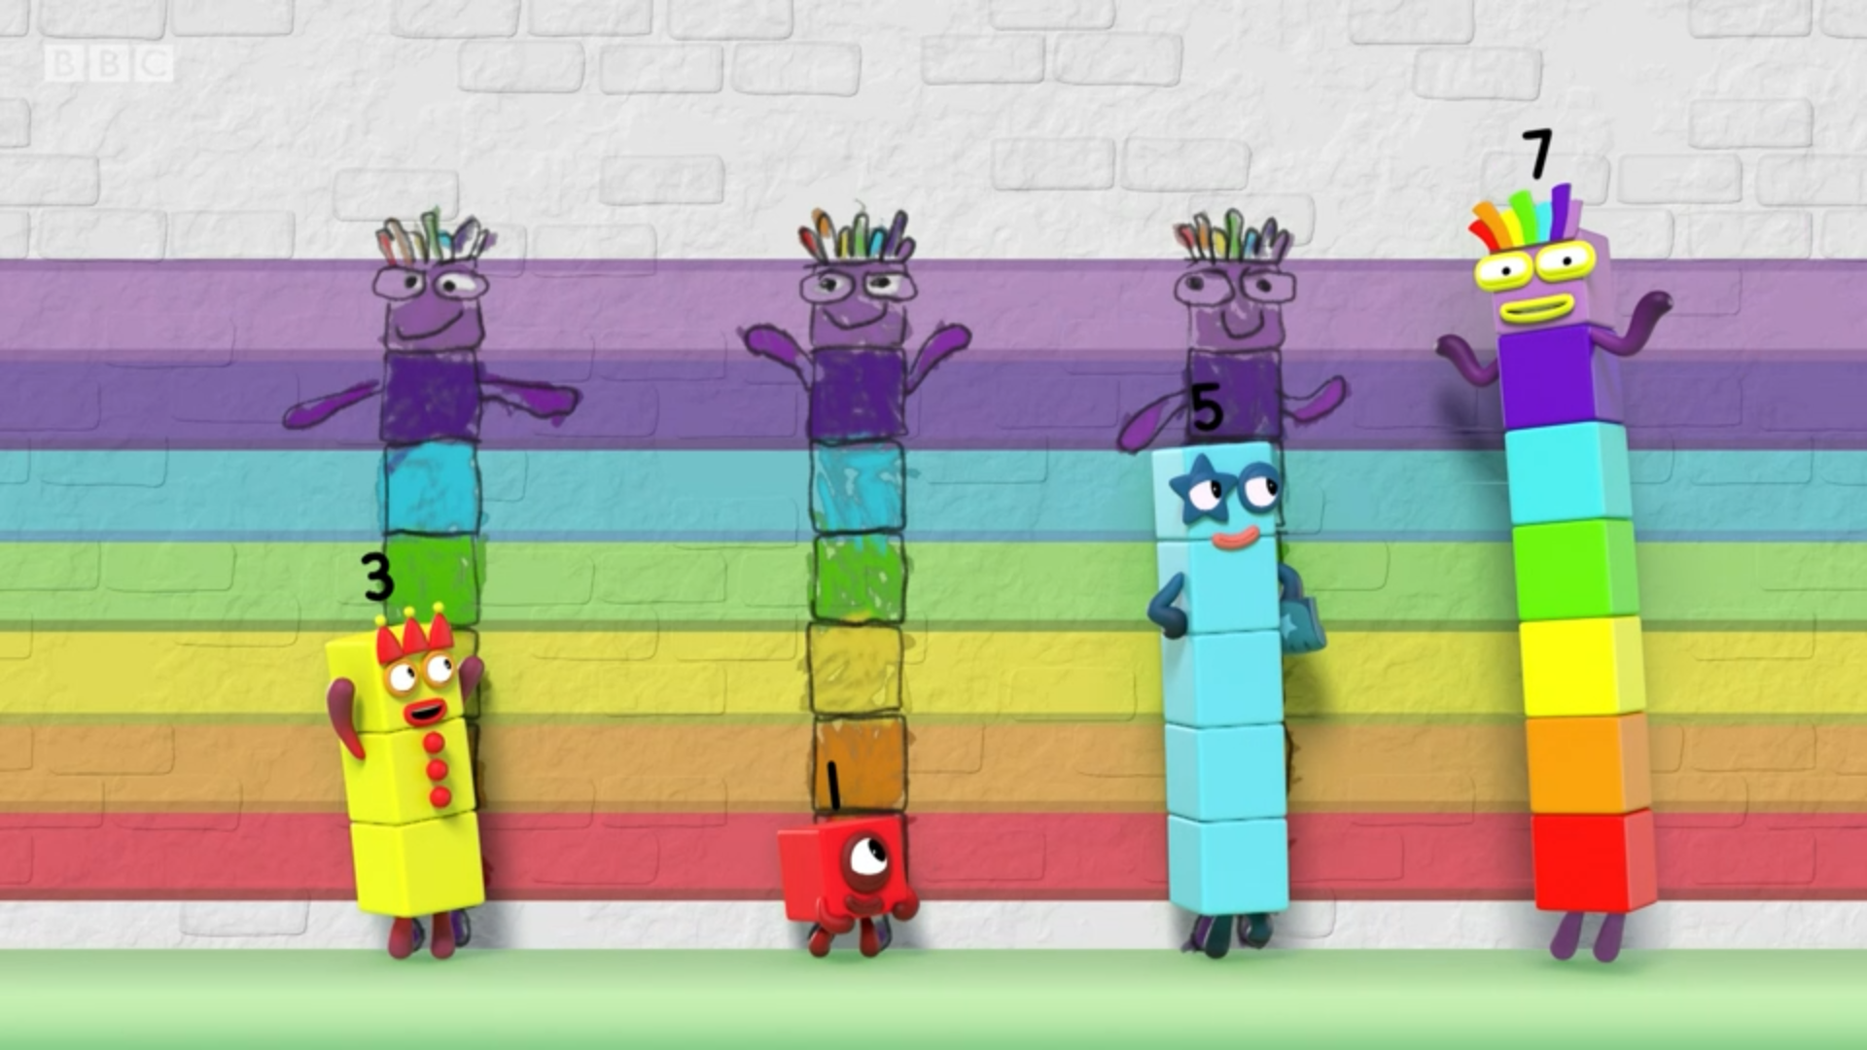

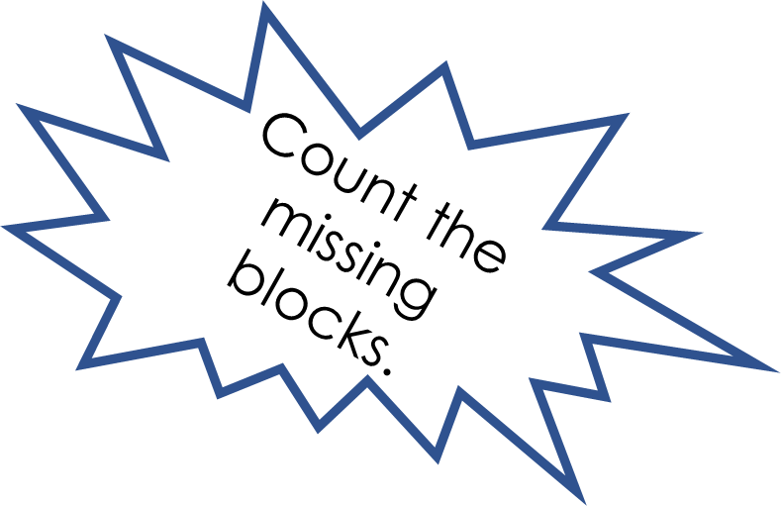

What’s the difference?
Images © 2017 Alphablocks Ltd. All Rights Reserved.
Notes:
Use this picture for children to find the difference between One and Seven and also between Five and Seven.
Encourage the children to select from the strategies on the previous slides. They can represent their thinking using cubes/ counters/ bar models/ a missing-number addition equation/a subtraction equation.
Ask children to talk about which way they found the difference.

Slide 23
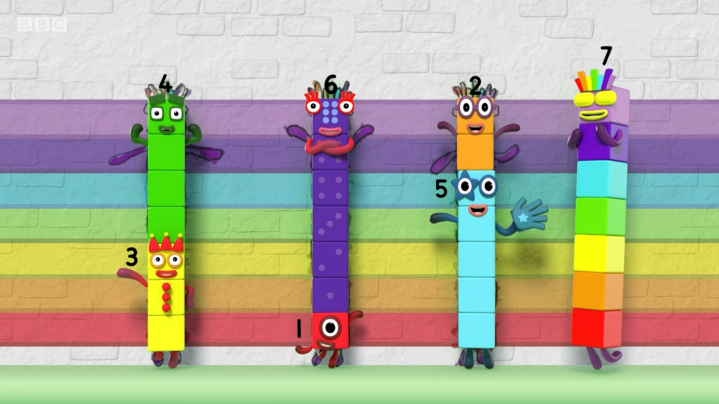
What’s the difference?
Images © 2017 Alphablocks Ltd. All Rights Reserved.
Notes:
Use this slide to check the answers.
Practise saying: “The difference between 3 and 7 is 4”; “The difference between 1 and 7 is 6”; “The difference between 5 and 7 is 2”.
Also model how it can be described by swapping the number around: we can say, ‘the difference between 1 and 7 is 6 or the difference between 7 and 1 is 6.’.
But when writing it as a subtraction equation, we need to put the bigger number first.

Slide 24
Further activities for Y2
Explore differences between 2 Numberblocks that are not represented in a tower. Discuss how to use the 3 strategies when the representations are not in towers. Does it matter? (See slide 25.)
Explore the difference between other Numberblocks, using other representations for example, with other structural apparatus such as Numicon or tens frames. How are these representations the same/ different?
Investigate 2 Numberblocks that have a difference of 3 blocks. Write the pairs of related sentences: 7 is 3 more than 4. 4 is 3 less than 7.
Write equations to represent finding the difference, for example, 7 = 4 + o or 7 – 3 = o

Slide 25
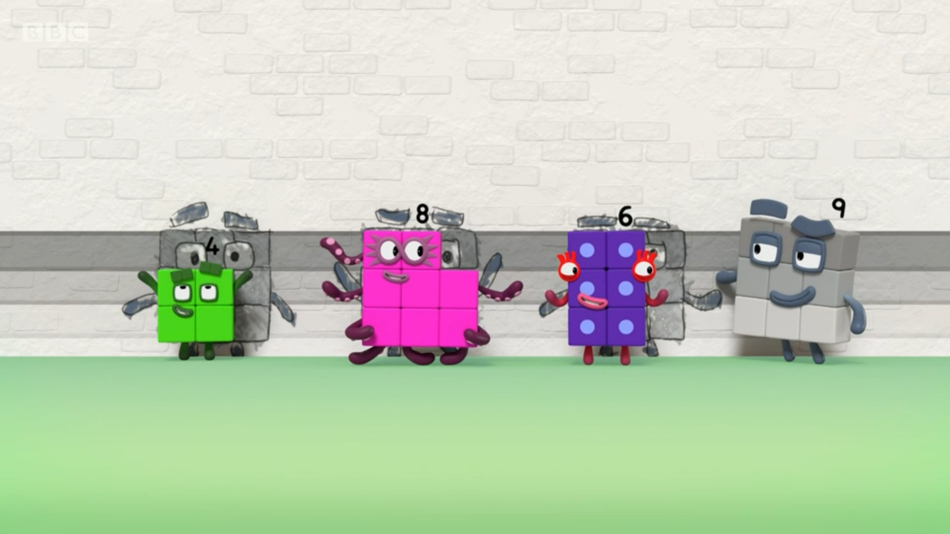
What’s the difference?
Images © 2017 Alphablocks Ltd. All Rights Reserved.
Notes:
Hidden slide.
Print this slide off for the children to compare difference when the Numberblocks are not 1-wide.

