Slide 1
Trigonometric functions and the unit circle
KS3 Mastery PD Materials: Exemplified Key Ideas
Materials for use in the classroom or to support professional development discussions
(from 3.2 Trigonometry)
Summer 2021

Slide 2
About this resource
These slides are designed to complement the 3.2 Trigonometry Core Concept document and its associated Theme Overview document 3 Multiplicative Reasoning, both found in the Secondary Mastery Professional Development pages.
These slides re-present the key examples from the Core Concept document so that the examples can be used either directly in the classroom or with a group of teachers. There are prompt questions alongside the examples, and further clarification in the notes.
These slides do not fully replicate the Core Concept document, so should be used alongside it. Reference to specific page numbers, and to other useful NCETM resources, can be found in the notes for each slide.
This slide deck is not designed to be a complete PD session, rather it is a selection of resources that you can adapt and use as needed when planning a session with a group of teachers.

Slide 3


About this resource
The slides are structured as follows:
  The big picture:
    Where does this fit in?
    What do students need to understand?
    Why is this key idea important?
  Prior learning
  Misconceptions
  Exemplified key ideas
  Reflection questions
  Appendices:
    Key vocabulary
    Representations and structure
    Previous and Future learning
    Useful links
The exemplified key idea slides have the following symbols to indicate how they have been designed to be used:
Into the classroom
The examples are presented on these slides so that they could be used in PD, but also directly in the classroom. The notes feature suggested questions and things teachers might consider when using with students.
PD discussion prompts
These slides look at the examples in more detail, with question prompts to promote discussion among maths teachers. The notes feature reference to further information and guidance within the Core Concepts document.

Slide 4
Where does this fit in?
The NCETM has identified a set of six ‘mathematical themes’ within Key Stage 3 mathematics that bring together a group of ‘core concepts’.
The third of these themes is Multiplicative reasoning, which covers the following interconnected core concepts:
    3.1 Understanding multiplicative relationships
    3.2 Trigonometry
Notes:
Linked on this slide is the Theme Overview document of Multiplicative Reasoning. This document includes why it is important, the key underpinning knowledge and links to prior and future learning. There is also guidance about how the five big ideas of Teaching for Mastery relate specifically to this theme.

Slide 5
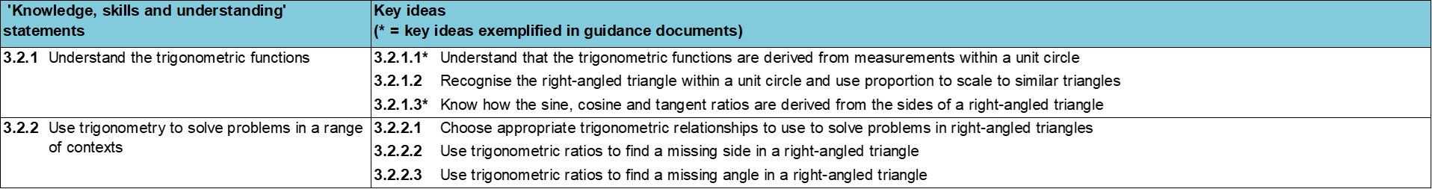
Where does this fit in?
Within this core concept, 3.2 Trigonometry, there are two statements of knowledge, skills and understanding.
These, in turn, are broken down into six key ideas. The highlighted key idea is exemplified in this slide deck.
Notes:
For key ideas marked with an asterisk, we exemplified the common difficulties and misconceptions that students might have and included elements of what teaching for mastery may look like. We have provided examples of possible student tasks and teaching approaches.
Within these slides are ‘classroom-ready’ versions of the examples for the key idea that has been highlighted. There are also slides that may be useful for discussion in a professional development session.

Slide 6
What do students need to understand?
3.2.1.1 Understand that the trigonometric functions are derived from measurements within a unit circle
Identify a triangle within the unit circle and understand that the hypotenuse is the only side with a constant length.
Understand that the height and length of the base of the triangle do not change in a linear way as the point moves around the circle’s edge.
  What prior knowledge might your students already have?
  What language might they use to describe this key idea?
  What questions might you want to ask to assess their prior learning?

Slide 7
Why is this key idea important?
At Key Stage 2, students solved problems involving similar shapes, where the scale factor was known or could be found. At Key Stage 3, this work on similarity and scale factors is linked to the trigonometric functions.
This sense of all right-angled triangles being a scaling of one of the two ‘unit’ right-angled triangles within the unit circle emphasises the multiplicative relationship between triangles. Another important awareness is the multiplicative relationship (or ratio) within each right-angled triangle.
This key idea makes explicit the connection to the unit circle so that trigonometry is connected to previous learning and not perceived as a stand-alone topic.
Notes:
A more detailed overview of the core concept of Trigonometry can be found on page 2 of the 3.2 Core Concept document.
The background to each key idea is also explored in more detail on the following pages:
3.2.1 Understand the trigonometric functions – pages 6-8
3.2.2 Use trigonometry to solve problems in a range of contexts – pages 8-9

Slide 8
Prior learning
  What prior knowledge might your students already have?
  What language might they use to describe this key idea?
  What questions might you want to ask to assess their prior learning?
Upper Key Stage 2 Learning Outcome
Solve problems involving similar shapes where the scale factor is known or can be found
Notes:
You may find it useful to speak to your partner schools to see how the above has been covered and the language used.
You can find further details regarding prior learning in the following segments of the NCETM primary mastery professional development materials (linked on final slide):
Year 4: 2.17 Structures: using measures and comparison to understand scaling
Year 6: 2.27 Scale factors, ratio and proportional reasoning
Year 6: 2.30 Multiplicative contexts: area and perimeter 2
Within the Multiplicative Reasoning Theme Overview document, you can also find a broader description of students’ potential previous learning (page 4).

Slide 9
Prior learning
  What representations might your students already be familiar with?
  What language might they use?
  How does this fit in with your curriculum progression?
Key Stage 3 Learning Outcome
6.1.2 Understand and use similarity and congruence
Please note: Numerical codes refer to statements of knowledge, skills and understanding in the NCETM breakdown of Key Stage 3 mathematics.

Slide 10
Checking prior learning
The following slides contain questions for checking prior learning.
  What representations might students use to support their understanding of these questions?
  What variation might you put in place for these questions to fully assess students’ understanding of the concept?
  How might changing the language of each question change the difficulty?
  Why are these such crucial pre-requisites for this key idea?

Slide 11
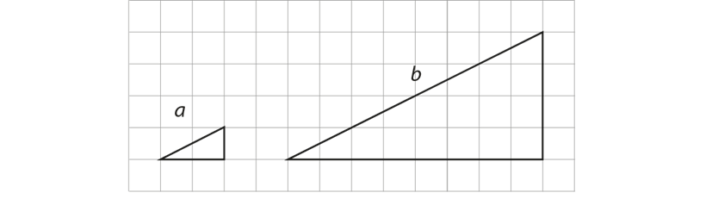
Checking prior learning
a)
Here are two similar right-angled triangles.
Write the ratio of side a to side b.
Notes:
References to the questions (links on final slide):
a) 2017 Key Stage 2 Mathematics Paper 2: reasoning, Question 22

Slide 12
Common difficulties and misconceptions
What aspects of this key idea might students find challenging?
What misconceptions might students have?
When teaching this topic, you may find students encounter difficulties with…
Relying on mnemonics such as SOHCAHTOA without understanding the underlying ideas, and so reduce the study of trigonometry to an entirely procedural application of these formulae.
More information, and some suggestions for overcoming these challenges, can be found on the following slides.

Slide 13
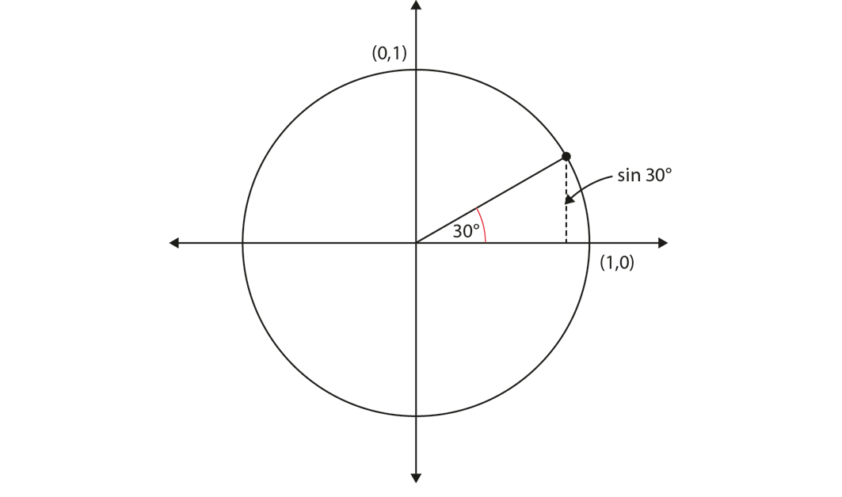
Common difficulties and misconceptions (1)
Students should understand the idea of the unit circle and the fact that, for example, the sine of an angle is the y-coordinate of the point where the radius has been rotated through that angle.
This should help students understand why sin 0° = 0 and sin 90° = 1, that the values in between do not follow a linear sequence and therefore, sin 30°, not sin 45°, is 0.5 and, later, why sin 30° = cos 60°, and so on.
Notes:
More detail can be found on page 10 of the 3.2 Core Concept document.
By introducing these trigonometric ratios (sine, cosine and tangent) through the accessible context of a point moving around a unit circle, students gain a coherent and connected view of these new ideas, which enables them to make sense of this area of mathematics.

Slide 14
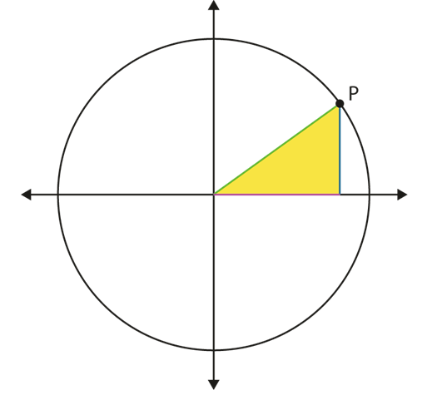
Identify a triangle within the unit circle and understand that the hypotenuse is the only side with a constant length
Example 1
A line joins the centre of the circle to a point, P, on the circumference.
Imagine the point P moving anticlockwise around the circle. As it does so, think about the length of:
the green line (the radius)
the purple line (the x-coordinate of P)
the blue line (the y-coordinate of P).
How does the length of the green line change?
How does the length of the blue line change?
How does the length of the purple line change?
What type of triangle is formed by these three lines? Is it the same kind of triangle for all possible positions of P?
Notes:
This slide is animated so that you can introduce prompts/questions one line at a time.
Suggested questioning:
Consider the green/purple/red lines, what stays the same and what changes as the point P move anti-clockwise?
When is the blue line at its smallest/greatest?
When is the purple line at its smallest/greatest?
Things for you to think about:
Students should be given time to imagine the point moving around the circle and to think about how the x- and y-coordinates of the point vary as the angle increases. Dynamic geometry software can helpfully be used in conjunction with mental imagery activities to develop a deep understanding of the structures and relationships involved.

Slide 15

Identify a triangle within the unit circle and understand that the hypotenuse is the only side with a constant length.
Example 1
  It could be argued that this image offers direct access to the topic of trigonometry because relatively little prior knowledge is required in order to be able to engage successfully with this part of the curriculum.
  To what extent do you agree with this? What does ‘successful engagement with this part of the curriculum’ look like to you?
A line joins the centre of the circle to a point, P, on the circumference. Imagine the point P moving anticlockwise around the circle. As it does so, think about the length of:
the green line (the radius)
the purple line (the x-coordinate of P)
the blue line (the y-coordinate of P).
How does the length of the green line change?
How does the length of the blue line change?
How does the length of the purple line change?
What type of triangle is formed by these three lines? Is it the same kind of triangle for all possible positions of P?
Notes:
Due to space constraints, the image on this PD discussion slide is very small. PD Leads might like to use or print the ‘in the classroom’ version of this slide for teachers to access during discussions.
More detail about the thinking behind this question can be found on page 11 of the 3.2 Core Concept document.

Slide 16
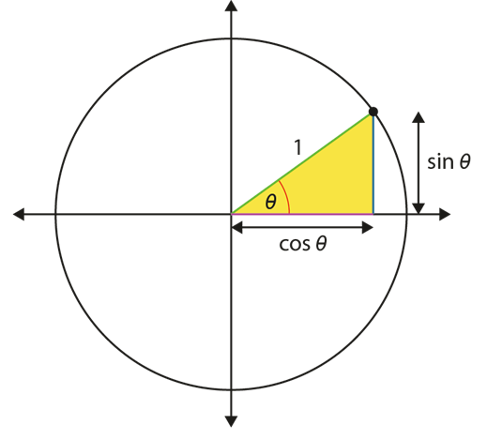
Identify a triangle within the unit circle and understand that the hypotenuse is the only side with a constant length
Example 2
The y-coordinate of the point as it moves around the circle is called the sine of the angle (sin θ). The x-coordinate is called cos θ.
Imagine the point P moving around the circle and the value of θ taking different values.
Find the value of:
sin 0°
cos 0°
sin 90°
cos 90°
Estimate the value of:
sin 45°
cos 45°
sin 30°
cos 30°
Notes:
Suggested questioning:
How does the length of the green line help you to answer the first 4 parts of the question?
Why can you only estimate the answers to the second part of the question?
What can you conclude about sin 45° and cos 45°?
Things for you to think about:
In Example 2, the unit circle is used to give meaning to the trigonometric functions of sine, cosine and tangent, and the relationship between them.
It does not offer a means to reach a solution to problems; rather, it offers a way for students to make sense of the mathematics involved and paves the way for more advanced study at Key Stages 4 and 5.

Slide 17

Identify a triangle within the unit circle and understand that the hypotenuse is the only side with a constant length
Example 2
The y-coordinate of the point as it moves around the circle is called the sine of the angle (sin θ). The x-coordinate is called cos θ.
Imagine the point P moving around the circle and the value of θ taking different values.
  How does the unit circle help give meaning to the trigonometric functions of sine, cosine and tangent, and the relationship between them?
  How will using the unit circle develop further into Key Stage 5?
Find the value of:
sin 0°
cos 0°
sin 90°
cos 90°
Estimate the value of:
sin 45°
cos 45°
sin 30°
cos 30°
Notes:
Due to space constraints, the image on this PD discussion slide is very small. PD Leads might like to use or print the ‘in the classroom’ version of this slide for teachers to access during discussions.
More detail about the thinking behind this question can be found on page 12 of the 3.2 Core Concept document.

Slide 18
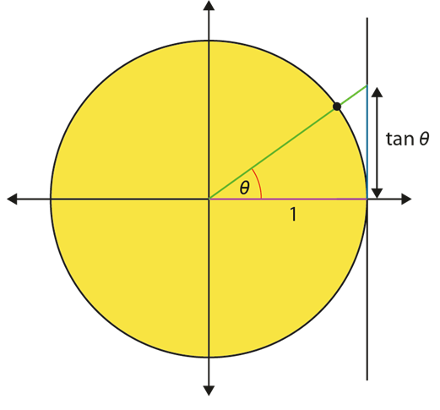
Identify a triangle within the unit circle and understand that the hypotenuse is the only side with a constant length
Example 3
The tangent of the angle is marked on the diagram on the right.
Find the value of, or estimate, as appropriate:
tan 0°
tan 30°
tan 45°
tan 60°
tan 90°
Notes:
Suggested questioning:
What is the same/different between this diagram and the one from example 2?
Which of the parts can you find the value of? Why?
Which ones do you need to estimate?
Things for you to think about:
The image in example 3 allows students to understand why the tangent function (unlike the sine and cosine functions) does not have a maximum or minimum value, but tends to infinity as θ tends to 90°.

Slide 19

Identify a triangle within the unit circle and understand that the hypotenuse is the only side with a constant length
Example 3
The tangent of the angle is marked on the diagram. Find the value of, or estimate, as appropriate:
tan 0°
tan 30°
tan 45°
tan 60°
tan 90°
  Example 3 allows students to understand why the tangent does not have a maximum or minimum value, but tends to infinity as θ tends to 90°.
  What opportunities are there within schemes of learning to introduce the concept of tending to infinity?
Notes:
Due to space constraints, the image on this PD discussion slide is very small. PD Leads might like to use or print the ‘in the classroom’ version of this slide for teachers to access during discussions.
More detail about the thinking behind this question can be found on page 13 of the 3.2 Core Concept document.

Slide 20
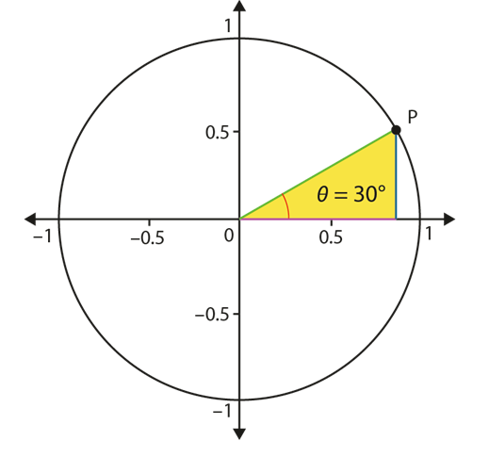
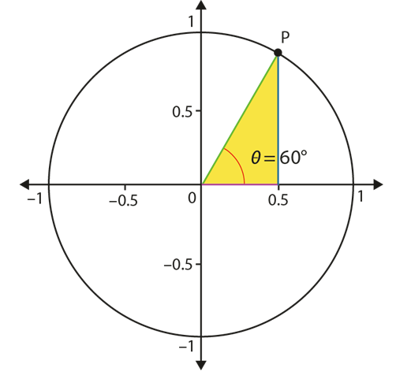
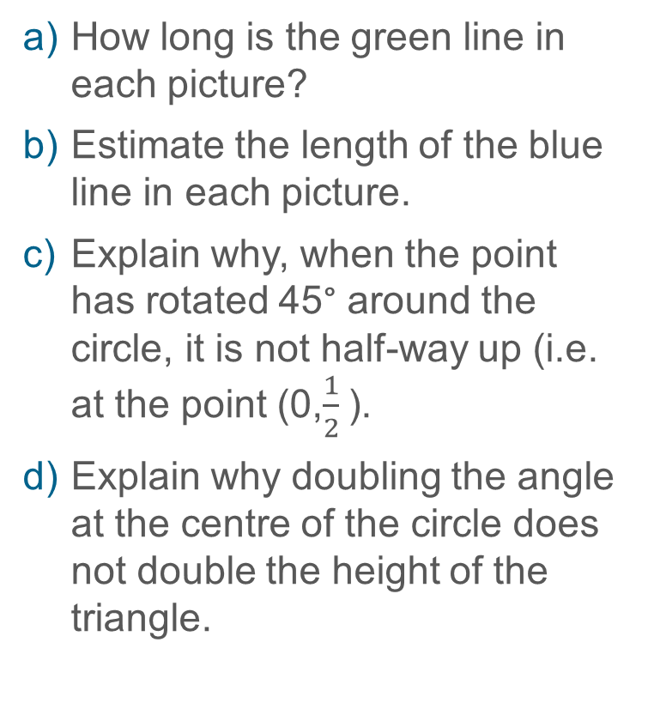
Understand that the height and length of the base of the triangle do not change in a linear way as the point moves around the circle’s edge
Example 4 (a-d)
How long is the green line in each picture?
Estimate the length of the blue line in each picture.
Explain why, when the point has rotated 45° around the circle, it is not half-way up (i.e. at the point (0,$\frac{1}{2}$).
Explain why doubling the angle at the centre of the circle does not double the height of the triangle.
The point P has been moved around the circle to create two different triangles. In one triangle, the green line makes an angle of 30° with the base; in the other triangle, it makes an angle of 60°.
Notes:
This slide has been animated; the questions will appear individually.
Suggested questioning:
The blue line is showing the vertical distance of P from the x-axis.
For which angle is the blue line the smallest? Can you state another angle that would have the same height of the blue line?
If the angle is 45°, is length of the blue line greater or less than the length in the picture on the left hand side?
Things for you to think about:
In Example 4, the dimensions of the circle have been included for the first time. Students’ experience of functions often leads them to assume that relationships are proportional. The use of the unit circle as a representation of a trigonometric function provides an image of why doubling the angle in a triangle does not double the height. This may not be obvious to students, so encouraging them to explain why this is so, followed by teacher-led discussion, should help them understand rather than just accept this as a given fact.
It is important also to draw students’ attention to the fact that there is a maximum height that can be reached. No matter how great the angle, the height of the triangle within the unit circle cannot exceed 1.
You could also ask students to estimate the height of the triangle when the angle is 45° (half-way between the two axes) to offer a further example of the non-linear relationship between the angle and the height.
If you are using a dynamic version of this image, then you might also like to show the height at, for example, 40° and ask students to then predict the height at 20° or at 80°. The use of dynamic software also allows for greater exploration of the height as the point moves out of the first quadrant.
It should be noted that the intention here is to further explore the unit circle as a representation, not to calculate or formalise the relationships.

Slide 21


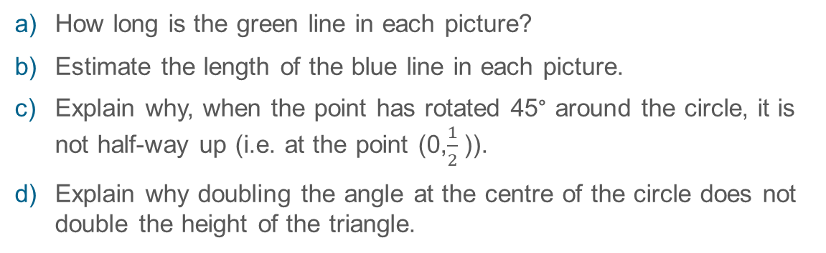
Understand that the height and length of the base of the triangle do not change in a linear way as the point moves around the circle’s edge
Example 4 (a-d)
The point P has been moved around the circle to create two different triangles. In one triangle, the green line makes an angle of 30° with the base; in the other triangle, it makes an angle of 60°.
  Students’ experience of functions often leads them to assume that relationships are proportional.
  How can using the unit circle provide an image of why doubling the angle in a triangle does not double the height?
How long is the green line in each picture?
Estimate the length of the blue line in each picture.
Explain why, when the point has rotated 45° around the circle, it is not half-way up (i.e. at the point (0,$\frac{1}{2}$)).
Explain why doubling the angle at the centre of the circle does not double the height of the triangle.
Notes:
Due to space constraints, the image on this PD discussion slide is very small. PD Leads might like to use or print the ‘in the classroom’ version of this slide for teachers to access during discussions.
More detail about the thinking behind this question can be found on page 14 of the 3.2 Core Concept document.

Slide 22
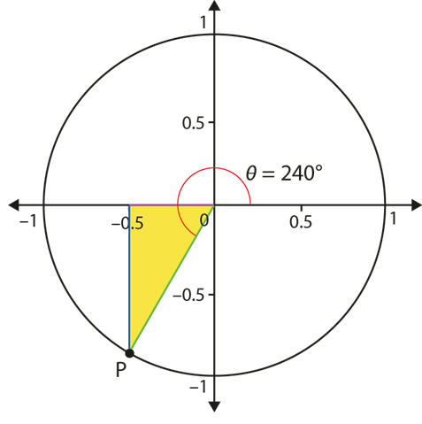
Understand that the height and length of the base of the triangle do not change in a linear way as the point moves around the circle’s edge
Example 4e
The point P has been moved around the circle to create two different triangles. In one triangle, the green line makes an angle of 30° with the base; in the other triangle, it makes an angle of 60°.
How would you estimate and describe the ‘height’ of the triangle below?
Notes:
Suggested questioning:
What is the same/different with this diagram for part e) and the other diagrams?
What other angles will give the same height as the 30° triangle?
Things for you to think about:
The use of the unit circle allows students to experience using trigonometric functions with angles greater than 90°. In part e), students are asked to make sense of an angle of 240°. If they do not notice that the triangle is congruent to one of those above, then their attention should be drawn to this.
It should be noted that the intention here is to further explore the unit circle as a representation, not to calculate or formalise the relationships.

Slide 23

Understand that the height and length of the base of the triangle do not change in a linear way as the point moves around the circle’s edge
Example 4e
The point P has been moved around the circle to create two different triangles. In one triangle, the green line makes an angle of 30° with the base; in the other triangle, it makes an angle of 60°.
  How can congruency be used to make sense of other angles greater than 90°?
  At what point would you introduce the graphs of the trigonometric functions?
How would you estimate and describe the ‘height’ of the triangle?
Notes:
Due to space constraints, the image on this PD discussion slide is very small. PD Leads might like to use or print the ‘in the classroom’ version of this slide for teachers to access during discussions.
More detail about the thinking behind this question can be found on page 14 of the 3.2 Core Concept document.

Slide 24
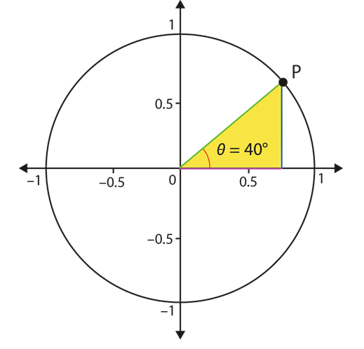
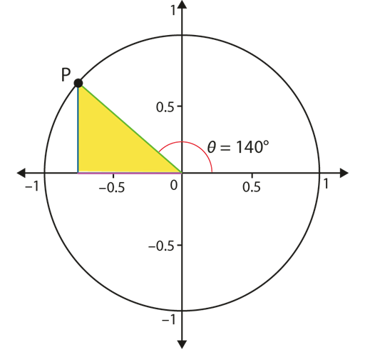
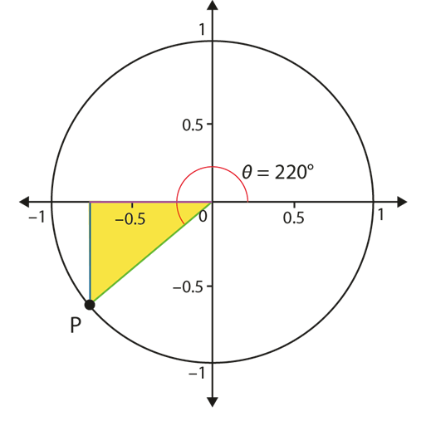
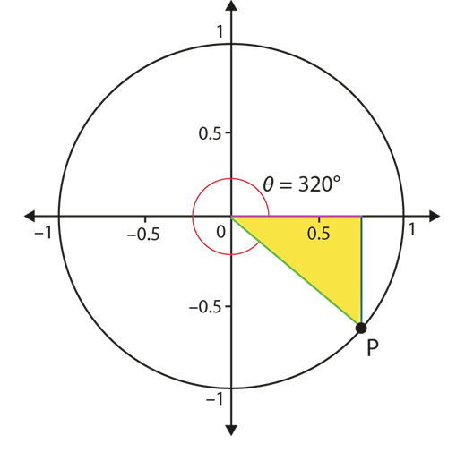
Understand that the height and length of the base of the triangle do not change in a linear way as the point moves around the circle’s edge
Example 5
What is the same and what is different about these triangles? Explain how you know.
Notes:
Suggested questioning:
Which lengths are the same in these diagrams?
How have the angles been calculated in the three on the right hand side?
If you considered 30° what would the other diagrams show to give congruent triangles?
Things for you to think about:
In Example 5, students are given an opportunity to explore the unit circle further in order to make sense of some relationships. Encourage students to fully explain their reasoning.

Slide 25




Understand that the height and length of the base of the triangle do not change in a linear way as the point moves around the circle’s edge
Example 5
What is the same and what is different about these triangles? Explain how you know.
  What mathematical language would you expect students to use in their explanations?
  At what point would you introduce the graphs of the trigonometric functions?
Notes:
Due to space constraints, the image on this PD discussion slide is very small. PD Leads might like to use or print the ‘in the classroom’ version of this slide for teachers to access during discussions.
More detail about the thinking behind this question can be found on page 15 of the 3.2 Core Concept document.

Slide 26
Reflection questions
What other mathematical concepts will be supported by students’ stronger understanding of this key idea?
What mathematical language will you continue to use to support pupils to make connections with other areas?
Which representations might you continue to use to further develop students’ understanding?

Slide 28
Appendices
You may choose to use the following slides when planning or delivering a PD session. They cover:
  Key vocabulary
  Representations and structure
  Previous learning
  Future learning
  Library of links

Slide 29
Key vocabulary (1)
Term | Definition
adjacent | In trigonometry, one of the shorter two sides in a right-angled triangle. The side adjacent or next to a given angle.
hypotenuse | In trigonometry, the longest side of a right-angled triangle. The side opposite the right-angle.
opposite | In trigonometry, one of the shorter two sides in a right-angled triangle. The side opposite a given angle.

Slide 30
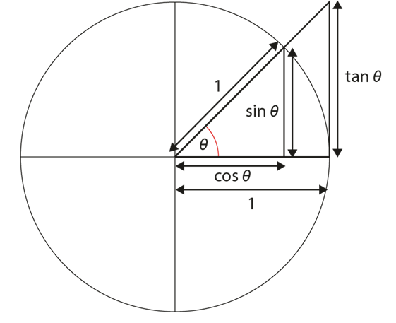



Key vocabulary (2)
Term | Definition
trigonometric functions (sine, cosine, tangent) | Functions of angles. The main trigonometric functions are cosine, sine and tangent. Other functions are reciprocals of these. Trigonometric functions (also called the ‘circular functions’) are functions of an angle. They relate the angles of a triangle to the lengths of its sides. The most familiar trigonometric functions are the sine, cosine and tangent in the context of the standard unit circle with radius 1 unit, where a triangle is formed by a ray originating at the origin and making some angle with the x-axis; the sine of the angle gives the length of the y-component (rise) of the triangle, the cosine gives the length of the x-component (run), and the tangent function gives the slope (y-component divided by the x-component). Trigonometric functions are commonly defined as ratios of two sides of a right-angled triangle containing the angle. They can equivalently be defined as the lengths of various line segments from a unit circle.

Slide 31
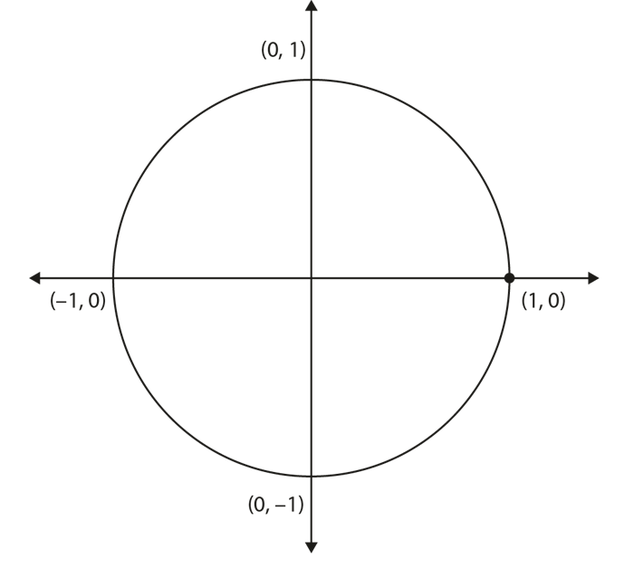
Representations and structure
There are a number of different representations that you may wish to use to support students’ understanding of this key idea. These might include:
The unit circle
A point moving around a unit circle (a circle of radius 1) provides a very rich representation for understanding and visualising the values of the trigonometric (or circular) functions.
When it is placed on a coordinate grid with its centre at the origin, the cosine and sine functions are represented by the x- and y-coordinates, respectively, of the point for different values of the angle θ.
Notes:
More information about the representations and structure involved in this key idea can be found:
On page 11-12 of Theme 3 Multiplicative Reasoning Overview
Links to all of these can be found on the final slide.

Slide 32
Previous learning
From Upper Key Stage 2, students will bring experience of:
multiplying proper fractions and mixed numbers by whole numbers, supported by materials and diagrams
recognising the per cent symbol (%) and understanding that per cent relates to ‘number of parts per hundred’, and writing percentages as a fraction with denominator 100, and as a decimal
using all four operations to solve problems involving measure (for example, length, mass, volume, money) using decimal notation, including scaling
solving problems involving the relative sizes of two quantities where missing values can be found by using integer multiplication and division facts
solving problems involving the calculation of percentages (for example, of measures, and such as 15% of 360) and the use of percentages for comparison
solving problems involving similar shapes where the scale factor is known or can be found
solving problems involving unequal sharing and grouping, using knowledge of fractions and multiples.
Notes:
Theme 3 Multiplicative reasoning

Slide 33
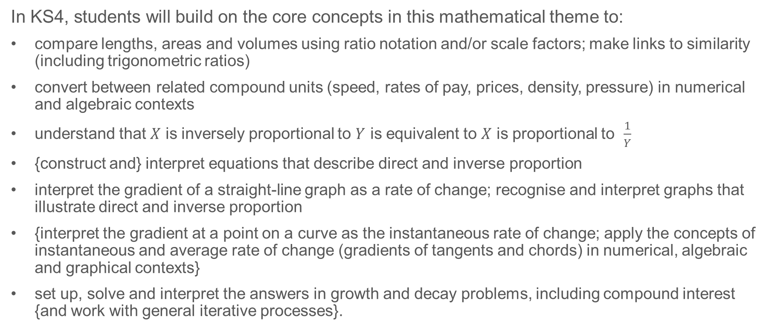
Future learning
In KS4, students will build on the core concepts in this mathematical theme to:
compare lengths, areas and volumes using ratio notation and/or scale factors; make links to similarity (including trigonometric ratios)
convert between related compound units (speed, rates of pay, prices, density, pressure) in numerical and algebraic contexts
understand that $X$ is inversely proportional to $Y$ is equivalent to $X$ is proportional to $\frac{1}{Y}$
{construct and} interpret equations that describe direct and inverse proportion
interpret the gradient of a straight-line graph as a rate of change; recognise and interpret graphs that illustrate direct and inverse proportion
{interpret the gradient at a point on a curve as the instantaneous rate of change; apply the concepts of instantaneous and average rate of change (gradients of tangents and chords) in numerical, algebraic and graphical contexts}
set up, solve and interpret the answers in growth and decay problems, including compound interest {and work with general iterative processes}.
Please note: Braces { } indicate additional mathematical content to be taught to more highly attaining students.
Notes:
Theme 3 Multiplicative reasoning

Slide 34
Library of links
The following resources from the NCETM website have been referred to within this slide deck:
  NCETM Secondary Mastery Professional Development
    3 Multiplicative Reasoning Theme Overview Document
    3.2 Trigonometry Core Concept Document
    6.1 Geometrical properties Core Concept Document
  NCETM primary mastery professional development materials
There are also references to:
  Standards & Testing Agency’s past mathematics papers

