Slide 1

Checkpoints
Year 8 diagnostic mathematics activities
Sequences
Twenty-two Checkpoint activities
Seven additional activities
Published in 2022/23

Slide 2
About this resource
This resource is designed to be used in the classroom with Year 8 students, although it may be useful for other students.
The Checkpoints are grouped around the key ideas in the core concept document, 4.1 Sequences, part of the NCETM Secondary Mastery Professional Development materials.
Before each set of Checkpoints, context is explored, to help secondary teachers to understand where students may have encountered concepts in primary school.
The 10-minute Checkpoint tasks might be used as assessment activities, ahead of introducing concepts, to help teachers explore what students already know and identify gaps and misconceptions.
Each Checkpoint has an optional question marked . This will provide further thinking for those students who have completed the rest of the activities on the slide.
The notes for each Checkpoint give answers (if appropriate), some suggested questions and things to consider.
After each Checkpoint, a guidance slide explores suggested adaptations, potential misconceptions and follow-up tasks. These may include the additional activities at the end of this deck.

Slide 3
Checkpoints 1–8
Checkpoint | Underpins | Code
1: Adders | The structure of patterns and sequences | 4.1.1 4.1.2
2: Counting counters
3: Same jump?
4: Multiples galore | Understand place value in decimals, including recognising exponent and fractional representations of the column headings | 1.1.1.2
5: Snapshots
6: Tell me all about it
7: 1, 3 …
8: Crossnumber
*This three-digit code refers to the statement of knowledge, skills and understanding in the NCETM’s Sample Key Stage 3 Curriculum Framework (see notes below for more information).
Notes:
In the Sample Key Stage 3 Curriculum Framework, statements of knowledge, skills and understanding are arranged to give an example teaching order. The three-digit code for each statement in the framework is a clickable hyperlink to documents with more detailed information, including the key ideas contained within that statement. These key ideas are also shown on slide 6 in this deck.

Slide 4
Checkpoints 9–16
Checkpoint | Underpins | Code
9: Which sequence? | The structure of patterns and sequences | 4.1.1 4.1.2
10: Sequence jumble
11: Nine dots
12: School dinners
13: Tiles and holes | Preparing for the nth term | 4.1.1 4.1.2
14: Patterns galore
15: Who gets there first?
16: Square patterns
*This three-digit code refers to the statement of knowledge, skills and understanding in the NCETM’s Sample Key Stage 3 Curriculum Framework (see notes below for more information).
Notes:
In the Sample Key Stage 3 Curriculum Framework, statements of knowledge, skills and understanding are arranged to give an example teaching order. The three-digit code for each statement in the framework is a clickable hyperlink to documents with more detailed information, including the key ideas contained within that statement. These key ideas are also shown on slide 6 in this deck.

Slide 5
Checkpoints 17–22
Checkpoint | Underpins | Code
17: Hidden numbers | Preparing for the nth term | 4.1.1 4.1.2
18: Left, right, up, down
19: Off the page
20: Four columns
21: More holes | Understand place value in decimals, including recognising exponent and fractional representations of the column headings | 1.1.1.2
22: Dice games
*This three-digit code refers to the statement of knowledge, skills and understanding in the NCETM’s Sample Key Stage 3 Curriculum Framework (see notes below for more information).
Notes:
In the Sample Key Stage 3 Curriculum Framework, statements of knowledge, skills and understanding are arranged to give an example teaching order. The three-digit code for each statement in the framework is a clickable hyperlink to documents with more detailed information, including the key ideas contained within that statement. These key ideas are also shown on slide 6 in this deck.

Slide 6
Key ideas
Understand the features of a sequence | Code
Appreciate that a sequence is a succession of terms formed according to a rule | 4.1.1.1*
Understand that a sequence can be generated and described using term-to-term approaches | 4.1.1.2
Understand that a sequence can be generated and described by a position-to-term rule | 4.1.1.3
Recognise and describe arithmetic sequences | Code
Understand the features of an arithmetic sequence and be able to recognise one | 4.1.2.1
Understand that any term in an arithmetic sequence can be expressed in terms of its position in the sequence (nth term) | 4.1.2.2*
Understand that the nth term allows for the calculation of any term | 4.1.2.3
Determine whether a number is a term of a given arithmetic sequence | 4.1.2.4
*‘There are additional resources exemplifying these key ideas in the Secondary Mastery Professional Development | NCETM.

Slide 7
The structure of patterns and sequences
Checkpoints 1–12

Slide 8
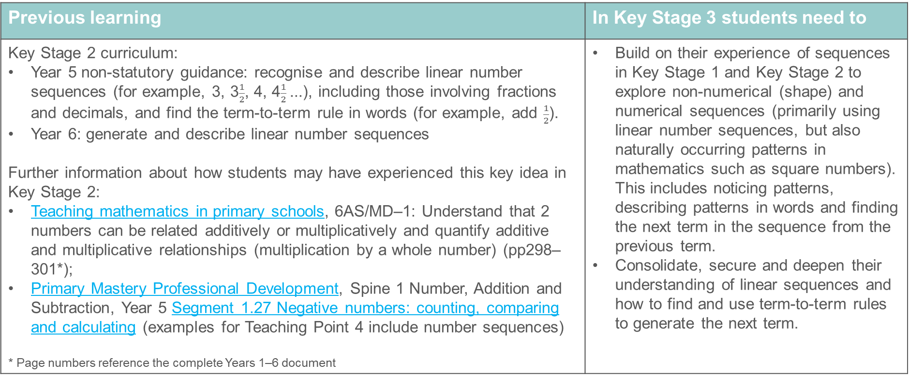
The structure of patterns and sequences
Previous learning | In Key Stage 3 students need to
Key Stage 2 curriculum: Year 5 non-statutory guidance: recognise and describe linear number sequences (for example, 3, 3$\frac{1}{2}$, 4, 4$\frac{1}{2}$...), including those involving fractions and decimals, and find the term-to-term rule in words (for example, add $\frac{1}{2}$). Year 6: generate and describe linear number sequences Further information about how students may have experienced this key idea in Key Stage 2: Teaching mathematics in primary schools, 6AS/MD–1: Understand that 2 numbers can be related additively or multiplicatively and quantify additive and multiplicative relationships (multiplication by a whole number) (pp298–301*); Primary Mastery Professional Development, Spine 1 Number, Addition and Subtraction, Year 5 Segment 1.27 Negative numbers: counting, comparing and calculating (examples for Teaching Point 4 include number sequences) * Page numbers reference the complete Years 1–6 document | Build on their experience of sequences in Key Stage 1 and Key Stage 2 to explore non-numerical (shape) and numerical sequences (primarily using linear number sequences, but also naturally occurring patterns in mathematics such as square numbers). This includes noticing patterns, describing patterns in words and finding the next term in the sequence from the previous term. Consolidate, secure and deepen their understanding of linear sequences and how to find and use term-to-term rules to generate the next term.

Slide 9

Checkpoint 1: Adders
Some students are making a number pattern using a rule.
Ahmed
Betty
Chi
Darcy
Ezra
Finn
Greg
Hannah
Ivy
Jo
Kay
Livy
Ahmed says any number, then Betty adds a number to it.
Each person in turn then adds the same number that Betty added.
If Ahmed says 5 and Betty says 7, then Chi will say 9, Darcy 11, and so on. What will Livy say? How do you know?
After a different starting number, Betty says 23 and Chi says 26. What did Ahmed say? How do you know?
Ahmed says 9 to start. Kay says 79. What will Livy say? How do you know?
The students make a new pattern. Three of the numbers are 10, 22 and 34. Which students might have said these? What might the other children students have said?
Notes:
This slide is animated. Each piece of information and question will appear separately so you can choose the pace at which to work with your class.
Answers
a) Livy will say 27. We know because the sequence is increasing by two each time, or because there are 11 jumps of 2 from Ahmed to Livy.
b) Ahmed said 20. We know because the common difference is 3 and 30 is 3 less than what Betty has said.
c) Livy will say 86. We know because from Ahmed to Kay is 10 jumps of 7 each.
? There are many possible solutions to this; check students’ suggestions are possible. Below are some sequences that students might suggest. Note that Ahmed does not need to be the first person, but is given as the first here as an example.
Three students (Ahmed, Betty, Chi). Sequence is going up in 12s.
Three alternate students (Ahmed, Chi, Ezra). Sequence is going up in 6s.
Three students with two students in between (Ahmed, Darcy, Greg). Sequence is going up in 4s.
Three students with three students in between (Ahmed, Ezra, Ivy). Sequence is going up in 3s.
Suggested questioning
How many students do you need to know about to work out the rule?
How could you describe Betty’s rule in each part?
How could you describe the sequence each time?
Will Ahmed always say the lowest number?
Things to think about
Checkpoint 1 could be an opportunity to do some ‘people maths’. Adapt the same structure to run as an activity with students. Assess whether students can predict numbers in a sequence without using all the consecutive numbers in between. This is built upon in Checkpoint 2 and explored further in Checkpoint 3.

Slide 10
Checkpoint 1: Guidance
Adaptations | Assessing understanding
Support If students find part c challenging, first model using two students with fewer gaps between them. For example, if Ahmed says 8 and Darcy or Ezra say 20. A number line (see below) might also be helpful. Challenge Build on the further thinking question by asking students to suggest their own sets of numbers for different combinations of students. Can they think of two numbers that could create a sequence of integers, no matter which pair of students said them? Representations A number line could be used to model the pattern of values: circle the numbers that are part of the sequence. This might be particularly helpful to model a strategy for part c. This is also a great opportunity to use your class! (See ‘assessing understanding’.) | This Checkpoint assesses whether students can identify a rule from different information about a sequence, and then use that rule to generate further values. The questions are structured so students work both backwards and across gaps in the sequence. Although only explicitly stated in part a, the question ‘how do you know?’ is key. You are not just looking to see that students can assign the right number to the right students, but also listening to their reasoning to understand how they think and reason about number sequences. While we have provided some prompts as starting points, we would encourage teachers to try this activity ‘for real’. Choose a student to pick a starting number, then ask the person adjacent to them to imagine a rule and state the next number. Can students continue the sequence? If they can, then you can start to ask questions like those in the task, such as, ‘What would X say?’ You could also create a pack of cards with rules, although asking students to create their own might provide more unexpected challenge!
Additional resources Page 27 of the Year 6 Primary Assessment Materials | NCETM explores ‘sequence-generating rules’ and might offer some insight into the language students may have used to explore sequences at primary. Examples exploring whether sequences are connected additively or multiplicatively are within 6AS/MS-1 in the Exemplification of ready-to-progress criteria NCETM. Download as part of the Year 6 deck or decks from the relevant strands.

Slide 11
Checkpoint 2: Counting counters
Allyce and Billy are making a repeating pattern from different counters.
1
3
4
5
6
7
8
9
10
11
12
15
2
13
14
16
17
Allyce puts down three counters numbered 179, 180 and 181.
What do Allyce’s counters look like? How do you know?
18
19
20
Billy then puts down three counters in a row. Two are yellow squares and one is a red hexagon. All his counters are numbered over 250.
What might the numbers on them be? How do you know?
21
22
Allyce and Billy run out of counters when they put down number 531. How many of each type of counter did they use in total?
23
24
25
26
Notes:
This slide is animated. Each question will appear separately so you can choose the pace at which to work with your class. The sequence is also animated to automatically build – clicking the mouse or pressing enter will skip this animation.
Answers
a) 180 is a red hexagon because it is a multiple of 5, therefore 179 is a yellow square and 181 is a blue circle.
b) The counters that Billy puts down are in a row so must be in the order blue circle, yellow square, yellow square. The first set of possible numbers over 250 are a blue circle 252, yellow square 253 and yellow square 254. Other sets of higher numbers are possible, as long as they are the three consecutive integers immediately below a multiple of 5.
? 106 red hexagons, 212 yellow squares and 213 blue circles.
Suggested questioning
How could you describe this pattern?
How often does the pattern repeat?
What type of counter would __ be?
Things to think about
Checkpoint 2 offers a simple sequence, likely to be familiar to students, but asks them to extrapolate to much larger numbers, which may be less familiar. Look for the key understanding that students are able to use a sequence to predict, without needing to be given all the consecutive numbers. This is also explored in the previous and next Checkpoints.

Slide 12
Checkpoint 2: Guidance
Adaptations | Assessing understanding
Support Students find part a hard to access as the numbers are so far away from the given sequence. Give them time to grapple with the numbers given, then offer three consecutive numbers that are closer to the sequence given, such as 39, 40 and 41. You can then build back up to 179, 180 and 181 if students find an approach they are comfortable with. Challenge Change one aspect of the pattern (for example, swap a yellow square for a blue circle) and ask students what has changed about their answers. Representations Although fundamentally about a number sequence, using counters with distinctive colours and shapes may help students to visualise the pattern. They may find it helpful to physically recreate the pattern. | Checkpoint 2 checks students know that by understanding the way that a pattern is built, they can know what that pattern will look like at a particular point – even if that point is far away. This is a key understanding built in Key Stage 3 when shifting from term-to-term to position-to-term rules. Students’ responses to the task may inform how you introduce this. Give students time to work with this task and to try out their own approaches. If they are struggling to articulate their reasoning, you may wish to give some prompts, like sentence starters (for example, ‘The red hexagons are all…’.). Listen for flawed reasoning based on multiplication or incorrect deductions, such as suggesting 180 must also be a yellow square as it’s 10 times bigger than 18. Take time to collate students’ different approaches to the further thinking question. Do they work out the red hexagons first? Do they notice that there will be one more yellow square than blue circle? How would their answers change if the sequence stopped at 529 or 543?
Additional resources Pages 27 and 28 of the Year 6 Primary Assessment Materials | NCETM offer examples of what students may have experienced of sequences at primary school.

Slide 13

Checkpoint 3: Same jump?
Is it possible to fill in the missing numbers for these sequences? Why or why not?
1
5
13
21
a)
b)
0.1
0.3
28
16
4
c)
d)
0
0.3
0.9
2
$$\frac{4}{3}$$
e)
For the ones that weren’t possible, what could you change so that they are possible?
Notes:
This slide is animated. Each question will appear separately so you can choose the pace at which to work with your class. A printable resource for this can be found on slide 72.
Answers
For each possible sequence, the full sequence is shown below. Missing numbers are in bold.
a) Possible as the sequence increases in the same jump of 4: -7, -3, 1, 5, 9, 13, 17, 21
b) Possible as the sequence increases in the same jump of 0.05: 0.1, 0.15, 0.2, 0.25, 0.3, 0.35, 0.4, 0.45
c) Not possible, as although there is the same jump of 12 between the given numbers, the gaps between are different.
d) Not possible, as although there is the same number of gaps between the given numbers, the difference between them is not the same.
e) Possible as the sequence increases in the same jump of $\frac{2}{3}$: $\frac{10}{3}$, $\frac{8}{3}$, 2, $\frac{4}{3}$, $\frac{2}{3}$, 0, $−\frac{2}{3}$, $−\frac{4}{3}$
? c) You could:
Move 4 so that there are only two gaps between 16 and 4,.
Change 4 to -2, so the sequence is decreasing by 6 each time (34, 28, 22, 16, 10, 4, -2).
Move 28 so that there are three gaps between 28 and 16, or change 28 to 24, so the sequence is decreasing by 4 each time (32, 28, 24, 20, 16, 12, 8, 4, 0).
d) You could:
Change 0.9 to 0.6
Remove 0.9 from the visible part of the number line, or extend the number line and move 0.9 to be 6 gaps away from 0.3, so that the sequence is increasing by 0.1 each time: 0, 0.1, 0.2, 0.3, 0.4, 0.5, 0.6, 0.7, 0.8, 0.9, 1.
Change 0 to -0.3, so that the sequence is increasing by 0.2 each time: -0.3, -0.1, 0.1, 0.3, 0.5, 0.7, 0.9, 1.1
Suggested questioning
Where did you start to find the missing numbers?
Did you use the same strategy in all parts of the question?
Which did you find easiest/hardest? Why?
Things to think about
Checkpoint 3 builds on the idea of continuing/predicting sequences, this time asking students to infill missing numbers. Note whether students struggle with any of the different types of number offered. If negatives, decimals or fractions cause challenge, they may need more time working with these numbers to build confidence and secure understanding.

Slide 14
Checkpoint 3: Guidance
Adaptations | Assessing understanding
Support If students find it hard to identify the equal steps when there is more than one missing number, try Additional activity A first. See also representations below. Challenge Encourage students to think of more than one solution to the further thinking question. How else could they change their impossible sequences to be correct? Could they change the values or the markings on the line? Representations The number line is a familiar representation that is often used to reference alongside sequences. Access to a ‘zoomable’ number line may help to support students to find missing numbers. You could circle the numbers that are in the sequence and then students can work with the visualisation of the other numbers to subdivide. | This Checkpoint assesses whether students recognise that to continue the pattern they need to calculate the difference (i.e. the ‘jump size’) between consecutive terms. The main assessment point is whether students can identify that it is not possible to complete parts c and d as the jumps are not equal. There might be a point of difficulty where there are one or more gaps between the given numbers. Check whether students have an efficient strategy to calculate these missing numbers. Those who are least secure might incorrectly identify one of the other sequences as ‘impossible’. Decimals and fractions have been included in the examples as students should have experienced number patterns with both at primary school. Listen to how students reason their thinking. Does working with non-integers throw them? Are they able to use similar reasoning or does their strategy change?
Additional resources Additional activity A is a similar task that just focuses on completing the values in possible sequences. Checkpoint 8 explores similar ideas in a different format. Similar examples are within 6AS/MS-1 in the Exemplification of ready-to-progress criteria NCETM. Download as part of the Year 6 deck or decks from the relevant strands

Slide 15
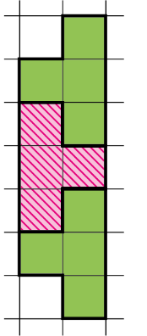
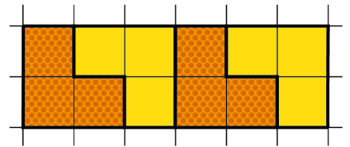

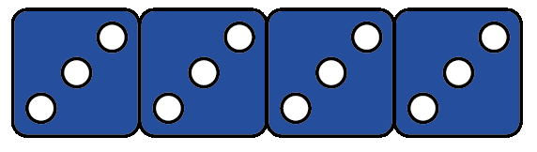
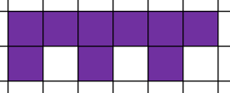
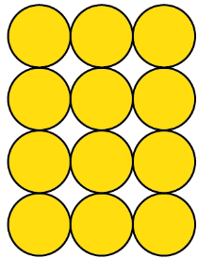
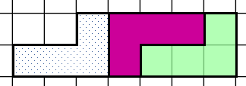


Checkpoint 4: Multiples galore
Nicola is making patterns that go up in fours.
Howard is making patterns that go up in threes.
They show one image from each of their patterns.
Which of these are Nicola’s and which are Howard’s? How do you know?
A
E
F
H
B
D
C
G
I
Create your own visual patterns going up in threes and fours. Could any of your images appear in both sequences?
Notes:
This slide is animated. Each pattern, and then the further thinking question, will appear separately so you can choose the pace at which to work with your class.
Answers
A: Nicola’s
B: Howard’s
C: Nicola’s
D: Nicola’s or Howard’s (rows of three or columns of four)
E: Nicola’s
F: Howard’s
G: Nicola’s or Howard’s (four sticks at a time, one vertical and three horizontal, or three horizontal sticks each time)
H: Howard’s or Nicola’s (three purple squares in an L shape each time, or a 2 x 2 set of squares consisting of three purple and one white each time)
I: Nicola’s or Howard’s (columns of three or rows of four)
? Students’ answers to this will vary; look out for whether they create sequences that can build and not, for example, just arranging 12. To check, ask them what the previous and next terms would be.
Suggested questioning
Where is the ‘three’ in this image? Where is the ‘four’?
What would the next/previous image look like in the pattern? What would the eighth image look like?
Which of these could be both? How do you know?
Things to think about
Even when they are proficient at working with numerical sequences, students can struggle to connect this understanding to a visual representation of the same sequence. Checkpoint 4 uses two different simple sequences (multiples of three and four) to allow students to compare and really think about the different structures and how they are represented. Note that in all of these examples the cardinality, or number of ‘elements’, is visible (i.e. there is a 1:1 correspondence between the total number of elements, whether they are dots or squares or sticks, and the number that the pattern represents). You could challenge students to think more deeply by showing a row of 3 counters, where each counter could either represent 3 or 4.

Slide 16
Checkpoint 4: Multiples galore
Adaptations | Assessing understanding
Support Pick just two images first and compare them. Start with A and B, which show the third multiple of four and fourth multiple of three, respectively. If students can manage this, then show a more ambiguous image, such as D. Challenge The further thinking question asks students to create their own visual patterns for sequences going up in threes or fours. If students interpret this as multiples of three and four, push them to think of other sequences, such as 2, 5, 8, 11, and ask how their representation changes. Representations A number of different visual representations are given here, some of which are likely to be familiar from primary school, such as the array, number tiles and dice. Using them in the context of sequences can be valuable for revealing mathematical structures at secondary level for all students. | Check if students can see and describe the structure of patterns. Listen for if they can recognise how, in each situation, they are related to the multiples of three or four. There are some deliberate potential misconceptions, that might help to identify where students have not fully understood how the mathematical structure is represented. For example, they might incorrectly identify B as a multiple of four as there are four dice, rather than that the dice represent four ‘terms’ of the multiples of three. Clarify this before moving on to teach position-to-term rules. Some patterns are even more ambiguous, and could be interpreted as a term in either sequence (see the answers for more information about D, G, H and I). Students that recognise this, and can imagine the sequences building in different ways, are likely to be more fluent in moving between representations for sequences.
Additional resources Page 28 of the Year 6 Primary Assessment Materials | NCETM shows how student might previously have worked with sequences built visually. Checkpoint 14 or Additional activity E could be a next step to link this activity to the nth term at Key Stage 3.

Slide 17
Checkpoint 5: Snapshots
When you click on each square, it will briefly reveal a pattern.
A
B
C
D
E
How many dots are in each pattern?
How do you know? Describe how you saw the pattern.
If each pattern was part of a different sequence, what might the next pattern be for each? What might the previous pattern have been?
Notes:
This slide is animated. In present or slide show mode, when you click on each square, it will disappear very briefly to reveal a pattern. The further thinking question appears separately (using normal ‘click through’ animations).
Answers
Students’ answers may vary; some examples of descriptions are below. You may find it helpful to show the following slide, which shows all five images, to check students’ answers.
A: 32 dots. Students might see this as a rectangle/array with four rows of eight dots; a rectangle/array of eight columns of four dots; two four-by-four squares; a five-by- four rectangle; and a three-by-four rectangle.
B: 13 dots. Students might see this as a cross with one central dot and three dots in each arm.
C: 19 dots. Students might see this as a six-pointed star with one central dot and three dots in each arm.
D: 20 dots. Students might see this as hollow square with four-by four-missing dots; four connecting lines of five dots; two horizontal lines of six dots joined by two vertical lines of four dots (or vice versa).
E: 15 dots. Students might see this as a triangle with a base of five dots; one dot on top of two dots on top of three etc.
? There are other potential answers for this, but the most likely are:
A: Next: five rows of eight dots or nine columns of four dots. Previous: three rows of eight dots or seven columns of four dots.
B: Next: a cross shape with a single dot in the centre and four dots in each arm. Previous: a cross shape with a single dot in the centre and two dots in each arm.
C: Next: a six-pointed star shape with a single dot in the centre and four dots in each arm. Previous: a cross shape with a single dot in the centre and two dots in each arm.
D: Next: a hollow square with seven-dot sides. Previous: a hollow square with five-dot sides.
E: Next: an isosceles triangle with a base of six dots. Previous: an isosceles triangle with a base of four dots.
Suggested questioning
What did you see? How can you be sure?
How did you organise the dots in your head?
What did you count? What did you ‘just see’?
Can you think about this pattern differently?
Things to think about
This is an unusual Checkpoint. One of the many skills you are checking is subitising – students’ ability to ‘see’ quantity without counting – an important skill they will have been developing since their very earliest experiences of number. Think ahead about how you will deliver this, and perhaps trial it with colleagues first, so you can hear how different people approach it. Focus on one snapshot at a time. Show it once, and ask students to share their different approaches, before showing it again and seeing if their ideas develop further. Once they have done one, you can repeat the process and see how their thinking/approaches develop as they get used to the idea.
It is worth noting that we can only perceptually subitise very small numbers; with this number of dots students will be subitising conceptually, which means they are using their knowledge of the smaller numbers that they can perceive to make connections to a larger number. This perceptual subitising is part of the task design, as it requires students to ‘see’ different structures of smaller numbers within the pattern. However, if students really struggle with this, you might like to create some dot patterns of much smaller numbers to check that they can ‘see’ quantities up to 6 or 7 without counting. Subitising activities can readily be found online by using search terms such as ‘subitise dot patterns’.
This task is inspired by the ATM task ‘Glimpses’.

Slide 18
Checkpoint 5: Snapshots (solutions)
A
B
C
D
E
How many dots are in each pattern?
How do you know? Describe how you saw the pattern.
Notes:
After completing Checkpoint 5, students could use this slide to check their different strategies.

Slide 19
Checkpoint 5: Snapshots (solutions to further thinking question part 1)
A
A
B
Notes:
After completing the further thinking question for Checkpoint 5, students could this slide to check their previous and next patterns for A and B.

Slide 20
Checkpoint 5: Snapshots (solutions to further thinking question part 2)
D
E
C
Notes:
After completing the further thinking question for Checkpoint 5, students could this slide to check their previous and next patterns for C, D and E.

Slide 21
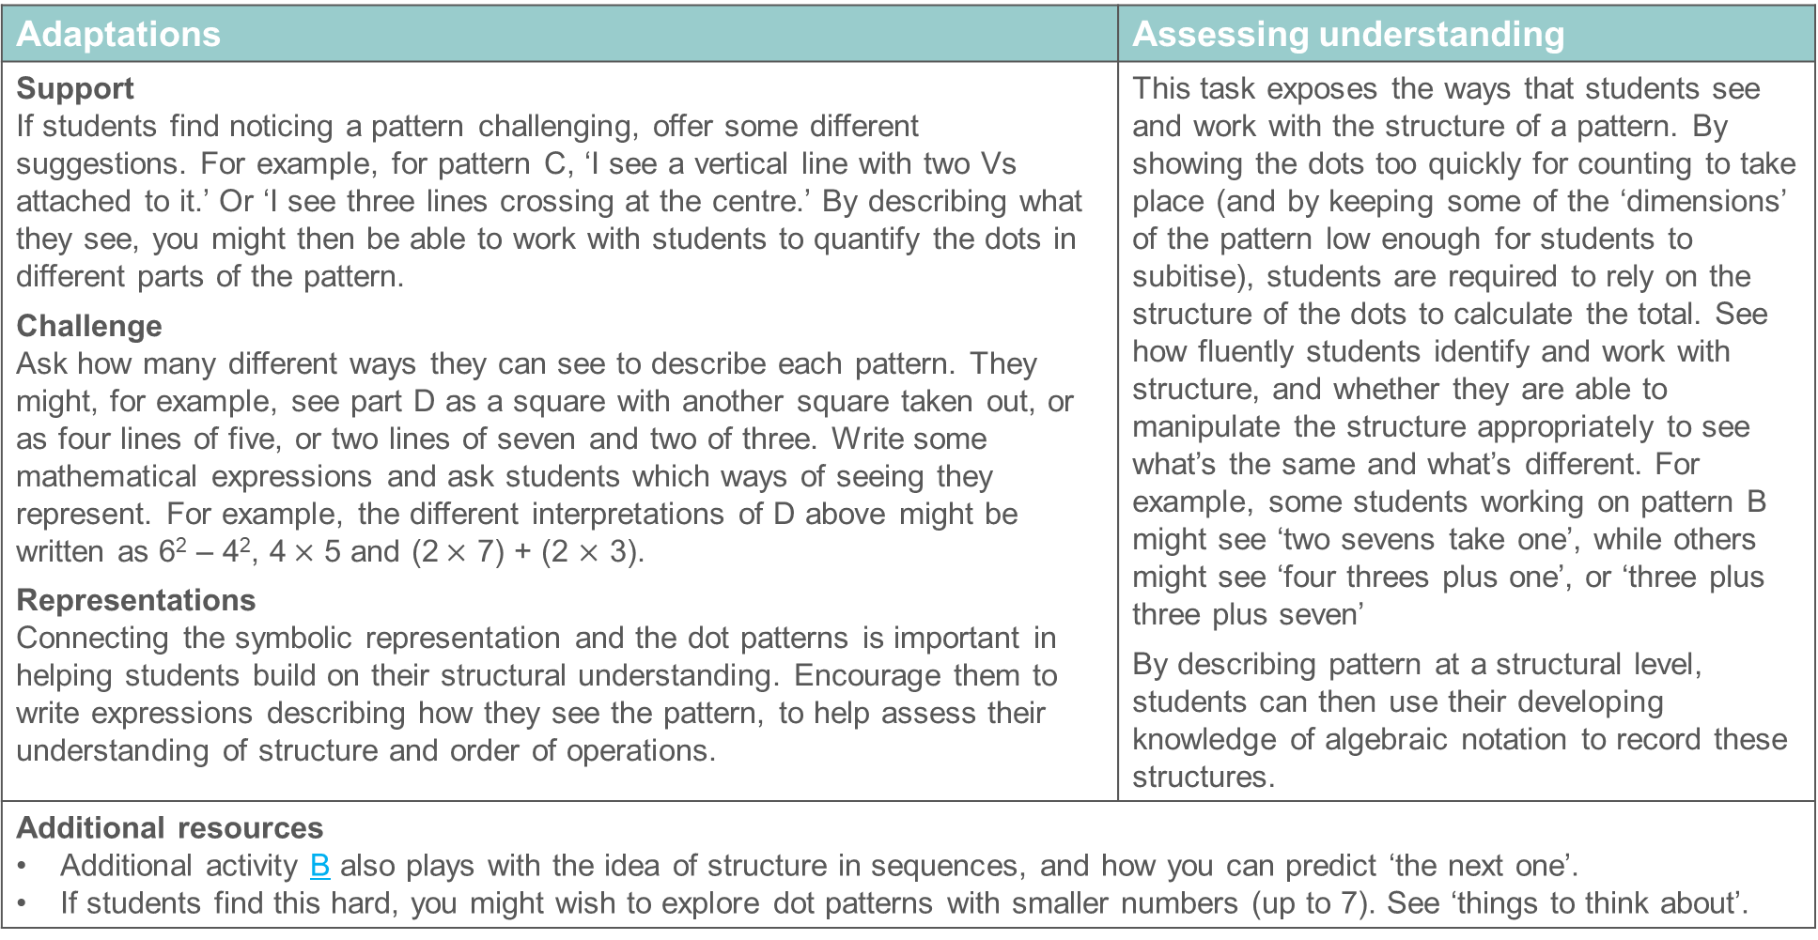
Checkpoint 5: Guidance
Adaptations | Assessing understanding
Support If students find noticing a pattern challenging, offer some different suggestions. For example, for pattern C, ‘I see a vertical line with two Vs attached to it.’ Or ‘I see three lines crossing at the centre.’ By describing what they see, you might then be able to work with students to quantify the dots in different parts of the pattern. Challenge Ask how many different ways they can see to describe each pattern. They might, for example, see part D as a square with another square taken out, or as four lines of five, or two lines of seven and two of three. Write some mathematical expressions and ask students which ways of seeing they represent. For example, the different interpretations of D above might be written as 6² – 4², 4$×$ 5 and (2$×$ 7) + (2 $×$ 3). Representations Connecting the symbolic representation and the dot patterns is important in helping students build on their structural understanding. Encourage them to write expressions describing how they see the pattern, to help assess their understanding of structure and order of operations. | This task exposes the ways that students see and work with the structure of a pattern. By showing the dots too quickly for counting to take place (and by keeping some of the ‘dimensions’ of the pattern low enough for students to subitise), students are required to rely on the structure of the dots to calculate the total. See how fluently students identify and work with structure, and whether they are able to manipulate the structure appropriately to see what’s the same and what’s different. For example, some students working on pattern B might see ‘two sevens take one’, while others might see ‘four threes plus one’, or ‘three plus three plus seven’ By describing pattern at a structural level, students can then use their developing knowledge of algebraic notation to record these structures.
Additional resources Additional activity B also plays with the idea of structure in sequences, and how you can predict ‘the next one’. If students find this hard, you might wish to explore dot patterns with smaller numbers (up to 7). See ‘things to think about’.

Slide 22
Checkpoint 6: Tell me all about it
Create sentences to describe each of the sequences below, using one or more words from the box.
You do not need to use all of the words and you can use the words more than once.
6, 15, 24, 33, 42 …
101, 96, 91, 86, 81 …
16, 8, 4, 2, 1 …
1, 3, 6, 10, 15 …
10 000, 1 000, 100, 10, 1, 0.1 …
1, 4, 9, 16, 25 …
ascending
descending
ascending
increasing
decreasing
difference
term
Can you describe any of the sequences using words that are not in the box?
Notes:
This slide is animated. Each sequence will appear separately so you can choose the pace at which to work with your class.
Answers
Students’ answers may vary. The below examples use as many of the given words as possible in the sentences, but this is not an expectation. Sentences that does not use all the words can still be correct. The intention is to check what vocabulary students know and can use confidently.
a) The sequence is increasing/ascending, with a difference of nine between each term.
b) The sequence is decreasing/descending, with a difference of five between each term.
c) The sequence is decreasing/descending, with the difference between each term halving each time.
d) The sequence is increasing/ascending, with the difference between each term increasing by one each time.
e) The sequence is decreasing/descending, with the difference between each term getting ten times smaller each time.
f) The sequence is increasing/ascending, with the difference between each term increasing by two each time.
? Students’ answers may vary, as the intention is to explore what other vocabulary or terminology they know. Below are examples of what students may notice:
a) Three less than the multiples of nine; every third multiple of three, starting at six.
b) One more than the multiples of five.
c) Powers of two/halving.
d) Triangular numbers
e) Powers of 10/dividing by 10.
f) Square numbers
Suggested questioning
How else could you describe this sequence?
What is important to describe a sequence?
Look at your description. Is there enough information to recreate this sequence? Could any other sequences have the same description?
Things to think about
Understanding what language students already know and understand is a helpful starting point for future learning. The vocabulary provided here is a mixture of words that are likely to have been used with sequences in primary, and words that might have been used in a different domain that students may or may not know how to apply to sequences. When planning next steps, think about the other contexts that students may have met these words in: are there any helpful connections that might help to embed understanding of these words? Are there any connotations that are unhelpful for the mathematical definition, or might cause confusion? For example, the meaning of the word ‘term’ when we refer to school terms has no relation to the meaning of terms in a sequence. Do students understand that this word has multiple meanings?

Slide 23
Checkpoint 6: Guidance
Adaptations | Assessing understanding
Support If students are struggling, try working with sentence stems. You could also express the sentences in simpler language first and then offer a choice between terms to check students’ understanding. For example, ‘The sequence in part a is getting ___. This means it is ascending/descending.’ Challenge Give students a set of sentences using the key terminology and ask them to create sequences that fit these descriptions. Representations This Checkpoint focuses on language as a representation: how students use their vocabulary to represent the sequences. We have offered some key terminology that is useful for working with sequences at Key Stage 3, but the further thinking question suggests asking students to choose their own vocabulary. This may be useful to ask all students earlier in the task. | Checkpoint 6 focuses on the language associated with sequences, so that you can be aware of which language is already familiar and which need to be explicitly taught at Key Stage 3. It is important that students understand that there is no perfect answer being sought. Rather, the intention is to listen and understand what they already know. Students should be aware of vocabulary such as ‘ascending’, descending’, ‘increasing’ and ‘decreasing’ from primary school. The word ‘difference’ is not explicitly taught in relation to sequences, but students may be able to relate their understanding of subtraction to this situation. Similarly, while the primary curriculum has an expectation to find the ‘term-to-term’ rule, students may not have used the word ‘term’ in their work on sequences.
Additional resources Page 27 of the Year 6 Primary Assessment Materials | NCETM explores ‘sequence-generating rules’ and might offer some insight into the language students have used at primary.

Slide 24
Checkpoint 7: 1, 3 …
Gina writes down the first two terms of a sequence: 1, 3 …
What do you think the next two terms will be?
Here are three different ways that Gina could have continued the sequence:
What might Gina’s rule for each option have been?
Which sequence should Gina choose if she wants to:
  only have odd numbers
  reach 100 using the smallest number of terms
  include 45?
1, 3, 6, 10 …
1, 3, 5, 7 …
1, 3, 9, 27 …
Gina says the only numbers common to her sequences are 1 and 3. Are there any other numbers common to two of the sequences? How about all three?
Notes:
This slide is animated. Each question will appear separately so you can choose the pace at which to work with your class. You will need to show students in present/slide show mode and use the animations to prevent the answers for each part being revealed ahead of time.
Answers
a) Students’ answers may vary. They are likely to continue additively, so: 1, 3, 5, 7. It is important that there are no ‘right’ answers and students are encouraged to answer creatively.
b) 1, 3, 6, 10 … Add one more to the difference each time, so add 1, add 2, add 3 etc (also known as the triangular numbers).
1, 3, 5, 7 … Add two each time.
1, 3, 9, 27 … Multiply by three each time.
c) To only have odd numbers, choose 1, 3, 5, 7 … or 1, 3, 9, 27 …
To reach 100 using the smallest number of terms, choose 1, 3, 9, 27 …
To include 45, choose 1, 3 6, 10 … or 1, 3, 5, 7 …
? There are numbers common to two of the sequences, such as nine (common to both 1, 3, 5, 7 … and 1, 3, 9, 27 …); all the powers of three (common to both 1, 3, 5, 7 … and 1, 3, 9, 27 as they are both odd); and all the odd triangular numbers (common to both 1, 3, 6, 10… and 1, 3, 5, 7 …). Students are not likely to find any other values that are common to all three sequences. Working up to the 10th power of three, which is 59 049, there are no other powers of three that are also triangular numbers.
Suggested questioning
What is your rule for finding your next two terms? Is there another rule you could use?
Which sequence is the easiest to continue? Why?
Things to think about
Students will have generated patterns and sequences from their very earliest experiences of mathematics at primary school. Part a offers an opportunity to let them be really creative about what a ‘sequence’ is and what a ‘rule’ could be. Prompt them to think of some different responses – perhaps some responses that no one else has thought of – before moving onto parts b and c.

Slide 25
Checkpoint 7: Guidance
Adaptations | Assessing understanding
Support Work just with the linear sequence and one other, so students are only grappling with two rules at a time. Then repeat the task, comparing the linear sequence with the other non-linear one. Challenge The further thinking question asks students to identify numbers in all three sequences (of which there are none before the 10th power of three). This could turn into an exercise of listing terms. Instead, tell students they will not find any values and ask them to justify how they know this to be true. Representations The triangular numbers are not explicitly mentioned in the curriculum, but they are a useful and interesting sequence to explore. Show students a visual representation of how the sequence builds, using dots or digits arranged in a triangle. | The non-statutory guidance for the primary curriculum states that children, ‘recognise and describe linear number sequences, including those involving fractions and decimals, and find the term-to-term rule’. This does not mean their experience of sequences in primary school will have been limited to linear sequences. For example, they also experience square and cube numbers from Year 5 onwards. Check whether students are aware that sequences do not always increase in equal steps. This is first checked in part a: do students all suggest five and seven as the next terms, or do some offer alternatives? Three options are then given so that, no matter what their initial response, they have the opportunity to identify different rules. The answer to part b is less important than the reasoning that it leads students engage with in part c. Dwell less on the rules and give students time to think about how each sequence will increase, and what they can generalise from this.
Additional resources Additional activity D explores non-linear sequences; C also includes an example of a non-linear sequence. Page 22 of Secondary Assessment Materials | NCETM gives some examples of what students need to understand about geometric sequences at Key Stage 3.

Slide 26
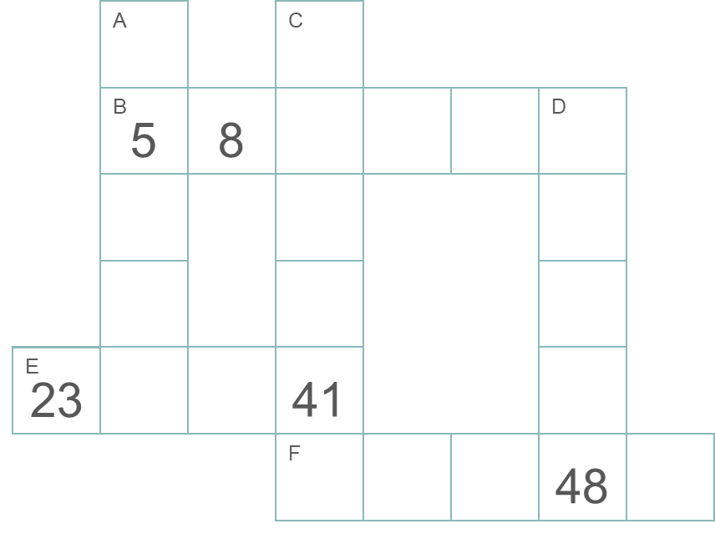
Checkpoint 8: Crossnumber
This puzzle is made from sequences where the same number is added or subtracted each time. Each sequence across or down has a different rule.
Complete the puzzle and fill in the gaps to complete the rule for each sequence.
Across
  B: Start at __ and + 3 each time.
  E: Start at 23 and __ each time.
  F: Start at __ and __ each time.
Down
  A: Start at __ and __ each time.
  C: Start at __ and __ each time.
  D: Start at __ and __ each time.
Continue sequences C and D. Write another clue ‘across’ to connect them. Will it be the same as F?
Notes:
This slide is animated. The further thinking question will appear separately so you can choose the pace at which to work with your class. A printable resource can be found on slide 73.
Answers
See the next slide for a completed version of this crossnumber and a set of rules.
Across
B: Start at 5 and + 3 each time
E: Start at 23 and + 6 each time
F: Start at 51 and - 1 each time
Down
A: Start at -3 and + 8 each time
C: Start at 1 and + 10 each time
D: Start at 20 and + 7 each time
? Another clue can be added but it will not be the same sequence as F as the C and D will have increased by different amounts. For example, if C was continued three more steps to 81, and D was continued three more steps to 69, then the new sequence would be ‘subtract four’: 81, 77, 73, 69 … If both sequences were continued four steps (to 91 and 76 respectively) the sequence would be ‘subtract five’: 91, 86, 81, 76 …
Suggested questioning
Which sequence will you work out first and why?
How can you work out the start number of sequence __?
How many times has __ been added on to reach the last number in the sequence?
Things to think about
Think about how to elicit the mathematical thinking, so that students are not just gap filling but rather engaging with the structure of the sequences. Pause after five minutes and ask them to compare their approaches. Have they all started with the same sequence? Why or why not?

Slide 27
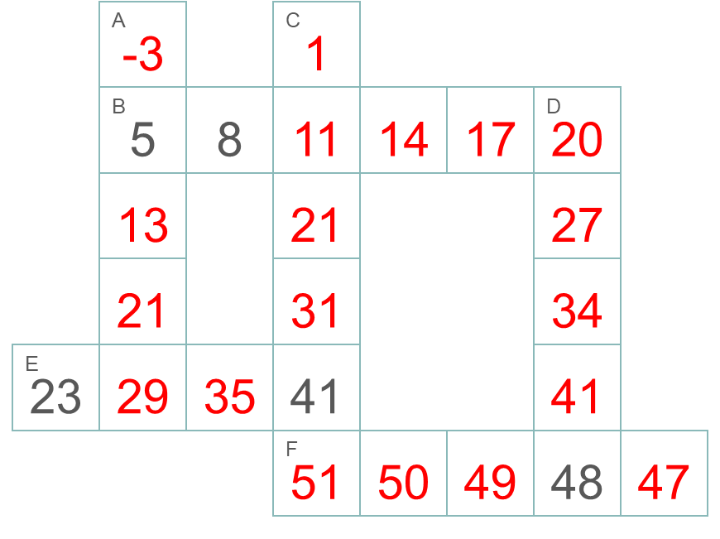
Checkpoint 8: Crossnumber (solutions)
This puzzle is made from sequences where the same number is added or subtracted each time. Each sequence across or down has a different rule.
Complete the puzzle and fill in the gaps to complete the rule for each sequence.
Across
  B: Start at 5 and + 3 each time.
  E: Start at 23 and + 6 each time.
  F: Start at 51 and - 1 each time.
Down
  A: Start at -3 and + 8 each time.
  C: Start at 1 and + 10 each time.
  D: Start at 20 and + 7 each time.

Slide 28
Checkpoint 8: Guidance
Adaptations | Assessing understanding
Support Use a number line to draw attention to the fact that two empty boxes means that there has been three 'jumps’. Model arrows starting at the first number and taking three ‘jumps’ to each empty box and then the next number. Challenge Students could design their own crossnumber using sequences with different rules. Representations Providing a number line alongside this task might be useful for students to represent the start points and differences in each sequence. Look out for students who are using the number line to work out the answers (for example by counting on in ones) rather than to ‘see’ the relationships as they may need more support. | Assess whether students can reason about the way that a sequence grows. Are they able to identify that, for example, across sequence B, three has been added on six times? This is a key point for understanding the way a linear sequence is developed. Students will have likely described linear sequences using term-to-term rules at primary. They may have focused more on the rule, and continuing the sequence, than on stating the start number. The answers are structured here so that the focus is on both. Think about whether to give students the printable resource or not. Will this make them more or less likely to continue the sequences term-to-term? Some students might, for example, realise that they need to add on 3 five times to get the start of sequence D. This starts to shift students towards position-to-term thinking. Viewing the structure of the sequence in this way gives meaning to the notation that they will later learn and suggests a readiness for this new learning.
Additional resources Pages 27 and 28 of the Year 6 Primary Assessment Materials | NCETM offer some examples of what students may have experienced of sequences at primary school.

Slide 29
Checkpoint 9: Which sequence?
Below are the first four terms in four different sequences.
A: 1, 4, 7, 10 ...
For which sequences will these statements be true?
Explain your reasoning.
B: 4, 7, 10, 13 ...
Has negative numbers.
Has 1 in it.
Has 4 in it.
Is ascending.
Has 19 in it.
Has a difference of 3.
Has 81 in it.
Has 82 in it.
C: 16, 13, 10, 7 ...
D: 4, 1, -2, -5 ...
Which of the statements are true for this sequence?
1, 3, 9, 27 ...
Notes:
This slide is animated. Each question will appear separately so you can choose the pace at which to work with your class.
Answers
Have negative numbers: C and D.
Have 1 in it: A, C and D.
Have 4 in it: A, B, C and D.
Are ascending: A and B.
Have 19 in it: A and B
Have a difference of 3: A, B, C and D. Make a distinction between a difference of +3 (A and B) and -3 (C and D). This is an understanding that students may not bring from primary.
Has 81 in it: none.
Have 82 in it: C and D.
? 1, 3 9, 27… has 1 in it; is ascending; and has 81 in it.
Suggested questioning
What is the same and what is different about each sequence?
What is the one thing that makes each sequence unique?
Things to think about
Checkpoint 9 asks students to think about statements in relation to four similar but different sequences. Students should engage with the structure of the sequence, and reason about it, rather than just mindlessly continuing to add or subtract the common difference. This relies on them appreciating the infinite nature of a sequence: they need to be able to reason with both the numbers that are there, and those that are not. An example is the negative numbers that will appear in sequence C – do students include this in their first answer?

Slide 30
Checkpoint 9: Guidance
Adaptations | Assessing understanding
Support Choose just two sequences to compare and discuss. First look at A compared with B, then A with C. Challenge Ask students to create their own sequences for which as many of the statements as possible are true. Can they create one where all eight statements are true? The maximum is seven statements (as sequences with a common difference of 3 cannot have both 81 and 82 in them); can they reason this? Representations The similarities and differences of these four sequences might be best teased out using a number line. Use different coloured marks to show each sequence and where they overlap. This will make it clear that, for example, 4 is in all four sequences but 1 and 10 are only in three. | Checkpoint 9 explores linear sequences but, rather than asking students to continue them or state a rule, gives them statements to reason about. This encourages deeper that you can assess. There are several key ideas here. One, that conventionally sequences continue indefinitely onwards, but the first number stated is the start number. So, although B follows the same pattern as A, it will not have a 1 in it (whereas C, which hasn’t yet reached 1, will). Working with the same common difference, both ascending and descending, will help you to explore students’ current definitions of sequences and how they need to be developed to encompass new learning at Key Stage 3. Ask students whether, for example, A and B are the same sequence. When they come to work with position-to-term rules, they need to be clear that they are not.
Additional resources Additional activity C also compares sequences to expose students’ understanding.

Slide 31




Checkpoint 10: Sequence jumble
Kayla creates a sequence of numbers using equal steps.
She writes one term per card, but then drops the cards!
$$2\frac{3}{4}$$
$$\frac{5}{4}$$
$$\frac{1}{2}$$
$$3\frac{1}{2}$$
Rearrange Kayla’s cards with the terms in ascending order.
What might be written on the upside-down cards?
Kayla thinks the integer 4 is in the sequence. Is she correct?
What other integers will be in the sequence?
Notes:
This slide is animated. The cards, and then each question, will appear separately so you can choose the pace at which to work with your class. A printable version can be found on slide 74.
Answers
a) $\frac{1}{2}$, $\frac{5}{4}$, $2\frac{3}{4}$, $3\frac{1}{2}$
b) One upside down card must say 2, in order for the sequence to be going up in equal steps of $\frac{3}{4}$. The other card could say $−\frac{1}{4}$or $4\frac{1}{4}.$
? No, Kayla is not correct. Every third integer is in the sequence so, as 2 is in the sequence, the next integer would be 5 not 4. Students might be able to list the start of the sequence of integers (2, 5, 8, 11…) or describe them as one less than the multiples of 3.
Suggested questioning
What is the greatest term shown? How do you know?
Is __ greater or less than __? How do you know?
Where might the missing cards go in the sequence of terms?
Is there another way to write each number? How might writing the numbers a different way help?
Things to think about
While examples of sequences at Key Stage 3 tend to focus on integers, students will have continued patterns using integers, decimals and fractions at primary school in order to build understanding of the nth term. This is likely to have started as early as year 3, when tenths are first introduced. However, fractions can cause some difficulty, so check which students are confident with common differences with fractions.

Slide 32
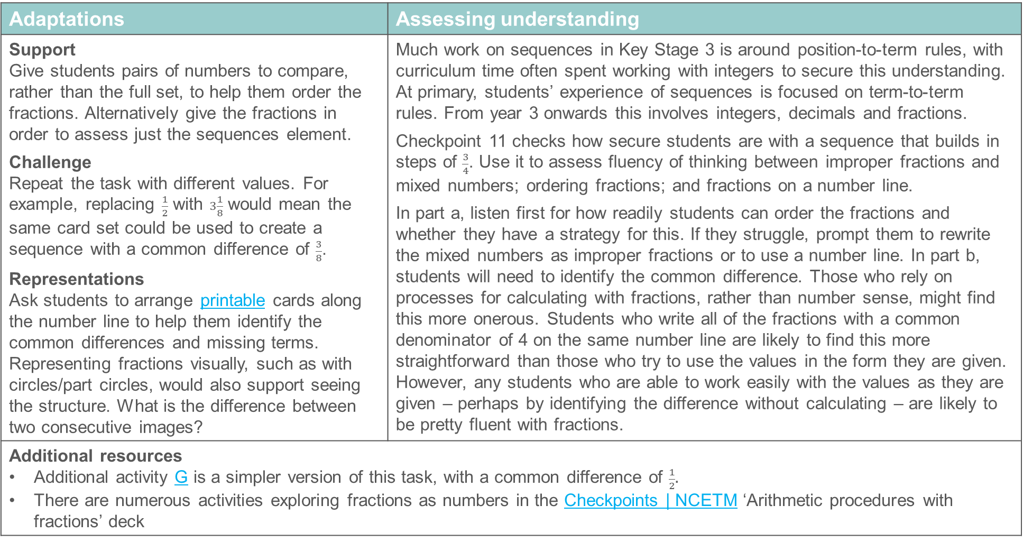
Checkpoint 10: Guidance
Adaptations | Assessing understanding
Support Give students pairs of numbers to compare, rather than the full set, to help them order the fractions. Alternatively give the fractions in order to assess just the sequences element. Challenge Repeat the task with different values. For example, replacing $\frac{1}{2}$ with $3\frac{1}{8}$ would mean the same card set could be used to create a sequence with a common difference of $\frac{3}{8}$. Representations Ask students to arrange printable cards along the number line to help them identify the common differences and missing terms. Representing fractions visually, such as with circles/part circles, would also support seeing the structure. What is the difference between two consecutive images? | Much work on sequences in Key Stage 3 is around position-to-term rules, with curriculum time often spent working with integers to secure this understanding. At primary, students’ experience of sequences is focused on term-to-term rules. From year 3 onwards this involves integers, decimals and fractions. Checkpoint 11 checks how secure students are with a sequence that builds in steps of $\frac{3}{4}$. Use it to assess fluency of thinking between improper fractions and mixed numbers; ordering fractions; and fractions on a number line. In part a, listen first for how readily students can order the fractions and whether they have a strategy for this. If they struggle, prompt them to rewrite the mixed numbers as improper fractions or to use a number line. In part b, students will need to identify the common difference. Those who rely on processes for calculating with fractions, rather than number sense, might find this more onerous. Students who write all of the fractions with a common denominator of 4 on the same number line are likely to find this more straightforward than those who try to use the values in the form they are given. However, any students who are able to work easily with the values as they are given – perhaps by identifying the difference without calculating – are likely to be pretty fluent with fractions.
Additional resources Additional activity G is a simpler version of this task, with a common difference of $\frac{1}{2}.$ There are numerous activities exploring fractions as numbers in the Checkpoints | NCETM ‘Arithmetic procedures with fractions’ deck

Slide 33

Checkpoint 11: Nine dots
These nine dots represent the third pattern in a sequence.
What do you think the second pattern in the sequence could have looked like?
Using your rule, what would the next pattern in the sequence be?
Using your rule, how many dots would there be in the tenth pattern?
Is there more than one possible answer?
Iman has 27 dots in her answer to part b. Gaia has 16 dots in her answer to part b. What might their rules be? How many more dots will Iman have than Gaia in their fifth patterns?
Notes:
This slide is animated. Each question will appear separately so you can choose the pace at which to work with your class. A printable resource to help students organise their thoughts can be found on slide 75.
Answers
a) Students’ answers will vary. It could have been two columns of three dots, two rows of three dots or a two by two square. See the animated solutions on the next slide. There are also various arrangements of dots for the sequence 1, 5, 9 … These are not shown on next slide or detailed for parts b to c as the possible arrangements of dots are infinite.
b) Students’ answers will vary depending on their answers to part a. For increasing columns of dots, it would be four columns of three dots; for increasing rows of dots, it would be four rows of three dots; for increasing squares, it would be a four by four square.
c) If students saw this as a linear sequence (rows or columns) there will be 30 dots in the tenth pattern. If they saw square numbers there will be 100 dots in the tenth pattern
d) Yes there are different ways to answer parts a to c, as described above.
? There are a multitude of possible sequences that Iman and Gaia could have chosen. Perhaps the most likely example for each is given here:
Iman's sequence could be 1, 3, 9, 27… Her rule is multiply by three.
Gaia's sequence could be 1, 4, 9, 16 … Her rule is +3, +5, +7 … (or recognising they are square numbers).
Iman’s fifth pattern will be 19 683 and Gaia’s will be 100, so Iman will have 18 683 more dots in her pattern.
Suggested questioning
How would you draw this pattern of nine dots? Is there more than one way to draw it?
If you have more than one answer to part a, how are your answers the same and how are they different?
How did you work out the tenth pattern?
Things to think about
Checkpoint 11 gives a term in a sequence and asks students to work backwards to consider the two terms that came before. The multiple possible answers provide rich scope for discussion. One of the ready-to-progress criteria for year 6 expects students to recognise the additive and multiplicative links between two numbers. If students struggle to consider a multiplicative scenario then they may need more time to develop their sense that any two numbers can be connected multiplicatively. See ‘additional resources’ on the Guidance slide for some suggestions).

Slide 34
Checkpoint 11: Nine dots (animated solution)
These nine dots represent the third pattern in a sequence.
Three possible previous patterns are shown; there are many others.
Columns
(3, 6, 9 …)
Rows
(3, 6, 9 …)
Squares
(1, 4, 9 …)
Notes:
This slide is animated. Each term in the three given sequences will appear separately. Note that these are just three examples, using perhaps the most likely patterns of dots that children might select due to their familiarity.

Slide 35
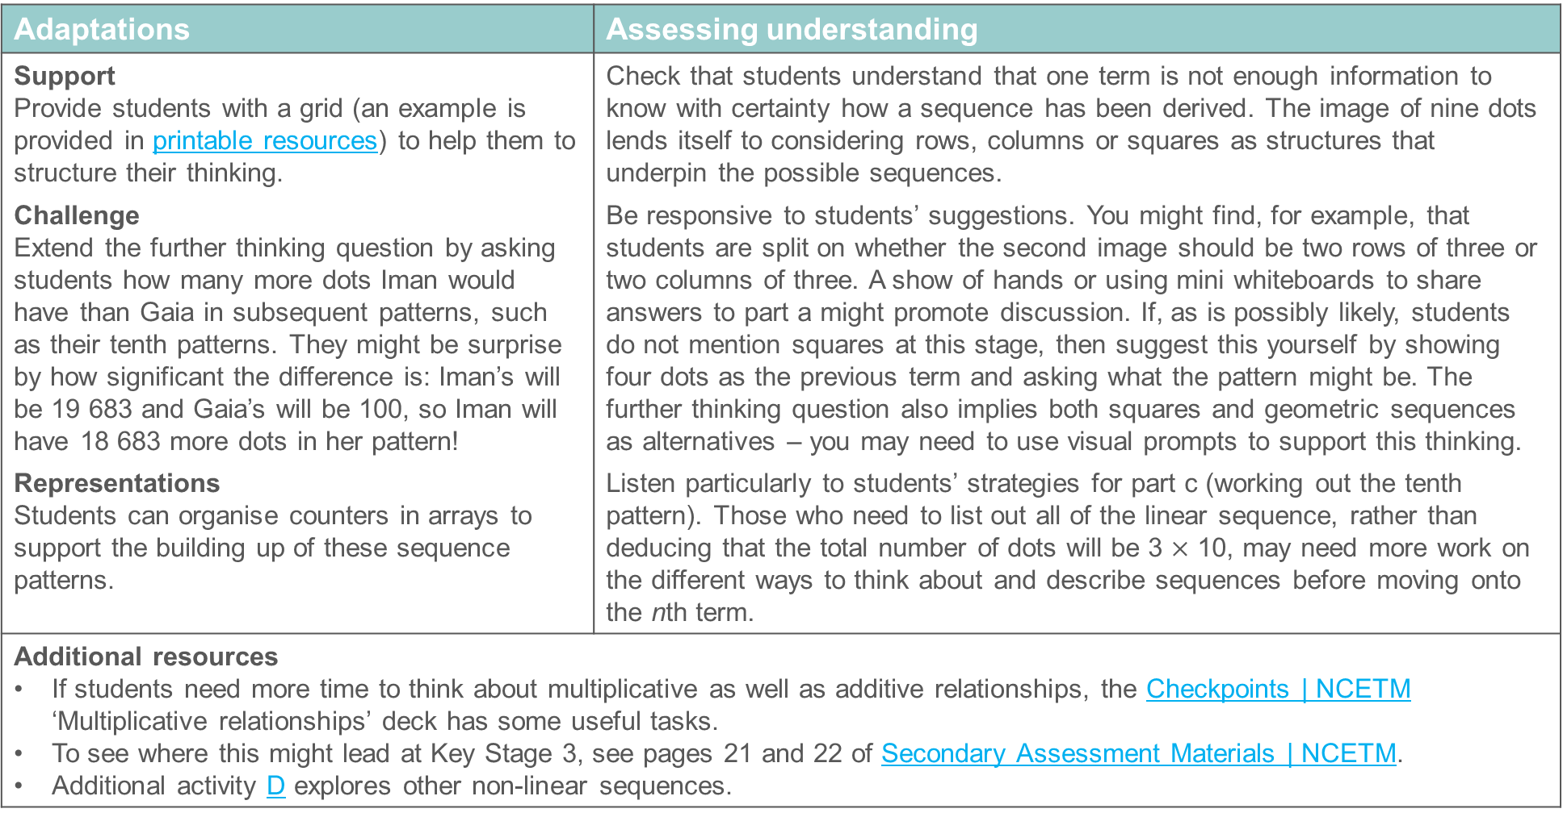
Checkpoint 11: Guidance
Adaptations | Assessing understanding
Support Provide students with a grid (an example is provided in printable resources) to help them to structure their thinking. Challenge Extend the further thinking question by asking students how many more dots Iman would have than Gaia in subsequent patterns, such as their tenth patterns. They might be surprise by how significant the difference is: Iman’s will be 19 683 and Gaia’s will be 100, so Iman will have 18 683 more dots in her pattern! Representations Students can organise counters in arrays to support the building up of these sequence patterns. | Check that students understand that one term is not enough information to know with certainty how a sequence has been derived. The image of nine dots lends itself to considering rows, columns or squares as structures that underpin the possible sequences. Be responsive to students’ suggestions. You might find, for example, that students are split on whether the second image should be two rows of three or two columns of three. A show of hands or using mini whiteboards to share answers to part a might promote discussion. If, as is possibly likely, students do not mention squares at this stage, then suggest this yourself by showing four dots as the previous term and asking what the pattern might be. The further thinking question also implies both squares and geometric sequences as alternatives – you may need to use visual prompts to support this thinking. Listen particularly to students’ strategies for part c (working out the tenth pattern). Those who need to list out all of the linear sequence, rather than deducing that the total number of dots will be 3 $×$ 10, may need more work on the different ways to think about and describe sequences before moving onto the nth term.
Additional resources If students need more time to think about multiplicative as well as additive relationships, the Checkpoints | NCETM ‘Multiplicative relationships’ deck has some useful tasks. To see where this might lead at Key Stage 3, see pages 21 and 22 of Secondary Assessment Materials | NCETM. Additional activity D explores other non-linear sequences.

Slide 36
Checkpoint 12: School dinners
In a school dining hall, six chairs fit around one rectangular table.
Below are four ways, A to D, to arrange four tables.
A
B
C
D
Describe how you would work out the maximum number of chairs you can add for each different arrangement of tables.
Mary adds two more tables to each of these arrangements. How many extra chairs could she add?
Mary adds even more tables to one of the original arrangements. This means she adds twice the original number of chairs. Which arrangement has she added to? How many tables did she add?
Notes:
This slide is animated. Each table arrangement, and then each question, will appear separately so you can choose the pace at which to work with your class.
Answers
a)
A: Six chairs for each table, so 24 chairs in total.
B: Four chairs down each of the long sides and two at the ends of the four short sides, so 12 chairs in total.
C: One at each short side and two along each long of the eight long sides, so 18 chairs in total.
D: One on each of the four short sides and two on each of the four long sides, so 12 chairs in total.
b)
A: She adds12 more chairs.
B: She adds four more chairs
C: She adds 8 more chairs
D: there are two possible ways for the pattern to continue. If she adds the two tables to the two short sides (increasing horizontally across the slide), she adds 4 more chairs. If she adds the two tables to the two long sides (increasing vertically across the slide), she adds 2 more chairs.
? Mary could have added the tables to three of the arrangements, each resulting in a different number of chairs.
A: She would have added 4 more tables.
B: She would have added 6 more tables.
C: It is not possible to add tables and double the number of chairs.
D: If the pattern was increasing horizontally, adding tables to the two short sides, then six more tables were added; if the pattern was increasing vertically, adding tables to the two long sides, then 12 tables were added.
Suggested questioning
How did you count the chairs?
Which arrangement gives you the most chairs? Which gives you the fewest?
Does one more table always mean six more chairs? Why or why not?
Which arrangement gives the most/fewest chairs per extra table?
Things to think about
Checkpoint 12, much like Checkpoint 5, looks at a ‘snapshot’ of a term in a sequence rather than a series of terms. While part b and the further thinking question do rely on the idea of the pattern growing, it is in part a where the focus is on the structure and how students describe it that provides the main assessment focus. This might provide enough rich discussion to fill 10 minutes alone, so it is valid to stop here if necessary.

Slide 37
Checkpoint 12: Guidance
Adaptations | Assessing understanding
Support Working with just arrangements B and C would allow students to focus on what is the same and what is different, without introducing too many patterns at once. Challenge Extend the further thinking question by specifying a number of chairs and asking students to work out which arrangement of tables it could apply to. For example, 30 chairs could be five tables in arrangement A, 13 tables in arrangement B or seven tables in arrangement C. Representations Interpreting sequences that are represented diagrammatically is a key understanding at Key Stage 3. Help students to organise their thinking by suggesting they draw the different arrangements of tables and mark chairs as dots to help them count. | Checkpoint 13 might not initially look like a sequences task; rather than showing sequences that are growing, the images show a ‘snapshot’ of the sequence. See whether students are able to identify the structure of the pattern. This is drawn out by the focus of the questions: rather than asking how many chairs are needed, students must to describe how they would work out their answers. Do not settle for numerical answers! Push students to talk about their strategy; can they spot where they can work multiplicatively rather than additively? Look out for students that count each chair in ones, rather than spotting where chairs can be counted in groups. These students may not have efficient strategies for counting and/or might find it more challenging to spot the mathematical structures. In part b, students are encouraged to imagine a ‘next step’ in the sequence by working out how many chairs are needed for two more tables. Those who found it harder to identify a strategy for calculating chairs may find this more challenging. These students may need to be encouraged to draw out the table arrangements. Part D offers some ambiguity, as the pattern could grow in different ways – ask students if there is another way to answer this question.
Additional resources Additional activity F looks in more detail at the ‘rules’ use to generate the number of chairs, and might be a suitable alternative or next step.

Slide 38
Preparing for the nth term
Checkpoints 13–22

Slide 39
Preparing for the nth term
Previous learning | In Key Stage 3 students need to
Key Stage 2 curriculum: Year 6: generate and describe linear number sentences, including those involving fractions and decimals, and find the term-to-term rule Year 6 non-statutory guidance: pupils should be introduced to the use of symbols and letters to represent variables and unknowns in mathematical situations that they already understand, such as generalisations of number patterns Further information about how students may have experienced this key idea in Key Stage 2: As the nth term is new learning at Key Stage 3, there is no mention of it in either Teaching mathematics in primary schools or Primary Mastery Professional Development. You may, however, find that some primary teachers have touched on this concept so students may show some evidence of prior learning. | Realise that generating many terms in a sequence using the term-to-term rule is not an efficient method and, using their understanding of the mathematical structure of a linear sequence, instead describe linear sequences using the nth term. Develop a deep and secure understanding of the nth term and how to use it, including in a range of ascending and descending sequences, and those containing terms that are decimals and fractions. Reason with the nth term rule and apply it in order to solve mathematical problems, such as finding the 50th and 100th terms of a linear sequence.

Slide 40
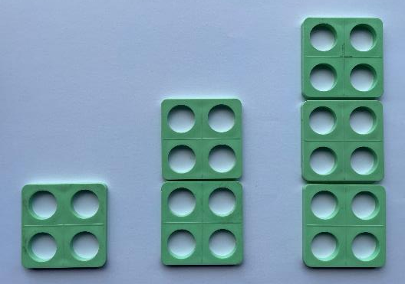
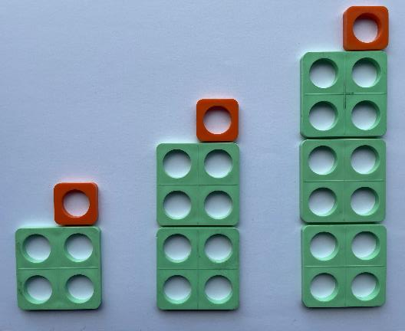
Checkpoint 13: Tiles and holes
A sequence of patterns is made from green tiles, each with four holes.
How many green tiles are in the 3rd pattern? The 6th pattern? The 10th pattern?
How many holes are there in the 3rd pattern? The 6th pattern? The 10th pattern?
Describe in words the relationship between the number of tiles and the number of holes.
1st 2nd 3rd
How does your answer to part c change if the sequence looks like the one on the bottom right of this slide instead?
If a pattern has 217 holes, which of the two sequences is it from? Describe what the pattern looks like.
Notes:
This slide is animated. Each question will appear separately so you can choose the pace at which to work with your class.
Answers
a) 3rd: 3, 6th: 6, 10th: 10
b) 3rd: 12, 6th: 24, 10th: 40
c) The number of holes is four times the number of green tiles
d) The number of holes is now four times the number of green tiles, plus an extra hole.
? 217 is not a multiple of four so must have come from the second sequence. There must be one orange single-hole tile and 216 ÷ 4 = 54 green four-hole tiles.
Suggested questioning
What is meant by ‘tiles’ in these examples? How is that different from the number of holes?
Describe in words how you would calculate how many holes there are in the 10th pattern of the second sequence on the bottom right of the slide.
Things to think about
Checkpoint 13 probes students’ readiness for using position-to term rules to describe sequences. They are asked to describe multiples that are no longer presented in the term-to-term way by predicting future terms that are not consecutive. Familiar representations are used. Use this after Checkpoint 4 so that you are confident the representation acts as a support and not a barrier.

Slide 41
Checkpoint 13: Guidance
Adaptations | Assessing understanding
Support Give physical number frames for students to build the patterns before looking at the questions. This is particularly important for any students with red/green visual impairment who might find the images on the slide less accessible. Use sentence stems to support students to notice the relevant features. For example, the third pattern will have __ tiles and __ holes because __ is the third multiple of three. Challenge Challenge students extend the idea of the ‘further thinking’ question by considering which numbers of holes are possible or not in these sequence patterns. Representations The number frames are chosen as a representation that students are likely to be familiar with from primary school. Using them here in the context of sequences can be valuable for revealing mathematical structures at secondary level for all students. | Assess students’ understanding and language, particularly whether they can comfortably shift to the position-to-term thinking they will need at Key Stage 3. Students will be familiar with describing sequences using term-to-term rules but will not have formally worked with position-to-term rules at primary. The simplicity of the sequences, alongside the visual representation, should mean that the questions are nonetheless accessible. Expect language such as, ‘The 10th pattern will have 40 holes because the 10th multiple of four is 40’. The language of 1st term may not have been seen before but the 1st, 2nd, 3rd have been included in the diagram to support the later development of position-to-term rules. Part c emphasises this further by clarifying the relationship between tiles (or the ‘position’) and holes (the ‘terms’). This might require some discussion to ensure students have fully understood and articulated the relationship. In part d, a second example encourages pattern spotting and looking at structure from patterns to help verbalise term-to-term and position-to-term rules using words. Note at this stage we are not looking for students to be able to generalise for n tiles; this is new teaching at Key Stage 3.
Additional resources Additional activity E is a lightly less structured version of this task.

Slide 42
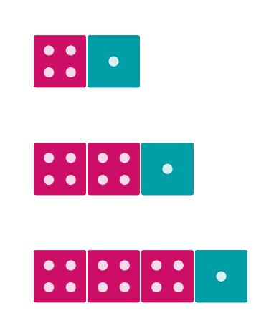
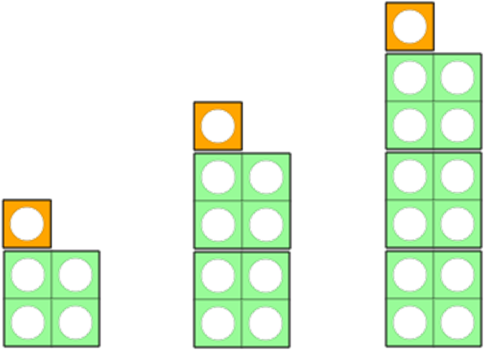
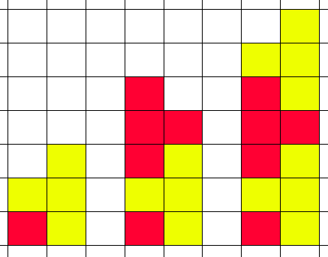
Checkpoint 14: Patterns galore
A
B
What is the same and what is different about the four sequences A to D on the left?
Describe the next pattern in each of A to D.
What would the 10th pattern look like in each of A to D?
What would the 13th pattern look like in each of A to D?
What was the same and what was different about your answers to parts b, c and d?
C
D
Design some other patterns that follow the same structure those in A to D.
Notes:
This slide is animated. Each question will appear separately so you can choose the pace at which to work with your class.
Answers
a) Same: they are all increasing by four (holes, dots, squares shaded, bars/posts); they all have a constant one (orange single top tile, blue face with one dot, red square at the bottom left, vertical fence post)
Different: each sequence looks different as it is created from different shapes. For example, both A and B have dots/holes, but one is arranged vertically and the other horizontally.
b) A: four green number frame tiles and one orange tile (17 holes in total)
B: four dice with four dots and one die with one dot (17 dots in total)
C: One red square and four ‘T’ shapes alternating in colour on top of each other (17 squares shaded in total)
D: Five vertical fence posts, with each pair connected by three horizontal bars (17 bars/posts in total)
c) A: 10 green number frame tiles and one orange (41 holes in total)
B: 10 dice with four dots and one die with one dot (41 dots in total)
C: One red square and 10 ‘T’ shapes on top of each other (41 squares shaded in total)
D: 11 vertical fence posts, with each pair connected by three horizontal bars (41 bars/posts in total)
d) A:13 green number frame tiles and one orange (53 holes in total)
B: 13 dice with four dots and one die with one dot (53 dots in total)
C: One red square and 13 ‘T’ shapes on top of each other (53 squares shaded in total)
D: 14 vertical fence posts, with each pair connected by three horizontal bars (53 bars/posts in total)
e) Same: they all had the same total number of parts (holes, dots, squares, bars/posts). Students might notice that this total is 4 $×$ pattern number + 1 extra.
Different: all of the sequences look different, despite having this same structure behind them.
Suggested questioning
What would the 8th item be in each of the cases shown?
How do you get from one pattern to the next?
What about if you wanted to jump 10 places further along?
Things to think about
There are threads woven through this deck, and Checkpoint 14 develops some of the images used in Checkpoint 4. This continuity may be helpful for building students’ understanding towards where they need to be for Key Stage 3. How might you adapt some of the other images from Checkpoint 4 to represent 4n + 1 rather than 4n? Is this something your students could do to support the further thinking question? Note that the terminology 4n + 1 is used for clarity for teachers and should not be student facing at this stage as it is new learning for Key Stage 3.

Slide 43
Checkpoint 14: Guidance
Adaptations | Assessing understanding
Support Choose just two of the representations; the task could then be repeated with the remaining two another time. Challenge The further thinking question asks students to create a different representation of the same structure. To extend them, you could ask students to adapt the representations given to model a different structure. Representations Visual representations of sequences can help students to identify their structure. This can be more obvious in some representations than others. Do your students find one easier to access than others? | Checkpoint 15 starts and ends with the same question: what is the same and what is different? These questions offer a useful framework for helping students to notice certain mathematical structures. The intention is that students look initially at what is the same and different about the images; at this stage, they might not notice the structural similarities. By asking students to continue the patterns parts b to d, they should have more experience of these similarities when they revisit the same/different question in part e. The intention is not to use this to teach nth term, but to see whether students are ready for teaching. Do they notice the constant +1 in each pattern? Can they see which part of each pattern is increasing by four each time? Students may particularly single D out as different, as the ‘+1’ is harder to identify as one of the vertical poles, and they may think of it as going up in threes due to the three horizontal bars. You may recognise many of the images from Checkpoint 4; it might be helpful to use these two tasks in sequence, perhaps a few lessons apart, to support students to make connections between them.
Additional resources Page 28 of the Year 6 Primary Assessment Materials | NCETM features sequences built visually. Page 22 of Secondary Assessment Materials | NCETM features questions that use multilink to explore the structure of nth term, to help you think about the next teaching step for using representations to model the nth term.

Slide 44
Checkpoint 15: Who gets there first?
Penny and James are writing different number patterns.
Penny counts in steps of 4. James counts in steps of 3.
Who will pass 20 first if:
They both start at 0?
Penny starts at 1 and James starts at 2?
Penny starts at 1 and James starts at 11?
Penny starts at 1 and James starts at 5?
Penny starts at -1 and James starts at 4?
What is the smallest difference needed for their starting numbers if James is going to pass 20 first? How about if they are to reach 20 at the same time?
Notes:
This slide is animated. Each question will appear separately so you can choose the pace at which to work with your class.
Answers
a) Penny 0, 4, 8, 12, 16, 20 … (vs James 0, 3, 5, 9, 12, 15, 18, 21 …)
b) Penny 1, 5, 9, 13, 17, 21 … (vs James 2, 5, 8, 11, 14, 17, 20 …)
c) James 11, 14, 17, 20 … (vs Penny 1, 5, 9, 13, 17, 21 …)
d) Penny 1, 5, 9, 13, 17, 21 … (vs James 5, 8, 10, 13, 16, 19, 22 …)
e) Both at the same time (Penny -1, 3, 7, 11, 15, 19, 23 … vs James 4, 7, 10, 13, 16, 19, 22 …. This one may cause debate; see the Guidance slide for more information.)
? For James to reach 20 first, the smallest difference in their start numbers is 2 (i.e. Penny starts on 15 and James on 17)
To reach 20 at the same time, arguably, the smallest difference could be 0 (i.e. they both start at 20). Otherwise, it would need to be 1 (Penny starts on 16 and James on 17).
Suggested questioning
What is the same and what is different each time?
Can you predict who will reach 20 first each time? Is it always the person who counts in bigger steps?
Things to think about
It is not uncommon to link sequences and graphs in a curriculum. One provides a helpful access point to the other, and graphs can be a useful representation for sequences. This might be a direction that you take this task, for example in identifying who passes 20 first for the more ambiguous part e. The given answer is both at the same time, as this is true regardless of which representation you use. Mapping both onto a graph would show a steeper gradient for Penny, suggesting that she passes 20 first. However, sequences and counting are not continuous, and so the line is arguably meaningless in representing this situation. The points are the most relevant part of the graph, as these are the numbers that they count. If you do choose to model this situation graphically, make sure this is clear to your students.

Slide 45
Checkpoint 15: Guidance
Adaptations | Assessing understanding
Support Offer students number lines and coloured pens so that they can highlight in different patterns or circle the two different patterns. Challenge Ask students to create their own pairs of sequences with constraints, such as, ‘The bigger jumps must reach the target number last’, or, ‘The lower start number must reach the target number first’. Representations Unlike the majority of other Checkpoints in this deck, this task is presented without any visual representations so that you can see which, if any, students naturally reach towards in their thinking. If students need support, a number line might be helpful (see above), or you could give counters for them to build up in piles of three or four. Squared paper could also be used: ask students to draw staircases representing their sequences, which offers a connection to later work on straight lines and gradient. | Checkpoint 16 explores the same ‘jumps’ with different start numbers. Play around with the sequences to see if students can anticipate when a greater start number is enough to ensure the smaller jumps reach a target number first. The first assessment point is the generation of the sequences – listen for how students do this. Do any of them think of shifting the entire times table, rather than building up in jumps from the start number? These students may find the shift to nth term less of a leap at Key Stage 3. Where both sequences reach a number greater than 20 at the same time (as in part e), students might debate which reached 20 first. If you have already taught the equations of lines then representing the sequences as graphs could be tempting. However, be sure to make clear the distinction between a continuous graph, which is represented by the line, and a discrete sequence, which is more accurately represented by the points on the line with integer x-coordinates.
Additional resources Page 27 of the Year 6 Primary Assessment Materials | NCETM explores sequence-generating rules and offers insight into the language students may have used to explore sequences at primary.

Slide 46
Checkpoint 16: Square patterns
1 | 2 | 3 | 4 | 5 | 6 | 7 | 8 | 9 | 10
11 | 12 | 13 | 14 | 15 | 16 | 17 | 18 | 19 | 20
21 | 22 | 23 | 24 | 25 | 26 | 27 | 28 | 29 | 30
31 | 32 | 33 | 34 | 35 | 36 | 37 | 38 | 39 | 40
41 | 42 | 43 | 44 | 45 | 46 | 47 | 48 | 49 | 50
Nawisah shades a number pattern in blue on the grid. She starts at 5.
What can you say about the pattern?
What will the next three numbers be after 45?
Will 80 be in the number pattern? Why/why not?
Ben starts a different pattern in orange stripes on the grid. Repeat questions a to c for his pattern.
Ben and Nawisah continue their patterns further down the grid. Have they shaded the correct numbers? How do you know?
81 | 82 | 83 | 84 | 85 | 86 | 87 | 88 | 89 | 90
91 | 92 | 93 | 94 | 95 | 96 | 97 | 98 | 99 | 100
Create your own pattern. Can you think of one that doesn’t share any numbers with Nawisah or Ben’s patterns?
Notes:
This slide is animated. Each question will appear separately so you can choose the pace at which to work with your class.
Answers
a) Nawisah’s pattern is going up in fours.
b) The next three numbers will be 49, 53 and 57.
c) Eighty will not be in Nawisah’s number pattern because it is a multiple of four, and all of her numbers are one more than a multiple of four.
d) a) Ben’s pattern is going up in tens. b) The next three numbers will be 52, 62 and 72; c) Eighty will not be in Ben’s pattern because all of the numbers are two more than a multiple of 10.
e) Ben’s are correct as they are all two more than a multiple of 10. Nawisah’s are not correct. Although they are going up in fours she has shifted her pattern by two. It should be 81, 85, 89, 93, 97…
? Students’ answers may vary. Examples of sequences that do not share any numbers with Ben or Nawisah’s patterns could include any sequence that increases in steps of 10 but starts on 4, 6, 8 or 10.
Suggested questioning
Which times table has the same pattern as __? What is the same and what is different about the pattern and the times table?
Will __ be in the pattern? How do you know?
Things to think about
Being able to compare a linear sequence to a multiplication table is a key understanding that is built on with new learning about the nth term at Key Stage 3. This Checkpoint uses a familiar representation – part of the hundred grid – to check how readily students can already do this.

Slide 47
Checkpoint 16: Guidance
Adaptations | Assessing understanding
Support Having access to their own physical hundred square might help students to consider and continue the patterns. Challenge Ask students to create their own sequences from descriptions, such as, ‘Must include half of Ben’s numbers and less than half of Nawisah’s numbers’. Representations Students will be familiar with the hundred square from primary school. Using it to help in making the links between linear sequences and patterns of multiples with the same common difference may be useful for teaching of the nth term over Key Stage 3. | Checkpoint 16 uses the hundred square to explore a sequence. Students might be used to seeing these patterns when shading times tables on the square. Now they are asked to consider the same patterns with different start numbers. Listen out for whether students automatically make links to the four and 10 times tables. If not, it will support future teaching to reinforce the links at this stage. Questions a to c, which are repeated in d with a different sequence, are a mix of open and closed questions. Listen for how students describe the sequences in part a, as this will help you learn what understanding you have to build on. Similarly, students’ explanations for why 80 is not in either sequence will give insight into their mathematical thinking. ‘Because it doesn’t end in two,’ might be considered a less sophisticated answer than, ‘Because all Ben’s numbers are two more than a multiple of 10, and 80 is a multiple of 10’. Students’ justifications for why Nawisah’s shading is incorrect in part e will be interesting. How do they explain how they know the pattern is wrong? Do they talk about the value in the tens column, and how, for example. the numbers with a three in the ones column need to have an odd number of 10s? Or do they just continue the pattern, and notice Nawisah is wrong?
Additional resources Key idea 4.1.1.1 from Secondary Mastery Professional Development | NCETM looks at ‘Understanding sequences’ and offers a range of different visualisations and ways to explore sequences and nth term at Key Stage 3. Pages 27 and 28 of the Year 6 Primary Assessment Materials | NCETM offer some examples of what students may have experienced of sequences at primary school, including linking sequences to ‘shifts’ of times tables.

Slide 48
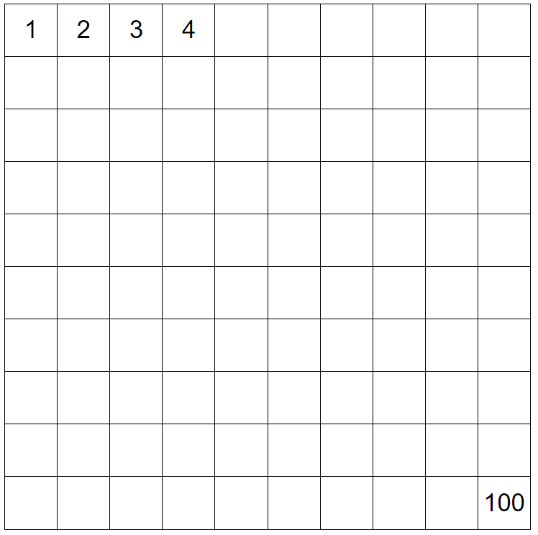
Checkpoint 17: Hidden numbers
Here is a 100 grid with most of the numbers hidden. Ben has shaded the multiples of 10.
Carla says she has shaded the multiples of nine. Is she correct? Why or why not?
How could Carla describe her numbers?
Dorian says he has used the same rule as Carla to colour in his squares. Do you agree?
Using the same grid, Eva thinks of a rule and shades two columns. What do you know about the rule she has chosen?
Notes:
This slide is animated. Each question will appear separately so you can choose the pace at which to work with your class.
Answers
a) Carla is not correct, as the multiples of nine should be nine apart and these are 10 apart. The multiples of nine form a diagonal line on a 10 by 10 grid.
b) She could describe her numbers as one less than the multiples of 10.
c) Dorian's sequence does not start in the same place as Carla’s. The starting number is 19, so a more accurate way to describe them is nine more than a multiple of 10.
? Eva's rule must have been add five to result in two columns being shaded. We cannot tell what her start number was from the information given.
Suggested questioning
What do you notice about the numbers that Carla has shaded?
How many different ways could Carla describe her numbers?
What is the same/different about the numbers that Dorian has shaded?
List all the numbers in Dorian’s column. What do they have in common?
Things to think about
Checkpoint 17 is another example of using the hundred grid to explore shifts from multiplication tables. Here two misconceptions are tackled: the different ways that different patterns of multiples appear on the grid, and how even a difference of one number in the sequence means there must be a different rule. There are other tasks in this deck that tackle similar misconceptions (see ‘Additional resources’). Consider which is the most accessible for your class or use one of the others to check students’ understanding after teaching.

Slide 49
Checkpoint 17: Guidance
Adaptations | Assessing understanding
Support Give students a hundred grid with all the numbers showing. Ask them to shade the columns that Ben and Carla shaded so they can see the numbers being referred to. Challenge Rules of adding ten result in columns being shaded in the hundred square. Ask students to explore what other addition rules result in complete columns being highlighted. Representations The hundred square is a familiar representation from primary. Students are likely to have explored patterns of multiples in a hundred square. This task hides the numbers so the structure can be made more evident. | Checkpoint 17 looks at a sequence using the representation of a hundred square, focusing on the idea that a set of multiples can be ‘shifted’ up or down. This is a useful understanding for teaching of the nth term. The task does not stray into teaching, but instead works with the understanding that students are likely to have from primary. See how comfortable students are with thinking in this way, to help you gauge how ready they are for this new teaching. Students might have the misconception that, because multiples of 10 all appear in the same column (the 10th column), multiples of nine must also appear in a column. Check if students can articulate that numbers highlighted by Carla can be referred to as one less than the multiples of 10. This will support them make generalisations later. For part c, check that students recognise that, while all the numbers shaded do fit the rule of being one less than multiple of 10, this doesn’t define the sequence, as the starting number is not nine. Later, this will develop into understanding the difference between 10n + 9 and 10n – 1. At this stage check students understand that sequences with the same ‘jump’ but different start numbers are distinct.
Additional resources Key idea 4.1.1.1 from Secondary Mastery Professional Development | NCETM looks at ‘Understanding sequences’ and offers a range of different visualisations and ways to explore sequences and nth term at Key Stage 3. Checkpoint 20 and Additional activity I offer different explorations of the same idea.

Slide 50
Checkpoint 18: Left, right, up, down
1 | 2 | 3 | 4 | 5 | 6 | 7
8 | 9 | 10 | 11 | 12 | 13 | 14
15 | 16 | 17 | 18 | 19 | 20 | 21
22 | 23 | 24 | 25 | 26 | 27 | 28
29 | 30 | 31 | 32 | 33 | 34 | 35
36 | 37 | 38 | 39 | 40 | 41 | 42
43 | 44 | 45 | 46 | 47 | 48 | 49
50 | 51 | 52 | 53 | 54 | 55 | 56
Describe the sequences created if you start at 31 (the green square) and move:
How would the sequences change if you moved the green square to a different place on the grid?
How would the sequences change if the grid was eight squares across, rather than seven?
left
right
up
down.
On a different grid, the red down arrow is placed over 25, 36 and 47. What can you tell about the grid? Where is the green square? Can you create a similar question about another grid?
Notes:
This slide is animated. Each question will appear separately so you can choose the pace at which to work with your class. The arrows are animated to appear in line with the related questions.
Answers
a) Left: decreasing in steps of -1 (for example, 31, 32, 33, 34, 35, 36, 37, 38, 39, 40)
Right: increasing in steps of 1 (for example, 31, 32, 33)
Up: decreasing in steps of -7 (for example, 31, 24, 17, 10, 3. Arguably this could continue to -4, -11 etc).
Down: increasing in steps of 7 (for example, 31, 38, 45, 52. Arguably this could continue to 59, 66, 73 etc).
b) The numbers would change but the horizontal sequences would still continue in steps of 1 or -1 and the vertical sequences would still continue in steps of 7 or -7.
c) The horizontal sequences would still continue in steps of 1 or -1 but the vertical sequences would now be in steps of 8 or -8.
? This grid must have a row length of 11. The green square is on 14 (or 3). Students’ answers to the second part of this question will vary, depending on the grid they choose.
Suggested questioning
What is the same/different about each sequence?
Why do the vertical sequences increase/decrease in steps of 7?
How would your sequences change if __ changes?
Things to think about
Checkpoint 18 is the first in a series of tasks that uses a number grid with different length rows, in order to generate sequences. All the columns increase by the same amount, so can be seen as ‘shifts’ of the multiples in the end column; this is explored in a fairly open way here. The Checkpoints that follow ask more direct questions to lead into the new teaching of nth term.

Slide 51
Checkpoint 18: Guidance
Adaptations | Assessing understanding
Support Focus just on the up and down arrows, to reduce the number of sequences being discussed while retaining the idea of sequences with the same ‘jump’. For part b, initially specify where the green square has moved to, such as one square to the right. Challenge Here, we consider the vertical and horizontal sequences. Consider the sequences that are made diagonally. Representations Checkpoint 18 is the first in a sequence of tasks that take a familiar representation – the number grid – and manipulate it so that the rows are different lengths. This is a useful representation for exposing the structure of linear sequences, as each column will have the same common difference, and all the columns represent a ‘shift’ of the multiples in the final column. | Listen to how students describe sequences. Do they recognise the need to give a start number, direction and step size? Do they already use any of the terminology you wish to use at Key Stage 3, such as difference? Do they describe the blue and orange arrows (up and left respectively) in terms of subtraction or adding a negative? Those students who are already thinking about the structure of sequences, and their relationship to multiples, might notice quickly that the blue and red arrows (looking up and down respectively) will always be in steps of 7. You could probe their understanding further in part c by asking them if they can generalise about any grid size.
Additional resources Checkpoints 19 and 20, as well as Additional activity I, explore the roots of the nth term using a similar representation. Additional activity H offers a version of this task that explores how the nth term changes, which might be useful once students have experienced some teaching at Key Stage 3. Key idea 4.1.1.1 from Secondary Mastery Professional Development | NCETM looks at ‘Understanding sequences’ and offers a range of different visualisations and ways to explore sequences and nth term at Key Stage 3.

Slide 52
Checkpoint 19: Off the page
1 | 2 | 3 | 4 | 5 | 6
7 | 8 | 9 | 10 | 11 | 12
13 | 14 | 15 | 16 | 17 | 18
19 | 20 | 21 | 22 | 23 | 24
The pattern of numbers in this grid continues off the page.
Which column will contain 60? How do you know?
Which column will contain 119? How do you know?
Ethan says all the numbers in the first (red) column are one more than a multiple of six. Is he correct?
Describe the numbers in the second (yellow) column.
Write down the numbers in the 100th row.
1 | 2 | 3 | 4 | 5
6 | 7 | 8 | 9 | 10
11 | 12 | 13 | 14 | 15
Ethan makes a new, similar pattern. Will any of the numbers be the same columns in this new grid as they were in the original grid?
Notes:
This slide is animated. Each question will appear separately so you can choose the pace at which to work with your class.
Answers
a) The sixth (orange) column contains 60 because all multiples of six are in this column.
b) The fifth (blue) column contains 119 because it is one less than 120 which is a multiple of 6 so in the sixth (orange) column.
c) Ethan is not correct. Nearly all of the numbers are one more than a multiple of 6, but one number does not fit that rule.
d) The numbers in the second (yellow) column can be thought of as 4 less than multiples of 6.
e) The numbers in the 100th row are 595, 596, 597, 598, 599 and 600.
? 5, 35, 65, …. will be in both fifth (blue) columns
4, 34, 64, … will be in both fourth (pink) columns
3, 33, 63, … will be in both third (green) columns
2, 32, 62, … will be in both second (yellow) columns
1, 31, 61, … will be in both first (red) columns
Suggested questioning
Describe what the sixth column (orange) numbers have in common. What about the fifth column (blue) numbers?
What are the numbers in the sixth row? The 10th row?
If I know ___, what else do I know? (For example, if I know the numbers in the final column are all multiples of six, what else do I know?)
Things to think about
Checkpoint 19 looks at whether students are confident with adding on the same amount each term in the context of a less familiar grid. In this case, the grid has six columns so assesses confidence both with the actual multiples of six, and with using informal relationships to describe how the other sequences relate to these multiples.

Slide 53
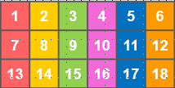
Checkpoint 19: Guidance
Adaptations | Assessing understanding
Support Provide the rectangular grid for students to continue writing the numbers down the page. Once the pattern of numbers has been written, discuss what they notice about sequence of numbers in each of the columns. Challenge This Checkpoint uses a grid of width six. The activity could be extended to widths larger than twelve, so students are reasoning with less familiar multiples. Representations This representation extends from the hundred grid, but also links to work on arrays and area. The 18 shown in the bottom right is the third multiple of six and the area of the rectangle shown as three rows of six: | Asses whether students can work with multiples that cannot be found efficiently by counting on. The number 119 assesses whether students recognise this as a near multiple of six and understand why this is useful in this context. As with Checkpoint 17, part b explores definitions that are true for most but not all values in the sequence. Do students understand why this is not a helpful way to describe these numbers, and can they suggest a better way? When describing the second (yellow) column, students may apply the model used to describe the first (red) column in part b. However, they may use different descriptions such as, They are all odd’. Discuss why that is not a sufficient description: while it is true, that definition would also include a lot of numbers that are not in that column. If students do describe them as odd numbers, also check they can generalise using the rule that adding an even number to an odd number results in another odd number. When considering the 100th row, listen for students’ strategies. Do they find 600 first and then adjust to find the preceding numbers?
Additional resources Checkpoints 18 and 20, as well as Additional activity I, explore the roots of the nth term using a similar representation.

Slide 54
Checkpoint 20: Four columns
1 | 2
This array contains the numbers 1–40 in order but most of them are hidden.
What do you notice about the numbers shaded yellow in the fourth column?
Becky says, ‘The numbers shaded red in the second column are all in the 2 times table.’ Is this a good way to describe them?
Nic says, ‘The numbers shaded blue in the first column are all one more than a multiple of 4.’ Is this a good way to describe them?
Rachel says, ‘The numbers shaded blue in the first column are all 3 less than a multiple of 4.’ Is this a good way to describe them?
Richard says, ‘The numbers shaded blue in the first column are all 5 more than a multiple of 4.’ Is this a good way to describe them?
Describe the numbers shaded purple in the third column. Is there more than one way to do this?
Notes:
This slide is animated. Each question will appear separately so you can choose the pace at which to work with your class.
Answers
a) The numbers are 4, 8, 12, 16, 20, 24 … They are the multiples of 4.
b) While numbers shaded red in the second column are all in the 2 times table, this is not the best way to describe them as the sequence doesn’t contain all even numbers.
c) Yes, the numbers shaded blue in the first column are all 1 more than the multiples of 4.
d) The numbers shaded blue in the first column are 3 less than multiples of 4 but notice that 1 is not highlighted so this is not the best way to describe them.
e) Most of the numbers shaded blue in the first column are 5 more than a multiple of 4, but the first number is not (as 0 is not a multiple of 4) so this is not the best way to describe them.
? The numbers shaded purple in the third column start at 11 and are increasing by 4 each time. Students might find the starting value as seeing it as 3 less than 16, 9 less than 20 or 4 more than 4.
Suggested questioning
What numbers are hidden? How do you know?
What strategies did you use to answer each question?
Where are the even numbers? Odd numbers? How do you know?
Is 0 a multiple of 4?
What can you do to work out the numbers in the __ column?
If I know a number in the __ column, what do I know about the number in the same row but in the __ column?
Things to think about
Checkpoint 20 looks at whether students are confident with adding on the same amount each term in the context of a less familiar grid. In this case, the grid has four columns so assesses confidence both with the actual multiples of four, and with using informal relationships to describe how the other sequences relate to these multiples. Here, the focus is more explicitly on how students describe the columns and ensuring that their sequence ‘rules’ encompass all of the values without including others. For example, Becky’s misconception in part b: the fourth (yellow) column shows multiples of four, but the second (red) column does not show all the multiples of two.

Slide 55
Checkpoint 20: Guidance
Adaptations | Assessing understanding
Support If students struggle to justify what a ‘good’ description means, use stem sentences to support discussions. For example, ‘The numbers highlighted purple could be described as __ more than __, or __ less than __.’ Challenge Ask students to experiment with moving the purple starting point to different places to see how their descriptions would change. Alternatively, the same ideas could be explored for different numbers of columns. Representations As with Checkpoints 18 and 19, this grid representation has been chosen to make the connection, with area and arrays, with multiplication tables. You want to know whether students notice that the multiples of four will all be in the right-hand column and, further, that all of the columns are sequences in steps of four. | Checkpoint 20 continues some themes that have been touched on in previous checkpoints. First, using a grid to make the connection between linear sequences and multiples. In this case, the grid width is four so the comparison is with the four times table. Second, and explored more deeply here, is the idea of a ‘good’ description for a sequence. Do students understand that this description needs to include all values that are in the sequence, and exclude all values that are not? The prompts put forward by Nic, Rachel and Richard enable discussion to assess this. Check whether students know that the first multiple of four is four, and can see that it is useful to anchor ’near multiples’ to this starting point rather than the multiple of four they are closest to when describing sequences. For example, for the purple column, students will more accurately describe the sequence if they relate back to 4 than 12, which is the nearest multiple to the first purple square. This is a useful point to clarify before future teaching on position-to-term rules.
Additional resources Checkpoint 17 and Additional activity I offer different explorations of the same idea. The middle questions on page 7 of Primary Assessment Materials | NCETM explore the same idea, but without a visual representation.

Slide 56
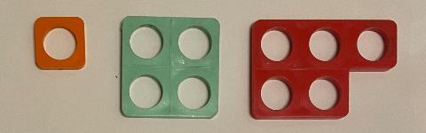
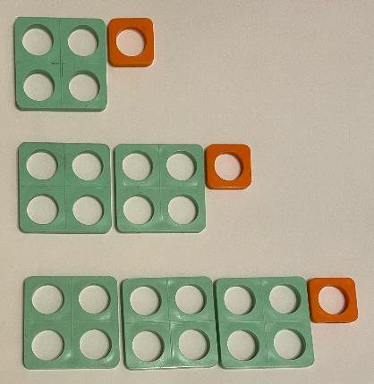
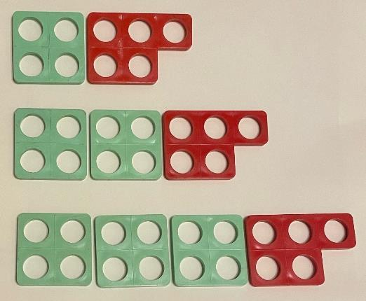
Checkpoint 21: More holes
David and Sally are building sequences out of these tiles.
They each choose two different types of tile.
David’s sequence:
Sally’s sequence:
Describe how David has created his sequence.
Describe how Sally has created her sequence.
The sequences are both continued.
If there are 41 holes, how many of each colour tile could there be?
If there are 41 green tiles, how many holes could there be?
There are only 19 green tiles available in total for both David and Sally to each make one of their patterns. Can they both make a pattern with the same number of holes?
Notes:
This slide is animated. Each term in each sequence and then each question will appear separately so you can choose the pace at which to work with your class.
Answers
a) David starts with a green tile and an orange tile and adds one green tile each time.
b) Sally starts with a green tile and a red tile and adds one green tile each time.
c) If there are 41 holes – David would have ten green tiles and one orange tile; Sally would have nine green tiles and one red tile.
d) If there are 41 green tiles – David would have (4 x 41 + 1) = 165 holes; Sally would have (4 x 41 + 5) = 169 holes.
? Yes; Sally could use nine (plus one red tile) and David 10 (plus one orange tile).
Suggested questioning
What is the same/different about the two sequences?
Are there ever five holes in Sally’s sequence?
Are there ever 17 holes in David’s sequence?
Things to think about
The number tile has been used throughout this deck to explore the structure of a sequence. This task possibly takes the closest step towards the nth term, although at this stage we are still only expecting an informal description of the relationships. Key here is that the number of green tiles represents the pattern number (or position) and the total number of holes form the terms of the sequence itself. You could suggest students use a tabular approach to record their thinking.

Slide 57
Checkpoint 21: Guidance
Adaptations | Assessing understanding
Support Use physical number frames for students to build the patterns before looking at the questions. This is particularly important for any students with red/green visual impairment who might find the images on the slide less accessible. Students could use a grid to record the values in each term, to help them compare. Challenge Challenge students to use the number frames to make different linear sequences that have the same number pattern as Sally (9, 13, 17 …) but look different. Representations Students are likely to be familiar with number frames from primary school. Using them here in the context of sequences can be valuable for revealing mathematical structures at secondary level for all students (see ‘support’ above). | This task explores whether students recognise that sequences with the same ‘jump’ but a different starting number are distinct. In this case, although in both cases you add a green (4) tile, the starting point is different due to the difference between a constant orange (1) tile in David’s sequence and red (5) tile in Sally’s. Students have explored similar ideas in Checkpoints 15 (with no representation) and 20 (using the four-column grid), but the number frames may make this distinction more visibly evident. Ask supporting questions, such as, ‘What is the same and what is different?’ to tease out this structure. Do students recognise that the number of green tiles corresponds to the position in the pattern? Those that do are likely to be more ready for teaching on nth term than those that do not. Spend more time on describing and building sequences according to their position before formally introducing position-to-term rules. Listen for the strategies and approaches that students are using to 'undo' the problem to get from the number of holes back to the tiles that were used to make the pattern.
Additional resources Checkpoint 13 or Additional activity E could be used as a precursor to this. The middle questions on page 7 of Primary Assessment Materials | NCETM explore the same idea, but without a visual representation.

Slide 58
Checkpoint 22: Dice games
Two students are playing a game. They each write an algebraic expression.
Cain writes 4n + 3.
Steph writes 5n – 2.
They roll a ten-sided die (labelled 0 to 9) and use the score on the die to be the number, n, in their expression.
The winner is the person whose expression has the highest value.
If the number on the die is 2, who wins?
If the number on the die is 9, who wins?
Is it possible for Cain and Steph to draw?
Who would you most expect to win? Explain why.
Notes:
This slide is animated. Parts of the rubric and then each question will appear separately so you can choose the pace at which to work with your class.
Answers
a) Cain scores 11 and Steph scores 8 so Cain wins.
b) Cain scores 39 and Steph scores 43 so Steph wins.
c) When n = 5 both players score 23 to draw.
? Students might list the possible outcomes on a ten-sided die labelled from 0 to 9 (shown below, with the winning score for each number shown in bold).
Cain’s scores: 3, 7, 11, 15, 19, 23, 27, 31, 35, 39
Steph’s scores: –2, 3, 8, 13, 18, 23, 28, 33, 38, 43
You would therefore expect Cain to win more games (five) than Steph (four).
Suggested questioning
What is the same/different about their expressions?
Steph multiplies her number by more than Cain multiplies his: does this mean she will always win? Why or why not?
How will you write your workings?
Things to think about
The majority of the tasks in this deck have focused on continuing, describing and exploring the structure of sequences. Checkpoint 22 focuses on a different but nonetheless important skill: substituting values into expressions. Students might notice the connection to sequences if they write out the possible scores for the further thinking question: they will generate the first 10 terms of a sequence with each person’s expression as the nth term.

Slide 59
Checkpoint 22: Guidance
Adaptations | Assessing understanding
Support Use dice to model playing the game with a pair of students. Use a table to capture the outcomes to help in identifying some of the structure of the rule, but take care that this does not become a formulaic strategy as students move to working more formally with the nth term rule for linear sequences. Challenge Add a third player into the game – is there a rule they could use which would mean that they always win? Or that they never win? Suggest that students swap the positions of the numbers in Cain’s rule so that 4n + 3 becomes 3n + 4. What difference does this make to Cain’s chance of winning? How about if Steph does the same? Representations Tabulating results can offer useful insight into the structure of the task. Some students may be comfortable in converting a table of values into a graph. This representation might offer insight, in part c, and also in identifying who is likely to win most often. | See whether students can substitute into simple expressions. It is unlikely that they will not have met substitution as a topic, and they will almost certainly have used formulae (for example, in the context of area). This task gives insight into students’ understanding and fluency with expressions of the form an + b. Use part c to check students’ understanding of the expressions. Those who make the two expressions equal are likely to show a deeper understanding than others who tackle this part of the task through trial and improvement strategies. The further thinking question asks students to think about who is most likely to win. Formal probability will not have been covered at primary school; instead we are exploring how students reason with this situation. They might, for example, realise they can list what each person will score for each possible number on the dice and count how many times each person wins.
Additional resources For more exploration of substitution, use the Checkpoints | NCETM deck on Expressions and equations.

Slide 60
Additional activities
Activities A–I

Slide 61

Activity A: Same jump
In each number line, fill in the missing values.
1
5
9
17
29
a)
0
0.9
1.8
2.1
b)
-1
3
11
27
c)
22
28
34
d)
$$\frac{4}{3}$$
2
e)
Create your own sequence using the same jump each time. What is the minimum information you need to give?
Notes:
This slide is animated. Each question will appear separately so you can choose the pace at which to work with your class. A printable version can be found on slide 76.
Answers
For each sequence, the full sequence is shown below. Missing numbers are in bold.
a) 1, 5, 9, 13, 17, 21, 25, 29
b) 0, 0.3, 0.6, 0.9, 1.2, 1.5, 1.8, 2.1
c) -1, 3, 7, 11, 15, 19, 23, 27
d) -8, -2, 4, 10, 16, 22, 28, 34
e) $\frac{2}{3}$, $\frac{4}{3}$, 2, $\frac{8}{3}$, $\frac{10}{3}$, 4, $\frac{14}{3}$, $\frac{16}{3}$
? Students’ answers may vary. As long as they give two numbers and they know that they are equal steps, then the rest of the sequence can be generated.
Suggested questioning
Where did you start to find the missing numbers?
Did you use the same strategy in all parts of the question?
Things to think about
Additional activity A is possibly the simplest task in this deck. It uses a similar representation to Checkpoint 3 but, rather than asking students to reason about which are possible, all of them are possible – students simply need to fill in the missing numbers. Use this task if students find Checkpoint 3 challenging or struggle with identifying missing numbers where the gaps are greater than one (which might also be picked up in Checkpoints 2 or 8 ). Students need to build on similar skills to writing fractions on the number line. It relies on an awareness that they need to split the difference by the number of ‘jumps’ not the number of missing numbers. For example, for part b there are two numbers missing on the arrows from 0.9 to 1.8. This is equivalent to three jumps of the same value.

Slide 62

Activity B: −− −−−· −· ··· · −· −· −−− −·· ·
Morse code is a way of writing messages using dots and dashes.
This is Morse code for the number 1:
Do you have enough information to work out Morse code for the number 2 ? Why or why not?
This is Morse code for the number 2:
What do you think Morse code for 3, 4 and 5 might be?
What do you predict might be Morse code for 6, 7, 8 and 9?
Here is some more Morse code. Use this to check your answers to parts b and c.
How do you think you would signal the number 10 in Morse code? How about 75? 84? 111?
6:
9:
0:
Notes:
This slide is animated. Each question will appear separately so you can choose the pace at which to work with your class. Display the slide in present/slide show mode and use the animations to prevent the answers for each part being revealed ahead of time.
Answers
a) Students may attempt to create a code, but without knowledge of the pattern there is not enough information to be sure.
b) Students may now be able to identify 3 as …--, 4 as ….- and 5 as …..
c) There is not really enough information, but students may try to create other logical combinations of dots and dashes that build sequentially. Ask students to explain the reasoning behind their sequences – check that they have a rule that leads from one number to the next.
? 6 is -…., 7 is --…, 8 is ---.., 9 is ----.
Morse code uses the same place-value system as written digits, so 10 is .---- -----, 75 is --… ….., 84 is ---.. …-- and 111 is .---- .---- .----
Suggested questioning
What do you know about the pattern already? Is this enough information to predict the next code?
What is the same/different about patterns __ and __?
Things to think about
This activity offers a different perspective on sequences. Rather than an infinite sequence, there are only ten different terms – in fact, arguably, the ten digits are built from two different sequences of five. The intention is to offer a new context for students to work with a pattern-forming rule, and particularly to consider when they have enough information to generate a sequence. There is a link to place value in the further thinking question.

Slide 63
Activity B: −− −−−· −· ··· · −· −· −−− −·· · (solutions for parts b and c)
1
2
3
4
5
6
7
8
9
0
Here is some more Morse code. Use this to check your answers to parts b and c.
How do you think you would signal the number 10? How about 75? 84? 111?

Slide 64
Activity C: Twos
Here are four sequences, all linked to the number two.
A: 2, 4, 6, 8, 10, …
Sufyan says, ‘I think 6, 4, 2, 0, -2, ... is the odd sequence out because it is the only one that will have negative numbers.’
Do you agree?
Can you think of a reason why each of the sequences could be described as the ‘odd one out’?
B: 11, 9, 7, 5, 3, …
C: 2, 4, 8, 16, 32, …
D: 6, 4, 2, 0, -2, …​
Can you design your own sequence with equal steps? How many terms do you need to reveal for someone to be able to continue the pattern?
Notes:
This slide is animated. Each sequence and then each question will appear separately so you can choose the pace at which to work with your class.
Answers
a) No. Although it is the only sequence that has a negative number in the first five terms, sequence B will also contain negatives.
b) Students’ answers may vary. Suggested answers include:
A: This is the only sequence that includes all of the multiples of 2.
B: This is the only sequence with odd numbers.
C: This is the only sequence not to increase with equal steps.
D: This is the only sequence to contain 0.
? Students will need to recognise that, if you know the rule is additive, only two terms are needed to define it. If that information isn't given, then a starting sequence of 2, 4 isn't enough, for example.
Suggested questioning
What is the same/different about the first and the second sequence?
What is the same/different between the first and the third sequence?
What is the same/different between the first and the fourth sequence?
What number will come next in each sequence? How do you know?
How could you describe each sequence?
Things to think about
Like Checkpoint 9, Activity C explores a set of sequences and rather than asking them to continue or describe the sequences, asks them to reason about their structure. The ‘odd one out’ format is a useful way to elicit students’ thinking. A particular misconception, around the infinite nature of sequences, is checked in part a. Students are then given an opportunity to be more creative in their thinking and to generalise about the sequences given. For example, can students recognise and describe that the third sequence is different from the rest because the term-to-term rule is not an additive relationship, it is multiplicative (i.e. a geometric sequence)? Students will not be familiar with the terms arithmetic, linear or geometric but should spot that sequences A, B and D increase/decrease by the same amount each time, but that sequence C does not.

Slide 65
Activity D: Bigger and bigger
A: 1, 3, 6, 10 …
B: 1, 4, 9, 16 …
C: 1, 8, 27, 64 …
D: 1, 1, 2, 3, 5, 8 …
E: 1, 2, 4, 8 …
F: 1, 10, 100, 1000 …
These sequences get bigger and bigger.
Do you recognise any of the sequences?
Which sequence gets bigger the quickest? Which gets bigger the slowest?
Which sequence would:
  get you closest to 100 after five terms
  get you closest to 100 after eight terms
  be greater than 1000 after 10 terms
  be greater than 1000 after 20 terms?
Which sequence would have an odd 100th term? Which would have odd 100th and 101st terms?
Notes:
This slide is animated. Each question will appear separately so you can choose the pace at which to work with your class.
Answers
a) Students’ answers may vary, and they may not recognise any. They are most likely to recognise B and C as these are the two sequences that remain on the primary curriculum.
A: triangular numbers
B: square numbers
C: cube numbers
D: Fibonacci sequence
E: powers of 2, starting at 1
F: powers of 10, starting at 1
b) The powers of 10 (sequence F) get bigger the quickest. The triangular numbers (sequence A) get bigger the slowest. Students might suggest that the Fibonacci sequence (sequence E) gets bigger the slowest. However, the 10th term for both the triangular numbers and Fibonacci numbers is the same (55) and after this the Fibonacci sequence overtakes the triangular numbers.
c)
Closest to 100 after five terms: C. The eighth term of this sequence is 125; the next closest is the fifth term of B which is 25.
Closest to 100 after eight terms: E. The eighth term of this sequence is 128; the next closest is the eighth term of B which is 64.
Be greater than 1000 after 10 terms: F. C is exactly 1000.
Be greater than 1000 after 20 terms: C, D, E, F.
? Four sequences have odd terms: A, B, C and D. The pattern of odds and evens is:
A: odd, odd, even, even …
B: odd, even, odd, even …
C: odd, even, odd, even …
D: odd, odd, even, odd, odd, even …
So, only A or D could have an odd 100th term. Only D could have odd 100th and 101st terms.
Suggested questioning
How could you describe the rule each time?
Can you put the sequences in order? How did you decide your order?
Does any sequence ‘overtake’ another?
Things to think about
Students are likely to have explored some non-linear sequences at primary school. This may have been either informally, through creating and exploring different sequences, or formally, through their work on square and cube numbers in upper Key Stage 2. There is no expectation that students will know any of these sequences other than B or C, but the task gives them a chance to reason about how sequences grow. You can learn about their reasoning, number sense and how well they can generalise without needing to see more terms of the sequences written out. Of all of the sequences, D (Fibonacci) might need some input to help students interpret it: more terms are given to help students spot the rule.

Slide 66
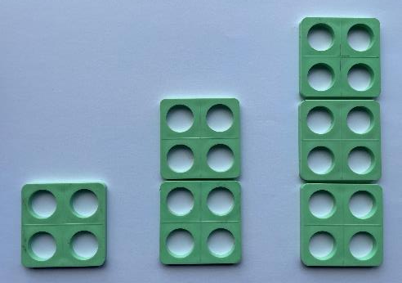
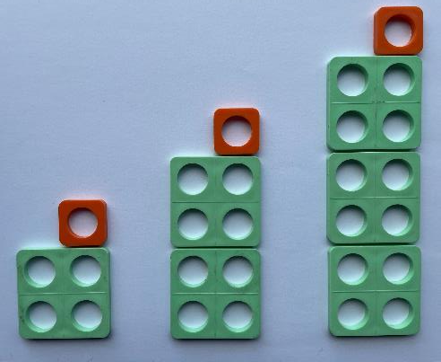
Activity E: Number tiles
Here is a sequence made using number tiles.
Describe what you see.
Describe what the next pattern in the sequence will look like.
Here is another sequence made using number tiles.
What is the same and what is different from the previous sequence?
Describe what the next pattern in the sequence will look like.
Describe to someone how to make these sequences using number frames. What about the 10th pattern in the sequence?
Notes:
This slide is animated. Each question will appear separately so you can choose the pace at which to work with your class.
Answers
a) The first picture has one tile with four holes, the second picture has two tiles with eight holes and the third picture has three tiles with 12 holes.
b) The next pattern in the sequence will have four tiles and a total of 12 holes.
c) An extra orange tile has been added to the top of each pattern which will increase the number of holes by one.
d) The next pattern will have four green tiles and one orange tile on top with a total of 17 holes.
? The 10th pattern in the sequence would need 10 green tiles or 10 green and one orange.
Suggested questioning
If you had to draw the sequence which part would you draw first? Why?
Can you describe the sequence using words? How about a calculation?
Things to think about
Activity E is very similar to Checkpoint 13, but offers a more open structure. Use this if your students respond well to more open discussion tasks, or if your focus is more on checking how students describe sequences than on how they predict them. Check students understand term-to-term rules without using the formal language, which hasn’t been taught at primary school. See if they can begin to think in a more positional way. As nth term is new learning at Key Stage 3, we are not looking for answers that describe the sequences in this way. You might revisit the task after teaching nth term to check how their answers have developed. Note that, as with Checkpoint 13, it may be helpful to use physical number frames for students to build the patterns before looking at the questions. This is particularly important for any students with red/green visual impairment who might find the images on the slide less accessible.

Slide 67
Activity F: School dinners
In a school dining hall, six chairs fit around one rectangular table.
Below are two ways, A and B, to arrange some tables.
To work out how many chairs she needs, the caretaker multiplies the number of tables by six. Which arrangement does she intend to use?
How could she work out the number of chairs for the other arrangement?
A
B
What other ways can you arrange the four tables?
Can you create an arrangement that uses eight tables and 36 chairs?
Notes:
This slide is animated. Each question will appear separately so you can choose the pace at which to work with your class.
Answers
a) The chairs for arrangement A can be found my multiplying the number of tables by six.
b) For arrangement B, she can work out the number of chairs by multiplying the number of tables by four and adding two for the chairs at either end.
? There are multiple other arrangements – see Checkpoint 12 for some examples. An example of an arrangement that uses eight tables and 36 chairs would be two rows of four tables, each row connected as in arrangement B.
Suggested questioning
How did you work out the number of chairs?
Which arrangement gives you the most chairs? Which gives you the least?
Does one more table always mean six more chairs? Why or why not?
Which arrangement gives the most/fewest chairs per extra table?
Things to think about
Activity F offers the same context as Checkpoint 12, but with a different focus for exploration. Here, the emphasis is on how the number of chairs is generated, and how this links to multiplication/addition. In A, it is a straightforward multiplicative relationship; in B there is both multiplication and addition. Focus on how the structure of the image relates to the multiplication/addition, and encourage students to think about what it would look like if there were one more or one fewer table. For example, do students recognise that there is always a ‘constant’ two chairs for arrangement B, but that there are four chairs per table. This task is effective as an assessment of understanding the structure of nth term after some teaching at Key Stage 3.

Slide 68




Activity G: More sequence jumble
Kayla creates a sequence of numbers using equal steps.
She writes one term per card, but then drops the cards!
$$\frac{3}{4}$$
$$\frac{5}{4}$$
$$2\frac{1}{4}$$
$$\frac{1}{4}$$
Rearrange the sequence with the terms in ascending order.
What might be written on the upside-down cards?
Kayla thinks the number 3 is in the sequence. Is she correct?
What integers will be in the sequence?
Notes:
This slide is animated. Each question will appear separately so you can choose the pace at which to work with your class. A printable resource can be found on slide 77.
Answers
a) $\frac{1}{4}$, $\frac{3}{4}$, $\frac{5}{4}$, $2\frac{1}{4}$,
b) One upside down card must say $1\frac{3}{4}$ or $\frac{7}{4}$, in order for the sequence to be going up in equal steps of $\frac{2}{4}$. The other card could say $−\frac{1}{4}$or $2\frac{3}{4}.$
? No, Kayla is not correct. There are no integers in this sequence as, although it is going up in equal steps of $\frac{2}{4}$, it started on $\frac{1}{4}$(or $−\frac{1}{4}$).
Suggested questioning
What is the biggest/smallest term shown? How do you know?
Is __ bigger or smaller than __? How do you know?
Where might the missing cards go in the sequence?
Is there another way to write each number? How might writing the numbers a different way help?
Things to think about
The examples of sequences offered at Key Stage 3 tend to focus on integers. However, in order to build understanding of the nth term, at primary school students will have continued patterns using integers, decimals and fractions. This is likely to have started as early as Year 3, when tenths are first introduced. However, fractions are also an area of mathematics that can cause some difficulty. Activity G offers checks which students are confident with common differences with fractions, using a slightly more straightforward common difference than its counterpart, Checkpoint 10. See the Guidance slide for Checkpoint 10 for more information.

Slide 69
Activity H: Left, right, up, down again
1 | 2 | 3 | 4 | 5 | 6 | 7
8 | 9 | 10 | 11 | 12 | 13 | 14
15 | 16 | 17 | 18 | 19 | 20 | 21
22 | 23 | 24 | 25 | 26 | 27 | 28
29 | 30 | 31 | 32 | 33 | 34 | 35
36 | 37 | 38 | 39 | 40 | 41 | 42
43 | 44 | 45 | 46 | 47 | 48 | 49
50 | 51 | 52 | 53 | 54 | 55 | 56
What are the nth terms of the sequences that are created if you start at 31 (the green square) and move:
How would the nth terms change as the green square moves around the grid?
How would the nth terms change as the grid changes?
left
right
up
down.
On a new grid, the sequence for the red arrow is 13n + 60. What are the nth terms for the other arrows?
Notes:
This slide is animated. Each question will appear separately so you can choose the pace at which to work with your class. The arrows are animated to appear in line with the related questions.
Answers
a) Left: 32 – n
Right: 30 + n
Up: 7n + 24
Down: 38 – 7n
b) The coefficient of n would remain the same, but the constant would change:
left: one more than the green square
right: one less than the green square
up: seven less than the green square
down: seven more than the green square.
c)
? This grid must have a row length of 13. The green square is on 57. The other nth terms are:
Left (orange arrow): 61 – n
Right (yellow arrow): 59 + n
Down (blue arrow): 73 – 13n
Suggested questioning
What is the same/different about each sequence?
Why do the vertical sequences increase/decrease in steps of seven?
Which part of the nth term rule is affected by the grid size? Which part is affected by the position of the green square?
Things to think about
Additional activity H is almost identical in structure to Checkpoint 18, but is designed for use after some Key Stage 3 teaching as the questions ask about the nth term. Unlike the rest of the activities in this deck, it is therefore primarily intended as a task to support teaching rather than assessment of prior learning. See the Guidance for Checkpoint 18 for more information about the task, but consider what additional learning students will bring to the task after they you have explored the nth term. Here, the vertical and horizontal sequences are considered; to extend the activity, consider the sequences that are made diagonally.

Slide 70
Activity I: Four more columns
Nia’s array
Alex’s array
This array contains the numbers 1 to 40 in order but most of them are hidden.
Nia shades two columns of her array.
What do you know about the numbers shaded yellow in the fourth column?
What can you do to work out the numbers shaded red in the second column?
Alex shades his columns a bit differently.
Is your answer to part b the same or different?
1 | 2
1 | 2
Create a similar arrangement of cells on a grid that has six columns. How would your answers change?
Notes:
This slide is animated. Each question will appear separately so you can choose the pace at which to work with your class.
Answers
a) They are all multiples of 4.
b) Subtract 2 from each of the shaded yellow numbers to give 2, 6, 10, 14, 18, 22, 26, ….
c) It is different: the first one shaded is 2 more than 4 not 2 less than 4.
? If the cells shaded yellow are the end column again, all of the numbers will be multiples of 6. Depending on the position of the cells shaded red, the numbers can all be described using this structure: ‘__ less/more than a multiple of 6’. For example, if the red cells are the entirety of the second column, the numbers will all be 4 less than a multiple of 6. If the red cells are the second column but starting in the second row, the numbers will all be 2 more than a multiple of 6.
Suggested questioning
What strategies did you use in each case?
Where are the even numbers? Odd numbers? How do you know?
Things to think about
Additional activity I uses the same representation as Checkpoint 20 but focuses on one potential misconception: where all but one term of a sequence are the same, and so the rule is different. This is particularly marked here, as the rules are so similar: one sequence is 2 more than the multiples of 4, and one is 2 less (or, using the nth term: one is 4n + 2 and the other is 4n – 2). Use this task if this understanding is proving to be a persistent problem with students. Or use it later in Key Stage 3 to check understanding of nth terms – in which case, be more explicit about an expectation to respond using the language of nth term. The Guidance slides for Checkpoints 17, 20 and 21 might be useful to reference before using this task.

Slide 71
Printable resources

Slide 72

1
5
13
21
a)
0.1
0.3
b)
28
16
4
c)
0
0.3
0.9
d)
2
$$\frac{4}{3}$$
e)
Notes:
This printable, editable resource might be useful for Checkpoint 3.

Slide 73
This puzzle is made from sequences where the same number is added or subtracted each time. Each sequence across or down has a different rule.
Complete the puzzle and fill in the gaps to complete the rule for each sequence.
A
C
Across
  B: Start at __ and + 3 each time
  E: Start at 23 and ___ each time
  F: Start at __ and ___ each time
Down
  A: Start at __ and ___ each time
  C: Start at __ and ___ each time
  D: Start at __ and ___ each time
B
5
8
D
23
E
41
F
48
Continue sequences C and D down. Could you add in another clue ‘across’ to connect them? Will it be the same as F?
Notes:
You might like to give students this printable resource for use with Checkpoint 8.

Slide 74
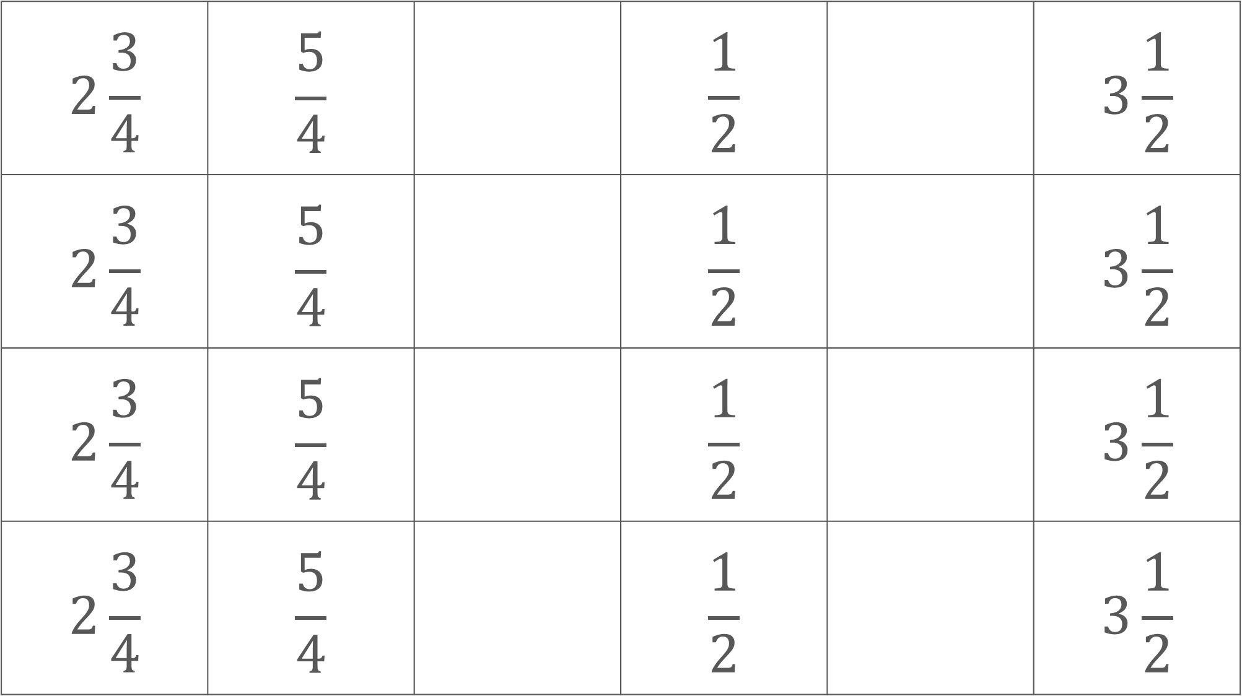
$$2\frac{3}{4}$$ | $$\frac{5}{4}$$ |  | $$\frac{1}{2}$$ |  | $$3\frac{1}{2}$$
$$2\frac{3}{4}$$ | $$\frac{5}{4}$$ |  | $$\frac{1}{2}$$ |  | $$3\frac{1}{2}$$
$$2\frac{3}{4}$$ | $$\frac{5}{4}$$ |  | $$\frac{1}{2}$$ |  | $$3\frac{1}{2}$$
$$2\frac{3}{4}$$ | $$\frac{5}{4}$$ |  | $$\frac{1}{2}$$ |  | $$3\frac{1}{2}$$
Notes:
These printable, editable cards (four on a page) could be used with Checkpoint 10.

Slide 75
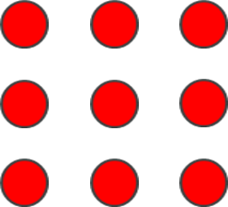
Pattern 1 | Pattern 2 | Pattern 3 | Pattern 4
Pattern 1 | Pattern 2 | Pattern 3 | Pattern 4
Notes:
These grids (2 per page) might be helpful for students to organise their thinking for Checkpoint 11.

Slide 76

1
5
9
17
29
a)
0
0.9
1.8
2.1
b)
-1
3
11
27
c)
22
28
34
d)
$$\frac{4}{3}$$
2
e)
Notes:
This printable, editable resource might be of use for Additional activity A.

Slide 77
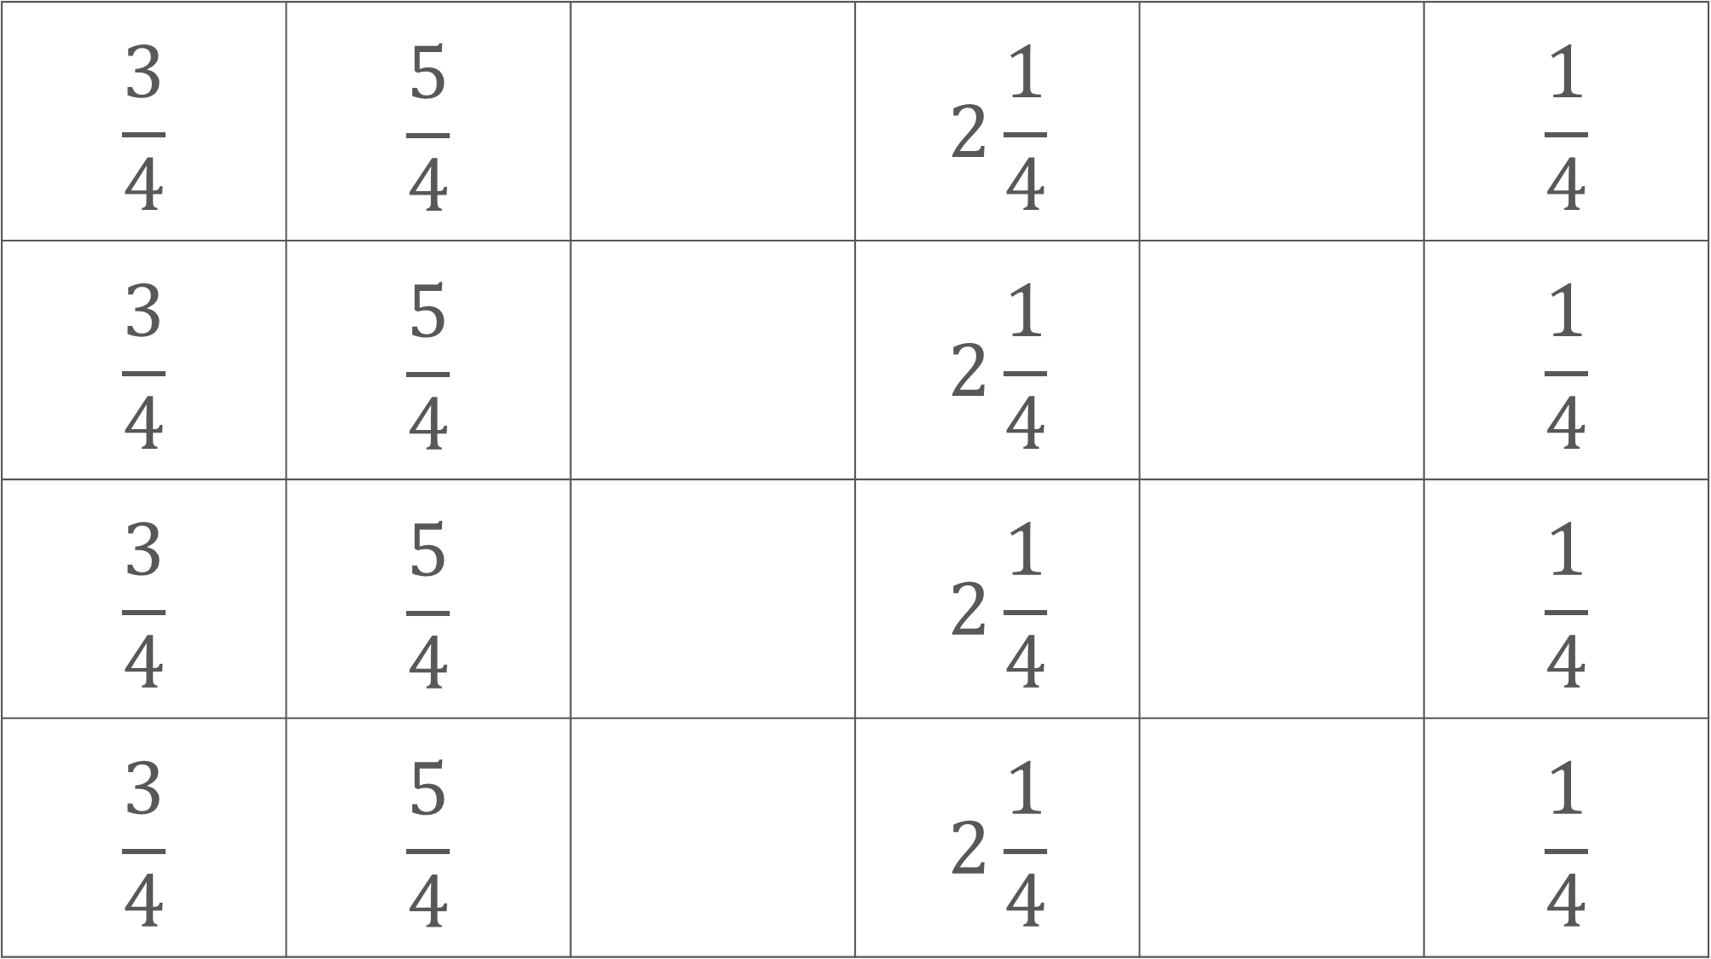
$$\frac{3}{4}$$ | $$\frac{5}{4}$$ |  | $$2\frac{1}{4}$$ |  | $$\frac{1}{4}$$
$$\frac{3}{4}$$ | $$\frac{5}{4}$$ |  | $$2\frac{1}{4}$$ |  | $$\frac{1}{4}$$
$$\frac{3}{4}$$ | $$\frac{5}{4}$$ |  | $$2\frac{1}{4}$$ |  | $$\frac{1}{4}$$
$$\frac{3}{4}$$ | $$\frac{5}{4}$$ |  | $$2\frac{1}{4}$$ |  | $$\frac{1}{4}$$
Notes:
These printable, editable cards (4 on a page) could be used with Additional activity G.

