Slide 1
The area of a circle
KS3 Mastery PD Materials: Exemplified Key Ideas
Materials for use in the classroom or to support professional development discussions
(from 6.2 Perimeter, area and volume)
Summer 2021

Slide 2
About this resource
These slides are designed to complement the 6.2 Area, perimeter and volume Core Concept document and its associated Theme Overview document 6 Geometry, both found in the Secondary Mastery Professional Development pages.
These slides re-present the key examples from the Core Concept document so that the examples can be used either directly in the classroom or with a group of teachers. There are prompt questions alongside the examples, and further clarification in the notes.
These slides do not fully replicate the Core Concept document, so should be used alongside it. Reference to specific page numbers, and to other useful NCETM resources, can be found in the notes for each slide.
This slide deck is not designed to be a complete PD session, rather it is a selection of resources that you can adapt and use as needed when planning a session with a group of teachers.

Slide 3


About this resource
The slides are structured as follows:
  The big picture:
    Where does this fit in?
    What do students need to understand?
    Why is this key idea important?
  Prior learning
  Misconceptions
  Exemplified key ideas
  Reflection questions
  Appendices:
    Key vocabulary
    Representations and structure
    Previous and Future learning
    Useful links
The exemplified key idea slides have the following symbols to indicate how they have been designed to be used:
Into the classroom
The examples are presented on these slides so that they could be used in PD, but also directly in the classroom. The notes feature suggested questions and things teachers might consider when using with students.
PD discussion prompts
These slides look at the examples in more detail, with question prompts to promote discussion among maths teachers. The notes feature reference to further information and guidance within the Core Concepts document.

Slide 4
Where does this fit in?
The NCETM has identified a set of six ‘mathematical themes’ within Key Stage 3 mathematics that bring together a group of ‘core concepts’.
The sixth of these themes is Geometry, which covers the following interconnected core concepts:
6.1 Geometrical properties
6.2 Perimeter, area and volume
6.3 Transforming shapes
6.4 Constructions
Notes:
Linked on this slide is the Theme Overview document of Geometry. This document includes why it is important, the key underpinning knowledge and links to prior and future learning. There is also guidance about how the five big ideas of Teaching for Mastery relate specifically to this theme.

Slide 5
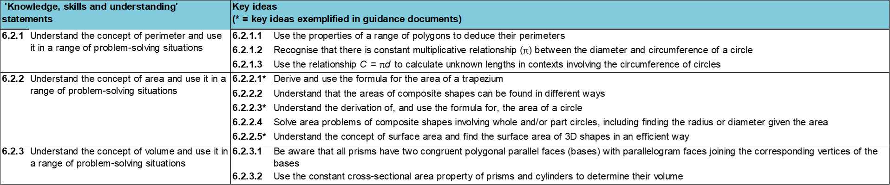
Where does this fit in?
Within this core concept, 6.2 Perimeter, area and volume, there are three statements of knowledge, skills and understanding.
These, in turn, are broken down into ten key ideas. The highlighted key idea is exemplified in this slide deck.
Notes:
For key ideas marked with an asterisk, we exemplified the common difficulties and misconceptions that students might have and included elements of what teaching for mastery may look like. We have provided examples of possible student tasks and teaching approaches.
Within these slides are ‘classroom-ready’ versions of the examples for the key idea that has been highlighted. There are also slides that may be useful for discussion in a professional development session

Slide 6
What do students need to understand?
6.2.2.3 Understand the derivation of, and use the formula for, the area of a circle
Understand the approximate relationship between the area of a circle and the square of its radius.
Appreciate that the formula for the area of a circle can be derived from prior knowledge.
Calculate the area of a circle and appreciate the effect of taking different values of 𝜋 .
Solve problems involving calculating the area of a circle in context.
  What prior knowledge might your students already have?
  What language might they use to describe this key idea?
  What questions might you want to ask to assess their prior learning?

Slide 7
Why is this key idea important?
Geometrical thinking is a fundamental and often intuitive and accessible way to engage students in mathematical activity.
The study of geometry helps to develop students’ spatial awareness, intuition and visualisation and can help them gain insights and hence solve many types of problems.
There are many applications of geometry relevant to employment and everyday life. Other subjects in the curriculum, such as science and technology, also make use of geometrical ideas and techniques.
Geometry is an important area of the curriculum where students can engage in making conjectures, using logical chains of reasoning and mathematical proof.
Notes:
A more detailed overview of the core concept of Perimeter, area and volume can be found on page 2 of the 6.2 Core Concept document.
The background to each key idea is also explored in more detail on the following pages:
6.2.1 Understand the concept of perimeter and use it in a range of problem-solving situations – pages 9 and 10
6.2.2 Understand the concept of area and use it in a range of problem-solving situations – page 11
6.2.3 Understand the concept of volume and use it in a range of problem-solving situations – pages 12 and 13

Slide 8
Prior learning
Upper Key Stage 2 Learning Outcome
Find the area of rectilinear shapes by counting squares
Calculate and compare the area of rectangles (including squares), and including using standard units, square centimetres (cm²) and square metres (m²) and estimate the area of irregular shapes
Recognise when it is possible to use formulae for area and volume of shapes
Calculate the area of parallelograms and triangles
  What prior knowledge might your students already have?
  What language might they use to describe this key idea?
  What questions might you want to ask to assess their prior learning?
Notes:
You may find it useful to speak to your partner schools to see how the above has been covered and the language used.
You can find further details regarding prior learning in the following segments of the NCETM primary mastery professional development materials (linked on final slide):
Year 4: 2.16 Multiplicative contexts: area and perimeter 1
Year 6: 2.30 Multiplicative contexts: area and perimeter 2
Within the Geometry Theme Overview document, you can also find a broader description of students’ potential previous learning (page 4), alongside further information about key underpinning knowledge (page 2).

Slide 9
Checking prior learning
The following slides contain questions for checking prior learning.
  What representations might students use to support their understanding of these questions?
  What variation might you put in place for these questions to fully assess students’ understanding of the concept?
  How might changing the language of each question change the difficulty?
  Why are these such crucial pre-requisites for this key idea?

Slide 10
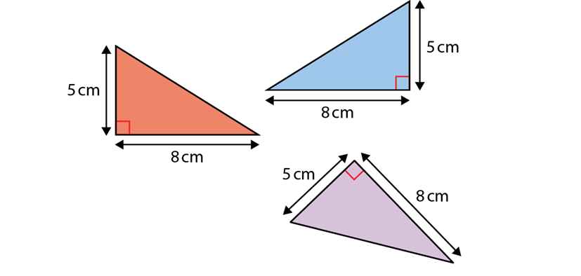
Checking prior learning (1)
Which of these right-angled triangles have an area of 20 cm²?
Notes:
References to the questions (links on final slide):
NCETM primary assessment materials: Year 6, page 32

Slide 11
Checking prior learning (2)
b)
Captain Conjecture says ‘The diameter of a circle is twice the length of its radius.’
Do you agree? Explain your answer.
Captain Conjecture says, ‘All circles with a radius of 4cm have circumferences that are the same length.’
Do you agree? Explain your answer
c)
The diameter of a golf ball is 4cm.
I want to make a box which will hold six golf balls.
What size could my box be?
Is there more than one answer?
Notes:
References to the questions (links on final slide):
b) NCETM primary assessment materials: Year 6, page 36
c) NCETM primary assessment materials: Year 6, page 32

Slide 12
Common difficulties and misconceptions
What aspects of this key idea might pupils find challenging?
What misconceptions might pupils have?
When teaching this topic, you may find students encounter difficulties with…
Confusing the definitions / formulae for area and perimeter
Finding the area of a shape with no straight sides
More information, and some suggestions for overcoming these challenges, can be found on the following slides

Slide 13
Common difficulties and misconceptions (1)
If the concept of the area of a circle is introduced at the same time as the circumference of a circle, then some students may confuse the definitions and/or formulae.
This can be avoided by introducing the circumference of a circle when thinking about perimeter alongside other shapes, and the area of a circle when considering area in general.
Notes:
More detail can be found on page 18 of the 6.2 Core Concept document.

Slide 14
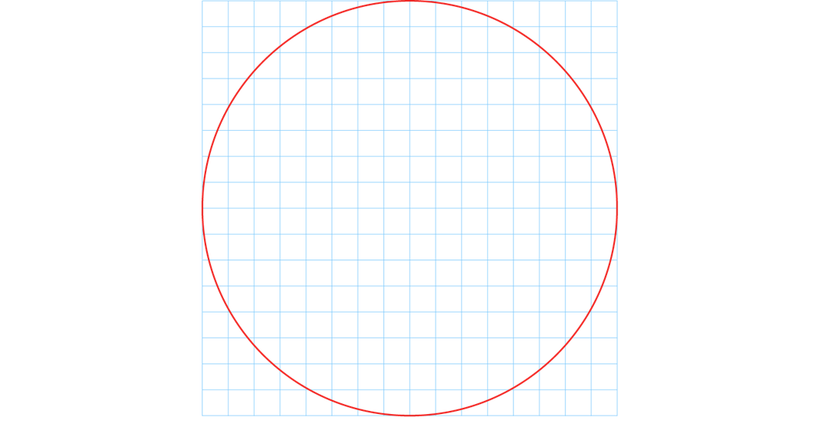
Common difficulties and misconceptions (2)
Students may have difficulty finding the area of a shape with no straight sides, since the areas of other shapes considered previously (such as parallelograms, triangles and trapezia) were all derived from the area of a rectangle and so involved multiplying two dimensions together.
Asking students questions, such as, ‘How can we find the area, measured in cm² (square centimetres) of something that is circular?’ could help students appreciate this apparent conundrum and begin to think about the problem of finding the area of a circle:
Notes:
More detail can be found on page 18 of the 6.2 Core Concept document.

Slide 15
Understand the approximate relationship between the area of a circle and the square of its radius
Example 1a
Close your eyes. Imagine a circle with a radius of r sitting inside a square. Grow the circle until it is the biggest it can be but still fitting inside the square.
  Now open your eyes and draw what you have imagined.
  Share your diagram with your desk partner and try to agree between you:
  What is the area of the square?
  What can you say about the area of the circle?
Notes:
Suggested questioning:
What is the same / different about your diagram and your partners?
Things for you to think about:
A visualisation exercise, such as the one offered in Example 1, encourages students to begin with their own mental image and, through discussion with desk partners, the teacher and the whole class, use this to get a sense of the area of a circle as some proportion of r².

Slide 16
Understand the approximate relationship between the area of a circle and the square of its radius
Example 1b,c
Now imagine a square inside the circle; grow it until it’s as large as possible whilst remaining inside the circle.
  Share your diagram with your desk partner and try to agree between you:
  What is the area of the square?
  What can you say about the area of the circle?
What would happen if you started with a larger circle? Or a smaller circle?
Notes:
Suggested questioning:
What is the same / different about your diagram and your partner’s?
Things for you to think about:
In part c), it is important for students to realise that whatever size the circle is, it will always be the same proportion of the square and, therefore, there exists a constant multiplier that can be used with r² to find the area of a circle.

Slide 17
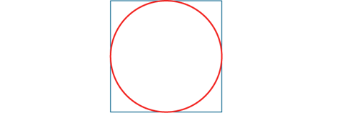

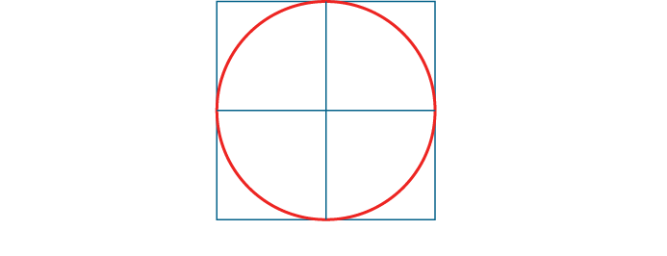

Understand the approximate relationship between the area of a circle and the square of its radius
Example 1
Close your eyes. Imagine a circle with a radius of r sitting inside a square. Grow the circle until it is the biggest it can be but still fitting inside the square.
  Now open your eyes and draw what you have imagined.
  Share your diagram with your desk partner and try to agree between you:
  What is the area of the square?
  What can you say about the area of the circle?
Now imagine a square inside the circle; grow it until it’s as large as possible whilst remaining inside the circle.
  Share your diagram with your desk partner and try to agree between you:
  What is the area of the square?
  What can you say about the area of the circle?
What would happen if you started with a larger circle? Or a smaller circle?
  What are the pros and cons of asking students to construct their own mental image of a situation first, before offering them an image yourself?
  In what other areas of the curriculum might such a strategy be useful?
Notes:
Due to space constraints, the image on this PD discussion slide is very small. PD Leads might like to use or print the ‘in the classroom’ version of this slide for teachers to access during discussions.
More detail about the sequencing of this example can be found on page 19 and 20 of the 6.2 Core Concept document.

Slide 18
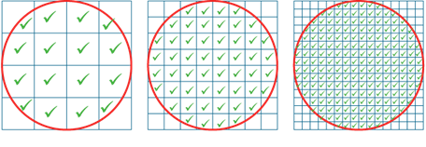
Understand the approximate relationship between the area of a circle and the square of its radius
Example 1
Close your eyes. Imagine a circle with a radius of r sitting inside a square. Grow the circle until it is the biggest it can be but still fitting inside the square.
  Now open your eyes and draw what you have imagined.
  Share your diagram with your desk partner and try to agree between you:
  What is the area of the square?
  What can you say about the area of the circle?
Now imagine a square inside the circle; grow it until it’s as large as possible whilst remaining inside the circle.
  Share your diagram with your desk partner and try to agree between you:
  What is the area of the square?
  What can you say about the area of the circle?
What would happen if you started with a larger circle? Or a smaller circle?
  What could you ask students to derive from the diagrams shown below?
Notes:
Due to space constraints, the image on this PD discussion slide is very small. PD Leads might like to use or print the ‘in the classroom’ version of this slide for teachers to access during discussions.
More detail about the sequencing of this example can be found on pages 19 and 20 of the 6.2 Core Concept document.

Slide 19
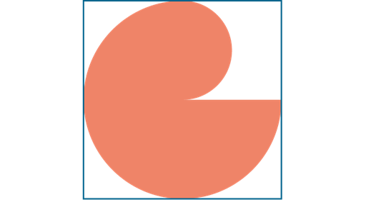
Understand the approximate relationship between the area of a circle and the square of its radius
Example 2
This shape is cut from a square piece of card measuring 12 cm by 12 cm.
Approximately what area of card remains?
Notes:
Suggested questioning:
How would you draw this shape?
What shapes can you see? What do you know about the dimensions?
Things for you to think about:
Students could be asked to tackle Example 2 by using one of the approximations obtained from the previous example, i.e. A ≈ 3r² or A ≈ 3 ¼r²
Students could be encouraged to accept the fact that they are not sure what this value is and, therefore, use A = kr² (where k is some constant).

Slide 20

Understand the approximate relationship between the area of a circle and the square of its radius
Example 2
This shape is cut from a square piece of card measuring 12 cm by 12 cm.
Approximately what area of card remains?
  When do you expect students to use an approximation for 𝜋 ?
  What approximations do you use and when?
  Why is it useful to introduce the idea of using the symbol 𝜋 in calculations and answers?
Notes:
This example can be found on page 21 of the 6.2 Core Concept document.

Slide 21
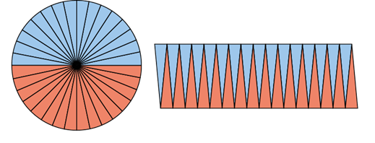
Appreciate that the formula for the area of a circle can be derived from prior knowledge
Example 3
Look at the images.
What do you see?
What do you know about the area of the circle on the left and the area of the shape on the right?
How might you find a good approximation of the area of the shape on the right?
Notes:
Suggested questioning:
Why do you think two colours have been used in the diagram?
What shapes do you recognise?
Things for you to think about:
The key points to draw out in any whole-class discussion about Example 3 are:
that the shape on the right is a pretty good approximation to a rectangle (and that this transformation cleverly turns the problem of finding areas of circles into one of finding areas of rectangles)
that the length of the rectangle which approximates to this shape is half the circumference of the circle
that the height of the rectangle which approximates to this shape is the radius of the circle.

Slide 22
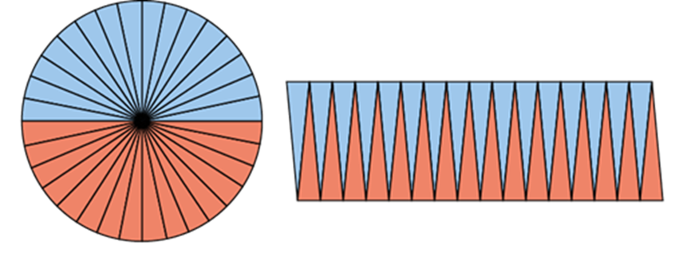
Appreciate that the formula for the area of a circle can be derived from prior knowledge
Example 3
Look at the images below.
What do you see?
What do you know about the area of the circle on the left and the area of the shape on the right?
How might you find a good approximation of the area of the shape on the right?
  How might the use of dynamic geometry software, such as GeoGebra, support the development of this idea?
  What other methods are accessible for students to derive the formula from prior knowledge?
Notes:
Due to space constraints, the image on this PD discussion slide is very small. PD Leads might like to use or print the ‘in the classroom’ version of this slide for teachers to access during discussions.
This example can be found on page 21 of the 6.2 Core Concept document.
2 other methods are presented.
Static images like this are useful; however, one of the key ideas here is thinking of the limit as the size of each sector becomes smaller, the number of sectors increases, and the right-hand diagram approaches a rectangle.

Slide 23
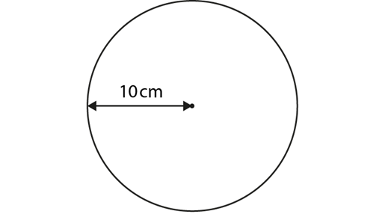
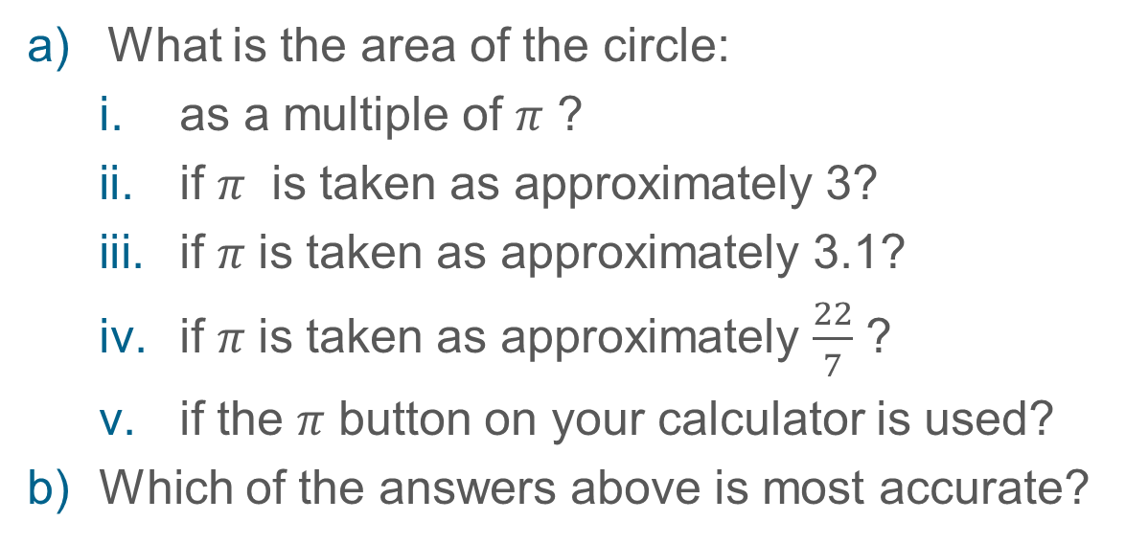
Calculate the area of a circle and appreciate the effect of taking different values of 𝜋
Example 4
What is the area of the circle:
  as a multiple of 𝜋 ?
  if 𝜋 is taken as approximately 3?
  if 𝜋 is taken as approximately 3.1?
  if 𝜋 is taken as approximately $\frac{22}{7}$ ?
  if the 𝜋 button on your calculator is used?
Which of the answers above is most accurate?
Notes:
Suggested questioning:
What is 𝜋 rounded to the nearest whole number?
What is 𝜋 rounded to the nearest one decimal place?
What is 𝜋 rounded to the three significant figures?
When might a rounded answer be sensible? When would the exact answer be needed?
Things for you to think about:
Building a sequence of questions with different required degrees of accuracy can raise some important issues regarding students’ understanding of accuracy and to what extent rounding the final answer is appropriate.
In Example 4, students may say the answer with the most decimal places is the most accurate, whereas the value 100𝜋 is not only the most accurate but also the most convenient. This example should reinforce the idea that any particular number used for 𝜋 will be an approximation and the only precise way of signifying 𝜋 is to use its symbol.

Slide 24


Calculate the area of a circle and appreciate the effect of taking different values of 𝜋
Example 4
What is the area of the circle:
  as a multiple of 𝜋 ?
  if 𝜋 is taken as approximately 3?
  if 𝜋 is taken as approximately 3.1?
  if 𝜋 is taken as approximately $\frac{22}{7}$ ?
  if the 𝜋 button on your calculator is used?
  When do you expect your students to round their answers and when to leave them in terms of 𝜋 ?
  What degree of accuracy do you expect them to use if it doesn’t state in the question?
Which of the answers above is most accurate?
Notes:
Due to space constraints, the image on this PD discussion slide is very small. PD Leads might like to use or print the ‘in the classroom’ version of this slide for teachers to access during discussions.
This example can be found on page 23 of the 6.2 Core Concept document.

Slide 25
Calculate the area of a circle and appreciate the effect of taking different values of 𝜋
Example 5
A circle has an area of 25 𝜋 cm². What is the length of its radius?
A circle has an area of 100 cm². What is the length of its radius?
Notes:
Suggested questioning:
What is the same / different about these two questions?
Things for you to think about:
Example 5 requires students to work with the formula for the area of a circle in reverse.
Part a) is in terms of 𝜋 and a square number, thus the underlying structure is clearer.
Part b) is slightly more complicated, owing to the nature of the numbers involved.

Slide 26
Calculate the area of a circle and appreciate the effect of taking different values of 𝜋
Example 5
A circle has an area of 25 𝜋 cm². What is the length of its radius?
A circle has an area of 100cm². What is the length of its radius?
  What steps do you expect your students to take to solve these questions?
  How do you expect them for formalise their written reasoning?
Notes:
This example can be found on page 24 of the 6.2 Core Concept document.

Slide 27
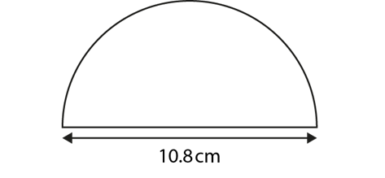
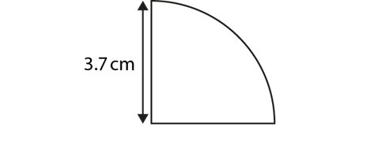
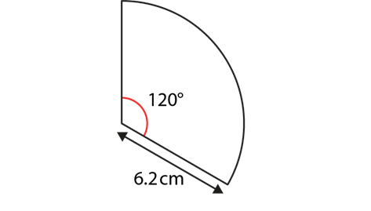
Solve problems involving calculating the area of a circle in context
Example 6
a) What is the area of this semi-circle?
b) What is the area of this quadrant?
c) What is the area of this sector?
Notes:
Suggested questioning:
Can you describe each of the shapes?
What fractions can you see of a whole circle?
Things for you to think about:
Example 6 encourages students to make connections with their knowledge of fractions. It lays the foundations for a more generalised approach to finding the area of sectors at Key Stage 4.

Slide 28



Solve problems involving calculating the area of a circle in context
Example 6
What is the area of this semi-circle?
What is the area of this quadrant?
What is the area of this sector?
  What steps do you expect your students to take to solve these questions?
  Would you prefer students to verbalise a) as one half or 180 degrees? Why or why not?
Notes:
Due to space constraints, the image on this PD discussion slide is very small. PD Leads might like to use or print the ‘in the classroom’ version of this slide for teachers to access during discussions.
This example can be found on page 24 of the 6.2 Core Concept document.

Slide 29
Solve problems involving calculating the area of a circle in context
Example 7
A takeaway sells two sizes of pizzas: 10” and 12”.
The Hawaiian 10” pizza costs £5.40.
The 12” costs £7.60.
Which pizza is better value for money?
Notes:
Suggested questioning:
Which do you predict will be better value for money and why?
How much more pizza are you getting when you increase the diameter by 2 inches?
Things for you to think about:
Example 7 provides students with the opportunity to apply their knowledge of the area formula.

Slide 30
Solve problems involving calculating the area of a circle in context
Example 7
A takeaway sells two sizes of pizzas: 10” and 12”.
The Hawaiian 10” pizza costs £5.40.
The 12” costs £7.60.
Which pizza is better value for money?
  How might students interpret their calculations given the context?
  What additional ‘awarenesses’ about the area of a circle might arise from discussion of such problems?
Notes:
This example can be found on page 24 of the 6.2 Core Concept document.

Slide 31
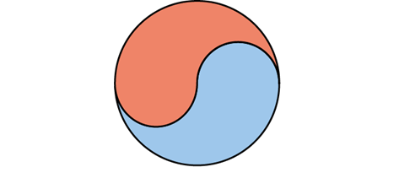
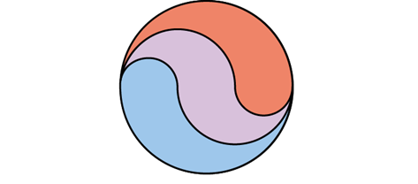
Solve problems involving calculating the area of a circle in context
Example 8
Using a pair of compasses, can you construct a diagram like this? If the radius of the circle is 10 cm, what is the area of the red and blue shapes?
Construct this diagram: If the radius of the circle is 10 cm, what is the area of the red, purple and blue shapes?
Notes:
Suggested questioning:
What shapes can you see?
Which part of the diagram do you think you should draw first?
How do you know how big to set your compass?
Things for you to think about:
Getting students to construct the diagram in part a) first is a good way to support them to see how each of the red and blue shapes is formed and therefore find their area.
Students may be surprised by the fact that the areas are equal.
Note that this problem is an ideal context in which to encourage students to use 𝜋 in their calculations rather than a numerical approximation.

Slide 32


(‘what do students need to understand’ statement)
Example 8
Using a pair of compasses, can you construct a diagram like this? If the radius of the circle is 10 cm, what is the area of the red and blue shapes?
Construct this diagram: If the radius of the circle is 10 cm, what is the area of the red, purple and blue shapes?
  Why might it be helpful for students to construct the diagram first?
  How can this task be generalised?
  What might students find surprising when doing this task?
Notes:
Due to space constraints, the image on this PD discussion slide is very small. PD Leads might like to use or print the ‘in the classroom’ version of this slide for teachers to access during discussions.
This example can be found on page 25 of the 6.2 Core Concept document.

Slide 33
Solve problems involving calculating the area of a circle in context
Example 9
Are all circles similar figures?
Explain your answer.
Notes:
Suggested questioning:
What do we mean by similar?
Things for you to think about:
Example 9 encourages students to make connections with their knowledge of proportional reasoning and scale factors.

Slide 34
Solve problems involving calculating the area of a circle in context
Example 9
Are all circles similar figures?
Explain your answer.
  What definition do you expect students to use to describe similar triangles ?
  Does their definition hold for circles? If not, how could you help them refine their understanding?
Notes:
This example can be found on page 25 of the 6.2 Core Concept document.

Slide 35
Reflection questions
What other mathematical concepts will be supported by students’ stronger understanding of this key idea?
What mathematical language will you continue to use to support pupils to make connections with other areas?
Which representations might you continue to use to further develop students’ understanding?

Slide 37
Appendices
You may choose to use the following slides when planning or delivering a PD session. They cover:
  Key vocabulary
  Representations and structure
  Previous learning
  Future learning
  Library of links

Slide 38
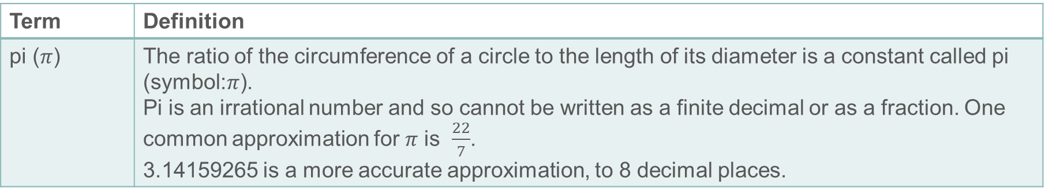
Key vocabulary
Term | Definition
pi ($π$) | The ratio of the circumference of a circle to the length of its diameter is a constant called pi (symbol:$π$). Pi is an irrational number and so cannot be written as a finite decimal or as a fraction. One common approximation for 𝜋 is $\frac{22}{7}$. 3.14159265 is a more accurate approximation, to 8 decimal places.

Slide 39
Representations and structure
There are a number of different representations that you may wish to use to support students’ understanding of this key idea. These might include:
Dynamic geometry software
  The guided use of dynamic geometry software can provide an environment in which students are able to make and test conjectures. By dragging and changing features, they are able to identify variant and invariant properties, leading to a deeper understanding of generalisations.
Mental imagery
  All concrete and pictorial representations have their limitations in the way they are able to represent the abstract world of mathematics. The ultimate purpose of all representations is to support students’ mental construct of an idea or concept. Students do not use the representation to do the mathematics; rather, the representation supports the student in making a mental representation of the idea.
Notes:
More information about the representations and structure involved in this key idea can be found:
On page 6 of the Theme Overview document
Links to all of these can be found on the final slide.

Slide 40
Previous learning
From Upper Key Stage 2, students will bring experience of:
drawing 2D shapes using given dimensions and angles
recognising, describing and building simple 3D shapes, including making nets
comparing and classifying geometric shapes based on their properties and sizes, and finding unknown angles in any triangles, quadrilaterals and regular polygons
illustrating and naming parts of circles, including radius, diameter and circumference, and knowing that the diameter is twice the radius
recognising angles where they meet at a point, are on a straight line or are vertically opposite, and finding missing angles
drawing and translating simple shapes on the coordinate plane and reflecting them in the axes.
Notes:
Theme 6 Geometry

Slide 41
Future learning (1)
In KS4, students will build on the core concepts in this mathematical theme to:
interpret and use fractional {and negative} scale factors for enlargements
{describe the changes and invariance achieved by combinations of rotations, reflections and translations}
identify and apply circle definitions and properties, including: centre, radius, chord, diameter, circumference, tangent, arc, sector and segment
{apply and prove the standard circle theorems concerning angles, radii, tangents and chords, and use them to prove related results}
construct and interpret plans and elevations of 3D shapes
interpret and use bearings
calculate arc lengths, angles and areas of sectors of circles
calculate surface areas and volumes of spheres, pyramids, cones and composite solids
Please note: Braces { } indicate additional mathematical content to be taught to more highly attaining students.

Slide 42
Future learning (2)
In KS4, students will build on the core concepts in this mathematical theme to:
apply the concepts of congruence and similarity, including the relationships between lengths, {areas and volumes} in similar figures
apply Pythagoras’ theorem and trigonometric ratios to find angles and lengths in right-angled triangles {and, where possible, general triangles} in two {and three} dimensional figures
know the exact values of sin θ and cos θ for θ = 30°, 45°, 60° and 90°; know the exact value of tan θ for θ = 30°, 45°, 60°
{know and apply the sine rule, $\frac{a}{SinA}=\frac{b}{SinB}=\frac{c}{SinC}$ , and cosine rule, $a^{2}=b^{2}+c^{2}– 2bc cos⁡A$, to find unknown lengths and angles}
{know and apply Area =$\frac{1}{2}ab\sin{C}$ to calculate the area, sides or angles of any triangle}
describe translations as 2D vectors
apply addition and subtraction of vectors, multiplication of vectors by a scalar, and diagrammatic and column representations of vectors; {use vectors to construct geometric arguments and proofs}.
Please note: Braces { } indicate additional mathematical content to be taught to more highly attaining students.
Notes:
Theme 6 Geometry

Slide 43
Library of links
The following resources from the NCETM website have been referred to within this slide deck:
  NCETM Secondary Mastery Professional Development
    6 Geometry Theme Overview Document
    6.1 Geometrical properties Core Concept Document
  NCETM primary assessment materials
  NCETM primary mastery professional development materials

