Slide 1
Fractions Key Stage 1
Video 1.2
Representing fractions

Slide 2
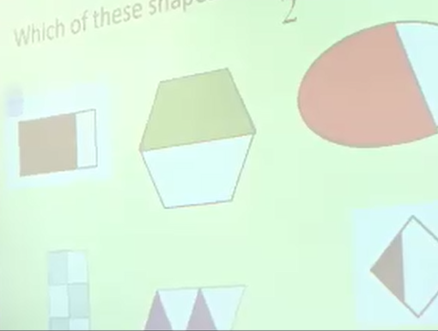
1.2 Representing fractions
Notice how the use of talk partners supports the children’s language and reasoning skills.
Notice how the teacher emphasises the importance of ‘equal parts’.
How does her choice of examples encourage discussion of this?

