Slide 1
Series 3 Episode 10
Hiccups

Slide 2
Practitioner Notes

Slide 3
Episode Description
One is taking photos of everyone. When it’s Nine’s turn, he stops sneezing but starts hiccupping and breaking into smaller Numberblocks. Soon, other Numberblock friends are also breaking apart. Someone needs to find a cure, but can they?

Slide 4
Maths in the Episode
Partitioning numbers to 10
In this episode the Numberblocks are partitioning into smaller Numberblocks. We see how they can partition into two parts, more than two parts and how some partition into equal parts. This episode is further developing the concept of part-whole relationships and the idea that a whole is the combination of smaller parts.

Slide 5
Using Mathematical Language
Use these stem sentences to rehearse the mathematical ideas in the programme:
“<9> is partitioned into <3> and <6>.”
“<3> is a part of <9>. <6> is a part of <9>.”
“<9> is the whole, <6> is a part, <2> is a part and <1> is a part.”
Notes:
< > indicates what can be changed in the stem sentence.

Slide 6
Talk and Discuss Together

Slide 7
Talk and Discuss Together
Watch the episode of Numberblocks. Use the following picture as a stimulus.
Has anyone ever had hiccups? Does anyone know a cure for hiccups? What happened to the Numberblocks when they had hiccups?
The following slides are designed to stimulate children and adults to talk about the episode and draw out some key aspects of the mathematics.

Slide 8
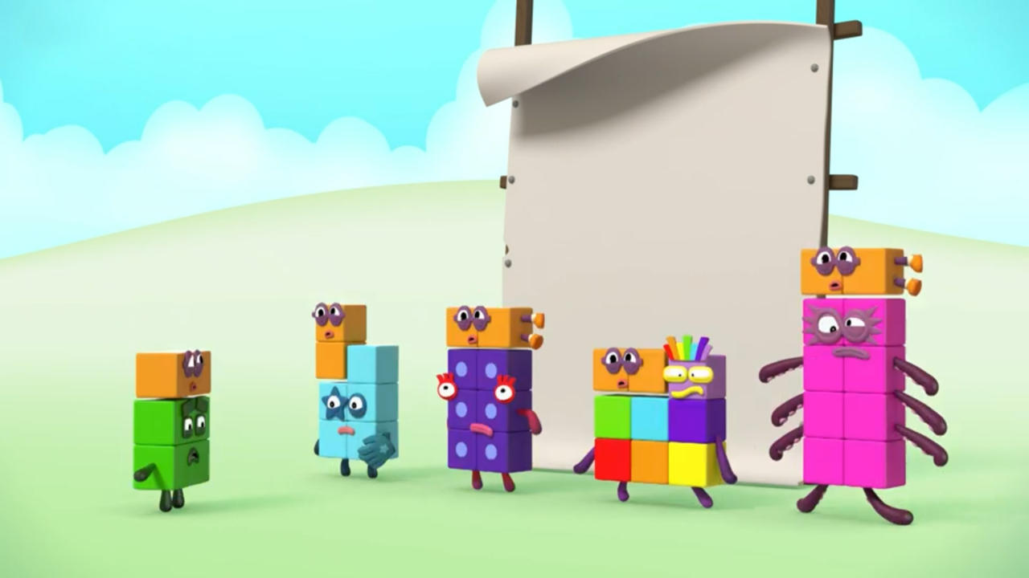
Images © 2017 Alphablocks Ltd. All Rights Reserved.
Notes:
Use this picture as the stimulus for Talk and Discussion (slide 7).

Slide 9
Enabling Environments in Reception

Slide 10
Enabling Environments
Playing and Exploring
Make tidying-up an opportunity for experiencing part-whole relations. When picking up pieces encourage the children to think about what it is part of. What does it go with?
Active Learning
Encourage the children to appreciate part-whole relations. For example, the wheel is part of a car. The tree is part of a forest. The potato is part of the dinner. Your hand is part of you.
Creating and Thinking Critically
Sort sets of similar objects into two groups. For example, sorting pebbles into ones that are rough and ones that are smooth; sorting pencils into writing pencils and colouring pencils; sorting toy vehicles into cars and lorries, etc. Encourage the children to refer to the whole set and the properties of the parts of the whole set. For example, “The rough pebbles are part of all the pebbles. The smooth pebbles are part of all the pebbles.”

Slide 11
Learning Together in Y1

Slide 12
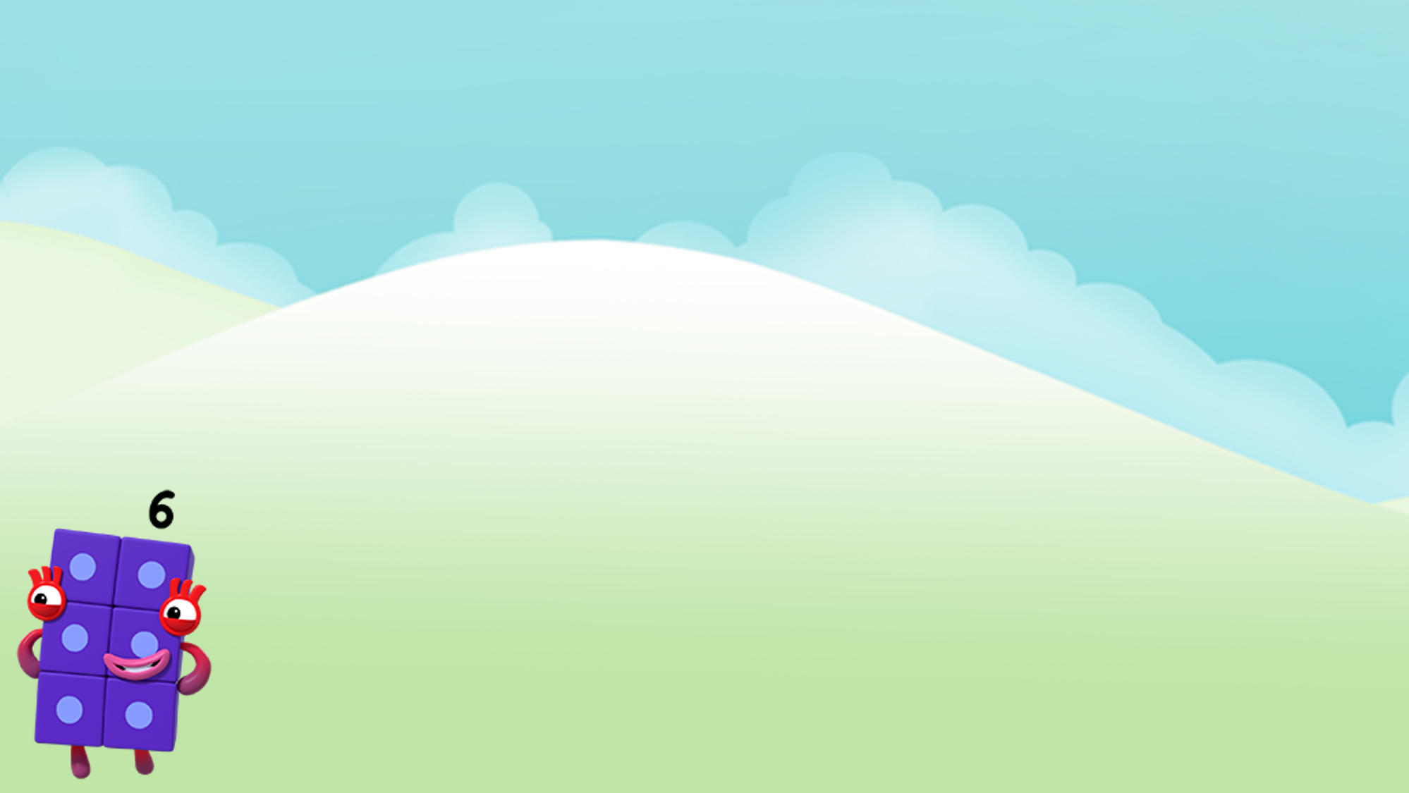







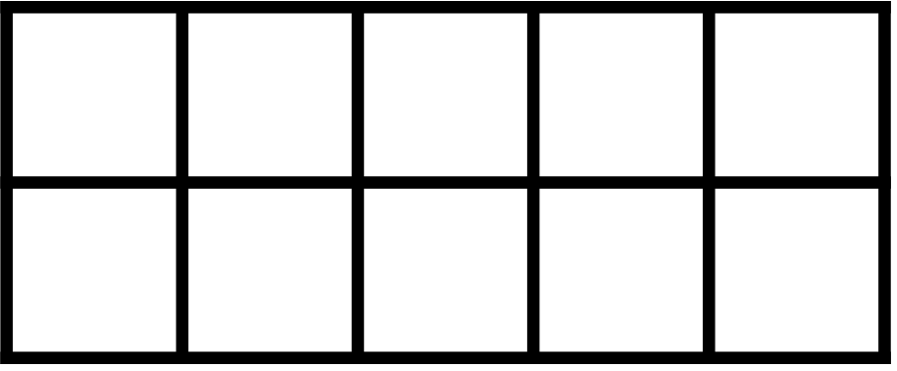
Images © 2017 Alphablocks Ltd. All Rights Reserved.
Notes:
Use this slide to explore the partitioning of 6 into 2 smaller parts.
Click directly on the purple groups of six cubes to change colour and discuss how each representation (part-whole diagram and tens frame) can represent this group of six cubes.
Discuss what is the same and what is different about each representation.

Slide 13


Images © 2017 Alphablocks Ltd. All Rights Reserved.
Notes:
Use this slide to explore the partitioning of 7 into 2 smaller parts.
Click directly on the groups of seven cubes to change colour and discuss how each representation (part-whole diagram and tens frame) can represent this group of cubes.
What is happening to the numbers of red and yellow counters as we move along the tens frame? (The number of yellow counters increases by one each time and the number of red counters decreases by one.)

Slide 14
Further activities for Y1
Explore ways of partitioning numbers to 10 using different representations, for example, double-sided counters, number plates.
Pairs of children play a game with a set of cubes; one child starts with all the cubes and ‘posts’ one cube at a time down a ‘chute’ (for example, a cardboard tube) to their friend who fixes the cubes into a tower. Encourage children to keep showing each other their towers - can they describe what is happening to the size of the towers and the numbers of cubes in each tower?
Tell ‘number stories’ which involving partitioning. For example, apples on a tree and apples on the ground under the tree, sweets in each hand, etc.
Draw representations of partitioning.
Play ‘hiding games’ with a given number of objects: can children say how many objects are hiding if they can see the ones which are NOT hiding? (For example, seven cars: I can see three on the road, how many are parked in the car park? Eight monkeys, five are asleep under the tree, how many are swinging in the trees?)

Slide 15
Learning Together in Y2

Slide 16
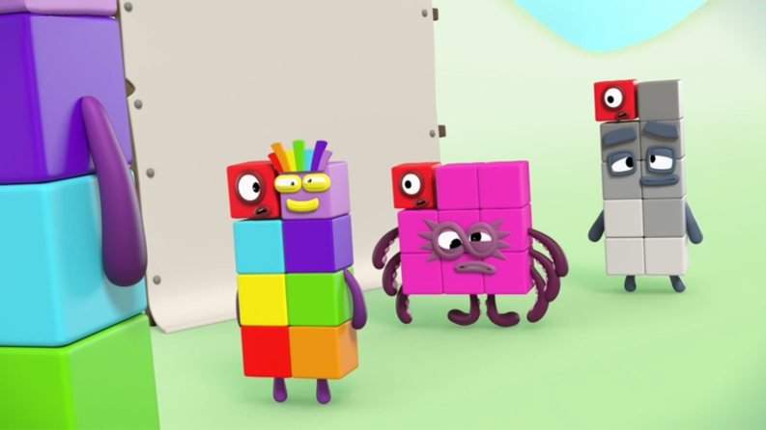
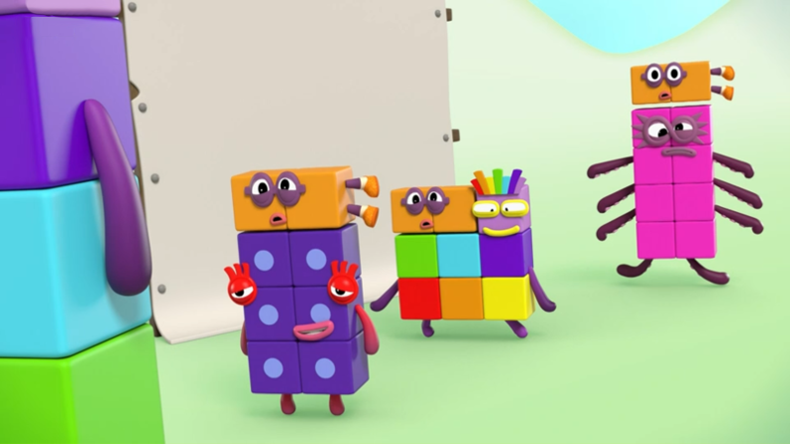
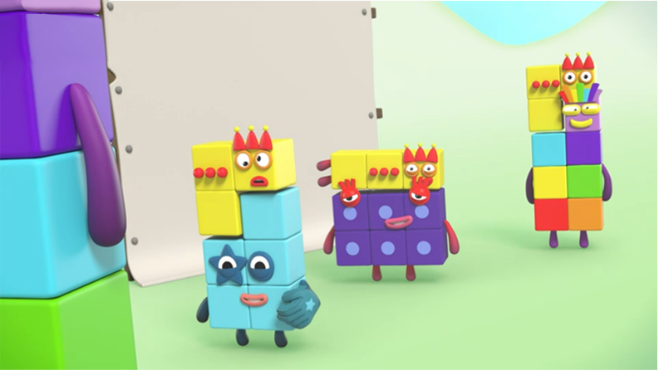
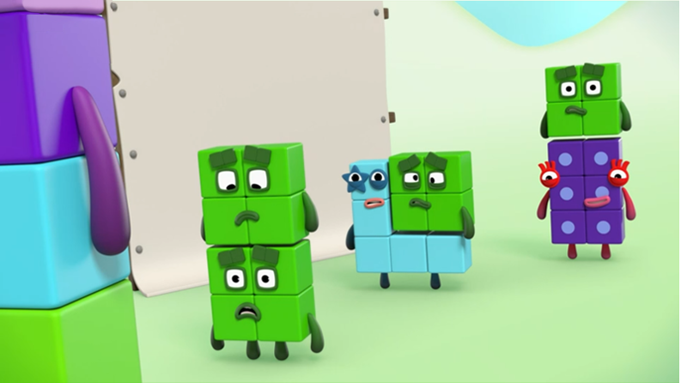
Images © 2017 Alphablocks Ltd. All Rights Reserved.
Notes:
Use this slide to compare the different partitioning of Eight, Nine and Ten.
What do you notice?
Use the stars to signpost the picture being referred to. “In the red-star picture…”
What’s the same about the four pictures? (Each picture shows Eight, Nine and Ten partitioned in different ways.)
What is different? (“In the red-star picture, One is a part of Eight, Nine and Ten, but in the other pictures, One is not a part.)

Slide 17





Images © 2017 Alphablocks Ltd. All Rights Reserved.
Notes:
Use this slide to represent the partitioning of 8, 9 and 10 (where 1 is always a part) in a part-part-whole diagram and as equations.
What is the same about the part-part-whole diagrams? (1 is a part.)
What is different? (The whole and the other part are different.)
How do the equations represent the part-part-whole diagrams?
What is the pattern in the equations? (The whole increases by one each time and one of the parts increases by one.)

Slide 18
Images © 2017 Alphablocks Ltd. All Rights Reserved.
Notes:
Use this slide to represent the partitioning of 8, 9 and 10 (where 2 is a part) in a part-part-whole diagram and as equations.
As in the previous slide, identify what stays the same. (2 is a part of each whole)
What is the pattern in the equations? (The whole increases by one each time and one of the parts increases by one.)
Why does one of the parts have to increase by one if the whole increases by one?

Slide 19
Images © 2017 Alphablocks Ltd. All Rights Reserved.
Notes:
Use this slide to represent the partitioning of 8, 9 and 10 (where 3 is a part) in a part-part-whole diagram and as equations.
Why does one of the parts need to increase by one each time the whole increases by one, if we keep one part the same?

Slide 20
Images © 2017 Alphablocks Ltd. All Rights Reserved.
Notes:
Can you predict what will happen now?
Do you think we will see the same pattern in the equations?
Use this slide to represent the partitioning of 8, 9 and 10 where 4 is always a part in a part-part-whole diagram and as equations.

Slide 21
8 = 1 + 7
9 = 1 + 8
10 = 1 + 9
8 = 2 + 6
9 = 2 + 7
10 = 2 + 8
8 = 3 + 5
9 = 3 + 6
10 = 3 + 7
8 = 4 + 4
9 = 4 + 5
10 = 4 + 6
Images © 2017 Alphablocks Ltd. All Rights Reserved.
Notes:
Use this slide to compare each column of equations. Clicking will move the red ‘picture frame’ along the columns.
What do you notice about the equations in the first column?
What is the staying the same? (The whole/ sum is 8.)
What is changing? (Both addends change. As one addend increases by one, the other decreases by one.)
Is it the same pattern in each column?
Why do you think that might be happening?
If children need further support, use two colours of cubes or double-sided counters to model that if the whole stays the same, then both addends need to change.

Slide 22
Further activities for Y2
Use a system to find all the ways to partition numbers 7-10. Use two different colours of cubes to support finding all the ways. Record ways in a table or using equations. See if children can explain how they know they have found all the ways to partition a given number and describe why there is a pattern in their answer.
Explore partitioning numbers into 3 parts, for example, 8 = 1 + 2 + 5; 8 = 2 + 2 + 4.

