Slide 1
Year 1, Unit 9
Unitising and coin recognition

Slide 2
Year 1, Unit 9
These materials heavily reflect the prioritisation approach of the ready-to-progress criteria in the DfE Primary Mathematics Guidance 2020 and on the PPTs that exemplify them on the NCETM website. They also include other relevant National Curriculum content. Related sections of the NCETM Primary Mastery Professional Development Materials provide small-step teaching guidance.
Ready-to-progress criteria addressed by this unit
Teaching of this unit supports the following criteria from the ‘DfE Mathematics Guidance: key stages 1 & 2’ (the 335-page document available as a download)
1NF-2 Page 26
Prior learning
If the children have the following previous experience, contained in the same DfE guidance document as above, they will be ready to start this unit.
Previous experience prior to 1NF-2 Page 16

Slide 3
Contents
The links below take you to the starting slide of each learning outcome.
1 | Pupils count efficiently in groups of two
2 | Pupils count efficiently in groups of ten
3 | Pupils count efficiently in group of five
4 | Pupils count efficiently by counting in groups of two, five and ten
5 | Pupils explain the value of a 1p coin in pence
6 | Pupils recognise and explain the value of 2p, 5p and 10p coins
7 | Pupils explain that a single coin can be worth several pennies
8 | Pupils use knowledge of the value of coins to solve problems
9 | Pupils calculate the total value of the coins in a set of 2p coins
Click the arrow button to return to this Contents slide.

Slide 4
Contents
The links below take you to the starting slide of each learning outcome.
10 | Pupils calculate the total value of the coins in a set of 5p coins
11 | Pupils calculate the total value of the coins in a set of 10p coins
12 | Pupils compare sets of 2p, 5p and 10p coins
13 | Pupils relate what they have learnt to a real-life context
14 | Pupils work out how many coins are needed to make a value of 10p
15 | Pupils work out how many coins are needed to make a total value of 20p
16 | Pupils use knowledge of the value of coins to solve problems
Click the arrow button to return to this Contents slide.

Slide 5
Year 1, Unit 9, Learning Outcome 1
Learning Outcome 1
Pupils count efficiently in groups of two
The following slides have been collated to support the teaching of this learning outcome.

Slide 6
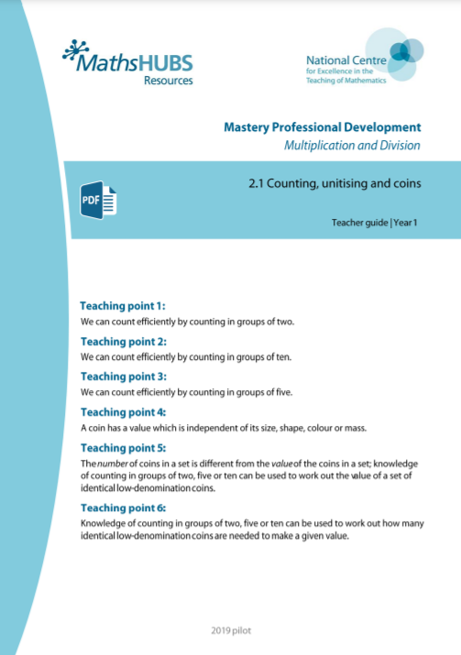
Year 1, Unit 9, Learning Outcome 1
Additional teacher guidance for this outcome should be read first and can be found in this segment of the NCETM Primary Mastery Professional Development Materials:
2.1 Counting, unitising and coins
The spine materials are divided into ‘teaching points’ and ‘steps in learning’.
Teaching point | Steps in learning | Pages
1 | 1:1-1:5 | 3-7

Slide 7
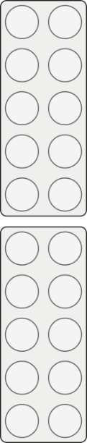



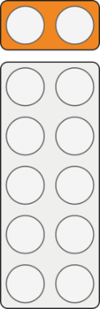
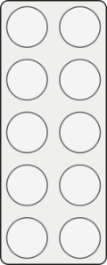




2.1 Counting and unitising Step 1:1
zero
two
four
six
eight
ten
twelve
fourteen
sixteen
eighteen
twenty
0
2
4
6
8
10
12
14
16
18
20

Slide 8
2.1 Counting and unitising Step 1:1
zero
two
four
six
eight
ten
twelve
fourteen
sixteen
eighteen
twenty
0
2
4
6
8
10
12
14
16
18
20

Slide 9
2.1 Counting and unitising Step 1:1
0
1
2
3
4
5
6
7
8
9
10
11
12
13
14
15
16
17
18
19
20

Slide 10
2.1 Counting and unitising Step 1:1
0
1
2
3
4
5
6
7
8
9
10
11
12
13
14
15
16
17
18
19
20

Slide 11
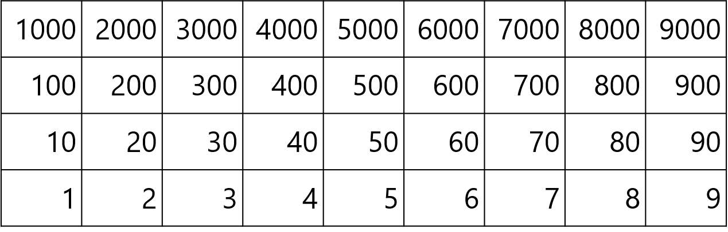
2.1 Counting and unitising Step 1:1

Slide 12
2.1 Counting and unitising Step 1:1

Slide 13

2.1 Counting and unitising Step 1:2
How many wheels are there?
Count in groups of two.
fourteen
sixteen
twelve
eight
four
two
ten
six
14
12
10
16
8
6
4
2

Slide 14
2.1 Counting and unitising Step 1:2
How many wheels are there?
Count in groups of two.

Slide 15

2.1 Counting and unitising Step 1:2
How many shoes are there?
Count in groups of two.
eighteen
fourteen
sixteen
twenty
twelve
eight
four
two
ten
six
14
12
10
16
18
20
8
6
4
2

Slide 16
2.1 Counting and unitising Step 1:2
How many shoes are there?
Count in groups of two.

Slide 17

2.1 Counting and unitising Step 1:2
How many dots are there?
Count in groups of two.
twelve
eight
four
two
ten
six
12
10
8
6
4
2

Slide 18
2.1 Counting and unitising Step 1:2
How many dots are there?
Count in groups of two.

Slide 19

2.1 Counting and unitising Step 1:2
How many hedgehogs are there?
Count in groups of two.
fourteen
twelve
eight
four
two
ten
six
14
12
10
8
6
4
2

Slide 20
2.1 Counting and unitising Step 1:2
How many hedgehogs are there?
Count in groups of two.

Slide 21

2.1 Counting and unitising Step 1:3
How many children are there?

Slide 22
2.1 Counting and unitising Step 1:3
How many children are there?
Count in groups of two.

Slide 23







2.1 Counting and unitising Step 1:4
How many hedgehogs are there?

Slide 24
2.1 Counting and unitising Step 1:5
‘Two groups of two.’
‘Three groups of two.’
‘Four groups of two.’
‘Seven groups of two.’
‘Eight groups of two.’
‘Five groups of two.’
‘Six groups of two.’

Slide 25
2.1 Counting and unitising Step 1:5
Notes:
Now ask children to count in twos from this new starting point, without on-screen prompts.

Slide 26
2.1 Counting and unitising Step 1:5
‘Four groups of two.’
‘Seven groups of two.’
‘Eight groups of two.’
‘Nine groups of two.’
‘Five groups of two.’
‘Ten groups of two.’
‘Six groups of two.’

Slide 27
2.1 Counting and unitising Step 1:5
Notes:
Now ask children to count in twos from this new starting point, without on-screen prompts.

Slide 28
2.1 Counting and unitising Step 1:5
‘Three groups of two.’
‘Four groups of two.’
‘Seven groups of two.’
‘Five groups of two.’
‘Six groups of two.’

Slide 29
2.1 Counting and unitising Step 1:5
Notes:
Now ask children to count in twos from this new starting point, without on-screen prompts.

Slide 30
2.1 Counting and unitising Step 1:5
‘Two groups of two.’
‘Three groups of two.’
‘Four groups of two.’
‘Seven groups of two.’
‘Five groups of two.’
‘Six groups of two.’

Slide 31
2.1 Counting and unitising Step 1:5
Notes:
Now ask children to count in twos from this new starting point, without on-screen prompts.

Slide 32
1NF-2 Count forwards and backwards in multiples of 2, 5 and 10
Let’s practise our counting in twos using the hundred square.
Watch the pattern carefully to 20. Can you describe what the pattern looks like?
Move your body to feel the pattern! Point at each number and move your body to follow the numbers as you say them.
Can you think how we can continue the pattern past 20? What will the pattern look like? What will it feel like?
1
2
3
4
5
6
7
8
9
10
11
12
13
14
15
16
17
18
19
20
21
22
23
24
25
26
27
28
29
30
31
32
33
34
35
36
37
38
39
40
41
42
42
44
45
46
47
48
49
50
51
52
53
54
55
56
57
58
59
60
61
62
63
64
65
66
67
68
69
70
71
72
73
74
75
76
77
78
79
80
81
82
83
84
85
86
87
88
89
90
91
92
93
94
95
96
97
98
99
100

Slide 33
Year 1, Unit 9, Learning Outcome 2
Learning Outcome 2
Pupils count efficiently in groups of ten
The following slides have been collated to support the teaching of this learning outcome.

Slide 34
Year 1, Unit 9, Learning Outcome 2
Additional teacher guidance for this outcome should be read first and can be found in this segment of the NCETM Primary Mastery Professional Development Materials:
2.1 Counting, unitising and coins
The spine materials are divided into ‘teaching points’ and ‘steps in learning’.
Teaching point | Steps in learning | Pages
2 | 2:1-2:6 | 8-10

Slide 35




2.1 Counting and unitising Step 2:2
How many fingers (and thumbs) are there?
Count in groups of ten.

Slide 36

2.1 Counting and unitising Step 2:2
How many dots are there?
Count in groups of ten.
twenty
thirty
forty
sixty
fifty
ten
60
50
40
30
10
20

Slide 37
2.1 Counting and unitising Step 2:2
How many dots are there?
Count in groups of ten.

Slide 38

2.1 Counting and unitising Step 2:2
How many pencils are there?
Count in groups of ten.
seventy
twenty
eighty
ninety
thirty
forty
sixty
fifty
ten
70
60
50
80
90
30
20
10
40

Slide 39
2.1 Counting and unitising Step 2:2
How many pencils are there?
Count in groups of ten.

Slide 40


2.1 Counting and unitising Step 2:3
How many counters are there?

Slide 41


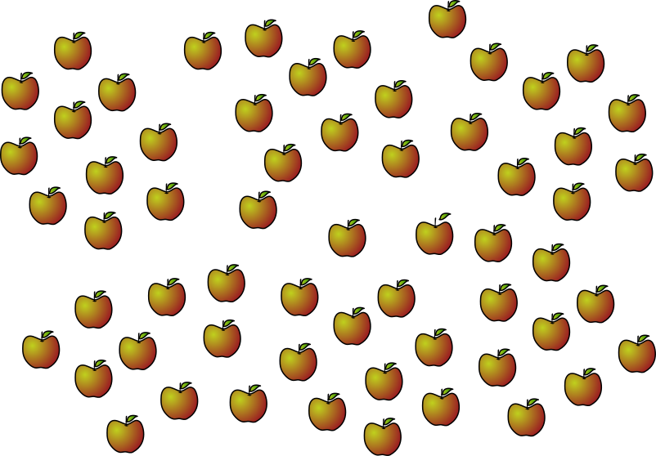




2.1 Counting and unitising Step 2:4
How many apples are there?

Slide 42
2.1 Counting and unitising Step 2:5
‘Four groups of ten.’
‘Seven groups of ten.’
‘Five groups of ten.’
‘Six groups of ten.’

Slide 43
2.1 Counting and unitising Step 2:5
Notes:
Now ask children to count in tens without on-screen prompts.

Slide 44
2.1 Counting and unitising Step 2:5
‘Three groups of ten.’
‘Four groups of ten.’
‘Seven groups of ten.’
‘Five groups of ten.’
‘Six groups of ten.’

Slide 45
2.1 Counting and unitising Step 2:5
Notes:
Now ask children to count in tens without on-screen prompts.

Slide 46
2.1 Counting and unitising Step 2:5
‘Two groups of ten.’
‘Three groups of ten.’
‘Four groups of ten.’
‘Seven groups of ten.’
‘Nine groups of ten.’
‘Eight groups of ten.’
‘Five groups of ten.’
‘Six groups of ten.’

Slide 47
2.1 Counting and unitising Step 2:5
Notes:
Now ask children to count in tens without on-screen prompts.

Slide 48
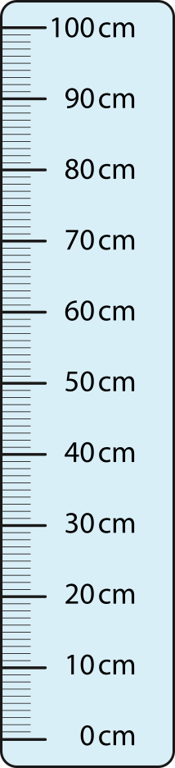
2.1 Counting and unitising Step 2:6

Slide 49
1NF-2 Count forwards and backwards in multiples of 2, 5 and 10
1
2
3
4
5
6
7
8
9
10
Let’s practise our counting in tens using the hundred square. Can you describe what the pattern looks like?
Move your body to feel the pattern! Point at each number and move your body to follow the number count. How does it feel different to counting in other multiples?
Are any of the numbers we say also in a different number count?
11
12
13
14
15
16
17
18
19
20
21
22
23
24
25
26
27
28
29
30
31
32
33
34
35
36
37
38
39
40
41
42
42
44
45
46
47
48
49
50
51
52
53
54
55
56
57
58
59
60
61
62
63
64
65
66
67
68
69
70
71
72
73
74
75
76
77
78
79
80
81
82
83
84
85
86
87
88
89
90
91
92
93
94
95
96
97
98
99
100

Slide 50
Year 1, Unit 9, Learning Outcome 3
Learning Outcome 3
Pupils count efficiently in group of five
The following slides have been collated to support the teaching of this learning outcome.

Slide 51
Year 1, Unit 9, Learning Outcome 3
Additional teacher guidance for this outcome should be read first and can be found in this segment of the NCETM Primary Mastery Professional Development Materials:
2.1 Counting, unitising and coins
The spine materials are divided into ‘teaching points’ and ‘steps in learning’.
Teaching point | Steps in learning | Pages
3 | 3:1-3:5 | 11-12

Slide 52
2.1 Counting and unitising Step 3:1
0
5
10
15
20
25
30
35
40
45
50

Slide 53
2.1 Counting and unitising Step 3:1

Slide 54
2.1 Counting and unitising Step 3:1

Slide 55




2.1 Counting and unitising Step 3:2
How many fingers (and thumbs) are there?
Count in groups of five.
twenty-five
twenty
fifteen
thirty
five
ten
thirty-five
forty-five
forty
30
25
20
15
10
40
35
45
5

Slide 56
2.1 Counting and unitising Step 3:2
How many fingers (and thumbs) are there?
Count in groups of five.
Notes:
Now ask children to count in fives without on-screen prompts.

Slide 57

2.1 Counting and unitising Step 3:2
How many dots are there?
Count in groups of five.
twenty
fifteen
five
ten
20
15
10
5

Slide 58
2.1 Counting and unitising Step 3:2
How many dots are there?
Count in groups of five.
Notes:
Now ask children to count in fives without on-screen prompts.

Slide 59

2.1 Counting and unitising Step 3:2
How many hedgehogs are there?
Count in groups of five.
twenty-five
twenty
fifteen
thirty
five
ten
30
25
20
15
10
5

Slide 60
2.1 Counting and unitising Step 3:2
How many hedgehogs are there?
Count in groups of five.
Notes:
Now ask children to count in fives without on-screen prompts.

Slide 61


2.1 Counting and unitising Step 3:3
How many counters are there?

Slide 62






2.1 Counting and unitising Step 3:4
How many stars are there?

Slide 63
2.1 Counting and unitising Step 3:5
‘Four groups of five.’
‘Five groups of five.’
‘Six groups of five.’
‘Seven groups of five.’
‘Eight groups of five.’
‘Nine groups of five.’

Slide 64
2.1 Counting and unitising Step 3:5
Notes:
Now ask children to count in groups of five from this new starting point without on-screen prompts.

Slide 65
2.1 Counting and unitising Step 3:5
‘Three groups of five.’
‘Four groups of five.’
‘Seven groups of five.’
‘Five groups of five.’
‘Six groups of five.’

Slide 66
2.1 Counting and unitising Step 3:5
Notes:
Now ask children to count in groups of five from this new starting point without on-screen prompts.

Slide 67
2.1 Counting and unitising Step 3:5
‘Two groups of five.’
‘Three groups of five.’
‘Four groups of five.’
‘Five groups of five.’
‘Six groups of five.’

Slide 68
2.1 Counting and unitising Step 3:5
Notes:
Now ask children to count in groups of five from this new starting point without on-screen prompts.

Slide 69
1NF-2 Count forwards and backwards in multiples of 2, 5 and 10
Let’s practise our counting in fives using the hundred square.
Watch the pattern carefully to 50. Can you describe what the pattern looks like?
Move your body to feel the pattern! Point at each number and move your body to follow the numbers as you say them.
Can you think how we can continue the pattern past 50? What will the pattern look like? What will it feel like?
1
2
3
4
5
6
7
8
9
10
11
12
13
14
15
16
17
18
19
20
21
22
23
24
25
26
27
28
29
30
31
32
33
34
35
36
37
38
39
40
41
42
42
44
45
46
47
48
49
50
51
52
53
54
55
56
57
58
59
60
61
62
63
64
65
66
67
68
69
70
71
72
73
74
75
76
77
78
79
80
81
82
83
84
85
86
87
88
89
90
91
92
93
94
95
96
97
98
99
100

Slide 70
Year 1, Unit 9, Learning Outcome 4
Learning Outcome 4
Pupils count efficiently by counting in groups of two, five and ten
The following slide supports the teaching of this learning outcome.

Slide 71
Year 1, Unit 9, Learning Outcome 4
Additional teacher guidance for this outcome should be read first and can be found in this segment of the NCETM Primary Mastery Professional Development Materials:
2.1 Counting, unitising and coins
The spine materials are divided into ‘teaching points’ and ‘steps in learning’.
Teaching point | Step in learning | Page
3 | 3:6 | 12-13

Slide 72
1NF-2 Count forwards and backwards in multiples of 2, 5 and 10
Counting in 10s
Counting in 2s
Counting in 5s
0
10
20
30
40
50
60
70
80
90
100
0
2
4
6
8
10
12
14
16
18
20
0
5
10
15
20
25
30
35
40
45
50
What numbers can you see on the number line?
Let’s count along the number line in multiples of…
Can you start in different places?
What’s the next multiple of… after…? What’s the multiple of… before…?
Can you count backwards as well as forwards?

Slide 73
Year 1, Unit 9, Learning Outcome 5
Learning Outcome 5
Pupils explain the value of a 1p coin in pence
The following slides have been collated to support the teaching of this learning outcome.

Slide 74
Year 1, Unit 9, Learning Outcome 5
Additional teacher guidance for this outcome should be read first and can be found in this segment of the NCETM Primary Mastery Professional Development Materials:
2.1 Counting, unitising and coins
The spine materials are divided into ‘teaching points’ and ‘steps in learning’.
Teaching point | Steps in learning | Pages
4 | 4:1-4:2 | 14-15

Slide 75


2.1 Counting and unitising Step 4:1
heads
tails

Slide 76

2.1 Counting and unitising Step 4:1

Slide 77
2.1 Counting and unitising Step 4:2
Notes:
There are three one-penny coins; the total value is three p or three pence.

Slide 78
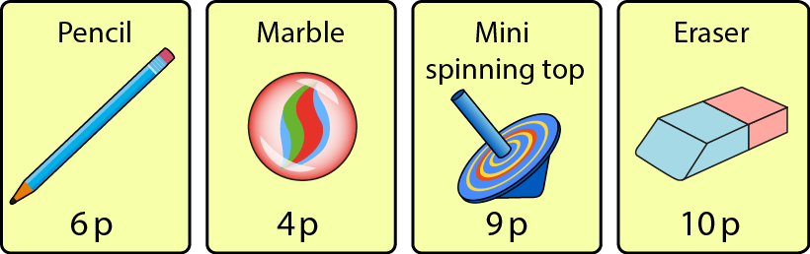
2.1 Counting and unitising Step 4:2
Notes:
How many pennies do you need to buy:
One marble?
One eraser?
One spinning top?
One pencil?

Slide 79
Year 1, Unit 9, Learning Outcome 6
Learning Outcome 6
Pupils recognise and explain the value of 2p, 5p and 10p coins
The following slides have been collated to support the teaching of this learning outcome.

Slide 80
Year 1, Unit 9, Learning Outcome 6
Additional teacher guidance for this outcome should be read first and can be found in this segment of the NCETM Primary Mastery Professional Development Materials:
2.1 Counting, unitising and coins
The spine materials are divided into ‘teaching points’ and ‘steps in learning’.
Teaching point | Step in learning | Page
4 | 4:3 | 16-17

Slide 81
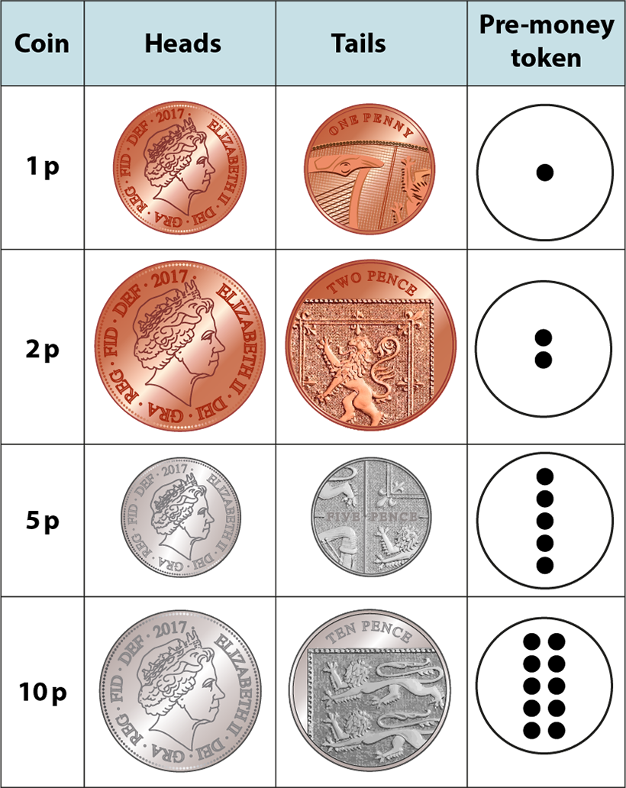

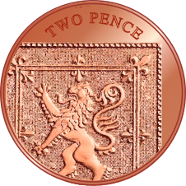

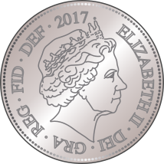


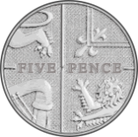
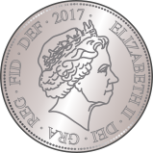

2.1 Counting and unitising Step 4:3
10 p
2 p
5 p
1 p
Notes:
I am thinking of a coin. It is silver. It is about the same size as a penny. Which coin is it?

Slide 82
Year 1, Unit 9, Learning Outcome 7
Learning Outcome 7
Pupils explain that a single coin can be worth several pennies
The following slides have been collated to support the teaching of this learning outcome.

Slide 83
Year 1, Unit 9, Learning Outcome 7
Additional teacher guidance for this outcome should be read first and can be found in this segment of the NCETM Primary Mastery Professional Development Materials:
2.1 Counting, unitising and coins
The spine materials are divided into ‘teaching points’ and ‘steps in learning’.
Teaching point | Step in learning | Pages
4 | 4:4 | 17-18

Slide 84
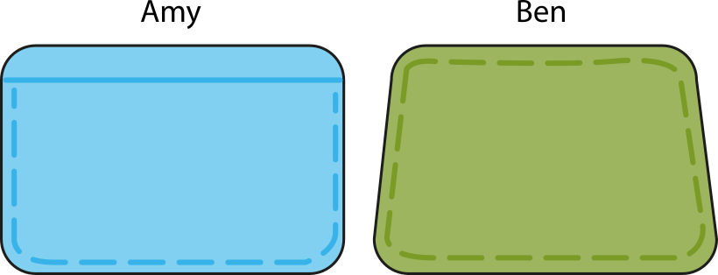



2.1 Counting and unitising Step 4:4
Can Amy buy an eraser?
Can Ben buy an eraser?
Yes ✓
Yes ✓
10 p
10 p
Notes:
For each count, ensure children first identify the skip-counting unit (the coin denomination) before beginning.

Slide 85
Year 1, Unit 9, Learning Outcome 8
Learning Outcome 8
Pupils use knowledge of the value of coins to solve problems
The following slide supports the teaching of this learning outcome.

Slide 86
Year 1, Unit 9, Learning Outcome 8
Additional teacher guidance for this outcome should be read first and can be found in this segment of the NCETM Primary Mastery Professional Development Materials:
2.1 Counting, unitising and coins
The spine materials are divided into ‘teaching points’ and ‘steps in learning’.
Teaching point | Step in learning | Page
4 | 4:5 | 18

Slide 87
Year 1, Unit 9, Learning Outcome 9
Learning Outcome 9
Pupils calculate the total value of the coins in a set of 2p coins
The following slides have been collated to support the teaching of this learning outcome.

Slide 88
Year 1, Unit 9, Learning Outcome 9
Additional teacher guidance for this outcome should be read first and can be found in this segment of the NCETM Primary Mastery Professional Development Materials:
2.1 Counting, unitising and coins
The spine materials are divided into ‘teaching points’ and ‘steps in learning’.
Teaching point | Steps in learning | Pages
5 | 5:1-5:3 | 19-21

Slide 89

2.1 Counting and unitising Step 5:1
eight one-pennies
8 p

Slide 90
2.1 Counting and unitising Step 5:2
nine two-pennies
18 p

Slide 91

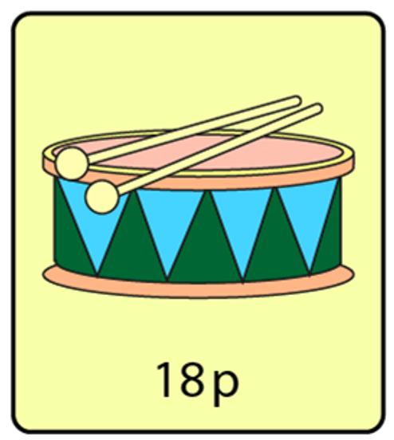
1NF-2 Count forwards and backwards in multiples of 2, 5 and 10
What sort of coins can you see in the purse? Can you find some of the same coins to use yourself?
How much does the drum cost?
Let’s see how many 2 pence coins we need to buy the drum.
If we count in twos, what number do we need to stop at? Why?
So how many 2 pence coins do we need?
Can you make your own 2p shop?
2p, 4p, 6p… 18p. There is 18 pence altogether.

Slide 92
Year 1, Unit 9, Learning Outcome 10
Learning Outcome 10
Pupils calculate the total value of the coins in a set of 5p coins
The following slides have been collated to support the teaching of this learning outcome.

Slide 93
Year 1, Unit 9, Learning Outcome 10
Additional teacher guidance for this outcome should be read first and can be found in this segment of the NCETM Primary Mastery Professional Development Materials:
2.1 Counting, unitising and coins
The spine materials are divided into ‘teaching points’ and ‘steps in learning’.
Teaching point | Steps in learning | Pages
5 | 5:4 (5:2-5:3) | 20-21

Slide 94
2.1 Counting and unitising Step 5:4
seven five-pennies
35 p

Slide 95
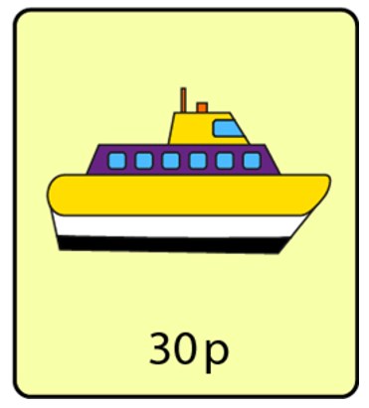
1NF-2 Count forwards and backwards in multiples of 2, 5 and 10
What sort of coins can you see in the purse? Can you find some of the same coins to use yourself?
How much does the boat cost?
Let’s see how many 5 pence coins we need to buy the boat.
If we count in fives, what number do we need to stop at? Why?
So how many 5 pence coins do we need?
Can you make your own 5p shop?
5, 10, 15… 30. There is 30 pence altogether.

Slide 96
Year 1, Unit 9, Learning Outcome 11
Learning Outcome 11
Pupils calculate the total value of the coins in a set of 10p coins
The following slides have been collated to support the teaching of this learning outcome.

Slide 97
Year 1, Unit 9, Learning Outcome 11
Additional teacher guidance for this outcome should be read first and can be found in this segment of the NCETM Primary Mastery Professional Development Materials:
2.1 Counting, unitising and coins
The spine materials are divided into ‘teaching points’ and ‘steps in learning’.
Teaching point | Steps in learning | Pages
5 | 5:5 (5.2-5.3) | 20-21

Slide 98
2.1 Counting and unitising Step 5:5
nine ten-pennies
90 p

Slide 99
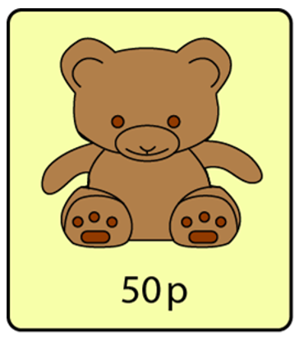
1NF-2 Count forwards and backwards in multiples of 2, 5 and 10
What sort of coins can you see in the purse? Can you find some of the same coins to use yourself?
How much does the bear cost?
Let’s see how many 10 pence coins we need to buy the bear.
If we count in tens, what number do we need to stop at? Why?
So how many 10 pence coins do we need?
Can you make your own 10p shop?
10, 20, 30, 40, 50. There is 50 pence altogether.

Slide 100
Year 1, Unit 9, Learning Outcome 12
Learning Outcome 12
Pupils compare sets of 2p, 5p and 10p coins
The following slides have been collated to support the teaching of this learning outcome.

Slide 101
Year 1, Unit 9, Learning Outcome 12
Additional teacher guidance for this outcome should be read first and can be found in this segment of the NCETM Primary Mastery Professional Development Materials:
2.1 Counting, unitising and coins
The spine materials are divided into ‘teaching points’ and ‘steps in learning’.
Teaching point | Step in learning | Page
5 | 5:6 | 22

Slide 102
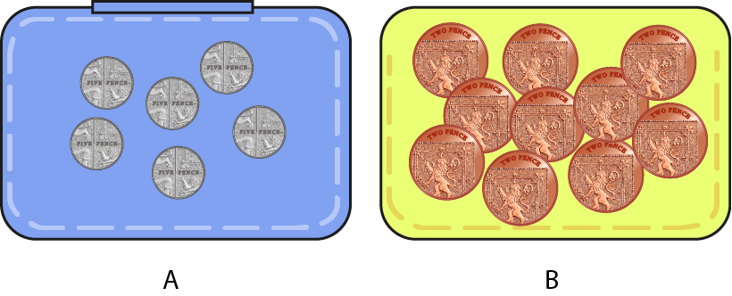

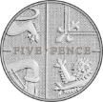
2.1 Counting and unitising Step 5:6
Which purse would you rather have?
30 p
20 p

Slide 103
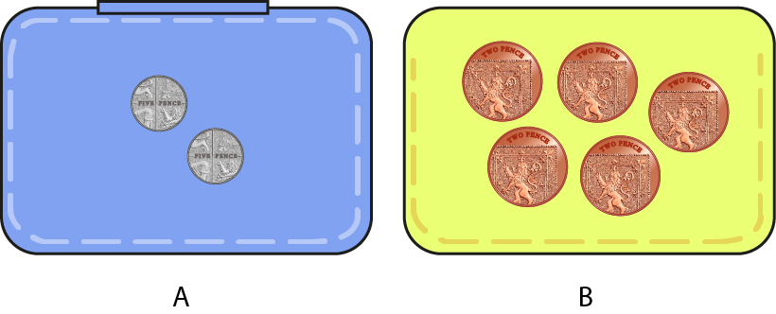
2.1 Counting and unitising Step 5:6
Which purse would you rather have?
10 p
10 p

Slide 104
Year 1, Unit 9, Learning Outcome 13
Learning Outcome 13
Pupils relate what they have learnt to a real-life context
The following slides have been collated to support the teaching of this learning outcome.

Slide 105
Year 1, Unit 9, Learning Outcome 13
Additional teacher guidance for this outcome should be read first and can be found in this segment of the NCETM Primary Mastery Professional Development Materials:
2.1 Counting, unitising and coins
The spine materials are divided into ‘teaching points’ and ‘steps in learning’.
Teaching point | Step in learning | Pages
5 | 5:7 | 23

Slide 106
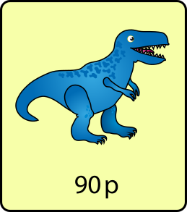
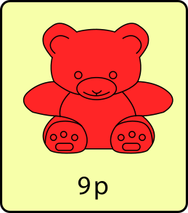
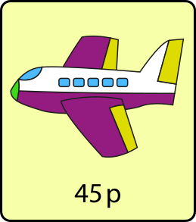
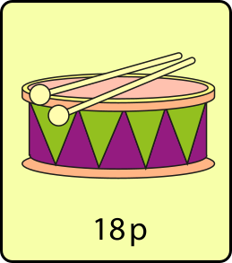
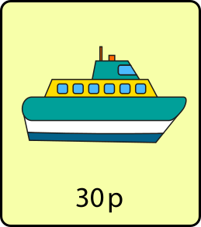
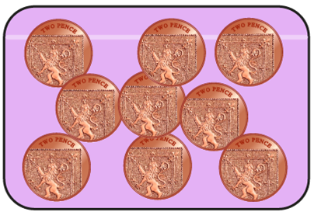
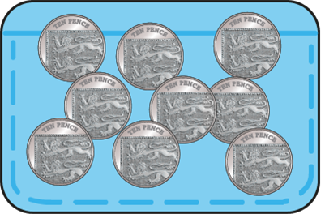
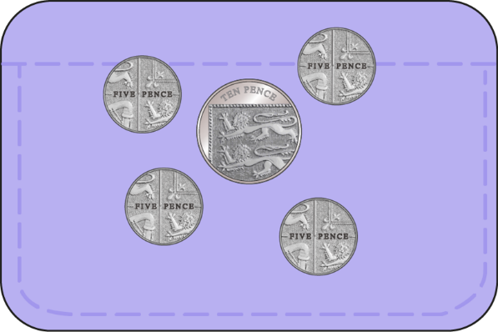
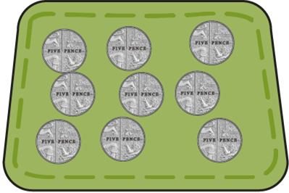



2.1 Counting and unitising Step 5:7
What could you buy with the coins in this purse?
90 p
18 p
45 p
30 p

Slide 107
Year 1, Unit 9, Learning Outcome 14
Learning Outcome 14
Pupils work out how many coins are needed to make a value of 10p
The following slides have been collated to support the teaching of this learning outcome.

Slide 108
Year 1, Unit 9, Learning Outcome 14
Additional teacher guidance for this outcome should be read first and can be found in this segment of the NCETM Primary Mastery Professional Development Materials:
2.1 Counting, unitising and coins
The spine materials are divided into ‘teaching points’ and ‘steps in learning’.
Teaching point | Steps in learning | Pages
6 | 6:1-6:4 | 24-27

Slide 109
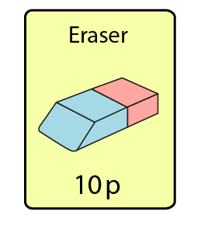
2.1 Counting and unitising Step 6:1
How many pennies would you need to buy this eraser?

Slide 110
2.1 Counting and unitising Step 6:2
How many two-pence coins would you need to buy this eraser?

Slide 111
2.1 Counting and unitising Step 6:3
How many five-pence coins would you need to buy this eraser?

Slide 112
2.1 Counting and unitising Step 6:4
How many ten-pence coins would you need to buy this eraser?

Slide 113
Year 1, Unit 9, Learning Outcome 15
Learning Outcome 15
Pupils work out how many coins are needed to make a total value of 20p
The following slide supports the teaching of this learning outcome.

Slide 114
Year 1, Unit 9, Learning Outcome 15
Additional teacher guidance for this outcome should be read first and can be found in this segment of the NCETM Primary Mastery Professional Development Materials:
2.1 Counting, unitising and coins
The spine materials are divided into ‘teaching points’ and ‘steps in learning’.
Teaching point | Steps in learning | Pages
6 | 6:5 (6:1 – 6:4) | 24-27

Slide 115
Year 1, Unit 9, Learning Outcome 16
Learning Outcome 16
Pupils use knowledge of the value of coins to solve problems
The following slides have been collated to support the teaching of this learning outcome.

Slide 116
Year 1, Unit 9, Learning Outcome 16
Additional teacher guidance for this outcome should be read first and can be found in this segment of the NCETM Primary Mastery Professional Development Materials:
2.1 Counting, unitising and coins
The spine materials are divided into ‘teaching points’ and ‘steps in learning’.
Teaching point | Steps in learning | Pages
6 | 6:6 | 27-28

Slide 117
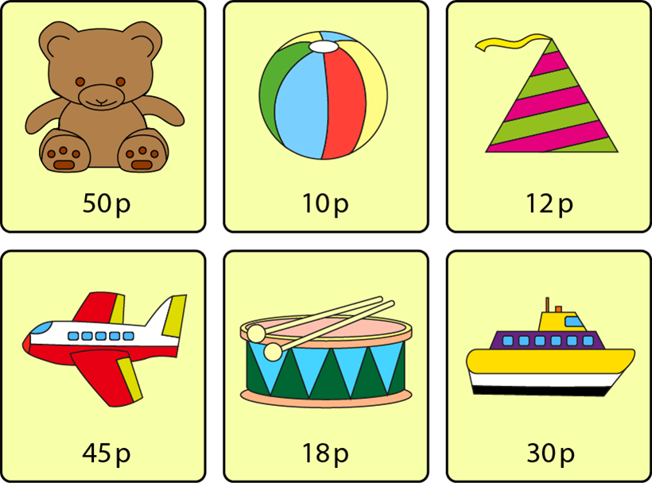
2.1 Counting and unitising Step 6:6

Slide 118
1NF-2 Count forwards and backwards in multiples of 2, 5 and 10
Read the prices in my shop! Did you say these numbers when you counted in multiples of 2, 5 or 10?
Collect some 2 pence, 5 pence and 10 pence coins.
Use all of the same sort of coin to buy the ball. Which coins could you use?
How can you pay for each of the other items?
Now you can make your own 2p, 5p and 10p shop and pay for your items using your coins.

